Slide 1
Electronic Health Records in Ambulatory Care – A National Survey of Physicians
Catherine M. DesRoches, Dr.P.H., Eric G. Campbell, Ph.D., Sowmya R. Rao, Ph.D., Karen Donelan, Sc.D.,
Timothy G. Ferris, M.D., M.P.H., Ashish Jha, M.D., M.P.H.,
Rainu Kaushal, M.D., M.P.H., Douglas E. Levy, Ph.D.,
Sara Rosenbaum, J.D., Alexandra E. Shields, Ph.D., and
David Blumenthal, M.D., M.P.P.

Slide 2
Outline & Speakers
Abstract
陳玟妤
Methods
陳柏安、周鈺翔
Results
郭泰源、許茗鈜
Discussion
魏逸昕、賴志豪、章偉恩

Slide 3
Introduction
EHRs have the potential to improve the delivery of health care services.
Recently, the adoption by physicians range from 9 to 29%
Goal:
Gather accurate information on current levels of adoption
Provide survey items that could be used to generate similar data

Slide 4
Questions addressed in this report…
Outpatient EHRs are available to physicians in office practice?
How physicians are satisfied with such system?
The quality of care which these systems can provide to the patients?

Slide 5
Methods
Measure of adoption
Survey sample: 2758(62%) of 4484 eligible respondents completed the survey.
Statistical analysis

Slide 6
Results
Survey respondent
Factors associated with availability
Frequency of use, capabilities, effect on practice, physician satisfaction…
Barriers to adoption
Facilitators of adoption

Slide 7
Discussions
Cost effects
Previous studies
Challenges
Contribution
EHR in Taiwan

Slide 8
Methods

Slide 9
Survey Development
survey research
health-information technology
health care management and policy
representatives of hospital and physician groups and organizations

Slide 10
Developing a Measure of Adoption
Fully functional system
1.Recording patients' clinical and demographic data
2. Viewing and managing results of laboratory tests
3. Imaging, managing order entry
4. Supporting clinical decisions
Basic system
1. No order-entry capabilities
2. No clinical-decision support

Slide 12
Survey Sample and Administration
2007 Physician Masterfile of the American Medical Association (AMA)
2758 Physicians
4484 Physicians
5000 Physicians
000. Practice Characteristics
100. Use of computers in your main practice site
200. Acquisition and Implementation of an EHR system
300. Experience with Electronic Health Records
400. Use of E-mail
500. Barriers to EHR adoption
600. Incentives for EHR adoption
900. Physician and practice characteristics

Slide 13
Statistical Analysis
Evaluation of the association between the characteristics of physicians and their practices with the availability of electronic health records
Association with the availability of electronic health records and the positive effect of EHR
Satisfaction with EHR
Barriers to and facilitators of adoption

Slide 14
Results

Slide 15
SURVEY RESPONDENTS(I)
29%
71%
13%
Reported using integrated system at the hospital where they admit patients
83%
44%
56%
Notes:
4% respondents reported having a full functional electronic-records.
->71% reported using integrated system at the hospital where they admit patients
13% reported having a basic system.
->as compared with only 56% of respondents with a basic system (P = 0.006).

Slide 16
SURVEY RESPONDENTS(II)
Reported that their practice had purchased but not yet implemented such a system at the time of the survey.
13%
83%
16%
26%
Respondents said that their practice intended to purchase an electronic-records system within the next 2 years.
58%
Notes:
83% of respondents who did not have electronic health records.
(1) 16% reported that their practice had purchased but not yet implemented such a system at the time of the survey.
-(2) 26% of respondents said that their practice intended to purchase an electronic-records system within the next 2 years.

Slide 17
Factors Associated with Availability
In multivariate analyses, having an electronic records system that applying to both individual physicians and their practices.
The systems are used by physicians who were younger, worked in large or primary care practices, worked in hospitals or medical centers, and lived in the western region of the United States.
The providers served rates of adoption is different from with less patients who were uninsured or receiving Medicaid.
Notes:
In multivariate analyses, having an electronicrecords
system was significantly associated with
several characteristics of both individual physicians
and their practices (Table 3). Electronicrecords
systems were more prevalent among
physicians who were younger, worked in large or
primary care practices, worked in hospitals or
medical centers, and lived in the western region
of the United States. Rates of adoption did not
differ significantly among providers serving a
high proportion of minority patients or patients
who were uninsured or receiving Medicaid, as
compared with other physicians (data not shown).

Slide 18
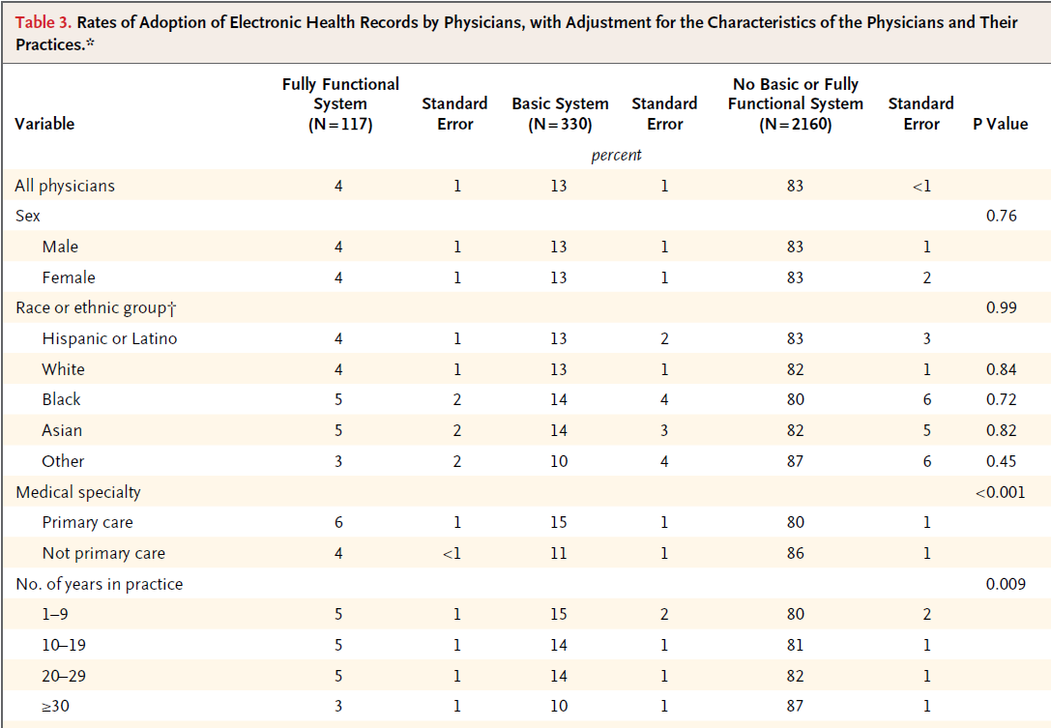

Slide 19
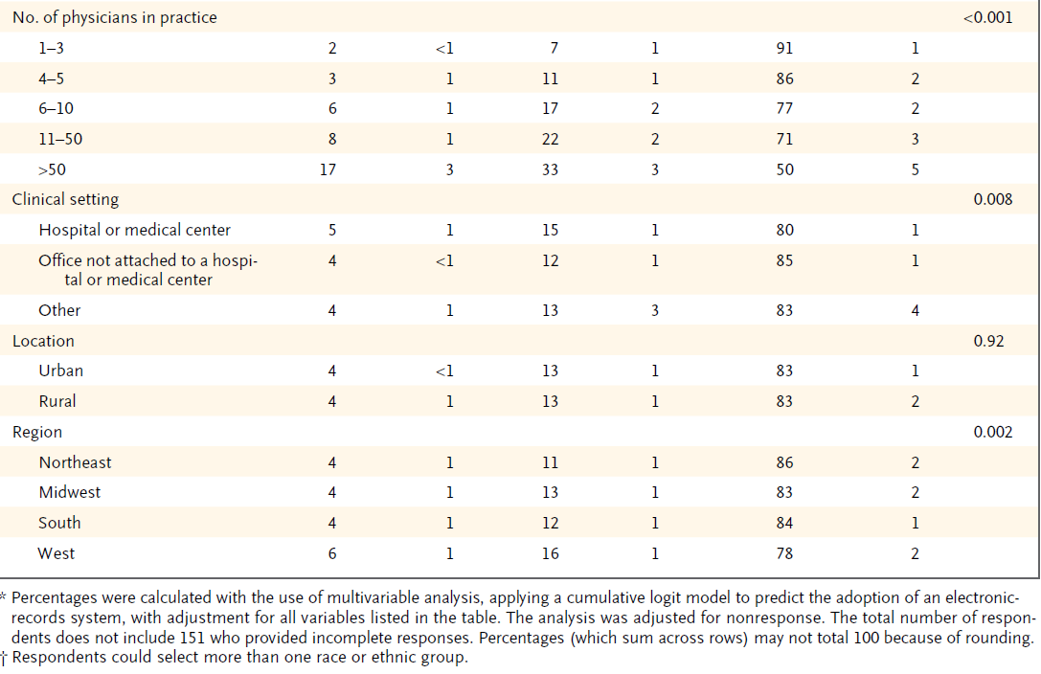

Slide 20
Frequency of Use
97% reported using all the functions at least some of the time.
13%
99% reported using all the functions at least some of the time.
83%
Notes:
4% doctors using a fully functional electronic-records system.
->97% reported using all the functions at least some of the time.
13% doctors with a basic system, more than 99% reported using all the functions at least some of the time.

Slide 21
Other Capabilities
Physicians with EHRs were asked to report the extent to which these systems allowed patients to do each of the following online:
View and make changes to their medical records and request prescription refills, appointments, and referrals.
Enabling patients to request a prescription refill online was a prevalent function for both basic systems and fully functional systems.
Notes:
Physicians with fully functional
electronic-records systems were significantly
more likely than those with basic systems to
have each of these functions (Table 4).

Slide 22
Extent Problems
HEALTH INFORMATION TECHNOLOGY
IMPLEMENTATION ASSISTANCE
Health Information Technology Extension Program-
To assist health care providers to adopt, implement, and effectively use certified EHR technology that allows for the electronic exchange and use of health information…
(b) Health Information Technology Regional Extension Centers-
IN GENERAL- The Secretary shall provide assistance for the creation and support of regional centers (in this subsection referred to as regional centers') to provide technical assistance and disseminate best practices and other information learned from the
39% Capacity to implement
[Reference] Health IT and Patient Safety: ONC Context
David R. Hunt, MD, FACS
Chief Medical Officer and Acting Director, OHITA
Office of the National Coordinator for HIT
41% Transition productivity loss
44% Concerns of obsolescence
54% Finding an EHR to meet needs

Slide 23
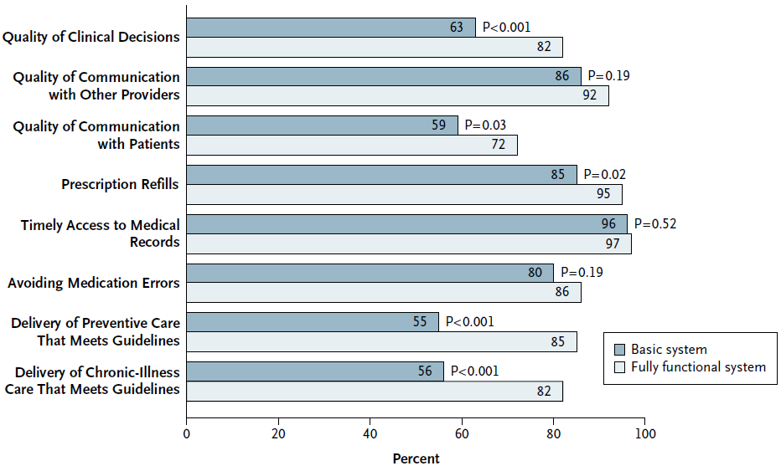
Effect on Practices

Slide 24
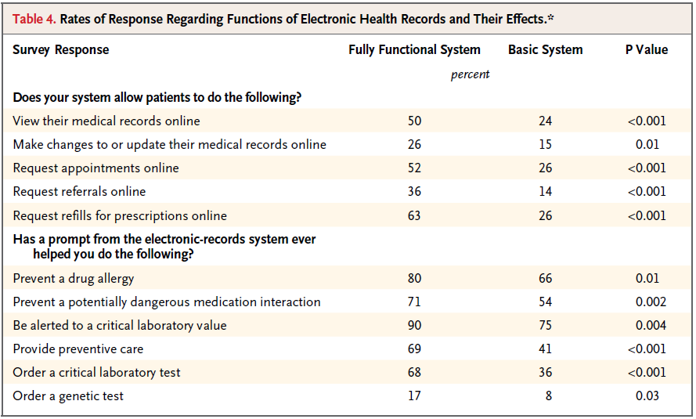
Effect on Practices

Slide 25
Physician Satisfaction
Large majority of physicians reported being satisfied with their electronic-records systems.
Fully ERS more likely to be satisfied with the reliability of their system than Basic ERS.
7%
12%

Slide 26
Barriers to Adoption
The common barriers to adoption among physicians who did not have access to an electronic-records system.
Capital costs—66%
Not met physicians’ need—55%
Uncertainty about ROI—50%
System become obsolete—44%

Slide 27
Facilitators of Adoption
The factors that were most frequently cited as facilitators of adoption.
Financial incentives for the purchase
With ERS—46%
Without ERS—55%
Payment for use
With ERS—52%
Without ERS—57%

Slide 28
Discussion

Slide 29
Review
EHR are available in the office setting to only a small minority (17%) of U.S. physicians at present.
- 3% basic
-14% fully functional

Slide 30
The effects of group size
Size of the group had a significant influence on the adoption of electronic health records
-Large groups with the basic system is three
times that of a small groups
-Large groups with the full functional system
is four times that of a small groups

Slide 31
What’s encouraging
The quality of their practice and clinical decisions and about their satisfaction with the system are encouraging
More capable systems offer greater benefits
Bias among early adopters especially greater receptivity to and facility with electronic health records cannot be excluded

Slide 32
Note
The quality and cost effects of electronic health records need to be confirmed by direct studies of clinical outcomes
The overall effect of electronic health records and research needs to clarify the effects of this technology on our health care system

Slide 33
Satisfaction
large majority of respondents reported overall satisfaction with their electronic-records system
Easy to use?
20% with basic systems expressed reservations
Improving the usability of electronic health records may be critical

Slide 34
Compare with other system
Adopting the similar definition
National Ambulatory Medical Care Survey
9.3% in 2006 (NAMCS)
14% in 2007-2008 (This paper)
Enable future researchers to gauge progress in the adoption

Slide 35
Prospect
the potential benefits
low current availability
major challenges
in taking full advantage of electronic health records to realize its health care goals.

Slide 36
The government’s attitude
President Bush
ERS should be widespread by 2014
both of the likely presidential candidates
Medicare cost-containment proposals included incentives as a means of spurring greater use.
The cost is high, the resource is uncertain
hundreds of billions of dollars

Slide 37
Benefit of EHR
lower overall national health expenditures
-physicians use computers over 90%
-a variety of interventions

Slide 38
Limitation
response bias
- physicians responded to our survey had a greater interest than did nonresponders
small number of respondents
-in their diffusion, the respondents with these systems are probably different from respondents without them.

Slide 39
Contribution
our study informs the debate by providing benchmark information about the levels of adoption of electronic health records by U.S.

Slide 40
EHR in Taiwan

Slide 41
EHR in Taiwan(cont.)
推動實施電子病歷子計畫
電子病歷推動現況(統計到100年底)
共590家醫院
績效指標 | 衡量標準 | 年度目標值
 |  | 97 | 98 | 99 | 100
醫療院所實施電子病歷比例 | (醫院使用電子病歷之家數／所有醫院數)*100% | － | 1% | 5% | 10%
關卡1 | 已宣告實施電子病歷且向衛生局報備 | 274家(46%)
關卡2 | 已通過電子病歷檢查 | 208家 (35%)
關卡3 | 已通過資訊安全制度ISO27001:2005驗證 | 93家(16%)
關卡4 | 已通過跨院交換互通查驗 | 150家(25%)

Slide 42
Source Information
From the Institute for Health Policy (C.M.D., E.G.C., S.R.R., K.D., D.E.L., A.E.S., D.B.) and the Massachusetts General Physicians Organization (T.G.F.), Massachusetts General Hospital; and Harvard Medical School (A.J.) — both in Boston; Weill Cornell Medical College, New York (R.K.); and the Department of Health Policy, George Washington University, Washington, DC (S.R.).
行政院衛生署 電子病歷推動專區 http://emr.doh.gov.tw

Slide 43
Thanks for your attention

