Slide 1
Selected Paper Presentation
資訊所 R00922070 韓政廷

Slide 2
SCIENCE AND SOCIETY From patients to partners: participant-centric initiatives in biomedical research
Nature Review Genetics 13, 371-376 (May 2012)
Jane Kaye, Liam Curren, Nick Anderson, Kelly Edwards, Stephanie M. Fullerton, Nadja Kanellopoulou, David Lund, Daniel G. MacArthur, Deborah Mascalzoni, James Shepherd, Patrick L. Taylor, Sharon F. Terry and Stefan F. Winter

Slide 3
Background
Advanced in computing technology and bioinformatics mean that medical research is increasingly characterized by large international consortia of researchers that reliant on large data sets and biobanks.
Recent advances in digital technologies have led to increasing concern about the use of personal data, in particular about amount of control that individuals have over their information and who may have access to it.

Slide 4
Emerging Issues
Protecting individual interests
New trends in research demanding new consents models
Giving research participants a greater choice

Slide 5
Protecting individual interests
The central concern of medical research ethics is to protect the interests of research participants while allowing beneficial research to proceed.
Those who agree to take part in any form of biomedical research are required to give their consent to the use of any donated samples and associated data in the given study before the research commences.
How to achieve enough?

Slide 6
New trends in research demanding new consents models
Consent is of fundamental importance, but there are no uniform standards of it.
The legal, ethical, and regulatory requirement may differ between jurisdictions at different levels.
As research evolve over time, it is increasingly difficult to guarantee individuals anonymous.
Ongoing participation is required to provide more detailed information or samples.

Slide 7
Giving research participants a greater choice
From an ethical perspective, it is necessary to enable participants that have given consent under one set of circumstances to reassess this in the light of new research possibilities on the same data sets that contain their information or samples.
The major challenge is to develop ways to engage and to communicate with diverse groups over long periods of time, as personal data are used and reused for new studies.

Slide 8
What is a PCI?
Participant-Centric Initiative
Generally defined as ‘tools, programs and projects that empower participants to engage in the research process’ using IT interface
The key feature of all PCI interfaces is that patients and research participants are located at the center of decision making as equal partners in the research process.

Slide 9
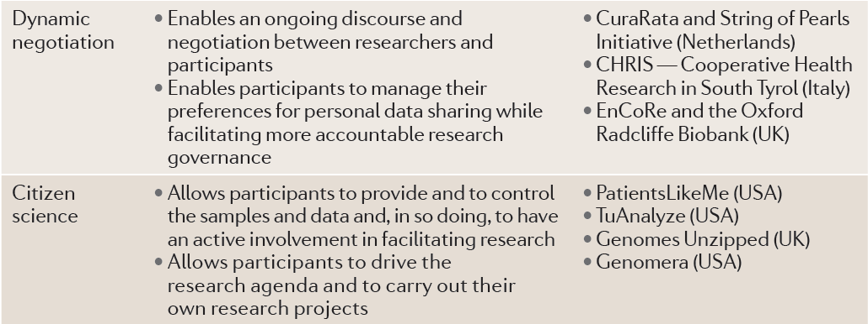

Slide 10
Features of PCIs
Placing participants in control
Place the individual at the center
Using social media technology
Phone, blog, FB, all IT interfaces
Promoting active participation
Reciprocity and commitment on both side
Facilitating communication
Inform participants and keep in regular contact
Appealing to public goods
Other advantages for public, such as accelerating research, improving clinical outcome, and increasing public knowledge about genomics.

Slide 11
Benefits of adopting a PCI approach
Streamlining the consent process
Removing the need for anonymized data
Facilitating participant recruitment
Facilitating participant retention
Promoting the delivery of better quality and more cost-effective health care
Sustain public confidence in research
Improving the quality of research

Slide 12
http://www.nature.com/nrg/journal/v13/n5/fig_tab/nrg3218_T2.html

Slide 16
Challenge of adopting PCIs
Require a shift in current attitudes and approaches towards patients and participants.
As the bulk of consent efforts are still paper-based, there are difficulties in making the transition to effective electronic consent models.
Boarder implementation in research will be hampered by the lack of a common reference ontology that can accurately capture a continuum of patient consent state.

Slide 17
Challenge of adopting PCIs
The implementation of PCIs also requires a change for research participants, as PCIs alter the nature of involvement in research.
Although the greater use of PCIs may lead to greater empowerment of participants and better control over personal information and samples, certain lines of research may not be possible if many participants opt out.

Slide 18
Conclusion
The motive and advantages of PCIs are wonderful, but there are still lots of problems and challenges to be overcome.

Slide 19
Thank you for listening!

