Slide 1
Ultrafast and memory-efficient alignment of short DNA sequences to the human genome
Ben Langmead, Cole Trapnell, Mihai Pop, Steven L Salzberg
林恩羽 宋曉亞 陳翰平

Slide 2
Rationale
Existing method(Maq, SOAP, …) → computational cost of many short reads is large
Align the 140 billion bases
Maq: 5 cpu-months
SOAP: 3 cpu-years
Clear need for new tools that consume less time and computational resources

Slide 3
Bowtie
Ultrafast, memory-efficient
Burrows-Wheeler indexing
25 million reads per CPU hour with a memory footprint of approximately 1.3 GB

Slide 4
Bowtie
Aligns 35-base pair reads → 25 million / hour (35 times faster than Maq / 300 times faster than SOAP)
Small footprint allows Bowtie to run on PC with 2 GB of RAM
Multiple processor cores → to achieve greater alignment speed

Slide 5
Compromise
Fail to align a small number of reads with valid alignment, if those reads have multiple mismatches
Options that increase accuracy at cost some performance

Slide 6
Environment
PC | Server
Intel Core 2 2.4GHz | AMD Opteron (4-core)
2GB RAM | 32GB RAM
Red Hat Enterprise Linux AS Release 4

Slide 7
Evaluation
Wall-clock time, CPU time
Time to build index is excluded
Reuse pre-computed index
Human
Chimp
Mouse
Dog
Rat
Arabidopsis thaliana

Slide 8
Comparison to SOAP and Maq
1,000 Genomes project (NCBI Short Read Archive: SRR001115)
8.84 million reads
Trimmed to 35bp
Aligned to Human Reference Genome (build 36.3)

Slide 9
Bowtie V.S. SOAP
99.7% were aligned by both
0.2% were aligned by Bowtie
0.1% were aligned by SOAP
Bowtie V.S. Maq
96.0% were aligned by both
0.1% were aligned by Bowtie
3.9% were aligned by Maq
Maq is more flexible → allows 3 mismatches

Slide 10
Maq with filtered read set
‘poly-A’ artifacts
‘catfilter’ → 438,145 reads

Slide 11
Read length and performance
Lengths of reads supported:
Bowtie – 1024bp
Maq – 127bp (v0.7.0)
SOAP – 60bp
Align 36-bp set, 50-bp set, 76-bp set to human genome
36-bp set (SRR003084)
50-bp set (SRR003092)
76-bp set (SRR003196)

Slide 12
Parameters
Bowtie
‘-v 2’ → allows 2 mismatches [SOAP]
‘--maxns 5’ → filter out reads with 5 or more no-confidence bases [SOAP]
‘-z’ → only forward index is resident in memory at one time [Maq]

Slide 13
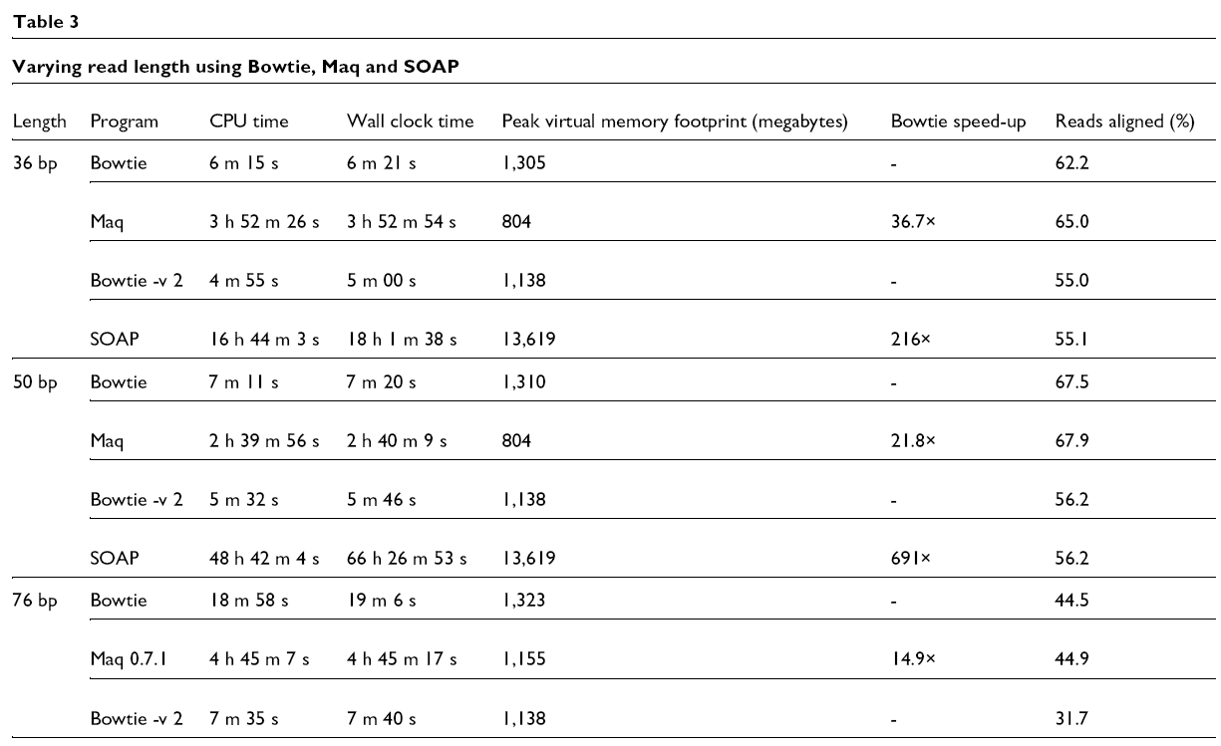

Slide 14
Parallel performance
Bowtie allows the user to specify a desired number of threads
The memory image of the index is shared by all threads

Slide 15
Parallel performance

Slide 16
Index building
Bowtie uses a flexible indexing algorithm that can be configured to trade off between memory usage and running time

Slide 17
Discussion
Unlike SOAP, Bowtie‘s 1.3 GB memory footprint allows it to run on a typical PC with 2 GB of RAM
Unlike many other short-read aligners, Bowtie creates a permanent index of the reference that may be re-used across alignment runs

Slide 18
Discussion
Bowtie‘s speed and small memory footprint are due chiefly to its use of the Burrows-Wheeler index
Does not yet support paired-end alignment or alignments with insertions or deletions

