Slide 1
On the Future of Genomic Data
R00922113 謝宗潛 R00922038楊竣宇 R00945018 邵祈諭 R00945019 徐國翔 R00945040 邱相茹 B96902082 邱璽安R009220xx 林易徵
advisor : Prof Kun-Mao Chao

Slide 2
Outline
Introduction of Genomic Data
Central challenge
Service-Oriented Architectures(SOAs)
Data security
Reference genome
Standards in genomic data
Conclusion

Slide 3
Genomic data
In modern molecular biology and genetics, the genome is the entirety of an organism's hereditary information. It is encoded either in DNA or, for many types of virus, in RNA. The genome includes both the genes and the non-coding sequences of the DNA/RNA.
The human genome occupies a total of just over three billion DNA base pairs.
Notes:
首先 那什麼是genome呢
有機體的所有遺傳資訊，其中包含的是DNA或是RNA等等
而人類的的genome大小則是大約在3 bilion個base pair
那這個3 billion這數字到底室督還是少呢
我們來跟其他物種來做個比較

Slide 4
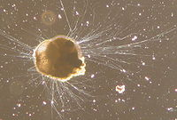
Genome size
Organism Type | Organism | Genome Size(base pairs) | Note
Virus | Bacteriophage MS2 | 4kb | First sequenced RNA-genome
Bacterium | Solibacter usitatus | 10Mb | Largest known Bacterial genome
Mammal | Homo sapiens | 3.2Gb
Amoeboid | Polychaos dubium | 670Gb | Largest known genome
Notes:
這個病毒有4k個bp 而他是最早被定序的RNA genome
第二個是細菌 最大的細菌genome大約是10Mb
我們人類是3.2Gb這樣到底算不算大
變形蟲əˋmibɔɪd

Slide 5
DNA sequencing History
1970s
Sanger sequencing (100 nucleotides per sample per day)
1990s
Sequencing technology was improved in the late 1980s by Leroy Hood who developed fluorescent color labels for the 4 terminator nucleotide bases. (100000 nucleotides per day)
Notes:
接下來我們來看看DNA sequencing的演進
在1970s
1990s Hood先生利用fluorescent color labels去改進定序的技術 大約每天可以訂續十萬個和甘酸

Slide 6
DNA sequencing History
2010s
NGS has grown from 10 Mb per day to 40 Gb per day on a single sequencer
Notes:
到了近幾年來 NGS的演進 從10Mb 到了40Gb
遠遠超過之前的速度

Slide 7
 | Sanger sequencing | Roche 454 | Illumina GA | ABI
Read length | 800 | 400 | 100 | 50
Output(reads)/run | 384 | 1M | 200M | 1G
Throuput | 300kb/hr | 0.5Gb/10hr | 30Gb/10days | 50Gb/14days
Notes:
讓我們看看這些方法的比較 右邊三個是現在NGS所使用的平台
很明顯的現在NGS的read 長度都叫之前的短許多
但是特點就在於output出相當大量的read
而且時間也縮短許多

Slide 8
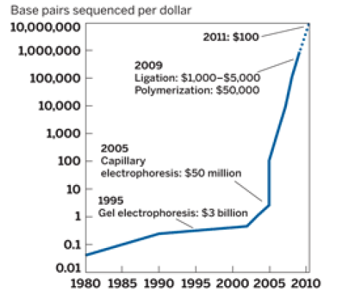
Sequencing cost
DNA sequencing technologies have advanced at a pace far greater than Moore’s Law for transistor density, so that it is now possible to order your personal genome sequenced today for a retail cost of under ~$20,000. This cost will likely fall to less than $1,000 by 2012, and to $100 by 2013.
Notes:
而現在NGS的好處不只是時間縮短 在於cost也是降低非常快
我們來看看這個曲線，縱軸是每一塊錢所能定序的bp
在兩千年時一塊錢只能訂續一個bp
但是到了2010左右我們一塊錢就能定序一百萬個bp
推測大約在2013年訂續一個仁可能只需要100元左右就能辦到

Slide 9
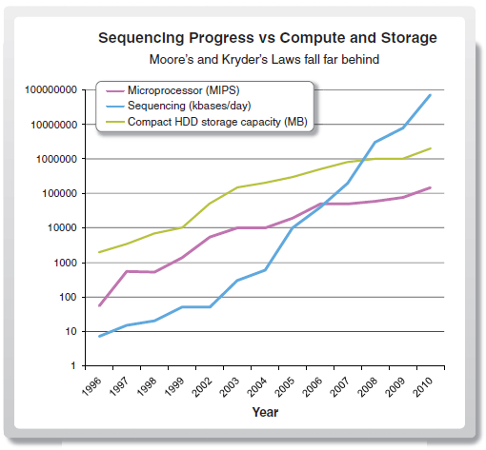
Notes:
接下來我們比較sequencing與CPU跟硬碟的發展速率
途中藍線是定序每天所能定序的bp數
而紫線是CPU每秒能直行多少指令
而綠線是一個硬碟能儲存多少MB
很明顯的定序的成長速度在2008年就完全遠超過CPU跟硬碟的成長

Slide 10
A doubling of sequencing output every 9 months has outpaced and overtaken performance improvements within the disk storage and high-performance computation fields.
Notes:
統計出來定序的output大約每九個月就會成長一倍
這個速度甚至連moore law都比不上

Slide 11
Challenges
Data storage and analysis problem
Notes:
而sequencing的進步真的就是愈快愈好愈多愈好嗎？當資料產生速度遠大於我們storage與analyze的發展時，我們就遇到了一些問題

Slide 12
Such a growth in raw output has outstripped the Moore’s Law advances in information technology and storage capacity, in which a standard analysis requires 1 to 2 days on a compute cluster and several weeks on a typical workstation.
The pace of innovation in genomic data creation is much higher than the rate of innovation within genomic informatics.
Notes:
通常用computer cluster需要1-2天，而用個工作站更可能要幾個星期才跑得完
而且當龐大的data不斷的產生，我們的storage的問題就會突顯出來，我們總不能一直去購買價格高昂的硬碟，而且之前泰國水災現在的硬碟還是價格高昂

Slide 13
Central challenge

Slide 14
Central to the challenge is the definition of the raw data
Many current sequencing technologies capture image data for each base being sequenced.
Notes:
現今的定序技術主要是把定序好的鹼基用圖像資料的方式儲存
圖像資料會被分析成一連串的base call(也就是鹼基數據)然後給予quality value
Quality value 佔儲存空間大多數

Slide 15
Quality scores are logarithmically linked to error probabilities
Quality value Score | Probability of incorrect base call | Base call accuracy
10 | 1/10 | 90%
20 | 1/100 | 99%
30 | 1/1000 | 99.9%
40 | 1/10000 | 99.99%
50 | 1/100000 | 99.999%
Notes:
這是quality value 的介紹，quality score 越高，base call出錯率越低

Slide 17
How to manage numerous data?
Notes:
那麼這些圖像如果真要儲存起來的話，每個lab每天大約可以存將近5TB的數據
如果真把這些數據儲存起來是非常荒謬的
一天5TB，假設每顆3.5吋硬碟存2TB
（人一生所發生所有事情的照起來記錄也才1TB）
我們於是有了動機想要去研發real-time processing
也就是不再需要把整個image data儲存起來，而是on time去分析image並把base call& quality value
並output 出來

Slide 18
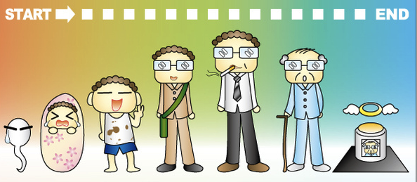
How to manage numerous data?
A person’s life can be recorded with in a Terabyte.
Notes:
那麼這些圖像如果真要儲存起來的話，每個lab每天大約可以存將近5TB的數據
如果真把這些數據儲存起來是非常荒謬的
一天5TB，假設每顆3.5吋硬碟存2TB
（人一生所發生所有事情的照起來記錄也才1TB）
我們於是有了動機想要去研發real-time processing
也就是不再需要把整個image data儲存起來，而是on time去分析image並把base call& quality value
並output 出來

Slide 19
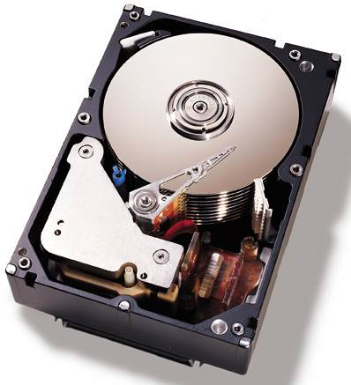
How to manage numerous data?
The size of these images for many labs is currently greater than 5 TB of information per day if they are stored
Notes:
那麼這些圖像如果真要儲存起來的話，每個lab每天大約可以存將近5TB的數據
如果真把這些數據儲存起來是非常荒謬的
一天5TB，假設每顆3.5吋硬碟存2TB
（人一生所發生所有事情的照起來記錄也才1TB）
我們於是有了動機想要去研發real-time processing
也就是不再需要把整個image data儲存起來，而是on time去分析image並把base call& quality value
並output 出來

Slide 20
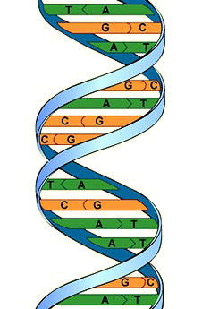
Real-time processing
Notes:
Real-time processing就是不再需要把整個image data儲存起來，而是on time去分析image並把base call& quality value並output 出來
如果有辦法在接近指定的時間把base call & quality value分析出來
我們就可以把定序的速度跟硬碟做一個切割(因為硬碟的常常是bottleneck)
雖然要把分析技術做到以接近real-time是有困難度的
但是只要這個想法能實現
幾乎可以將需要被處理的資料量降低100倍
雖然資料格式還正在擬定、規劃中，但原始數據已被重新定義為由base及quality組成

Slide 21
The ways in which base quality scores are captured, compressed, and archived will optimize storage and improve analysis.

Slide 22
Collective Data Emerges
Raw
Data
Raw
Data
Raw
Data
Raw
Data
Raw
Data
Raw
Data
Raw
Data
biologically or medically relevant information
Raw
Data
Raw
Data
analyses
comparisons
Challenge?
Notes:
如同前二位同學所提的，DNA定序的速度太快了，以致於資料量越來越多，
世界各地的實驗室紛紛累積了一堆資料
當資料很豐富的時候，我們可以把他們收集起來做
分析和比較
之後把這些分析比較後的結果
拿去提供給生物或醫療相關的資訊
可是 這麼多的資料會有什麼問題呢?
資料不是越多越好嗎

Slide 23
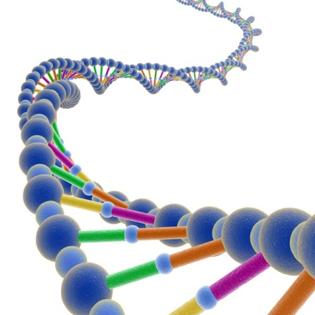
1000 Genomes Project
Network and Storage Capabilities
the download time for a well-connected site within North America:
7.3 TB of sequence data.
629 people
1000 Genomes Project
Notes:
舉個例子來看
光在1000 genomes project這一個project裡
就有629個人的dna序列資料
並且裡頭總共有7.3X10^12對dna序列資料
如果看這些數字沒有什麼感覺的話
那我們來看 假如你要把整個存在1000 genomes projet裡的資料
全部存下來的話會發生什麼事呢

Slide 24
Network and Storage Capabilities
the download time for a well-connected site within North America:
1000 Genomes Project
7 days up
Notes:
假設我們人處在北美，然後最佳的網路環境下
我們仍然需要高達7天
而且是最少要7天
這是目前為止資料量大所遇到的問題

Slide 25
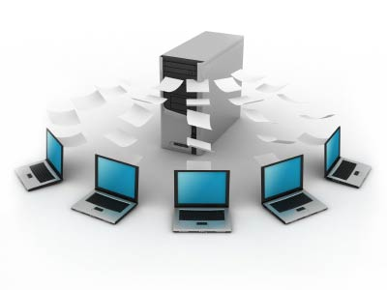
Network and Storage Capabilities
Having this data reside within a storage cloud does not entirely mitigate the longer-term challenges
Notes:
回到一開始的問題，世界各地都在做dna定序
因此每個地方存的資料會越來越大
可是把這些資料一直存著都不流通
只是暫時把問題給留著，
不是長遠之計
因此作者提出了一些想法

Slide 26
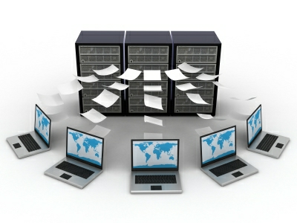
Aggregation of Multiple Data Stores
Aggregation of multiple data stores will be required to perform the comparative analyses and searching of information
Notes:
他希望把許多在世界不同地方的這些資料給整合起來
這樣不僅之後的找data會更方便，
也能做各地的dna序列比較，
節省資源，
就不用一直重複存一些相同的資訊

Slide 27
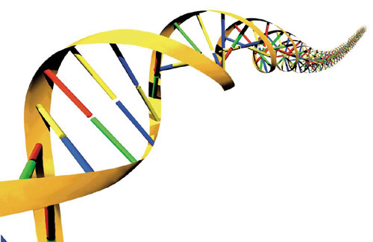
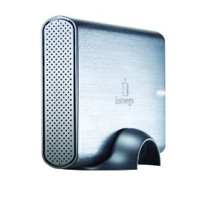
Inability
This fundamental inability to move sequence data in its current form argues for considerable changes in format and approach.
Notes:
剛剛講的資料量大的問題，
除了用整合data store外，
其實很重要的一點
是這些dna序列有本質上的問題
那就是資料都是用raw data也就是原始沒有處理過的資料存的
如果這樣一直存下去
總有一天會遇到dead end!

Slide 28
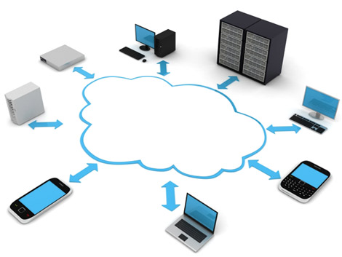
Centralized Cloud
A substantial leap in informatics capability and concomitant changes in the definition of data must take place to support movement of the field forward. Centralization of data on the Cloud is a positive start.
Notes:
因此小總結一下
我們建一個centralized cloud應該會是一個好的開始
而這個cloud裡頭的data是重新定義過的data
至於怎麼個重新定義
之後的同學會詳細說明
我們只要知道我們不要再存raw data
而是一個重新定義的
這樣資料大小就會差很多

Slide 29
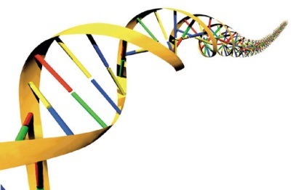
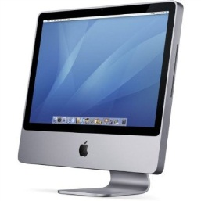
Service-Oriented Architectures
One approach that is being explored is to move computation to the data rather than moving the data to the computation.
Notes:
剛剛講重新定義
可能有點太抽象
這邊我來介紹一個架構
是所謂的服務導向架構
Service-Oriencted Architectures
他的主要理念就是把計算移到資料上
而不是把資料移去計算
白話一點
這個就是把資料移去計算
這樣我們光是花在下載資料就會浪費一堆時間
我們也許根本不需要這麼多的資料 但我們卻花了很多資源

Slide 30
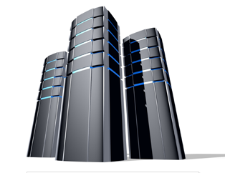
Service-Oriented Architectures
One approach that is being explored is to move computation to the data rather than moving the data to the computation.
Notes:
我們要的是像下面這種的
這邊我們用箱子來代表
我們把需要的服務或者說是運算傳上去雲端
然後雲端的主機會把需要的資料及使用者需要做的運算給算出來
然後再把結果放回去，如此一來，我們只需要用一個輕量化的箱子
就可以上傳然後加以運算比較等等 再載回結果就好
方便很多

Slide 31
Service-Oriented Architectures
SOA compute objects function like applications that are temporarily installed on a remote computer, perform an operation, and then are uninstalled
Notes:
總結一下SOA
他是個服務導向架構
就好像是某些電腦應用程式暫時安裝在遠端的電腦
然後運算，然後得到要的資料後再解安裝
所講的就是這種概念

Slide 32
Another New Challenge
How compute costs are shared when the computers performing the work are maintained by the data owners rather than the researchers performing the analysis.
?
Notes:
不過剛剛講的雖然很方便聰明
但仍然會遇到一些問題
就像下面圖表示的
我們有很多個雲端主機
然後會有使用者上傳需要的計算的小箱子
那們計算的分配該怎麼分配才好呢
這變成一個新的問題
不過其實作者提到下面的方法
也許可以拿來解決

Slide 33
Possible Solution
Collaborative compute grids may offer a solution here
Notes:
那就是所謂的 collaborative compute grid
聚集式計算網格
簡單來說，就是網格計算的概念
它可以虛擬化計算資源
下面的擷圖是一家專門做這件事的公司官網

Slide 34
XSEDE
The Extreme Science and Engineering Discovery Environment (XSEDE) is the most advanced, powerful, and robust collection of integrated digital resources and services in the world.
It is a single virtual system that scientists can use to interactively share computing resources, data, and expertise.
Notes:
這家公司叫
XSEDE
科學家可以用這個公司提供的資源用來做到計算資源，資料，以及企業共享
以上是我的部份的報告

Slide 35
Data Security

Slide 36
Data Security
Protection of subject/patient privacy
Researchers should not know the individuals’ exact information

Slide 37
Research on Privacy Issue
Informed Consent Form(ICF)
Let subjects or patients know that their privacy information might be informed by researchers
De-identification
A process by which a collection of data is stripped of information which would allow the identification of the source of the data

Slide 38
HIPAA
Health Insurance Portability and Accountability Act
Enact by U.S. congress in 1996
An Objective: Preventing health care fraud and abuse

Slide 39
HIPAA Privacy Rules
(1) Names
(2) All geographic subdivisions smaller than a state, including: street, city, county, precinct, zip code
(3) All elements of dates (except year) related to an individual, including birth date, admission date, discharge date, date of death.
(4) Telephone numbers
(5) FAX numbers
(6) Electronic mail addresses
(7) SSN
(8) Medical record numbers

Slide 40
HIPAA Privacy Rules(Cont.)
(9) Health plan beneficiary numbers
(10) Account numbers
(11) Certificate/license numbers
(12) Vehicle identifiers and serial numbers, including license plates
(13) Device identifiers and serial numbers
(14) Web universal resource locators (URLs)
(15) Internet protocol (IP) address
(16) Biometric identifiers, including finger and voice prints
(17) Full face photos, and comparable images
(18) Any unique identifying numbers

Slide 41
More About De-identification
Does the de-identification process really ensures subjects’/patients’ privacy?
Will the de-identification process lose some data which might be important or related to research?

Slide 42
Re-identification
Example:
Data #1: 葉Ｘ雄
Data #2: Ｘ大雄
Data #3: 葉大Ｘ
Re-identification: 葉大雄

Slide 43
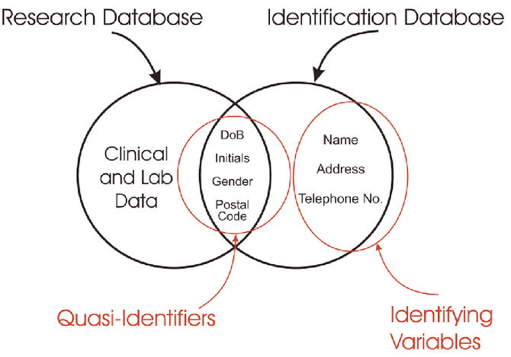
Research & Identification Database Relation Graph

Slide 44
Unfortunately…
You cannot have it in both ways
Re-Identification technology moves faster than de-Identification
Add more safeguards or regulations to discourage some inappropriate use by person with bad intention

Slide 45
GINA
Genetic Information Nondiscrimination Act
Officially enact in 2008
An act to prohibit discrimination on the basis of genetic information with respect to health insurance and employment

Slide 46
Reference Genome

Slide 47
Way to Minimize data storage
Reference Genome
Only bases that are distinct from the reference need to be saved
0.1% of the data are different from reference

Slide 48
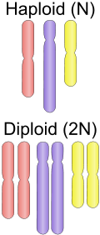
Reference Genome
Do not accurately represent the set of genes of any single individual
assembled from a number of donors
Provides a haploid mosaic of different DNA sequences from each donor

Slide 49
Reference Genome
Used as a guide on which new genomes are built
Enabling them to be assembled much more quickly and cheaply than the initial Human Genome Project
Provides a good approximation of the DNA of any single individual

Slide 50
Reference Genome
The human and mouse reference genomes
maintained by the Genome Reference Consortium (GRC)
Web tool
Ensembl
UCSC Genome Browser
Notes:
European Bioinformatics Institute, the National Center for Biotechnology Information, The Sanger Institute and Washington University in St. Louis.

Slide 51
Problems
Analysis tool may be premature for the transition to reference format.
Much of the sequencing data is dynamic.
Different time or tissue
Standards in quality and data vary or evolve

Slide 52
Problems
No such reference exists within
Metagenomics
Epigenomics

Slide 53
Metagenomics
Genetic material recovered directly from environmental samples
also be referred to as environmental genomic

Slide 54
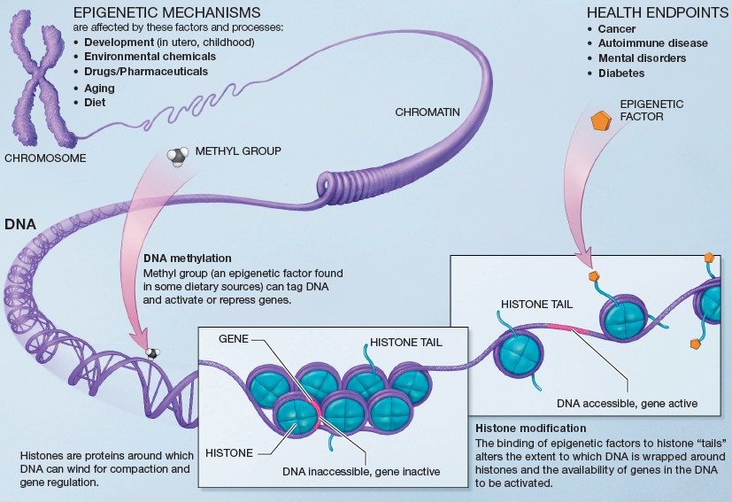
Epigenomics
Set of epigenetic modifications on the genetic material of a cell
Epigenetic modifications
reversible modifications on a cell’s DNA that affect gene expression without altering the DNA sequence

Slide 56
Medical Information Standards
Clinical information exchange protocol
Health Level Seven (HL7)
DICOM
(Digital Imaging and Communications in Medicine)
Diagnosis code protocol
LONIC
(Logical Observation Identifier Names and Codes)
Notes:
從剛剛那位同學的報告我們知道
若是能夠建立起referential genomic data 或是 genomic data的 standard
那麼不同地方收集到的定序資料就可以有統一規範 格式 像剛剛說的0.1%
在做資料的統計 檢索 運用 研究時更有效率
作者接著舉了電子病歷作為例子
所以接下來會和各位介紹電子病例所使用的國際通用標準
以及台灣電子病歷的簡介
HL7 國內外使用最頻繁的傳輸標準
XML base ANSI ISO
彙集了不同廠商用來設計應用軟體間介面的標準格式，它允許各個醫療機構不同的應用系統間，進行一些重要資料的溝通
設計同時保留相當的彈性，使得一些特定需求資料得處理維持相容性
DICOM
醫學影像的處理、儲存、列印、傳輸
檔案格式的定義及網路通信協定
整合不同廠商的醫療影像儀器、伺服器、工作站、列印機和網路設備
診斷代碼協定
HL7等傳輸標準，將其結果數據以電子消息的形式從報告系統發送至臨床資訊系統時
檢驗項目或觀測指標的編碼往往採用單位內部獨有的代碼
驗血 測血紅蛋白

Slide 57
EMR
Traditional medical records
Disorganization and Low Legibility
Low Accessibility and Low Transferability
Electronic medical records
Inter-hospital transfer
High efficiency
Correctness
Legal document
Environmental friendly
Notes:
各機構 單位 文化 表單格式皆不同
同一本病歷中 缺乏統一格式 醫療機構之間 也缺乏統一格式
各種看不同科的資料混雜在一起
字跡潦草 模糊 碰到水 等造成資料難以復原
病例的傳遞分送 花費人力
紙本資料難以進行大規模的運算、統計
透過HL7/DICOM的標準 不同醫療機構間也可互相取得資料
相較於手寫 筆跡 電子病例較清楚 易了解
醫生為了某些利益竄改病歷的情況 每次修改都有紀錄 因此可以預防這樣的情形

Slide 58
EMR
Project name
NHIP智慧醫療 計畫
Legal status
個人資料保護法
醫療法
醫療機構電子病歷製作及管理辦法

Slide 59
EMR
Protocol status
HL7 / DICOM
Safety status
醫事憑證管理中心 (HCA)
醫事人員憑證IC卡
Notes:
行政院衛生署
配合電子病歷及健保IC卡使用
代表醫事人員於醫療資訊電子化環境之個人行為—印鑑證明。
權限控管：健保第二階段存放內容讀取權限憑證(限醫師卡)、簽章：如電子病歷。

Slide 60
Challenge
meaningful genomic sequencing information
guide clinical diagnoses and treatment
Comprehensive, interoperable and practical informatics strategy is needed.
Notes:
雖然電子病歷看起來前景一片大好
但是回到這篇主題的部分genomic data
作者提到電子病例和這些定序出來的資料之間的關聯性相當弱
雖然現有相當多的定序資料
但是對於臨床上的診斷幫助非常有限
Genomic data也需要這樣的一個標準協定 許多大型的機構也正在嘗試
這樣的事情 看起來還需要一段時間

Slide 61
Conclusion
The future of genomic data is rich with
promise and challenge.
Referential compression will improve data issues.
The nature of derived information used for clinical applications also raises issues must be stored as part of the medical record.

Slide 62
The evolution of EMR and SOA to handle genomic data for advancing in sequencing technologies.
Notes:
informatics frameworks (such as EMRs)
scalable informatics imple- mentations (such as SOA
biological and medical sciences

Slide 63
Thanks for listening

