Slide 1
DNA sequencing :
Read with quantum mechanics
Thomas Thundat
Nature Nanotechnology 5, 246 - 247 (2010)
R00945002 楊偉杰

Slide 2
Introduction
DNA sequencing
  Single molecule
  Multiple molecules
  Some disadvantages for sequencing multiple molecules
  Expensive and time-consuming sample preparation
  Difficult to discover repeated sequences
  A single-molecule physics-based sequencing method is introduced
  Quantum sequencing

Slide 3
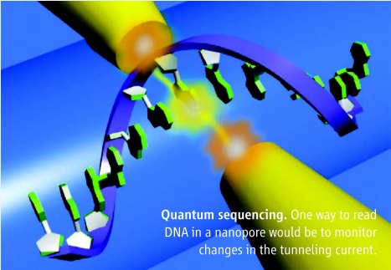
Quantum sequencing(1/2)
Ref : Going Solid-State,Elizabeth Pennisi, Science 4 May 2012: Vol. 336 no. 6081 p. 536

Slide 4
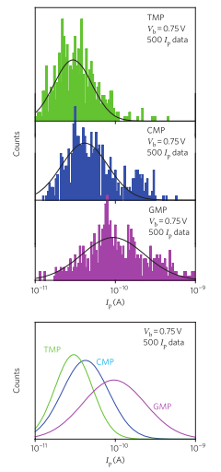
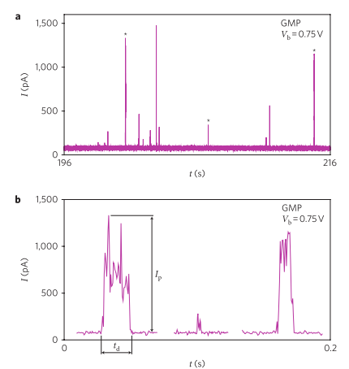
Quantum sequencing(2/2)
Ref : Identifying single nucleotides by tunneling current ,Tomoji Kawai et al, Nature Nanotechnology,21 May 2010

Slide 5
Recent progress
 | Stuart Lindsay | Tomoji Kawai
Identified molecules | Nucleoside | Nucleotide
Identified types | A、T、C、G | T、C、G
Electrode | Functionalized | Nanofabricated, reconfigurable
Current distribution | narrow | wide

Slide 6
Discussion & Conclusion
Challenges
  Overlapped distribution
    Overlap between different nucleotides
    Trade-off : time accuracy
  Techniques for creating reliable and precise nanogaps
  Nucleotide localization
    Speed
    One base at a time
  Thermal noise
Quantum sequencing is
  Physics-based
  Label-free
  Potentially obtaining sequence information at very high rate

