Slide 1
Will Computer Crash Genomics? -Elizabeth Pennisi Science 11 February 2011: 666-668.
組員：吳宜瑾 何宜靜 林芳伃
魏裕明 范剛瑋 陳柏融
2012/06/04

Slide 2
Outline
Introduction
Sequencing
Storage
Cloud Computing
Application
Conclusion

Slide 3
Introduction

Slide 4
Structure of Old Genome Informatics
Lincoln D Stein, Genome Biology 2010, 11:207 (5 May 2010)

Slide 5
Sequencing V.S. Storage
Lincoln D Stein, Genome Biology 2010, 11:207 (5 May 2010)

Slide 6
Structure of New Genome Informatics
Lincoln D Stein, Genome Biology 2010, 11:207 (5 May 2010)

Slide 7
Sequencing

Slide 8
First Generation
Sanger sequencing
Ref：Shendure J, Ji H. Next-generation DNA sequencing. Nat Biotechnol 2008;26 (10):1135–1145.

Slide 9
Second –generation DNA sequencing
Cyclic-array method
Ref：Shendure J, Ji H. Next-generation DNA sequencing. Nat Biotechnol 2008;26 (10):1135–1145.

Slide 10
Third-generation
Pacific Biosciences

Slide 11
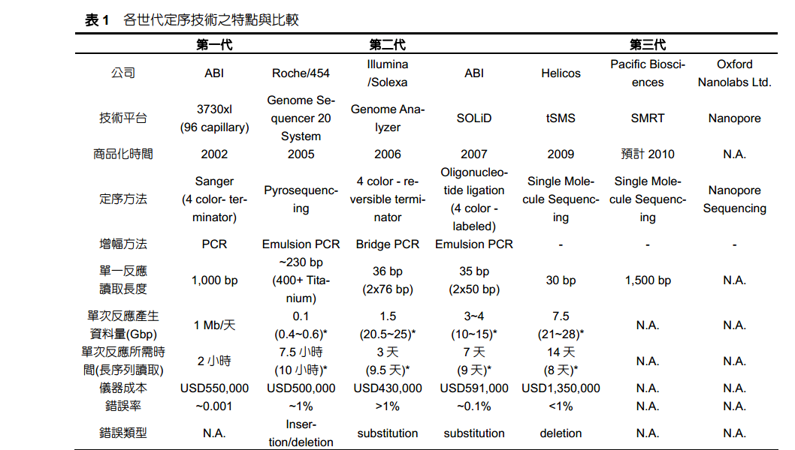
Ref：李思元，莊以光。DNA定序計數之演進與發展。

Slide 12
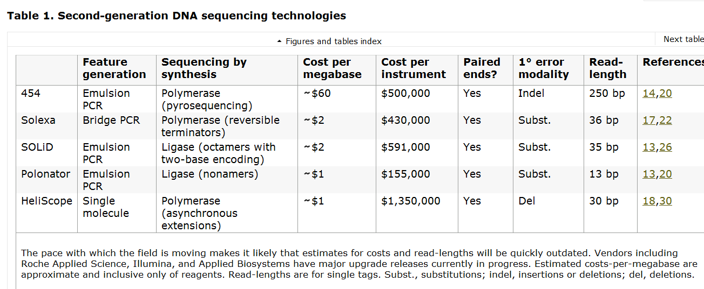
Ref：Shendure J, Ji H. Next-generation DNA sequencing. Nat Biotechnol 2008;26 (10):1135–1145.

Slide 13
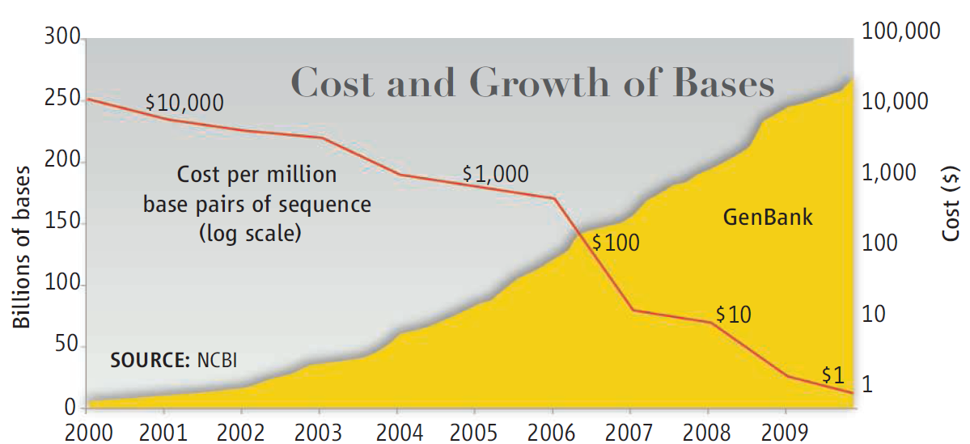
Cost and Growth of Bases
The decline in sequencing costs (red line) has led to a surge in stored DNA data.

Slide 14
New generation
20 Gbp
Roughly estimate: 5 month/per
MBP: million base pair
Illumina GAII
GAII and the SOLiD systems
Illumina and Applied Biosystems (AB)
GS-FLX
5-fold data output improvement
Roche 454 GS20
pyrose-quencing

Slide 15
Growth of GenBank
High resolution image
Microarray, SAGE
Protein 3-D structure
single nucleotide polymorphism
Human Genome Project
NIH
Start project
Notes:
不同的基因在何時表達以及在何種組織器官中表達 (eg. microarray, SAGE)
蛋白質的形狀和結構 (3-D structure)
一蛋白質如何與其它蛋白質交互作用
單一核甘酸多樣性(single nucleotide polymorphism, or SNP)

Slide 16
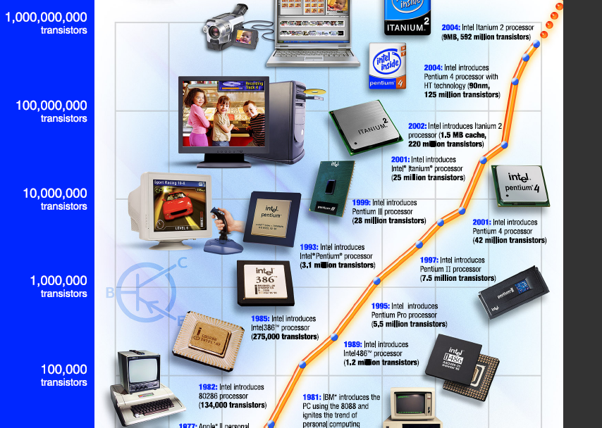
Moore’s law
Moore‘s law：the number of transistors that can be placed inexpensively on an integrated circuit doubles approximately every two years. The period often quoted as "18 months.
Notes:
摩爾定律是由英特爾（Intel）創始人之一戈登·摩爾（Gordon Moore）提出來的。其內容為：當價格不變時，積體電路（IC）上可容納的電晶體數目，約每隔24個月（1975年摩爾將24個月更改為18個月）便會增加一倍，性能也將提升一倍；或者說，每一美元所能買到的電腦性能，將每隔18個月翻兩倍以上。^{[1]}這一定律揭示了信息技術進步的速度。

Slide 17
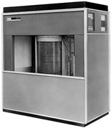
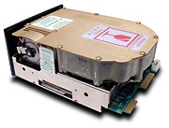
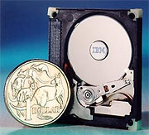
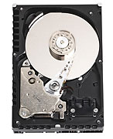
Moore’s law
Moore‘s law：the number of transistors that can be placed inexpensively on an integrated circuit doubles approximately every two years. The period often quoted as "18 months.
Photograph: Courtesy of Seagate Technology
1956 | 1979 | 1997: | 2006
RAMAC 305 | Piccolo | Deskstar 16GP Titan | Barracuda 7200.10
store 5MB | store 64MB | stores 16.8GB | Store 750GB
$10,000 /megabyte | six 8-inch platters | 3.5-inch platters | 3.5-inch platters
Notes:
摩爾定律是由英特爾（Intel）創始人之一戈登·摩爾（Gordon Moore）提出來的。其內容為：當價格不變時，積體電路（IC）上可容納的電晶體數目，約每隔24個月（1975年摩爾將24個月更改為18個月）便會增加一倍，性能也將提升一倍；或者說，每一美元所能買到的電腦性能，將每隔18個月翻兩倍以上。^{[1]}這一定律揭示了信息技術進步的速度。

Slide 18
Cloud computing

Slide 19
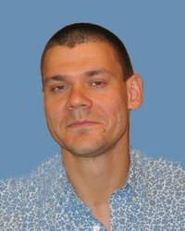
James Taylor
Emory University in Atlanta
Anton Nekrutenko
Penn State, University Park
The goal was “to make collaborations between experimental and computational researchers easier and more efficient”

Slide 20
Genomic tools and Database
Galaxy, a software package that can be downloaded to a personal computer or accessed on Penn States computers via any Internet-connected machine.
The public portal for Galaxy works well, but, as a shared resource, it can get bogged down, says Taylor.

Slide 21
Cloud computing
It contains renting off-site computing memory to store data, running ones own software on another facility’s computers.
Amazon Web Services and Microsoft are among the heavy-weights running cloud-computing facilities.
Open Cloud Consortium

Slide 22
Galaxy on Cloud
Virtual computer
Worked with Penn State colleague Kateryna Makova, who wanted to look at how the genomes of mitochondria vary from cell to cell in an individual.
Generating 1.8 gigabases of DNA sequence, about 1/10 of the human genome scale.

Slide 23
Cloud computing
Biology of Genomes meeting in Cold Spring Harbor, New York.
Upload and analyze data on cloud, cost-effective solution.
Michael Schatz, CSHL.
Ben Langmead, a computer scientist at the Johns Hopkins Bloomberg School of Public Health in Bal-timore, Maryland.

Slide 24
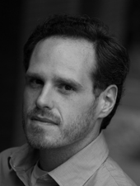
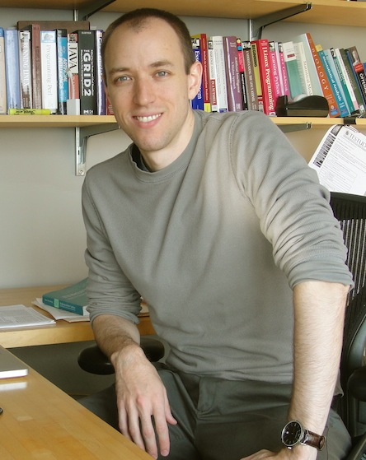
Identify common sites of DNA variation known as single-nucleotide polymorphisms (SNPs)
Program called Myrna that determines the differential expression of genes from RNA sequence data and for parallelizing.

Slide 25
Cloud computing
”Cloud computing may represent the democratization of computation”, says Schatz.
But cloud computing is not mature.
- Sneaker net (limited speed)
- Connections among the cloud processors can be fairly slow

Slide 26
Application

Slide 27
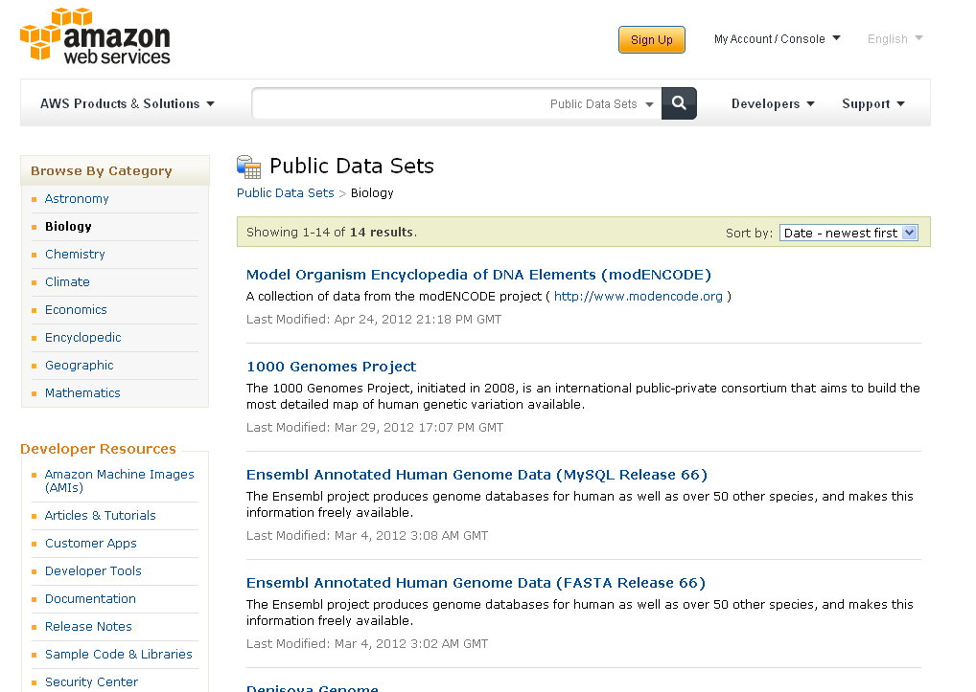
Commercialized platform : Amazon Web Service
Notes:
目前較成熟的商業化雲端平台為amazon web service，這個雲端平台上有各個領域的公開資料庫

Slide 28
Commercialized platform : Amazon Web Service
1000 Genomes Project: detailed human genome dataset
Ensembl: include human and other 50 species genome sets
GenBank: NIH genetic sequence database
Notes:
其中我列出比較重要的3個基因序列資料庫

Slide 29
Amazon Web Service: cost calculator
Notes:
On demand: 需要多少硬體，且按小時計算，需要多少時間就付多少費用
Reserved: 一次付清，可以得到折扣
選擇storage需要儲存的空間大小，個人化幫你計算每月需繳交的費用

Slide 30
Academic Cloud Platform
Open Cloud Consortium
Group of American Universities and industrial companies (IBM, Google)
US National Science Foundation
Academic clouds will be a better long-term solution
High data read and write speeds
Notes:
另外現在也有漸漸增加學術研究雲端平台，其中之一是open cloud consortium
長期上來說，學術雲端平台對基因序列分析為較好的選擇，主要因為學術雲端平台有考慮科學運算的讀取和寫入速度，對於大型資料量的基因分析上來說會比商業化的平台來的好

Slide 31
Galaxy
Pennsylvania State University
Web-based genome analysis tool
Accessible: no need for programming experience.
Reproducible: Galaxy gather information so any user can repeat the complete analysis
Transparent: allow users to share and publish genome analysis
Notes:
另外除了雲端運算平台外，還需要跟基因分析軟體做結合，由PSU所研發的galaxy是一個分析基因序列的網頁系統
它主要有三個特點
不需具有寫程式的經驗就可以很容易操作方法
收集以前的資料使得任何使用者可以重複使用且了解完整的分析方式
讓使用者可以在網路上分享完整的分析方法

Slide 32
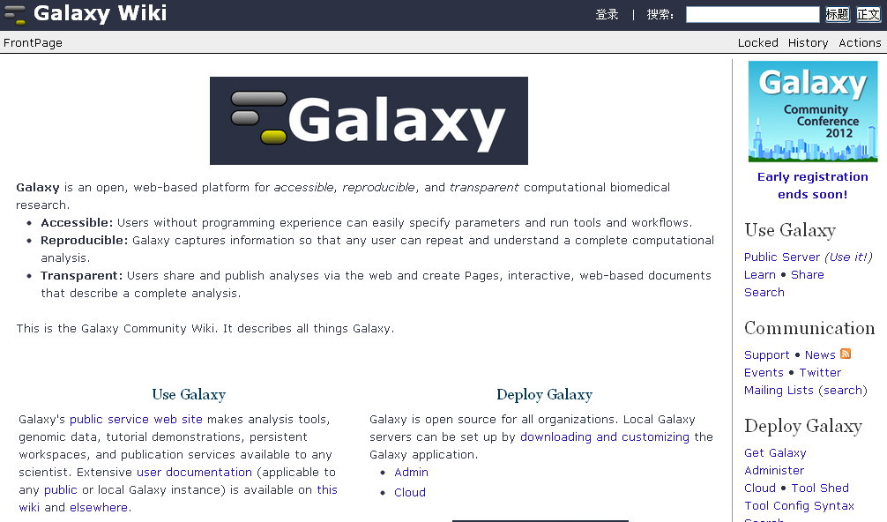
Galaxy Wiki
http://wiki.g2.bx.psu.edu/
Notes:
Galaxy還有提供一個教學網站，內有各種基因序列分析方法的教學，還有包含如何與雲端結合的教學

Slide 33
Downside of moving to cloud
Restricted-access databases: need to be encrypted on public clouds.
Network bandwidth:
 | Transfer rate | Uploading data days
Typical research institution | 5-10 megabytes/second | About a week
Major universities of large research institutions | 1.25 gigabytes/second | Under a day
Notes:
但是除了前面所述將基因序列分析都移到雲端的投資報酬率是否一定最高呢?
把基因序列分析都移到雲端還是會面臨到一些問題
有些基因序列的資料庫是加密的，要把這些資料庫移到公開的雲端上會需要另一層的授權，這會造成需要考慮很多的隱私條款。
另外要把現有的資料庫以及研究機關的資料庫移動到雲端也需要大量的頻寬，以目前的機構來說傳輸這些資料量還需要很多的時間
所以雲端運算是否真的降低基因序列分析成本還未知

Slide 34
Conclusion

Slide 35
Data
Sequencing technology develop
Data cost decrease
“Data tsunami”
Notes:
定序技術，定序方法開發進步
Human Genome Project完成
因此，累積了大量的資料量

Slide 36
Hardware
Computer memory and processing
Database
Easier and more efficient
Notes:
硬體速度開發，所以可以來處理大量的資料，且很簡單且有效率
但資料成長的速度超過目前的硬體
使用雲端運算

Slide 37
Cloud Computing
Cloud computing-divided into many separate tasks handled by multiple processors
Galaxy software
Notes:
雲端運算不是一個新技術，是一個概念
切成許多分別的部分，讓多個處理器來運算
舉例來說，Galaxy—download to a personal computer-Penn State via any Internet-connected machine

Slide 38
Disadvantage
Cloud computing
hot and sexy, but it’s not the answer to everything
Issue
data storage and transfer
Others
internet security
Notes:
但cloud computing也有缺點，並非everything
但就目前來說，data storage 和 傳輸改善是目前的議題
喪失控制權
需要網路，
「你不該用網路應用程式來處理運算任務的一大理由，就是你會喪失控制權。這和使用專屬軟體一樣糟糕。」 「在自己的電腦上，用自己的一份自由軟體，做自己的運算。如果你用的是專屬軟體，或某某人的網路伺服器，你就失去防衛力，受制於開發那個軟體的人，不論他是何人。」

Slide 39
Issue of Cloud Computing
Storage costs are dropping much more slowly than the costs of generating sequence data.
-> Spend an exponential amount on data storage
Raw data storage type from next-generation machine (high- resolution image) have to be changed to stored by processed sequence data.
-> More efficient and economical data storage type.

Slide 40
Issue of Cloud Computing
Putting the data in an off-site facility could relieve some of the pressure, and it ‘s more economical than putting in local system.
For example :
Amazon Web server at 14 cents / GB*month
Local system at 50-100 cents / GB*month

Slide 41
Issue of Cloud Computing
Instead of uploading and downloading the data from cloud to client for computing , we should directly computing on the cloud ( public system ) to save data transferring time.
Safety of genome information on the cloud.

Slide 42
Advantage
Cloud computing
Open source
Portable
Convenient
Low cost
Make contributions to the society
Notes:
1.允許小企業買不起超級電腦也是可以分析結果
2.未來十年以後，也許目前的問題都不會是問題
3.研究的目的是要貢獻於人類社會，就以目前bio-information來說，使用雲端運算的方式來協助處理大量的序列分析，會是一個趨勢。

