Slide 1
虛擬實境
VR Craze and Four Major Technical Problems to Solve in VR/AR: with an example application
Ming Ouhyoung, Professor
Dept. of CSIE, National Taiwan University
2018/3 at Dept. of CSIE, NTU

Slide 2
Outline
1. VR/AR is just going through a Cambrian explosion
2. Four Major Problems to Solve in VR and AR
3. An example application:
Scope+ : A Stereoscopic Video See-Through Augmented Reality Microscope

Slide 3
Definition of Virtual Reality and Augmented Reality
Virtual Reality:
Virtual reality (virtual realities VR) typically refers to computer technologies that use software to generate realistic images, sounds and other sensations that replicate a real environment (or create an imaginary setting).
Augmented Reality:
Augmented reality (AR) is a live direct or indirect view of a physical, real-world environment whose elements are augmented (or supplemented) by computer-generated sensory input such as sound, video, graphics or GPSdata.

Slide 4
It seems that VR/AR is just going through the Cambrian explosion!
Google glass (product cancelled)
Oculus Rift/Rift 2 (purchased by Facebook, 2 billion US$)
Google Cardboard VR project
Magic Leap secures 542M by Google Inc.
Microsoft HoloLens project
all these happened in 2014/2015!

Slide 5
Four major problems in VR/AR
1. Display resolution: wide angle display, without seeing pixels in display
2.Latency: should be less than 20 to 50ms
If greater than 50 to 100 ms, will cause dizziness, even nausea.
3.fixed focus vs. variable focus in observation through HMD or others.
4.Registration of real objects and virtual environments in AR

Slide 6
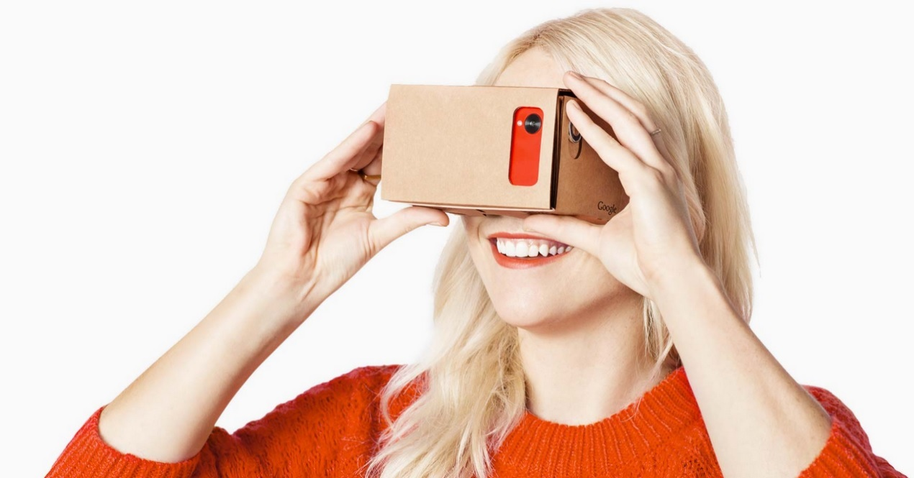
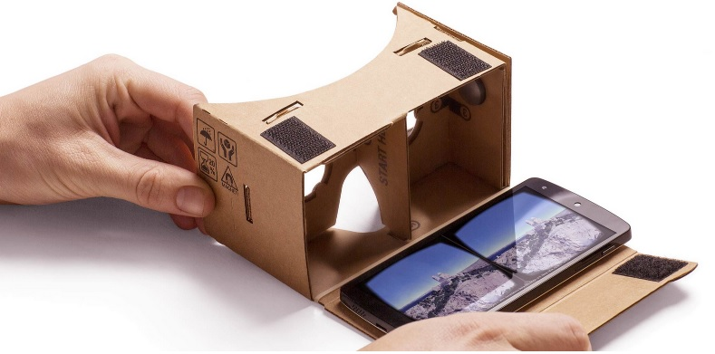
Extremely cheap HMD: US$6-20

Slide 7
Half a million sold in one week!
(December 16, 2014 news)
Less than a week after going on sale and dropping rather quietly on an unsuspecting America, Project Cardboard has rocketed past the 500,000 sales mark. Such is the popularity of the DIY virtual reality toy that Google has even built and launched a dedicated area of the Play Store for apps created for or ideally suited for use with the unusual piece of facewear.

Slide 8
Why so popular?
“The growth of mobile, and the acceleration of open platforms like Android make it an especially exciting time for VR,” beamed Andrew Nartker, project manager for Google Cardboard.

Slide 9
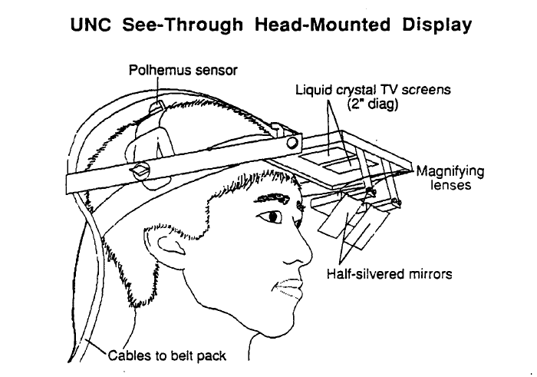
30 years from UNC HMD: much cheaper! (Display, Sensors)(Ref: paper in 1989!)
Polhemus position/orientation sensor: US$2000, 25 years ago.
Display: LCD TV screens: US$400 per set, and need 2 of them!

Slide 10
Polhemus trackers
Polhemus pioneered the original AC electromagnetic head tracking in the late 1960's and has advanced the technology in tracking excellence ever since.
full six-degrees-of-freedom (6DOF) motion tracking

Slide 11
Android Apps
For HTC, Samsung, Xiaomi Inc. etc.: best VR Apps,
1. Rollercoaster VR
2. Cardboard VR app
3. Cosmic Rollercoaster VR app
4. Jurassic Dino VR
5. Crazy Swing VR
6. Space Terror (need Bluetooth controller to play)

Slide 12
3D Video from Youtube
Key word: “3D” or “3D trailers” “360 vr” for 3D glasses
Example titles:
Air Racers, real airplane stunt show
Samsung 3D demo
Avatar 3D
WoW, World of Warcraft
Finding Nimos, is one good example,
NYT vrse,

Slide 13
Google Street View (VR mode)
Lower falls of the Yellowstone,
Old Faithful, Yellowstone
Musee d'Orsay, Paris
Musee du Lourve, Paris,
Niagara falls, On, Canada, (Google, on boat move forward)
Himalayas (ABC， Annapurna Base Camp， by Jonathan Jenkins, clear view of Everest
Avila Spain (City walls, ancient one）
Segovia Spain, Sevilla, Spain
Toledo, Spain

Slide 14
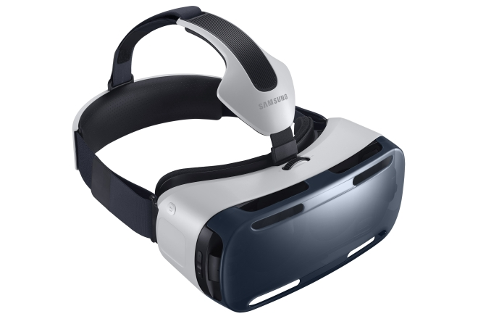
More choices: Gear VR by Oculus (US$199.), and from HTC!

Slide 15
Spec.
  96˚ Field of View
Sensor:
  Accelerator, Gyrometer, Geomagnetic, Proximity
Motion to Photon Latency: < 20ms
Focal Adjustment:
  Covers Nearsighted / Farsighted Eyes
Interpupillary Distance Coverage
  55 ~ 71 mm

Slide 16
Gear VR with Samsung Galaxy Note 4
Display:
  5.7 inch (143.9mm) Quad HD Super AMOLED (2560×1440)
Physical User Interface
  Touch Pad, Back Button, Volume Key
Audio:
  3D Spatial Sound on Samsung VR Player for VR Gallery contents
  (Earphone needed)

Slide 17
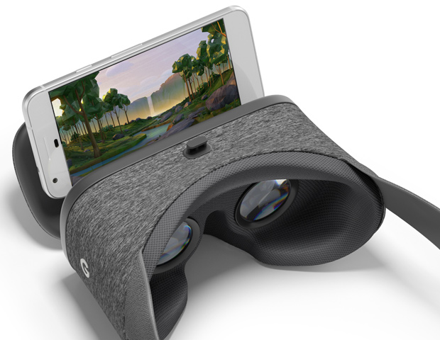
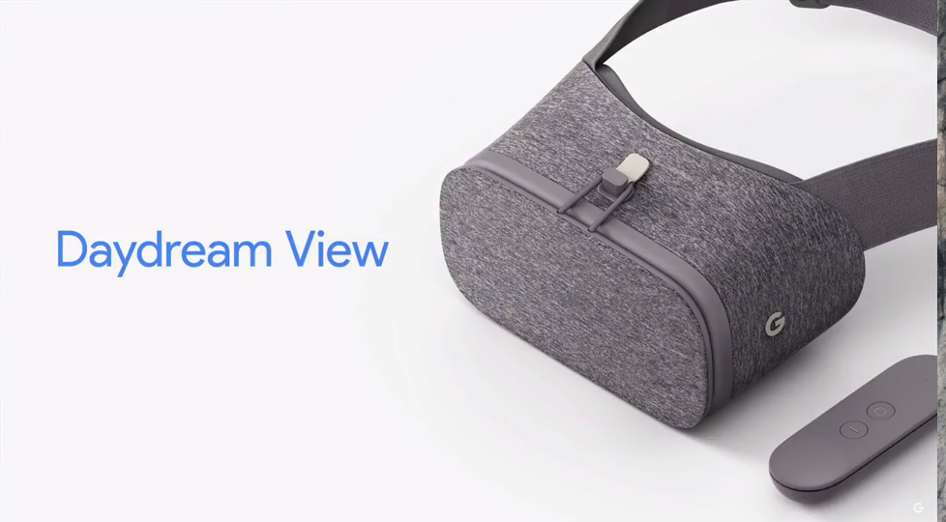
Google Daydream View VR

Slide 18
Daydream View VR FOV: 90 degrees
For Pixel, you're looking at 1080 x 1920 pixels, 5 inch AMOLED (441ppi) and while the XL is 1440 x 2560 pixels, 5.5 inch AMOLED display (534ppi).
There are only five buttons including a trackpad that doubles as a button. Below the trackpad, you'll find an app button, which can show menus, pause, go back or change modes depending on the app itself.
When you look at the screen in your VR headset, you will often see a regular grid of lines.

Slide 19
HTC VIVE HMD
Vive has a refresh rate of 90Hz,
two screens, one per eye, having a total resolution of 2160x1200 (1080 x 1200 per eye)
uses more than 70 sensors including a MEMS gyroscope, accelerometer and laser position sensors, and is said to operate in a 15 feet by 15 feet (4.5 by 4.5 meters) tracking space if used with a passive "Lighthouse" base station (x2)

Slide 20
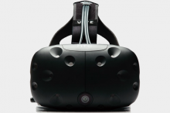
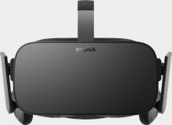
Oculus Rift 2 vs. HTC Vive
 | Oculus Rift | HTC Vive
Display | OLED | OLED
Resolution | 2160 x 1200 | 2160 x 1200
Refresh Rate | 90Hz | 90Hz
Platform | Oculus Home | SteamVR
Field of view | 110 degrees | 110 degrees
Tracking area | 5x11 feet | 15 x 15 feet
Built-in audio | Yes | Promised, not yet available
Built-in mic | Yes | TBA
Controller | Oculus Touch, Xbox One controller | SteamVR controller, any PC compatible gamepad
Sensors | Accelerometer, gyroscope, magnetometer, 360-degree positional tracking | Accelerometer, gyroscope, laser position sensor, front-facing camera
Connections | HDMI, USB 2.0, USB 3.0 | HDMI, USB 2.0, USB 3.0
Requirements | NVIDIA GTX 970 / AMD 290 equivalent or greater Intel i5-4590 equivalent or greater 8GB+ RAM Compatible HDMI 1.3 video output 2x USB 3.0 ports Windows 7 SP1 or newer | TBA
Price | $600 | TBA
Consumer Release | Pre-orders ship March 28, 2016 | April 2016
DT review | Hands-on | Hands-on

Slide 21
Need very powerful GPU for display, and that powerful PC can be very expensive!
HTC VIVE: NVIDIA GeForce GTX 970 /AMD Radeon RX 480 equivalent or greater
Occulus Rift 2: NVIDIA GeForce GTX 960 / AMD Radeon RX 470 or greater
Because the FOV is 110 degrees, we can easily see pixel grid in the display (The display resolution of 2160 x 1200 is NOT enough for 110 degrees field-of-view. 10K by 10K is the optimal solution in the future)

Slide 22
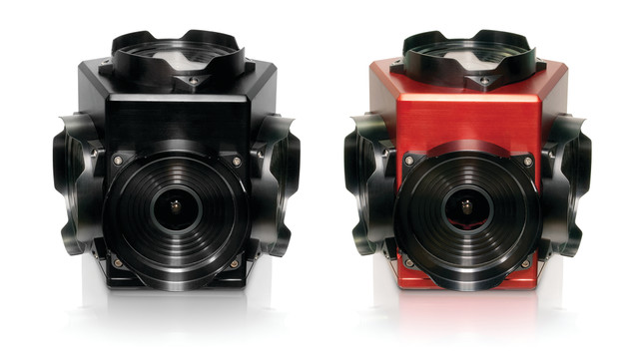
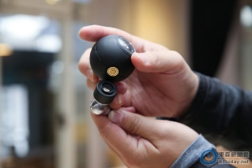
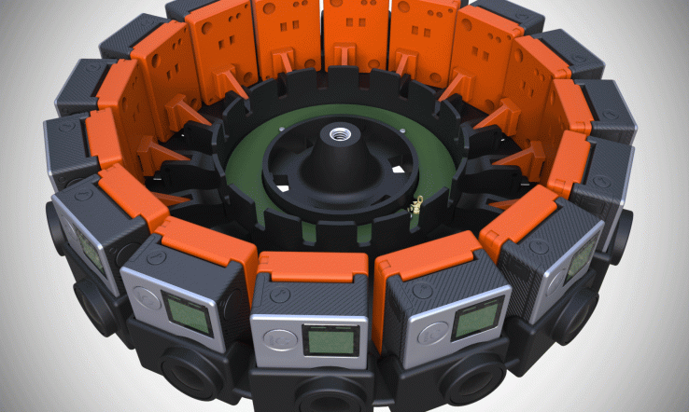
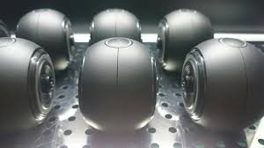
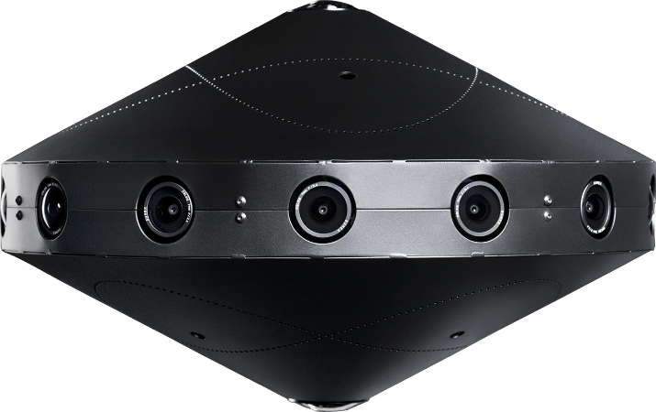
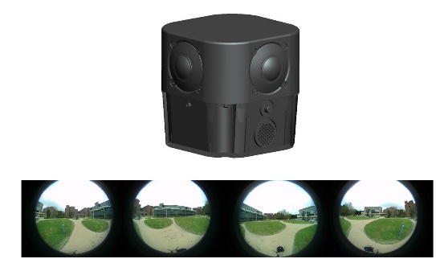
360 degree imaging devices
1
1. Ladybug 5 spherical camera:
(five cameras)
2. Luna 360 camera
(two fisheye cameras)
3. Google Jump VR Project (16 cameras)
4. Facebook surround 360 video camera
(with 17 cameras)
5. Polycamera 360 imaging
(with 4 fish eye camera)
2
3
4
5

Slide 23
360 imaging with stereo
360 imaging but without stereoscopic capture:
Ladybug 5 spherical camera, Luna 360 camera
360 imaging with stereo:
Google Jump VR Project, Facebook surround 360 video camera,
Polycamera 360 imaging

Slide 24
Luna 360 camera: initial evaluation
2018/2
The app connects to iPhone WiFi well
Overall image quality is reasonably good, but not HD.
Video quality is about the same, but audio seems to be poor. I could only hear muffled sounds.
For images that are converted to panoramas, the stitching of the two images together is poorly done. Offsets and image scenes are very apparent.
Both Pic and Vid are at 1920x1080. It's supposed to be 2 x 1080p camera but actually it's 960x960 x 2 lenses written into one 1920x1080 file.

Slide 25
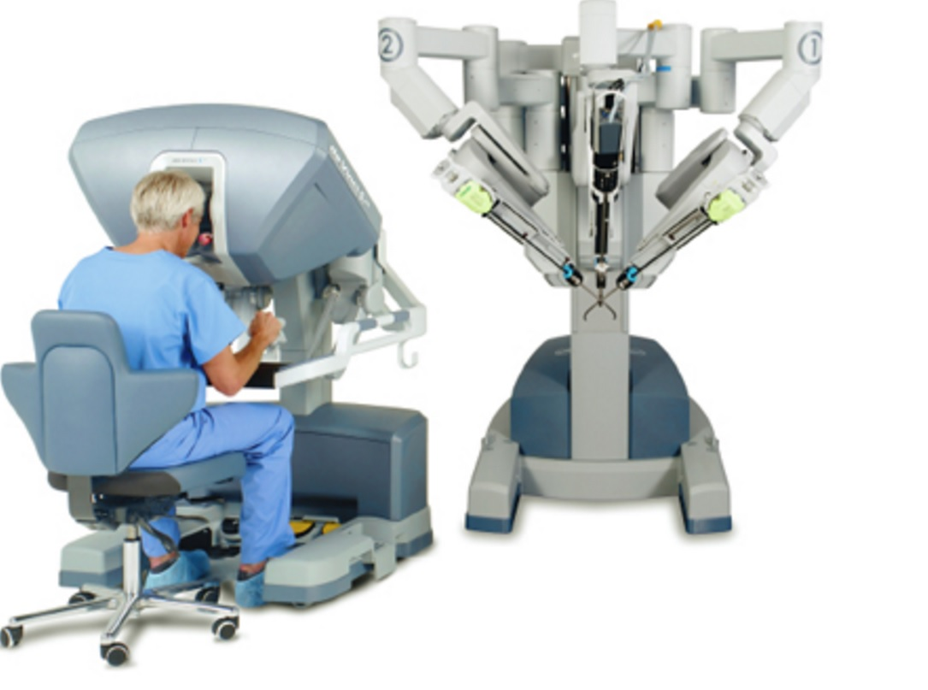
One of the best apps in AR in the future, if combined with machine learning, (Even in Taiwan, we have 26 sets!)
DaVinci surgery machine

Slide 26
Four major problems in VR/AR
1. Display resolution: wide angle display, without seeing pixels in display
2.Latency: should be less than 20 to 50ms
If greater than 50 to 100 ms, will cause dizziness, even nausea.
3.fixed focus vs. variable focus in observation through HMD or other display.
4.Registration of real and virtual objects in AR

Slide 27
Problem 2: Latency (Compensation)
References
Azuma R, Bishop G (1994) Improving static and dynamic registration in an optical see-through HMD. SIGGRAPH’94 Conference Proceedings,
Jiann-Rong Wu and Ming Ouhyoung, "On Latency Compensation and its Effects for Head Motion Trajectories in Virtual Environments," The Visual Computer, vol. 16, no. 2, pp. 79—90, 2000.
Jiann-Rong Wu and Ming Ouhyoung, "A 3D Tracking Experiment on Latency and Its Compensation Methods in Virtual Environments", Proc. of UIST'95 (User Interface and Software Technology 1995), pp. 41-49, ACM Press Pittsburgh, USA

Slide 28
One of the critical problems is the perceived latency, or lag. This is the time delay from the user’s input action until the response becomes available for display.
The illusion of a virtual world is destroyed if the objects on the screen jitter signiﬁcantly while the head is not in motion – the “swimming effect”
Major components of end-to-end latency include (1) the time for internal processing by input sensors,(2) data transfer from the sensors to the host computer, (3) update of the physical simulation output by applications in response to user input, and (4) image rendering and display.

Slide 29
System latency is the largest single source of registration error in existing AR systems, outweighing all others combined. Latency of ten results in virtual imagery lagging behind or “swimming” around the intended position.

Slide 30
Azuma and Bishop [1] used Kalman ﬁltering with inertial sensors mounted on a see-through HMD to improve the dynamic registration, that is, to reduce the latency.
The result can signiﬁcantly aid the head-motion prediction in real cases; on the average, prediction with inertial sensors produces two to three times less errors than that of prediction without inertial sensors, and ﬁve to ten times less than that of using no prediction at all.
However, at bigger latency (more than 130 ms), the prediction accuracy, with or without the use of inertial sensor in Kalman ﬁltering, is not signiﬁcantly different

Slide 31
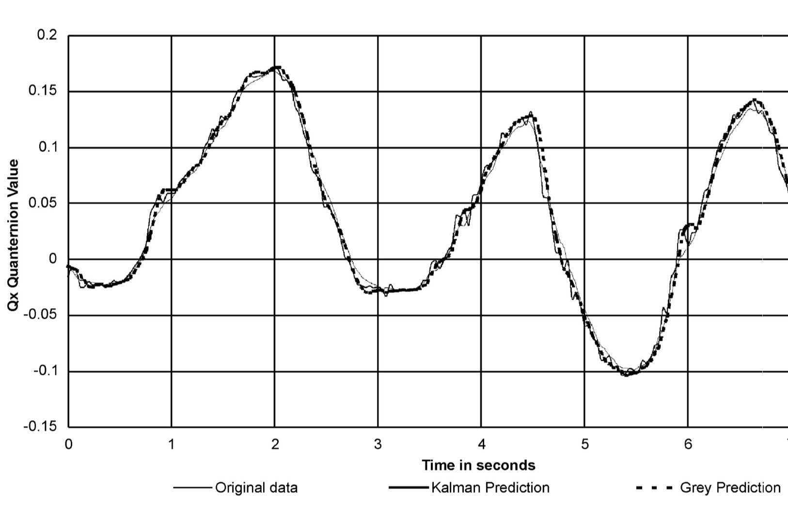
Plot of quaternion curve Qx (quaternion) with Kalman prediction without inertial sensor versus grey system prediction

Slide 32
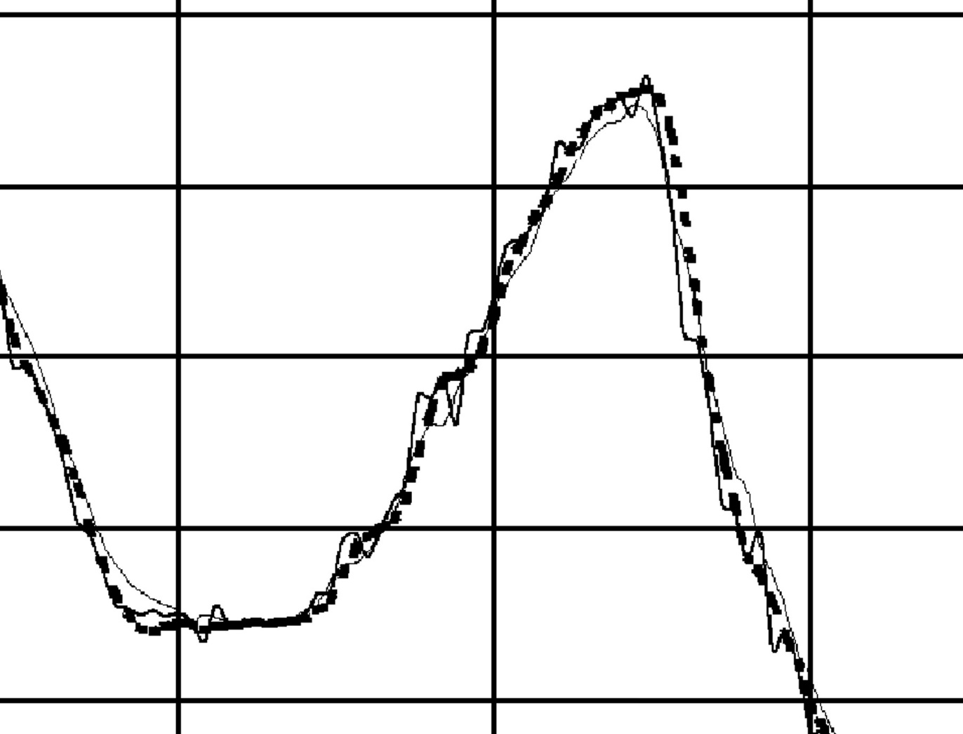
Motion curve with latency compensation: Blow up figure

Slide 33
From Motion to Photons in 80 Microseconds: Towards Minimal Latency for Virtual and Augmented Reality, 2015 IEEE Trans. On Visulization & CG
by Peter Lincoln, Alex Blate, Montek Singh, Turner Whitted, Andrei State, Anselmo Lastra, and Henry Fuchs

Slide 34
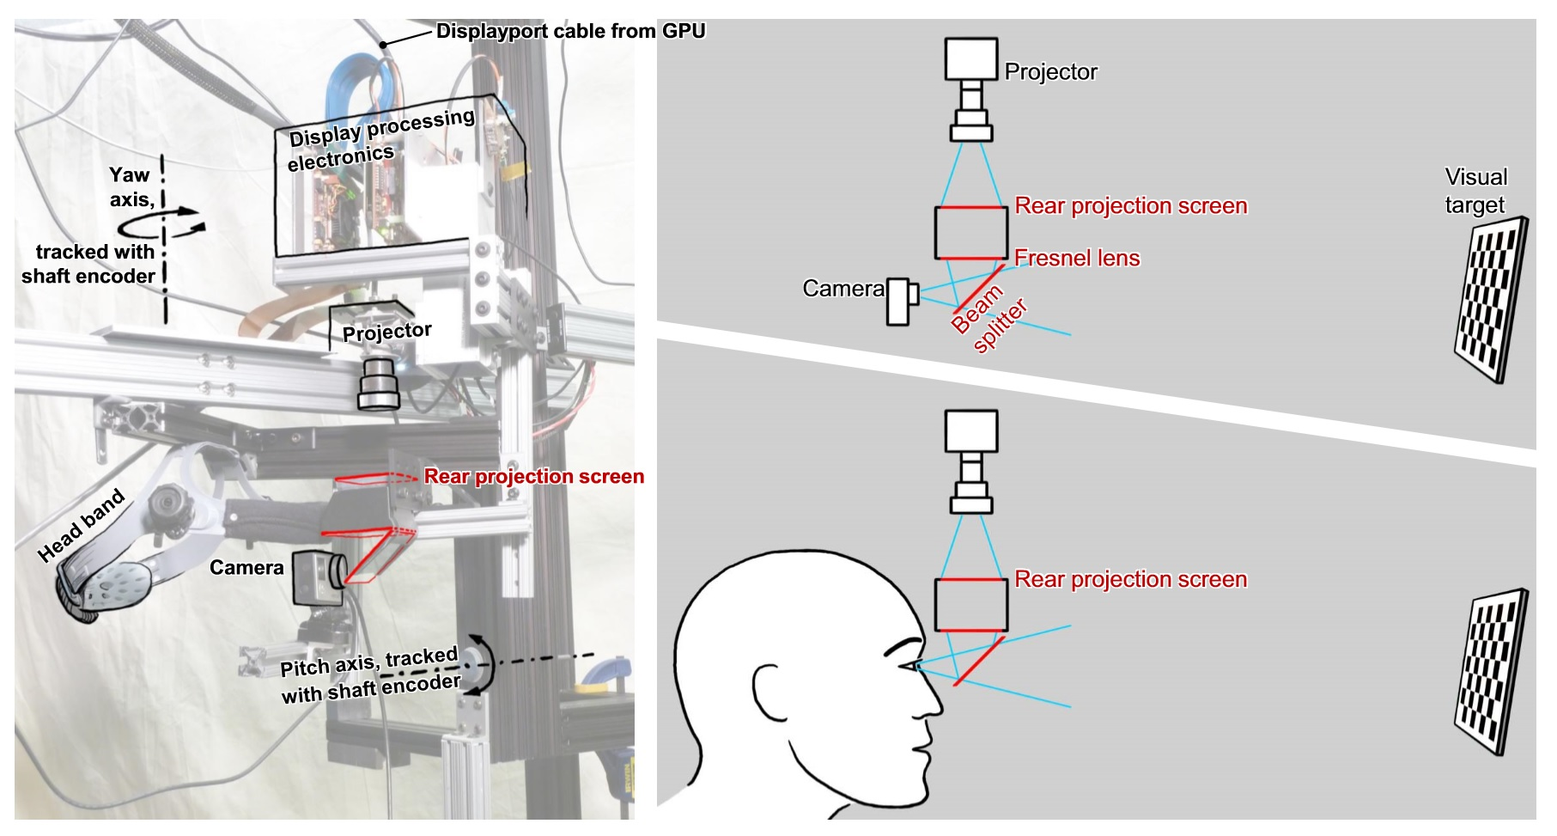
How to measure latency?

Slide 35
A simple method: video demo
Show the output from LCD/OLED panel against the tracker motion
Latency measurement video

Slide 36
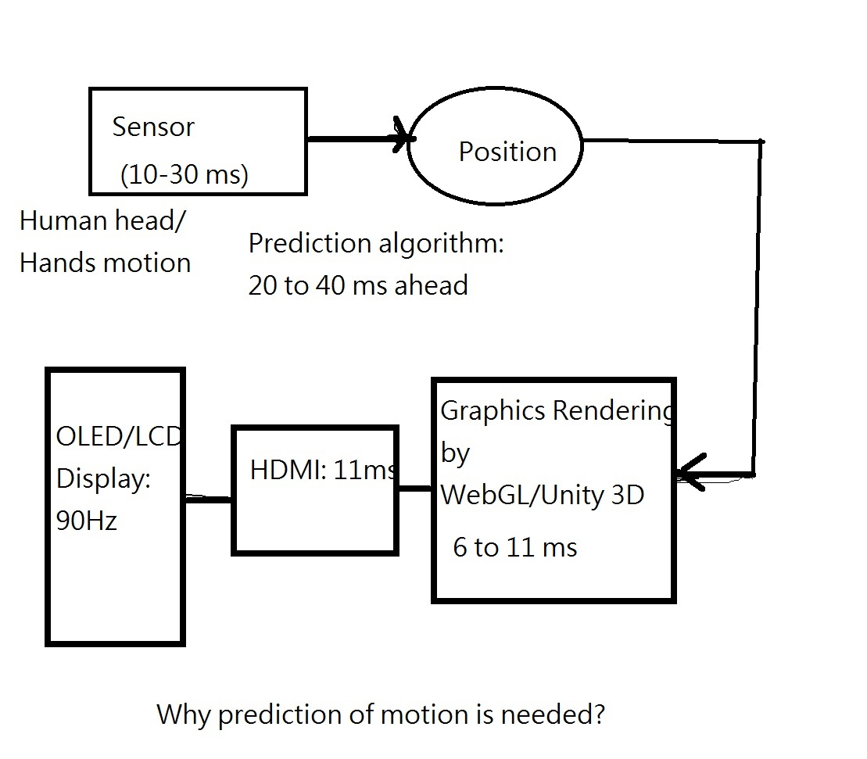
Reducing the latency: Prediction (by Kalmann Filter, for example, for 20-40 ms prediction of head/hand motion)
Occulus as well as HTC Vive

Slide 37
Latency in a typical very old VR system in early 90s
the update rate can reach 15–20 frames/s on an SGI Indigo2 Extreme graphics workstation. Even though the update rate is enough to work with, it still has an overall latency of about 300 ms. The tracker contributes approximately 70 ms; the rendering pipeline, 80 ms; and the LCDs with relatively low refresh rates in the HMD contributes 150 ms.

Slide 38

How to verify if VR/AR is useful?
(How Real?)
Fred Brooks, ACM Siggraph 2002
Observation: Skin conductance, respiration, heart beat rate.
Meehan, M., B. Insko, M.C. Whitton, F.P. Brooks Jr., 2002: "Physiological Measures of Presence in Stressful Virtual Environments," ACM Transactions on Graphics, 21, 3: 645-652. (Proc. of ACM SIGGRAPH 2002, San Antonio, TX).

Slide 39
We hypothesized that to the degree that a VE seems real, it would evoke physiological responses similar to those evoked by the corresponding real environment, and that greater presence would evoke a greater response.

Slide 40
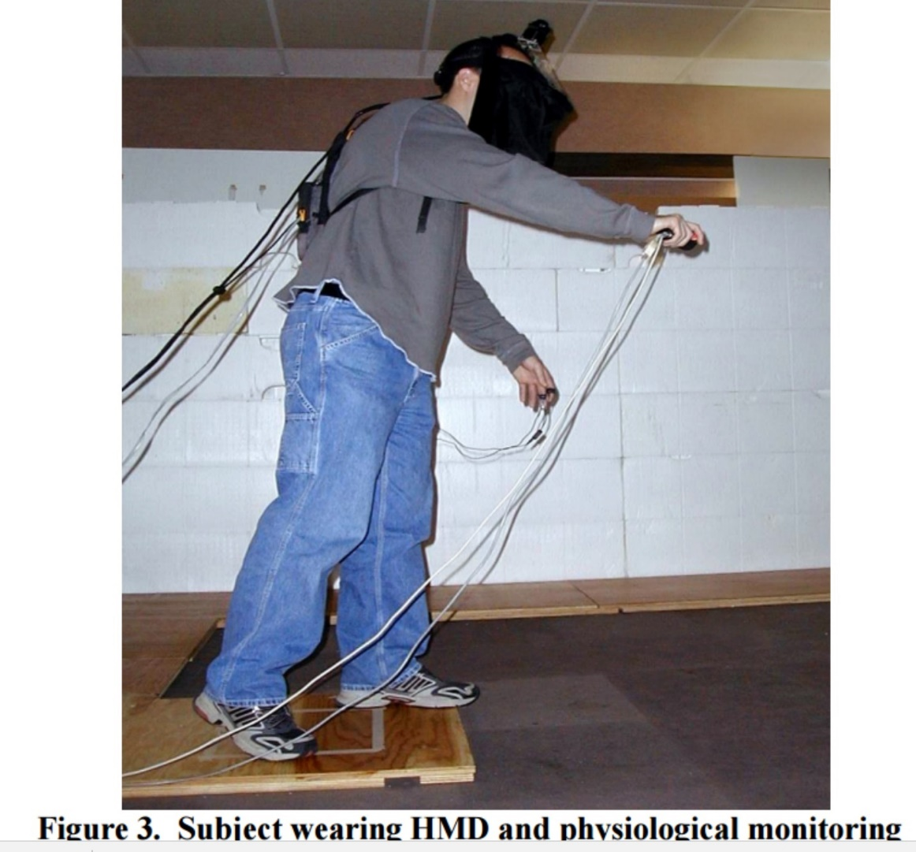
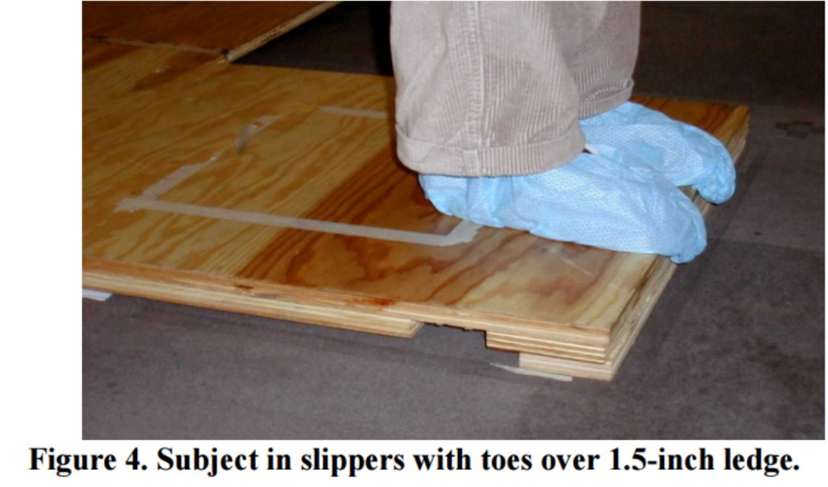


Set up: with a ledge (a board), 1.5 inch thick

Slide 41
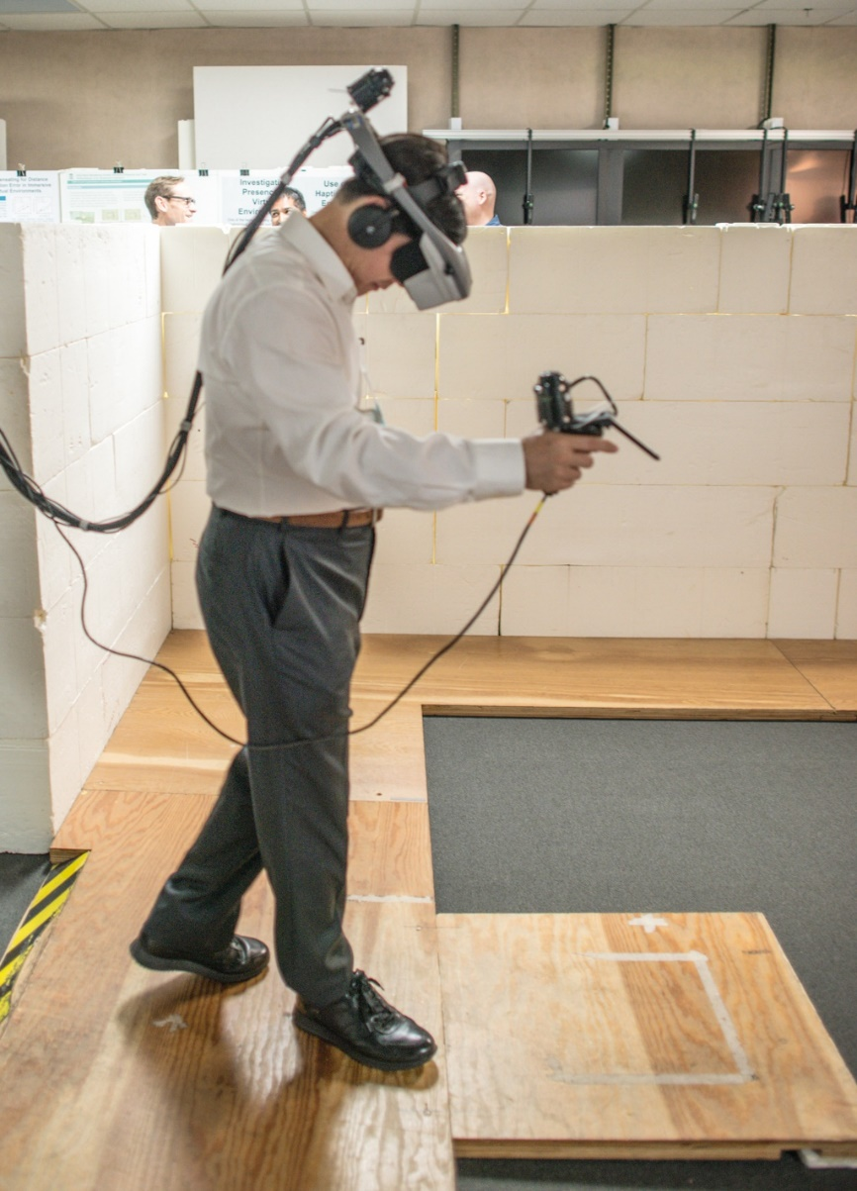
Physiological Measures of Presence:
I was at UNC-CH, 2015, playing it.

Slide 42
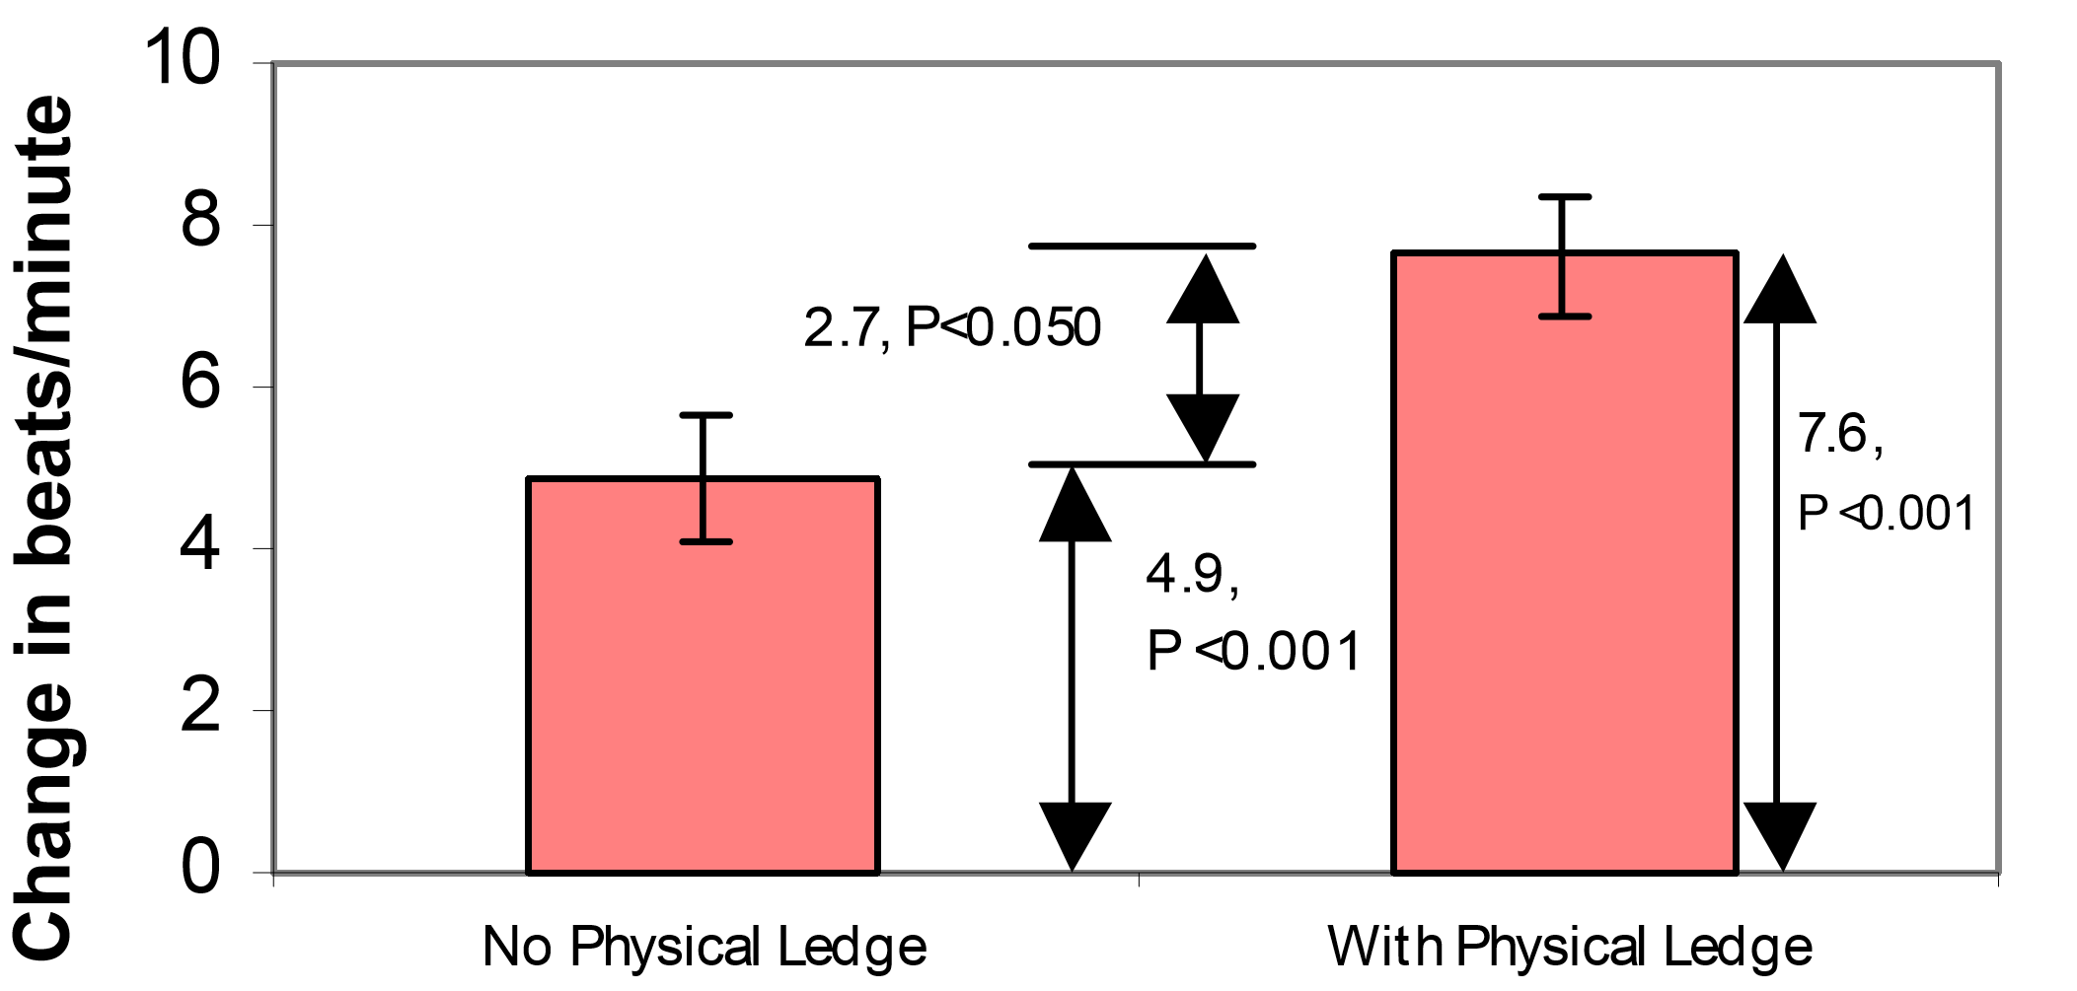
Heart Rate Changes: without vs. with a ledge

Slide 43
Experimental Results
We found that change in heart rate satisfied our requirements for a measure of presence, change in skin conductance did to a lesser extent, and that change in skin temperature did not. Moreover, the results showed that inclusion of a passive haptic element in the VE significantly increased presence and that for presence evoked: 30FPS > 20FPS > 15FPS.

Slide 44
Problem 3: fixed focus vs. variable focus:
"The Light Field Stereoscope: Immersive Computer Graphics via Factored Near-Eye Light Field Display with Focus Cues",
Fu-Chung Huang, Kevin Chen, and Gordon Wetzstein,
Youtube Link
ACM SIGGRAPH 2015, Los Angeles
"Eyeglasses-free Display: Towards Correcting Visual Aberrations with Computational Light Field Displays",
Fu-Chung Huang, Gordon Wietzstein, Brian Barsky, and Ramesh Raskar,
- 10 World Changing Ideas 2014, Scientific American
ACM SIGGRAPH 2014, Vancouver

Slide 45
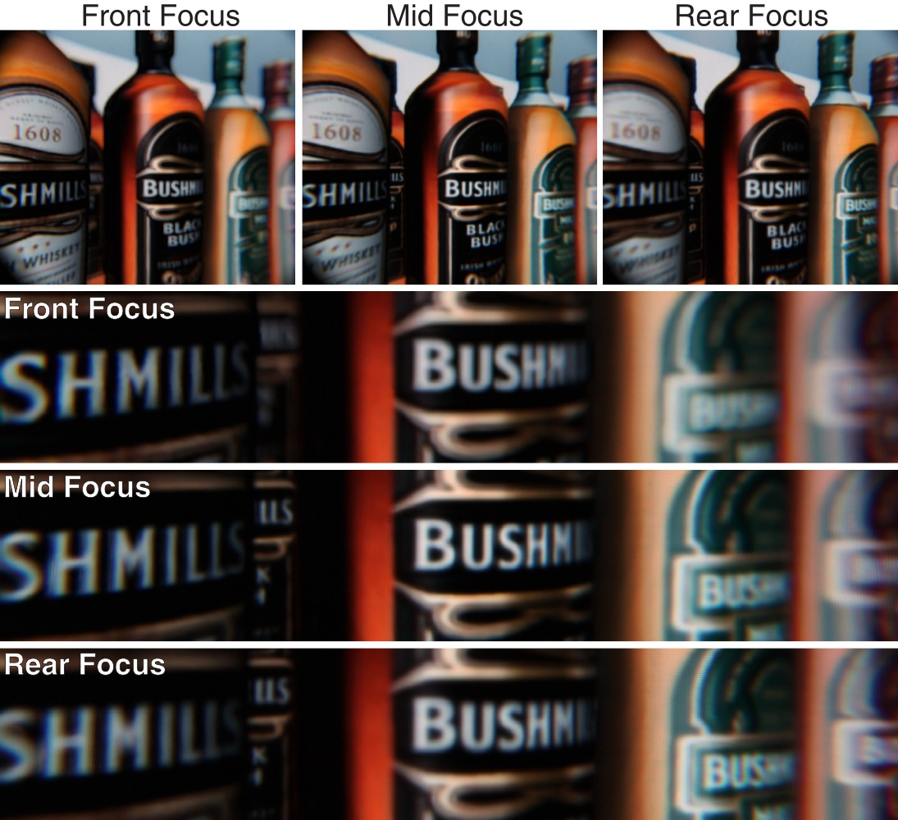
Front,middle,rear: three types of focus

Slide 46
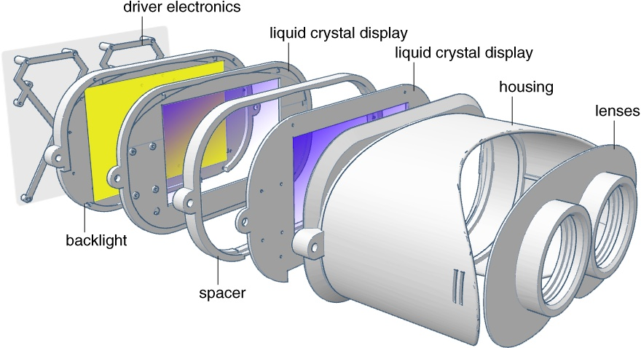
Innovation: vergence-accommodation conflict inherent to all stereoscopic displays

Slide 47
Problem 1: Display resolution (not to see pixels)
What is the best resolution in display in HMD?
For example, for mobile device display:
For Google Cardboard VR HMD, if the field of view (angle) is 60 degrees, the required screen resolution is around 5700x5700,
For Oculus Rift2/Gear VR, or HTC Vive, the filed of view is 90-110 degrees, the required resolution should be 10Kx10K !
(Because in visual acuity: eye’s ability to distinguish two points of light is limited to 1.5 – 2.0 mm at a distance of 10 meters. (or 2 microns on the retina)).

Slide 48
New types of display, other than LCD and OLED.
Playnitrade Inc. for example
can possibly provide a display of resolution 10Kx10K in a few years.
Semiconductor components for laser diodes (LD) , more density, brighter, and 85% efficiency in energy consumption.
(UV-LED)
LCD has a energy efficiency of 5% only, while OLED is about 35%.

Slide 49
Problem 4: Registration in AR
What’s wrong in Pokemon Go (AR mode, with camera display)
Virtual objects cannot easily rest on chairs/table top.
See our example AR application.

Slide 50
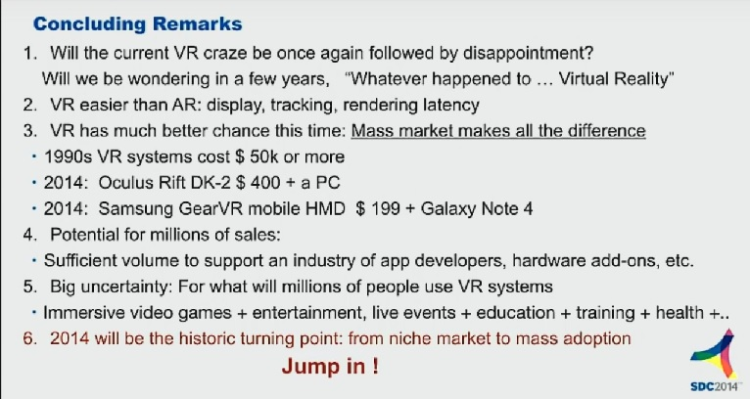
Estimation in SDC 2014

Slide 51
Influence of the future smartphones, a prediction: Google Daydream project
In the past, GPUs in phones are not really important, VIDEO codecs are more important! (Flicker, Youtube Inc.)
Now, heterogeneous systems (CPU+GPU) are increasingly important, a must! (VR, AR)
New sensors (position sensor, roll sensor) needed for HCI, probably as additional NFC/Bluetooth devices.
Higher resolution (toward 4x by 4k x2)

Slide 52
Application and opportunity:
Apps, new sensors, higher resolution display
Apps development, including health and medical care
position sensors, or camera-based tracking device (using Church’s algorithm): problem 2: Latency reduction
Super-resolution display (eg. UV-LED), up to 10k by 10k
Image processing and SOC for super-resolution.
new type HCI (Finer pad, gesture control, new HCI, game pad with joystick using USB)
form factors for HMD

Slide 53
END of Part 1
”Duen-Huang Cave VR/AR Display”
SCOPE+: One example of medical training application
caTAR: eye surgery for Cataract removal
(future predictions/imagination)
Docomo Vision 2020
MicroSoft’s Concept: Future Vision 2020
Samsung’s vision: display
What’s NOT really true here
Magic Leap’s “whale in a gym” show
JJ Lin’s show Chinese New Year 2017 (live broadcasting)

Slide 54
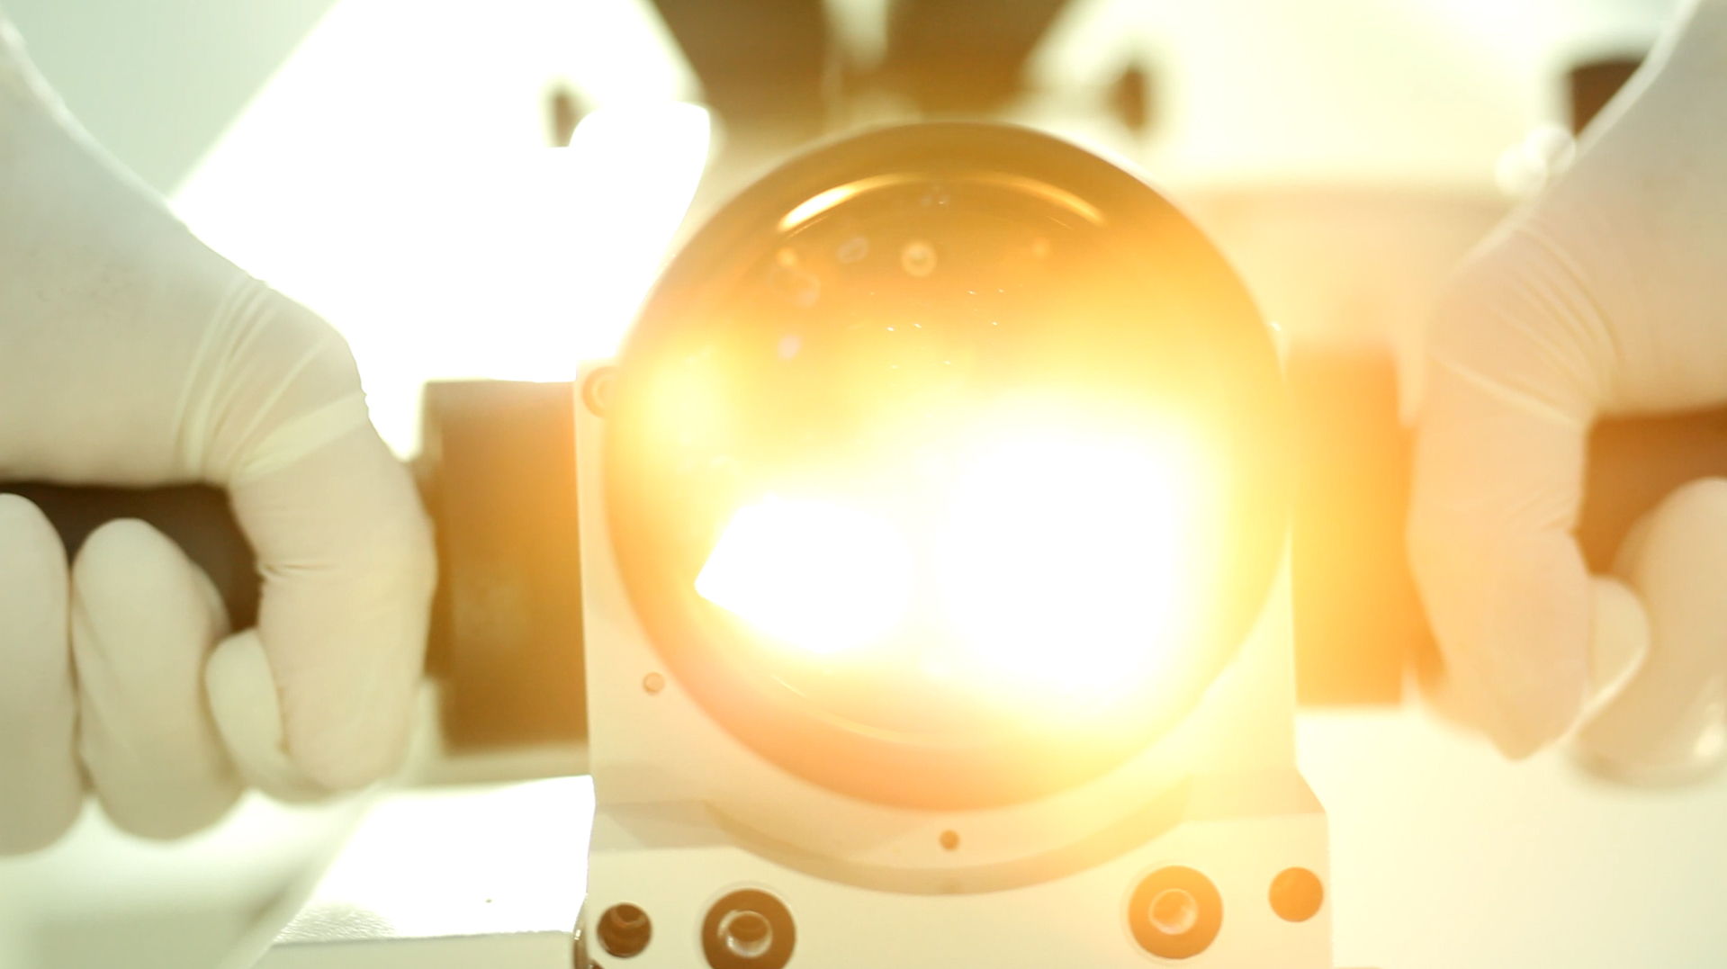


A Stereoscopic Video See-Through
Augmented Reality Microscope
Yu-Hsuan Huang
Tzu-Chieh Yu
Pei-Hsuan Tsai
Yu-Xiang Wang
Wan-Ling Yang
歐陽明(Ming Ouhyoung)
National Taiwan University

Slide 55
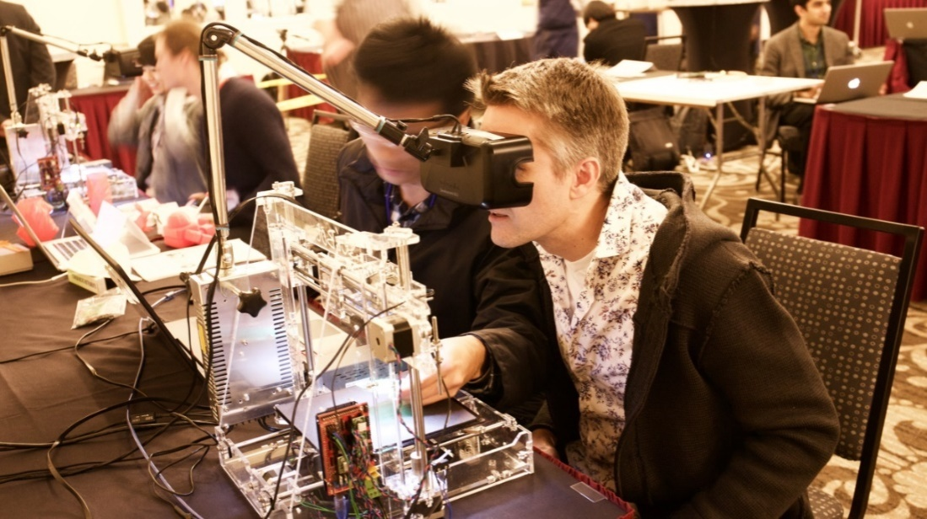

Scope+: won Best Demo in ACM UIST 2015 Conference Demo Competition ！
Scope+ : A Stereoscopic Video See-Through Augmented Reality Microscope
Notes:
分項5網媒
歐陽明

Slide 56
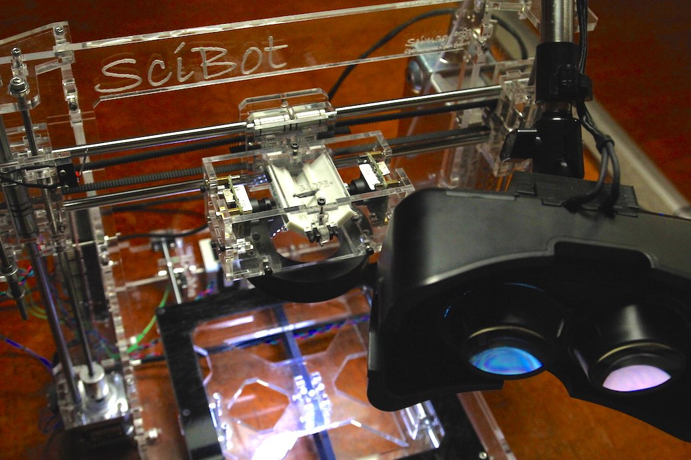
Motor & Display System
3-Axis Motor System
Head Mounted Display

Slide 57
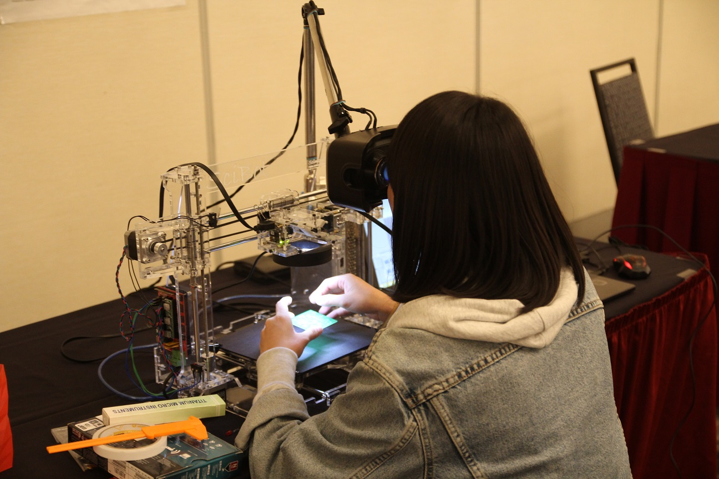

Slide 58
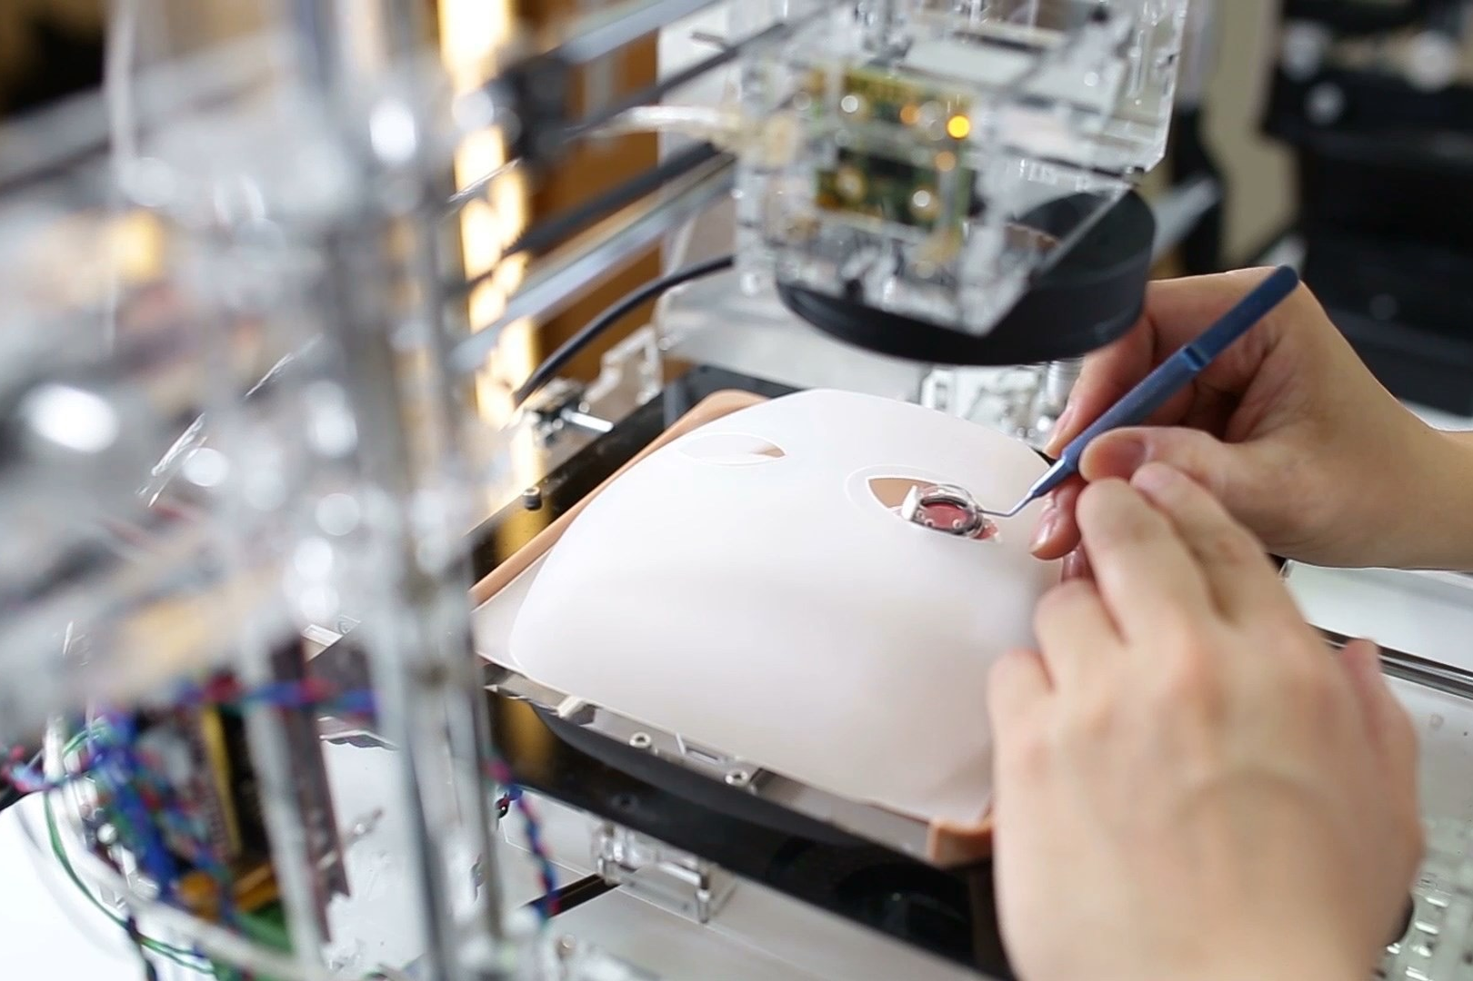
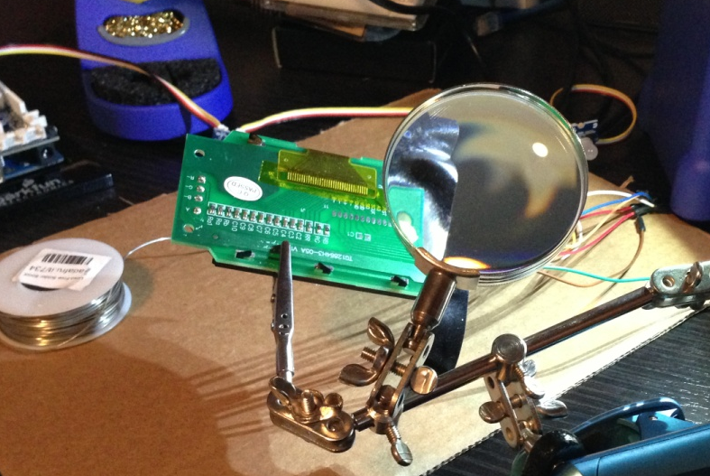
Interactive Guidance

Slide 59
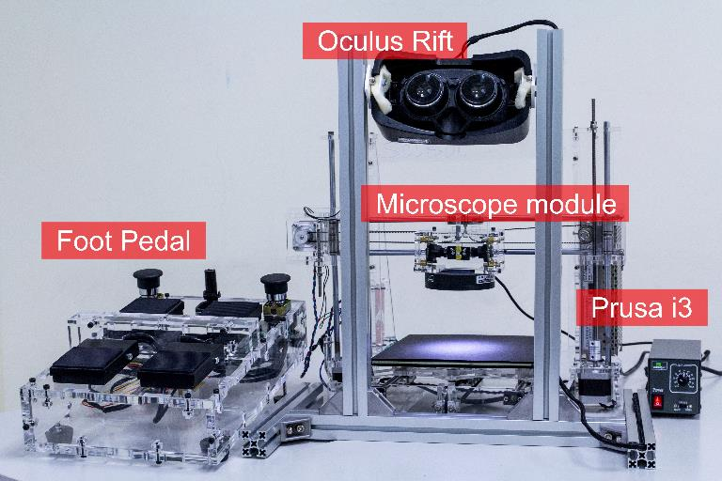
Scope+ hardware platform:

Slide 60
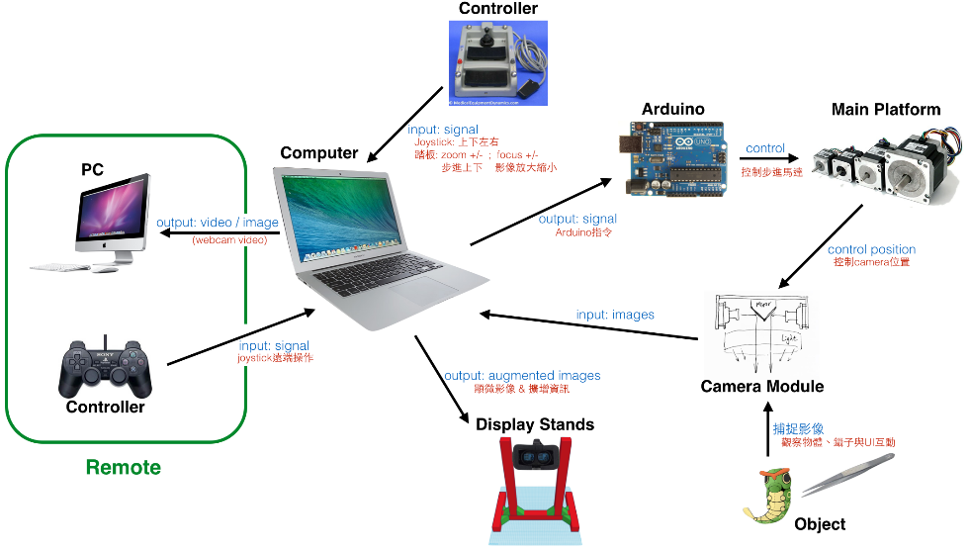
Scope+ System Architecture

Slide 61
Functions:
Reference: CatAR: A Novel Stereoscopic Augmented Reality Cataract Surgery Training System with 7-DOF Dexterous Instruments Tracking Technology (Siggraph Asia 2016, VR Showcase)
Stereoscopic augmented reality cataract surgery training system.
The spatial resolution is 0.015mm
It provides 7 degree-of-freedom dexterous instruments tracking ability by utilizing infrared optical based tracking system with 2 cameras and 1 reﬂective marker only.

Slide 62
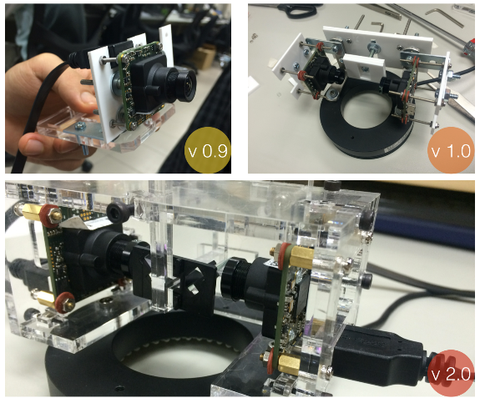
Camera lenz assembly

Slide 63
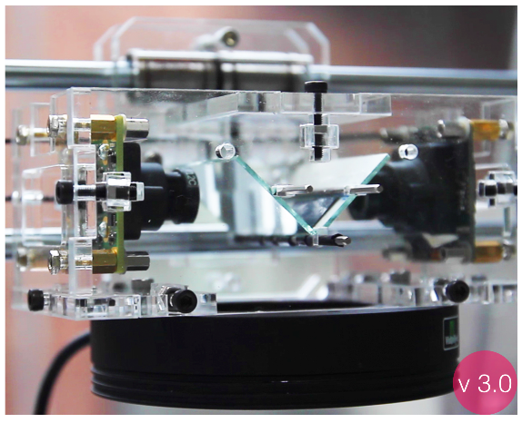
Near-field augmented reality

Slide 64
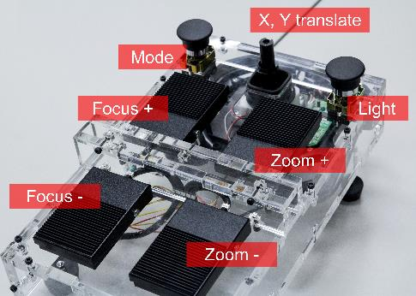
Foot Pedal Controller: to help both hands

Slide 65
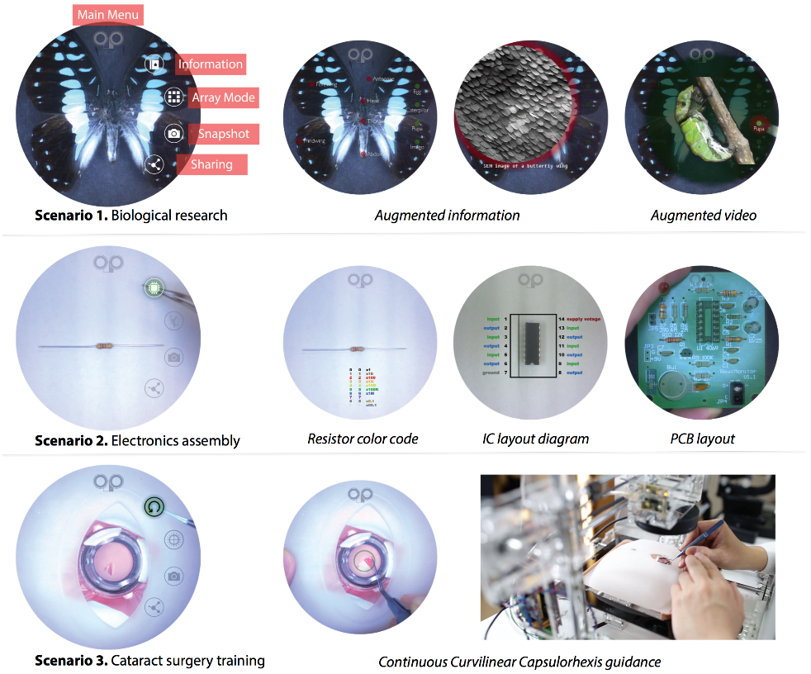
Applications (DEMO): 1. Butterfly observation, 2. Circuit board assembly 3. Eye surgery training

Slide 66
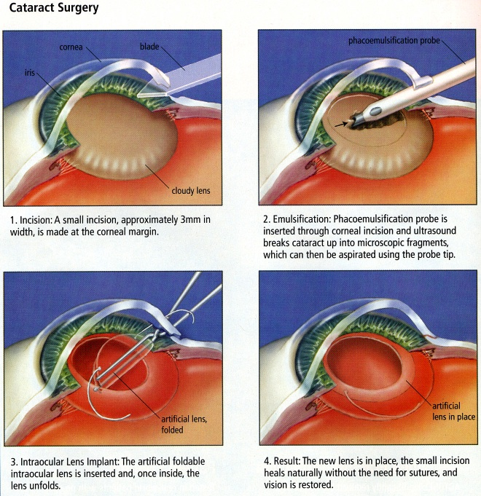
Cataract surgery

Slide 67
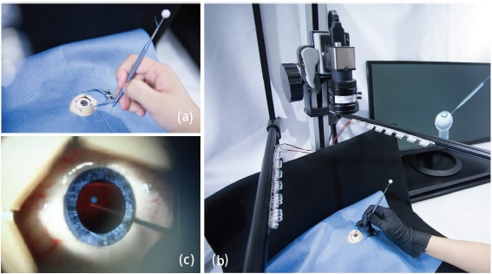
Eye surgery AR simulator (DEMO 2)

Slide 68
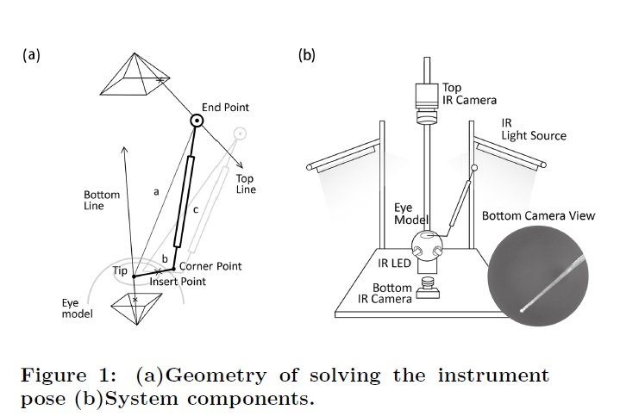
Surgical Instrument Motion Detection

Slide 69
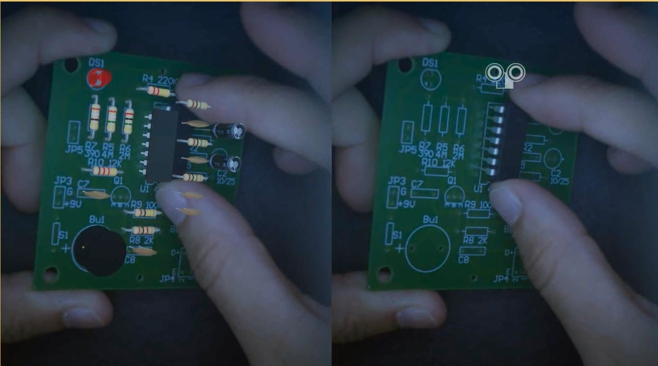
Registration of Virtual Objects with Real Ones: left eye view (circuit board with virtual elements), and right eye view
Youtube: https://www.youtube.com/watch?v=vV83pWR4Dko&feature=youtu.be
DEMO

Slide 70
END
Reference for video
Short VIDEO, Circuit Board
https://www.youtube.com/watch?v=vV83pWR4Dko&feature=youtu.be
Long VIDEO, SCOPE+
https://www.youtube.com/watch?v=rmohFEAreUs&feature=youtu.be
https://01.org/zh/intel-deep-learning-framework?langredirect=1

Slide 71
AR + VR
Microsoft Inc. HoloLens Project, Windows 10, Holographics Live Demo
https://www.youtube.com/watch?v=kCMxBw-utEY&feature=youtu.be
https://www.youtube.com/watch?v=vsKMi1377cU
.NTU MediaTek collaborative project: concept demo (Taiwan 2025)
D:\Ming_1\NSC\2012_前瞻技術產學大聯盟\Final_2013_4_10\2017_5_短片宣導/1003_聯發科_Final_Version.mp4

Slide 72
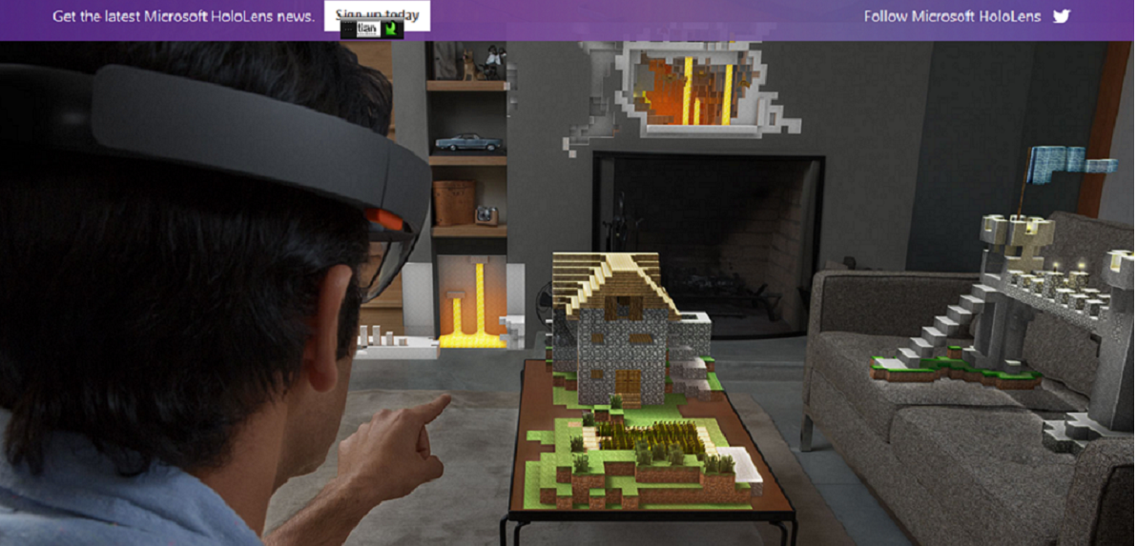
HoloLens Project

Slide 73
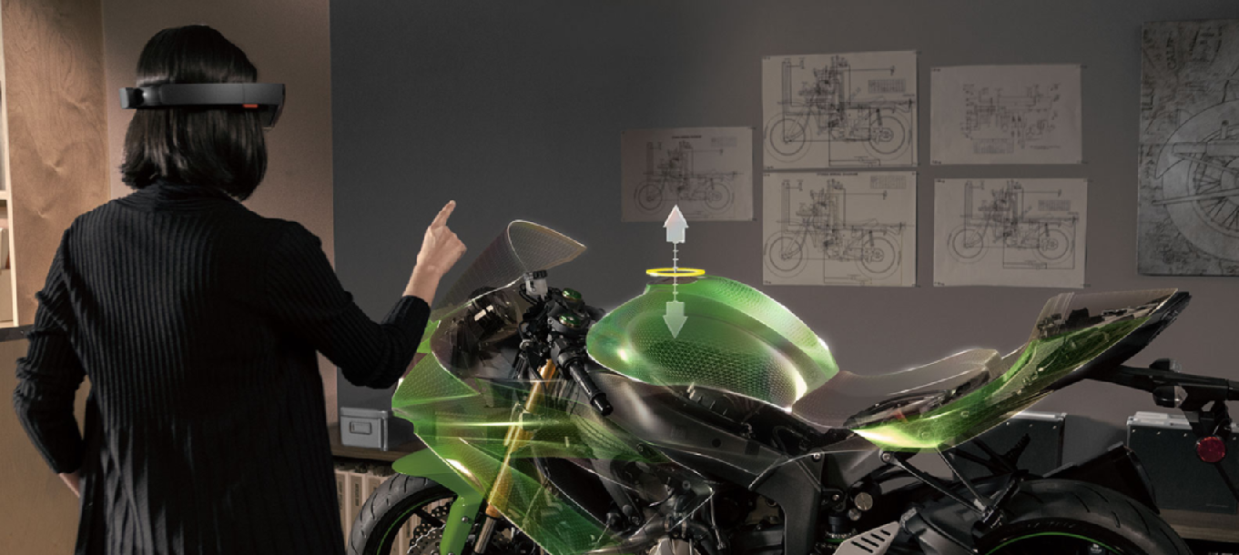

Slide 74
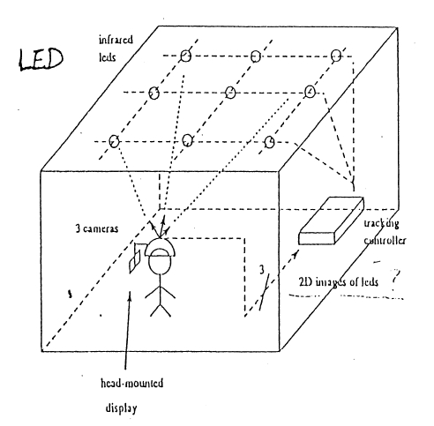
Optical Trackers
Environment setup
Outside-in vs Inside-out optical trackers
Environment

Slide 75

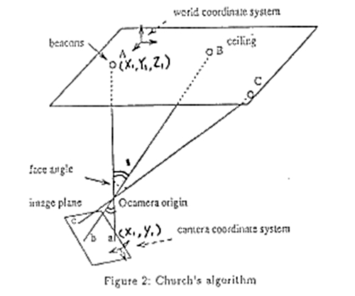
Algorithms: Inferring 3D position
Inferring 3D position from 2D image
12 unknowns in M, each 3D point provides 2 independent constrains => 6 points

Slide 76
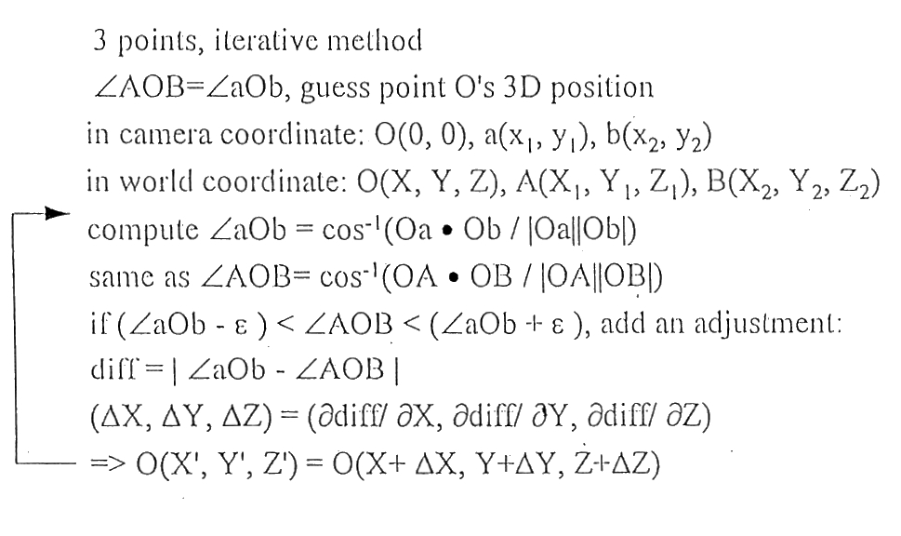
Algorithms: Inferring 3D position
Church(1945) method: modified by iterative converging.

Slide 77
Algorithms: System errors
Result
  In camera coordinate
    long focal length
    large separation between image points
    high resolution of photodiode
In world coordinate
  large separation between beacons

