Slide 1
Intelligent Transportation System (ITS) User Experiences Group
Progress Report
08.22

Slide 2
Users view in scooter driving
Road
(Focus)
Rearview Mirror
Rearview Mirror
Dashboard

Slide 3
It’s dangerous to ride without looking at rearview mirrors

Slide 4
1 second before the accident

Slide 5
Unfortunately, the passive rearview mirrors
cannot push proactive warnings toward drivers attention

Slide 6
Using Tertiary, Proactive Display?

Slide 7
A Tertiary, Proactive Display may cause more distractions!

Slide 8
Embedding LCD in the Rearview Mirror
Electronic Rearview Mirror (e.g. Smartphone)
Displaying on the Rearview Mirror Directly

Slide 9
Embedding LCD in the Rearview Mirror
Electronic Rearview Mirror (e.g. Smartphone)
Displaying on the Rearview Mirror Directly
More direct notification, but only simple warnings

Slide 10
Rich information that replaces the original rearview can be dangerous
(users can only serially process information by their focus vision)
infoVis should be carefully designed

Slide 11
Our method: Borrow the concept from Augmented Reality

Slide 12
Our method: Borrow the concept from Augmented Reality
Augment the real rearview

Slide 13
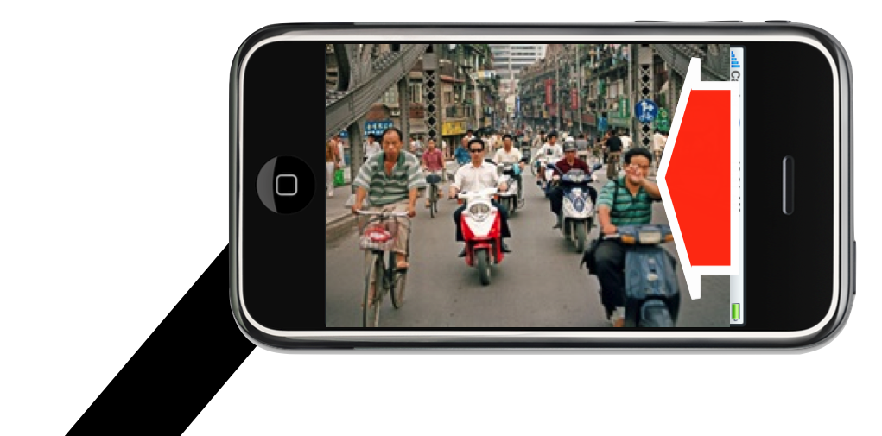
Our method: Borrow the concept from Augmented Reality
Visualize the offscreen events

Slide 14
When speed = 0
Touch to Activate the Interactive Mode

Slide 15
When speed > 0
Auto Deactivate the Interactive Mode

Slide 16
Guidelines for designing infoVis in
Attention-Limited Conditions
Using pre-attentive features
  Shapes and Colors (Color > Shape) have greate salience to human information processors due to the sharp contrast that they are able to create.
Grouping eases searching
  Finding clusters of visually similar items is easier than locating a single item.
Minimalism
  Lower density displays can result in performance that is as good or better than high density displays in dual-tasking.
Make sure the cues are semantically understandable
  Easily understandable visual cues can be comprehended by peripheral vision without hindering primary task performance.

Slide 17
Resulting Challenges
How to overlay information accurately on the camera view

Slide 18
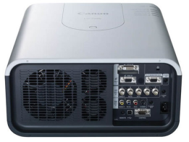
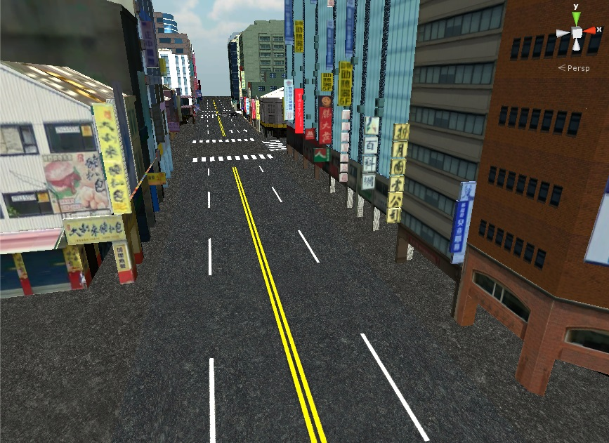

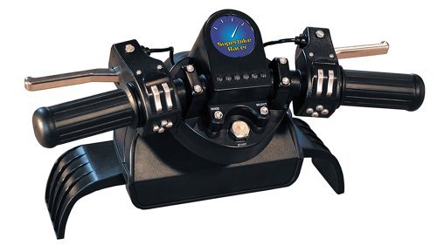
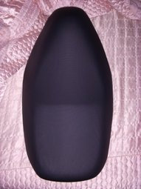
Step 1: User Study with the Simulator
Projector screen to show the virtual environment from
the driver’s view
Scooter game controller + simple scooter mobility model give the user the ability to react to traffic events.
Smartphone screen displays rear view (in virtual environment) + additional markers

Slide 19
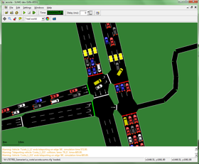
Step 1: User Study with the Simulator
Report the status of the user controlled vehicle
SUMO traffic simulator
Report the status of all other non-user controlled vehicles (for rendering in virtual environment)
Then, script an accident scene in the traffic simulator!

Slide 20
Step 2: User Study in the Real-World
Too Hard!!
How to overlay information accurately on the camera view
Have to cheat…

Slide 21
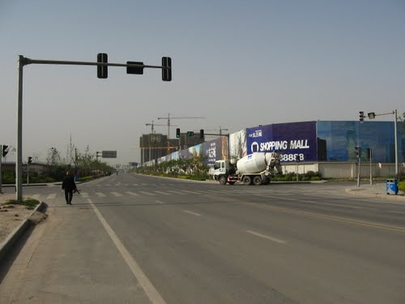
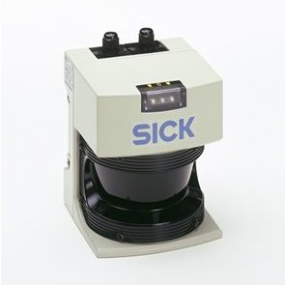

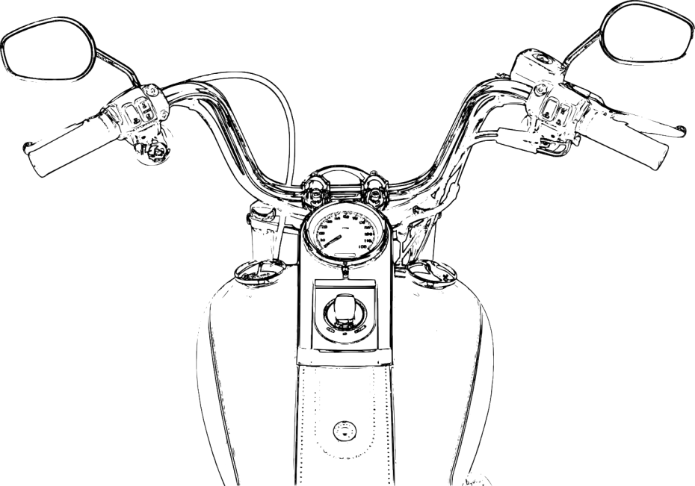
Since the main goal is to evaluate the UI…
1. Pick an open road with almost no vehicles.
3. Use a few controlled vehicles to create potentially hazardous and repeatable scenario.
2. Use road-side LIDAR and cameras to obtain addition location information of neighboring vehicles
4. On-board smartphone obtain LIDAR and camera information to calculate necessary markers to be shown in AR.

Slide 22
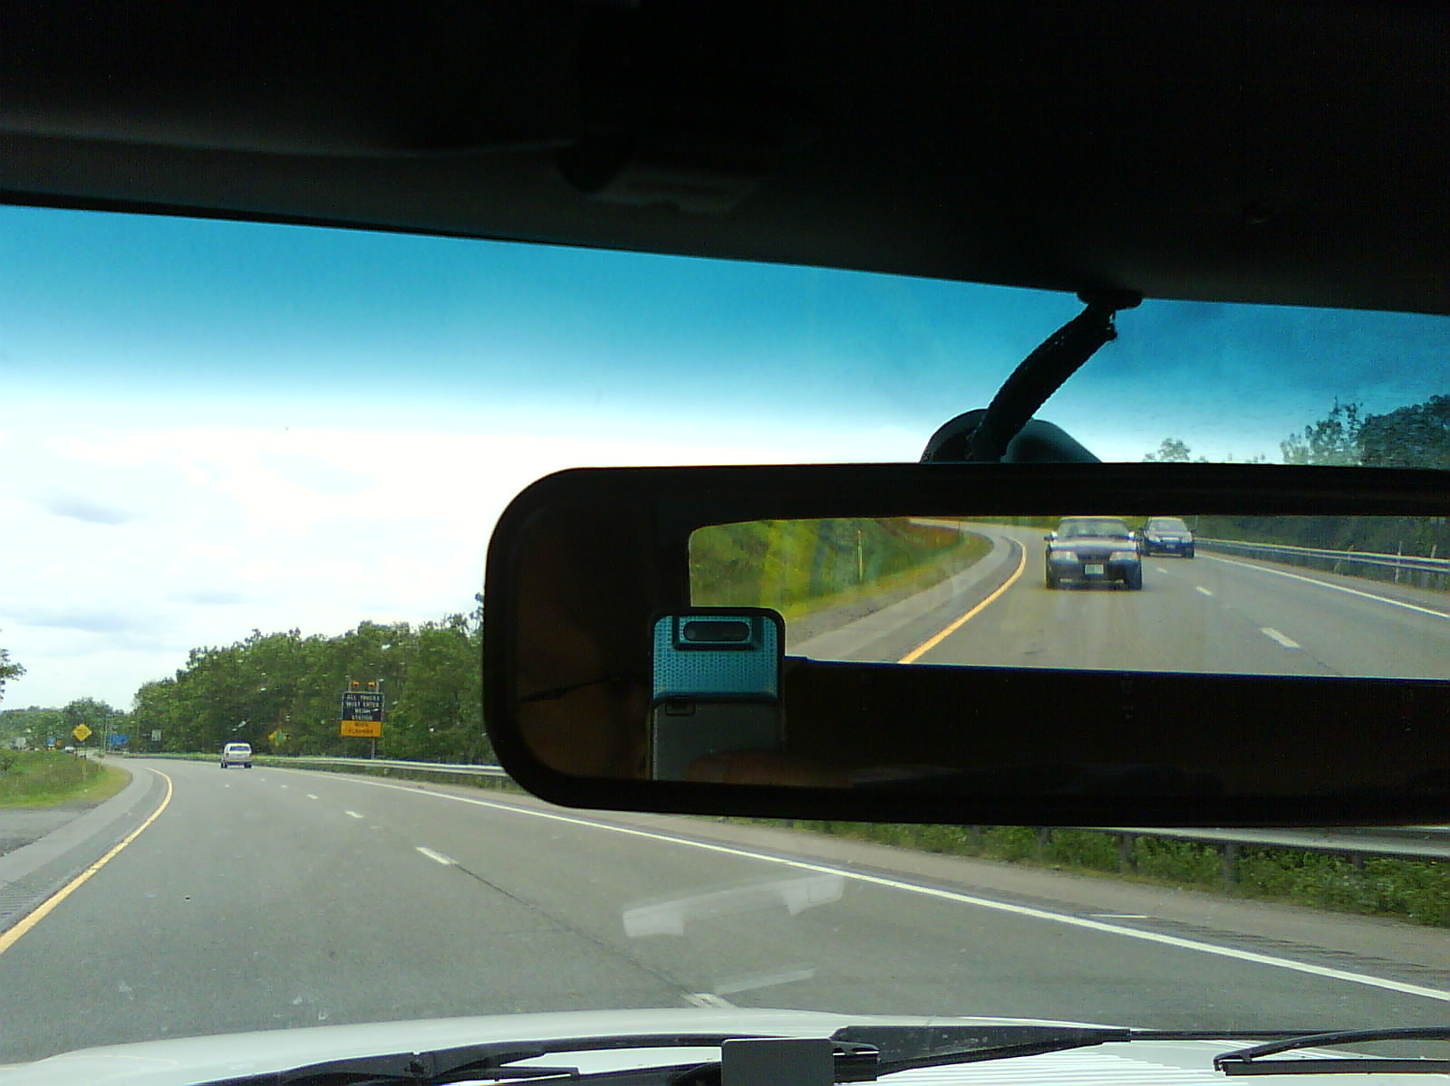
Possible Generalization
Augmenting Rearview mirror in the car

