Slide 1
Hsin-Mu (Michael) Tsai (蔡欣穆)
12pt Medium Subhead

Slide 2
Vehicular Visible Light Communications
IoV: Cooperation between Vehicles
  Building Roads: No Moore’s Law Here
  Increase Road and Energy Efficiency
Challenges: V2V Communications
  Challenge 1: Density and Speed
  Challenge 2:Who is Speaking?
  Challenge 3: Cost and Benefit
Vehicular Visible Light Communications
  Keep the Light’s Original Function
  Receiver Options
  V2LC for Scooter Safety
Conclusion

Slide 3
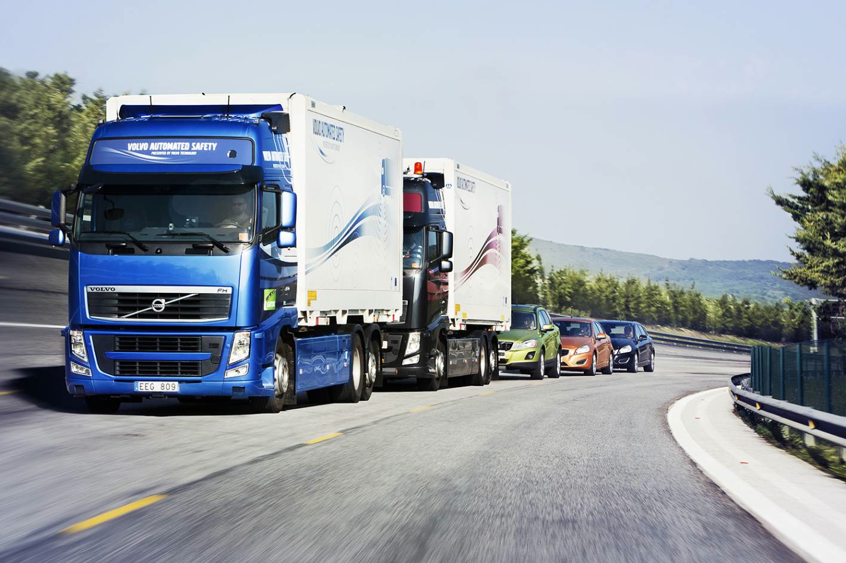
IoV: Cooperation between Vehicles
http://www.forcegt.com/wp-content/uploads/2012/09/volvo_road_train-11.jpg

Slide 4
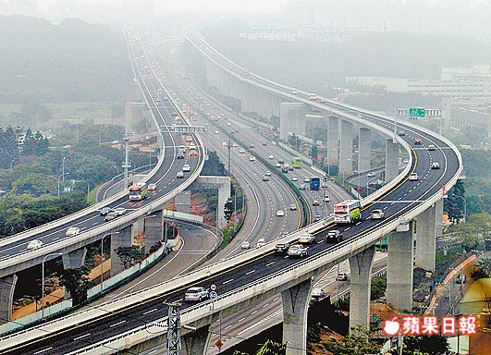
Building Roads: No Moore’s Law Here
Wugu-Yangmei Overpass (completed in 2013)
(for Freeway No. 1 in Taiwan)
  Cost: 3B USD for 40 km of elevated road
    The most expensive (per unit length) in the history
  Divert approximately 25% of traffic from the original highway
  Improve rush hour average speed:
    40-50 kmph → 80-90 kmph
http://twimg.edgesuite.net//images/twapple/640pix/20121217/LN06/LN06_004.jpg

Slide 5

Increase Road and Energy Efficiency
At 100 km/h, the road surface utilization = 5%
Reduce the gap - Longitudinal control (adaptive cruise control)
Reduce lane width - Automatic steering
Reduce aerodynamic drag - Close-formation automated platoons can save 10% to 20% of total energy use
Only possible through cooperation with communications
  Drivers’ response delays cause stop and go disturbances
3.5 m
1.8 m
45.5 m
5 m

Slide 6
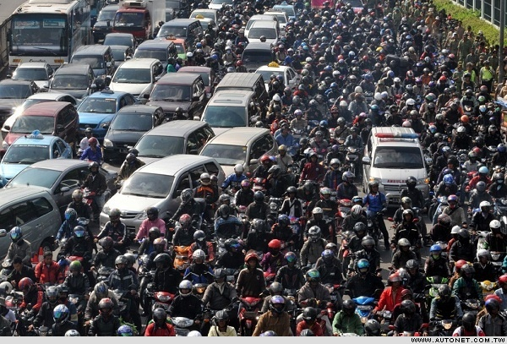
Challenges: V2V Communications
http://img.autonet.com.tw/news/img/2012/8/bb20802621.jpg

Slide 7
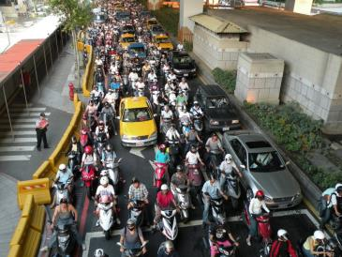

Challenge 1: Density and Speed
Range →reaction time
200 km/h relative speed 100 m = 1.8 s @ 200 km/h
A 100-m road segment can have:
  More than 600 scooters
  More than 120 cars
Heavy Interference
The need for reliable communications
Notes:
100/2 = 50* 3*2 = 300

Slide 8
Challenge 2:Who is Speaking?
My location is (X1, Y1) and my speed is 106 mph.
Is the car in front of me braking?
My location is (X3, Y3) and my speed is 98 mph, and I am braking.
My location is (X2, Y2) and my speed is 101 mph.
GPS Uncertainty = 5 -10 m

Slide 9
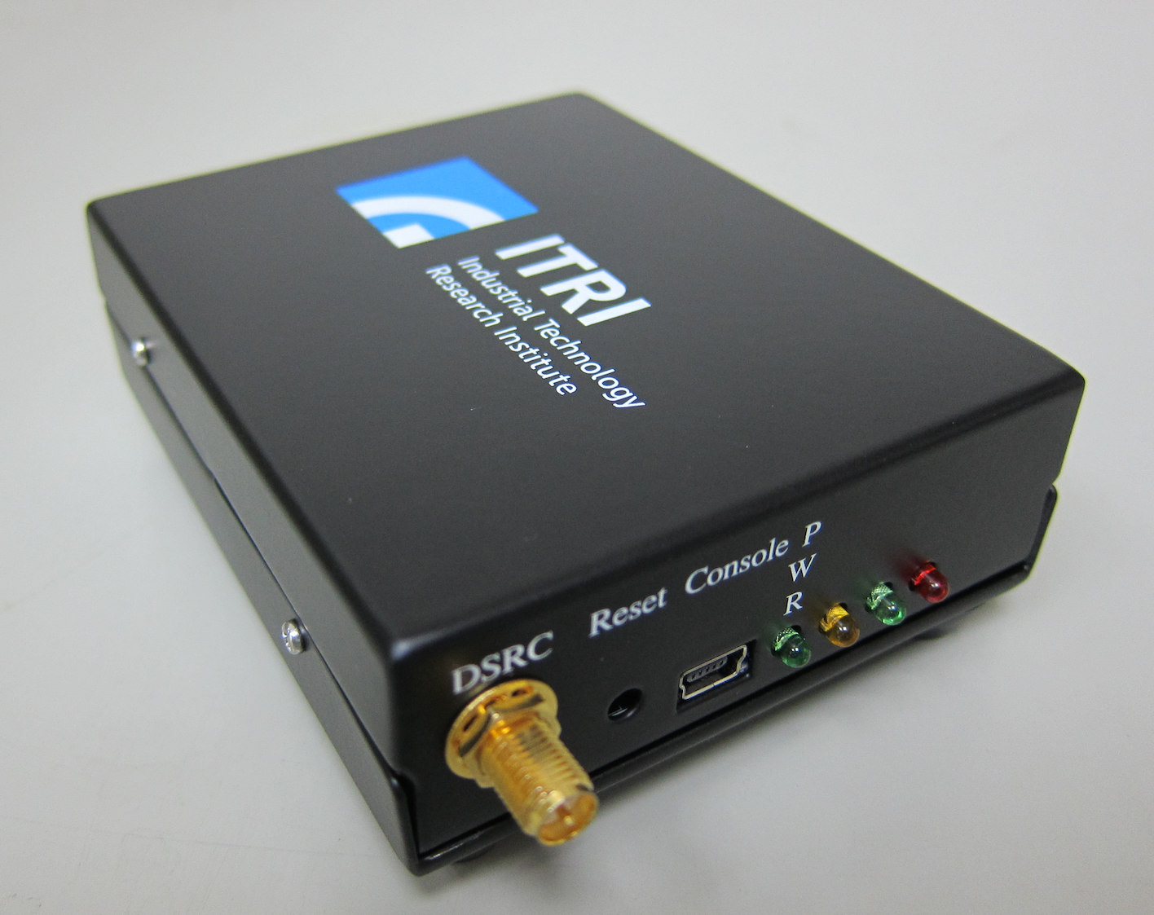
Challenge 3: Cost and Benefit
DSRC (IEEE 802.11p) – the current dominant standard for vehicular communications
NOT in vehicle products today
Low adoption incentive: where is the (day 1) benefit?
  Minimum market penetration rate: 10%
  (All new cars have it have to wait for 2 years)
Low adoption incentive: high initial cost
  Complexity similar to a WiFi radio
  But with much lower quantity, when bootstrapping the market

Slide 10
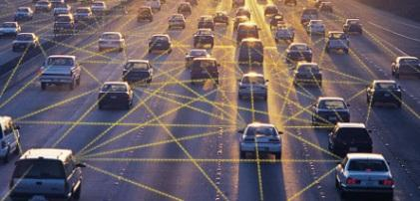
Vehicular Visible Light Communications
EE Times: Top 10 Automotive Agendas for 2014 & Beyond
7. Time to act on V2V,V2I

Slide 11
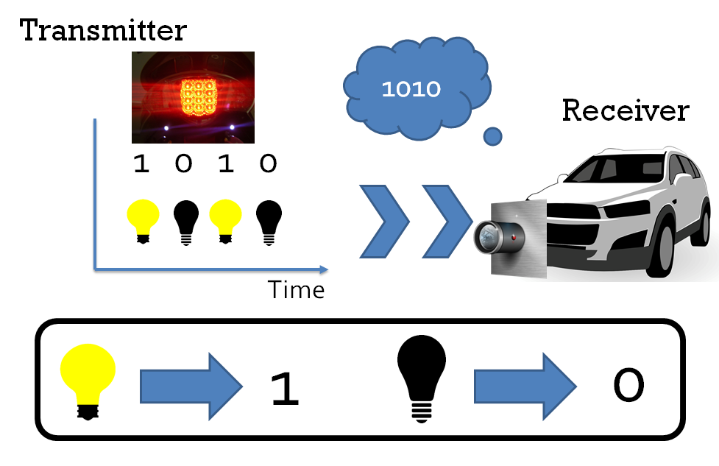
Vehicular Visible Light Communications

Slide 12
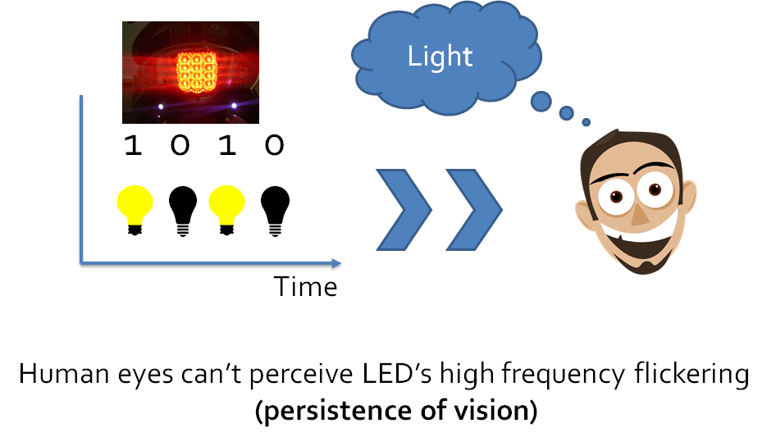
Keep the Light’s Original Function

Slide 13
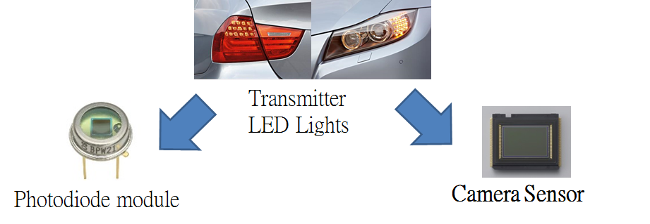
Receiver Options
 | Data Rate | Number of pixels | Cost
Photodiode module | Up to several Mb/s | 1 | Extra
Camera sensor | A few Bytes/s | Millions | Use existing cameras

Slide 14

V2LC for Scooter Safety
S.-H. You, S.-H. Chang, H.-M. Lin, H.-M. Tsai, "Demo: Visible Light Communications for Scooter Safety,“ ACM MobiSys, Taipei, Taiwan, June 2013
Video: http://goo.gl/lo1f9

Slide 15

Automatic Interference Filtering
Challenge 1
Visible light cannot penetrate obstacles = line-of-sight only
VLC communication coverage = immediate neighbors only
→ only those that could immediately collide with you
Comparison: RF coverage includes a lot more irrelevant vehicles → additional interference → less reliable
Automatic interference filtering with VLC
→ Zero delay + zero overhead
→ Always scalable to density & speed*!
RF Coverage
!
!
VLC Coverage
!
!
Your Car
!
!
*S.-H. You, O. Shih, N. Wisitpongphan, H.-M. Tsai, and R. D. Roberts, “Smart Automotive Lighting for Vehicle Safety,” IEEE Communications, vol.51, no.12, pp. 50-59, December 2013.

Slide 16
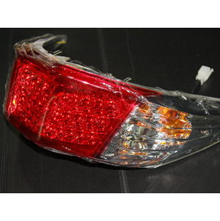
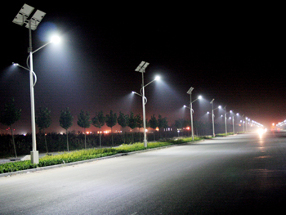
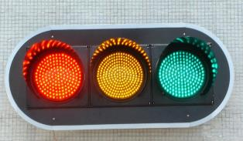
Highly Directional Transmission
Challenge 1
Easily regulated output radiation pattern
→Highly directional transmission with minimal leakage
Scooter Tail Light
Radiation Pattern
T→
Safety regulation specifies the minimum light intensity (at 30.48 m) within 20 degrees of irradiance angle.
W. Viriyasitavat, S.-H. Yu, and H.-M. Tsai, “Short Paper: Channel Model for Visible Light Communications using Off-the-shelf Scooter Taillight,” in Proc. IEEE Vehicular Networking Conference, pp. 170-173, Boston, United States, December 2013.
16
Notes:
Think about illumination

Slide 17
Simultaneous Transmissions
Challenge 1
Lights occupy disjoint sets of pixels (except when very far away: > 1km)
Simultaneous transmissions with no collision, interference, and access delay

Slide 18
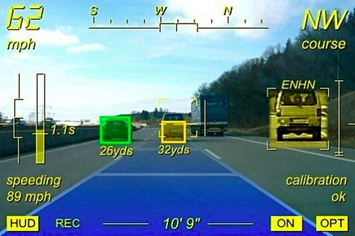

Talking Pixels
Challenge 2
Computer vision:
associate pixels with information (distance) and context
V2LC: direct association -Information directly comes from the pixels!
Photogrammetry: sub-meter accuracy for positioning
www.ionroad.com
Notes:
Vision-base method inaccuracy → pixels transmitting information combined with the context in the image
How to estimate relative position? Object recognition + assumption

Slide 19
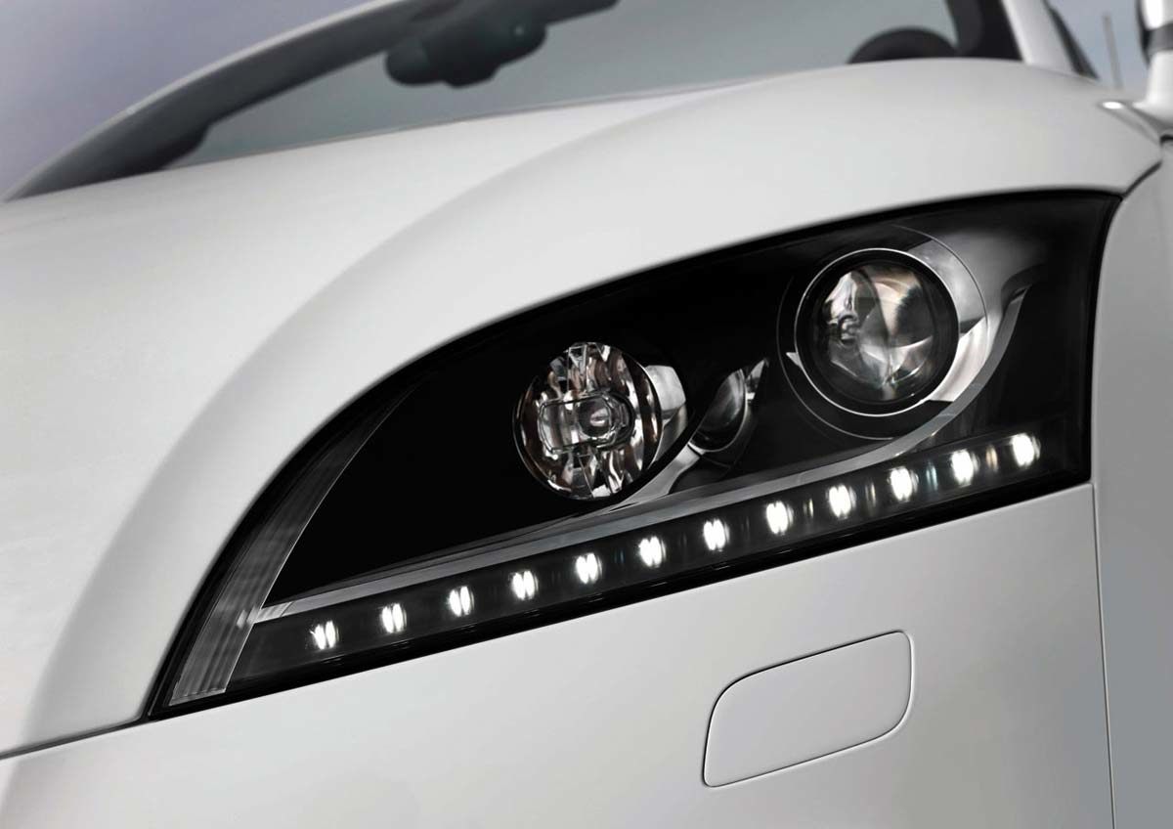
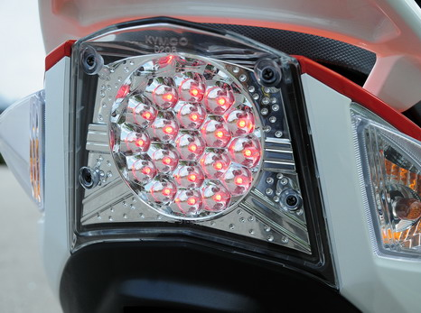
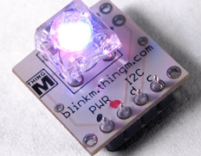
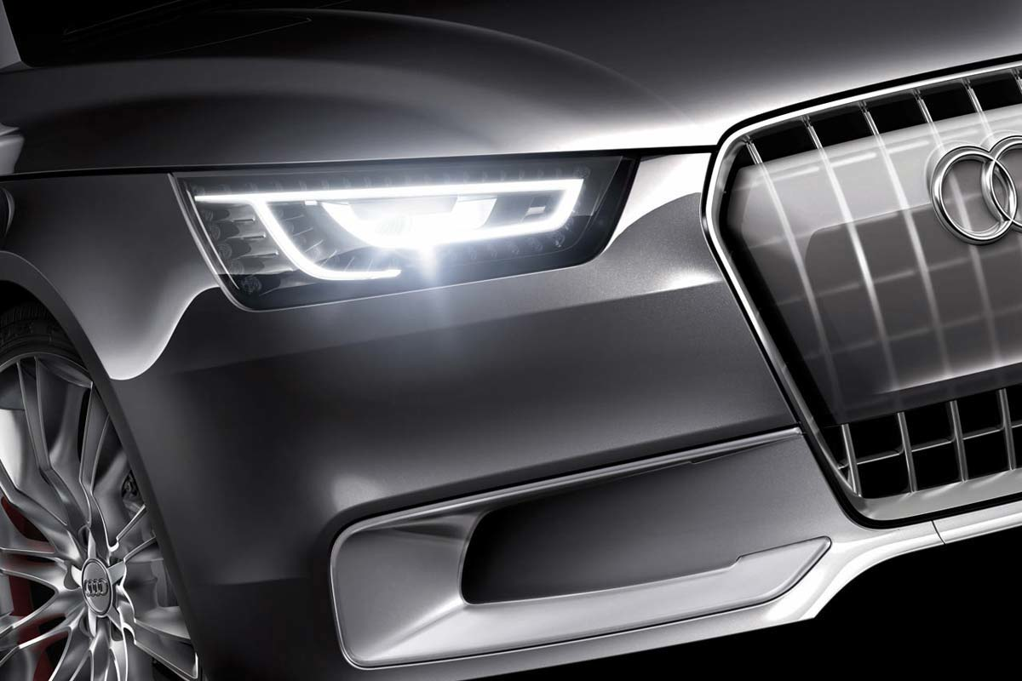
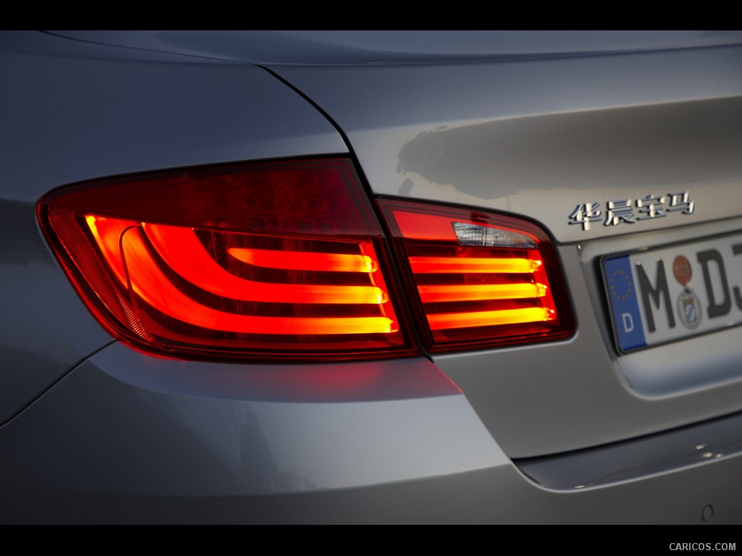
Low-Cost Transmitter:
Pervasive Existence of Automotive LED lights
Challenge 3
Low Cost: LED lights already used extensively for vehicles
Extremely simple driver circuit: USD$2 microcontroller
Aftermarket product is feasible: driver module and/or light module

Slide 20
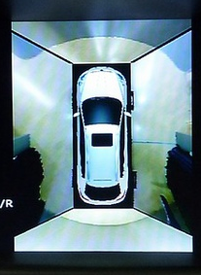
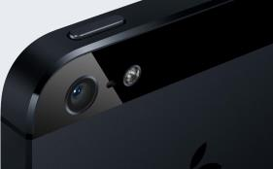
Low-Cost Receiver: Cameras Everywhere
Challenge 3
Low cost: cameras already exist in many cars
Aftermarket product is feasible:
  App download for mobile devices
  WiFi/Bluetooth link to light module
Luxgen’s Eagle View+
360 degree vision coverage

Slide 21
Conclusion
IoV creates new opportunities for both new applications and huge performance improvements
New challenges need to be addressed:
  Vehicle density and speed
  Association of information and identity
  Market penetration
V2LC: new solution for vehicular communications
  Reliable “point-to-point” V2V communications
  Direct association of information and pixels
  Low-cost system design with aftermarket product options

