Slide 1


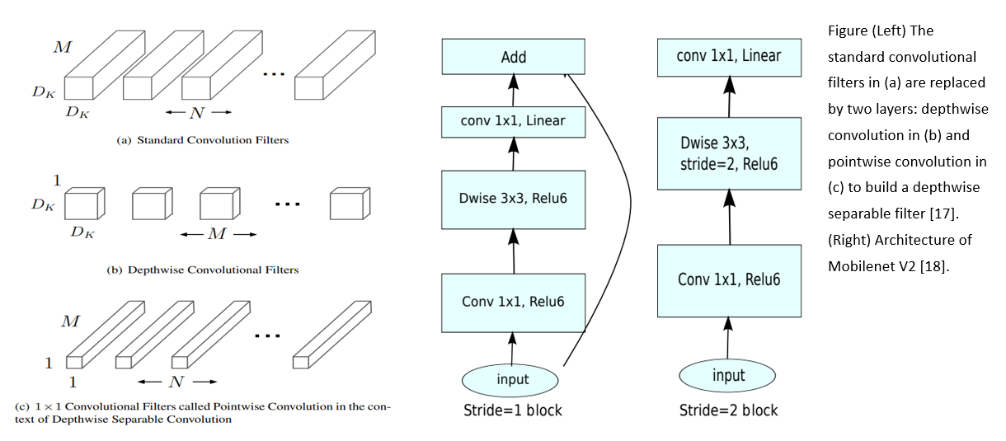
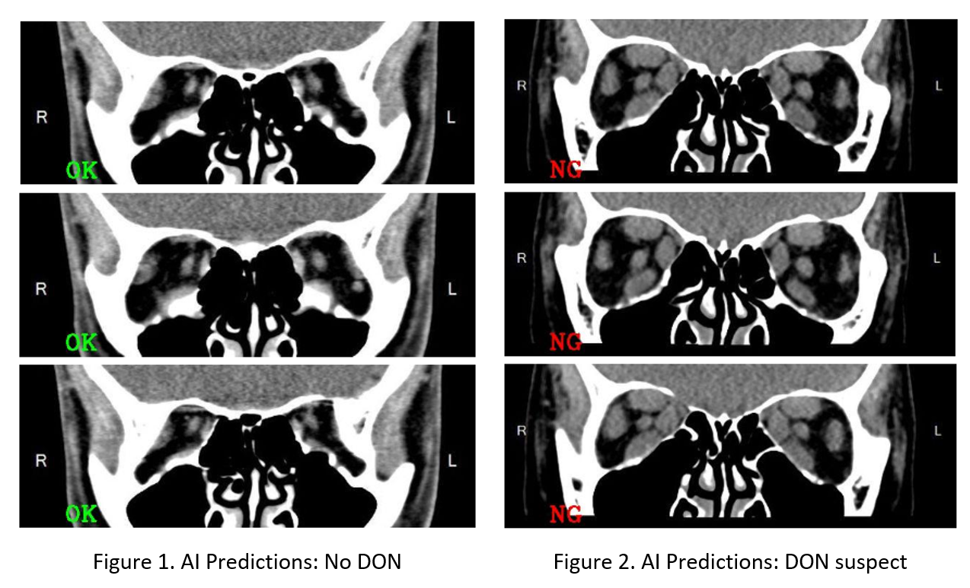
Posterboard Number: 2394 - C0457
Automated Detection of Dysthyroid Optic Neuropathy
in Graves’ Ophthalmopathy with Computed Tomography (CT) Scans by Convolutional Neural Networks
(Claudia) Ju-Yi Hung^{1,2}, An-Chun Luo³, Yu-Shan Deng³, Chu-Ying Chung⁴, Chiou-Shann Fuh², Chandrashan Perera¹, David Myung¹, Andrea Lora Kossler¹, Shu-Lang Liao⁴
1. Ophthalmology, Byers Eye Institute at Stanford University, United States
2. Computer Science and Information Engineering, National Taiwan University, Taiwan
3. (Non-Profit) Industrial Technology Research Institute, Taiwan
4. Ophthalmology, National Taiwan University Hospital, Taiwan
INTRODUCTION
MODEL Architecture
Dysthyroid optic neuropathy (DON) is a severe manifestation of thyroid eye disease (TED) that can result in permanent vision loss [1]. Multiple objective measures grade the physical signs, symptoms, and severity of TED, including CAS, VISA, and EUGOGO [2-4]; however, no single protocol completely characterizes DON. Orbital imaging techniques, particularly CT imaging [5–7], help to diagnose and follow DON. In addition to apical crowding, the overwhelming majority of CT imaging studies in cases of DON demonstrate moderate-to-severe muscle enlargement [8]. Imaging gains particular importance in patients with bilateral disease as an afferent pupillary defect and color testing are less useful in this situation[9]. It is also important when other diagnostic tests do not point to DON, as almost all patients with DON demonstrate CT imaging findings [1].
Prompt diagnosis for DON is important because oral or intravenous (IV) glucocorticoids, possibly orbital radiotherapy (ORT), and surgical decompression are beneficial to prevent ongoing irreversible optic nerve damage [10-14]. With some development of artificial intelligence (AI) for orbital CT scans and Graves’ disease [15,16], there is still a lack of AI exploration for dysthyroid optic neuropathy. Therefore, we propose the AI model which assists in the automated diagnosis of DON by orbital CT scans, using convolutional neural network.
Convolutional neural networks have revolutionized many areas of machine intelligence, enabling superhuman accuracy for challenging image recognition tasks. However, the drive to improve accuracy often comes at a cost: modern state-of-the-art networks require high computational resources beyond the capabilities of many mobile and embedded applications [17,18]. MobileNet pushes the state of the art for mobile-tailored computer vision models, by significantly decreasing the number of operations and memory needed while retaining the same accuracy [17,18].
For healthcare institute, too high a demand for computational resources becomes the bottleneck issue that limits the development of AI in healthcare. Meanwhile, the responsibility of healthcare is data security and privacy protection. The aim to decrease the computational demand would be one solution to balance patient rights and AI development. Hence, we built our state-of-art neural network architecture for dysthyroid optic neuropathy in Graves’ Ophthalmopathy on MobieNet [17,18] that is specifically tailored for mobile and resource-constrained environments.
Email : hungjuyi@gmail.com (Dr. Claudia Ju-Yi Hung)
CONCLUSION
Our preliminary results suggest that MobileNetV2 may assist in the detection of Dysthyroid Optic Neuropathy in Graves’ disease via autonomous analysis of coronal serial orbital CT scans. Further independent testing is merited for validation.
REFERENCES
Blandford, Alexander D., et al. "Dysthyroid optic neuropathy: update on pathogenesis, diagnosis, and management." Expert review of ophthalmology 12.2 (2017): 111-121.
Mourits MP, Prummel MF, Wiersinga WM, et al. Clinical activity score as a guide in the management of patients with Graves’ ophthalmopathy. Clin Endocrinol (Oxf). 1997;47(1):9–14.
Dolman PJ, Rootman J. VISA classification for Graves orbitopathy. Ophthal Plast Reconstr Surg. 2006;22(5):319–324.
Bartalena L, Baldeschi L, Dickinson A, et al. Consensus statement of the European Group on Graves’ orbitopathy (EUGOGO) on management of GO. Eur J Endocrinol. 2008;158(3):273–285.
Mourits MP, Suttorp-Schulten MS, Tijssen RO, et al. Contrast sensitivity and the diagnosis dysthyroid optic neuropathy. Doc Ophthalmol. 1990;74(4):329–335.
Mourits MP, Koornneef L, Wiersinga WM, et al. van der Gaag R. Orbital decompression for Graves’ ophthalmopathy by inferomedial, by inferomedial plus lateral, and by coronal approach. Ophthalmology. 1990;97(5):636–641.
Suttorp-Schulten MS, Tijssen R, Mourits MP, et al. Contrast sensitivity function in Graves’ ophthalmopathy and dysthyroid optic neu-ropathy. Br J Ophthalmol. 1993;77(11):709–712.
Neigel JM, Rootman J, Belkin RI, et al. Dysthyroid optic neuropathy. The crowded orbital apex syndrome. Ophthalmology. 1988;95(11):1515–1521.
Barrett L, Glatt HJ, Burde RM, et al. Optic nerve dysfunction in thyroid eye disease: CT. Radiology. 1988;167(2):503–507.
Liao SL, Chang, TC, Lin L. Transcaruncular orbital decompression: an alternate procedure for Graves ophthalmopathy with compressive optic neuropathy. Am J Ophthalmol 2006; 141:810–818.
Hsia, Yun, et al. "The Changes in Optic Nerve after Orbital Decompression Surgery for Thyroid Eye Disease and Case Reports of Ischemic Optic Neuropathy." BioMed Research International 2022 (2022).
Wei, Yi Hsuan, Meng Chin Chi, and Shu Lang Liao. "Predictability of visual function and nerve fiber layer thickness by cross-sectional areas of extraocular muscles in graves ophthalmopathy." American journal of ophthalmology 151.5 (2011): 901-906.
Cheng, Anny M., et al. "Long-term outcomes of orbital fat decompression in Graves’ orbitopathy." British Journal of Ophthalmology 102.1 (2018): 69-73.
Liao, Shu-Lang, and Shih-Wei Huang. "Correlation of retrobulbar volume change with resected orbital fat volume and proptosis reduction after fatty decompression for Graves ophthalmopathy." American journal of ophthalmology 151.3 (2011): 465-469.
Hanai, Kaori, et al. "Automated detection of enlarged extraocular muscle in Graves’ ophthalmopathy with computed tomography and deep neural network." Scientific Reports 12.1 (2022): 1-7.
Hamwood, Jared, et al. "A deep learning method for automatic segmentation of the bony orbit in MRI and CT images." Scientific Reports 11.1 (2021): 1-12.
Howard, Andrew G., et al. "Mobilenets: Efficient convolutional neural networks for mobile vision applications." arXiv preprint arXiv:1704.04861 (2017).
18.Sandler, Mark, et al. "Mobilenetv2: Inverted residuals and linear bottlenecks." Proceedings of the IEEE conference on computer vision and pattern recognition. 2018.
RESULTS
PURPOSE
With little development of artificial intelligence (AI) for orbital CT scans and Graves’ disease, there is still a lack of AI exploration for dysthyroid optic neuropathy (DON). Therefore, we propose an AI model which assists in the autonomous diagnosis of DON by coronal orbital CT scans, using convolutional neural networks
DATA and METHODS
A mobile convolutional neural networks model was constructed and trained on coronal CT scans of 50 patients with Graves’ disease. Of these, 25 CT scans were of patients without DON, and 25 CT scans were of patients with DON. Four to six consecutive coronal scans were retrieved between the posterior globe and orbital apex for each patient, yielding 116 images in Graves’ group, and 93 images in the DON group. A total of 209 serial coronal CT slices from each CT scan were utilized for training and inference of the AI model. The MobileNetV2 architecture, with pre-train by the BVLC model, formed the basis of the AI model which was trained to identify CT scans with or without DON.
Ground truth was determined by comprehensive clinical examination (visual acuity, pupillary examination, intraocular pressure, Hertel measurement, color vision, contrast sensitivity, visual field testing, Clinical Activity Scores (CAS) scores, optical coherence tomography, optical coherence tomography angiography, computed tomography (CT) scans, magnetic resonance imaging, and visual evoked potential/response, etc.) with a degree of confidence such that DON patients all underwent subsequent surgical orbital decompression.
The prediction accuracy is 95.215% ([110+89)/(93+116)*100%=95.215%] in MobileNetV2, while AlexNet cannot reach convergence under a similar training process. Overfitting is suspected.

