Slide 1
SURE-based Optimization for Adaptive Sampling and Reconstruction
Tzu-Mao Li, Yu-Ting Wu, Yung-Yu Chuang
National Taiwan University
Notes:
Hello, I am Tzu-Mao Li from National Taiwan University and today I am going to present our paper
“SURE-based Optimization for Adaptive Sampling and Reconstruction.”

Slide 2
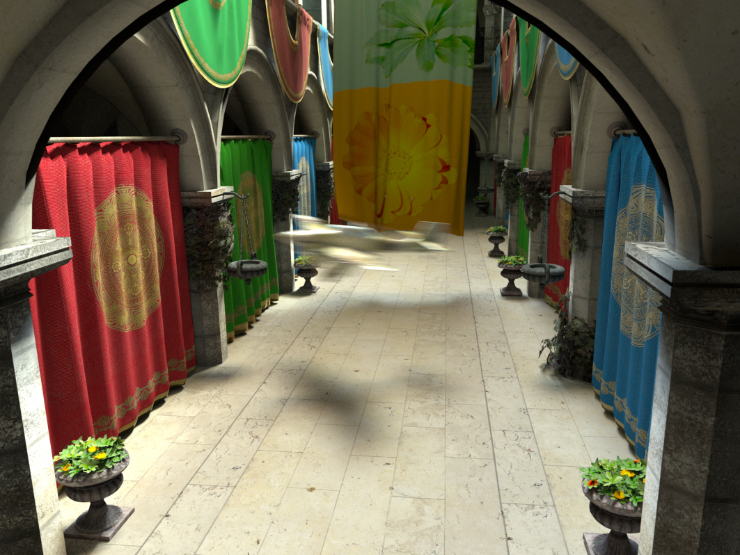
Monte Carlo ray tracing
$$I\left(x,y\right)=\int_{Ω}{f\left(x,y,s\right)ds}≈\frac{1}{N}\sum_{i=1}^{N}{f(x,y,s_{i})}$$
Notes:
In this paper, we deal with Monte Carlo ray tracing for rendering realistic images.
Each pixel of the image involves solving an integral,
Monte Carlo ray tracing approximates the integral by taking discrete samples for each pixel.

Slide 3
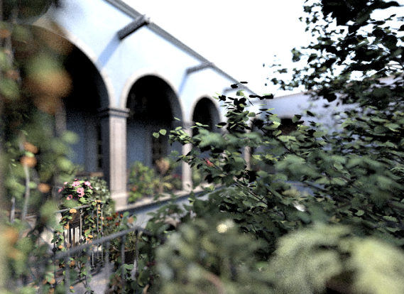
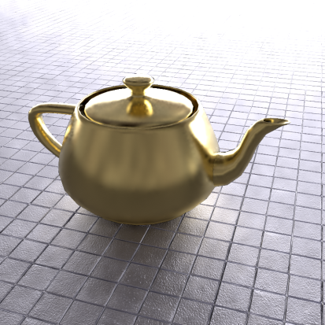
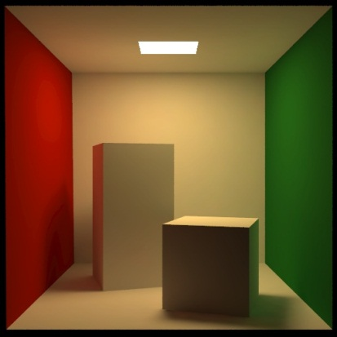
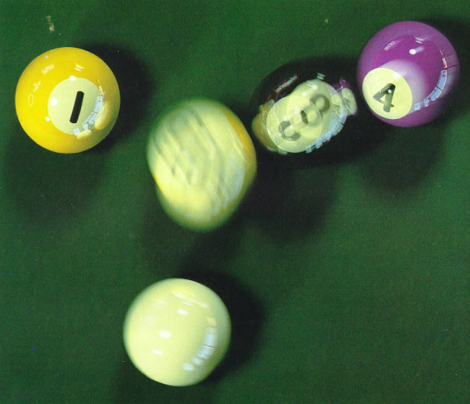
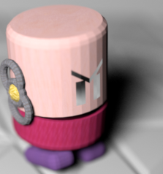
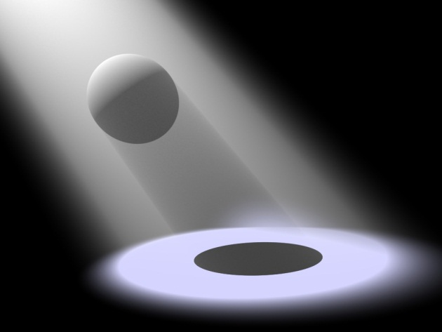
Monte Carlo ray tracing
Depth of field
Glossy reflection
Global illumination
Motion blur
Soft shadow
Participating media
Notes:
Monte Carlo ray tracing can simulate many effects in an unified scheme,
such as depth of field, glossy reflection, global illumination, motion blur, soft shadow, and participating media.

Slide 4
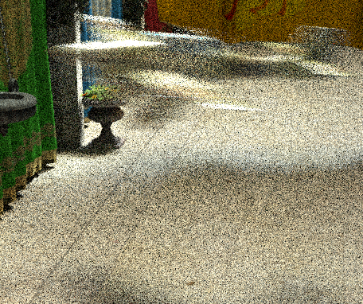
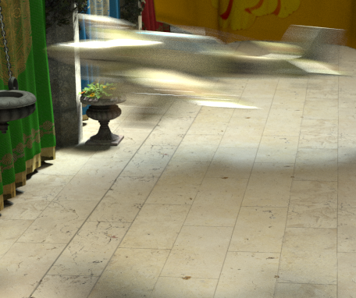
Noise of Monte Carlo
68 samples per pixel
~890 seconds
8192 samples per pixel
~1 day 4 hours
Notes:
The main problem of Monte Carlo integration, is that if we do not use enough samples, the result image will look noisy due to variances.
For example, for the image shown on your left, each pixel is reconstructed from sixty-eight samples and it took us around eight hundred and ninety seconds to render it on a quad-core cpu.
Although the time is reasonable, the quality of the image is nothing close to useful.
One way to reduce the noise is to increase the number of samples, however each sample involves ray tracing and evaluation of shaders, which are pretty expensive.
We could obtain the high-quality image as shown on the right by having eight thousand samples per pixel, but it took us about a day and four hours to render the image.

Slide 5
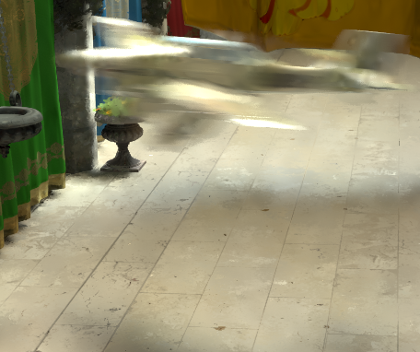
Noise of Monte Carlo
Avg. 64 samples per pixel
~890 seconds
8192 samples per pixel
~1 day 4 hours
Notes:
Our solution can produce good-quality result with fewer samples by adapting samples to difficult regions and filtering the image.
The overhead of our method is small.
Compared with the noisy image in the previous slide, given the same amount of time, we can generates a much better image with almost the same number of samples per pixel.

Slide 6
Previous work
Image space methods
Mitchell [1987, 1991], Bala et al. [2003], Overbeck et al. [2009], Chen et al. [2011], Rousselle et al. [2011], Sen and Darabi [2012]
Handle general effects, usually more computationally efficient and use less memory
Notes:
There are many papers dealing with adaptive sampling and reconstruction, some of them work in the image space,
usually handling Monte Carlo noise by filtering, and allocating samples to difficult regions on the image.

Slide 7
Previous work
Image space methods
Mitchell [1987, 1991], Bala et al. [2003], Overbeck et al. [2009], Chen et al. [2011], Rousselle et al. [2011], Sen and Darabi [2012]
Handle general effects, usually more computationally efficient and use less memory
Multidimensional methods
Hachisuka et al. [2008], Soler et al. [2009], Egan et al. [2009, 2011], Lehtinen et al. [2011, 2012]
May eliminate the noise using fewer samples, but often limited to a few effects
Notes:
Others work in a higher dimension space, utilizing the anisotropy of the integral.
These methods may do better using fewer samples in some cases, but they are often limited to a few effects due to the curse of dimensionality.

Slide 8
Previous work
+ Ours
Image space methods
Mitchell [1987, 1991], Bala et al. [2003], Overbeck et al. [2009], Chen et al. [2011], Rousselle et al. [2011], Sen and Darabi [2012]
Handle general effects, usually more computationally efficient and use less memory
Multidimensional methods
Hachisuka et al. [2008], Soler et al. [2009], Egan et al. [2009, 2011], Lehtinen et al. [2011, 2012]
May eliminate the noise using fewer samples, but often limited to a few effects
Notes:
Our method belongs to the category of image space methods as we filter pixels and adaptively take samples on the image.

Slide 9
GEM [Rousselle et al. 2011]
Notes:
Our method follows the image space adaptive sampling and filtering framework proposed by Rousselle et al in last year’s SIGGRAPH Asia.
Their method is named greedy error minimization. We use GEM for short.

Slide 10
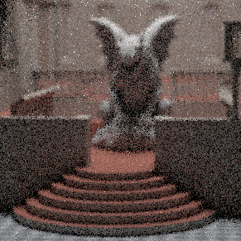
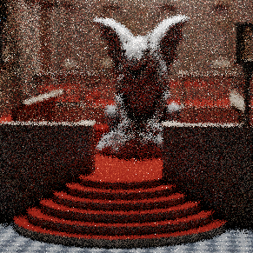
GEM [Rousselle et al. 2011]
Renderer
Color
Mean
Var
Notes:
First, by taking a number of samples for each pixel, the renderer outputs an noisy image and the sample variance for each pixel.
A simple way to remove noises is to filter the image. However, applying filters often involves choosing appropriate parameters.
Large filter kernel will remove noises better but could lead to oversmooth images.
On the other hand, small kernels generate crispy images but often cannot remove noises well.

Slide 11
GEM [Rousselle et al. 2011]
Renderer
Color
Filterbank
Mean
Var
Notes:
To select a proper filter kernel for each pixel, the noisy image is filtered several times, each time a different kernel is used.
The kernels form a filterbank with different scales of filters… (click 3 times)

Slide 12
GEM [Rousselle et al. 2011]
Renderer
Color
Filterbank
Mean
Var

Slide 13
GEM [Rousselle et al. 2011]
Renderer
Color
Filterbank
Mean
Var

Slide 14
GEM [Rousselle et al. 2011]
Renderer
Color
Filterbank
Mean
Var
Notes:
The image is filtered by different sizes of filters, so it is blurred in several levels.

Slide 15
GEM [Rousselle et al. 2011]
Renderer
Color
Filterbank
Mean
Var
Error Estimator
Notes:
To determine the proper kernel for each pixel, they proposed an error estimator specially designed for isotropic filters.
The method utilizes theorems from density estimation to estimate the error of Gaussian filtered images.

Slide 16
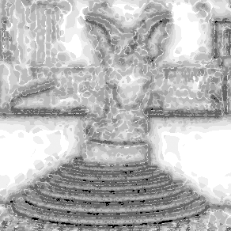
GEM [Rousselle et al. 2011]
Renderer
Color
Filterbank
Mean
Var
Error Estimator
Filter
Scale
Notes:
After estimating the error, for each pixel, they choose the filtered value that causes the smallest error.

Slide 17
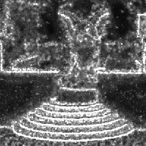
GEM [Rousselle et al. 2011]
Renderer
Color
Filterbank
Mean
Var
Error Estimator
Sample
Density
Filter
Scale
Notes:
And more samples are distributed into the areas where the errors are still very large.
The sample density is roughly proportional to the error.
More samples are spent on more difficult regions.

Slide 18
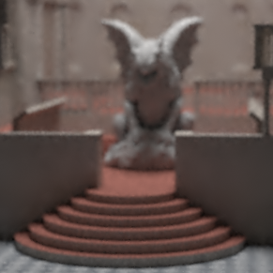
GEM [Rousselle et al. 2011]
Renderer
Color
Filterbank
No
Finish?
Mean
Var
Yes
Error Estimator
Sample
Density
Filter
Scale
Notes:
This process is iterated until the sample budget is used up.
And the result is a smooth image.

Slide 19
GEM [Rousselle et al. 2011]
Renderer
Color
Filterbank
No
Isotropic
Filters Only!
Finish?
Mean
Var
Yes
Error Estimator
Sample
Density
Filter
Scale
Notes:
Unfortunately, as I mentioned, their error estimator uses theorems from density estimation and assumes vanishing first central moments.
Thus, their error estimation can only estimates errors for isotropic filters and the filterbank is limited to those.

Slide 20
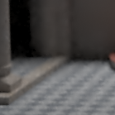
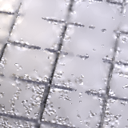
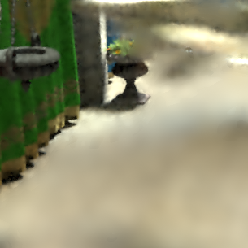
GEM [Rousselle et al. 2011]
Isotropic filters cannot adapt to scene features well!
Notes:
Isotropic filters have limitations.
First, they cannot adapt to image content.
Also, they cannot utilize and adapt to the scene features.
Therefore, they often produce blurry results when the image contains complex geometry or texture details.
To improve the framework, instead of isotropic filters, we choose to use cross bilateral filters that can better adapt to image and scene content.

Slide 21
Bilateral filters [Tomasi and Manduchi 1998]
Preventing Gaussian filters from blurring image edges.
Notes:
Bilateral filters was designed to improve Gaussian filters for better preserving details and edges.

Slide 22
Bilateral filters [Tomasi and Manduchi 1998]
Preventing Gaussian filters from blurring image edges.
$$w_{ij}=exp⁡(−\frac{{\left\|p_{i}−p_{j}\right\|}^{2}}{2{σ_{s}}^{2}})$$
Noisy
Position
Gaussian
Notes:
In Gassuain filter, the weight between pixel i and pixel j is determined by the spatial distance of two pixels in the image space.
It completely ignores image content and often blurs out edges and details.

Slide 23
Bilateral filters [Tomasi and Manduchi 1998]
Preventing Gaussian filters from blurring image edges.
$$w_{ij}=exp⁡(−\frac{{\left\|p_{i}−p_{j}\right\|}^{2}}{2{σ_{s}}^{2}})exp⁡(−\frac{{\left\|c_{i}−c_{j}\right\|}^{2}}{2{σ_{r}}^{2}})$$
Noisy
Position
Color
Bilateral
Notes:
In addition to spatial distance, bilateral filter also takes the color similarity of two pixels into account.
And it better preserves edges and details.

Slide 24
Cross bilateral filters [Eisemann and Durand 2004]
$$w_{ij}=exp⁡(−\frac{{\left\|p_{i}−p_{j}\right\|}^{2}}{2{σ_{s}}^{2}})exp⁡(−\frac{{\left\|c_{i}−c_{j}\right\|}^{2}}{2{σ_{r}}^{2}})\prod_{k=1}^{m}{exp⁡(−\frac{{D({\overline{f}}_{ik},{\overline{f}}_{jk})}^{2}}{2{σ_{f_{k}}}^{2}})}$$
Position
Color
Scene Features
Notes:
For rendering, we can furthermore measure the similarity between two pixels by utilizing scene features such as normal, texture and depth.
By doing so, we have a more reliable weighting scheme.
This is called the cross bilateral filters and previous work has shown that it is effective for graphics applications.
Unfortunately, it is an anisotropic filter and cannot be used in the GEM framework because we do not know how to estimate the errors for cross bilateral filters.

Slide 25
Estimating filter error
Notes:
So, the key is to estimate the filter error for non-isotropic filters.
Let’s step back and see the problem we try to solve.

Slide 26
Estimating filter error
Notes:
Here, each cell represents a pixel.
For each pixel, we will have several Monte Carlo samples.
From these Monte Carlo samples, we apply reconstruction filters to obtain the pixel value for each pixel.
(click twice)

Slide 27
Estimating filter error
$$y_{i}$$
Mean
Notes:
We use y to represent the pixel value reconstructed from Monte Carlo samples.

Slide 28
Estimating filter error
$$y_{i}$$
Mean
$$σ_{i}$$
Variance
Notes:
In addition to the pixel value, we can also calculate the sample variance for each pixel.
Here, we denote it as sigma.

Slide 29
Estimating filter error
Converged
$$x_{i}$$
$$y_{i}$$
Mean
$$σ_{i}$$
Variance
Notes:
If infinitely many samples were used, the estimated pixel value y would converge to the true pixel value x.
That is, we want to estimate x. But, we can only afford to take a limited number of samples.
Thus, we want to use y to approximate x.
When the number of samples are not sufficient, the approximation could be very bad.
That is what we called noises.

Slide 30
Estimating filter error
Converged
$$x_{i}$$
$$y_{i}$$
Mean
$$σ_{i}$$
Variance
Notes:
To address the problem of noises, instead of using y as the pixel value,
we use a filter to average over nearby pixels to have a more reliable estimation.

Slide 31
Estimating filter error
Converged
$$x_{i}$$
$$y_{i}$$
Mean
Filtered
$$f(y_{i})$$
$$σ_{i}$$
Variance
Notes:
The filter f is expressed here as a weighted average of neighboring pixels.
In our case, we use cross bilateral filters and the weights are determined by features associated with each pixel.

Slide 32
Estimating filter error
Want to estimate:
$$E[{(f\left(y_{i}\right)−x_{i})}^{2}]$$
Notes:
To apply for the adaptive sampling and filtering framework, we need to estimate the error of the filtered pixel value f(y) to the true pixel value x.
It is defined as the expectation value of squared difference between filtered pixel value and true pixel value.

Slide 33
Estimating filter error
Want to estimate:
$$E[{(f\left(y_{i}\right)−x_{i})}^{2}]$$
Don’t know!
Notes:
Unfortunately, we do not know the true value x; otherwise we do not need to estimate it in the first place.
Since we do not know x, we cannot calculate the error.

Slide 34
Estimating filter error
Stein’s Unbiased Risk Estimator!
Want to estimate:
$$E[{(f\left(y_{i}\right)−x_{i})}^{2}]=E[SURE(f(y))]$$
Notes:
The good news is that, although we cannot calculate the error, we can still estimate it.
A great statistician named Charles Stein proposed an error estimator which is known as SURE, standing for Stein’s Unbiased Risk Estimator.
He showed that the estimator can unbiasedly estimate the error under the assumption that y is Gaussian distributed.
That is, SURE is a good estimator for the mean square error of the filtered pixel values.

Slide 35
Estimating filter error
Want to estimate:
$$E[{(f\left(y_{i}\right)−x_{i})}^{2}]=E[SURE(f(y))]$$
$$SURE\left(f\left(y_{i}\right)\right)=$$
$${(f\left(y_{i}\right)−y_{i})}^{2}+2{σ_{i}}^{2}\frac{df(y_{i})}{dy_{i}}−{σ_{i}}^{2}$$
Notes:
We show SURE’s definition here.
Recall that f is the filter function, y is the estimated pixel value and sigma is the variance of Monte Carlo samples.
As long as we can calculate the derivatives of the filters, we can compute SURE and obtain a good estimation for filter errors.

Slide 36
Estimating filter error
Want to estimate:
$$E[{(f\left(y_{i}\right)−x_{i})}^{2}]=E[SURE(f(y))]$$
$$SURE\left(f\left(y_{i}\right)\right)=$$
$${(f\left(y_{i}\right)−y_{i})}^{2}+2{σ_{i}}^{2}\frac{df(y_{i})}{dy_{i}}−{σ_{i}}^{2}$$
Analytically derived for
cross bilateral filters.
Notes:
Fortunately, it is possible to derive the derivatives analytically for cross bilateral filters, and many others.

Slide 37
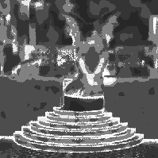
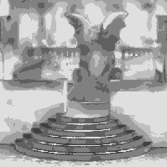
Our framework
Color
Renderer
No
Mean
Var
Finish?
Yes
SURE
MSE Estimator
Sample
Density
Filter
Scale
Notes:
We now plug the SURE error estimator into the adaptive sampling and filtering framework.

Slide 38
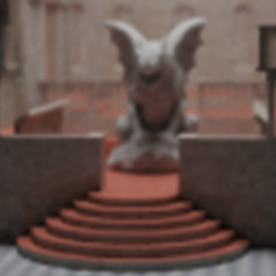
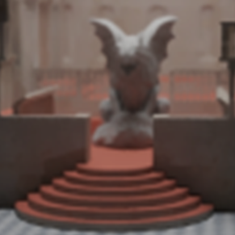
Our framework
Color
(Cross Bilateral)
Filterbank
Renderer
No
Mean
Var
Finish?
Yes
SURE
MSE Estimator
Sample
Density
Filter
Scale
Notes:
We use SURE to estimate the error for each filtered image in the cross bilateral filterbank.
We can also use other filters as long as we have their derivatives.

Slide 39
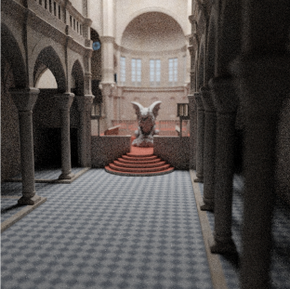
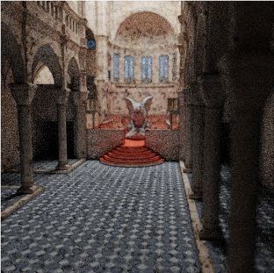
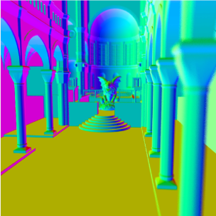
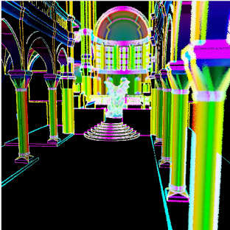
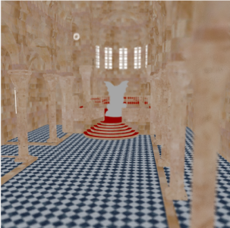
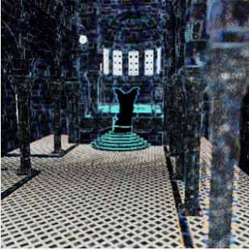
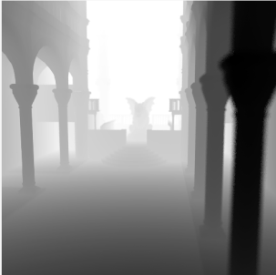
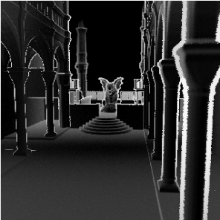
Our framework
Color
(Cross Bilateral)
Filterbank
Renderer
Scene Features
No
Mean
Var
Finish?
Mean
Var
Yes
SURE
MSE Estimator
Sample
Density
Filter
Scale
Notes:
By using cross bilateral filters, we can utilize scene features and adapt to them.

Slide 40
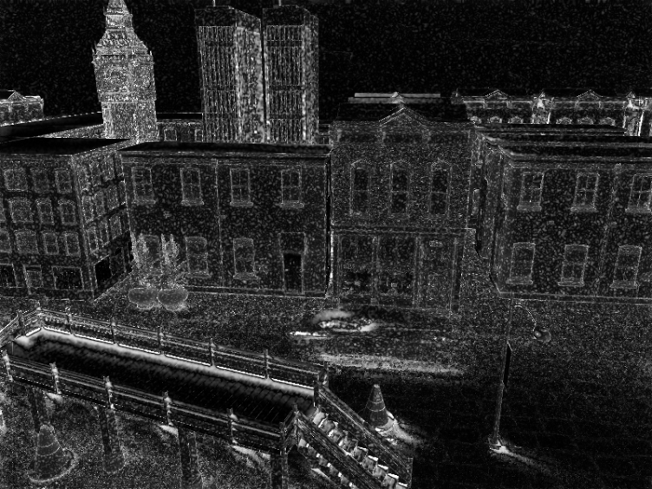
Variance of the error estimator
$SURE\left(f\left(y_{i}\right)\right)$ has its own variance!
Notes:
Notice that SURE is an estimation of the error.
Like all estimators, it has its own variance.
Here, we show an error map generated by SURE and it is noisy.

Slide 41
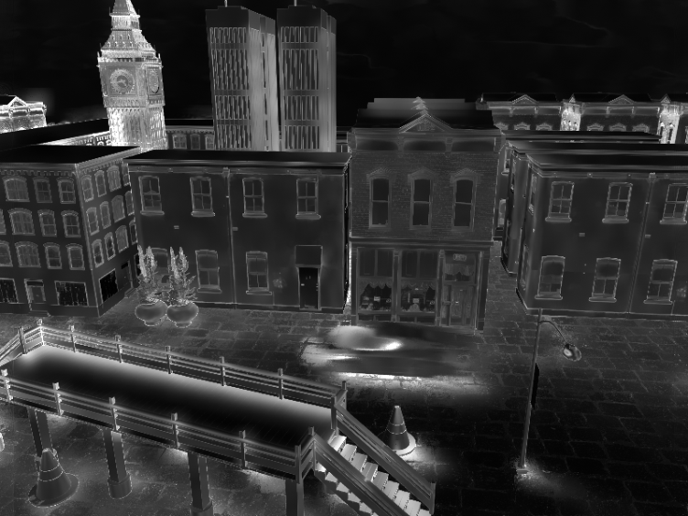
Variance of the error estimator
$SURE\left(f\left(y_{i}\right)\right)$ has its own variance!
We need to filter the estimated error.
We use a fixed size cross bilateral filter to filter the estimated error.
Before Filter
After Filter
Notes:
Like the Monte Carlo estimator, we can deal with the noise by filtering.
We filter the estimated error by a fixed size cross bilateral filter, and the error map becomes much smoother.
By doing so, we have a more reliable error estimation.

Slide 42
Results
Notes:
Here we show some results, we will compare to baseline Monte Carlo ray tracing result, and two recent image-space filtering methods.

Slide 43
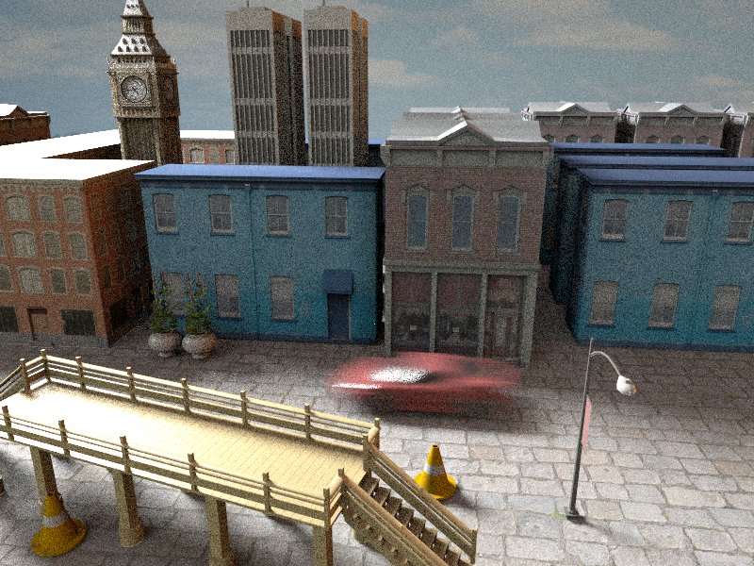
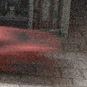
Results
Monte Carlo – 82 spp (60sec)
Notes:
This is a noisy image produces by monte carlo ray tracing,
the scene is illuminated by an environment light, and the car is moving causing motion blur.

Slide 44
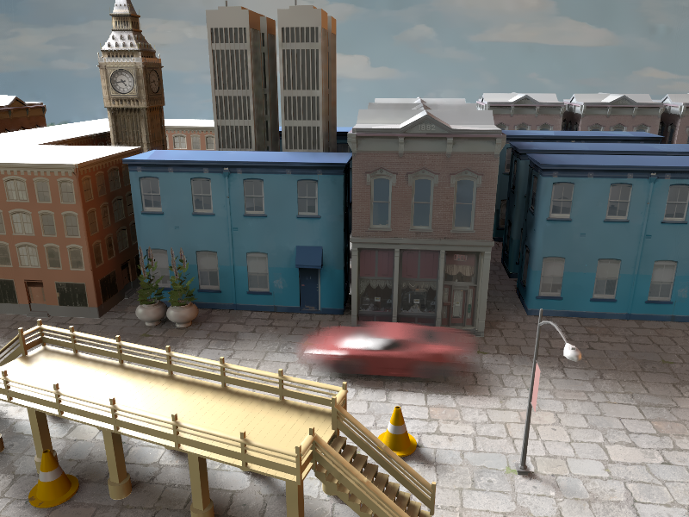
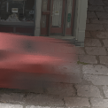
Results
Our – 40 spp (60 sec)
Notes:
Given the same amount of time, our method generates a higher-quality image.
Since this scene is rather simple, and we only evaluated direct illumination,
the overhead of filtering is rather large compared to ray tracing.
Thus, we can only afford a half number of samples.
Nevertheless, even with fewer samples, our method can still produce an image with better quality.

Slide 45
Results
Compare with GEM [Rousselle et al. 2011] and RPF [Sen and Darabi 2012]
Notes:
Next, we compare our method to two recent image-space methods, GEM and RPF.

Slide 46
Results
Compare with GEM [Rousselle et al. 2011] and RPF [Sen and Darabi 2012]
GEM selects from a discrete filter set similar to our algorithm, but is limited to isotropic filters.
Notes:
As I have mentioned, GEM is a framework that is very similar to ours, but only limited to isotropic filters.

Slide 47
Results
Compare with GEM [Rousselle et al. 2011] and RPF [Sen and Darabi 2012]
GEM selects from a discrete filter set similar to our algorithm, but is limited to isotropic filters.
RPF is an advanced cross bilateral filter operating on Monte Carlo samples.
Notes:
RPF is an advanced cross bilateral filter that automatically adjusts the weight of each scene feature,
base on dependency between random parameters and the features.

Slide 48
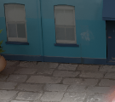
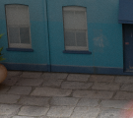
Comparison to GEM
GEM
Average 52 spp
~60 sec
Our
Average 40 spp
~60 sec
Reference
4096 spp
~3000 sec
Notes:
Within the same amount of time, GEM can use more samples compared to our method because it uses computationally cheaper Gaussian filters while we use more expensive cross bilateral filters.
However, since GEM can only use isotropic filters, its ability of eliminating noise is limited especially where there are complex texture and geometry,
Thus, our method produces much sharper result within the same amount of time.

Slide 49
Comparison to GEM
Reference
4096 spp
~3000 sec
Notes:
We visualize the kernels of a pixel here to show the difference between Gaussian filters and cross bilateral filters.
Cross bilateral filter is able to adapt to the texture pattern on the floor, while Gaussian filter simply blurs everything.

Slide 50
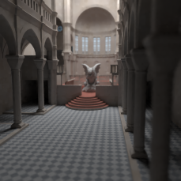
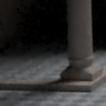
Comparison to GEM
GEM
Average 40 spp
~140 sec
Our
Average 27 spp
~140 sec
Reference
4096 spp
~13000 sec
Notes:
Here is another example. The pattern on the floor and the geometry of the pillar make Gaussian filter less effective.

Slide 51
Comparison to GEM
Reference
4096 spp
~13000 sec
Notes:
We also show the kernels here, the geometry of the pillar limited the filter radius of Gaussian filter.
Our cross bilateral filter did not suffer from the problem because it better adapts to scene features.

Slide 52
Comparison to RPF
RPF
8 spp
~370 sec
Our
8 spp
~40 sec
Reference
4096 spp
~5000 sec
Notes:
Here is a comparison with RPF.
The glossy self-reflection of teapot has high dependency to random parameters and RPF considers it "noisy" and filters it heavily.
By selecting the filter with the smallest estimated error, we can alleviate the oversmoothing problem of cross-bilateral filters.
Note that here we use the same number of samples.

Slide 53
Comparison to RPF
RPF
8 spp
~370 sec
Our
Avg 289 spp
~370 sec
Reference
4096 spp
~5000 sec
Notes:
Because RPF operates on samples instead of pixels, it is both time-consuming and memory-hungry.
If given the same amount of time, our method can afford much more samples than RPF and generate better results.
In addition, it is almost impossible for RPF to store this many samples in memory for filtering.

Slide 54
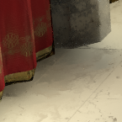
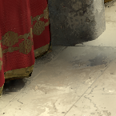
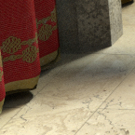
Comparison to RPF
RPF
16 spp
~1700 sec
Our
16 spp
~270 sec
Reference
8192 spp
~100000 sec
Notes:
Here is another example, RPF oversmoothes the shadow nearby the curtain.
Given the same number o samples, our method also slightly oversmoothes the shadow but it is much closer to the reference,

Slide 55
Comparison to RPF
RPF
16 spp
~1700 sec
Our
Avg 133 spp
~1700 sec
Reference
8192 spp
~100000 sec
Notes:
Under the same time budget, our method can use more samples and produce a even better result.

Slide 56
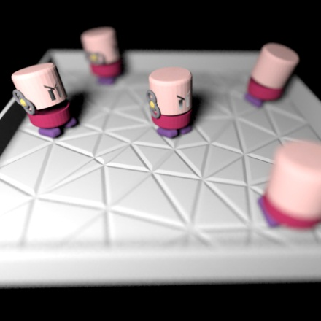
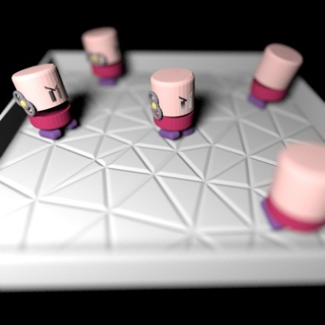
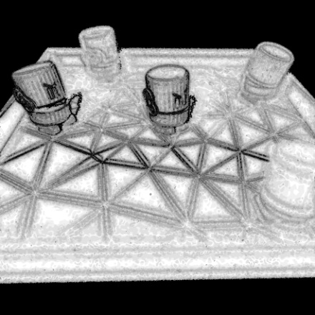
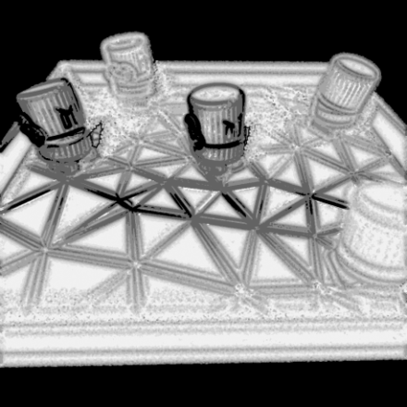
Gaussian filters
Filtered Image
Filter Selection Map
GEM
Our
Notes:
SURE is versatile and not limited to cross bilateral filters.
For example, one can choose to use Gaussian filters and use SURE to estimate their errors, the framework boils down to GEM.
We compare the images and filter selection maps of GEM and our framework with Gaussian filters.
They are almost the same, showing that our framework works equally well for isotropic filters.

Slide 57
Non-local means filters
Single NLM filter
Reference
Notes:
And it is also possible to use other effective filters in our framework, such as the non-local means filters which is famous in image processing community.
We augment the non-local mean filters with the scene feature buffer to make it adapt to textures and geometry structures better.
On the left, we show the result of using a single-scale non-local means filter in which all the pixels are filtered with the same filtering parameter.
The single non-local means filter in this case produces a large bias, often shown as over-smoothing, sometimes even over-sharpening the image.

Slide 58
Non-local means filters
Combining all NLM filters
Reference
Notes:
By applying non-local means filters with different parameters and choosing the one with the smallest estimated error,
we can significantly reduce the bias compared to the single-scale non-local means filter shown in the previous slide.
It shows that our framework can be effectively applied to other complex filters.
Given the same number of samples, we found that non-local means filters sometimes perform better than cross bilateral filters,
However, non-local means filters are computationally more expensive and cross bilateral filters are more efficient.
Thus, in most cases, we used cross bilateral filters.

Slide 59
Discussion
Our method inherits most of the advantages and disadvantages of the image space methods.
Advantages:
It does not assume any specific effects
The computation and memory complexity only relate to the number of pixels
Notes:
As I mentioned, our method is an image-space method and inherits most of its advantages and disadvantages.
The advantages are that the method is general, and computationally efficient, since the complexity only relates to number of pixels.

Slide 60
Discussion
Our method inherits most of the advantages and disadvantages of the image space methods.
Advantages:
It does not assume any specific effects
The computation and memory complexity only relate to the number of pixels
Disadvantages:
Oversmoothing
Not considering high dimensional information
Notes:
One disadvantage is that, although we have chosen the filters that minimized the SURE error,
Our method could still over-smooth the images if not enough samples are used.
Another disadvantage is that we do not consider the anisotropy of the integrals in high dimension.

Slide 61
Discussion
Disadvantages:
Oversmoothing
Not considering high dimensional information
Image from
[Hachisuka et al. 2008]
Image-space Methods
Multidimensional Methods
Notes:
The figure on the bottom is from Hachisuka et al.’s paper. It shows the inefficiency of image-space methods.
The horizontal axis represents the pixels, the vertical axis represents the integral domain.
Image-space methods only adapt to the difficult area on the image dimensions, but do not consider the integral dimensions.
It will be less efficient in some cases compared to multi-dimensional methods.

Slide 62
Conclusion and future work
We have presented a SURE-based Adaptive Sampling and Reconstruction framework.
Allow to use almost arbitrary filters.
Future Work
Implementation on GPUs for interactive applications
Animation rendering
More rendering applications using SURE
Notes:
In conclusion, we have presented a SURE-based adaptive sampling and reconstruction framework, which allows us to use almost arbitrary filters as long as we have their derivatives.
As future work, we would like to implement our algorithm on GPU for interactive applications.
We also did not consider temporal information when filtering, rendering animation is also an important future work.
Finally, it will be interesting to adapt SURE for other rendering algorithms which needs error estimation, for example, the multi-dimensional methods I have mentioned before.

Slide 63
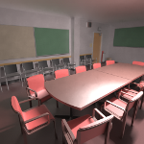
Conclusion and future work
Rousselle et al. [2012] introduces an advanced non-local means filter designed for rendering task.
Incorporate SURE and scene features buffer into their method?
Notes:
In the next talk of this session, you will hear about an more advanced non-local means filter that is designed for rendering.
They use an interesting dual-buffer method to estimate the error.
It will also be interesting to incorporate SURE and the scene features buffer into their framework.

Slide 64
Acknowledgements
Anonymous reviewers
Funding agencies: NSC and NTU
Model creators: Pedro Caparros, RenderHere, Unity Development, Tippy, Skipper25, jotijoti, ShareCG.com, dogbite1066, Tiago Crisostomo, Marko Dabrovic and Crytek GmbH, Marko Dabrovic and Mihovil Odak, Andrew Kensler.
Notes:
We would like to thank these people for their help on this project.
Thank you for attention, and I will be happy to answer your questions.

Slide 66
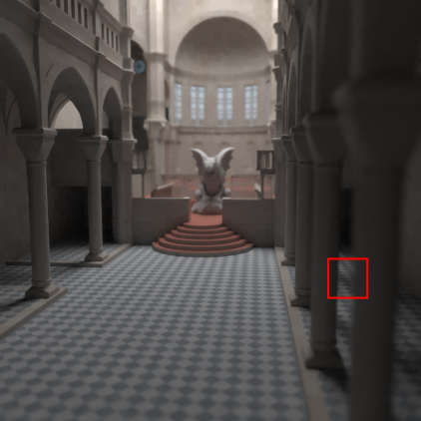
Improving cross bilateral filter
Cross Bilateral Filter
Depth Buffer
Reference
Depth Variance
Notes:
Cross bilateral has a problem: it is sensitive to the variance on scene feature buffer.
The depth buffer has high variance due to depth of field. Cross bilateral filters fail to
filter the noise here because it tries to preserve the noise on the depth buffer.
(pause)

Slide 67
Improving cross bilateral filter
$$w_{ij}=exp⁡(−\frac{{\left\|p_{i}−p_{j}\right\|}^{2}}{2{σ_{s}}^{2}})exp⁡(−\frac{{\left\|c_{i}−c_{j}\right\|}^{2}}{2{σ_{r}}^{2}})\prod_{k=1}^{m}{exp⁡(−\frac{{D({\overline{f}}_{ik},{\overline{f}}_{jk})}^{2}}{2{σ_{f_{k}}}^{2}})}$$
Position
Color
Scene Features
Notes:
Recall that we have mentioned a D distance function for scene features.

Slide 68
Improving cross bilateral filter
$$w_{ij}=exp⁡(−\frac{{\left\|p_{i}−p_{j}\right\|}^{2}}{2{σ_{s}}^{2}})exp⁡(−\frac{{\left\|c_{i}−c_{j}\right\|}^{2}}{2{σ_{r}}^{2}})\prod_{k=1}^{m}{exp⁡(−\frac{{D({\overline{f}}_{ik},{\overline{f}}_{jk})}^{2}}{2{σ_{f_{k}}}^{2}})}$$
$$D\left({\overline{f}}_{ik},{\overline{f}}_{jk}\right)=\sqrt{\frac{{\left\|{\overline{f}}_{ik}−{\overline{f}}_{jk}\right\|}^{2}}{{σ_{ik}}^{2}+{σ_{jk}}^{2}}}$$
Position
Color
Scene Features
Feature Mean
Feature Variance
Notes:
We normalize the distance between features with their variances.
So now the features that have high variances will have low distance.
By this way, we can effectively exclude unreliable features.

Slide 69
Improving cross bilateral filter
normalized distance
depth buffer
reference
depth variance
Notes:
Now the features with high variance are given relatively low weight, and we can filter the depth of field area now. (pause)

Slide 70
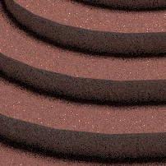
Filtering Monte Carlo Noise
Cross bilateral filters may introduce large error if the scene feature buffer does not capture the edges on the image.
Noisy Input
Filtered
Reference
Notes:
However, cross bilateral filters oversmooth the images if the scene features fail to detect the edges of the image, like the shadow on the stair and the glossy reflection of the teapot. (pause)

Slide 71
Filtering Monte Carlo Noise
We provide a way to estimate the error of the filter.
Noisy Input
Filtered
Reference
Estimated Filter Error
Notes:
We provide a way to estimate the error of filtering, as you can see, the shadow and the glossy reflection has high estimated error. (pause)

Slide 72
Filtering Monte Carlo Noise
And for each pixel we choose a filter size from a discrete filter set that has the smallest estimated error.
Noisy Input
Filtered
Reference
Estimated Filter Error
Filter Selection Map
Notes:
For each pixel, we choose a filter size from a discrete filter set that has the smallest estimated error.
The brightness of selection map corresponds to the size of filter.
The estimated error is much smaller now. But since we filter with less neighbors, there are some
noise left on the teapot.

Slide 73
Filtering Monte Carlo Noise
We can further improve the image by sending more Monte Carlo samples proportional to the estimated error.
Noisy Input
Filtered
Reference
Estimated Filter Error
Filter Selection Map
Notes:
We can furthermore eliminate the noise by distributing samples proportional to the estimated error, now the noise on the teapot is reduced. (pause)

