Slide 1
3D Cinematography Principles and Their Applications to Stereoscopic Media Processing
Chun-Wei Liu, Tz-Huan Huang,
Ming-Hsu Chang, Ken-Yi Lee,
Chia-Kai Liang, and Yung-Yu Chuang
National Taiwan University and Lytro, Inc.
Notes:
Good afternoon, my name is Tz-Huan Huang. I will present this paper 3D Cinematography Principles and Their Applications to Stereoscopic Media Processing co-authored by Chun-Wei Liu, Ming-Hsu Chang, Ken-Yi Lee, Chia-Kai Liang and Yung-Yu Chuang.

Slide 2
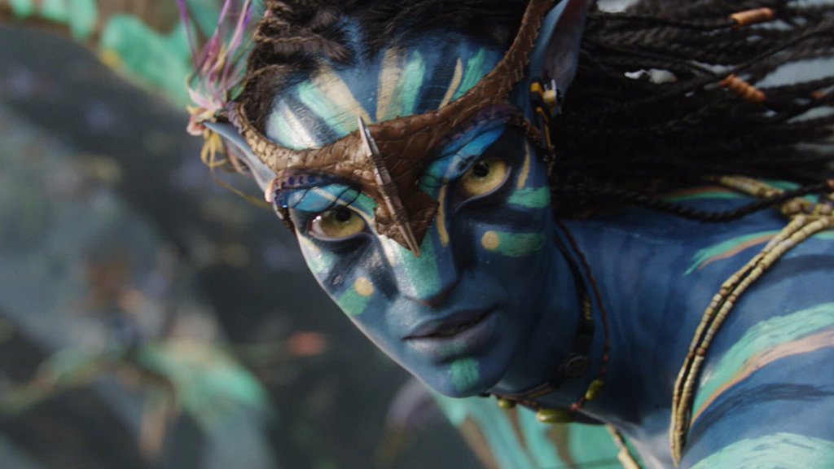
3D is hot today
Notes:
This is the screenshot of a very popular 3D movie, Avatar. I believe that most of you have watched it because it is the best seller of the film history worldwide. Since then, 3D has been getting hotter and hotter. Many 3D movies, 3D games or other types of 3D contents have been released.

Slide 3
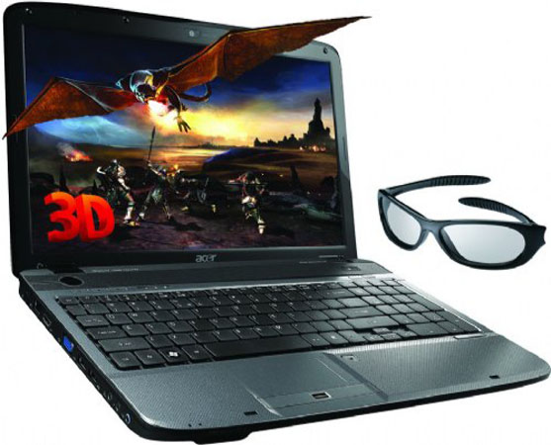
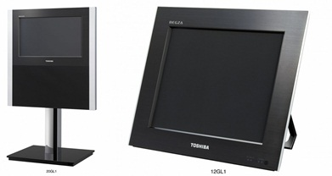

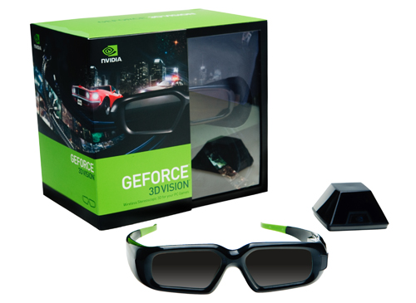
3D display devices
Notes:
In addition to 3D contents, a lot of 3D devices for consumers have been launched. Many companies have their own 3D displays. These displays are of various sizes and resolutions. Almost for every type of 2D displays, we can find its 3D counterpart. There are 3D TVs, 3D computer displays and notebooks with 3D displays. They are either with glasses or glasses-free. 3D displays have also come to the mobile world such as 3D game consoles and mobile phones.

Slide 4
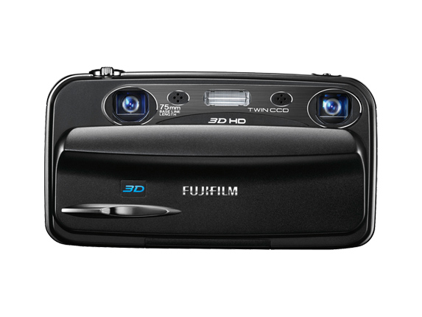
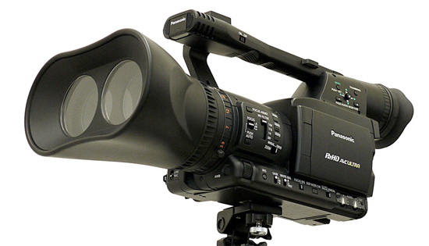
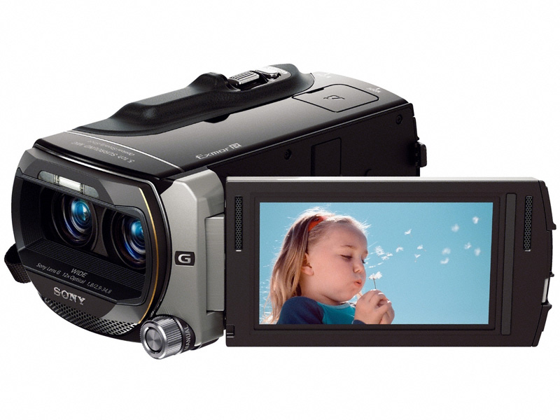
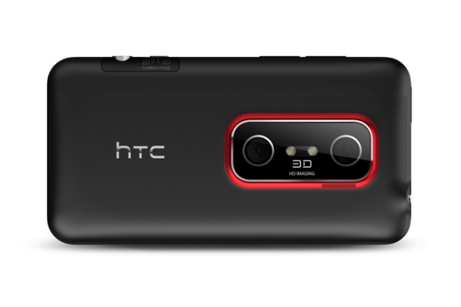
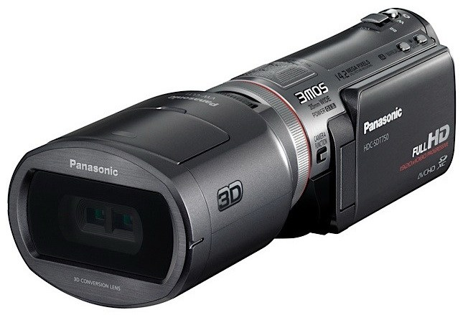
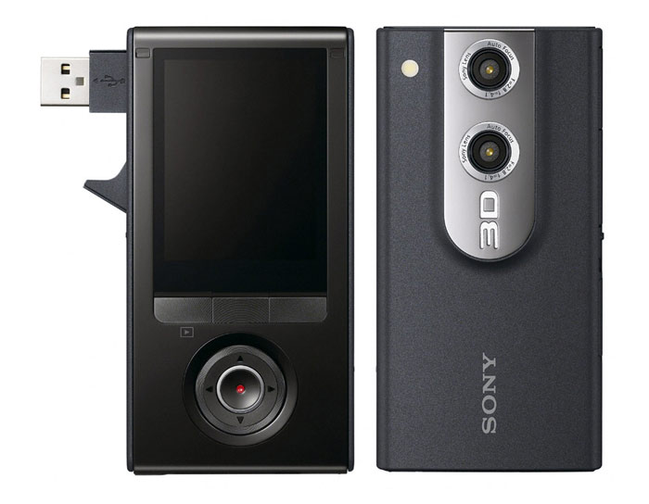
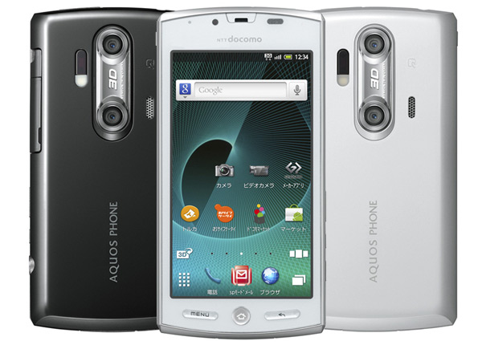
3D capturing devices
Notes:
On the acquisition side, we have also seen a lot of 3D cameras. For example, in 2009, Fuji announced a 3D camera with two lens and sensors. Users can capture the left and right images at the same time. In addition, there is a glasses-free 3D display on its back so that users can view the captured 3D images immediately after capturing. After that, Panasonic and Sony have also launched several 3D cameras for consumers. For mobile phones, this year, HTC and LG have phones with two lens and users can now even capture 3D contents with mobile phones.

Slide 5
Media life cycle
Acquisition
Presentation
Notes:
With the rapid development of 3D cameras and displays, consumers are able to capture and display their own 3D videos or photos easily.

Slide 6
Media life cycle
Enhancement
Analysis
Organization
Acquisition
Presentation
Processing
Notes:
Similar to 2D media, after acquisition and before display, users might want to enhance, analyze and organize their 3D contents. Thus, in addition to hardware for capturing and displaying, they will also need software for authoring 3D media. Unfortunately, unlike the fast progress of 3D hardware, the development of 3D authoring tools have not received sufficient attention.

Slide 7
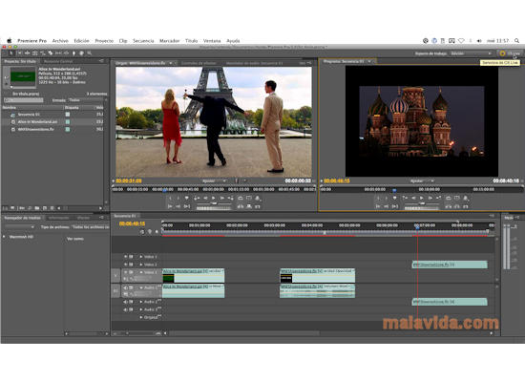
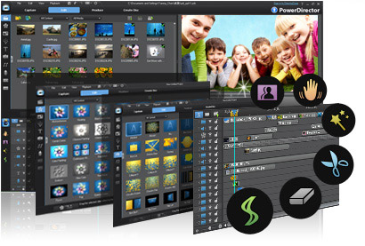
3D authoring tools
Little progress has been made on the software side for the consumer 3D media processing.
Many operations that are not important to professionals but essential for consumers.
Notes:
There are 3D authoring tools for professional. However, they are usually designed for making professional 3D films. Thus, they might not fit the needs of consumers. Some operations that are not important to professional could be essential for consumers. For example, photo slideshow is seldom necessary for film makers, but almost used everyday for consumers.

Slide 8
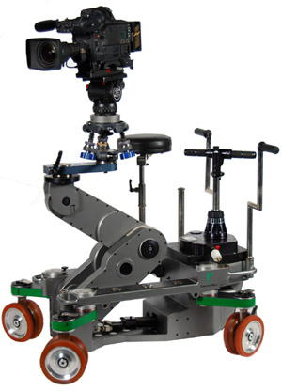
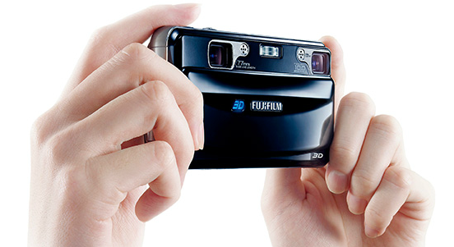
3D authoring tools
Professional
Consumer
VS.
Notes:
Video stabilization is another example, because filmmakers often plan the shots ahead and use camera dolly for shooting, they do not need video stabilization. On the other hand, consumer cameras is usually light weighted and held by hands. Hence, video stabilization is essential for movies captured by consumers.

Slide 9
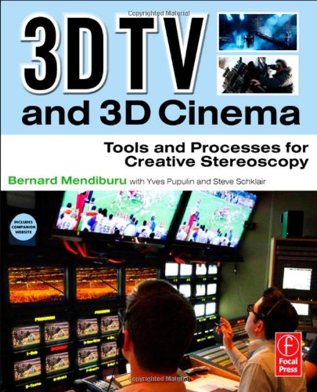
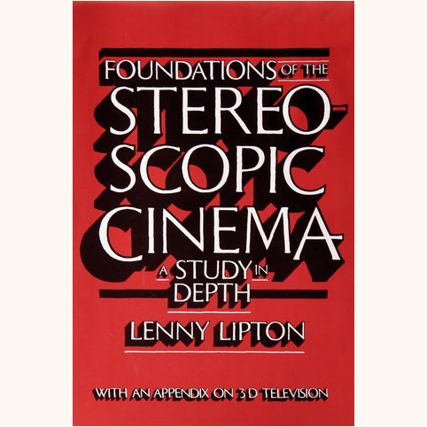
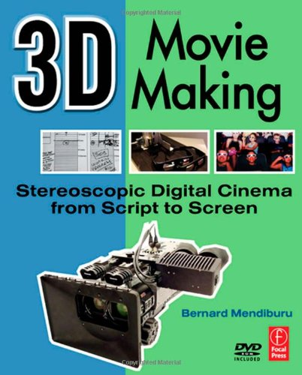
Books of 3D cinematography
Notes:
We expect that more and more 3D authoring tools will be developed for consumers to fill in the needs. Although there are differences between 3D authoring needs of professionals and amateurs, we can still borrow 3D cinematography principles from professionals when designing 3D authoring tools. Even though 3D movies have just become hot again, 3D filmmaking has actually developed for more than 50 years. Many principles have been learned through the process for making 3D watching experiences more comfortable. Several books have talked about these principles. In this paper, we organize 3D cinematography principles and suggest to incorporate a set of them into consumer 3D media authoring tools.

Slide 10


Binocular disparity
Left view
Right view
Notes:
Before jumping into these principles, for building up the background, I will first review how stereoscopic displays work. As you know, our two eyes are roughly 6.5 centimeters apart. Thus, each of them sees a slightly different image. Here is an example. I display the left view and the right view for a scene. It might not be obvious to you how they are different.

Slide 11
Binocular disparity
Notes:
Let us show them one by one. Here is the left view.
And the right one.

Slide 12
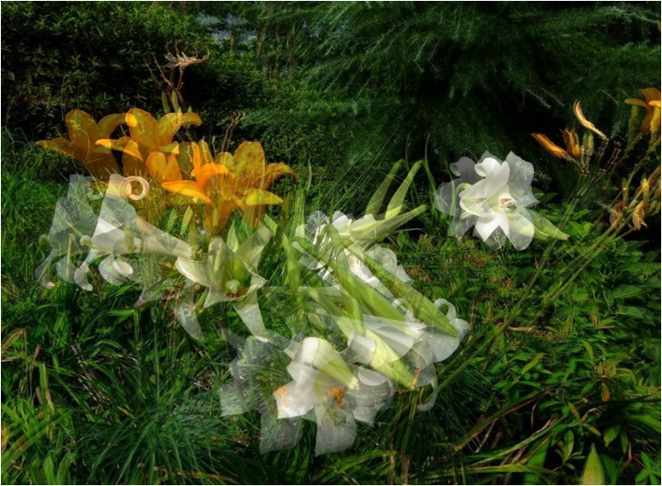
Binocular disparity
Notes:
Let us put the left view on the top of the right view and make it transparent. Now, we can see both the left view and the right view. You should notice that there is a horizontal shift for each point in the scene. For example, for the yellow flower at the front, the tip of the petal has a horizontal position shift as shown here with a red line. We call the horizontal position shift of a corresponding point in both views the binocular disparity. It is highly related to our depth perception. A point closer to us has a larger disparity and a further point has a smaller disparity.
Here is the disparity for the white flower.
And the flower in the far back.
The disparity is inversely related to the depth.
In addition, note that there is no vertical shift for the corresponding points. It is because our eyes are horizontally aligned.
Binocular disparity is one of the most important cue for human depth perception. Most of todays stereoscopic displays are built based on this principle by delivering different images to both eyes.

Slide 13
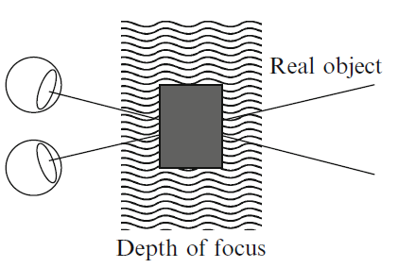
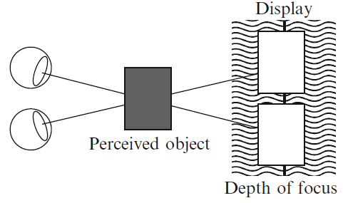
Accommodation and vergence
Real world
Stereoscopic displays
Notes:
However, there are differences between how we see a real object in 3D and perceive an object with 3D displays.
When we watch a real 3D object, our eyes change focus so that the object is in focus and its image in clear. It is called accommodation.
At the same time, both eyes rotate around a vertical axis so that the projection of the image is in the center of the retina in both eyes. This is called vergence.
However, when seeing a 3D object on the stereoscopic display, the focus of our eyes will be on the display so that we can see clear images.
But, the vergence will happen on the depth of the perceived object.
The decoupling of accommodation and vergence often add requirements to 3D content. If the 3D contents are not prepared appropriately, viewers could experience dizziness and double vision or even cannot perceive 3D at all.

Slide 14
3D cinematography principles
Maintain coordination between views.
Have a continuous depth chart.
Place rest areas between strong 3D shots.
Use a shallow depth of field for shots with excessive depth brackets.
Be careful about the stereoscopic window.
Notes:
Here, we present five 3D cinematography principles for proper 3D content production.
I will discuss them in detail and apply them to two 3D media authoring operations, video stabilization and photo slideshow.

Slide 15
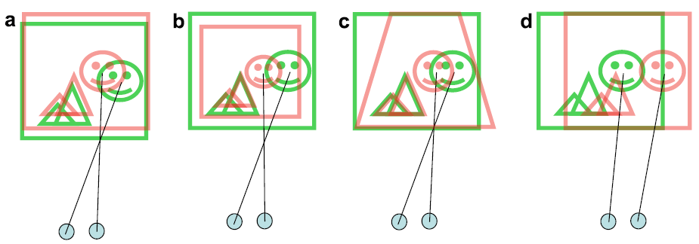
1. Maintain coordination between views
Vertical
shift
Size
difference
Distortion
difference
Diverged
☺
☹
☹
☹
☹
Notes:
The first principle is to maintain coordination between views. As mentioned, binocular vision is probably the most important cue for depth perception. Thus, any dissimilarity between two views other than horizontal shift could lead to view discomfort. These dissimilarities include vertical shift, size difference, different distortions and divergence because of extremely large disparity.
This principle requires us to process both views in coordination. Otherwise, it could lead to bad 3D watching experience.

Slide 16
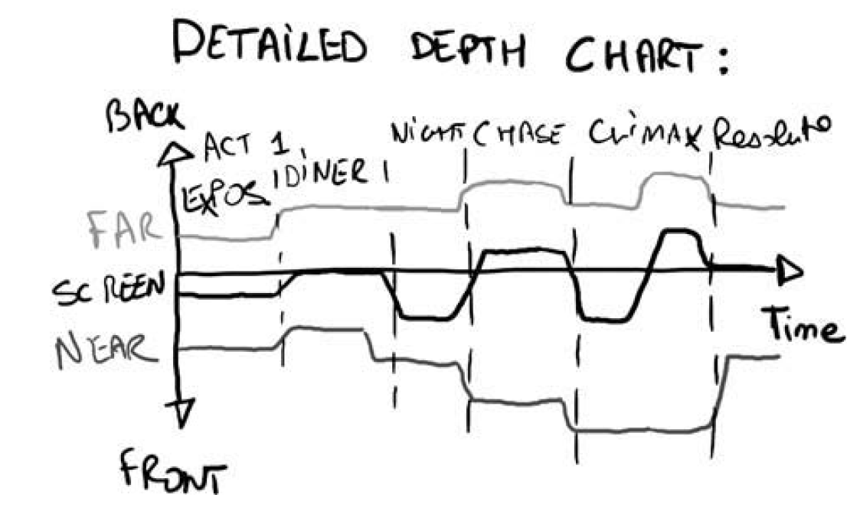
2. Have a continuous depth chart
Notes:
The second principle is to "have a continuous depth chart''. Before shooting 3D films, filmmakers usually analyze the depth chart first. For each shot, we have the depth of the furthest object and the depth of the closest object. The depth chart plots the far depth and near depth for each shot along time. It shows how depth ranges change along time.

Slide 17





2. Have a continuous depth chart
Time
☹
☺
Notes:
Our visual system prefer a continuous depth chart. That is, the depth range changes continuously along time. When there is a significant depth change between neighboring shots, our visual system could have difficulty with accommodation and vergence as they require significant eye movement.

Slide 18
3. Place rest areas between strong 3D shots
Time
☹
Rest area
☺
Notes:
The third principle states that we should place rest areas between shots with strong 3D effects. When the depth range stays large for quite a long time, our visual system could become tired with strong 3D effects. It is preferred to place shots with mild 3D effects to give our eyes chances to rest as shown as the green region.

Slide 19
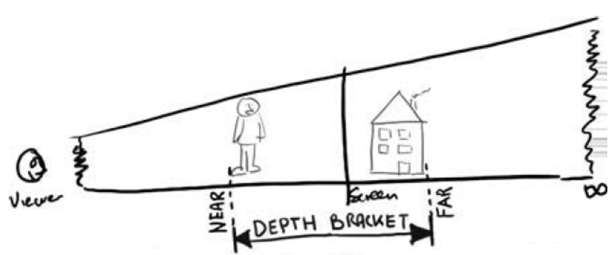
4. Shallow DoF for excessive depth brackets
Notes:
The fourth principle is to use a shallow depth of field for shots with excessive depth brackets. The depth bracket is also called the depth range. It is defined by the nearest depth and the furthest depth. It defines the depth variation within a shot. When a shot contains an excessive depth bracket, it means that the furthest object is very far away from the closest object in depth. This could cause a problem because viewers have to focus on both objects.

Slide 20
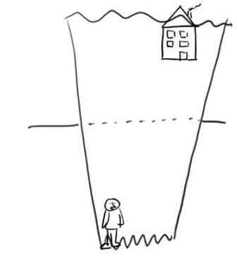
4. Shallow DoF for excessive depth brackets
In focus
Out of focus
☹
☺
☺
Notes:
A solution to this problem is to use depth of field. That is, we let part of the image be out of focus so that viewers pay less attention to it. One can choose to focus on the foreground or the background. Either way effectively reduces the depth range, so viewers will not have problems when viewing them.

Slide 21
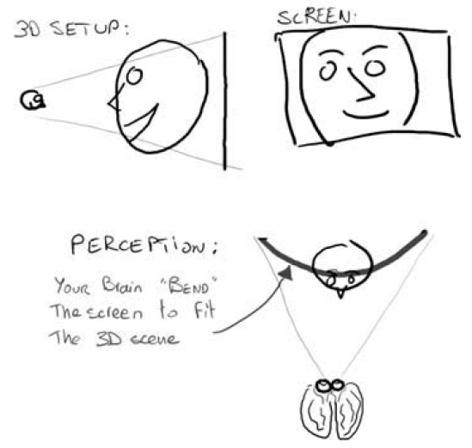
5. Be careful about the stereoscopic window
Notes:
The final principle is to be careful about the stereoscopic window. Occlusion is an important cue for depth perception. When one object is occluded by the other object, we infer that the occluder is closer to us. Assume that we adjust disparity values so that the object is in front of the display. If the object is on the border of the display and only part of it is visible, viewers will feel that the object is occluded by the display and should be behind the display. These have conflicts. We call the border of the display the stereoscopic window. One should be careful with placing important objects around the stereoscopic window especially when they are in front of the display.

Slide 22
Guidelines for the principles
Temporal media
2
Depth change
3
4
Re-frame media
1
5
Notes:
These principles can be applied to many 3D media authoring tools. Here, we give a guideline on when to apply which principle.

Slide 23
Guidelines for the principles
Maintain coordination between views.
Almost every stereoscopic media authoring method should obey this fundamental principle.
Notes:
The first principle, maintaining coordination between views, is essential and almost all 3D authoring tools should follow.

Slide 24
Guidelines for the principles
Have a continuous depth chart.
Place rest areas between strong 3D shots.
Relevant for temporal media editing
Video editing
Video retargeting
Notes:
The second and third principles are especially important for temporal media, such as videos or slideshows. Example authoring operations include video editing and video retargeting.

Slide 25
Guidelines for the principles
Use a shallow depth of field for shots with excessive depth brackets.
When the authoring operations cause changes in the depth brackets
Image stitching
Photomontage
Notes:
The fourth principle becomes relevant when the authoring operations cause changes in the depth brackets. For example, when you stitch two 3D photos together, the depth bracket could become the union of their depth brackets. For such operations, if the resulting depth bracket is excessive, depth of field should be applied.

Slide 26
Guidelines for the principles
Be careful about the stereoscopic window.
When the authoring operators re-frame media
Cropping
Compositing
Resizing
Notes:
Finally, the fifth principle should be considered when the authoring operations re-frame the media such as cropping, compositing and resizing. For these cases, one should pay attention to stereoscopic window so that there is no conflict.

Slide 27
Application 1:
Stereoscopic video stabilization
Notes:
I have introduced the principles and guidelines to apply them. Next, I will demonstrate their use in two specific authoring operations, stereoscopic video stabilization and stereoscopic photo slideshow.
Here is the first one, video stabilization.
When we take a video by hand, the video could become shaky. Such a video is particularly painful to watch if it is in 3D.

Slide 28
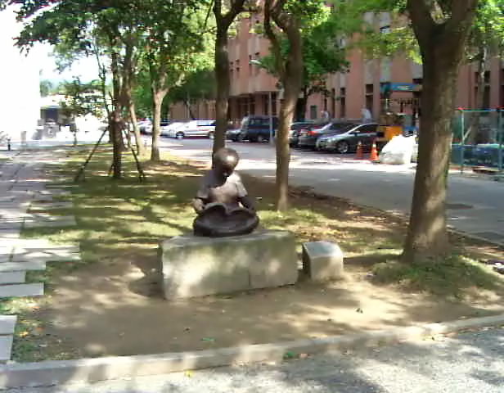
Jittered video
Notes:
Let's start from 2D. Here is an example of a shaky video.

Slide 29
Video stabilization
Our stereoscopic video stabilization approach is based on this method:
Video stabilization using robust feature trajectories
Ken-Yi Lee, Yung-Yu Chuang, Bing-Yu Chen, and Ming Ouhyoung
ICCV 2009
Notes:
Our method is based on Lee et al.'s iccv 2009 paper on 2D video stabilization.

Slide 30
Key idea
T0
T1
T4
T5
T6
T7
T3
T2
Notes:
Let's start by reviewing the basic idea behind their paper. We first extract features from video frames. Corresponding features along time are connected together to form a feature trajectory. Because the video is shaky, the feature trajectory looks jaggy in the original video. The goal is to find a transform for each frame so that the feature trajectory becomes smooth in the transformed video.

Slide 31
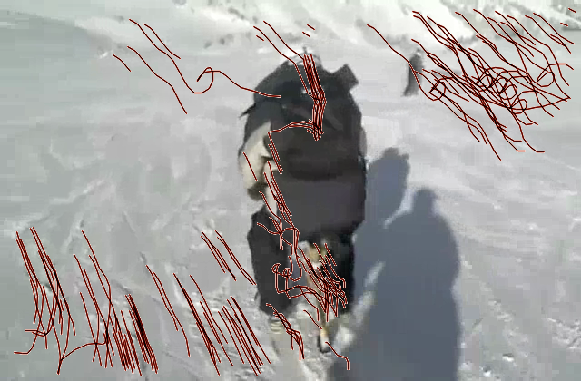
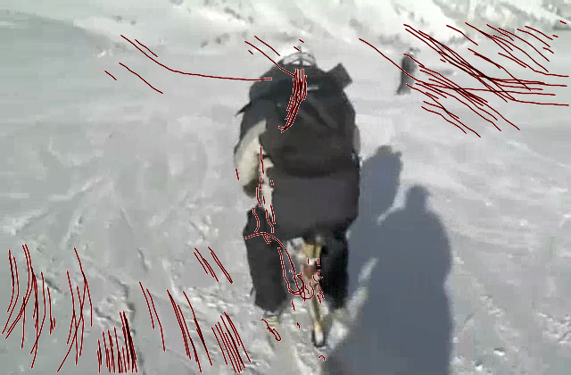
Key idea
Before stabilization
After stabilization
Notes:
Here is a real example. Before stabilization, the feature trajectories are rough. After stabilization, the feature trajectories become much smoother.

Slide 32
Approach
Robust Feature Trajectories
Original video
Stabilization
by Optimization
Stabilized video
Notes:
Given the basic idea, the method consists of two parts: robust feature trajectory extraction and stabilization by finding the optimal transforms for video frames.

Slide 33
Robust feature trajectories
.......
Notes:
For robust feature trajectories, we first extract features for each frame independently. For a pair of neighboring frames, features are connected by their similarities.
We also consider the motion coherence. That is, neighboring features should have similar motion. Correspondences with incoherent feature motions are removed, like the blue feature here.
We continue this process until all frames have been processed. Now, we have obtained feature trajectories.

Slide 34
Stabilization by optimization
Trajectory Roughness
Video Quality Degradation
  Distortion
  Scale
  Uncovered area
Notes:
Given these trajectories, the next step is to find a set of optimal transforms for all frames. The transforms are measured by trajectory roughness and video quality degradation.
For trajectory roughness, we require the feature trajectories become smooth in the transformed video.
For quality degradation, we prefer to reduce the number of uncovered pixels and frame distortion.

Slide 35
Amateur stereoscopic video
Notes:
Our goal is to extend the previous idea to 3D. Here is an example of a shaky 3D video displayed in red-blue anaglyph.

Slide 36
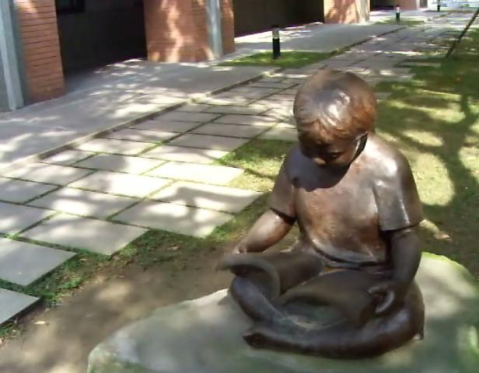
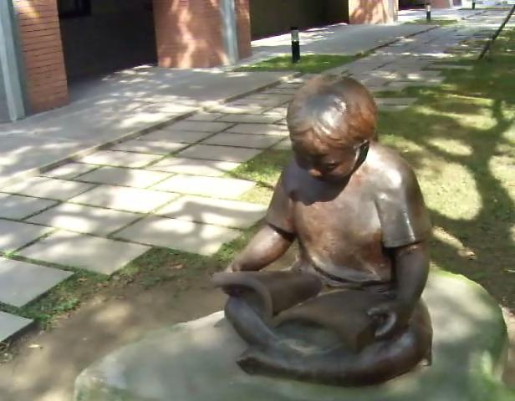
Stereoscopic video stabilization
Feature trajectories
Joint optimization
Notes:
We extend the iccv paper to deal with 3D video stabilization by two steps.

Slide 37
Robust feature trajectories
Feature detection
  SIFT
Feature verification
  Fundamental Matrix
Trajectory tracking
  Base on Lee et al. in ICCV 2009
Feature trajectories
Joint optimization
Notes:
The first step is to extract robust feature trajectories for both views independently. It is similar to the iccv paper. However, since we are dealing with 3D videos, we can take advantages of fundamental matrices to make the feature extraction and matching more robust.

Slide 38
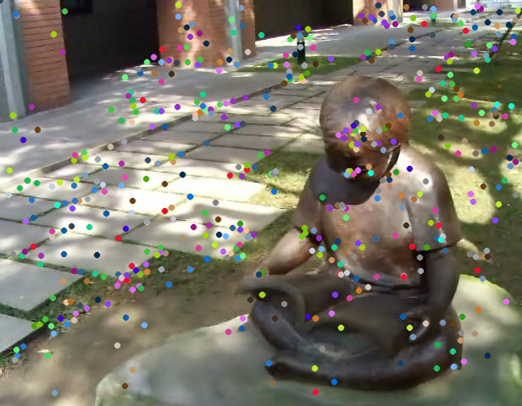
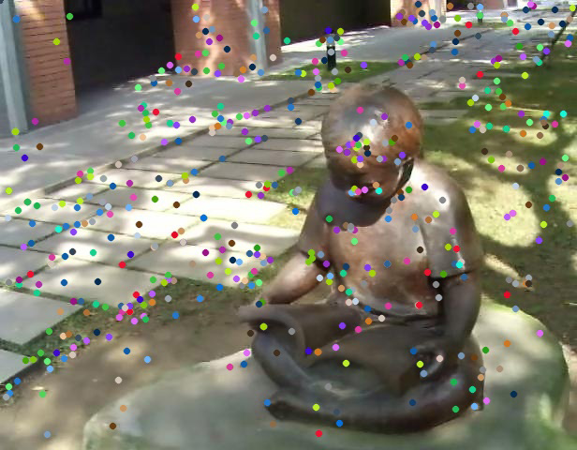
Joint optimization
Perform the optimization jointly for two views.
Incorporate stereoscopic constraints (Principle 1).
Feature trajectories
Left
Right
Disparity
Joint optimization
Notes:
If we apply the previous method on both views independently, it violates the first principle because it could destroy coordination between views.
Thus, we have to perform a joint optimization to process both views together.

Slide 39
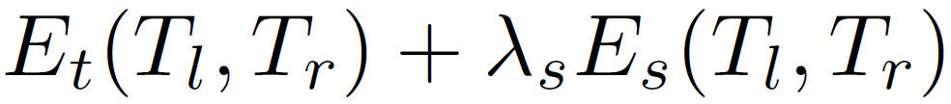
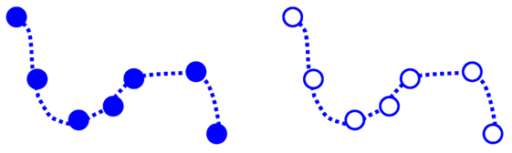



Joint optimization: feature trajectory
Feature trajectories
Joint optimization
Notes:
Thus, our optimization function has two terms. The first one is similar to the iccv paper. It ensures that the feature trajectories are smooth in the transformed video and reduces the quality degradation.

Slide 40
Joint optimization: stereoscopic constraint
Motion estimation
2
Joint optimization
Notes:
The second term require that the transforms for the left and right view must maintain coordination. That is, the disparities in the transformed video must be similar to the disparities in the original video. It ensures that there is no vertical drift and the depth is consistent with the depth of the original video.

Slide 41
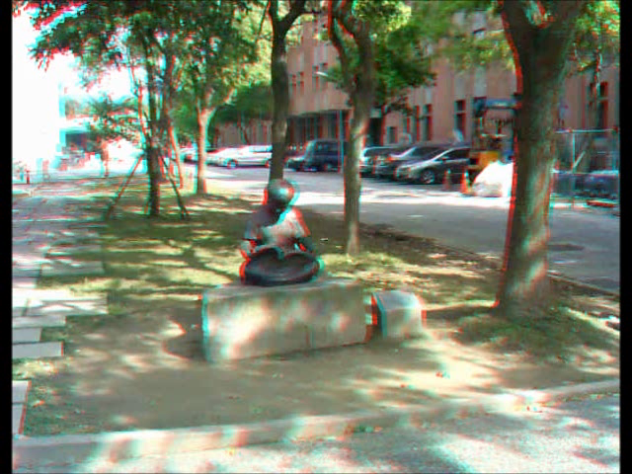
Input
Notes:
Here, we show the input video again. Note that it is shaky.

Slide 42
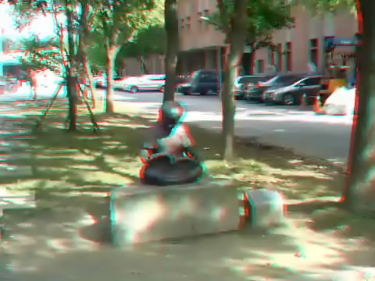
Naïve solution
Notes:
Here, we show the result of naïve approach by applying the iccv approach to both views independently. Note that, although the video becomes smooth, the coordination between views is destroyed. First, there are vertical drifts between the red and blue layers. It could destroy 3D effects. Second, the horizontal shifts are not consistent along time. It leads to depth inconsistency between neighboring frames. The viewer might feel that the scene moves back and forth along time.

Slide 43
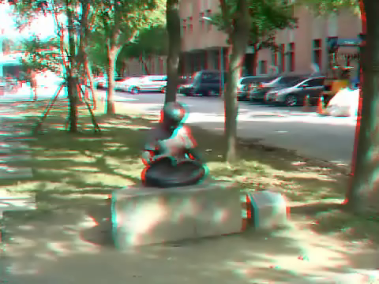
Our result
Notes:
Here we show the result with our approach. The video is both smooth and consistent.

Slide 44
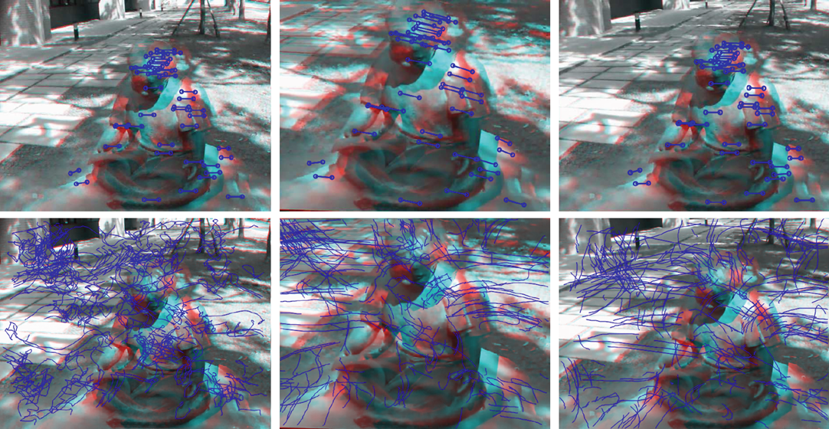
Comparisons
Original
Naive
Our method
Notes:
We visualize disparity and feature trajectories here. For the top row, note that the iccv paper could have vertical drifts while the original video and our result do not suffer from this problem.
For the bottom row, note that the trajectories are jaggy in the input video while both iccv and our method produce smooth trajectories.

Slide 45
User study
30 subjects
5 questions, 1-5 scores
3 cases
  children
  csiegirl
  redgirl
Notes:
We have performed a user study to validate our approach. 30 subjects were invited to the study. Three videos were used. For each of them, we show the results of naïve application of deshaker, iccv 2009 and our method. Users have to score 1 to 5 for each result on five aspects.

Slide 46
Questions
Stabilization. What do they think about the 2D stabilization?
Depth continuity. What do you think about the depth stabilization of the video?
Stereoscopic effect. What do you think about the comfort and the stereoscopic effect in the video?
Experience. How does the stabilization effect help you experience the video?
Acceptance. How much are you willing to adopt the stabilization effect?
Notes:
Including stabilization, depth continuity, stereoscopic effect, overall experience and acceptance.

Slide 47
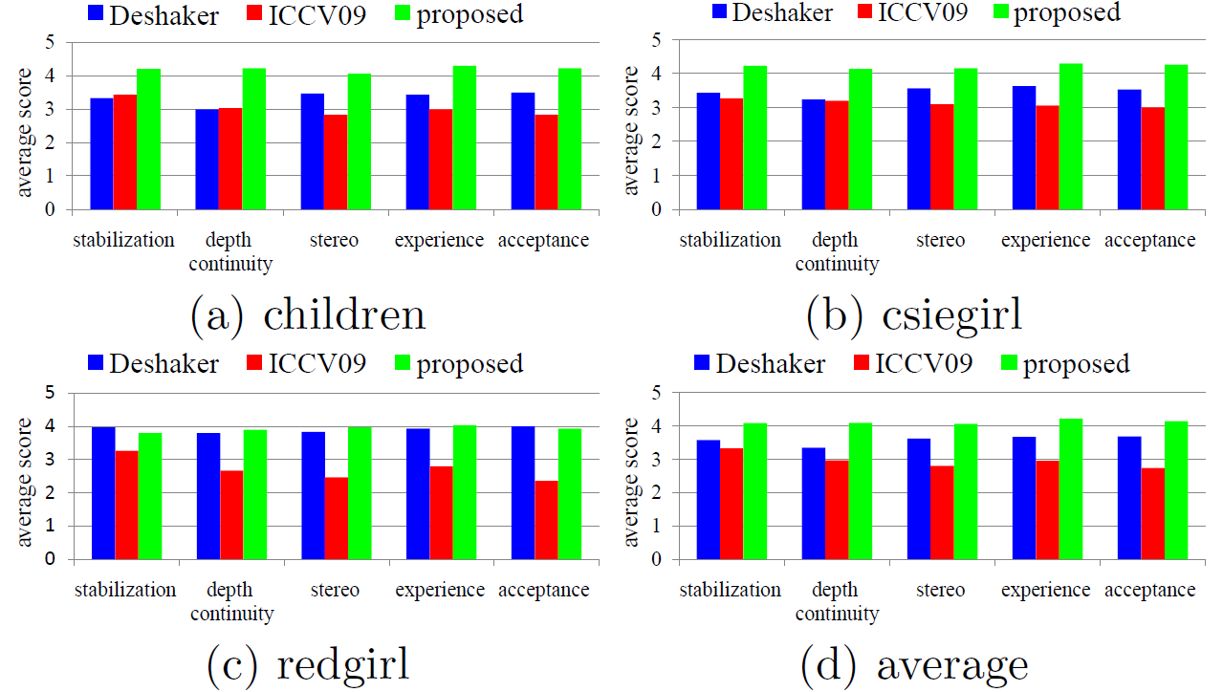
Results of user study
Notes:
Our method generally scores the highest in all aspects.

Slide 48
Application 2:
Stereoscopic photo slideshow
Notes:
The second application is stereoscopic photo slideshow. A typical slideshow system usually has to consider three aspects.

Slide 49








The order for displaying photos
In their temporal order
Random
User defined
…
Notes:
First, what is the best order of photos in the slideshow? For example, we can display the photos in sequence, in random orders, or other possibilities.

Slide 50

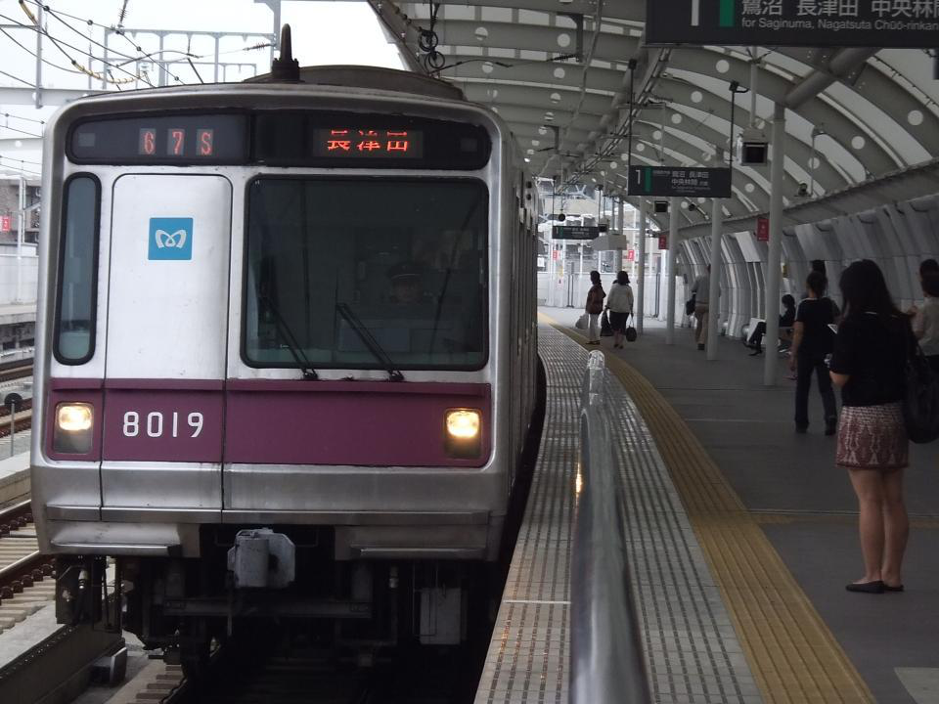

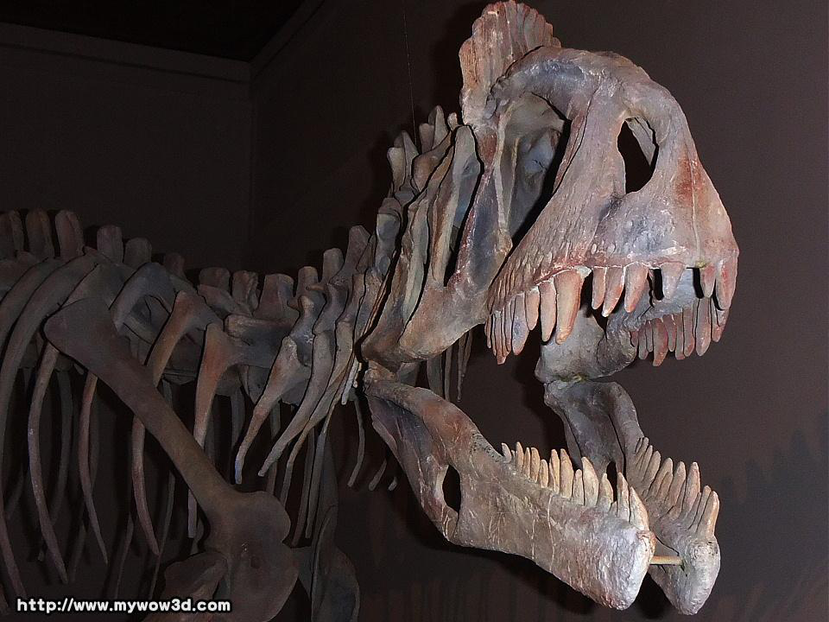
Inter-photo effects
No effect
Fade-in/fade-out
Blending
Notes:
Second, inter-photo effects, what effect should we use when switching from one photo to the next one?
We can just make the next one appear,
fad-in and fade-out,
blending
And many others.

Slide 51
Intra-photo effects
No effect
Pan
Zoom
…
Notes:
Third, intra-photo effects, what effect should we choose to display within the current photo?
For example, we could choose none,
Pan
and others.

Slide 52
Stereoscopic photo slideshow
The order for displaying slides
  Photo ordering (Principle 2)
Inter-slide effects
  Active depth cuts (Principle 2, 3)
Intra-slide effects
  Shallow depth-of-field effects (Principle 4)
Notes:
Our slideshow system answers these three questions by resorting to the 3D cinematography principles.

Slide 53


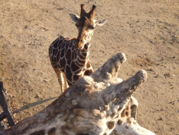

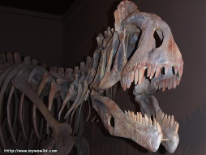



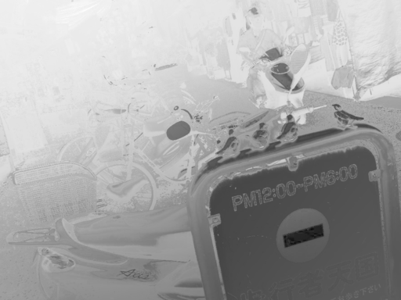


Photo reordering
Normalized
2
Disparity map
ROI map
Histogram
Notes:
Since the photos have different depth brackets, if we display them without any constraint, the depth chart is not necessarily continuous and it violates the principle 2. We proposed two methods to reorder the photos so that the depth chart is continuous.
In the first method, we calculate a weighted average depth value for each photos, and then reorder the photos depending on this value to make a more continuous depth chart. Take the first photo as the example, we can calculate the disparity map from the left and right views. We also compute the Region-Of-Interest map and use it to weight the disparity map. We calculate average depth for each photo by taking the weighted average of the depth map weighted by the ROI map. Each photo can then be represented by a single depth value. Next, we find a sequence by minimizing the difference between adjacent photos. The red line is the reordering result. The depth chart is more continuous than the original one .
However, ROI is subjective. To avoid using it, instead of calculating the average depth, we obtain the histogram of the depths. Take the first photo as the example again. We obtain its depth histogram. This way, we can obtain the depth histograms for all photos. The distance between two depth histograms can be defined by Jensen-Shannon divergence. Again, we reorder the photos by minimizing the distance of the depth histograms between adjacent photos. Here is the reordered results.
Both results are not exactly the same, but they are both effective in producing continuous depth chart.

Slide 54
Active depth cuts
Depth shift: translate two images horizontally to change the depth brackets.
Photo 1
Photo 2
Depth bracket
No effect,
Fade-in/out,
Blending,
…
Screen
Depth bracket
Notes:
For the inter-photo effects, we again take the continuous depth chart into account. When switching from one photo to another, we adopt the active depth cut technique. That is, we shift the depth bracket so that the median disparity is zero. This can be achieved by horizontally shifting one view. Next, we switch to another photo. Similar to 2D images, there are several options such as fad-in fade-out or blending. Finally, we shift the depth bracket of the coming image to its original position, again by horizontal shift. The advantage of active depth cut is two-fold. First, it makes a continuous depth chart. Second, it creates a rest area by reducing the depth range.
We have not answered the question about what effect to use for color switching.

Slide 55
User study
15 subjects
5 questions, 1-5 scores
8 photos in the slideshow
6 combinations
  No effect
  Blending
  Fade-in/fade-out
  Depth shift
  Depth shift + blending
  Depth shift + fade-in/fade-out
Notes:
To answer this question, we perform a user study to determine the best effects. We tested six options. For color, we tried no effect, blending and fad-in/fad-out. For depths, we tried with active depth cut and without. 15 subjects were invited to score a slideshow of 8 photos with these options.

Slide 56
Questions
Smoothness. What do you think about the smoothness of photo transitions?
Depth continuity. What do you think about the smoothness of the depth (disparity) variation on the display of each photo?
Stereoscopic effect. What do you think about the comfort and stereoscopic effect of the slideshow?
Experience. To what extent does the transition effect help you experience the trip?
Acceptance. How much are you willing to adopt the transition effect?
Notes:
They scored slideshows with five aspects: smoothness, depth continuity, stereoscopic effects, experience and acceptance.

Slide 57
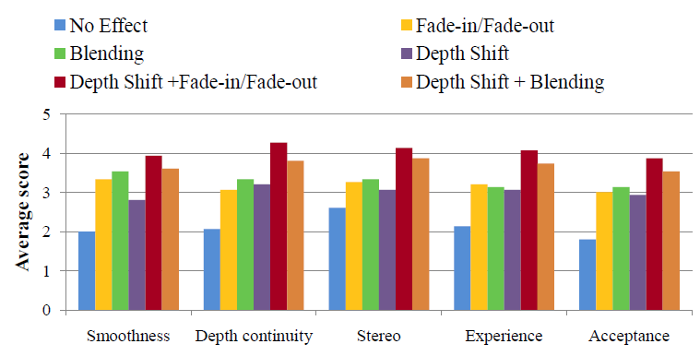
Results of the user study
Notes:
And here are the results. The results show that the active depth cut greatly enhances the viewing experience regardless of the transition effect used. It demonstrates that the continuous depth chart principle is useful. As for color effects, fade-in fade-out is the best one. In blending, images are overlapped together. It often confuses viewer and degrades 3D viewing experience.

Slide 58
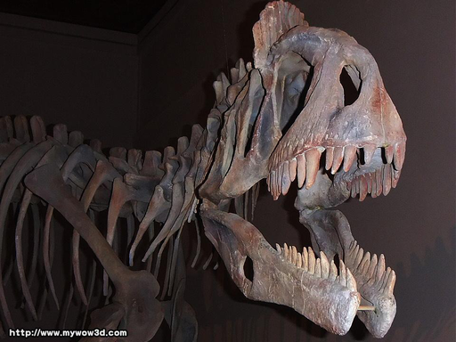
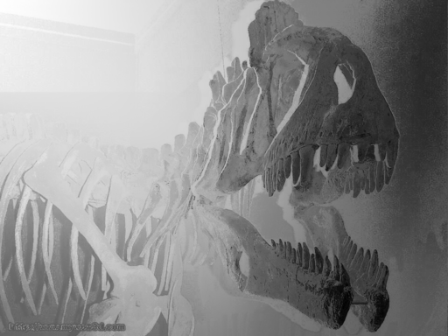
Shallow depth-of-field effects
Blur image according to the depth
Disparity map
Near
Far
Notes:
For the intra-photo effects, we apply the principle 4. Some photos might have excessive depth bracket. They are difficult for viewers to fuse depth perception. For those photos, we applied the shallow depth-of-field effects so that viewers can have a better viewing experience. We blur each pixel based on its depth.

Slide 59
Shallow depth-of-field effects
Blur image according to the depth
Disparity map
Focused depth
Notes:
So that pixels in the focus depth are blurred with a smaller kernel and keep sharp.
Pixels further from the focused depth are filtered with a larger kernel and become blurred.

Slide 60
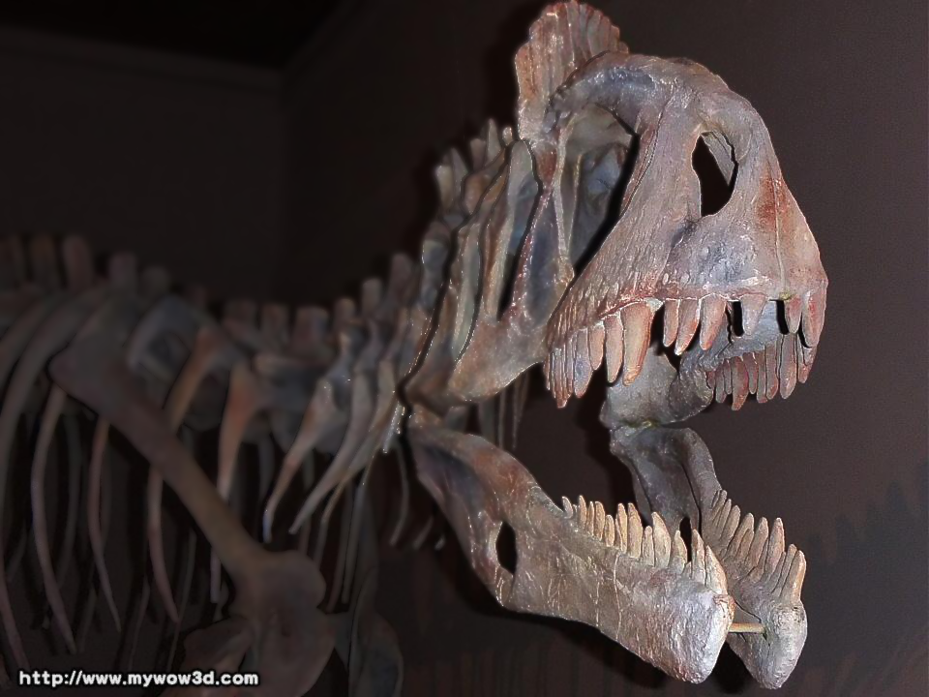
Shallow depth-of-field effects
Notes:
In this example, we focus on the front.

Slide 61
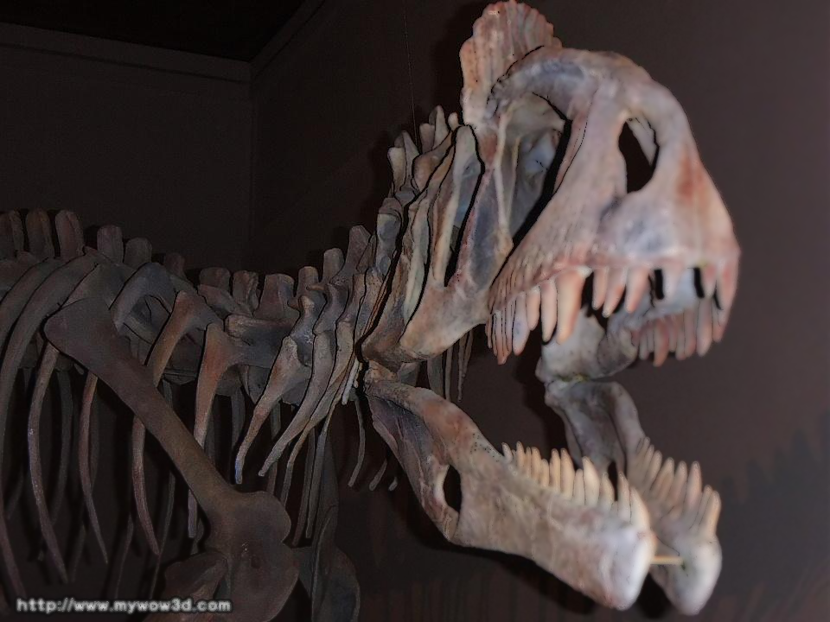
Shallow depth-of-field effects
Notes:
For this one, the focus is on the back. Within the time of displaying a photo, we shift the focused depth from the front to the back continuously.

Slide 62

Shallow depth-of-field effects
Notes:
Here is another example. Focus is on the front.

Slide 63

Shallow depth-of-field effects
Notes:
And the back.

Slide 64
Summary
The order for displaying slides
  If allowed, reorder the photo sequence (Principle 2).
Inter-photo effects
  If there is a large depth jump, use active depth cuts and fade-in/fade-out effect (Principle 2, 3).
Intra-photo effects
  If the depth bracket of the image is excessive, apply shallow depth-of-field blur filtering (Principle 4).
Notes:
In sum, we propose to make a 3D photo slideshow with these options. First, we reorder photos to make a continuous depth chart. Second, we use active depth cut to smoothly transit between photos. For photos with excessive depth ranges, we apply a shallow depth of field effect.

Slide 65

Video
Notes:
Here we show an example of it.

Slide 66
Conclusion
Introduce the principles for stereoscopic cinematography.
Two applications, stabilization and slideshow, show that these principles are essential for stereoscopic media processing.
Notes:
To conclude, in this paper, we have introduced a set of stereoscopic cinematography principles and adapted them to two stereoscopic media authoring applications. In the future, we would like to use them on other 3D media authoring operations. This concludes my talk. Thanks.

Slide 67
Thanks for your attention

