Slide 1

Multi-Cue Fusion for Semantic Video Indexing
Ming-Fang Weng and Yung-Yu Chuang
National Taiwan University
mfueng@cmlab.csie.ntu.edu.tw
Notes:
Good afternoon.
I am Ming-Fang Weng from National Taiwan University.
I will present our paper, Multi-Cue Fusion for Semantic Video Indexing.

Slide 2

Motivation
A rapidly growing amount of videos derives a need in semantic video search
Concept-based video indexing
Query-by-concept
Video archives
Semantic video search
Semantic gaps
Notes:
I will start from motivation first.
Since there is a rapidly growing amount of videos, people usually feel that finding a desired video is not easy.
Therefore, <click> there is a need for semantic video search.
However, using semantic queries to retrieve a video poses a difficult problem, <click> because there are semantic gaps between low-level representation and high-level interpretation.
Recently, <click> query-by-concept has been proposed to handle this problem.
However, it depends greatly on the accuracy of concept-based video indexing.

Slide 3



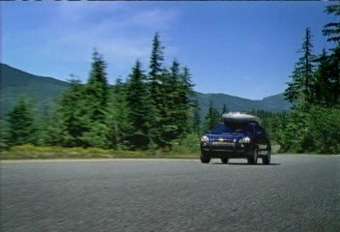
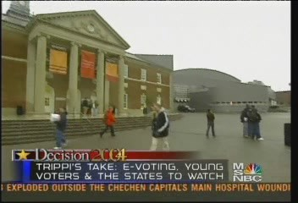
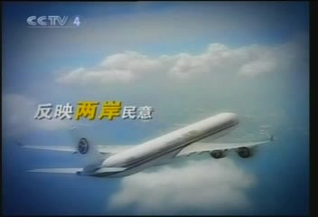
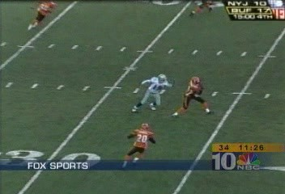
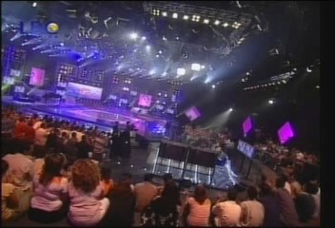


Semantic Concepts
  Comprehensively characterize the meaning of the video content, e.g.,
Airplane
Sports
Crowd
Mountain
Building
Notes:
Semantic concepts such as Airplane, Sports, Crowd, Mountain, and Building are used to comprehensively characterize the meaning of the video content.
Detecting the presence of these concepts in video shots leads to more effective results for semantic video search.

Slide 4


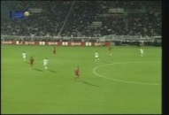
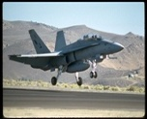
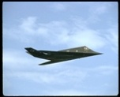


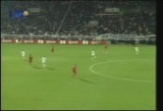

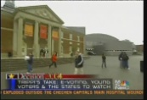


Goal
To improve the accuracy of semantic video indexing
Detecting Airplane
Detecting Sports
Detecting …
1
4
A ranking list according to confidence measure
1
4
2
2
5
5
3
6
3
6
Notes:
Our goal for this project is to make the detection as accurate as possible.
We propose a novel approach to improve the accuracy of semantic video indexing by effectively ranking the relevant shots.

Slide 5
A Typical Approach
Supervised learning
Feature Extraction
Training Concept Classifiers
Semantic Concept Prediction
Video Segmentation
Lexicon Annotation
Shot Ranking
Video Archive
Training path:
Testing path:
Notes:
A typical approach for solving this problem is supervised learning.
The supervised learning approaches usually use low-level features and manually labeled ground truth to train a set of classifiers, and then use them to classify the unlabeled data.
Generally, these classifiers provide prediction scores for the presence of the detecting concept.
Although this approach achieves moderate performance for some concepts, unfortunately, most concepts are still not easily detected.

Slide 6
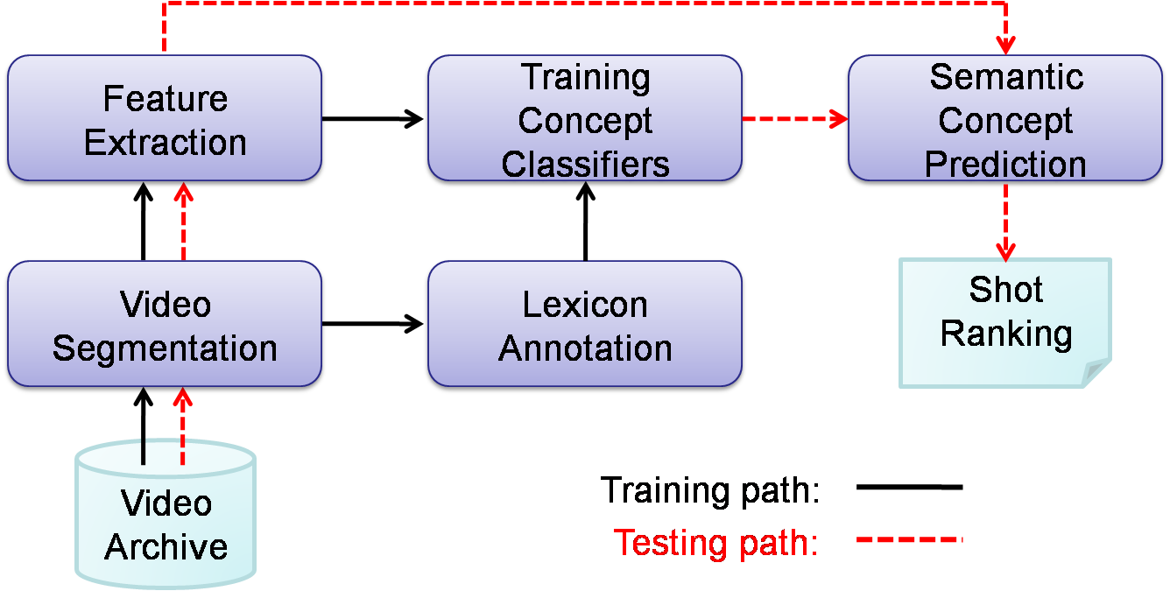
A Typical Approach
Supervised learning
Main problems:
    The annotation data is not fully utilized
    The label for all concepts in all shots are predicted independently
Notes:
In our opinion, the typical approach usually has two main problems.
First, the annotation data is not fully utilized.
Second, the label for all concepts in all shots are predicted independently.

Slide 7

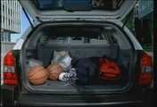
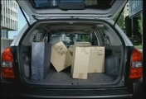





Ground Truth Annotation
A sequence of video shots (training set)
car
1
1
1
1
1
1
1
1
outdoor
1
1
1
1
1
1
1
1
urban
1
1
0
1
1
1
1
1
building
1
0
0
1
1
1
1
0
sky
0
1
1
1
0
1
1
0
people
0
0
0
1
0
1
1
0
A lexicon
of concepts
Temporal dependency
Contextual correlation
Notes:
This figure is an illustration of ground truth annotation. The horizontal axis represents a sequence of video shots, and the vertical axis represents a lexicon of concepts. Here, one indicates the concept is present in the shot, otherwise it`s zero.
It`s true that all of these labels are annotated independently by human. However, if we observe them together, we find that the annotation actually contains much more information.
<click> For example, these green boxes show the temporal dependency. We can find that, once a concept occurs in a video, it generally spans multiple consecutive shots, such as car, outdoor, and urban.
<click> In addition, the orange boxes show the contextual correlation. In this example, some concepts often co-occur within a shot, such as car, outdoor, and urban.
These facts are useful for inference of concept occurrence; thus, our goal is to discover these relationships from annotation and utilize them for improving the detection accuracy.

Slide 8
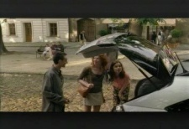
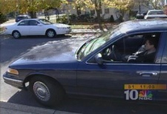
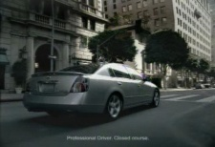
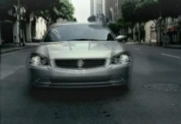

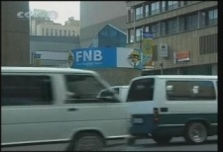
Semantic Concept Prediction
A sequence of video shots (test set)
car
0.92
0.75
0.84
0.33
0.84
0.96
outdoor
0.66
0.91
0.21
0.87
0.94
0.83
urban
0.81
0.72
0.86
0.73
0.62
0.74
building
0.62
0.37
0.88
0.61
0.83
0.90
sky
0.74
0.68
0.85
0.75
0.26
0.80
people
0.56
0.61
0.62
0.64
0.69
0.58
A lexicon of concepts
Notes:
Next, I`m going to explain the semantic concept prediction of the typical approach.
Given a sequence of shots, <click> the concept detectors produce the prediction scores for each concept in each shot independently.
In most cases, these scores are treated as the final results.

Slide 9
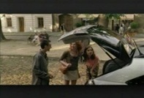





Our Views
Detectors’ predictions form a “noisy image” in the contextual-temporal domain
A sequence of video shots (test set)
car
0.92
0.75
0.84
0.33
0.84
0.96
NOISE
outdoor
0.66
0.91
0.21
0.87
0.94
0.83
urban
0.81
0.73
0.86
0.73
0.62
0.74
building
0.62
0.37
0.88
0.66
0.83
0.90
sky
0.72
0.68
0.93
0.75
0.26
0.80
people
0.56
0.61
0.69
0.64
0.67
0.58
A lexicon of concepts
Notes:
However, we treat these results in a very different view.
We take concept labels for shots as nodes; <click> thus, the detectors` predictions form an image in the contextual-temporal domain.
Since the detectors are often not good enough, some predictions may not be accurate.
Therefore, <click> we can treat them as noise in an image, like this.
That is, we cast the problem as an image denoising problem.

Slide 10
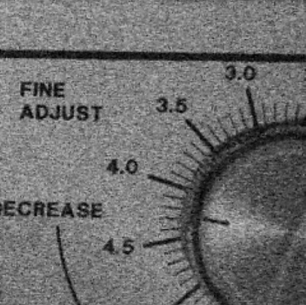
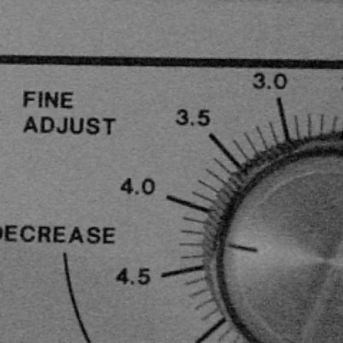
Image Denoising
Image denoising
Input Image
Output image
Notes:
What`s the image denoising?
Image denoising is the process of removing noise from an image.
For example, given an input image, like the one in your left-hand side; we can find this image looks noisy.
Then, the image denoising is going to output a better image, like the one in your right-hand side.
Next, I will introduce a popular method for image denoising.

Slide 11


Image Denoising
Observation
Hidden variable
Notes:
In the slide, the purple nodes, <click> qij, represent the observations; that is the input image in the previous slide.
Some of the observations may be noisy.
The gray nodes, <click> pij, represent the hidden variables, that`s the output image which we want to obtain.
In order to reduce the noise in an image, a common approach is to exploit the prior relationships among nodes, <click> like this.

Slide 12
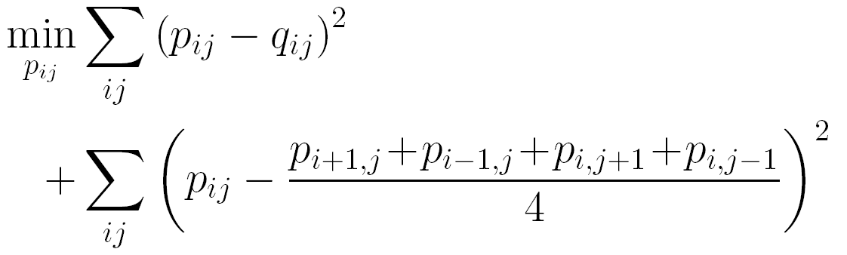
Image Denoising
Observation
Prior relationship
Observation
Energy
minimization
Hidden variable
Observation
Prior relationship
Enhanced image
Notes:
Then, it uses an energy function to capture both the observation and the prior relationship.
A common prior relationship used in image denoising is that each of pixels is assumed to equal the average of its adjacent pixels.
So, with such an energy function, it obtains an optimal result that approximates the observation and fits the prior relationship.
<click> As the example shows, the enhanced image is obtained from an observation combined with the prior relationship through the energy minimization process.

Slide 13
Main Ideas
Denoising: Exploit prior relationships among nodes to reduce the noise
A sequence of video shots (test set)
car
Contextual correlation
NOISE
outdoor
urban
building
Temporal dependency
sky
people
A lexicon of concepts
Notes:
Now, let`s back to the problem of semantic concept prediction.
In the similar manner to image denoising, <click> we take the contextual correlation and the temporal dependency as prior relationships, and then use them to correct the noise in detectors` predictions.
So that, <click> we can obtain better results.

Slide 14
For Semantic Video Indexing
Observation＝Detectors’ prediction
Prior relationships＝？
Energy function＝？
Notes:
To borrow this idea for semantic video indexing, we have three decisions to make.
What are our observations, prior relationships, and energy function?
In terms of observation, it`s trivial, because the detector`s prediction is exactly what we need.
The choices for prior relationships and energy function, however, are not easy ones.
Next, I will show you how we discover prior relationships and design an energy function.

Slide 15
Outline
Multi-Cue Fusion Framework
Modeling High-Order Relationship
Inference using High-Order Relationship
Experiments and Results
Conclusions
Notes:
First, I will sketch our system, the multi-cue fusion framework.
Next, I will introduce how to model the high-order relationship, and how to infer the hidden scores by using them.
Then, I will present our experiments and results.
Finally, I will give the conclusions.

Slide 16
System Framework
Feature Extraction
Training
Concept Classifiers
Semantic Concept Prediction
Video Segmentation
Lexicon Annotation
Modeling High-Order Relationships
Inference Using High-Order Relationships
Video Archive
Training path:
Shot Ranking
Testing path:
Notes:
This slide shows our system framework.
In addition to the components that are used in the typical approach, we propose two new components.
During the training phase, the first component, modeling high-order relationships, captures the contextual and temporal cues as prior relationships.
At the testing stage, the second component, inference using high-order relationships, fuses the prediction scores with these discovered relationships for more accurate results.

Slide 17
Relationship Modeling
Two issues
  Relationship discovering?
  Relationship representation?
Notes:
There are two issues in relationship modeling.
First, because relationships are usually hidden in data, discovering them is not easy.
Second, it`s important to well represent the discovered relationships; thus we can use them for further inference.
Next, I will introduce how we represent a relationship first.

Slide 18

Relationship Representation
The probability of presence of X
Notes:
Given a target variable X, we use the probability of presence of X to represent the relationship for X.
In this example, there is no given variables, except X.
Under this condition, the relationship for X is represented by a constant function; that is P of X equals a constant.
Actually, this constant is the marginal probability of X occurs in the whole data.

Slide 19


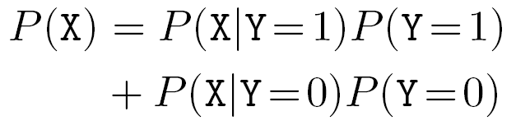
Relationship Representation
The probability of presence of X
    Given a binary variable Y
Notes:
We take another for example.
Given a binary variable Y, we can partition the data into two parts according to the presence of Y.
Under this condition, the relationship for X is typically represented by summing the joint probability over Y, as the equation shows here.

Slide 20
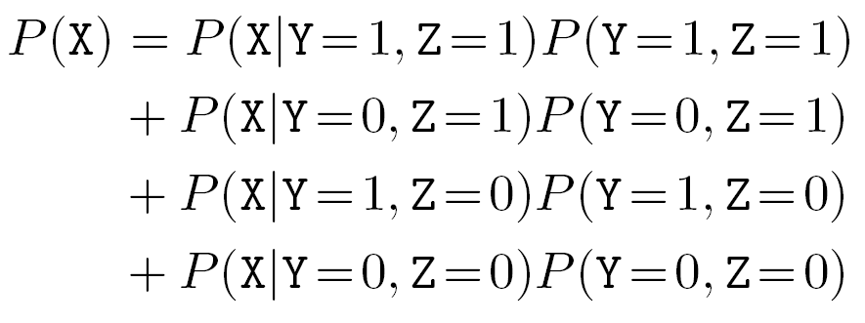


Relationship Representation
The probability of presence of X
    Given two binary variables Y and Z
Notes:
Further, given two binary variables Y and Z, the data can be partitioned into four parts according to the presence of Y and Z.
In the similar manner, the relationship for X is represented by summing the joint probability, but over Y and Z as this equation shows.

Slide 21
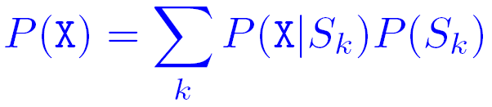
Relationship Representation
The probability of presence of X
    Given a partition of data
S₁
S₂
S₃
S_{k}
S_{k+1}
S_{n}
Notes:
In principle, the relationship for X can be represented by this equation as long as Sk is a partition of data.
A partition of data means that all subsets are non-overlapping and together cover the whole data.
Since there are many ways to partition the data, the relationship for X could be represented by many conditions.
Therefore, to be more effective, we propose a recursive algorithm to obtain the mainly associative conditions.

Slide 22
Relationship Discovering
A recursive algorithm selects the variables which are
  Highly correlated to the target variable
  Independent of other selected variables
Chi-square test
  Discovers the hidden associations
  Judges whether a correlation is reliable
Notes:
The recursive algorithm forms a proper partition by selecting the variables which are highly correlated to the target variable and also independent of other selected variables.
Additionally, this algorithm combined with the chi-square test, in the meanwhile, also discovers the hidden associations and judges whether a correlation is reliable.
Next, I will use a toy example to walk you through our data-driven approach for discovering high-order relationships from the ground truth annotation.

Slide 23

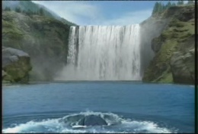
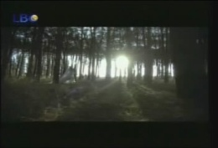
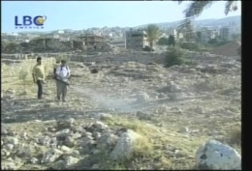

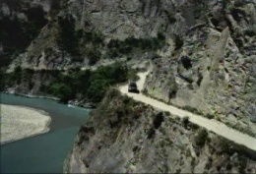
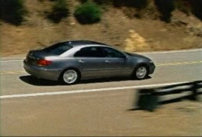
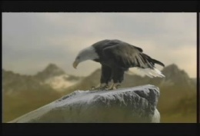
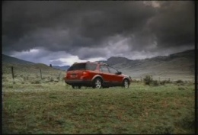

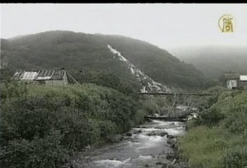



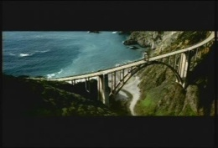
Toy Example
Concept lexicon:
  {Mountain(M), Sky(S), Tree(T), River(R)}
Annotation data D:
To discover the contextual relationship for Mountain
Notes:
In this example, there are 4 concepts in lexicon, Mountain, Sky, Tree, and River.
Given the annotation data D with 15 images, each of them is manually labeled according to the concept lexicon.
Assume that we are going to discover the contextual relationship for Mountain.

Slide 24
















Toy Example
Correlation measuring
  Assume that Sky is the most correlative concept to Mountain
Notes:
In the first step, for data D, we measure the correlation between Mountain and each concept in the lexicon by calculating the chi-square values.
Assume that Sky has the highest chi-square value.
It means that Sky is the most correlative concept to Mountain in the lexicon.

Slide 25







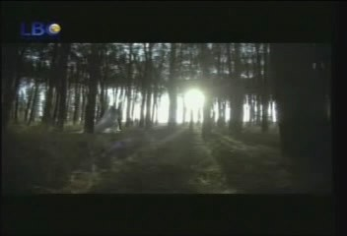


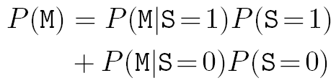

Toy Example
Data partition according to Sky
Notes:
Next, we partition data D into two subsets according to whether Sky is present or not.
Then, we have two subsets.
One is the set, S+, comprises the shots with Sky, and the other, S-, is without Sky.
According to the relationship representation I just described, we can represent the relationship for Mountain as a function of the probability of Sky`s presence and absence, as the equation shows at the bottom of the slide.
However, there may be more correlative concepts with Mountain, and we will continue the processes of correlation measuring and data partition.

Slide 26
Toy Example
Correlation measuring
  Assume that there is no concept with significant correlation to Mountain
Notes:
Next, for data S+, we try to find the most correlative concept to Mountain.
Assume that there is no concept with significant correlation.
This means that, under the condition that Sky is present, the remaining concepts, Tree and River, are not correlated to Mountain.
Thus, we can stop partition for S+.

Slide 27
Toy Example
Correlation measuring
  Assume that River is the most correlative concept to Mountain
Notes:
For data S-, assume that River is the most correlative concept to Mountain among the remaining concepts in lexicon.
It means that, under the condition that Sky is not present, River is highly correlated to the presence of Mountain, and we should model the relationship between them.
Hence, we should further partition S- according to the presence of River.

Slide 28




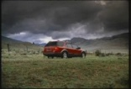







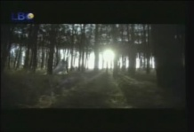

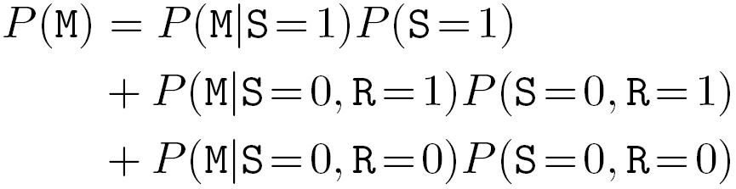

Toy Example
Data partition according to River
Notes:
We use R plus and R minus to indicate the new subsets, respectively.
Then, we expand the relationship for Mountain with River, as this equation shows.
Here, we assume that there is no concept further significantly correlated to Mountain.
Hence, the recursion is done and we have the complete relationship for Mountain.

Slide 29
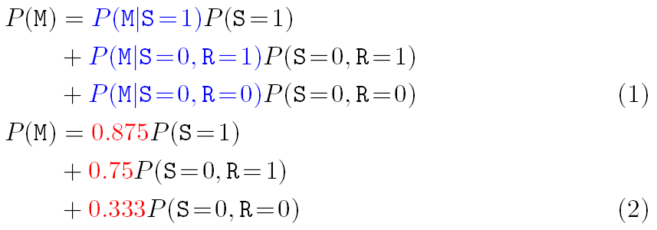



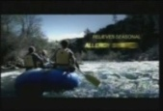

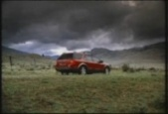



Toy Example
  Conditional probability estimation
  E.g.,
Notes:
Next, we estimate the conditional probabilities of occurrence of Mountain in equation (1).
For example, <click> the conditional probability of occurrence of Mountain given Sky is present is calculated over S+.
There are total 8 shots in S+ and 7 of them are relevant to Mountain.
So that the conditional probability is equal to seven eighth.
Therefore, <click> we can update equation (1) with such parameters, and obtain the relationship for Mountain as equation (2).

Slide 30
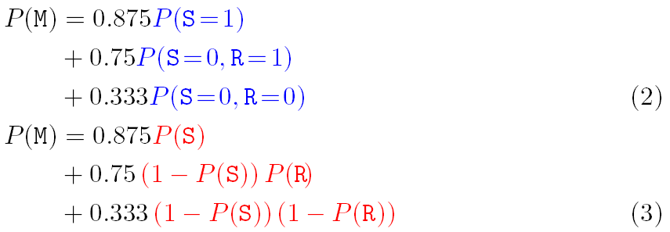
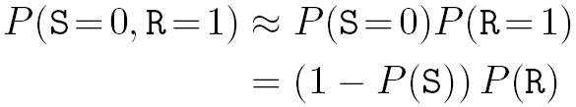
Toy Example
The high-order relationship
  Independence assumption
Notes:
Finally, we assume that the selected correlative variables are independent to each other.
Therefore, the joint probability in equation (2) can be approximated with the product of the marginal probabilities.
For example, <click> p of S equals 0 and R equals 1 is approximated with P of S equals 0 times p of R equals 1.
This independence assumption is valid, because we know that River is still highly related to Mountain given that Sky is not present.
It reveals that Sky and River must be somewhat orthogonal in terms of providing information about occurrence of Mountain.
In practice, this assumption works quite well. Therefore, <click> we obtain the high-order relationship for Mountain, equation (3), based on this independence assumption. That is, we can infer the probability of presence of Mountain from the probability of Sky and River by equation (3).

Slide 31
An Example from Real Data
Concept lexicon: Columbia374
Annotation data: TRECVid 2005 devel. set
The discovered contextual relationship of concept Mountain
The whole dataset
H⁺
H⁻
H: hill
P: military_personnel
S: sky
G: group
L: landscape
V: valleys
C: commercial_advertisement
R: river
F: forest
K: rocky_ground
W: waterways
T: trees
P⁺
P⁻
L⁺
L⁻
S⁺
S⁻
V⁺
V⁻
K⁺
K⁻
G⁺
G⁻
C⁺
C⁻
F⁺
F⁻
S⁺
S⁻
S⁺
S⁻
F⁺
F⁻
T⁺
T⁻
R⁺
R⁻
K⁺
K⁻
W⁺
W⁻
Leaf node
R⁺
R⁻
Internal node
Notes:
This slide shows the mined relationship for Mountain from the real data.
The concept lexicon we used is Columbia374 and the annotation data we used is TRECVid 2005 development set.
We can observe that the relationship is rather complex.

Slide 32
Temporal Relationships
Discover temporal dependence among neighboring shots
Similar to the way discovering the contextual relationships
Tests the correlation between neighboring shots in the temporal order
Notes:
As to the temporal relationships of each concept, we use a similar algorithm to discover.
The only difference is that this algorithm tests the correlation between neighboring shots in a temporal order.
This is reasonable, because temporally closer shots should have higher correlation than the more distant shots.

Slide 33
Inference using Relationships
A sequence of shots
A lexicon of concepts
Prediction score
Hidden variable
Contextual cues
Temporal cues
Notes:
Once we have high-order contextual and temporal relationships, this slide shows how we integrate these multiple cues for inference.
<click> Suppose this node is a hidden variable we attempt to obtain.
First, it should be close to the prediction score.
<click> Also, it should satisfy the discovered contextual relationship, <click> and it should satisfy the discovered temporal relationship as well.
Therefore, we`d like to seek a solution in which all nodes simultaneously satisfy all these conditions.

Slide 34
Energy Function
Observed Likelihood
Contextual Relationship
Temporal Relationship
Notes:
According to these, we formulate an energy function to find a solution that best fits the above conditions in the least square sense.
That is, we find all labels for all shots and concepts all at once so that the resulted labels satisfy the prediction scores and our discovered relationships.
In addition, we observe the effectiveness of these terms varies from concept to concept.
So, we use concept-dependent parameters to weight each of them.

Slide 35
Optimization
Parameter estimation
  Obtain the concept-dependent parameters from training corpus with cross validation
Energy minimization
  Use Conjugate Gradient Methods to solve this non-linear function
  Adopt prediction scores from detectors as an initial guess
Notes:
In this work, we obtain the concept-dependent parameters from training corpus with cross validation.
And we solve the energy minimization problem by using Conjugate Gradient Method.
The success of this method for solving such a non-linear function depends on a good initial guess.
Fortunately, the prediction scores from detectors provide just such a guess.

Slide 36
Experimental Settings^{1/2}
TRECVid benchmark
Performance evaluation
  20 officially selected concepts in TRECVid 2006
  Inferred average precision (infAP) for individual concept performance
  Mean infAP for overall system performance
 | Dataset | # of Videos | # of Shots
Training data | TV05 devel set | 137 | 43,907
Test data | TV06 test set | 259 | 79,484
Notes:
Next, I am going to present experiments to validate our approach.
We adopted the TRECVid benchmark and used TV05 development set and TV06 test set as the training data and the test data.
For performance evaluation, we use the 20 officially selected concepts in TRECVid 2006.
In addition, we use infAP and mean infAP as metrics to report the individual concept performance and the overall system performance.

Slide 37
Experimental Settings^{2/2}
Baselines in our experiments
 | VIREO-374 | Columbia374
Provider | City U. of H. K. | Columbia University
Feature | Color moment, Wavelet texture, Keypoint features | Edge direction histogram, Garbor, Grid color moment
Learning | SVMs | SVMs
Fusion | lately average | lately average
Accuracy | high | medium
Notes:
For detectors, we adopt two popular sets of detection scores for the test data, VIREO-374 and Columbia374.
They are respectively released by City University of Hong Kong and Columbia University.
As highlighted in the table, VIREO-374 exhibits high performance and Columbia374 is considered a median performer.

Slide 38
Overall performance
Baseline |  | VIREO-374 | Columbia374
Mean infAP |  | 0.1542 | 0.0948
Contextual cues only | Liu et al. | 0.2% | 0.5%
 | MCF | 16.7% | 19.6%
Temporal cues only | Liu et al. | 10.6% | 16.9%
 | MCF | 14.6% | 17.3%
Both cues | Liu et al. | 11.2% | 18.1%
 | MCF-AC | 19.7% | 23.3%
 | MCF-EM | 27.3% | 32.1%
MCF-AC: MCF with average combination
MCF-EM: MCF with energy minimization
Notes:
As a comparison, we compare with Liu et al`s work on improving detection by fusing with contextual and temporal cues.
M-C-F represents our multi-cue fusion approach.
As shown in the table, our multi-cue fusion with energy minimization has about 27% and 32% improvements over the VIREO-374 and Columbia374 baselines; while the performance gains of the Liu et al.`s method are only about 11% and 18%.

Slide 39
Performance of Individual Concepts
Notes:
This chart shows the performance of individual concepts with different approaches.
We note that some concepts benefit greatly from multi-cue fusion, <click> such as People-Marching, Car, and Sports, while the performance gains of others are not obvious, <click> such as Charts, Computer_TV-screen, and Meeting.

Slide 40
Comparison with TRECVid 2006 Submissions
MCF on VIREO-374
The best run of each group
VIREO-374 Baseline
Baselines
MCF
MCF on Columbia374
Columbia374 Baseline
Notes:
This chart compares the detection performance of our approach with the TRECVid 2006 submissions.
The white bars indicate the best runs of each group.
We find that our multi-cue fusion approach advanced the rank of the Columbia374 baseline <click> from the medium level to the first tier and turned the VIREO-374 baseline <click> into the best one.

Slide 41
Observations
MCF improved each of the 20 concepts with ranges varying from 5.9% to 88.1%
15 of 20 concepts showed more than 20% improvement
We achieved ~30% performance gain for two detectors with different levels of accuracy
Notes:
Next, let me sum up our observations on these experimental results.
First, the multi-cue fusion improved each of the twenty concepts with ranges varying from 5.9% to 88.1%.
Second, 15 of 20 concepts showed more than 20% improvement.
Finally, we achieved about 30% performance gain for two detectors with different levels of accuracy.

Slide 42
Concluding Remarks
Proposed a general framework which improved the accuracy of semantic concept detection in videos
MCF has 4 advantages:
  Salable
  Annotation data is reused
  Temporal and contextual information are used simultaneously
  Independent to classifiers
Notes:
I will conclude my presentation with the following remarks.
We proposed a general framework which improved the accuracy of semantic concept detection in videos.
The proposed framework has 4 advantages.
Firs, it`s scalable to number of concepts and number of shots.
Second, the same training data is used to learn both classifiers and prior relationships.
So that reusing the annotation data obviates the need for extra training data.
Third, the temporal and contextual information are used simultaneously.
This integration gives significant performance gains.
Finally, our framework is independent to classifiers and it can be applied to any classification results without re-training models.
It means that the decomposition of classifier learning and filter learning makes the framework more flexible.

Slide 43
Thank You for Your Attention
Notes:
This is the end of my presentation.
Thank you.

