Slide 1
Cubical Marching Squares:
Adaptive Feature Preserving
Surface Extraction from Volume Data
Chien-Chang Ho, Fu-Che Wu, Bing-Yu Chen, Yung-Yu Chuang, Ming Ouhyoung
National Taiwan University
Notes:
Good afternoon ladies and gentlemen. My name is Chien-Chang Ho. I’m from National Taiwan University.
It’s an honor to have the opportunity to present my works today. The subject of my presentation is “Title”.

Slide 2
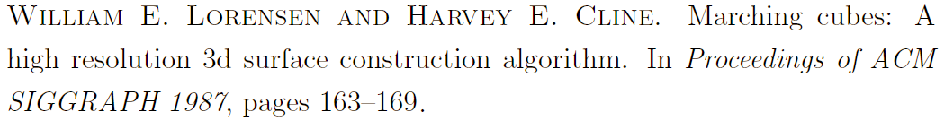
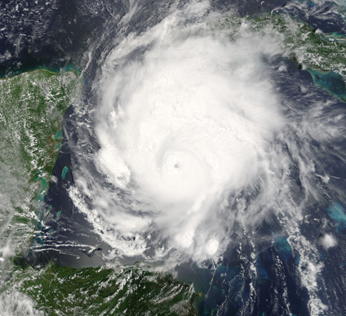
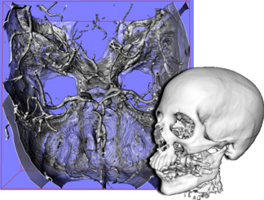
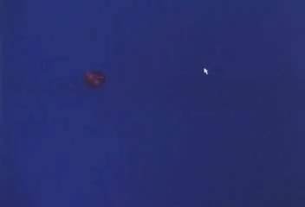
Overview
Marching Cubes:
  Most cited paper in history of SIGGRAPH
  http://www.siggraph.org/conferences/reports/s2004/articles/Visualizing_SIGGRAPH.html
from www.nasa.gov from www.openqvis.com from graphics.csie.ntu.edu.tw
Notes:
When we talk about surface extraction from volume data. The most famous paper is Marching Cubes. It first invented in 1987. Currently, it is the most cited paper in history of SIGGRAPH. Marching Cubes has such importance because it is a simple and effective solution. When we have the requirement to visualize a volume data, Marching Cubes is the best choice for simple. Various applications are related to Marching Cubes. For example, scientific visualization, medical image, CSG modeling, or the application we shown here, a Virtual Sculptor. This application deform a volumetric model in real-time.
--Additional Info----------------------------------------
The most cited paper was published in 1967 by Steven Weinberg. It established the link between the electromagnetic and weak interactions ?work for which Weinberg would share the 1979 Nobel Prize for physics. It has been cited more than 4,600 times.
http://uahnews.uah.edu/scienceread.asp?newsID=204
http://scholar.google.com/scholar?hl=en&lr=&q=Steven+Weinberg

Slide 3
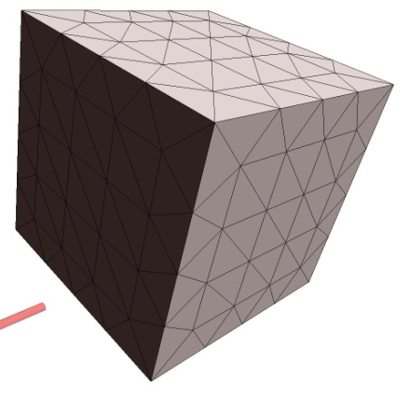
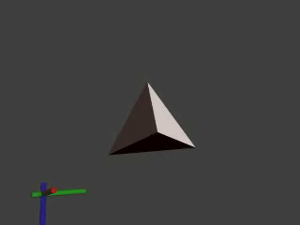
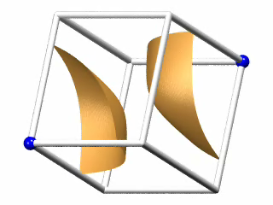
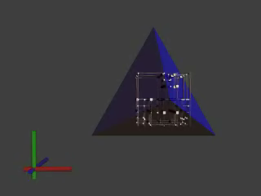
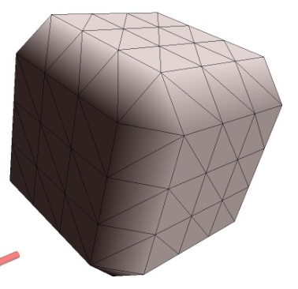
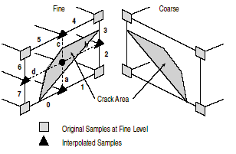
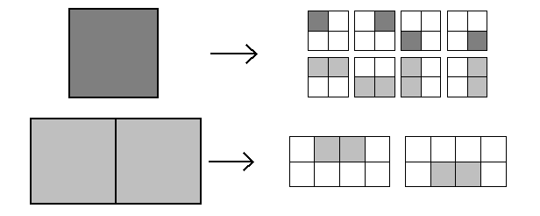
Problems
Sharp Features
Consistent
Topology
Adaptive Resolution
Real-time
Notes:
However, since marching cubes has been invented, several problems has been discovered. Moreover, some problems become critical especially for handling geometric objects.
These problems include “Consistent topology”, “Adaptive resolution”, “Sharp features”, and “Performance”.
We will discuess them in detail later.

Slide 4
Outline
Previous work
& Problems
Solutions
Results &
Conclusions
Notes:
I plan to be brief. Thus, the outline of this presentation is as following. After the short introduction & previous work, the next is Problem & Solutions. Then Results & Conclusions. Now, let’s go on to “Problems & Solutions”.
The outline for today is as following. Previous work & Problems, then solutions and, finally, Results & Conclusions.

Slide 5
Previous work
& Problems
Solutions
Results &
Conclusions
Notes:
In this talk, we will spend more time on problems to make things clearly.

Slide 6
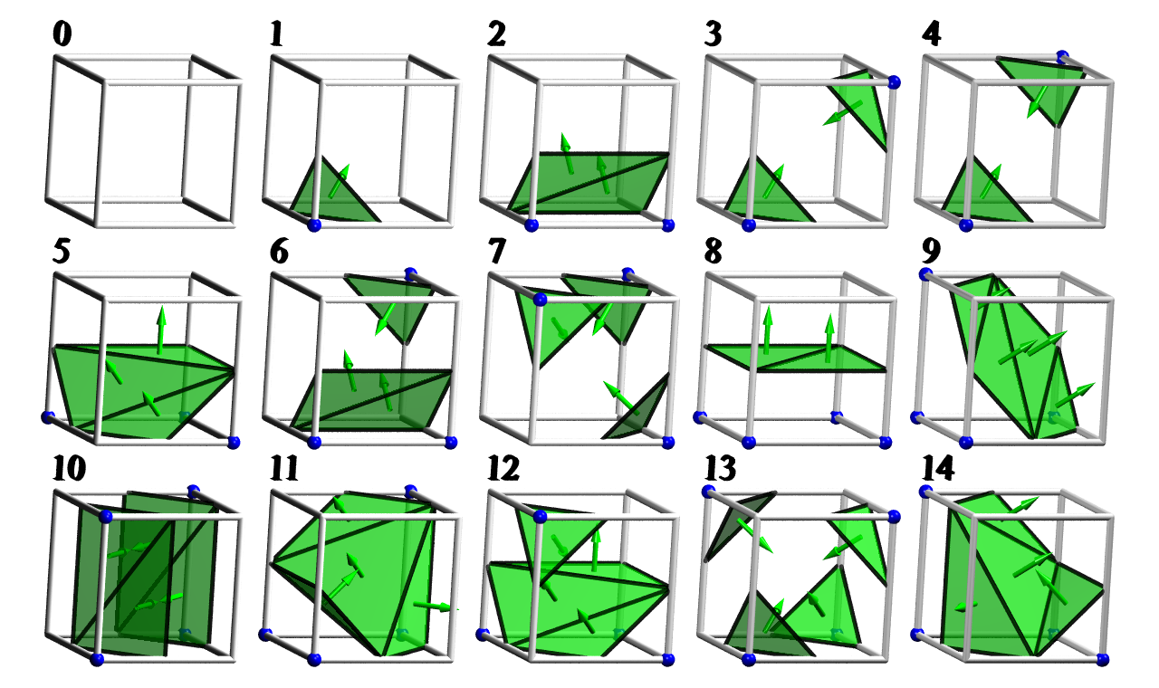
Marching Cubes Table
Using binary pattern of eight vertices
Totally 256 cases in 15 classes
Notes:
Marching Cubes is a one pass, table driven algorithm.
It analyzes the binary pattern of eight vertices of a cube to construct a surface that approximates the underlying surface.
Considering rotations and symmetries, they reduce the original 256 patterns to a total of 15 configurations.

Slide 7
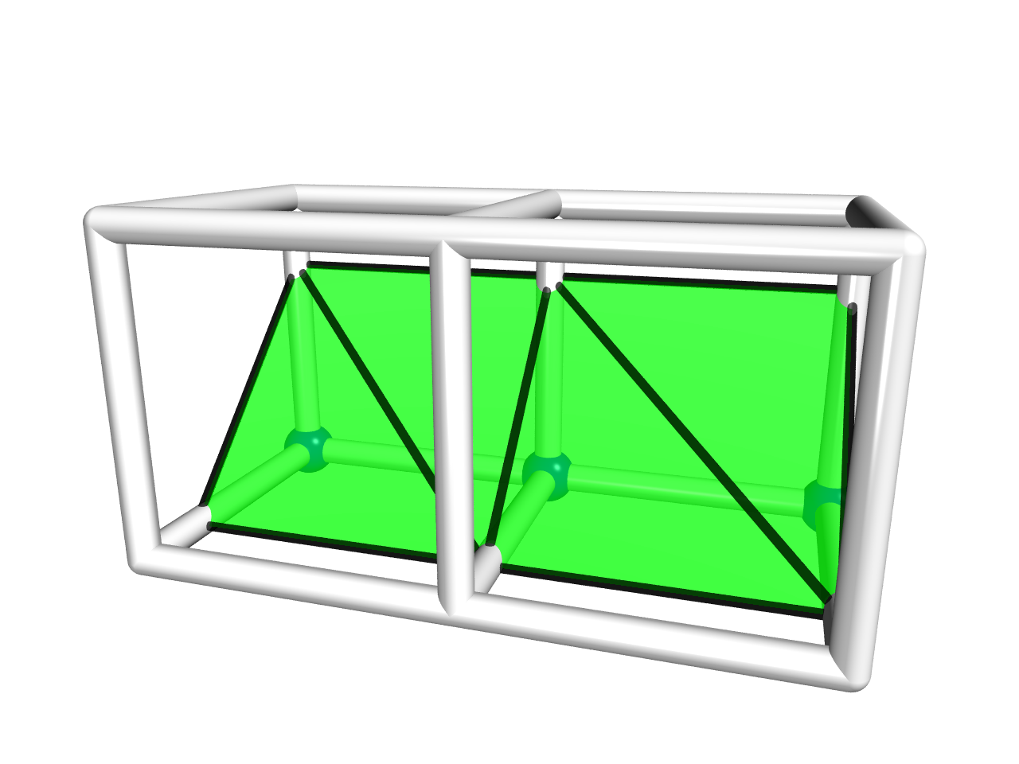
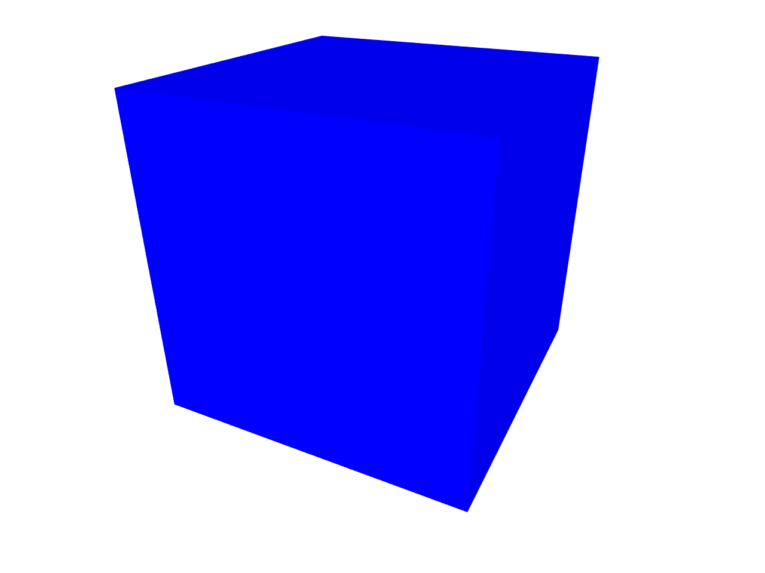
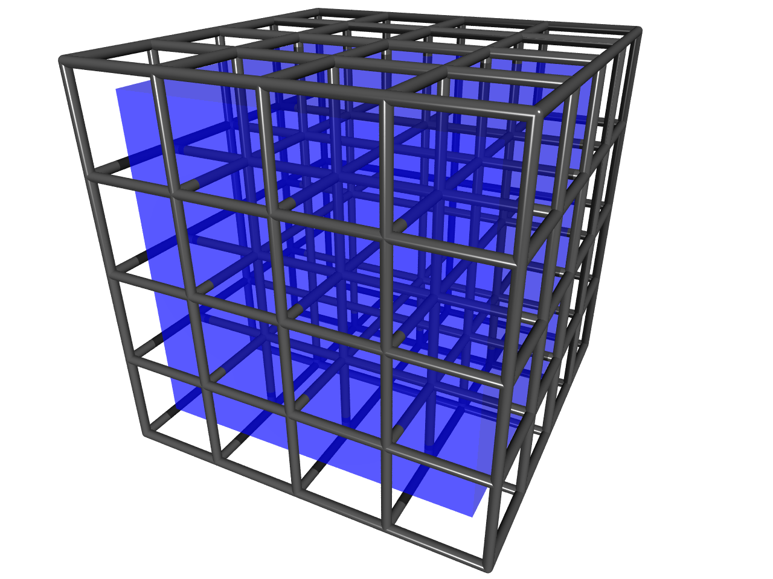
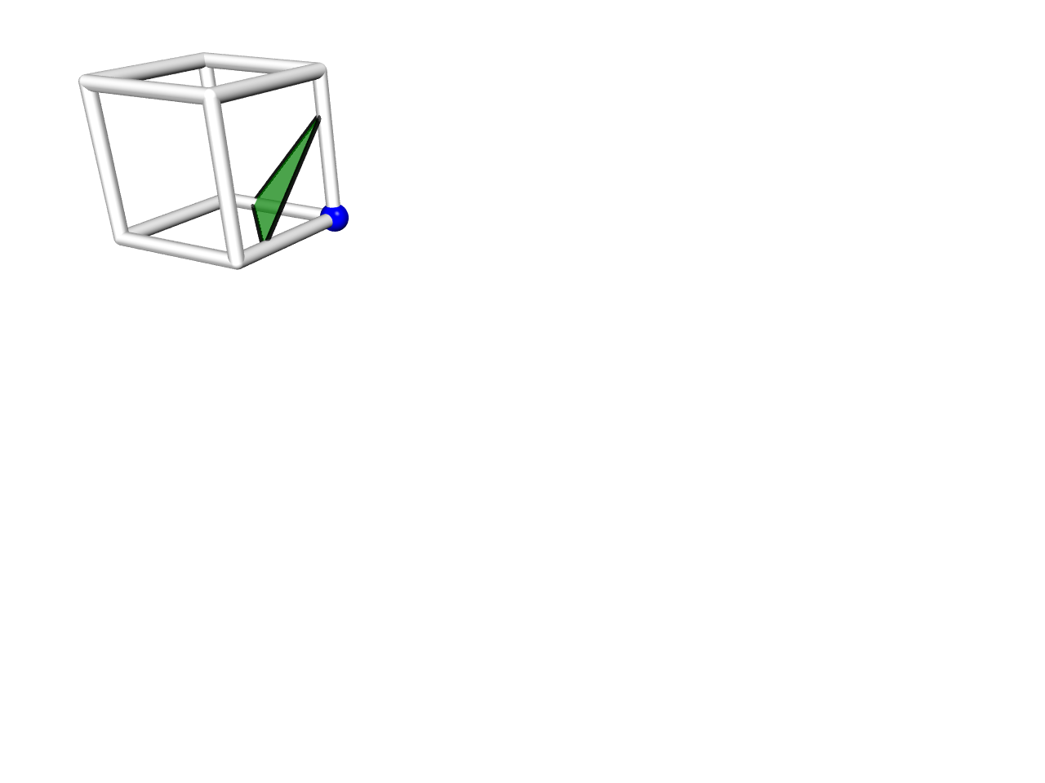
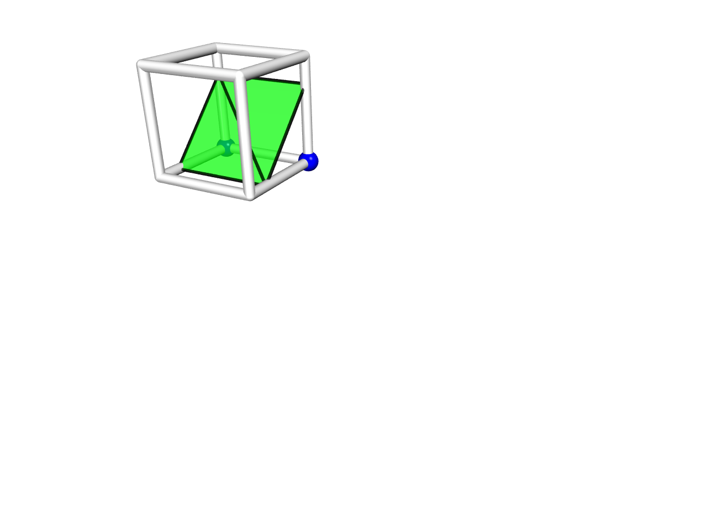
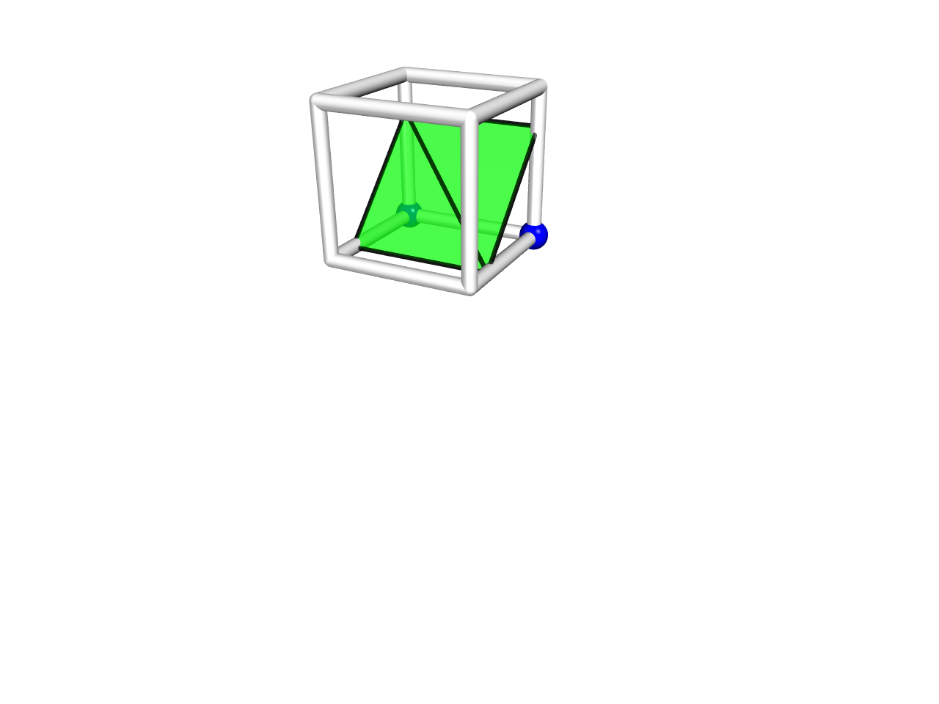
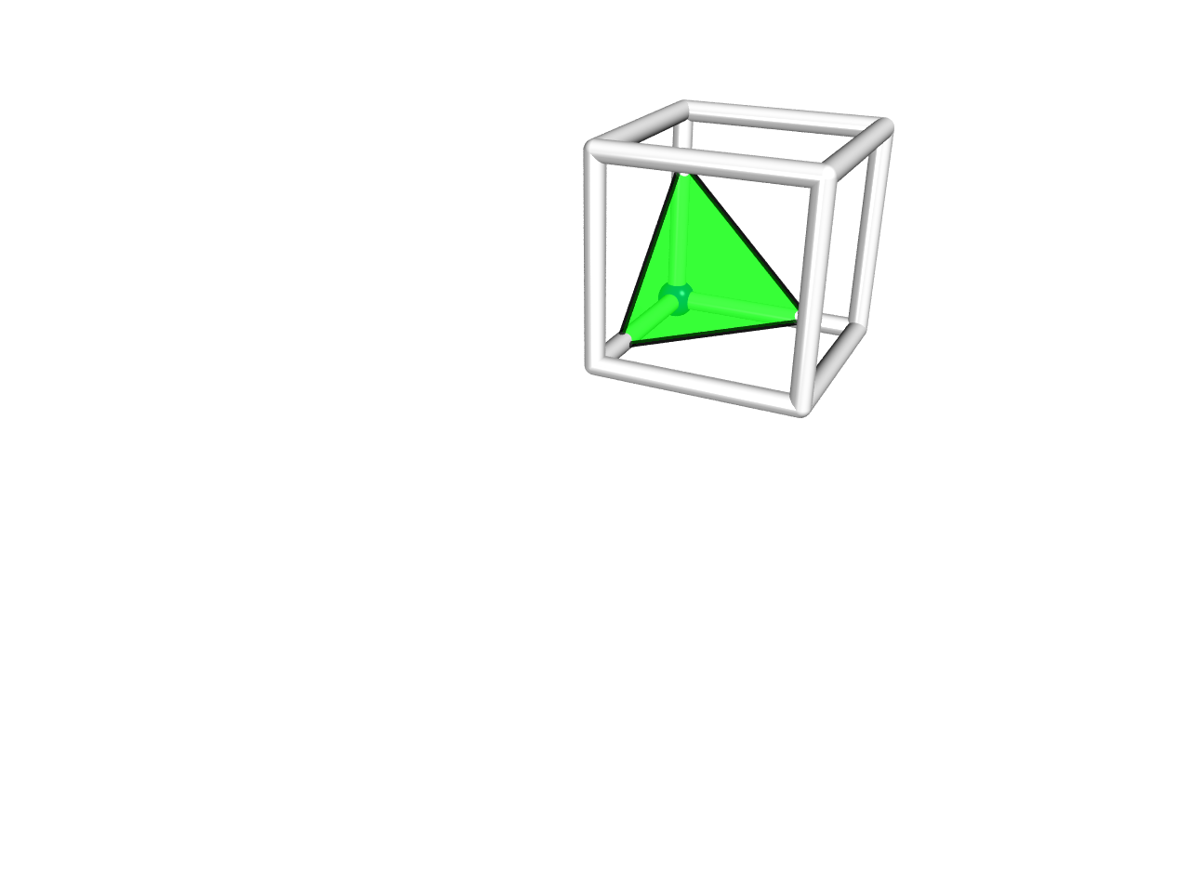
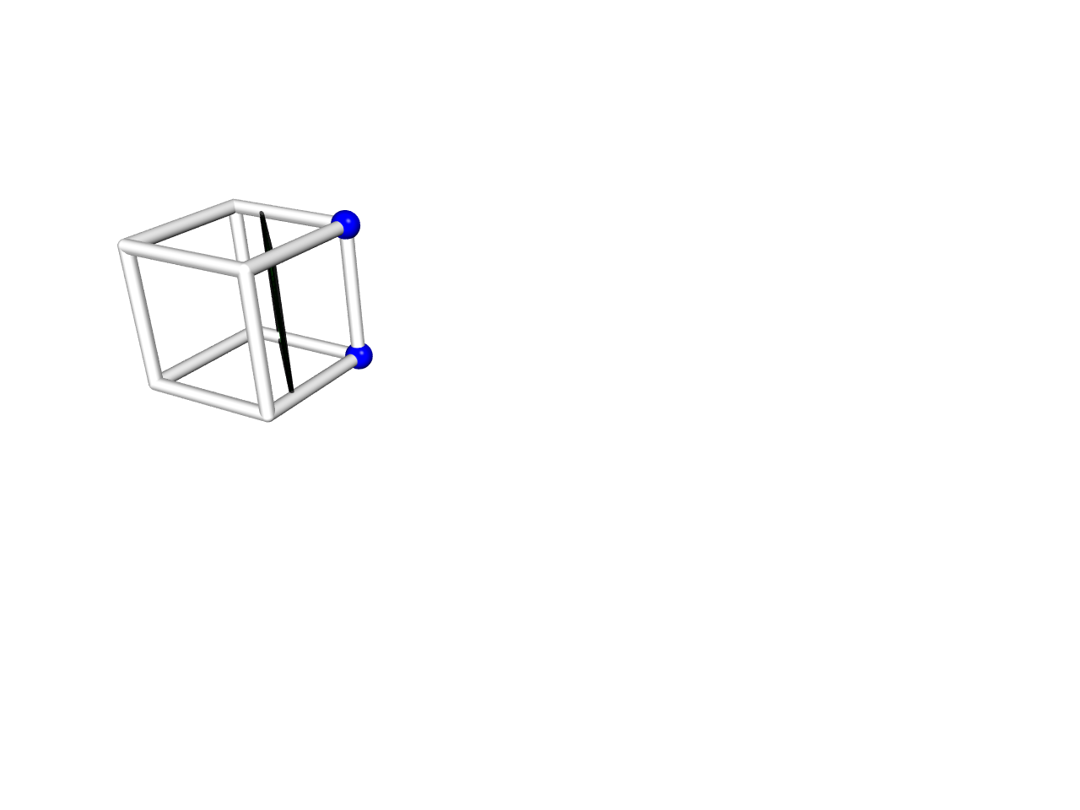
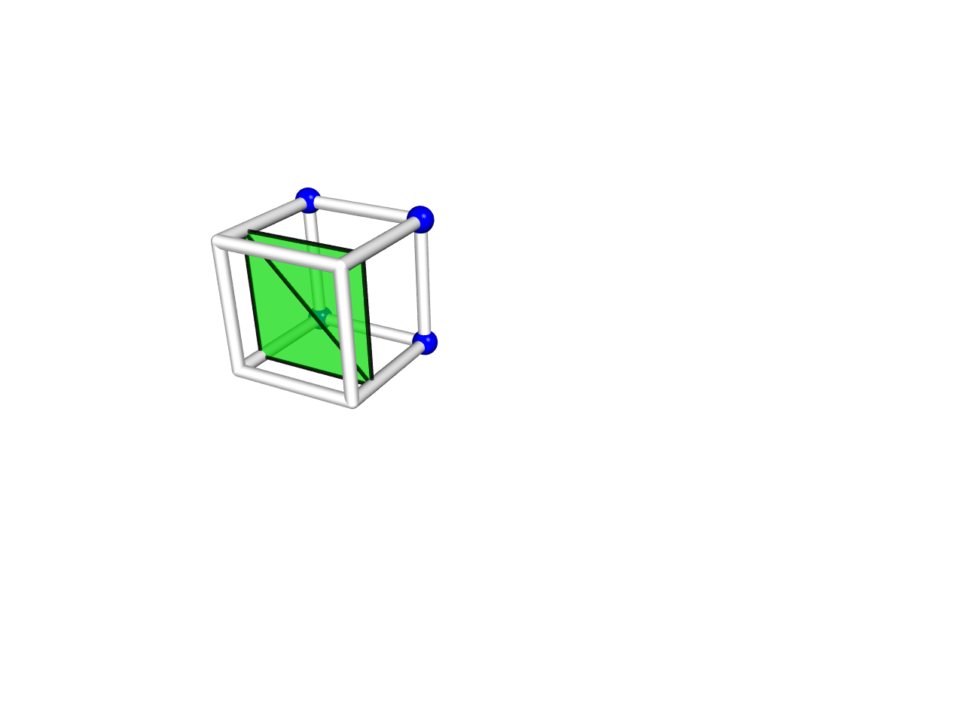
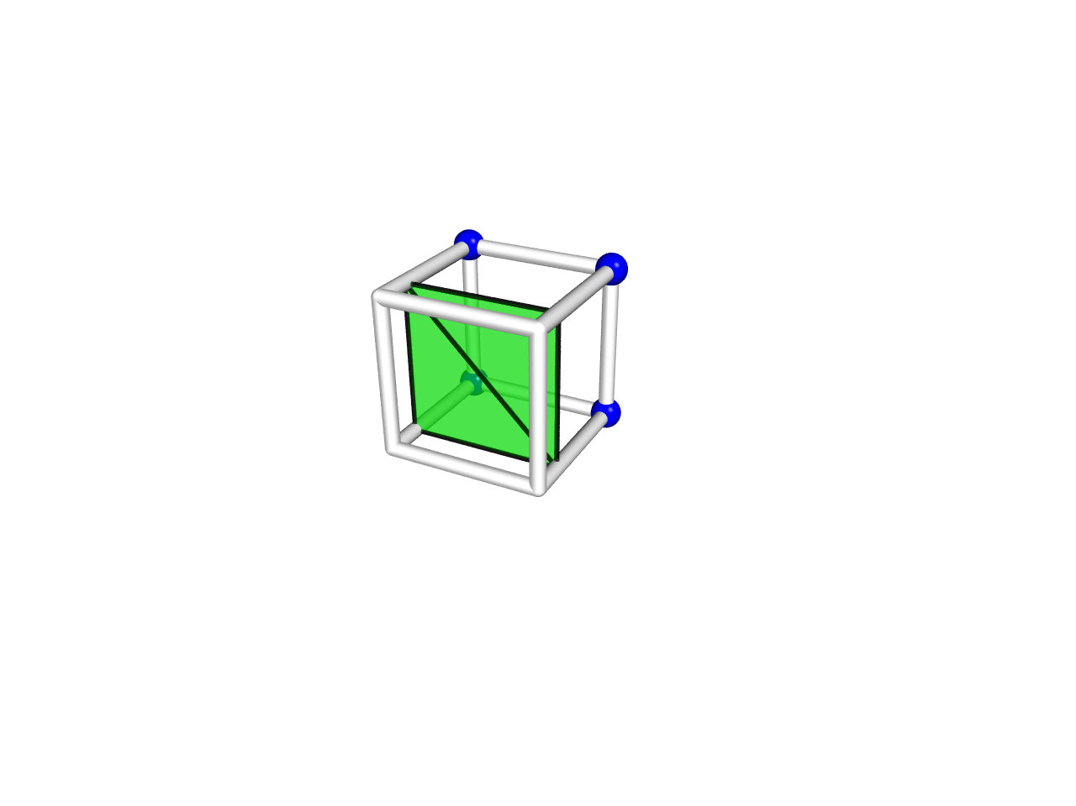
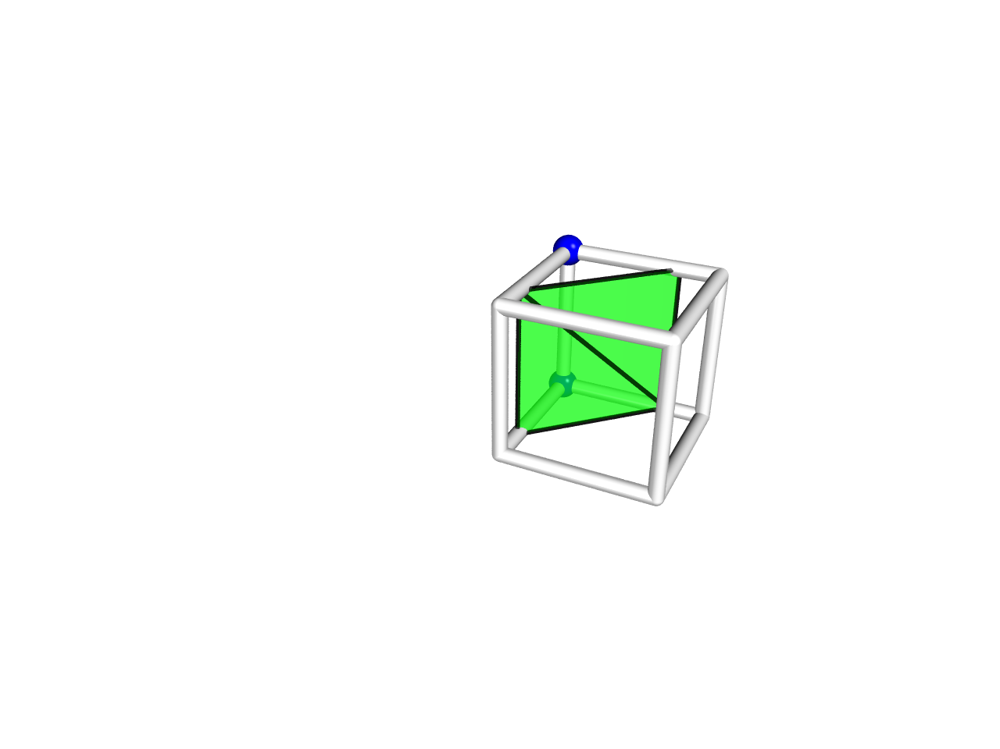
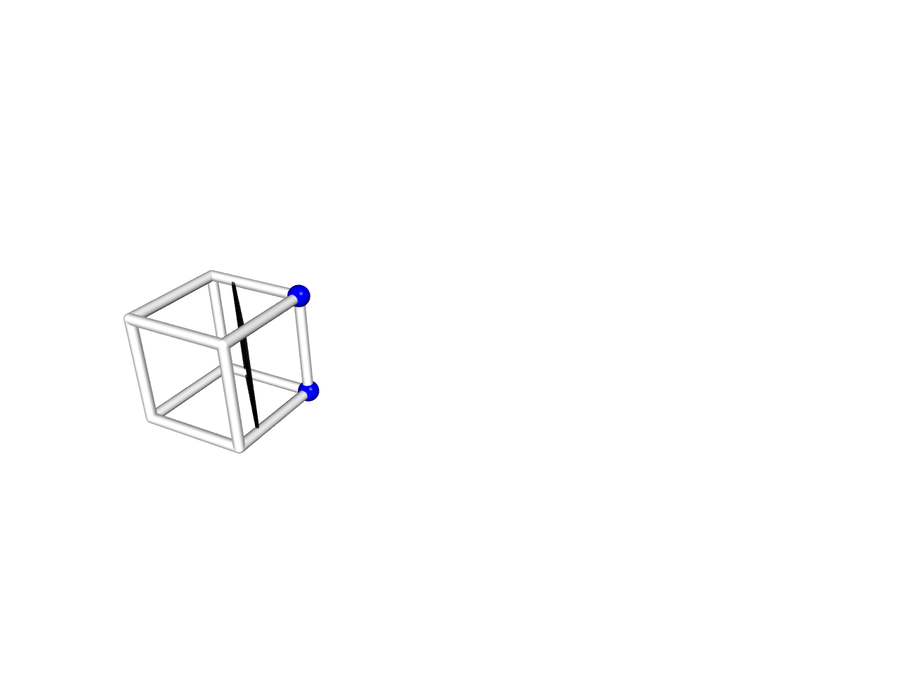
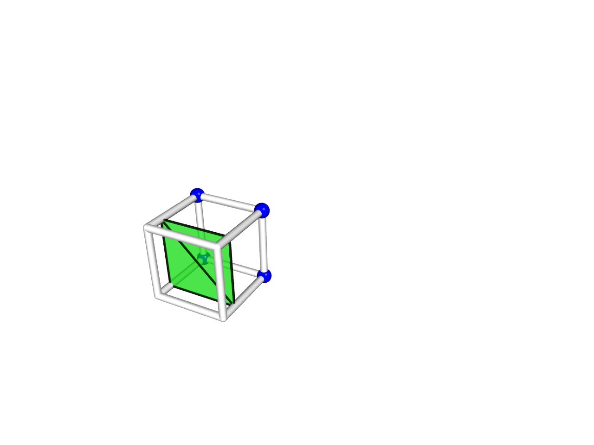
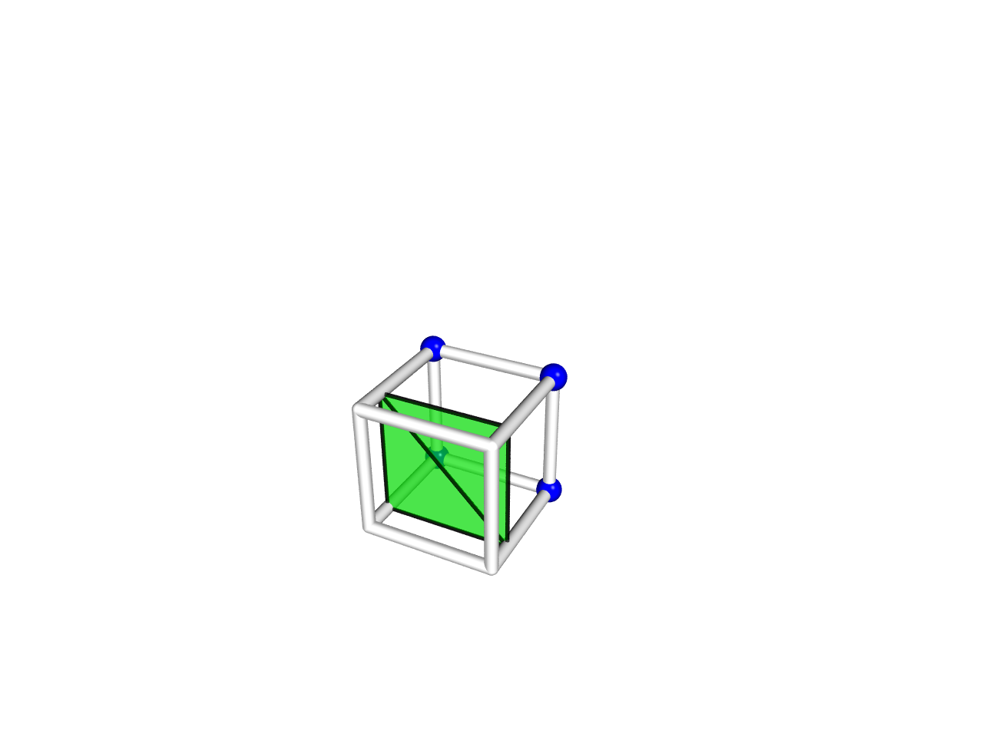
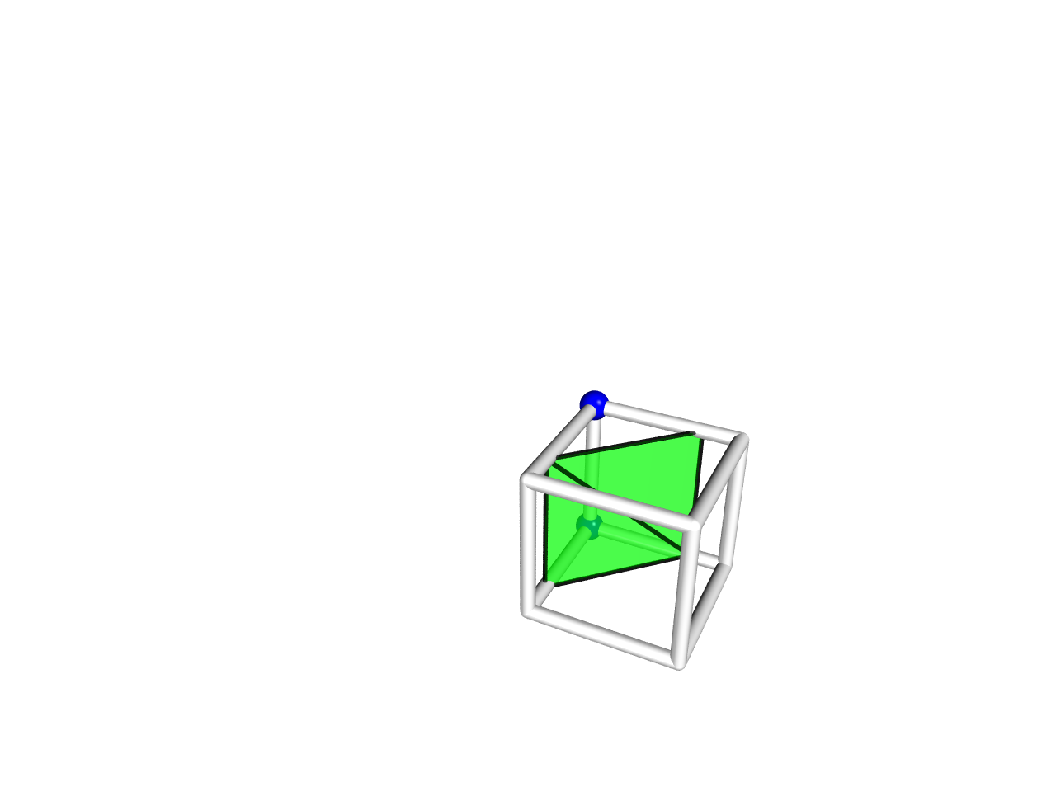
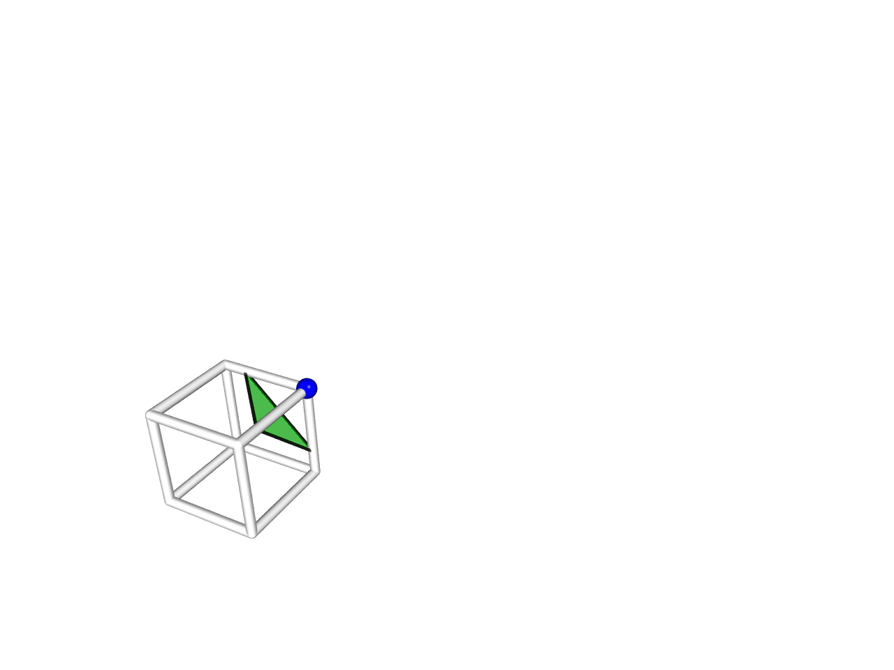
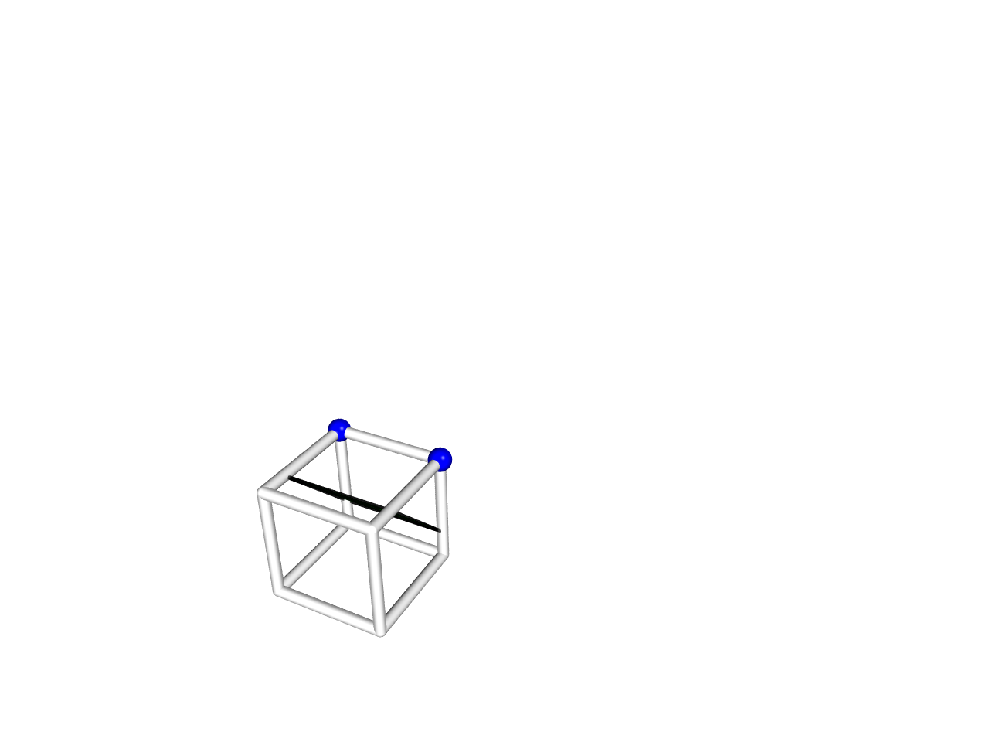
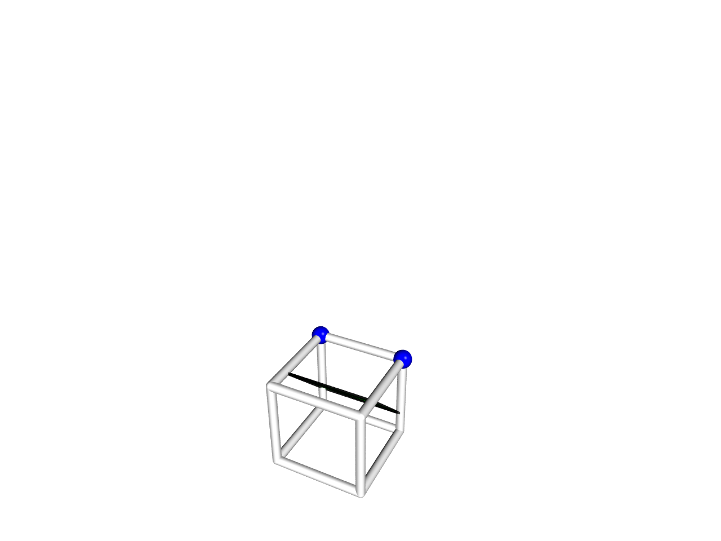
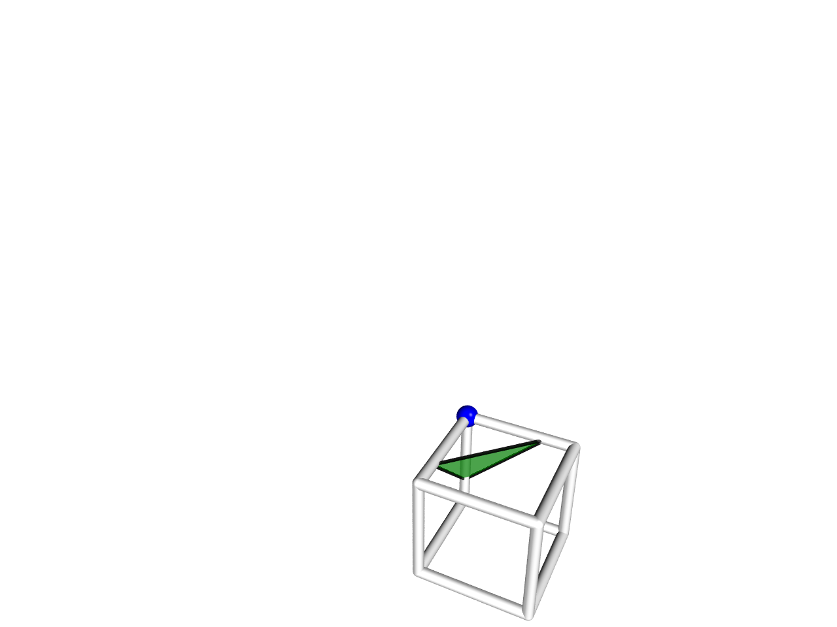
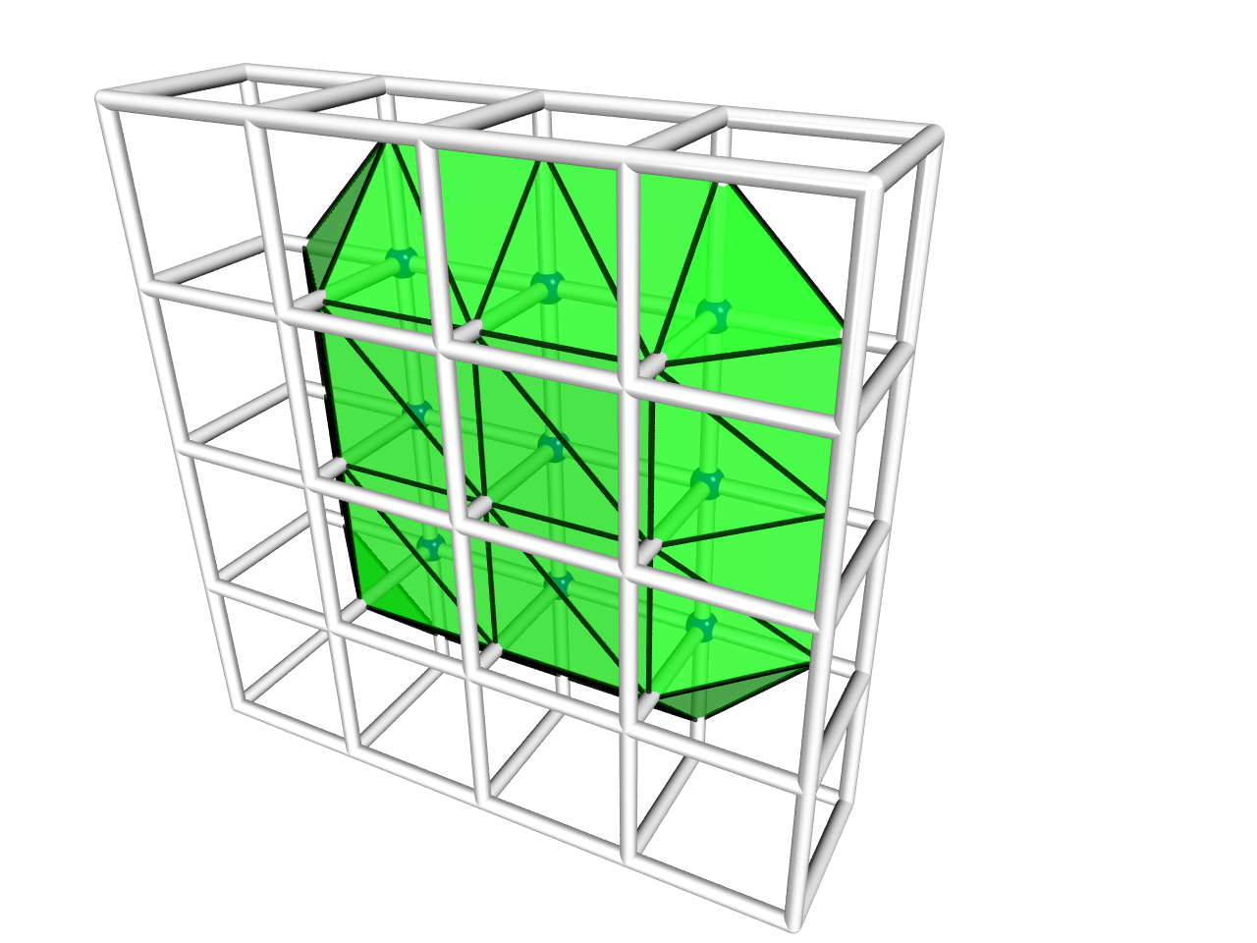
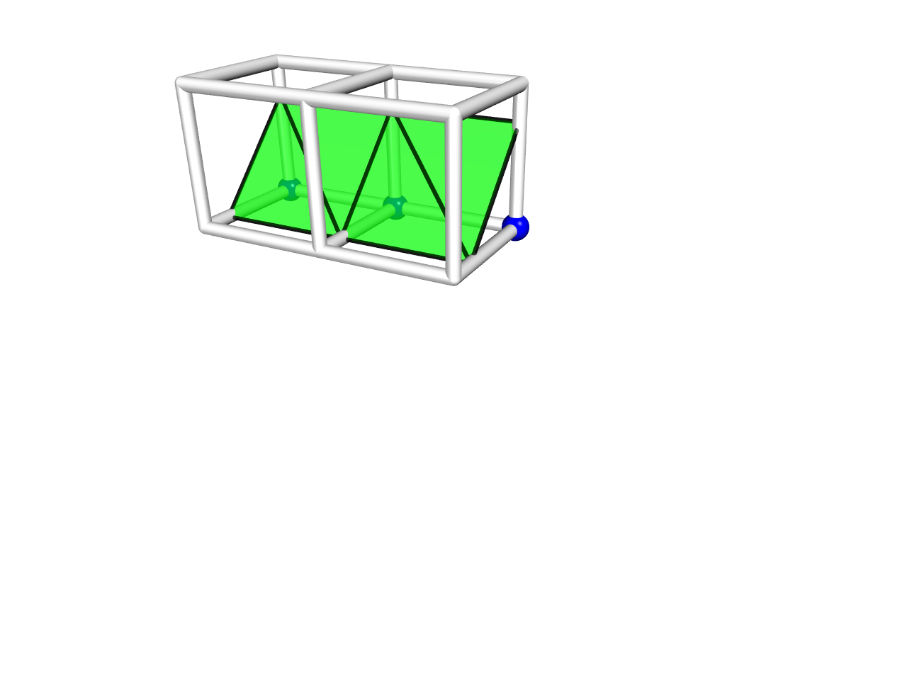
Surface extraction from volume data
Notes:
For instance, a cube in space.
We record this cube in volumetric form, regularly sample a data at each grid point.
For each cube in space, we look up the table, find a suitable pattern, and generate surface one by one.
This is the procedure of marching cubes.
In the following slides, we use these 2 cubes to illustrate the 4 problems.

Slide 8
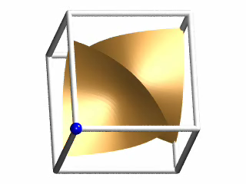
Consistent topology
Consistent
Topology
Ambiguity problems
  [NIELSON G. M., HAMANN B. 1991]
  [NATARAJAN B. K., 1994]
  [CHERNYAEV E., 1995], etc.
Notes:
The first problem is related to consistent topology.
Cubes classified in the same marching cubes pattern may have various topology.
As shown on the screen, there are 2 possible topology: 2 disk like patch, one cylindrical patch.
Also, the topologies of successive cubes could be inconsistent.

Slide 9
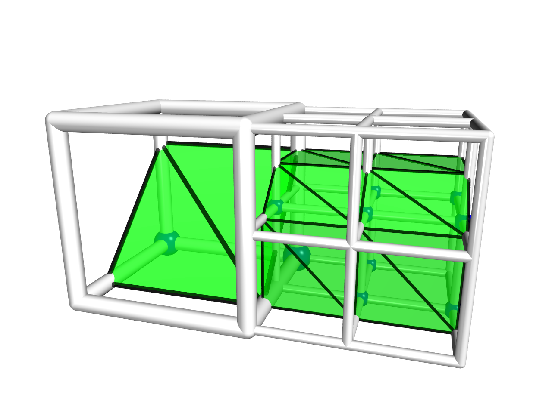
Adaptive resolution
Adaptive Resolution
  [WILHELMS J., GELDER A. V.,1992]
  [SHU R. et al, 1995], etc.
Notes:
The second problem is related to adaptive resolution.
With adaptive resolution, we can use higher resolution for regions with complex shapes, use lower resolution to save memory for regions with smooth shapes.
In other words, use the same size of memory, we can show more detail in adaptive resolution.

Slide 10
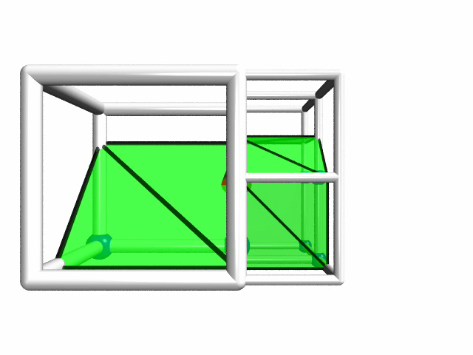
Adaptive resolution
Adaptive Resolution
Notes:
However, they can result in cracks. As we can see here, the left side is a single cube in lower resolution, and the right side is some cubes in higher resolution.
We split up these 2 cubes, then we find the crack.
At the left side, on the face, there is a single line represents the surface in lower resolution. At the right side, there are 3 lines represent the surface in higher resolution. Thus, the more precise data in higher resolution make the crack happens.
We can clearly see this crack in different view.

Slide 11
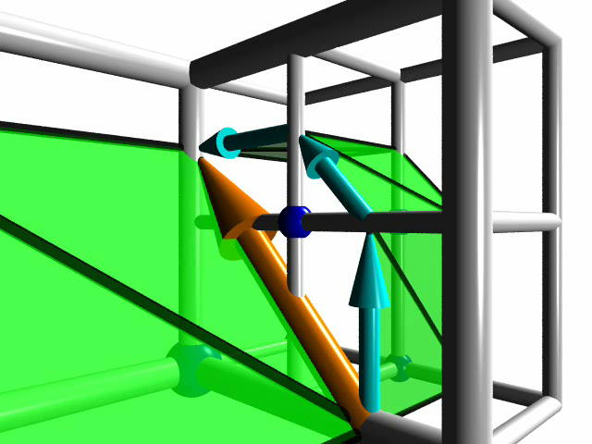
Crack patching
Adaptive Resolution
Notes:
Cracks are not nature. And it should be fixed. Traditionally, crack patching is applied to fix this problem. The idea is by fitting high resolution data to low resolution data. This process shows in the video. Now, cracks are fixed. But, we can found that these exact samples move to different locations. This makes the error higher after patching. Moreover, sample points belong to a cube may outside the cube. This makes difficulty in processing these data.
* Therefore, instead of cubes, we opted to use square as the basic element to overcome this problem.

Slide 12
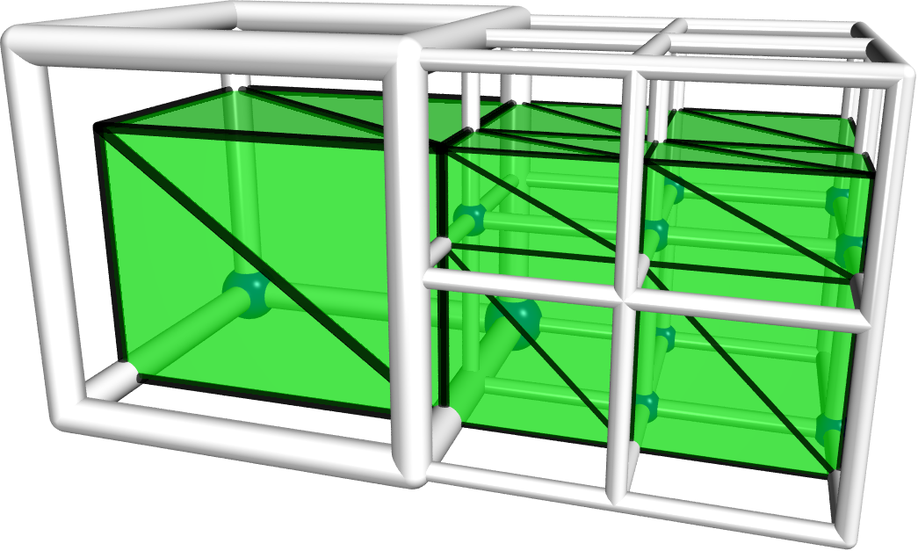
Sharp feature
Sharp Features
  [KOBBELT L. P. et al, 2001]
  [JU T. et al, 2002]
Notes:
The third problem is the inability to preserve sharp features.
As shown on the screen, the sharp edge of the cube become a flat surface.
It will be better if we can preserve the feature as this.

Slide 13
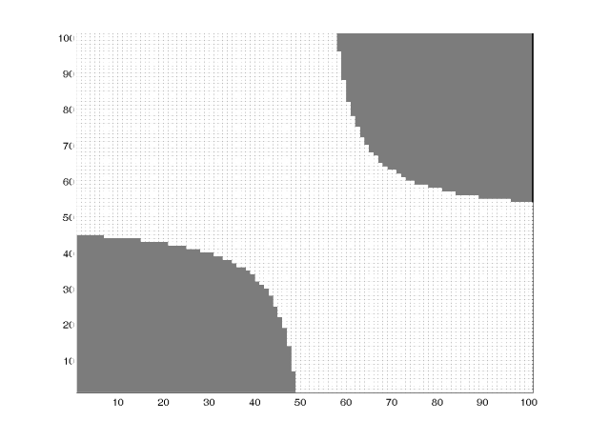
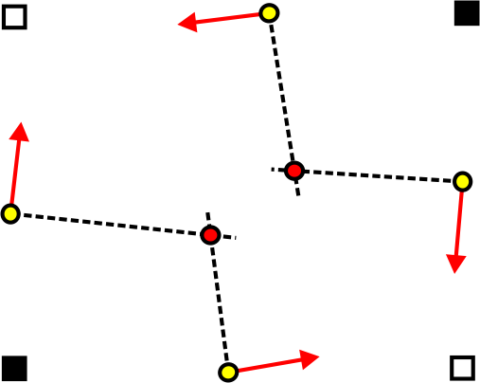
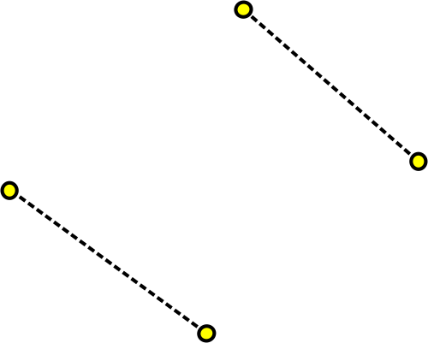
Hermite data
Sharp Features

Slide 14
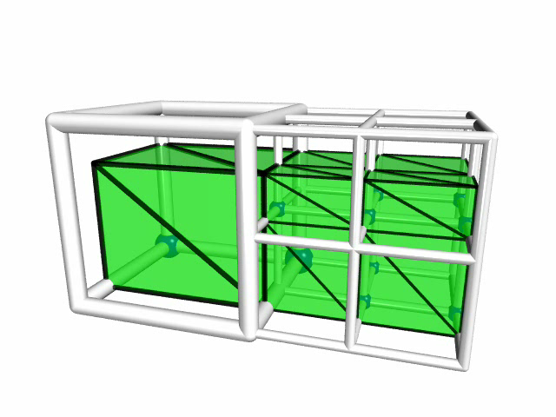
Realtime
Notes:
Finally, marching cubes algorithm can process in parallel.
We can SEE the parallelizability as this. Cubes can be disjoint in space.
That means, there is no dependency between cubes.
However, sharp-feature-preserving algorithms introduce another problem, inter-cell dependency.

Slide 15
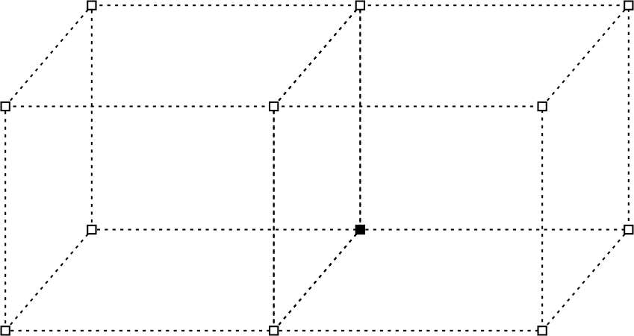
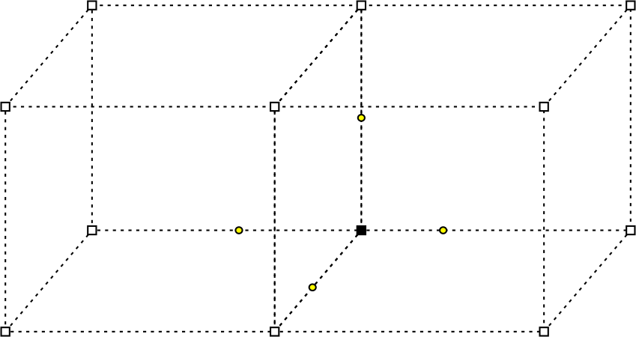
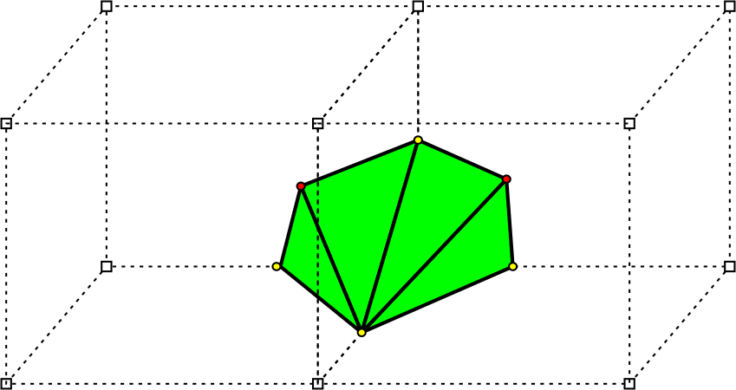
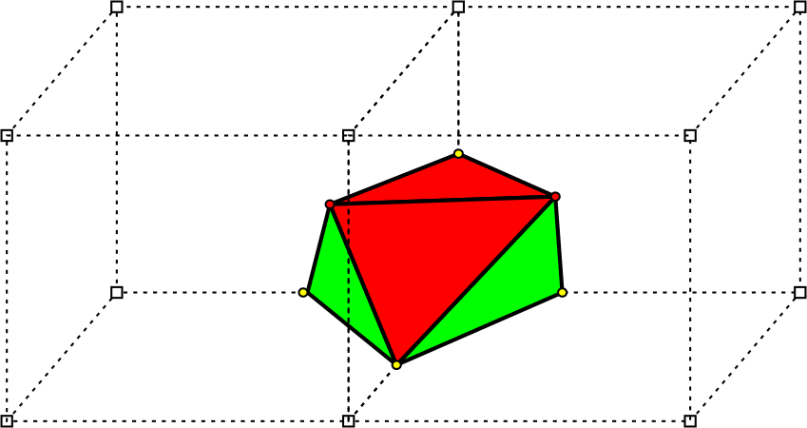
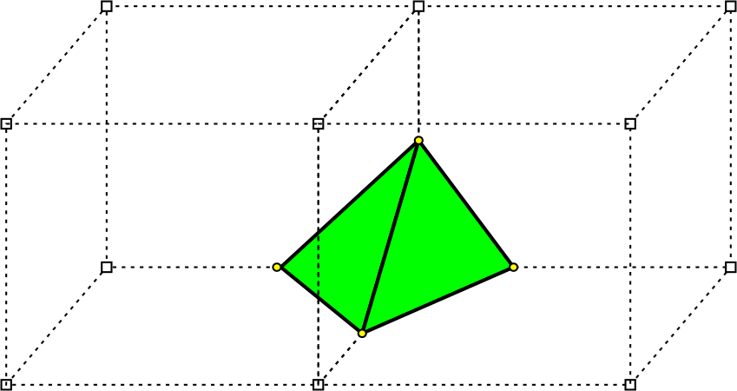
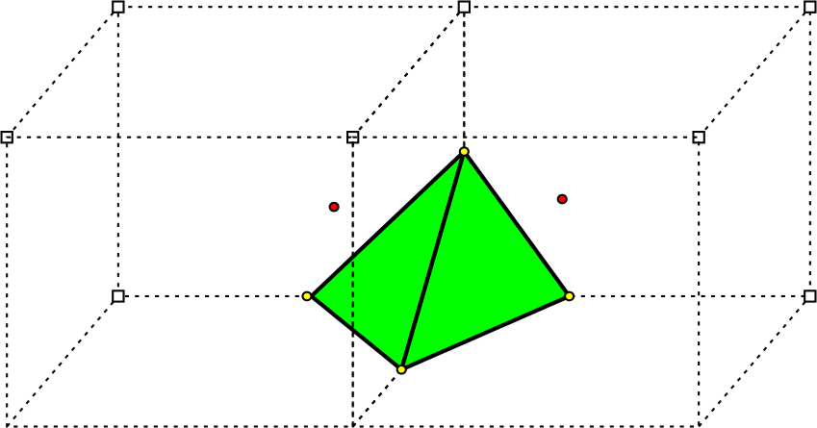
Inter-cell dependency
Real-time
Notes:
For instance, we provide a example to show why previous methods cause inter-cell dependency. And, how we solve this problem.
For 2 successive cubes with a vertex marked inside. The process of EMC is as following.
Firstly, we get 4 samples on these sign change edges. Then, we generate triangle according to the look up table of marching cubes.
Sampling the sharp features.
Doing edge flipping.
Comparing the shapes before and after the flip.
We found the triangle in red color across 2 cubes. That means, after this step, the left cube requires information from the right cube.
And, so is the right cube. The flip makes the dependency arise.
The difference before and after the flip on the interfacing face are shown here (on the right of the screen).
EMC flips an edge to restore the lost information, the sharp feature, on the interfacing face.
In CMS, we do sample sharp features on the faces. Thus, no inter-cell dependency arise while preserving sharp features.

Slide 16
Previous work
& Problems
Solutions
Results &
Conclusions

Slide 17
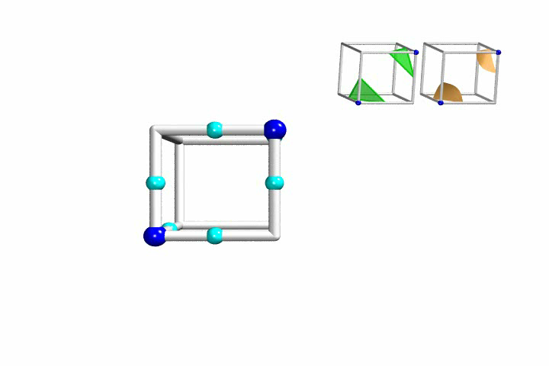
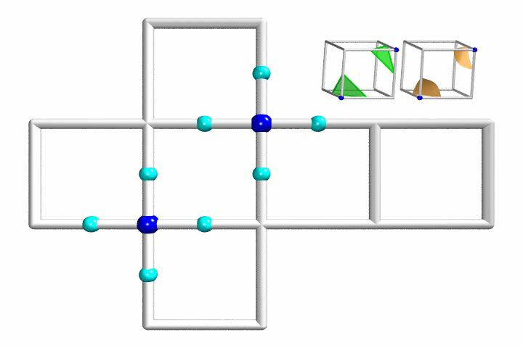

Cubical Marching Squares
Adaptive Resolution
Notes:
Therefore, instead of cubes, we opted to use square as the basic element to overcome this problem.
The process could be visualize as unfolding cubes into squares.
First of all, we process each face independently to determine its topology and sharp features. Then, we re-composite squares back to cubes. Last of all, we generate surface according to previous collected information.

Slide 18

CMS Algorithm
Notes:
We summarize the CMS algorithm as this pseudo code.

Slide 19


CMS Algorithm
Notes:
Firstly, the input is hermite data, a set of sample points which record locations and normal directions.

Slide 20

CMS Algorithm
Notes:
We start from a very coarse uniform base grid.

Slide 21

CMS Algorithm
Notes:
Then, we construct adaptive cells by a heuristic method of subdivision.
We use higher resolution for a region with the tendency to contain a complicated surface.
When subdividing a cell, we subdivide its faces first, and the relationships between subcells and subfaces are recorded.
Note that, a face is shared by 2 cubes. Thus, this method guarantees the consistency between successive cubes.
.

Slide 22

CMS Algorithm
Notes:
Then, generating segments for each leaf face for sharp features and topology.
This process can be summarized as following.

Slide 23



Analysis of face ambiguity
Consistent
Topology
Separated
Joined
Notes:
There are 2 feasible assignments for this case. Separated and Joined.
These 2 vertices are separated by the shape. Or, joined.
As EMC and DC, we use the Hermite data to detect and to sample the sharp features.
We can have tangent lines from the normal direction of samples. Then, the intersection of the tangent lines is the sharp feature.
After that, we analysis the separated case and joined case.
We found that the segments with sharp features overlap each other in joined case.
Thus, we may distinguish separated and joined cases by overlap detection.

Slide 24








Resolving face ambiguty
Consistent
Topology
Notes:
For instance, we shows an example of 2 successive fill operations to illustrate this idea.
We apply a fill operation on the left-lower corner. Then, we apply the same operation on the right-upper corner.
After that, the hermite data is as this. According to the lookup table, we use the separated pattern.
Then, the segments overlap. More precisely, the hermite data describes a volume and a volume should not intersect itself.
Thus, we choose the assignment without feature overlaps. Then, we get the correct result.
In addition to a static case, we provide a video to show the detection is smooth under various situations.
2 boxes move toward together, then separating. As you can see here, the segments are detected correctly with the motion.
Let’s go on to the problem of inter-cell dependency.

Slide 25


Algorithm – CubicalMarchingSquares
Notes:
Finally, extracting surfaces for each cell.
We sample sharp features for each component as EMC does.
Then, generate triangle fans.

Slide 26



Transition Face
Adaptive Resolution
Notes:
Because we use highest resolution data on the faces in each cube. Thus, With this, being adaptive without cracks is achieved in the manner of nature.
The video on the left shows the result of CMS.
Comparing these figures, we can see the face do the transition between different resolution. The cyan and orange lines are exactly the same on both side.
Let’s go on to problems in squares.

Slide 27





Inter-cell independency
Real-time
Notes:
Let’s go on to the problem of inter-cell dependency.
For instance, we provide a example to show why previous methods cause inter-cell dependency. And, how we solve this problem.
For 2 successive cubes with a vertex marked inside. The process of EMC is as following.
Firstly, we get 4 samples on these sign change edges. Then, we generate triangle according to the look up table of marching cubes.
Sampling the sharp features.
Doing edge flipping.
Comparing the shapes before and after the flip.
We found the triangle in red color across 2 cubes. That means, after this step, the left cube requires information from the right cube.
And, so is the right cube. The flip makes the dependency arise.
The difference before and after the flip on the interfacing face are shown here (on the right of the screen).
EMC flips an edge to restore the lost information, the sharp feature, on the interfacing face.
In CMS, we do sample sharp features on the faces. Thus, no inter-cell dependency arise while preserving sharp features.

Slide 28
Previous work
& Problems
Solutions
Results &
Conclusions
Notes:
Let’s move on to Results & Conclusions.

Slide 29


Simulation
Available shapes
generated randomly in a limited space
Notes:
To compare CMS with EMC and DC quantitatively, we design a simulator. Several basic shapes are
generated randomly in a limited space and their union is used as the input model. We first convert it into Hermite data and
apply EMC, DC and CMS to this model to extract surfaces. We then measure the geometric distances between the resulting
surface for each method and the input model.

Slide 30

Average geometric errors
Notes:
This table summarizes the average error for each case of the marching cube
lookup table for each method. CMS has the lowest errors for all cases.

Slide 31

Error distribution
Average Error
Maximum Error
Notes:
This table summarizes the error distribution for each method. Most the error of CMS are in the lowest part.

Slide 32
Comparison
Real-time
Sharp Features
Consistent
Topology
Adaptive Resolution
MarchingCubes
«
TopologicalMarchingCubes
«
«
ExtendedMarchingCubes
«
DualContouring
«
«
CubicalMarchingSquares
«
«
«
«
Notes:
This table summarizes the comparison of the five related methods, original marching cubes (MC), topology-consistent marching cubes (TMC), extended marching cubes (EMC), dual contouring (DC) and our method (CMS).
Note that previous methods could be combined, but sometimes, such a combination might not be straightforward.
Hence, we make this table by only considering the original version of each method.

Slide 33

Benefits - inter-cell independency
1.Faster 2.Parallelizable 3.Lower Error
Notes:
This video shows the benefit of inter-cell independency.
The process could be faster and it can process in parallel.
Moreover, the error can be lower, because a error can be localize in a cell. Comparing to others with dependency, errors wouldn’t propagate to other cells.

Slide 34

Benefits - consistent topology
1. Correct Shape 2. Lower Error
Notes:
This video shows the benefit of consistent topology. A case in our six million simulation cases. Comparing to the source model, the result of CMS is exactly the same as the source. Other methods produce wrong shapes.

Slide 35

Benefits - consistent topology
1. Correct Shape 2. Lower Error
Notes:
Instead of static scene, this video shows a dynamic scene, which shows the benefit of consistent topology.
2 blue boxes move around between separated and joined together.
We can see CMS always produces correct sharp.
Others may result in wrong topology.

Slide 36

Benefits – adaptive & crack free
1. Smooth Shape 2. Reduce 3D ➔ 2D
Notes:
This video illustrate the unfolding process visually. As we previously discussed, it reduces 3D problem to 2D and produces smooth shapes.

Slide 37




Virtual Sculptor
Notes:
We demonstrate several possible applications here. Firstly, a virtual sculptor. Basically, it process CSG operations in real-time.
The blue transparent sphere is the tool for sculpting. The figures on the right are close-up views of the left-lower figure. We can see the resulting model preserves sharp features well.

Slide 38




Remeshing
Notes:
Secondly, remeshing. The source is provided on the left and the remeshing result is on the right. The lower pictures are close-up views.
We can see the mesh of the source is kind of irregular. After remeshing, mesh could be regular, it may suitable for simulation.
However, the source model is optimized for space. We can not judge which one is better.

Slide 39



CSG & LOD
Notes:
Last of all, Level of detail. Extracting different depth of the cells can produces different level of detail.

Slide 40
Conclusions
Real-time
Sharp Features
Consistent
Topology
Adaptive Resolution
Inter-cell dependency is eliminated.
Sharp features are well preserved.
Topologies are well preserved by examining the sharp features.
Our method generates surface adaptively without cracks.
Computation can be accelerated using programmable graphic hardware.
It is easy to incorporate our algorithm into the existing marching cubes implementations.
Notes:
Finally, conclusions.
The CMS algorithm has the following features.
For real-time, inter-cell dependency is eliminated.
For sharp features, they are well preserved.
For consistent topology, topologies are well preserved by examining the sharp features and shared components guarantee the consistency.
For adaptive resolution, our method generates surface adaptively without cracks.
Moreover, computation can be accelerated using GPU.
And, It is easy to incorporate our algorithm, or part of it, into the existing marching cubes implementations.

Slide 41

Acceleration using GPU
Real-time
Packing
Bus
Computing
Bus
Unpacking
Notes:
Furthermore, without inter-cell dependency, acceleration of CMS using GPU is easy.
We pack the data in textures. Through the bus. The shader takes the data, then, computes sharp features and topologies in 2D.
Finally, unpacking the data, get the results.
We observe a 8-16 times speed up in our current GPU implementation compare to our CPU implementation.
However, the over all speed is only comparable to our CPU implementation. As many other GPU algorithms, the bottleneck
is the data transfer between CPU and GPU.
Let’s move on to Results & Conclusions.

Slide 42
Future work
Full GPU implementation
Applying CMS to distance fields
Notes:
There are a lot of future works, but we list 2 of our current working researches.
First of it is Fully implement the GPU version of CMS algorithm.
This may save the time wasted in bus transfer.
Second of it is applying CMS to traditional distance fields.
We wish it can explore more detail than previous methods.
This is my presentation for today. Thanks for your attending.

