Slide 1
High Dynamic Range Image Reconstruction from
Hand-held Cameras
Pei-Ying Lu Tz-Huan Huang Meng-Sung Wu Yi-Ting Cheng Yung-Yu Chuang
National Taiwan University
Notes:
Good afternoon. I will present the paper “high dynamic range image reconstruction from hand-held cameras” co-authored by 呂培瑛, 黃子桓, 吳孟松, 鄭逸廷, and 莊永裕.

Slide 2
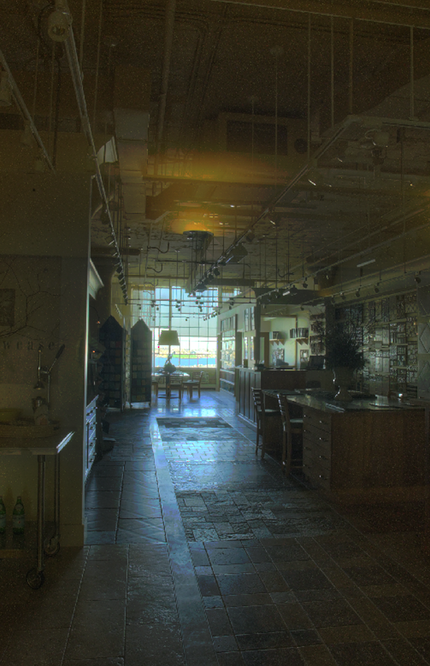
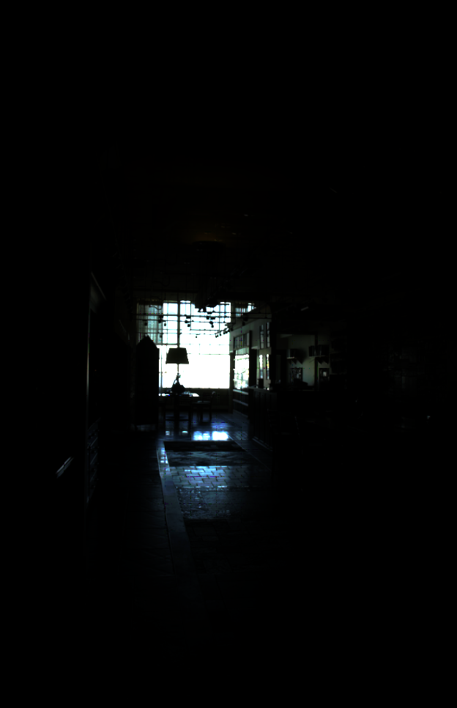
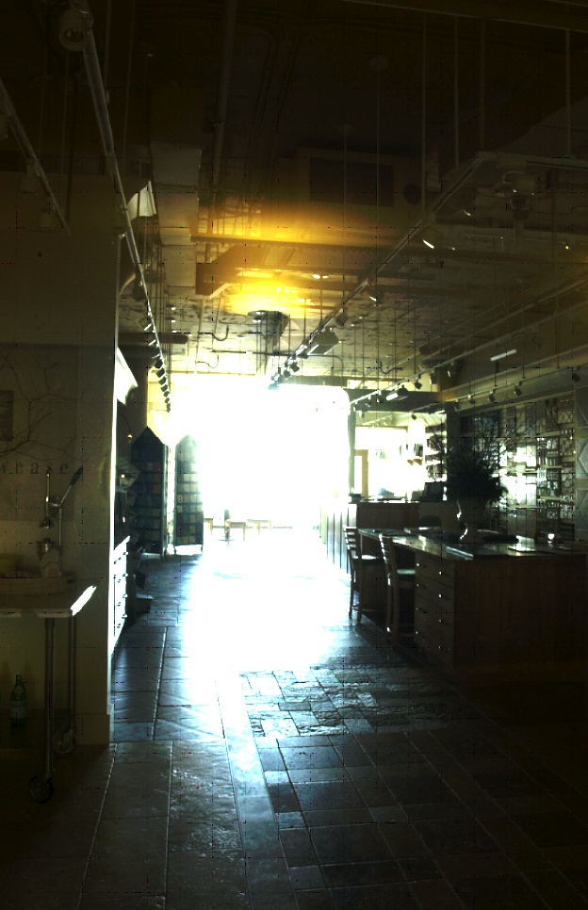
The world is of high dynamic range
scene
short exposure
long exposure
Notes:
Our world is of high dynamic range. For the scene shown here, the ratio between the brightness and the darkest points could be more than tens of thousands. Unfortunately, limited by its capability, a camera often cannot capture the whole dynamic range in a single shot. When we take a picture to this scene with a short exposure, we miss the details for the interior of the room. If taking a picture with a long shutter speed, we lost the details for the outside.

Slide 3
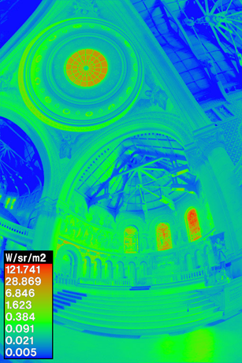
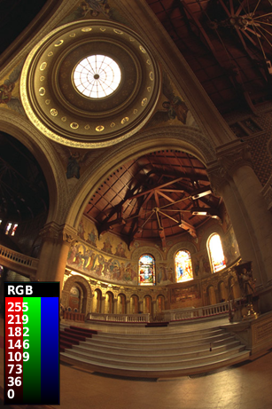
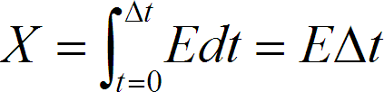

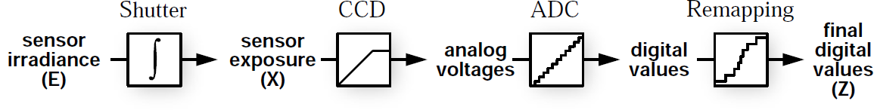
Camera pipeline
E
Z
Notes:
Consider a scene shown here with full high dynamic range. Called the irradiance image E. For a given shutter speed delta t, the camera accumulates the exposure X, which equals E times delta t. The exposure is further processed by the pipeline, clamped by the capacity of the CCD array, quantized by analog-to-digital converter and nonlinearly mapped to give the intensity Z. The mapping between the exposure and the intensity can by modeled by a camera response function f as shown here.

Slide 4
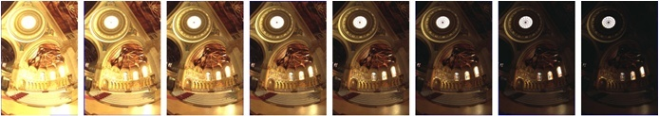


HDR image reconstruction
Notes:
To recover the irradiance image E, we can take a series of LDR images Z_i with different exposures. With this set of images, many algorithms can be used to recover both the camera response function and the irradiance image.

Slide 5
HDR image reconstruction
Recovering High Dynamic Range Radiance Maps from Photographs, SIGGRAPH 1997.
Radiometric Self Calibration, CVPR 2001.
Estimation-theoretic approach to dynamic range enhancement using multiple exposures, JEI 2003.
All assume static cameras and thus require tripods.
Notes:
Several algorithms have been proposed for HDR construction with different models for camera response curves.
However, all these algorithms require that all the LDR images are aligned pixel-by-pixel. Thus, it is often necessary to use a tripod when taking these pictures. The goal of our paper is to remove such a requirement.

Slide 6
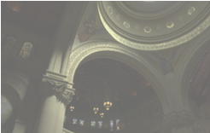
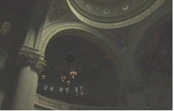
Images from hand-held camera
Challenge #1: image mis-alignment
Notes:
To reconstruct an HDR image without tripods, we have to overcome a couple of challenges. The first challenge is that the images taken with a hand-held camera are mis-aligned.
We used a modified medium threshold bitmap algorithm for solving this problem.

Slide 7
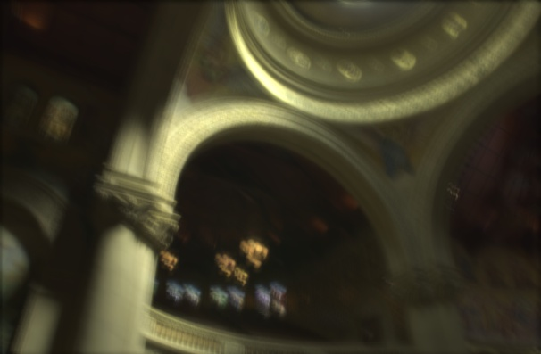
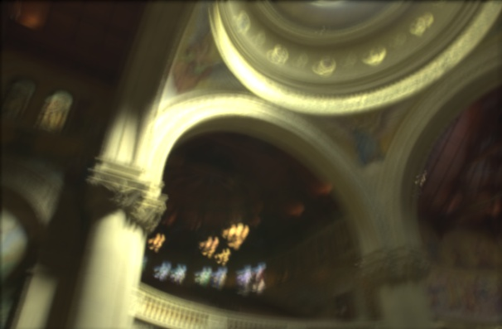
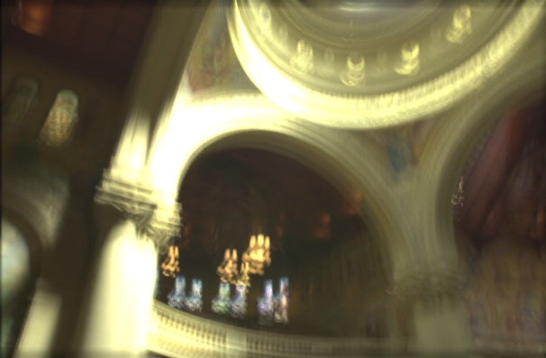
Images from hand-held camera
Challenge #1: image mis-alignment
Challenge #2: image blur
1/64 s
1/32 s
1/16 s
Notes:
Our paper focuses on solving the second challenge, image blur. For long shutter speeds, the taken images are often seriously blurred with a hand-held camera due to camera shake. As seen from the examples shown here, the images are more blurred for longer exposure times.

Slide 8
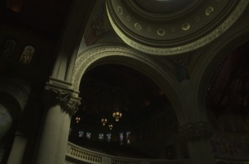
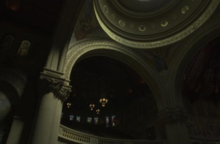
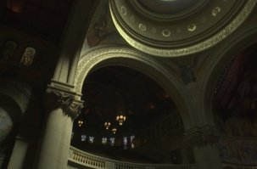

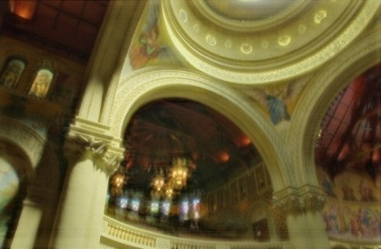
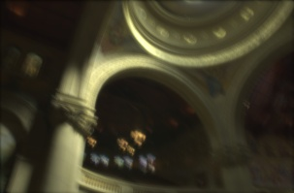
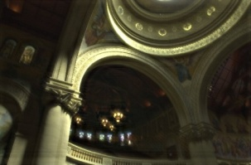
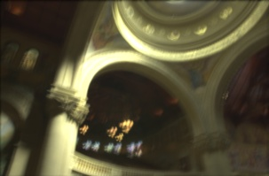
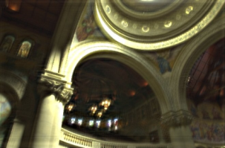

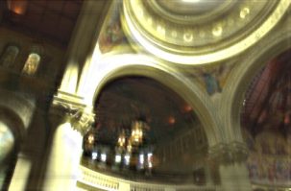
A naïve approach
deblur
reconstruct
Notes:
A naïve solution is to individually deblur the LDR images and then reconstruct the HDR image from the deblurred images.
Many algorithms have been proposed for image deblurring recently.

Slide 9
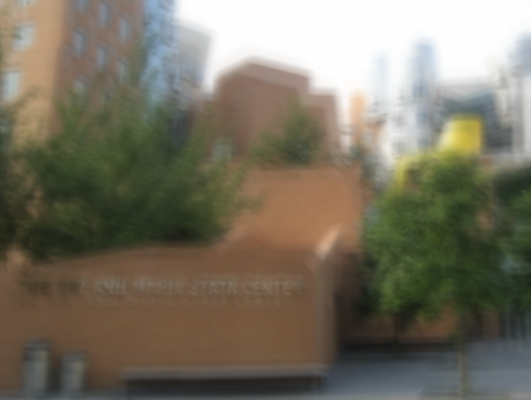
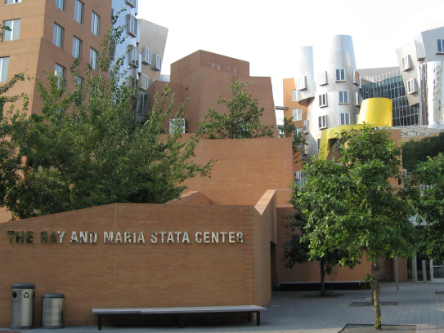
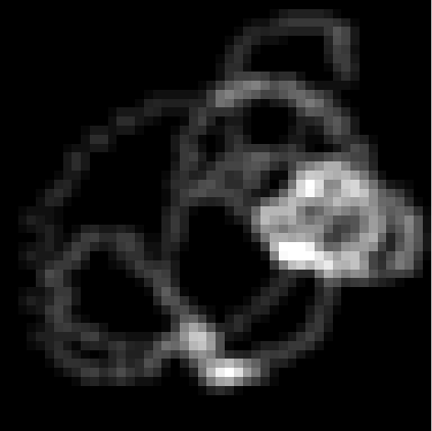
Image blurring process
convolution
=
⊗
blur
kernel
blur image
sharp image
Notes:
Most of these algorithms assume a shift-invariant blur kernel. Thus, the blur image is formed by the convolution of the kernel and the sharp image. The goal of image deblurring is thus to recover the blur kernel and the sharp image from the observed blur image.

Slide 10
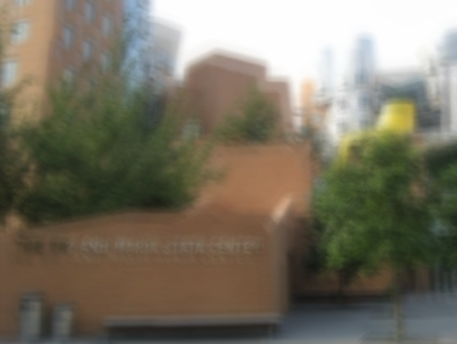

An under-determined problem
=
⊗
=
⊗
=
⊗
Notes:
This problem is unfortunately under-determined. There are multiple kernel-sharp-image pairs that will give us the same blur image shown here.
For example, all these three pairs give the same blur image. Constraints must be added to recover what we want.

Slide 11
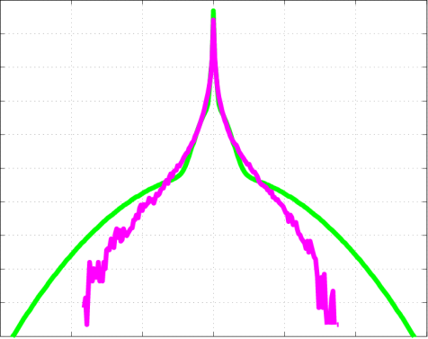
Adding priors
1. Reconstruction constraint:
⊗
=
Input blurry image
Fergus et. al. SIGGRAPH 2006
2. Image prior:
3. Blur prior:
distribution of gradients
positive
& sparse
Notes:
To solve this under-determined problem, in their SIGGRAPH 2006 paper, Fergus et al. added priors,
One for the sharp image by measuring the gradient distribution of the sharp image
And one prior for blur kernel that prefers positive and sparse kernels.
With these priors, this method can reconstruct a sharp image and a kernel from a single blur image.

Slide 12
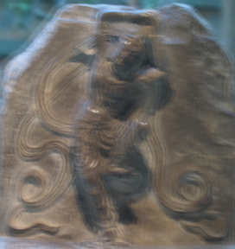
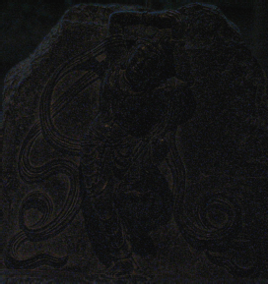
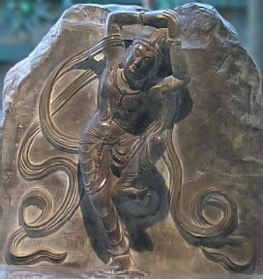
Adding observation (a noisy image)
blurred image
noisy image
deblurred image
Yuan et. al. SIGGRAPH 2007
Notes:
In SIGGRAPH 2007, Yuan et al. proposed a method to deblur images from a blurred and noisy image pair. In addition to the blur image taken with a long shutter speed, a noisy image is taken with a short shutter speed. With this additional observation to the scene, they obtain better results.

Slide 13
A naïve approach
deblur
reconstruct
Notes:
Unfortunately, when applying these deblurring algorithm to our problem, we did not get satisfied results.
Fergus’s algorithm deblurs each image separately. Thus, the recovered high-frequency details for each LDR image are often not spatially coherent and the resulting image often contains artifacts and is still blurred.
We can use Yuan’s method. We use the image with the shortest exposure time as the noisy image to deblur other images with longer shutter speed. Although all images are somehow coherent to the darkest image, the resulting image often contains aliasing artifacts.

Slide 14
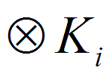
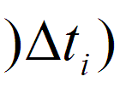

Image formation model
Observed LDR images
Exposure time
Camera curve
Irradiance
Blur kernels
Notes:
To address this problem, we intend to use all images to reconstructed the HDR image. For this purpose, we first formulate the image formation process for the images taken with a hand-held camera.
This is the image formation model we used for traditional HDR reconstruction algorithms. Scene irradiance image E is exposed for a given shutter speed delta t_i, and the exposure E times delta_t_i is mapped to an intensity value Z_i by the camera response function f.
When taking with a hand-held camera, the irradiance image is first convolved with a blur kernel K_i describing the camera shake during exposure. The blurred irradiance is then multiplied by delta_t_i and mapped by the camera curve f to give us the observed blurred LDR image Z_i.
Here, f, E and K_i are unknows
And Z_i and delta_t_i are given.
The goal of our method is to recover the unknows f, E and K_i from the observation Z_i and known exposure time delta_t_i

Slide 15
Bayesian framework
Notes:
We formulate it using the Bayesian framework. Given the observations Z_i, the idea is to find the optimal E, f, and Ki that maximize the probability. Since we have multiple observations, we do not add priors and turn the problem into a maximal likelihood problem.
It leads to the following energy minimization problem as highlighted here.

Slide 16
Bayesian framework

Slide 17
Iterative solution
Fix E, f to solve K_{i}
Fix K_{i,} f, to solve E
Fix E, K_{i} to solve f
Notes:
To solve the problem, we iteratively solve for one variable at a time while fixing the other two.. In the first step, we fix f and E to solve K_i. Next, we fix f and K_i to solve E. Finally we fix E and K_i to solve f. The process is repeated until the solution converges. In our experiments, the procedure usually converges in less than twenty iterations.
At the beginning, the initial guess of irradiance E is to reconstruct HDR from LDR images directly without deblurring. It is blurred but good enough as the initial guess. The initial guess for kernels Ki are delta kernels, and the initial guess of camera curve is linear mapping.

Slide 18
Optimization of K_{i} and E
Notes:
Here are the details for each steps.
First, the procedure for solving K_i. The convolution can be rewritten as the matrix multiplication form. Thus the optimal Ki can be obtained by finding the least-square solution to the linear system E K equals to B. However this linear system is often ill-posed so we add a regularization term to stabilize the solution. The Landweber method is used to update the Ki iteratively.
Since the convolution operation is symmetric, we can use the similar procedure to solve E when K and f are fixed.

Slide 19
Optimization of f
Notes:
The optimization of response curve function f is similar to Paul Debevec’s work. Let g is the inverse function of f, we add a smooth term to the objective function to ensure the smoothness of the curve. The objective function can be optimized as a linear least square problem, and we use this weighting function to weight the pixel values Z i.

Slide 20
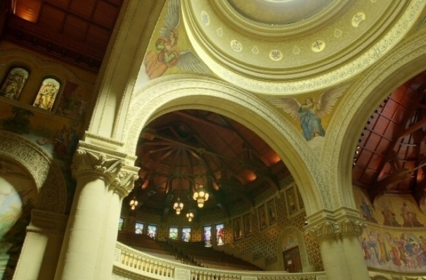

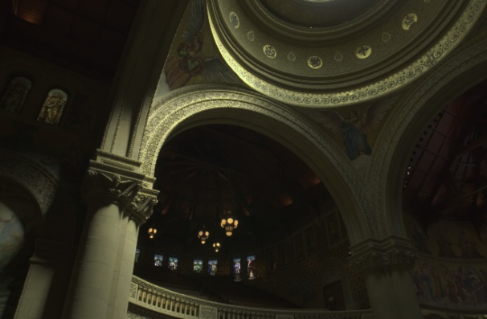




A synthetic example
Groundtruth
1/512
1/256
1/128
1/64
1/32
Notes:
We have tested our method on both synthetic and real examples.
For the synthetic case, we start with an HDR image reconstructed from a series of images taken with a tripod as shown on the top left. From this ground truth, we synthesize five LDR image corresponding to five different shutter speeds. Each of them is blurred with a blur kernel. These kernels are borrowed from those image deblurring papers. Thus, they should be very realistic. We used the camera curve for Canon G7 to map exposures to intensity values.
This set of resulting blurred LDR images is the input to our algorithm.

Slide 21

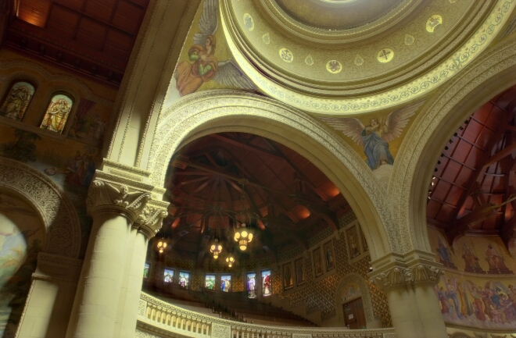


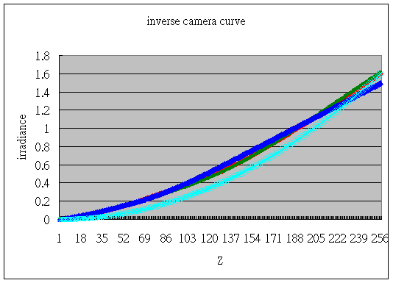



Our results
Groundtruth
Our result
Groundtruth
Our result
Camera curve
Notes:
Here are our results. The left hand side are the groundtruth of irradiance and kernels, and the right hand side are the results of our algorithm. The results look pretty good visually. On the bottom right, we show the camera curve, the light blue line is the groundtruth curve. The red, green and blue ones are the estimated camera curves of three color channels.

Slide 22
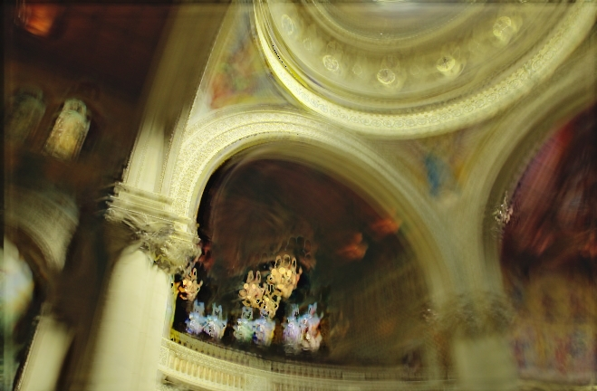

Comparisons
Groundtruth
Our result
Fergus et al.
Yuan et al.
Notes:
Here we show the comparison of the groundtruth, our algorithm and two naïve algorithms using Fergues and Yuan’s methods. Obviously naïve approaches are not good in this case. The reconstructed HDR images are still blurry. The result of Fergus is worse than Yuan’s because it is less coherent. Note that comparisons to Fergus and Yuan’s are not fair as they were not designed to solve the problem. We just use them to illustrate that naïve approaches cannot work well for the problem we want to solve. Thus, it is necessary to devise a new algorithm.

Slide 23
Groundtruth
Notes:
Here are the close-ups. The ground truth

Slide 24
Our result
Notes:
Our result

Slide 25
Fergus et al.
Notes:
Fergus’ result

Slide 26
Yuan et al.
Notes:
And Yuan’s result

Slide 27
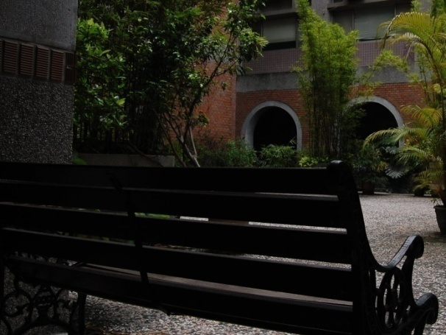
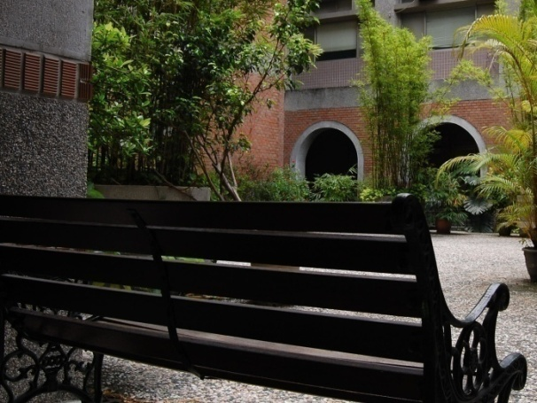
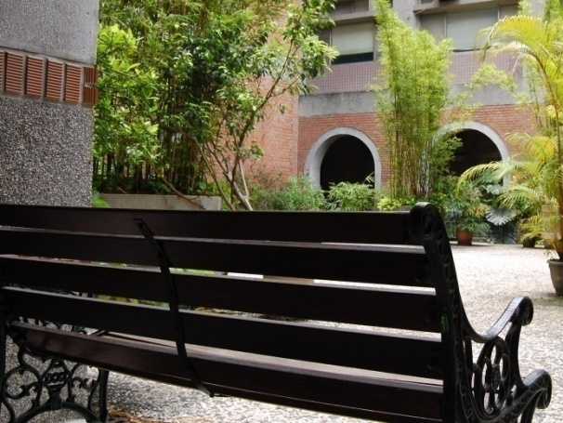
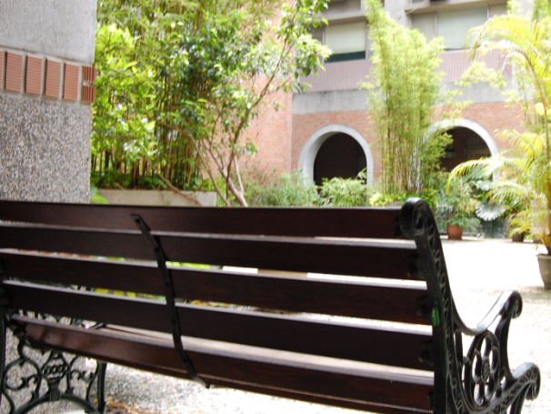
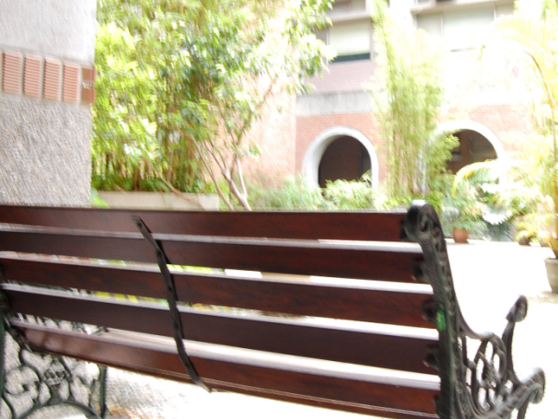
Real example I
1/256
1/128
1/64
1/32
1/16
Notes:
We then show two real examples. Here are the five input LDR images for example 1.

Slide 28
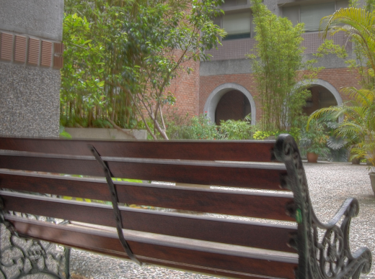
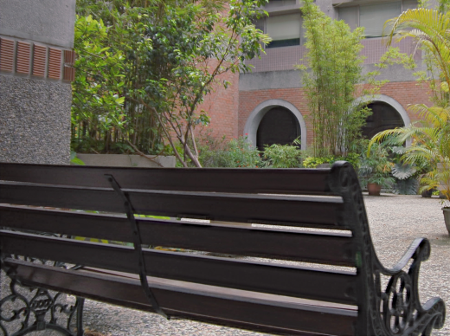
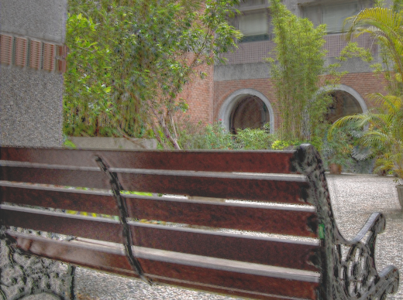
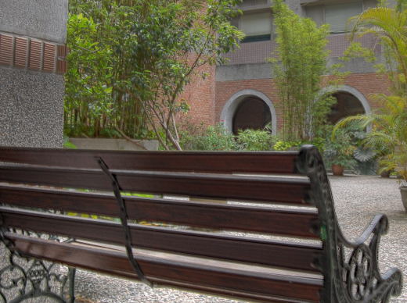
Comparisons
Initial guess
Our result
Fergus et al.
Yuan et al.
Notes:
Here are the results for comparisons. As it is hard to see details from this distance,

Slide 29
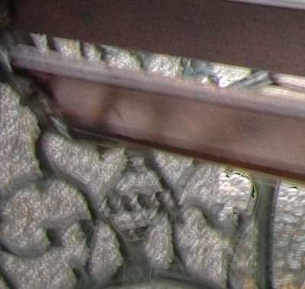
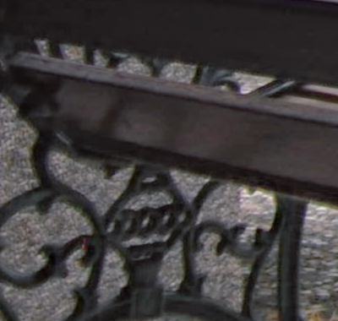
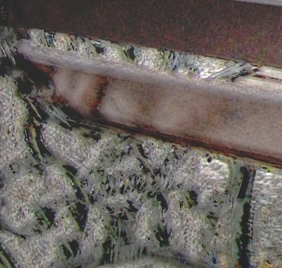
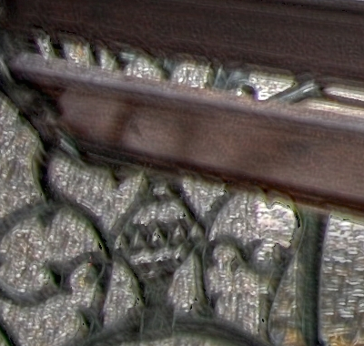
Close-up comparisons
Initial guess
Our result
Fergus et al.
Yuan et al.
Notes:
we show their close-ups here. The top left is the initial guess. The top right shows our result. You can see that the initial guess is blurred and our method shows better results.
The bottom left is Fergus’s and the bottom right is Yuan’s. Both contains artifacts.

Slide 30
Initial guess
Notes:
Here, we show the larger close-up for more details. Here is the initial guess.

Slide 31
Our result
Notes:
Our result

Slide 32
Fergus et al.
Notes:
Fergus’s result

Slide 33
Yuan et al.
Notes:
And Yuan’s result. Again, Yuan’s result is better than Fergus’s as it guarantees more coherence by aligning all images to the darkest image.

Slide 34





Real example II
1/64
1/32
1/16
1/8
1/4
Notes:
Here are the inputs to another real example.

Slide 35




Comparisons
Initial guess
Our result
Fergus et al.
Yuan et al.
Notes:
The results.

Slide 36




Close-up comparisons
Initial guess
Our result
Fergus et al.
Yuan et al.
Notes:
The close-ups for more details. Similarly, Fergus result contains artifacts. Interestingly, in this example, Yuan result seems sharper than our result. However, we found that the recovered high-frequency component are more high-frequency aliasing than details.

Slide 37
Initial guess
Notes:
The close-up for the initial guess

Slide 38
Our result
Notes:
Our result

Slide 39
Fergus et al.
Notes:
Fergus result. It is blurry and contains artifacts.

Slide 40
Yuan et al.
Notes:
Yuan result. As we mentioned, it seems to recover more high-frequency details. However, when looking closely, the vertical stripe pattern of the wall is replaced by ripples. Thus, even if the HDR may contain more high-frequency, some of them are aliasing instead of details.

Slide 41
Conclusions
A technique for reconstructing a non-blurred HDR image from a set of differently exposed and blurred images taken with a hand-held camera.
A unified formulation for recovering the irradiance image, blur kernels and the camera response curve.
Notes:
In this paper, we introduce the problem of reconstructing HDR images from potentially blurred LDR images with different shutter speeds.
We formulate the problem and propose a method to solve for the irradiance image, blur kernels and camera response curve simultaneously. The results are better than naïve methods.

Slide 42
Future Work
Adding priors for kernels, HDR images and camera curves.
Handling the shift-variant cases.
Notes:
The equation in our model is an ill-posed linear system, so the regularization term is involved to solve the system. In the current implementation, the kernel and HDR images are assumed to be Gaussian models. This could be far from true. We expect the results will be better if we use better priors. Another issue is the blur model, most proposed work assumed the blurring is a convolution of image and kernel. This might not always be practical. It is possible to model blur in a shift-variant way to make deblurring and our work more useful and reliable.
These concluse my talk, thank you for attention.

Slide 43
Thanks you for listening.

