Slide 1
Image stitching
Digital Visual Effects
Yung-Yu Chuang
with slides by Richard Szeliski, Steve Seitz, Matthew Brown and Vaclav Hlavac

Slide 2
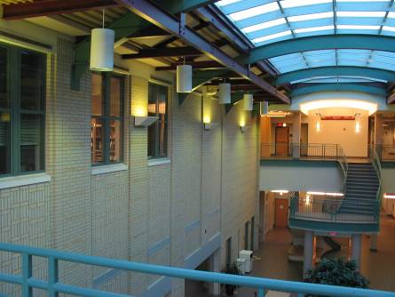
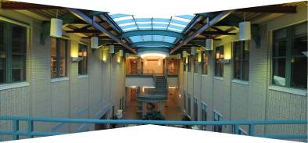
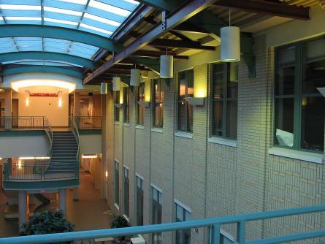
Image stitching
Stitching = alignment + blending
geometrical
registration
photometric
registration

Slide 3
Applications of image stitching
Video stabilization
Video summarization
Video compression
Video matting
Panorama creation

Slide 4
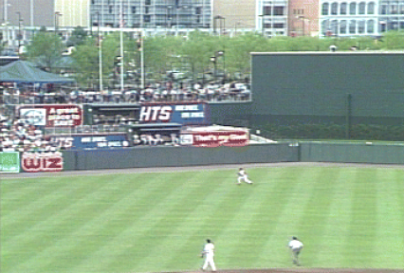
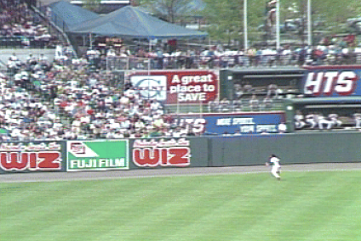
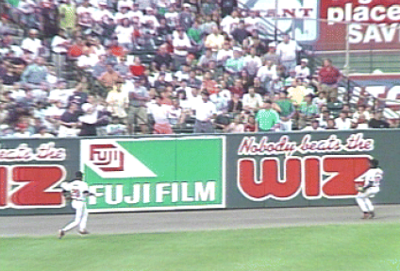
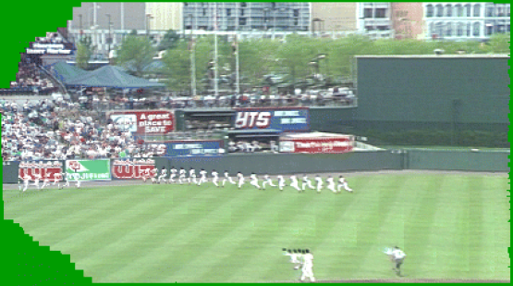
Video summarization

Slide 5
Video compression

Slide 6
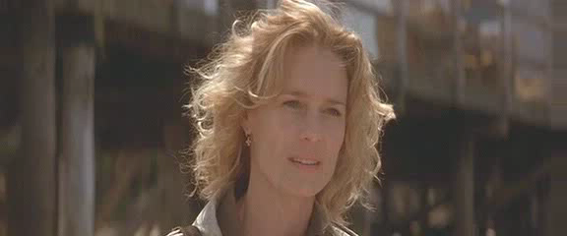
Object removal
input video

Slide 7
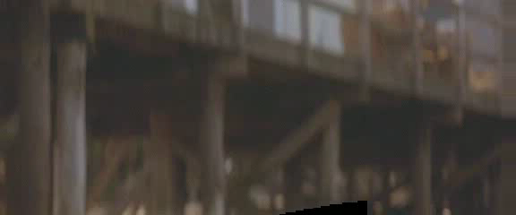
Object removal
background estimation

Slide 8
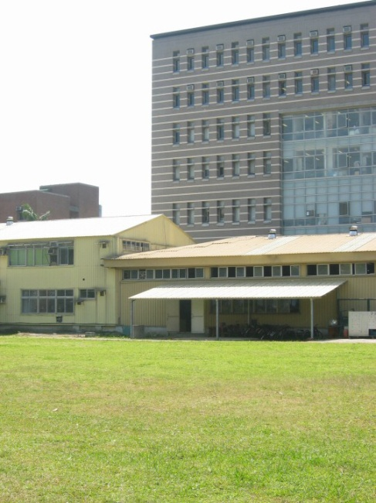
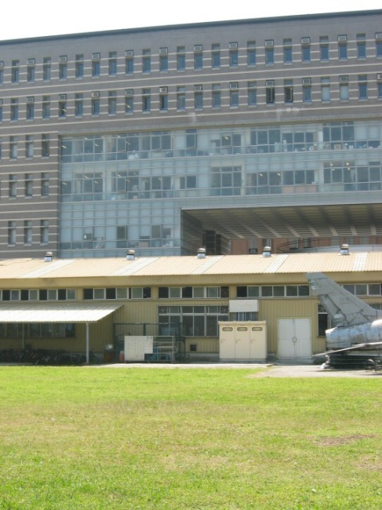
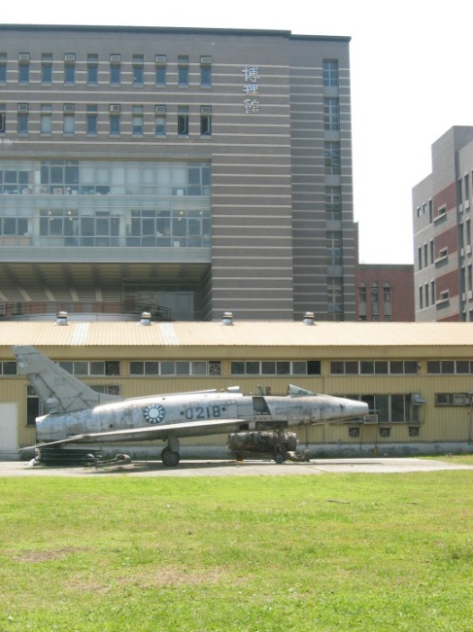
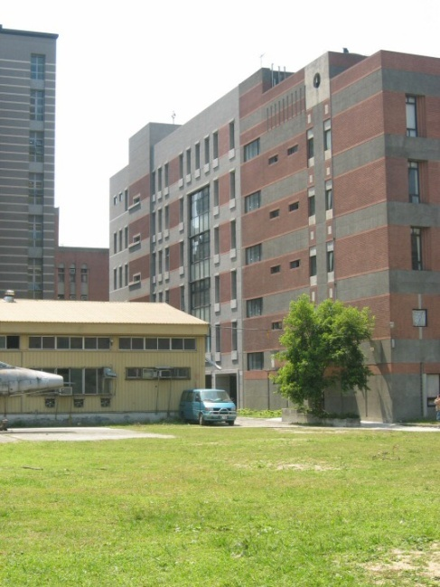
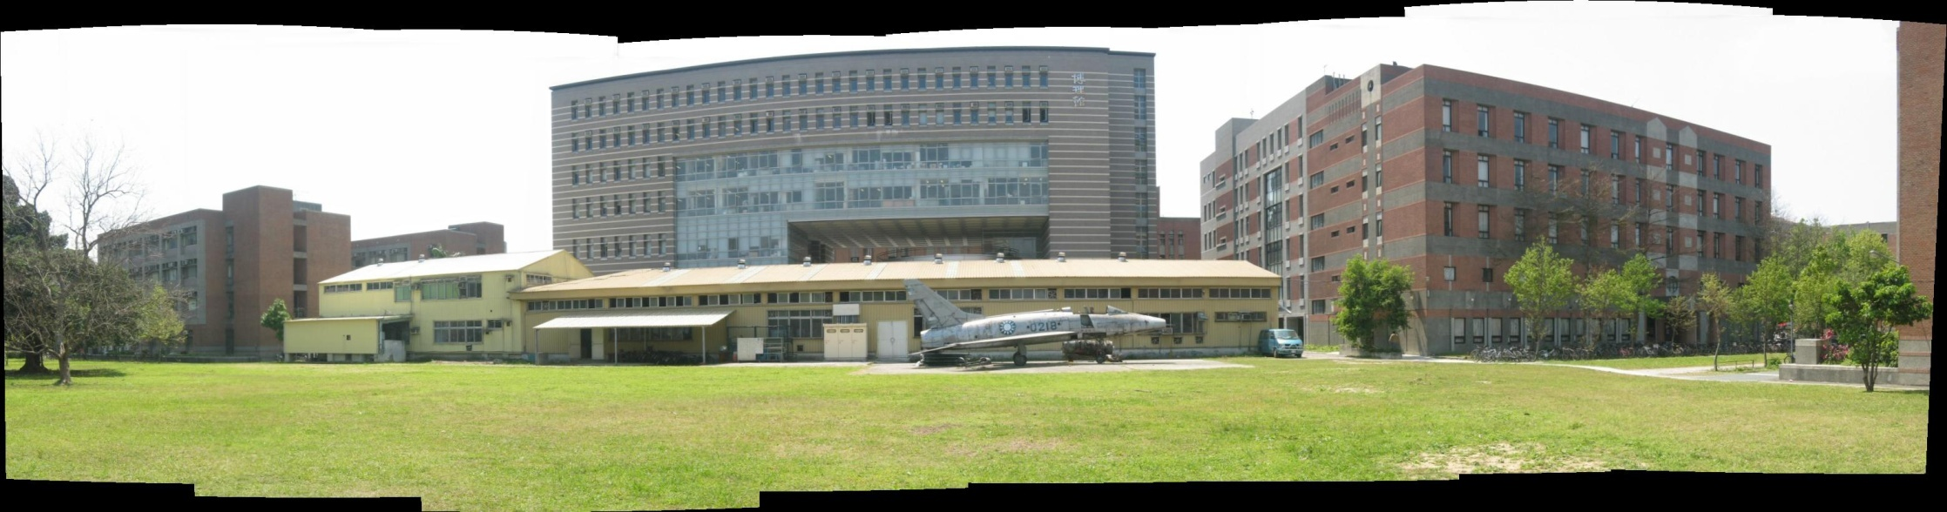
Panorama creation

Slide 9

Why panorama?
Are you getting the whole picture?
  Compact Camera FOV = 50 x 35°

Slide 10
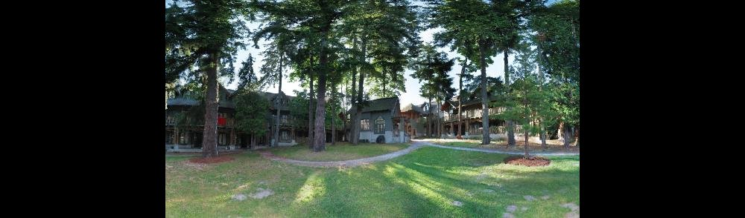
Why panorama?
Are you getting the whole picture?
  Compact Camera FOV = 50 x 35°
  Human FOV = 200 x 135°
Notes:
200度包括轉頭?

Slide 11
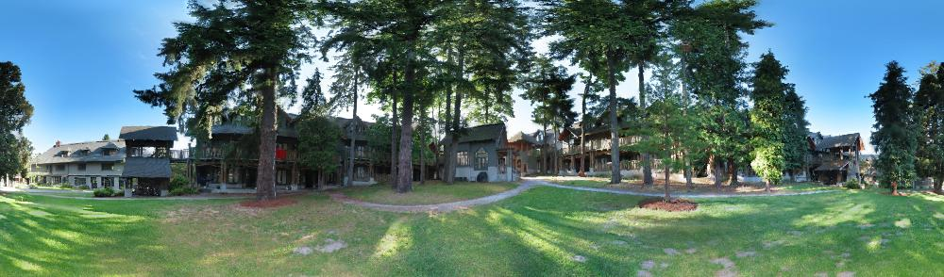
Why panorama?
Are you getting the whole picture?
  Compact Camera FOV = 50 x 35°
  Human FOV = 200 x 135°
  Panoramic Mosaic = 360 x 180°

Slide 12
Panorama examples
Similar to HDR, it is a topic of computational photography, seeking ways to build a better camera using either hardware or software.
Most consumer cameras have a panorama mode
Mars:
http://www.panoramas.dk/fullscreen3/f2_mars97.html
Earth:
http://www.panoramas.dk/new-year-2006/taipei.html
http://www.360cities.net/
http://maps.google.com.tw/
Notes:
中正紀念堂 photo tourism style browsing

Slide 13
What can be globally aligned?
In image stitching, we seek for a matrix to globally warp one image into another. Are any two images of the same scene can be aligned this way?
  Images captured with the same center of projection
  A planar scene or far-away scene

Slide 14
A pencil of rays contains all views
real
camera
synthetic
camera
Can generate any synthetic camera view
as long as it has the same center of projection!

Slide 15
Mosaic as an image reprojection
mosaic projection plane
The images are reprojected onto a common plane
The mosaic is formed on this plane
Mosaic is a synthetic wide-angle camera

Slide 16
Changing camera center
Does it still work?
synthetic PP
PP1
PP2

Slide 17
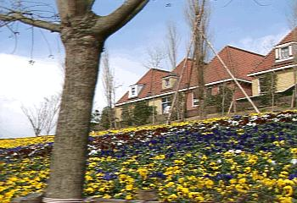
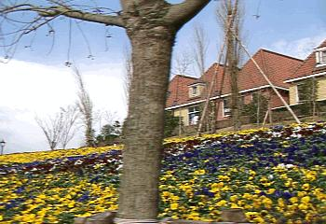
What cannot
The scene with depth variations and the camera has movement

Slide 18

Planar scene (or a faraway one)
PP3
PP1
PP2
PP3 is a projection plane of both centers of projection, so we are OK!
This is how big aerial photographs are made

Slide 19
Motion models
Parametric models as the assumptions on the relation between two images.

Slide 20
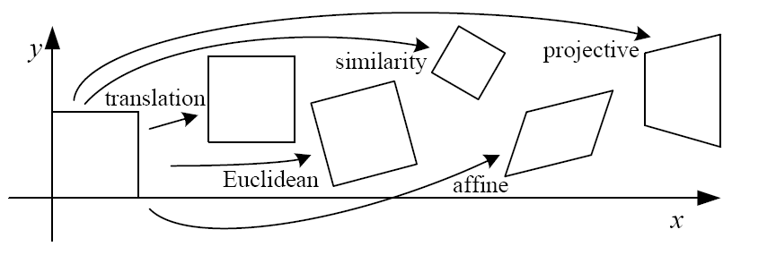
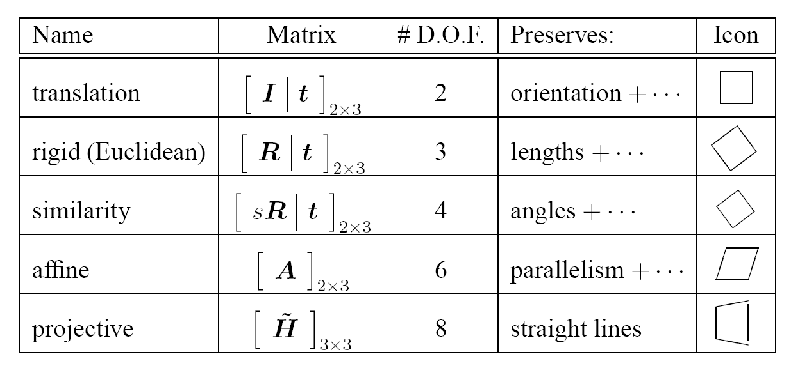
2D Motion models

Slide 21
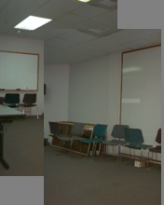

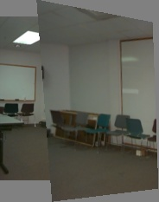
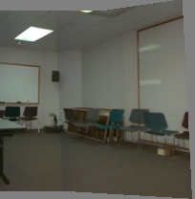
Motion models
Translation
Affine
Perspective
3D rotation
2 unknowns
6 unknowns
8 unknowns
3 unknowns

Slide 22
A case study: cylindrical panorama
What if you want a 360° field of view?
mosaic projection cylinder

Slide 23
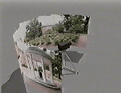
Cylindrical panoramas
Steps
  Reproject each image onto a cylinder
  Blend
  Output the resulting mosaic

Slide 24
applet
http://graphics.stanford.edu/courses/cs178/applets/projection.html

Slide 25
Cylindrical panorama
Take pictures on a tripod (or handheld)
Warp to cylindrical coordinate
Compute pairwise alignments
Fix up the end-to-end alignment
Blending
Crop the result and import into a viewer
It is required to do radial distortion
correction for better stitching results!

Slide 26
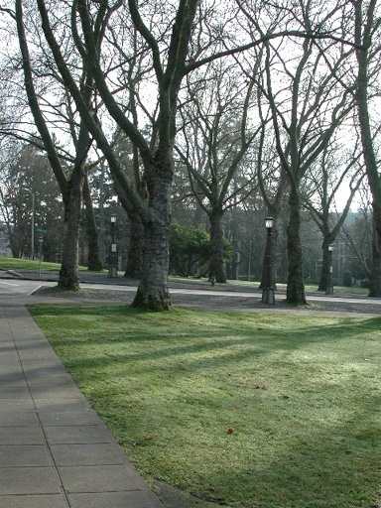
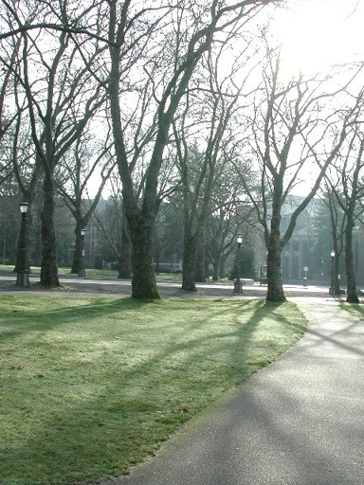
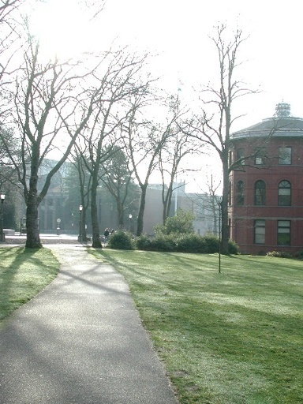
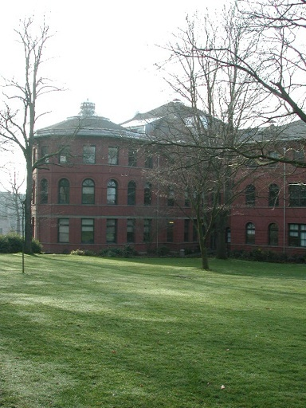
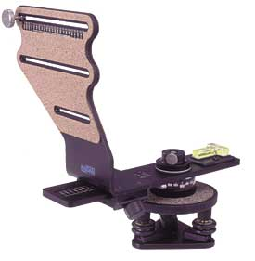
Taking pictures
Kaidan panoramic tripod head

Slide 27
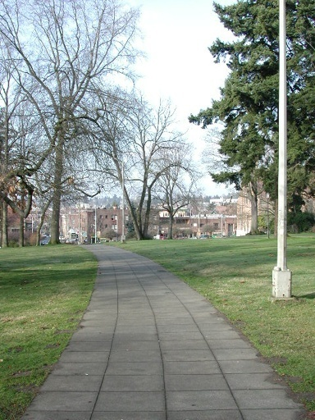
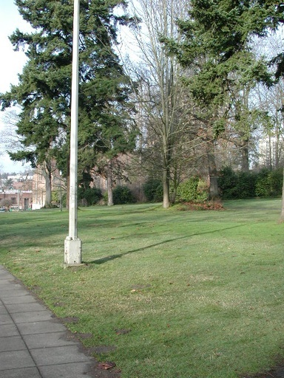
Translation model

Slide 28
Where should the synthetic camera be
The projection plane of some camera
Onto a cylinder
real
camera
synthetic
camera

Slide 29
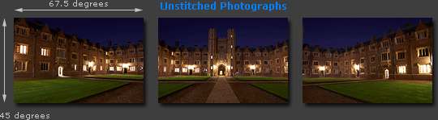
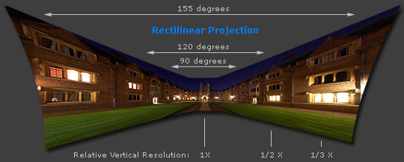
Cylindrical projection
Adopted from http://www.cambridgeincolour.com/tutorials/image-projections.htm
Notes:
http://www.cambridgeincolour.com/tutorials/image-projections.htm

Slide 30
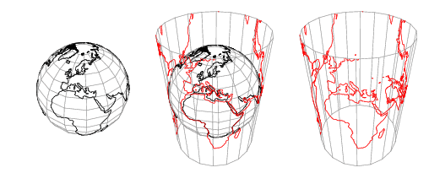
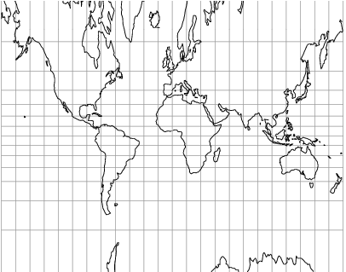
Cylindrical projection

Slide 31
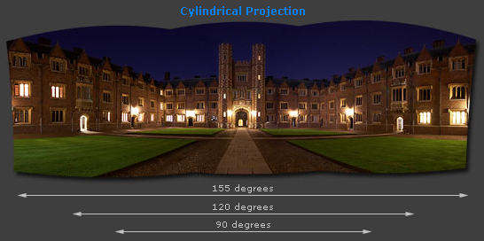
Cylindrical projection
Adopted from http://www.cambridgeincolour.com/tutorials/image-projections.htm
Notes:
http://www.cambridgeincolour.com/tutorials/image-projections.htm

Slide 32




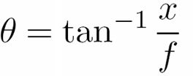
Cylindrical projection
y
x
unwrapped cylinder
x
θ
f

Slide 33
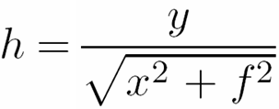
Cylindrical projection
y
x
unwrapped cylinder
y
z
f
θ
x

Slide 34
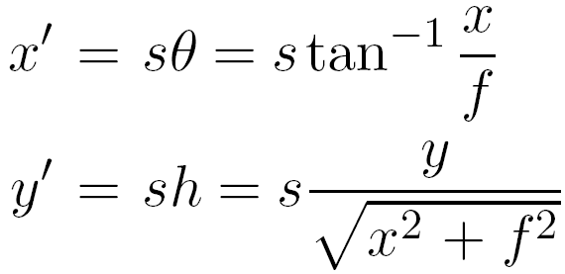
Cylindrical projection
y
x
unwrapped cylinder
y
z
s=f gives less
distortion
f
x

Slide 35




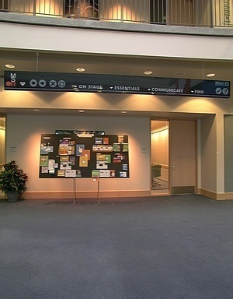
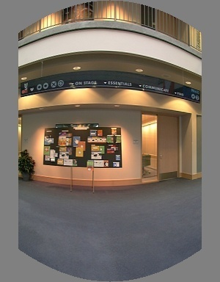
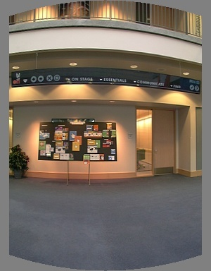
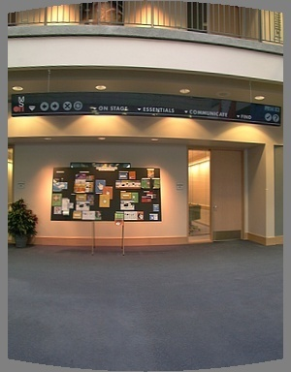
Cylindrical reprojection
top-down view
Focal length – the dirty secret…
Image 384x300
f = 180 (pixels)
f = 280
f = 380
Notes:
Therefore, it is desirable if the global motion model we need to recover is translation, which has only two parameters. It turns out that for a pure panning motion, if we convert two images to their cylindrical maps with known focal length, the relationship between them can be represented by a translation.
Here is an example of how cylindrical maps are constructed with differently with f’s. Note how straight lines are curved.
Similarly, we can map an image to its longitude/latitude spherical coordinates as well if f is given.

Slide 36
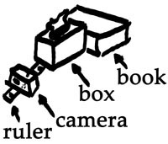
A simple method for estimating f
w
p
d
f
Or, you can use other software, such as AutoStich, to help.

Slide 37

Input images

Slide 38
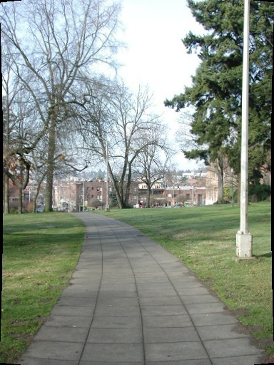
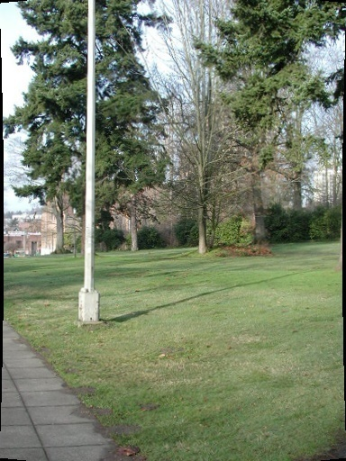
Cylindrical warping

Slide 39
Blending
Why blending: parallax, lens distortion, scene motion, exposure difference

Slide 40
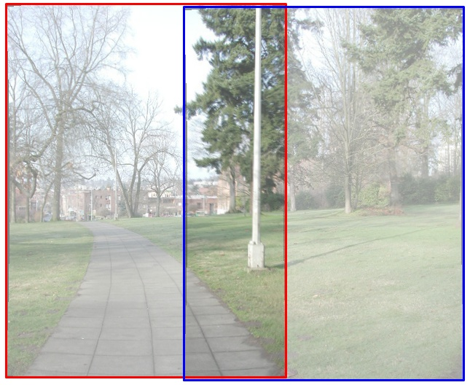
Blending

Slide 41
Blending

Slide 42
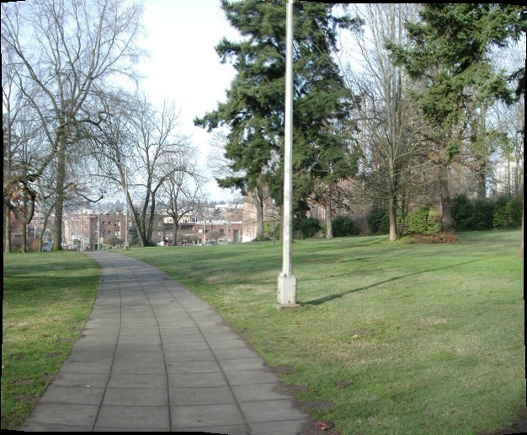
Blending

Slide 43
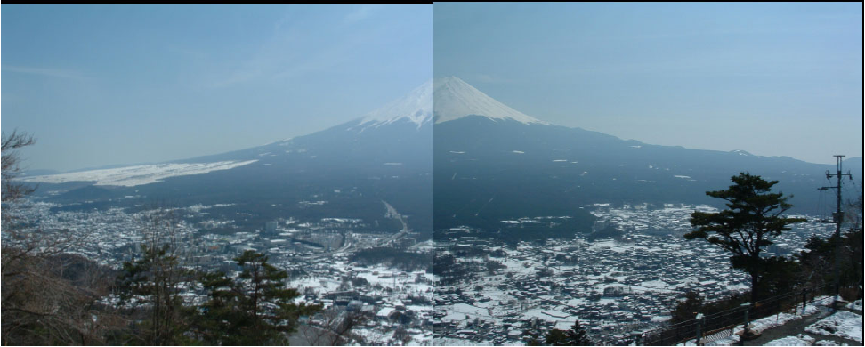
Gradient-domain stitching

Slide 44
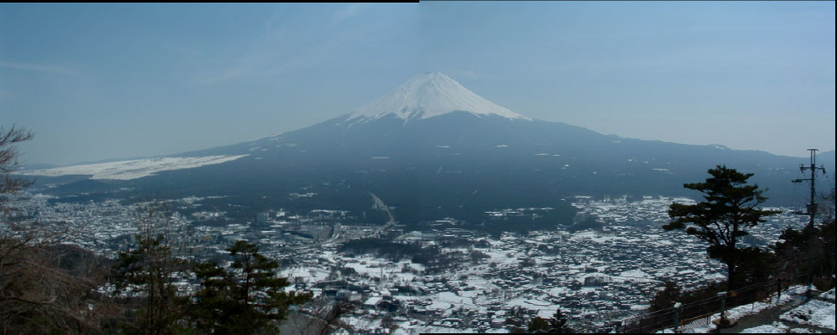
Gradient-domain stitching

Slide 45
Assembling the panorama
Stitch pairs together, blend, then crop

Slide 46
Problem: Drift
Error accumulation
  small errors accumulate over time

Slide 47
Problem: Drift
(x₁,y₁)
(x_{n},y_{n})
copy of first image
Solution
  add another copy of first image at the end
  there are a bunch of ways to solve this problem
    add displacement of (y₁ – y_{n})/(n -1) to each image after the first
    compute a global warp: y’ = y + ax
    run a big optimization problem, incorporating this constraint
      best solution, but more complicated
      known as “bundle adjustment”

Slide 48


End-to-end alignment and crop

Slide 49

Rectangling panoramas
video

Slide 50

Rectangling panoramas

Slide 51

Rectangling panoramas

Slide 52






Viewer: panorama
+
+
+
+
example: http://www.cs.washington.edu/education/courses/cse590ss/01wi/projects/project1/students/dougz/index.html

Slide 53





Viewer: texture mapped model
example: http://www.panoramas.dk/

Slide 54

365-GB panorama (biggest on the earth)
Mont Blanc / Canon 70D / 70,000 images /
2-week shooting / 2-month processing
video
web
London
Notes:
http://chinese.engadget.com/2015/05/25/365-gigapixel-panorama-of-mont-blanc/?ncid=rss_truncated
全景照片功能在一般相機甚至是手機上，都已經不是太稀奇的功能了，但如果是一張破紀錄的 365 Gigapixel 接圖所拍出來的壯闊風景，是否就能讓數百萬人震驚吸引到你的目光呢？這張打破世界上最大全景照的照片，是以 Canon EOS 70D 搭配 EF 400mm f/2.8 鏡頭與 2x 增距鏡，共拍攝了多達 70,000 張照片（46TB 的檔案大小啊！）、耗時兩個月的後製時間完成，一口氣超越了先前於倫敦拍下創造紀錄的 320 Gigapixel 全景照片。
這支由攝影師 Filippo Blengini 率領的五人拍攝團隊，在 2014 年底耗費了 2 個星期的時間，在海拔 3,500 公尺、溫度約零下 10 度的山區，以連拍接圖的方式記錄下了義、法邊境白朗峰（Mont Blanc）的壯闊全景景致 -- 有興趣的朋友可以直接點入觀看這張破紀錄的全景照片。
是說，雖然這是「世界上」最大的全景照片無誤，但根據 PetaPixel 的報導指出，其實目前為止的最大全景照片應該還是 2014 年由 NASA 太空總署，在太空中拍下的月球表面照片才是目前的記錄保持人（ 高達 681 Gigapixel），所以這次破的算是地球上的記錄囉，但還是相當厲害啦！

Slide 55
Cylindrical panorama
Take pictures on a tripod (or handheld)
Warp to cylindrical coordinate
Compute pairwise alignments
Fix up the end-to-end alignment
Blending
Crop the result and import into a viewer

Slide 56
Determine pairwise alignment?
Feature-based methods: only use feature points to estimate parameters
We will study the “Recognising panorama” paper published in ICCV 2003
Run SIFT (or other feature algorithms) for each image, find feature matches.

Slide 57
Determine pairwise alignment
p’=Mp, where M is a transformation matrix, p and p’ are feature matches
It is possible to use more complicated models such as affine or perspective
For example, assume M is a 2x2 matrix
Find M with the least square error

Slide 58
Determine pairwise alignment
Overdetermined system

Slide 59
Normal equation
Given an overdetermined system
the normal equation is that which minimizes the sum of the square differences between left and right sides
Why?

Slide 60
Normal equation
nxm, n equations, m variables

Slide 61
Normal equation

Slide 62
Normal equation
→

Slide 63
Normal equation

Slide 64
Normal equation

Slide 65
Determine pairwise alignment
p’=Mp, where M is a transformation matrix, p and p’ are feature matches
For translation model, it is easier.
What if the match is false? Avoid impact of outliers.

Slide 66
RANSAC
RANSAC = Random Sample Consensus
An algorithm for robust fitting of models in the presence of many data outliers
Compare to robust statistics
Given N data points x_{i}, assume that majority of them are generated from a model with parameters Θ, try to recover Θ.

Slide 67
RANSAC algorithm
Run k times:
(1) draw n samples randomly
(2) fit parameters Θ with these n samples
(3) for each of other N-n points, calculate
its distance to the fitted model, count the
number of inlier points, c
Output Θ with the largest c
How many times?
How big?
Smaller is better
How to define?
Depends on the problem.

Slide 68
How to determine k
p: probability of real inliers
P: probability of success after k trials
n samples are all inliers
a failure
failure after k trials
n | p | k
3 | 0.5 | 35
6 | 0.6 | 97
6 | 0.5 | 293
for P=0.99

Slide 69

Example: line fitting

Slide 70

Example: line fitting
n=2

Slide 71

Model fitting

Slide 72

Measure distances

Slide 73

Count inliers
c=3

Slide 74

Another trial
c=3

Slide 75

The best model
c=15

Slide 76




RANSAC for Homography

Slide 77


RANSAC for Homography

Slide 78

RANSAC for Homography

Slide 79

Tools for image stitching
Hugin
Image Composite Editor
AutoStitch
Google photo
…

Slide 80
Applications of panorama in VFX
Background plates
Image-based lighting

Slide 81

Troy (image-based lighting)
http://www.cgnetworks.com/story_custom.php?story_id=2195&page=4

Slide 82

Spiderman 2 (background plate)

Slide 83
Reference
Richard Szeliski, Image Alignment and Stitching: A Tutorial, Foundations and Trends in Computer Graphics and Computer Vision, 2(1):1-104, December 2006.
R. Szeliski and H.-Y. Shum. Creating full view panoramic image mosaics and texture-mapped models, SIGGRAPH 1997, pp251-258.
M. Brown, D. G. Lowe, Recognising Panoramas, ICCV 2003.

