Slide 1
Image warping/morphing
Digital Visual Effects
Yung-Yu Chuang
with slides by Richard Szeliski, Steve Seitz, Tom Funkhouser, Jia-Bing Huang and Alexei Efros

Slide 2
Image warping

Slide 3
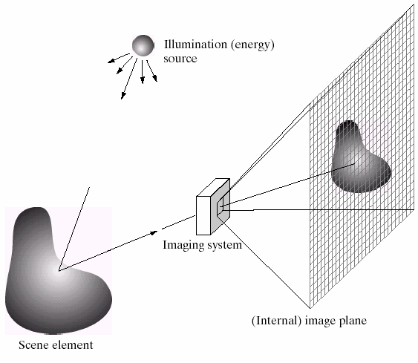
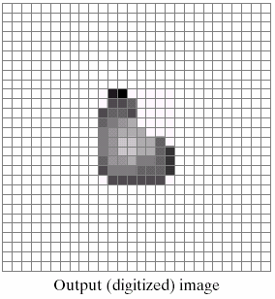
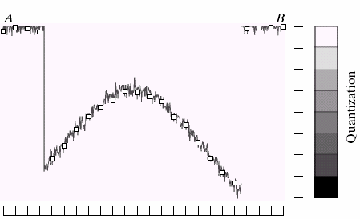
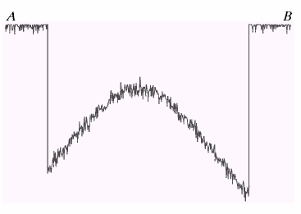
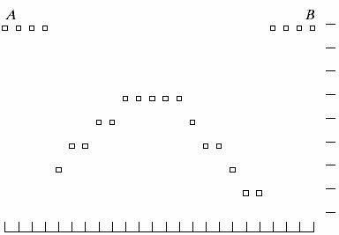
Image formation
B
A

Slide 4
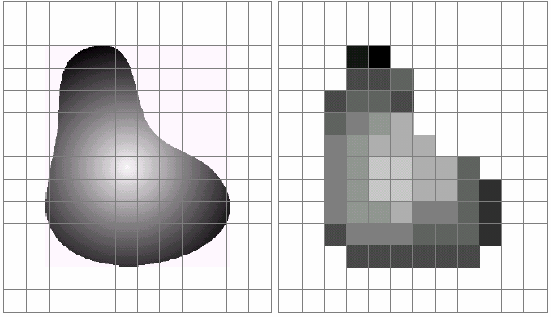
Sampling and quantization

Slide 5
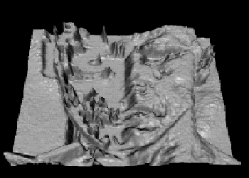
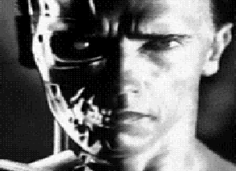
What is an image
We can think of an image as a function, f: R²→R:
  f(x, y) gives the intensity at position (x, y)
  defined over a rectangle, with a finite range:
    f: [a,b]x[c,d] → [0,1]
A color image
f
x
y

Slide 6

A digital image
We usually operate on digital (discrete) images:
  Sample the 2D space on a regular grid
  Quantize each sample (round to nearest integer)
If our samples are D apart, we can write this as:
f[i ,j] = Quantize{ f(i D, j D) }
The image can now be represented as a matrix of integer values

Slide 7
Image warping
image filtering: change range of image
g(x) = h(f(x))
h(y)=0.5y+0.5
f
g
h
x
x
image warping: change domain of image
g(x) = f(h(x))
h(y)=2y
f
g
h
x
x

Slide 8
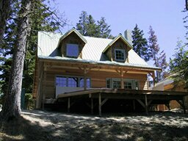
Image warping
image filtering: change range of image
g(x) = h(f(x))
h(y)=0.5y+0.5
f
g
h
image warping: change domain of image
g(x) = f(h(x))
h([x,y])=[x,y/2]
f
h
g

Slide 9
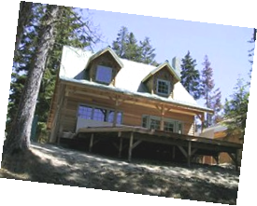
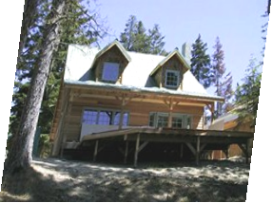
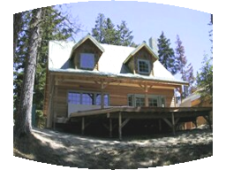
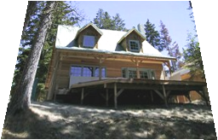
Parametric (global) warping
Examples of parametric warps:
translation
rotation
aspect
perspective
affine
cylindrical

Slide 10
Parametric (global) warping
T
p = (x,y)
p’ = (x’,y’)
Transformation T is a coordinate-changing machine: p’ = T(p)
What does it mean that T is global?
  Is the same for any point p
  can be described by just a few numbers (parameters)
Represent T as a matrix: p’ = M*p

Slide 11
Scaling
Scaling a coordinate means multiplying each of its components by a scalar
Uniform scaling means this scalar is the same for all components:
g
f
× 2

Slide 12
Scaling
Non-uniform scaling: different scalars per component:
x × 2,
y × 0.5

Slide 13
Scaling
Scaling operation:
Or, in matrix form:
scaling matrix S
What’s inverse of S?

Slide 14
2-D Rotation
This is easy to capture in matrix form:
Even though sin(θ) and cos(θ) are nonlinear to θ,
  x’ is a linear combination of x and y
  y’ is a linear combination of x and y
What is the inverse transformation?
  Rotation by –θ
  For rotation matrices, det(R) = 1 so
R

Slide 15
2x2 Matrices
What types of transformations can be
represented with a 2x2 matrix?
2D Identity?
2D Scale around (0,0)?

Slide 16
2x2 Matrices
What types of transformations can be
represented with a 2x2 matrix?
2D Rotate around (0,0)?
2D Shear?

Slide 17
2x2 Matrices
What types of transformations can be
represented with a 2x2 matrix?
2D Mirror about Y axis?
2D Mirror over (0,0)?

Slide 18
All 2D Linear Transformations
Linear transformations are combinations of …
  Scale,
  Rotation,
  Shear, and
  Mirror
Properties of linear transformations:
  Origin maps to origin
  Lines map to lines
  Parallel lines remain parallel
  Ratios are preserved
  Closed under composition

Slide 19
2x2 Matrices
What types of transformations can not be
represented with a 2x2 matrix?
2D Translation?
NO!
Only linear 2D transformations
can be represented with a 2x2 matrix

Slide 20
Translation
Example of translation
Homogeneous Coordinates
t_{x} = 2
t_{y} = 1

Slide 21
Affine Transformations
Affine transformations are combinations of …
  Linear transformations, and
  Translations
Properties of affine transformations:
  Origin does not necessarily map to origin
  Lines map to lines
  Parallel lines remain parallel
  Ratios are preserved
  Closed under composition
  Models change of basis

Slide 22
Projective Transformations
Projective transformations …
  Affine transformations, and
  Projective warps
Properties of projective transformations:
  Origin does not necessarily map to origin
  Lines map to lines
  Parallel lines do not necessarily remain parallel
  Ratios are not preserved
  Closed under composition
  Models change of basis

Slide 23
Image warping
Given a coordinate transform x’ = T(x) and a source image I(x), how do we compute a transformed image I’(x’) = I(T(x))?
T(x)
x
x’
I(x)
I’(x’)

Slide 24
Forward warping
Send each pixel I(x) to its corresponding location x’ = T(x) in I’(x’)
T(x)
x
x’
I(x)
I’(x’)

Slide 25
Forward warping
fwarp(I, I’, T)
{
for (y=0; y<I.height; y++)
for (x=0; x<I.width; x++) {
(x’,y’)=T(x,y);
I’(x’,y’)=I(x,y);
}
}
I
I’
T
x
x’

Slide 26
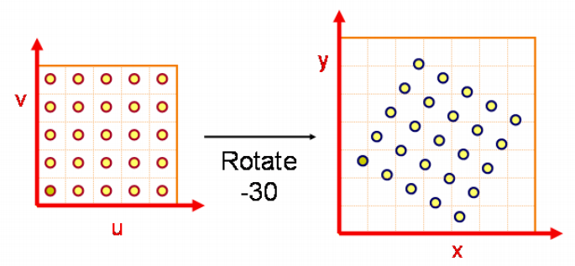
Forward warping
Some destination may
not be covered
Many source pixels could map
to the same destination

Slide 27
Forward warping
Send each pixel I(x) to its corresponding location x’ = T(x) in I’(x’)
What if pixel lands “between” two pixels?
Will be there holes?
Answer: add “contribution” to several pixels, normalize later (splatting)
h(x)
x
x’
f(x)
g(x’)

Slide 28
Forward warping
fwarp(I, I’, T)
{
for (y=0; y<I.height; y++)
for (x=0; x<I.width; x++) {
(x’,y’)=T(x,y);
Splatting(I’,x’,y’,I(x,y),kernel);
}
}
I
I’
T
x
x’

Slide 29
Inverse warping
Get each pixel I’(x’) from its corresponding location x = T⁻¹(x’) in I(x)
T⁻¹(x’)
x
x’
I(x)
I’(x’)

Slide 30
Inverse warping
iwarp(I, I’, T)
{
for (y'=0; y’<I’.height; y’++)
for (x’=0; x’<I’.width; x’++) {
(x,y)=T⁻¹(x’,y’);
I’(x’,y’)=I(x,y);
}
}
I
T⁻¹
I’
x
x’

Slide 31
Inverse warping
Get each pixel I’(x’) from its corresponding location x = T⁻¹(x’) in I(x)
What if pixel comes from “between” two pixels?
Answer: resample color value from interpolated (prefiltered) source image
x
x’
f(x)
g(x’)

Slide 32
Inverse warping
iwarp(I, I’, T)
{
for (y’=0; y’<I’.height; y’++)
for (x’=0; x’<I’.width; x’++) {
(x,y)=T⁻¹(x’,y’);
I’(x’,y’)=Reconstruct(I,x,y,kernel);
}
}
I
T⁻¹
I’
x
x’

Slide 33
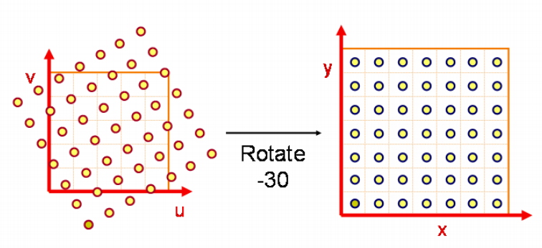
Inverse warping
No hole, but must resample
What value should you take for non-integer coordinate? Closest one?

Slide 34
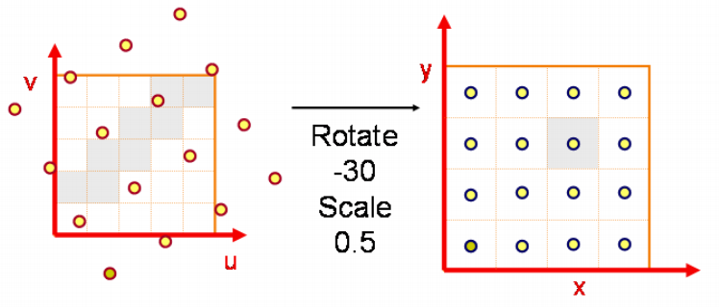
Inverse warping
It could cause aliasing

Slide 35
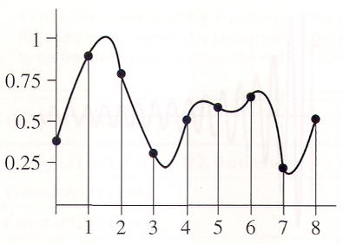
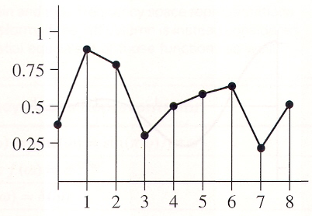
Reconstruction
Reconstruction generates an approximation to the original function. Error is called aliasing.
sampling
reconstruction
sample value
sample position

Slide 36
Reconstruction
Computed weighted sum of pixel neighborhood; output is weighted average of input, where weights are normalized values of filter kernel k
color=0;
weights=0;
for all q’s dist < width
d = dist(p, q);
w = kernel(d);
color += w*q.color;
weights += w;
p.Color = color/weights;
p
width
d
q

Slide 37
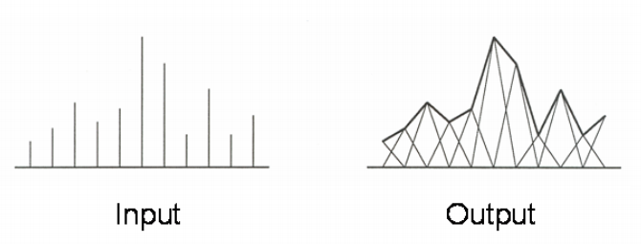
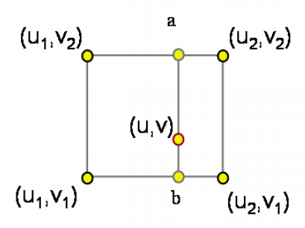
Triangle filter

Slide 38
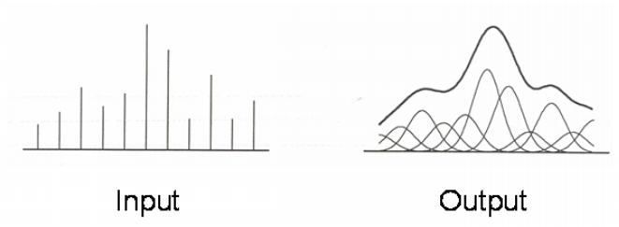
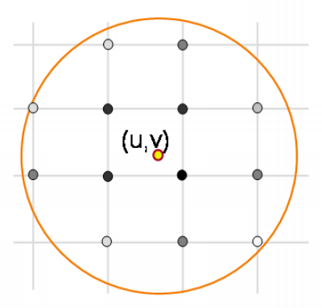
Gaussian filter

Slide 39
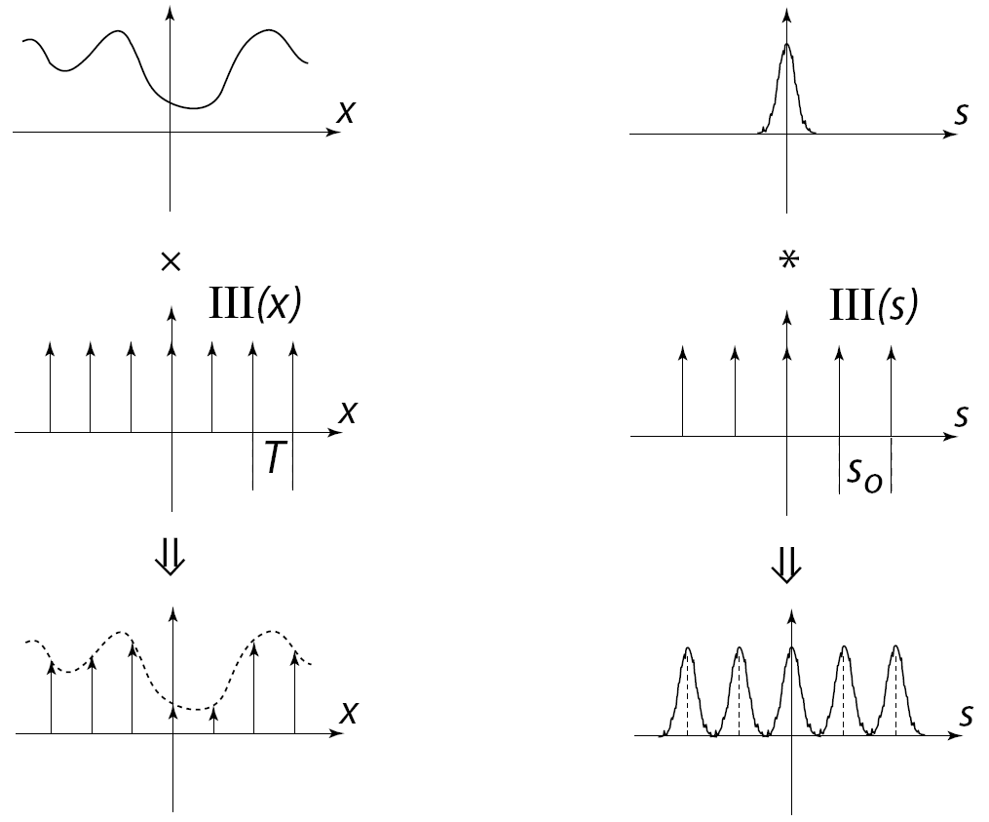
Sampling
band limited

Slide 40
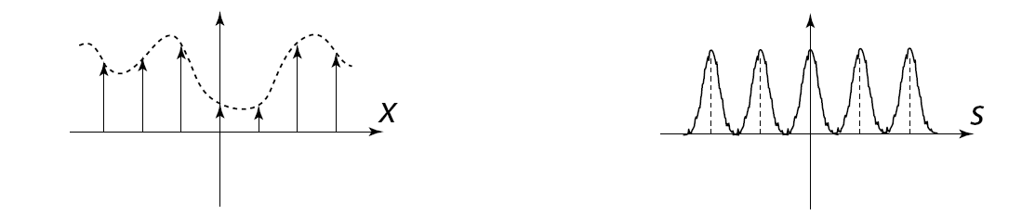
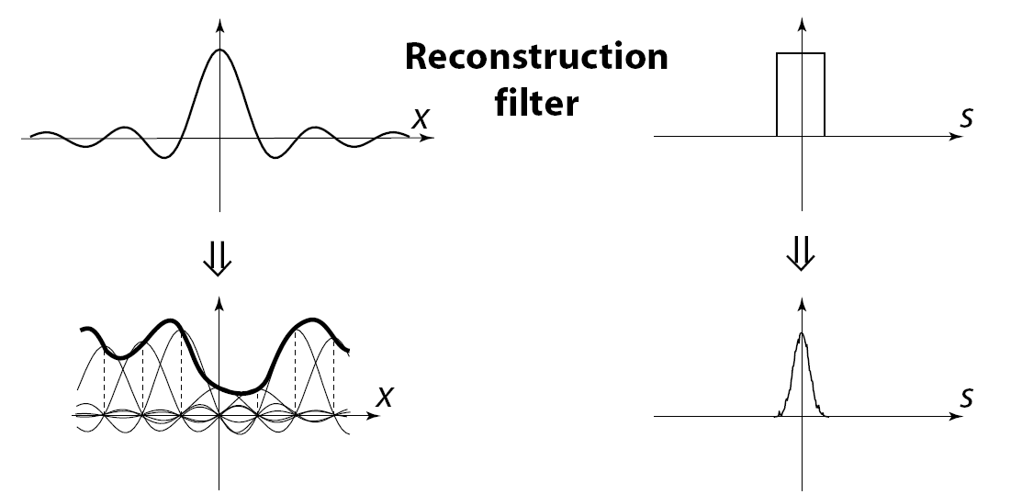
Reconstruction
The reconstructed function is obtained by interpolating
among the samples in some manner

Slide 41
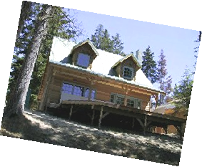
Reconstruction (interpolation)
Possible reconstruction filters (kernels):
  nearest neighbor
  bilinear
  bicubic
  sinc (optimal reconstruction)

Slide 42




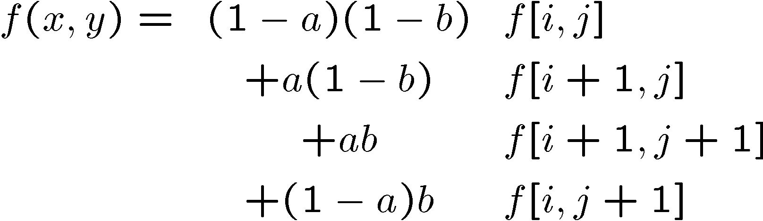
Bilinear interpolation (triangle filter)
A simple method for resampling images

Slide 43
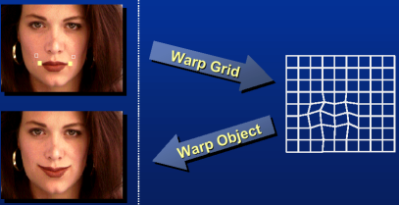
Non-parametric image warping
Specify a more detailed warp function
Splines, meshes, optical flow (per-pixel motion)

Slide 44
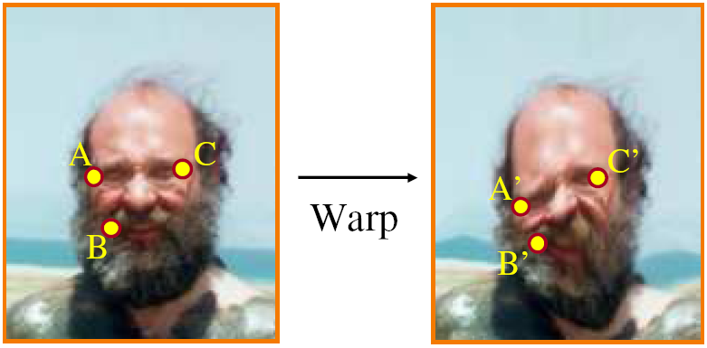
Non-parametric image warping
Mappings implied by correspondences
Inverse warping
P’
?

Slide 45
Non-parametric image warping
Barycentric coordinate
P
P’

Slide 46
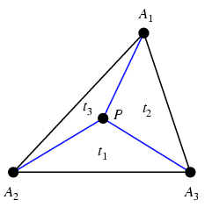
Barycentric coordinates

Slide 47
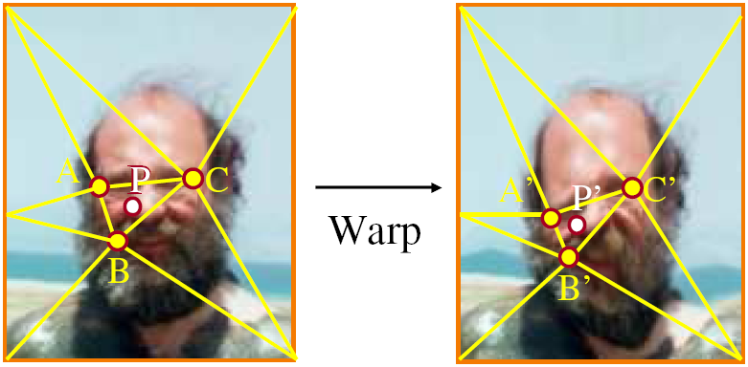
Non-parametric image warping
Barycentric coordinate

Slide 48
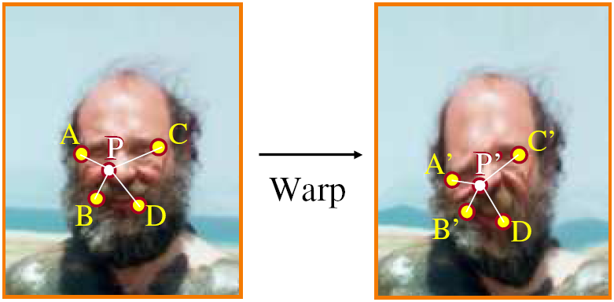
Non-parametric image warping
Gaussian
thin plate
spline
radial basis function

Slide 49
Image warping
Warping is a useful operation for mosaics, retargeting, video matching, view interpolation and so on.

Slide 50
An application of image warping: face beautification

Slide 51
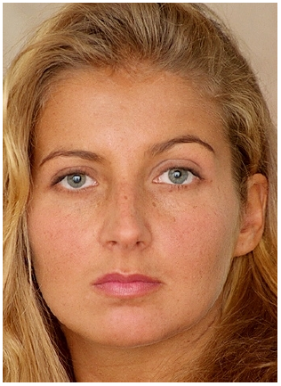
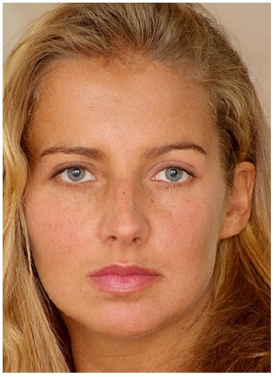
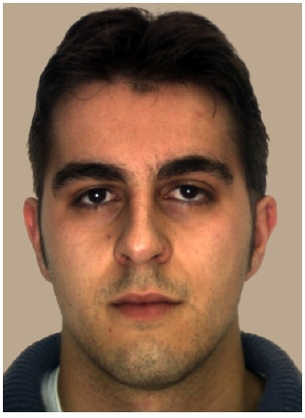
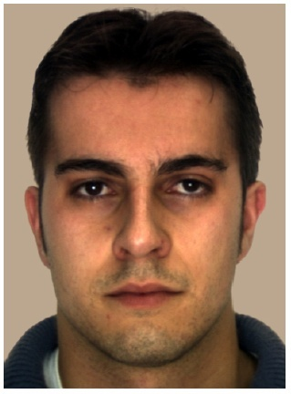
Data-driven facial beautification

Slide 52
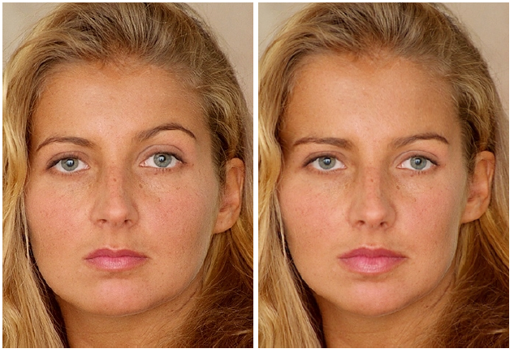
Facial beautification

Slide 53
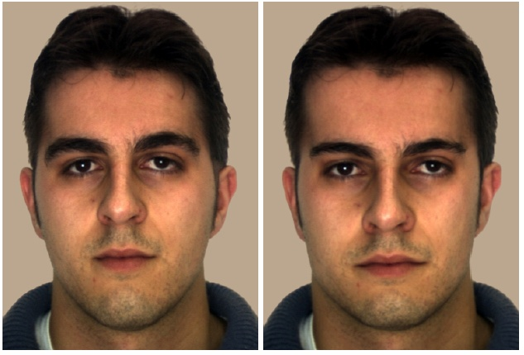
Facial beautification

Slide 54
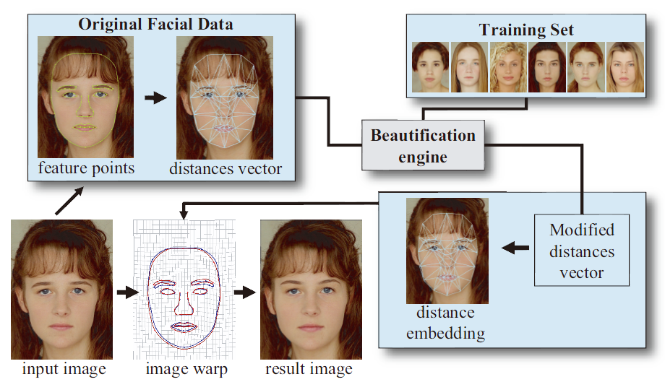
Facial beautification

Slide 55
Training set
Face images
  92 young Caucasian female
  33 young Caucasian male

Slide 56
Feature extraction

Slide 57
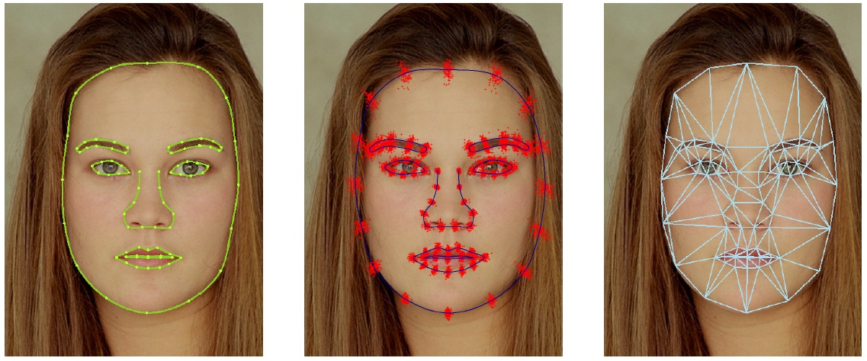
Feature extraction
Extract 84 feature points by BTSM
Delaunay triangulation -> 234D distance vector (normalized by the square root of face area)
scatter plot for
all training faces
234D vector
BTSM

Slide 58
Beautification engine

Slide 59
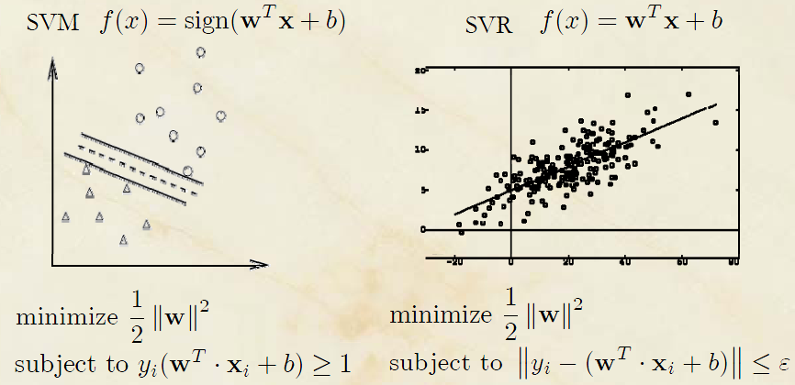
Support vector regression (SVR)
Similar concept to SVM, but for regression
RBF kernels
f_{b}(v)

Slide 60
Beautification process
Given the normalized distance vector v, generate a nearby vector v’ so that
f_{b}(v’) > f_{b}(v)
Two options
  KNN-based
  SVR-based

Slide 61
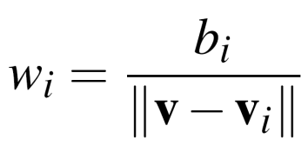
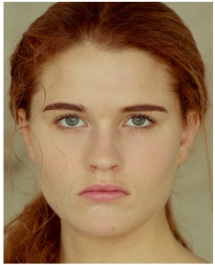
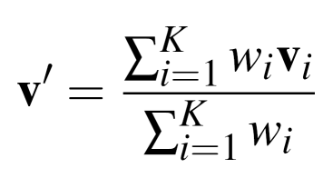
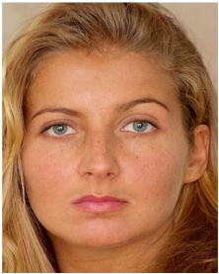
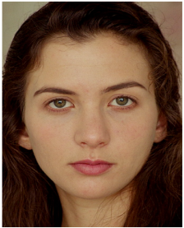
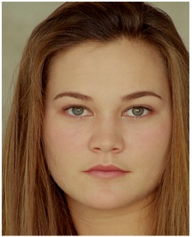
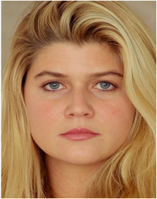
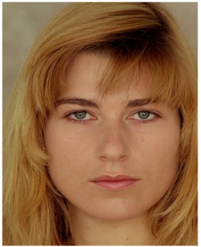
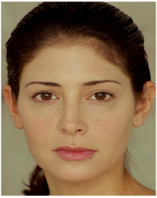
KNN-based beautification
5.1
4.3
3.1
v'
v
4.5
4.6
5.3

Slide 62

SVR-based beautification
Directly use f_{b} to seek v’
Use standard no-derivative direction set method for minimization
Features were reduced to 35D by PCA

Slide 63






SVR-based beautification
Problems: it sometimes yields distance vectors corresponding to invalid human face
Solution: add log-likelihood term (LP)
LP is approximated by modeling face space as a multivariate Gaussian distribution
’s i-th
component
u’s projection
in PCA space
i-th eigenvalue

Slide 64

PCA
λ₂
λ₁

Slide 65
Embedding and warping

Slide 66

Distance embedding
Convert modified distance vector v’ to a new face landmark
A graph drawing problem referred to as a stress minimization problem, solved by LM algorithm for non-linear minimization
1 if i and j belong to different facial features
10 otherwise

Slide 67


Distance embedding
Post processing to enforce similarity transform for features on eyes by minimizing

Slide 68

Original
K=3
K=5
SVR

Slide 69

Results (in training set)

Slide 70

User study

Slide 71

Results (not in training set)

Slide 72

By parts
eyes
mouth
full

Slide 73

Different degrees
50%
100%

Slide 74

Facial collage

Slide 75
Results
video

Slide 76
Image morphing

Slide 77



Image morphing
The goal is to synthesize a fluid transformation from one image to another.
Cross dissolving is a common transition between cuts, but it is not good for morphing because of the ghosting effects.
image #1
dissolving
image #2

Slide 78


Artifacts of cross-dissolving
http://www.salavon.com/

Slide 79
Image morphing
Why ghosting?
Morphing = warping + cross-dissolving
shape
(geometric)
color
(photometric)

Slide 80



Image morphing
image #1
cross-dissolving
image #2
warp
morphing
warp

Slide 81

Morphing sequence

Slide 82



Face averaging by morphing
average faces

Slide 83
Image morphing
create a morphing sequence: for each time t
  Create an intermediate warping field (by interpolation)
  Warp both images towards it
  Cross-dissolve the colors in the newly warped images
t=0
t=0.33
t=1

Slide 84





An ideal example (in 2004)
t=0
t=0.25
t=0.5
t=1
t=0.75

Slide 85

An ideal example (in 2004)
t=0
morphing
t=1

Slide 86
An ideal example
t=0
middle face (t=0.5)
t=1

Slide 87

Warp specification (mesh warping)
How can we specify the warp?
  1. Specify corresponding spline control points
    interpolate to a complete warping function
easy to implement, but less expressive

Slide 88


Warp specification
How can we specify the warp
  2. Specify corresponding points
    interpolate to a complete warping function

Slide 89

Solution: convert to mesh warping
Define a triangular mesh over the points
  Same mesh in both images!
  Now we have triangle-to-triangle correspondences
Warp each triangle separately from source to destination
  How do we warp a triangle?
  3 points = affine warp!
  Just like texture mapping

Slide 90


Warp specification (field warping)
How can we specify the warp?
  Specify corresponding vectors
    interpolate to a complete warping function
    The Beier & Neely Algorithm

Slide 91


Beier&Neely (SIGGRAPH 1992)
Single line-pair PQ to P’Q’:

Slide 92

Algorithm (single line-pair)
For each X in the destination image:
  Find the corresponding u,v
  Find X’ in the source image for that u,v
  destinationImage(X) = sourceImage(X’)
Examples:
Affine transformation

Slide 93


Multiple Lines
length = length of the line segment,
dist = distance to line segment
The influence of a, p, b. The same as the average of X_{i}’

Slide 94

Full Algorithm

Slide 95

Resulting warp

Slide 96



Comparison to mesh morphing
Pros: more expressive
Cons: speed and control

Slide 97
Warp interpolation
How do we create an intermediate warp at time t?
  linear interpolation for line end-points
  But, a line rotating 180 degrees will become 0 length in the middle
  One solution is to interpolate line mid-point and orientation angle
t=0
t=1

Slide 98

Animation

Slide 99
Animated sequences
Specify keyframes and interpolate the lines for the inbetween frames
Require a lot of tweaking

Slide 100

Results
Michael Jackson’s MTV “Black or White”
Notes:
Start roughly from 4:50

Slide 101

Multi-source morphing

Slide 102

Multi-source morphing

Slide 103








Miss Korea

Slide 104

Picasa recognizes them as the same person

Slide 105


Align and mean face

Slide 106
Morphing sequence
video

Slide 107

Woman in arts

Slide 108
References
Thaddeus Beier, Shawn Neely, Feature-Based Image Metamorphosis, SIGGRAPH 1992, pp35-42.
Detlef Ruprecht, Heinrich Muller, Image Warping with Scattered Data Interpolation, IEEE Computer Graphics and Applications, March 1995, pp37-43.
Seung-Yong Lee, Kyung-Yong Chwa, Sung Yong Shin, Image Metamorphosis Using Snakes and Free-Form Deformations, SIGGRAPH 1995.
Seungyong Lee, Wolberg, G., Sung Yong Shin, Polymorph: morphing among multiple images, IEEE Computer Graphics and Applications, Vol. 18, No. 1, 1998, pp58-71.
Peinsheng Gao, Thomas Sederberg, A work minimization approach to image morphing, The Visual Computer, 1998, pp390-400.
George Wolberg, Image morphing: a survey, The Visual Computer, 1998, pp360-372.
Data-Driven Enhancement of Facial Attractiveness, SIGGRAPH 2008

