Slide 1
High dynamic range imaging
Digital Visual Effects
Yung-Yu Chuang
with slides by Fredo Durand, Brian Curless, Steve Seitz, Paul Debevec and Alexei Efros
Notes:
Basics for cameras
Some things you might want to know when you shoot pictures
First time, not well-organized yet
Scribe
Assignments
Slides available before Thursday

Slide 2
Camera is an imperfect device
Camera is an imperfect device for measuring the radiance distribution of a scene because it cannot capture the full spectral content and dynamic range.
Limitations in sensor design prevent cameras from capturing all information passed by lens.

Slide 3
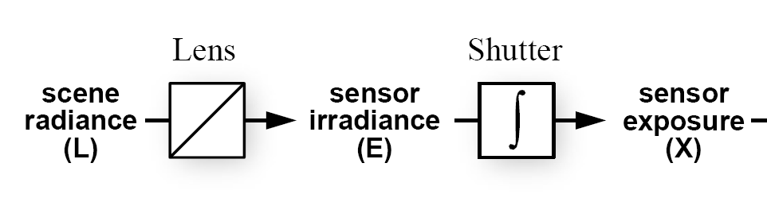
Camera pipeline
Assume a static
scene, Thus, L
is not a function
of time.
lens
shutter
sensor

Slide 4
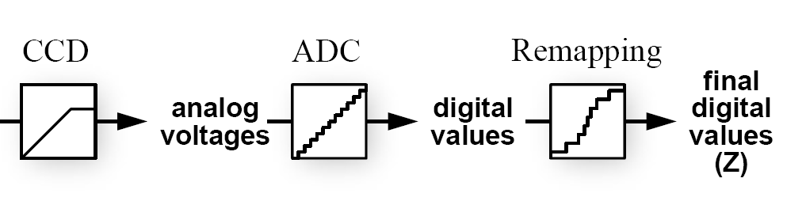
Camera pipeline
12 bits
8 bits

Slide 5
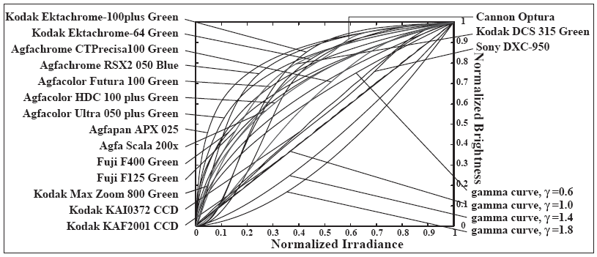
Real-world response functions
In general, the response function is not provided
by camera makers who consider it part of their
proprietary product differentiation. In addition,
they are beyond the standard gamma curves.

Slide 6
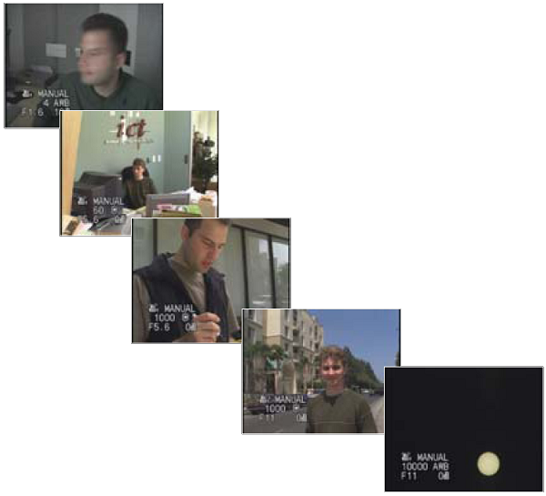
The world is high dynamic range
1
1,500
25,000
400,000
2,000,000,000

Slide 7
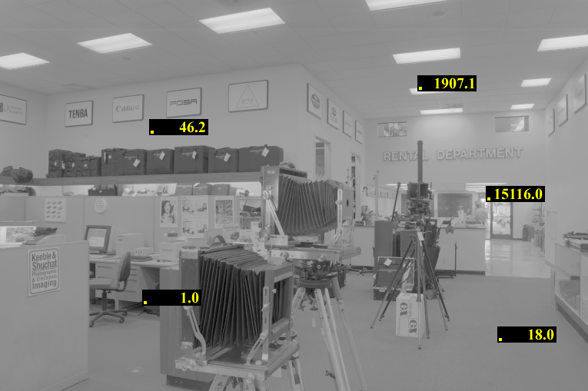
The world is high dynamic range

Slide 8
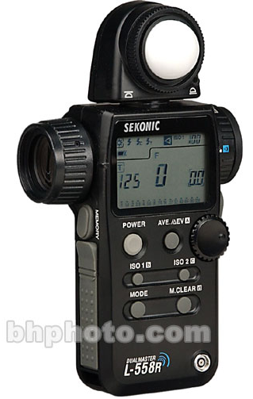
Real world dynamic range
Eye can adapt from ~ 10⁻⁶ to 10⁶ cd/m²
Often 1 : 100,000 in a scene
Typical 1:50, max 1:500 for pictures
10⁻⁶
10⁶
Real world
High dynamic range
spotmeter

Slide 9
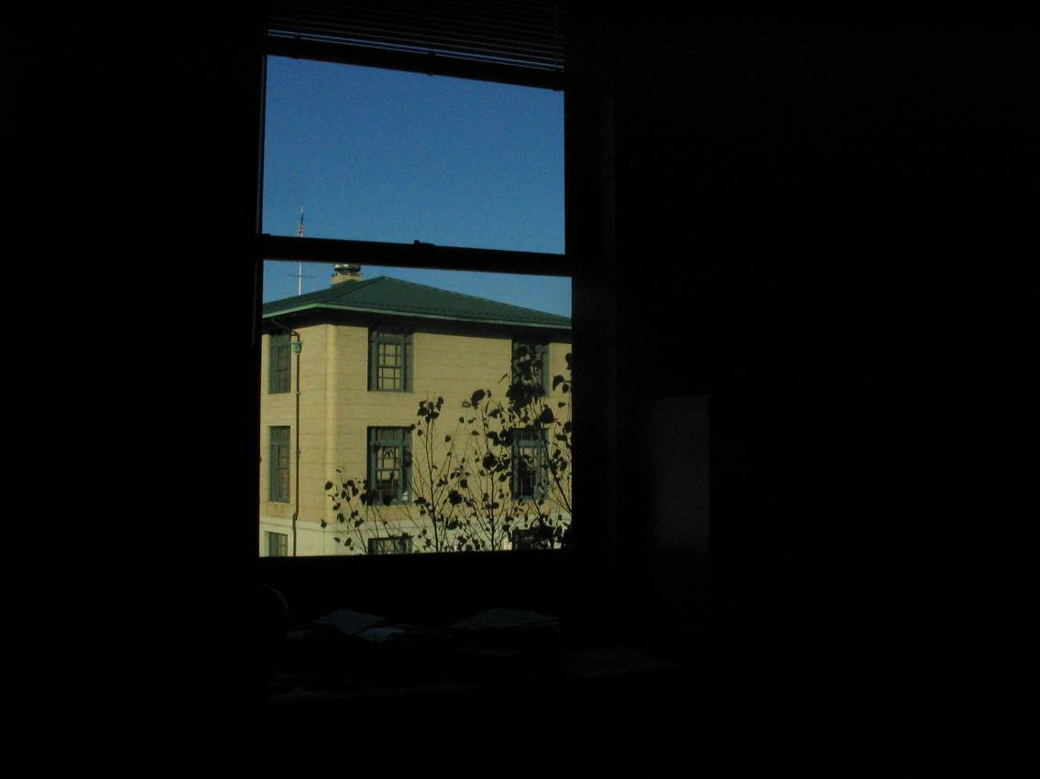
Short exposure
10⁻⁶
10⁶
dynamic range
Real world
radiance
10⁻⁶
10⁶
Picture
intensity
^{Pixel value 0 to 255}

Slide 10
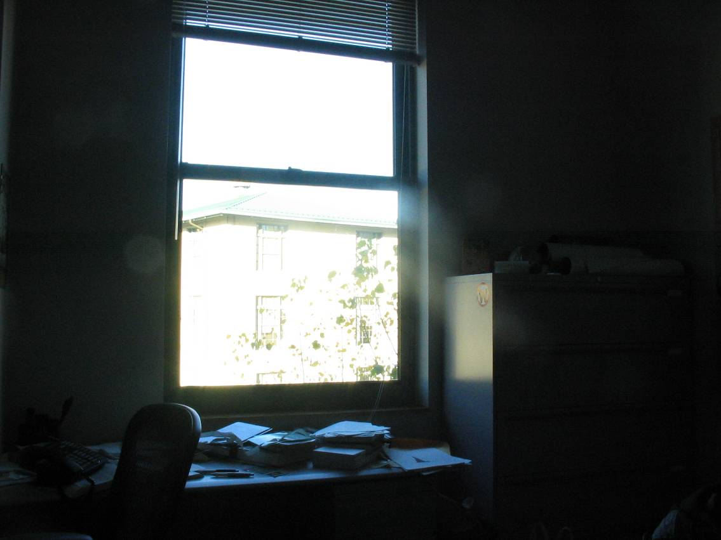
Long exposure
10⁻⁶
10⁶
dynamic range
Real world
radiance
10⁻⁶
10⁶
Picture
intensity
^{Pixel value 0 to 255}

Slide 11
Camera is not a photometer
Limited dynamic range
  Perhaps use multiple exposures?
Unknown, nonlinear response
  Not possible to convert pixel values to radiance
Solution:
  Recover response curve from multiple exposures, then reconstruct the radiance map

Slide 12
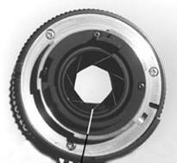
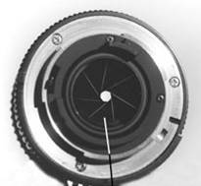
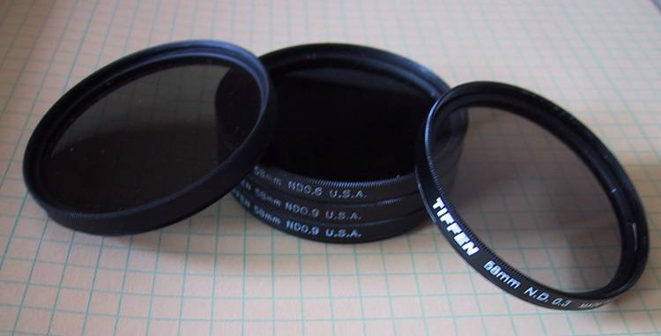
Varying exposure
Ways to change exposure
  Shutter speed
  Aperture
  Neutral density filters
Notes:
Why shutter speed

Slide 13
Shutter speed
Note: shutter times usually obey a power series – each “stop” is a factor of 2
¼, 1/8, 1/15, 1/30, 1/60, 1/125, 1/250, 1/500, 1/1000 sec
Usually really is:
¼, 1/8, 1/16, 1/32, 1/64, 1/128, 1/256, 1/512, 1/1024 sec

Slide 14
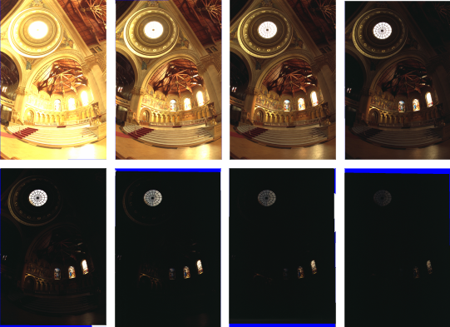
Varying shutter speeds

Slide 15
HDRI capturing from multiple exposures
Capture images with multiple exposures
Image alignment (even if you use tripod, it is suggested to run alignment)
Response curve recovery
Ghost/flare removal

Slide 16
Image alignment
We will introduce a fast and easy-to-implement method for this task, called Median Threshold Bitmap (MTB) alignment technique.
Consider only integral translations. It is enough empirically.
The inputs are N grayscale images. (You can either use the green channel or convert into grayscale by Y=(54R+183G+19B)/256)
MTB is a binary image formed by thresholding the input image using the median of intensities.

Slide 17
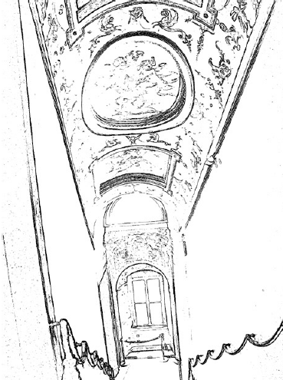
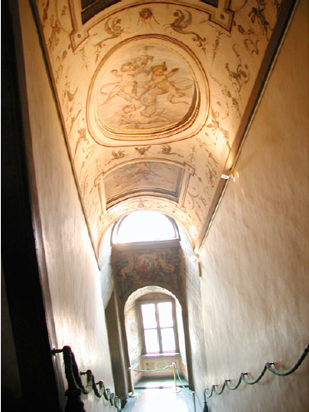
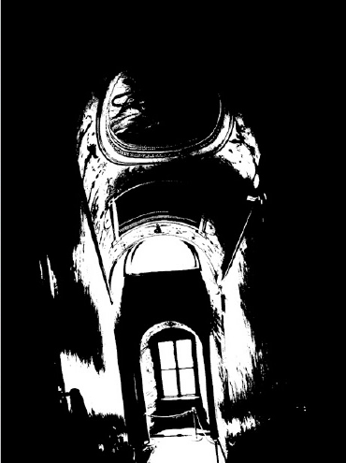
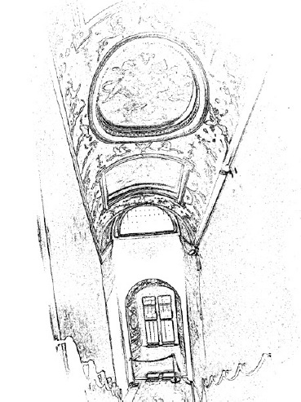
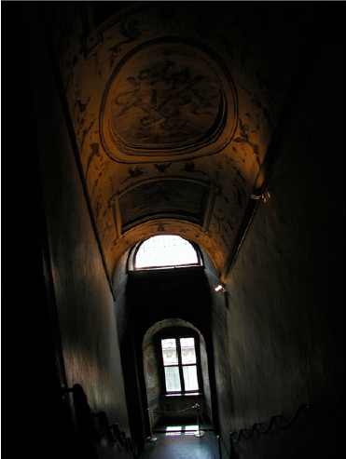
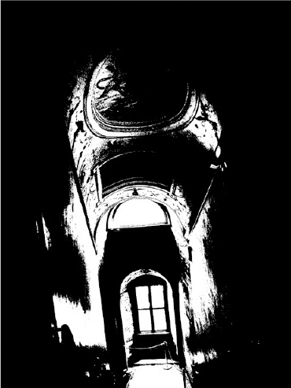

Slide 18
Why is MTB better than gradient?
Edge-detection filters are dependent on image exposures
Taking the difference of two edge bitmaps would not give a good indication of where the edges are misaligned.

Slide 19
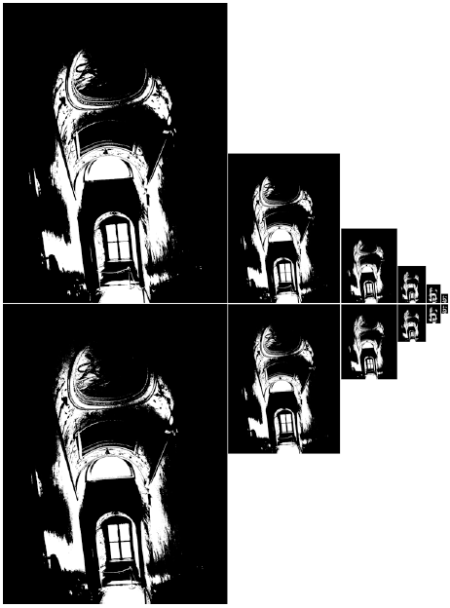
Search for the optimal offset
Try all possible offsets.
Gradient descent
Multiscale technique
log(max_offset) levels
Try 9 possibilities for the top level
Scale by 2 when passing down; try its 9 neighbors

Slide 20
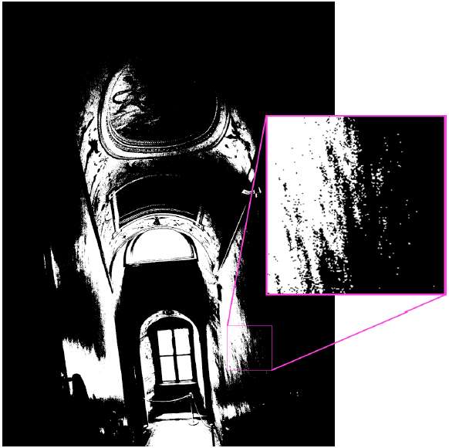
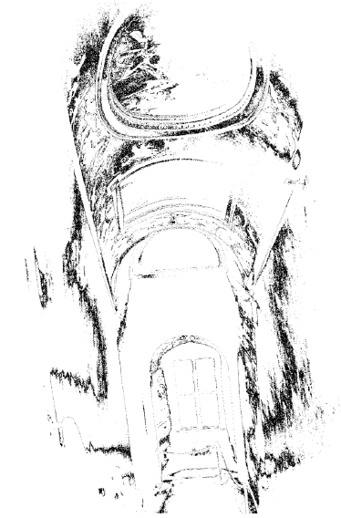
Threshold noise
ignore pixels that are
close to the threshold
exclusion bitmap

Slide 21
Efficiency considerations
XOR for taking difference
AND with exclusion maps
Bit counting by table lookup

Slide 22
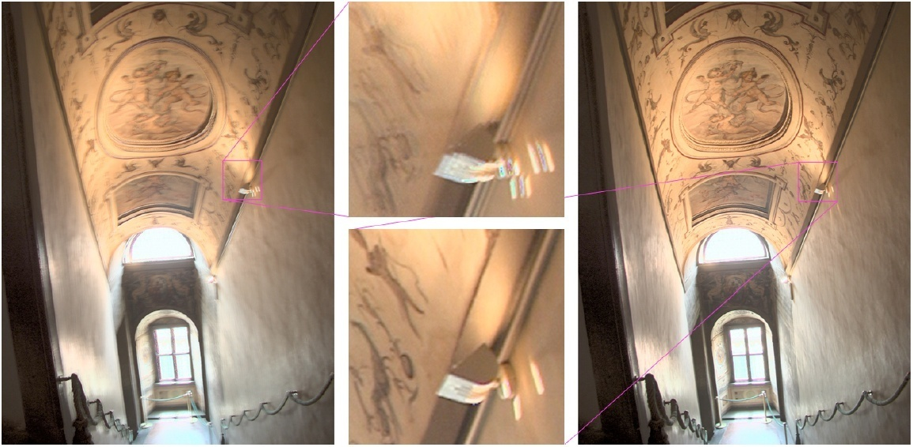
Results
Success rate = 84%. 10% failure due to rotation.
3% for excessive motion and 3% for too much
high-frequency content.

Slide 23

Recovering response curve
12 bits
8 bits

Slide 24


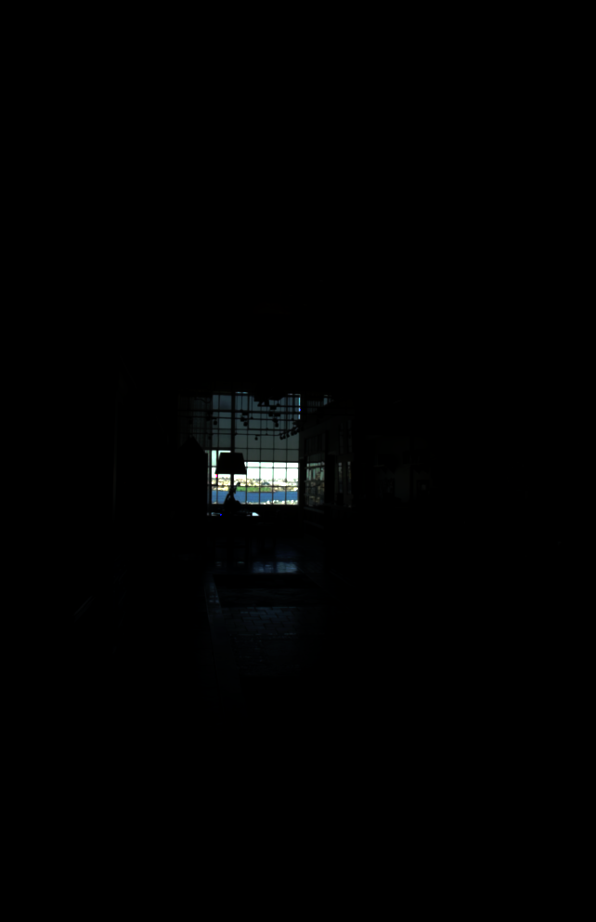
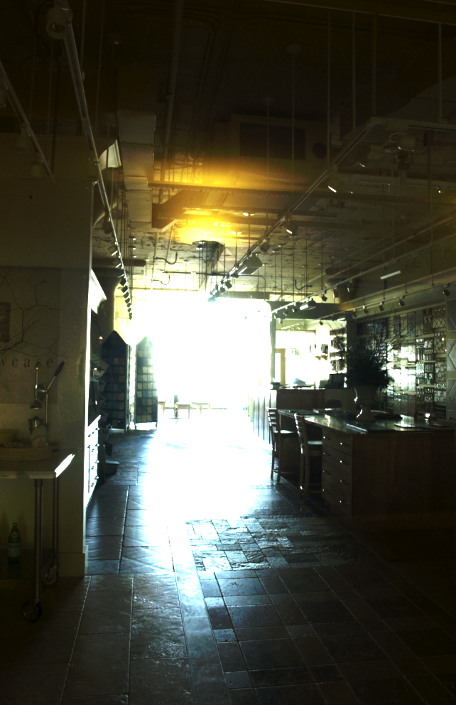
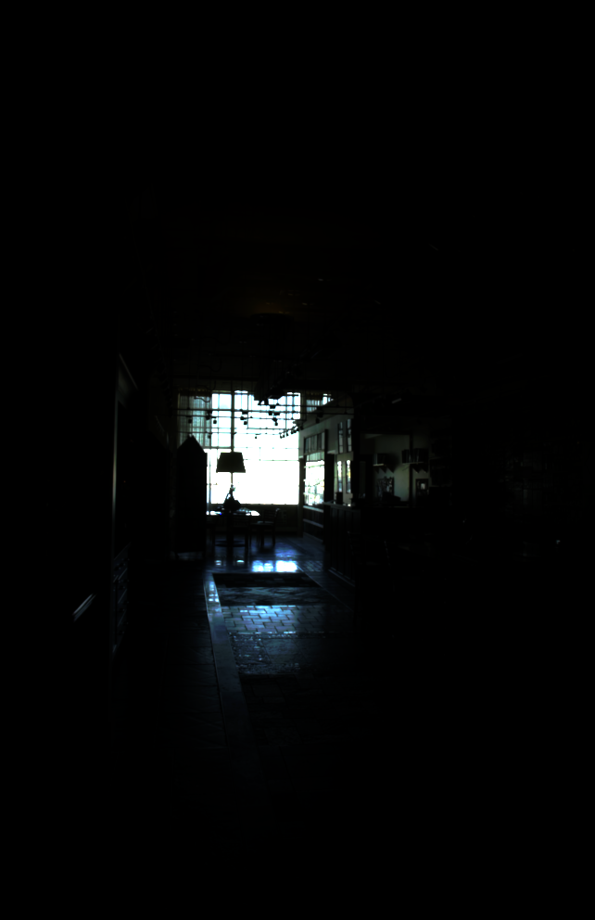
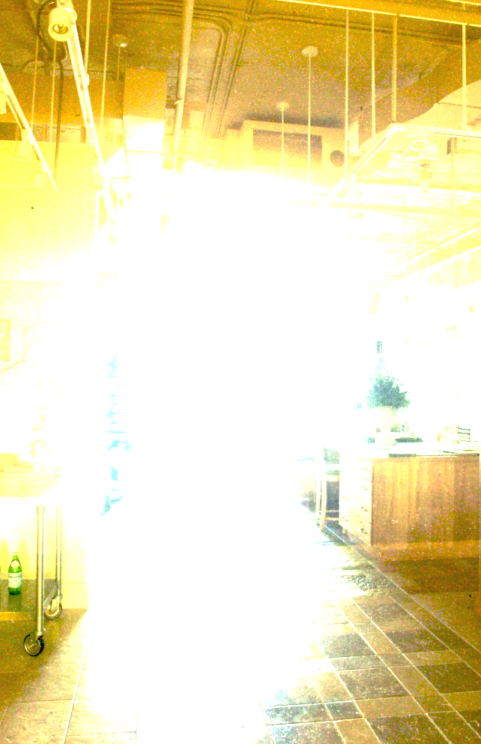
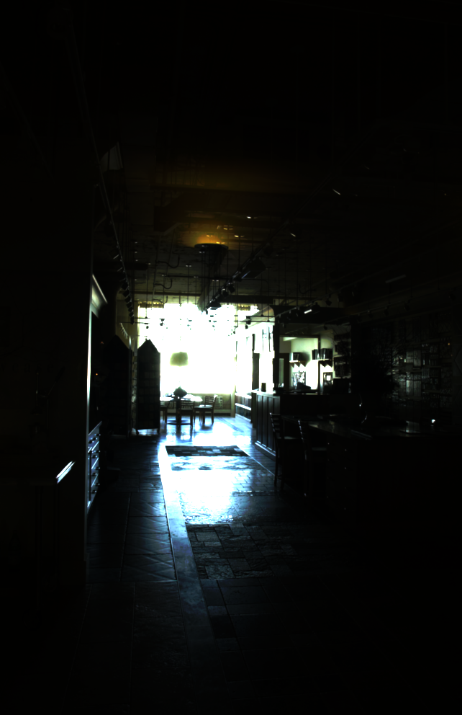
Recovering response curve
We want to obtain the inverse of the response curve
255
0
Notes:
j-th image i-th pixel

Slide 25
Recovering response curve
Image series
• 2
• 2
• 2
• 2
• 2
• 3
• 3
• 3
• 3
• 3
• 1
• 1
• 1
• 1
• 1
Δt =
2 sec
Δt =
1 sec
Δt =
1/2 sec
Δt =
1/4 sec
Δt =
1/8 sec
255
0
Notes:
10

Slide 26



Recovering response curve
Image series
• 2
• 2
• 2
• 2
• 2
• 3
• 3
• 3
• 3
• 3
• 1
• 1
• 1
• 1
• 1
Δt =
2 sec
Δt =
1 sec
Δt =
1/2 sec
Δt =
1/4 sec
Δt =
1/8 sec
X_{ij} =
ln X_{ij}
Notes:
10

Slide 27
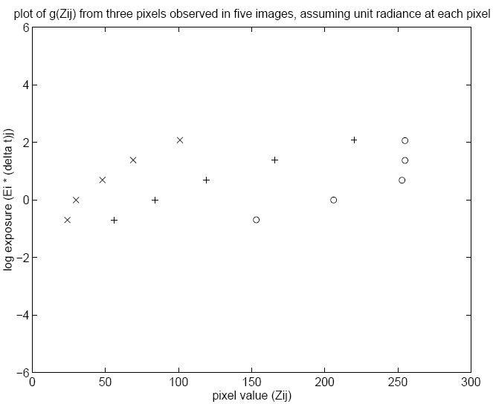
Idea behind the math
ln2

Slide 28
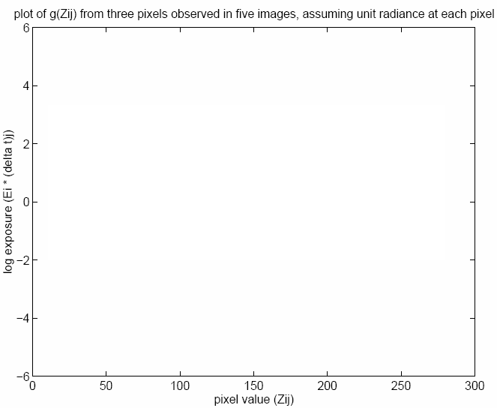
Idea behind the math
Each line for a scene point.
The offset is essentially
determined by the
unknown E_{i}

Slide 29
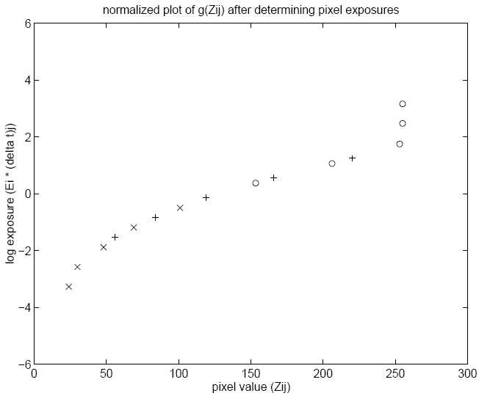
Idea behind the math
Note that there is a shift
that we can’t recover

Slide 30
Basic idea
Design an objective function
Optimize it

Slide 31



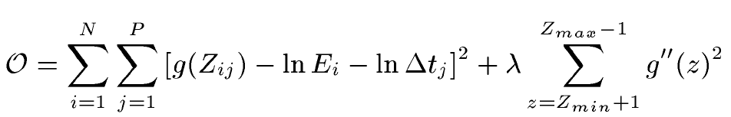
Math for recovering response curve
Notes:
g’(z)=g(z+0.5)-g(z-0.5)
g’’(z)=g’(z+0.5)-g’(z-0.5)
=[g(z+1)-g(z)]-[g(z)-g(z-1)]
=g(z+1)-2g(z)+g(z-1)
g(z+1) - 2*g(z) + g(z-1) 用 Tylor 展開式展完相消就變 g''(z)
255+N variables
N*P equations

Slide 32
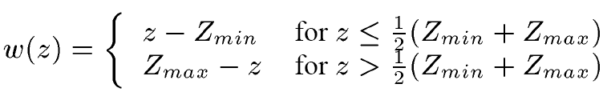
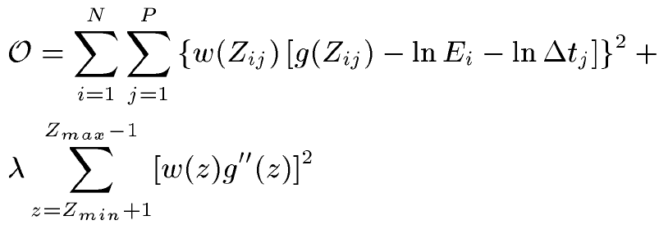
Recovering response curve
The solution can be only up to a scale, add a constraint
Add a hat weighting function

Slide 33
Recovering response curve
We want
If P=11, N~25 (typically 50 is used)
We prefer that selected pixels are well distributed and sampled from constant regions. They picked points by hand.
It is an overdetermined system of linear equations and can be solved using SVD

Slide 34
How to optimize?

Slide 35
How to optimize?
Set partial derivatives to zero

Slide 36
Sparse linear system
256
n
g(0)
n×p
:
g(255)
lnE₁
:
:
1
lnE_{n}
254
Ax=b

Slide 37
Questions
Will g(127)=0 always be satisfied? Why or why not?
How to find the least-square solution for an over-determined system?

Slide 38
Least-square solution for a linear system
They are often mutually incompatible. We instead find x to
minimize the norm of the residual vector .
If there are multiple solutions, we prefer the one with the
minimal length .

Slide 39
Least-square solution for a linear system
If we perform SVD on A and rewrite it as
then is the least-square solution.
pseudo inverse

Slide 40






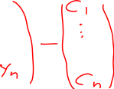

Proof
Notes:
Tomasi, chap 3 Singular Value Decomposition, p.32

Slide 41

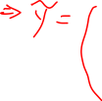





Proof

Slide 42
Libraries for SVD
Matlab
GSL
Boost
LAPACK
ATLAS

Slide 43
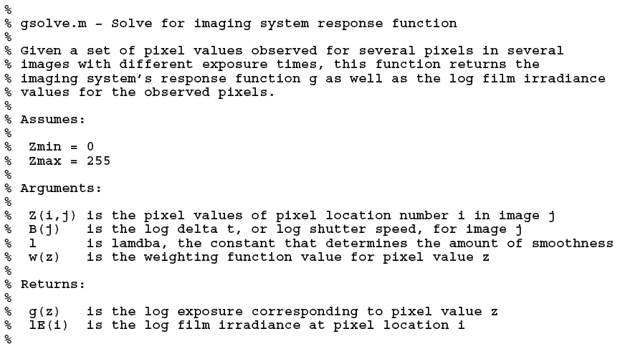
Matlab code

Slide 44
Matlab code
function [g,lE]=gsolve(Z,B,l,w)
n = 256;
A = zeros(size(Z,1)*size(Z,2)+n+1,n+size(Z,1));
b = zeros(size(A,1),1);
k = 1; %% Include the data-fitting equations
for i=1:size(Z,1)
for j=1:size(Z,2)
wij = w(Z(i,j)+1);
A(k,Z(i,j)+1) = wij; A(k,n+i) = -wij; b(k,1) = wij * B(i,j);
k=k+1;
end
end
A(k,129) = 1; %% Fix the curve by setting its middle value to 0
k=k+1;
for i=1:n-2 %% Include the smoothness equations
A(k,i)=l*w(i+1); A(k,i+1)=-2*l*w(i+1); A(k,i+2)=l*w(i+1);
k=k+1;
end
x = A\b; %% Solve the system using SVD
g = x(1:n);
lE = x(n+1:size(x,1));

Slide 45
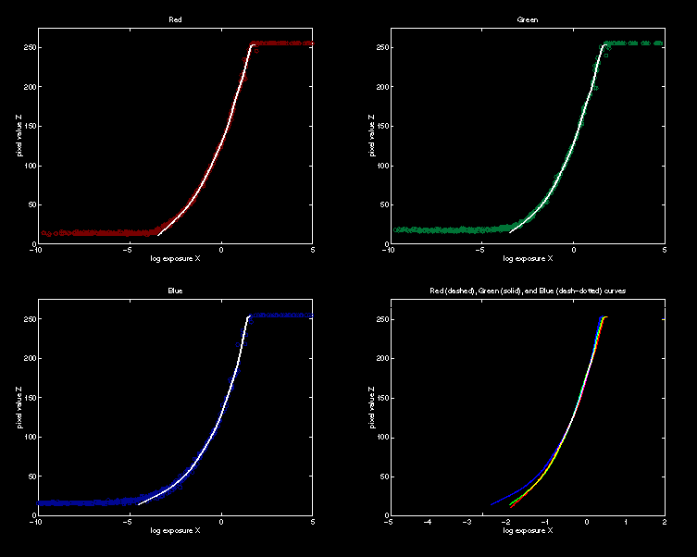
Recovered response function

Slide 46

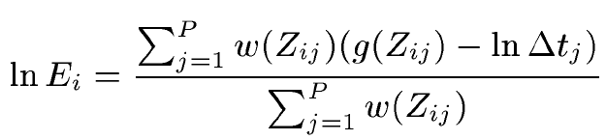
Constructing HDR radiance map
combine pixels to reduce noise and obtain a more reliable estimation

Slide 47
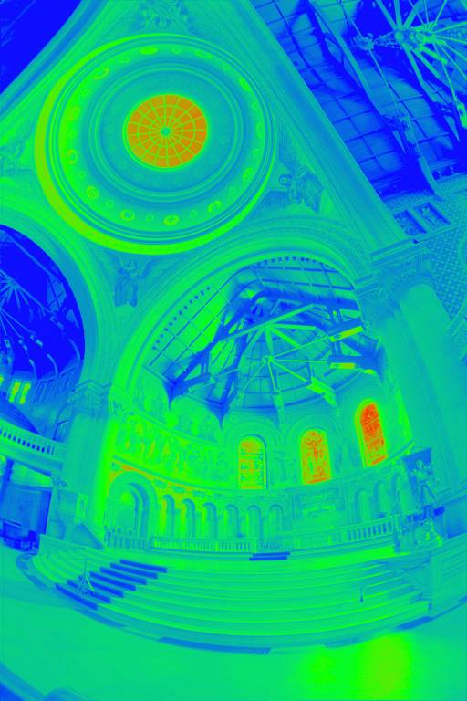
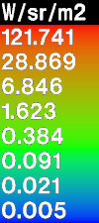
Reconstructed radiance map

Slide 48
What is this for?
Human perception
Vision/graphics applications

Slide 49
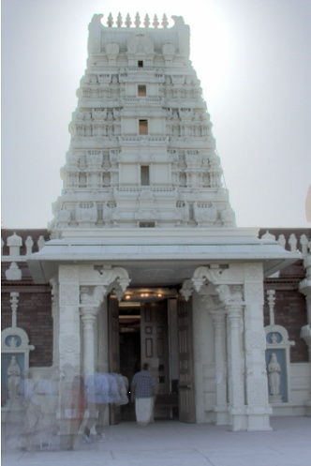
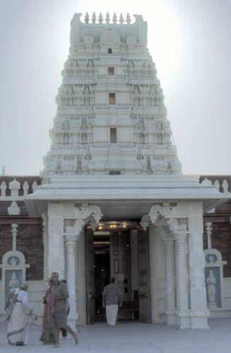
Automatic ghost removal
before
after

Slide 50
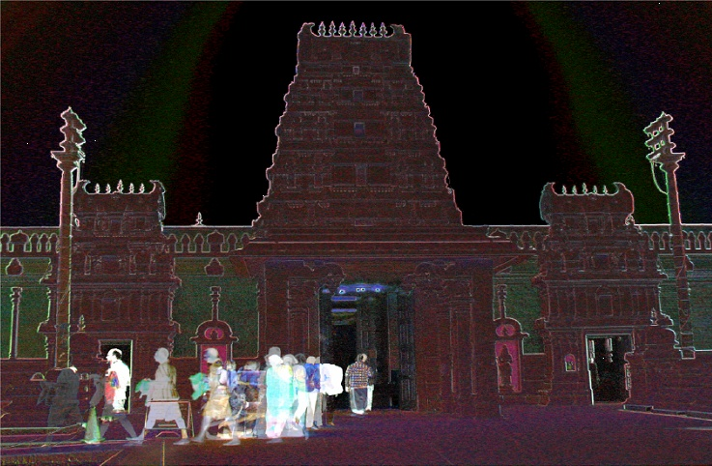
Weighted variance
Moving objects and high-contrast edges render high variance.

Slide 51
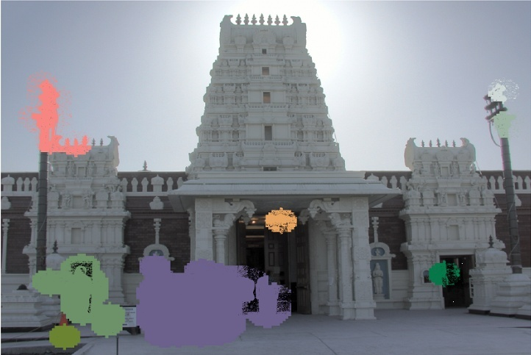
Region masking
Thresholding; dilation; identify regions;

Slide 52
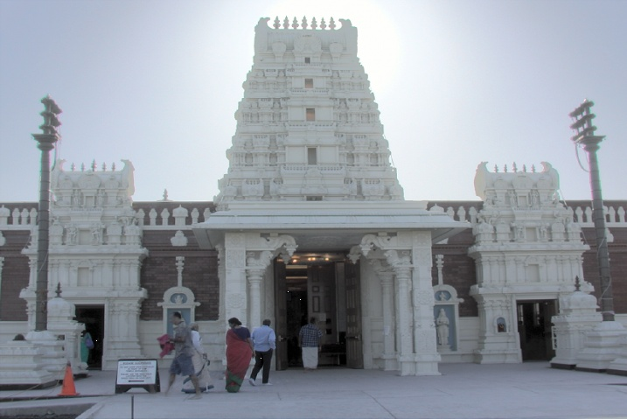
Best exposure in each region

Slide 53
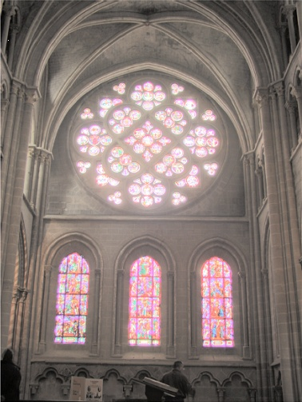
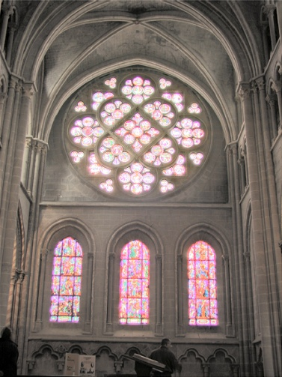
Lens flare removal
before
after

Slide 54

Easier HDR reconstruction
raw image =
12-bit CCD snapshot

Slide 55
Easier HDR reconstruction
Exposure (X)
Xij=E_{i}* Δt_{j}
Δt

Slide 56
Portable floatMap (.pfm)
12 bytes per pixel, 4 for each channel
sign
exponent
mantissa
Text header similar to Jeff Poskanzer’s .ppm
image format:
PF
768 512
1
<binary image data>
Floating Point TIFF similar

Slide 57
Radiance format (.pic, .hdr, .rad)
32 bits/pixel
Red
Green
Blue
Exponent
(145, 215, 87, 149) =
(145, 215, 87) * 2^(149-128) =
(1190000, 1760000, 713000)
(145, 215, 87, 103) =
(145, 215, 87) * 2^(103-128) =
(0.00000432, 0.00000641, 0.00000259)
Ward, Greg. "Real Pixels," in Graphics Gems IV, edited by James Arvo, Academic Press, 1994

Slide 58
ILM’s OpenEXR (.exr)
6 bytes per pixel, 2 for each channel, compressed
sign
exponent
mantissa
Several lossless compression options, 2:1 typical
Compatible with the “half” datatype in NVidia's Cg
Supported natively on GeForce FX and Quadro FX
Available at http://www.openexr.net/

Slide 59
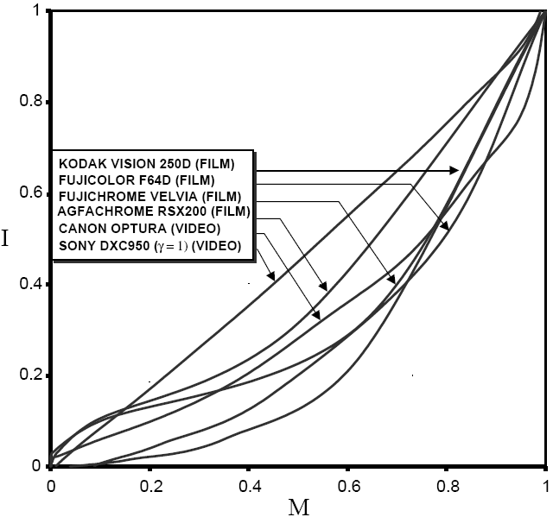
Radiometric self calibration
Assume that any response function can be modeled as a high-order polynomial
No need to know exposure time in advance. Useful for cheap cameras
X
Z

Slide 60
Mitsunaga and Nayar
To find the coefficients c_{m} to minimize the following
A guess for the ratio of

Slide 61
Mitsunaga and Nayar
Again, we can only solve up to a scale. Thus, add a constraint f(1)=1. It reduces to M variables.
How to solve it?

Slide 62
Mitsunaga and Nayar
We solve the above iteratively and update the exposure ratio accordingly
How to determine M? Solve up to M=10 and pick up the one with the minimal error. Notice that you prefer to have the same order for all channels. Use the combined error.

Slide 63
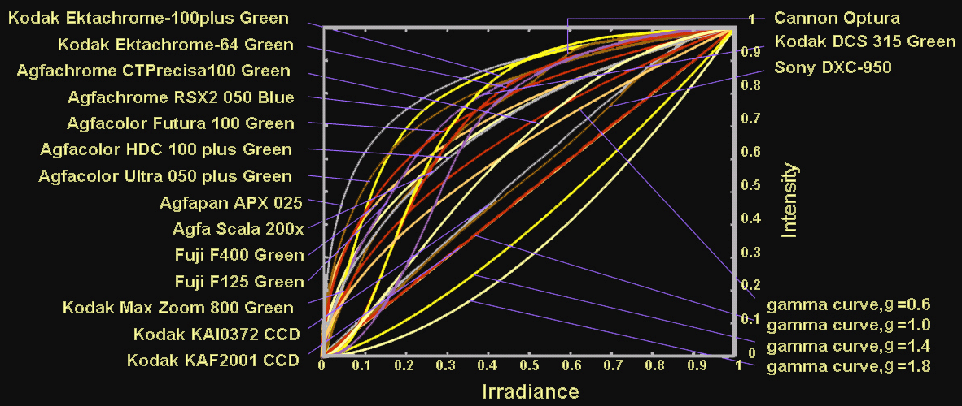
Space of response curves

Slide 64
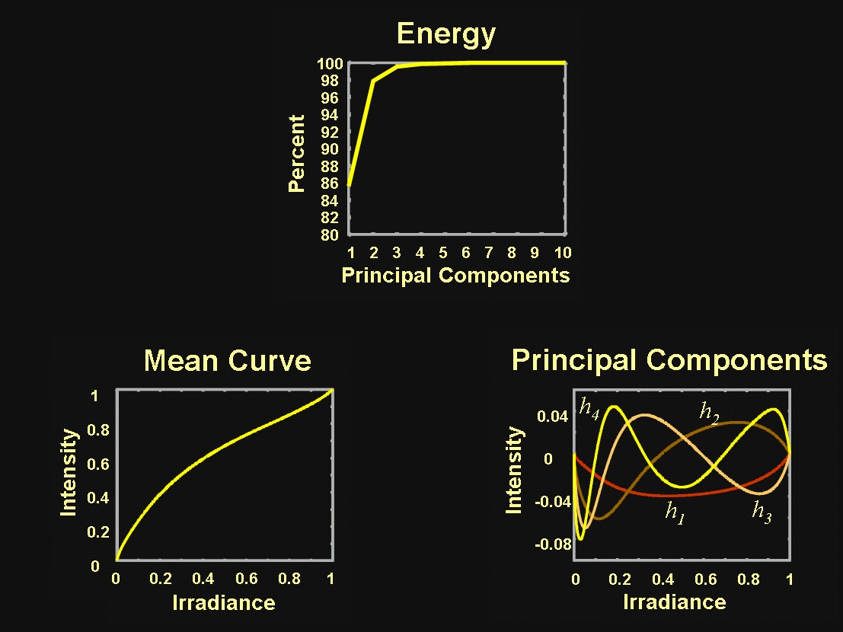
Space of response curves

Slide 65
Robertson et. al.
Given and , the goal is to find both
and
Maximum likelihood

Slide 66
Robertson et. al.
repeat
assuming is known, optimize for
assuming is known, optimize for
until converge

Slide 67
Robertson et. al.
repeat
assuming is known, optimize for
assuming is known, optimize for
until converge

Slide 68
Robertson et. al.
repeat
assuming is known, optimize for
assuming is known, optimize for
until converge

Slide 69
Robertson et. al.
repeat
assuming is known, optimize for
assuming is known, optimize for
until converge
normalize so that

Slide 70

Patch-Based HDR

Slide 71

Deep learning HDR assembly

Slide 72

Deep learning HDR assembly

Slide 73
Deep single-image HDR reconstruction
DrTMO
HDRCNN
ExpandNet

Slide 74


Learning to reverse the pipeline
Camera pipeline
Learning to reverse the camera pipeline

Slide 75
Comparison
input
DrTMO
HDRCNN
Truth
ExpandNet
Ours

Slide 76
Input

Slide 77
Result

Slide 78
Input

Slide 79
Result

Slide 80
HDR Video
High Dynamic Range Video
Sing Bing Kang, Matthew Uyttendaele, Simon Winder, Richard Szeliski
SIGGRAPH 2003
video

Slide 81



Assorted pixel

Slide 82

Assorted pixel

Slide 83

Assorted pixel

Slide 84


A Versatile HDR Video System
video

Slide 85


A Versatile HDR Video System

Slide 86
HDR becomes common practice
Many cameras has bracket exposure modes
For example, since iPhone 4, iPhone has HDR option. But, it could be more exposure blending rather than true HDR.
Notes:
包圍曝光(Bracket Exposure)

Slide 87

References

Slide 88
References
Paul E. Debevec, Jitendra Malik, Recovering High Dynamic Range Radiance Maps from Photographs, SIGGRAPH 1997.
Tomoo Mitsunaga, Shree Nayar, Radiometric Self Calibration, CVPR 1999.
Mark Robertson, Sean Borman, Robert Stevenson, Estimation-Theoretic Approach to Dynamic Range Enhancement using Multiple Exposures, Journal of Electronic Imaging 2003.
Michael Grossberg, Shree Nayar, Determining the Camera Response from Images: What Is Knowable, PAMI 2003.
Michael Grossberg, Shree Nayar, Modeling the Space of Camera Response Functions, PAMI 2004.
Srinivasa Narasimhan, Shree Nayar, Enhancing Resolution Along Multiple Imaging Dimensions Using Assorted Pixels, PAMI 2005.
G. Krawczyk, M. Goesele, H.-P. Seidel, Photometric Calibration of High Dynamic Range Cameras, MPI Research Report 2005.
G. Ward, Fast Robust Image Registration for Compositing High Dynamic Range Photographs from Hand-held Exposures, jgt 2003.

