Slide 1
Cameras
Digital Visual Effects
Yung-Yu Chuang
with slides by Fredo Durand, Brian Curless, Steve Seitz and Alexei Efros
Notes:
Basics for cameras
Some things you might want to know when you shoot pictures
First time, not well-organized yet
Scribe
Assignments
Slides available before Thursday

Slide 2
Camera trial #1
scene
film
Put a piece of film in front of an object.
Notes:
Camera records light, film is sensitivity to light
It gets blurred

Slide 3
Pinhole camera
pinhole camera
scene
barrier
film
Add a barrier to block off most of the rays.
It reduces blurring
The pinhole is known as the aperture
The image is inverted
Notes:
Shutter
A pinhole camera is the simplest camera possible. It consists of a light-proof box, some sort of film and a pinhole.
Usually, you have to expose the film for a long time because the pinhole lets so little light through
The pinhole in a pinhole camera acts as the lens.
The pinhole forces every point emitting light in the scene to form a small point on the film, so the image is crisp. The reason a normal camera uses a lens rather than a pinhole is because the lens creates a much larger hole through which light can make it onto the film, meaning the film can be exposed faster.
Pinhole cameras are used for fun, for art and for science
Depth of the room is the focal length
The first camera
Known to Aristotle
How does the aperture size affect the image?

Slide 4
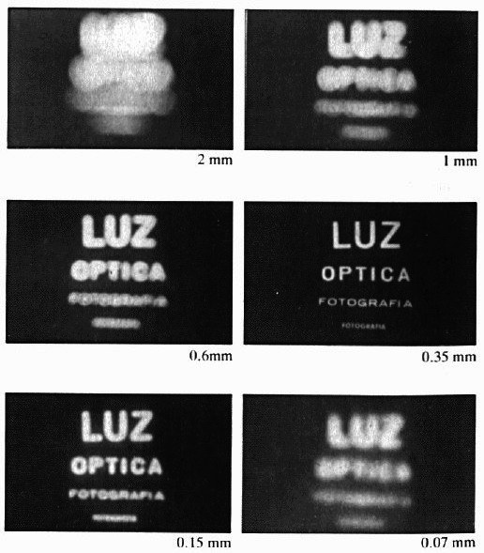
Shrinking the aperture
Why not making the aperture as small as possible?
Less light gets through
Diffraction effect

Slide 5
Shrinking the aperture

Slide 6
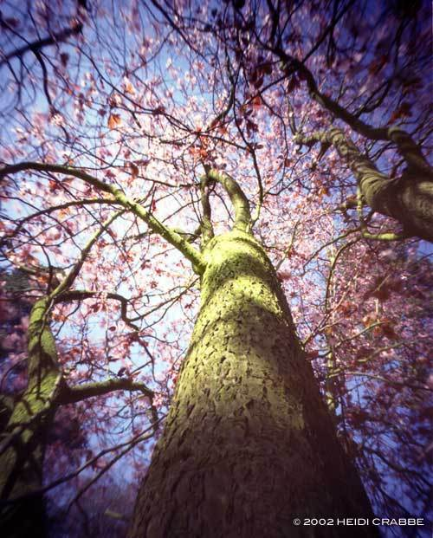
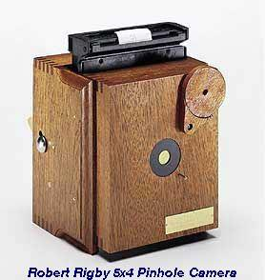
High-end commercial pinhole cameras
$200~$700
Notes:
~$300

Slide 7
Adding a lens
scene
lens
film

Slide 8
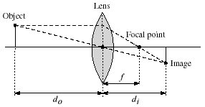
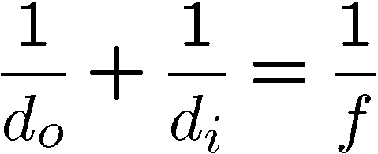
Lenses
Thin lens equation:

Slide 9
Thin lens formula
y’/y = D’/D
Similar triangles everywhere!
D’
D
f
y
y’
Frédo Durand’s slide

Slide 10
Thin lens formula
y’/y = D’/D
Similar triangles everywhere!
y’/y = (D’-f)/f
D’
D
f
y
y’
Frédo Durand’s slide

Slide 11
Thin lens formula
1
1
1
The focal length f determines the
lens’s ability to bend (refract) light. It is a function of the shape and index of refraction of the lens.
+
=
D’
D
f
D’
D
f
Frédo Durand’s slide

Slide 12
Adding a lens
“circle of
confusion”
scene
lens
film
A lens focuses light onto the film
There is a specific distance at which objects are “in focus”
other points project to a “circle of confusion” in the image
Thin lens applet: http://www.phy.ntnu.edu.tw/java/Lens/lens_e.html

Slide 13
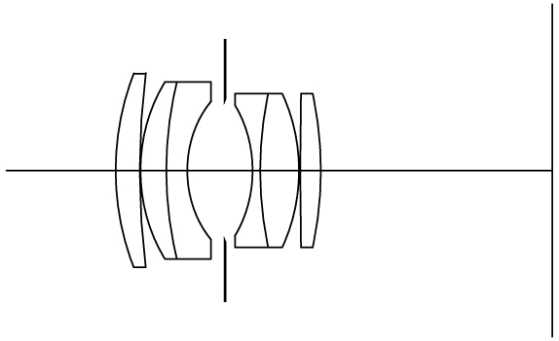
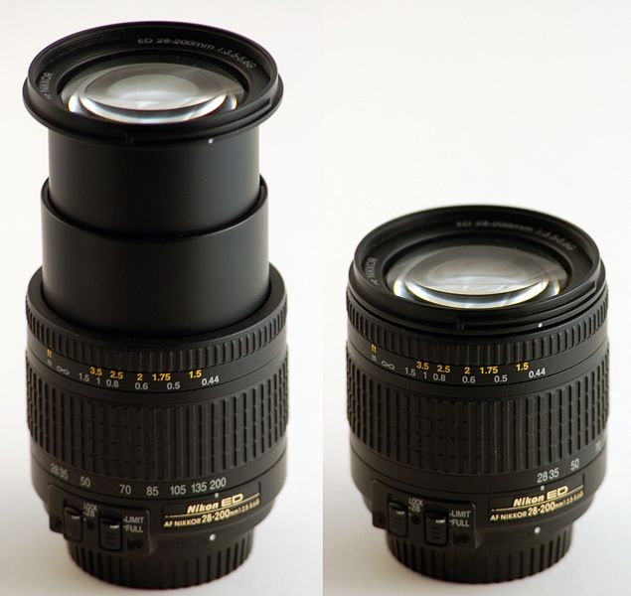
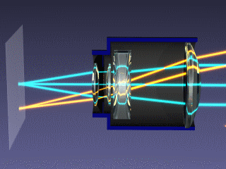
Zoom lens
200mm
28mm
simplified zoom lens in operation
Nikon 28-200mm zoom lens.
From wikipedia
Notes:
變焦鏡指可以改變焦距的鏡頭. 光圈有些會隨變焦而縮小, 一些則不會,這些鏡頭稱為恆定光圈鏡頭。 因其快速拉近或拉遠, 能立即改變構圖, 以方便快捷見稱. 但图像質素一般較差。 [wikipedia]
A zoom lens is a mechanical assembly of lens elements with the ability to vary its focal length (and thus angle of view), as opposed to a fixed focal length (FFL) lens (see prime lens). [wikipedia]

Slide 14
Field of view vs focal length
i
o
Scene
w
α
Sensor
f
Gaussian Lens Formula:
Field of View:
α = 2arctan(w/(2i))
≈ 2arctan(w/(2f))
Example: w = 30mm, f = 50mm => α ≈ 33.4º
Slides from Li Zhang

Slide 15
Focal length in practice
24mm
50mm
135mm
Notes:
焦距 (focal length) 即是指鏡頭至焦點平面(即感光元件的位置，以前是底片，數位單眼則是CCD或CMOS。以D80為例，在模式轉盤的後面有個符號"Φ"，就是指焦點平面)之間的距離
焦距，也稱為焦長，是光學系統中衡量光的聚集或發散的度量方式，指從透鏡中心到光聚集之焦點的距離。亦是照相機中，從鏡片中心到底片或CCD等成像平面的距離。具有短焦距的光學系統比長焦距的光學系統有更佳聚集光的能力。 (wikipedia)
視野的大小取決於鏡頭的焦距和底片大小的比例。由於最大眾化的是35mm規格，鏡頭的視野經常是根據這種規格標示的。對標準鏡頭（50mm）、廣角鏡頭（24mm）、望遠鏡頭（500mm）視野都是不一樣的。對數位相機上也是一樣，它們的感光器比一般傳統的35mm底片還要更小，所以相對的只要更短的焦距，就可以得到相同的影像。 (wikipedia)

Slide 16
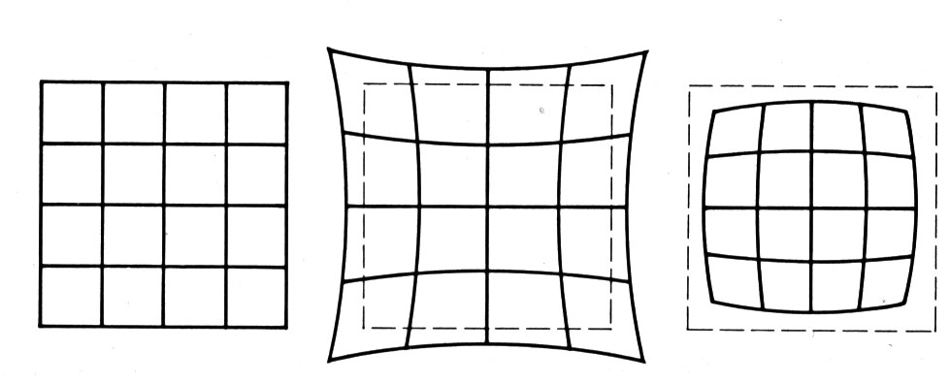
Distortion
No distortion
Pin cushion
Barrel
Radial distortion of the image
Caused by imperfect lenses
Deviations are most noticeable for rays that pass through the edge of the lens
Notes:
Vinyetting

Slide 17
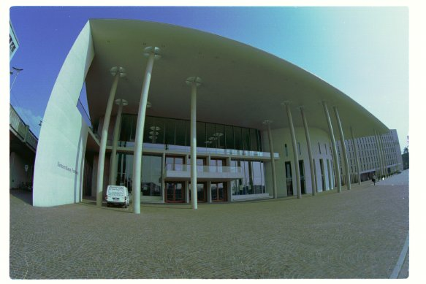
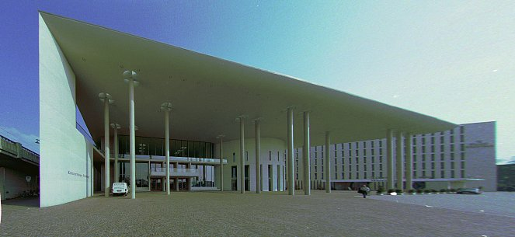
Correcting radial distortion
from Helmut Dersch

Slide 18
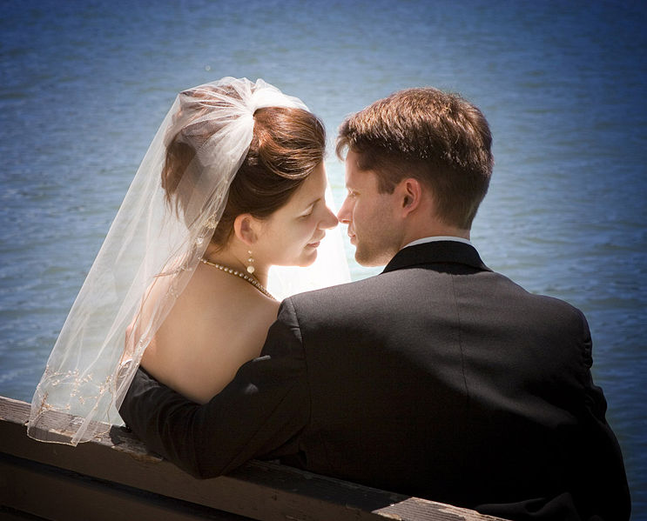
Vignetting
Vignetting
B
A
more light from A than B !
Slides from Li Zhang

Slide 19
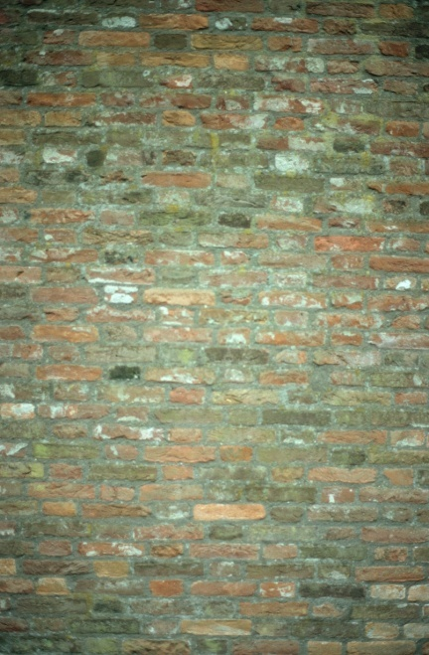
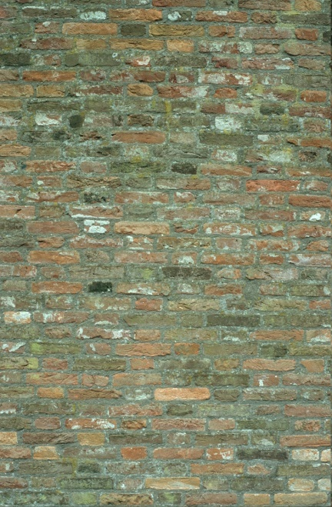
Vignetting
Vignetting
B
A
more light from A than B !
original
corrected
Goldman & Chen ICCV 2005
Slides from Li Zhang

Slide 20
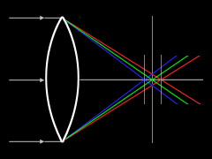
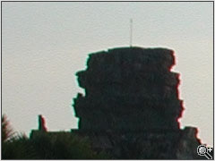
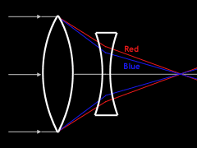
Chromatic Aberration
Lens has different refractive indices
for different wavelengths.
http://www.dpreview.com/learn/?/Glossary/Optical/chromatic_aberration_01.htm
Special lens systems using two or more pieces of glass with different refractive indexes can reduce or eliminate this problem.
Slides from Li Zhang

Slide 21
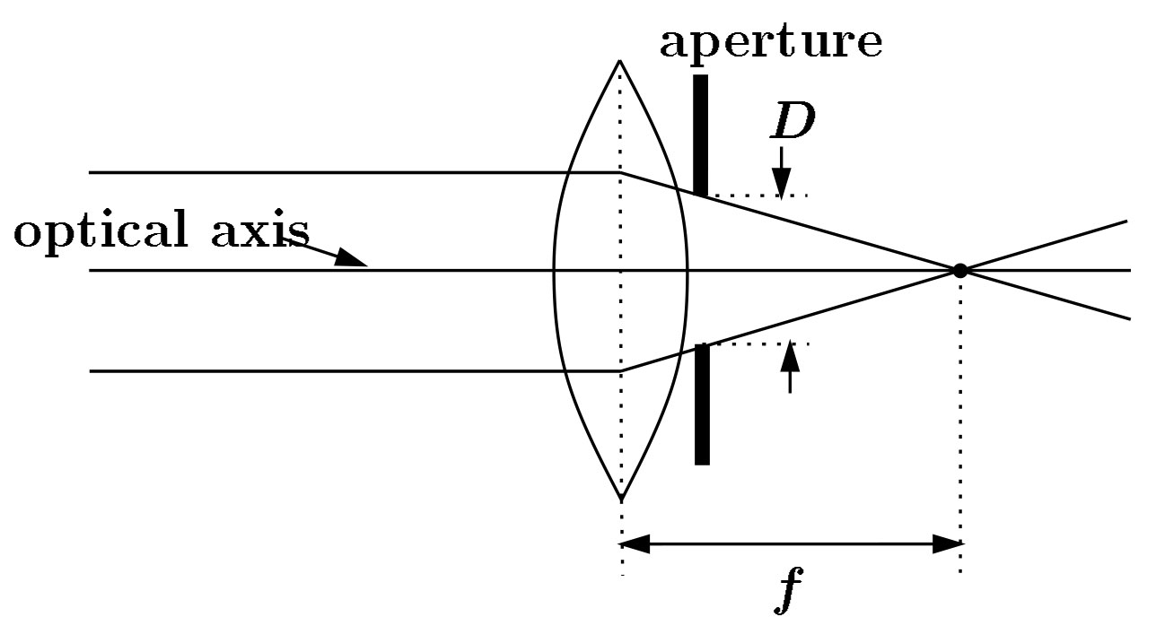
Exposure = aperture + shutter speed
F
Aperture of diameter D restricts the range of rays (aperture may be on either side of the lens)
Shutter speed is the amount of time that light is allowed to pass through the aperture

Slide 22
Exposure
Two main parameters:
Aperture (in f stop)
Shutter speed (in fraction of a second)

Slide 23
Effects of shutter speeds
Slower shutter speed => more light, but more motion blur
Faster shutter speed freezes motion
From Photography, London et al.
Walking people
Running people
Car
Fast train
1/125
1/250
1/500
1/1000

Slide 24
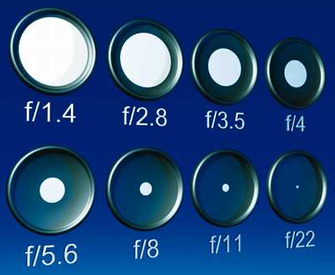
Aperture
Aperture is the diameter of the lens opening, usually specified by f-stop, f/D, a fraction of the focal length.
f/2.0 on a 50mm means that the aperture is 25mm
f/2.0 on a 100mm means that the aperture is 50mm
When a change in f-stop occurs, the light is either doubled or cut in half.
Lower f-stop, more light (larger lens opening)
Higher f-stop, less light (smaller lens opening)
Notes:
http://www.uscoles.com/fstop.htm
1.4 2.0 2.8 4 5.6 8 11 16 22

Slide 25
Depth of field
Changing the aperture size affects depth of field. A smaller aperture increases the range in which the object is approximately in focus
Diaphragm
Point in focus
sensor
lens
Object with texture

Slide 26
Depth of field
Changing the aperture size affects depth of field. A smaller aperture increases the range in which the object is approximately in focus
Diaphragm
Point in focus
sensor
lens
Object with texture

Slide 27
Depth of field
From Photography, London et al.

Slide 28
Exposure
Two main parameters:
Aperture (in f stop)
Shutter speed (in fraction of a second)
Reciprocity
The same exposure is obtained with an exposure twice as long and an aperture area half as big
Hence square root of two progression of f stops vs. power of two progression of shutter speed
Reciprocity can fail for very long exposures
From Photography, London et al.

Slide 29
Reciprocity
Assume we know how much light we need
We have the choice of an infinity of shutter speed/aperture pairs
What will guide our choice of a shutter speed?
Freeze motion vs. motion blur, camera shake
What will guide our choice of an aperture?
Depth of field, diffraction limit
Often we must compromise
Open more to enable faster speed (but shallow DoF)

Slide 30
Exposure & metering
The camera metering system measures how bright the scene is
In Aperture priority mode, the photographer sets the aperture, the camera sets the shutter speed
In Shutter-speed priority mode, photographers sets the shutter speed and the camera deduces the aperture
In Program mode, the camera decides both exposure and shutter speed (middle value more or less)
In Manual mode, the user decides everything (but can get feedback)

Slide 31
Pros and cons of various modes
Aperture priority
Direct depth of field control
Cons: can require impossible shutter speed (e.g. with f/1.4 for a bright scene)
Shutter speed priority
Direct motion blur control
Cons: can require impossible aperture (e.g. when requesting a 1/1000 speed for a dark scene)
Note that aperture is somewhat more restricted
Program
Almost no control, but no need for neurons
Manual
Full control, but takes more time and thinking

Slide 32
Sensitivity (ISO)
Third variable for exposure
Linear effect (200 ISO needs half the light as 100 ISO)
Film photography: trade sensitivity for grain
Digital photography: trade sensitivity for noise
From dpreview.com

Slide 33
Summary in a picture
source hamburgerfotospots.de

Slide 34
Demo
See http://www.photonhead.com/simcam/

Slide 35
Film camera
aperture
& shutter
scene
lens &
motor
film

Slide 36
Digital camera
aperture
& shutter
scene
lens &
motor
sensor
array
A digital camera replaces film with a sensor array
Each cell in the array is a light-sensitive diode that converts photons to electrons

Slide 37
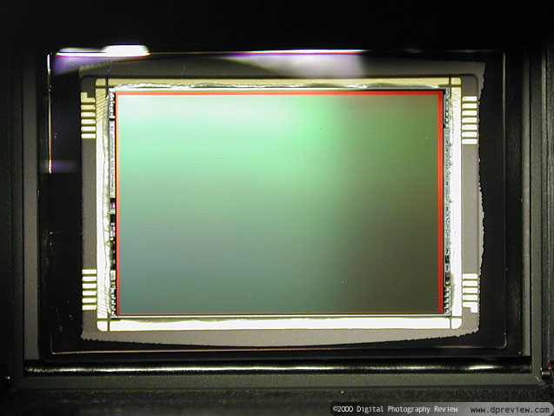
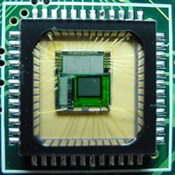
CCD v.s. CMOS
CCD is less susceptible to noise (special process, higher fill factor)
CMOS is more flexible, less expensive (standard process), less power consumption
CCD
CMOS

Slide 38
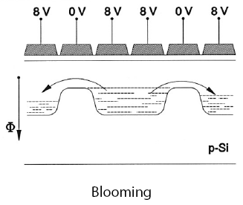
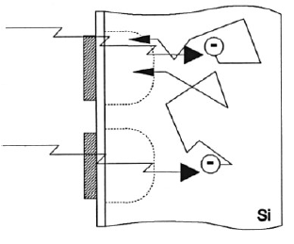
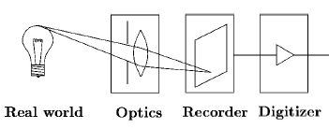
Sensor noise
Blooming
Diffusion
Dark current
Photon shot noise
Amplifier readout noise
Notes:
diffusion: 由於熱能的影響, 使得電子跑到附近的pixel去而產生crosstalk * photon shot noise: 光子到達detector的過程為一個Poisson process, 所以在 計算一個時間內所有收集的光子數會有一個uncertainty, 其標準差為sqrt(S), S為所估計的光子個數 * amplifier readout noise: readout amplifier的阻抗產生的熱所產生的noise

Slide 39
SLR (Single-Lens Reflex)
Reflex (R in SLR) means that we see through the same lens used to take the image.
Not the case for compact cameras

Slide 40
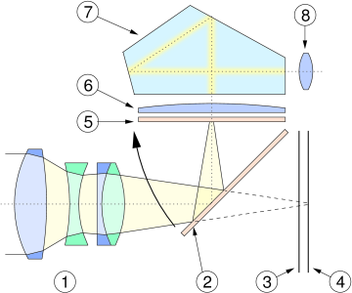
SLR view finder
Prism
Your eye
Mirror (flipped for exposure)
Film/sensor
Mirror (when viewing)
Light from scene
lens

Slide 41
Color
So far, we’ve only talked about monochrome sensors. Color imaging has been implemented in a number of ways:
Field sequential
Multi-chip
Color filter array
X3 sensor

Slide 42
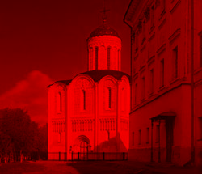
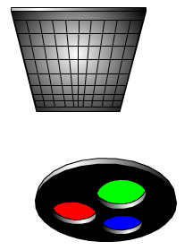
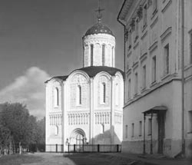
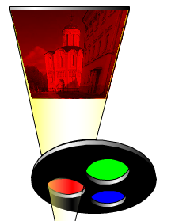
Field sequential

Slide 43
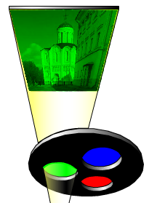
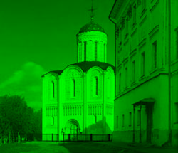
Field sequential

Slide 44
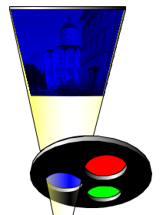
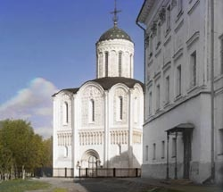
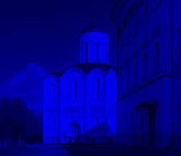
Field sequential

Slide 45
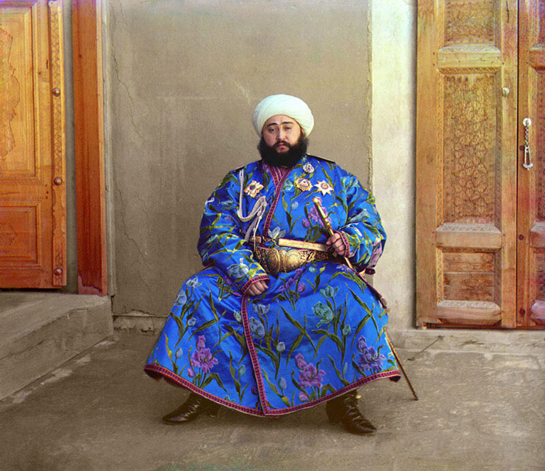
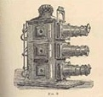
Prokudin-Gorskii (early 1900’s)
Lantern
projector
http://www.loc.gov/exhibits/empire/

Slide 46
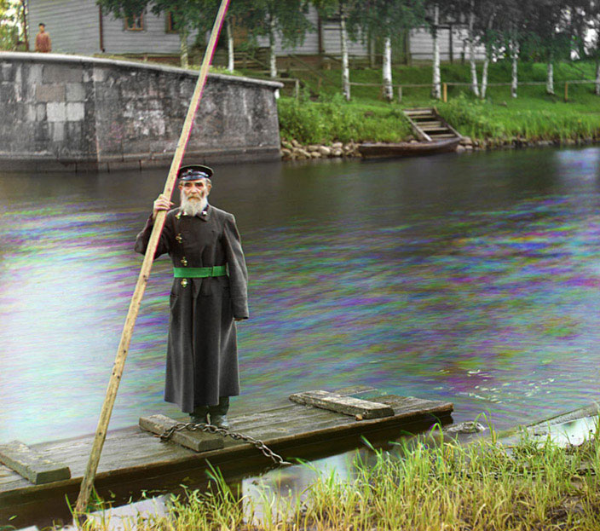
Prokudin-Gorskii (early 1900’s)

Slide 47
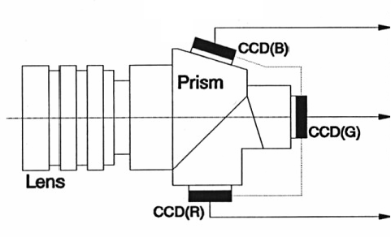
Multi-chip
wavelength
dependent
Notes:
Bulky and expensive

Slide 48
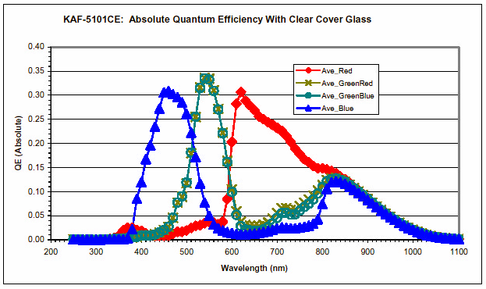
Embedded color filters
Color filters can be manufactured directly onto
the photodetectors.

Slide 49
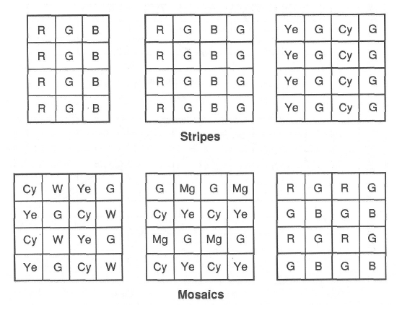
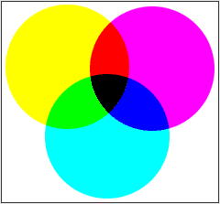
Color filter array
Kodak DCS620x
CMY
Color filter arrays (CFAs)/color filter mosaics
Notes:
The GRGB Bayer Pattern is the most common CFA used, it was used by Kodak on the DCS series cameras and is used in most consumer digital cameras (except for Canon up until the S100 who used a CYGM CFA).
CYGM gives more accurate luminance information than the Bayer filter, hence a wider dynamic range, but at the expense of colour accuracy.
The new CCD offers a wide ISO range (400-4000), 8-9 stops of dynamic range and with the addition of new lower noise electronics and a 12-bit ADC the overall result is the most sensitive CCD yet available
Kodak DCS620x CMY CFA

Slide 50
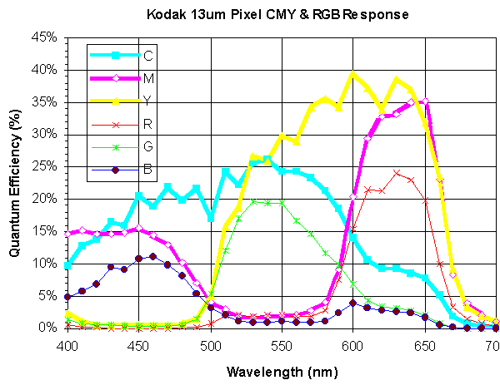
Why CMY CFA might be better
Notes:
http://www.lonestardigital.com/DCS620x.htm
The major advantage of CMY CFA colors is sensitivity, or speed. In photographic terms, speed is equivalent to ISO. The CMY CFA has two attributes that increase effective speed:
· Less unwanted dye absorption
· Increased color signal and signal-to-noise ratio

Slide 51
Color filter array
Bayer pattern
Color filter arrays (CFAs)/color filter mosaics
Notes:
The GRGB Bayer Pattern is the most common CFA used, it was used by Kodak on the DCS series cameras and is used in most consumer digital cameras (except for Canon up until the S100 who used a CYGM CFA).
The new CCD offers a wide ISO range (400-4000), 8-9 stops of dynamic range and with the addition of new lower noise electronics and a 12-bit ADC the overall result is the most sensitive CCD yet available

Slide 52
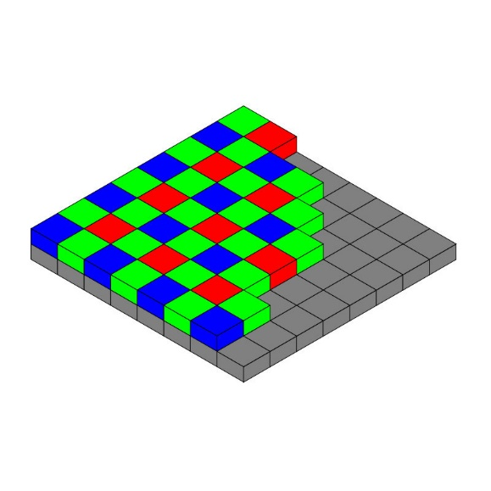
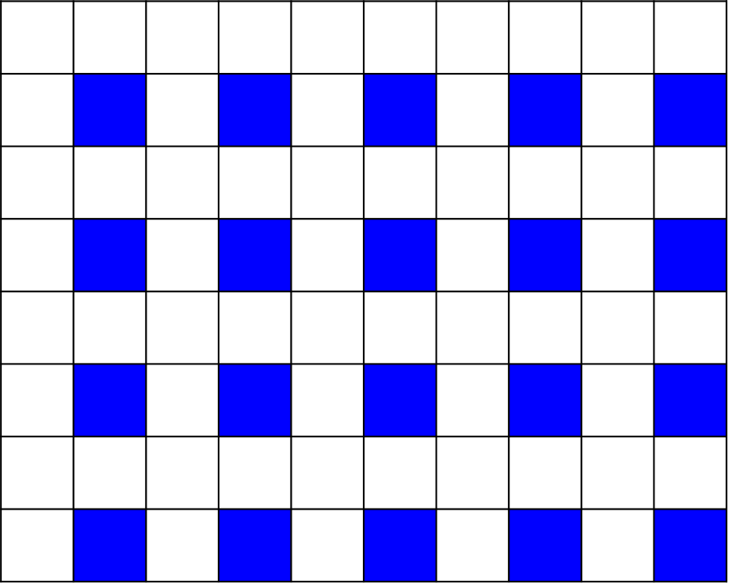
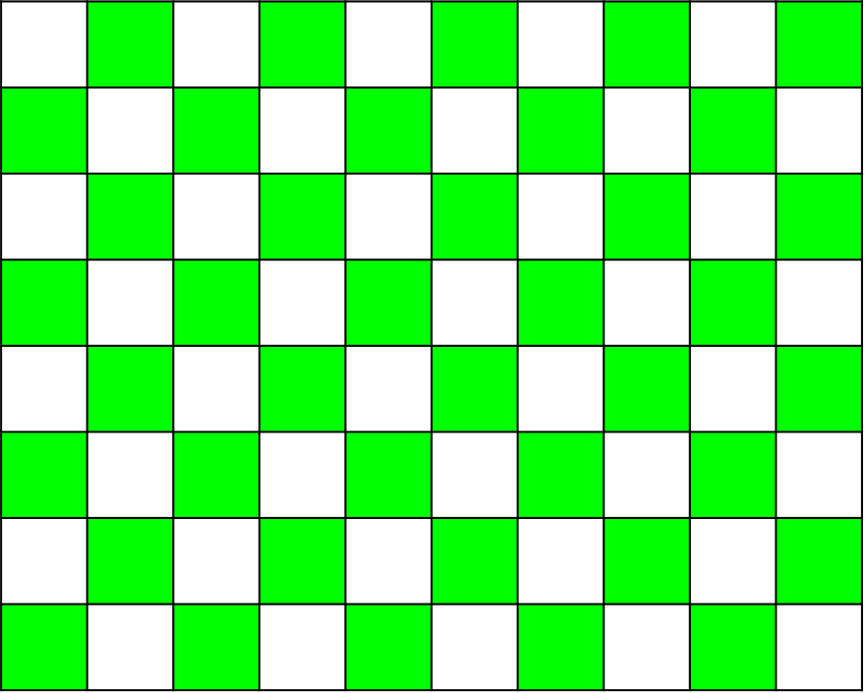
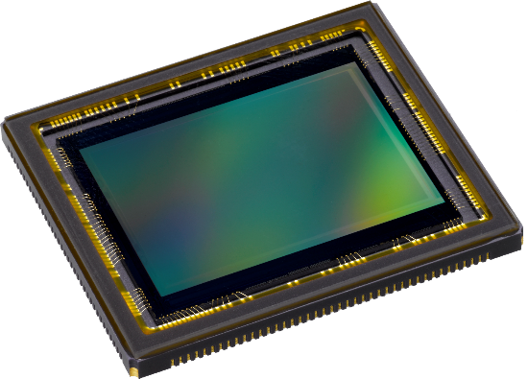
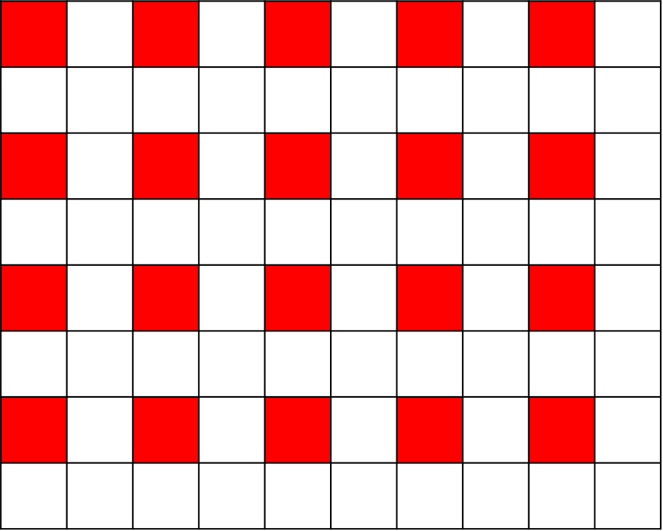
Demosaicking
Color filter array (CFA)
Sensor array
Pattern Design
Bayer CFA
Demosaicking

Slide 53
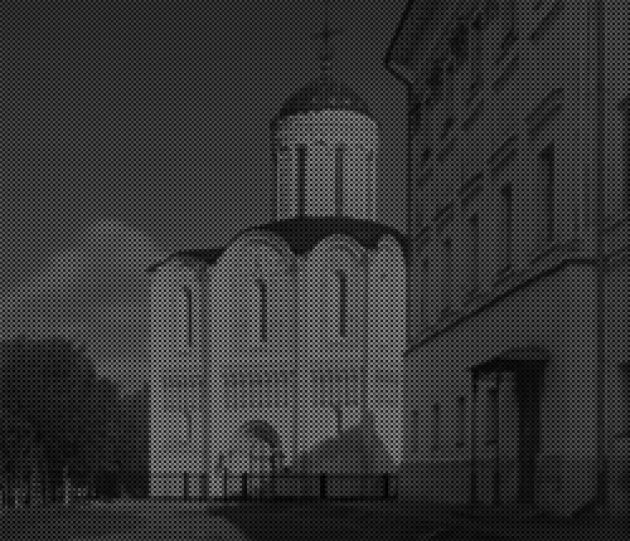
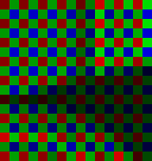
Bayer’s pattern

Slide 54
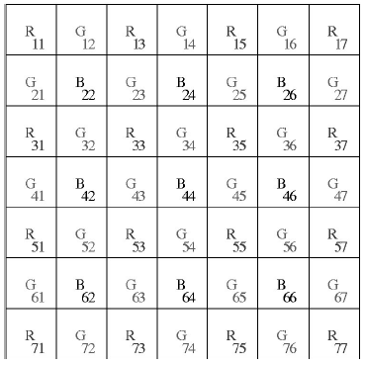
Demosaicking CFA’s
bilinear interpolation
original
input
linear interpolation

Slide 55
Demosaicking CFA’s
Constant hue-based
interpolation (Cok)
Hue:
Interpolate G first

Slide 56
Demosaicking CFA’s
Median-based interpolation
(Freeman)
1. Linear interpolation
2. Median filter on color
differences

Slide 57
Demosaicking CFA’s
Median-based interpolation (Freeman)
original
input
linear interpolation
color difference
(e.g. G-R)
median filter (kernel size 5)
Reconstruction
(G=R+filtered difference)

Slide 58
Demosaicking CFA’s
Gradient-based interpolation
(LaRoche-Prescott)
1. Interpolation on G

Slide 59
Demosaicking CFA’s
Gradient-based interpolation
(LaRoche-Prescott)
2. Interpolation of color
differences

Slide 60
Demosaicking CFA’s
bilinear
Cok
Freeman
LaRoche

Slide 61
Demosaicking CFA’s
Generally, Freeman’s is the best, especially for natural images.

Slide 62
Interpolation-based methods
Observations
Interpolation
mosaicked image
full-color image

Slide 63
Deep learning approach
Deep Learned CNN
Convolution
mosaicked image
full-color image

Slide 64
CNN-based demosaicking
Demosaicking
(learning residual)
………
$$+$$
ReLU

Slide 65
evaluation
Algorithm | Kodak (12 photos) |  |  |  | McM (18 photos) |  |  |  | Kodak + McM (30 photos)
 | PSNR |  |  | CPSNR | PSNR |  |  | CPSNR | PSNR |  |  | CPSNR
 | R | G | B |  | R | G | B |  | R | G | B
SA | 39.8 | 43.31 | 39.5 | 40.54 | 32.73 | 34.73 | 32.1 | 32.98 | 35.56 | 38.16 | 35.06 | 36.01
SSD | 38.83 | 40.51 | 39.08 | 39.4 | 35.02 | 38.27 | 33.8 | 35.23 | 36.54 | 39.16 | 35.91 | 36.9
NLS | 42.34 | 45.68 | 41.57 | 42.85 | 36.02 | 38.81 | 34.71 | 36.15 | 38.55 | 41.56 | 37.46 | 38.83
CS | 41.01 | 44.17 | 40.12 | 41.43 | 35.56 | 38.84 | 34.58 | 35.92 | 37.74 | 40.97 | 36.8 | 38.12
ECC | 39.87 | 42.17 | 39.00 | 40.14 | 36.67 | 39.99 | 35.31 | 36.78 | 37.95 | 40.86 | 36.79 | 38.12
RI | 39.64 | 42.17 | 38.87 | 39.99 | 36.07 | 39.99 | 35.35 | 36.48 | 37.5 | 40.86 | 36.76 | 37.88
MLRI | 40.59 | 42.97 | 39.86 | 40.94 | 36.35 | 39.9 | 35.36 | 36.62 | 38.04 | 41.13 | 37.16 | 38.35
ARI | 40.81 | 43.66 | 40.21 | 41.31 | 37.41 | 40.72 | 36.05 | 37.52 | 38.77 | 41.9 | 37.72 | 39.03
PAMD | 41.88 | 45.21 | 41.23 | 42.44 | 34.12 | 36.88 | 33.31 | 34.48 | 37.22 | 40.21 | 36.48 | 37.66
AICC | 42.04 | 44.51 | 40.57 | 42.07 | 35.66 | 39.21 | 34.34 | 35.86 | 38.21 | 41.33 | 36.83 | 38.34
DMCNN | 39.86 | 42.97 | 39.18 | 40.37 | 36.50 | 39.34 | 35.21 | 36.62 | 37.85 | 40.79 | 36.79 | 38.12
DMCNN-DR | 42.43 | 45.66 | 41.55 | 42.86 | 39.37 | 42.24 | 37.45 | 39.14 | 40.59 | 43.61 | 39.09 | 40.63

Slide 66
Visual Comparisons
ARI
RTF
ground truth
DMCNN-DR
DMCNN-DR-Tr

Slide 67
Evaluation with different patterns
Algorithms | Patern | Kodak (12 photos) |  |  |  | McM (18 photos) |  |  |  | Kodak + McM (30 photos)
 |  | PSNR |  |  | CPSNR | PSNR |  |  | CPSNR | PSNR |  |  | CPSNR
 |  | R | G | B |  | R | G | B |  | R | G | B
NLS | Bayer | 42.34 | 45.68 | 41.57 | 42.85 | 36.02 | 38.81 | 34.71 | 36.15 | 38.55 | 41.56 | 37.46 | 38.83
ARI | Bayer | 40.75 | 43.59 | 40.16 | 41.25 | 37.39 | 40.68 | 36.03 | 37.49 | 38.73 | 41.84 | 37.68 | 39.00
DMCNN-DR | Bayer | 42.43 | 45.66 | 41.55 | 42.86 | 39.37 | 42.24 | 37.45 | 39.14 | 40.59 | 43.61 | 39.09 | 40.63
DMCNN-DR | Diagonal Stripe | 42.00 | 42.47 | 41.36 | 41.91 | 39.70 | 39.5 | 38.02 | 38.87 | 40.62 | 40.69 | 39.36 | 40.08
DMCNN-DR | CYGM | 41.16 | 46.00 | 41.80 | 42.48 | 38.64 | 41.98 | 38.44 | 39.36 | 39.65 | 43.59 | 39.78 | 40.60
DMCNN-DR | Hirakawa | 43.20 | 44.95 | 42.53 | 43.43 | 39.59 | 40.52 | 38.42 | 39.38 | 41.03 | 42.29 | 40.06 | 41.00
Condat | Hirakawa | 41.99 | 43.18 | 41.53 | 42.16 | 33.93 | 34.83 | 33.44 | 33.94 | 37.15 | 38.17 | 36.68 | 37.23
Condat | Condat | 41.68 | 42.7 | 41.27 | 41.83 | 34.05 | 35.08 | 33.57 | 34.1 | 37.1 | 38.13 | 36.65 | 37.19
Diagonal Stripe
CYGM
Hirakawa
Condat pattern

Slide 68
Pattern optimization
Demosaicking
(Learning Residual)
Color
Reconstruction
Pattern Design
$$3×3=9$$
$$9$$
………
$$+$$
ReLU
$3×3$ kernel

Slide 69
Learned pattern
Without non-negative
constraints
With non-negative
constraints

Slide 70
Evaluation with the learned pattern
Algorithm | Kodak (12 photos) |  |  |  | McM (18 photos) |  |  |  | Kodak + McM (30 photos)
 | PSNR |  |  | CPSNR | PSNR |  |  | CPSNR | PSNR |  |  | CPSNR
 | R | G | B |  | R | G | B |  | R | G | B
SA | 39.80 | 43.31 | 39.50 | 40.54 | 32.73 | 34.73 | 32.10 | 32.98 | 35.56 | 38.16 | 35.06 | 36.01
SSD | 38.83 | 40.51 | 39.08 | 39.40 | 35.02 | 38.27 | 33.80 | 35.23 | 36.54 | 39.16 | 35.91 | 36.90
NLS | 42.34 | 45.68 | 41.57 | 42.85 | 36.02 | 38.81 | 34.71 | 36.15 | 38.55 | 41.56 | 37.46 | 38.83
CS | 41.01 | 44.17 | 40.12 | 41.43 | 35.56 | 38.84 | 34.58 | 35.92 | 37.74 | 40.97 | 36.80 | 38.12
ECC | 39.87 | 42.17 | 39.00 | 40.14 | 36.67 | 39.99 | 35.31 | 36.78 | 37.95 | 40.86 | 36.79 | 38.12
RI | 39.64 | 42.17 | 38.87 | 39.99 | 36.07 | 39.99 | 35.35 | 36.48 | 37.50 | 40.86 | 36.76 | 37.88
MLRI | 40.59 | 42.97 | 39.86 | 40.94 | 36.35 | 39.9 | 35.36 | 36.62 | 38.04 | 41.13 | 37.16 | 38.35
ARI | 40.81 | 43.66 | 40.21 | 41.31 | 37.41 | 40.72 | 36.05 | 37.52 | 38.77 | 41.9 | 37.72 | 39.03
PAMD | 41.88 | 45.21 | 41.23 | 42.44 | 34.12 | 36.88 | 33.31 | 34.48 | 37.22 | 40.21 | 36.48 | 37.66
AICC | 42.04 | 44.51 | 40.57 | 42.07 | 35.66 | 39.21 | 34.34 | 35.86 | 38.21 | 41.33 | 36.83 | 38.34
DMCNN | 39.86 | 42.97 | 39.18 | 40.37 | 36.50 | 39.34 | 35.21 | 36.62 | 37.85 | 40.79 | 36.79 | 38.12
DMCNN-DR | 42.43 | 45.66 | 41.55 | 42.86 | 39.37 | 42.24 | 37.45 | 39.14 | 40.59 | 43.61 | 39.09 | 40.63
DMCNN-Pa | 43.06 | 43.76 | 42.13 | 42.92 | 40.63 | 40.14 | 38.74 | 39.68 | 41.60 | 41.59 | 40.01 | 40.98

Slide 71
Visual Comparisons
CS
NLS
ARI
original
image
ground truth
DMCNN-DR
DMCNN-DR-Pa

Slide 72
Foveon X3 sensor
light penetrates to different depths for different wavelengths
multilayer CMOS sensor gets 3 different spectral sensitivities

Slide 73
Color filter array
red
green
blue
output

Slide 74
X3 technology
red
green
blue
output

Slide 75
Foveon X3 sensor
Bayer CFA
X3 sensor

Slide 76
Cameras with X3
Sigma SD10, SD9
Polaroid X530

Slide 77
Sigma SD9 vs Canon D30

Slide 78
Color processing
After color values are recorded, more color processing usually happens:
White balance
Non-linearity to approximate film response or match TV monitor gamma

Slide 79
White Balance
warmer +3
automatic white balance
Notes:
The reason that pictures turn out with a yellow/orange cast in incandescent (tungsten) lighting and bluish in fluorescent lighting is because light has a colour temperature
This is where the concept of "White Balance" comes in. If we can tell the camera which object in the room is white and supposed to come out white in the picture
cameras provide preset WB settings such as, Tungsten, Flourescent, Cloudy, Sunny, etc. Using preset WB can improve on a picture, especially under indoors lighting.
Auto White Balance

Slide 80
White Balance
illumination
reflectance
perception

Slide 81
Color constancy
What color is the dress?
Notes:
http://pansci.tw/archives/76012
從演化上來看，這是因為自然世界中的物品大多數不會變色，會改變的通常是光源，因此大腦才演化出根據光源和周遭各種物體資訊來調整物體最後顏色的「色彩恆常性」。

Slide 82
Color constancy

Slide 83
Human vision is complex

Slide 84
Color perception depends on surrounding

Slide 85
Color perception depends on surrounding

Slide 86
Color perception depends on surrounding

Slide 87
Autofocus
Active
Sonar
Infrared
Passive

Slide 88
Digital camera review website
A cool video of digital camera illustration
http://www.dpreview.com/

Slide 89
Camcorder
Notes:
A typical analog camcorder contains two basic parts:
A camera section, consisting of a CCD, lens and motors to handle the zoom, focus and apeture
A VCR section, in which a typical TV VCR is shrunk down to fit in a much smaller space.
A third component, the viewfinder,
To create a video signal, a camcorder CCD must take many pictures every second, which the camera then combines to give the impression of movement.
If you've read How Television Works, you know that a television "paints" images in horizontal lines across a screen, starting at the top and working downward. TVs actually paint every other line in one pass (this is called a "field") and then paint the alternate lines in the next pass. To create a video signal, a camcorder captures a frame of video from the CCD and records it as the two fields. The CCD actually has another sensor layer behind the image sensor. For every field of video, the CCD transfers all the photosite charges to this second layer, which then transmits the electric charges at each photosite, one by one. In an analog camcorder, this signal goes to the VCR, which records the electric charges (along with color information) as a magnetic pattern on videotape. While the second layer is transmitting the video signal, the first layer has refreshed itself and is capturing another image.
Interlaced digital camcorders record each frame as two fields, just as analog camcorders do. Progressive digital camcorders record video as an entire still frame, which they then break up into two fields when you output the video as an analog signal
This is why all camcorders come with an autofocus device, usually an infrared beam that bounces off objects in the center of the frame and comes back to a sensor on the camcorder.
To find the distance to the object, the processor calculates how long it takes the beam to bounce and return, multiplies this time by the speed of light, and divides the product by two (because it traveled the distance twice -- to the object and back again). The camcorder has a small motor that moves the lens, focusing it on objects at this distance. This works pretty well most of the time, but sometimes you have to override it -- you may want to focus on something in the side of the frame, for example, but the autofocus is picking up what's right in front of the camcorder. To learn more about autofocus mechanisms, check out How Autofocus Cameras Work.
The difference between regular interlaced video and progressive scan video is that instead of breaking up a video sequence into two fields sixty times per second, both fields are captured at the same time thirty frames per second.
I used the deinterlace filter in virtualdub selecting "duplicate field 1" (or 2) in combination with the "3x3 average" filter. This filter significantly improved the video quality
Do you think you record 25 frames per second when you make a movie with your digital camcorder
Your digital camcorder does the following: Records 50 pictures per second, intermixing every 2 consecutive pictures (with half the height) into 1 frame.
In fact, you don't call them pictures, but fields. So 2 fields are mixed into 1 frame. This mixing is called interlacing.
1)Record field 12)Record field 23)Mix (=interlace) field 1 and field 2 into one frame and save the frame as frame 1.4)Record field 35)Record field 46)Mix (=interlace) field 3 and field 4 into one frame and save the frame as frame 2.Note: The timeline of your analog camcorder is usually different. Analog camcorders, VCRs etc do not mix the recorded pictures. They record picture after picture after picture. Analog camcorders use "odd" and "even" sets of scan lines, too, but they don't intermix them into 1 frame.
So the timeline of the analog camcorder is/was:
1)Record field 1 (=frame 1) (odd scan lines)2)Record field 2 (=frame 2) (even scan lines)4)Record field 3 (=frame 3) (odd scan lines)5)Record field 4 (=frame 4) (even scan lines)
The main reason for this: Movies with 25 non-interlaced (=progressive) frames per second don't look very fluid. If you watched a football game with 25 progressive fps it would look as if the ball isn't flying fluidly thru the air. With 50 fields per second which are then combined to 25 frames per second this looks much better. So why not record 50 images per second? Because so far there wasn't a technology available that could record so fast or display so fast (slow LCD in camcorders and slow TV sets).
It is true that cinema movies are filmed with 24 noninterlaced (=progressive) frames per second (thus about 2/2.5 times less than PAL/NTSC) and look fluid, but this has a special reason:
The fact is that the human eye perceives the typical cinema film motion as being fluid at about 18fps, because of its blurring.
If you could see your moving hand very clear and crisp, then your eye needed to make more snapshots of it to make it look fluid. If you had a movie with 50 very sharp and crisp images per second, your eye would make out lots of details from time to time and you had the feeling, that the movie is stuttering.
Just think of modern games: Have you ever played Quake with 18fps? There is no motion blur in those games, thus you need a lot of frames per second more.
several methods of de-interlacing

Slide 90
Interlacing
without interlacing
with interlacing
Notes:
60 fps
Old TV design

Slide 91
Deinterlacing
blend
weave

Slide 92
Deinterlacing
Discard
(even field only or
odd filed only)
Progressive scan

Slide 93
Hard cases

Slide 94
Computational cameras

Slide 95
More emerging cameras

Slide 96
References
http://www.howstuffworks.com/digital-camera.htm
http://electronics.howstuffworks.com/autofocus.htm
Ramanath, Snyder, Bilbro, and Sander. Demosaicking Methods for Bayer Color Arrays, Journal of Electronic Imaging, 11(3), pp306-315.
Rajeev Ramanath, Wesley E. Snyder, Youngjun Yoo, Mark S. Drew, Color Image Processing Pipeline in Digital Still Cameras, IEEE Signal Processing Magazine Special Issue on Color Image Processing, vol. 22, no. 1, pp. 34-43, 2005.
http://www.worldatwar.org/photos/whitebalance/index.mhtml
http://www.100fps.com/

