Slide 1
More on natural image matting
Digital Visual Effects
Yung-Yu Chuang
with slides by

Slide 2
A closed form solution to natural alpha matting, CVPR 2006
With slides from Prof. Hwann-Tzong Chen

Slide 3
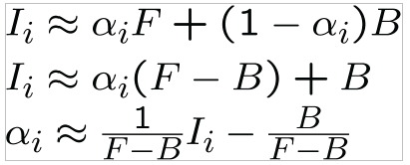
Linear relation (grayscale for now)

Slide 4
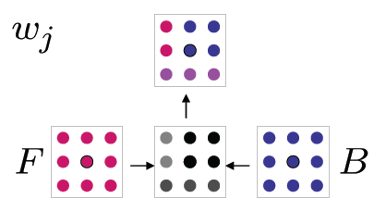
Linear relation

Slide 5
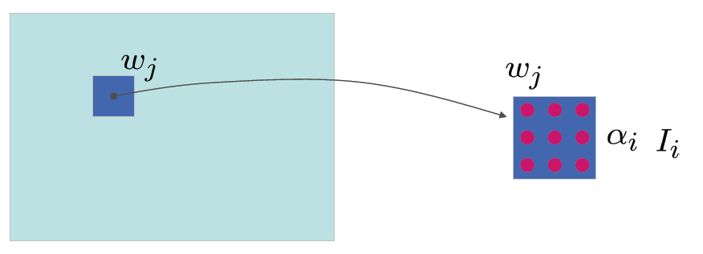
Optimization

Slide 6
Optimization

Slide 7
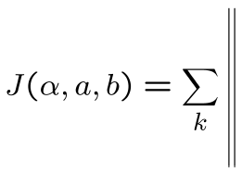
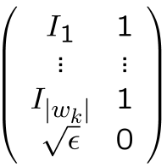
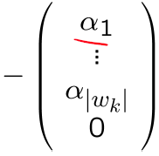
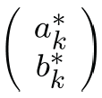
Optimization

Slide 8
Optimization

Slide 9
Optimization

Slide 10
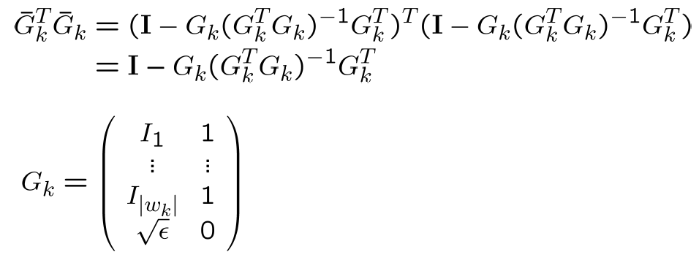
Optimization

Slide 11
Optimization

Slide 12
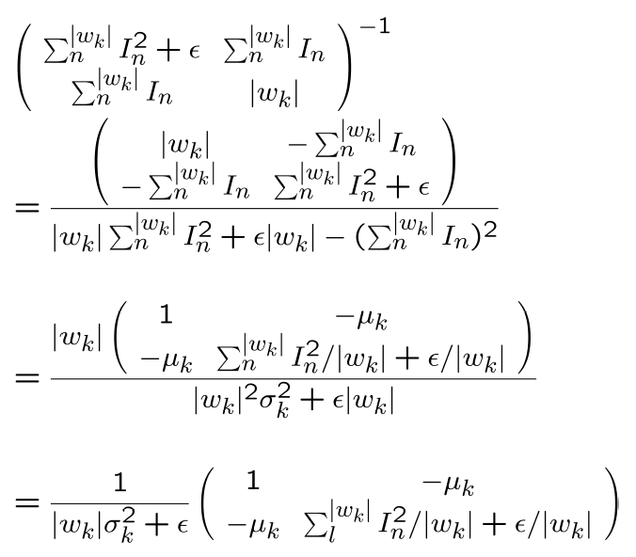
The inverse

Slide 13
Optimization

Slide 14
Optimization

Slide 15
A global sampling method for alpha matting, CVPR 2011

Slide 16
Idea
input
robust
improved
color
shared
global

Slide 17
Search space

Slide 18
Propagation and random search
Propagation
Random search

Slide 21
KNN Matting, CVPR 2012

Slide 22
Nonlocal principle

Slide 23
Nonlocal principle for mattes

Slide 24
Kernels and features

Slide 25
KNN matting

Slide 26
Results

Slide 27
Results

Slide 28
Results

