Slide 1
Features
Digital Visual Effects
Yung-Yu Chuang
with slides by Trevor Darrell Cordelia Schmid, David Lowe, Darya Frolova, Denis Simakov, Robert Collins and Jiwon Kim

Slide 2
Outline
Features
Harris corner detector
SIFT
Extensions
Applications

Slide 3
Features

Slide 4

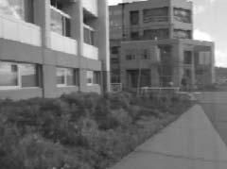
Features
Also known as interesting points, salient points or keypoints. Points that you can easily point out their correspondences in multiple images using only local information.
?

Slide 5
Desired properties for features
Distinctive: a single feature can be correctly matched with high probability.
Invariant: invariant to scale, rotation, affine, illumination and noise for robust matching across a substantial range of affine distortion, viewpoint change and so on. That is, it is repeatable.

Slide 6
Applications
Object or scene recognition
Structure from motion
Stereo
Motion tracking
…

Slide 7
Components
Feature detection locates where they are
Feature description describes what they are
Feature matching decides whether two are the same one

Slide 8
Harris corner detector

Slide 9
Moravec corner detector (1980)
We should easily recognize the point by looking through a small window
Shifting a window in any direction should give a large change in intensity

Slide 10
Moravec corner detector
flat

Slide 11
Moravec corner detector
flat

Slide 12
Moravec corner detector
flat
edge

Slide 13
Moravec corner detector
corner
isolated point
flat
edge

Slide 14
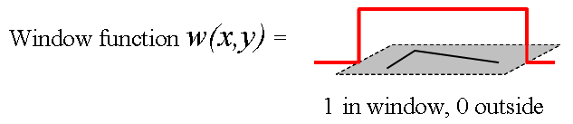
Moravec corner detector
Change of intensity for the shift [u,v]:
window function
shifted intensity
intensity
Four shifts: (u,v) = (1,0), (1,1), (0,1), (-1, 1)
Look for local maxima in min{E}

Slide 15
Problems of Moravec detector
Noisy response due to a binary window function
Only a set of shifts at every 45 degree is considered
Only minimum of E is taken into account
Harris corner detector (1988) solves these problems.

Slide 16
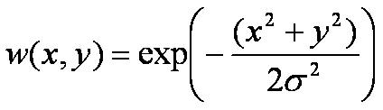
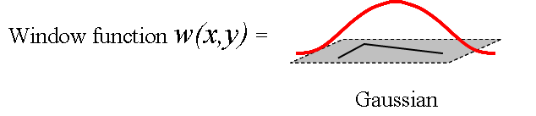
Harris corner detector
Noisy response due to a binary window function
Use a Gaussian function

Slide 17
Harris corner detector
Only a set of shifts at every 45 degree is considered
Consider all small shifts by Taylor’s expansion

Slide 18
Harris corner detector
Only a set of shifts at every 45 degree is considered
Consider all small shifts by Taylor’s expansion

Slide 19
Harris corner detector
Equivalently, for small shifts [u,v] we have a bilinear approximation:
, where M is a 2×2 matrix computed from image derivatives:

Slide 20
Harris corner detector (matrix form)

Slide 21
Harris corner detector
Only minimum of E is taken into account
A new corner measurement by investigating the shape of the error function
represents a quadratic function; Thus, we can analyze E’s shape by looking at the property of M

Slide 22
Harris corner detector
High-level idea: what shape of the error function will we prefer for features?
flat
edge
corner

Slide 23
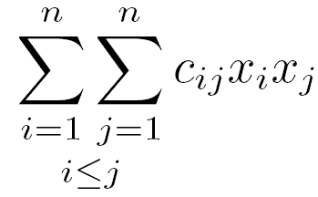
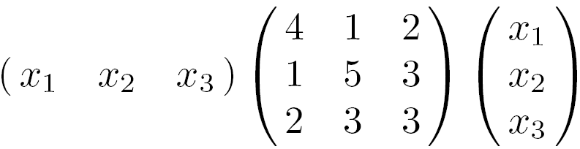
Quadratic forms
Quadratic form (homogeneous polynomial of degree two) of n variables x_{i}
Examples
=
Notes:
See W W L Chen’s linear algebra book, chap 11

Slide 24
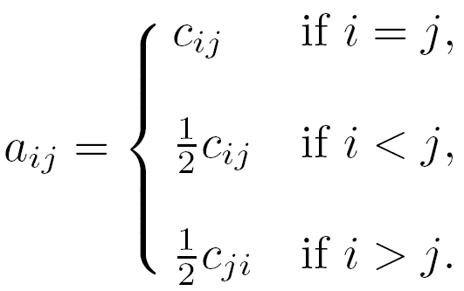
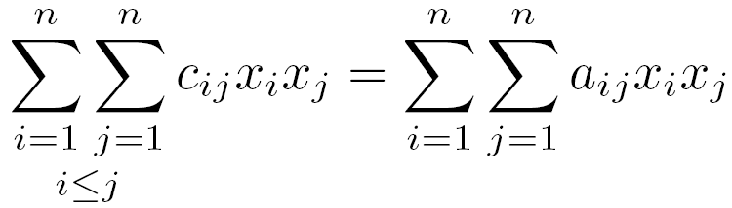
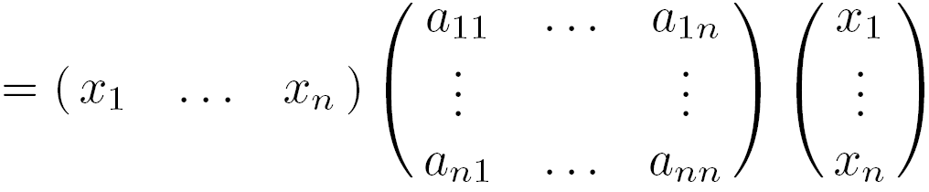


Symmetric matrices
Quadratic forms can be represented by a real symmetric matrix A where

Slide 25
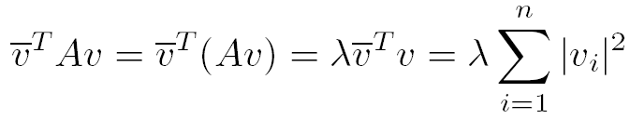
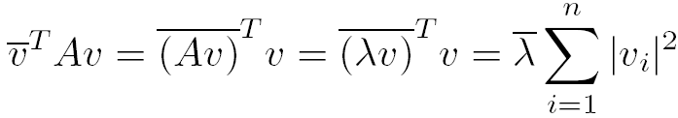


Eigenvalues of symmetric matrices
Brad Osgood

Slide 26

Eigenvectors of symmetric matrices

Slide 27
Eigenvectors of symmetric matrices
Notes:
藍色座標系內的正圓在黑色座標系內看起來變成橢圓。

Slide 28
Harris corner detector
Intensity change in shifting window: eigenvalue analysis
λ₁, λ₂ – eigenvalues of M
Ellipse E(u,v) = const
direction of the fastest change
direction of the slowest change
(λ_{max})^{-1/2}
(λ_{min})^{-1/2}

Slide 29
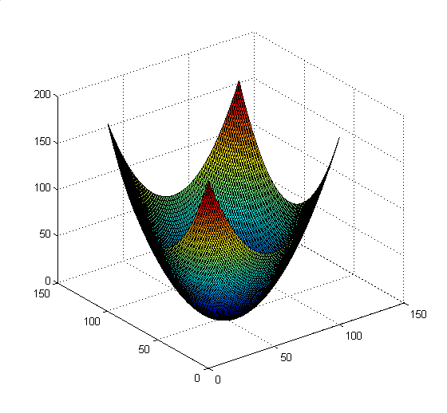
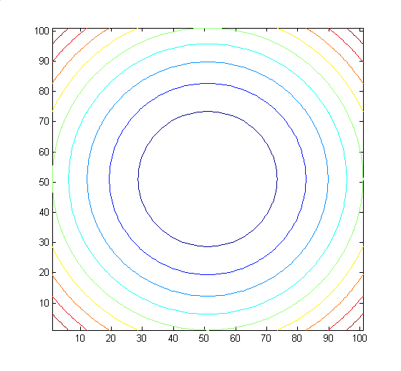
Visualize quadratic functions

Slide 30
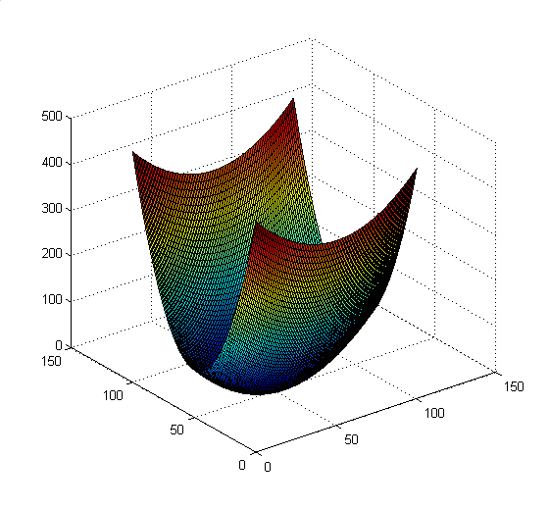
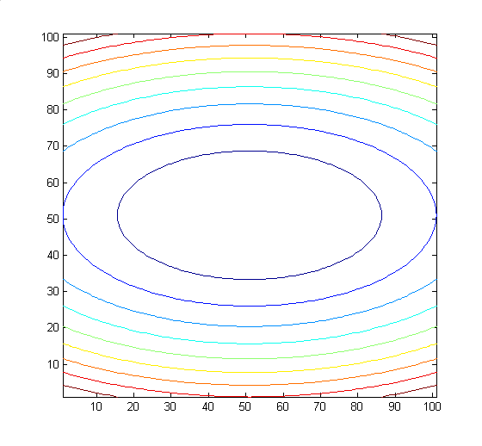
Visualize quadratic functions

Slide 31
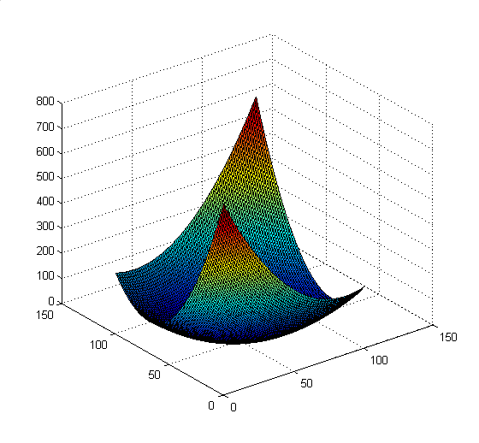
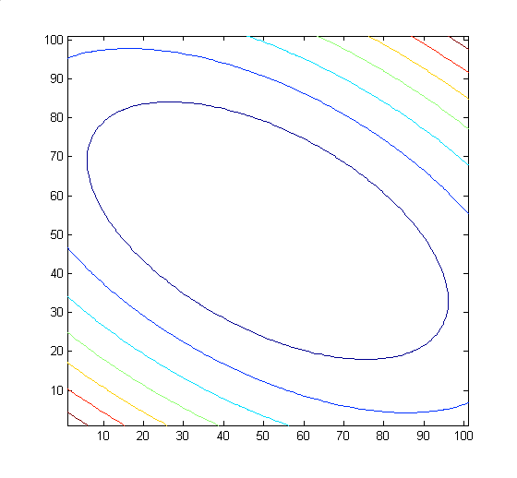
Visualize quadratic functions

Slide 32
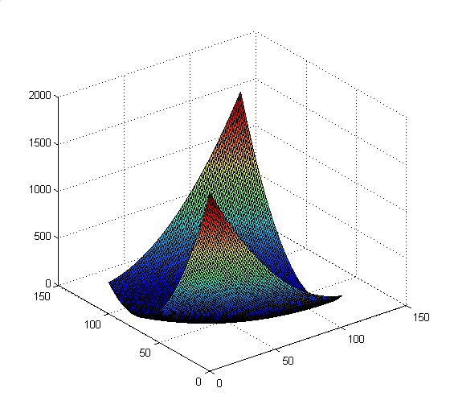
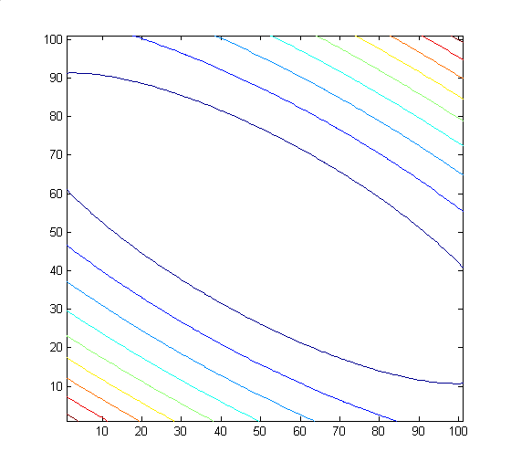
Visualize quadratic functions

Slide 33
Harris corner detector
Classification of image points using eigenvalues of M:
λ₂
edge
λ₂ >> λ₁
Corner
λ₁ and λ₂ are large,
λ₁ ~ λ₂;
E increases in all directions
λ₁ and λ₂ are small;
E is almost constant in all directions
edge
λ₁ >> λ₂
flat
λ₁

Slide 34
Harris corner detector
Only for reference,
you do not need
them to compute R
Measure of corner response:
(k – empirical constant, k = 0.04-0.06)
Notes:
http://mathworld.wolfram.com/Eigenvalue.html

Slide 35
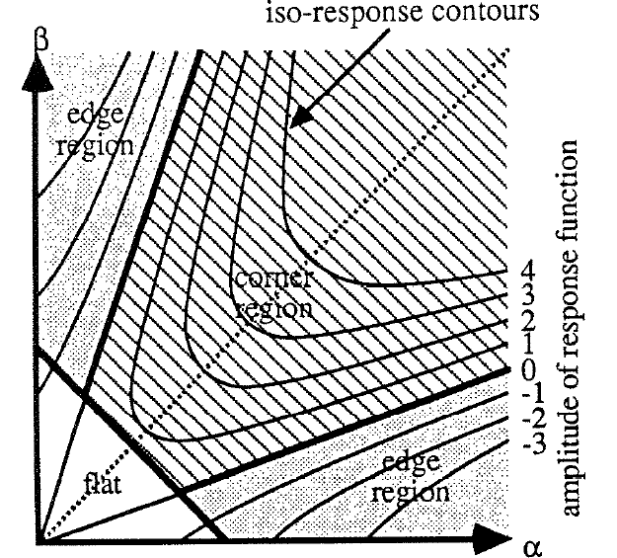
Harris corner detector

Slide 36
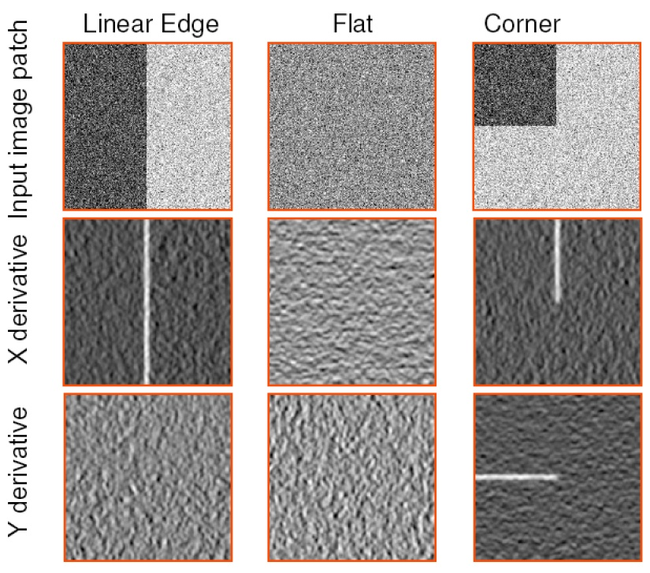
Another view

Slide 37
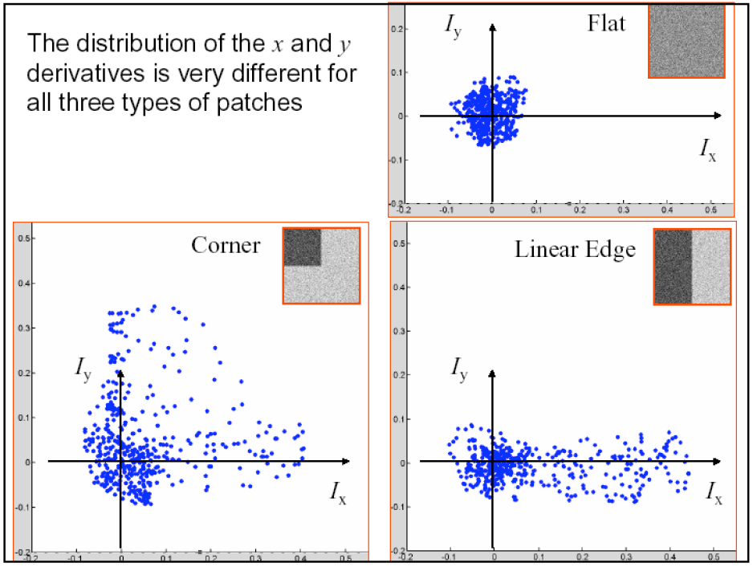
Another view

Slide 38
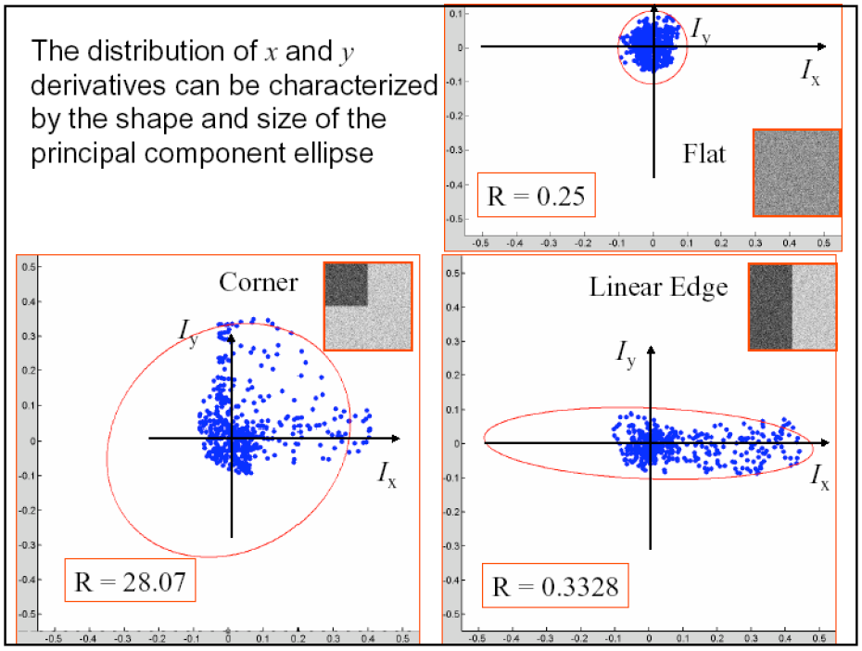
Another view

Slide 39
Summary of Harris detector
Compute x and y derivatives of image
Compute products of derivatives at every pixel
Compute the sums of the products of derivatives at each pixel

Slide 40
Summary of Harris detector
Define the matrix at each pixel
Compute the response of the detector at each pixel
Threshold on value of R; compute nonmax suppression.

Slide 41

Harris corner detector (input)

Slide 42

Corner response R

Slide 43

Threshold on R

Slide 44
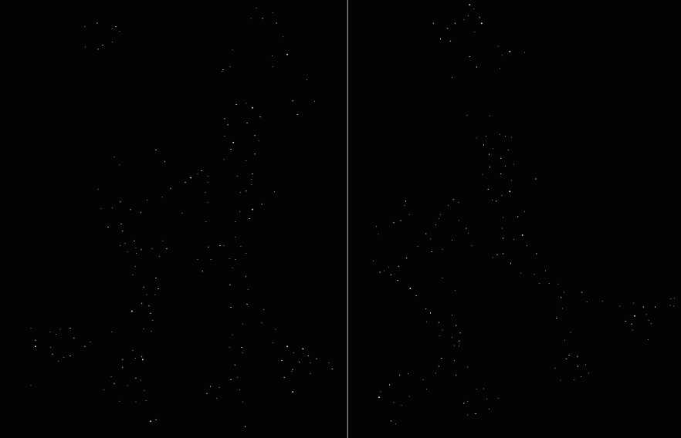
Local maximum of R

Slide 45

Harris corner detector

Slide 46
Harris detector: summary
Average intensity change in direction [u,v] can be expressed as a bilinear form:
Describe a point in terms of eigenvalues of M:
measure of corner response
A good (corner) point should have a large intensity change in all directions, i.e. R should be large positive

Slide 47
Now we know where features are
But, how to match them?
What is the descriptor for a feature? The simplest solution is the intensities of its spatial neighbors. This might not be robust to brightness change or small shift/rotation.
1
2
3
4
5
6
7
8
9
(
)
1
2
3
4
5
6
7
8
9

Slide 48
Harris detector: some properties
Partial invariance to affine intensity change
Only derivatives are used => invariance to intensity shift I → I + b
Intensity scale: I → a I
R
R
threshold
x (image coordinate)
x (image coordinate)

Slide 49
Harris Detector: Some Properties
Rotation invariance
Ellipse rotates but its shape (i.e. eigenvalues) remains the same
Corner response R is invariant to image rotation

Slide 50
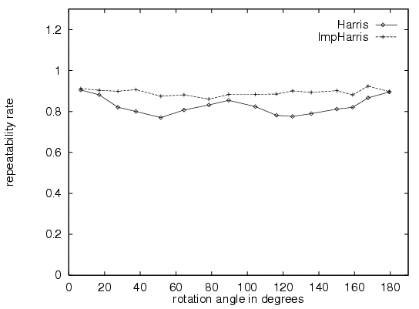
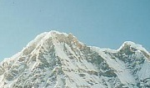

Harris Detector is rotation invariant
Repeatability rate:
# correspondences
# possible correspondences

Slide 51
Harris Detector: Some Properties
But: not invariant to image scale!
All points will be classified as edges
Corner !

Slide 52
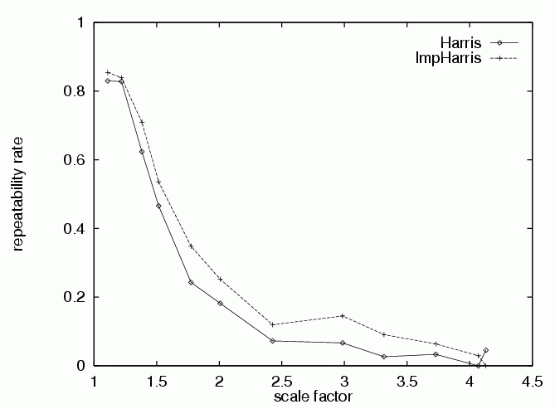
Harris detector: some properties
Quality of Harris detector for different scale changes
Repeatability rate:
# correspondences
# possible correspondences

Slide 53
Scale invariant detection
Consider regions (e.g. circles) of different sizes around a point
Regions of corresponding sizes will look the same in both images

Slide 54
Scale invariant detection
The problem: how do we choose corresponding circles independently in each image?
Aperture problem

Slide 55
SIFT
(Scale Invariant Feature Transform)

Slide 56
SIFT
SIFT is an carefully designed procedure with empirically determined parameters for the invariant and distinctive features.

Slide 57
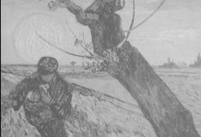
SIFT stages:
Scale-space extrema detection
Keypoint localization
Orientation assignment
Keypoint descriptor
detector
descriptor
( )
local descriptor
A 500x500 image gives about 2000 features

Slide 58
1. Detection of scale-space extrema
For scale invariance, search for stable features across all possible scales using a continuous function of scale, scale space.
SIFT uses DoG filter for scale space because it is efficient and as stable as scale-normalized Laplacian of Gaussian.

Slide 59



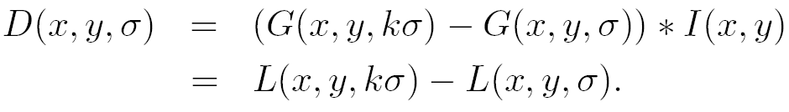
DoG filtering
Convolution with a variable-scale Gaussian
Difference-of-Gaussian (DoG) filter
Convolution with the DoG filter

Slide 60
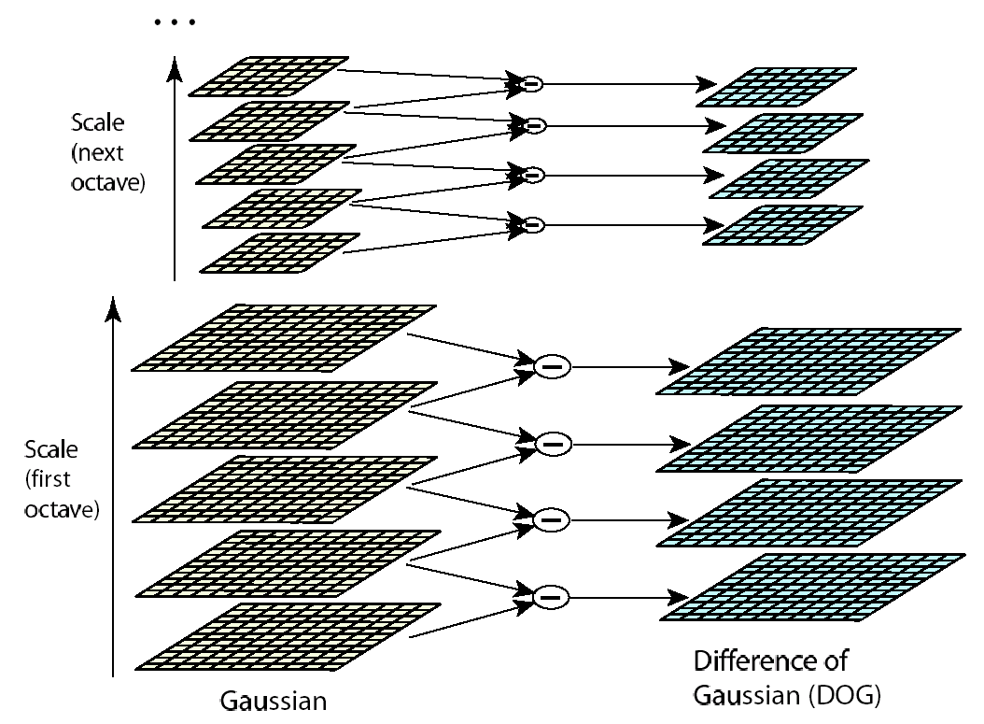
Scale space
σ doubles for
the next octave
K=2^{(1/s)}
Dividing into octave is for efficiency only.

Slide 61
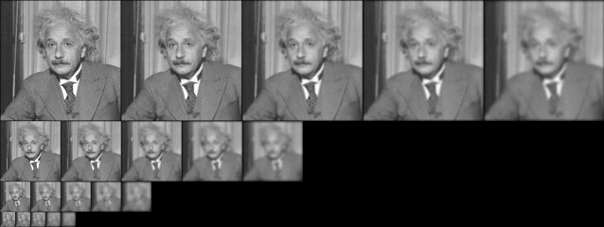
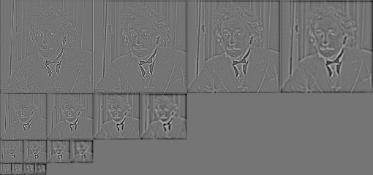
Detection of scale-space extrema

Slide 62

Keypoint localization
X is selected if it is larger or smaller than all 26 neighbors

Slide 63
Decide scale sampling frequency
It is impossible to sample the whole space, tradeoff efficiency with completeness.
Decide the best sampling frequency by experimenting on 32 real image subject to synthetic transformations. (rotation, scaling, affine stretch, brightness and contrast change, adding noise…)

Slide 64
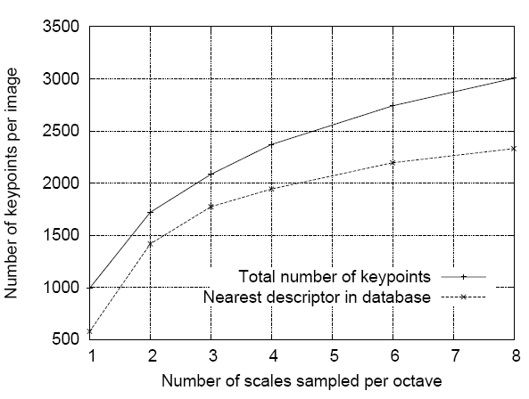
Decide scale sampling frequency

Slide 65
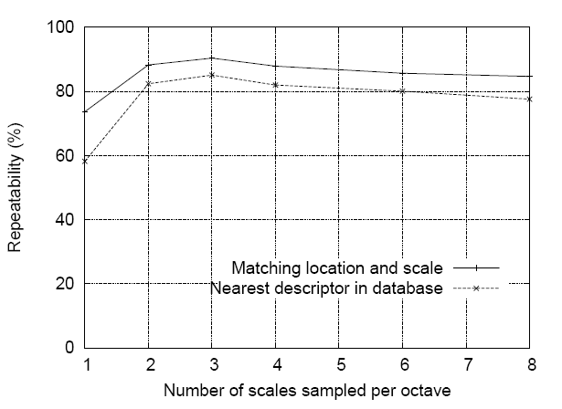
Decide scale sampling frequency
for detector,
repeatability
for descriptor,
distinctiveness
s=3 is the best, for larger s, too many unstable features

Slide 66
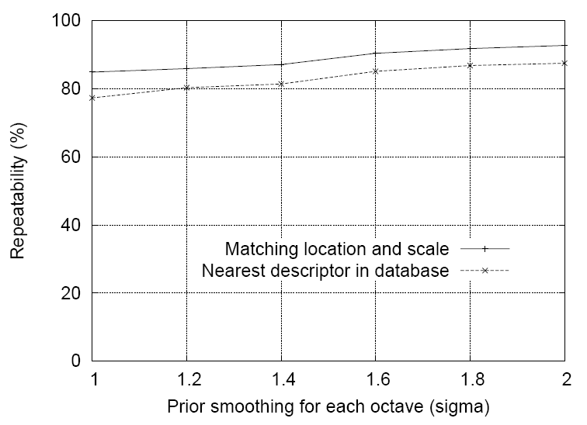
Pre-smoothing
σ =1.6, plus a double expansion

Slide 67
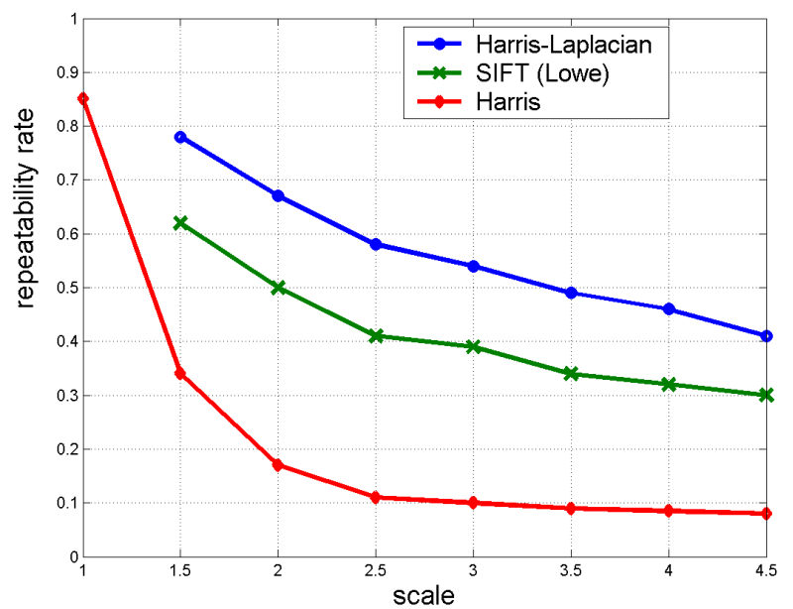
Scale invariance

Slide 68
2. Accurate keypoint localization
Reject points with low contrast (flat) and poorly localized along an edge (edge)
Fit a 3D quadratic function for sub-pixel maxima
6
5
1
-1
0
+1

Slide 69
2. Accurate keypoint localization
Reject points with low contrast (flat) and poorly localized along an edge (edge)
Fit a 3D quadratic function for sub-pixel maxima
6
5
1
-1
0
+1

Slide 70
2. Accurate keypoint localization
Taylor series of several variables
Two variables

Slide 71
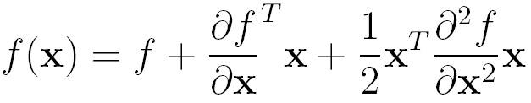
Accurate keypoint localization
Taylor expansion in a matrix form, x is a vector, f maps x to a scalar
Hessian matrix
(often symmetric)
gradient

Slide 72
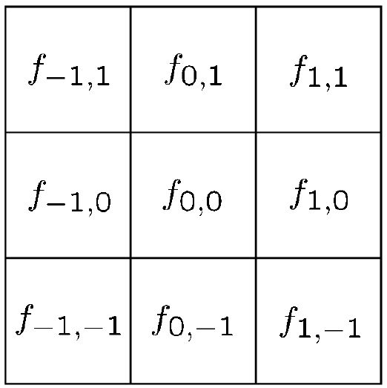
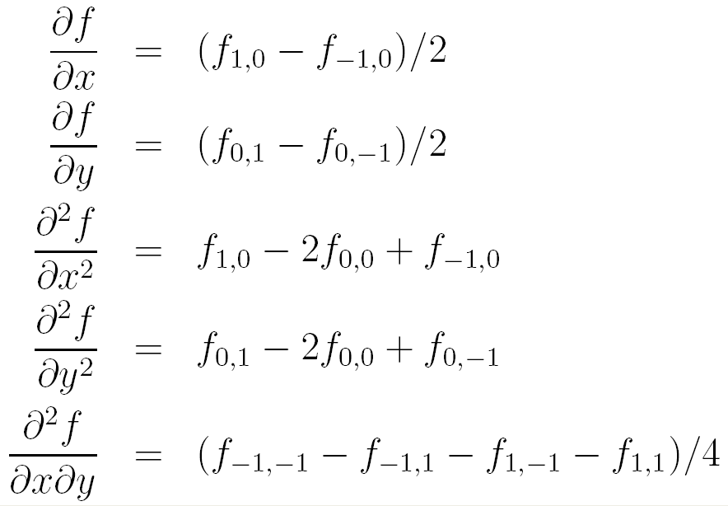
2D illustration

Slide 73
2D example
-17
-1
-1
-9
7
7
-9
7
7
Notes:
F(x)=7+(8 -4)’ x + ½ x’ (-8 0; 0 -4) x

Slide 74
Derivation of matrix form

Slide 75
Derivation of matrix form

Slide 76
Derivation of matrix form

Slide 77
Derivation of matrix form

Slide 78
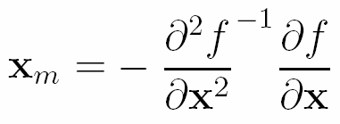
Derivation of matrix form

Slide 79
Accurate keypoint localization
x is a 3-vector
Change sample point if offset is larger than 0.5
Throw out low contrast (<0.03)

Slide 80
Accurate keypoint localization
Throw out low contrast

Slide 81

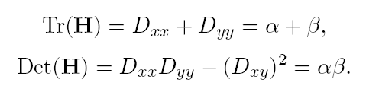


Eliminating edge responses
Hessian matrix at keypoint location
Let
Keep the points with
r=10

Slide 82
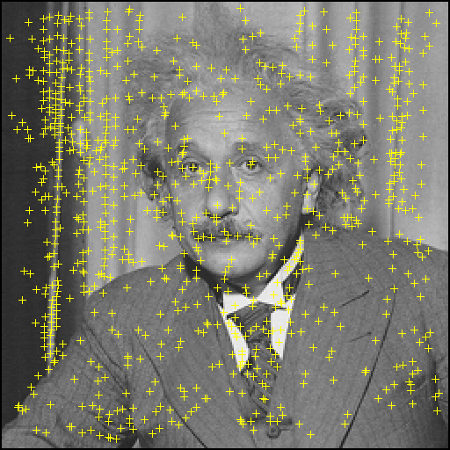
Maxima in D

Slide 83
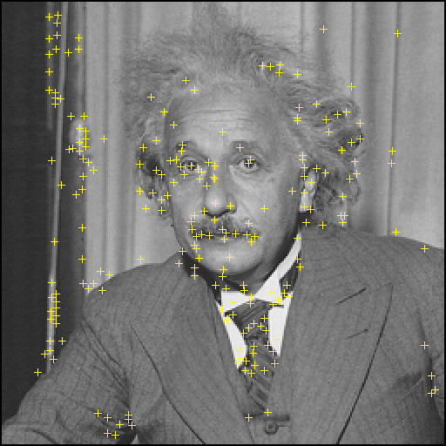
Remove low contrast and edges

Slide 84
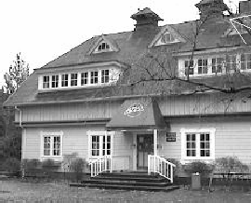
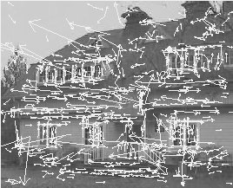
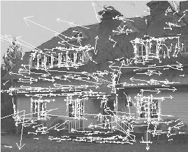
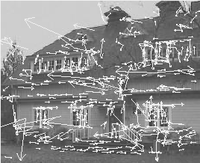
Keypoint detector
233x89
832 extrema
729 after con-
trast filtering
536 after cur-
vature filtering

Slide 85
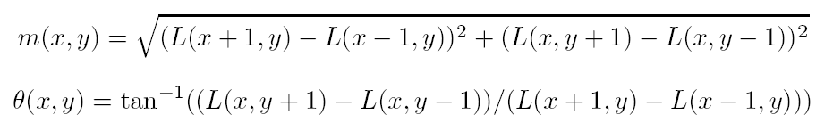
3. Orientation assignment
By assigning a consistent orientation, the keypoint descriptor can be orientation invariant.
For a keypoint, L is the Gaussian-smoothed image with the closest scale,
(Lx, Ly)
m
θ
orientation histogram (36 bins)

Slide 86
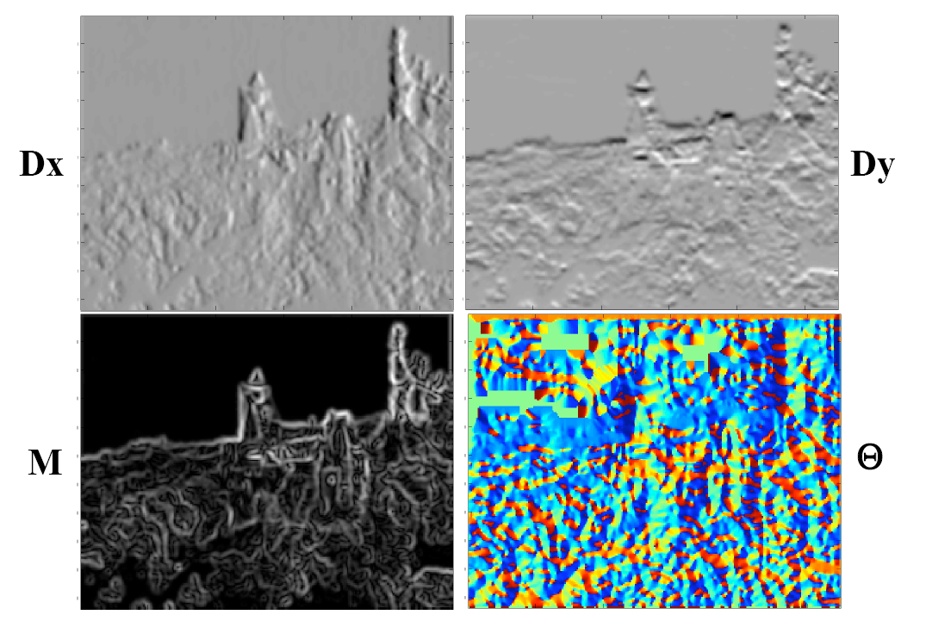
Orientation assignment

Slide 87
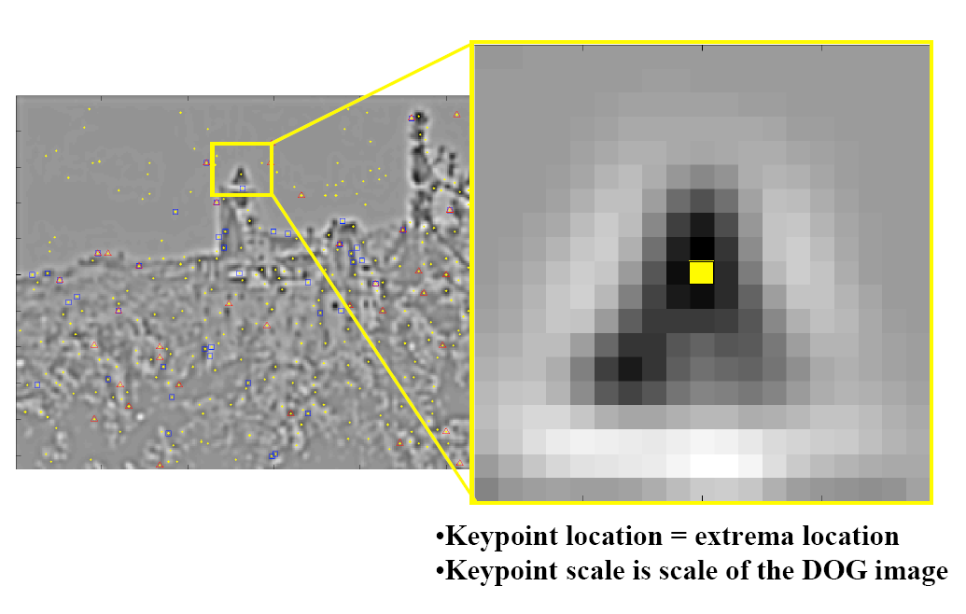
Orientation assignment

Slide 88

Orientation assignment

Slide 89

Orientation assignment
σ=1.5*scale of
the keypoint

Slide 90

Orientation assignment

Slide 91

Orientation assignment

Slide 92

Orientation assignment
accurate peak position
is determined by fitting

Slide 93
Orientation assignment
36-bin orientation histogram over 360°,
weighted by m and 1.5*scale falloff
Peak is the orientation
Local peak within 80% creates multiple orientations
About 15% has multiple orientations and they contribute a lot to stability

Slide 94

SIFT descriptor

Slide 95

4. Local image descriptor
Thresholded image gradients are sampled over 16x16 array of locations in scale space
Create array of orientation histograms (w.r.t. key orientation)
8 orientations x 4x4 histogram array = 128 dimensions
Normalized, clip values larger than 0.2, renormalize
σ=0.5*width

Slide 96

Why 4x4x8?

Slide 97

Sensitivity to affine change

Slide 98
Feature matching
for a feature x, he found the closest feature x₁
and the second closest feature x₂. If the distance ratio of d(x, x₁) and d(x, x₂) is smaller than 0.8, then it is accepted as a match.

Slide 99
SIFT flow

Slide 100
Maxima in D

Slide 101

Remove low contrast

Slide 102
Remove edges

Slide 103
SIFT descriptor

Slide 104


Slide 105
Estimated rotation
Computed affine transformation from rotated image to original image:
0.7060 -0.7052 128.4230
0.7057 0.7100 -128.9491
0 0 1.0000
Actual transformation from rotated image to original image:
0.7071 -0.7071 128.6934
0.7071 0.7071 -128.6934
0 0 1.0000

Slide 106
SIFT extensions

Slide 107

PCA

Slide 108
PCA-SIFT
Only change step 4
Pre-compute an eigen-space for local gradient patches of size 41x41
2x39x39=3042 elements
Only keep 20 components
A more compact descriptor

Slide 109


GLOH (Gradient location-orientation histogram)
SIFT
17 location bins
16 orientation bins
Analyze the 17x16=272-d
eigen-space, keep 128 components
SIFT is still considered the best.

Slide 110
Multi-Scale Oriented Patches
Simpler than SIFT. Designed for image matching. [Brown, Szeliski, Winder, CVPR’2005]
Feature detector
  Multi-scale Harris corners
  Orientation from blurred gradient
  Geometrically invariant to rotation
Feature descriptor
  Bias/gain normalized sampling of local patch (8x8)
  Photometrically invariant to affine changes in intensity

Slide 111




Multi-Scale Harris corner detector
Image stitching is mostly concerned with matching images that have the same scale, so sub-octave pyramid might not be necessary.

Slide 112




Multi-Scale Harris corner detector
smoother version of gradients
Corner detection function:
Pick local maxima of 3x3 and larger than 10

Slide 113


Keypoint detection function
Experiments show roughly
the same performance.

Slide 114
Non-maximal suppression
Restrict the maximal number of interest points, but also want them spatially well distributed
Only retain maximums in a neighborhood of radius r.
Sort them by strength, decreasing r from infinity until the number of keypoints (500) is satisfied.

Slide 115

Non-maximal suppression

Slide 116
Sub-pixel refinement

Slide 117



Orientation assignment
Orientation = blurred gradient

Slide 118

Descriptor Vector
Rotation Invariant Frame
  Scale-space position (x, y, s) + orientation (θ)

Slide 119



MSOP descriptor vector
8x8 oriented patch sampled at 5 x scale. See TR for details.
Sampled from with spacing=5
40 pixels
8 pixels

Slide 120
MSOP descriptor vector
8x8 oriented patch sampled at 5 x scale. See TR for details.
Bias/gain normalisation: I’ = (I – μ)/σ
Wavelet transform
40 pixels
8 pixels

Slide 121
Detections at multiple scales

Slide 122
Summary
Multi-scale Harris corner detector
Sub-pixel refinement
Orientation assignment by gradients
Blurred intensity patch as descriptor

Slide 123
Feature matching
Exhaustive search
  for each feature in one image, look at all the other features in the other image(s)
Hashing
  compute a short descriptor from each feature vector, or hash longer descriptors (randomly)
Nearest neighbor techniques
  k-trees and their variants (Best Bin First)

Slide 124

Wavelet-based hashing
Compute a short (3-vector) descriptor from an 8x8 patch using a Haar “wavelet”
Quantize each value into 10 (overlapping) bins (10³ total entries)
[Brown, Szeliski, Winder, CVPR’2005]

Slide 125

Nearest neighbor techniques
k-D tree
and
Best Bin
First
(BBF)
Indexing Without Invariants in 3D Object Recognition, Beis and Lowe, PAMI’99

Slide 126
Applications

Slide 127

Recognition
SIFT Features

Slide 128

3D object recognition

Slide 129


3D object recognition

Slide 130








Office of the past
Video of desk
Images from PDF
Internal representation
Track & recognize
Desk
Desk
Scene Graph
T
T+1

Slide 131







Image retrieval
…
> 5000
images
change in viewing angle

Slide 132


Image retrieval
22 correct matches

Slide 133

Image retrieval
…
> 5000
images
change in viewing angle
+ scale change

Slide 134



Robot location

Slide 135

Robotics: Sony Aibo
SIFT is used for
Recognizing charging station
Communicating with visual cards
Teaching object recognition
soccer

Slide 136
Structure from Motion
The SFM Problem
  Reconstruct scene geometry and camera motion from two or more images
Track
2D Features
Estimate
3D
Optimize
(Bundle Adjust)
Fit Surfaces
SFM Pipeline

Slide 137





Structure from Motion
Poor mesh
Good mesh

Slide 138






Augmented reality

Slide 139




Automatic image stitching

Slide 140

Automatic image stitching

Slide 141
























Automatic image stitching

Slide 142
Automatic image stitching

Slide 143




Automatic image stitching

Slide 144
Reference
Chris Harris, Mike Stephens, A Combined Corner and Edge Detector, 4th Alvey Vision Conference, 1988, pp147-151.
David G. Lowe, Distinctive Image Features from Scale-Invariant Keypoints, International Journal of Computer Vision, 60(2), 2004, pp91-110.
Yan Ke, Rahul Sukthankar, PCA-SIFT: A More Distinctive Representation for Local Image Descriptors, CVPR 2004.
Krystian Mikolajczyk, Cordelia Schmid, A performance evaluation of local descriptors, Submitted to PAMI, 2004.
SIFT Keypoint Detector, David Lowe.
Matlab SIFT Tutorial, University of Toronto.

