Slide 1
Course overview
Digital Visual Effects
Yung-Yu Chuang

Slide 2
Logistics
Meeting time: 2:20pm-5:20pm, Wednesday
Classroom: CSIE Room 104
Instructor: Yung-Yu Chuang (cyy@csie.ntu.edu.tw)
Teaching assistants: 許若漢、施雅方
Textbook: Readings from books, journals and proceedings. Richard Szeliski’s Computer Vision: Algorithms and Applications. Richard Radke’s Computer Vision for Visual Effects.
Webpage: (user name/password) http://www.csie.ntu.edu.tw/~cyy/vfx

Slide 3
This course is NOT about …

Slide 4
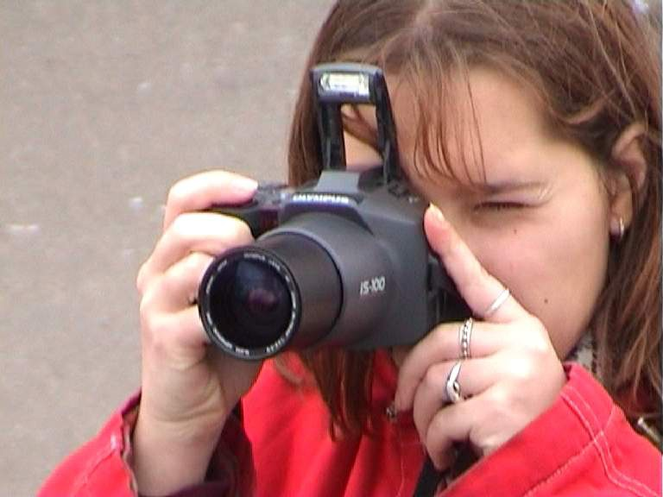
It isn’t about photography

Slide 5
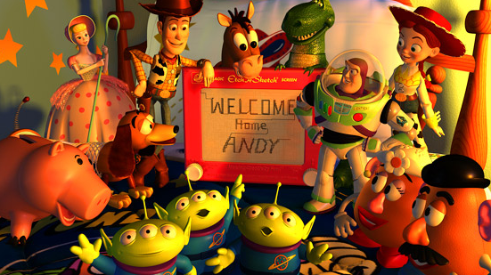
It isn’t about 3D animations

Slide 6
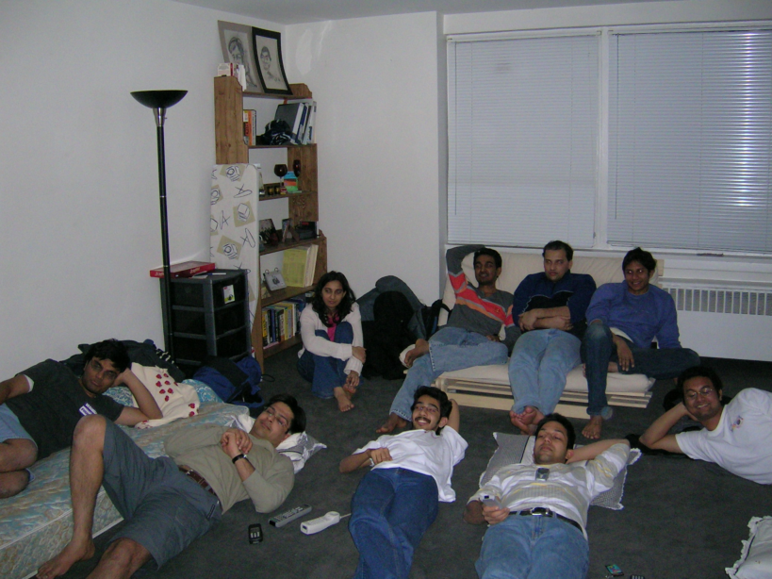
It isn’t about watching movies

Slide 7
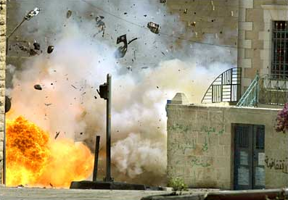
It isn’t about physical effects

Slide 8
It’s not about industrial tricks
You will learn more about Taylor and Poisson than Lucas
and Spielberg in this course. If you hear Lucas in the class,
it is more likely to refer to Bruce Lucas, not George Lucas.
computer
graphics
computer
vision
image
processing
Notes:
More academic. Today is the most related to industry.
I am not an expert, it is just my understanding to vfx

Slide 9
Prerequisites
It is a must that you have programming experiences.
It is a must that you have basic knowledge on linear algebra and probability.
It is a plus if you have background knowledge on computer vision, image processing and computer graphics.
It is a plus if you have access to digital cameras and camcorders.

Slide 10
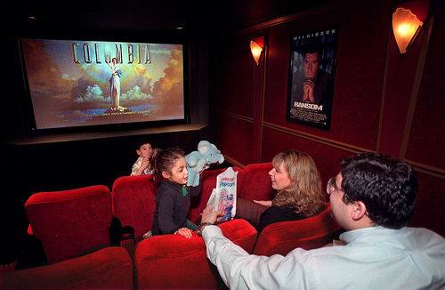
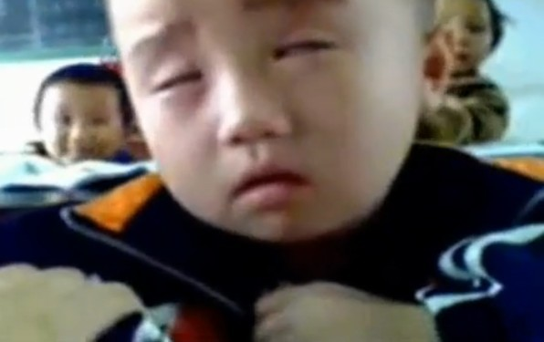
The vfx course
what other professors
think you do
what other students
think you do
what you thought
you will do
what you actually do

Slide 11
Be cautious!

Slide 12
Warning from previous students
請學期初老師要多提醒這門課的困難度請興趣或實力不足的同學勿修，否則就會像我一樣停修 XD

Slide 13
This course is about …

Slide 14
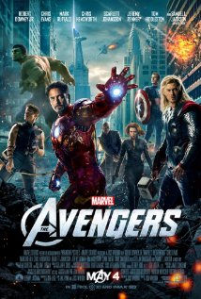
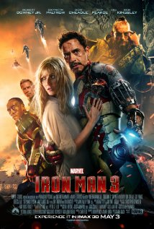
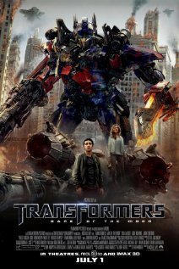
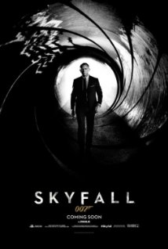
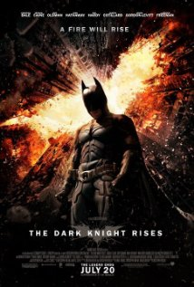
Digital Visual Effects
Notes:
Harry potter

Slide 15
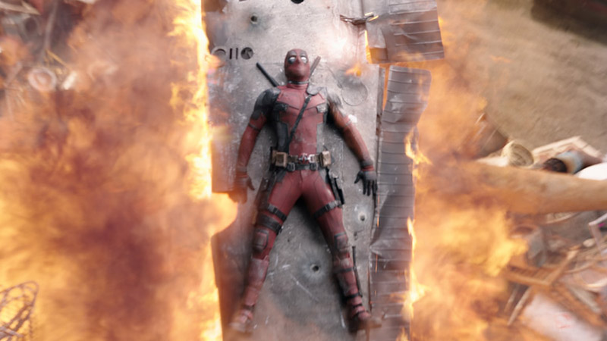
Deadpool

Slide 16
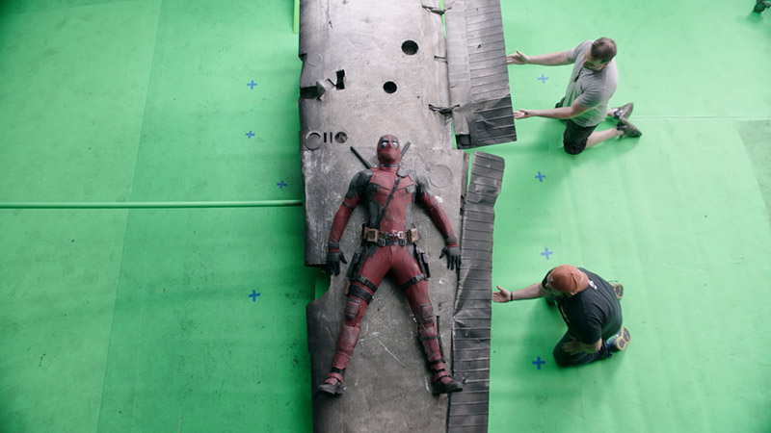
Deadpool

Slide 17
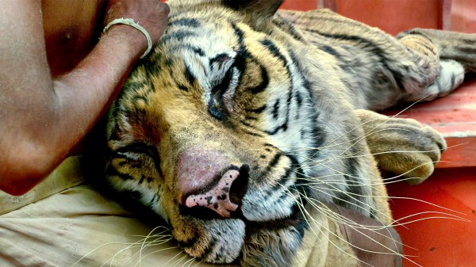
Life of Pi

Slide 18
Life of Pi

Slide 19
獨自一人拍和十三人的戲
要把身材高大的甘道夫和小矮人們拍攝在一起，我們是沒法在同一個片場的。和我一起拍攝的只有柱子上貼著的13張他們的照片，後面還有一個小燈，哪個角色說話了燈就亮起來。想像一下你在拍一場和13個人一起演的戲，但你卻只有獨自一人。這真的會把你的演技推到極限。我哭了，真的，我當時真的哭了。然後我還說出了聲：我認真演了一輩子不是為了跟這些照片對戲啊！

Slide 20
VFX of the Hobbit

Slide 21
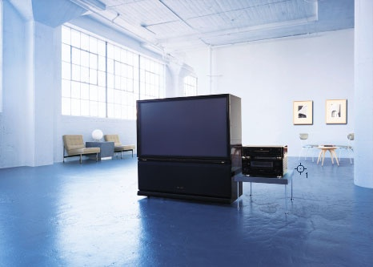
Reality?
Notes:
For example, is it a reality?

Slide 22
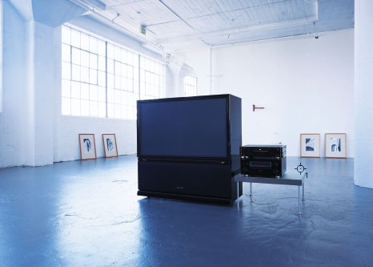
Retouching

Slide 23
Retouching
Notes:
http://ck101.com/thread-2832680-1-1.html

Slide 24
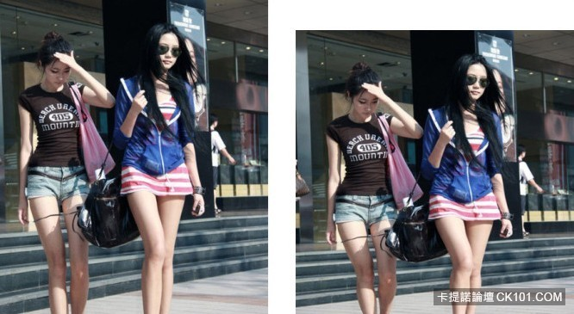
Retouching

Slide 25
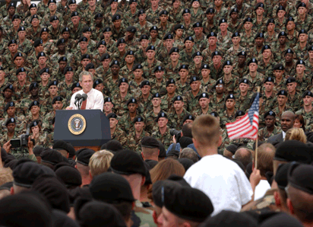
Bush campaign’s TV AD, 2004

Slide 26
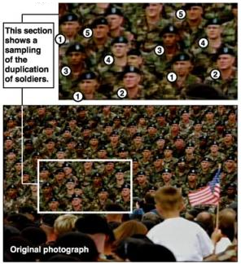
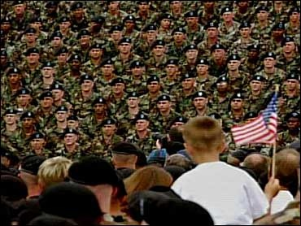
Texture synthesis and inpainting

Slide 27
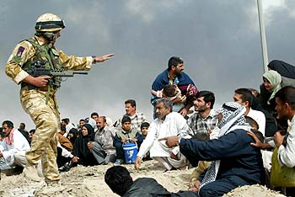
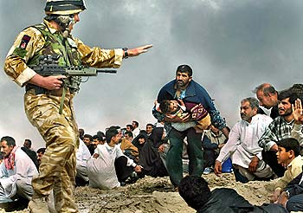
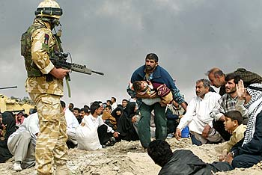
Iraq War, LA Times, April 2003
Digital photomontage

Slide 28
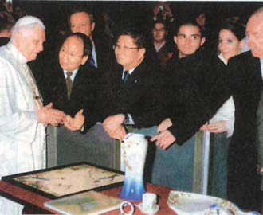
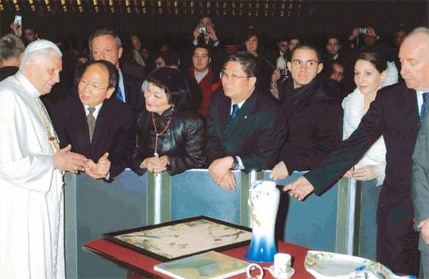
Domestic example
The Liberty Times
2007.12.17

Slide 29
Special effects

Slide 30
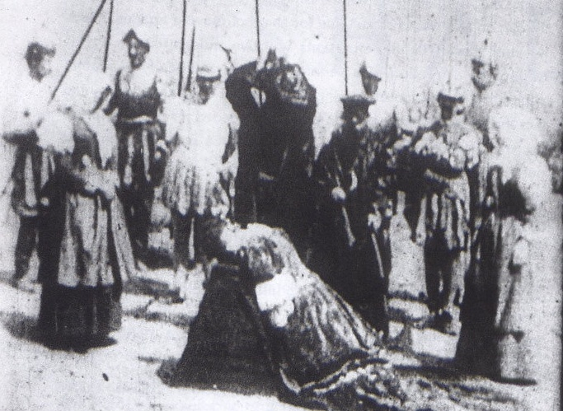
Stop action
The execution of Mary, 1895

Slide 31
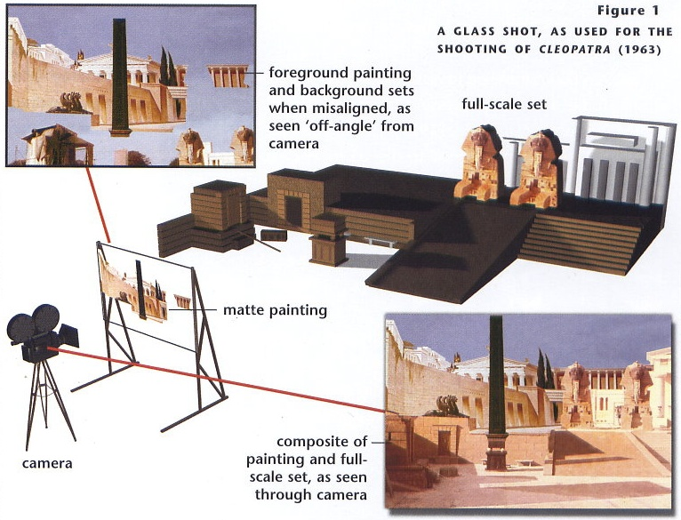
Glass shot

Slide 32
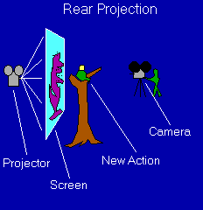
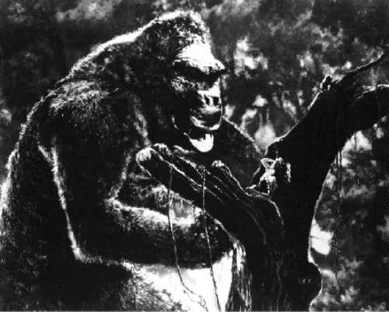
Rear projection
stop motion
King Kong, 1933

Slide 33
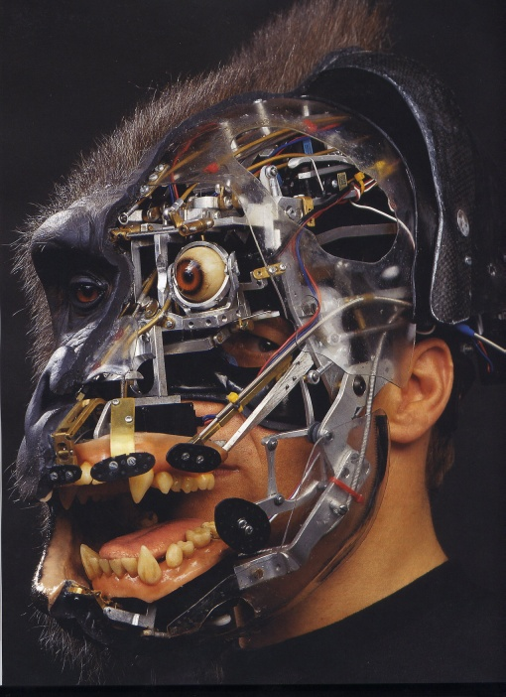
Special effects (make-up)

Slide 34
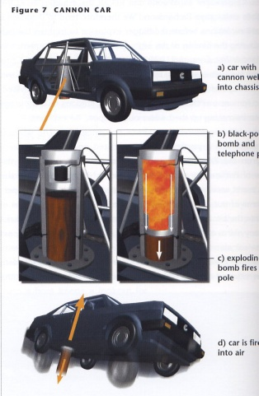
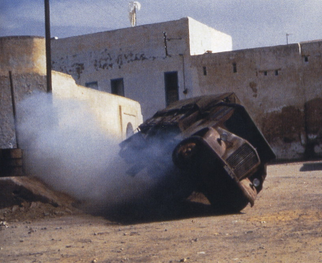
Special effects (physical effects)
Notes:
Explosion
Rain
Blood
Car
Double
Wire

Slide 35
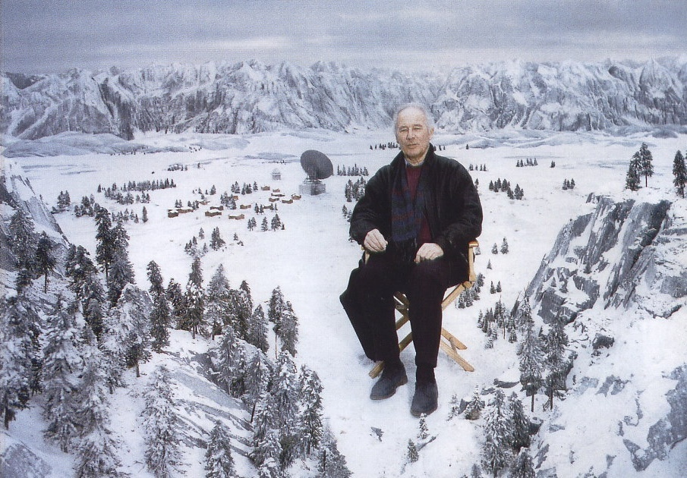
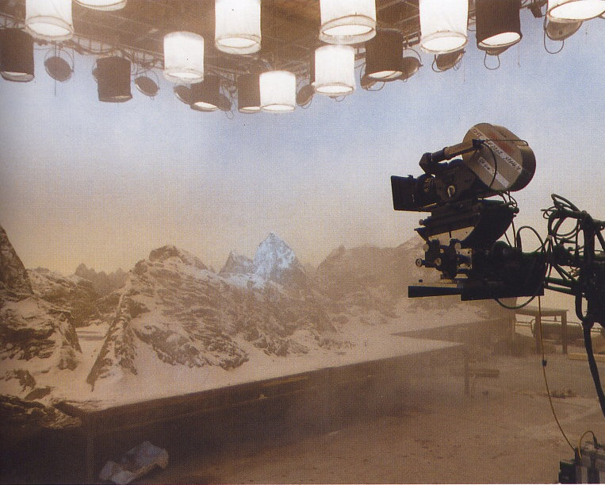
Special effects (miniature)

Slide 36
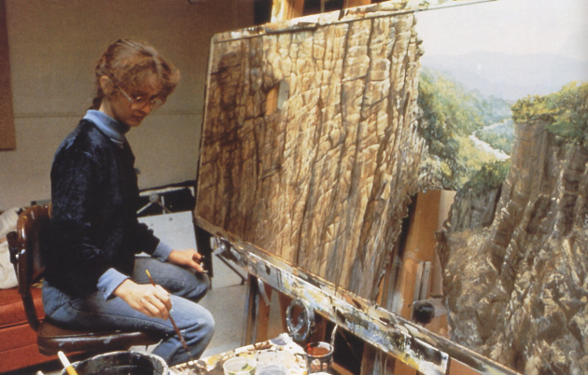
Special effects (matte painting)

Slide 37
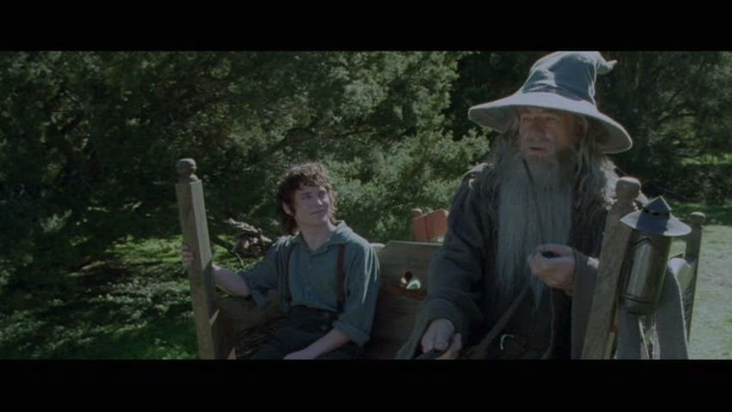
Lord of the Rings

Slide 38
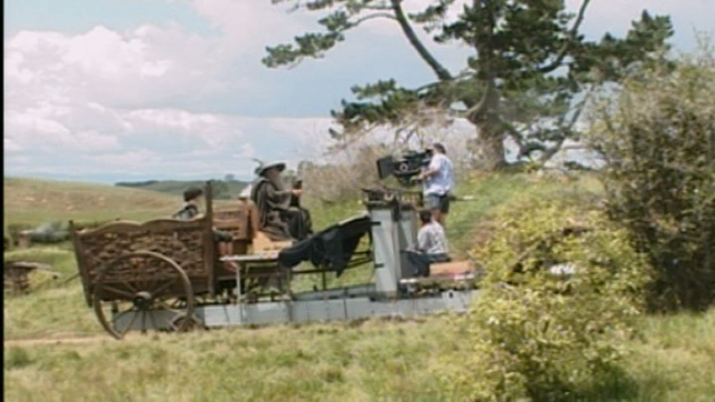
Illusion - forced perspective

Slide 39
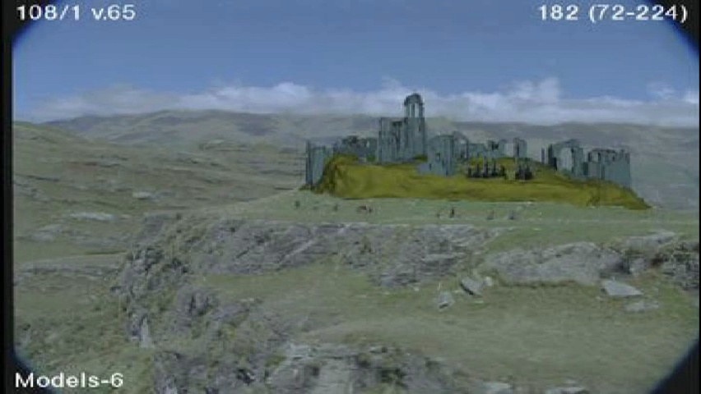
Computer-generated model

Slide 40
The Avengers (1978 vs 2012)

Slide 41
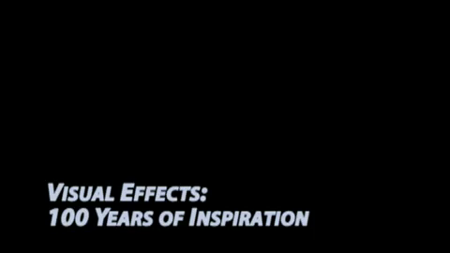
Visual effects 100 Years

Slide 42
Production pipeline

Slide 43
Production pipeline
Preproduction
Production
Effects
Storyboard
Artwork
Reference
Stills
Plates
Post-production
VFX
Editing
Music
Sound
Film
Notes:
Storyboard
Artwork
Reference
Research
Effects

Slide 44
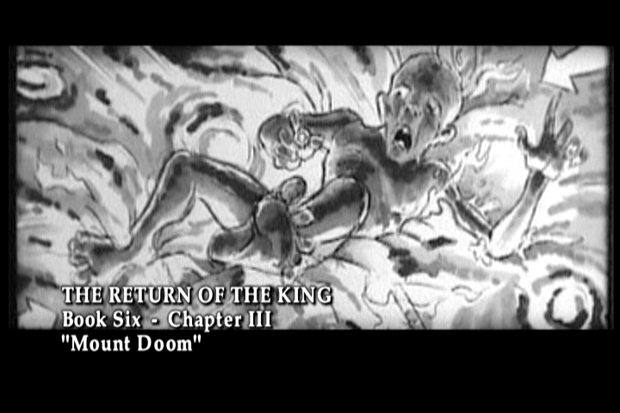
Preproduction
Storyboard

Slide 45
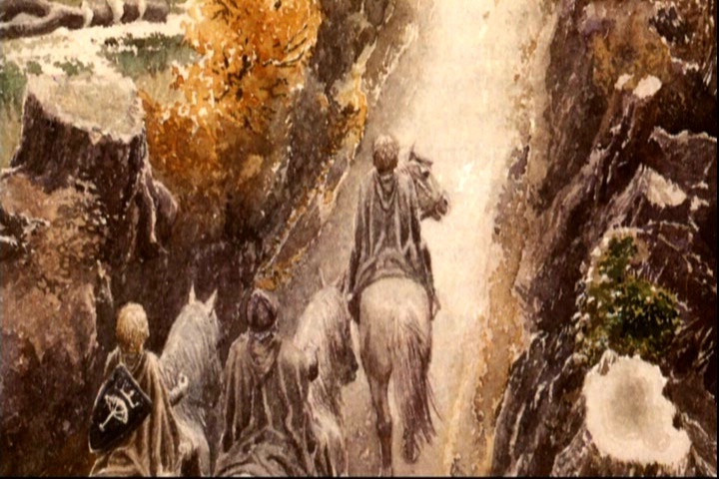
Preproduction
Artwork

Slide 46
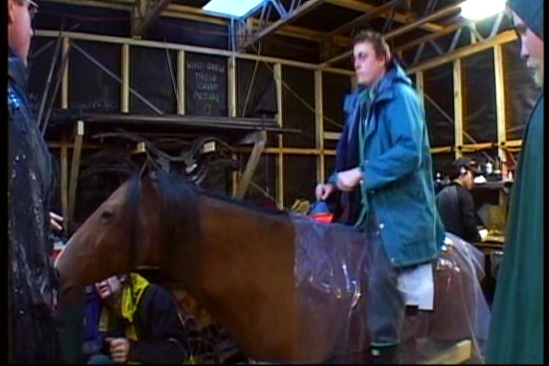
Preproduction
Reference & Research

Slide 47
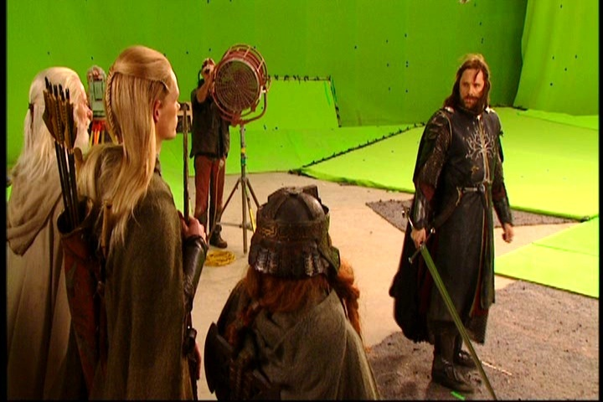
Production
Shooting

Slide 48
Post-production

Slide 49
Visual effects production
Preproduction
Production
Effects
Storyboard
Artwork
Reference
Stills
Plates
Scanning
Post-production
Matchmove and Matchmodel
Model Geometry
Effects
Animation
Character
Animation
Skeleton
Textures
Lighting and
Rendering
Skinning
Materials
Compositing
Assets
Shots
Film Recording

Slide 50
Visual effects post-production
Notes:
Return of the king, Disc 4, Visual Effects
Weta 0:00-
And Visual Effects Demonstration

Slide 51
A case study

Slide 52
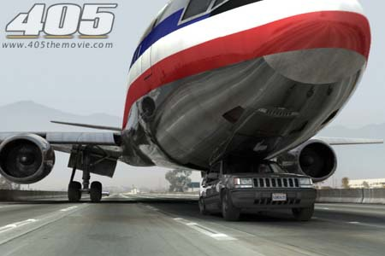
405: The Movie
This movie were created solely by two visual effects artists in the year of 2000. It was a process that took over three months of nights, weekends and any spare moments that they could find.
https://en.wikipedia.org/wiki/405_(film)
An early example of digital filmmaking and the use of Internet as media
Budget: $300 ($140 for
tickets. The officer is
acknowledged)
Notes:
405 was created by Bruce Branit and Jeremy Hunt using only consumer level computers, off-the-shelf software, and their imaginative talents. This short film was shot in two days on location on the busy I-405 freeway in Los Angeles and Orange County. But it really came to be only after three more months of hard work using computer graphics. Much of the movie, featuring a DC-10 and a Jeep Grand Cherokee, was created entirely inside these computers. There are 62 shots in this 3 minute film and 42 of those shots are enhanced with digital visual effects. Nineteen shots are entirely digital creations, using no live action footage whatsoever. There is no real airplane in this film. The DC-10 was created digitally in a 3D environment. Both cars in this film are also created digitally using Lightwave 3D. Both actors were shot inside real vehicles, however, most shots--including all of the old woman's scenes--were shot standing still. Even the freeway backgrounds were created digitally and added to the filmed footage later.

Slide 53
405: The Movie

Slide 54
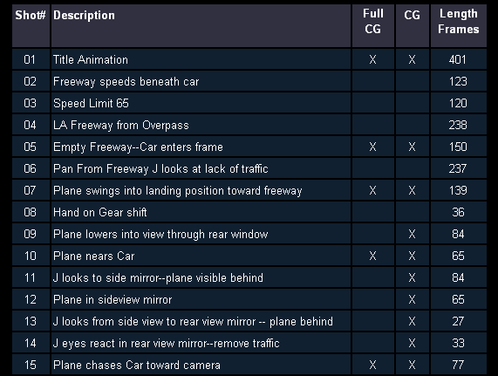
Making of 405
Step 0: script and shooting plan
Notes:
Step 1: shooting
Optura 30fps progressive mode
In all about 70 minutes of DV tape was shot, 2 days,
The first day of shooting consisted largely of scenes with the Driver, played by Jeremy Hunt. The bulk of shots on this first day were shot while actually driving on the freeway.
The second day of filming was primarily of Angela Burns. Given that she was not very mobile, she was filmed in front of her residence and the backgrounds had to be added later.
Some pickup shots
Step 2: digital
It was found that more control over shot design could be achieved if an entirely believable digital environment could be created. Using photographs shot around LA on a digital camera, Bruce Branit created several photo-based 3D environments inside of which the virtual camera could be placed and pointed in any direction. The road surface was created using photographs of LA's famous freeway surfaces and stitched together into long, usable maps. With this realistic, virtual world, the camera can then be put in places inside the computer's worlds where it would be much too dangerous to risk the lives of a real camera crew.
In almost all shots the Jeep seen on camera is actually the CG model and not a real car.
head geometry had been created long ago during a demo for a handheld cyberscaner. The face was mapped on using several digital photographs.
Step 3: digital plane
As a result the model needed to be very detailed. The entire process of building the plane in the computer, creating the image maps, and "dialing in" the look of the surfaces took over a month.
Jeremy created from scratch all of the different maps in Photoshop to affect the DC-10's color, reflectivity, bumps, dirt, and transparency. The final 405 DC-10 is comprised of 59 different, linked objects, 142,439 polygons almost 100 megabytes of image maps.

Slide 55
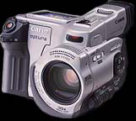
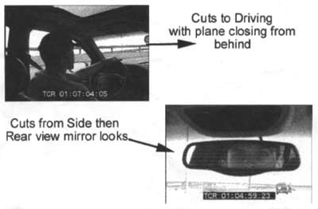
Making of 405
Step 1: shooting
two days with a Canon Optura DV
camera with progressive mode.
⇨ a 70-minute raw footage
initial editing
⇨ pickup shots
Notes:
Step 1: shooting
Optura 30fps progressive mode
In all about 70 minutes of DV tape was shot, 2 days,
The first day of shooting consisted largely of scenes with the Driver, played by Jeremy Hunt. The bulk of shots on this first day were shot while actually driving on the freeway.
The second day of filming was primarily of Angela Burns. Given that she was not very mobile, she was filmed in front of her residence and the backgrounds had to be added later.
Some pickup shots
Step 2: digital
It was found that more control over shot design could be achieved if an entirely believable digital environment could be created. Using photographs shot around LA on a digital camera, Bruce Branit created several photo-based 3D environments inside of which the virtual camera could be placed and pointed in any direction. The road surface was created using photographs of LA's famous freeway surfaces and stitched together into long, usable maps. With this realistic, virtual world, the camera can then be put in places inside the computer's worlds where it would be much too dangerous to risk the lives of a real camera crew.
In almost all shots the Jeep seen on camera is actually the CG model and not a real car.
head geometry had been created long ago during a demo for a handheld cyberscaner. The face was mapped on using several digital photographs.
Step 3: digital plane
As a result the model needed to be very detailed. The entire process of building the plane in the computer, creating the image maps, and "dialing in" the look of the surfaces took over a month.
Jeremy created from scratch all of the different maps in Photoshop to affect the DC-10's color, reflectivity, bumps, dirt, and transparency. The final 405 DC-10 is comprised of 59 different, linked objects, 142,439 polygons almost 100 megabytes of image maps.

Slide 56
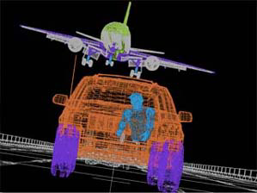
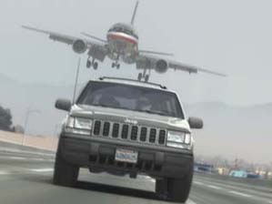
Making of 405
Step 2: building CG world
total 62 shots, 42 enhanced with digital VFX.
19 shots are entirely digital creations.
plane, two cars, freeway background are digital
photo-based 3D environment

Slide 57
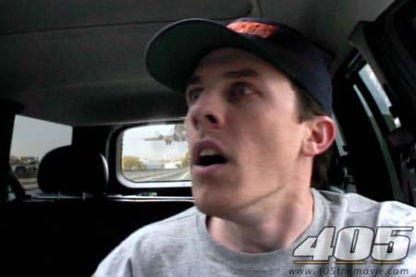
Making of 405
Real cars were used for close-up and interior shots
A low-resolution mesh scanned
by a cyberscanner.
Mapped with photographs.

Slide 58
Making of 405
DC-10 plane took a month
to model in details for the
needs of close-up shots.
59 objects, 142,439 polygons
reference modeling material painting

Slide 59
Making of 405
Step 3: traffic clearing
clean plate
close-up shots
inpainting
Notes:
Step 4: clean up traffic
For some of the live action scenes shot from the inside of the moving vehicle, a less-used section of the 105 freeway near El Segundo was used. Using careful shooting and editing it was possible to use short takes where no cars were visible.
For some scenes, however, no take could be used where cars were not still visible in front of or beside the Jeep. One such scene is the scene where Jeremy's eyes react to seeing the incoming airliner in the rearview mirror. Some traffic was unfortunately visible directly though the windshield in front of the car. Since no better take was adequate, the filmakers decided to just fix this take digitally. An area of empty freeway from an unused part of this edit was tracked on top of this unwanted traffic. The result, the freeway appears vacant and the shot is saved.

Slide 60
Making of 405
Step 4: compositing
shot with the vehicle standing still in a backyard
Notes:
Step 5: look outside the window
The old woman character in 405 was played by Angela Burns, who although perfectly cast for the part, was unable to safely drive the Lincoln Continental as shown in the film.
After filming was completed, computer generated backgrounds were created in the proper perspective to match the live-action plate. The two images were then put together by carefully removing the unwanted areas of the image through the windows and replacing that area with the new backgrounds.

Slide 61
Making of 405
Notes:
The bottom one is a pickup shot. It could be shot on the freeway, but they didn’t do it because of time constraints.

Slide 62
Making of 405
Step 5: fine touchup
3D hat compositing and inpainting
Notes:
Step 7: fine touch
a simple digital hat was created and matched, frame by frame, to the actor's head, and the shot was saved.
This scene was shot in a parking lot at Santa Monica Airport. In order for the shot to appear as one take a few things needed to be added digitally. First the reflection of Ange driving by was created by using a still frame of footage shot of Ange sitting in her car. This was bent to conform to the contour of the Jeep and animated across its surface. Next a still frame of Ange's hand was shot using a digital camera. A matte was created, outlining the finger, and the image was animated passing through the frame. Then the nose section of the digital DC-10 was rendered and placed on top of the vehicle. Also, notice that there is a restricted parking sign on the pole in the background. This sign would be quite out of place on a freeway shoulder, so it too was removed.
One of the great aspects of digital filmmaking is that it allows you to shoot individual elements, like ingredients of a recipe, and put them together exactly as needed later.

Slide 63
Making of 405
Step 6: music and delivery

Slide 64
Bloody Omaha

Slide 65
Breakdown (Wolf of Wall Street)

Slide 66
Topics we plan to cover

Slide 67
Camera
Canon 10D
Notes:
Construction
Camera model
Bayor’s pattern
HDR

Slide 68
High dynamic range imaging/display

Slide 69
Image warping/morphing
someone not
that famous
someone very
famous
video

Slide 70
Image warping/morphing

Slide 71
Tracking
Feature tracking

Slide 72
Image stitching

Slide 73
MatchMove
Move matching using scene planes

Slide 74
Matchmove
Move matching using scene planes

Slide 75
Matchmove
Move matching using scene planes

Slide 76
Photo tourism

Slide 77
Video matching
Matrix
MOCO (Motion control camera)

Slide 78
Video matching
Video matching

Slide 79
Matting and compositing
Titanic

Slide 80
Matting

Slide 81
Object selection
LazySnapping

Slide 82
Image-based modeling
photogrammetric modeling and projective texture-mapping

Slide 83
Image-based modeling
photogrammetric modeling and projective texture-mapping

Slide 84
Image-based modeling
photogrammetric modeling and projective texture-mapping

Slide 85
Image-based modeling
Tour into a picture

Slide 86
Image-based modeling
Tour into a picture

Slide 87
3D photography (active)
Cyberware whole body scanner

Slide 88
3D photography (active)
Photometric stereo

Slide 89
3D photography (passive)
left
right
depth
Stereo

Slide 90
Image-based rendering
Surface lightfield

Slide 91
View interpolation
Bullet time video

Slide 92
View interpolation
High-Quality Video View Interpolation

Slide 93
Image manipulation
GraphCut Texture

Slide 94
Image manipulation
Poisson blending

Slide 95
Stereoscopic films

Slide 96
Making face
Gollum
Spacetime face

Slide 97
Virtual human

Slide 98
Video rewrite
Trainable videorealistic speech animation

Slide 99
Inpainting (wire removal)
Inpainting

Slide 100
Texture synthesis/replacement
Texture replacement

Slide 101
Semi-automatic matte painting
Image analogies

Slide 102
Video editing
Flow-based video editing

Slide 103
Grading (subject to change)
3 programming assignments (60%)
HDR Imaging (18%)
AutoStitch (24%)
MatchMove (18%)
Class participation (5%)
Final project (35%)
Research
System
Film

Slide 104
High dynamic range imaging

Slide 105
From past semesters (鄭逸廷 陳柏叡)

Slide 106
From past semesters (吳侑親,張書瑋)

Slide 107
From past semesters (王瑋馥,余雁雲)

Slide 108
AutoStitch

Slide 109
AutoStitch
羅聖傑
連奕婷 張宇蓓

Slide 110
MathMove
梁家愷 鐘志遠
姜任遠 林立峯
楊宗碩 林柏劭
翁憲政 洪韶憶

Slide 111
YoYo Flight

Slide 112
Making of YoYo Flight

