Slide 1
VFX Project #3: MatchMove
Digital Visual Effects, Spring 2015
2015/4/29

Slide 2
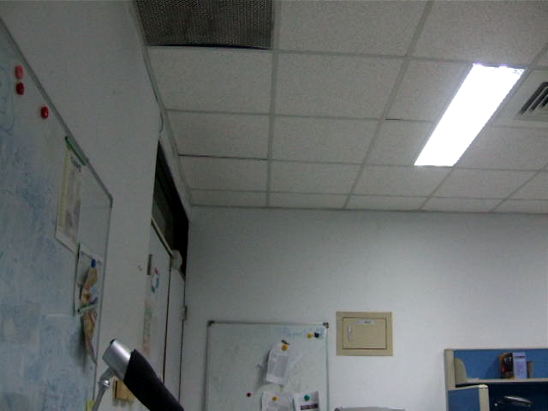
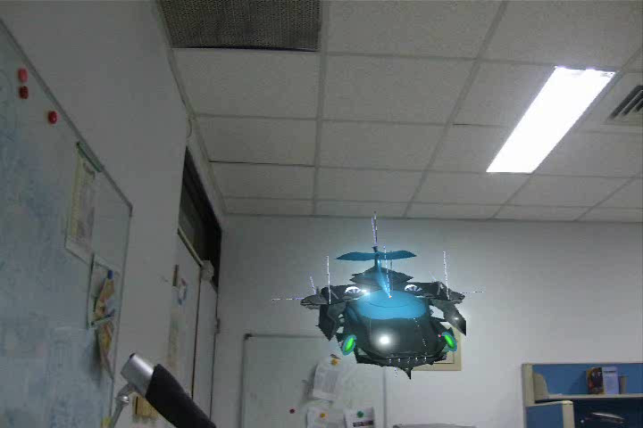
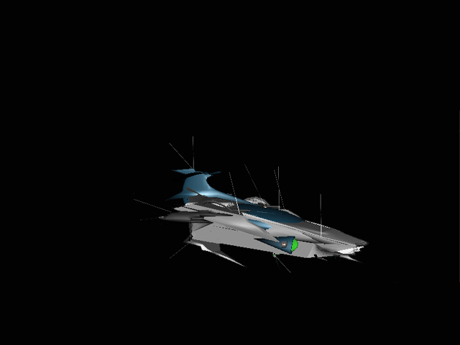
Overview
Input
Matchmove is a technique of estimating camera parameters from an input video sequence so that computer generated imagery (CGI) could be seamlessly inserted into the sequence.
Example
Output
Video
Composite Video
CGI Animation

Slide 3
Environment Setting
Blender
  Version 2.6.2 http://download.blender.org/release/Blender2.62/
  Using version higher than 2.6.6 might get error while running voodoo python scripts
Voodoo
  Version 1.2.0 http://www.viscoda.com/en/voodoo-download
Other options
  Free: Blender + ICARUS
  Pay: boujou + 3D Max, boujou + Maya, …
3D models
  *.obj, *.3ds…

Slide 4
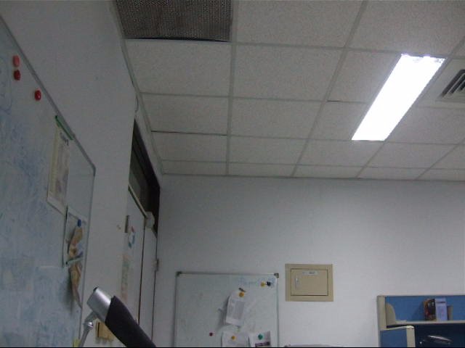
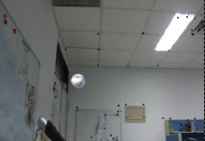
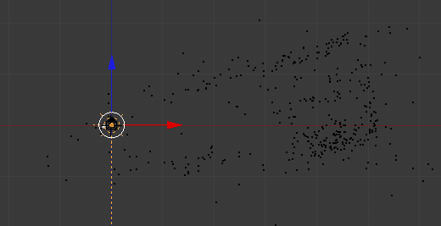

Flowchart
Blender
Voodoo
Split
Calibration
Video
Image sequences
Camera parameters
Load virtual camera
Blender
Edit Pose/Position
Composition
3D models
Animation
Output Video

Slide 5
Flowchart (detailed)
Three main stages:
  In Blender: Split video into image sequences
    Input: video
    Output: image sequence (*.tga)
  In Voodoo: Camera calibration/tracking
    Input: image sequence (*.tga)
    Output: voodoo python script (*.py)
  In Blender: Combine video and 3D model
    Input: 3D model, video, voodoo python script (*.py)
    Output: video with 3D model
  (Option) Edit your video with other software (ex. Adobe After Effects, VideoStudio, PowerDirector, Final Cut)

Slide 6
Stage 1: Get Image Sequence
Blender
Split
Calibration
Video
Image sequences
Camera parameters
Load virtual camera
Edit Pose/Position
Composition
3D models
Animation
Output Video

Slide 7
Stage 1: Get Image Sequence
Open Blender
Load video file:
  Change window type to “Video Sequence Editor”
  Select Add →Movie
  Put the strip in Layer 1
Do sequence:
  Frame
    Set number of frames and resolution of frames
    Choose output file type (Targa, *.tga)
  Time interval: select start and end of the sequence
  Choose output location
Click “Animation” button

Slide 8
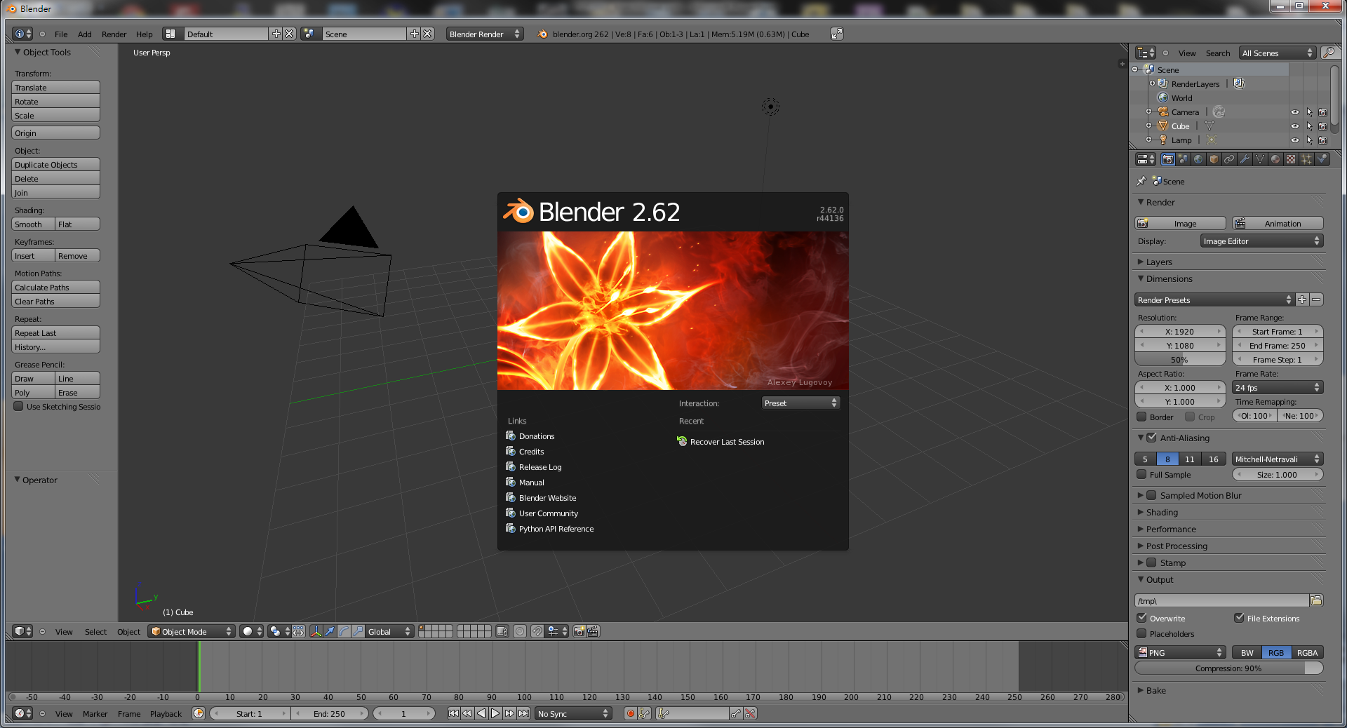
Stage 1: Get Image Sequence
Start up Blender

Slide 9
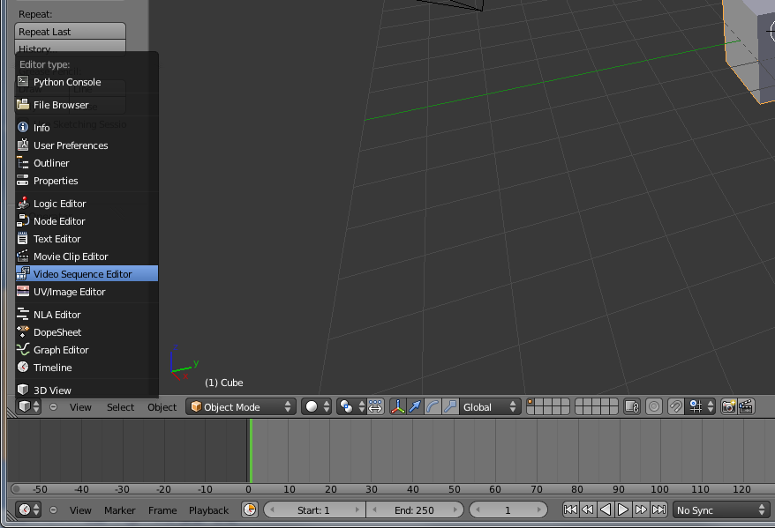
Stage 1: Get Image Sequence
2. Change to Video Sequence Editor
1. Click to change window type
Change window type

Slide 10
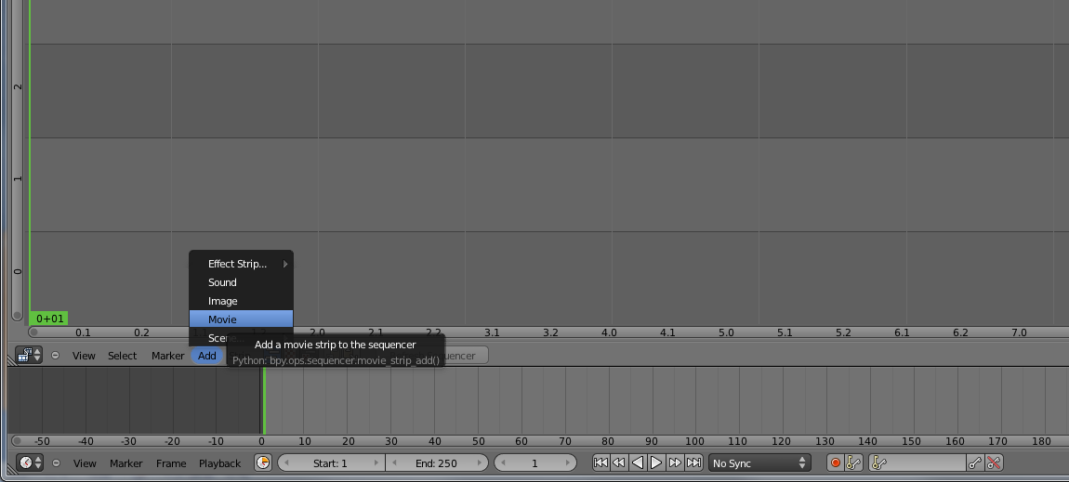
Stage 1: Get Image Sequence
Select
Add → Movie
Add video

Slide 11
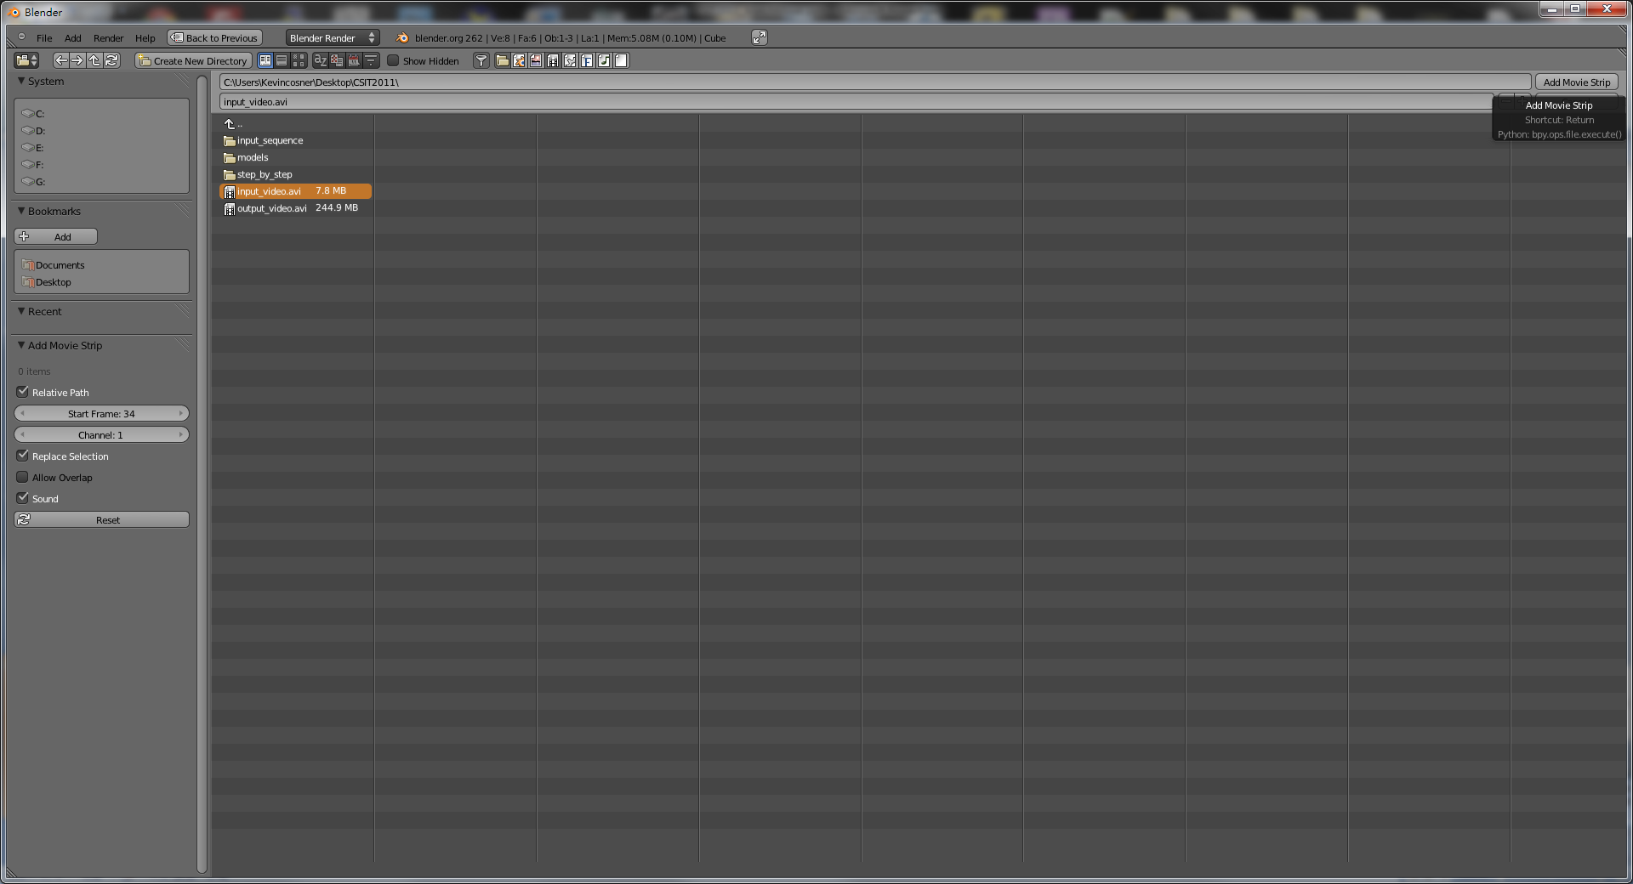
Stage 1: Get Image Sequence
2. Select input file
3. Add
~
1. Select file directory
Select input video

Slide 12
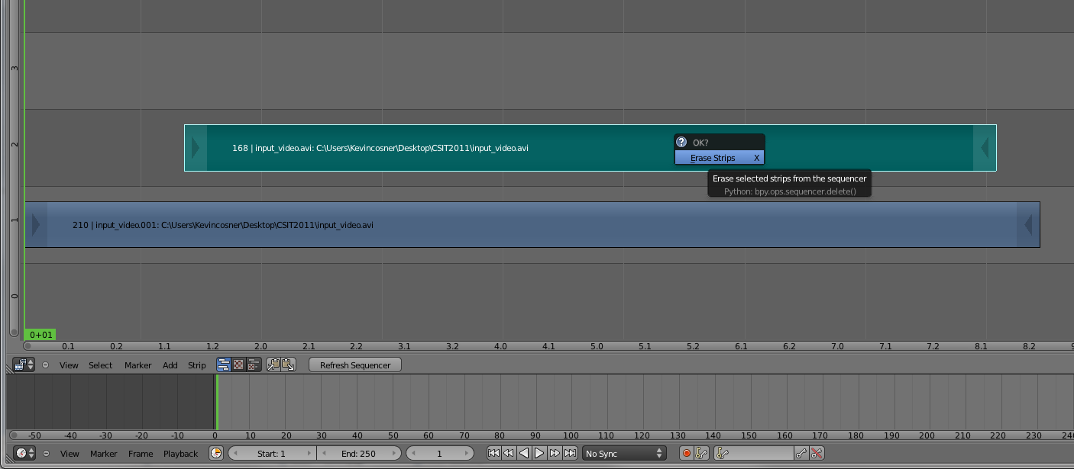
Stage 1: Get Image Sequence
1. Delete unnecessary layer (audio)
2. Right-click to drag the strip to the “1st Frame” in Layer 1
Edit layers (Right click and drag, left click to set)

Slide 13
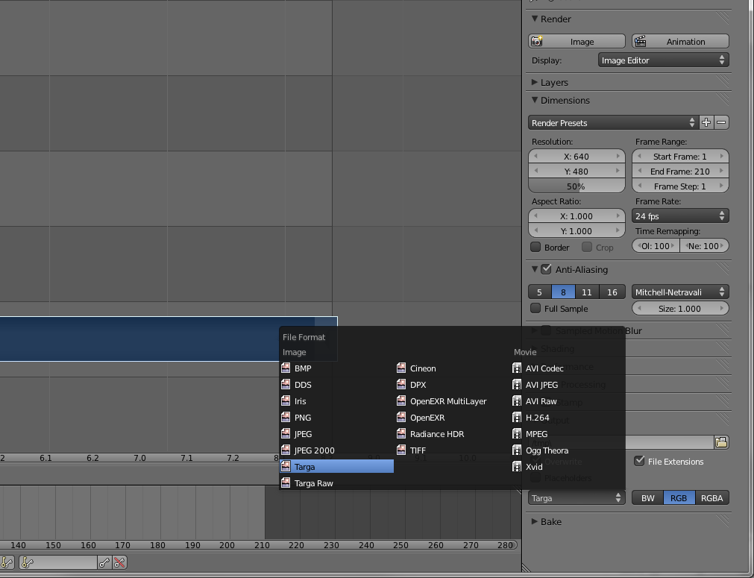
Stage 1: Get Image Sequence
Set
  Resolution
  Start/End Frame
Set file types to Targa(TGA)
3. Modify output directory
Do video setting

Slide 14
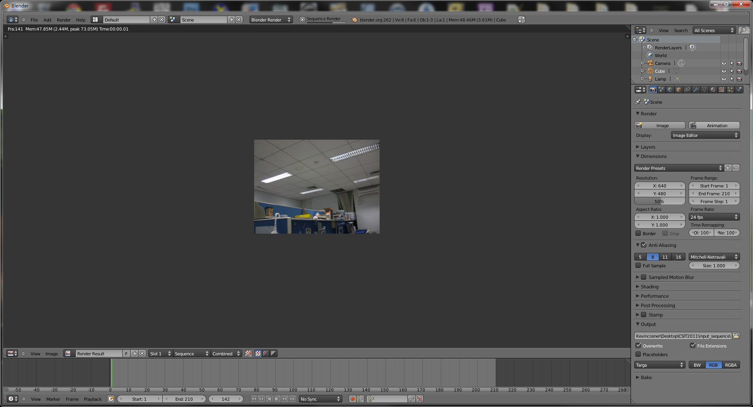
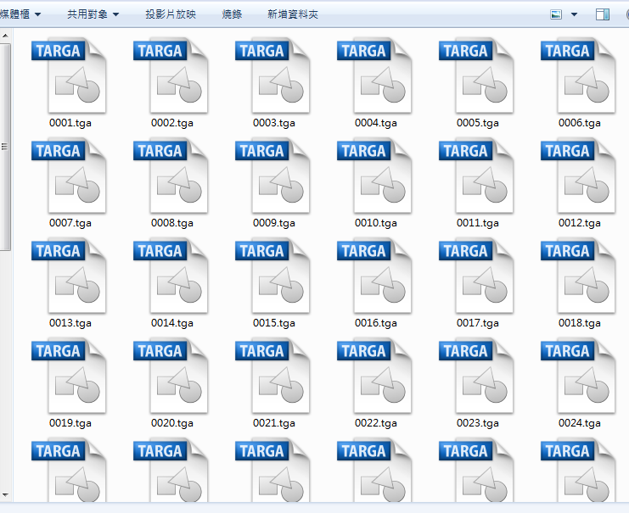
Stage 1: Get Image Sequence
Finish!
You can find the image sequences in output directory
Click Animation
You’ll see playing video and increasing frame number
Render image sequence

Slide 15
Stage 2: Camera Calibration
Voodoo
Split
Calibration
Video
Image sequences
Camera parameters
Load virtual camera
Edit Pose/Position
Composition
3D models
Animation
Output Video

Slide 16
Stage 2: Camera Calibration
Open Voodoo
Open image sequence:
  Select File → Open → Sequence
  Select the first frame
  Set Move Type to “free move”
Track:
  Click Track button
Export Python script:
  Select File → Save → Blender Python Script
  Save .py file (Blender 2.5x and higher)
  Export all

Slide 17
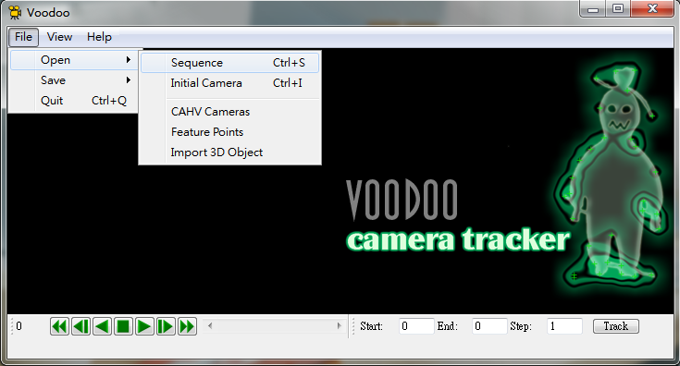
Stage 2: Camera Calibration
Select
File → Open → Sequence
Use Voodoo to load image sequence

Slide 18
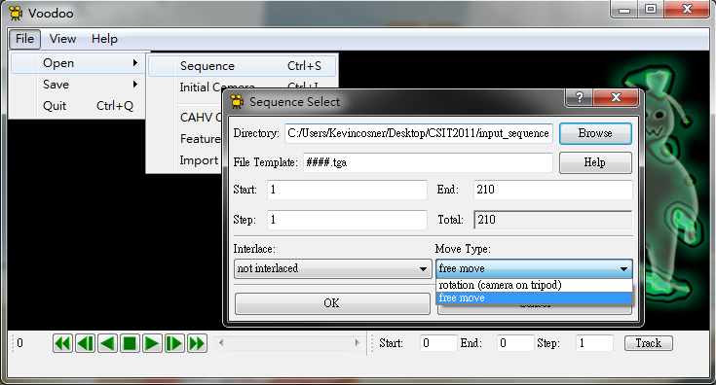
Stage 2: Camera Calibration
Select the first frame
(ex: 0001.tga)
2. Select “free move”
(general moving of camera)
Choose and set sequence

Slide 19
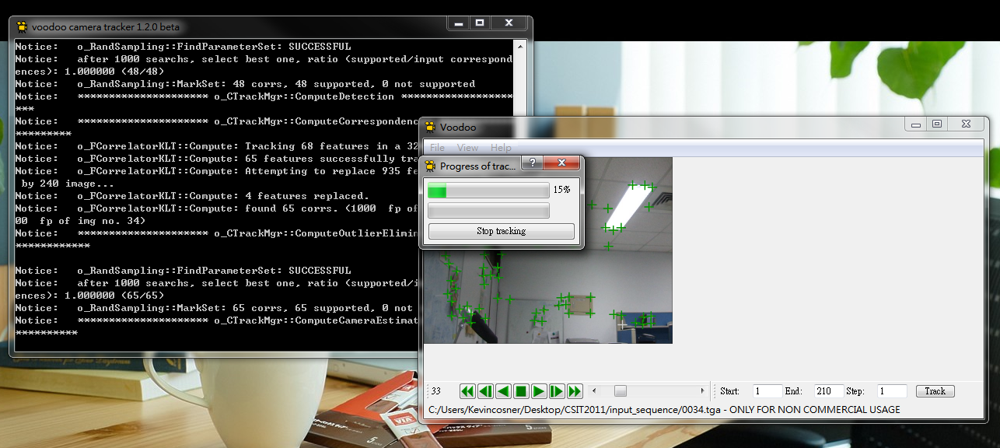
Stage 2: Camera Calibration
Click “Track” button
Tracking features

Slide 20
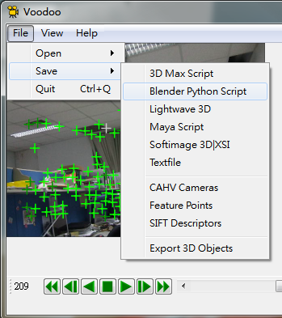
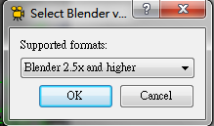
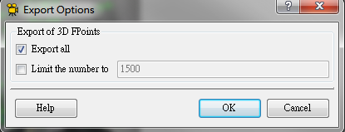
Stage 2: Camera Calibration
Select
File → Save → Blender Python Script
Select
“Blender 2.5x and higher”
Select “Export all”
Save results to “Blender Python Script”

Slide 21
Stage 3: Combine Video and 3D Model
Split
Calibration
Video
Image sequences
Camera parameters
Load virtual camera
Blender
Edit Pose/Position
Composition
3D models
Animation
Output Video

Slide 22
Stage 3: Combine Video and 3D Model
Stage 3-1: Load virtual camera (python script from voodoo)
Stage 3-2: Show background images
Stage 3-3: Load 3D model
Stage 3-4: Set model animation
Stage 3-5: Render video

Slide 23
Stage 3: Combine Video and 3D Model
Split
Calibration
Video
Image sequences
Camera parameters
Load virtual camera
Blender
Edit Pose/Position
Composition
3D models
Animation
Output Video

Slide 24
Stage 3-1 ~ 3-2
Open Blender
Delete default objects
Load Python Script
  Change Window Type to “Text Editor”
  Select Text → Open Text Block
  Select the *.py file (exported from Voodoo)
  Click “Run Script”
Load Background Images
  Change window type to “3D View”
  Select View → Cameras → Set Active Object as Active Camera
  Load background images
  Set the parameters of background images

Slide 25
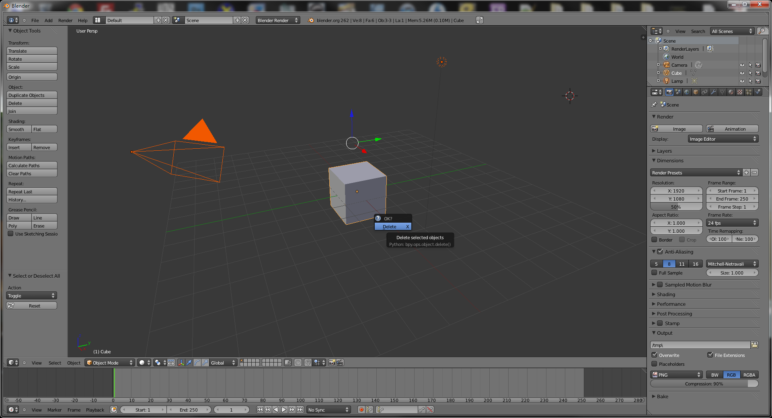
Stage 3-1: Load Virtual Camera
Press “a” twice to select all objects,
then press “Delete” on your keyboard
Delete default objects

Slide 26
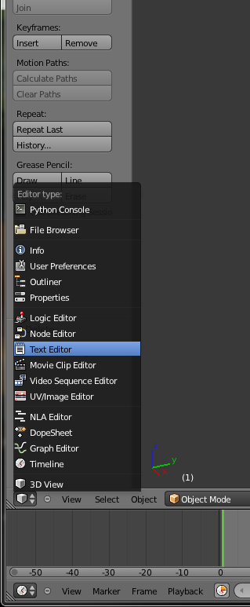
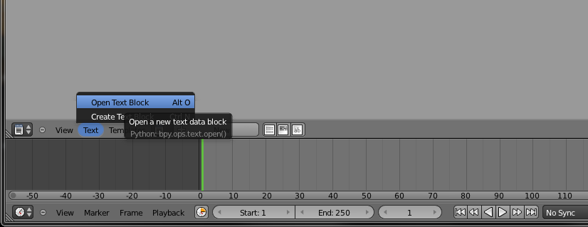
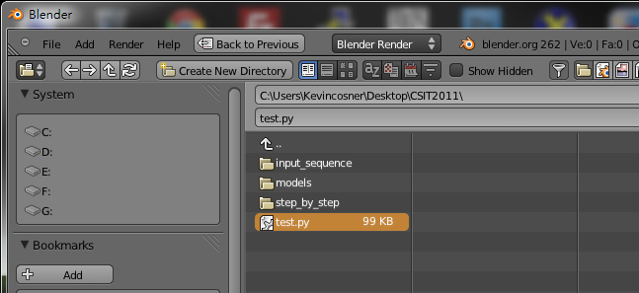
Stage 3-1: Load Virtual Camera
Select “Text → Open Text Block”
Change window type to
“Text Editor”
Select the Python script exported by Voodoo
Load python script

Slide 27
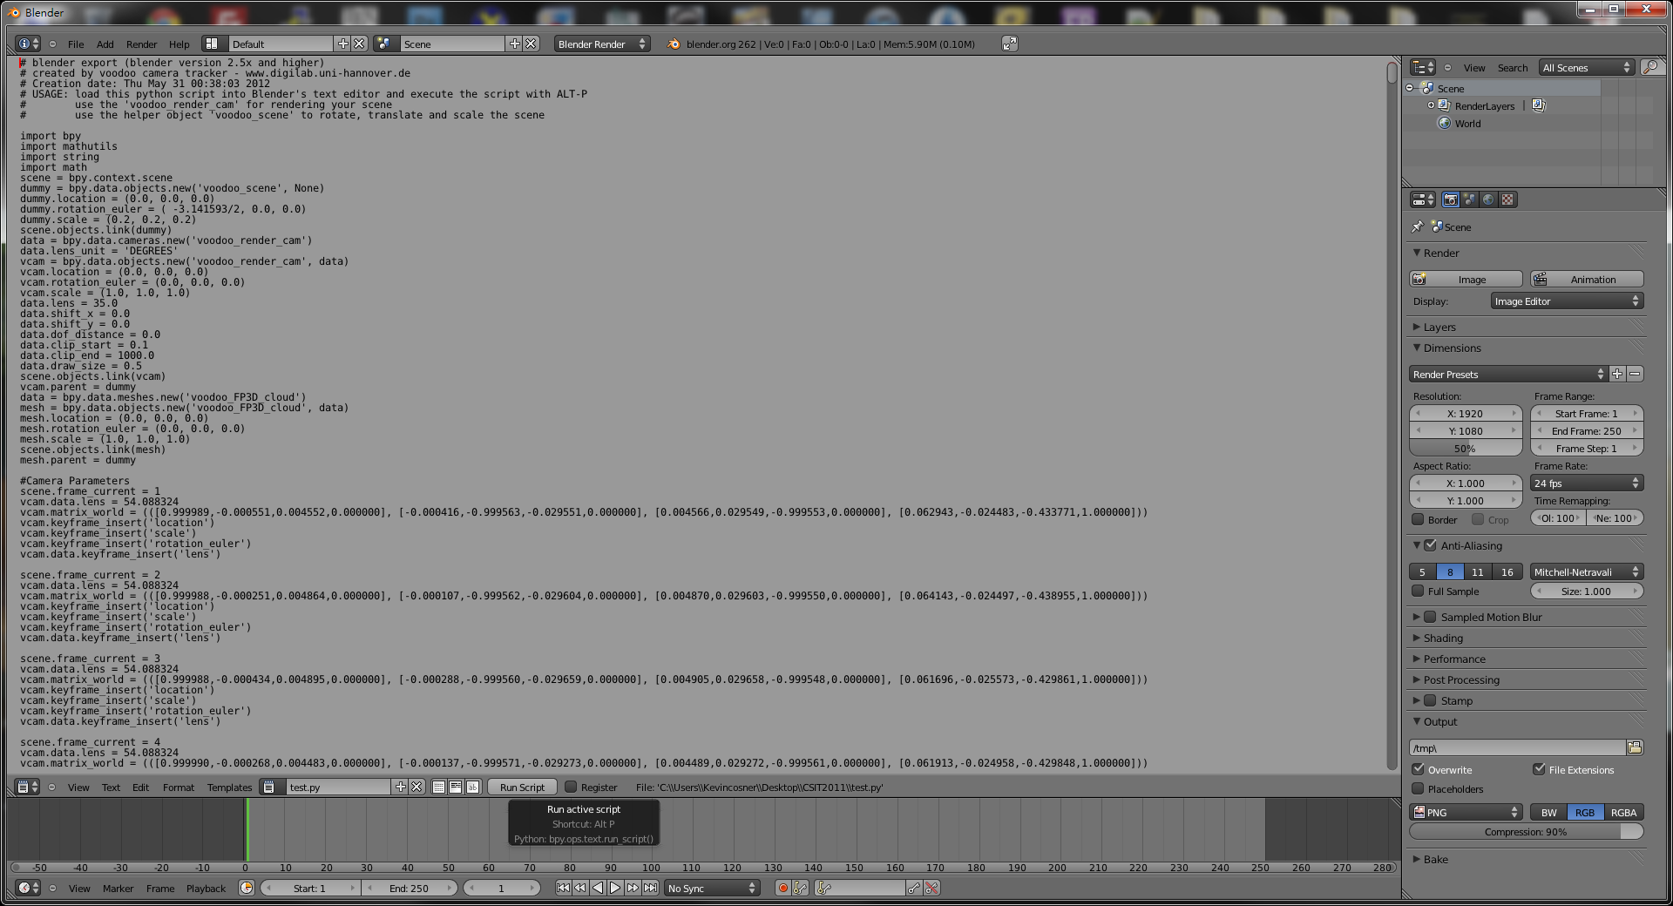
Stage 3-1: Load Virtual Camera
2. Return to “3D View”
1. Press “Run Script”
Run script

Slide 28
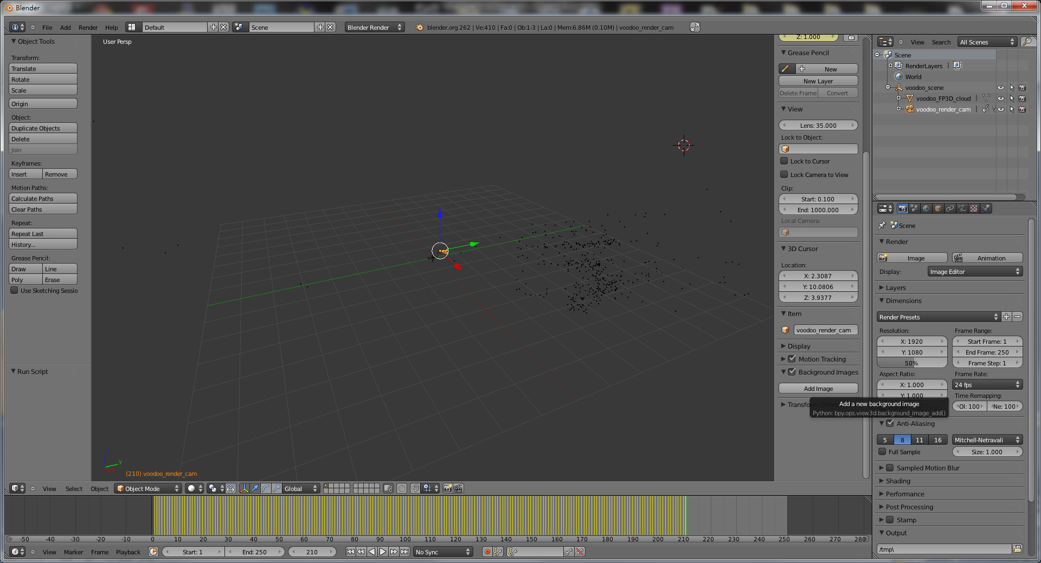
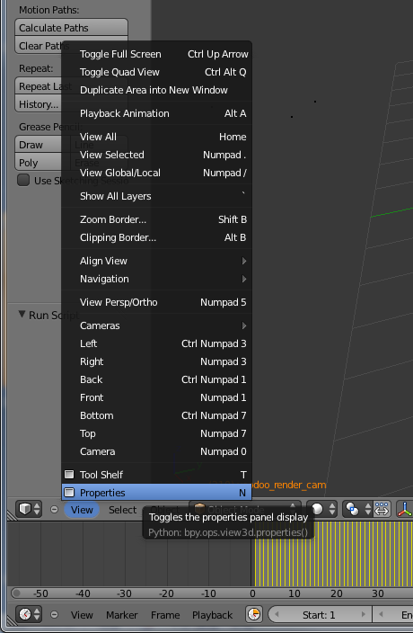
Stage 3-2: Show Background Images
Turn on
“Properties” Panel
Show Property Panel

Slide 29
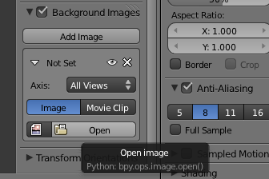
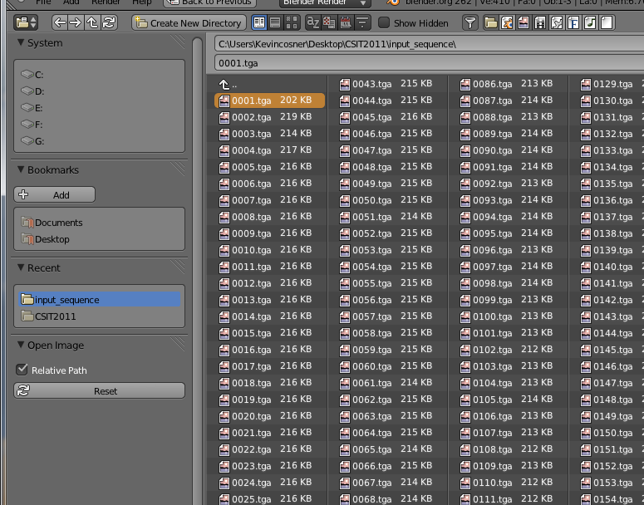
Stage 3-2: Show Background Images
Press “Open”
Tick-off
“Background Images”
Select
the first frame

Slide 30
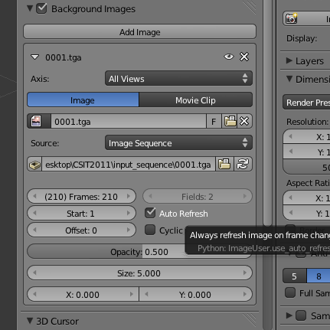
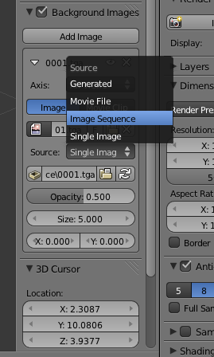
Stage 3-2: Show Background Images
Set
Number of frames
Start frame (1)
Enable “Auto Refresh”
Select
“Image Sequence”
Change
background type

Slide 31
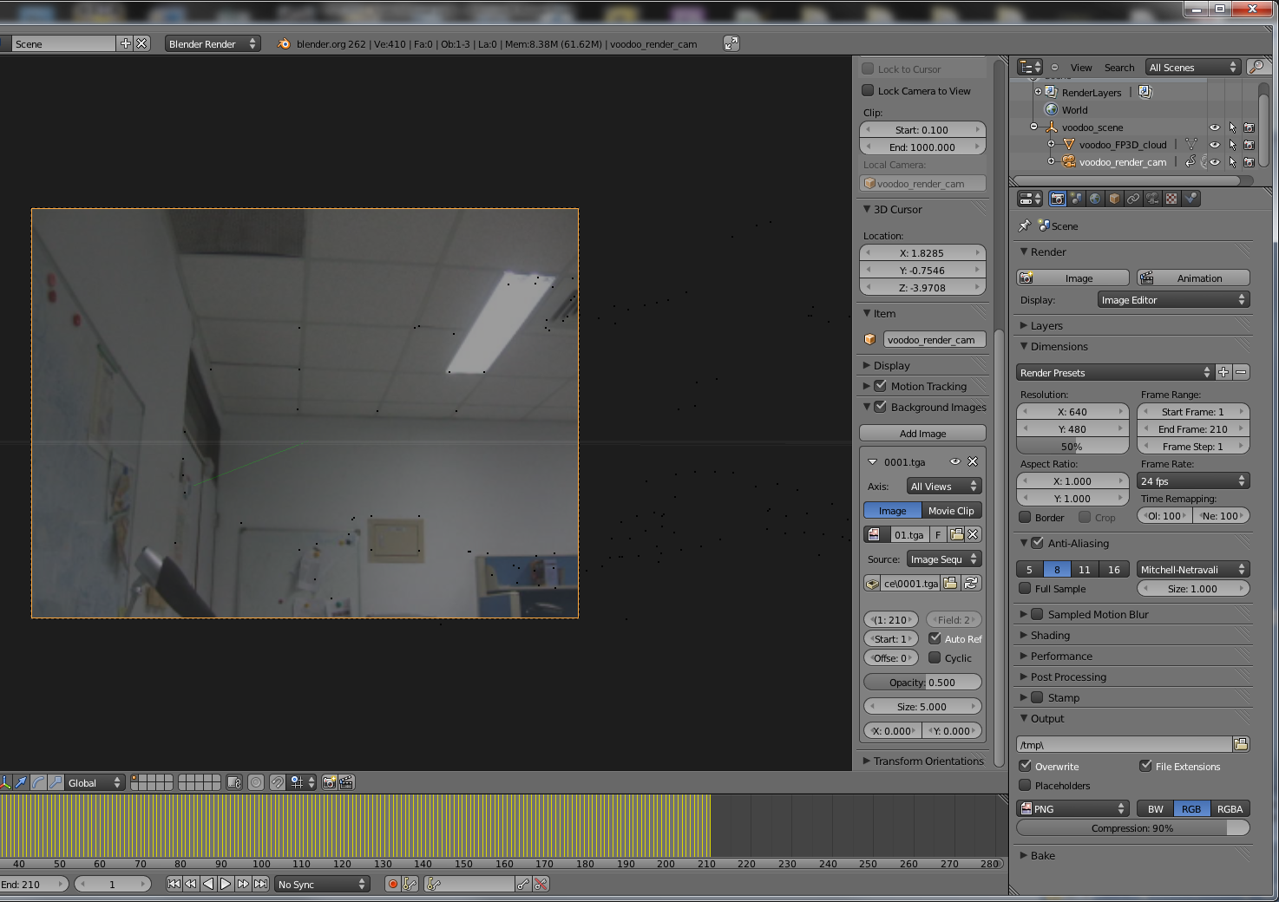
Stage 3-2: Show Background Images
Set
Number of frames
Resolution
Set resolution

Slide 32
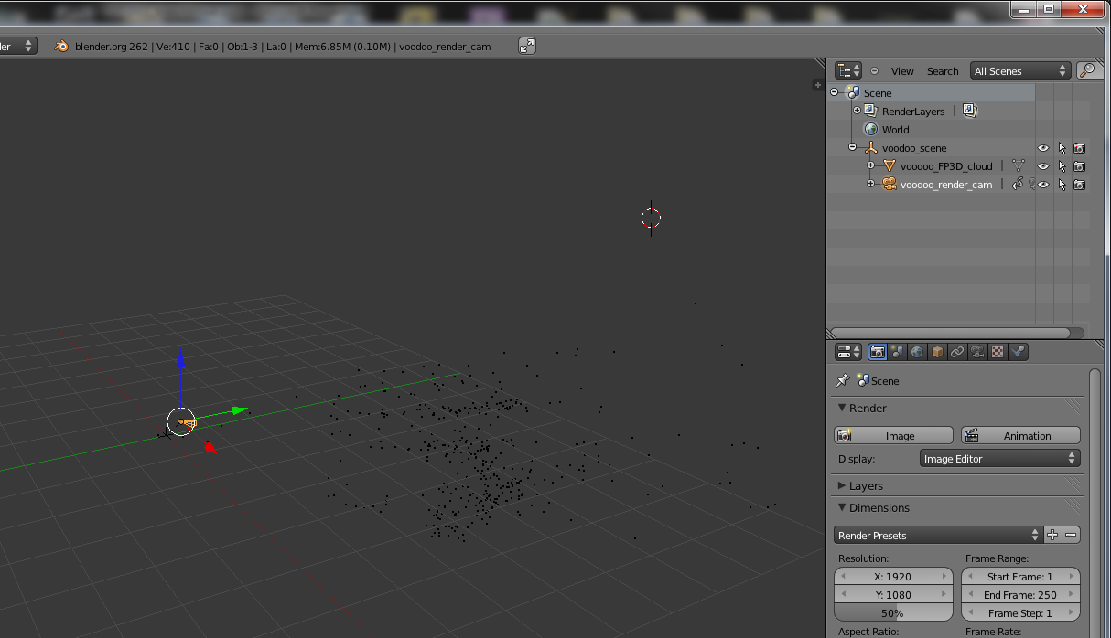
Stage 3-2: Show Background Images
Select
“voodoo_render_cam”
Select Voodoo camera

Slide 33
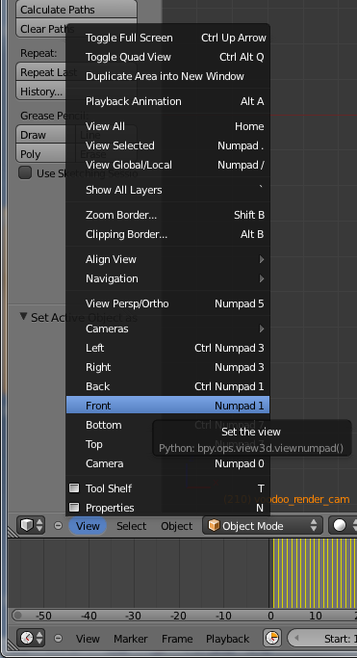
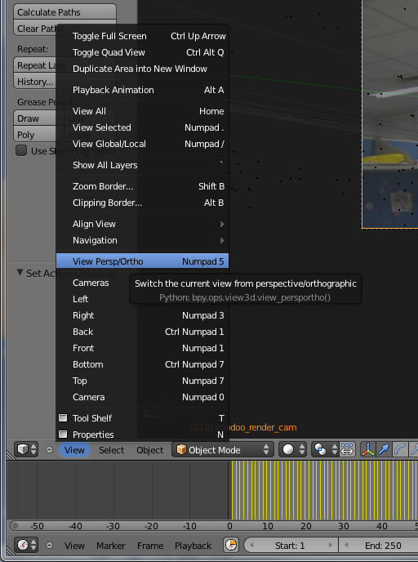
Stage 3-2: Show Background Images
Switch view to
“Front”
Switch view to
“View Persp/Ortho”
Set view

Slide 34
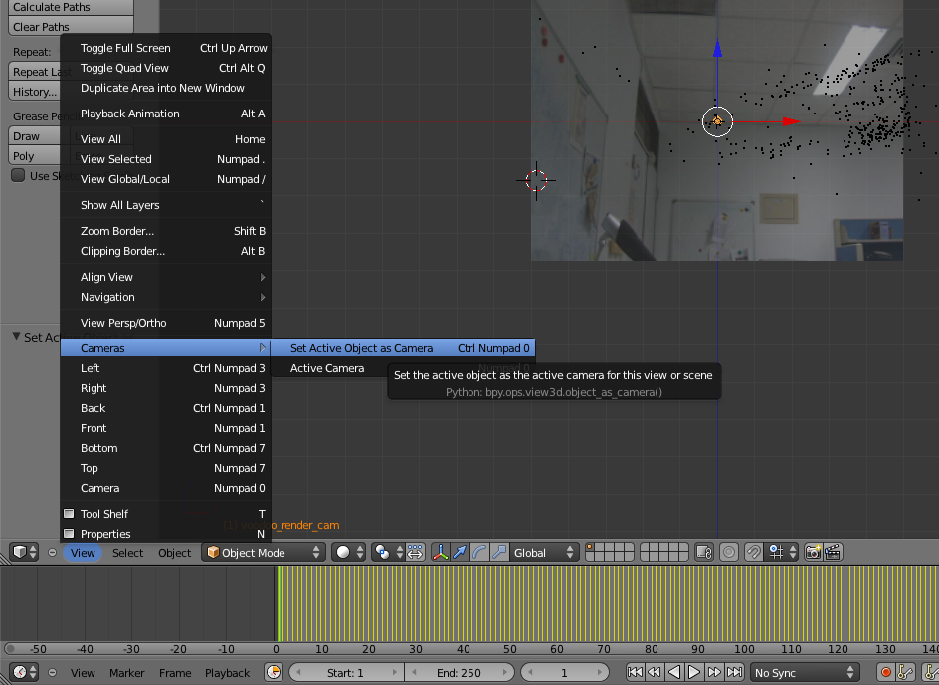
Stage 3-2: Show Background Images
Set
Cameras → Set Active Object as Camera
Set active camera

Slide 35
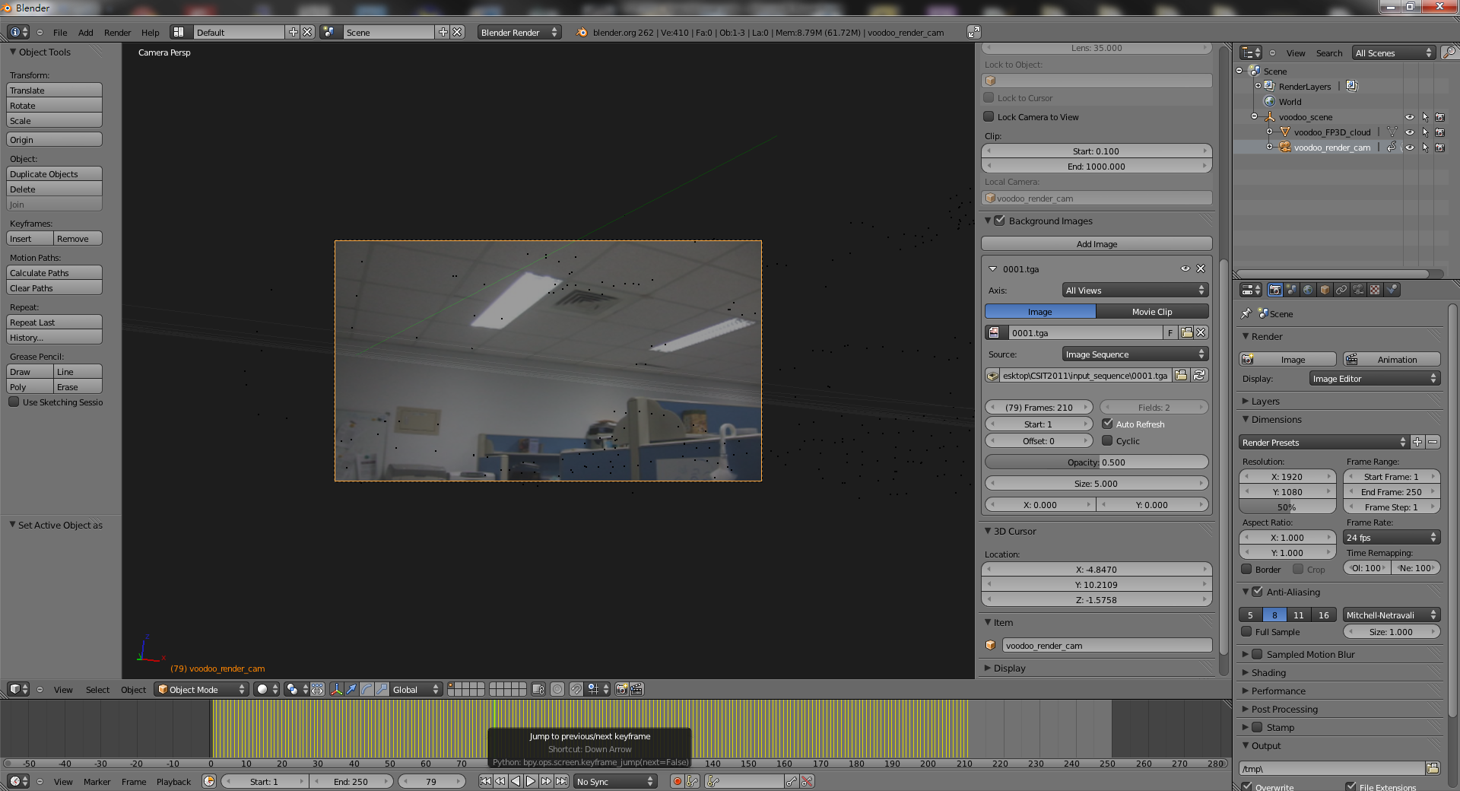
Stage 3-2: Show Background Images
Make sure “voodoo_render_cam” is selected
You can drag here to see the camera motions
Check background

Slide 36
Stage 3: Combine Video and 3D Model
Split
Calibration
Video
Image sequences
Camera parameters
Load virtual camera
Blender
Edit Pose/Position
Composition
3D models
Animation
Output Video

Slide 37
Stage 3-3 ~ 3-4
Load models
  File → Import → *.obj
Edit model poses/motions in the video
  Object → Animation → Insert keyframe (or press “I”)
  Fine tuning

Slide 38
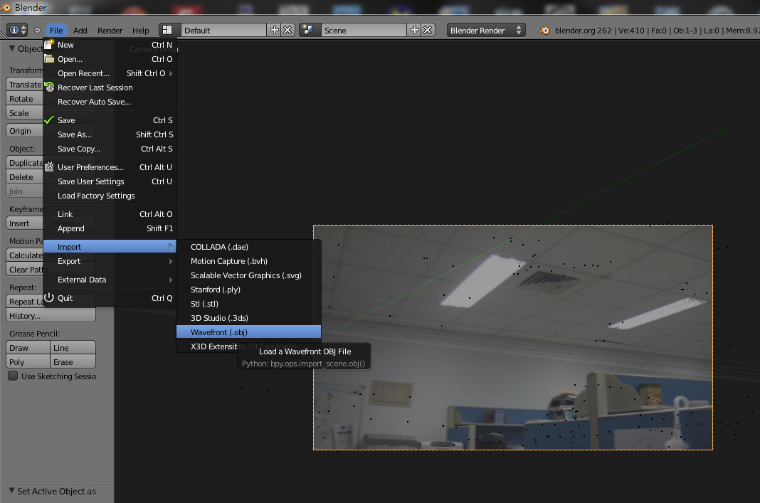
Stage 3-3: Load 3D Model
Select
File → Import →Wavefront
(you can also use other file format)
Load models

Slide 39
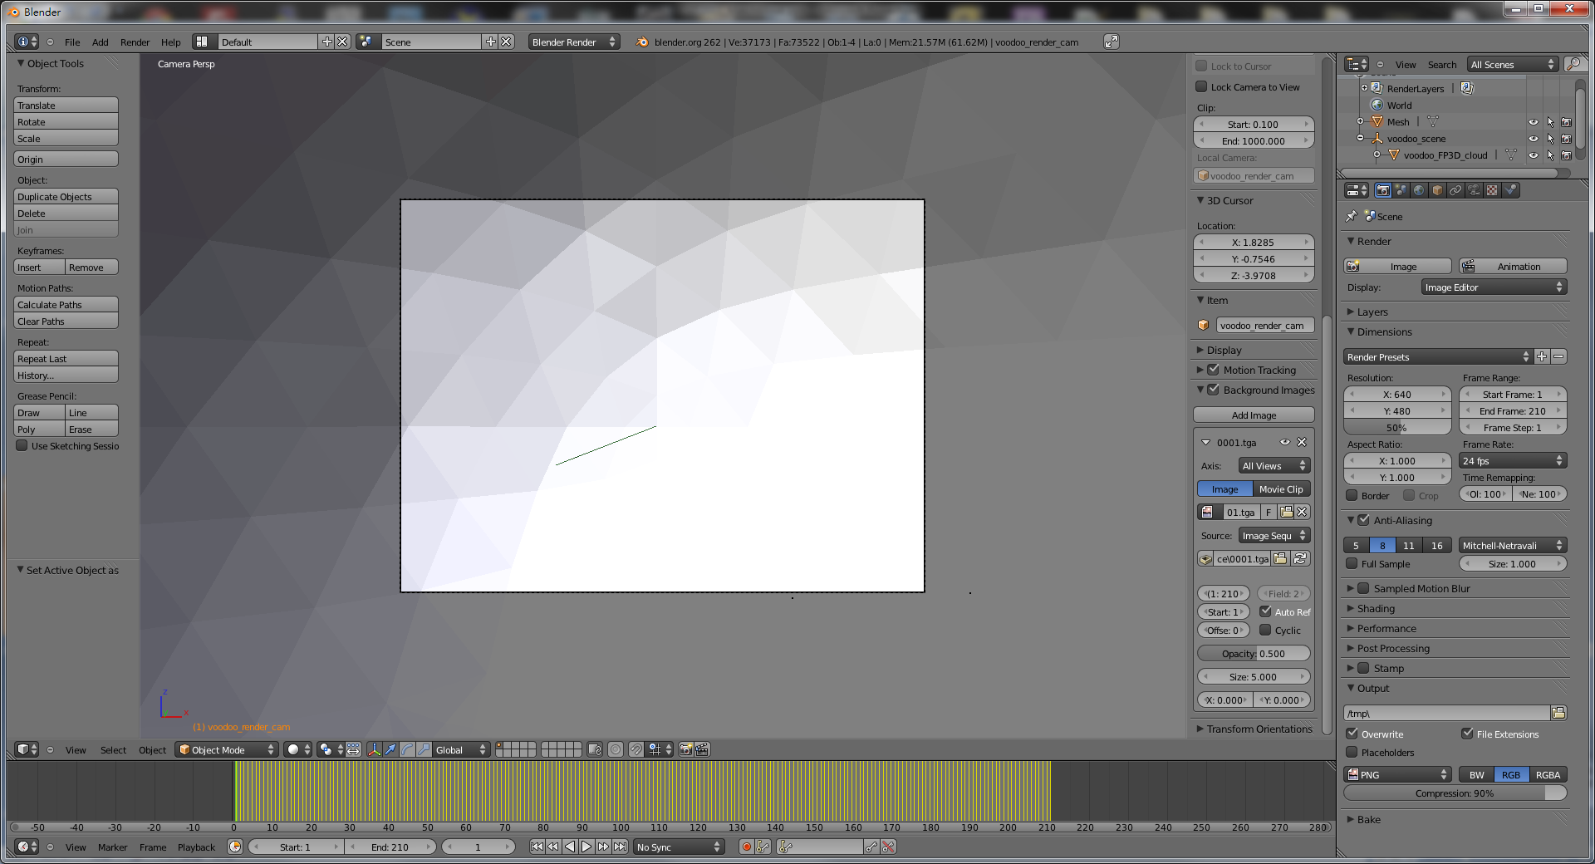
Stage 3-3: Load 3D Model
You can set the transform of your objects to edit their positions and poses
Set poses / positions for models

Slide 40
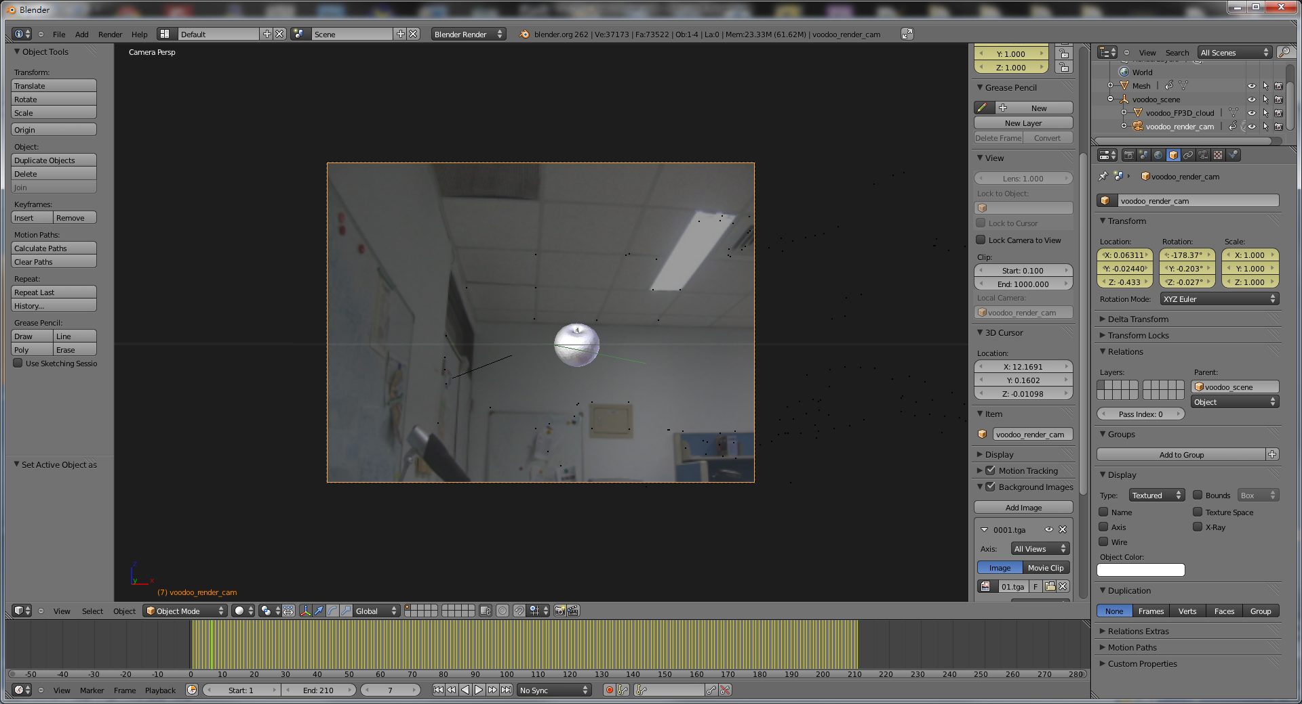
Stage 3-3: Load 3D Model
This step needs lots of fine tuning
Fine tuning
You can drag here to see whether your tuning is correct or not
(is the object located at the correct position?)

Slide 41
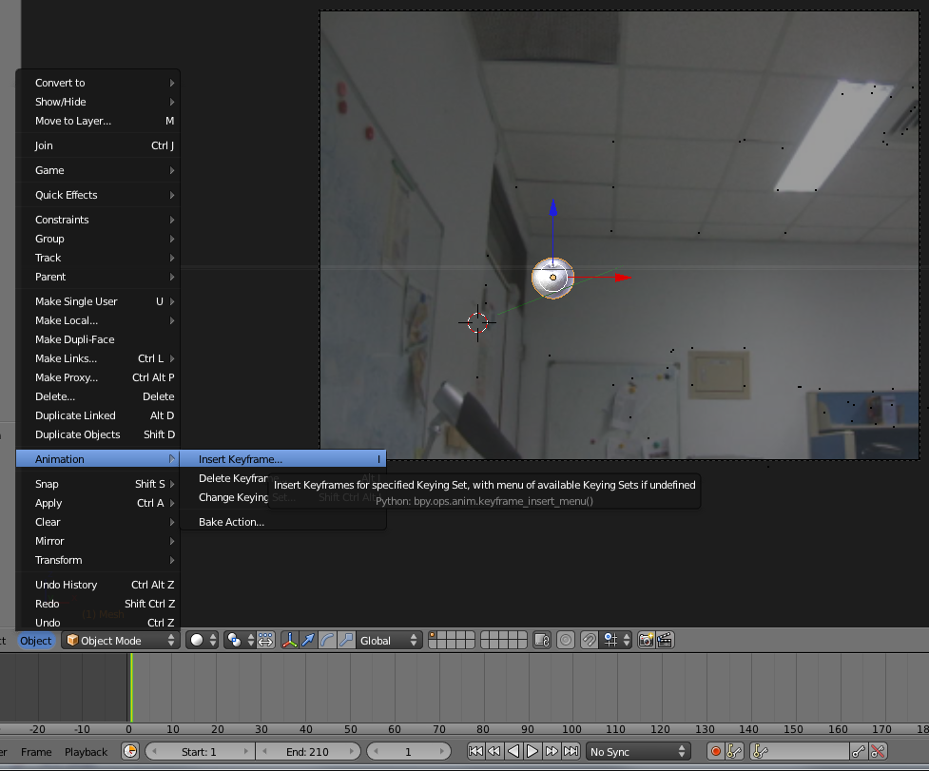
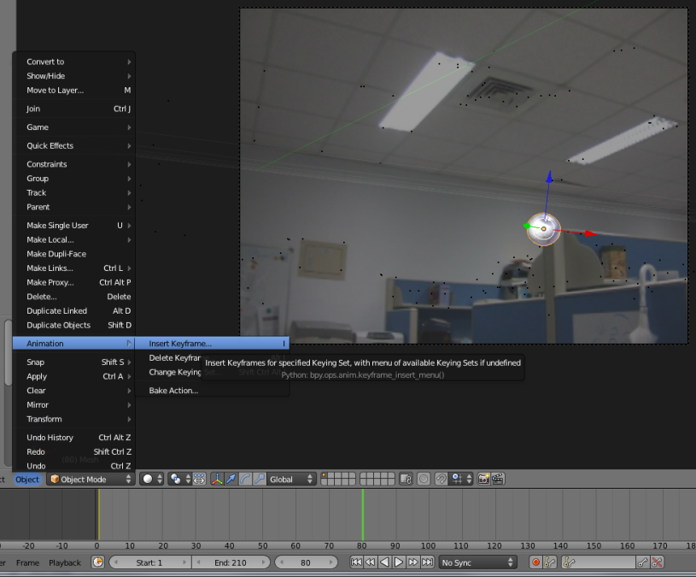
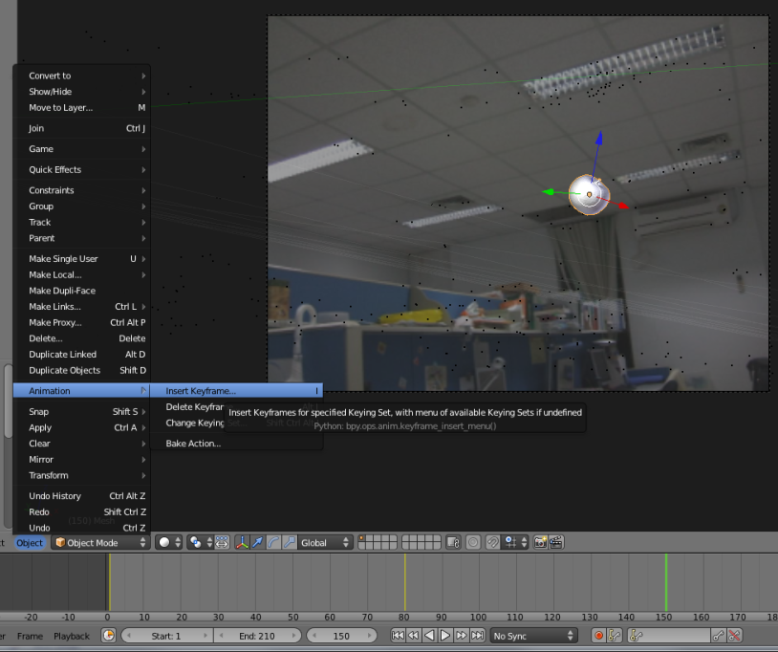
Stage 3-4: Set Model Animation
Select the frame that you want to insert a key frame
Select
Object → Animation → Insert Keyframe..
3. Repeat multiple times
Frame 1
Frame 80
Set keyframes
Frame 150

Slide 42
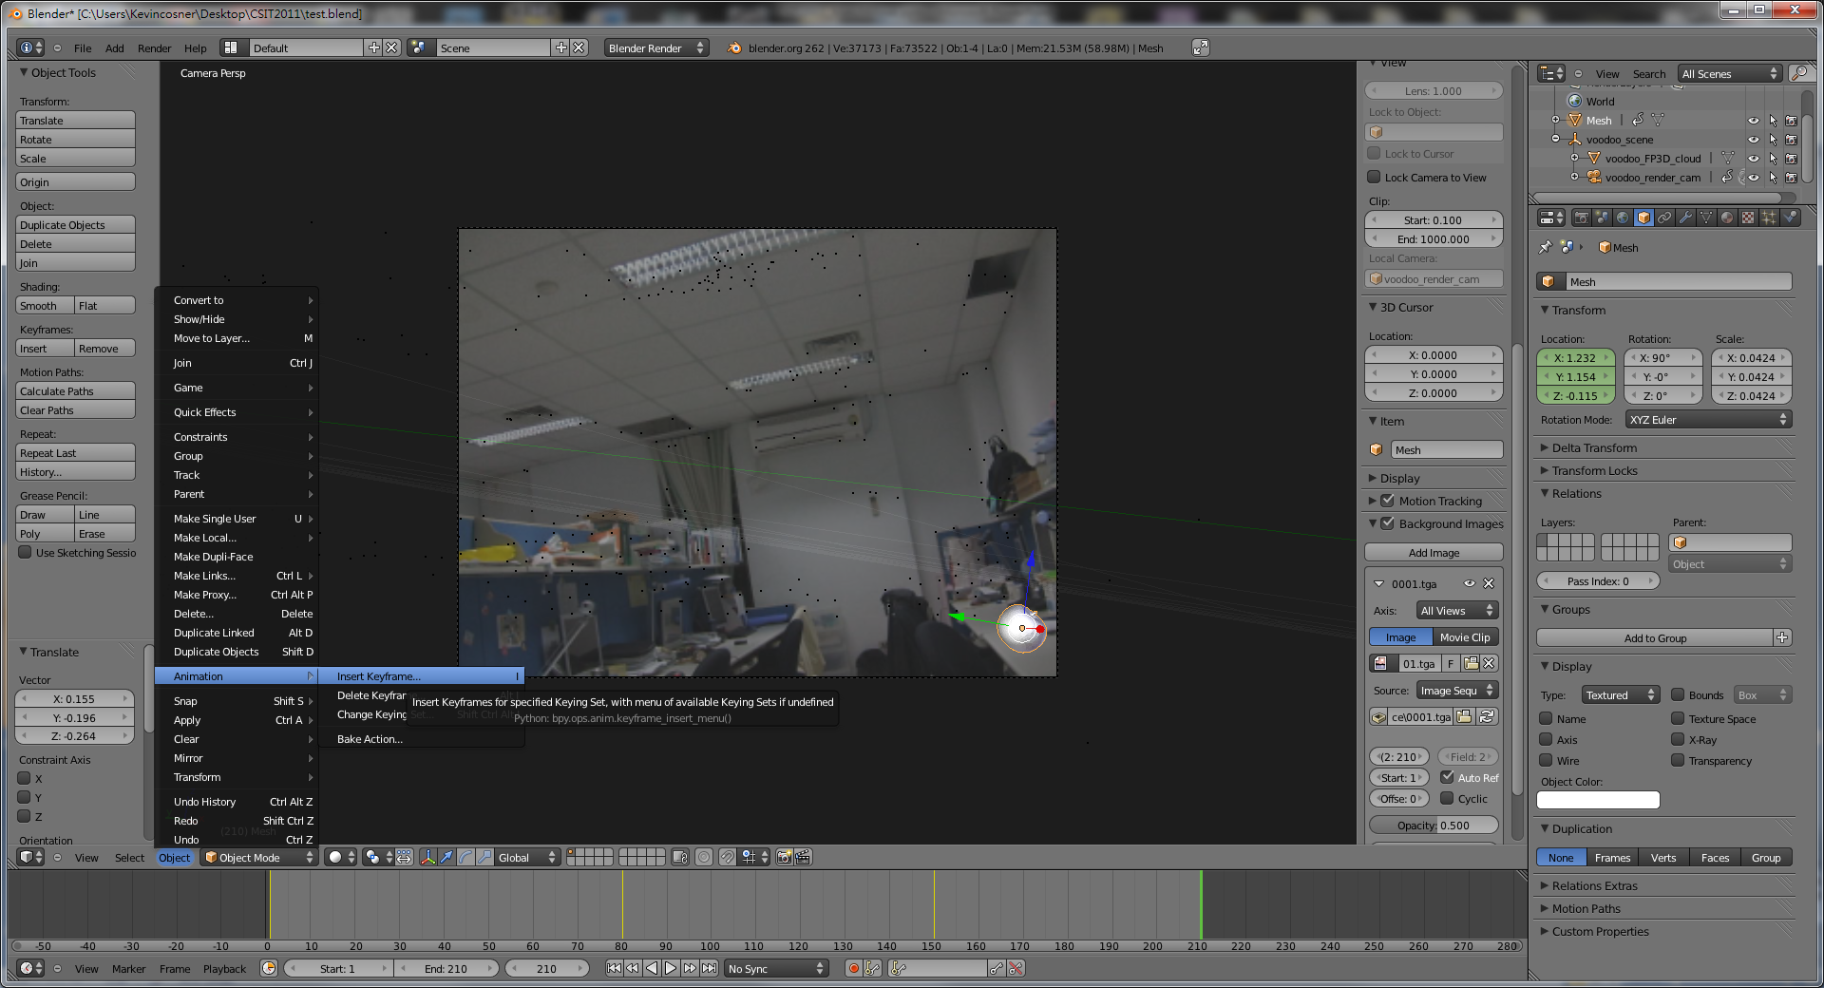
Stage 3-4: Set Model Animation
You can fine-tune the transformation of objects in a keyframe here
Fine tuning

Slide 43
Stage 3: Combine Video and 3D Model
Split
Calibration
Video
Image sequences
Camera parameters
Load virtual camera
Blender
Edit Pose/Position
Composition
3D models
Animation
Output Video

Slide 44
Stage 3-5
Add image sequence
  Change window type to “Video Sequence Editor”
  Select Add → Images and select all images
  Drag the strip to the “1st Frame” in Layer 1
Add scene
  Select Add → Scene
  Drag the scene strip to the “1st Frame” in Layer 2
  Change scene property to “Alpha Over”
  Set parameters of output video
Click “Animation”

Slide 45
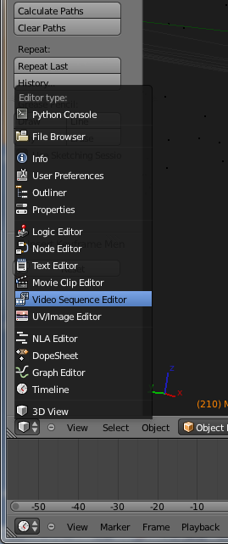
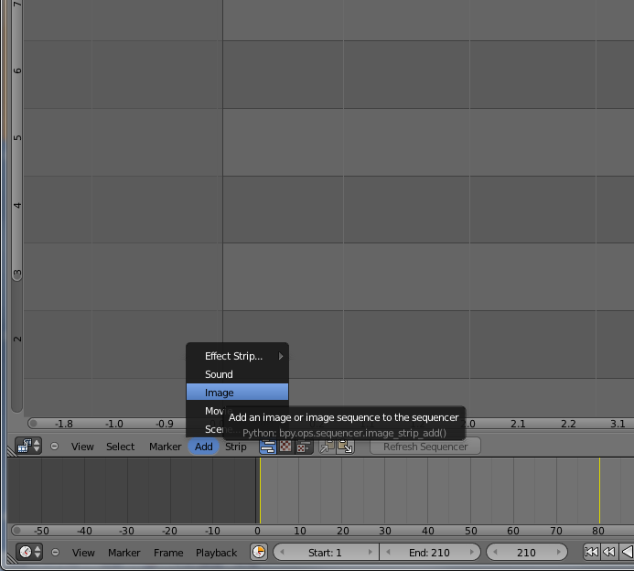
Stage 3-5: Render Video
Select
Add → Image
Set to Video Sequence Editor
Add image sequence (Video Channel)

Slide 46
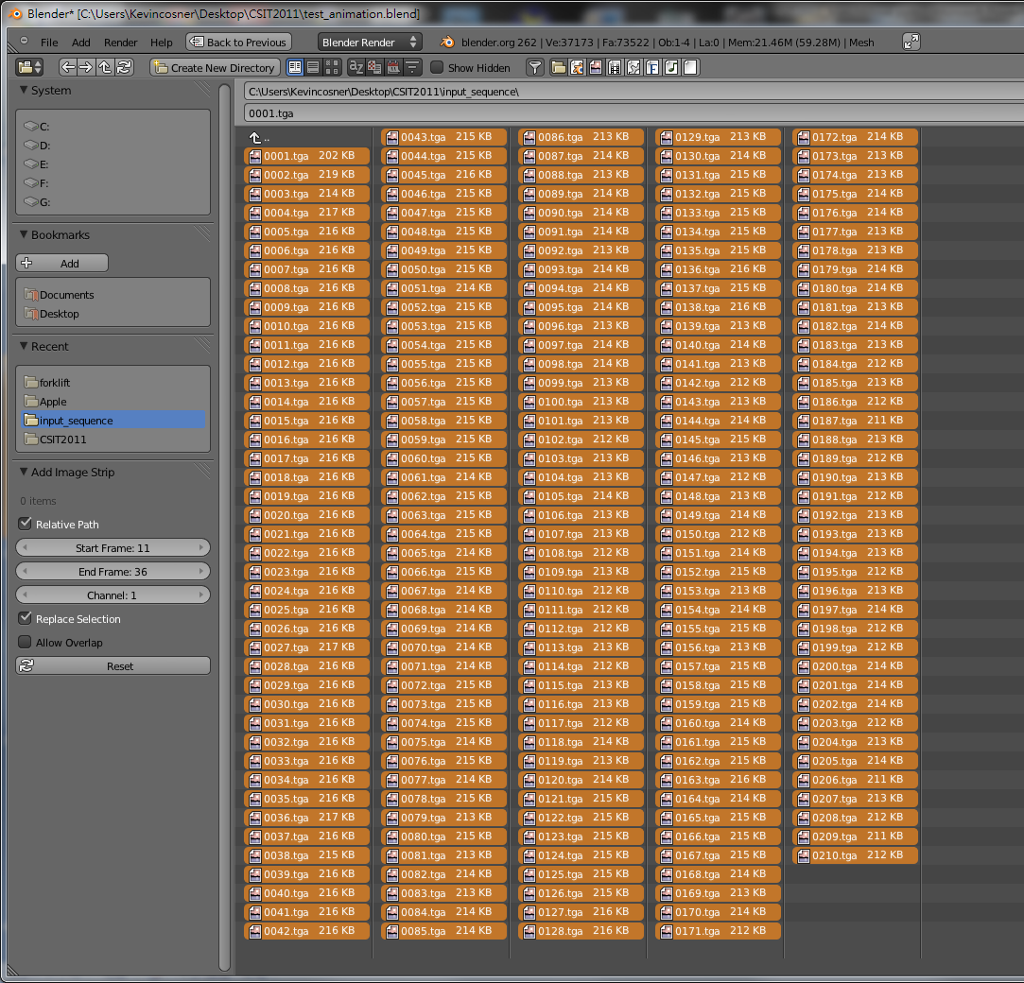
Stage 3-5: Render Video
This time, select all frames (Press A)

Slide 47
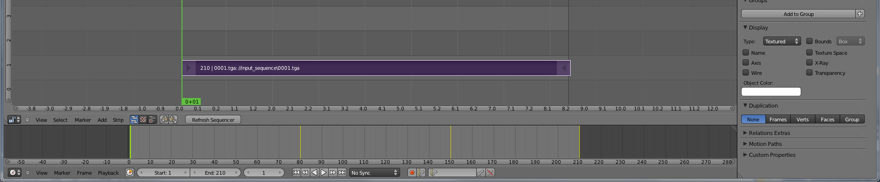
Stage 3-5: Render Video
Drag the strip to the
“1st Frame” in Layer 1
Edit Video Layer (Right click and drag, left click to set)

Slide 48
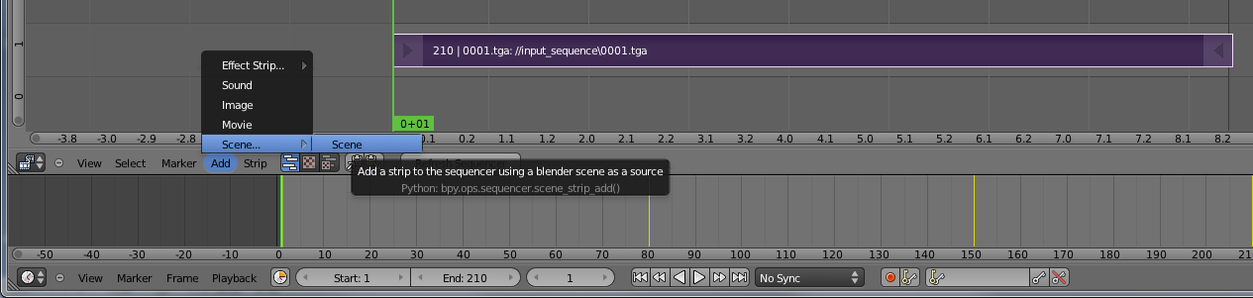
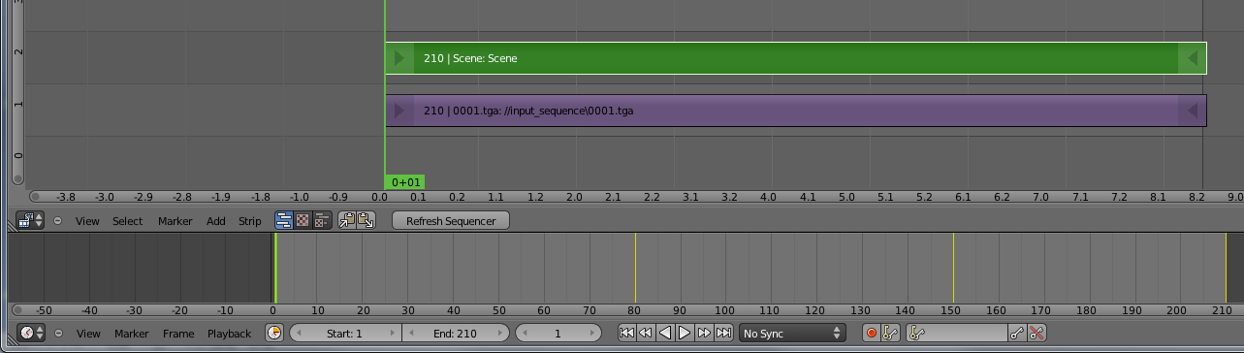
Stage 3-5: Render Video
Select
Add → Scene → Scene
Add scene layer
Drag the strip to the
“1st Frame” in Layer 2
Edit scene layer (Right click and drag, left click to set)

Slide 49


Stage 3-5: Render Video
You will see the Properties Panel
Select
View → Properties
Show Properties Panel
Select
Blend → Alpha Over
Set Blend Type

Slide 50


Stage 3-5: Render Video
Set scene camera to
“voodoo_render_cam”
Enable!
Select Premultiply
Set scene camera

Slide 51

Stage 3-5: Render Video
Check output setting again!

Slide 52

Stage 3-5: Render Video
Change the viewing type
Preview your video

Slide 53


Stage 3-5: Render Video
Choose
H.264
File path
Select output format
Press !
Finish !!
Oh yeah!!
Final Output

Slide 54
Demo
https://www.youtube.com/watch?v=DzTiVhdxJk0
https://www.youtube.com/watch?v=QU4pPnsqbeM
https://www.youtube.com/watch?v=1f3fMV3v7Xg
https://www.youtube.com/watch?v=B8LN9nMM3Wg
https://www.youtube.com/watch?v=BM5EmTMjFy0
More examples:
  http://ntuvfx.csie.org/vfx/2015/
  http://192.168.1.110/vfx/2015/

Slide 55
Submission
You need to submit:
  Artifact video: final video with CGI
  Raw video: video without CGI
  Report in html/pdf format
Upload a compressed file (including raw video and report) and your artifact to the submission website.
  http://ntuvfx.csie.org/vfx/2015/proj3_submit.php
  http://192.168.1.110/vfx/2015/proj3_submit.php

Slide 56
Grading Criterion
Camera motion
Model motion: ex. moving on the ground vs. flying
Video completeness: ex. story
Creativity
Bonus: voting

Slide 57
FAQ
Voodoo會當掉！
  拍攝的影片內容差異太大
  調整tracking的方式
為什麼我在Blender中的Background和Feature沒辦法配合?
  記得要先選取 voodoo_render_cam
  設定 Cameras → Set Active Object as Camera
3D models的位置/動作好難調整…
  多利用座標系相對位置以及不同視角會有幫助, 不過還是需要一些時間
  設定動作時, 盡量避免大角度或大範圍的interpolation, 多設一些 key frames
為什麼最後做出來的動畫Model是黑的?
  記得在場景裡加盞燈
我該去哪裡找3D models?
  網路上免費資源非常多!
  例如: http://www.3dm3.com/modelsbank/
      http://www.sharecg.com/

Slide 58


FAQ
調整設定
View → controls

Slide 59




FAQ
Use different views to adjust the positions and poses of objects
Camera
view
Top
view
Set view
Front
view

Slide 60

FAQ
Add lights
記得開燈!
Add → Lamp

Slide 61
Document
Blender official website
  http://www.blender.org/education-help/
Voodoo document website
  http://www.viscoda.com/index.php/en/voodoo-manual

