Slide 1
MatchMove
Digital Visual Effects, Spring 2013
Tzu-Kuei Huang (kuei@cmlab.csie.ntu.edu.tw)
2013/4/24

Slide 2
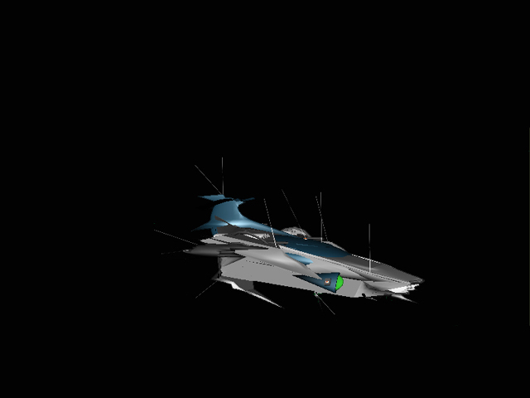
Flowchart
Input
Matchmove is a technique of estimating camera parameters from an input video sequence so that computer generated imagery (CGI) could be seamlessly inserted into the sequence.
Output
+
=
Video
Composite Video
CGI Animation

Slide 3
Flowchart (detailed)
P13-P17
Camera parameters
P5-P12
Calibration
Blender
Voodoo
Video
Image sequences
Load
P18-P30
Aid Design
P31-P35
Edit Pose/Position
Composite
P36-P46
Blender
Blender
3D models
Animation
Output Video

Slide 4
Environment Setting
Blender
Version 2.6.2 http://download.blender.org/release/
Using version 2.6.6 might get error while running python scripts
Voodoo
Version 1.2.0 http://www.viscoda.com/index.php/en/voodoo-download
Other options
Free: Blender + ICARUS
Pay: boujou + 3D Max, boujou + Maya, …

Slide 5
Recipe: Get Image Sequence
Open Blender
Load video file:
Change window type to “Video Sequence Editor”
Select Add →Movie
Put the strip in Layer 1
Do sequence:
Frame
Set number of frames and resolution of frames
Choose output file type (Targa)
Time interval: select start and end of the sequence
Choose output location
Click “Animation” button

Slide 6
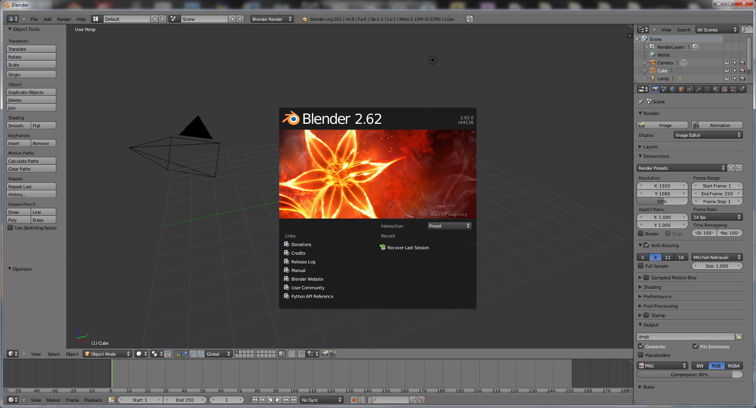
Step by Step: Get Image Sequence
Start up Blender

Slide 7
Step by Step: Get Image Sequence
2. Change to Video Sequence Editor
1. Click to change window type
Change window type

Slide 8
Step by Step: Get Image Sequence
Select
Add → Movie
Add video

Slide 9
Step by Step: Get Image Sequence
2. Select input file
3. Add
~
1. Select file directory
Select input video

Slide 10
Step by Step: Get Image Sequence
1. Delete unnecessary layer (audio)
2. Right-click to drag the strip to the “1st Frame” in Layer 1
Edit layers (Right click and drag, left click to set)

Slide 11
Step by Step: Get Image Sequence
Set
Resolution
Start/End Frame
Set file types to Targa(TGA)
3. Modify output directory
Do video setting

Slide 12
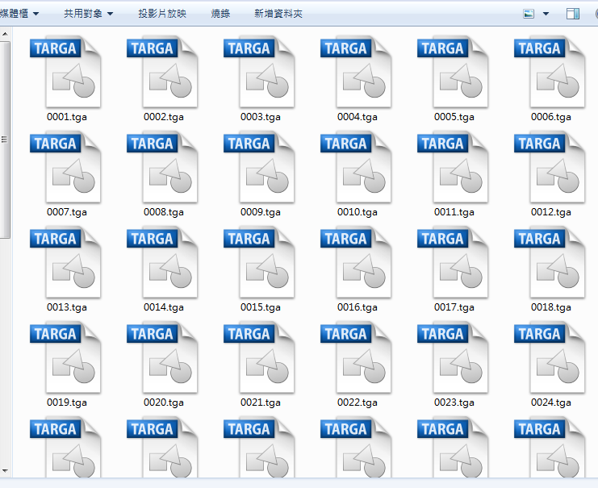
Step by Step: Get Image Sequence
Finish!
You can find the image sequences in output directory
Click Animation
You’ll see playing video and increasing frame number
Back to flowchart
Render image sequence

Slide 13
Recipe: Calibration
Open Voodoo
Open image sequence:
Select File → Open → Sequence
Select the first frame
Set Move Type to “free move”
Track:
Click Track button
Export Python script:
Select File → Save → Blender Python Script
Save .py file (Blender 2.5x and higher)

Slide 14
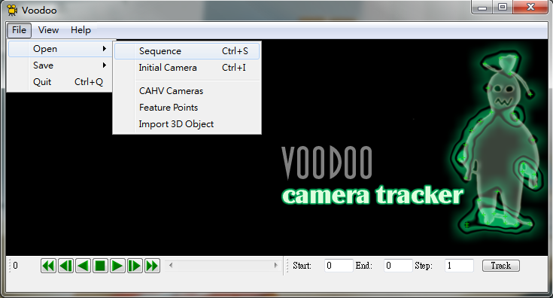
Step by Step: Calibration
Select
File → Open → Sequence
Use Voodoo to load image sequence

Slide 15
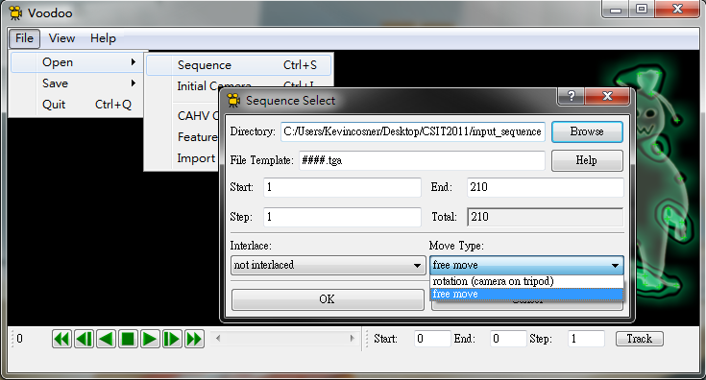
Step by Step: Calibration
Select the first frame
(ex: 0001.tga)
2. Select “free move”
(general moving of camera)
Choose and set sequence

Slide 16
Step by Step: Calibration
Click “Track” button
Tracking features

Slide 17
Step by Step: Calibration
Back to flowchart
Select
File → Save → Blender Python Script
Select
“Blender 2.5x and higher”
Select “Export all”
Save results to “Blender Python Script”

Slide 18
Recipe: Import 3D Motions
Open Blender
Delete default objects
Choose the object and press “Delete”
Load Python Script
Change Window Type to “Text Editor”
Select Text → Open Text Block
Select the .py file (exported from Voodoo)
Click “Run Script”
(cont.)

Slide 19
Recipe: Import 3D Motions
(cont.)
Load Background Images
Change window type to “3D View”
Select View → Cameras → Set Active Object as Active Camera
Load background images
Set the parameters of background images
Change the view
View → View Persp / Ortho
View → Front
Load models and edit their poses/motions in the video

Slide 20
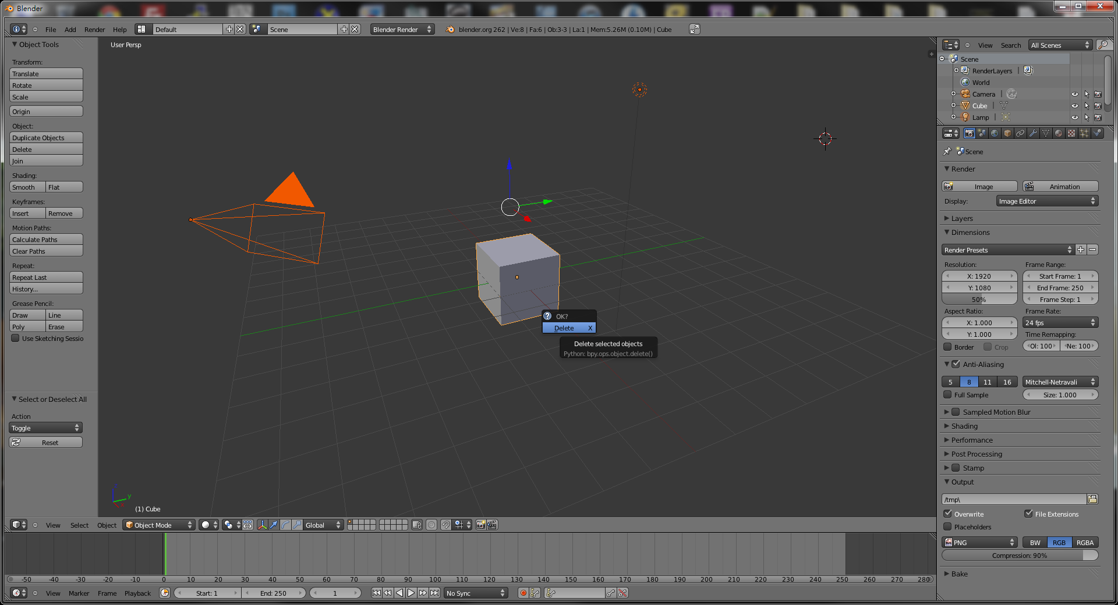
Step by Step: Import 3D Motions
Press “a” twice to select all objects,
then press “Delete” on your keyboard
Delete default objects

Slide 21
Step by Step: Import 3D Motions
Select “Text → Open Text Block”
Change window type to
“Text Editor”
Select the Python script exported by Voodoo
Load python script

Slide 22
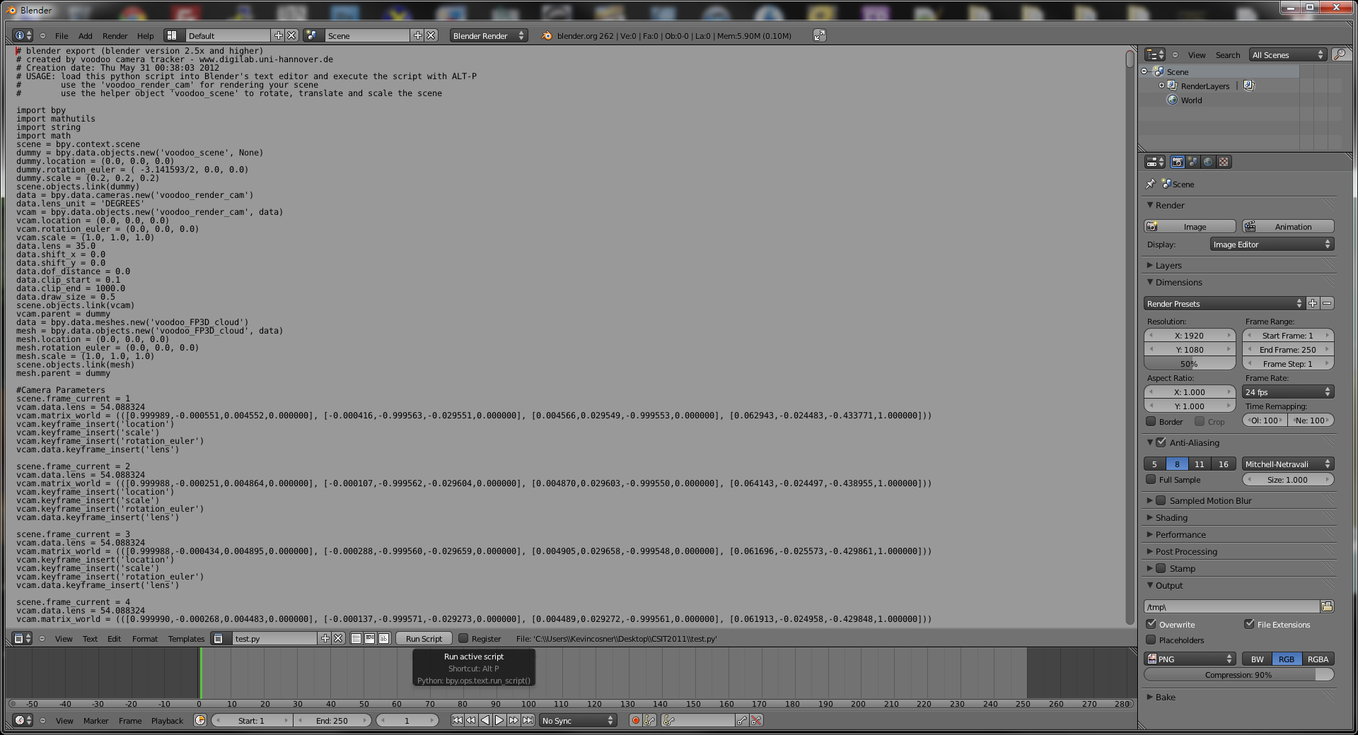
Step by Step: Import 3D Motions
2. Return to “3D View”
1. Press “Run Script”
Run script

Slide 23
Step by Step: Show Background Images
Select
“voodoo_render_cam”
Select Voodoo camera

Slide 24
Step by Step: Show Background Images
Turn on
“Properties” Panel
Show Property Panel

Slide 25
Step by Step: Show Background Images
Press “Open”
Tick-off
“Background Images”
Select
the first frame

Slide 26
Step by Step: Show Background Images
Set
Number of frames
Start frame (1)
Enable “Auto Refresh”
Select
“Image Sequence”
Change
background type

Slide 27
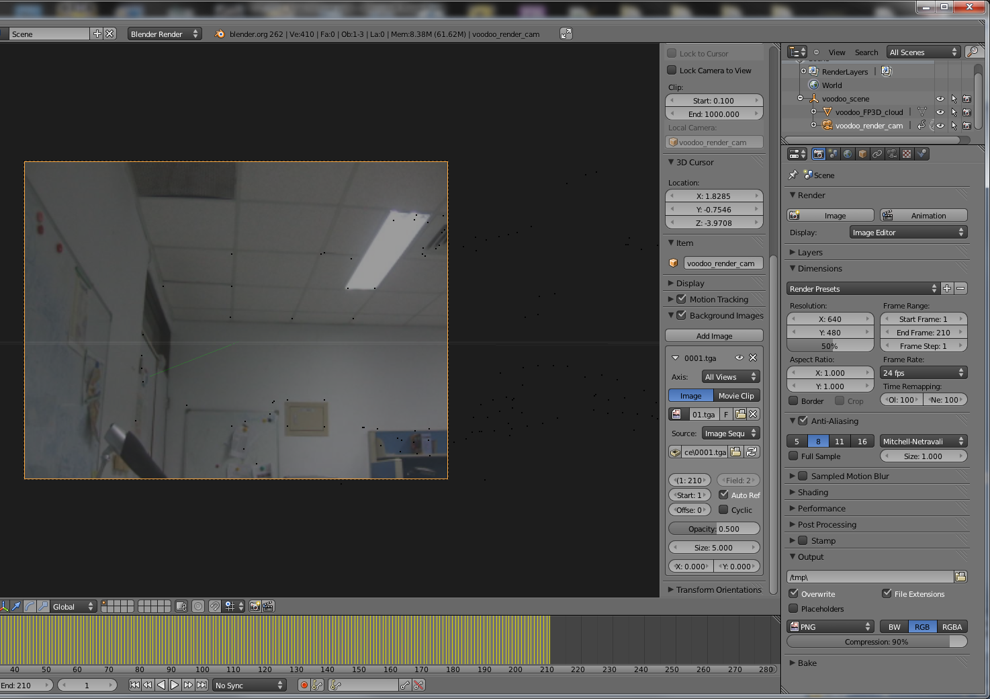
Step by Step: Show Background Images
Set
Number of frames
Resolution
Set resolution

Slide 28
Step by Step: Show Background Images
Switch view to
“Front”
Switch view to
“View Persp/Ortho”
Set view

Slide 29
Step by Step: Show Background Images
Set
Cameras → Set Active Object as Camera
Set active camera

Slide 30
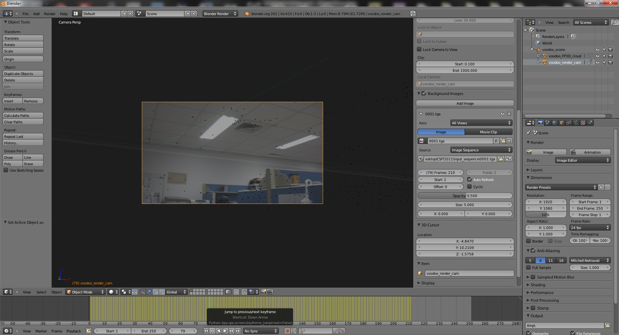
Step by Step: Show Background Images
Make sure “voodoo_render_cam” is selected
You can drag here to see the camera motions
Check background
Back to flowchart

Slide 31
Step by Step: Load Models
Select
File → Import →Wavefront
(you can also use other file format)
Load models

Slide 32
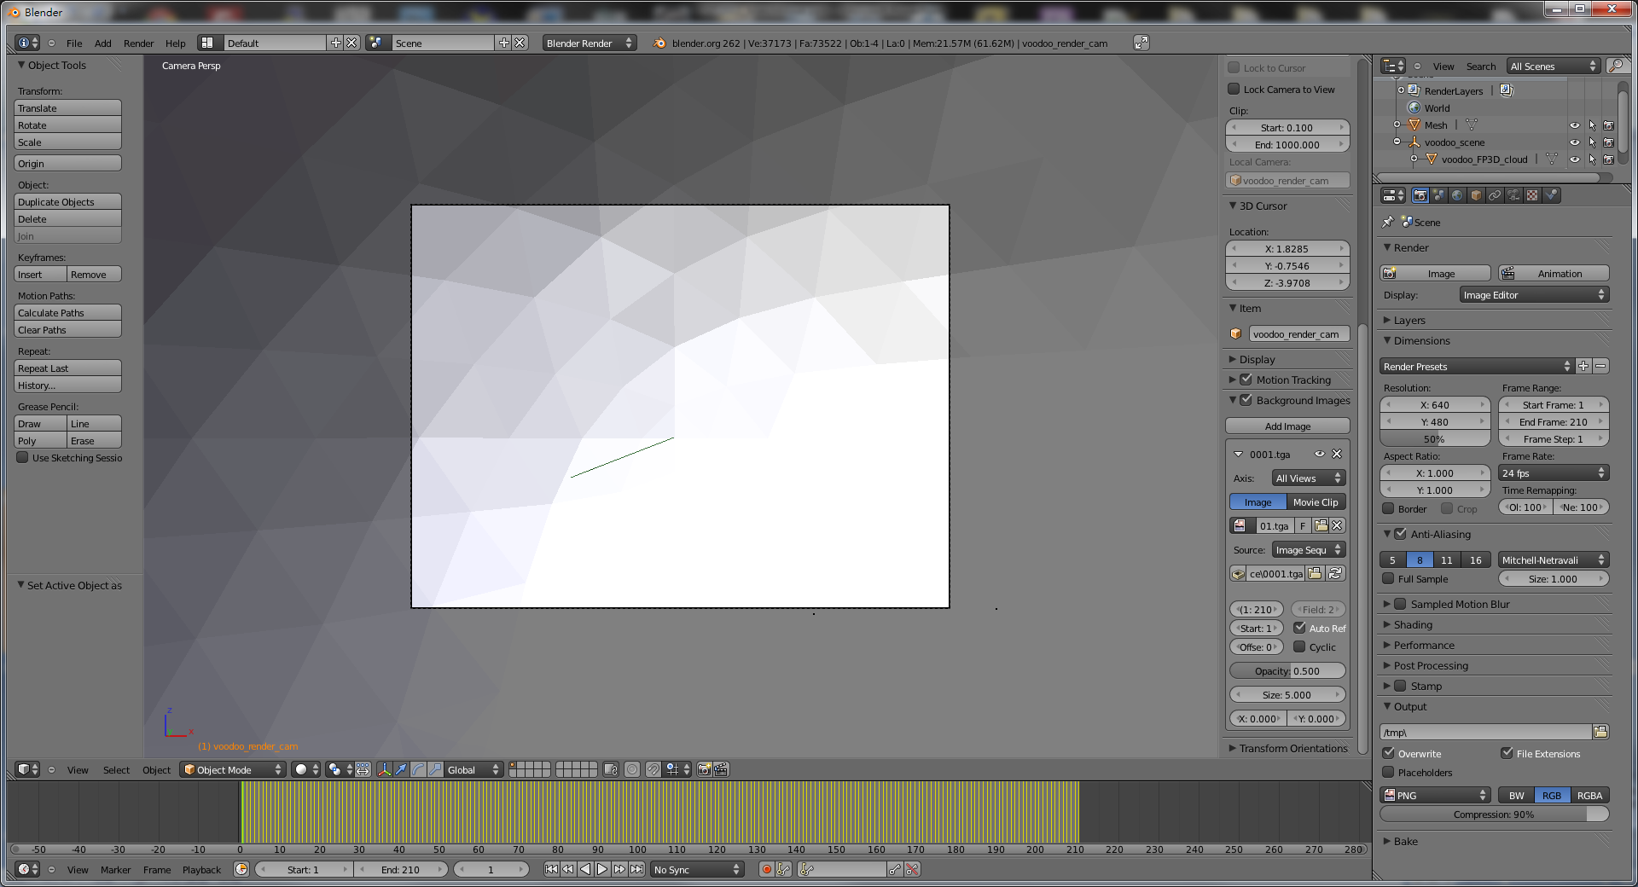
Step by Step: Load Models
You can set the transform of your objects to edit their positions and poses
Set poses / positions for models

Slide 33
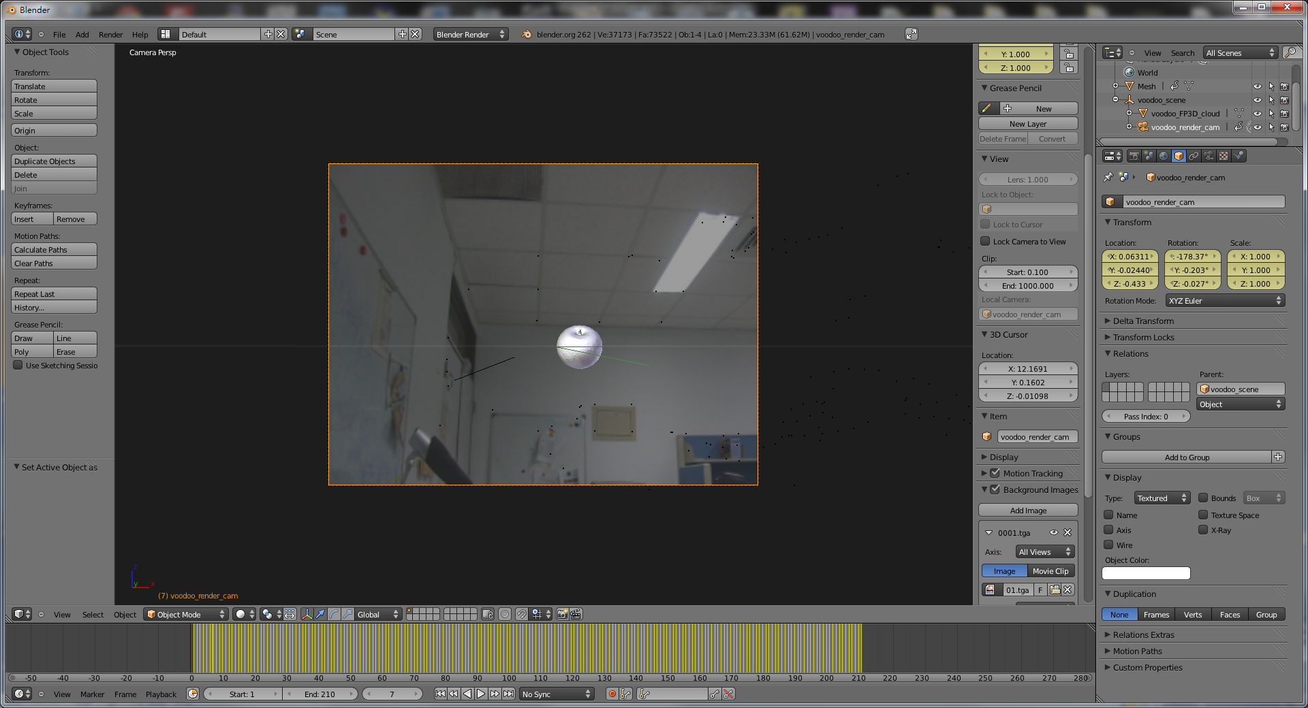
Step by Step: Load Models
This step needs lots of fine tuning
Fine tuning
You can drag here to see whether your tuning is correct or not
(is the object located at the correct position?)

Slide 34
Step by Step: Set Animation
Select the frame that you want to insert a key frame
Select
Object → Animation → Insert Keyframe..
3. Repeat multiple times
Frame 1
Frame 80
Set keyframes
Frame 150

Slide 35
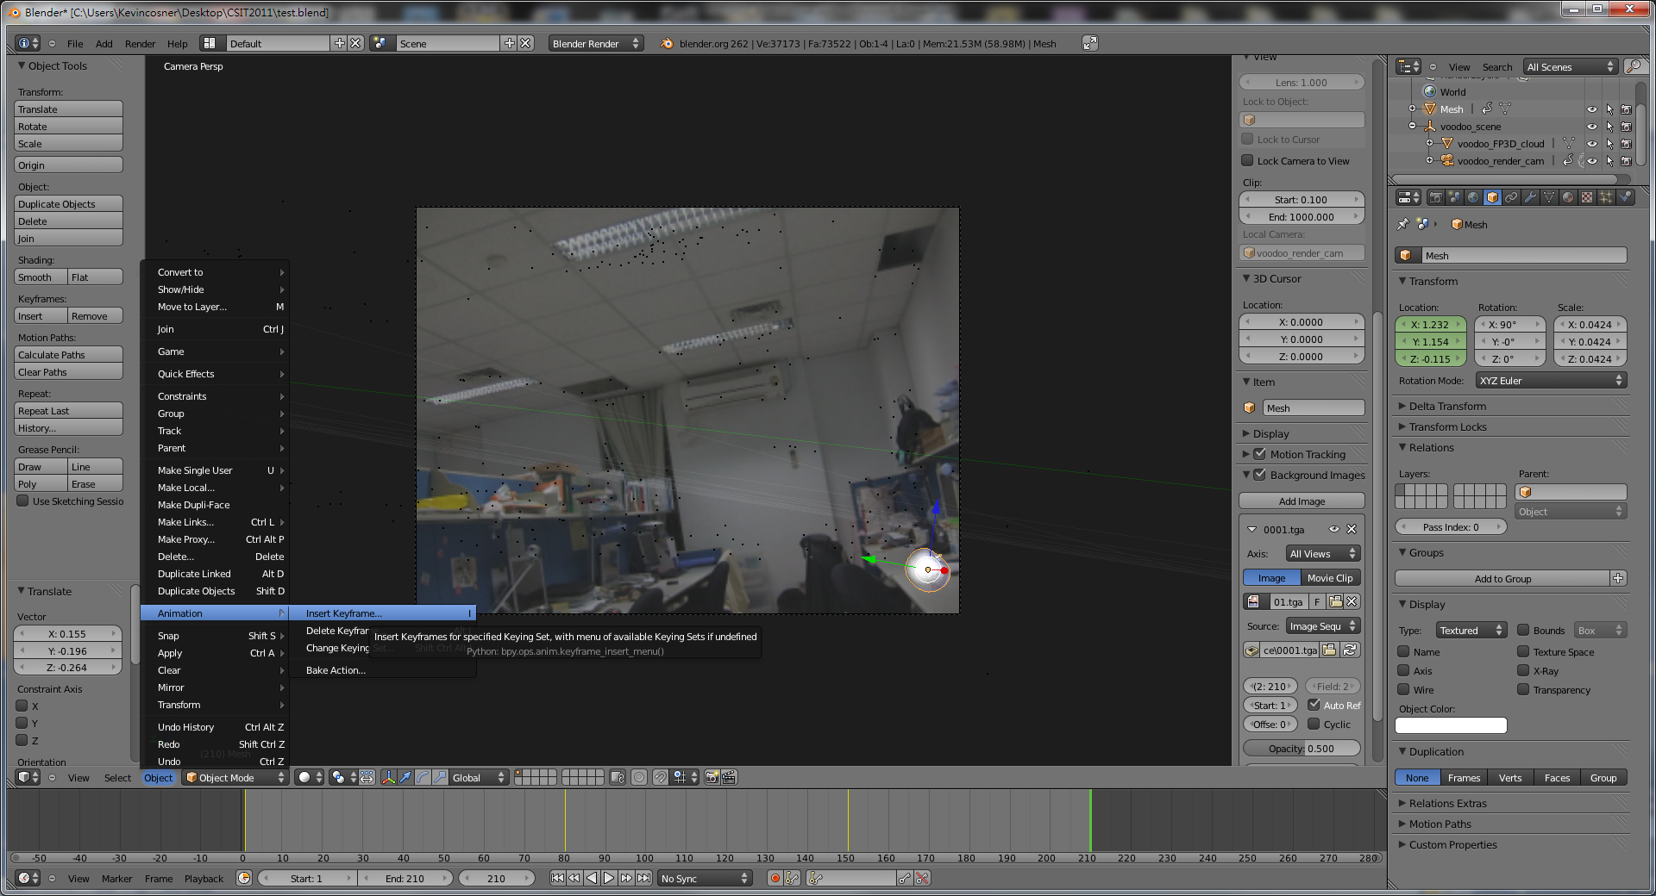
Step by Step: Set Animation
You can fine-tune the transformation of objects in a keyframe here
Fine tuning
Back to flowchart

Slide 36
Recipe: Compositing
Add image sequence
Change window yype to “Video Sequence Editor”
Select Add → Images and select all images
Drag the strip to the “1st Frame” in Layer 1
Add scene
Select Add → Scene
Drag the scene strip to the “1st Frame” in Layer 2
Set Scene
Change scene property to “Alpha Over”
Set parameters of frame and video
Click “Animation”

Slide 37
Step by Step: Compositing
Select
Add → Image
Set to Video Sequence Editor
Add image sequence (Video Channel)

Slide 38
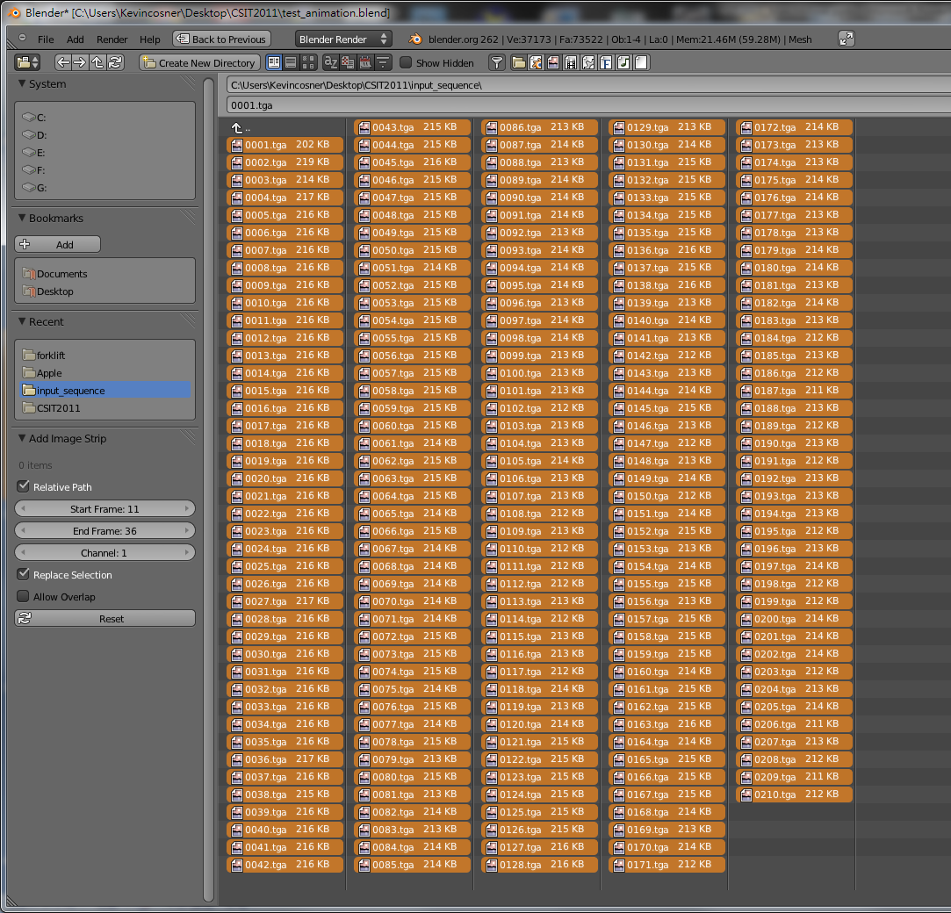
Step by Step: Compositing
This time, select all frames (Press A)

Slide 39
Step by Step: Compositing
Drag the strip to the
“1st Frame” in Layer 1
Edit Video Layer (Right click and drag, left click to set)

Slide 40
Step by Step: Compositing
Select
Add → Scene → Scene
Add scene layer
Drag the strip to the
“1st Frame” in Layer 2
Edit scene layer (Right click and drag, left click to set)

Slide 41
Step by Step: Compositing
You will see the Properties Panel
Select
View → Properties
Show Properties Panel
Select
Blend → Alpha Over
Set Blend Type

Slide 42
Step by Step: Compositing
Set scene camera to
“voodoo_render_cam”
Enable!
Select Premultiply
Set scene camera

Slide 43
Step by Step: Compositing
Check output setting again!

Slide 44
Step by Step: Compositing
Change the viewing type
Preview your video

Slide 45
Step by Step: Compositing
File path
Select output format
Press !
Finish !!
Oh yeah!!
Back to flowchart
Final Output

Slide 46
More Examples
CSIE Robot

Slide 47
More Examples

Slide 48
More Examples

Slide 49
FAQ
Voodoo會當掉！
拍攝的影片內容差異太大
調整tracking的方式
為什麼我在Blender中的Background和Feature沒辦法配合
記得要設定 Cameras → Set Active Object as Camera
3D models的 位置/動作 好難調整…
你是對的!
多利用座標系相對位置以及不同視角會有幫助, 不過還是需要一些時間
設定動作時, 盡量避免大角度或大範圍的 interpolation, 多設一些 key frames
為什麼最後做出來的動畫 Model 是黑的?
記得在場景裡加盞燈
我該去哪裡找3D models
網路上免費資源非常多!
例如: http://www.3dm3.com/modelsbank/
http://www.sharecg.com/

Slide 50
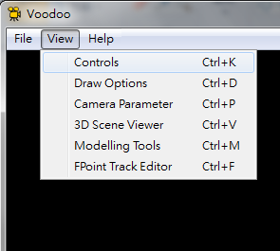
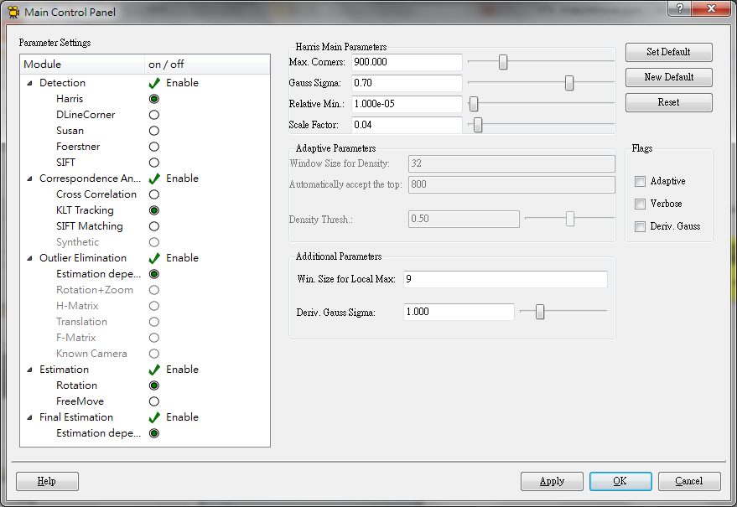
FAQ
調整設定
View → controls

Slide 51
FAQ
Use different views to adjust the positions and poses of objects
Camera
view
Top
view
Set view
Front
view

Slide 52
FAQ
Add lights
記得開燈!
Add → Lamp

Slide 53
Document
Blender official website
http://www.blender.org/education-help/
Voodoo document website
http://www.viscoda.com/index.php/en/voodoo-manual

