Slide 1
3D photography
Digital Visual Effects
Yung-Yu Chuang
with slides by Szymon Rusinkiewicz, Richard Szeliski, Steve Seitz and Brian Curless

Slide 2
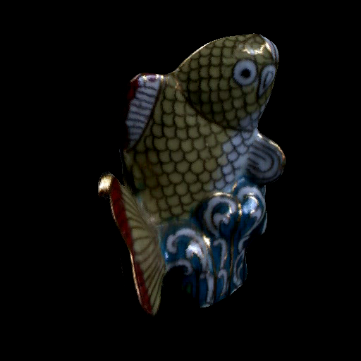
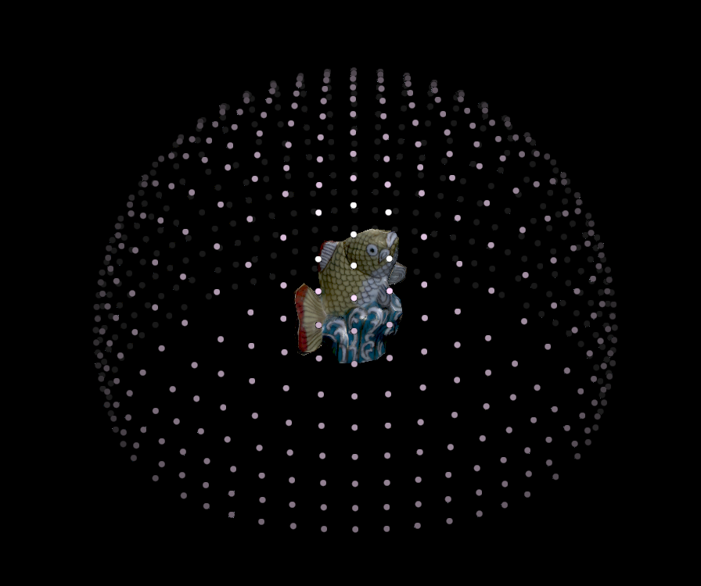
3D photography
Acquisition of geometry and material

Slide 3
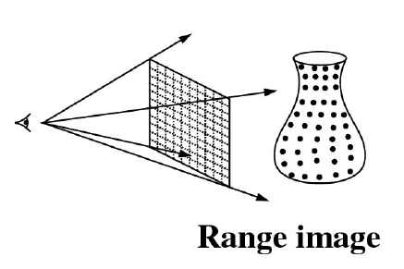
Range acquisition

Slide 4
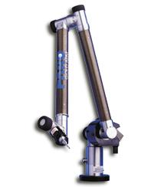
Range acquisition taxonomy
mechanical (CMM, jointed arm)
inertial (gyroscope, accelerometer)
contact
ultrasonic trackers
magnetic trackers
industrial CT
range
acquisition
transmissive
ultrasound
MRI
radar
non-optical
reflective
sonar
optical

Slide 5
Range acquisition taxonomy
shape from X:
stereo
motion
shading
texture
focus
defocus
passive
optical
methods
active variants of passive methods
Stereo w. projected texture
Active depth from defocus
Photometric stereo
active
time of flight
triangulation

Slide 6
Outline
Passive approaches
  Stereo
  Multiview approach
Active approaches
  Triangulation
  Shadow scanning
Active variants of passive approaches
  Photometric stereo
  Example-based photometric stereo

Slide 7
Passive approaches

Slide 8
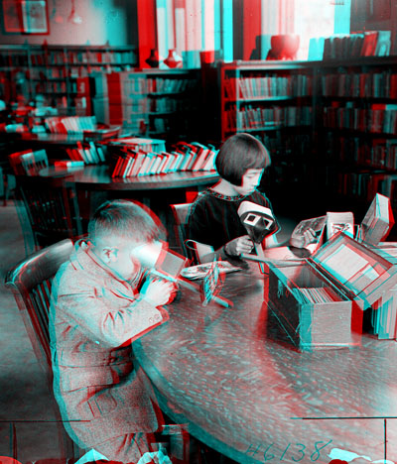

Stereo
Public Library, Stereoscopic Looking Room, Chicago, by Phillips, 1923

Slide 9
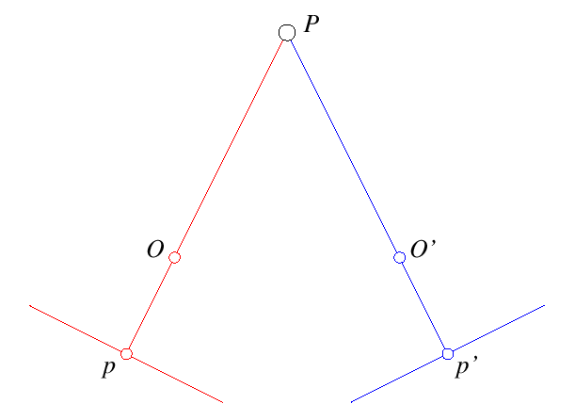
Stereo
One distinguishable point being observed
  The preimage can be found at the intersection of the rays from the focal points to the image points

Slide 10
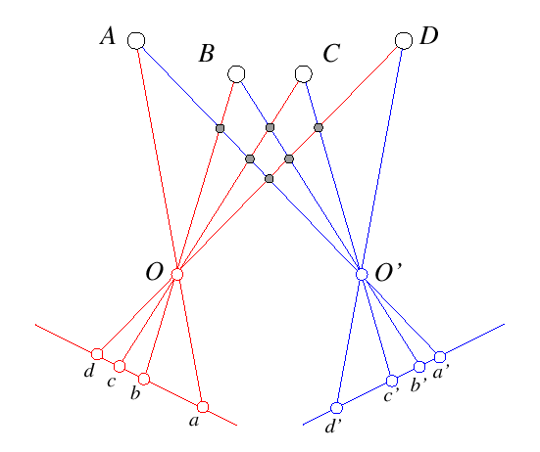
Stereo
Many points being observed
  Need some method to establish correspondences

Slide 11
Components of stereo vision systems
Camera calibration
Image rectification: simplifies the search for correspondences
Correspondence: which item in the left image corresponds to which item in the right image
Reconstruction: recovers 3-D information from the 2-D correspondences

Slide 12
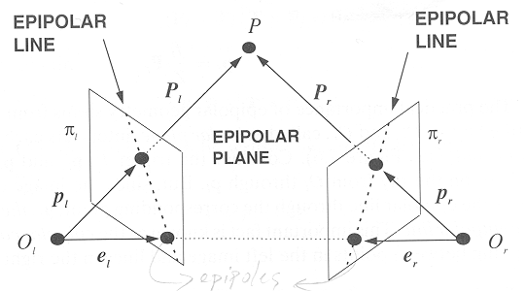
Epipolar geometry
Epipolar constraint: corresponding points must lie on conjugate epipolar lines
  Search for correspondences becomes a 1-D problem

Slide 13
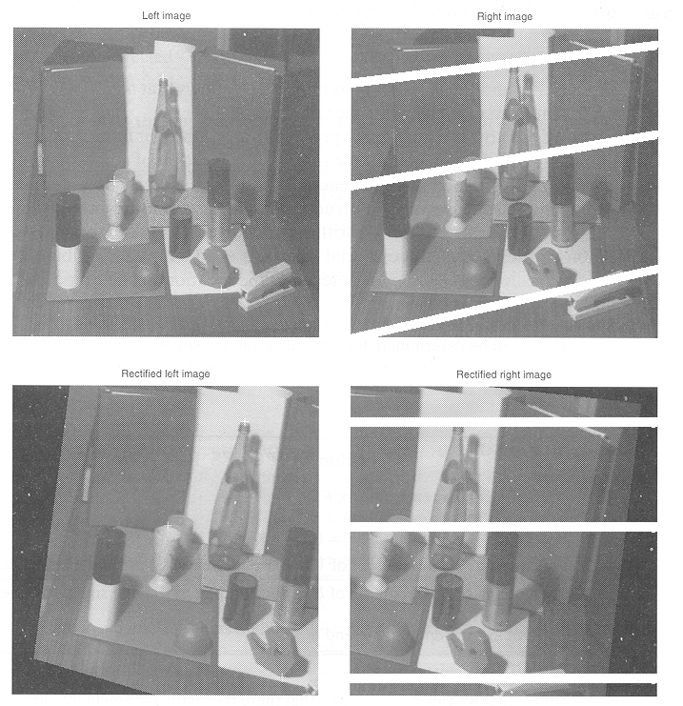
Image rectification
Warp images such that conjugate epipolar lines become collinear and parallel to u axis

Slide 14
Disparity
With rectified images, disparity is just (horizontal) displacement of corresponding features in the two images
  Disparity = 0 for distant points
  Larger disparity for closer points
  Depth of point proportional to 1/disparity

Slide 15
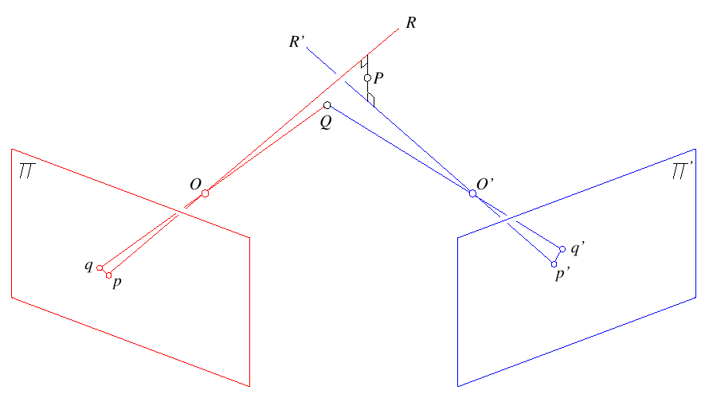
Reconstruction
Geometric
  Construct the line segment perpendicular to R and R' that intersects both rays and take its mid-point

Slide 16
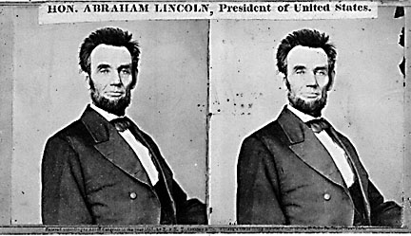
Basic stereo algorithm
For each epipolar line
For each pixel in the left image
    compare with every pixel on same epipolar line in right image
    pick pixel with minimum match cost
Improvement: match windows

Slide 17
Basic stereo algorithm
For each pixel
  For each disparity
    For each pixel in window
      Compute difference
  Find disparity with minimum SSD

Slide 18
Reverse order of loops
For each disparity
  For each pixel
    For each pixel in window
      Compute difference
Find disparity with minimum SSD at each pixel

Slide 19
Incremental computation
Given SSD of a window, at some disparity
Image 1
Image 2

Slide 20
Incremental computation
Want: SSD at next location
Image 1
Image 2

Slide 21
Incremental computation
Subtract contributions from leftmost column, add contributions from rightmost column
-
+
Image 1
-
+
-
+
-
+
-
+
-
+
Image 2
-
+
-
+
-
+
-
+

Slide 22
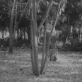
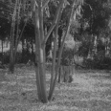
Selecting window size
Small window: more detail, but more noise
Large window: more robustness, less detail
Example:

Slide 23
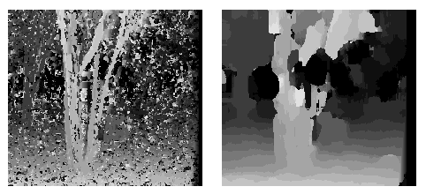
Selecting window size
3 pixel window
20 pixel window

Slide 24
Non-square windows
Compromise: have a large window, but higher weight near the center
Example: Gaussian
Example: Shifted windows

Slide 25
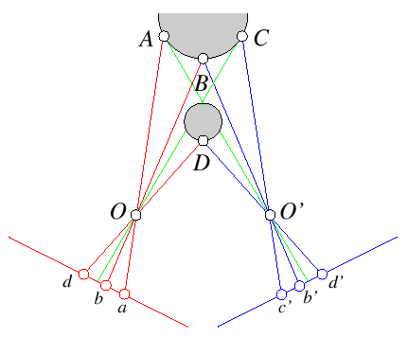
Ordering constraint
Order of matching features usually the same
in both images
But not always: occlusion

Slide 26
Dynamic programming
Treat feature correspondence as graph problem
Right image features
1
2
3
4
1
Cost of edges =
similarity of
regions between
image features
Left image
features
2
3
4

Slide 27
Dynamic programming
Find min-cost path through graph
Right image features
1
2
3
4
1
1
1
Left image
features
2
2
3
2
3
4
3
4
4

Slide 28
Energy minimization
Another approach to improve quality of correspondences
Assumption: disparities vary (mostly) smoothly
Minimize energy function:
E_{data}+λE_{smoothness}
E_{data}: how well does disparity match data
E_{smoothness}: how well does disparity match
that of neighbors – regularization

Slide 29
Energy minimization
If data and energy terms are nice (continuous, smooth, etc.) can try to minimize via gradient descent, etc.
In practice, disparities only piecewise smooth
Design smoothness function that doesn’t penalize large jumps too much
  Example: V(α,β)=min(|α−β|, K)

Slide 30
Stereo as energy minimization
Matching Cost Formulated as Energy
  “data” term penalizing bad matches
  “neighborhood term” encouraging spatial smoothness

Slide 31
Energy minimization
Hard to find global minima of non-smooth functions
  Many local minima
  Provably NP-hard
Practical algorithms look for approximate minima (e.g., simulated annealing)

Slide 32
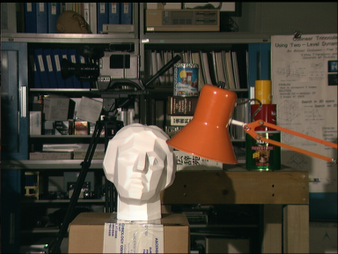
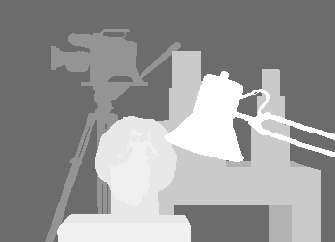
Stereo results
  Data from University of Tsukuba
scene
ground truth
http://cat.middlebury.edu/stereo/

Slide 33
Results with window correlation
normalized correlation
(best window size)
ground truth

Slide 34
Results with graph cuts
graph cuts
(Potts model E,
expansion move algorithm)
ground truth

Slide 35
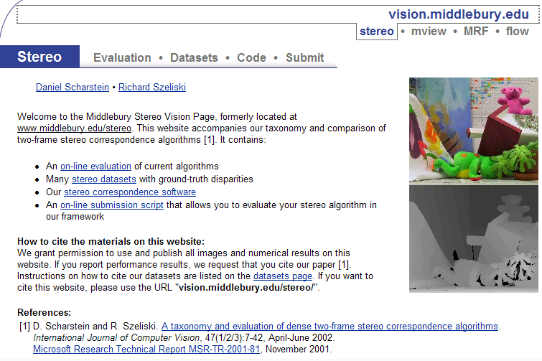
Stereo evaluation

Slide 36
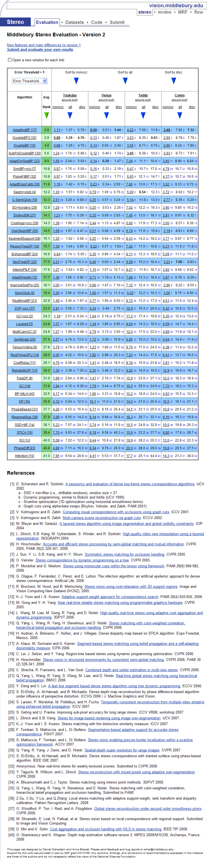
Stereo—best algorithms

Slide 37
Volumetric multiview approaches
Goal: find a model consistent with images
“Model-centric” (vs. image-centric)
Typically use discretized volume (voxel grid)
For each voxel, compute occupied / free
(for some algorithms, also color, etc.)

Slide 38
Photo consistency
Result: not necessarily the correct scene
Many scenes produce the same images
True scene
Reconstructed
scene
All scenes
Photo-consistent scenes

Slide 39
Silhouette carving
Find silhouettes in all images
Exact version:
  Back-project all silhouettes, find intersection
Binary Images

Slide 40
Silhouette carving
Find silhouettes in all images
Exact version:
  Back-project all silhouettes, find intersection

Slide 41
Silhouette carving
Limit of silhouette carving is visual hull or
line hull
Complement of lines that don’t intersect object
In general not the same as object
  Can’t recover “pits” in object
Not the same as convex hull

Slide 42
Silhouette carving
Discrete version:
  Loop over all voxels in some volume
  If projection into images lies inside all silhouettes, mark as occupied
  Else mark as free

Slide 43
Silhouette carving

Slide 44
Voxel coloring
Seitz and Dyer, 1997
In addition to free / occupied, store color
at each voxel
Explicitly accounts for occlusion

Slide 45
Voxel coloring
Basic idea: sweep through a voxel grid
  Project each voxel into each image in which
  it is visible
  If colors in images agree, mark voxel with color
  Else, mark voxel as empty
Agreement of colors based on comparing standard deviation of colors to threshold

Slide 46
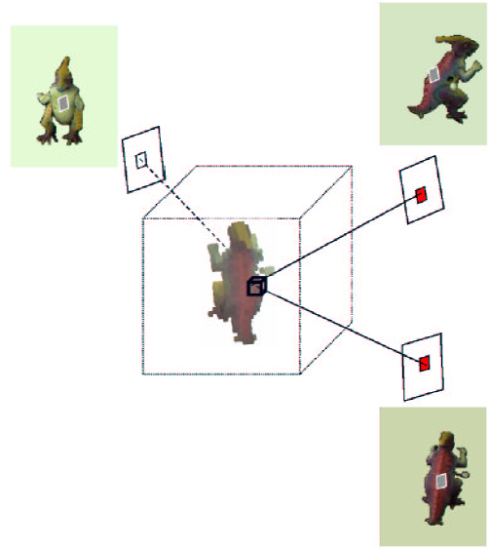
Voxel coloring and occlusion

Slide 47
Voxel coloring and occlusion
Problem: which voxels are visible?
Solution: constrain camera views
  When a voxel is considered, necessary occlusion information must be available
  Sweep occluders before occludees
  Constrain camera positions to allow this sweep

Slide 48
Voxel coloring sweep order
Scene
Traversal

Slide 49
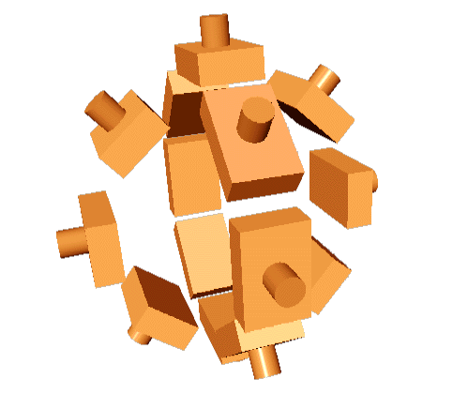
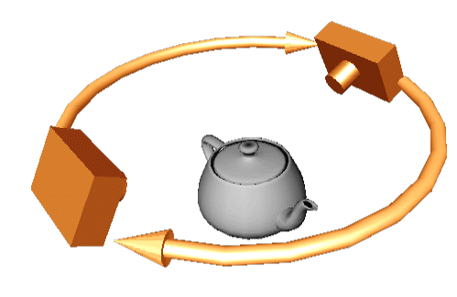
Voxel coloring camera positions
Inward-looking
  Cameras above scene
Outward-looking
  Cameras inside scene
Seitz

Slide 50
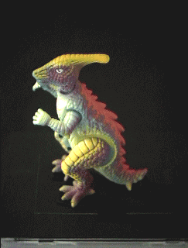
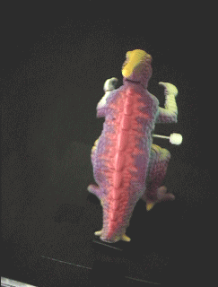
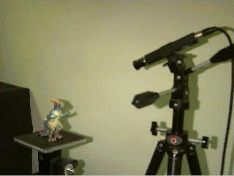
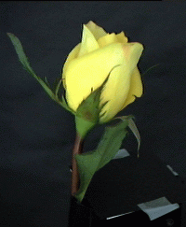
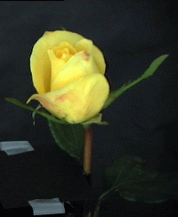
Image acquisition
Selected Dinosaur Images
Calibrated Turntable
360° rotation (21 images)
Selected Flower Images

Slide 51
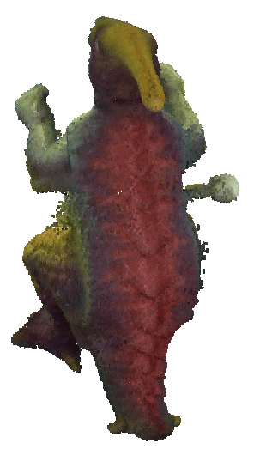

Voxel coloring results
Dinosaur Reconstruction
72 K voxels colored
7.6 M voxels tested
7 min. to compute
on a 250MHz SGI
Flower Reconstruction
70 K voxels colored
7.6 M voxels tested
7 min. to compute
on a 250MHz SGI

Slide 52
Space carving
Image 1
Image N
…...
  Initialize to a volume V containing the true scene
  Choose a voxel on the current surface
  Project to visible input images
  Carve if not photo-consistent
  Repeat until convergence

Slide 53
Multi-pass plane sweep
Faster alternative:
  Sweep plane in each of 6 principal directions
  Consider cameras on only one side of plane
  Repeat until convergence

Slide 54

Multi-pass plane sweep
True Scene
Reconstruction

Slide 55
Multi-pass plane sweep

Slide 56
Multi-pass plane sweep

Slide 57
Multi-pass plane sweep

Slide 58
Multi-pass plane sweep

Slide 59
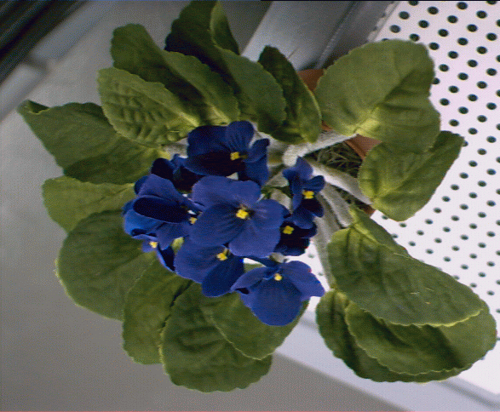
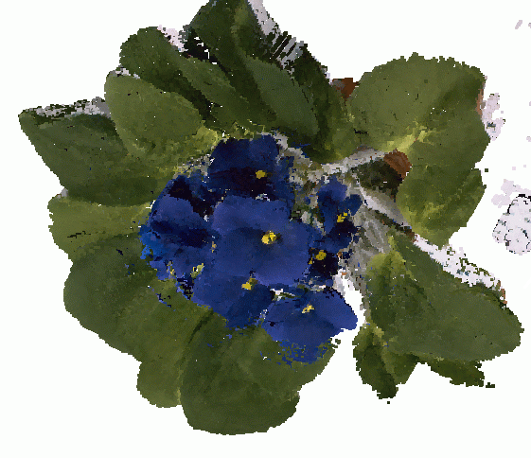
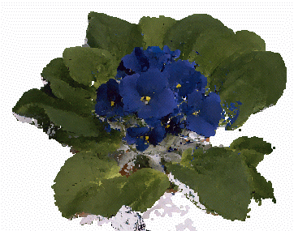
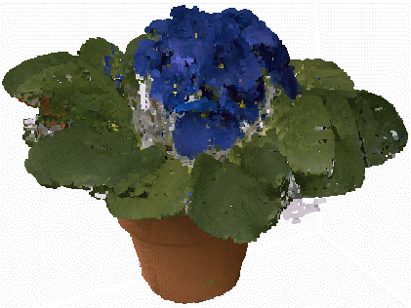
Space carving results: African violet
Input image (1 of 45)
Reconstruction
Reconstruction
Reconstruction

Slide 60
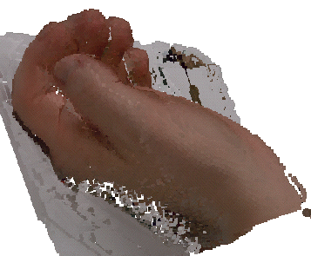
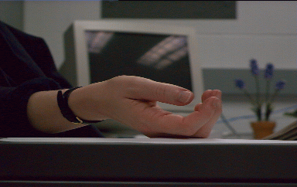
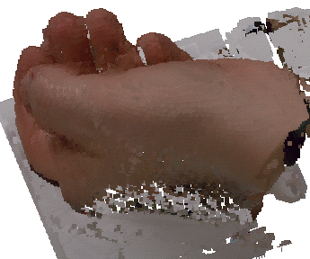
Space carving results: hand
Input image
(1 of 100)
Reconstruction

Slide 61
Active approaches

Slide 62
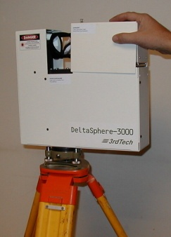
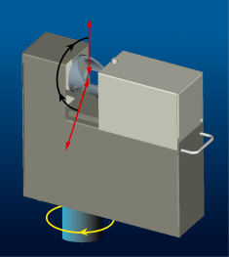
Time of flight
Basic idea: send out pulse of light (usually laser), time how long it takes to return

Slide 63
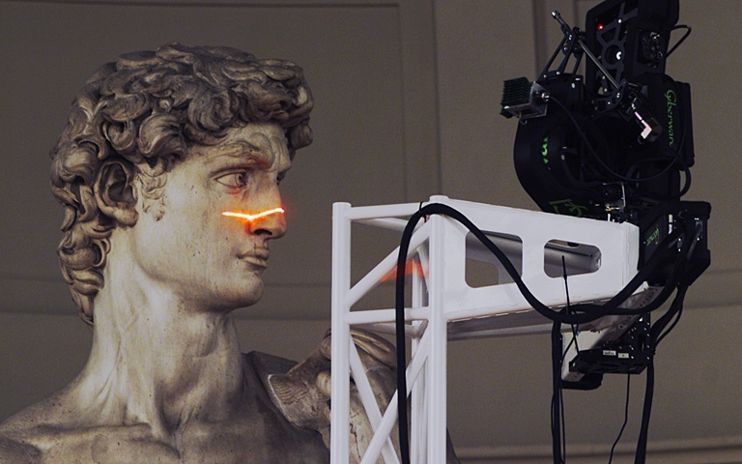
Laser scanning (triangulation)
Digital Michelangelo Project
http://graphics.stanford.edu/projects/mich/
Optical triangulation
  Project a single stripe of laser light
  Scan it across the surface of the object
  This is a very precise version of structured light scanning
Other patterns are possible

Slide 64
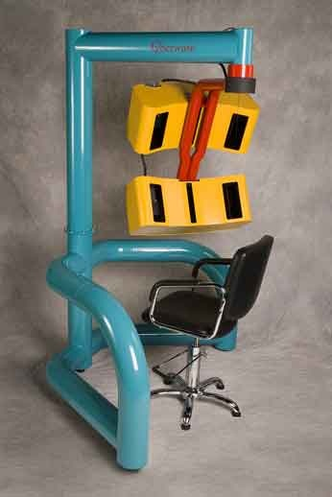
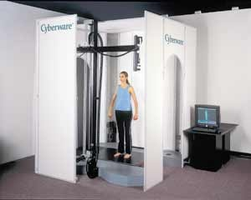
Cyberware
face and hand
full body

Slide 65
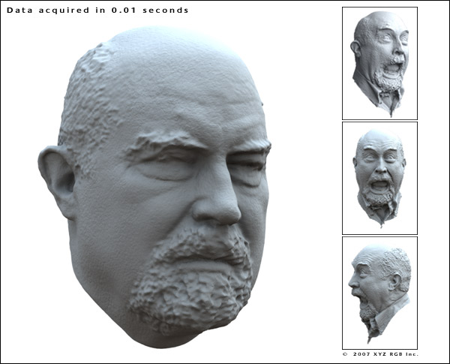
XYZRGB

Slide 66
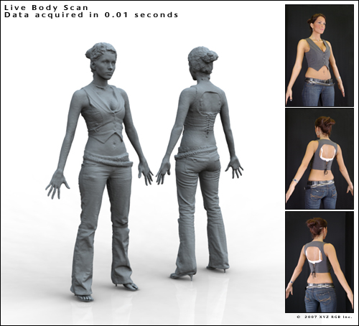
XYZRGB

Slide 67
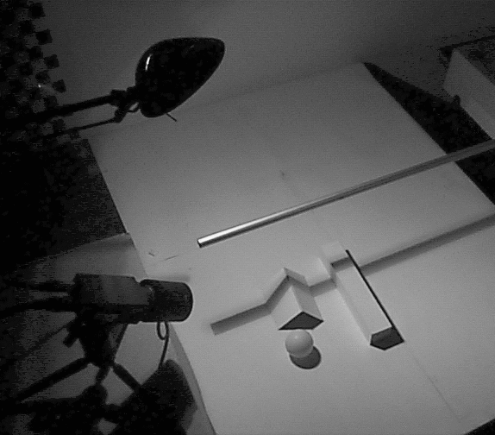
Shadow scanning
Desk
Lamp
Stick or
pencil
Camera
Desk
http://www.vision.caltech.edu/bouguetj/ICCV98/

Slide 68
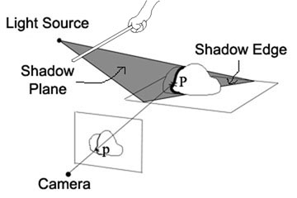
Basic idea
Calibration issues:
  where’s the camera wrt. ground plane?
  where’s the shadow plane?
    depends on light source position, shadow edge

Slide 69
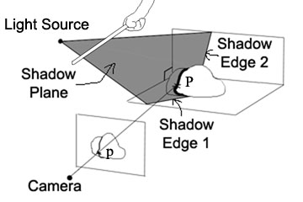
Two Plane Version
Advantages
  don’t need to pre-calibrate the light source
  shadow plane determined from two shadow edges

Slide 70
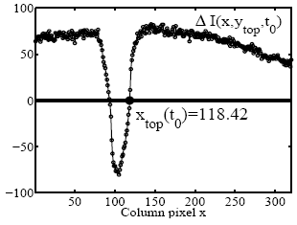
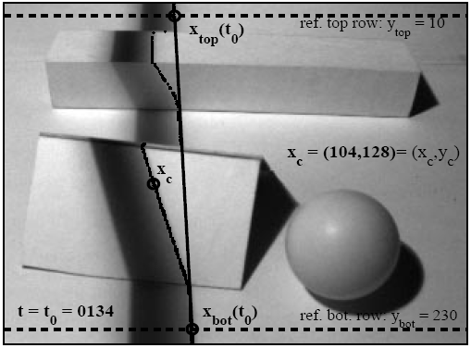
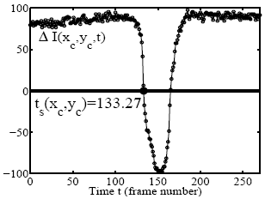
Estimating shadow lines

Slide 71
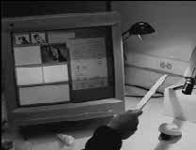
Shadow scanning in action

Slide 72
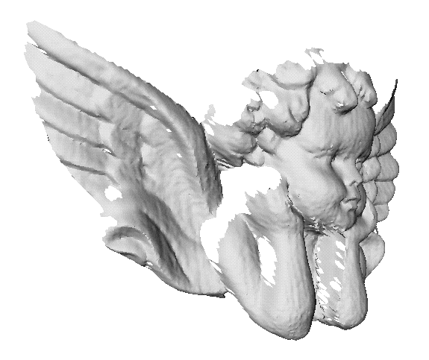




Results
accuracy: 0.1mm over 10cm
~ 0.1% error

Slide 73









Textured objects

Slide 74



Scanning with the sun
accuracy: 1mm over 50cm
~ 0.5% error

Slide 75




Scanning with the sun
accuracy: 1cm over 2m
~ 0.5% error

Slide 76
Active variants of passive approaches

Slide 77



The BRDF
The Bidirectional Reflection Distribution Function
  Given an incoming ray and outgoing ray
  what proportion of the incoming light is reflected along outgoing ray?
surface normal

Slide 78


Diffuse reflection (Lambertian)
albedo
Assuming that light strength is 1.

Slide 79




Photometric stereo
N
L₃
L₂
L₁
V
Can write this as a matrix equation:

Slide 80









Solving the equations

Slide 81


More than three lights
Get better results by using more lights
Least squares solution:
Solve for N, k_{d} as before

Slide 82


Trick for handling shadows
Weight each equation by the pixel brightness:
Gives weighted least-squares matrix equation:
Solve for N, k_{d} as before

Slide 83

Photometric Stereo Setup

Slide 84
Procedure
Calibrate camera
Calibrate light directions/intensities
Photographing objects (HDR recommended)
Estimate normals
Estimate depth

Slide 85



Estimating light directions
Trick: place a chrome sphere in the scene
  the location of the highlight tells you where the light source is
Use a ruler

Slide 86






Photographing objects

Slide 87


Normalize light intensities

Slide 88


Estimate normals

Slide 89

Depth from normals

Slide 90




Results

Slide 91
Limitations
Big problems
  doesn’t work for shiny things, semi-translucent things
  shadows, inter-reflections
Smaller problems
  calibration requirements
    measure light source directions, intensities
    camera response function

Slide 92
Example-based photometric stereo
Estimate 3D shape by varying illumination, fixed camera
Operating conditions
  any opaque material
  distant camera, lighting
  reference object available
  no shadows, interreflections, transparency

Slide 93
same surface normal
“Orientation consistency”

Slide 99


Slide 100




Virtual views

Slide 101

Velvet

Slide 102


Virtual Views

Slide 103

Brushed Fur

Slide 104


Virtual Views

Slide 105


Slide 106

Active stereo with structured light
Li Zhang’s one-shot stereo
camera 1
camera 1
projector
projector
camera 2
Project “structured” light patterns onto the object
  simplifies the correspondence problem

Slide 107


Spacetime Stereo
http://grail.cs.washington.edu/projects/stfaces/

Slide 108

3D Model Acquisition Pipeline
3D Scanner
Notes:
To understand the problem, let’s look at the entire 3D model acquisition pipeline. We start with the 3D scanner, which typically returns a range image: 3D shape as seen from a single point of view.

Slide 109


3D Model Acquisition Pipeline
3D Scanner
View Planning
Notes:
In order to get the entire object, need to move scanner around object (or move object w.r.t. scanner). This requires figuring out where to put the scanner.

Slide 110

3D Model Acquisition Pipeline
3D Scanner
View Planning
Alignment
Notes:
Multiple scans need to be aligned.

Slide 111

3D Model Acquisition Pipeline
3D Scanner
View Planning
Alignment
Merging
Notes:
The scans are then merged into a single model.

Slide 112

Volumetric reconstruction

Slide 113


Signed distance function

Slide 114

Results

Slide 115
The Digital Michelangelo Project
Goal: scan 10 sculptures by Michelangelo
High-resolution (“quarter-millimeter”) geometry
Stanford University, led by Marc Levoy

Slide 116
Systems, projects and applications

Slide 117

Scanning the David
height of gantry: 7.5 meters
weight of gantry: 800 kilograms
Notes:
2:30 through closeup of eye
0:40
So here we are scanning our “piece de resistance”
the gantry is extended to nearly its full height
If you’ve looked at our web site
you know the little story about the gantry being too short initially
because we relied on art history books for the height of the David
and they're all wrong – by 3 feet !!
so at the last minute we had to add a piece to the gantry…here
and load another few hundred pounds of ballast to the base…here – to keep the gantry from tipping over on the statue
But as you can see from the photo on the right,
we did finally reach the top of the statue
0:45
4:00 through architectural reps

Slide 118




Range processing pipeline
steps
  1. manual initial alignment
  2. ICP to one existing scan
  3. automatic ICP of all overlapping pairs
  4. global relaxation to spread out error
  5. merging using volumetric method

Slide 119

Statistics about the scan
480 individually aimed scans
2 billion polygons
7,000 color images
32 gigabytes
30 nights of scanning
22 people
Notes:
0:20
So here’s a rendering of our computer model of the David
we rolled the gantry, which now weighed about a ton, 480 times
2 billion polygons
you can read the rest
It took 30 days to scan the statue
but we were only allowed to scan at night, when the museum was closed
so it was basically 30 all-nighters in a row
0:30

Slide 120


Comparison
photograph
1.0 mm computer model
Notes:
0:20
We haven’t assembled the David at full-resolution yet
Here’s a 1 mm model of the head
watertight
with color
The photograph at the left was taken with uncalibrated lighting
so the two images don’t match exactly
but hopefully you agree that we’ve basically captured the statue’s appearance

Slide 121










Results

Slide 122

The Great Buddha Project
Great Buddha of Kamakura
Original made of wood, completed 1243
Covered in bronze and gold leaf, 1267
Approx. 15 m tall
Goal: preservation of
cultural heritage
Institute of Industrial Science,
University of Tokyo, led by
Katsushi Ikeuchi

Slide 123


Scanner
Cyrax range scanner
by Cyra Technologies
Laser pulse time-of-flight
Accuracy: 4 mm
Range: 100 m

Slide 124



Processing
20 range images (a few million points)
Simultaneous all-to-all ICP
Variant of volumetric merging (parallelized)

Slide 125

Results

Slide 126
Applications in VFX
3D scanning
Hybrid camera for IMAX
View interpolation

Slide 127

3D scanning
XYZRGB Inc.

Slide 128

IMAX 3D
6K resolution, 42 linear bits per pixel
For CG, it typically takes 6 hours for a frame
45-minute IMAX 3D CG film requires a 100-CPU rendering farm full-time for about a year just for rendering
For live-action, camera is bulky (like a refrigerator)

Slide 129

Hybrid stereo camera

Slide 130

Live-action sequence

Slide 131


Hybrid input
left
right

Slide 132

Hybrid input
left
left
right

Slide 133

Combine multiple hires to lores

Slide 134
Results

Slide 135

View interpolation
Bullet time video

Slide 136

View interpolation
High-quality video view interpolation

