Slide 1
MatchMove
Digital Visual Effects, Spring 2012
Winble 2012/04/26

Slide 2
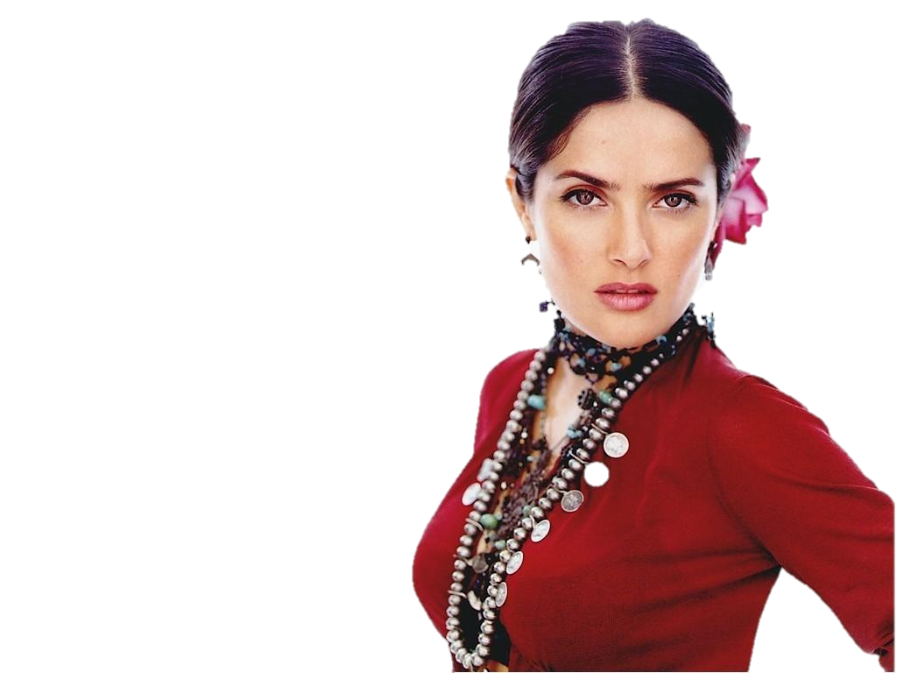
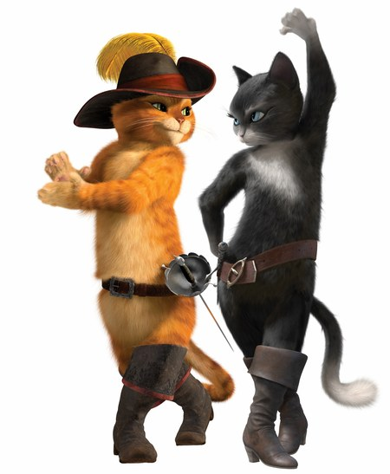
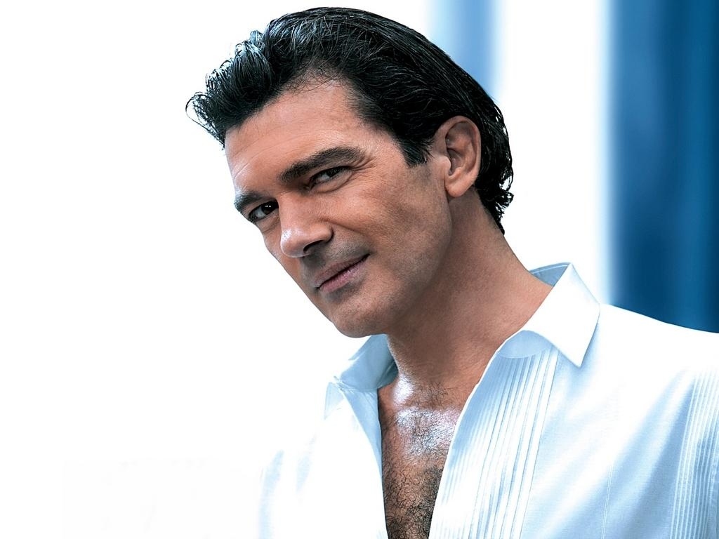
WorkFlow
Input
Video
CGI Animation

Slide 3
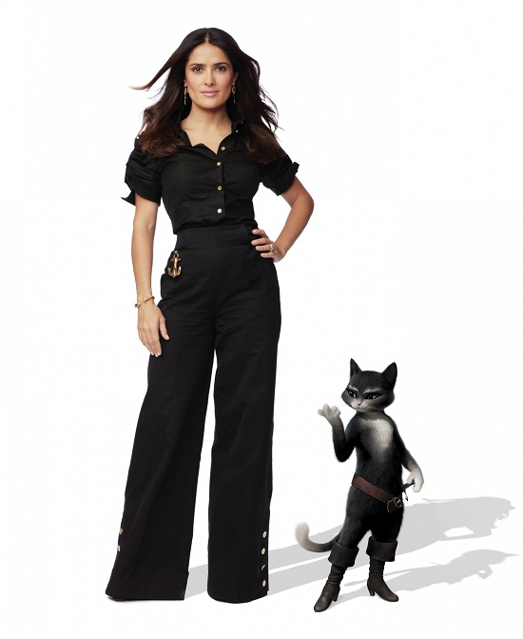
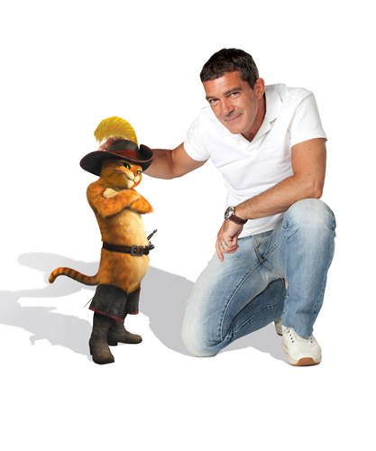
WorkFlow
Output
Composite Video

Slide 4
Setting
Blender
Version: 2.62
Operating System
Windows XP/Vista/7 32/64 bits, Linux, Mac OS X
Web Site: http://www.blender.org/
Voodoo
Version: 1.2.0 beta
Operating System
Windows 95/98/NT/2000/Me/XP/Vista/7, Linux
Web Site: http://www.digilab.uni-hannover.de/
Other Options
Free: Blender + ICARUS
Pay: boujou + 3D Max, boujou + Maya, ...

Slide 5
Recipe: Get Image Sequence
Open Blender
Add Video File
Change Window Type to Video Sequence Editor
Select Add → Movie
Drag the strip to Layer 1
Render Images
Choose Render
Frame
Set frame size and resolution
Choose output file type (Targa)
Time interval → Select start and end of the sequence
Choose output directory
Click Animation button

Slide 6
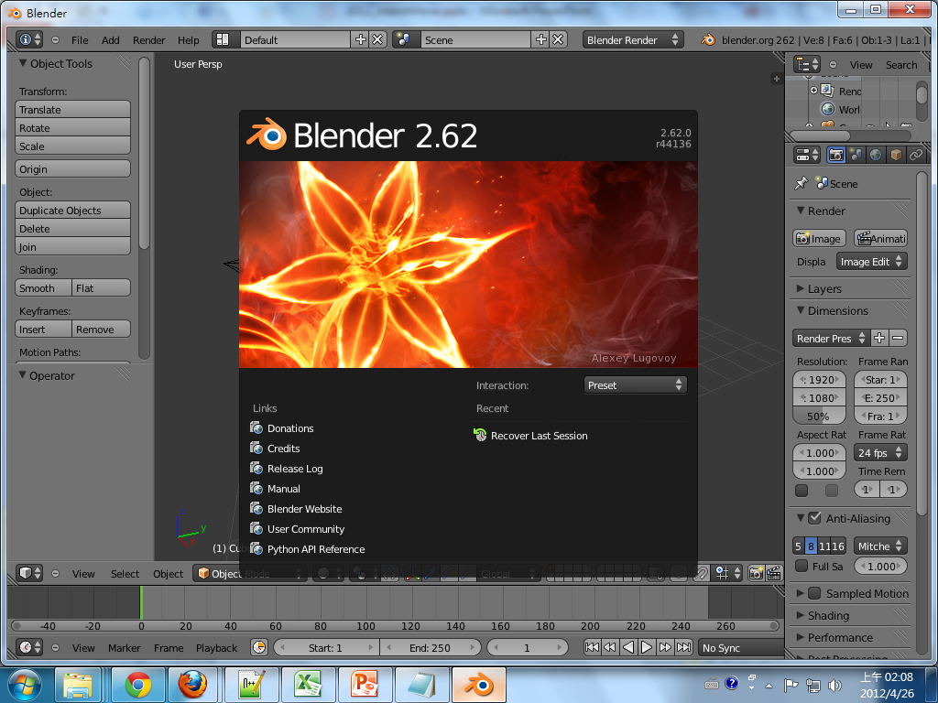
Get Image Sequence : Blender Interface

Slide 7
Get Image Sequence : Add Video File
Change to Video Sequence Editor
Click here to change window type

Slide 8
Get Image Sequence : Add Video File
Add → Movie

Slide 9
Get Image Sequence : Add Video File
Add video file
Select video file
Select file directory

Slide 10
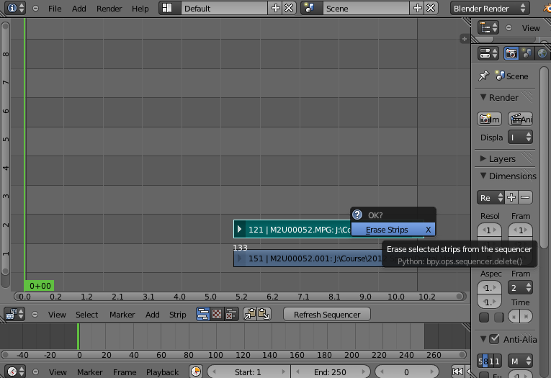
Get Image Sequence : Add Video File
This is the sound track. Since we only need images for feature tracking, you can choose to remove it here, and add it back at the video editing stage!
Click “Delete” button

Slide 11
Get Image Sequence : Add video file
Right-click to Drag the strip to the “1st Frame” in Layer 1

Slide 12
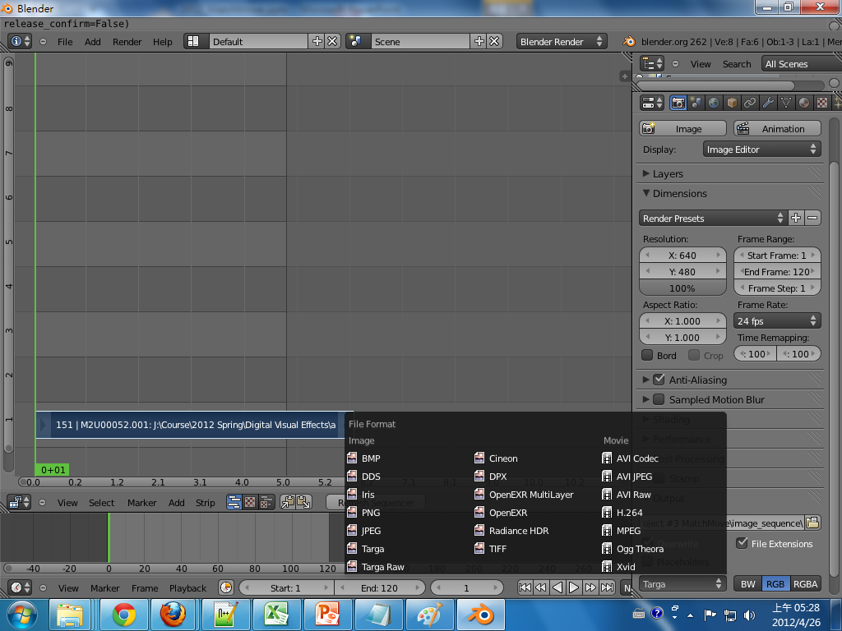
Get Image Sequence : Render Images
Choose Render
Set Frame size
& Resolution
Click Here!
Select Start & End frame
Choose output file type “Targa”
Set output directory

Slide 13
Recipe: Calibration
Open Voodoo
Open Image Sequence
Select File → Open → Sequence
Select the first frame
Select Move Type “Free Move”
Track → Click Track button
Export Python Script
Select File → Save → Blender Python Script
Save .py file
Choose File type “Blender 2.5x and higher (*.py)”

Slide 14
Calibration : Choose Sequence
File → Open → Sequence

Slide 15
Calibration : Choose Sequence
Choose “free move”
Note!!!
1. “free move” is for general moving conditions
2. “rotation (camera on tripod)” is for the special case with only the rotation
Only select 1st frame

Slide 16
Calibration : Choose Sequence
Unrecognized path

Slide 17
Calibration : Track
Track

Slide 18
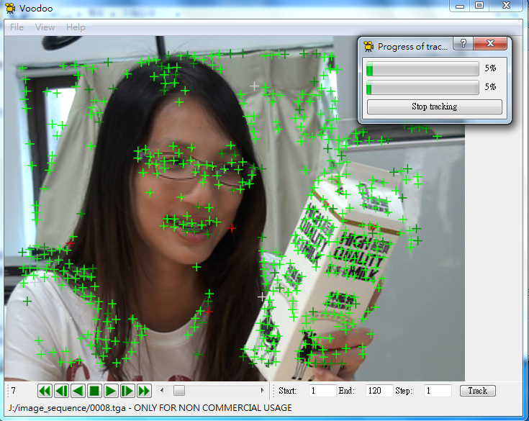
Calibration : Track
Process Progress

Slide 19
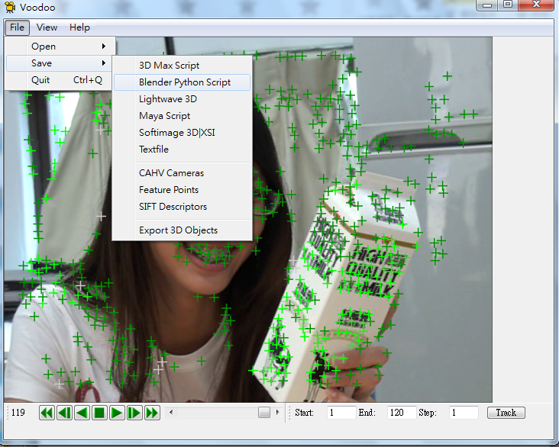
Calibration : Export Python Script
File → Save → Blender Python script

Slide 20
Calibration : Export Python Script
Choose File type “Blender 2.5x and higher (*.py)”

Slide 21
Recipe: Import 3D Motions
Open Blender
Delete Default Objects
Choose the object and click “Delete”
Open Python Script
Change Window Type to Text Editor
Select Text → Open Text Block
Select the .py file exported from Voodoo
Click Run Script

Slide 22
Recipe: Import 3D Motions
Load Background Images:
Change Window Type to 3D View
Select View → Cameras → Set Active Object as Active Camera
Load background images
Set the video parameters of background images
Change the view
View → View Persp/Ortho
View → Front
Check any frame and adjust the opacity of background images
Load models & editing their motions in the video!

Slide 23
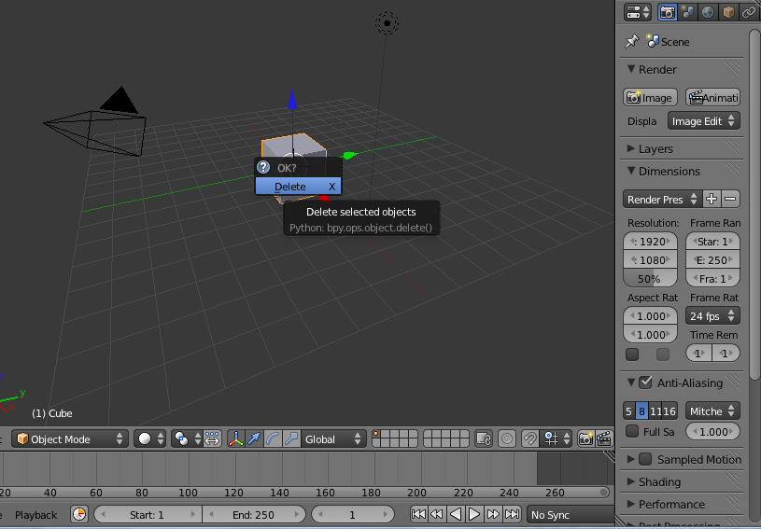
Import 3D Motions : Delete Default Objects
Click “Delete” to erase

Slide 24
Import 3D Motions : Open Python Script
Text → Open Text Block
Choose “Text Editor”

Slide 25
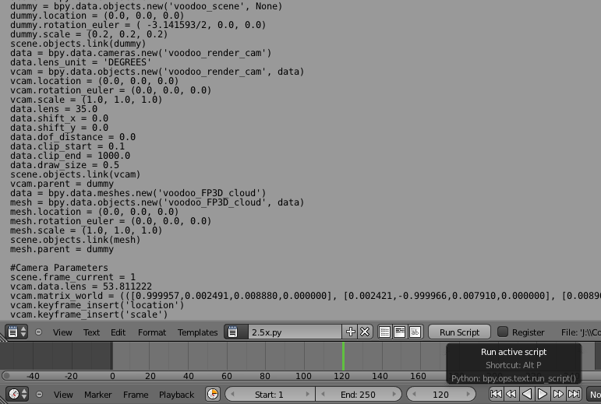
Import 3D Motions : Open Python Script
Run Script
Back to “3D view”

Slide 26
Import 3D Motions : Adjust Rendering
To avoid rendering the feature point cloud in your result

Slide 27
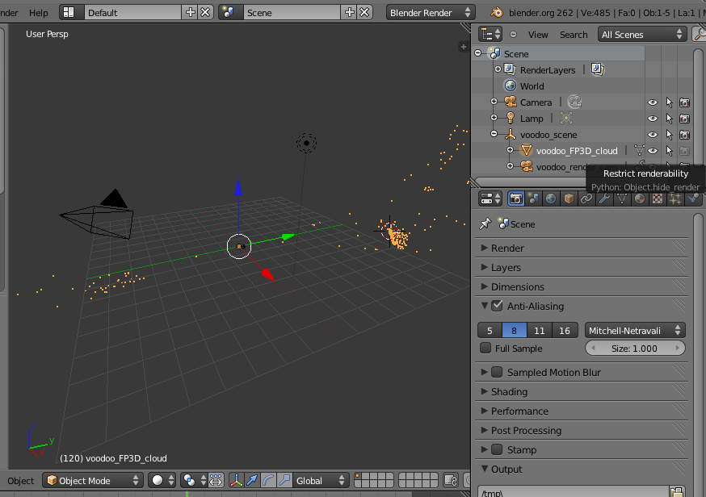
Import 3D Motions : Adjust Rendering
Cancel the Renderability of the feature point cloud

Slide 28
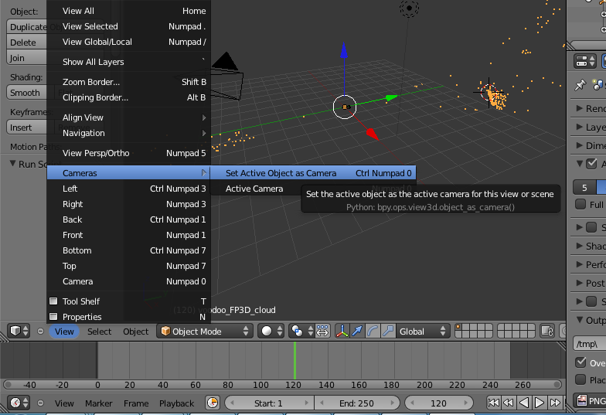
Import 3D Motions : Load Background Images
View → Cameras → Set Active Object as Active Camera

Slide 29
Import 3D Motions : Load Background Images
Click the “+”
View → Properties
or

Slide 30
Import 3D Motions : Load Background Images
Tick off “Background Images” & click “Add Image” on the menu
Click “Open”

Slide 31
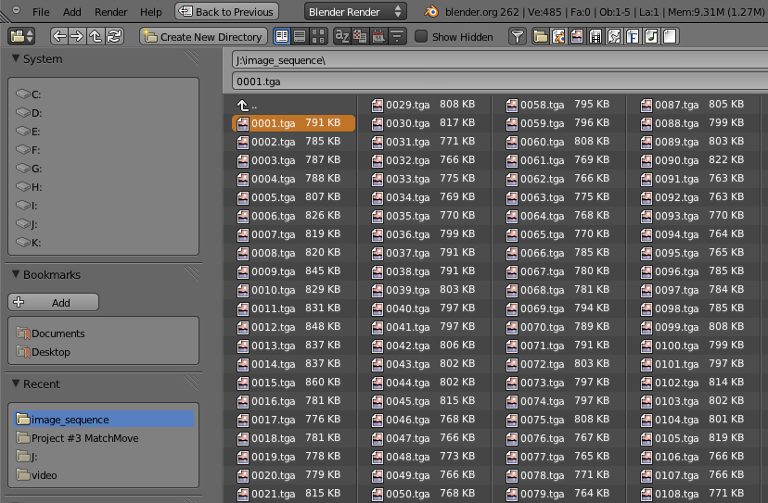
Import 3D Motions : Load Background Images
Choose the 1st frame image

Slide 32
Import 3D Motions : Load Background Images
Tick off “Auto Refresh”
Set Frames: # images to use
Start Frame : 1st
Select “Image Sequence”

Slide 33
Import 3D Motions : Load Background Images
View → View Persp/Ortho
View → Front

Slide 34
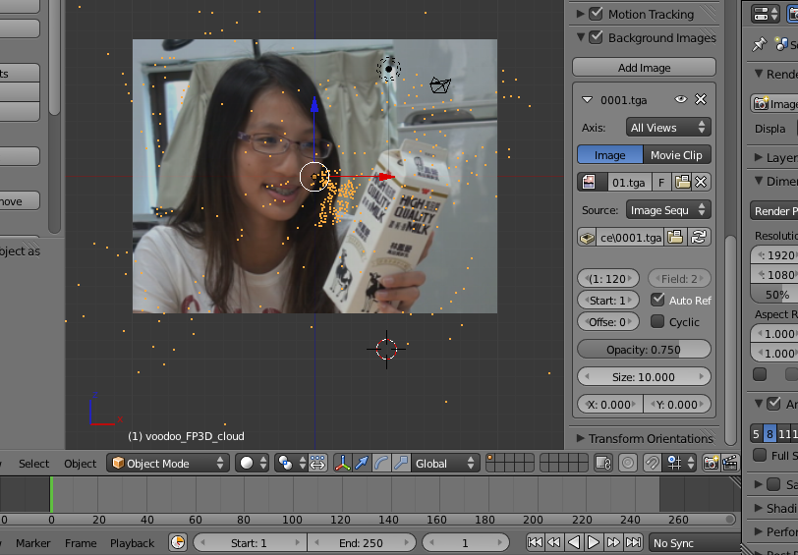
Import 3D Motions : Load Background Images
You can adjust background image’s
Opacity, Scale & Position
Use any frame to check background image

Slide 35
Import 3D Motions : Load Models
File → Import → “Model Type”

Slide 36
Import 3D Motions : Load Models
To use the model as a “single object” instead of many “small groups(components)” ,you can close the group options

Slide 37
Import 3D Motions : Load Models
Model split by groups (for finer operations)

Slide 38
Import 3D Motions : Set Keyframes
Object → Animation → Insert Keyframe…
Set the motions of your model !

Slide 39
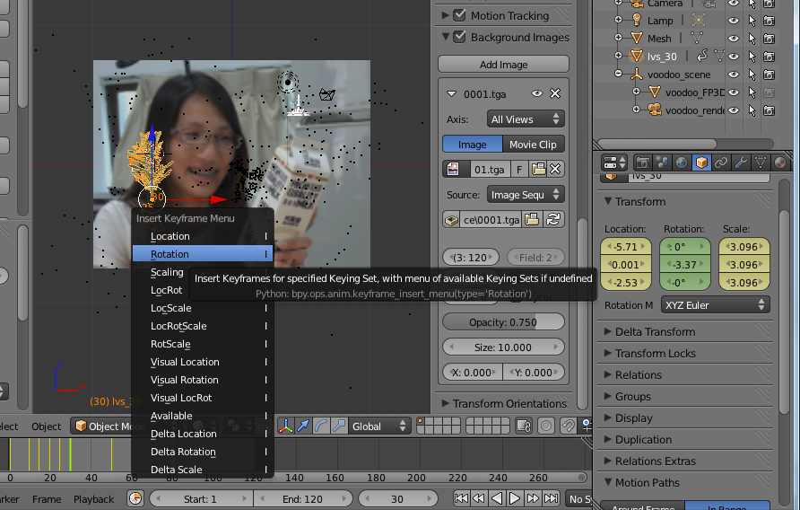
Import 3D Motions : Set Keyframes
Lock the parameters in keyframe
Model parameters and corresponding lock in keyframe
Choose Object Mode
Choose keyframe

Slide 40
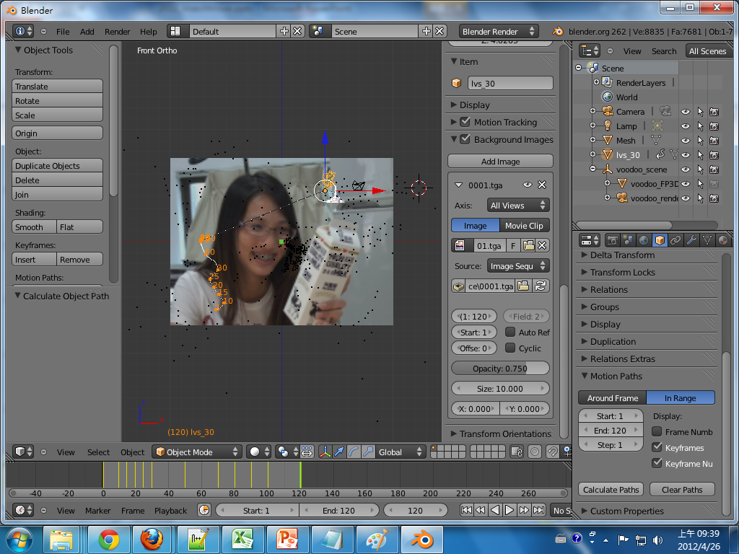
Import 3D Motions : Set Keyframes
You can use Object → Motion Paths → Calculate Paths
to see the motion path of models
Motion Path
Time point of Keyframes

Slide 41
Import 3D Motions : Set Keyframes
Some notes
Different camera views are helpful
Fine adjust 3D position & shape
Preview is your good friend
Ensure your model condition shown in that frame
Don’t forget the light (lamp)
Preview won’t show the lighting
Avoid model “in the dark”
Unstable model motion
Set more keyframes
Split fast-moving video into more small-period clips

Slide 42
Recipe: Compositing
Add Image Sequence
Change Window Type to Video Scene Editor
Select Add → Images and select all images
Drag the strip to the “1st Frame” in Layer 1
Add Scene
Select Add → Scene
Drag the scene strip to the “1st Frame” in Layer 2
Set Scene
Change scene property to “Alpha Over”
Set frame and video parameters
Click Animation

Slide 43
Compositing: Add Image Sequence
Add → Image
Choose “Sequence Editor”

Slide 44
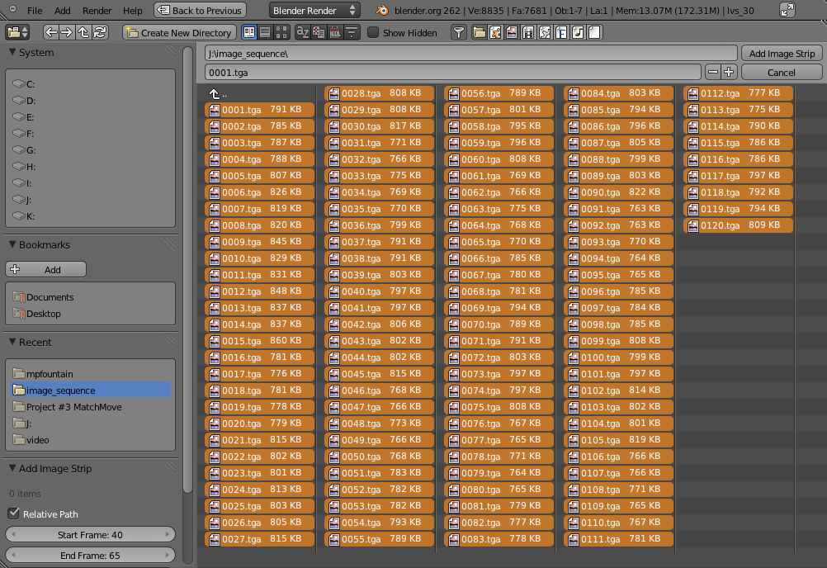
Compositing: Add Image Sequence
Select all images

Slide 45
Compositing: Add Image Sequence
Drag the strip to the “1st Frame” in Layer 1

Slide 46
Compositing: Add Scene
Add → Scene → Scene

Slide 47
Compositing: Add Scene
Drag the scene strip to the “1st Frame” in Layer 2

Slide 48
Compositing: Set Scene
View → Properties
Set Blend “Alpha Over”

Slide 49
Compositing: Set Scene
Tick off “Premultiply”
Select ”Voodoo_render_cam”

Slide 50
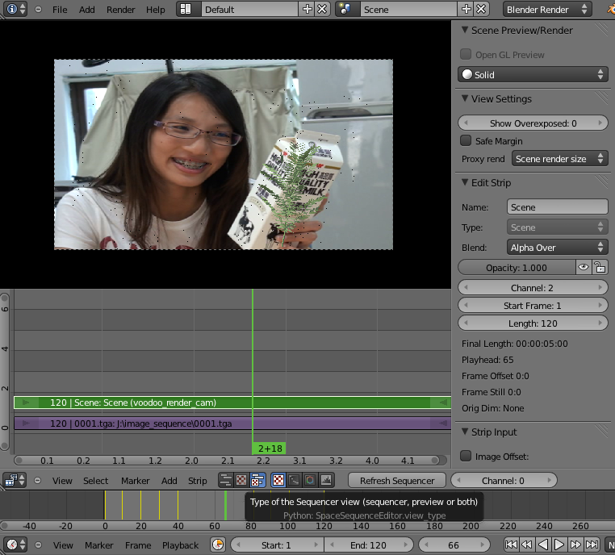
Compositing: Output Video
You can change “Sequencer view” to "Preview" or "both“ to preview the result

Slide 51
Compositing: Set Scene
Set “Start Frame” and “(Video) Length”
Set video Resolution, Frame Range (time) & Frame Rate

Slide 52
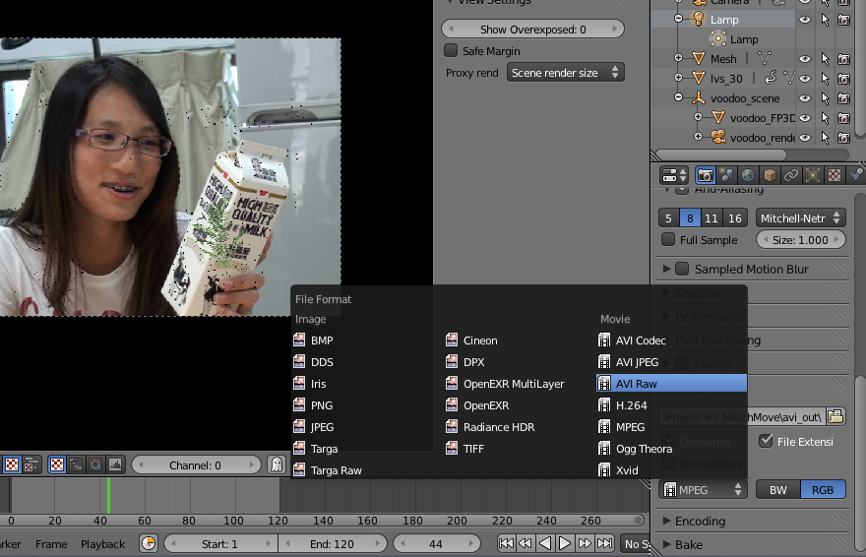
Compositing: Output Video
Select output video type
Select output directory

Slide 53
Compositing: Output video
Click Animation!
Example of Composited result

Slide 54
Reference
Blender
Official website
http://www.blender.org/
2.62 release log
http://www.blender.org/development/release-logs/blender-262/
2.61 demo files
http://www.blender.org/development/release-logs/blender-261/blender-261-demo-files/
Overview of 2.62
http://www.youtube.com/watch?v=2-DXwepGNNw

Slide 55
Reference
Blender
Blender 2.6 Tutorial 17 - Camera Tracking http://www.youtube.com/watch?v=qTwZO9Gi5yw http://www.youtube.com/watch?v=XZGx6UI0s2U
Match Moving Tutorial in Blender http://www.youtube.com/watch?v=5oWctBTjGcI
Basic video tutorial for 2.56 & 2.57 [1~8] [Older vision] https://www.youtube.com/watch?v=WSj23GDGNiI
Basic video tutorial for Blender and Voodoo [Older vision] http://www.youtube.com/watch?v=kPZbtKQ1a4g http://www.youtube.com/watch?v=sO4kmT-n3lU

Slide 56
Reference
Voodoo
Python problem between Voodoo and Blender
Voodoo camera tracker and blender 2.57 fixed http://0rz.tw/PqDVr
Voodoo camera Import (io_import_voodoo_camera.py) [Official released] http://0rz.tw/BNDm8
Voodoo document website http://0rz.tw/c2ceR
CINEMA 4D + VOODOO – TUTORIAL http://www.youtube.com/watch?v=JWlW7ay0yi4

Slide 57
Reference
Other Resources
K-Lite Codec Pack
Mega, Full, Standard and Basic http://www.codecguide.com/download_kl.htm
Video Editing Tools
威力導演、繪聲繪影、 …
Sony Vegas, Adobe After Effects, Premiere, …
Sound/Music Editing Tools
Adobe Audition ( original cooledit ), Goldwave, …

Slide 58
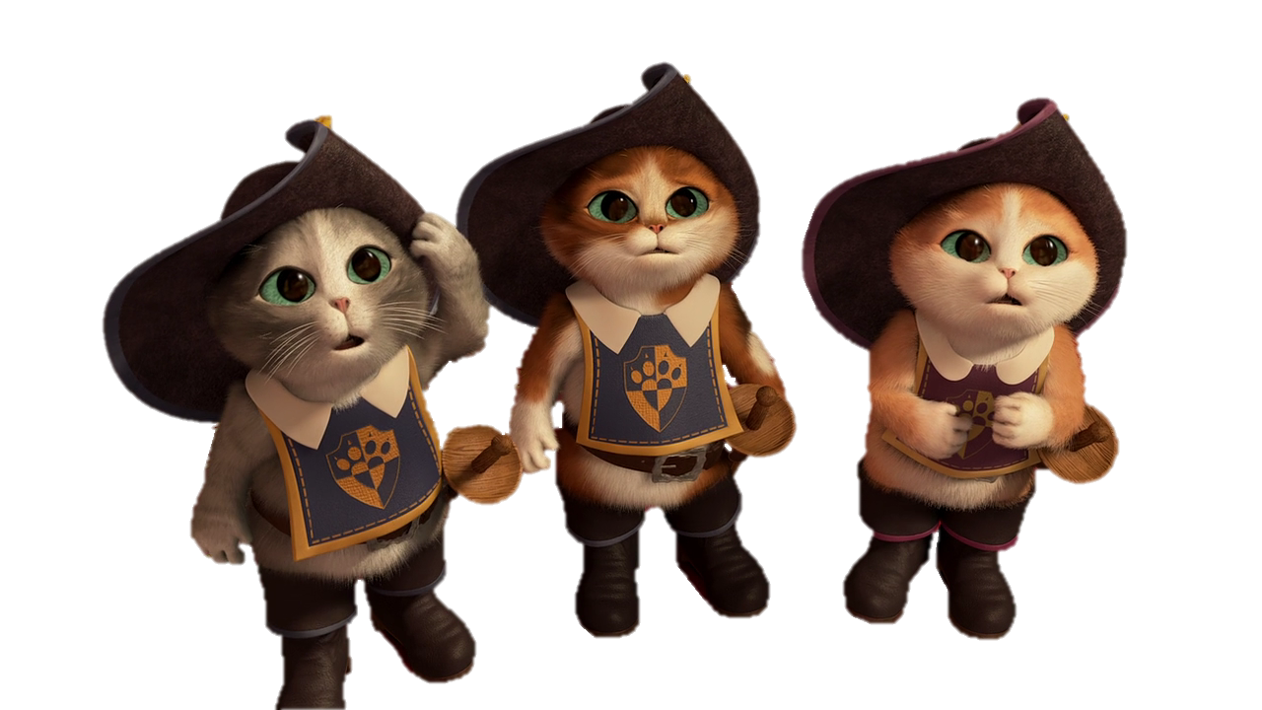
Thank you for your attention!

Slide 59
Import 3D Motions : Open Python Script
Select io_import_voodoo_camera.py
Run Python Script

Slide 60
Import 3D Motions : Open Python Script
File → Import → Voodoo camera

