Slide 1
Surface Integrators
Digital Image Synthesis
Yung-Yu Chuang
with slides by Peter Shirley, Pat Hanrahan, Henrik Jensen, Mario Costa Sousa and Torsten Moller

Slide 2
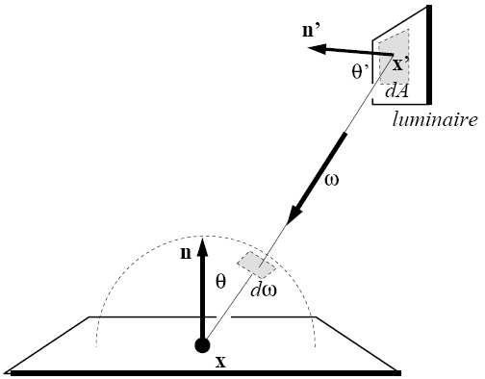

Direct lighting via Monte Carlo integration
diffuse

Slide 3



Direct lighting via Monte Carlo integration
parameterization over hemisphere
parameterization over surface
have to add visibility

Slide 4

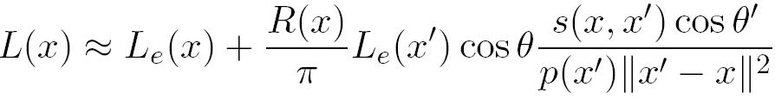

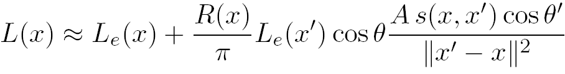
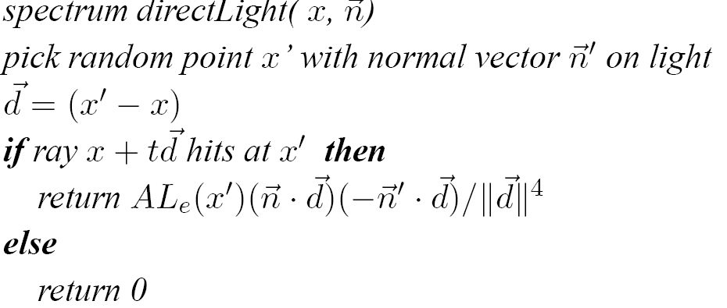
Direct lighting via Monte Carlo integration
take one sample according to a density function
let’s take

Slide 5
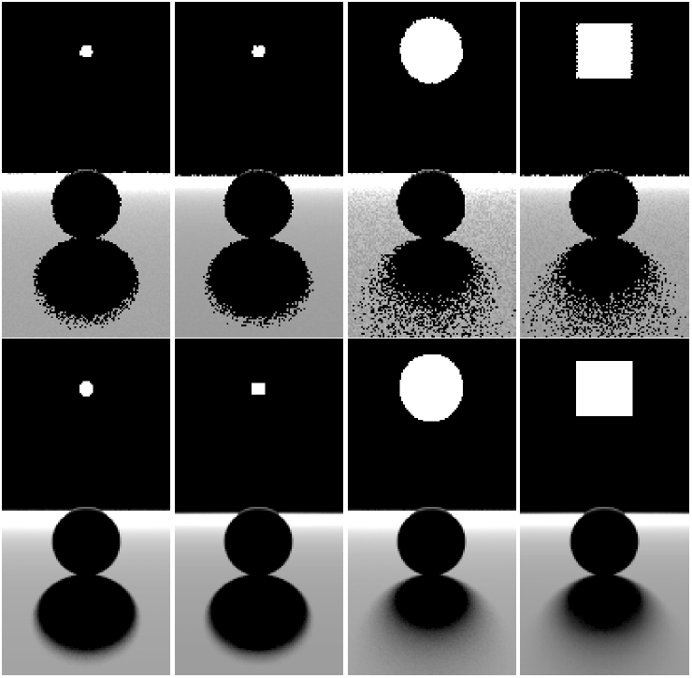
Direct lighting via Monte Carlo integration
1 sample/pixel
100 samples/pixel
Lights’ sizes matter
more than shapes.
Noisy because
x’ could be on the
back
cos varies

Slide 6

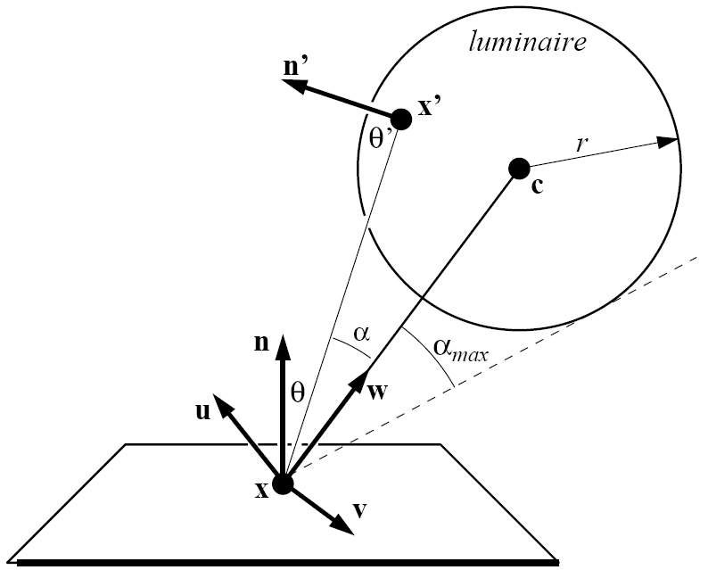
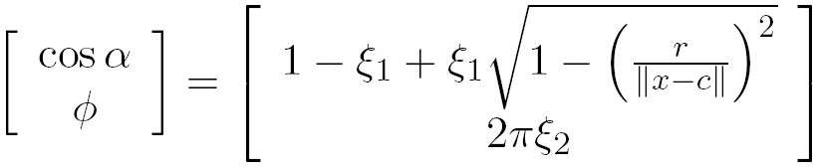
Noise reduction
choose better density function
It is equivalent to uniformly sampling over
the cone cap in the last lecture.

Slide 7


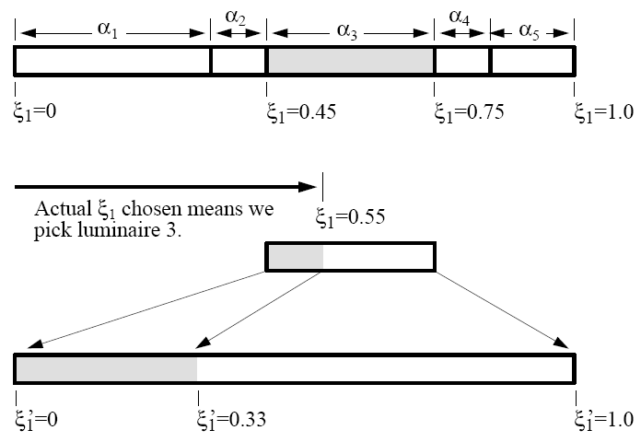
Direct lighting from many luminaries
Given a pair , use it to select light and generate new pair for sampling that light.
α could be constant for proportional to power

Slide 8
Rendering
Rendering is handled by Renderer class.
class Renderer {
…
virtual void Render(Scene *scene) = 0;
virtual Spectrum Li(Scene *scn, RayDifferential &r,
Sample *sample, RNG &rng,
MemoryArena &arena, Intersection *isect,
Spectrum *T) const = 0;
virtual Spectrum Transmittance(Scene *scene,
RayDifferential &ray, Sample *sample,
RNG &rng, MemoryArena &arena) const = 0;
};
given a scene, render an image or a set of measurements
computer radiance along a ray
for MC sampling
transmittance
return transmittance along a ray
The later two are usually relayed to Integrator

Slide 9
SamplerRenderer
class SamplerRenderer : public Renderer {
…
private:
// SamplerRenderer Private Data
Sampler *sampler;
Camera *camera;
SurfaceIntegrator *surfaceIntegrator;
VolumeIntegrator *volumeIntegrator;
};
choose samples on image plane
and for integration
determine lens parameters (position,
orientation, focus, field of view)
with a film
calculate the rendering equation

Slide 10
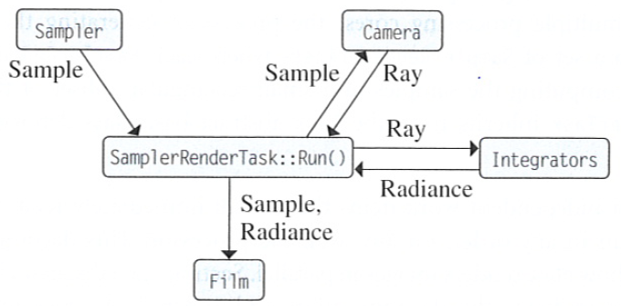
The main rendering loop
After scene and Renderer are constructed, Renderer:Render() is invoked.

Slide 11
Renderer:Render()
void SamplerRenderer::Render(const Scene *scene) {
…
surfaceIntegrator->Preprocess(scene,camera,this);
volumeIntegrator->Preprocess(scene,camera,this);
Sample *sample = new Sample(sampler,
surfaceIntegrator, volumeIntegrator, scene);
int nPixels = camera->film->xResolution
* camera->film->yResolution;
int nTasks = max(32 * NumSystemCores(),
nPixels / (16*16));
nTasks = RoundUpPow2(nTasks);
scene-dependent initialization such photon map
sample structure depends on types of integrators
We want many tasks to fill in the core (see histogram next page).
If there are too few, some core will be idle. But, threads have
overheads. So, we do not want too many either.
at least 32 tasks
for a core
a task is about 16x16
power2 easier to divide

Slide 12
Renderer:Render()
vector<Task *> renderTasks;
for (int i = 0; i < nTasks; ++i)
renderTasks.push_back(new
SamplerRendererTask(scene,this,camera,reporter,
sampler, sample, nTasks-1-i, nTasks));
EnqueueTasks(renderTasks);
WaitForAllTasks();
for (int i = 0; i < renderTasks.size(); ++i)
delete renderTasks[i];
delete sample;
camera->film->WriteImage();
}
all information about renderer
must be passed in
task id
total tasks

Slide 13
SamplerRenderTask::Run
When the task system decided to run a task on a particular processor, SamplerRenderTask::Run() will be called.
void SamplerRendererTask::Run() {
// decided which part it is responsible for
…
int sampleCount;
while ((sampleCount=sampler ->
GetMoreSamples(samples, rng)) > 0) {
// Generate camera rays and compute radiance

Slide 14
SamplerRenderTask::Run
for (int i = 0; i < sampleCount; ++i) {
float rayWeight = camera->
GenerateRayDifferential(samples[i], &rays[i]);
rays[i].ScaleDifferentials(
1.f / sqrtf(sampler->samplesPerPixel));
if (rayWeight > 0.f)
Ls[i] = rayWeight * renderer->Li(scene, rays[i],
&samples[i], rng, arena, &isects[i], &Ts[i]);
else { Ls[i] = 0.f; Ts[i] = 1.f; }
for (int i = 0; i < sampleCount; ++i)
camera->film->AddSample(samples[i], Ls[i]);
}
for vignetting
ray differential
for antialiasing

Slide 15
SamplerRender::Li
Spectrum SamplerRender::Li(Scene *scene,
RayDifferential &ray, Sample *sample,
…, Intersection *isect, Spectrum *T)
{ Spectrum Li = 0.f;
if (scene->Intersect(ray, isect))
Li = surfaceIntegrator->Li(scene,this,
ray, *isect, sample,rng, arena);
else { // ray that doesn't hit any geometry
for (i=0; i<scene->lights.size(); ++i)
Li += scene->lights[i]->Le(ray);
}
Spectrum Lvi = volumeIntegrator->Li(scene, this,
ray, sample, rng, T, arena);
return *T * Li + Lvi;
}

Slide 16
Surface integrator’s Li
L_{o}

Slide 17
SamplerRender::Li
Lvi
L_{i}
T

Slide 18
Integrators
core/integrator.* integrator/*
Class Integrator {
virtual void Preprocess(Scene *scene,
Camera *camera, Renderer *renderer){}
virtual void RequestSamples(Sampler
*sampler, Sample *sample, Scene *scene){}
};

Slide 19
Integrators
void Preprocess(…)
Called after scene has been initialized; do scene-dependent computation such as photon shooting for photon mapping.
void RequestSamples(…)
Sample is allocated once in Render(). There, sample’s constructor will call integrator’s RequestSamples to allocate appropriate space.
Sample::Sample(Sampler *sampler, SurfaceIntegrator *surf, VolumeIntegrator *vol, Scene *scene) {
if (surf)
surf>RequestSamples(sampler,this,scene);
if (vol)
vol->RequestSamples(sampler, this, scene);
…

Slide 20
Surface integrators
Responsible for evaluating the integral equation
class SurfaceIntegrator:public Integrator {
public:
virtual Spectrum Li(Scene *scene, Renderer
*renderer, RayDifferential &ray,
Intersection &isect, Sample *sample,
RNG &rng, MemoryArena &arena) const = 0;
};
Whitted, directlighting, path, irradiancecache,
photonmap, igi, exphotonmap
We could call Renderer’s
Li or Transmittance

Slide 21
Direct lighting
Rendering equation
If we only consider direct lighting, we can replace
L_{i} by L_{d}.
simplest form of equation
somewhat easy to solve (but a gross approximation)
major contribution to the final radiance
not too bad since most energy comes from direct lights
kind of what we do in Whitted ray tracing

Slide 22
Direct lighting
Monte Carlo sampling to solve
Sampling strategy A: sample only one light
  pick up one light as the representative for all lights
  distribute N samples over that light
  Use multiple importance sampling for f and L_{d}
  Scale the result by the number of lights N_{L}
Randomly pick f or g and then sample, multiply the result by 2

Slide 23
Direct lighting
Sampling strategy B: sample all lights
  do A for each light
  sum the results
  smarter way would be to sample lights according to their power
sample f or g separately and then sum them together

Slide 24
DirectLighting
enum LightStrategy {
SAMPLE_ALL_UNIFORM, SAMPLE_ONE_UNIFORM
};
class DirectLighting : public SurfaceIntegrator {
public:
DirectLighting(
LightStrategy ls = SAMPLE_ALL_UNIFORM,
int md=5
);
...
}
two possible strategies; if there are many image samples for a pixel
(e.g. due to depth of field), we prefer only sampling one light at a
time. On the other hand, if there are few image samples, we often
prefer sampling all lights at once.
maximal depth

Slide 25
Data structure
Different types of lights require different numbers of samples, usually 2D samples.
Sampling BRDF requires 2D samples.
Selection of BRDF components requires 1D samples.
filled in by integrators
sample
n1D
3
1
2
n2D
2
2
1
1
2
2
oneD
twoD
allocate together to avoid cache miss
mem
PathIntegrator
1
2
3
1
3
5
2
4
6
lightNumOffset
lightSampleOffset
bsdfSampleOffset

Slide 26
DirectLighting::RequestSamples
void DirectLightingIntegrator::RequestSamples(
Sampler *sampler, Sample *sample, Scene *scene) {
if (strategy == SAMPLE_ALL_UNIFORM) {
uint32_t nLights = scene->lights.size();
lightSampleOffsets=new LightSampleOffsets[nLights];
bsdfSampleOffsets = new BSDFSampleOffsets[nLights];
for (uint32_t i = 0; i < nLights; ++i) {
const Light *light = scene->lights[i];
int nSamples = light->nSamples;
if (sampler) nSamples=sampler->RoundSize(nSamples);
lightSampleOffsets[i]
= LightSampleOffsets(nSamples, sample);
bsdfSampleOffsets[i]
= BSDFSampleOffsets(nSamples, sample);
}
lightNumOffset = -1;
}
gives sampler a chance to adjust to an appropriate value

Slide 27
DirectLighting::RequestSamples
else {
lightSampleOffsets = new LightSampleOffsets[1];
lightSampleOffsets[0]
= LightSampleOffsets(1, sample);
lightNumOffset = sample->Add1D(1);
bsdfSampleOffsets = new BSDFSampleOffsets[1];
bsdfSampleOffsets[0] = BSDFSampleOffsets(1, sample);
}
}
which light to sample
lightSampleOffsets records where the samples are in the sample structure.
With this information, we can drive the required random numbers for
generating light samples and store all random numbers required for one
sample in LightSample. Similar for bsdfSample.

Slide 28
DirectLighting::Li
Spectrum DirectLighting::Li(…)
{
Spectrum L(0.f);
BSDF *bsdf = isect.GetBSDF(ray, arena);
Vector wo = -ray.d;
const Point &p = bsdf->dgShading.p;
const Normal &n = bsdf->dgShading.nn;
L += isect.Le(wo);
if (scene->lights.size() > 0) {
switch (strategy) {
case SAMPLE_ALL_UNIFORM:
L += UniformSampleAllLights(scene, renderer,
arena, p, n, wo, isect.rayEpsilon,
ray.time, bsdf, sample, rng,
lightSampleOffsets, bsdfSampleOffsets);
break;

Slide 29
DirectLighting::Li
case SAMPLE_ONE_UNIFORM:
L += UniformSampleOneLight(scene, renderer,
arena, p, n, wo, isect.rayEpsilon,
ray.time, bsdf, sample, rng,
lightNumOffset, lightSampleOffsets,
bsdfSampleOffsets);
break;
}
}
if (ray.depth + 1 < maxDepth) {
Vector wi;
L += SpecularReflect(…);
L += SpecularTransmit(…);
}
return L;
}
This part is essentially the same as Whitted integrator. The main difference
is the way they sample lights. Whitted uses sample_L to take one sample for
each light. DirectLighting uses multiple Importance sampling to sample both
lights and BRDFs.

Slide 30
Whitted::Li
...
// Add contribution of each light source
for (int i = 0; i < scene->lights.size(); ++i) {
Vector wi;
float pdf;
VisibilityTester visibility;
Spectrum Li = scene->lights[i]->Sample_L(…);
if (Li.IsBlack() || pdf == 0.f) continue;
Spectrum f = bsdf->f(wo, wi);
if (!f.IsBlack() && visibility.Unoccluded(scene))
L += f * Li * AbsDot(wi, n) *
visibility.Transmittance(…) / pdf;
}

Slide 31
UniformSampleAllLights
Spectrum UniformSampleAllLights(...)
{
Spectrum L(0.);
for (u_int i=0;i<scene->lights.size();++i) {
Light *light = scene->lights[i];
int nSamples = lightSampleOffsets ?
lightSampleOffsets[i].nSamples : 1;
Spectrum Ld(0.);
for (int j = 0; j < nSamples; ++j) {
<Find light and BSDF sample values>
Ld += EstimateDirect(...); }
L += Ld / nSamples;
}
return L;
}
[[lightSample=LightSample(sample,lightSampleOffsets[i],j);]]
compute contribution for one
sample for one light

Slide 32
UniformSampleOneLight
Spectrum UniformSampleOneLight (...)
{
int nLights = int(scene->lights.size());
if (nLights == 0) return Spectrum(0.);
int lightNum;
if (lightNumOffset != -1)
lightNum =
Floor2Int(sample->oneD[lightNumOffset][0]*nLights);
else
lightNum = Floor2Int(RandomFloat() * nLights);
lightNum = min(lightNum, nLights-1);
Light *light = scene->lights[lightNum];
<Find light and BSDF sample values>
return (float)nLights * EstimateDirect(...);
}

Slide 33
EstimateDirect
Spectrum EstimateDirect(Scene *scene, Renderer *renderer,
Light *light, Point &p, Normal &n, Vector &wo,
float rayEpsilon, float time, BSDF *bsdf, RNG &rng,
LightSample &lightSample, BSDFSample &bsdfSample,
BxDFType flags)
{
Spectrum Ld(0.);
Vector wi;
float lightPdf, bsdfPdf;
VisibilityTester visibility;
Here, we use multiple importance sampling to estimate the above
term by taking one sample according to the light and the other
according to BSDF.

Slide 34
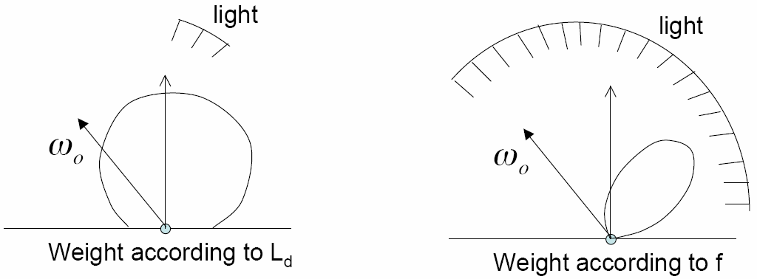
Multiple importance sampling
Here, n_{f}=n_{g}=1

Slide 35
Sample light with MIS
Spectrum Li = light->Sample_L(p, rayEpsilon, lightSample,
time, &wi, &lightPdf, &visibility);
if (lightPdf > 0. && !Li.IsBlack()) {
Spectrum f = bsdf->f(wo, wi, flags);
if (!f.IsBlack() && visibility.Unoccluded(scene)) {
Li *= visibility.Transmittance(…);
if (light->IsDeltaLight())
Ld += f * Li * (AbsDot(wi, n) / lightPdf);
else {
bsdfPdf = bsdf->Pdf(wo, wi, flags);
float weight =
PowerHeuristic(1, lightPdf, 1, bsdfPdf);
Ld += f * Li * (AbsDot(wi, n) * weight / lightPdf);
}
}
}

Slide 36
Sample BRDF with MIS
If it is delta light, no need
to sample BSDF
if (!light->IsDeltaLight()) {
BxDFType sampledType;
Spectrum f = bsdf->Sample_f(wo, &wi, bsdfSample,
&bsdfPdf, flags, &sampledType);
if (!f.IsBlack() && bsdfPdf > 0.) {
float weight = 1.f;
if (!(sampledType & BSDF_SPECULAR)) {
lightPdf = light->Pdf(p, wi);
if (lightPdf == 0.) return Ld;
weight = PowerHeuristic(1, bsdfPdf, 1, lightPdf);
}
Intersection lightIsect;
Spectrum Li(0.f);
RayDifferential ray(p, wi, rayEpsilon, INFINITY, time);
weight=1 is for specular lights
We need to test whether we can see the light along the sampled direction

Slide 37
Sample BRDF with MIS
if (scene->Intersect(ray, &lightIsect)) {
if (lightIsect.primitive->GetAreaLight() == light)
Li = lightIsect.Le(-wi);
} else
Li = light->Le(ray);
if (!Li.IsBlack()) {
Li *= renderer->Transmittance(…);
Ld += f * Li * AbsDot(wi, n) * weight / bsdfPdf;
}
}
return Ld;
}
If we can see it, record its Li
No intersection, but it could be an infinite
area light. For non-infinite-area lights,
Le return 0.

Slide 38
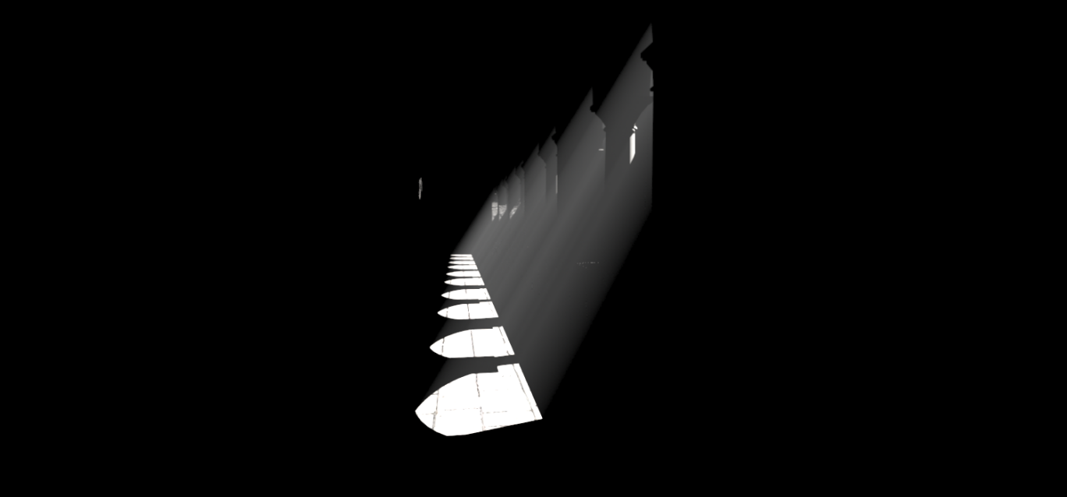
Direct lighting

Slide 39
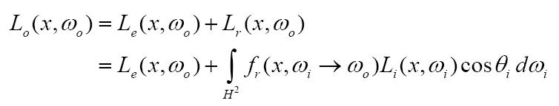
The light transport equation
The goal of integrator is to numerically solve the light transport equation, governing the equilibrium distribution of radiance in a scene.

Slide 40
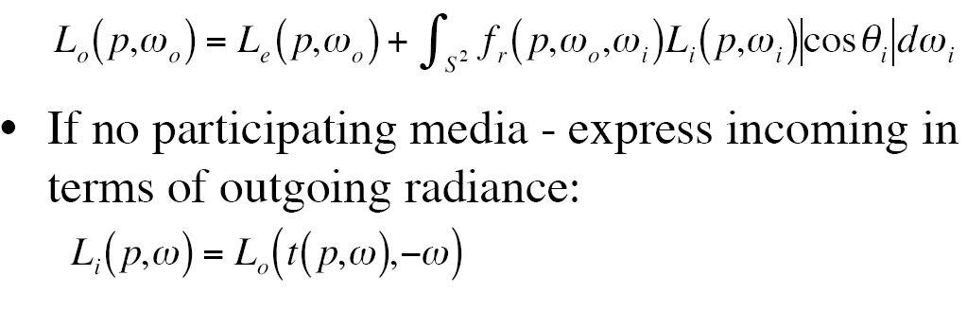
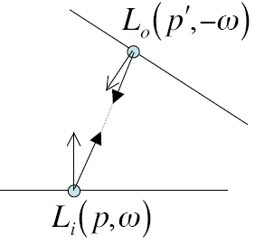
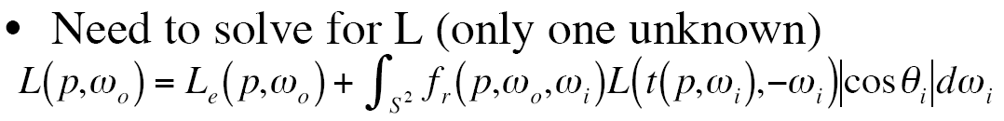
The light transport equation

Slide 41

Analytic solution to the LTE
In general, it is impossible to find an analytic solution to the LTE because of complex BRDF, arbitrary scene geometry and intricate visibility.
For an extremely simple scene, e.g. inside a uniformly emitting Lambertian sphere, it is however possible. This is useful for debugging.
Radiance should be the same for all points

Slide 42
Analytic solution to the LTE

Slide 43
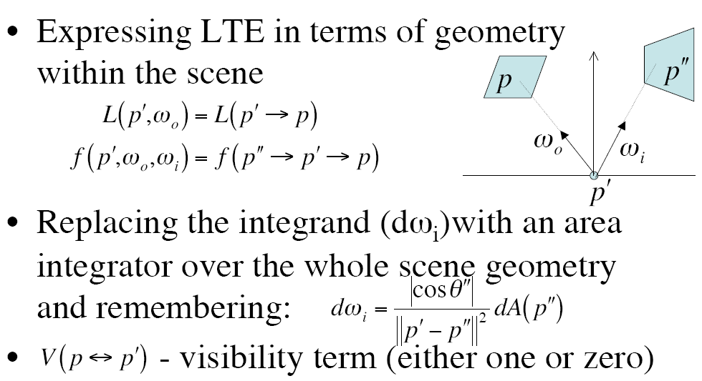
Surface form of the LTE

Slide 44
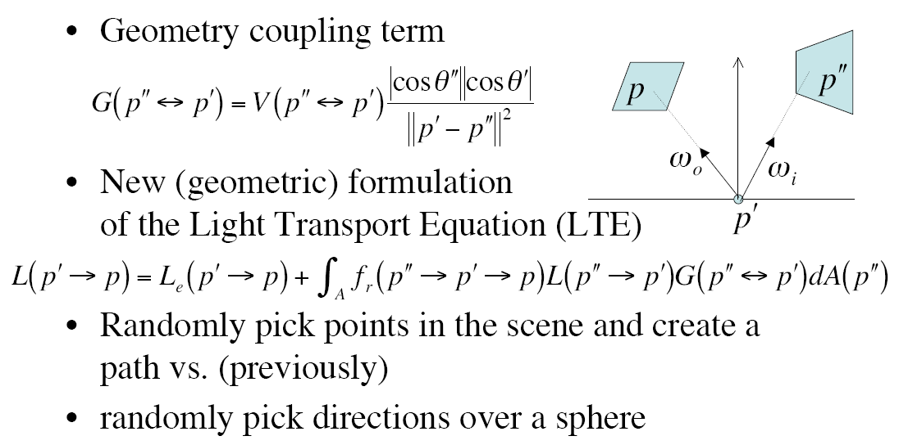
Surface form of the LTE
These two forms are equivalent, but they represent two
different ways of approaching light transport.

Slide 45
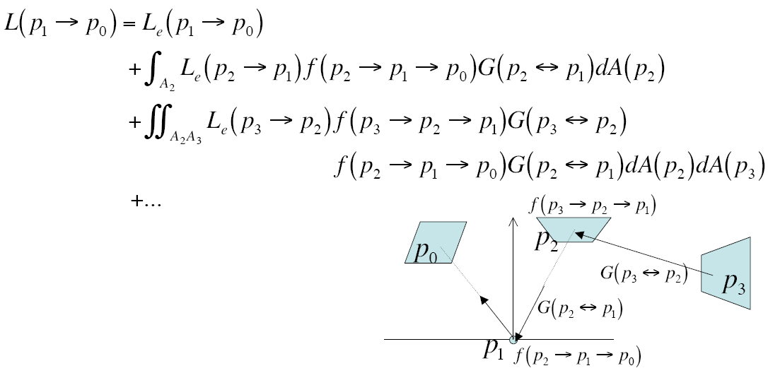
Surface form of the LTE

Slide 46
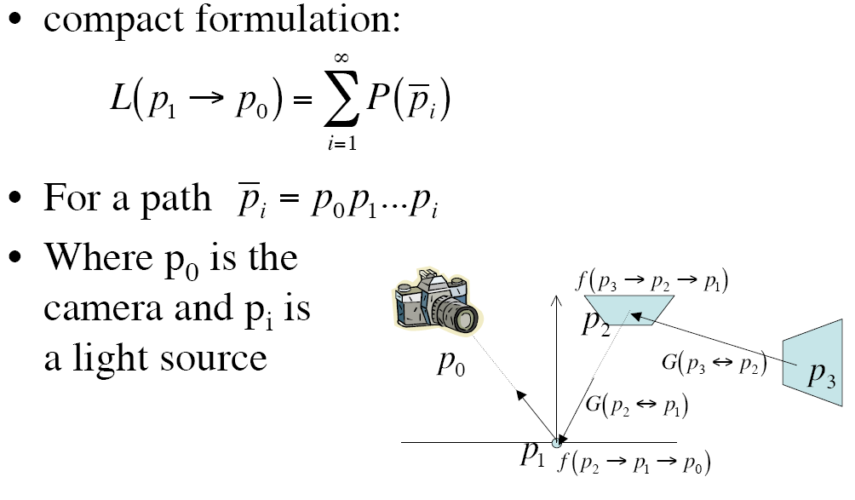
Surface form of the LTE

Slide 47
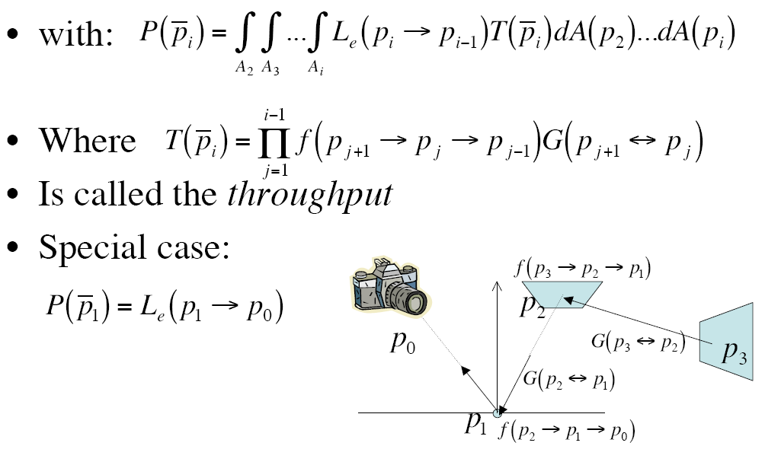
Surface form of the LTE

Slide 48
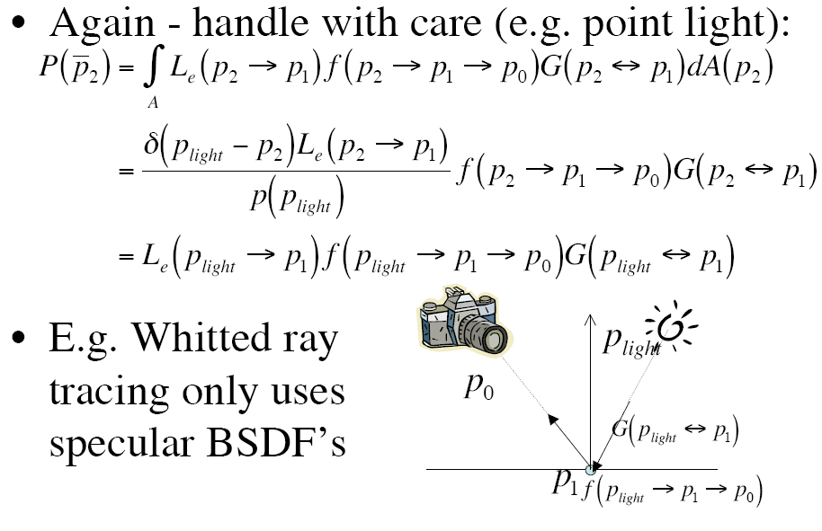
Delta distribution

Slide 49
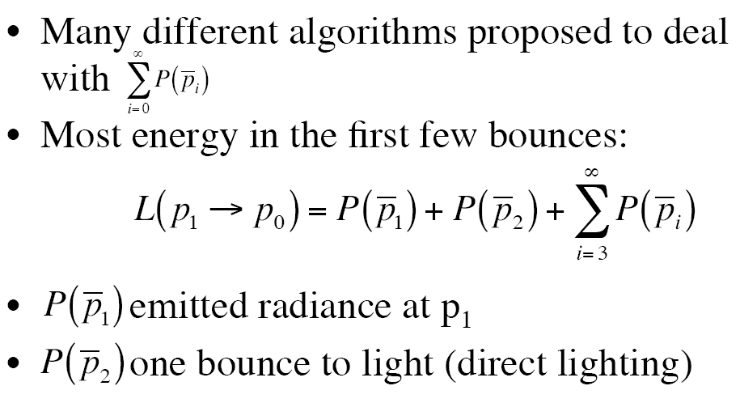
Partition the integrand

Slide 50
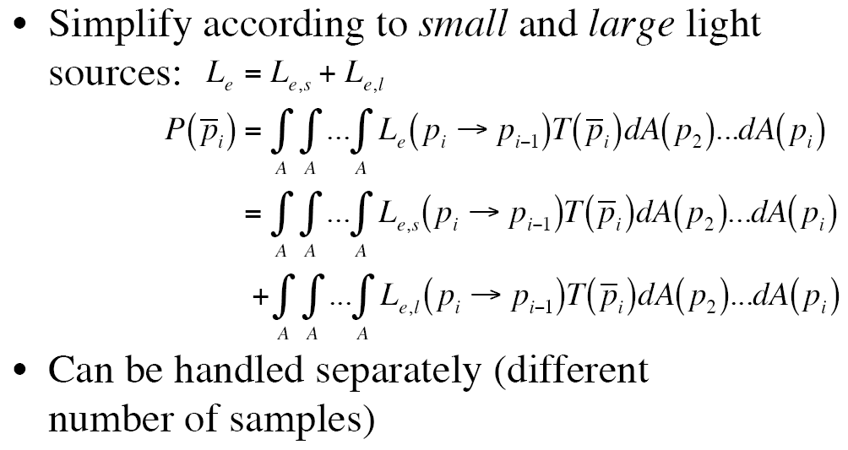
Partition the integrand

Slide 51
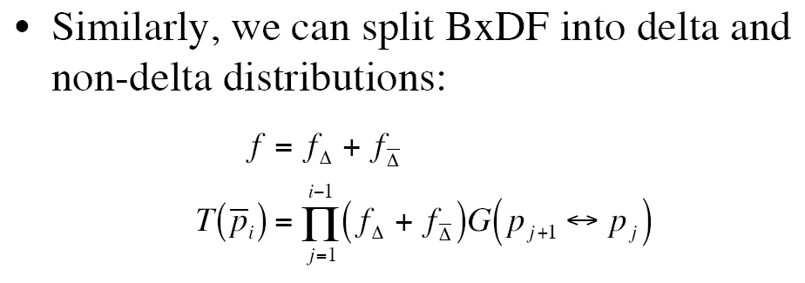
Partition the integrand

Slide 52
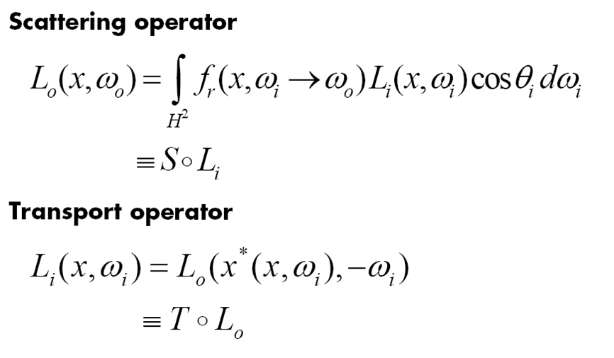
Rendering operators

Slide 53
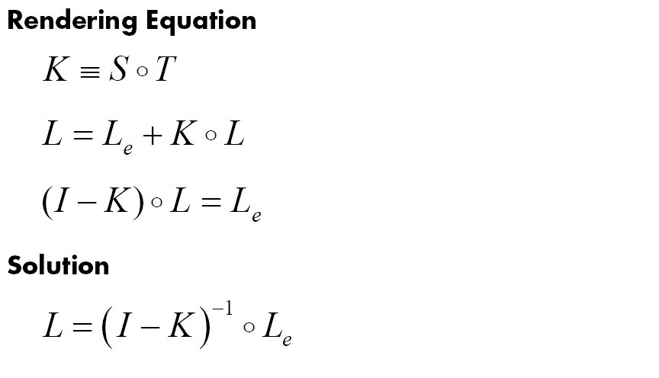
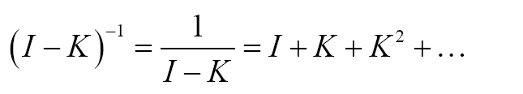
Solving the rendering equation

Slide 54
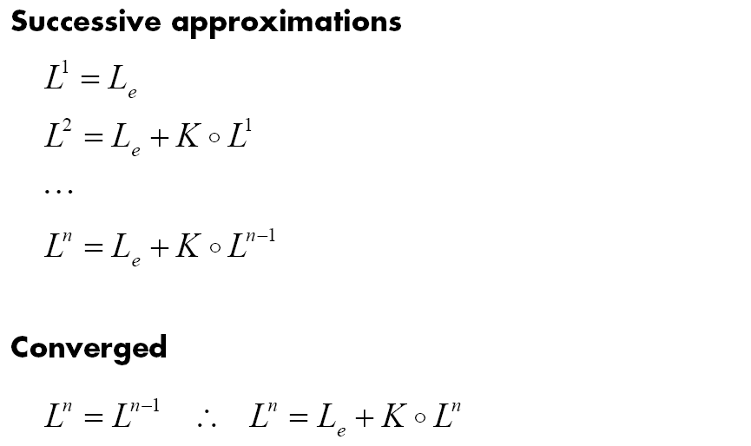
Successive approximation

Slide 55
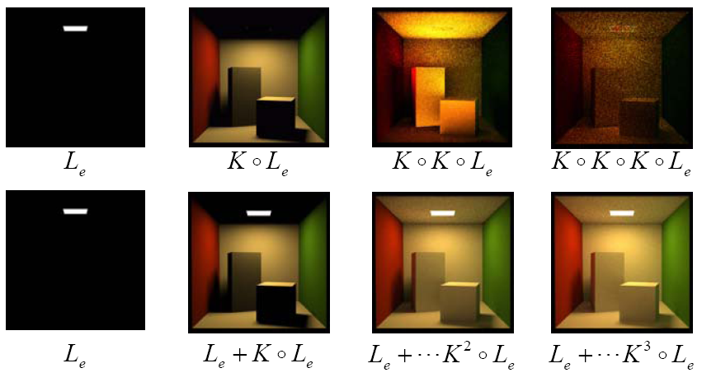
Successive approximation

Slide 56
Light transport notation (Hekbert 1990)
Regular expression denoting sequence of events along a light path alphabet: {L,E,S,D,G}
  L a light source (emitter)
  E the eye
  S specular reflection/transmission
  D diffuse reflection/transmission
  G glossy reflection/transmission
operators:
  (k)⁺ one or more of k
  (k)* zero or more of k (iteration)
  (k|k’) a k or a k’ event

Slide 57
Light transport notation: examples
LSD
  a path starting at a light, having one specular reflection and ending at a diffuse reflection
D
L
S

Slide 58
Light transport notation: examples
L(S|D)⁺DE
  a path starting at a light, having one or more diffuse or specular reflections, then a final diffuse reflection toward the eye
E
D
L
S

Slide 59
Light transport notation: examples
L(S|D)⁺DE
  a path starting at a light, having one or more diffuse or specular reflections, then a final diffuse reflection toward the eye
E
D
L
S
D
S

Slide 60
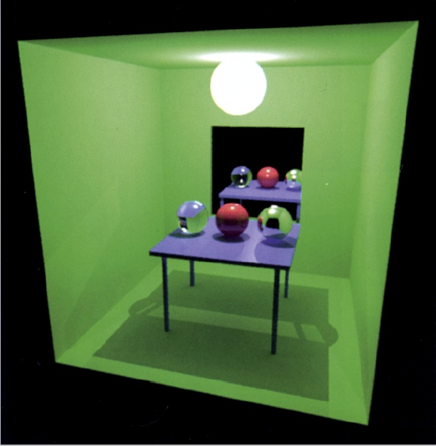

Slide 61
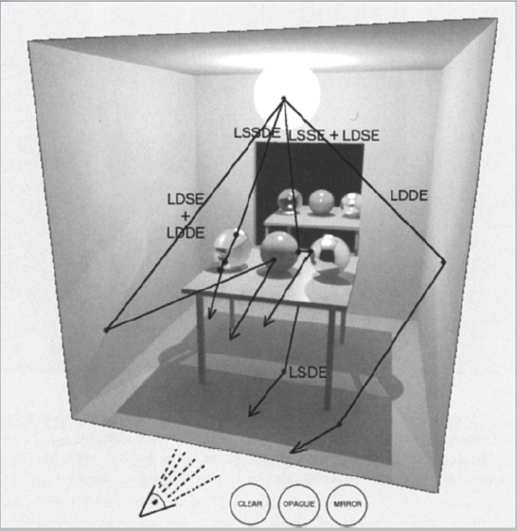

Slide 62
Rendering algorithms
Ray casting: E(D|G)L
Whitted: E[S*](D|G)L
Kajiya: E[(D|G|S)⁺(D|G)]L
Goral: ED*L

Slide 63
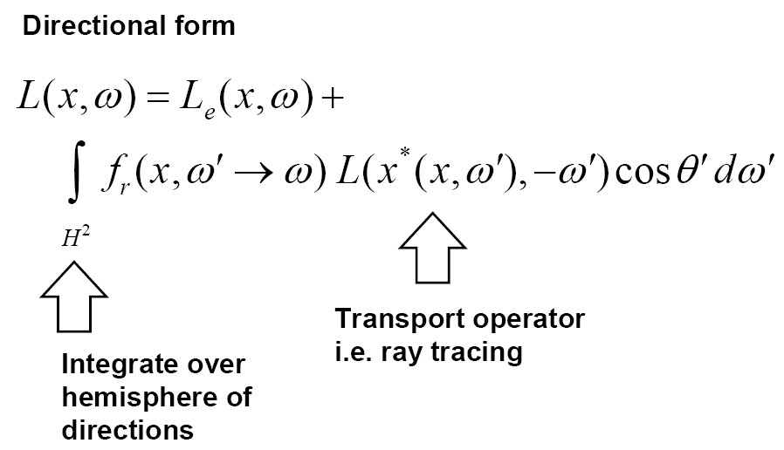
The rendering equation

Slide 64
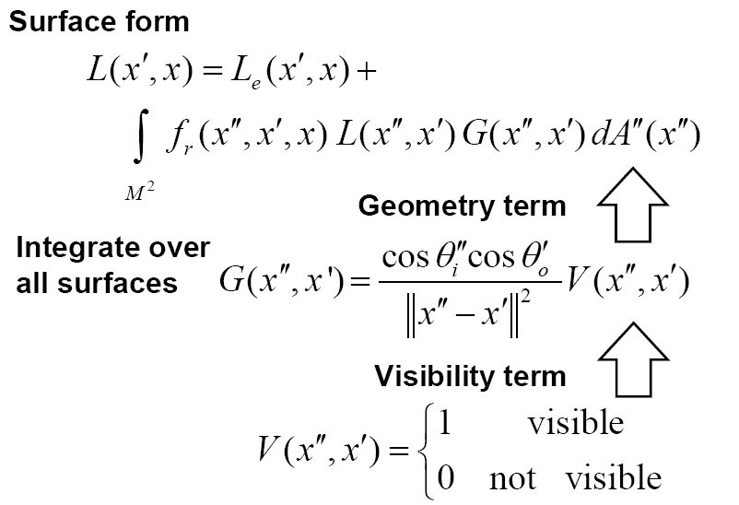
The rendering equation

Slide 65
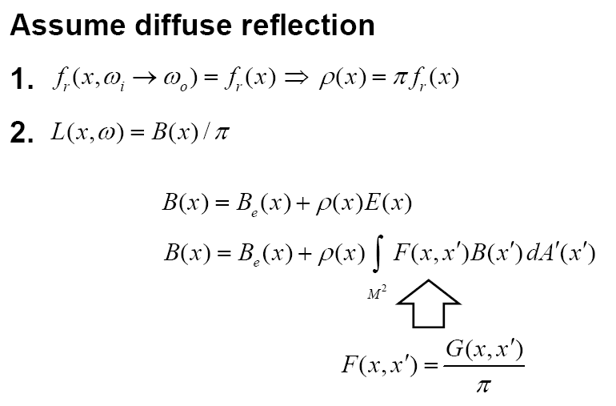
The radiosity equation

Slide 66
Radiosity
formulate the basic radiosity equation:
B_{m} = radiosity = total energy leaving surface m (energy/unit area/unit time)
E_{m} = energy emitted from surface m (energy/unit area/unit time)
ρ_{m} = reflectivity, fraction of incident light reflected back into environment
F_{mn} = form factor, fraction of energy leaving surface n that lands on surface m
(A_{m} = area of surface m)

Slide 67
Radiosity
Bring all the B’s on one side of the equation
this leads to this equation system:

Slide 68


Path tracing
Proposed by Kajiya in his classic SIGGRAPH 1986 paper, rendering equation, as the solution for
Incrementally generates path of scattering events starting from the camera and ending at light sources in the scene.
Two questions to answer
  How to do it in finite time?
  How to generate one or more paths to compute

Slide 69
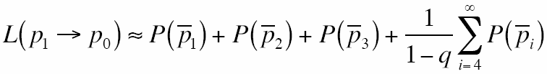
Infinite sum
In general, the longer the path, the less the impact.
Use Russian Roulette after a finite number of bounces
  Always compute the first few terms
  Stop after that with probability q

Slide 70
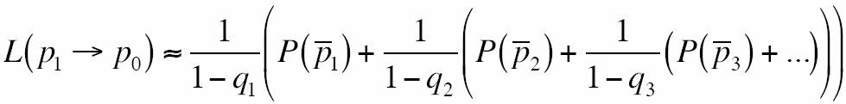
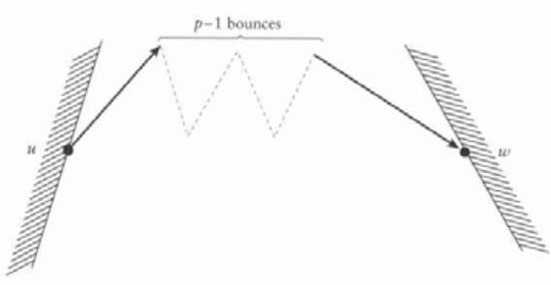
Infinite sum
Take this idea further and instead randomly consider terminating evaluation of the sum at each term with probability q_{i}

Slide 71
Path generation (first trial)
First, pick up surface i in the scene randomly and uniformly
Then, pick up a point on this surface randomly and uniformly with probability
Overall probability of picking a random surface point in the scene:

Slide 72
Path generation (first trial)
This is repeated for each point on the path.
Last point should be sampled on light sources only.
If we know characteristics about the scene (such as which objects are contributing most indirect lighting to the scene), we can sample more smartly.
Problems:
  High variance: only few points are mutually visible, i.e. many of the paths yield zero.
  Incorrect integral: for delta distributions, we rarely find the right path direction

Slide 73
Incremental path generation
For path
  At each p_{j}, find p_{j+1} according to BSDF (in this way, they are guaranteed to be mutually visible)
  At p_{i-1}, find p_{i} by multiple importance sampling of BSDF and L
This algorithm distributes samples according to solid angle instead of area. So, the distribution p_{A} needs to be adjusted

Slide 74
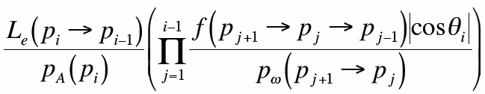
Incremental path generation
Monte Carlo estimator
Implementation re-uses path for new path This introduces correlation, but speed makes up for it.

Slide 75
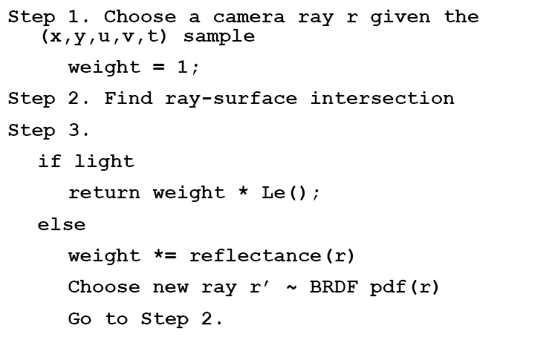
Path tracing

Slide 76
Direct lighting

Slide 77
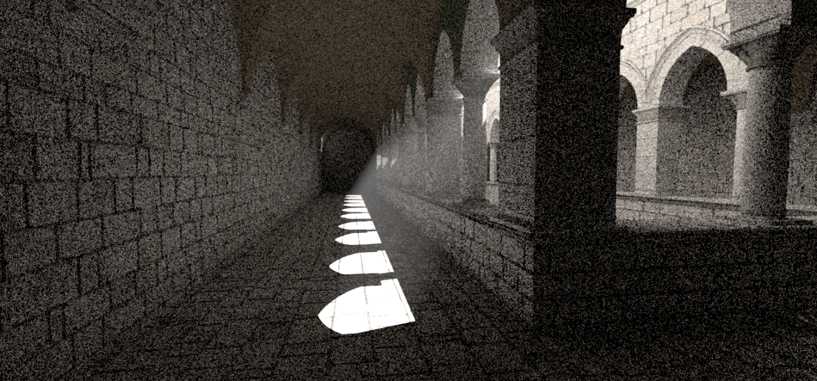
Path tracing
8 samples per pixel

Slide 78

Path tracing
1024 samples per pixel

Slide 79
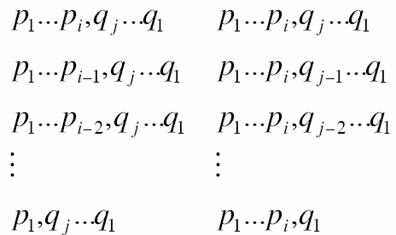
Bidirectional path tracing
Compose one path from two paths
  p₁p₂…p_{i} started at the camera p₀ and
  q_{j}q_{j-1}…q₁ started at the light source q₀
Modification for efficiency:
  Use all paths whose
  lengths ranging from
  2 to i+j
Helpful for the situations in which lights are difficult
to reach and caustics

Slide 80
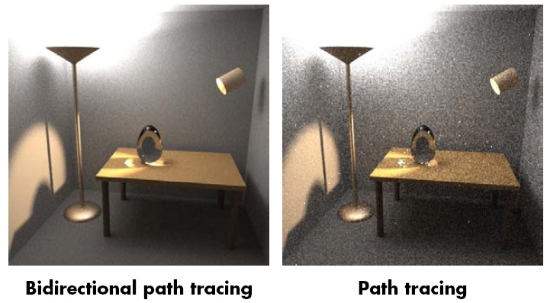
Bidirectional path tracing

