Slide 1
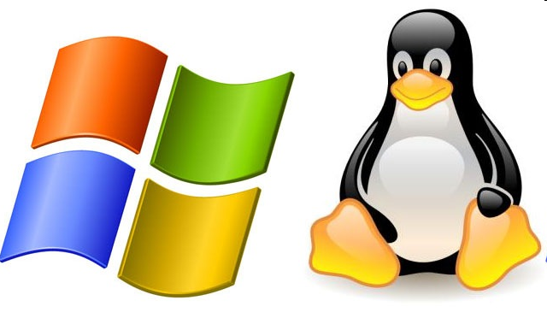
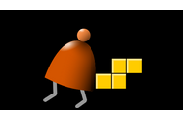
Operating Systems
Elements of Computing Systems, Nisan & Schocken, MIT Press www.idc.ac.il/tecs
Building a Modern Computer From First Principles
www.nand2tetris.org

Slide 2
Where we are at:
Human
Abstract design
Software
Thought
abstract interface
hierarchy
Chapters 9, 12
H.L. Language
Compiler
&
abstract interface
Operating Sys.
Chapters 10 - 11
Virtual
VM Translator
Machine
abstract interface
Chapters 7 - 8
Assembly
Language
Assembler
Chapter 6
abstract interface
Computer
Machine
Architecture
Language
abstract interface
Chapters 4 - 5
Gate Logic
Hardware
abstract interface
Platform
Chapters 1 - 3
Electrical
Hardware
Chips &
Engineering
Logic Gates
Physics
hierarchy

Slide 3
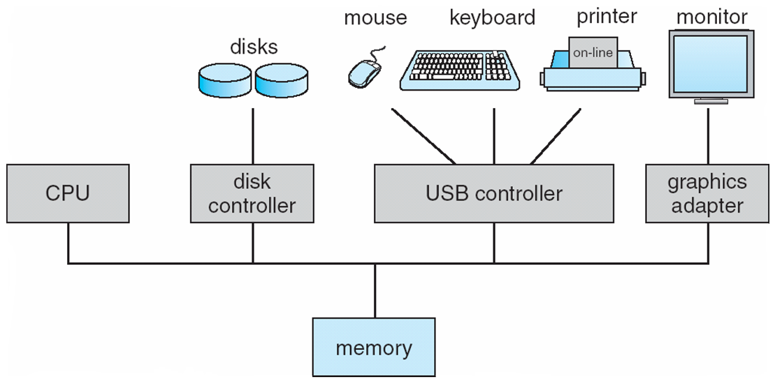
Operating system
A software layer to
manage resources
provide an abstract interface to application developers
Applications
OS
Hardware

Slide 4
Typical OS functions
Language extensions / standard library
Mathematical operations
(abs, sqrt, ...)
Abstract data types
(String, Date, ...)
Output functions
(printChar, printString ...)
Input functions
(readChar, readLine ...)
Graphics functions
(drawPixel, drawCircle, ...)
And more ...
System-oriented services
Memory management
(objects, arrays, ...)
I/O device drivers
Mass storage
File system
Multi-tasking
UI management (shell / windows)
Security
Communications
And more ...

Slide 5
Jack revisited
/** Computes the average of a sequence of integers. */
class Main {
function void main() {
var Array a;
var int length;
var int i, sum;
let length = Keyboard.readInt(”How many numbers? ”);
let a = Array.new(length); // Constructs the array
let i = 0;
while (i < length) {
let a[i] = Keyboard.readInt(”Enter the next number: ”);
let sum = sum + a[i];
let i = i + 1;
}
do Output.printString(”The average is: ”);
do Output.printInt(sum / length);
do Output.println();
return;
}
}

Slide 6
Jack revisited
/** Computes the average of a sequence of integers. */
class Main {
function void main() {
var Array a;
var int length;
var int i, sum;
let length = Keyboard.readInt(”How many numbers? ”);
let a = Array.new(length); // Constructs the array
let i = 0;
while (i < length) {
let a[i] = Keyboard.readInt(”Enter the next number: ”);
let sum = sum + a[i];
let i = i + 1;
}
do Output.printString(”The average is: ”);
do Output.printInt(sum / length);
do Output.println();
return;
}
}

Slide 7
The Jack OS
Math: Provides basic mathematical operations;
String: Implements the String type and related operations;
Array: Implements the Array type and related operations;
Output: Handles text output to the screen;
Screen: Handles graphic output to the screen;
Keyboard: Handles user input from the keyboard;
Memory: Handles memory operations;
Sys: Provides some execution-related services.

Slide 8
Jack OS API
class Math {
function void init()
function int abs(int x)
function int multiply(int x, int y)
function int divide(int x, int y)
function int min(int x, int y)
function int max(int x, int y)
function int sqrt(int x)
}

Slide 9
Jack OS API
Class String {
constructor String new(int maxLength)
method void dispose()
method int length()
method char charAt(int j)
method void setCharAt(int j, char c)
method String appendChar(char c)
method void eraseLastChar()
method int intValue()
method void setInt(int j)
function char backSpace()
function char doubleQuote()
function char newLine()
}

Slide 10
Jack OS API
Class Array {
function Array new(int size)
method void dispose()
}
class Memory {
function int peek(int address)
function void poke(int address, int value)
function Array alloc(int size)
function void deAlloc(Array o)
}

Slide 11
Jack OS API
class Output {
function void moveCursor(int i, int j)
function void printChar(char c)
function void printString(String s)
function void printInt(int i)
function void println()
function void backSpace()
}
Class Screen {
function void clearScreen()
function void setColor(boolean b)
function void drawPixel(int x, int y)
function void drawLine(int x1, int y1, int x2, int y2)
function void drawRectangle(int x1, int y1, int x2, int y2)
function void drawCircle(int x, int y, int r)
}

Slide 12
Jack OS API
Class Keyboard {
function char keyPressed()
function char readChar()
function String readLine(String message)
function int readInt(String message)
}
Class Sys {
function void halt():
function void error(int errorCode)
function void wait(int duration)
}

Slide 13
A typical OS:
Is modular and scalable
Empowers programmers (language extensions)
Empowers users (file system, GUI, ...)
Closes gaps between software and hardware
Runs in “protected mode”
Typically written in some high level language
Typically grows gradually, assuming more and more functions
Must be efficient.

Slide 14
Efficiency
We have to implement various operations on n-bit binary numbers
(n = 16, 32, 64, ...).
For example, consider multiplication
Naïve algorithm: to multiply x*y: { for i = 1 ... y do sum = sum + x }
Run-time is proportional to y
In a 64-bit system, y can be as large as 2^{64.}
Multiplications can take years to complete
Algorithms that operate on n-bit inputs can be either:
  Naïve: run-time is proportional to the value of the n-bit inputs
  Good: run-time is proportional to n, the input’s size.

Slide 15
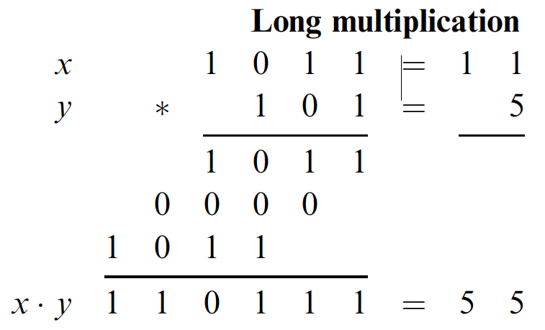
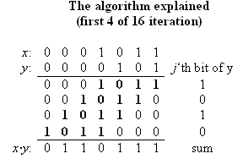
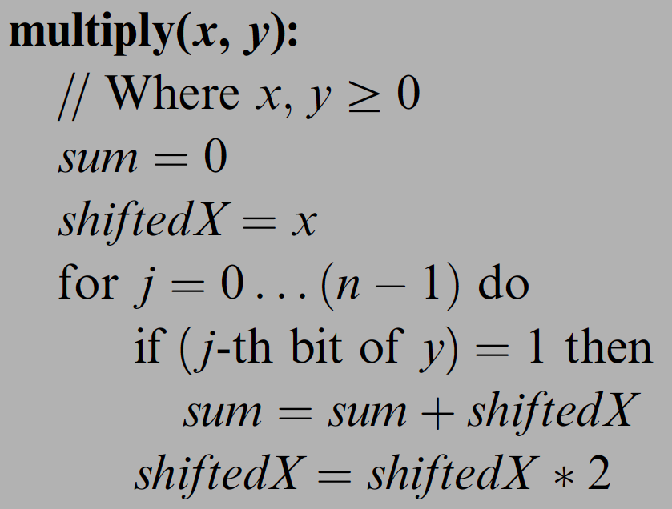
Example I: multiplication
Run-time: proportional to n
Can be implemented in SW or HW
Division: similar idea.

Slide 16
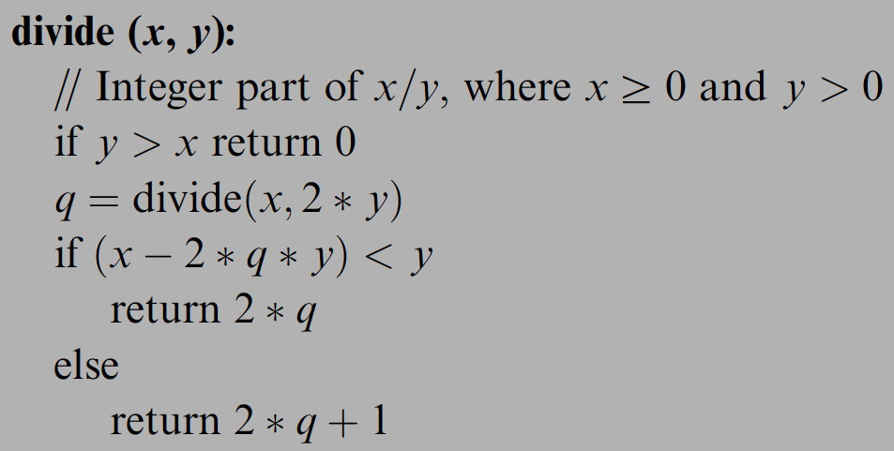
Division
Run-time: proportional to n instead of y

Slide 17
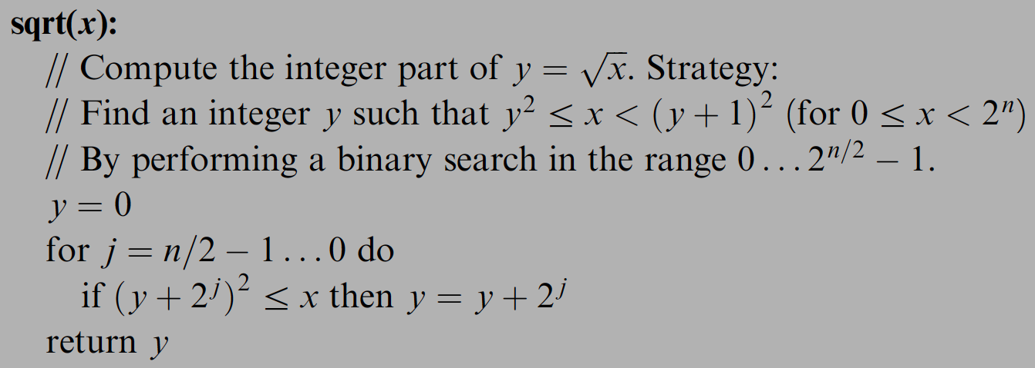
Example II: square root
The square root function has two convenient properties:
  Its inverse function is computed easily
  Monotonically increasing
Functions that have these two properties can be computed by binary search:
Number of loop iterations is bounded by n/2, thus the run-time is O(n).

Slide 18
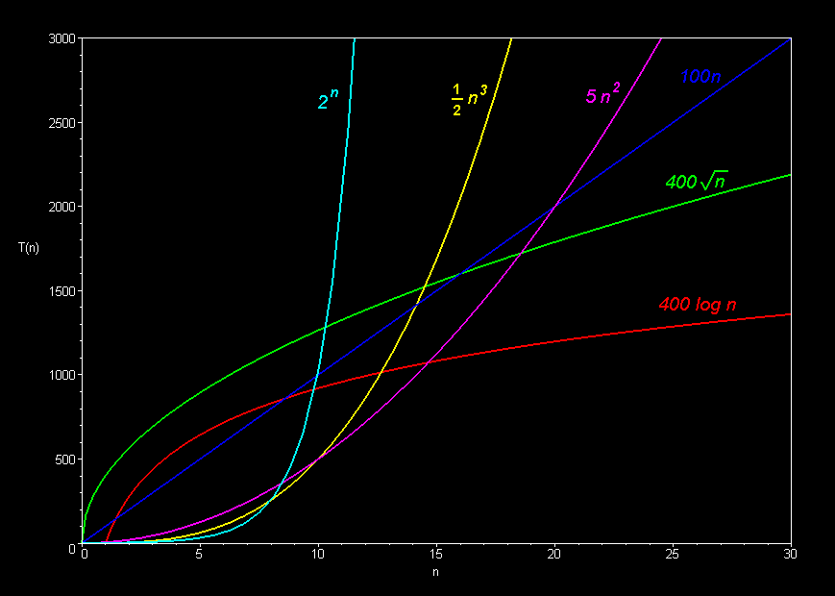
Complexity

Slide 19
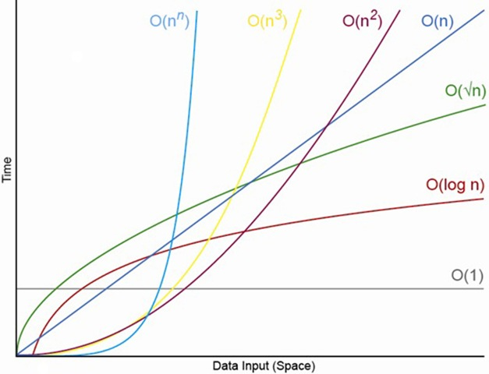
Complexity

Slide 20
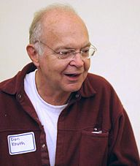
Donald Knuth 高德納
Born in 1938
Author of “The Art of Computer Programming”
《美國科學家》（American Scientist）雜誌曾將該書與愛因斯坦的《相對論》、狄拉克的《量子力學》、理查·費曼的《量子電動力學》等書並列為20世紀最重要的12本物理科學類專論書之一。
Creator of Tex and metafont
Turing Award, 1974
$2.56 check
Sorting animation 1 2

Slide 21
Math operations (in the Jack OS)
class Math {
class String {
class Array {
class Math {
function void init()
function int abs(int x)
function int multiply(int x, int y)
function int divide(int x, int y)
function int min(int x, int y)
function int max(int x, int y)
function int sqrt(int x)
}
class Output {
class Screen {
class Memory {
class Keyboard {
class Sys {
function (…)
…
}



The remaining functions are simple to implement.

Slide 22
String processing (in the Jack OS)
class Math {
class String {
Class String {
constructor String new(int maxLength)
method void dispose()
method int length()
method char charAt(int j)
method void setCharAt(int j, char c)
method String appendChar(char c)
method void eraseLastChar()
method int intValue()
method void setInt(int j)
function char backSpace()
function char doubleQuote()
function char newLine()
}
class Array {
class Output {
class Screen {
class Memory {
class Keyboard {
class Sys {
function (…)
…
}

Slide 23
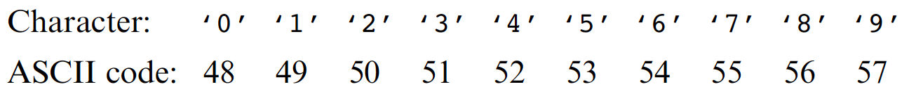
Single digit ASCII conversions
asciiCode(digit) == digit + 48
digit(asciiCode) == asciiCode - 48

Slide 24
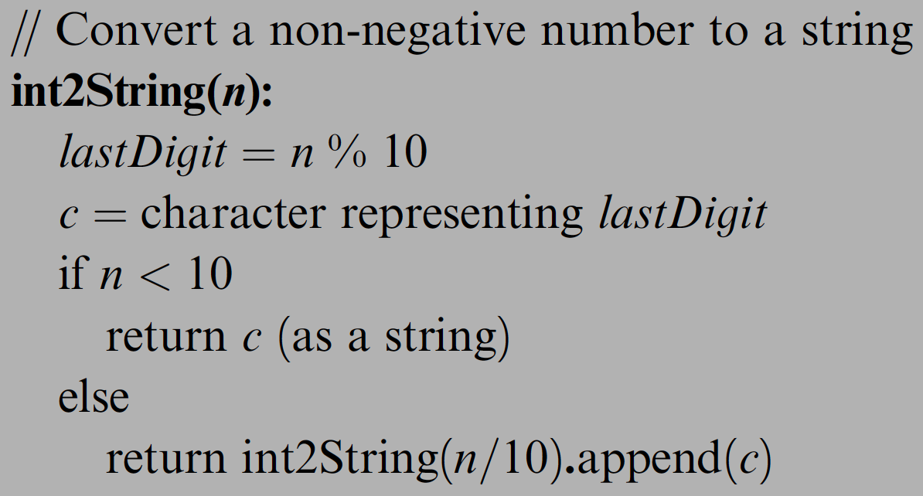
Converting a number to a string
SingleDigit–to-character conversions: done
Number–to-string conversions:

Slide 25
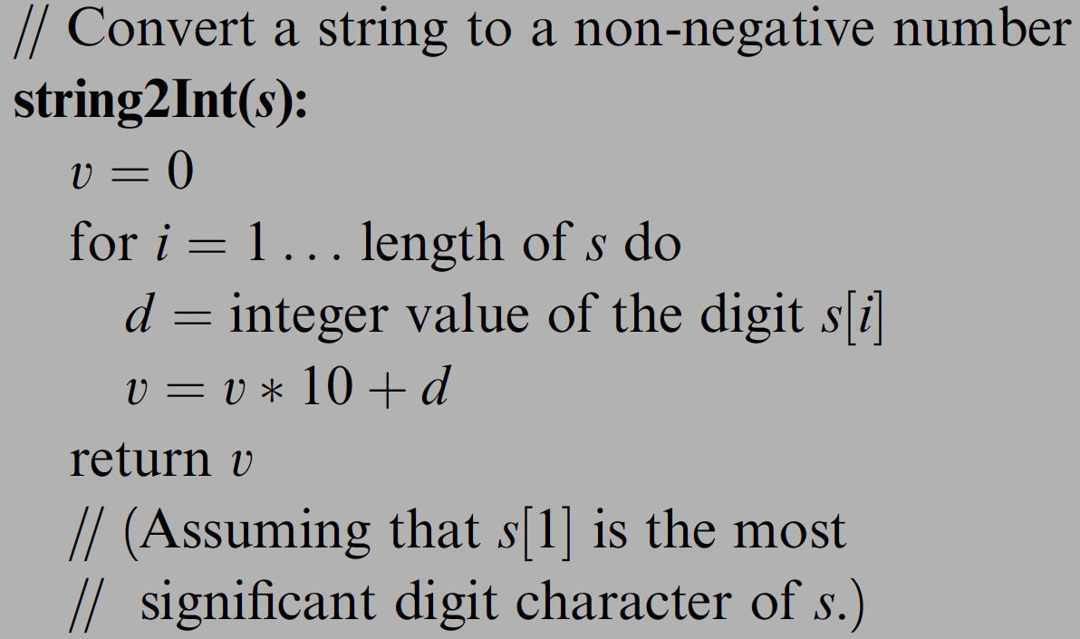
Converting a number to a string
SingleDigit–to-character conversions: done
Number–to-string conversions:

Slide 26
Memory management (in the Jack OS)
class Math {
class String {
class Array {
class Output {
class Screen {
class Memory {
class Keyboard {
class Sys {
function (…)
…
}
class Memory {
function int peek(int address)
function void poke(int address, int value)
function Array alloc(int size)
function void deAlloc(Array o)
}

Slide 27
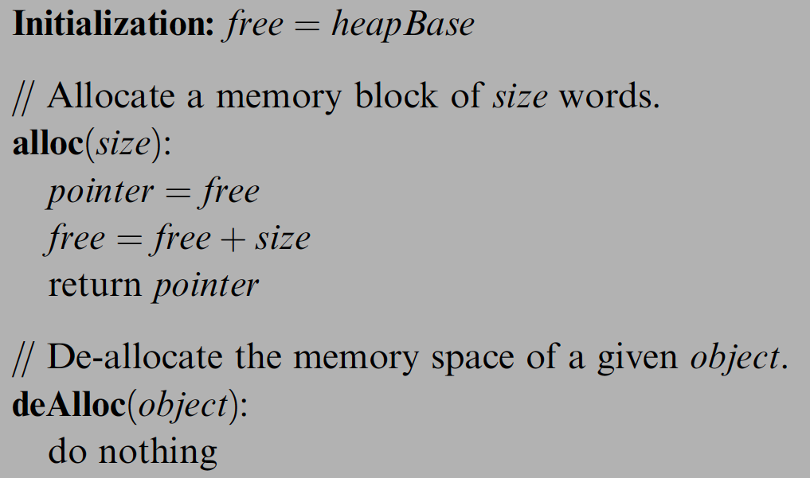
Memory management (naive)
When a program constructs (destructs) an object, the OS has to allocate (de-allocate) a RAM block on the heap:
  alloc(size): returns a reference to a free RAM block of
  size size
  deAlloc(object): recycles the RAM block that object refers to
The data structure that this algorithm manages is a single pointer: free.

Slide 28
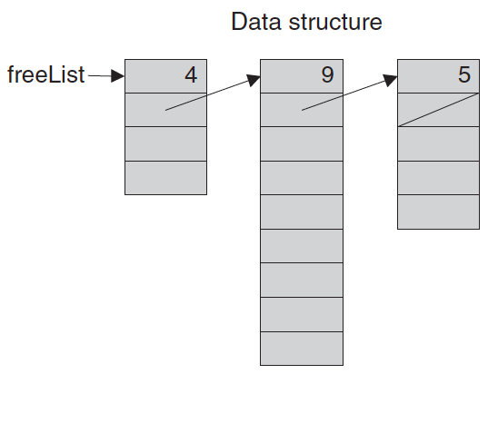
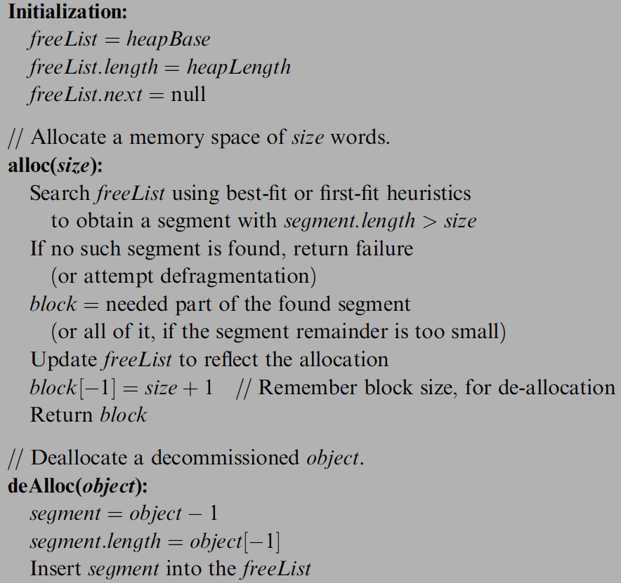
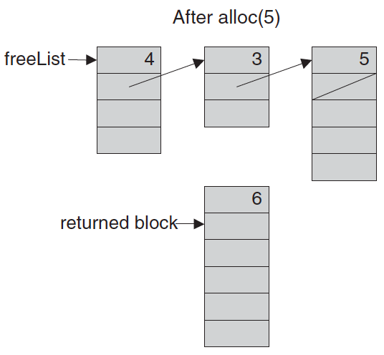
Memory management (improved)

Slide 29
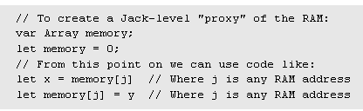
Peek and poke
class Memory {
function int peek(int address)
function void poke(int address, int value)
function Array alloc(int size)
function void deAlloc(Array o)
}
Implementation: based on our ability to exploit exotic casting in Jack:

Slide 30
Graphics primitives (in the Jack OS)
class Math {
class String {
class Array {
class Output {
class Screen {
class Memory {
class Keyboard {
class Sys {
function (…)
…
}
Class Screen {
function void clearScreen()
function void setColor(boolean b)
function void drawPixel(int x, int y)
function void drawLine(int x1, int y1, int x2, int y2)
function void drawRectangle(int x1, int y1,int x2, int y2)
function void drawCircle(int x, int y, int r)
}

Slide 31
Memory-mapped screen
Memory
Screen
mapBase

Slide 32
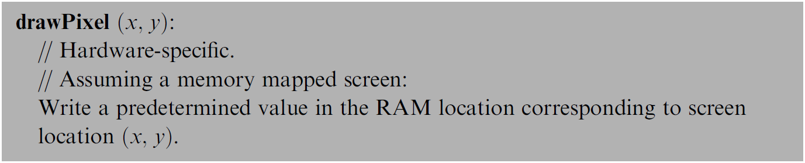
Pixel drawing
Implementation: using poke(address,value)

Slide 33
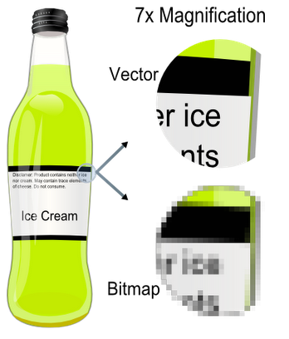
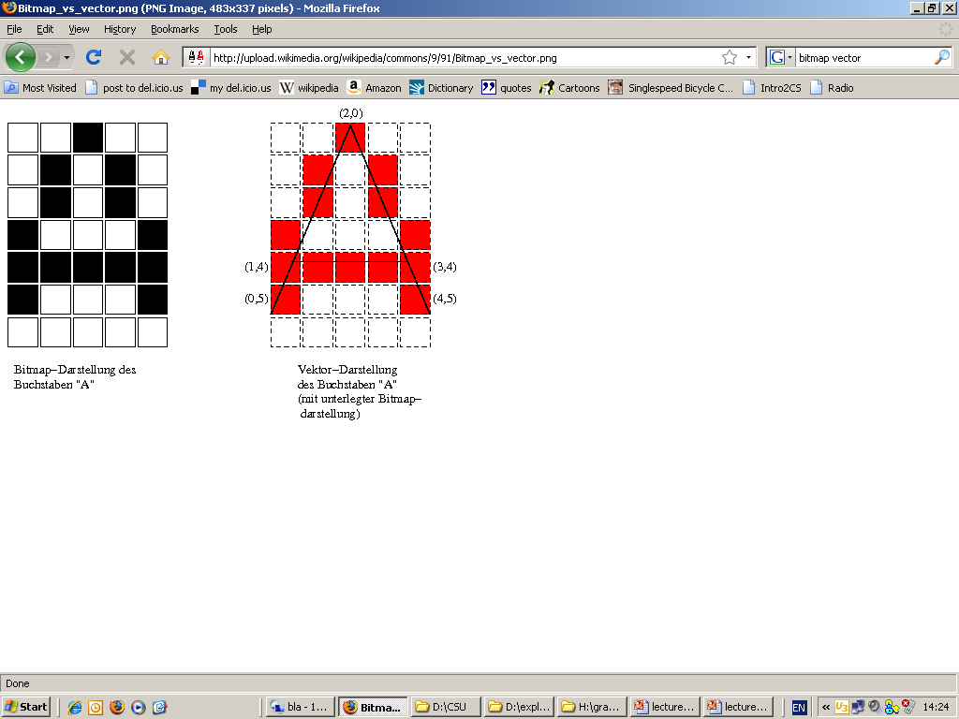
Image representation: bitmap versus vector graphics
pixel
(0,0)
bitmap
vector
Bitmap file: 00100, 01010,01010,10001,11111,10001,00000, . . .
Vector graphics file: drawLine(2,0,0,5), drawLine(2,0,4,5), drawLine(1,4,3,4)
Pros and cons of each method.
Notes:
33

Slide 34

Vector graphics: basic operations
0
1
2
3
.
.
.
0
drawPixel(x,y)
(Primitive operation)
1
2
drawLine(x1,y1,x2,y2)
3
Screen =
grid of pixels
.
drawCircle(x,y,r)
.
.
drawRectangle(x1,y1,x2,y2)
drawTriangle(x1,y1,x2,y2,x3,y3)
etc. (a few more similar operations)
0
1
2
3
4
5
6
7
8
9
10
11
12
13
0
1
drawLine(0,3,0,11)
drawRectangle(1,3,5,9)
drawLine(1,12,2,12)
drawLine(3,10,3,11)
drawLine(6,4,6,9)
drawLine(7,0,7,12)
drawLine(8,1,8,12)
2
3
4
5
6
7
8
9
Notes:
34

Slide 35
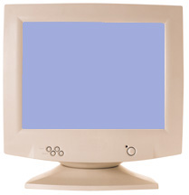
How to draw a line?
drawLine(x1,y1,x2,y2)
Basic idea: drawLine is implemented through a sequence of drawPixel operations
Challenge 1: which pixels should be drawn ?
Challenge 2: how to draw the line fast ?
Simplifying assumption: the line that we are asked to draw goes north-east.
Notes:
35

Slide 36
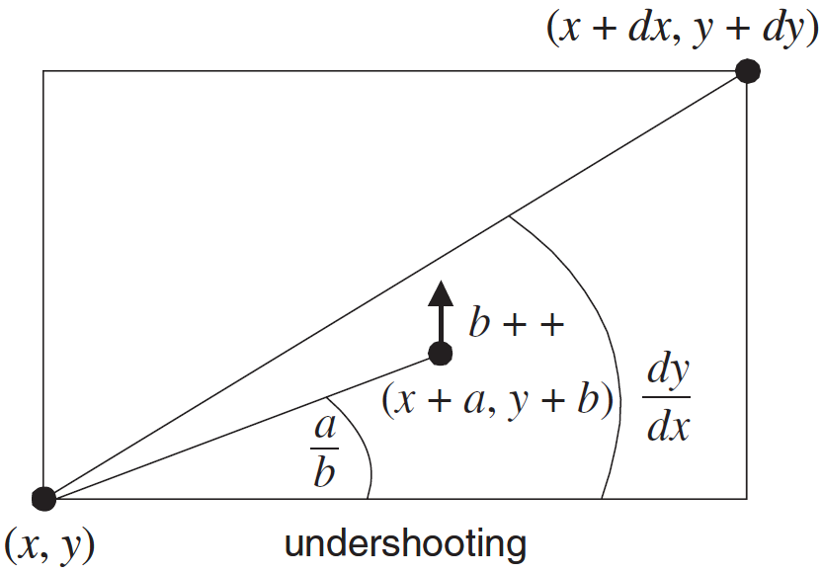


Line Drawing
Given: drawLine(x1,y1,x2,y2)
Notation: x=x1, y=y1, dx=x2-x1, dy=y2-y1
Using the new notation:
We are asked to draw a line
between (x,y) and (x+dx,y+dy)
set (a,b) = (0,0)
while there is more work to do
drawPixel(x+a,y+b)
decide if you want to go right, or up
if you decide to go right, set a=a+1;
if you decide to go up, set b=b+1
set (a,b) = (0,0)
while (a ≤ dx) and (b ≤ dy)
drawPixel(x+a,y+b)
decide if you want to go right, or up
if you decide to go right, set a=a+1;
if you decide to go up, set b=b+1
Notes:
36

Slide 37
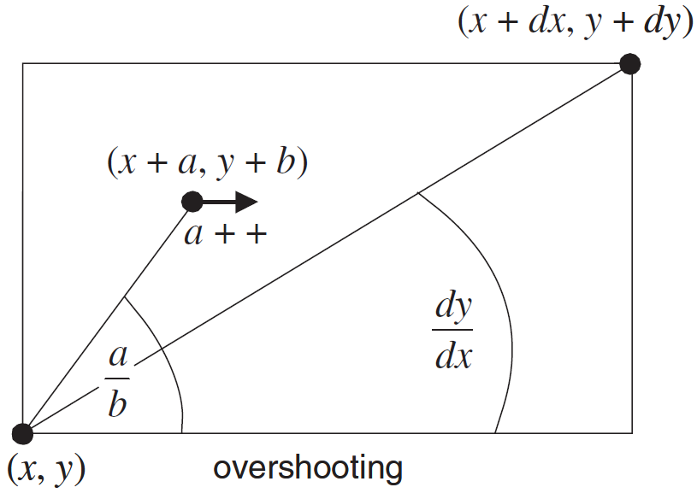
Line Drawing algorithm
drawLine(x,y,x+dx,y+dy)
set (a,b) = (0,0)
while (a ≤ dx) and (b ≤ dy)
drawPixel(x+a,y+b)
decide if you want to go right, or up
if you decide to go right, set a=a+1;
if you decide to go up, set b=b+1
drawLine(x,y,x+dx,y+dy)
set (a,b) = (0,0)
while (a ≤ dx) and (b ≤ dy)
drawPixel(x+a,y+b)
if b/a > dy/dx set a=a+1
else set b=b+1
costy
Notes:
37

Slide 38
Line Drawing algorithm, optimized
Motivation
When you draw polygons, e.g. in animation or video, you need to draw millions of lines
Therefore, drawLine must be ultra fast
Division is a very slow operation
Addition is ultra fast (hardware based)
drawLine(x,y,x+dx,y+dy)
set (a,b) = (0,0)
while (a ≤ dx) and (b ≤ dy)
drawPixel(x+a,y+b)
if b/a > dy/dx set a=a+1
else set b=b+1
b/a > dy/dx is the same as a*dy < b*dx
Define diff = a*dy – b*dx
Let’s take a close look at this diff:
b/a > dy/dx is the same as diff < 0
When we set (a,b)=(0,0), diff = 0
When we set a=a+1, diff goes up by dy
When we set b=b+1, diff goes down by dx
drawLine(x,y,x+dx,y+dy)
set (a,b) = (0,0), diff = 0
while (a ≤ dx) and (b ≤ dy)
drawPixel(x+a,y+b)
if diff < 0 set a=a+1, diff = diff + dy
else set b=b+1, diff = diff - dx
Notes:
38

Slide 39
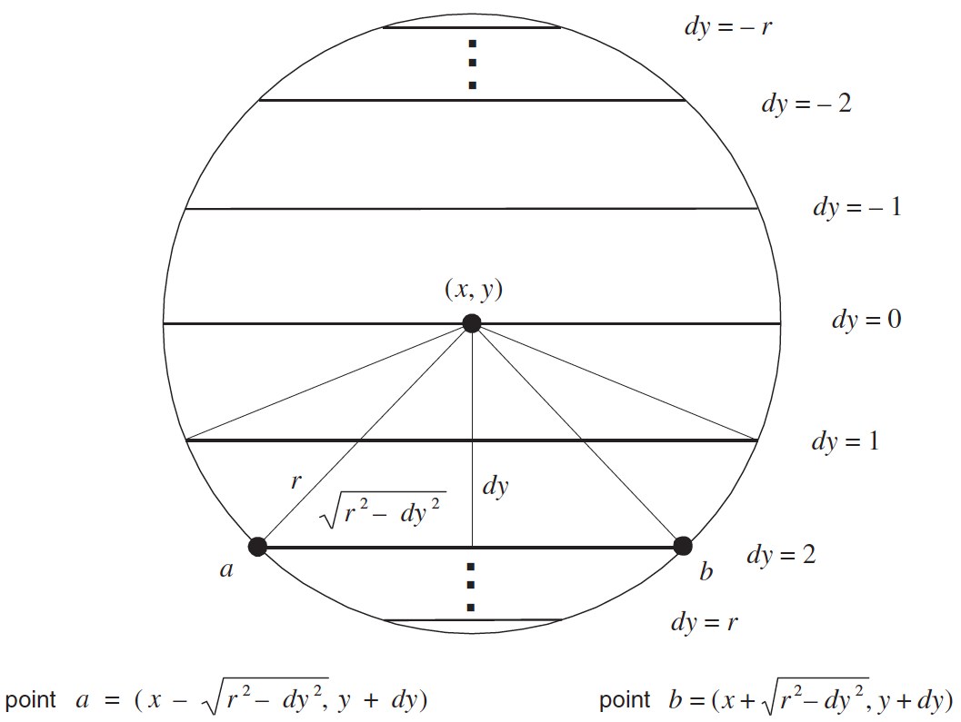
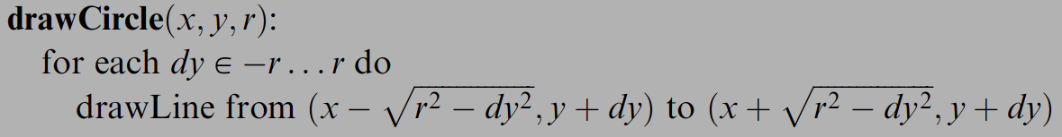
Circle drawing
The screen origin (0,0)
is at the top left.

Slide 40
To sum up (vector graphics)…
To do vector graphics (e.g. display a PPT file), you have to draw polygons
To draw polygons, you need to draw lines
To draw lines, you need to divide
Division can be
re-expressed as multiplication
Multiplication can be
reduced to addition
Addition is easy.
Notes:
40

Slide 41
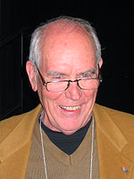
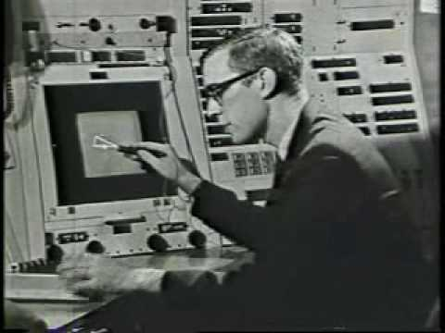
Ivan Sutherland
Born in 1938
PhD dissertation on Sketchpad (3D demo), 1963
one of the most influential computer programs ever written. This work was seminal in Human-Computer Interaction, Graphics and Graphical User Interfaces (GUIs), Computer Aided Design (CAD), and contraint/object-oriented programming.
TX-2 computer (built circa 1958) on which the software ran was built from discrete transistors (not integrated circuits -it was room-sized) and contained just 64K of 36-bit words (~272k bytes).
PhD advisor: Claude Shannon
Father of computer graphics
Turing Award, 1988

Slide 42
Character output primitives (in the Jack OS)
class Math {
class String {
class Array {
class Output {
class Screen {
class Memory {
class Keyboard {
class Output {
function void moveCursor(int i, int j)
function void printChar(char c)
function void printString(String s)
function void printInt(int i)
function void println()
function void backSpace()
}
class Sys {
function (…)
…
}

Slide 43
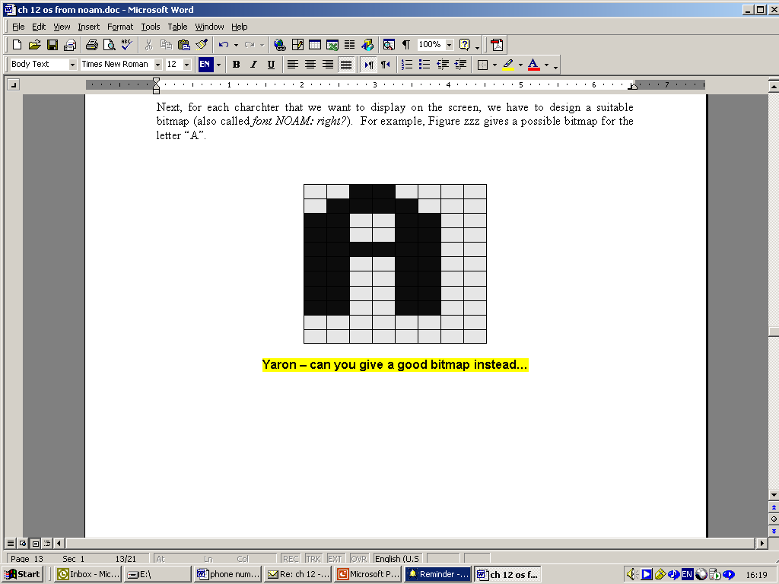
Character output
Given display: a physical screen, say 256 rows by 512 columns
We can allocate an 11 by 8 grid for each character
Hence, our output package should manage a 23 lines by 64 characters screen
Font: each displayable character must have an agreed-upon bitmap
In addition, we have to manage a “cursor”.

Slide 44
Font implementation (in the Jack OS)
class Output {
static Array charMaps;
function void initMap() {
let charMaps = Array.new(127);
// Assign a bitmap for each character
do Output.create(32,0,0,0,0,0,0,0,0,0,0,0); // space
do Output.create(33,12,30,30,30,12,12,0,12,12,0,0); // !
do Output.create(34,54,54,20,0,0,0,0,0,0,0,0); // “
do Output.create(35,0,18,18,63,18,18,63,18,18,0,0); // #
...
do Output.create(48,12,30,51,51,51,51,51,30,12,0,0); // 0
do Output.create(49,12,14,15,12,12,12,12,12,63,0,0); // 1
do Output.create(50,30,51,48,24,12,6,3,51,63,0,0); // 2
. . .
do Output.create(65,0,0,0,0,0,0,0,0,0,0,0); // A ** TO BE FILLED **
do Output.create(66,31,51,51,51,31,51,51,51,31,0,0); // B
do Output.create(67,28,54,35,3,3,3,35,54,28,0,0); // C
. . .
return;
}

Slide 45
Font implementation (in the Jack OS)
// Creates a character map array
function void create(int index, int a, int b, int c, int d, int e,
int f, int g, int h, int i, int j, int k) {
var Array map;
let map = Array.new(11);
let charMaps[index] = map;
let map[0] = a;
let map[1] = b;
let map[2] = c;
...
let map[10] = k;
return;
}

Slide 46
Keyboard primitives (in the Jack OS)
class Math {
class String {
class Array {
class Output {
class Screen {
class Memory {
class Keyboard {
class Sys {
function (…)
…
}
Class Keyboard {
function char keyPressed()
function char readChar()
function String readLine(String message)
function int readInt(String message)
}

Slide 47
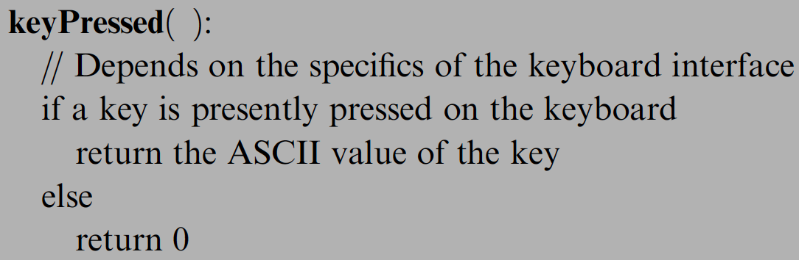
Keyboard input
If the RAM address of the keyboard’s memory map is known,
the above logic can be implemented using a peek function
Problem I: the elapsed time between a “key press” and key release” events is unpredictable
Problem II: when pressing a key, the user should get some visible feedback (cursor, echo, ...).

Slide 48
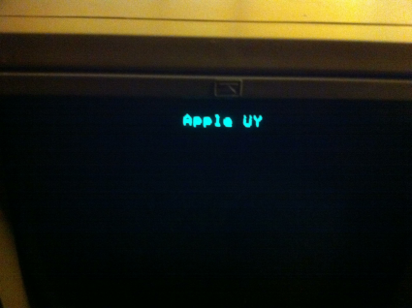
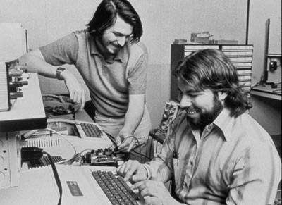
A historic moment remembered
… Wozniak began writing the software that would get the microprocessor to display images on the screen. After a couple of month he was ready to test it. “I typed a few keys on the keyboard and I was shocked! The letters were displayed on the screen.”
It was Sunday, June 29, 1975, a milestone for the personal computer. “It was the first time in history,” Wozniak later said, “anyone had typed a character on a keyboard and seen it show up on their own computer’s screen right in front of them”
(Steve Jobs, by Walter Isaacson, 2012)

Slide 49
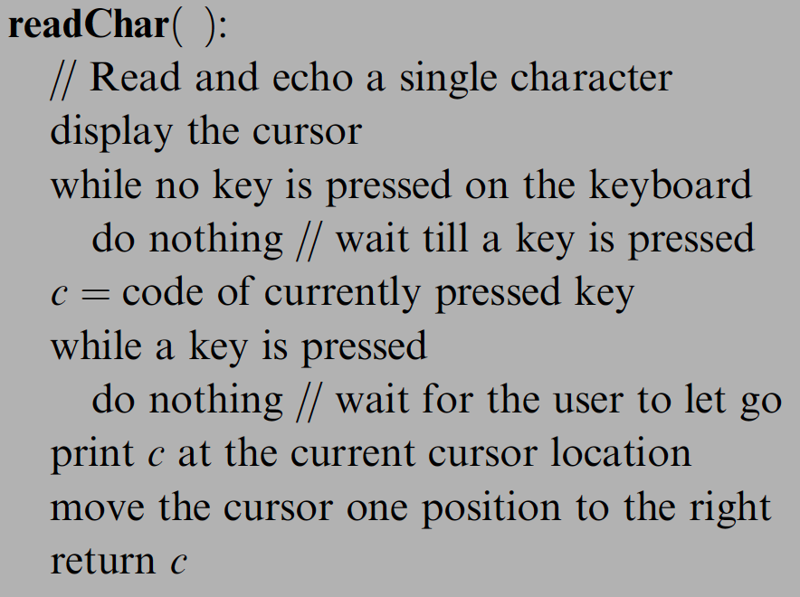
Keyboard input (cont.)

Slide 50
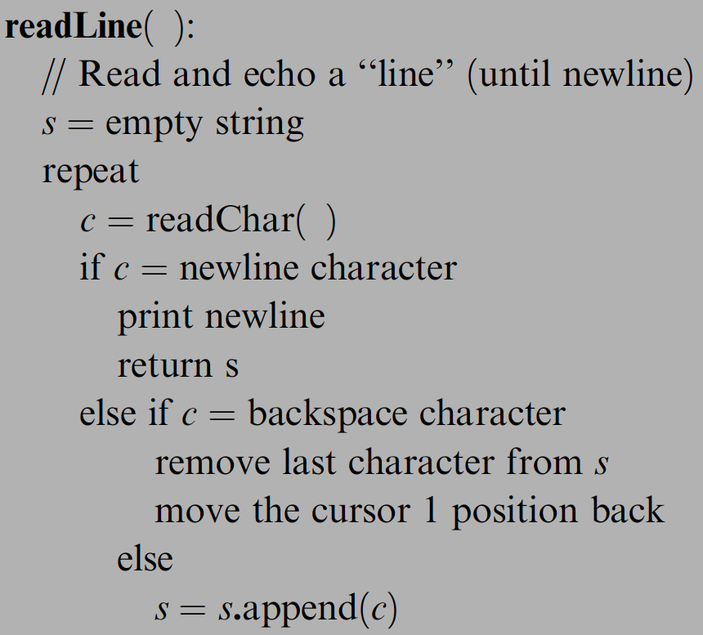
Keyboard input (cont.)

Slide 51
Jack OS recap
Project 12:
Build it.
class Math {
function void init()
function int abs(int x)
Class String {
Class Array {
function Array new(int size)
method void dispose()
}
class Output {
Class Screen {
class Memory {
function int peek(int address)
Class Keyboard {
Class Sys {
function void halt():
function void error(int errorCode)
function void wait(int duration)
}
Implementation: just like GNU Unix and Linux were built:
Start with an existing system,
and gradually replace it with a new system,
one library at a time.

Slide 52
Perspective
What we presented can be described as a:
  mini OS
  Standard library
Many classical OS functions are missing
No separation between user mode and OS mode
Some algorithms (e.g. multiplication and division) are standard
Other algorithms (e.g. line- and circle-drawing) can be accelerated with special hardware
And, by the way, we’ve just finished building the computer.

Slide 53
Operating system
A software layer to
manage resources
provide an abstract interface to application developers
Applications
OS
Hardware

Slide 54
Operating system
An OS mediates programs’ access to hardware resources
  Computation (CPU)
  Volatile storage (memory) and persistent storage (disk, etc.)
  Network communications (TCP/IP stacks, ethernet cards, etc.)
  Input/output devices (keyboard, display, sound card, etc.)
The OS abstracts hardware into logical resources and well-defined interfaces to those resources
  processes (CPU, memory)
  files (disk)
  sockets (network)

Slide 55
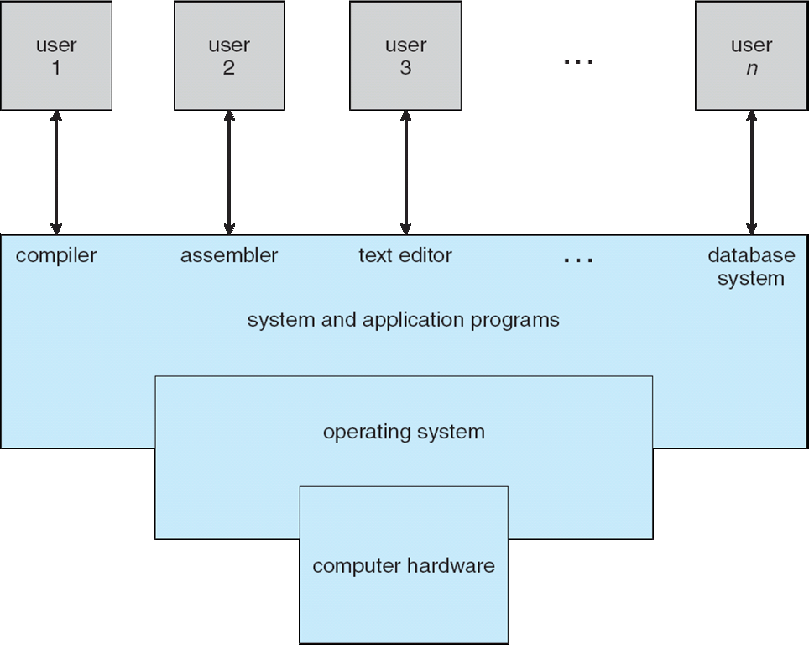
OS as a resource manager

Slide 56
A detailed view of OS
Slide by Tom Anderson

Slide 57
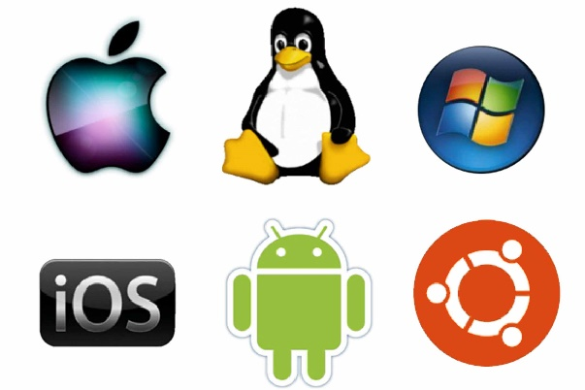
OS History
Slide by Tom Anderson
Notes:
Walk through some of the connections: Windows dragged in some tech from VMS and UNIX
If relevant, draw in Toy, Nachos, Pintos
Also: Pilot, Taos -> Nachos

Slide 58
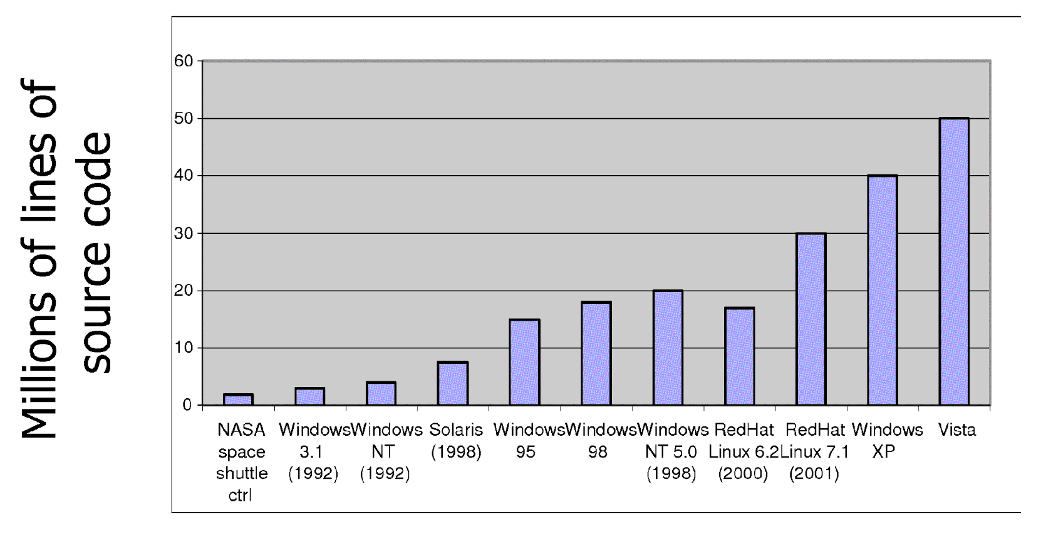
Increasing software complexity

Slide 59
Computer Performance Over Time
Slide by Tom Anderson
Notes:
If the OS code base lasts for 20 years, it has to survive between at least two of these columns – that’s a huge amount of change; a couple orders of magnitude in CPU speed, cost/performance, DRAM, and disk capacity. You often hear about More’s Law – how CPU has sped up a huge amount. But memory and disk have gone up by even more!
A lot of hardware has sped up, but some hasn’t. These relative performance changes are pretty important. Its not listed here, but disks have become much bigger, but they haven’t gotten much faster – a disk access still takes almost as long as it did in 1981, so the relative speed of the CPU and the disk has become enormous.
Same thing for the network: the Internet backbone has sped up a lot, but a bit harder to see that difference per machine.
Perhaps most interesting is the # of users per machine – that ratio has changed dramatically, and it’s a consequence of the 200K times change in cost/performance of computing. Here I have four computers doing just this presentation! (Tablet, portable, the one driving the monitor, the one handling the wireless hot spot)
Maybe things will suddenly stop, but more likely that we’ll see continued speed improvements. The right hand colum – you’d find that so painfully slow that you wouldn’t be able to stand it. Yet that’s what we had when I was in college. Most of your professional life, you’ll be using this right hand column as the illustration of how slow things were when you were in college!

Slide 60
OS Challenges
Performance
  Latency/response time
    How long does an operation take to complete?
  Throughput
    How many operations can be done per unit of time?
  Overhead
    How much extra work is done by the OS?
  Fairness
    How equal is the performance received by different users?
  Predictability
    How consistent is the performance over time?
Slide by Tom Anderson

Slide 61
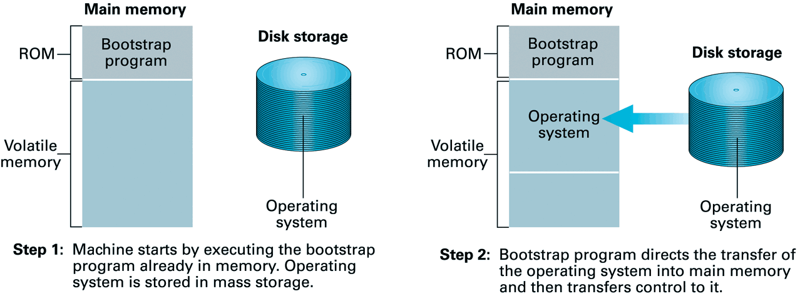
Booting
The bootstrap program and other basic input/output functions are contained in a special ROM, called BIOS (basic input/output system)
A program stored in ROM is called firmware.

Slide 62
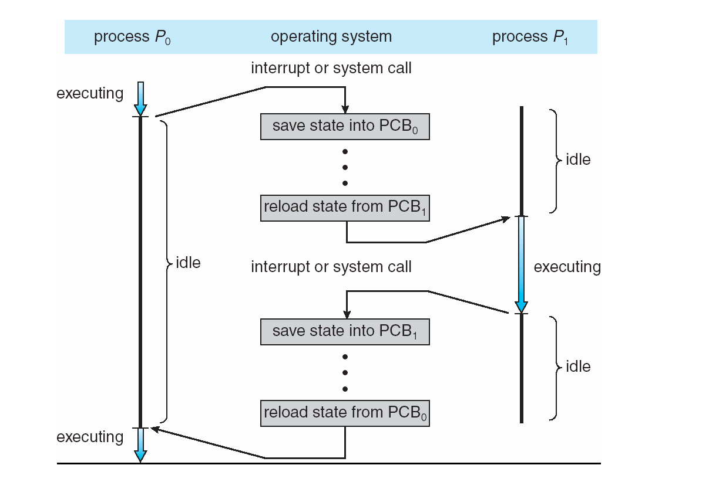
Process switching

Slide 63
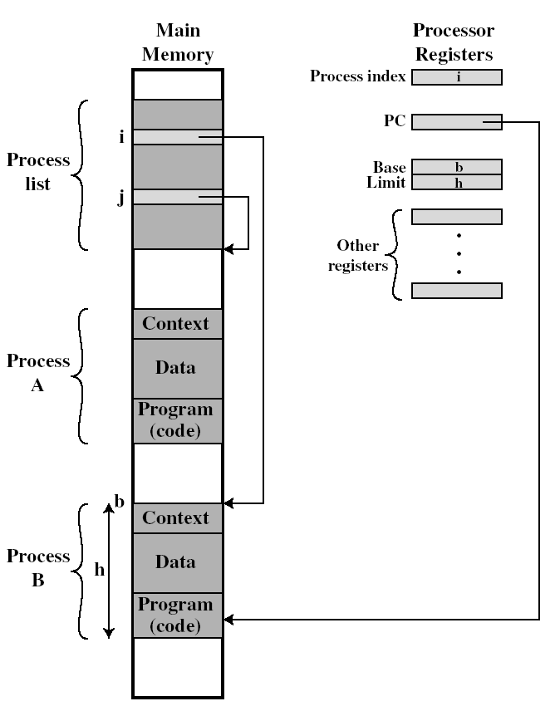
Process and context switching
When to switch?
  Call system service
  Interrupts (e.g. time slice)
Switch to which process?
  Scheduling: first-com-first-serve, shortest job first, round robin …
What to store/restore?
  Basically registers
Competition to resource
  Semaphore
  Critical section

Slide 64
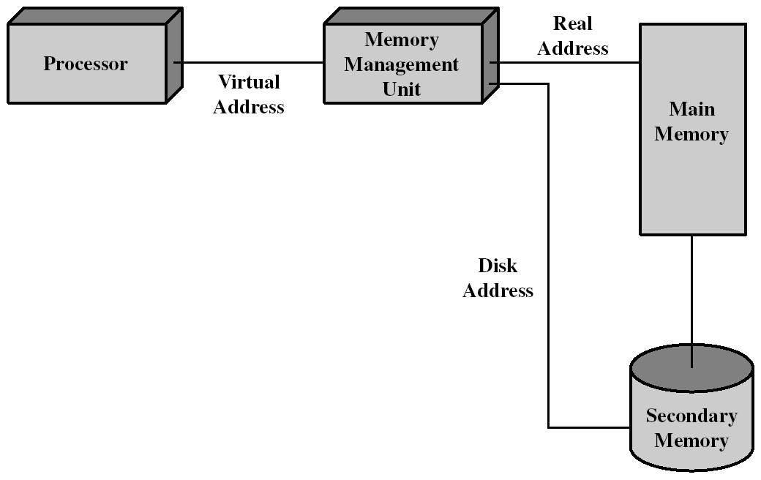
Memory management
64

Slide 65
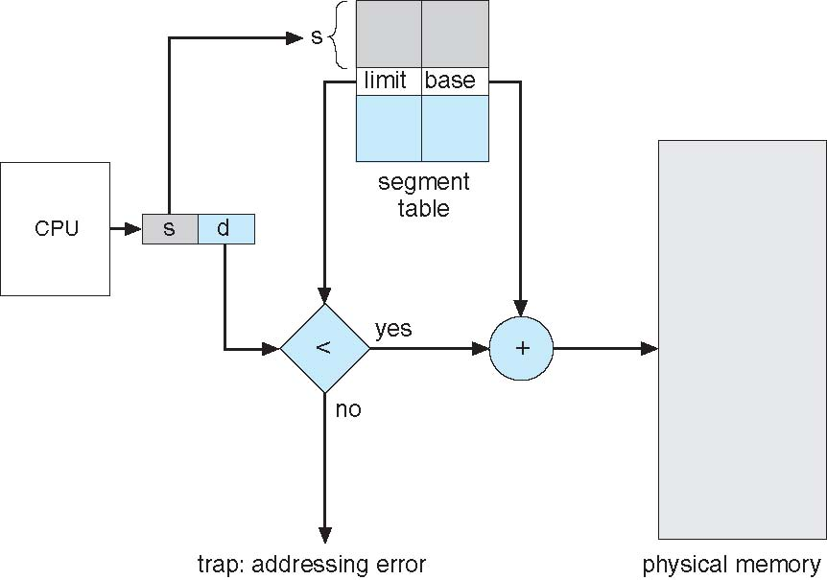
Segmentation hardware
Each process has its own segment table managed by OS.

Slide 66
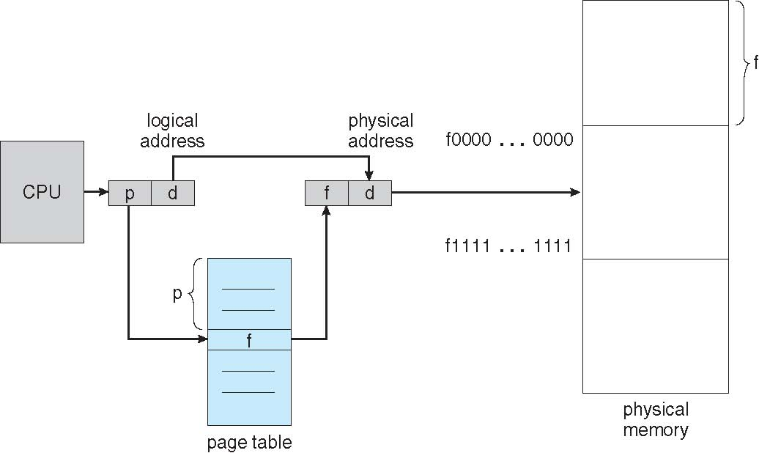
Paging hardware

Slide 67
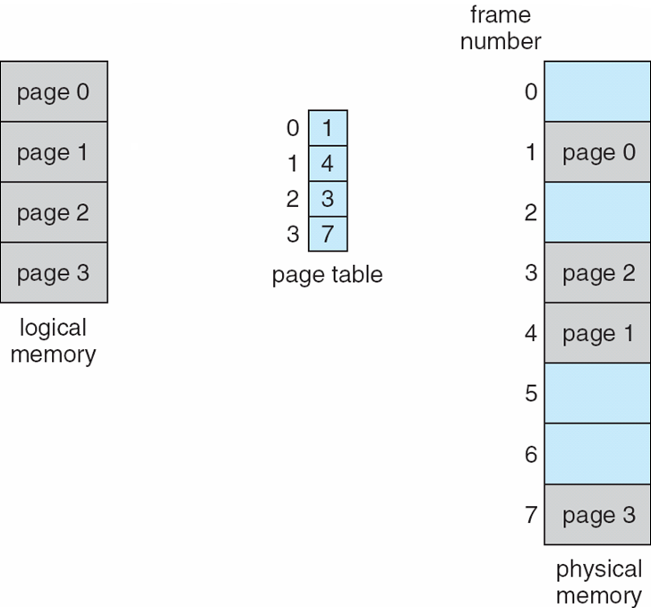
Paging example

Slide 68
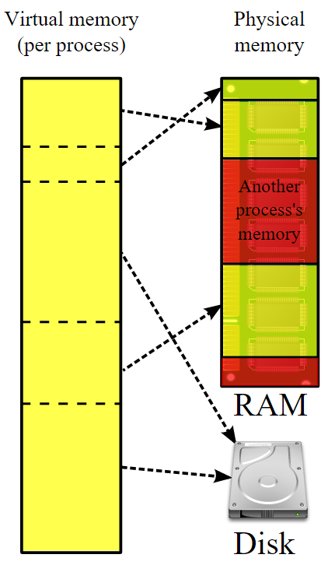
Virtual memory
The page could locate on the disk => virtual memory

Slide 69
Hierarchical file systems
Root directory
bin
cse
faculty
grads
ls
ps
cp
csh
elm
sbrandt
kag
amer4
classes
research
stuff
stuff

Slide 70
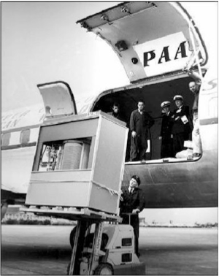
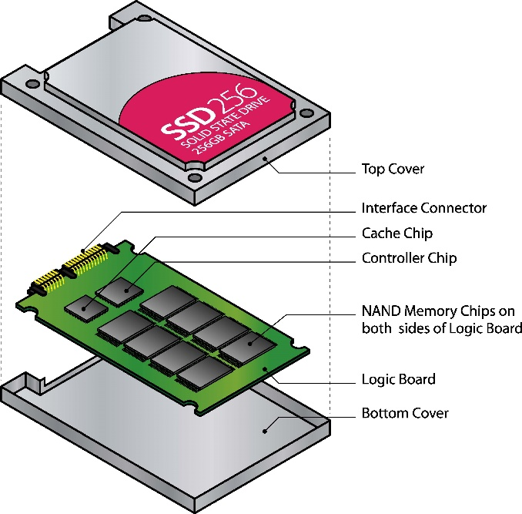
Storage
Hard Disk
Solid State Disk
1956 IBM RAMDAC computer included the IBM Model 350 disk storage system
(5M)

Slide 71
The tour map
線性代數 (二上)，機率 (二下)
資料結構與演算法(一下)，演算法設計與分析(二上)
系統程式設計(二上) ，計算機網路(三上)
Human
Abstract design
Compiler
Software
Thought
abstract interface
hierarchy
Chapters 9, 12
H.L. Language
Compiler
&
abstract interface
Operating Sys.
Chapters 10 - 11
Virtual
VM Translator
自動機與形式語言(三上)
作業系統(二下)
Machine
abstract interface
Chapters 7 - 8
Assembly
Course overview:
Building this world,
from the ground up
Language
Assembler
Chapter 6
abstract interface
Computer
Machine
Architecture
Language
abstract interface
數位電子與數位電路
(二上)
Chapters 4 - 5
Gate Logic
計算機結構(三上)
Hardware
abstract interface
Platform
Chapters 1 - 3
Electrical
Hardware
Chips &
Engineering
Logic Gates
Physics
hierarchy
數位系統與實驗(二下)

