Slide 1
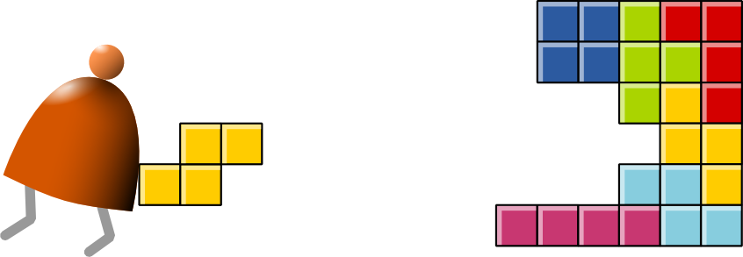
Compiler II: Code Generation
Building a Modern Computer From First Principles
www.nand2tetris.org
Notes:
1

Slide 2
Course map
Human
Abstract design
Software
Thought
abstract interface
hierarchy
Chapters 9, 12
H.L. Language
Compiler
&
abstract interface
Operating Sys.
Chapters 10 - 11
Virtual
VM Translator
Machine
abstract interface
Chapters 7 - 8
Assembly
Language
Assembler
Chapter 6
abstract interface
Computer
Machine
Architecture
Language
abstract interface
Chapters 4 - 5
Gate Logic
Hardware
abstract interface
Platform
Chapters 1 - 3
Electrical
Hardware
Chips &
Engineering
Logic Gates
Physics
hierarchy

Slide 3
The big picture
previous
chapter
1. Syntax analysis: extracting the semantics from the source code
2. Code generation: expressing the semantics using the target language
This
chapter

Slide 4
Syntax analysis (review)
Class Bar {
method Fraction foo(int y) {
var int temp; // a variable
let temp = (xxx+12)*-63;
...
...
<varDec>
<keyword> var </keyword>
<keyword> int </keyword>
<identifier> temp </identifier>
<symbol> ; </symbol>
</varDec>
<statements>
<letStatement>
<keyword> let </keyword>
<identifier> temp </identifier>
<symbol> = </symbol>
<expression>
<term>
<symbol> ( </symbol>
<expression>
<term>
<identifier> xxx </identifier>
</term>
<symbol> + </symbol>
<term>
<int.Const.> 12 </int.Const.>
</term>
</expression>
...
Syntax analyzer
The code generation challenge:
Program = a series of operations
that manipulate data
Compiler: converts each “understood” (parsed) source operation and data item into corresponding operations and data items in the target language

Slide 5
Syntax analysis (review)
Class Bar {
method Fraction foo(int y) {
var int temp; // a variable
let temp = (xxx+12)*-63;
...
...
<varDec>
<keyword> var </keyword>
<keyword> int </keyword>
<identifier> temp </identifier>
<symbol> ; </symbol>
</varDec>
<statements>
<letStatement>
<keyword> let </keyword>
<identifier> temp </identifier>
<symbol> = </symbol>
<expression>
<term>
<symbol> ( </symbol>
<expression>
<term>
<identifier> xxx </identifier>
</term>
<symbol> + </symbol>
<term>
<int.Const.> 12 </int.Const.>
</term>
</expression>
...
Syntax analyzer
The code generation challenge:
Thus, we have to generate code for
  handling data
  handling operations
Our approach: morph the syntax analyzer (project 10) into a full-blown compiler: instead of generating XML, we’ll make it generate VM code.

Slide 6
Memory segments (review)
VM memory Commands:
pop segment i
push segment i
Where i is a non-negative integer and segment is one of the following:
static: holds values of global variables, shared by all functions in
the same class
argument: holds values of the argument variables of the current function
local: holds values of the local variables of the current function
this: holds values of the private (“object”) variables of the current
object
that: holds array values (silly name, sorry)
constant: holds all the constants in the range 0 … 32767 (pseudo
memory segment)
pointer: used to anchor this and that to various areas in the heap
temp: fixed 8-entry segment that holds temporary variables for
general use; Shared by all VM functions in the program.

Slide 7
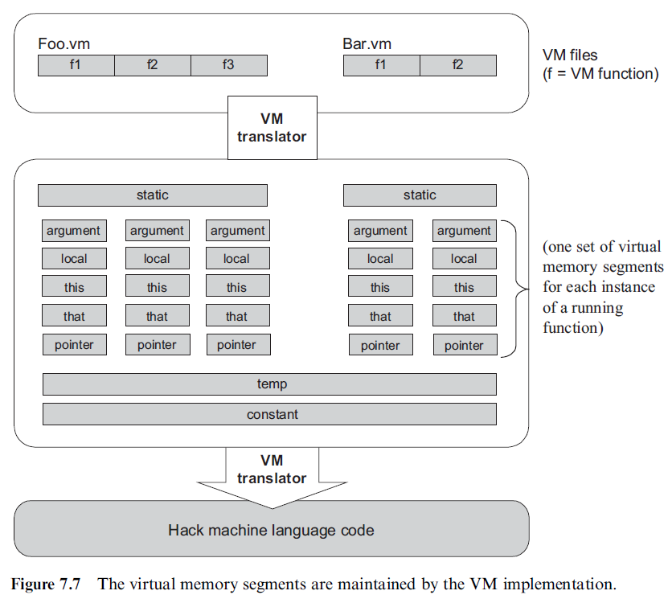
Memory segments (review)

Slide 8

VM implementation on the Hack platform (review)
Basic idea: the mapping of the stack and the global segments on the RAM is easy (fixed);
the mapping of the function-level segments is dynamic, using pointers
The stack: mapped on RAM[256 .. 2047];
The stack pointer is kept in RAM address SP
static: mapped on RAM[16 ... 255];
each segment reference static i appearing in a VM file named f is compiled to the assembly language symbol f.i (recall that the assembler further maps such symbols to the RAM, from address 16 onward)
Host
RAM
Notes:
8

Slide 9
VM implementation on the Hack platform (review)
local,argument: these method-level segments are stored in the stack, The base addresses of these segments are kept in RAM addresses LCL and ARG. Access to the i-th entry of any of these segments is implemented by accessing RAM[segmentBase + i]
this,that: these dynamically allocated segments are mapped somewhere from address 2048 onward, in an area called “heap”. The base addresses of these segments are kept in RAM addresses THIS, and THAT.
constant: a truly a virtual segment:
access to constant i is implemented by supplying the constant i.
pointer: contains this and that.
Host
RAM
Notes:
9

Slide 10
VM implementation on the Hack platform (review)
Global stack:
the entire RAM area dedicated for holding the stack
Working stack:
The stack that the current function sees
Notes:
10

Slide 11
VM implementation on the Hack platform (review)
At any point of time, only one function (the current function) is executing; other functions may be waiting up the calling chain
Shaded areas: irrelevant to the current function
The current function sees only the working stack, and has access only to its memory segments
The rest of the stack holds the frozen states of all the functions up the calling hierarchy.
Notes:
11

Slide 12
Code generation example
method int foo() {
var int x;
let x = x + 1;
...
(note that x is the first local variable
declared in the method)
<letStatement>
<keyword> let </keyword>
<identifier> x </identifier>
<symbol> = </symbol>
<expression>
<term>
<identifier> x </identifier>
</term>
<symbol> + </symbol>
<term>
<constant> 1 </constant>
</term>
</expression>
</letStatement>
Code
generation
Syntax
analysis
push local 0
push constant 1
add
pop local 0

Slide 13
Handling variables
When the compiler encounters a variable, say x, in the source code, it has to know:
What is x’s data type?
Primitive, or ADT (class name) ?
(Need to know in order to properly allocate RAM resources for its representation)
What kind of variable is x?
static, field, local, argument ?
( We need to know in order to properly allocate it to the right memory segment; this also implies the variable’s life cycle ).

Slide 14
Handling variables: mapping them on memory segments (example)
class BankAccount {
// class variables
static int nAccounts;
static int bankCommission;
// account propetrties
field int id;
field String owner;
field int balance;
method void transfer(int sum, BankAccount from, Date when){
var int i, j; // some local variables
var Date due; // Date is a user-define type
let balance = (balance + sum) – commission(sum * 5);
// More code ...
}
The target language uses 8 memory segments
Each memory segment, e.g. static, is an indexed sequence of 16-bit values that can be referred to as static 0, static 1, static 2, etc.

Slide 15
Handling variables: mapping them on memory segments (example)
class BankAccount {
// class variables
static int nAccounts;
static int bankCommission;
// account propetrties
field int id;
field String owner;
field int balance;
When compiling this class, we have to create the following mappings:
The class variables nAccounts , bankCommission
are mapped on static 0,1
The object fields id, owner, balance
are mapped on this 0,1,2

Slide 16
Handling variables: mapping them on memory segments (example)
method void transfer(int sum, BankAccount from, Date when){
var int i, j; // some local variables
var Date due; // Date is a user-define type
let balance = (balance + sum) – commission(sum * 5);
// More code ...
}
When compiling this class, we have to create the following mappings:
The class variables nAccounts , bankCommission
are mapped on static 0,1
The object fields id, owner, balance
are mapped on this 0,1,2
The argument variables sum, bankAccount, when
are mapped on argument 0,1,2
The local variables i, j, due
are mapped on local 0,1,2.

Slide 17
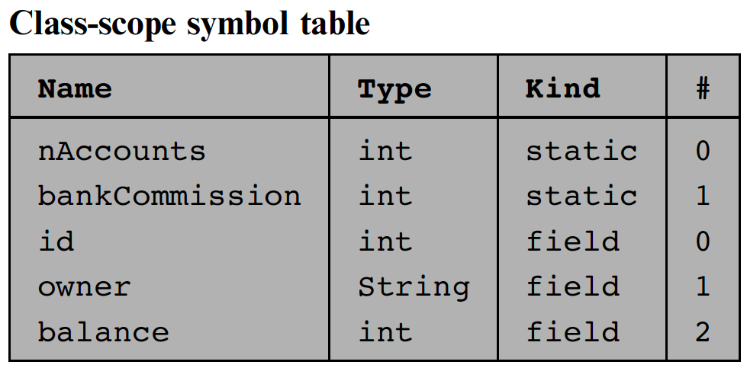
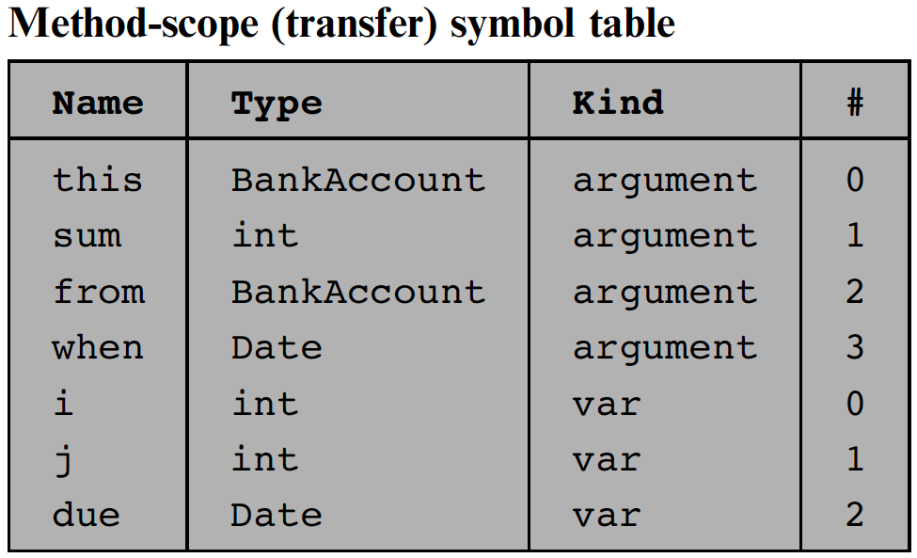
Handling variables: symbol tables
class BankAccount {
static int nAccounts;
static int bankCommission;
field int id;
field String owner;
field int balance;
method void transfer(int sum, BankAccount from, Date when){
var int i, j;
var Date due;
let balance = (balance + sum) – commission(sum * 5);
// More code ...
}
How the compiler uses symbol tables:
The compiler builds and maintains a linked list of hash tables, each reflecting a single scope nested within the next one in the list
Identifier lookup works from the current symbol table back to the list’s head
(a classical implementation).

Slide 18

Handling variables: managing their life cycle
Variables life cycle
static variables: single copy must be kept alive throughout the
program duration
field variables: different copies must be kept for each object
local variables: created on subroutine entry, killed on exit
argument variables: similar to local variables.
Good news: the VM implementation already handles all these details !

Slide 19
Handling objects: establishing access to the object’s fields
Background: Suppose we have an object named b of type Ball. A Ball has x, y coordinates, a radius, and a color.
Class Ball {
field int x, y, radius, color;
method void SetR(int r) { radius = r; }
}
...
Ball b; b=Ball.new();
b.SetR(17);

Slide 20
Handling objects: establishing access to the object’s fields
Class Ball {
...
void SetR(int r) { radius = r; }
}
...
Ball b;
b.SetR(17);

Slide 21

Handling objects: establishing access to the object’s fields
Class Ball {
...
void SetR(int r) { radius = r; }
}
...
Ball b;
b.SetR(17);
// Get b's base address:
push argument 0
// Point the this segment to b:
pop pointer 0
// Get r's value
push argument 1
// Set b's third field to r:
pop this 2
need to know which instance it is working on
need to pass the object into the function
=> Ball.SetR(b, 17)
this 0 is now aligned with RAM[3012]

Slide 22
Handling objects: construction / memory allocation
Java code
class Complex {
// Fields (properties):
int re; // Real part
int im; // Imaginary part
...
/** Constructs a new Complex number */
public Complex (int re, int im) {
this.re = re;
this.im = im;
}
...
}

Slide 23
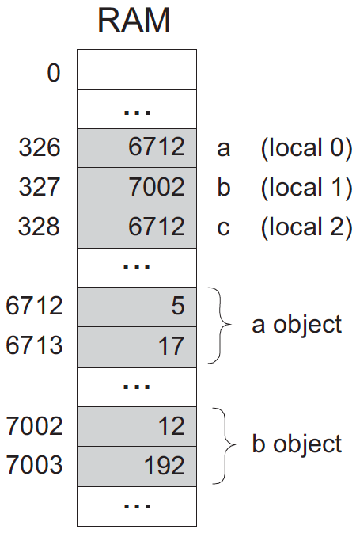
Handling objects: construction / memory allocation
Java code
class Foo {
public void bla() {
Complex a, b, c;
...
a = new Complex(5,17);
b = new Complex(12,192);
...
// Only the reference is copied
c = a;
...
}
Following
execution:

Slide 24
Handling objects: construction / memory allocation
Java code
How to compile:
foo = new ClassName(…)
The compiler generates code affecting:
foo = Memory.alloc(n)
Where n is the number of words necessary to represent the object in question, and Memory.alloc is an OS method that returns the base address of a free memory block of size n words.
class Foo {
public void bla() {
Complex a, b, c;
...
a = new Complex(5,17);
b = new Complex(12,192);
...
// Only the reference is copied
c = a;
...
}

Slide 25
Handling objects: accessing fields
Java code
class Complex {
// Fields (properties):
int re; // Real part
int im; // Imaginary part
...
/** Constructs a new Complex number */
public Complex (int re, int im) {
this.re = re;
this.im = im;
}
/** Multiplies this Complex number
by the given scalar */
public void mult (int c) {
re = re * c;
im = im * c;
}
...
}
How to compile:
im = im * c ?
1. look up the two variables in the symbol table
2. Generate the code:
*(this + 1) = *(this + 1)
times
(argument 0)
This pseudo-code should be expressed in the target language.

Slide 26
Handling objects: method calls
Java code
class Complex {
...
public void mult (int c) {
re = re * c;
im = im * c;
}
...
}
class Foo {
...
public void bla() {
Complex x;
...
x = new Complex(1,2);
x.mult(5);
...
}
}
How to compile:
x.mult(5) ?
This method call can also be viewed as:
mult(x,5)
Generate the following code:
push x
push 5
call mult

Slide 27
Handling objects: method calls
Java code
class Complex {
...
public void mult (int c) {
re = re * c;
im = im * c;
}
...
}
class Foo {
...
public void bla() {
Complex x;
...
x = new Complex(1,2);
x.mult(5);
...
}
}
General rule: each method call
foo.bar(v1,v2,...)
is translated into:
push foo
push v1
push v2
...
call bar

Slide 28
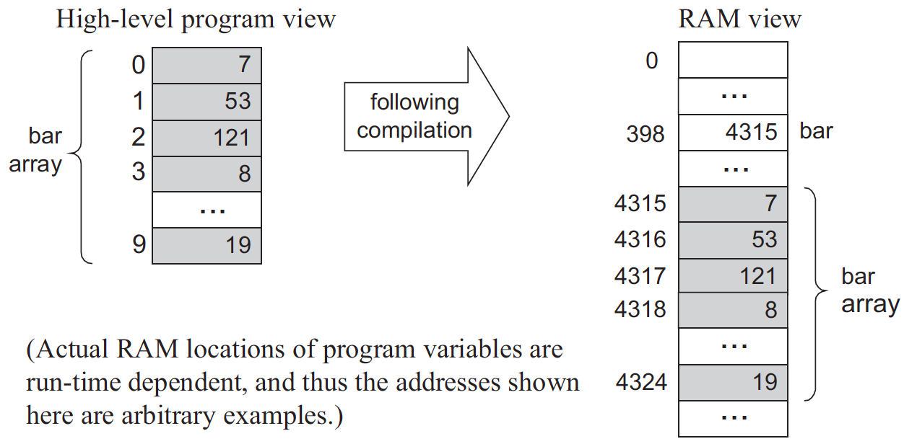
Handling array
int foo() { // some language, not Jack
int bar[10];
...
bar[2] = 19;
}

Slide 29
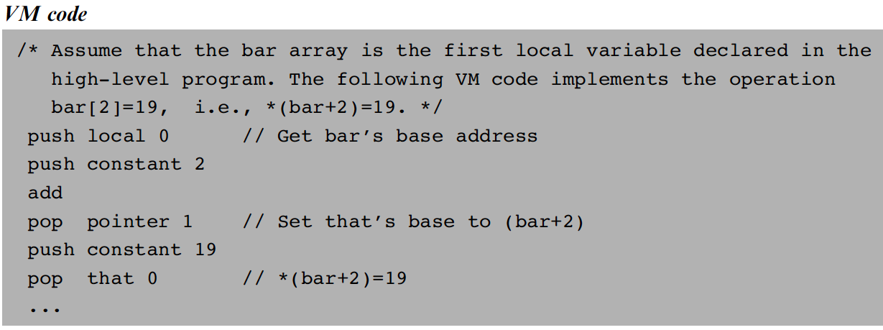
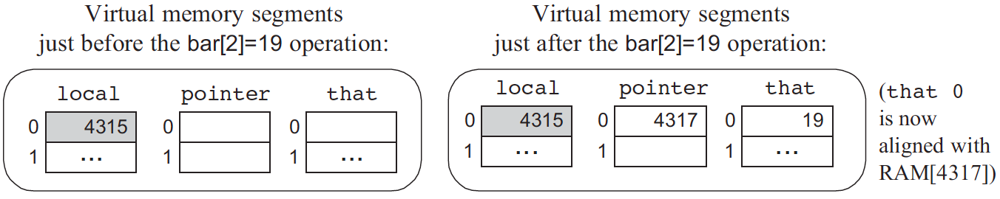
Handling array

Slide 30
Handling arrays: declaration / construction
Java code
class Bla {
...
void foo(int k) {
int x, y;
int[] bar; // declare an array
// Construct the array:
bar = new int[10];
...
bar[k]=19;
}
...
Main.foo(2); // Call the foo method
RAM state
0
...
275
x
(local 0)
276
y
(local 1)
277
4315
bar
(local 2)
...
Following
compilation:
504
2
k
(argument 0)
...
4315
4316
How to compile:
bar = new int(n) ?
Generate code affecting:
bar = Memory.alloc(n)
4317
0
(bar array)
4318
...
4324
...

Slide 31
Handling arrays: accessing an array entry by its index
Java code
class Bla {
...
void foo(int k) {
int x, y;
int[] bar; // declare an array
// Construct the array:
bar = new int[10];
...
bar[k]=19;
}
...
Main.foo(2); // Call the foo method
RAM state
0
...
275
x
(local 0)
276
y
(local 1)
277
4315
bar
(local 2)
...
Following
compilation:
504
2
k
(argument 0)
...
4315
4316
4317
19
RAM state, just after
executing bar[k] = 19
(bar array)
4318
...
4324
...
How to compile: bar[k] = 19 ?
Notes:
31

Slide 32
Handling arrays: accessing an array entry by its index
How to compile: bar[k] = 19 ?
VM Code (pseudo)
VM Code (actual)
// bar[k]=19,
// or *(bar+k)=19
push bar
push k
add
// Use a pointer to
// access x[k]
// addr points to bar[k]
pop addr
push 19
// Set bar[k] to 19
pop *addr
// bar[k]=19,
// or *(bar+k)=19
push local 2
push argument 0
add
// Use a pointer to
// access x[k]
pop pointer 1
push constant 19
pop that 0
Notes:
32

Slide 33
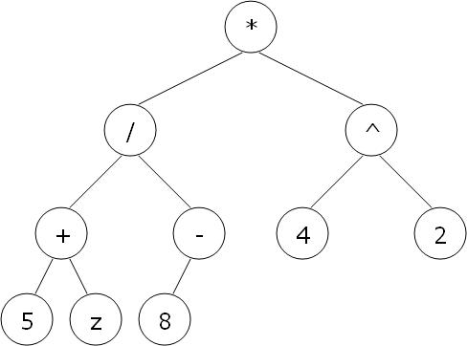
Handling expressions
High-level code
((5+z)/-8)*(4^2)
VM code
push 5
push z
add
push 8
neg
call div
push 4
push 2
call power
call mult
syntax
analysis
parse tree
code
generation

Slide 34
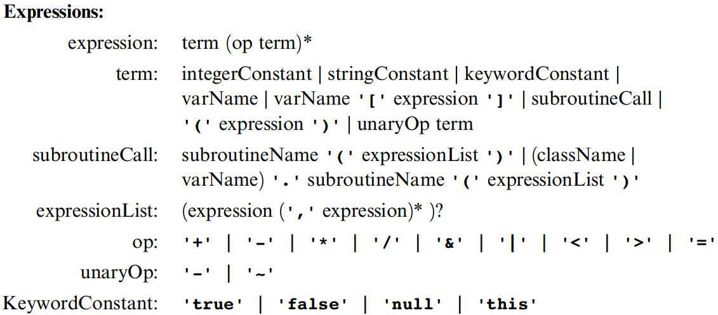
Handling expressions (Jack grammar)
term
binary term
’x’: x appears verbatim
x: x is a language construct
x?: x appears 0 or 1 times
x*: x appears 0 or more times
x|y: either x or y appears
(x,y): x appears, then y.

Slide 35
Handling expressions (Jack grammar)
term
constant
function
variable
unary op
’x’: x appears verbatim
x: x is a language construct
x?: x appears 0 or 1 times
x*: x appears 0 or more times
x|y: either x or y appears
(x,y): x appears, then y.

Slide 36
Handling expressions
To generate VM code from a parse tree exp, use the following logic:
The codeWrite(exp) algorithm:
if exp is a constant n then output "push n"
if exp is a variable v then output "push v"
if exp is op(exp₁) then codeWrite(exp₁);
output "op";
if exp is f (exp₁, ..., exp_{n}) then codeWrite(exp1);
...
codeWrite(expn);
output "call f";
if exp is (exp₁ op exp₂) then codeWrite(exp₁);
codeWrite(exp₂);
output "op";

Slide 37
The Jack grammar (Expression)

Slide 38
From parsing to code generation (simplified expression)
EXP → TERM (OP TERM)*
TERM → integer | variable
OP → + | - | * | /

Slide 39
From parsing to code generation
EXP → TERM (OP TERM)*
TERM → integer | variable
OP → + | - | * | /
EXP() :
TERM();
while (next()==OP)
OP();
TERM();

Slide 40
From parsing to code generation
EXP → TERM (OP TERM)*
TERM → integer | variable
OP → + | - | * | /
EXP() :
TERM();
while (next()==OP)
OP();
TERM();
TERM():
switch (next())
case INT:
eat(INT);
case VAR:
eat(VAR);

Slide 41
From parsing to code generation
EXP → TERM (OP TERM)*
TERM → integer | variable
OP → + | - | * | /
EXP() :
TERM();
while (next()==OP)
OP();
TERM();
OP():
switch (next())
case +: eat(ADD);
case -: eat(SUB);
case *: eat(MUL);
case /: eat(DIV);
TERM():
switch (next())
case INT:
eat(INT);
case VAR:
eat(VAR);

Slide 42
From parsing to code generation
EXP → TERM (OP TERM)*
TERM → integer | variable
OP → + | - | * | /
EXP() :
TERM();
while (next()==OP)
OP();
TERM();
OP():
switch (next())
case +: eat(ADD);
case -: eat(SUB);
case *: eat(MUL);
case /: eat(DIV);
TERM():
switch (next())
case INT:
eat(INT);
case VAR:
eat(VAR);

Slide 43
From parsing to code generation
EXP → TERM (OP TERM)*
TERM → integer | variable
OP → + | - | * | /
EXP() :
TERM();
while (next()==OP)
op=OP();
TERM();
write(op);
OP():
switch (next())
case +: eat(ADD);
return ‘add’;
case -: eat(SUB);
return ‘sub’;
case *: eat(MUL);
return ‘call Math.mul’;
case /: eat(DIV);
return ‘call Math.div’;
TERM():
switch (next())
case INT: write(‘push constant ’
+next());
eat(INT);
case VAR: write(‘push ’
+lookup(next()));
eat(VAR);

Slide 44
The Jack grammar (Expression)

Slide 45
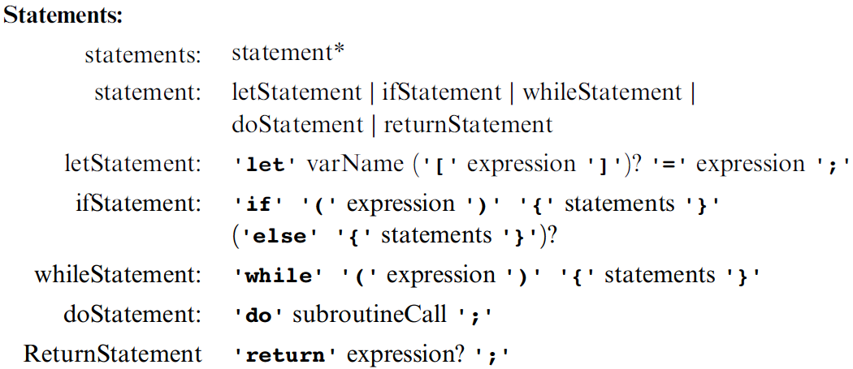
The Jack grammar (statement)
STATEMENTS() :
while (next() in {let, if, while, do, return})
STATEMENT();

Slide 46
The Jack grammar (statement)
STATEMENT() :
switch (next())
case LET: LET_STAT();
case IF: IF_STAT();
case WHILE: WHILE_STAT();
case DO: DO_STAT();
case RETURN: RETURN_STAT();

Slide 47
let statement
Parsing
Parsing with code generation
LET_STAT():
eat(LET);
eat(VAR);
eat(EQ);
EXP();
eat(SEMI);
LET_STAT():
eat(LET);
variable=lookup(next());
eat(VAR);
eat(EQ);
EXP();
eat(SEMI);
write(‘pop ’ + variable)

Slide 48
Handling program flow
if (cond)
s1
else
s2
...
High-level code
VM code
VM code to compute and push !(cond)
if-goto L1
VM code for executing s1
goto L2
label L1
VM code for executing s2
label L2
...
code
generation

Slide 49
Handling program flow
while (cond)
s
...
High-level code
VM code
label L1
VM code to compute and push !(cond)
if-goto L2
VM code for executing s
goto L1
label L2
...
code
generation

Slide 50
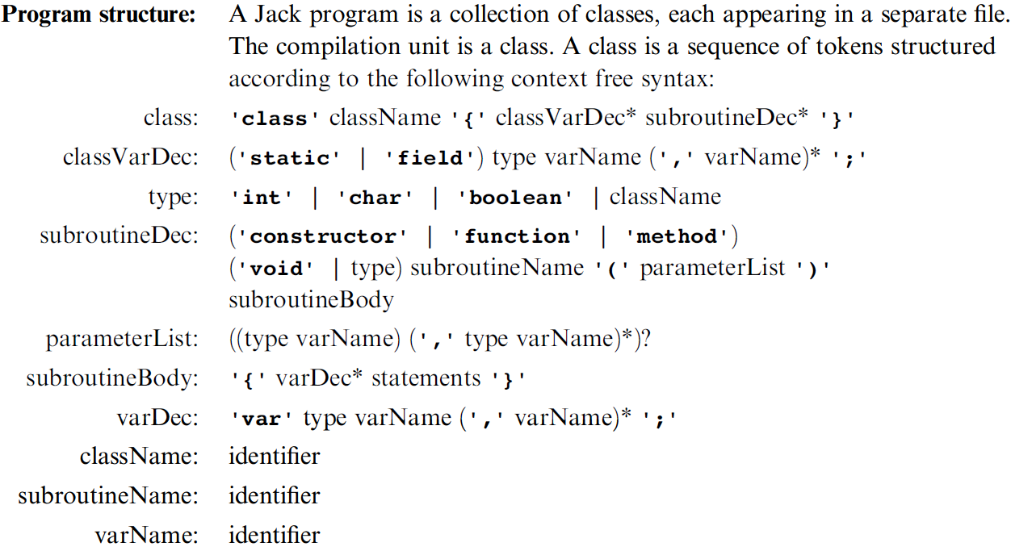
The Jack grammar (class)
CLASS() :
eat(CLASS);
eat(ID);
eat(‘{‘);
while (next() in {static, field})
CLASSVARDEC();
while (next() in {constructor, function, method})
SUBROUTINEDEC();
eat(‘}’);

Slide 51
The Jack grammar (class)
CLASS() :
eat(CLASS); class=registerClass(next());
eat(ID);
eat(‘{‘);
while (next() in {static, field})
CLASSVARDEC(class);
while (next() in {constructor, function, method})
SUBROUTINEDEC(class);
eat(‘}’);

Slide 52
The Jack grammar (class)
CLASSVARDEC(class) :
switch (next())
case static: eat(STATIC); kind=STATIC;
case field: eat(FIELD); kind=FIELD;
switch (next())
case int: type=INT; eat(INT);
case char: type=CHAR; eat(CHAR);
case boolean: type=BOOLEAN; eat(BOOLEAN);
case ID: type=lookup(next()); eat(ID);
registerClassVar(class, next(), kind, type);
eat(ID);
while (next()=COMMA)
registerClassVar(class, next(), kind, type);
eat(ID);

Slide 53
Put them together
class BankAccount {
static int nAccounts;
static int bankCommission;
field int id;
field String owner;
field int balance;
method void transfer(int sum, BankAccount from, Date when){
var int i, j;
var Date due;
let balance = (balance + sum) – commission(sum * 5);
// More code ...
}

Slide 54
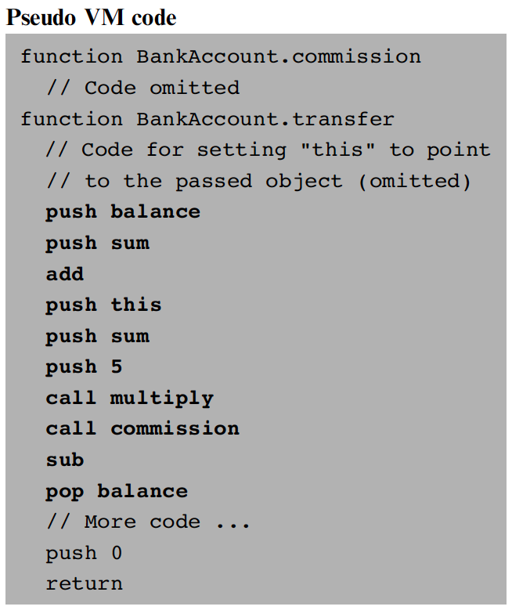
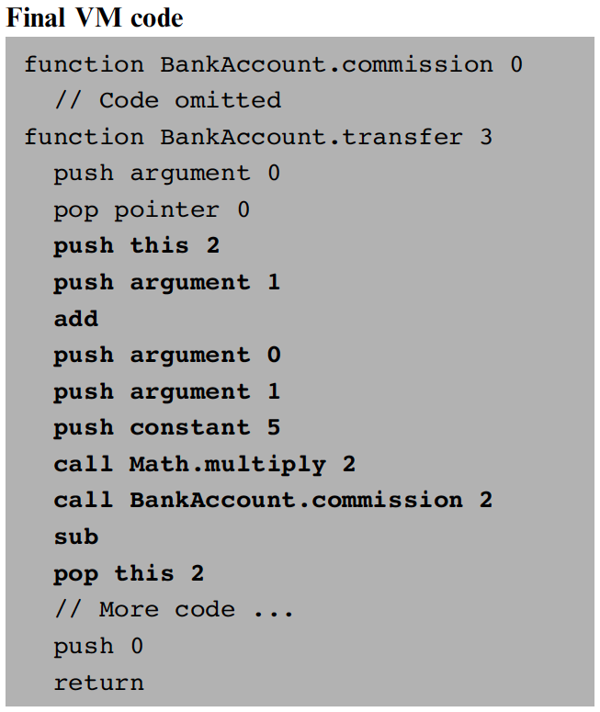
...
let balance = (balance + sum) – commission(sum * 5)

Slide 55
Perspective
Jack simplifications that are challenging to extend:
  Limited primitive type system
  No inheritance
  No public class fields, e.g. must use r = c.getRadius()
  rather than r = c.radius
Jack simplifications that are easy to extend: :
  Limited control structures, e.g. no for, switch, …
  Cumbersome handling of char types, e.g. cannot use let x=‘c’
Optimization
  For example, c=c+1 is translated inefficiently into push c, push 1, add, pop c.
  Parallel processing
  Many other examples of possible improvements …

