Slide 1
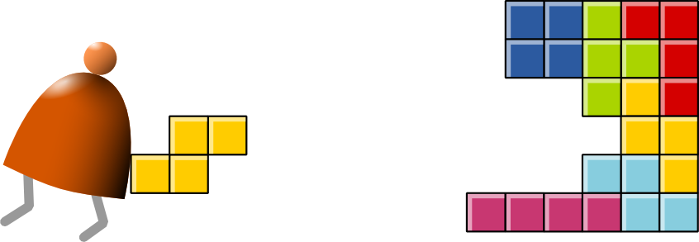
Compiler I: Syntax Analysis
Building a Modern Computer From First Principles
www.nand2tetris.org
Notes:
1

Slide 2
Course map
Human
Abstract design
Software
Thought
abstract interface
hierarchy
Chapters 9, 12
H.L. Language
Compiler
&
abstract interface
Operating Sys.
Chapters 10 - 11
Virtual
VM Translator
Machine
abstract interface
Chapters 7 - 8
Assembly
Language
Assembler
Chapter 6
abstract interface
Computer
Machine
Architecture
Language
abstract interface
Chapters 4 - 5
Gate Logic
Hardware
abstract interface
Platform
Chapters 1 - 3
Electrical
Hardware
Chips &
Engineering
Logic Gates
Physics
hierarchy

Slide 3
Motivation: Why study about compilers?
The first compiler is FORTRAN compiler developed by an IBM team led by John Backus (Turing Award, 1977) in 1957. It took 18 man-month.
Because Compilers …
Are an essential part of applied computer science
Are very relevant to computational linguistics
Are implemented using classical programming techniques
Employ important software engineering principles
Train you in developing software for transforming one structure to another (programs, files, transactions, …)
Train you to think in terms of ”description languages”.
Parsing files of some complex syntax is very common in many applications.
Notes:
1953年巴克斯向當時IBM董事長卡斯伯特·赫德（Cuthbert Hurd），提交了一分備忘錄，建議設計一種接近人類語言的編程語言代替機器語言，後來赫德批准了這項計劃。1957年4月他所領導13人小組推出全世界第一套高階電腦語言FORTRAN，首次用在IBM 704計算機上面，1958年推出FORTRAN Ⅱ，幾年後又推出FORTRAN Ⅲ，1962年推出FORTRAN Ⅳ，被稱為FORTRAN語言之父。六十年代巴克斯轉到沃森研究中心，參加了ALGOL語言的設計。1977年10月17日在西雅圖舉行的ACM年會上獲得計算機界最高獎圖靈獎，會中他發表了「程序設計能從馮·伊曼形式中解脫出來嗎？函數式風格及其程序的代數」（Can Programming be Liberated from the von Neumann Style? A Functional Style and Its Algebra of Programs）演說，這篇演說有時被看作是他為發明了Fortran而致歉。1991年退休。1994年美國工程院授予他Charles Stark Draper獎。2007年3月17日在美國俄勒岡州的家中去世，享年82歲。

Slide 4
The big picture
Modern compilers are two-tiered:
Front-end:
from high-level language to some intermediate language
Back-end:
from the intermediate language to
binary code.
. . .
. . .
Some
Some Other
Jack
language
language
language
Compiler
lectures
Some
Some Other
Jack
(Projects
10,11)
compiler
compiler
compiler
Intermediate code
VM
VM
implementation
VM imp.
VM imp.
lectures
over CISC
over RISC
VM
over the Hack
platforms
platforms
emulator
platform
(Projects
7-8)
CISC
RISC
. . .
written in
Hack
machine
machine
a high-level
machine
language
language
language
language
HW
lectures
. . .
. . .
(Projects
1-6)
CISC
RISC
other digital platforms, each equipped
Any
Hack
machine
machine
with its VM implementation
computer
computer

Slide 5

Compiler architecture (front end)
(source)
scanner
(target)
Syntax analysis: understanding the structure of the source code
Code generation: reconstructing the semantics using the syntax of the target code.
  Tokenizing: creating a stream of “atoms”
  Parsing: matching the atom stream with the language grammar
  XML output = one way to demonstrate that the syntax analyzer works

Slide 6
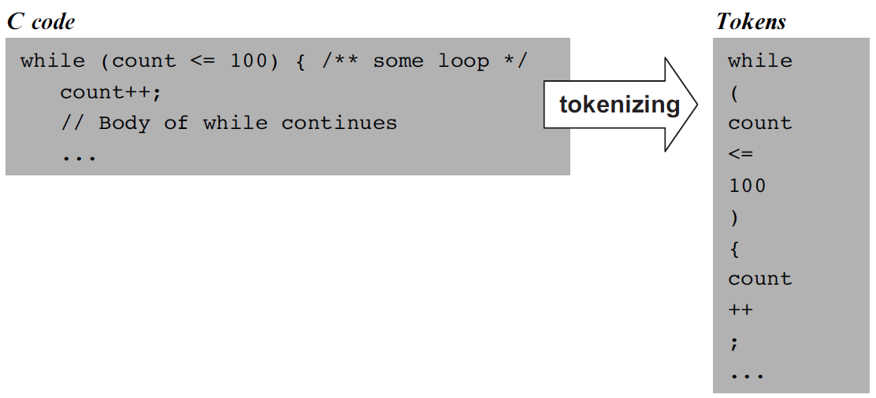
Tokenizing / Lexical analysis / scanning
Remove white space
Construct a token list (language atoms)
Things to worry about:
  Language specific rules: e.g. how to treat “++”
  Language-specific classifications:
  keyword, symbol, identifier, integerConstant, stringConstant,...
While we are at it, we can have the tokenizer record not only the token, but also its lexical classification (as defined by the source language grammar).

Slide 7
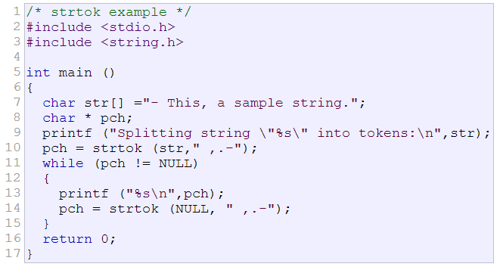
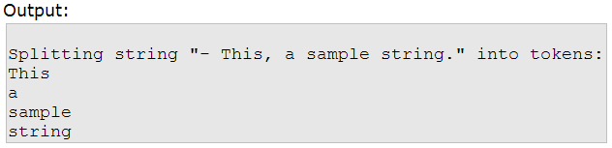
C function to split a string into tokens
char* strtok(char* str, const char* delimiters);
  str: string to be broken into tokens
  delimiters: string containing the delimiter characters

Slide 8
Jack Tokenizer
if (x < 153) {let city = ”Paris”;}
Source code
Tokenizer’s output
<tokens>
<keyword> if </keyword>
<symbol> ( </symbol>
<identifier> x </identifier>
<symbol> &lt; </symbol>
<integerConstant> 153 </integerConstant>
<symbol> ) </symbol>
<symbol> { </symbol>
<keyword> let </keyword>
<identifier> city </identifier>
<symbol> = </symbol>
<stringConstant> Paris </stringConstant>
<symbol> ; </symbol>
<symbol> } </symbol>
</tokens>
Tokenizer

Slide 9
Parsing
The tokenizer discussed thus far is part of a larger program called parser
Each language is characterized by a grammar.
The parser is implemented to recognize this grammar in given texts
The parsing process:
  A text is given and tokenized
  The parser determines weather or not the text can be generated from the grammar
  In the process, the parser performs a complete structural analysis of the text
The text can be in an expression in a :
  Natural language (English, …)
  Programming language (Jack, …).

Slide 10
Parsing examples
English
Jack
He ate an apple on the desk.
(5+3)*2 – sqrt(9*4)
parse
ate
he
an apple
on
the desk

Slide 11
Regular expressions
a|b*
{ε, “a”, “b”, “bb”, “bbb”, …}
(a|b)*
{ε, “a”, “b”, “aa”, “ab”, “ba”, “bb”, “aaa”, …}
ab*(c|ε)
{a, “ac”, “ab”, “abc”, “abb”, “abbc”, …}

Slide 12
Lex
A computer program that generates lexical analyzers (scanners or lexers)
Commonly used with the yacc parser generator.
Structure of a Lex file
Definition section
%%
Rules section
%%
C code section
Notes:
https://en.wikipedia.org/wiki/Lex_(software)

Slide 13
Example of a Lex file
/*** Definition section ***/
%{
/* C code to be copied verbatim */
#include <stdio.h>
%}
/* This tells flex to read only one input file */
%option noyywrap
/*** Rules section ***/
%%
[0-9]+ {
/* yytext is a string containing the
matched text. */
printf("Saw an integer: %s\n", yytext);
}
.|\n { /* Ignore all other characters. */ }
Notes:
https://en.wikipedia.org/wiki/Lex_(software)

Slide 14
Example of a Lex file
%%
/*** C Code section ***/
int main(void)
{
/* Call the lexer, then quit. */
yylex();
return 0;
}
Notes:
https://en.wikipedia.org/wiki/Lex_(software)

Slide 15
Example of a Lex file
> flex test.lex
(a file lex.yy.c with 1,763 lines is generated)
> gcc lex.yy.c
(an executable file a.out is generated)
> ./a.out < test.txt
Saw an integer: 123
Saw an integer: 2
Saw an integer: 6
test.txt
abc123z.!&*2gj6
Notes:
https://en.wikipedia.org/wiki/Lex_(software)

Slide 16
Another Lex example
%{
int num_lines = 0, num_chars = 0;
%}
%option noyywrap
%%
\n ++num_lines; ++num_chars;
. ++num_chars;
%%
main() {
yylex();
printf( "# of lines = %d, # of chars = %d\n",
num_lines, num_chars );
}

Slide 17
A more complex Lex example
%{
/* need this for the call to atof() below */
#include <math.h>
%}
%option noyywrap
DIGIT [0-9]
ID [a-z][a-z0-9]*
%%
{DIGIT}+ {
printf( "An integer: %s (%d)\n", yytext,
atoi( yytext ) );
}
{DIGIT}+"."{DIGIT}* {
printf( "A float: %s (%g)\n", yytext,
atof( yytext ) );
}

Slide 18
A more complex Lex example
if|then|begin|end|procedure|function {
printf( "A keyword: %s\n", yytext );
}
{ID} printf( "An identifier: %s\n", yytext );
"+"|"-"|"="|"("|")" printf( “Symbol: %s\n", yytext );
[ \t\n]+ /* eat up whitespace */
. printf("Unrecognized char: %s\n", yytext );
%%
void main(int argc, char **argv ) {
if ( argc > 1 ) yyin = fopen( argv[1], "r" );
else yyin = stdin;
yylex();
}

Slide 19
A more complex Lex example
pascal.txt
output
if (a+b) then
foo=3.1416
else
foo=12
A keyword: if
Symbol: (
An identifier: a
Symbol: +
An identifier: b
Symbol: )
A keyword: then
An identifier: foo
Symbol: =
A float: 3.1416 (3.1416)
An identifier: else
An identifier: foo
Symbol: =
An integer: 12 (12)

Slide 20
Context-free grammar
Terminals: 0, 1, #
Non-terminals: A, B
Start symbol: A
Rules:
  A→0A1
  A→B
  B→#
Simple (terminal) forms / complex (non-terminal) forms
Grammar = set of rules on how to construct complex forms from simpler forms
Highly recursive.

Slide 21
Examples of context-free grammar
S→()
S→(S)
S→SS
S→a|aS|bS
strings ending with ‘a’
S → x
S → y
S → S+S
S → S-S
S → S*S
S → S/S
S → (S)
(x+y)*x-x*y/(x+x)

Slide 22
Examples of context-free grammar
non-terminals: S, E, Elist
terminals: ID, NUM, PRINT, +, :=, (, ), ;
rules:
S → S; S
S → ID := E
S → PRINT ( Elist )
E → ID
E → NUM
E → E + E
E → ( S , Elist )
Elist → E
Elist → Elist , E
Try to derive:
ID = NUM ; PRINT ( NUM )
slide credit: David Walker

Slide 23
Examples of context-free grammar
non-terminals: S, E, Elist
terminals: ID, NUM, PRINT, +, :=, (, ), ;
rules:
S → S; S
S → ID := E
S → PRINT ( Elist )
E → ID
E → NUM
E → E + E
E → ( S , Elist )
Elist → E
Elist → Elist , E
left-most derivation
right-most derivation
S
S ; S
ID = E ; S
ID = NUM ; S
ID = NUM ; PRINT ( Elist )
ID = NUM ; PRINT ( E )
ID = NUM ; PRINT ( NUM )
S
S ; S
S ; PRINT ( Elist )
S ; PRINT ( E )
S ; PRINT ( NUM )
ID = E ; PRINT ( NUM )
ID = NUM ; PRINT ( NUM )
slide credit: David Walker

Slide 24
Parse tree
Two derivations, but 1 tree
S
S ; S
ID = E ; S
ID = NUM ; S
ID = NUM ; PRINT ( Elist )
ID = NUM ; PRINT ( E )
ID = NUM ; PRINT ( NUM )
S
S
;
S
ID
:=
E
PRINT
(
L
)
S
S ; S
S ; PRINT ( Elist )
S ; PRINT ( E )
S ; PRINT ( NUM )
ID = E ; PRINT ( NUM )
ID = NUM ; PRINT ( NUM )
NUM
E
NUM
slide credit: David Walker

Slide 25
Ambiguous Grammars
a grammar is ambiguous if the same sequence of tokens can give rise to two or more parse trees
non-terminals: E
terminals: ID, NUM, PLUS, MUL
rules:
E → ID
E → NUM
E → E + E
E → E * E
characters: 4 + 5 * 6
tokens: NUM(4) PLUS NUM(5) MUL NUM(6)
slide credit: David Walker

Slide 26
Ambiguous Grammars
characters: 4 + 5 * 6
tokens: NUM(4) PLUS NUM(5) MUL NUM(6)
E
E
+
E
E → ID
E → NUM
E → E + E
E → E * E
E
E
NUM(4)
*
NUM(5)
NUM(6)
E
E
*
E
E
E
+
NUM(6)
NUM(4)
NUM(5)
slide credit: David Walker

Slide 27
Ambiguous Grammars
problem: compilers use parse trees to interpret the meaning of parsed expressions
  different parse trees have different meanings
  eg: (4 + 5) * 6 is not 4 + (5 * 6)
  languages with ambiguous grammars are DISASTROUS; The meaning of programs isn’t well-defined! You can’t tell what your program might do!
solution: rewrite grammar to eliminate ambiguity
  fold precedence rules into grammar to disambiguate
  fold associativity rules into grammar to disambiguate
  other tricks as well
slide credit: David Walker

Slide 28
Recursive descent parser
Recursive Descent Parsing
  aka: predictive parsing; top-down parsing
  simple, efficient
  can be coded by hand in ML quickly
  parses many, but not all CFGs
    parses LL(1) grammars
      Left-to-right parse; Leftmost-derivation; 1 symbol lookahead
  key ideas:
    one recursive function for each non terminal
    each production becomes one clause in the function
slide credit: David Walker
Notes:
LL(0): In an LL(0) grammar, the parser decides whether to do a predict or a match step based on the next symbol left in the sentential form. If it's a terminal, it does a match step. If it's a nonterminal, it does a predict step based on what that nonterminal is. When doing the predict step, the parser looks at the next 0 tokens of the input stream to determine which production to use. Because of this, the parser has to be able to uniquely determine which production to use based on the nonterminal in the sentential form, without looking at the input at all.

Slide 29
Recursive descent parser
Non-terminals: S, E, L
Terminals: NUM, IF, THEN, ELSE, BEGIN, END, PRINT, =, ;
Rules:
  S -> IF E THEN S ELSE S
  | BEGIN S L
  | PRINT E
  L -> END
  | ; S L
  E -> NUM = NUM
slide credit: David Walker

Slide 30
Recursive descent parser
Non-terminals: S, E, L
Terminals: NUM, IF, THEN, ELSE, BEGIN, END, PRINT, =, ;
Rules:
  S -> IF E THEN S ELSE S
  | BEGIN S L
  | PRINT E
  L -> END
  | ; S L
  E -> NUM = NUM
S()
{
switch (next()) {
case IF:
eat(IF); E(); eat(THEN);
S(); eat(ELSE); S();
break;
case BEGIN:
eat(BEGIN); S(); L();
break;
case PRINT:
eat(PRINT); E();
break;
}
}
slide credit: David Walker

Slide 31
Recursive descent parser
Non-terminals: S, E, L
Terminals: NUM, IF, THEN, ELSE, BEGIN, END, PRINT, EQ(=), SEMI(;)
Rules:
  S -> IF E THEN S ELSE S
  | BEGIN S L
  | PRINT E
  L -> END
  | ; S L
  E -> NUM = NUM
L()
{
switch (next()) {
case END:
eat(END);
break;
case SEMI:
eat(SEMI); S(); L();
break;
default:
error();
}
}
slide credit: David Walker

Slide 32
Recursive descent parser
Non-terminals: S, E, L
Terminals: NUM, IF, THEN, ELSE, BEGIN, END, PRINT, EQ(=), SEMI(;)
Rules:
  S -> IF E THEN S ELSE S
  | BEGIN S L
  | PRINT E
  L -> END
  | ; S L
  E -> NUM = NUM
E()
{
eat(NUM);
eat(EQ);
eat(NUM);
}
slide credit: David Walker

Slide 33
Recursive descent parser
Non-terminals: S, A, E, L
Terminals: EOF, ID, NUM, ASSIGN(:=), PRINT, LPAREN((), RPAREN())
Rules:
  S -> A EOF
  A -> ID := E
  | PRINT(L)
  E -> ID
  | NUM
  L -> E
  | L, E
slide credit: David Walker

Slide 34
Recursive descent parser
Non-terminals: S, A, E, L
Terminals: EOF, ID, NUM, ASSIGN(:=), PRINT, LPAREN((), RPAREN())
Rules:
  S -> A EOF
  A -> ID := E
  | PRINT(L)
  E -> ID
  | NUM
  L -> E
  | L, E
S()
{
A();
eat(EOF);
}
slide credit: David Walker

Slide 35
Recursive descent parser
Non-terminals: S, A, E, L
Terminals: EOF, ID, NUM, ASSIGN(:=), PRINT, LPAREN((), RPAREN())
Rules:
  S -> A EOF
  A -> ID := E
  | PRINT(L)
  E -> ID
  | NUM
  L -> E
  | L, E
A()
{
switch (next()) {
case ID:
eat(ID); eat(ASSIGN);
E();
break;
case PRINT:
eat(PRINT); eat(LPAREN);
L(); eat(RPAREN);
break;
}
}
slide credit: David Walker

Slide 36
Recursive descent parser
Non-terminals: S, A, E, L
Terminals: EOF, ID, NUM, ASSIGN(:=), PRINT, LPAREN((), RPAREN())
Rules:
  S -> A EOF
  A -> ID := E
  | PRINT(L)
  E -> ID
  | NUM
  L -> E
  | L, E
E()
{
switch (next()) {
case ID:
eat(ID);
break;
case NUM:
eat(NUM);
break;
}
}
slide credit: David Walker

Slide 37
Recursive descent parser
Non-terminals: S, A, E, L
Terminals: EOF, ID, NUM, ASSIGN(:=), PRINT, LPAREN((), RPAREN())
Rules:
  S -> A EOF
  A -> ID := E
  | PRINT(L)
  E -> ID
  | NUM
  L -> E
  | L, E
L()
{
switch (next()) {
case ID:
???
case NUM:
???
}
}
Problem:
E could be ID
L could be E could be ID

Slide 38
Recursive descent parser
Non-terminals: S, A, E, L
Terminals: EOF, ID, NUM, ASSIGN(:=), PRINT, LPAREN((), RPAREN())
Rules:
  S -> A EOF
  A -> ID := E
  | PRINT(L)
  E -> ID
  | NUM
  L -> E
  | L, E
Problem:
E could be ID
L could be E could be ID
  L -> E M
  M -> , E M
  | ε
slide credit: David Walker

Slide 39
A typical grammar of a typical C-like language
Code samples
while (expression) {
if (expression)
statement;
while (expression) {
statement;
if (expression)
statement;
}
while (expression) {
statement;
statement;
}
}
if (expression) {
statement;
while (expression)
statement;
statement;
}
if (expression)
if (expression)
statement;
}

Slide 40
A typical grammar of a typical C-like language
program: statement;
statement: whileStatement
| ifStatement
| // other statement possibilities ...
| '{' statementSequence '}'
whileStatement: 'while' '(' expression ')' statement
ifStatement: simpleIf
| ifElse
simpleIf: 'if' '(' expression ')' statement
ifElse: 'if' '(' expression ')' statement
'else' statement
statementSequence: '' // null, i.e. the empty sequence
| statement ';' statementSequence
expression: // definition of an expression comes here

Slide 41
Parse tree
program: statement;
statement: whileStatement
| ifStatement
| // other statement possibilities ...
| '{' statementSequence '}'
whileStatement: 'while'
'(' expression ')'
statement
...

Slide 42
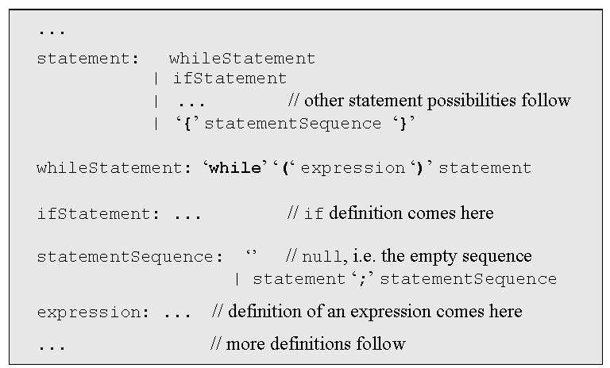
Recursive descent parsing
code sample
while (expression) {
statement;
statement;
while (expression) {
while (expression)
statement;
statement;
}
}
Highly recursive
LL(0) grammars: the first token determines in which rule we are
In other grammars you have to look ahead 1 or more tokens
Jack is almost LL(0).
Parser implementation: a set of parsing methods, one for each rule:
parseStatement()
parseWhileStatement()
parseIfStatement()
parseStatementSequence()
parseExpression().

Slide 43
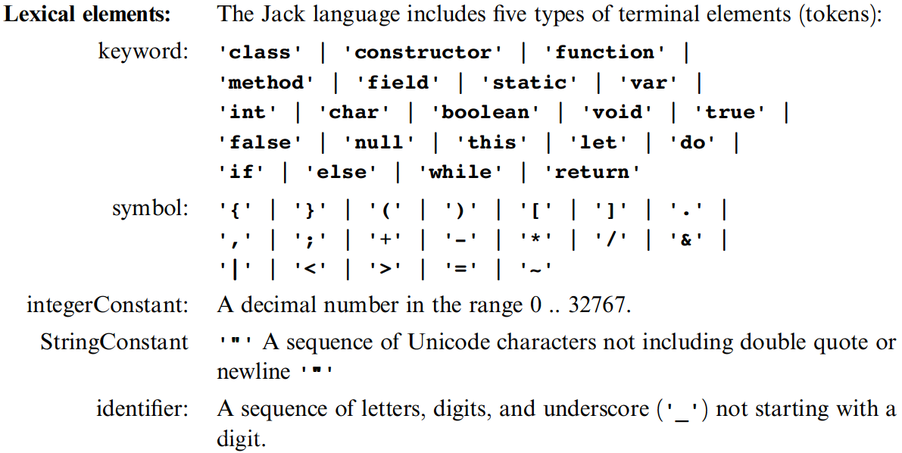
The Jack grammar
’x’: x appears verbatim
x: x is a language construct
x?: x appears 0 or 1 times
x*: x appears 0 or more times
x|y: either x or y appears
(x,y): x appears, then y.

Slide 44
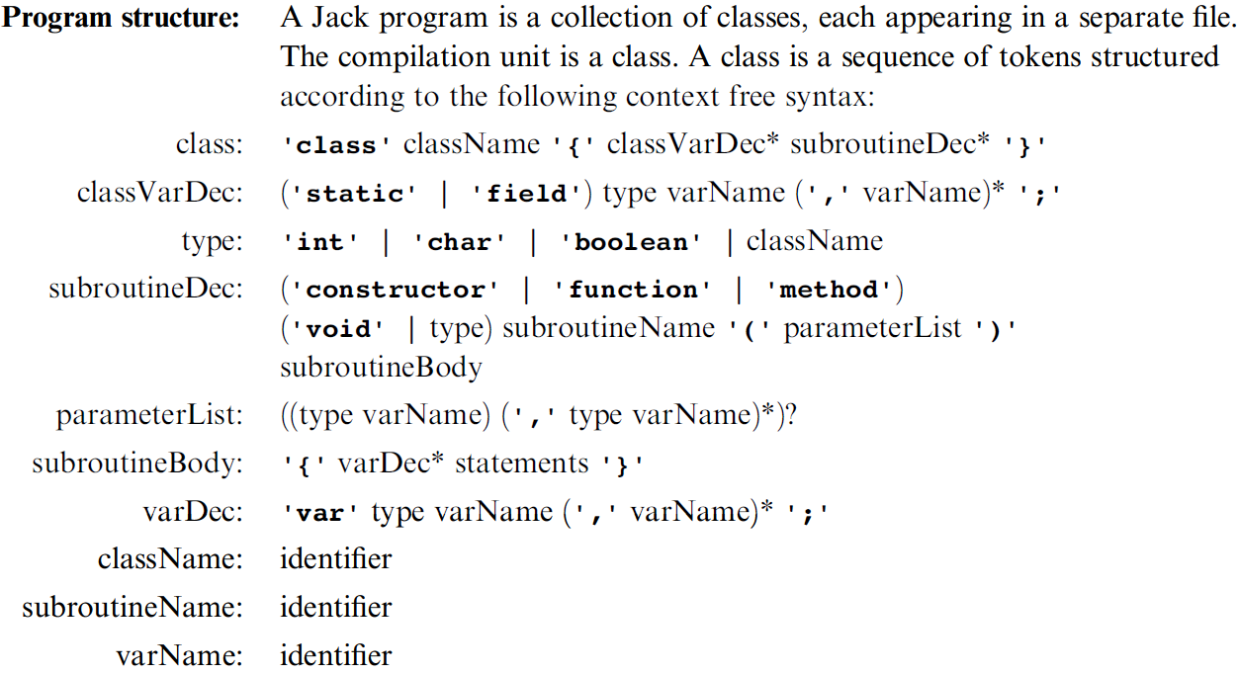
The Jack grammar
’x’: x appears verbatim
x: x is a language construct
x?: x appears 0 or 1 times
x*: x appears 0 or more times
x|y: either x or y appears
(x,y): x appears, then y.

Slide 45
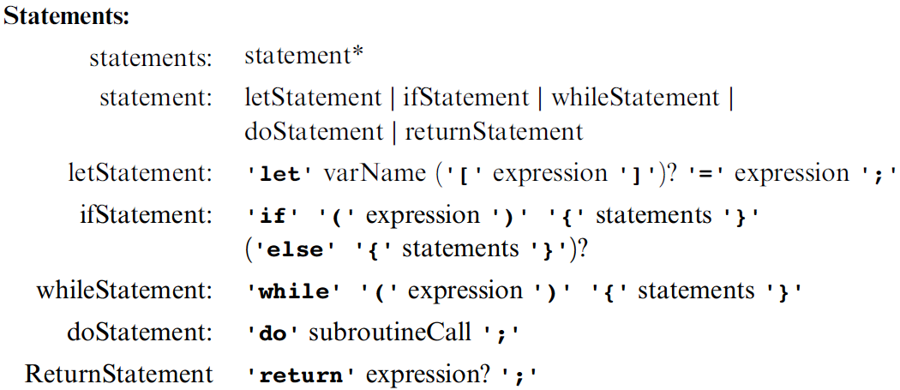
The Jack grammar
’x’: x appears verbatim
x: x is a language construct
x?: x appears 0 or 1 times
x*: x appears 0 or more times
x|y: either x or y appears
(x,y): x appears, then y.

Slide 46
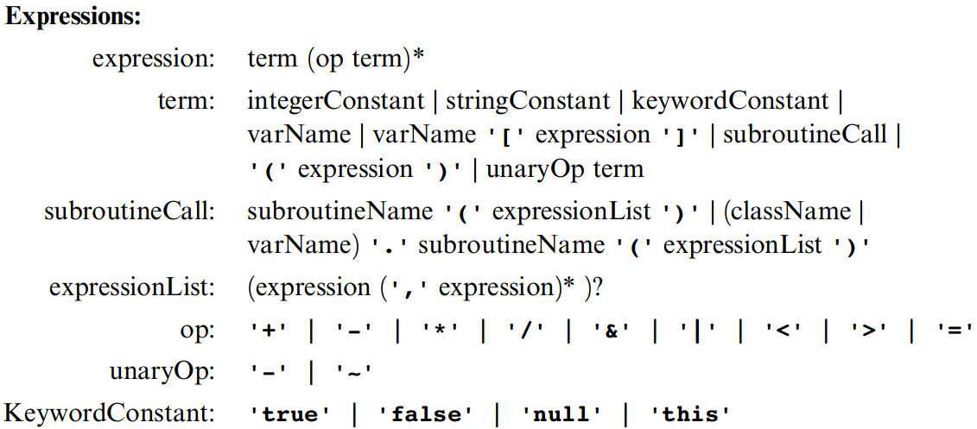
The Jack grammar
’x’: x appears verbatim
x: x is a language construct
x?: x appears 0 or 1 times
x*: x appears 0 or more times
x|y: either x or y appears
(x,y): x appears, then y.

Slide 47
Jack syntax analyzer in action
Class Bar {
method Fraction foo(int y) {
var int temp; // a variable
let temp = (xxx+12)*-63;
...
...
<varDec>
<keyword> var </keyword>
<keyword> int </keyword>
<identifier> temp </identifier>
<symbol> ; </symbol>
</varDec>
<statements>
<letStatement>
<keyword> let </keyword>
<identifier> temp </identifier>
<symbol> = </symbol>
<expression>
<term>
<symbol> ( </symbol>
<expression>
<term>
<identifier> xxx </identifier>
</term>
<symbol> + </symbol>
<term>
<int.Const.> 12 </int.Const.>
</term>
</expression>
...
Syntax analyzer
Syntax analyzer
With the grammar,
we can write a syntax analyzer program (parser)
The syntax analyzer takes a source text file and attempts to match it on the language grammar
If successful, it can generate a parse tree in some structured format, e.g. XML.

Slide 48
Jack syntax analyzer in action
Class Bar {
method Fraction foo(int y) {
var int temp; // a variable
let temp = (xxx+12)*-63;
...
...
<varDec>
<keyword> var </keyword>
<keyword> int </keyword>
<identifier> temp </identifier>
<symbol> ; </symbol>
</varDec>
<statements>
<letStatement>
<keyword> let </keyword>
<identifier> temp </identifier>
<symbol> = </symbol>
<expression>
<term>
<symbol> ( </symbol>
<expression>
<term>
<identifier> xxx </identifier>
</term>
<symbol> + </symbol>
<term>
<int.Const.> 12 </int.Const.>
</term>
</expression>
...
Syntax analyzer
If xxx is non-terminal, output:
<xxx>
Recursive code for
the body of xxx
</xxx>
If xxx is terminal (keyword, symbol, constant, or identifier) , output:
<xxx>
xxx value
</xxx>

Slide 49
The Jack grammar
’x’: x appears verbatim
x: x is a language construct
x?: x appears 0 or 1 times
x*: x appears 0 or more times
x|y: either x or y appears
(x,y): x appears, then y.

Slide 50
Recursive descent parser (simplified expression)
EXP → TERM (OP TERM)*
TERM → integer | variable
OP → + | - | * | /

Slide 51
From parsing to code generation
EXP → TERM (OP TERM)*
TERM → integer | variable
OP → + | - | * | /
EXP() :
TERM();
while (next()==OP)
OP();
TERM();

Slide 52
From parsing to code generation
EXP → TERM (OP TERM)*
TERM → integer | variable
OP → + | - | * | /
EXP() :
TERM();
while (next()==OP)
OP();
TERM();
TERM():
switch (next())
case INT:
eat(INT);
case VAR:
eat(VAR);

Slide 53
From parsing to code generation
EXP → TERM (OP TERM)*
TERM → integer | variable
OP → + | - | * | /
EXP() :
TERM();
while (next()==OP)
OP();
TERM();
OP():
switch (next())
case +: eat(ADD);
case -: eat(SUB);
case *: eat(MUL);
case /: eat(DIV);
TERM():
switch (next())
case INT:
eat(INT);
case VAR:
eat(VAR);

Slide 54
From parsing to code generation
EXP → TERM (OP TERM)*
TERM → integer | variable
OP → + | - | * | /
EXP() :
TERM();
while (next()==OP)
OP();
TERM();
OP():
switch (next())
case +: eat(ADD);
case -: eat(SUB);
case *: eat(MUL);
case /: eat(DIV);
TERM():
switch (next())
case INT:
eat(INT);
case VAR:
eat(VAR);

Slide 55
From parsing to code generation
EXP → TERM (OP TERM)*
TERM → integer | variable
OP → + | - | * | /
EXP() : print(‘<exp>’);
TERM();
while (next()==OP)
OP();
TERM();
print(‘</exp>’);
OP(): print(‘<op>’);
switch (next())
case +: eat(ADD);
print(‘<sym> + </sym>’);
case -: eat(SUB);
print(‘<sym> - </sym>’);
case *: eat(MUL);
print(‘<sym> * </sym>’);
case /: eat(DIV);
print(‘<sym> / </sym>’);
print(‘</op>’);
TERM(): print(‘<term>’);
switch (next())
case INT: print(‘<int> next() </int>’);
eat(INT);
case VAR: print(‘<id> next() </id>’);
eat(VAR);
print(‘</term>’);

Slide 56
Summary and next step
Syntax analysis: understanding syntax
Code generation: constructing semantics
The code generation challenge:
Extend the syntax analyzer into a full-blown compiler that, instead of passive XML code, generates executable VM code
Two challenges: (a) handling data, and (b) handling commands.

Slide 57
Perspective
The parse tree can be constructed on the fly
The Jack language is intentionally simple:
  Statement prefixes: let, do, ...
  No operator priority
  No error checking
  Basic data types, etc.
The Jack compiler: designed to illustrate the key ideas that underlie modern compilers, leaving advanced features to more advanced courses
Richer languages require more powerful compilers

Slide 58
Perspective
Syntax analyzers can be built using:
  Lex tool for tokenizing (flex)
  Yacc tool for parsing (bison)
  Do everything from scratch (our approach ...)
Industrial-strength compilers: (LLVM)
  Have good error diagnostics
  Generate tight and efficient code
  Support parallel (multi-core) processors.

