Slide 1
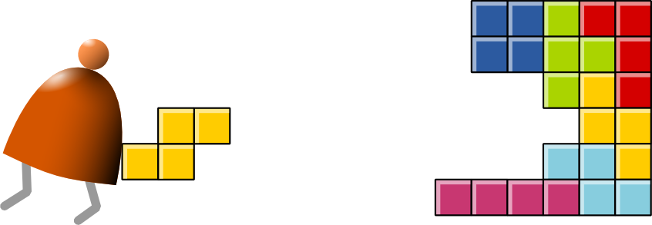
High-Level Language
Building a Modern Computer From First Principles
www.nand2tetris.org
Notes:
1

Slide 2
Where we are at:
Human
Abstract design
Software
Thought
abstract interface
hierarchy
Chapters 9, 12
H.L. Language
Compiler
&
abstract interface
Operating Sys.
Chapters 10 - 11
Virtual
VM Translator
Machine
abstract interface
Chapters 7 - 8
Assembly
Language
Assembler
Chapter 6
abstract interface
Computer
Machine
Architecture
Language
abstract interface
Chapters 4 - 5
Gate Logic
Hardware
abstract interface
Platform
Chapters 1 - 3
Electrical
Hardware
Chips &
Engineering
Logic Gates
Physics
hierarchy

Slide 3
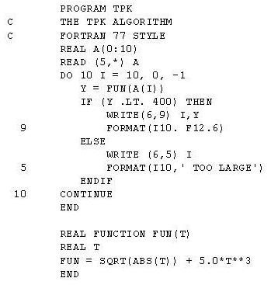
Some milestones in the evolution of programming languages
Machine language (binary code)
Assembly language (low-level symbolic programming)
Simple procedural languages, e.g. Fortran, Basic, Pascal, C

Slide 4
Some milestones in the evolution of programming languages
Machine language (binary code)
Assembly language (low-level symbolic programming)
Simple procedural languages, e.g. Fortran, Basic, Pascal, C
Simple object-based languages (without inheritance),
e.g. early versions of Visual Basic, JavaScript
Fancy object-oriented languages (with inheritance):
C++, Java, C#
Jack

Slide 5
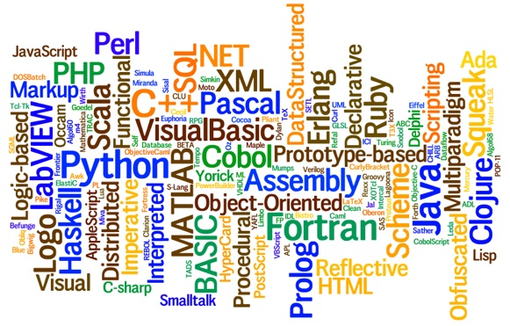
Programming languages
Procedural programming (e.g. C, Fortran, Pascal)
Object-oriented programming (e.g. C++, Java, Python)
Functional programming (e.g. Lisp, ML, Haskell)
Logic programming (e.g. Prolog)

Slide 6
ML
fun fac(x) =
if x=0 then 1
  else x*fac(x-1);
fun length(L) =
  if (L=nil) then 0
  else 1+length(tl(L));

Slide 7
Prolog
Facts
  human(kate).
  human(bill).
  Human(John).
  likes(bill,kate).
  likes(kate,john).
  likes(john,kate).
Rules
  friend(X,Y) :- likes(X,Y),likes(Y,X).

Slide 8
Prolog
Absolute value
  abs(X, Y) :- X <0, Y is –X.
  abs(X, X) :- X>=0.
  ?- abs(-9,8).
  No
  ?- abs(-9,R).
  R=9
Length of a list
  my_length([], 0).
  my_length([_|T],R) :- my_length(T, R1), R is R1+1.
  ?- my_length([a, b, [c, d], e], R).
  R = 4

Slide 9
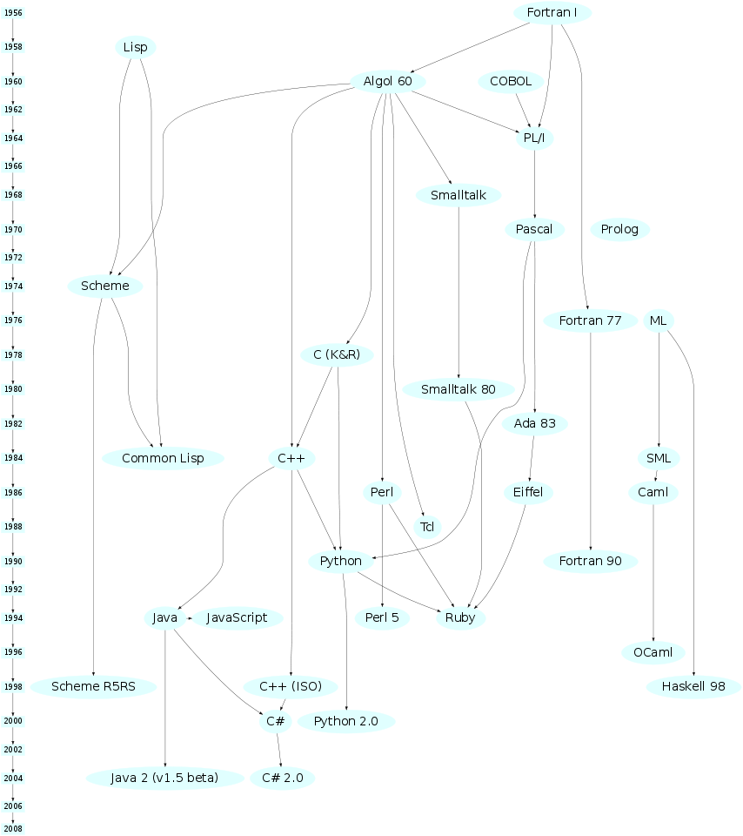

Slide 10
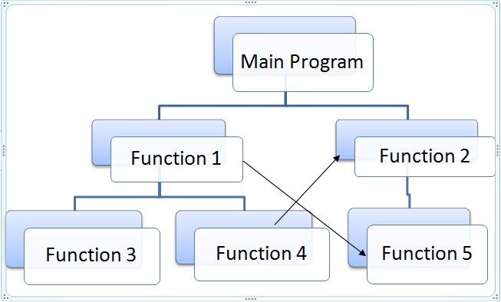
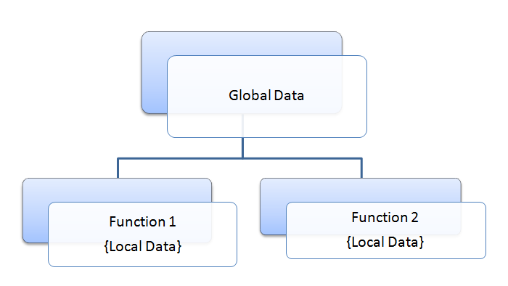
Procedure oriented programming
Notes:
http://www.circuitstoday.com/difference-between-procedure-oriented-and-object-oriented-programming

Slide 11
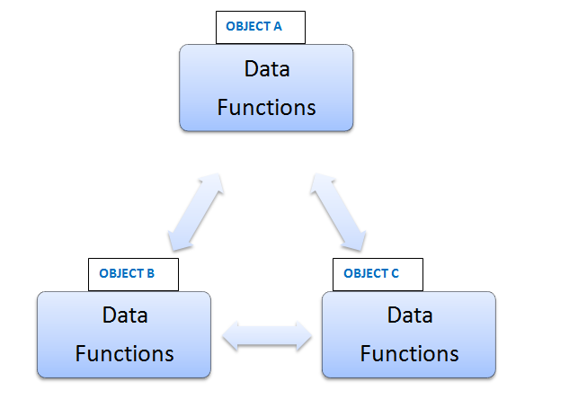
Object oriented programming
message
Notes:
http://www.circuitstoday.com/difference-between-procedure-oriented-and-object-oriented-programming

Slide 12
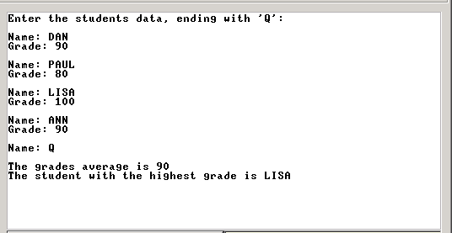
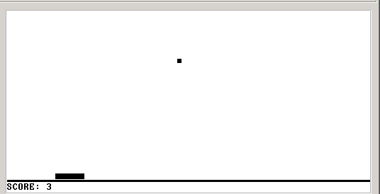
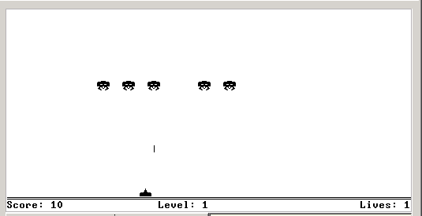
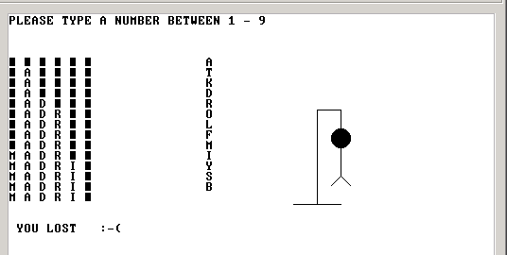
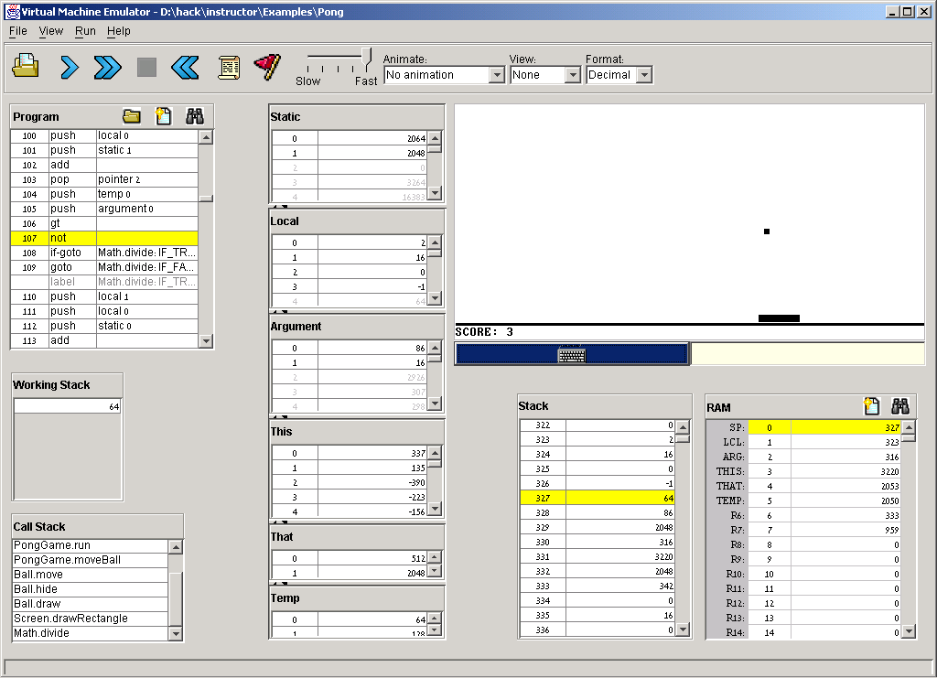
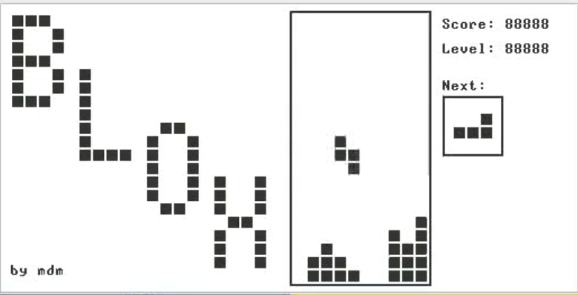
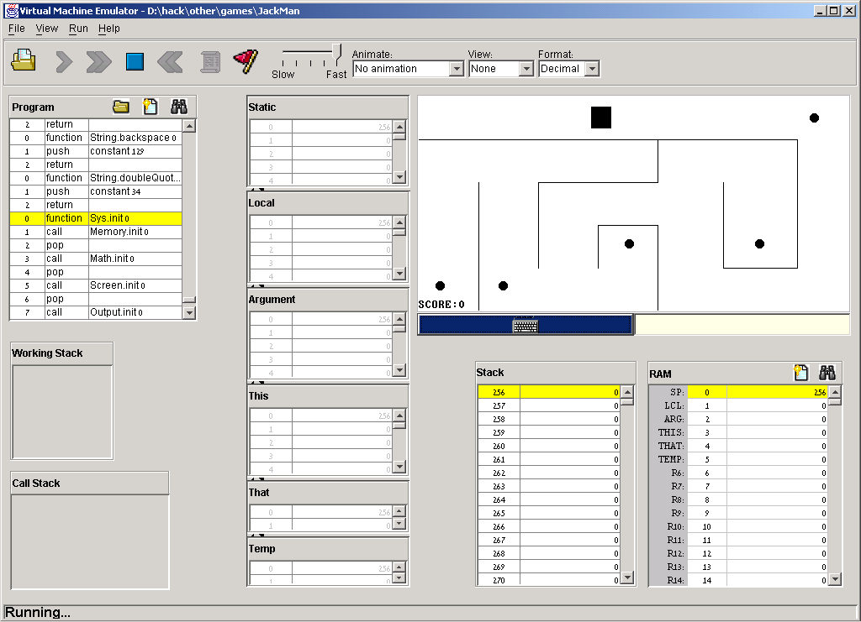

The Jack programming language
Jack: a simple, object-based, high-level language with a Java-like syntax
Some sample applications written in Jack:
procedural
programming
Pong game
Space Invaders
Tetris

Slide 13
Disclaimer
Although Jack is a real programming language, we don’t view it as an end.
Rather, we use Jack as a means for teaching:
  How to build a compiler
  How the compiler and the language interface with the operating system
  How the topmost piece in the software hierarchy fits into the big picture
Jack can be learned (and un-learned) in one hour.

Slide 14
Roadmap for learning Jack
Start with examples
  Hello World
  Procedure and array
  Abstract data types
  Linked list
  ...
Formal Jack Spec.
More complex examples

Slide 15
Hello world
/** Hello World program. */
class Main {
function void main () {
// Prints some text using the standard library
do Output.printString("Hello World");
do Output.println(); // New line
return;
}
}
Some observations:
Java-like syntax
Classes
Entry point: Main.main
Typical comments format
do for function calls
Class_name.method_name
Standard library a set of OS services (methods and functions) organized in 8 supplied classes: Math, String. Array, Output, Keyboard, Screen, Memory, Sys

Slide 16
Jack standard library aka language extensions aka Jack OS
class Math {
function void init()
function int abs(int x)
function int multiply(int x, int y)
function int divide(int x, int y)
function int min(int x, int y)
function int max(int x, int y)
function int sqrt(int x)
}

Slide 17
Jack standard library aka language extensions aka Jack OS
Class String {
constructor String new(int maxLength)
method void dispose()
method int length()
method char charAt(int j)
method void setCharAt(int j, char c)
method String appendChar(char c)
method void eraseLastChar()
method int intValue()
method void setInt(int j)
function char backSpace()
function char doubleQuote()
function char newLine()
}

Slide 18
Jack standard library aka language extensions aka Jack OS
Class Array {
function Array new(int size)
method void dispose()
}
class Memory {
function int peek(int address)
function void poke(int address, int value)
function Array alloc(int size)
function void deAlloc(Array o)
}

Slide 19
Jack standard library aka language extensions aka Jack OS
class Output {
function void moveCursor(int i, int j)
function void printChar(char c)
function void printString(String s)
function void printInt(int i)
function void println()
function void backSpace()
}
Class Screen {
function void clearScreen()
function void setColor(boolean b)
function void drawPixel(int x, int y)
function void drawLine(int x1, int y1, int x2, int y2)
function void drawRectangle(int x1, int y1, int x2, int y2)
function void drawCircle(int x, int y, int r)
}

Slide 20
Jack standard library aka language extensions aka Jack OS
Class Keyboard {
function char keyPressed()
function char readChar()
function String readLine(String message)
function int readInt(String message)
}
Class Sys {
function void halt():
function void error(int errorCode)
function void wait(int duration)
}

Slide 21
Typical programming tasks in Jack
Jack can be used to develop any app that comes to my mind, for example:
Array processing a program storing numbers in an array
Procedural programming: a program that computes 1 + 2 + ... + n
Object-oriented programming: a class representing bank accounts
Abstract data type representation: a class representing fractions (like 2/5)
Data structure representation: a class representing linked lists
We will now discuss the above examples
As we do so, we’ll begin to unravel how the magic of a high-level object-based language is delivered by the compiler and by the VM
These insights will serve us in the next lectures, when we build the Jack compiler.

Slide 22
Array example
class Main {
function void main () {
var Array a;
var int length, i, sum;
let length = Keyboard.readInt(“#number:”)
let a = Array.new(length);
let i = 0;
let sum = 0;
while (i < length) {
let a[i] = Keyboard.readInt("next: ");
let sum = sum + a[i];
let i = i+1;
}
do Output.printString("The average: ");
do Output.printInt(sum / length);
do Output.println();
return;
}
}
var: variable declaration
type: int, Array
let: assignment
Array: provided by OS. No type for an array. Actually, it can contain any type and even different types in an array.
Primitive types: int, boolean, char.
All types in Jack occupy one word. When declaring a variable of primitive types, the space is reserved. For other types, a reference is reserved.

Slide 23
Procedural programming example
class Main {
/** Sums up 1 + 2 + 3 + ... + n */
function int sum (int n) {
var int sum, i;
let sum = 0;
let i = 1;
while (~(i > n)) {
let sum = sum + i;
let i = i + 1;
}
return sum;
}
function void main () {
var int n;
let n = Keyboard.readInt("Enter n: ");
do Output.printString("The result is: ");
do Output.printInt(sum(n));
return;
}
}
Jack program = a collection of one or more classes
Jack class = a collection of one or more subroutines
Execution order: when we execute a Jack program, Main.main() starts running.
Jack subroutine:
  method
  constructor
  function (static method)
  (the example on the left has functions only, as it is “object-less”)

Slide 24
Object-oriented programming example
The BankAccount class (skeletal)
/** Represents a bank account.
A bank account has an owner, an id, and a balance.
The id values start at 0 and increment by 1 each
time a new account is created. */
class BankAccount {
/** Constructs a new bank account with a 0 balance. */
constructor BankAccount new(String owner)
/** Deposits the given amount in this account. */
method void deposit(int amount)
/** Withdraws the given amount from this account. */
method void withdraw(int amount)
/** Prints the data of this account. */
method void printInfo()
/** Disposes this account. */
method void dispose()
}

Slide 25
Object-oriented programming example (continues)
/** Represents a bank account. */
class BankAccount {
// class-level variable
static int newAcctId;
// Private variables(fields/properties)
field int id;
field String owner;
field int balance;
/** Constructs a new bank account */
constructor BankAccount new (String owner) {
let id = newAcctId;
let newAcctId = newAcctId + 1;
let this.owner = owner;
let balance = 0;
return this;
}
// More BankAccount methods.
}
// Code in any other class:
var int x;
var BankAccount b;
let b = BankAccount.new("joe");
1
3
Explain b = BankAccount.new("joe")
Calls the constructor (which creates a new BankAccount object)
Explain return this
The constructor returns the RAM base address of the memory block that stores the data of the newly created BankAccount object
Explain b = BankAccount.new("joe")
stores in variable b a pointer to the object’s base memory address
2

Slide 26
Object-oriented programming example (continues)
/** Represents a bank account. */
class BankAccount {
// class-level variable
static int newAcctId;
// Private variables(fields/properties)
field int id;
field String owner;
field int balance;
/** Constructs a new bank account */
constructor BankAccount new (String owner) {
let id = newAcctId;
let newAcctId = newAcctId + 1;
let this.owner = owner;
let balance = 0;
return this;
}
// More BankAccount methods.
}
// Code in any other class:
var int x;
var BankAccount b;
let b = BankAccount.new("joe");
1
3
Behind the scene (following compilation):
// b = BankAccount.new("joe")
push "joe"
call BankAccount.new
pop b
Explanation: the calling code pushes an argument and calls the constructor; the constructor’s code (not shown above; the compiler generates Memory.alloc(n) for constructors) creates a new object, pushes its base address onto the stack, and returns;
The calling code then pops the base address into a variable that will now point to the new object.
2

Slide 27
Object-oriented programming example (continues)
class BankAccount {
static int nAccounts;
field int id;
field String owner;
field int balance;
// Constructor ... (omitted)
/** Handles deposits */
method void deposit (int amount) {
let balance = balance+amount;
return;
}
/** Handles withdrawls */
method void withdraw (int amount){
if (~(amount > balance)) {
let balance = balance-amount;
}
return;
}
// More BankAccount methods.
}
...
var BankAccount b1, b2;
...
let b1 = BankAccount.new("joe");
let b2 = BankAccount.new("jane");
do b1.deposit(5000);
do b1.withdraw(1000);
...
Explain do b1.deposit(5000)
In Jack, void methods are invoked
using the keyword do
(a compilation artifact)
The object-oriented method invocation style b1.deposit(5000) is a fancy way to express the procedural semantics deposit(b1,5000)
Behind the scene (following compilation):
// do b1.deposit(5000)
push b1
push 5000
call BankAccount.deposit

Slide 28
Object-oriented programming example (continues)
class BankAccount {
static int nAccounts;
field int id;
field String owner;
field int balance;
// Constructor ... (omitted)
/** Prints information about this account. */
method void printInfo () {
do Output.printInt(id);
do Output.printString(owner);
do Output.printInt(balance);
return;
}
/** Disposes this account. */
method void dispose () {
do Memory.deAlloc(this);
return;
}
// More BankAccount methods.
}
// Code in any other class:
...
var int x;
var BankAccount b;
let b = BankAccount.new("joe");
// Manipulates b...
do b.printInfo();
do b.dispose();
Explain
do b.dispose()
Jack has no garbage collection; The programmer is responsible for explicitly recycling memory resources of objects that are no longer needed. If you don’t do so, you may run out of memory.

Slide 29
Object-oriented programming example (continues)
class BankAccount {
static int nAccounts;
field int id;
field String owner;
field int balance;
// Constructor ... (omitted)
/** Prints information about this account. */
method void printInfo () {
do Output.printInt(id);
do Output.printString(owner);
do Output.printInt(balance);
return;
}
/** Disposes this account. */
method void dispose () {
do Memory.deAlloc(this);
return;
}
// More BankAccount methods.
}
// Code in any other class:
...
var int x;
var BankAccount b;
let b = BankAccount.new("joe");
// Manipulates b...
do b.printInfo();
do b.dispose();
Explain
do Memory.deAlloc(this)
This is a call to an OS function that knows how to recycle the memory block whose base-address is this. We will write this function when we develop the OS (project 12).

Slide 30
Abstract data type example
The Fraction class API (method signatures)
/** A fraction consists of a numerator and a denominator, both int values */
class Fraction {
/** Constructs a fraction from the given data */
constructor Fraction new(int numerator, int denominator)
/** Reduces this fraction, e.g. changes 20/100 to 1/5. */
method void reduce()
/** Accessors
method int getNumerator()
method int getDenominator()
/** Returns the sum of this fraction and the other one */
method Fraction plus(Fraction other)
/** Returns the product of this fraction and the other one */
method Fraction product(Fraction other)
/** Prints this fraction */
method void print()
/** Disposes this fraction */
method void dispose()
}

Slide 31
Abstract data type example (continues)
class Fraction {
field int numerator, denominator;
constructor Fraction new (int numerator, int denominator) {
let this.numerator = numerator;
let this.denominator = denominator;
do reduce() // Reduces the new fraction
return this
}
/** Reduces this fraction */
method void reduce () { // Code omitted }
// A static method computing the greatest common denominator of a and b.
function int gcd (int a, int b) { // Code omitted }
method int getNumerator () {
return numerator;
}
method int getDenominator () {
return denominator;
}
// More Fraction methods follow.
// Code in any other class:
...
var Fraction a, b;
let a = Fraction.new(2,5);
let b = Fraction.new(70,210);
do b.print() // prints "1/3"
...
// (print method in next slide)

Slide 32
Abstract data type example (continues)
...
// Constructor and previously defined methods omitted
/** Returns the sum of this fraction the other one */
method Fraction plus (Fraction other) {
var int sum;
let sum = (numerator * other.getDenominator()) +
(other.getNumerator() * denominator);
return Fraction.new(sum , denominator * other.getDenominator());
}
// Similar fraction arithmetic methods follow, code omitted.
/** Prints this fraction */
method void print () {
do Output.printInt(numerator);
do Output.printString("/");
do Output.printInt(denominator);
return
}
}
// Code in any other class:
var Fraction a, b, c;
let a = Fraction.new(2,3);
let b = Fraction.new(1,5);
// computes c = a + b
let c = a.plus(b);
do c.print(); // prints "13/15"

Slide 33
Data structure example
/** Represents a sequence of int values, implemented as a linked list.
The list consists of an atom, which is an int value,
and a tail, which is either a list or a null value. */
class List {
field int data;
field List next;
/* Creates a new list */
constructor List new (int car, List cdr) {
let data = car;
let next = cdr;
return this;
}
/* Disposes this list by recursively disposing its tail. */
method void dispose() {
if (~(next = null)) {
do next.dispose();
}
do Memory.deAlloc(this);
return;
}
...
} // class List.
v
5
v
2
3
5
// Code in any other class:
...
// Creates a list holding 2,3, and 5:
var List v;
let v = List.new(5 , null);
let v = List.new(2 , List.new(3,v));
...

Slide 34
Jack language specification
Syntax
Program structure
Data types
Variable kinds
Expressions
Statements
Subroutine calling
(for complete language specification, see the book).

Slide 35
Jack syntactic elements
A jack program is a sequence of tokens separated by an arbitrary amount of white space and comments.
Tokens can be symbols, reserved words, constants and identifiers.
/** Hello World program. */
class Main {
function void main () {
// Prints some text using the standard library
do Output.printString("Hello World");
do Output.println(); // New line
return;
}
}

Slide 36
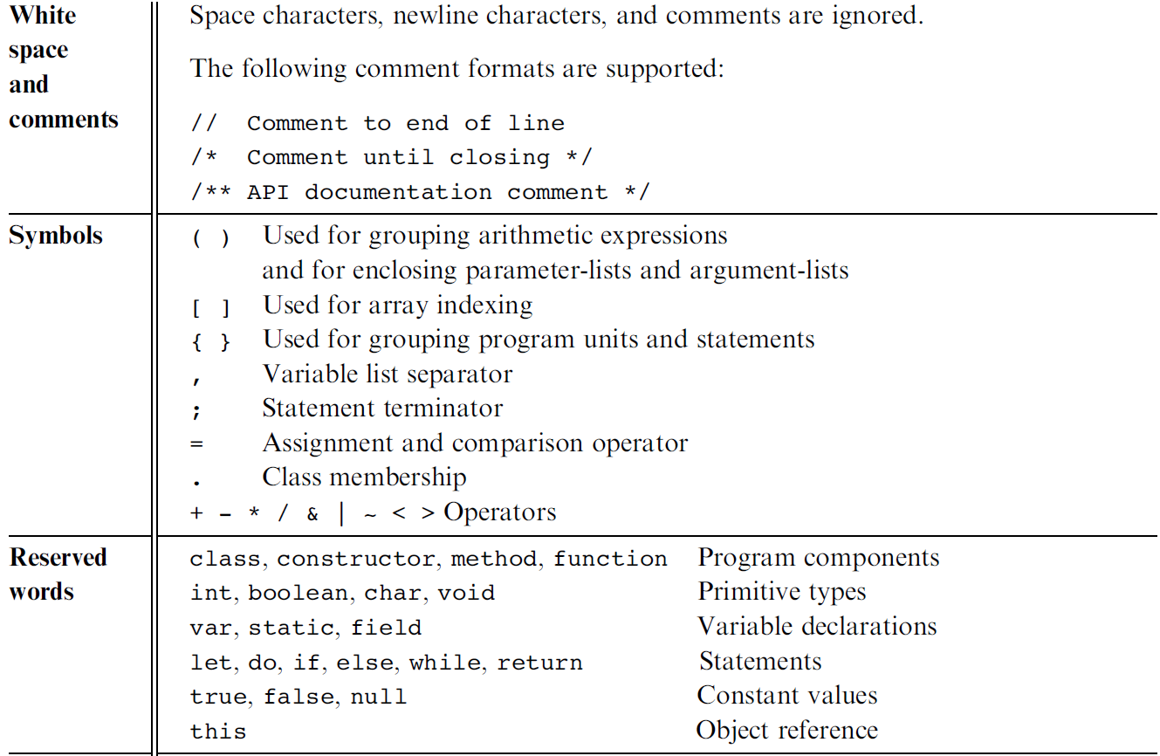
Jack syntactic elements

Slide 37
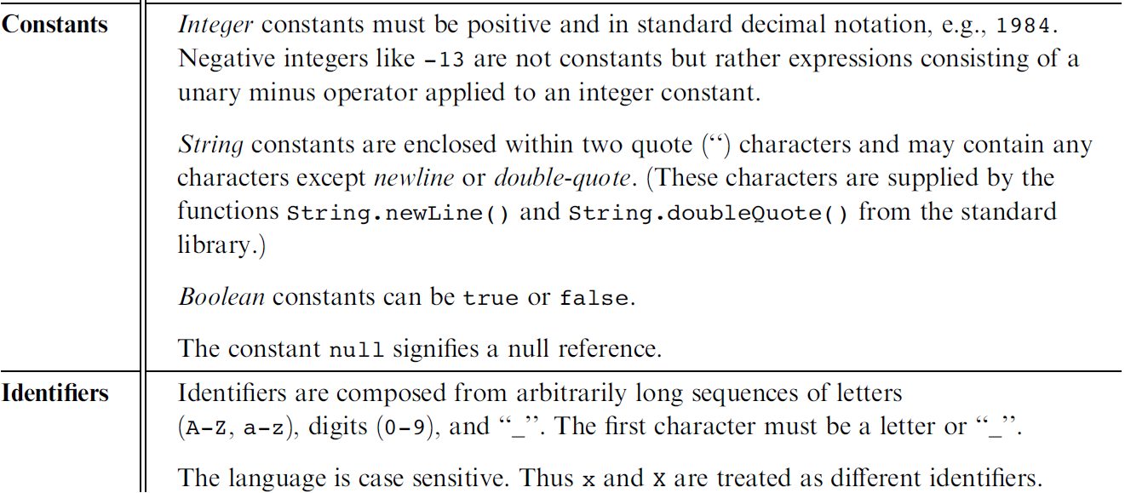
Jack syntactic elements

Slide 38
Jack program structure
About this spec:
Every part in this spec can appear 0 or more times
The order of the field / static declarations is arbitrary
The order of the subroutine declarations is arbitrary
Each type is either int, boolean, char, or a class name.
class ClassName {
field variable declarations;
static variable declarations;
constructor type { parameterList ) {
local variable declarations;
statements
}
method type { parameterList ) {
local variable declarations;
statements
}
function type { parameterList ) {
local variable declarations;
statements
}
}
A Jack program:
Each class is written in a separate file (compilation unit)
Jack program = collection of one or more classes, one of which must be named Main
The Main class must contain at least one method, named main()

Slide 39
Jack data types
Primitive types (Part of the language; Realized by the compiler):
  int 16-bit 2’s complement (from -32768 to 32767)
  boolean 0 and –1, standing for true and false
  char unicode character (‘a’, ‘x’, ‘+’, ‘%’, ...)
Abstract data types (Standard language extensions; Realized by the OS / standard library):
  String
  Array
  ... (extensible)
Application-specific types (User-defined; Realized by user applications):
  BankAccount
  Fraction
  List
  Bat / Ball . . . (as needed)

Slide 40
Jack data types
Jack is weakly typed. The language does not define the results of attempted assignment or conversion from one type to another, and different compilers may allow or forbid it.
var char c; var String s;
Let c = 33; // ‘A’
// Equivalently
Let s = “A”; let c=s.charAt(0);
var Array a;
Let a = 5000;
Let a[100] = 77; // RAM[5100]=77
var Complex c; var Array a;
let a = Array.new(2);
Let a[0] = 7; let a[1] = 8;
Let c = a; // c==Complex(7, 8)

Slide 41
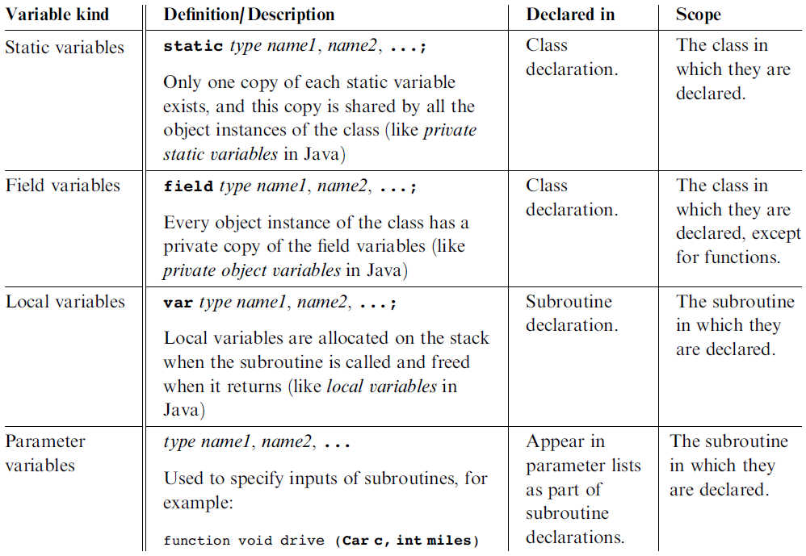
Jack variable kinds and scope

Slide 42
Jack Statements (five types)
let varName = expression;
or
let varName[expression] = expression;
if (expression) {
statements
}
else {
statements
}
while (expression) {
statements
}
do function-or-method-call;
return expression;
or
return;

Slide 43
Jack expressions
A Jack expression is any one of the following:
A constant
A variable name in scope (the variable may be static, field, local, or a parameter)
The keyword this, denoting the current object
An array element using the syntax arrayName[expression],
where arrayNname is a variable name of type Array in scope
A subroutine call that returns a non-void type
An expression prefixed by one of the unary operators – or ~ :
  -expression (arithmetic negation)
  ~expression (logical negation)
An expression of the form expression op expression where op is one of the following:
  + - * / (integer arithmetic operators)
  & | (boolean and and or operators, bit-wise)
  < > = (comparison operators)
( expression ) (an expression within parentheses)

Slide 44
Jack subroutine calls
General syntax: subroutineName(arg0, arg1, …)
where each argument is a valid Jack expression
Parameter passing is by-value (primitive types) or by-reference (object types)
Example 1:
Consider the function (static method): function int sqrt(int n)
This function can be invoked as follows:
  sqrt(17)
  sqrt(x)
  sqrt((b * b) – (4 * a * c))
  sqrt(a * sqrt(c - 17) + 3)
etc. In all these examples the argument value is computed and passed by-value
Example 2:
Consider the method: method Matrix plus (Matrix other);
If u and v were variables of type Matrix, this method can be invoked using: u.plus(v)
The v variable is passed by-reference, since it refers to an object.

Slide 45
Noteworthy features of the Jack language
The (cumbersome) let keyword, as in let x = 0;
The (cumbersome) do keyword, as in do reduce();
No operator priority: (language does not define, compiler-dependent)
  1 + 2 * 3 yields 9, since expressions are evaluated left-to-right;
  To effect the commonly expected result, use 1 + (2 * 3)
Only three primitive data types: int, boolean, char;
In fact, each one of them is treated as a 16-bit value
No casting; a value of any type can be assigned to a variable of any type
Array declaration: Array x; followed by x = Array.new();
Static methods are called function
Constructor methods are called constructor;
Invoking a constructor is done using the syntax ClassName.new(argsList)
Q: Why did we introduce these features into the Jack language?
A: To make the writing of the Jack compiler easy!
Any of these language features can be modified, with a reasonable amount of work, to make them conform to a more typical Java-like syntax.

Slide 46
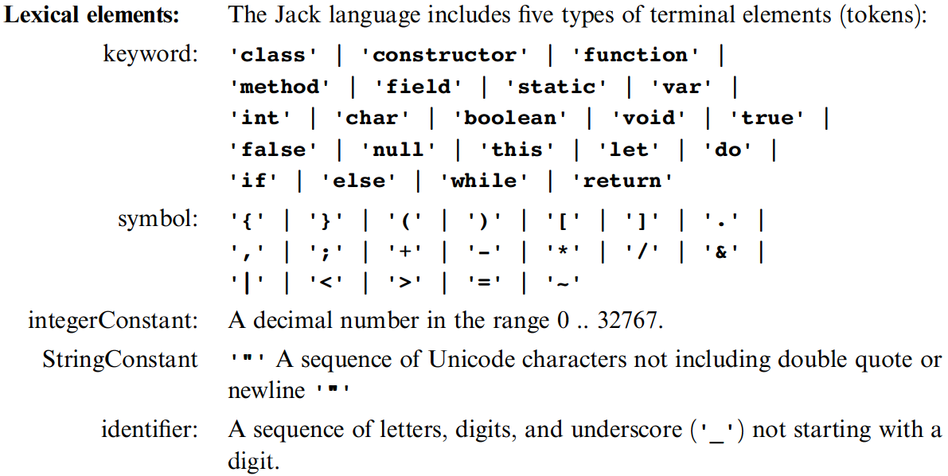
The Jack grammar
’x’: x appears verbatim
x: x is a language construct
x?: x appears 0 or 1 times
x*: x appears 0 or more times
x|y: either x or y appears
(x,y): x appears, then y.

Slide 47
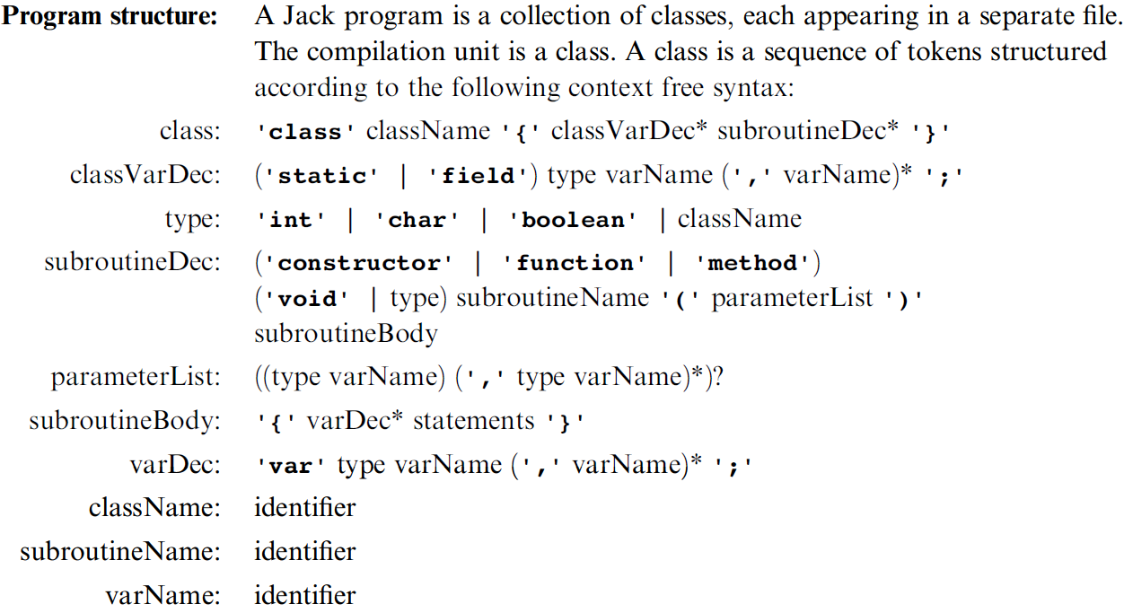
The Jack grammar
’x’: x appears verbatim
x: x is a language construct
x?: x appears 0 or 1 times
x*: x appears 0 or more times
x|y: either x or y appears
(x,y): x appears, then y.

Slide 48
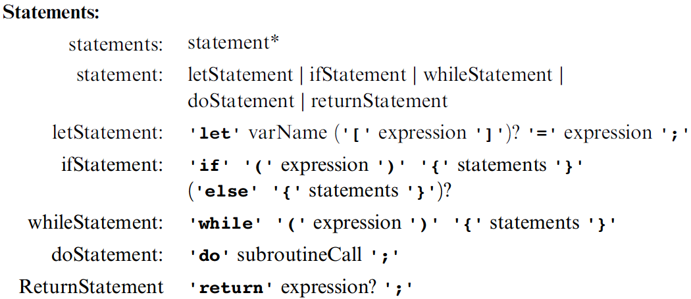
The Jack grammar
’x’: x appears verbatim
x: x is a language construct
x?: x appears 0 or 1 times
x*: x appears 0 or more times
x|y: either x or y appears
(x,y): x appears, then y.

Slide 49
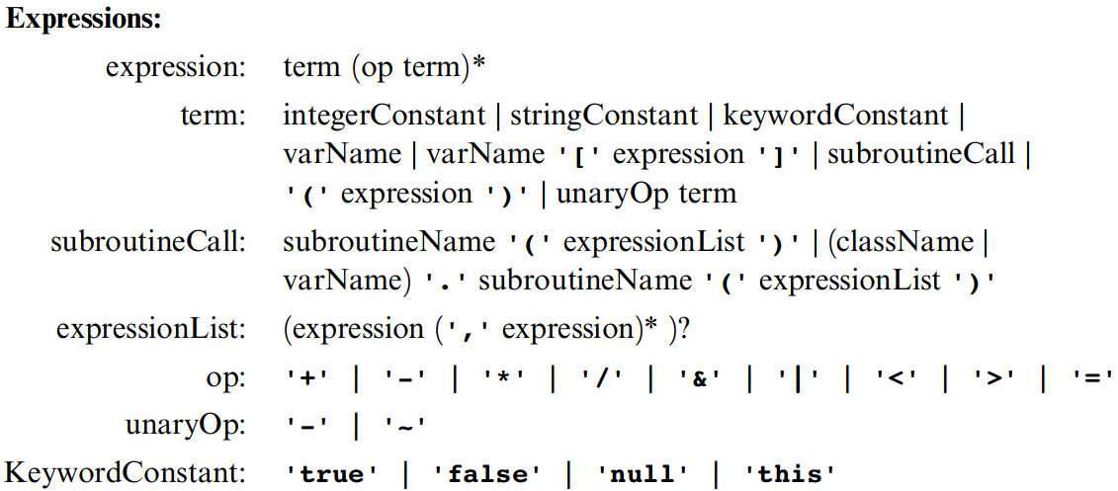
The Jack grammar
’x’: x appears verbatim
x: x is a language construct
x?: x appears 0 or 1 times
x*: x appears 0 or more times
x|y: either x or y appears
(x,y): x appears, then y.

Slide 50
VM programming: multiple functions
Compilation:
A Jack application is a set of 1 or more class files (just like .java files).
When we apply the Jack compiler to these files, the compiler creates a set of 1 or more .vm files (just like .class files). Each method in the Jack app is translated into a VM function written in the VM language
Thus, a VM file consists of one or more VM functions.
Notes:
50

Slide 51
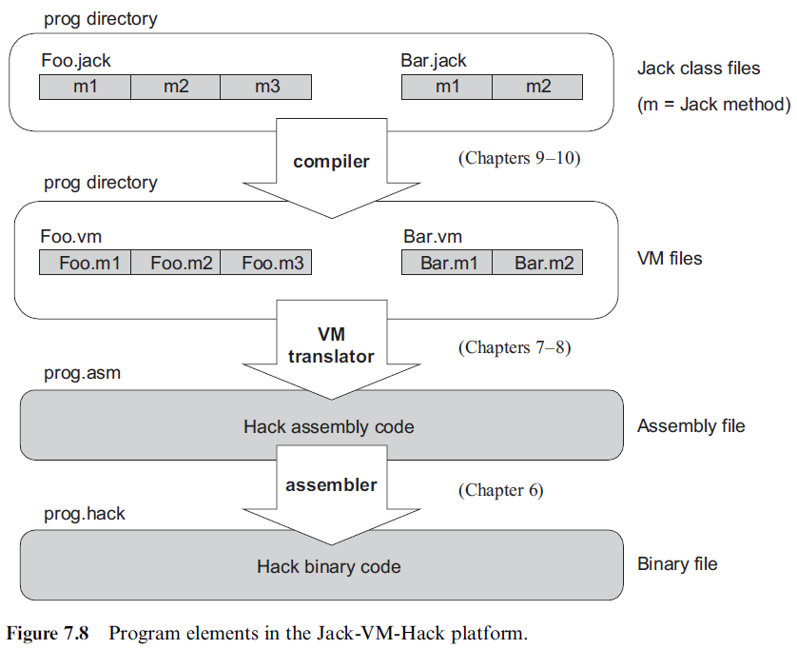
VM programming: multiple functions (files)

Slide 52
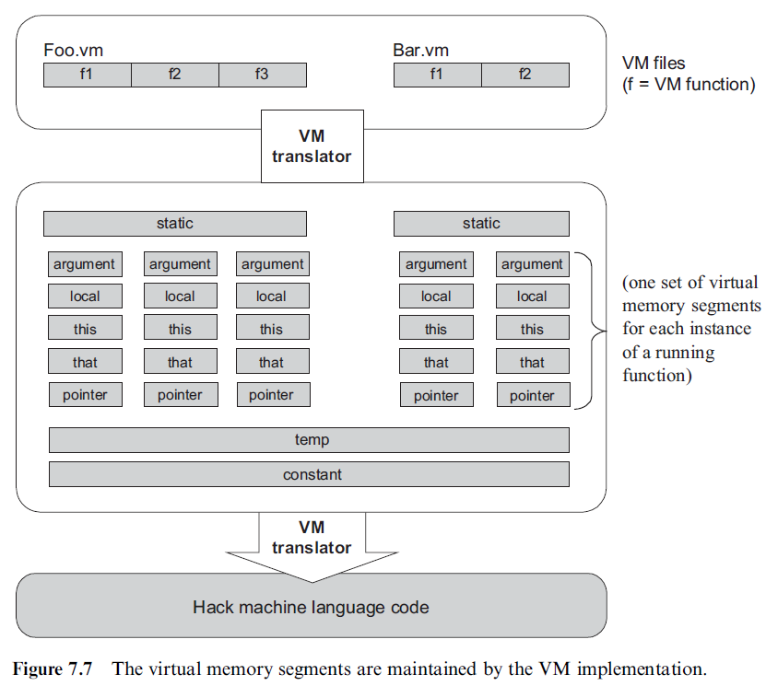
VM programming: multiple functions (memory)

Slide 53
A simple game: square
(Demo)
Use Square as an example.
Design a class: think of its
  States: data members
  Behaviors: function members
Square
  x, y, size
  MoveUp, MoveDown, IncSize, …

Slide 54
Main
/** Initializes a new Square Dance game and starts running it. */
class Main {
function void main() {
var SquareGame game;
let game = SquareGame.new();
do game.run();
do game.dispose();
return;
}
}

Slide 55
SquareGame
class SquareGame {
field Square square; // the square of this game
field int direction; // the square's current direction:
// 0=none, 1=up, 2=down, 3=left, 4=right
/** Constructs a new Square Game. */
constructor SquareGame new() {
// Creates a 30 by 30 pixels square and positions it at the top-left
// of the screen.
let square = Square.new(0, 0, 30);
let direction = 0; // initial state is no movement
return this;
}
/** Disposes this game. */
method void dispose() {
do square.dispose();
do Memory.deAlloc(this);
return;
}

Slide 56
SquareGame
/** Moves the square in the current direction. */
method void moveSquare() {
if (direction = 1) { do square.moveUp(); }
if (direction = 2) { do square.moveDown(); }
if (direction = 3) { do square.moveLeft(); }
if (direction = 4) { do square.moveRight(); }
do Sys.wait(5); // delays the next movement
return;
}
method void run() {
var char key; // the key currently pressed by the user
var boolean exit;
let exit = false;

Slide 57
SquareGame
while (~exit) {
// waits for a key to be pressed
while (key = 0) {
let key = Keyboard.keyPressed();
do moveSquare();
}
if (key = 81) { let exit = true; } // q key
if (key = 90) { do square.decSize(); } // z key
if (key = 88) { do square.incSize(); } // x key
if (key = 131) { let direction = 1; } // up arrow
if (key = 133) { let direction = 2; } // down arrow
if (key = 130) { let direction = 3; } // left arrow
if (key = 132) { let direction = 4; } // right arrow
// waits for the key to be released
while (~(key = 0)) {
let key = Keyboard.keyPressed();
do moveSquare();
}
} // while
return;
}
}

Slide 58
Square
class Square {
field int x, y; // screen location of the square's top-left corner
field int size; // length of this square, in pixels
/** Constructs a new square with a given location and size. */
constructor Square new(int Ax, int Ay, int Asize) {
let x = Ax;
let y = Ay;
let size = Asize;
do draw();
return this;
}
/** Disposes this square. */
method void dispose() {
do Memory.deAlloc(this);
return;
}

Slide 59
Square
/** Draws the square on the screen. */
method void draw() {
do Screen.setColor(true);
do Screen.drawRectangle(x, y, x + size, y + size);
return;
}
/** Erases the square from the screen. */
method void erase() {
do Screen.setColor(false);
do Screen.drawRectangle(x, y, x + size, y + size);
return;
}
/** Increments the square size by 2 pixels. */
method void incSize() {
if (((y + size) < 254) & ((x + size) < 510)) {
do erase();
let size = size + 2;
do draw();
}
return;
}

Slide 60
Square
/** Decrements the square size by 2 pixels. */
method void decSize() {
if (size > 2) {
do erase();
let size = size - 2;
do draw();
}
return;
}
/** Moves the square up by 2 pixels. */
method void moveUp() {
if (y > 1) {
do Screen.setColor(false);
do Screen.drawRectangle(x, (y + size) - 1, x + size, y + size);
let y = y - 2;
do Screen.setColor(true);
do Screen.drawRectangle(x, y, x + size, y + 1);
}
return;
}

Slide 61
Square
/** Moves the square down by 2 pixels. */
method void moveDown() {
if ((y + size) < 254) {
do Screen.setColor(false);
do Screen.drawRectangle(x, y, x + size, y + 1);
let y = y + 2;
do Screen.setColor(true);
do Screen.drawRectangle(x, (y + size) - 1, x + size, y + size);
}
return;
}
/** Moves the square left by 2 pixels. */
method void moveLeft() {
if (x > 1) {
do Screen.setColor(false);
do Screen.drawRectangle((x + size) - 1, y, x + size, y + size);
let x = x - 2;
do Screen.setColor(true);
do Screen.drawRectangle(x, y, x + 1, y + size);
}
return;
}

Slide 62
Square
/** Moves the square right by 2 pixels. */
method void moveRight() {
if ((x + size) < 510) {
do Screen.setColor(false);
do Screen.drawRectangle(x, y, x + 1, y + size);
let x = x + 2;
do Screen.setColor(true);
do Screen.drawRectangle((x + size) - 1, y, x + size, y + size);
}
return;
}
}

Slide 63
Perspective
Jack is an object-based language: no inheritance
Primitive type system (3 types)
Standard library
Our hidden agenda: gearing up to learn how to develop the ...
  Compiler (projects 10 and 11)
  OS (project 12).

Slide 64
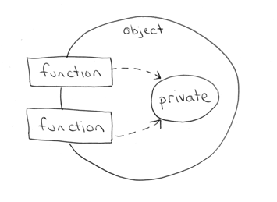
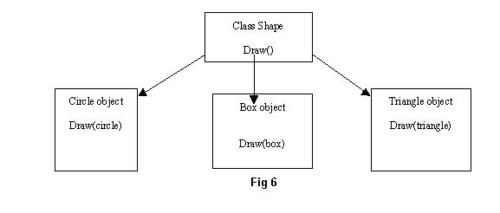
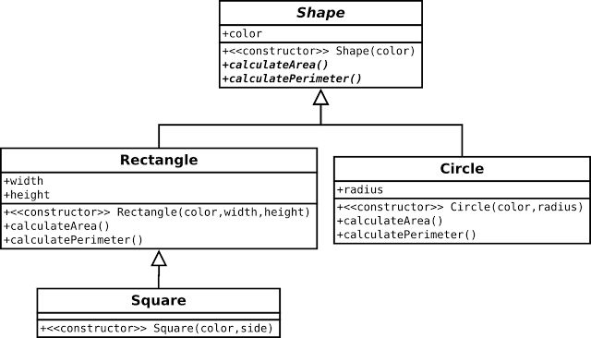
Principles of object-oriented programming
encapsulation (information hiding)
polymorphism
inheritance

Slide 65
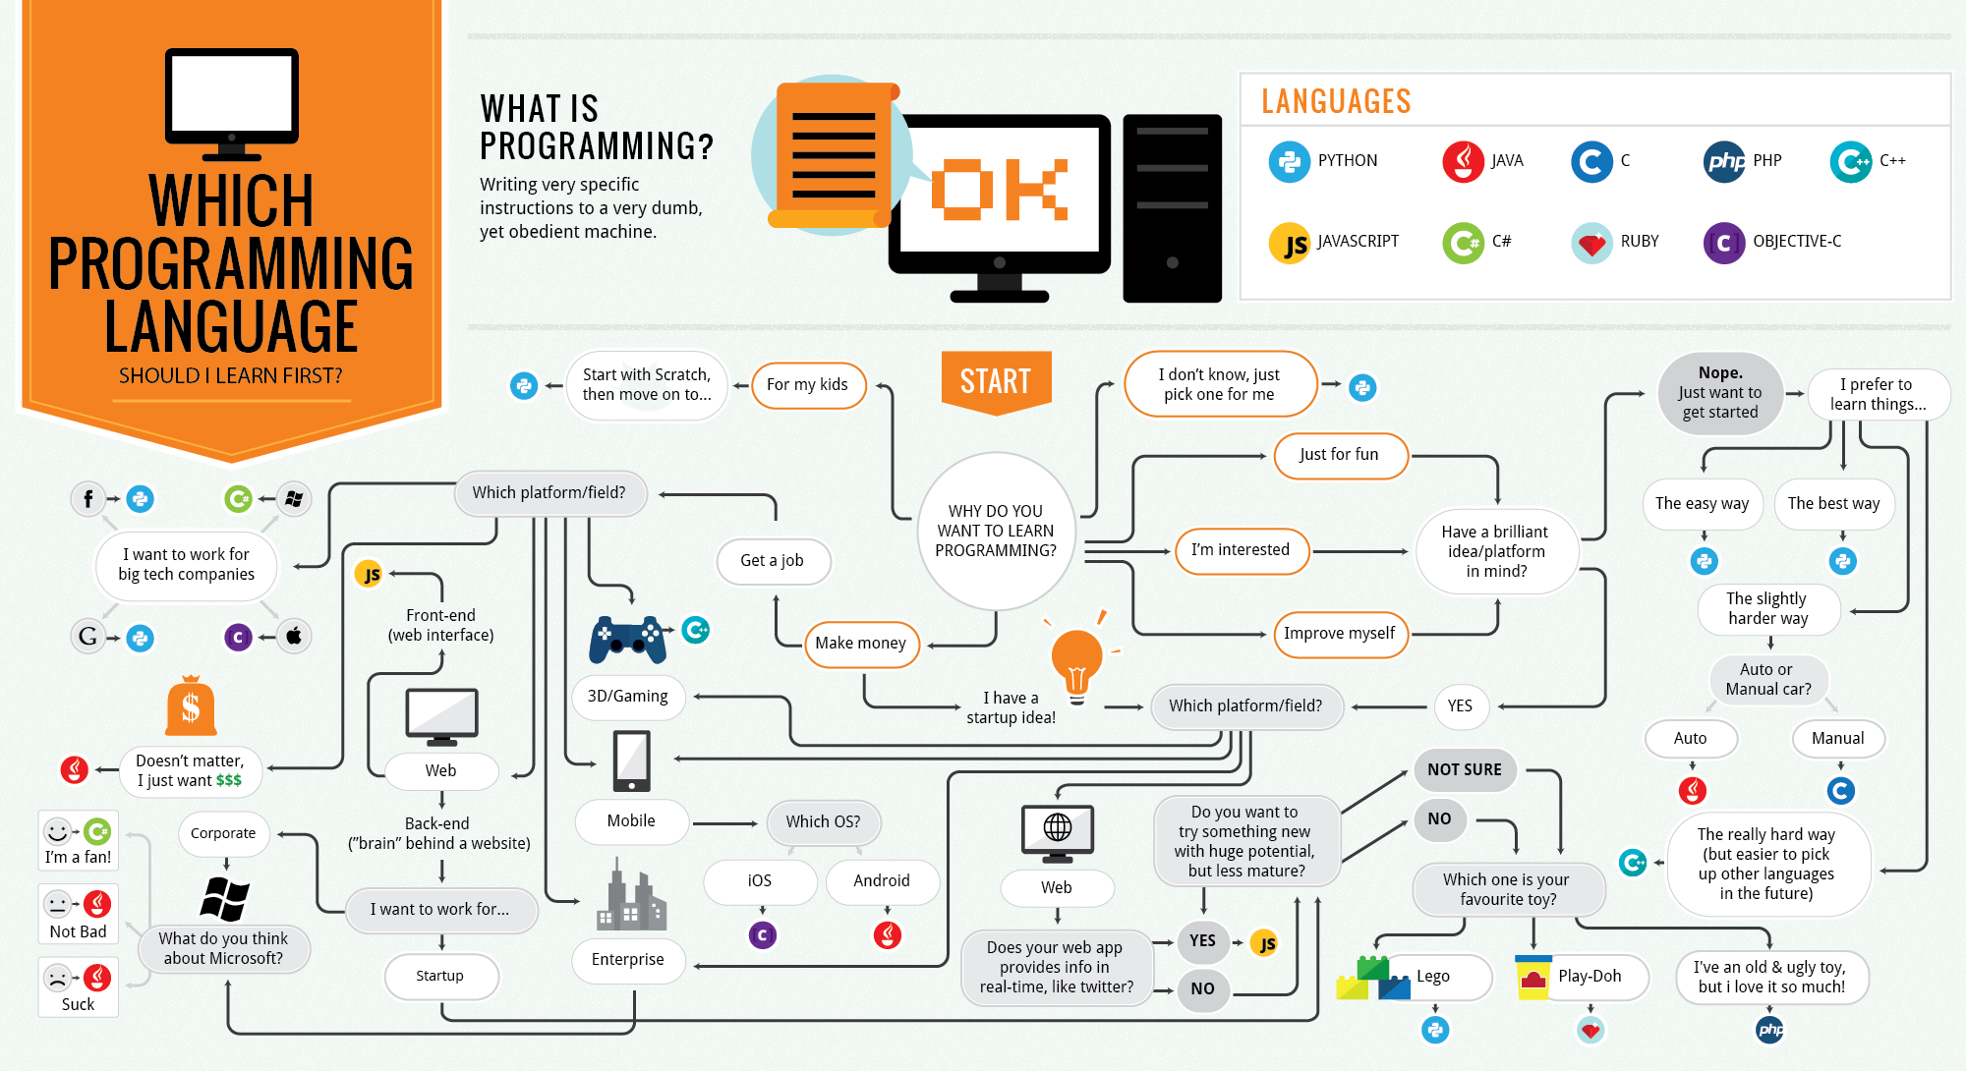
Which language should you learn?

Slide 68
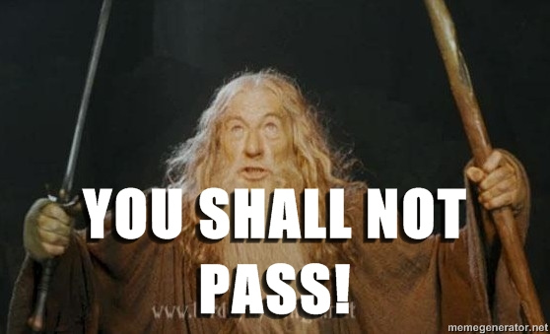
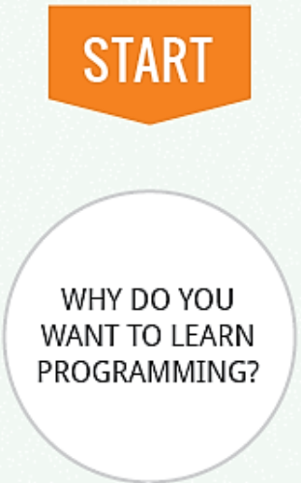


Which language should you learn?
To pass intro.
to programming

Slide 69
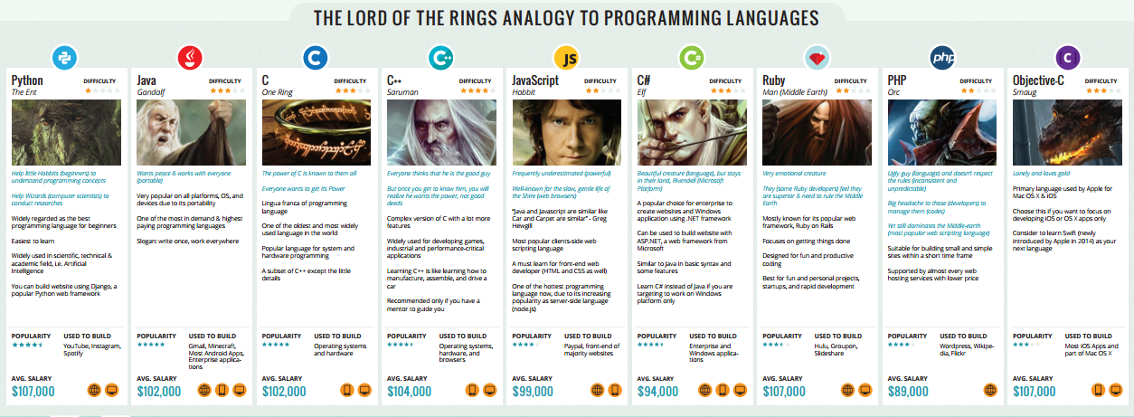

Slide 71
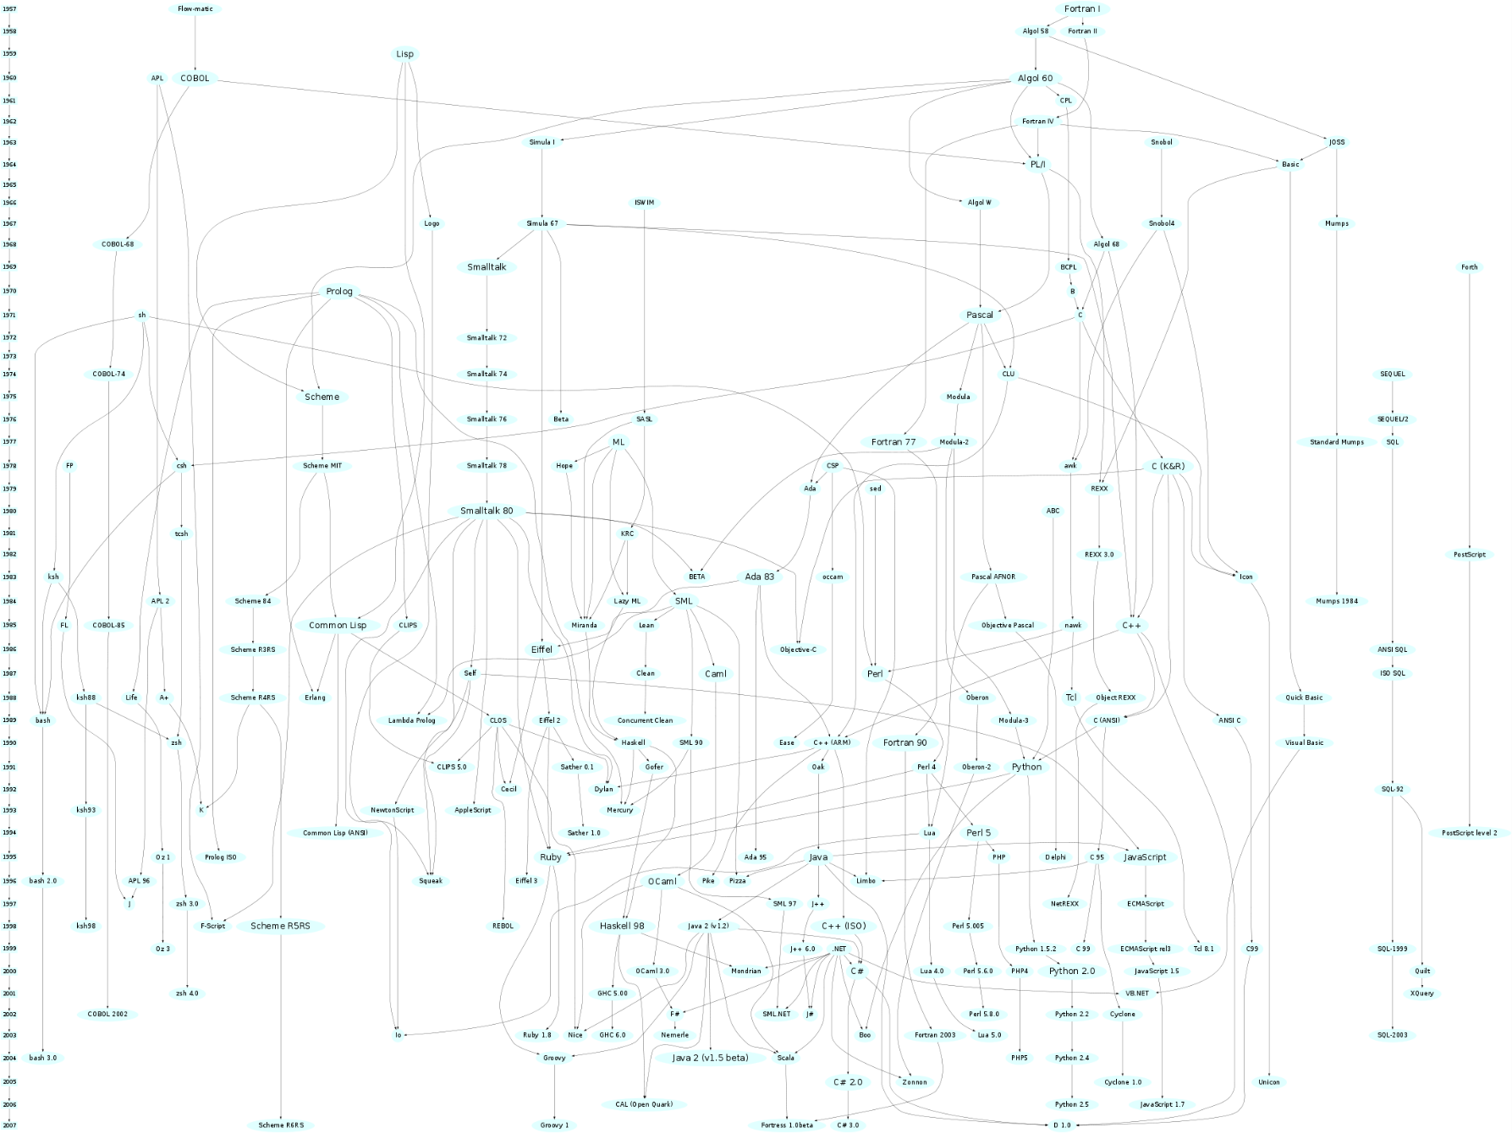
Programming languages

Slide 72
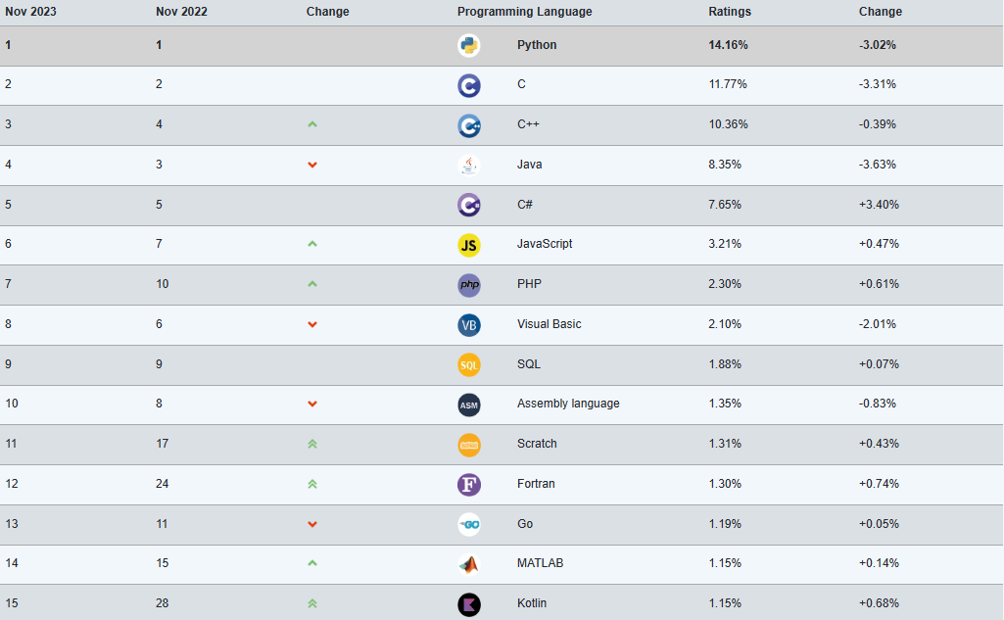
Most popular PLs (2023/11)

Slide 73
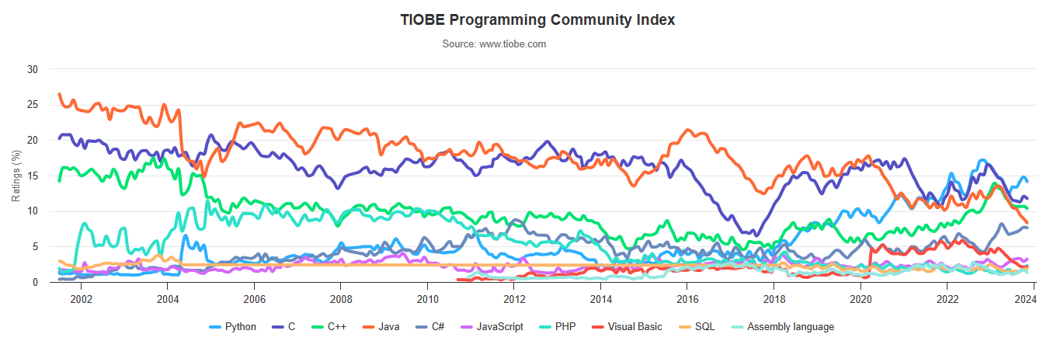
Most popular PL trends
30
20
10

Slide 74
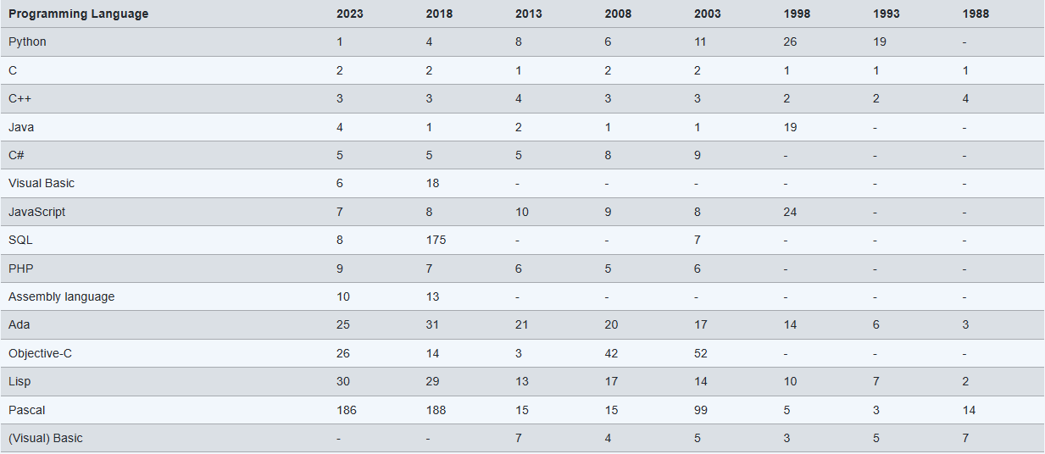
Long-term history

Slide 75
Final project
Assembler for Hack/Toy
VM translator
Compiler for Jack
Finish OS implementation
Develop applications with Jack
Design your own computers
<Fill your ideas here>

