Slide 1
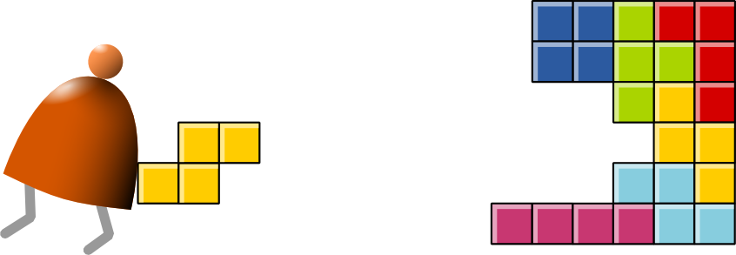
Virtual Machine
Part I: Stack Arithmetic
Building a Modern Computer From First Principles
www.nand2tetris.org
Notes:
1

Slide 2
Where we are at:
Human
Abstract design
Software
Thought
abstract interface
hierarchy
Chapters 9, 12
H.L. Language
Compiler
&
abstract interface
Operating Sys.
Chapters 10 - 11
Virtual
VM Translator
Machine
abstract interface
Chapters 7 - 8
Assembly
Language
Assembler
Chapter 6
abstract interface
Computer
Machine
Architecture
Language
abstract interface
Chapters 4 - 5
Gate Logic
Hardware
abstract interface
Platform
Chapters 1 - 3
Electrical
Hardware
Chips &
Engineering
Logic Gates
Physics
hierarchy

Slide 3
Motivation
Jack code (example)
Hack code
class Main {
static int x;
function void main() {
// Inputs and multiplies two numbers
var int a, b, x;
let a = Keyboard.readInt(“Enter a number”);
let b = Keyboard.readInt(“Enter a number”);
let x = mult(a,b);
return;
}
}
// Multiplies two numbers.
function int mult(int x, int y) {
var int result, j;
let result = 0; let j = y;
while ~(j = 0) {
let result = result + x;
let j = j – 1;
}
return result;
}
}
0000000000010000
1110111111001000
0000000000010001
1110101010001000
0000000000010000
1111110000010000
0000000000000000
1111010011010000
0000000000010010
1110001100000001
0000000000010000
1111110000010000
0000000000010001
0000000000010000
1110111111001000
0000000000010001
1110101010001000
0000000000010000
1111110000010000
0000000000000000
1111010011010000
0000000000010010
1110001100000001
0000000000010000
1111110000010000
0000000000010001
...
Our ultimate goal:
Translate high-level programs into executable code.
Compiler

Slide 4
Compilation models
Two-tier compilation:
First stage: depends only on the details of the source language
Second stage: depends only on the details of the target language.

Slide 5
The big picture
The intermediate code:
The interface between
the 2 compilation stages
Must be sufficiently general to support many <high-level language,
machine-language>
pairs
Can be modeled as the language of an abstract virtual machine (VM)
Can be implemented in several different ways.

Slide 6
Focus of this lecture (yellow):
. . .
. . .
Jack
Some
Some Other
Book chapters and
Course projects:
language
language
language
Some
Jack
9, 10, 11, 12
compiler
Some Other
compiler
compiler
VM language
VM
VM imp.
implementation
VM imp.
VM
over the Hack
7, 8
(this and the
next lecture)
over CISC
over RISC
emulator
platform
platforms
platforms
CISC
RISC
. . .
written in
Hack
machine
machine
a high-level
machine
language
language
language
language
. . .
. . .
1, 2, 3, 4, 5, 6
CISC
RISC
other digital platforms, each equipped
Any
Hack
machine
machine
with its VM implementation
computer
computer
Notes:
6

Slide 7
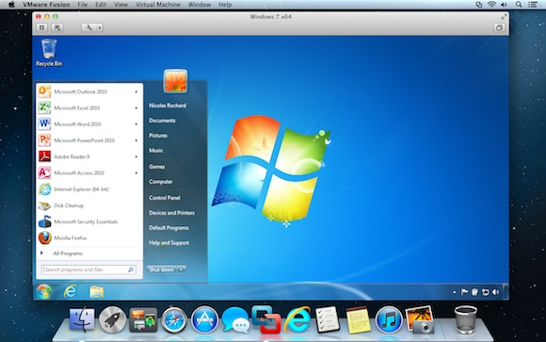
Virtual machines
A virtual machine (VM) is an emulation of a particular (real or hypothetical) computer system.
  System virtual machine (full virtualization VMs): a complete substitute for the targeted real machine and a level of functionality required for the execution of a complete operating system, e.g., VirtualBox.

Slide 8
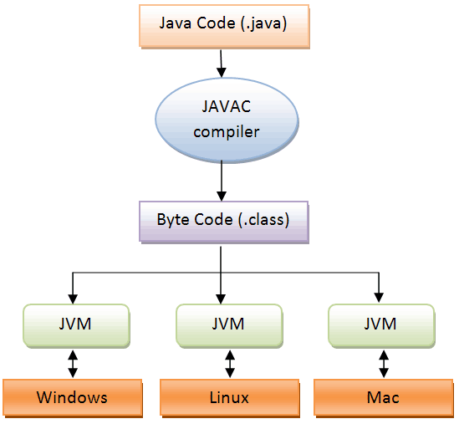
Virtual machines
A virtual machine (VM) is an emulation of a particular (real or hypothetical) computer system.
  System virtual machine (full virtualization VMs): a complete substitute for the targeted real machine and a level of functionality required for the execution of a complete operating system, e.g., VirtualBox.
  Process virtual machine: designed to execute a single computer program by providing an abstracted and platform-independent program execution environment, e.g., Java virtual machine (JVM).

Slide 9
The VM model and language
Perspective:
From here till the end of the next lecture we describe the VM model used in the Hack-Jack platform
Other VM models (like Java’s JVM/JRE and .NET’s IL/CLR) are similar in spirit, but differ in scope and details.

Slide 10
Hack virtual machine
Goal: Specify and implement a VM model and language:
Arithmetic / Boolean commands
add
sub
neg
eq
gt
lt
and
or
not
Memory access commands
pop x (pop into x, which is a variable)
push y (y being a variable or a constant)
Program flow commands
label (declaration)
goto (label)
if-goto (label)
Function calling commands
function (declaration)
call (a function)
return (from a function)
Chapter 7
Chapter 8
Our game plan: (a) describe the VM abstraction (3 types of instructions)
(b) propose how to implement it over the Hack platform.
Notes:
10

Slide 11

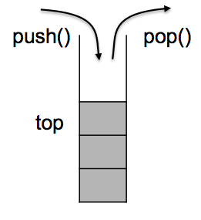

The stack
The stack:
A classical LIFO data structure
Elegant and powerful
Several hardware / software implementation options.

Slide 12
The stack
The stack:
A classical LIFO data structure
Elegant and powerful
Several hardware / software implementation options.
Several flavors: next empty/valid, increase/decrease
push(x)
stack[top]=x;
top++;
pop()
top--;
return stack[top];
peek(), empty()

Slide 13
What is the stack good for?
Stack can be used for evaluating arithmetic expressions
Expression: 5 * (6+2) – 12/4
  Infix
  Prefix
  Postfix
Stack is also good for implementing function call structures, such as subroutines, local variables and recursive calls. Will discuss it later.

Slide 14
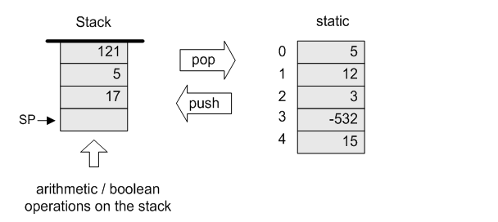
Our VM model is stack-oriented
All operations are done on a stack
Data is saved in several separate memory segments
All the memory segments behave the same
One of the memory segments m is called static, and we will use it
(as an arbitrary example) in the following examples:

Slide 15
Data types
Our VM model features a single 16-bit data type that can be used as:
an integer value (16-bit 2’s complement: -32768, ... , 32767)
a Boolean value (0 and -1, standing for true and false)
a pointer (memory address)

Slide 16
Memory access operations
(before)
(after)

Slide 17
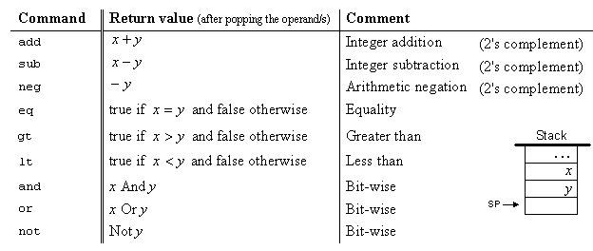

Arithmetic and Boolean commands in the VM language (wrap-up)

Slide 18
Evaluation of arithmetic expressions
VM code (example)
// z=(2-x)-(y+5)
push 2
push x
sub
push y
push 5
add
sub
pop z
(suppose that
x refers to static 0,
y refers to static 1,
z refers to static 2)

Slide 19
Evaluation of Boolean expressions
VM code (example)
// (x<7) or (y=8)
push x
push 7
lt
push y
push 8
eq
or
(suppose that
x refers to static 0,
y refers to static 1)
(actually true and false
are stored as 0 and -1, respectively)

Slide 20
The VM’s Memory segments
A VM program is designed to provide an interim abstraction of a program written in some high-level language.
Modern OO languages normally feature the following variable kinds:
Class level:
  Static variables (class-level variables)
  Private variables (aka “object variables” / “fields” / “properties”)
Method level:
  Local variables
  Argument variables
When translated into the VM language,
The static, private, local and argument variables are mapped by the compiler on the four memory segments static, this, local, argument
In addition, there are four additional memory segments, whose role will be presented later: that, constant, pointer, temp.

Slide 21
Memory segments and memory access commands
The VM abstraction includes 8 separate memory segments named:
static, this, local, argument, that, constant, pointer, temp
As far as VM programming commands go, all memory segments look and behave the same
To access a particular segment entry, use the following generic syntax:
Memory access VM commands:
  pop memorySegment index
  push memorySegment index
Where memorySegment is static, this, local, argument, that, constant, pointer, or temp
And index is a non-negative integer
(In all our code examples thus far, memorySegment was static)
The different roles of the eight memory segments will become relevant when we’ll talk about the compiler
At the VM abstraction level, all memory segments are treated the same way.

Slide 22
VM programming
VM programs are normally written by compilers, not by humans
However, compilers are written by humans ...
In order to write or optimize a compiler, it helps to first understand the spirit of the compiler’s target language – the VM language
So, we’ll now see an example of a VM program

Slide 23
VM programming
The example includes three new VM commands:
function functionSymbol // function declaration
label labelSymbol // label declaration
if-goto labelSymbol // pop x
// if x=true, jump to execute the
// command after labelSymbol
// else proceed to execute the next
// command in the program
For example, to effect if (x > n) goto loop, we can use the following VM commands:
push x
push n
gt
if-goto loop // Note that x, n, and the truth value
// were removed from the stack.

Slide 24
High-level code
function mult (x,y) {
int result, j;
result = 0;
j = y;
while ~(j = 0) {
result = result + x;
j = j - 1;
}
return result;
}

Slide 25
High-level code
function mult (x,y) {
int result, j;
result = 0;
j = y;
while ~(j = 0) {
result = result + x;
j = j - 1;
}
return result;
}
Pseudo code
...
loop:
if (j=0) goto end
result=result+x
j=j-1
goto loop
end:
...

Slide 26
High-level code
VM code (first approx.)
VM code
function mult (x,y) {
int result, j;
result = 0;
j = y;
while ~(j = 0) {
result = result + x;
j = j - 1;
}
return result;
}
function mult(x,y)
push 0
pop result
push y
pop j
label loop
push j
push 0
eq
if-goto end
push result
push x
add
pop result
push j
push 1
sub
pop j
goto loop
label end
push result
return
function mult 2
push constant 0
pop local 0
push argument 1
pop local 1
label loop
push local 1
push constant 0
eq
if-goto end
push local 0
push argument 0
add
pop local 0
push local 1
push constant 1
sub
pop local 1
goto loop
label end
push local 0
return
Pseudo code
...
loop:
if (j=0) goto end
result=result+x
j=j-1
goto loop
end:
...

Slide 27
High-level code
VM code (first approx.)
VM code
function mult (x,y) {
int result, j;
result = 0;
j = y;
while ~(j = 0) {
result = result + x;
j = j - 1;
}
return result;
}
function mult(x,y)
push 0
pop result
push y
pop j
label loop
push j
push 0
eq
if-goto end
push result
push x
add
pop result
push j
push 1
sub
pop j
goto loop
label end
push result
return
function mult 2
push constant 0
pop local 0
push argument 1
pop local 1
label loop
push local 1
push constant 0
eq
if-goto end
push local 0
push argument 0
add
pop local 0
push local 1
push constant 1
sub
pop local 1
goto loop
label end
push local 0
return

Slide 28
Lecture plan
Summary: Hack VM has the following instructions and eight memory segments.
Arithmetic / Boolean commands
add
sub
neg
eq
gt
lt
and
or
not
Memory access commands
pop x (pop into x, which is a variable)
push y (y being a variable or a constant)
Program flow commands
label (declaration)
goto (label)
if-goto (label)
Function calling commands
function (declaration)
call (a function)
return (from a function)
Chapter 7
Chapter 8
Method: (a) specify the abstraction (stack, memory segments, commands)
(b) how to implement the abstraction over the Hack platform.
Notes:
28

Slide 29
Implementation
VM implementation options:
  Emulator-based (e.g. emulate the VM model using Java)
  Translator-based (e. g. translate VM programs into the Hack machine language)
  Hardware-based (realize the VM model using dedicated memory and registers)

Slide 30
Implementation of VM on Hack
Each VM instruction must be translated into a set of Hack assembly code
VM segments need to be realized on the host memory

Slide 31
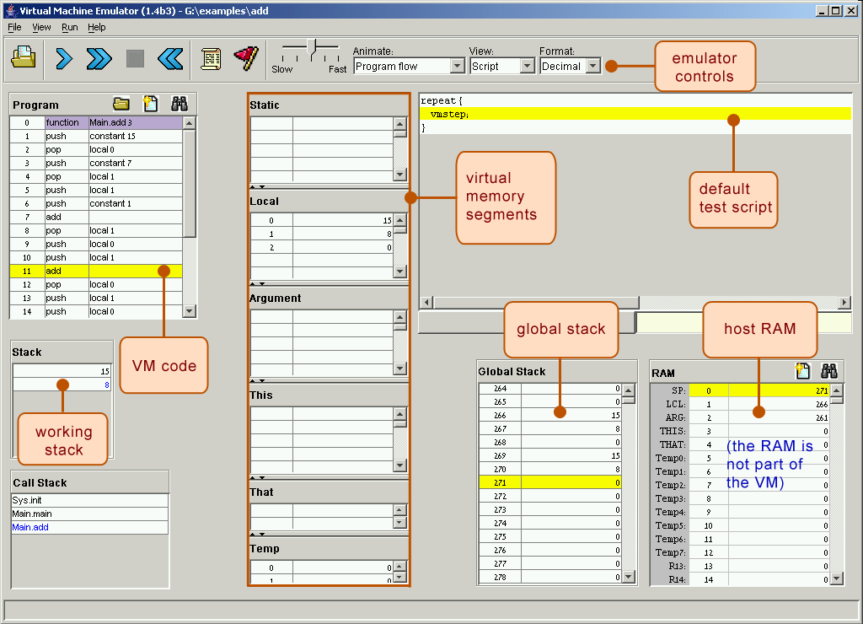
Software implementation: VM emulator (part of the course software suite)

Slide 32
VM implementation on the Hack platform (memory)
The stack: a global data structure, used to save and restore the resources of all the VM functions up the calling hierarchy.
The top of this stack is the working stack of the current function
static, constant, temp:
Global memory segments, all functions
see the same four segments
local,argument,this,that, pointer:
these segments are local at the function level; each function sees its own, private copy of each one of these four segments
The challenge:
represent all these logical constructs on the same single physical address space -- the host RAM.
Host
RAM
Notes:
32

Slide 33
VM implementation on the Hack platform (memory)
Basic idea: the mapping of the stack and the global segments on the RAM is easy (fixed);
the mapping of the function-level segments is dynamic, using pointers
The stack: mapped on RAM[256 .. 2047];
The stack pointer is kept in RAM address SP
static: mapped on RAM[16 ... 255];
each segment reference static i appearing in a VM file named f is compiled to the assembly language symbol f.i (recall that the assembler further maps such symbols to the RAM, from address 16 onward)
Host
RAM
Notes:
33

Slide 34
VM implementation on the Hack platform (memory)
local,argument: these method-level segments are stored in the stack, The base addresses of these segments are kept in RAM addresses LCL and ARG. Access to the i-th entry of any of these segments is implemented by accessing RAM[segmentBase + i]
this,that: these dynamically allocated segments are mapped somewhere from address 2048 onward, in an area called “heap”. The base addresses of these segments are kept in RAM addresses THIS, and THAT.
constant: a truly virtual segment:
access to constant i is implemented by supplying the constant i.
pointer: discussed later.
Host
RAM
Notes:
34

Slide 35
VM implementation on the Hack platform (memory)
Practice exercises
Now that we know how the memory segments are mapped on the host RAM, we can write Hack commands that realize the various VM commands.
for example, let us write the Hack code that implements the following VM commands:
push constant 1
pop static 7 (suppose it appears in a VM file named f)
push constant 5
add
pop local 2
eq
Tips:
The implementation of any one of these VM commands requires several Hack assembly commands involving pointer arithmetic
(using commands like A=M)
If you run out of registers (you have only two ...),
you may use R13, R14, and R15.
Host
RAM
Notes:
35

Slide 36
Memory Segments
Static
Local
@16?
@LCL
Argument
Pointer
@3
@ARG
Temp
@5
This
That
@THIS
@THAT

Slide 37
VM implementation on the Hack platform (translation)
push constant 1
add
pop local 2
Notes:
37

Slide 38
VM implementation on the Hack platform (translator)
push constant 1
@1
D=A
@SP
A=M
M=D
@SP
M=M+1
add
@SP
AM=M-1
D=M
A=A-1
M=M+D
pop local 2
@LCL
D=M
@2
D=D+A
@R15
M=D
@SP
AM=M-1
D=M
@R15
A=M
M=D
Notes:
38

Slide 39
Perspective
In this lecture we began the process of
building a compiler
Modern compiler architecture:
  Front-end (translates from a high-level language to a VM language)
  Back-end (translates from the VM language to the machine
  language of some target hardware platform)
Brief history of virtual machines:
  1970’s: p-Code
  1990’s: Java’s JVM
  2000’s: Microsoft .NET
A full blown VM implementation typically also includes a common software library (can be viewed as a mini, portable OS).
We will build such a mini OS later in the course.

Slide 40
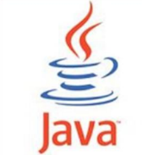
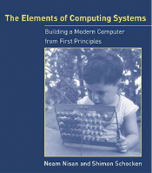


The big picture
JVM
Java
Java compiler
JRE
CLR
C#
C# compiler
.NET base
class library
VM
Jack
Jack compiler
Mini OS
7, 8
9
10, 11
12
(Book chapters and
Course projects)
Notes:
40

