Slide 1

Machine (Assembly) Language
Building a Modern Computer From First Principles
www.nand2tetris.org
Notes:
1

Slide 2
Where we are at:
Human
Abstract design
Software
Thought
abstract interface
hierarchy
Chapters 9, 12
H.L. Language
Compiler
&
abstract interface
Operating Sys.
Chapters 10 - 11
Virtual
VM Translator
Machine
abstract interface
Chapters 7 - 8
Assembly
Language
Assembler
Chapter 6
abstract interface
Computer
Machine
Architecture
Language
abstract interface
Chapters 4 - 5
Gate Logic
Hardware
abstract interface
Platform
Chapters 1 - 3
Electrical
Hardware
Chips &
Engineering
Logic Gates
Physics
hierarchy

Slide 3
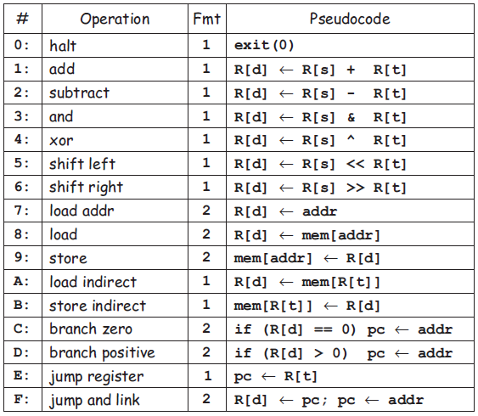
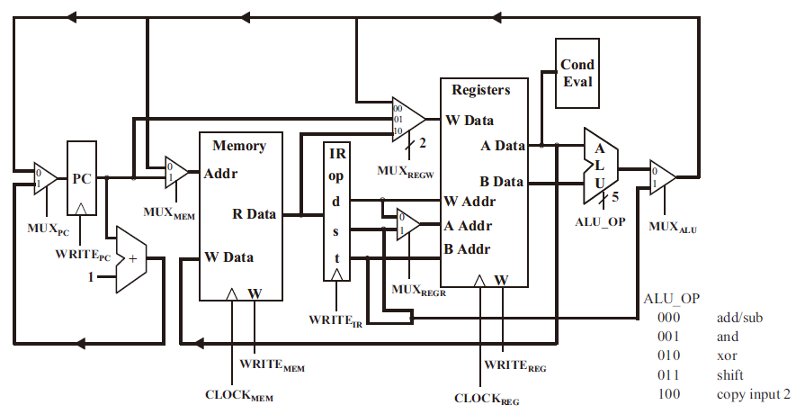
Machine language
Abstraction – implementation duality:
Machine language ( = instruction set) can be viewed as a programmer-oriented abstraction of the hardware platform
The hardware platform can be viewed as a physical means for realizing the machine language abstraction

Slide 4
Machine language
Abstraction – implementation duality:
Machine language ( = instruction set) can be viewed as a programmer-oriented abstraction of the hardware platform
The hardware platform can be viewed as a physical means for realizing the machine language abstraction
Another duality:
Binary version: 0001 0001 0010 0011 (machine code)
Symbolic version ADD R1, R2, R3 (assembly)

Slide 5
Machine language
Abstraction – implementation duality:
Machine language ( = instruction set) can be viewed as a programmer-oriented abstraction of the hardware platform
The hardware platform can be viewed as a physical means for realizing the machine language abstraction
ALU
combinational
Another duality:
Binary version
Symbolic version
Memory
state
Loose definition:
Machine language = an agreed-upon formalism for manipulating
a memory using a processor and a set of registers
Same spirit but different syntax across different hardware platforms.

Slide 6
Lecture plan
Machine languages at a glance
The Hack machine language:
  Symbolic version
  Binary version
Perspective
(The assembler will be covered in chapter 6).

Slide 7
Typical machine language commands (3 types)
ALU operations
Memory access operations
(addressing mode: how to specify operands)
  Immediate addressing, LDA R1, 67 // R1=67
  Direct addressing, LD R1, 67 // R1=M[67]
  Indirect addressing, LDI R1, R2 // R1=M[R2]
Flow control operations

Slide 8
Typical machine language commands (a small sample)
// In what follows R1,R2,R3 are registers, PC is program counter,
// and addr is some value.
ADD R1,R2,R3 // R1 ← R2 + R3
ADDI R1,R2,addr // R1 ← R2 + addr
AND R1,R1,R2 // R1 ← R1 and R2 (bit-wise)
JMP addr // PC ← addr
JEQ R1,R2,addr // IF R1 == R2 THEN PC ← addr ELSE PC++
LOAD R1, addr // R1 ← RAM[addr]
STORE R1, addr // RAM[addr] ← R1
NOP // Do nothing
// Etc. – some 50-300 command variants

Slide 9
The Hack computer
A 16-bit machine consisting of the following elements:

Slide 10
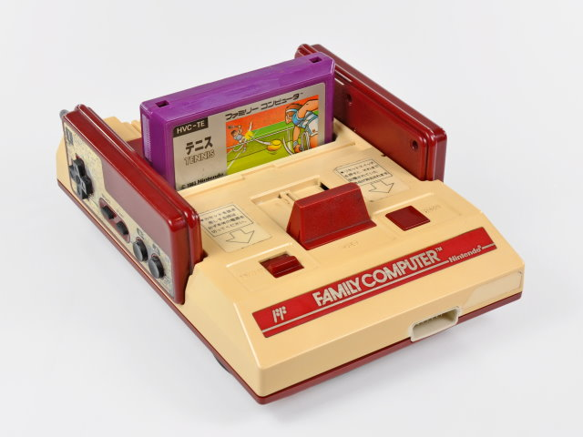
The Hack computer
The ROM is loaded with a Hack program
The reset button is pushed
The program starts running

Slide 11
The Hack computer
A 16-bit machine consisting of the following elements:
Both memory chips are 16-bit wide and have 15-bit address space.

Slide 12
The Hack computer (CPU)
A 16-bit machine consisting of the following elements:

Slide 13
The Hack computer
A 16-bit machine consisting of the following elements:
Data memory: RAM – an addressable sequence of registers
Instruction memory: ROM – an addressable sequence of registers
Registers: D, A, M, where M stands for RAM[A]
Processing: ALU, capable of computing various functions
Program counter: PC, holding an address
Control: The ROM is loaded with a sequence of 16-bit instructions, one per memory location, beginning at address 0. Fetch-execute cycle: later
Instruction set: Two instructions: A-instruction, C-instruction.

Slide 14
The A-instruction
@value // A ← value
Where value is either a number or a symbol referring to some number.
Why A-instruction?
In TOY, we store address in the instruction (fmt #2). But, it is impossible to pack a 15-bit address into a 16-bit instruction. So, we have the A-instruction for setting addresses if needed.
Example:
@21
Effect:
Sets the A register to 21
RAM[21] becomes the selected RAM register M

Slide 15
The A-instruction
@value // A ← value
Used for:
Entering a constant value
( A = value)
Coding example:
@17 // A = 17
D = A // D = 17
Selecting a RAM location
( register = RAM[A])
@17 // A = 17
D = M // D = RAM[17]
M = -1 // RAM[17]=-1
Selecting a ROM location
( PC = A )
@17 // A = 17
JMP // fetch the instruction
// stored in ROM[17]

Slide 16
The C-instruction
dest = comp ; jump
Both dest and jump are optional.
First, we compute something.
Next, optionally, we can store the result, or use it to jump to somewhere to continue the program execution.
comp:
0, 1, -1, D, A, !D, !A, -D, -A, D+1, A+1, D-1, A-1, D+A, D-A, A-D, D&A, D|A
M, !M, -M, M+1, M-1, D+M, D-M, M-D, D&M, D|M
dest: null, A, D, M, MD, AM, AD, AMD
Compare to zero. If the condition holds, jump to ROM[A]
jump: null, JGT, JEQ, JLT, JGE, JNE, JLE, JMP

Slide 17
The C-instruction
dest = comp ; jump
Computes the value of comp
Stores the result in dest
If (the condition jump compares to zero is true), goto the instruction at ROM[A].

Slide 18
The C-instruction
dest = comp ; jump
comp:
0, 1, -1, D, A, !D, !A, -D, -A, D+1, A+1, D-1, A-1, D+A, D-A, A-D, D&A, D|A
M, !M, -M, M+1, M-1, D+M, D-M, M-D, D&M, D|M
dest: null, A, D, M, MD, AM, AD, AMD
jump: null, JGT, JEQ, JLT, JGE, JNE, JLE, JMP
Example: set the D register to -1
D = -1
Example: set RAM[300] to the value of the D register minus 1
@300
M = D-1
Example: if ((D-1) == 0) goto ROM[56]
@56
D-1; JEQ

Slide 19
Hack programming reference card
Hack commands:
A-command: @value // set A to value
C-command: dest = comp ; jump // dest = and ;jump
// are optional
Where:
comp =
0 , 1 , -1 , D , A , !D , !A , -D , -A , D+1 , A+1 , D-1, A-1 , D+A , D-A , A-D , D&A , D|A,
M , !M , -M , M+1, M-1 , D+M, D-M, M-D, D&M, D|M
dest = M, D, A, MD, AM, AD, AMD, or null
jump = JGT , JEQ , JGE , JLT , JNE , JLE , JMP, or null
In the command dest = comp; jump, the jump materialzes if (comp jump 0) is true. For example, in D=D+1,JLT, we jump if D+1 < 0.

Slide 20
The Hack machine language
Two ways to express the same semantics:
Binary code (machine language)
Symbolic language (assembly)
symbolic
binary
@17
D+1; JLE
0000 0000 0001 0001
1110 0111 1100 0110
translate
execute
hardware

Slide 21
The A-instruction
symbolic
binary
@value
0value
value is a non-negative decimal number <= 2¹⁵-1 or
A symbol referring to such a constant
value is a 15-bit binary number
Example
@21
0000 0000 0001 0101

Slide 22
The C-instruction
symbolic
binary
dest = comp ; jump
111A C₁C₂C₃C₄ C₅C₆ D₁D₂ D₃J₁J₂J₃
]
comp
dest
jump
not used
opcode

Slide 23
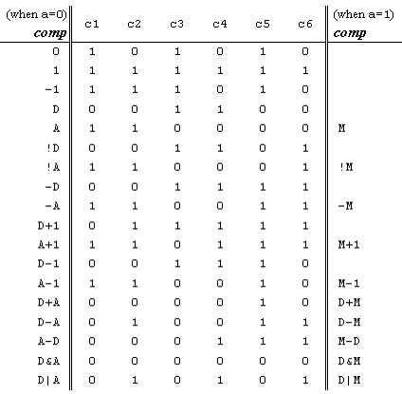

The C-instruction
111A C₁C₂C₃C₄ C₅C₆ D₁D₂ D₃J₁J₂J₃
comp
dest
jump

Slide 24
The C-instruction
111A C₁C₂C₃C₄ C₅C₆ D₁D₂ D₃J₁J₂J₃
comp
dest
jump
A D M
dest | d | d | d | effect: the value is stored in:
null | 0 | 0 | 0 | the value is not stored
M | 0 | 0 | 1 | RAM[A]
D | 0 | 1 | 0 | D register
DM | 0 | 1 | 1 | D register and RAM[A]
A | 1 | 0 | 0 | A register
AM | 1 | 0 | 1 | A register and RAM[A]
AD | 1 | 1 | 0 | A register and D register
ADM | 1 | 1 | 1 | A register, D register, and RAM[A]

Slide 25
The C-instruction
111A C₁C₂C₃C₄ C₅C₆ D₁D₂ D₃J₁J₂J₃
comp
dest
jump
< = >
jump | j | j | j | effect:
null | 0 | 0 | 0 | no jump
JGT | 0 | 0 | 1 | if comp > 0 jump
JEQ | 0 | 1 | 0 | if comp = 0 jump
JGE | 0 | 1 | 1 | if comp ≥ 0 jump
JLT | 1 | 0 | 0 | if comp < 0 jump
JNE | 1 | 0 | 1 | if comp ≠ 0 jump
JLE | 1 | 1 | 0 | if comp ≤ 0 jump
JMP | 1 | 1 | 1 | Unconditional jump

Slide 26
Hack assembly/machine language
Source code (example)
Target code
// Computes 1+...+RAM[0]
// And stored the sum in RAM[1]
@i
M=1 // i = 1
@sum
M=0 // sum = 0
(LOOP)
@i // if i>RAM[0] goto WRITE
D=M
@R0
D=D-M
@WRITE
D;JGT
@i // sum += i
D=M
@sum
M=D+M
@i // i++
M=M+1
@LOOP // goto LOOP
0;JMP
(WRITE)
@sum
D=M
@R1
M=D // RAM[1] = the sum
(END)
@END
0;JMP
0000000000010000
1110111111001000
0000000000010001
1110101010001000
0000000000010000
1111110000010000
0000000000000000
1111010011010000
0000000000010010
1110001100000001
0000000000010000
1111110000010000
0000000000010001
1111000010001000
0000000000010000
1111110111001000
0000000000000100
1110101010000111
0000000000010001
1111110000010000
0000000000000001
1110001100001000
0000000000010110
1110101010000111
assemble
Hack assembler
or CPU emulator
We will focus on writing the assembly code.

Slide 27
Working with registers and memory
D: data register
A: address/data register
M: the currently selected memory cell, M=RAM[A]
Data memory
Instruction memory
0
1
2
...
0
1
2
...
RAM
ROM
address
M
out
address
instruction
out
...
32766
32767
...
32766
32767
Address register
Data register
A
D

Slide 28
Hack programming exercises
Exercise: Implement the following tasks
using Hack commands:
Set D to A-1
Set both A and D to A + 1
Set D to 19
D++
D=RAM[17]
Set RAM[5034] to D - 1
Set RAM[53] to 171
Add 1 to RAM[7],
and store the result in D.

Slide 29
Hack programming exercises
Exercise: Implement the following tasks
using Hack commands:
Set D to A-1
Set both A and D to A + 1
Set D to 19
D++
D=RAM[17]
Set RAM[5034] to D - 1
Set RAM[53] to 171
Add 1 to RAM[7],
and store the result in D.
1. D = A-1
2. AD=A+1
3. @19
D=A
4. D=D+1
5. @17
D=M
6. @5034
M=D-1
7. @171
D=A
@53
M=D
8. @7
D=M+1

Slide 30
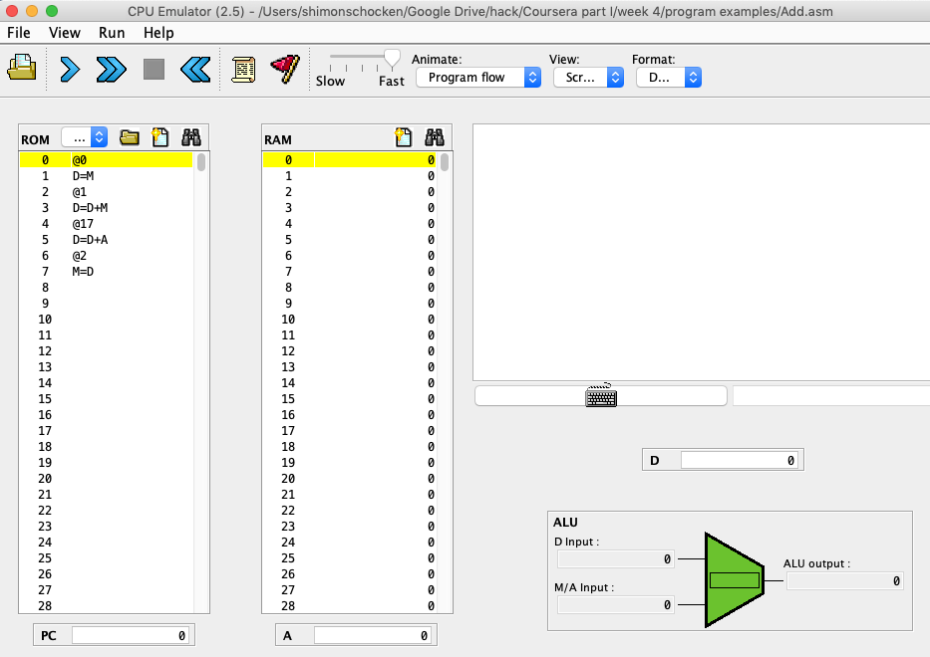
A simple program: add two numbers (demo)
Add.asm (example)
Binary
// Computes: RAM[2] = RAM[0] + RAM[1]
// D = RAM[0]
@0
D=M
// D = D + RAM[1]
@1
D=D+M
// RAM[2] = D
@2
M=D
0000000000000000
1000010010001101
0000000000000001
1010011001100001
0000000000000010
1110010010010011
Load into the
CPU emulator
Execute
When loading a symbolic program into the CPU emulator, the emulator translates it into binary code (using a built-in assembler)

Slide 31
Terminate properly
To avoid malicious code, you could terminate your program with an infinite loop, such as
@6
0; JMP
00: @0
01: D=M
02: @1
03: D=D+M
04: @2
05: M=D

Slide 32
Built-in symbols
symbol | value
R0 | 0
R1 | 1
R2 | 2
… | …
R15 | 15
SCREEN | 16384
KBD | 24576
symbol | value
SP | 0
LCL | 1
ARG | 2
THIS | 3
THAT | 4
R0, R1, …, R15 : virtual registers
SCREEN and KBD : base address of I/O memory maps
Others: used in the implementation of the Hack Virtual Machine
Note that Hack assembler is case-sensitive, R5 != r5

Slide 33
Branching
// Program: branch.asm
// if R0>0
// R1=1
// else
// R1=0

Slide 34
Branching
// Program: branch.asm
// if R0>0
// R1=1
// else
// R1=0
@R0
D=M // D=RAM[0]
@8
D; JGT // If R0>0 goto 8
@R1
M=0 // R1=0
@10
0; JMP // go to end
@R1
M=1 // R1=1
@10
0; JMP

Slide 35
Branching
// Program: branch.asm
// if R0>0
// R1=1
// else
// R1=0
@R0
D=M // D=RAM[0]
@8
D; JGT // If R0>0 goto 8
@R1
M=0 // R1=0
@10
0; JMP // go to end
@R1
M=1 // R1=1
@10
0; JMP

Slide 36
Branching with labels
// Program: branch.asm
// if R0>0
// R1=1
// else
// R1=0
@R0
D=M // D=RAM[0]
@POSTIVE
D; JGT // If R0>0 goto 8
@R1
M=0 // R1=0
@END
0; JMP // go to end
(POSTIVE)
@R1
M=1 // R1=1
(END)
@10
0; JMP
0
1
2
3
4
5
6
7
8
9
10
11
12
13
14
15
16
@0
D=M
@8
D;JGT
@1
M=0
@10
refer a label
0;JMP
@1
M=1
@10
0; JMP
declare a label

Slide 37
IF logic – Hack style
High level:
Hack:
if condition {
code block 1
} else {
code block 2
}
code block 3
D ← condition
@IF_TRUE
D;JEQ
code block 2
@END
0;JMP
(IF_TRUE)
code block 1
(END)
code block 3
Hack convention:
True is represented by -1
False is represented by 0

Slide 38
Coding examples (practice)
Exercise: Implement the following tasks using Hack commands:
goto 50
if D==0 goto 112
if D<9 goto 507
if RAM[12] > 0 goto 50
if sum>0 goto END
if x[i]<=0 goto NEXT.

Slide 39
Coding examples (practice)
Exercise: Implement the following tasks using Hack commands:
goto 50
if D==0 goto 112
if D<9 goto 507
if RAM[12] > 0 goto 50
if sum>0 goto END
if x[i]<=0 goto NEXT.
1. @50
0; JMP
2. @112
D; JEQ
3. @9
D=D-A
@507
D; JLT
4. @12
D=M
@50
D; JGT
5. @sum
D=M
@END
D: JGT
6. @i
D=M
@x
A=D+M
D=M
@NEXT
D; JLE

Slide 40
variables
// Program: swap.asm
// temp = R1
// R1 = R0
// R0 = temp

Slide 41
variables
// Program: swap.asm
// temp = R1
// R1 = R0
// R0 = temp
@R1
D=M
@temp
M=D // temp = R1
@R0
D=M
@R1
M=D // R1 = R0
@temp
D=M
@R0
M=D // R0 = temp
(END)
@END
0;JMP
When a symbol is encountered, the assembler looks up a symbol table
If it is a new label, assign a number (address of the next available memory cell) to it.
For this example, temp is assigned with 16.
If the symbol exists, replace it with the number recorded in the table.
With symbols and labels, the program is easier to read and debug. Also, it can be relocated.

Slide 42
Hack program (exercise)
Exercise: Implement the following tasks
using Hack commands:
sum = 0
j = j + 1
q = sum + 12 – j
arr[3] = -1
arr[j] = 0
arr[j] = 17

Slide 43
Hack program (exercise)
Exercise: Implement the following tasks
using Hack commands:
sum = 0
j = j + 1
q = sum + 12 – j
arr[3] = -1
arr[j] = 0
arr[j] = 17
1. @sum
M=0
2. @j
M=M+1
3. @sum
D=M
@12
D=D+A
@j
D=D-M
@q
M=D
4. @arr
D=M
@3
A=D+A
M=-1
5. @j
D=M
@arr
A=D+M
M=0
6. @j
D=M
@arr
D=D+M
@ptr
M=D
@17
D=A
@ptr
A=M
M=D

Slide 44
WHILE logic – Hack style
High level:
Hack:
while condition {
code block 1
}
Code block 2
(LOOP)
D ← condition
@END
D;JNE
code block 1
@LOOP
0;JMP
(END)
code block 2
Hack convention:
True is represented by -1
False is represented by 0

Slide 45
Complete program example
C language code:
// Adds 1+...+100.
int i = 1;
int sum = 0;
while (i <= 100){
sum += i;
i++;
}
Hack assembly convention:
Variables: lower-case
Labels: upper-case
Commands: upper-case

Slide 46
Complete program example
Pseudo code:
Hack assembly code:
i = 1;
sum = 0;
LOOP:
if (i>100) goto END
sum += i;
i++;
goto LOOP
END:
// Adds 1+...+100.
@i // i refers to some RAM location
M=1 // i=1
@sum // sum refers to some RAM location
M=0 // sum=0
(LOOP)
@i
D=M // D = i
@100
D=D-A // D = i - 100
@END
D;JGT // If (i-100) > 0 goto END
@i
D=M // D = i
@sum
M=D+M // sum += i
@i
M=M+1 // i++
@LOOP
0;JMP // Got LOOP
(END)
@END
0;JMP // Infinite loop
Hack assembly convention:
Variables: lower-case
Labels: upper-case
Commands: upper-case
Demo
CPU emulator

Slide 47
Example
// for (i=0; i<n; i++)
// arr[i] = -1;
Pseudo code:

Slide 48
Example
// for (i=0; i<n; i++)
// arr[i] = -1;
Pseudo code:
i = 0
(LOOP)
if (i-n)>=0 goto END
arr[i] = -1
i++
goto LOOP
(END)

Slide 49
Example
// for (i=0; i<n; i++)
// arr[i] = -1;
@i
M=0
(LOOP)
@i
D=M
@n
D=D-M
@END
D; JGE
@arr
D=M
@i
A=D+M
M=-1
@i
M=M+1
@LOOP
0; JMP
(END)
Pseudo code:
i = 0
(LOOP)
if (i-n)>=0 goto END
arr[i] = -1
i++
goto LOOP
(END)

Slide 50
Perspective
Hack is a simple machine language
User friendly syntax: D=D+A instead of ADD D,D,A
Hack is a “½-address machine”: any operation that needs to operate on the RAM must be specified using two commands: an A-command to address the RAM, and a subsequent C-command to operate on it
A Macro-language can be easily developed
  D=D+M[XXX] => @XXX followed by D=D+M
  GOTO YYY => @YYY followed by 0; JMP
A Hack assembler is needed and will be discusses and developed later in the course.

