Slide 1
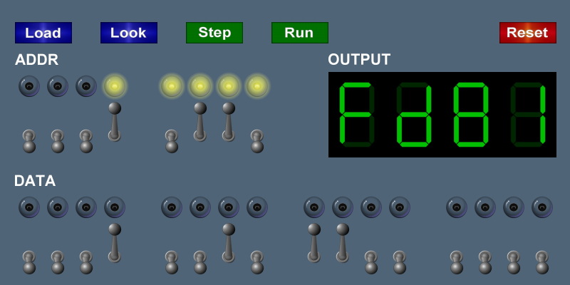
The TOY Machine
Notes:
1,4-8,10-35
You now have ideas of how to make a computer do something interesting
in the next 5 lectures, we go deeper and explore how computer works and how it relates to the physical world.
We begin at a high level. Then on to low level details. We end with a triumphant design of an entire computer.
[wayne: I ended 5 minutes early, perhaps I need more stories or we should add back in binary multiply]

Slide 2
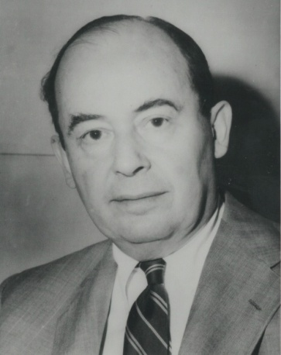
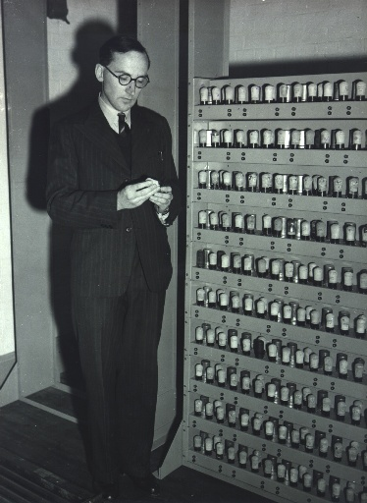
Basic Characteristics of TOY Machine
TOY is a general-purpose computer.
  Sufficient power to perform ANY computation.
  Limited only by amount of memory and time.
Stored-program computer. (von Neumann memo, 1944)
  Data and instructions encoded in binary.
  Data and instructions stored in SAME memory.
John von Neumann
All modern computers are general-purpose computers
and have same (von Neumann/Princeton) architecture.
Maurice Wilkes (left)
EDSAC (right)
Notes:
TOY is a general purpose machine that can perform any computation that any computer can perform, including simulation of any computer, including itself! We'll discuss later why we can assert such a statement with such conviction. Important feature of our understanding of computation. It's really true - with enough memory, TOY can perform any computation that any other computer can.
Stored program computer: difference between a computer and a calculator. No difference between instructions and data now seems obvious in hindsight.
Von Neumann memo (reflects ideas from Eckert, Mauchly, Burks, von Neumann)
EDSAC (Electronic Storage Delay Automatic Calculator) was first working full-scale stored-program computer in 1949
Mark I was finished before EDSAC, but smaller scale
immediate applications, profound implications

Slide 3
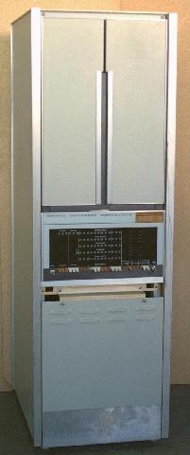
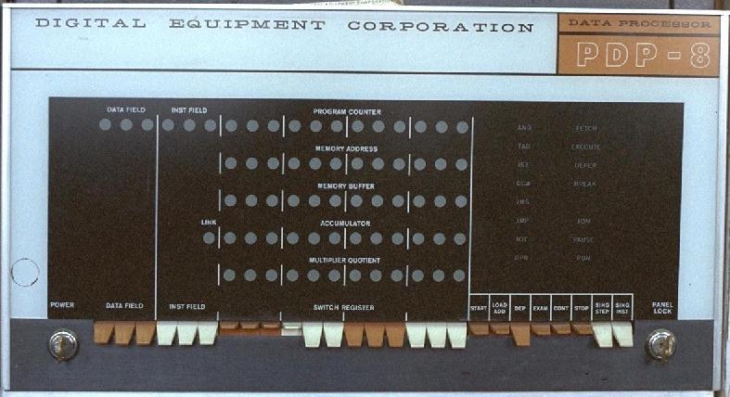
What is TOY?
An imaginary machine similar to:
  Ancient computers. (PDP-8, world's first commercially successful minicomputer. 1960s)
    12-bit words
    2K words of memory
    Used in Apollo project
Notes:
We use imaginary machine as a teaching tool to understand what a computer is and how it works.
Our machine is based on PDP-8. The venerable PDP-8 was world's first commercially successful minicomputer.
12-bit words
2K words of memory
PDP8 might be propping up corner of table in Jadwin ☺
[??? 8K of memory, each word was 8 bits.]
We sent astronauts to the moon using devices like this.
picture shows (very crude) light/switch interface between human and machine

Slide 4
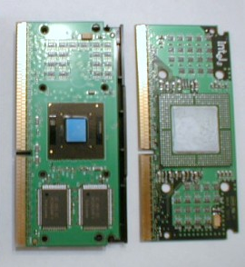
What is TOY?
An imaginary machine similar to:
  Ancient computers.
  Today's microprocessors.
Pentium
Celeron
Notes:
Say what? Surprisingly little has changed in machine architecture.

Slide 5
What is TOY?
An imaginary machine similar to:
  Ancient computers.
  Today's microprocessors.
Why study TOY?
  Machine language programming.
    how do high-level programs relate to computer?
    a favor of assembly programming
  Computer architecture.
    how is a computer put together?
    how does it work?
  Optimized for understandability, not cost or performance.
Notes:
insight into how machine works is important to anyone who wants to use computers effectively
still (a few) situations today where machine language programming is really necessary - computer graphics card
1965 = ancient ☺

Slide 6
Inside the Box
Switches. Input data and programs.
Lights. View data.
Memory.
  Stores data and programs.
  256 "words." (16 bits each)
  Special word for stdin / stdout.
Program counter (PC).
  An extra 8-bit register.
  Keeps track of next instruction to be executed.
Registers.
  Fastest form of storage.
  Scratch space during computation.
  16 registers. (16 bits each)
  Register 0 is always 0.
Arithmetic-logic unit (ALU). Manipulate data stored in registers.
Standard input, standard output. Interact with outside world.
Notes:
computer stores a pile of input bits (program): toggle switches to set individual bits; output: look at lights to see individual bits
powerful abstraction got us a long way. Tedious to enter program, so editor was invented. Tedious to look at results, so tty and windows were invented.
Registers are interface between memory and ALU (variables)
256 words of memory (not 256GB, or 256MB, just 256 = 512 bytes = 1/2K)
small so we can keep whole machine in front of us (machine design scales to handle more memory), but can accomplish amazing amounts of stuff with this little thing

Slide 7
Machine "Core" Dump
Machine contents at a particular place and time.
  Record of what program has done.
  Completely determines what machine will do.
Registers
pc
Main Memory
R0
R1
R2
R3
10
00:
0008 0005 0000 0000 0000 0000 0000 0000
0000
0000
0000
0000
08:
0000 0000 0000 0000 0000 0000 0000 0000
R4
R5
R6
R7
next
instruction
10:
8A00 8B01 1CAB 9C02 0000 0000 0000 0000
0000
0000
0000
0000
18:
0000 0000 0000 0000 0000 0000 0000 0000
R8
R9
RA
RB
data
20:
0000 0000 0000 0000 0000 0000 0000 0000
0000
0000
0000
0000
28:
0000 0000 0000 0000 0000 0000 0000 0000
program
.
RC
RD
RE
RF
.
0000
0000
0000
0000
E8:
0000 0000 0000 0000 0000 0000 0000 0000
variables
F0:
0000 0000 0000 0000 0000 0000 0000 0000
F8:
0000 0000 0000 0000 0000 0000 0000 0000
Notes:
Core dump completely describes state of machine. This is the entire state of the machine. "snapshot"
2 hex digits specify memory location
Programmers still look at dumps occasionally, even today

Slide 8
Program and Data
Instructions
Program: Sequence of instructions.
16 instruction types:
  16-bit word (interpreted one way).
  Changes contents of registers, memory, and
  PC in specified, well-defined ways.
Data:
  16-bit word (interpreted other way).
Program counter (PC):
  Stores memory address of "next instruction.“
  TOY usually starts at address 10.
0:
halt
1:
add
2:
subtract
3:
and
4:
xor
5:
shift left
6:
shift right
7:
load address
8:
load
9:
store
A:
load indirect
B:
store indirect
C:
branch zero
D:
branch positive
E:
jump register
F:
jump and link
Notes:
only 16 instructions (but they suffice to solve any problem that any computer can solve!)
We've seen ¼ of them already
in 60-80's machines had lots of instructions, now transition to RISC machines with fewer instructions that are easier to fabricate
What instructions do we need? What instructions should be there? Theoretical and practical considerations.

Slide 9
TOY Reference Card
15
14
13
12
11
10
9
8
7
6
5
4
6
3
2
1
0
Format 1
opcode
dest d
source s
source t
Format 2
opcode
dest d
addr
#
Operation
Fmt
Pseudocode
0:
halt
1
exit(0)
1:
add
1
R[d] ← R[s] + R[t]
2:
subtract
1
R[d] ← R[s] - R[t]
3:
and
1
R[d] ← R[s] & R[t]
4:
xor
1
R[d] ← R[s] ^ R[t]
Register 0 always 0.
Loads from mem[FF] from stdin.
Stores to mem[FF] to stdout.
5:
shift left
1
R[d] ← R[s] << R[t]
6:
shift right
1
R[d] ← R[s] >> R[t]
7:
load addr
2
R[d] ← addr
8:
load
2
R[d] ← mem[addr]
9:
store
2
mem[addr] ← R[d]
A:
load indirect
1
R[d] ← mem[R[t]]
B:
store indirect
1
mem[R[t]] ← R[d]
C:
branch zero
2
if (R[d] == 0) pc ← addr
D:
branch positive
2
if (R[d] > 0) pc ← addr
E:
jump register
1
pc ← R[t]
F:
jump and link
2
R[d] ← pc; pc ← addr

Slide 10
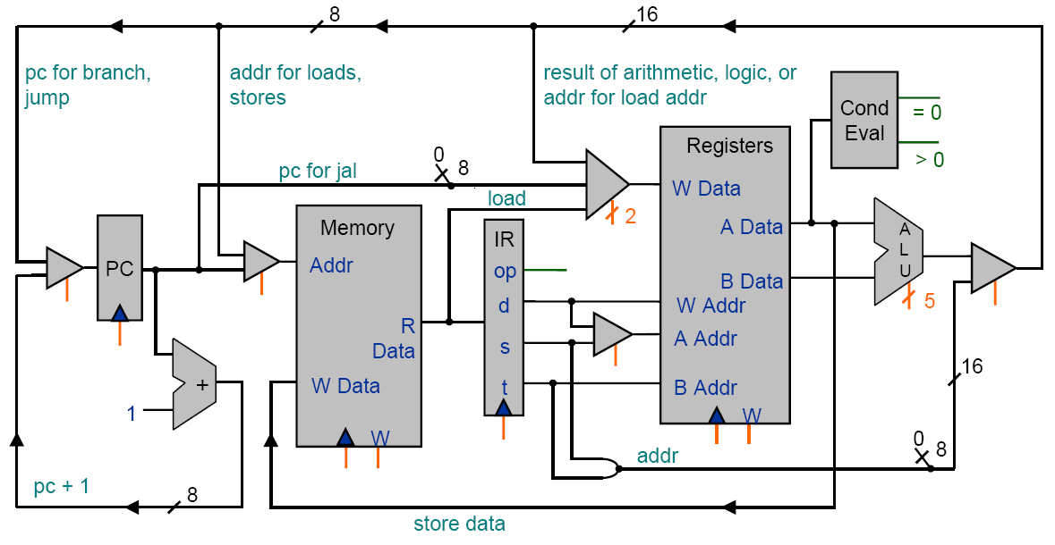
TOY Architecture (level 1)

Slide 11
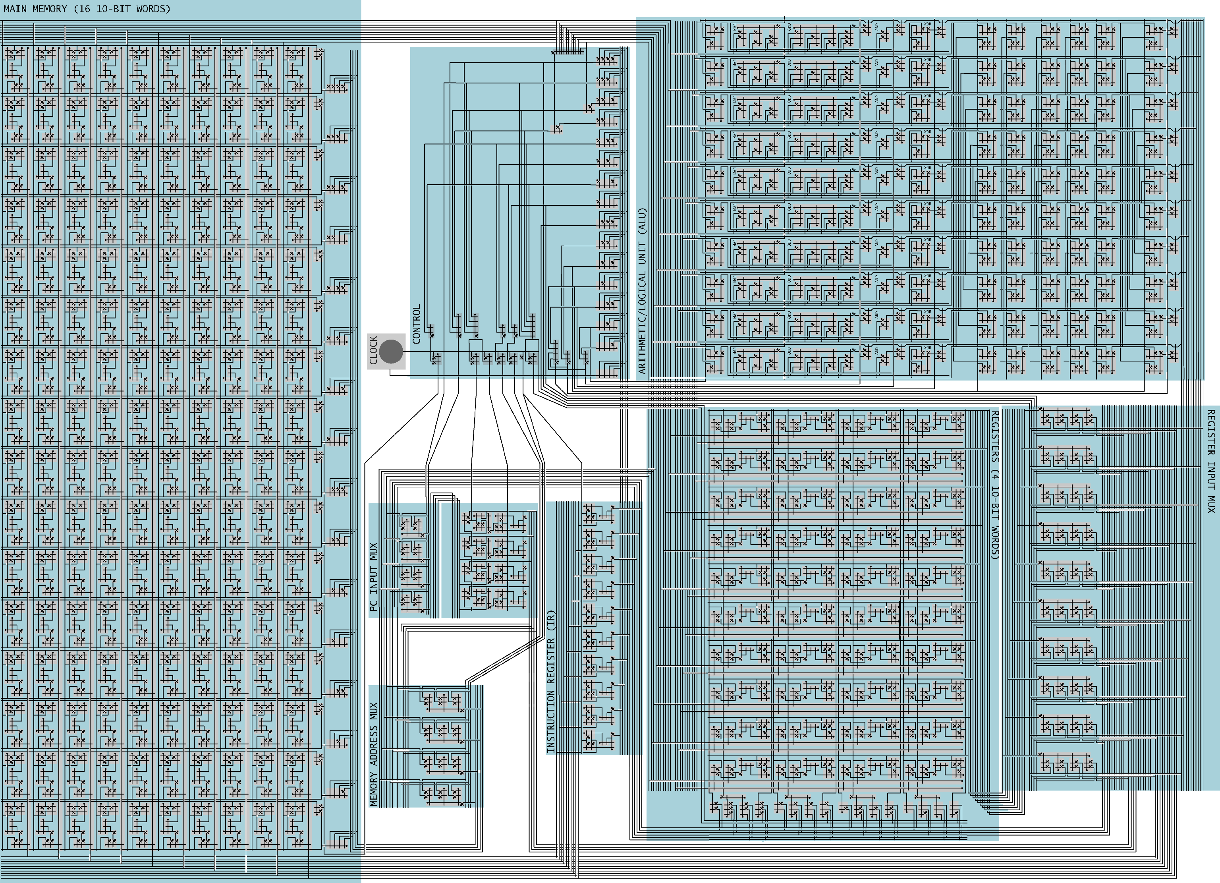
level 0

Slide 12
Programming in TOY
Hello, World. Add two numbers.
  Adds 8 + 5 = D.

Slide 13
A Sample Program
A sample program.
  Adds 8 + 5 = D.
00: 0008 8
01: 0005 5
10: 8A00 RA ← mem[00]
11: 8B01 RB ← mem[01]
12: 1CAB RC ← RA + RB
13: 9CFF mem[FF] ← RC
14: 0000 halt
add.toy
RA
RB
RC
pc
0000
0000
0000
10
Registers
Memory
Since PC = 10, machine interprets 8A00 as an instruction.
Notes:
The program consists of only the hex digits – the rest is comments are for the human

Slide 14
Load
Load. (opcode 8)
  Loads the contents of some memory location into a register.
  8A00 means load the contents of memory cell 00 into register A.
00: 0008 8
01: 0005 5
10: 8A00 RA ← mem[00]
11: 8B01 RB ← mem[01]
12: 1CAB RC ← RA + RB
13: 9CFF mem[FF] ← RC
14: 0000 halt
add.toy
RA
RB
RC
pc
0000
0000
0000
10
Registers
15
14
13
12
11
10
9
8
7
6
5
4
6
3
2
1
0
1
0
0
0
1
0
1
0
0
0
0
0
?
0
0
0
0
8₁₆
A₁₆
00₁₆
opcode
dest d
addr
Notes:
machine treats last two hex digits as a single number that indexes memory

Slide 15
Load
Load. (opcode 8)
  Loads the contents of some memory location into a register.
  8B01 means load the contents of memory cell 01 into register B.
00: 0008 8
01: 0005 5
10: 8A00 RA ← mem[00]
11: 8B01 RB ← mem[01]
12: 1CAB RC ← RA + RB
13: 9CFF mem[FF] ← RC
14: 0000 halt
add.toy
RA
RB
RC
pc
0008
0000
0000
11
Registers
15
14
13
12
11
10
9
8
7
6
5
4
6
3
2
1
0
1
0
0
0
1
0
1
1
0
0
0
0
?
0
0
0
1
8₁₆
B₁₆
01₁₆
opcode
dest d
addr

Slide 16
Add
Add. (opcode 1)
  Add contents of two registers and store sum in a third.
  1CAB adds the contents of registers A and B and put the result into register C.
00: 0008 8
01: 0005 5
10: 8A00 RA ← mem[00]
11: 8B01 RB ← mem[01]
12: 1CAB RC ← RA + RB
13: 9CFF mem[FF] ← RC
14: 0000 halt
add.toy
RA
RB
RC
pc
0008
0005
0000
12
Registers
15
14
13
12
11
10
9
8
7
6
5
4
6
3
2
1
0
0
0
0
1
1
1
0
0
1
0
1
0
?
1
0
1
1
1₁₆
C₁₆
A₁₆
B₁₆
opcode
dest d
source s
source t
Notes:
now, last two hex digits are treated individually (instead of as group)

Slide 17
Store
Store. (opcode 9)
  Stores the contents of some register into a memory cell.
  9CFF means store the contents of register C into memory cell FF (stdout).
00: 0008 8
01: 0005 5
10: 8A00 RA ← mem[00]
11: 8B01 RB ← mem[01]
12: 1CAB RC ← RA + RB
13: 9CFF mem[FF] ← RC
14: 0000 halt
add.toy
RA
RB
RC
pc
0008
0005
000D
13
Registers
15
14
13
12
11
10
9
8
7
6
5
4
6
3
2
1
0
1
0
0
1
1
1
0
0
1
1
1
1
?
1
1
1
1
9₁₆
C₁₆
FF₁₆
opcode
dest d
addr

Slide 18
Halt
Halt. (opcode 0)
  Stop the machine.
00: 0008 8
01: 0005 5
10: 8A00 RA ← mem[00]
11: 8B01 RB ← mem[01]
12: 1CAB RC ← RA + RB
13: 9CFF mem[FF] ← RC
14: 0000 halt
add.toy
RA
RB
RC
pc
0008
0005
000D
14
Registers

Slide 19
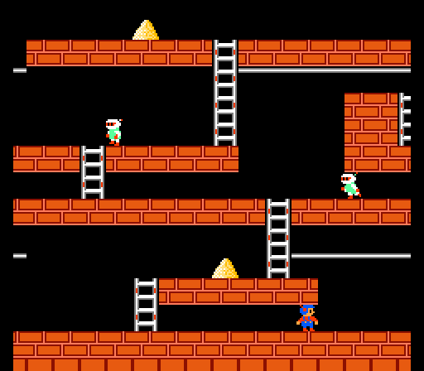
Simulation
Consequences of simulation.
  Test out new machine or microprocessor using simulator.
    cheaper and faster than building actual machine
  Easy to add new functionality to simulator.
    trace, single-step, breakpoint debugging
    simulator more useful than TOY itself
  Reuse software from old machines.
Ancient programs still running on modern computers.
  Lode Runner on Apple IIe.
  Gameboy simulator on PCs.
Notes:
Bob has good Princeton-Ticketron story. Stanford grad student took a year and wrote code to sell Ticketron in machine language PDP8 (point of sale equipment). No idea what it was worth or how to compensate, so he just asked for a piece of every ticket told. Such a compact (and indecipherable) piece of code that it was easier to emulate than rewrite. Running PDP10. Then Compaq. Needless to say Stanford grad student never got his phd, but still collects his nickel on every sale!
Most of nations business software written in COBOL. Now emulated on IBM since no COBOL compiler for Pentium.
Gameboy games are now emulated on Windows. Write a simulator for the Gameboy and then all games work – no need to rewrite code.

Slide 20
Interfacing with the TOY Machine
To enter a program or data:
  Set 8 memory address switches.
  Set 16 data switches.
  Press LOAD.
    data written into addressed word of memory
To view the results of a program:
  Set 8 memory address switches.
  Press LOOK: contents of addressed word appears in lights.
Notes:
pre-load in the add.toy program. Change one of the data lines to add 8 and 6.
Or change the add instruction to 2CAB so that it subtracts 8 – 5 = 3.
Note: students don’t know about 2's complement representation of negative integers yet.

Slide 21
Using the TOY Machine: Run
To run the program:
  Set 8 memory address switches to address of first instruction.
  Press LOOK to set PC to first instruction.
  Press RUN button to repeat fetch-execute cycle until halt opcode.
Fetch
Execute

Slide 22
Branch in TOY
To harness the power of TOY, need loops and conditionals.
  Manipulate PC to control program flow.
Branch if zero. (opcode C)
  Changes PC depending of value of some register.
  Used to implement: for, while, if-else.
Branch if positive. (opcode D)
  Analogous.

Slide 23
An Example: Multiplication
Multiply.
  No direct support in TOY hardware.
  Load in integers a and b, and store c = a × b.
  Brute-force algorithm:
    initialize c = 0
    add b to c, a times
Issues ignored: slow, overflow, negative numbers.
int a = 3;
int b = 9;
int c = 0;
while (a != 0) {
c = c + b;
a = a - 1;
}
Java
Notes:
No multiply instruction in TOY! Why not? Can do it with add/sub; saves special (and cumbersome) multiply hardware.
We create this abstraction in software.
more convenient to count down in TOY
BTW that was one SLOW multiply function, e.g., 5000 x 4000 requires 4000 additions. Let's get a better implementation
Actually works for negative numbers and handles overflow in traditional way.

Slide 24
Multiply
int a = 3;
int b = 9;
int c = 0;
while (a != 0) {
c = c + b;
a = a - 1;
}
Notes:
Note that register 0 is always 0 in C014 instruction.
Note: could get away with just one "branch if positive" statement if we didn't mind getting multiplication wrong when RA = 0. or RA < 0

Slide 25
Multiply
0A: 0003 3
0B: 0009 9
0C: 0000 0
0D: 0000 0
0E: 0001 1
10: 8A0A RA ← mem[0A] a
11: 8B0B RB ← mem[0B] b
12: 8C0D RC ← mem[0D] c = 0
13: 810E R1 ← mem[0E] always 1
14: CA18 if (RA == 0) pc ← 18 while (a != 0) {
15: 1CCB RC ← RC + RB c = c + b
16: 2AA1 RA ← RA - R1 a = a - 1
17: C014 pc ← 14 }
18: 9CFF mem[FF] ← RC
19: 0000 halt
inputs
output
constants
loop
multiply.toy
Notes:
Note that register 0 is always 0 in C014 instruction.
Note: could get away with just one "branch if positive" statement if we didn't mind getting multiplication wrong when RA = 0. or RA < 0

Slide 26
Step-By-Step Trace
R1 RA RB RC
10: 8A0A RA ← mem[0A] 0003
11: 8B0B RB ← mem[0B] 0009
12: 8C0D RC ← mem[0D] 0000
13: 810E R1 ← mem[0E] 0001
14: CA18 if (RA == 0) pc ← 18
15: 1CCB RC ← RC + RB 0009
16: 2AA1 RA ← RA – R1 0002
17: C014 pc ← 14
14: CA18 if (RA == 0) pc ← 18
15: 1CCB RC ← RC + RB 0012
16: 2AA1 RA ← RA – R1 0001
17: C014 pc ← 14
14: CA18 if (RA == 0) pc ← 18
15: 1CCB RC ← RC + RB 001B
16: 2AA1 RA ← RA – R1 0000
17: C014 pc ← 14
14: CA18 if (RA == 0) pc ← 18
18: 9CFF mem[FF] ← RC
19: 0000 halt
multiply.toy

Slide 27
An Efficient Multiplication Algorithm
Inefficient multiply.
  Brute force multiplication algorithm loops a times.
  In worst case, 65,535 additions!
"Grade-school" multiplication.
  Always 16 additions to multiply 16-bit integers.
1
2
3
4
1
0
1
1
Decimal
*
1
5
1
2
Binary
*
1
1
0
1
2
4
6
8
1
0
1
1
1
2
3
4
0
0
0
0
6
1
7
0
1
0
1
1
1
2
3
4
1
0
1
1
0
1
8
6
5
8
0
8
1
0
0
0
1
1
1
1
Notes:
Make all programs that use multiply function faster. All muls take 16 adds. Only need to change software, not build a new machine in hardware.

Slide 28
Binary Multiplication
Grade school binary multiplication algorithm to compute c = a × b.
  Initialize c = 0.
  Loop over i bits of b.
    if b_{i} = 0, do nothing
    if b_{i} = 1, shift a left i bits and
    add to c
Implement with built-in TOY shift instructions.
1
0
1
1
a
*
1
1
0
1
b
1
0
1
1
a << 0
b_{i} = i^{th} bit of b
0
0
0
0
1
0
1
1
a << 2
1
0
1
1
a << 3
1
0
0
0
1
1
1
1
c
int c = 0;
for (int i = 15; i >= 0; i--)
if (((b >> i) & 1) == 1)
c = c + (a << i);
b_{i} = i^{th} bit of b
Notes:
overflow very possible. Multiplying negative integers doesn't just work without some care (neg x neg = neg).

Slide 29
Shift Left
Shift left. (opcode 5)
  Move bits to the left, padding with zeros as needed.
  1234₁₆ << 7₁₆ = 1A00₁₆
discard
0
0
0
1
0
0
1
0
0
0
1
1
0
1
0
0
1₁₆
2₁₆
3₁₆
4₁₆
<< 7
pad with 0’s
0
0
0
1
1
0
1
0
0
0
0
0
0
0
0
0
1₁₆
A₁₆
0₁₆
0₁₆
Notes:
How much to shift is stored in a register. equivalent to multiplying by 2^7

Slide 30
Shift Right
Shift right. (opcode 6)
  Move bits to the right, padding with sign bit as needed.
  1234₁₆ >> 7₁₆ = 0024₁₆
discard
sign bit
0
0
0
1
0
0
1
0
0
0
1
1
?
0
1
0
0
1₁₆
2₁₆
3₁₆
4₁₆
pad with 0’s
>> 7
0
0
0
0
0
0
0
0
0
0
1
0
0
1
0
0
0₁₆
0₁₆
2₁₆
4₁₆
Notes:
example of shifting a negative integer is in course notes

Slide 31
Shift Right (Sign Extension)
Shift right. (opcode 6)
  Move bits to the right, padding with sign bit as needed.
  FFCA₁₆ >> 2₁₆ = FFF2₁₆
  -53₁₀ >> 2₁₀ = -13₁₀
discard
sign bit
1
1
1
1
1
1
1
1
1
1
0
0
1
0
1
0
F₁₆
F₁₆
C₁₆
A₁₆
pad with 1s
>> 2
1
1
1
1
1
1
1
1
1
1
1
1
0
0
1
0
F₁₆
F₁₆
F₁₆
2₁₆
Notes:
example of shifting a negative integer

Slide 32
Bitwise AND
x | y | AND
0 | 0 | 0
0 | 1 | 0
1 | 0 | 0
1 | 1 | 1
Logical AND. (opcode 3)
  Logic operations are BITWISE.
  0024₁₆ & 0001₁₆ = 0000₁₆
0
0
0
0
0
0
0
0
0
0
1
0
?
0
1
0
0
0₁₆
0₁₆
2₁₆
4₁₆
&
0
0
0
0
0
0
0
0
0
0
0
0
?
0
0
0
1
0₁₆
0₁₆
0₁₆
1₁₆
=
0
0
0
0
0
0
0
0
0
0
0
0
0
0
0
0
0₁₆
0₁₆
0₁₆
0₁₆
Notes:
picks out rightmost bit

Slide 33
Shifting and Masking
Shift and mask: get the 7th bit of 1234.
  Compute 1234₁₆ >> 7₁₆ = 0024₁₆.
  Compute 0024₁₆ && 1₁₆ = 0₁₆.
0
0
0
1
0
0
1
0
0
0
1
1
?
0
1
0
0
1₁₆
2₁₆
3₁₆
4₁₆
>> 7
0
0
0
0
0
0
0
0
0
0
1
0
0
1
0
0
0₁₆
0₁₆
2₁₆
4₁₆
&
0
0
0
0
0
0
0
0
0
0
0
0
?
0
0
0
1
0₁₆
0₁₆
0₁₆
1₁₆
=
0
0
0
0
0
0
0
0
0
0
0
0
0
0
0
0
0₁₆
0₁₆
0₁₆
0₁₆
Notes:
picks out rightmost bit

Slide 34
Binary Multiplication
int c = 0;
for (int i = 15; i >= 0; i--)
if (((b >> i) & 1) == 1)
c = c + (a << i);
Notes:
can make goto 15

Slide 35
Binary Multiplication
0A: 0003 3
0B: 0009 9
0C: 0000 0
0D: 0000 0
0E: 0001 1
0F: 0010 16
10: 8A0A RA ← mem[0A] a
11: 8B0B RB ← mem[0B] b
12: 8C0D RC ← mem[0D] c = 0
13: 810E R1 ← mem[0E] always 1
14: 820F R2 ← mem[0F] i = 16
do {
15: 2221 R2 ← R2 - R1 i--
16: 53A2 R3 ← RA << R2 a << i
17: 64B2 R4 ← RB >> R2 b >> i
18: 3441 R4 ← R4 & R1 b_{i} = i^{th} bit of b
19: C41B if (R4 == 0) goto 1B if b_{i} is 1
1A: 1CC3 RC ← RC + R3 add a << i to sum
1B: D215 if (R2 > 0) goto 15 } while (i > 0);
1C: 9CFF mem[FF] ← RC
inputs
output
constants
16 bit words
loop
branch
multiply-fast.toy
Notes:
can make goto 15

Slide 36
Useful TOY "Idioms"
Jump absolute.
  Jump to a fixed memory address.
    branch if zero with destination
    register 0 is always 0
Register assignment.
  No instruction that transfers contents of one register into another.
  Pseudo-instruction that simulates assignment:
    add with register 0 as one of two source registers
No-op.
  Instruction that does nothing.
  Plays the role of whitespace in C programs.
    numerous other possibilities!
17: C014 pc ← 14
17: 1230 R[2] ← R[3]
17: 1000 no-op
Notes:
assignment and jump absolute used in multiply instruction

Slide 37
Standard Input and Output: Implications
Standard input and output enable you to:
  Process more information than fits in memory.
  Interact with the computer while it is running.
Standard output.
  Writing to memory location FF sends one word to TOY stdout.
  9AFF writes the integer in register A to stdout.
Standard input.
  Loading from memory address FF loads one word from TOY stdin.
  8AFF reads in an integer from stdin and store it in register A.
Notes:
computer is an abstract machine. Stdin lets you interact with the physical world.

Slide 38


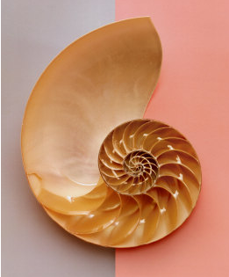
Fibonacci Numbers
Fibonacci sequence: 0, 1, 1, 2, 3, 5, 8, 13, 21, 34, . . .
Reference: http://www.mcs.surrey.ac.uk/Personal/R.Knott/Fibonacci/fibnat.html
Notes:
In 1225 Fibonacci took part in a tournament at Pisa ordered by the emperor himself, Frederick II. It was in just this type of competition that the following problem arose: Beginning with a single pair of rabbits, if every month each productive pair bears a new pair, which becomes productive when they are 1 month old, how many rabbits will there be after n months?
Imagine that there are x_{n} pairs of rabbits after n months. The number of pairs in month n+1 will be x_{n} (in this problem, rabbits never die) plus the number of new pairs born. But new pairs are only born to pairs at least 1 month old, so there will be x_{n-1} new pairs. x_{n+1} = x_{n} + x_{n-1}
Simplification: If a cow produces its first she-calf at age two years and after that produces another single she-calf every year, how many she-calves are there after 12 years, assuming none die?

Slide 39
Standard Output
00: 0000 0
01: 0001 1
10: 8A00 RA ← mem[00] a = 0
11: 8B01 RB ← mem[01] b = 1
do {
12: 9AFF print RA print a
13: 1AAB RA ← RA + RB a = a + b
14: 2BAB RB ← RA - RB b = a - b
15: DA12 if (RA > 0) goto 12 } while (a > 0)
16: 0000 halt
0000
0001
0001
0002
0003
0005
0008
000D
0015
0022
0037
0059
0090
00E9
0179
0262
03DB
063D
0A18
1055
1A6D
2AC2
452F
6FF1
fibonacci.toy
Notes:
two magic spots in TOY: R[0] = 0 and mem[FF] for stdin/stdout
can't actually store an integer in mem[FF] - hardware traps this location and sends output to a physical device (screen, or punch cards)
Run TOY demo (see stdout in LCD or stdout' with Princeton punch card)

Slide 40
Standard Input
Ex: read in a sequence of integers and print their sum.
  In Java, stop reading when EOF.
  In TOY, stop reading when user enters 0000.
00AE
0046
0003
0000
00F7
while(!StdIn.isEmpty()) {
a = StdIn.readInt();
sum = sum + a;
}
System.out.println(sum);
00: 0000 0
10: 8C00 RC <- mem[00]
11: 8AFF read RA
12: CA15 if (RA == 0) pc ← 15
13: 1CCA RC ← RC + RA
14: C011 pc ← 11
15: 9CFF write RC
16: 0000 halt

Slide 41
Load Address (a.k.a. Load Constant)
Load address. (opcode 7)
  Loads an 8-bit integer into a register.
  7A30 means load the value 30 into register A.
Applications.
  Load a small constant into a register.
  Load a 8-bit memory address into a register.
    register stores "pointer" to a memory cell
a = 30;
Java code
15
14
13
12
11
10
9
8
7
6
5
4
6
3
2
1
0
0
1
1
1
1
0
1
0
0
0
1
1
?
0
0
0
0
7₁₆
A₁₆
3₁₆
0₁₆
opcode
dest d
addr

Slide 42
Arrays in TOY
TOY main memory is a giant array.
  Can access memory cell 30 using load and store.
  8C30 means load mem[30] into register C.
  Goal: access memory cell i where i is a variable.
Load indirect. (opcode A)
  AC06 means load mem[R6] into register C.
Store indirect. (opcode B)
  BC06 means store contents of register C into mem[R6].
a variable index (like a pointer)
a variable index
for (int i = 0; i < N; i++)
a[i] = StdIn.readInt();
for (int i = 0; i < N; i++)
System.out.println(a[N-i-1]);
Reverse.java
Notes:
more instructions ….
More flexibility needed to implement arrays.

Slide 43
TOY Implementation of Reverse
TOY implementation of reverse.
  Read in a sequence of integers and store in memory 30, 31, 32, …
  Stop reading if 0000.
  Print sequence in reverse order.
Notes:
Problem: program doesn't know what input will look like. What if there are 5000 words of input? Only 256 words of memory.

Slide 44
TOY Implementation of Reverse
TOY implementation of reverse.
  Read in a sequence of integers and store in memory 30, 31, 32, …
  Stop reading if 0000.
  Print sequence in reverse order.
10: 7101 R1 ← 0001 constant 1
11: 7A30 RA ← 0030 a[]
12: 7B00 RB ← 0000 n
while(true) {
13: 8CFF read RC c = StdIn.readInt();
14: CC19 if (RC == 0) goto 19 if (c == 0) break;
15: 16AB R6 ← RA + RB address of a[n]
16: BC06 mem[R6] ← RC a[n] = c;
17: 1BB1 RB ← RB + R1 n++;
18: C013 goto 13 }
read in the data
Notes:
Problem: program doesn't know what input will look like. What if there are 5000 words of input? Only 256 words of memory.

Slide 45
TOY Implementation of Reverse
TOY implementation of reverse.
  Read in a sequence of integers and store in memory 30, 31, 32, …
  Stop reading if 0000.
  Print sequence in reverse order.
19: CB20 if (RB == 0) goto 20 while (n > 0) {
1A: 16AB R6 ← RA + RB address of a[n]
1B: 2661 R6 ← R6 – R1 address of a[n-1]
1C: AC06 RC ← mem[R6] c = a[n-1];
1D: 9CFF write RC System.out.println(c);
1E: 2BB1 RB ← RB – R1 n--;
1F: C019 goto 19 }
20: 0000 halt
print in reverse order

Slide 46
Unsafe Code at any Speed
What happens if we make array start at 00 instead of 30?
  Self modifying program.
  Exploit buffer overrun and run arbitrary code!
10: 7101 R1 ← 0001 constant 1
11: 7A00 RA ← 0000 a[]
12: 7B00 RB ← 0000 n
while(true) {
13: 8CFF read RC c = StdIn.readInt();
14: CC19 if (RC == 0) goto 19 if (c == 0) break;
15: 16AB R6 ← RA + RB address of a[n]
16: BC06 mem[R6] ← RC a[n] = c;
17: 1BB1 RB ← RB + R1 n++;
18: C013 goto 13 }
1 1 1 1 1 1 1 1
1 1 1 1 1 1 1 1
8888 8810
98FF C011
Crazy 8s Input
Notes:
same effect if 7A30 and user inputs 200 values – would wrap-around and start overwriting at 00
note: no way to type integers in X-TOY in simulator mode (instead enter in edit mode or load stdin from a file)

Slide 47
What Can Happen When We Lose Control?
#include <stdio.h>
int main(void) {
char buffer[100];
scanf("%s", buffer);
printf("%s\n", buffer);
return 0;
}
Buffer overrun.
  Array buffer[] has size 100.
  User might enter 200 characters.
  Might lose control of machine behavior.
  Majority of viruses and worms caused by
  similar errors.
Robert Morris Internet Worm.
  Cornell grad student injected worm into Internet in 1988.
  Exploited buffer overrun in finger daemon fingerd.
unsafe C program
Notes:
Java security manager can ensure that program doesn't access certain hardware (e.g., file system). Basic programming assumption: stored variable remains unchanged unless the program explicitly changes it. Appel and Govindavajhala induce memory errors by aiming 50W reflector bulb at DRAM inside a standard PC from 2cm. After one minute of heating (to 100C) their program escaped Java security manager.
http://sunland.gsfc.nasa.gov/info/guide/The_Internet_Worm.html
On November 2, 1988, Robert Morris, Jr., a graduate student in Computer Science at Cornell, wrote an experimental, self-replicating, self-propagating program called a worm and injected it into the Internet. He chose to release it from MIT, to disguise the fact that the worm came from Cornell. Morris soon discovered that the program was replicating and reinfecting machines at a much faster rate than he had anticipated---there was a bug. Ultimately, many machines at locations around the country either crashed or became ``catatonic.'' When Morris realized what was happening, he contacted a friend at Harvard to discuss a solution. Eventually, they sent an anonymous message from Harvard over the network, instructing programmers how to kill the worm and prevent reinfection. However, because the network route was clogged, this message did not get through until it was too late. Computers were affected at many sites, including universities, military sites, and medical research facilities. The estimated cost of dealing with the worm at each installation ranged from $200 to more than $53,000. [1]
The program took advantage of a hole in the debug mode of the Unix sendmail program, which runs on a system and waits for other systems to connect to it and give it email, and a hole in the finger daemon fingerd, which serves finger requests (see Finger). People at the University of California at Berkeley and MIT had copies of the program and were actively disassembling it (returning the program back into its source form) to try to figure out how it worked.
Teams of programmers worked non-stop to come up with at least a temporary fix, to prevent the continued spread of the worm. After about twelve hours, the team at Berkeley came up with steps that would help retard the spread of the virus. Another method was also discovered at Purdue and widely published. The information didn't get out as quickly as it could have, however, since so many sites had completely disconnected themselves from the network.
After a few days, things slowly began to return to normalcy and everyone wanted to know who had done it all. Morris was later named in The New York Times as the author (though this hadn't yet been officially proven, there was a substantial body of evidence pointing to Morris).
Robert T. Morris was convicted of violating the computer Fraud and Abuse Act (Title 18), and sentenced to three years of probation, 400 hours of community service, a fine of $10,050, and the costs of his supervision. His appeal, filed in December, 1990, was rejected the following March.

Slide 48
Function Call: A Failed Attempt
10: 8AFF
11: 8BFF
12: C030
13: 1AC0
14: 8BFF
15: C030
16: 9CFF
17: 0000
30: 7C00
31: 7101
32: CA36
33: 1CCB
34: 2AA1
35: C032
36: C013?
function?
Goal: x × y × z.
  Need two multiplications: x × y, (x × y) × z.
      Solution 1: write multiply code 2 times.
      Solution 2: write a TOY function.
A failed attempt:
  Write multiply loop at 30-36.
  Calling program agrees to store arguments
  in registers A and B.
  Function agrees to leave result in register C.
  Call function with jump absolute to 30.
  Return from function with jump absolute.
Reason for failure.
      Need to return to a VARIABLE
      memory address.

Slide 49
Multiplication Function
10: 8AFF
11: 8BFF
12: FF30
13: 1AC0
14: 8BFF
15: FF30
16: 9CFF
17: 0000
30: 7C00
31: 7101
32: CA36
33: 1CCB
34: 2AA1
35: C032
36: EF00
function
Calling convention.
  Jump to line 30.
  Store a and b in registers A and B.
  Return address in register F.
  Put result c = a × b in register C.
  Register 1 is scratch.
  Overwrites registers A and B.
30: 7C00 R[C] ← 00
31: 7101 R[1] ← 01
32: CA36 if (R[A] == 0) goto 36
33: 1CCB R[C] += R[B]
34: 2AA1 R[A]--
35: C032 goto 32
36: EF00 pc ← R[F]
function.toy
opcode E
jump register
return
Notes:
actually only overwrites register A, but in another implementation we might want to overwrite B

Slide 50
Multiplication Function Call
Client program to compute x × y × z.
  Read x, y, z from standard input.
  Note: PC is incremented before instruction is executed.
    value stored in register F is correct return address
opcode F
jump and link
10: 8AFF read R[A] x
11: 8BFF read R[B] y
12: FF30 R[F] ← pc; goto 30 x * y
13: 1AC0 R[A] ← R[C] (x * y)
14: 8BFF read R[B] z
15: FF30 R[F] ← pc; goto 30 (x * y) * z
16: 9CFF write R[C]
17: 0000 halt
function.toy (cont)
R[F] ← 13
R[F] ← 16

Slide 51
Function Call: One Solution
Contract between calling program and function:
  Calling program stores function parameters in specific registers.
  Calling program stores return address in a specific register.
    jump-and-link
  Calling program sets PC to address of function.
  Function stores return value in specific register.
  Function sets PC to return address when finished.
    jump register
What if you want a function to call another function?
  Use a different register for return address.
  More general: store return addresses on a stack.
Notes:
.

Slide 52
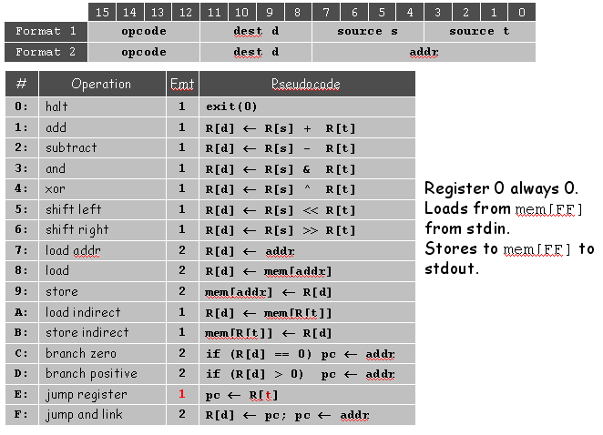
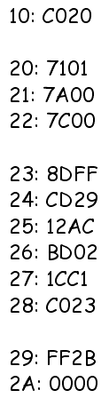
Virtual machines
Abstractions for computers

Slide 53
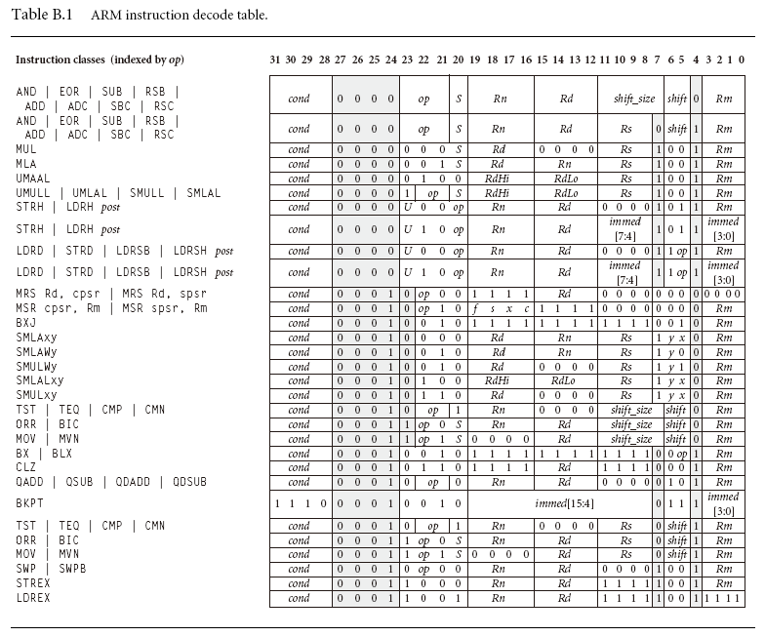
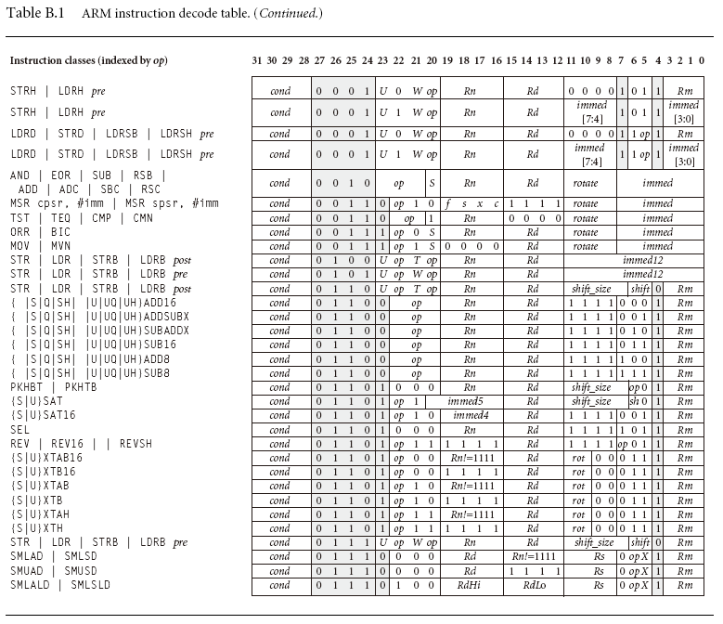
Problems with programming using machine code
  Difficult to remember instructions
  Difficult to remember variables
  Hard to calculate addresses/relocate variables or functions
  Need to handle instruction encoding

Slide 54
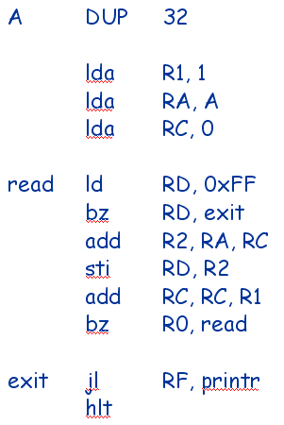
Virtual machines
Abstractions for computers

