Slide 1
Sequential Logic
Introduction to Computer
Yung-Yu Chuang
with slides by Sedgewick & Wayne (introcs.cs.princeton.edu), Nisan & Schocken (www.nand2tetris.org) and Harris & Harris (DDCA)

Slide 2
Logic gates
Model: And, Or, Not, …
Simple, and powerful:
Logic gates can realize any Boolean function, and can be combined to form powerful chips, like an ALU
But, as a general model of computation, logic gates fall short
Limitations
Logic gates cannot store information (bits) over time
Feedback loops are not allowed: A chip’s output cannot serve as its input
Logic gates can handle only inputs of a fixed size.
For example, we can build an Or3 gate, and an Or4 gate, and so on, but we cannot build a single gate that computes Or for any given number of inputs
Extension
Allow logic gates to be sensitive to the progression of time.
Notes:
The same principle as we design adder
We can only compute functions which can be described by rules (computable). For the functions which can not be described compactly, they are not computable.

Slide 3
Time-independent Logic
So far we ignored time
The chip’s inputs were just “sitting there” – fixed and unchanging
The chip’s output was a function (“combination”) of the current inputs, and the current inputs only
This style of gate logic is sometimes called:
  time-independent logic
  combinational logic
All the chips that we discussed
and developed so far were combinational
+
0101
1101
ALU
1000
Notes:
The same principle as we design adder
We can only compute functions which can be described by rules (computable). For the functions which can not be described compactly, they are not computable.

Slide 4
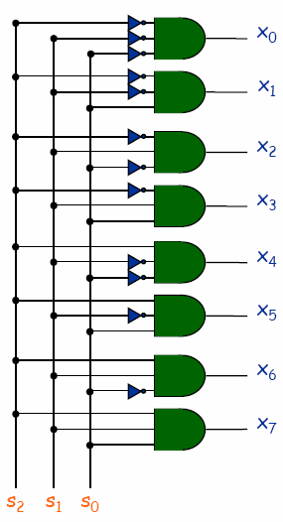
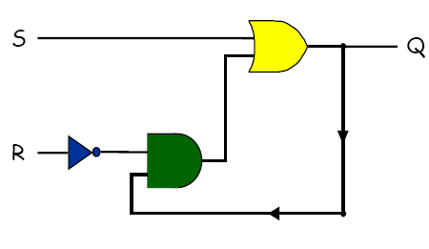
Combinational vs. Sequential Circuits
Combinational circuits.
  Output determined solely by inputs.
  Can draw with no loops.
  Ex: majority, adder, ALU.
Sequential circuits.
  Output determined by inputs and previous outputs.
  Ex: memory, program counter, CPU.

Slide 5
Combinational vs. Sequential Circuits
Combinational circuits.
  Basic abstraction = switch.
  In principle, can build TOY computer with a combinational circuit.
    255 × 16 = 4,080 inputs ⇒ 2⁴⁰⁸⁰ rows in truth table!
    no simple pattern
    each circuit element used at most once
Sequential circuits. Reuse circuit elements by storing bits in "memory."
ALU
combinational
Memory
state
Notes:
The same principle as we design adder
We can only compute functions which can be described by rules (computable). For the functions which can not be described compactly, they are not computable.

Slide 6
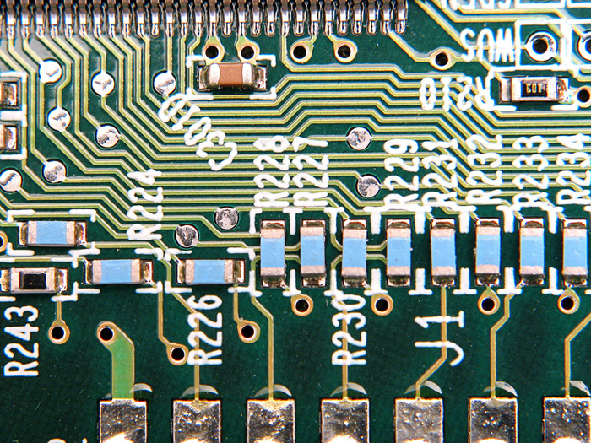
Time
Software needs:
Example (variables):
The hardware must be able to remember things, over time:
x = 17
Example (iteration):
The hardware must be able to do things, one at a time (sequentially):
for i in range(0, 10):
print(i)
Hardware needs:
The hardware must handle the physical time delays associated with computing and moving data from one chip to another.
Notes:
The same principle as we design adder
We can only compute functions which can be described by rules (computable). For the functions which can not be described compactly, they are not computable.

Slide 7
Representing time
physical time:
Arrow of time:
Continuous
Notes:
The same principle as we design adder
We can only compute functions which can be described by rules (computable). For the functions which can not be described compactly, they are not computable.

Slide 8
Representing time
physical time:
Arrow of time:
Continuous
clock:
1
0
Notes:
The same principle as we design adder
We can only compute functions which can be described by rules (computable). For the functions which can not be described compactly, they are not computable.

Slide 9
Chip behavior over time (example: Not gate)
physical time:
Arrow of time:
Continuous
clock:
1
Discrete time:
Design decision:
Track state changes only when advancing from one time-step to another
0
time: 1 2 3 4 5 . . .
Notes:
The same principle as we design adder
We can only compute functions which can be described by rules (computable). For the functions which can not be described compactly, they are not computable.

Slide 10
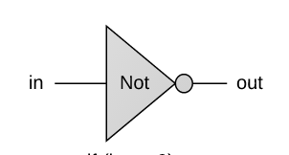
Chip behavior over time (example: Not gate)
physical time:
Arrow of time:
Continuous
clock:
1
Discrete time:
Design decision:
Track state changes only when advancing from one time-step to another
0
time: 1 2 3 4 5 . . .
in:
(arbitrary values)
in:
1
0
out:
(Not(in))
1
0
(example)
Notes:
The same principle as we design adder
We can only compute functions which can be described by rules (computable). For the functions which can not be described compactly, they are not computable.

Slide 11
Chip behavior over time (example: Not gate)
clock:
1
Discrete time:
Design decision:
Track state changes only when advancing from one time-step to another
0
time: 1 2 3 4 5 . . .
in:
(arbitrary values)
1
0
out:
(Not(in))
1
0
(example)
Desired / idealized behavior of the in and out signals:
That’s how we want the hardware to behave
Notes:
The same principle as we design adder
We can only compute functions which can be described by rules (computable). For the functions which can not be described compactly, they are not computable.

Slide 12
Chip behavior over time (example: Not gate)
physical time:
Arrow of time:
Continuous
clock:
1
Discrete time:
Design decision:
Track state changes only when advancing from one time-step to another
0
time: 1 2 3 4 5 . . .
in:
(arbitrary values)
1
0
out:
(Not(in))
1
0
(example)
Actual behavior of the in and out signals:
Influenced by physical time delays
Notes:
The same principle as we design adder
We can only compute functions which can be described by rules (computable). For the functions which can not be described compactly, they are not computable.

Slide 13
Chip behavior over time (example: Not gate)
physical time:
Arrow of time:
Continuous
clock:
1
Discrete time:
Design decision:
Track state changes only when advancing from one time-step to another
0
time: 1 2 3 4 5 . . .
in:
(arbitrary values)
1
0
out:
(Not(in))
1
0
(example)
Time delays
Propagation delays
Computation delays
Cycle length
Design parameter
Set to be slightly > max(time delays)
Notes:
The same principle as we design adder
We can only compute functions which can be described by rules (computable). For the functions which can not be described compactly, they are not computable.

Slide 14
Chip behavior over time (example: Not gate)
physical time:
Arrow of time:
Continuous
clock:
1
Discrete time:
Design decision:
Track state changes only when advancing from one time-step to another
0
time: 1 2 3 4 5 . . .
in:
(arbitrary values)
1
0
out:
(Not(in))
1
0
(example)
Resulting effect:
Combinational chips react “immediately” to their inputs
Facilitated by the decision to track changes only at cycle ends
Notes:
The same principle as we design adder
We can only compute functions which can be described by rules (computable). For the functions which can not be described compactly, they are not computable.

Slide 15


Clock
Clock.
  Fundamental abstraction: regular on-off pulse.
    on: fetch phase
    off: execute phase
  External analog device.
  Synchronizes operations of different circuit elements.
  Requirement: clock cycle longer than max switching time.
cycle time
on
Clock
off
Notes:
Clock is outside Boolean/digital logic framework. Need external source. Can wire up minute hand of Big Ben to computer. In real
computer, clock abstraction implemented using electric phenomenon like a crystal oscillator, a piezoelectric device that generates oscillating voltage
Clock is like a conductor's baton or metrononme (asssuming no ritardando = ree-tar-DAHN-doe), except that it beats at rate of millions of times per second. Note 1GHz machine cycle takes 1 billionth of a second (nanosecond). To put things in perspective, a standard light bulb switches on and off at the rate of 120 times per second! (Patt, Patel, p. 83) In that time, a computer completes around 10 million machine cycles.
Computer engineers make circuit, then crank up the clock as fast as possible until circuit no longer works. Then crank it down just a bit, and sell it. Maybe manufactures should put dial on the computer and let user crank it up until their program no longer works! To get faster computer, need to adjust wire lengths, circuit layout, change components.

Slide 16
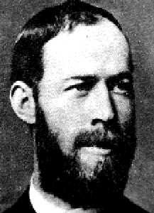
How much does it Hert?
Frequency is inverse of cycle time.
  Frequency of 1 Hz (Hertz) means that there is 1 cycle per second.
    1 kilohertz (kHz) means 1000 cycles/sec.
    1 megahertz (MHz) means 1 million cycles/sec.
    1 gigahertz (GHz) means 1 billion cycles/sec.
    1 terahertz (THz) means 1 trillion cycles/sec.
Physical clock
An oscillator is used to deliver an ongoing train of “tick/tock” signals
“1 MHz electronic oscillator circuit which uses the resonant properties of an internal quartz crystal to control the frequency. Provides the clock signal for digital devices such as computers.” (Wikipedia)
Heinrich Rudolf Hertz
(1857-1894)
Notes:
unit named in honor of Heinrich Rudolf Hertz.
BTW, no such thing as 1 "hert". This comes as a surprise to a recent graduate of my department, now a PhD candidate at Stanford
THz clock: to compare, it would take an average person more than 15,000 years to turn a light switch on and off a trillion times.

Slide 17
Flip-Flop
Flip-flop
  A small and useful sequential circuit
  Abstraction that remembers one bit
  Basis of important computer components for
    register
    memory
    counter
  There are several flavors

Slide 18
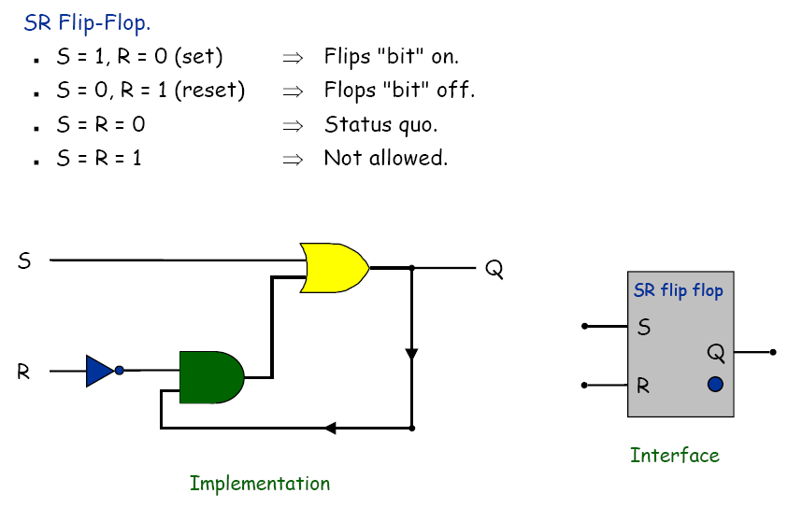
S-R flip flop
R | S | Q
0 | 0
0 | 1
1 | 0
1 | 1
Q=S+RQ

Slide 19
S-R flip flop
R | S | Q
0 | 0
0 | 1
1 | 0
1 | 1
Q=S+RQ

Slide 20
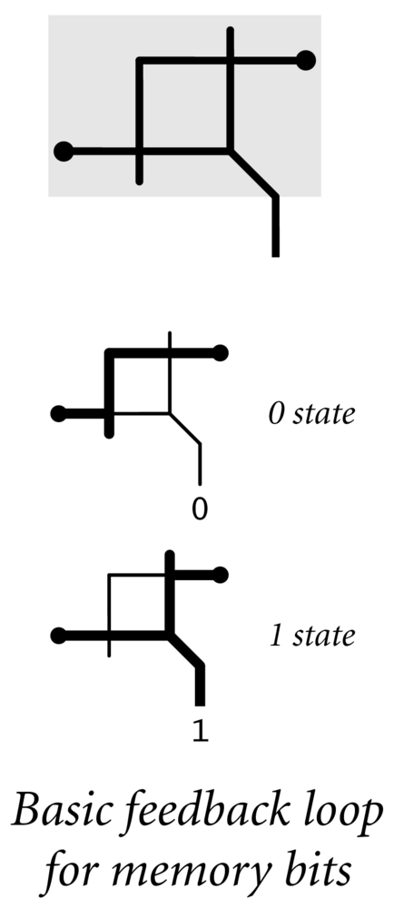
Relay-based flip-flop
  Ex. Simplest feedback loop.
  Two relays A and B, both connected
  to power, each blocked by the other.
  State determined by whichever switches first. The state is latched.
  Stable.
output1
input2
input1
output2

Slide 21
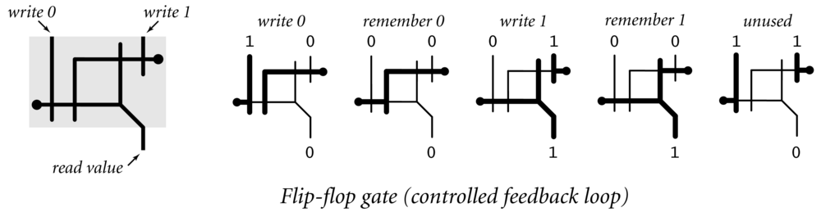
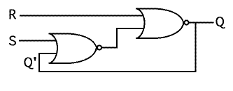
SR Flip Flop
SR flip flop. Two cross-coupled NOR gates.
Q=R(S+Q)
R
S
R | S | Q
0 | 0
0 | 1
1 | 0
1 | 1
Q

Slide 22
Flip-Flop
Flip-flop.
  A way to control the feedback loop.
  Abstraction that "remembers" one bit.
  Basic building block for memory and registers.
Caveat. Need to deal with switching delay.
Notes:
RS flip-flop

Slide 23
Truth Table and Timing Diagram
SR Flip Flop Truth Table
Truth table.
  Values vary over time.
  S(t), R(t), Q(t) denote value at time t.
Sample timing diagram for SR flip-flop.
S(t)
R(t)
Q(t)
Q(t+ε)
0
0
0
0
0
0
1
1
0
1
0
0
0
1
1
0
1
0
0
1
1
0
1
1
1
1
0
1
1
1
ε
ε
Q
1
0
1
R
0
1
S
time
0
Notes:
Can break down truth table into 4 regions (remember, reset, set, excluded for technical reasons)
Need to introduce time into equation with sequential circuits.
Note Q(t+e) becomes input at next time quantum.
epsilon exaggerated for effect – it is very small relative to other signals: we'll ignore timing delays in future slides.

Slide 24
Clock
Clock.
  Fundamental abstraction: regular on-off pulse.
    on: fetch phase
    off: execute phase
  External analog device.
  Synchronizes operations of different circuit elements.
  Requirement: clock cycle longer than max switching time.
cycle time
on
Clock
off
Notes:
Clock is outside Boolean/digital logic framework. Need external source. Can wire up minute hand of Big Ben to computer. In real
computer, clock abstraction implemented using electric phenomenon like a crystal oscillator, a piezoelectric device that generates oscillating voltage
Clock is like a conductor's baton or metrononme (asssuming no ritardando = ree-tar-DAHN-doe), except that it beats at rate of millions of times per second. Note 1GHz machine cycle takes 1 billionth of a second (nanosecond). To put things in perspective, a standard light bulb switches on and off at the rate of 120 times per second! (Patt, Patel, p. 83) In that time, a computer completes around 10 million machine cycles.
Computer engineers make circuit, then crank up the clock as fast as possible until circuit no longer works. Then crank it down just a bit, and sell it. Maybe manufactures should put dial on the computer and let user crank it up until their program no longer works! To get faster computer, need to adjust wire lengths, circuit layout, change components.

Slide 25
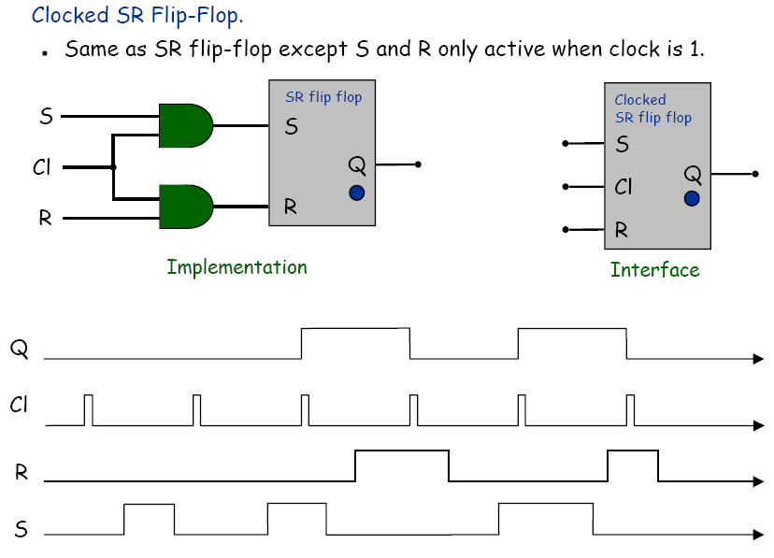
Clocked S-R flip-flop

Slide 26
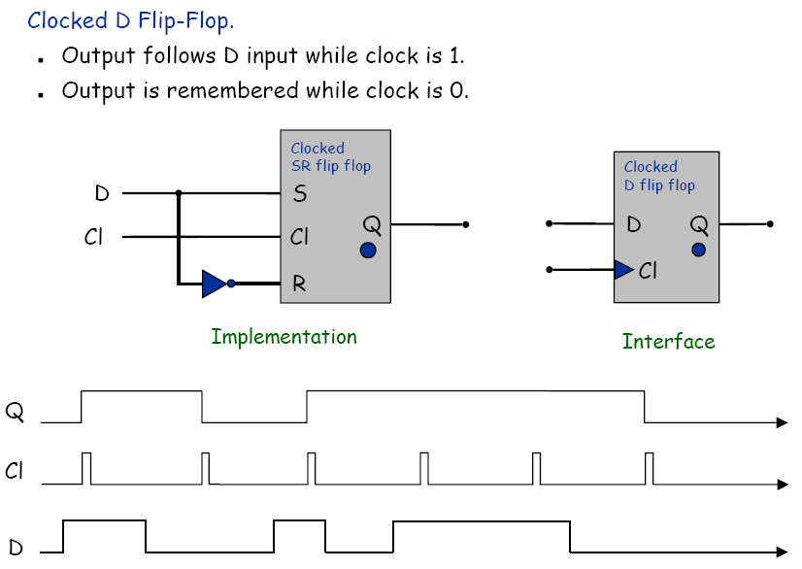
Clocked D flip-flop

Slide 27
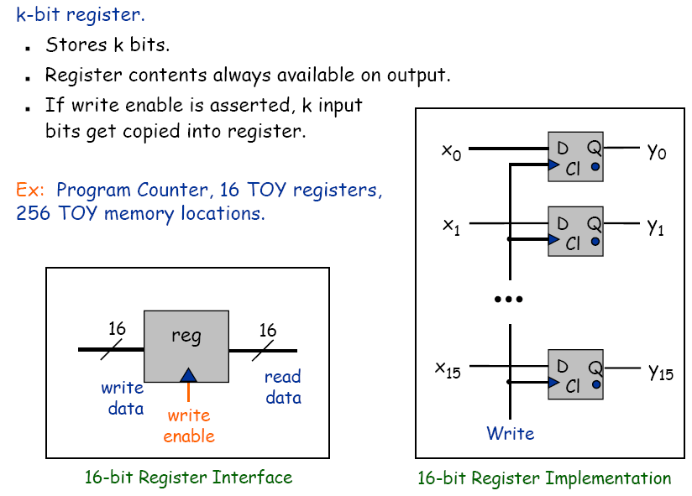
Stand-Alone Register

Slide 28
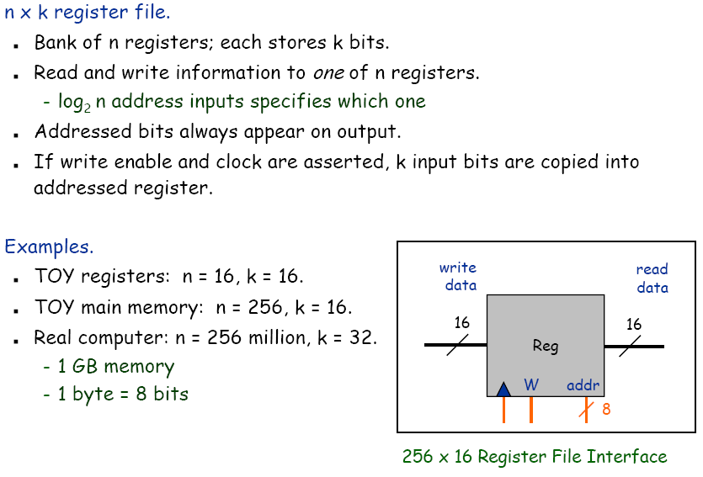
Register file interface

Slide 29
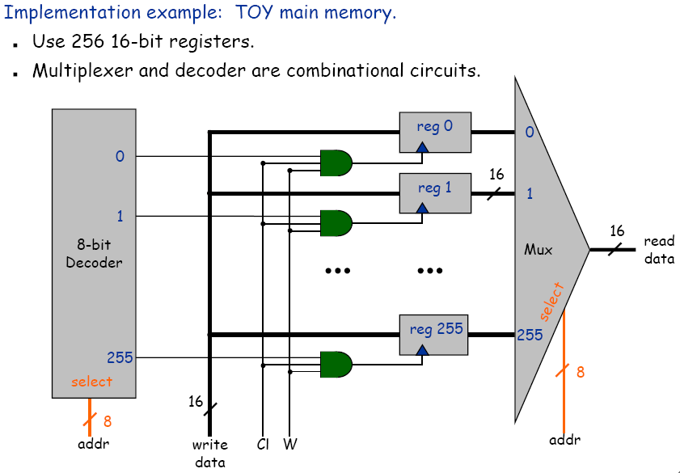
Register file implementation

Slide 30
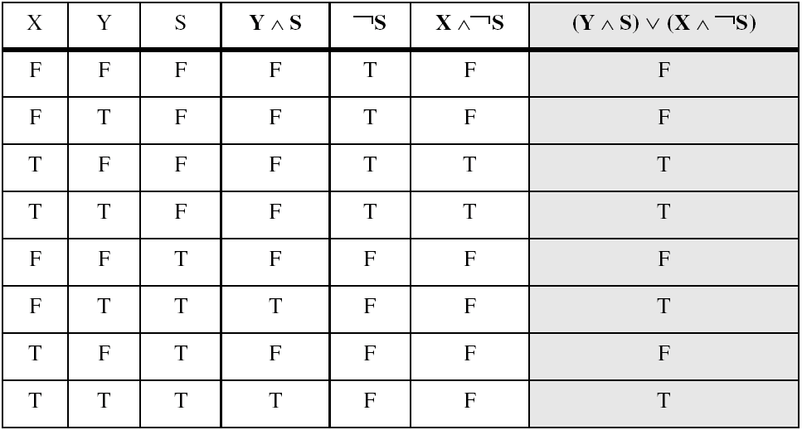
Multiplexer
When s=0, return x; otherwise, return y.
Example: (Y ∧ S) ∨ (X ∧ ¬S)
Two-input multiplexer

Slide 31
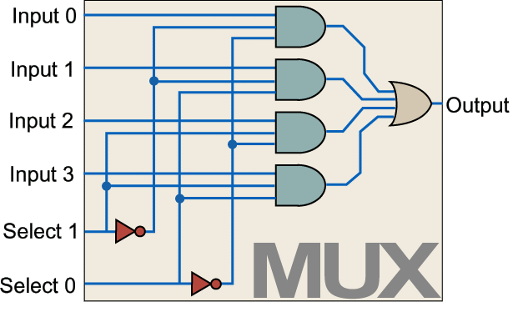
4-to-1 multiplexer
x₀
4MUX
x₁
z
x₂
x₃
s₀
s₁

Slide 32
4-to-1 multiplexer
x₀
2MUX
x₀
4MUX
x₁
x₁
z
2MUX
x₂
z
x₃
x₂
2MUX
x₃
s₀
s₁
s₀
s₁

Slide 33
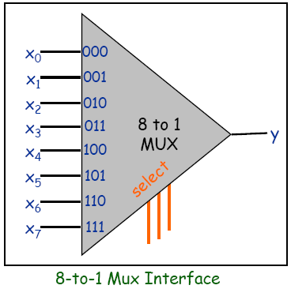
8-to-1 Multiplexer
2^{N}-to-1 multiplexer
  N select inputs, 2^{N} data
  inputs, 1 output
  Copies “selected” data input
  bit to output

Slide 34
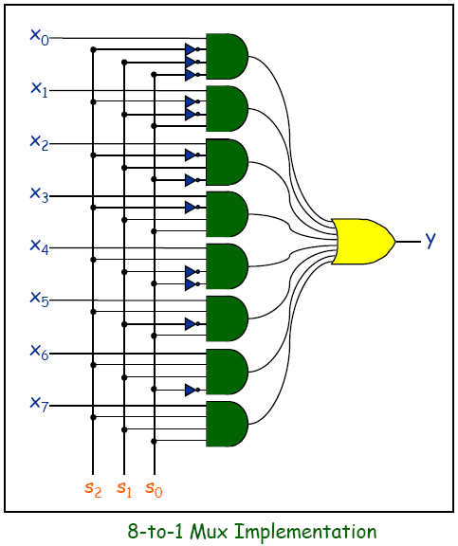
8-to-1 Multiplexer
2^{N}-to-1 multiplexer
  N select inputs, 2^{N} data
  inputs, 1 output
  Copies “selected” data input
  bit to output

Slide 35
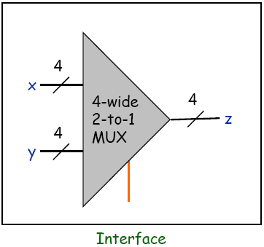
4-Wide 2-to-1 Multiplexer
Goal: select from one of two 4-bit buses

Slide 36
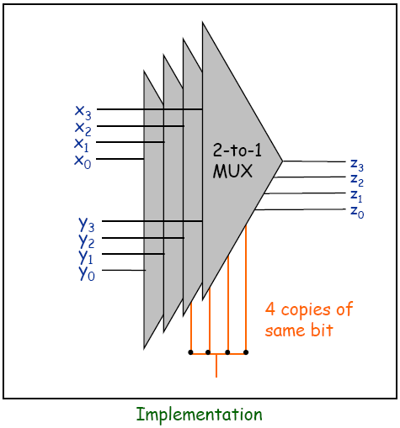
4-Wide 2-to-1 Multiplexer
Goal: select from one of two 4-bit buses
  Implemented by layering 4 2-to-1 multiplexer

Slide 37
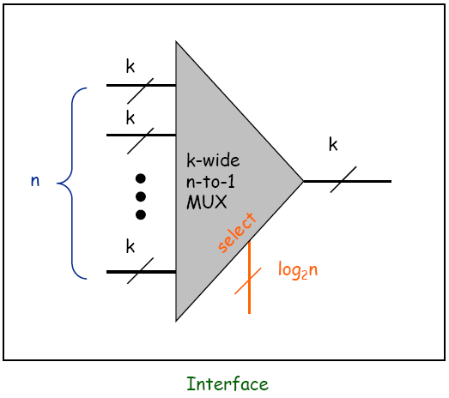
k-Wide n-to-1 Multiplexer
Goal: select from one of n k-bit buses
  Implemented by layering k n-to-1 multiplexer

Slide 38
Register file implementation

Slide 39
Memory Overview
Computers and TOY have several memory components.
  Program counter.
  Registers.
  Main memory.
Implementation. Use one flip-flop for each bit of memory.
Access. Memory components have different access mechanisms.
Organization. Need mechanism to manipulate groups of related bits.
TOY has 16 bit words,
8 bit memory addresses, and
4 bit register names.
Notes:
memory is abstraction: we use flip-flops
TOY has 16-bit words.
Memory hierarchy makes architecture manageable.
It wasn't always this way. First computer memory implemented with vacuum tubes. Big advance in 1960's was "core memory." Used magnetism. Human still had to wire each bit individually. Nowadays, this is done my machine and cost/bit has decreased dramatically.

Slide 40
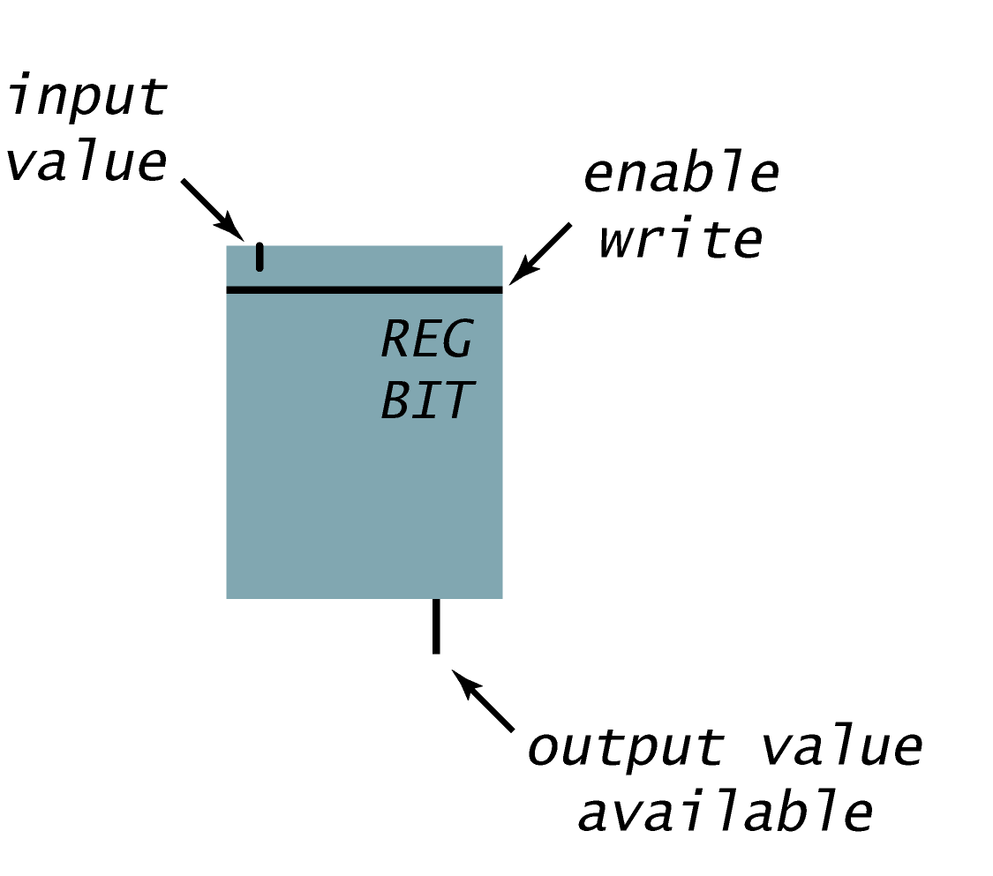
Register Bit
Register bit. Extend a flip-flop to allow easy access to values.

Slide 41
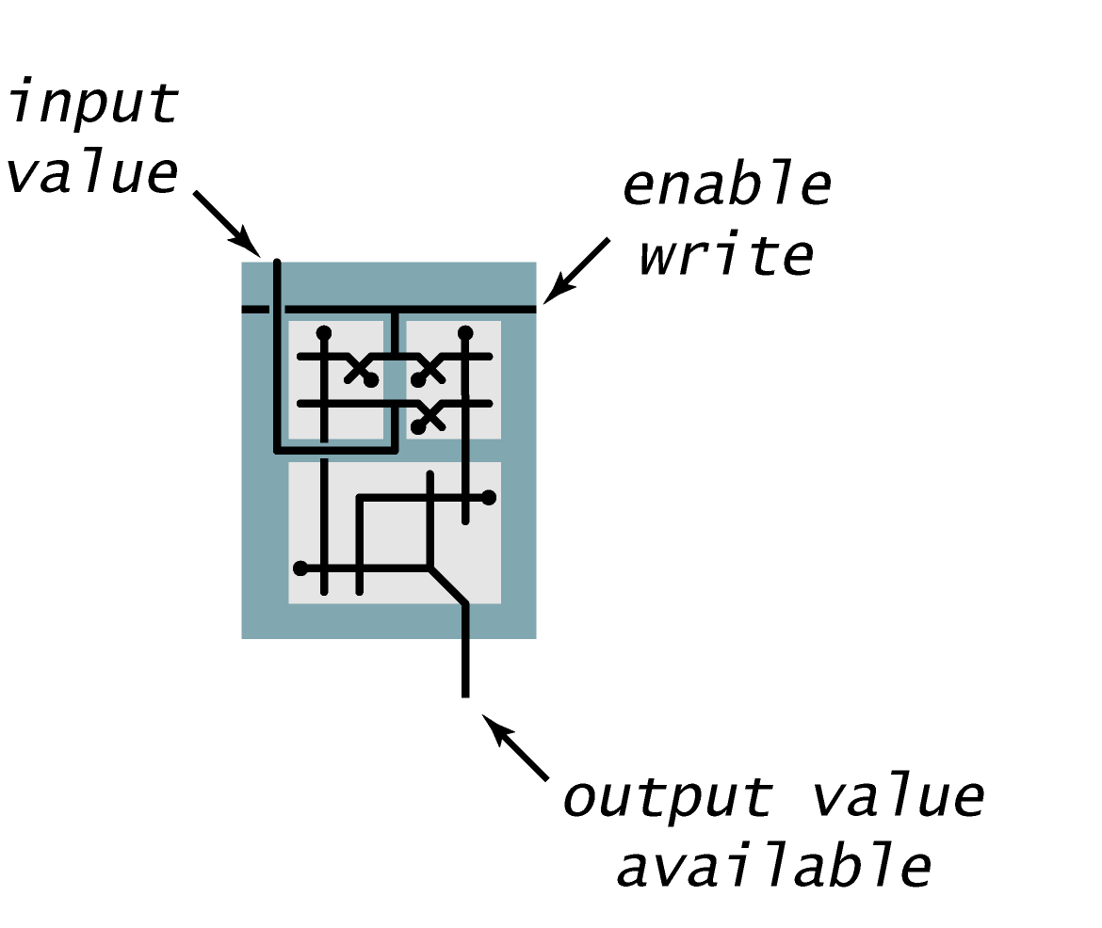
Register Bit
Register bit. Extend a flip-flop to allow easy access to values.
D
W
DW
DW

Slide 42
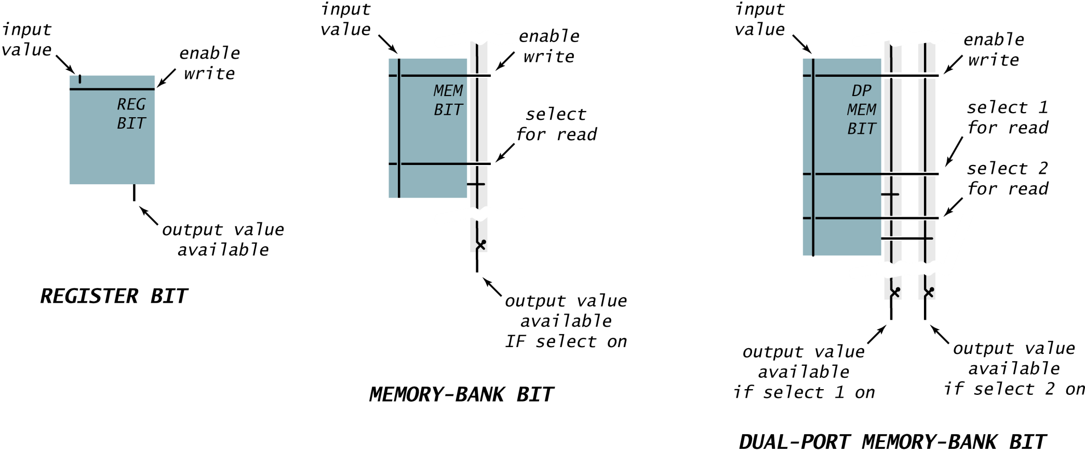
Memory Bit: Interface
Memory bit. Extend a flip-flop to allow easy access to values.
[ TOY PC, IR ]
[ TOY main memory ]
[ TOY registers ]

Slide 43
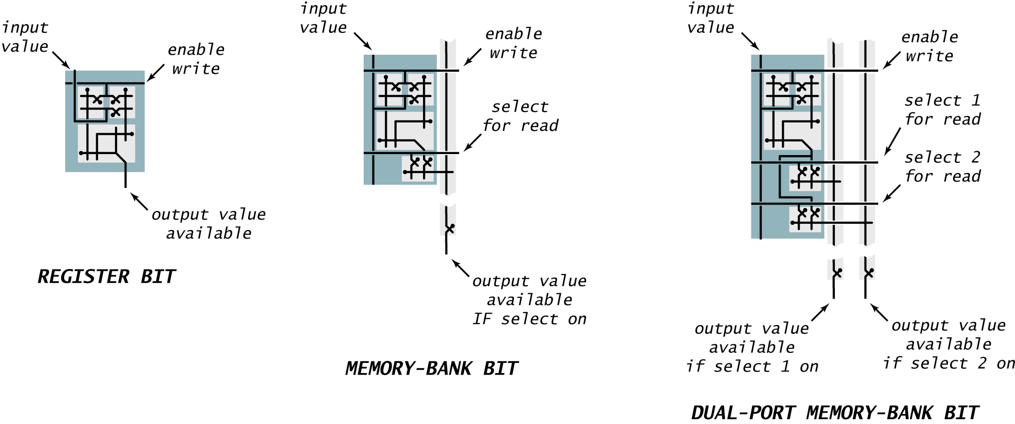
Memory Bit: Switch Level Implementation
Memory bit. Extend a flip-flop to allow easy access to values.
[ TOY PC, IR ]
[ TOY main memory ]
[ TOY registers ]
Notes:
redownload figures from book when Bob fixes (there is a ppt hack in the last two)

Slide 44
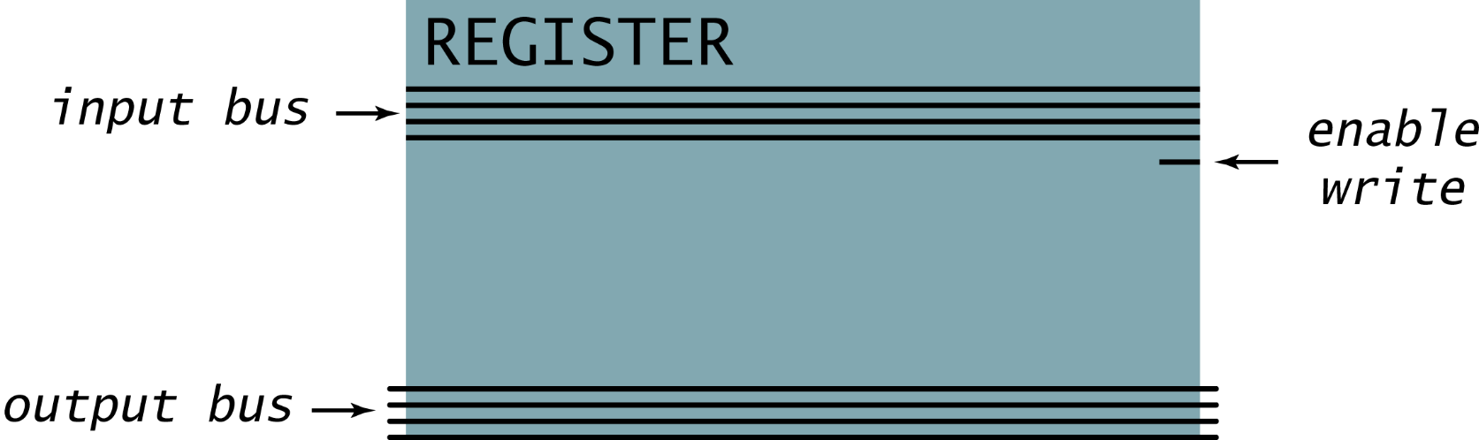
Processor Register
Processor register.
  Stores k bits.
  Register contents always available on output bus.
  If enable write is asserted, k input bits get copied into register.
Ex 1. TOY program counter (PC) holds 8-bit address.
Ex 2. TOY instruction register (IR) holds 16-bit current instruction.

Slide 45
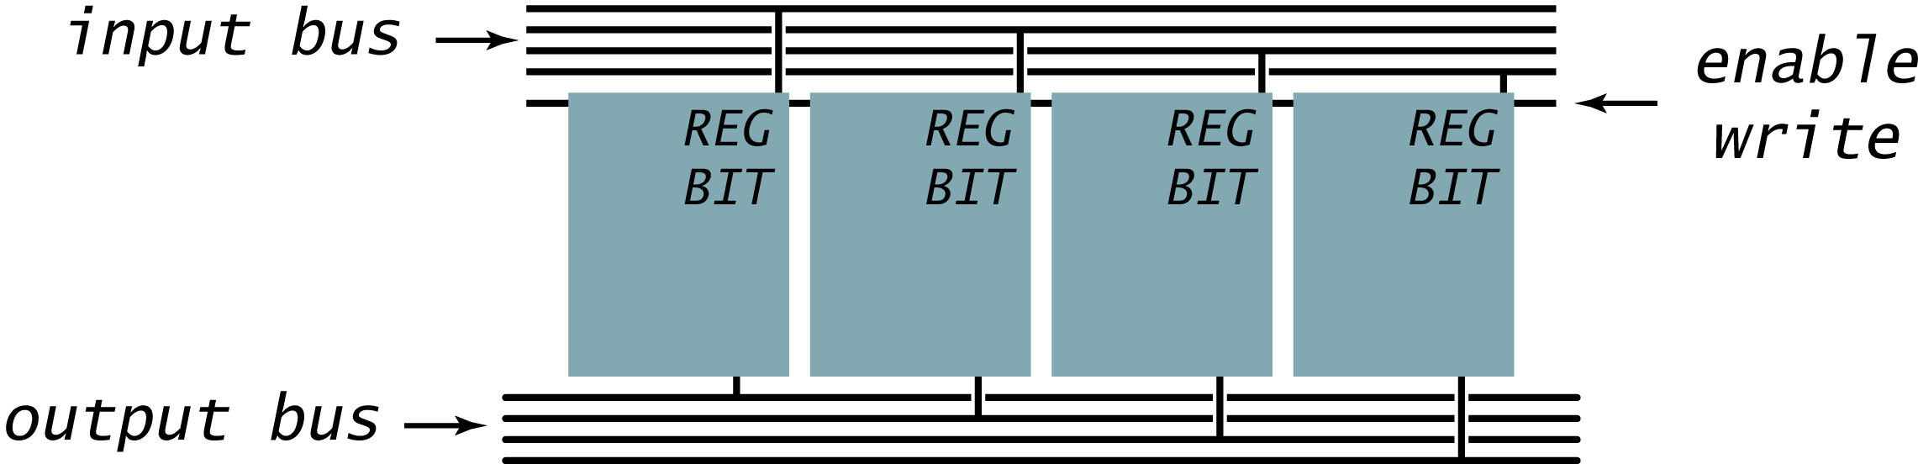
Processor Register
Processor register.
  Stores k bits.
  Register contents always available on output bus.
  If enable write is asserted, k input bits get copied into register.
Ex 1. TOY program counter (PC) holds 8-bit address.
Ex 2. TOY instruction register (IR) holds 16-bit current instruction.

Slide 46
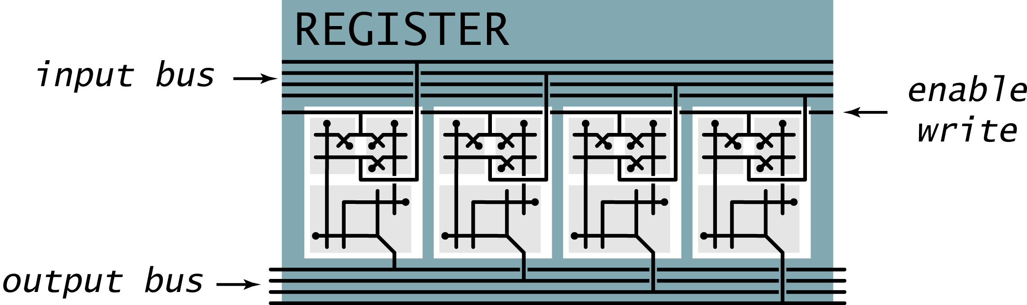
Processor Register
Processor register.
  Stores k bits.
  Register contents always available on output bus.
  If enable write is asserted, k input bits get copied into register.
Ex 1. TOY program counter (PC) holds 8-bit address.
Ex 2. TOY instruction register (IR) holds 16-bit current instruction.

Slide 47
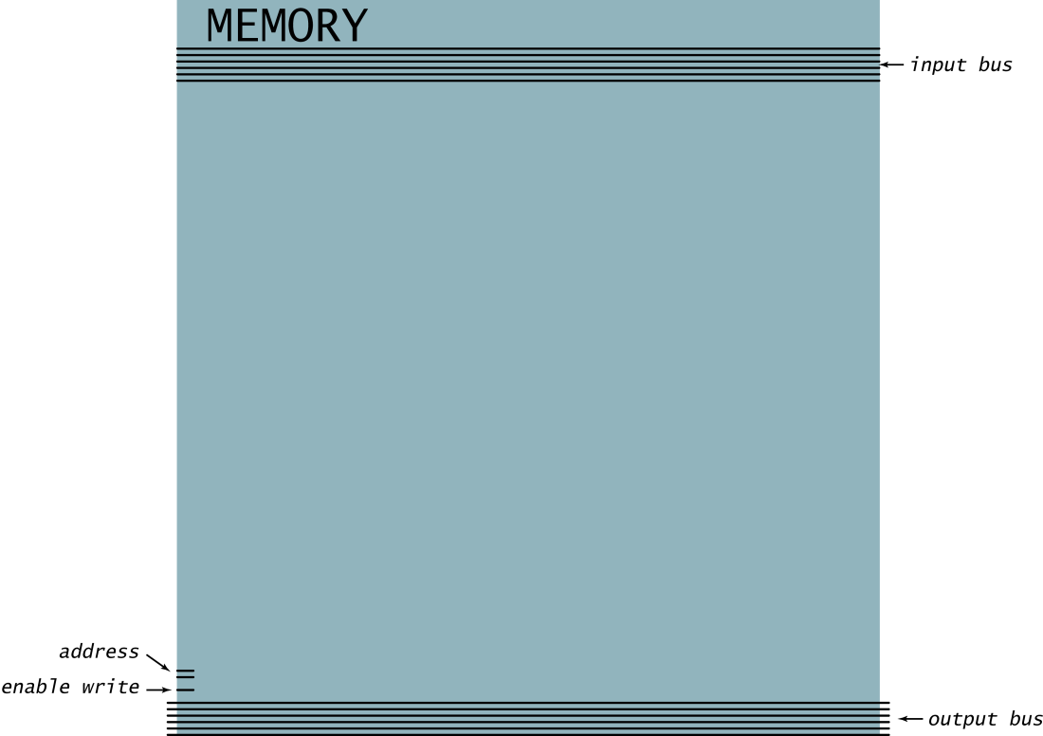
Memory Bank
Memory bank.
  Bank of n registers; each stores k bits.
  Read and write information to one of n registers.
  Address inputs specify which one.
  Addressed bits always appear on output.
  If write enabled, k input bits are copied into addressed register.
Ex 1. TOY main memory.
  256-by-16 memory bank.
Ex 2. TOY registers.
  16-by-16 memory bank.
  Two output buses.
log₂n address bits needed
(four 6-bit words)
6-bit input bus
2-bit address
6-bit output bus

Slide 48

Memory: Interface
(four 6-bit words)

Slide 49
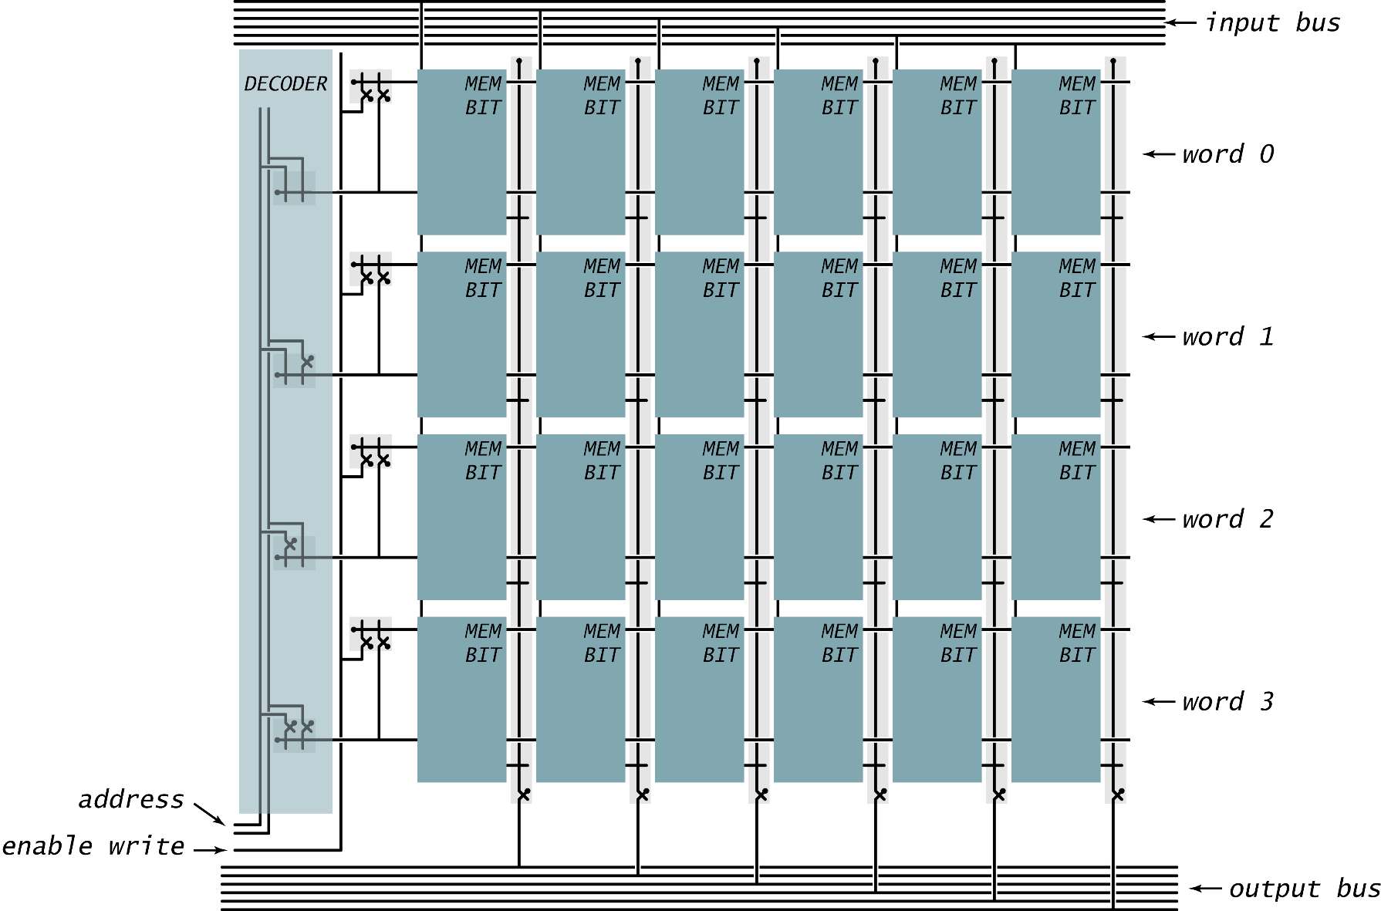
Memory: Component Level Implementation

Slide 50
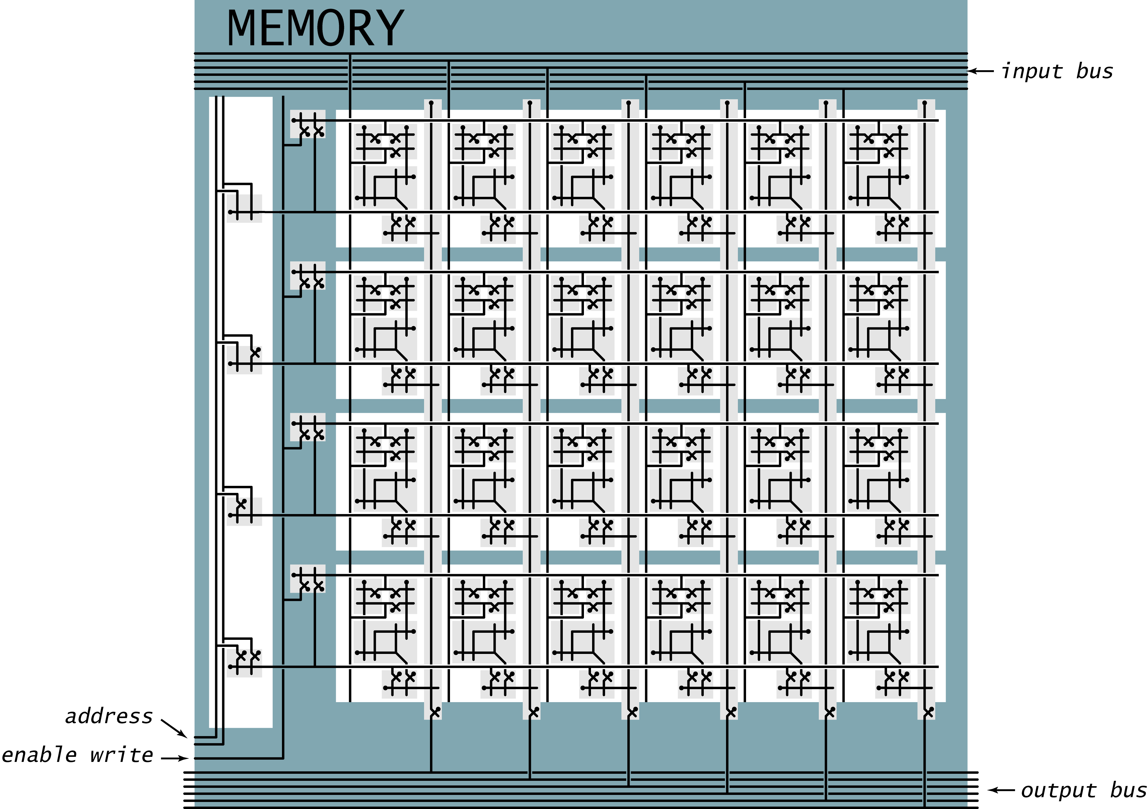
Memory: Switch Level Implementation
(four 6-bit words)

Slide 51
TOY sequential circuits
Sequential circuits add "state" to digital hardware.
  Flip-flop. [represents 1 bit]
  TOY word. [16 flip-flops]
  TOY registers. [16 words]
  TOY main memory. [256 words]
Modern technologies for registers and main memory are different.
  Few registers, easily accessible, high cost per bit.
  Huge main memories, less accessible, low cost per bit.
  Drastic evolution of technology over time.
Next. Build a complete TOY computer.

Slide 52
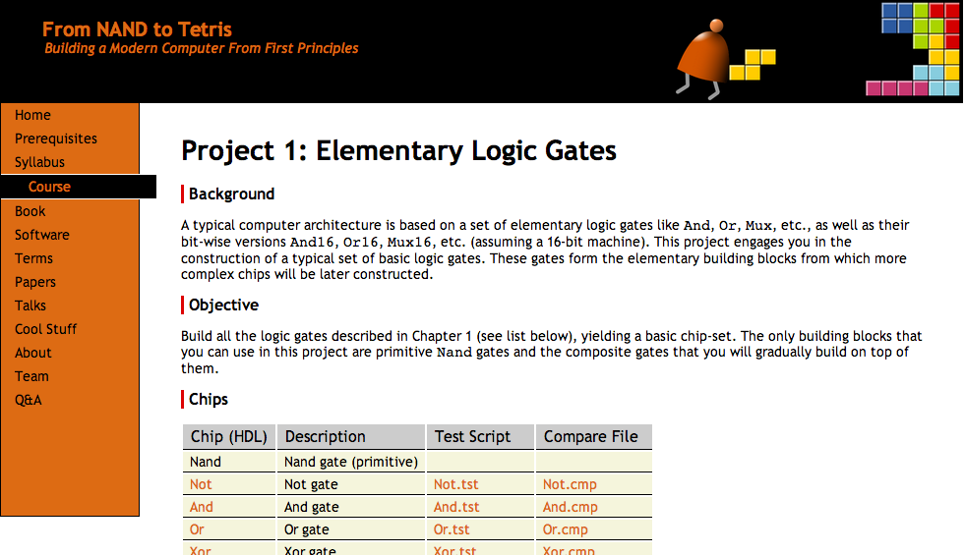
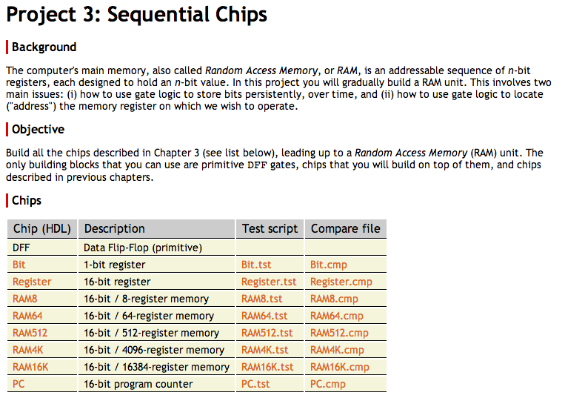
Project 3
www.nand2tetris.org
All the necessary project 3 files are available in:
nand2tetris / projects / 03

Slide 53
Project 3
Given:
All the chips built in projects 1 and 2
Data Flip-Flop (built-in DFF gate)
Build:
Bit
Register
PC
RAM8
RAM64
RAM512
RAM4K
RAM16K

Slide 54
Registers
load
load
in
out
in
out
Bit
Register
w
w
1-bit register
multi-bit register
Designed to:
“Store” / “remember” / “maintain” / “persist” a value , until...
“Instructed” to “load”, and then “store”, another value.
time:
x = 17, 17, 17, 17, 17, 17, 17, ..., 17
x = 21, 21, 21, 21, 21, 21, ..., 21
loading
maintaining state
loading
maintaining state

Slide 55
Memory hierarchy
Random Access Memory
0
Register
1
Register
Data
Flip-Flop
1-bit
register
16-bit register
...
n-1
Register
?
Bit
Bit
...
Bit
DFF
DFF
Bit
Register
RAMn

Slide 56
DFF
Data Flip Flop (aka latch)
The most elementary sequential gate: Outputs the input in the previous time-step
in
DFF
out
out(t) = in(t – 1)
time:
1
2
3
4
5
6
7
8
examples
of arbitrary inputs
in:
1
0
out:
1
0

Slide 57
DFF
Data Flip Flop (aka latch)
The most elementary sequential gate: Outputs the input in the previous time-step
in
DFF
out
out(t) = in(t – 1)
time:
1
2
3
4
5
6
7
8
examples
of arbitrary inputs
in:
1
0
out:
1
0

Slide 58
DFF
Data Flip Flop (aka latch)
The most elementary sequential gate: Outputs the input in the previous time-step
in
DFF
out
out(t) = in(t – 1)
time:
1
2
3
4
5
6
7
8
examples
of arbitrary inputs
in:
1
0
out:
1
0

Slide 59
DFF
Data Flip Flop (aka latch)
The most elementary sequential gate: Outputs the input in the previous time-step
in
DFF
out
out(t) = in(t – 1)
time:
1
2
3
4
5
6
7
8
examples
of arbitrary inputs
in:
1
0
out:
1
0

Slide 60
1-bit register
Bit.hdl
/** 1-bit register:
if load(t – 1) then out(t) = in(t – 1)
else out(t) = out(t – 1)) */
CHIP Bit {
IN in, load;
OUT out;
PARTS:
// Put your code here:
}
load
in
Bit
out
load
Implementation tip:
Follow the chip diagram
in
out

Slide 61
16-bit register
Register.hdl
/** 1-bit register:
if load(t – 1) then out(t) = in(t – 1)
else out(t) = out(t – 1)) */
CHIP Bit {
IN in[16], load;
OUT out[16];
PARTS:
// Put your code here:
}
load
in
out
Register
16
16
load
in
out
Implementation tip:
Follow the chip diagram
...
16
16
Partial diagram, showing some of the chip-parts, without connections

Slide 62
Counter
Later in the course, we will see that the computer must keep track of which instruction should be fetched and executed next
This task is regulated by a register typically called Program Counter
We’ll use the PC to store the address of the instruction that should be fetched and executed next
The PC should support three abstractions:
  Reset: fetch the first instruction
  Next: fetch the next instruction
  Goto: fetch instruction n
PC = 0
PC++
PC = n

Slide 63
Counter
load
inc
reset
if reset(t) out(t + 1) = 0
else if load(t) out(t + 1) = in(t)
else if inc(t) out(t + 1) = out(t) + 1
else out(t + 1) = out(t)
in
out
16
PC (counter)
16

Slide 64
Counter
load
inc
reset
if reset(t) out(t + 1) = 0
else if load(t) out(t + 1) = in(t)
else if inc(t) out(t + 1) = out(t) + 1
else out(t + 1) = out(t)
in
out
16
PC (counter)
16
Usage:
To read:
probe out
To set:
set in to v,
assert load,
set the other control bits to 0
To reset:
assert reset,
set the other control bits to 0
To count:
assert inc,
set the other control bits to 0

Slide 65
16-bit counter
load
inc
reset
/**
A 16-bit counter with control bits.
if reset(t – 1) out(t) = 0 // resetting
else if load(t – 1) out(t) = in(t – 1) // setting
else if inc(t – 1) out(t) = out(t – 1) + 1 // incrementing
else out(t) = out(t – 1) // maintaining
*/
CHIP PC {
IN in[16], load, inc, reset;
OUT out[16];
PARTS:
// Put your code here:
}
in
out
16
PC (counter)
16
Implementation tip: Can be built from a Register, an Incrementer, and Mux’s

Slide 66

Project 3
Given:
All the chips built in projects 1 and 2
Data Flip-Flop (built-in DFF gate)
Build the following chips
Bit
Register
PC
RAM8
RAM64
RAM512
RAM4K
RAM16K

Slide 67
8-register RAM: abstraction
load
RAM8.hdl
/*
Let M stand for the state of the register
selected by address.
if load(t – 1) then {M = in(t), out(t) = M}
else out(t) = M
*/
CHIP RAM8 {
IN in[16], load, address[3];
OUT out[16];
PARTS:
// Put your code here:
}
RAMn
in
Register
16
Register
out
address
16
3
...
Register

Slide 68
8-register RAM: implementation
load
in
out
Register
16
16
in
16
load
in
out
Register
out
load
DMux
(1 to 8)
16
16
Mux
(8 to 1)
16
address
...
load
3
in
out
Register
16
16
Partial diagram, showing some of the chip-parts, without connections
Implementation tip:
Follow the chip diagram

Slide 69
Project 3
Given:
All the chips built in projects 1 and 2
Data Flip-Flop (built-in DFF gate)
Build the following chips
Bit
Register
PC
RAM8
RAM64
RAM512
RAM4K
RAM16K
A family of RAM chips

Slide 70
N-Register RAM
load
RAMn.hdl
/*
Let M stand for the state of the register
selected by address.
if load(t – 1) then {M = in(t), out(t) = M}
else out(t) = M
*/
CHIP RAMn {
IN in[16], load, address[k];
OUT out[16];
PARTS:
// Put your code here:
}
RAMn
in
Register
16
Register
out
address
16
k
...
Register

Slide 71
N-Register RAM
load
chip name | n | k
RAM8 | 8 | 3
RAM64 | 64 | 6
RAM512 | 512 | 9
RAM4K | 4096 | 12
RAM16K | 16384 | 14
RAMn
in
Register
16
Register
out
address
16
k
...
Register
Implementation tips
Think about the RAM’s address input
as consisting of two fields:
  One field selects a RAM-part;
  The other field selects a register within that RAM-part
Use logic gates to effect this addressing scheme.

