Slide 1
Arithmetic Logic Unit (ALU)
Introduction to Computer
Yung-Yu Chuang
with slides by Sedgewick & Wayne (introcs.cs.princeton.edu), Nisan & Schocken (www.nand2tetris.org) and Harris & Harris (DDCA)

Slide 2
Let's Make an Adder Circuit
Goal. x + y = z for 4-bit integers.
  We build 4-bit adder: 9 inputs, 4 outputs.
  Same idea scales to 128-bit adder.
  Key computer component.
1
1
1
0
2
4
8
7
+
3
5
7
9
6
0
6
6
Notes:
We treat 4 Boolean variables as a singe 4-bit binary integer.
Ignore c₀ (carry into bit 0) for now

Slide 3
Binary addition
Assuming a 4-bit system:
0 0 0 1
1 0 0 1
0 1 0 1
0 1 1 1 0
1 1 1 1
1 0 1 1
0 1 1 1
1 0 0 1 0
+
+
no overflow
overflow
Algorithm: exactly the same as in decimal addition
Overflow (MSB carry) has to be dealt with.

Slide 4
Representing negative numbers (4-bit system)
0 0000
1 0001 1111 -1
2 0010 1110 -2
3 0011 1101 -3
4 0100 1100 -4
5 0101 1011 -5
6 0110 1010 -6
7 0111 1001 -7
1000 -8
The codes of all positive numbers
begin with a “0”
The codes of all negative numbers
begin with a “1“
To convert a number:
leave all trailing 0’s and first 1 intact,
and flip all the remaining bits
Example: 2 - 5 = 2 + (-5) = 0 0 1 0
+ 1 0 1 1
1 1 0 1 = -3

Slide 5
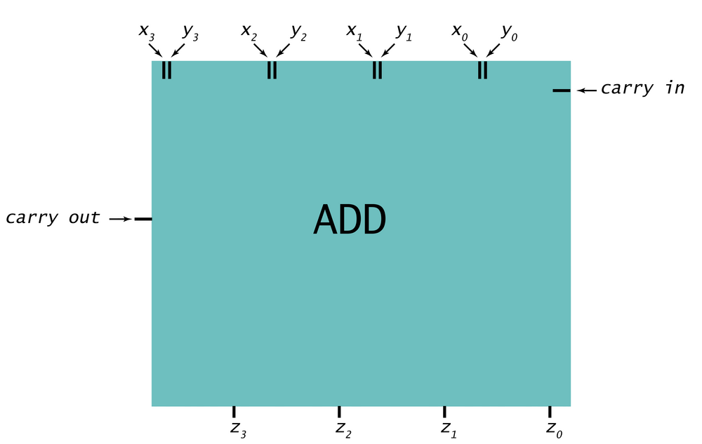
Let's Make an Adder Circuit
Step 1. Represent input and output in binary.
1
1
0
0
0
0
1
0
+
0
1
1
1
1
0
0
1
x₃
x₂
x₁
x₀
+
y₃
y₂
y₁
y₀
z₃
z₂
z₁
z₀
Notes:
We treat 4 Boolean variables as a singe 4-bit binary integer.
Ignore c₀ (carry into bit 0) for now

Slide 6
Let's Make an Adder Circuit
c_{out}
c_{in}
Goal. x + y = z for 4-bit integers.
Step 2. [first attempt]
  Build truth table.
Q. Why is this a bad idea?
A. 128-bit adder: 2²⁵⁶⁺¹ rows >> # electrons in universe!
x₃
x₂
x₁
x₀
+
y₃
y₂
y₁
y₀
z₃
z₂
z₁
z₀
4-Bit Adder Truth Table
c₀
x₃
x₂
x₁
x₀
y₃
y₂
y₁
y₀
z₃
z₂
z₁
z₀
0
0
0
0
0
0
0
0
0
0
0
0
0
0
0
0
0
0
0
0
0
1
0
0
0
1
0
0
0
0
0
0
0
1
0
0
0
1
0
0
0
0
0
0
0
0
1
1
0
0
1
1
2⁸⁺¹ = 512 rows!
0
0
0
0
0
0
1
0
0
0
1
0
0
.
.
.
.
.
.
.
.
.
.
.
.
.
1
1
1
1
1
1
1
1
1
1
1
1
1
Notes:
Building truth table is a bit unwieldy. If N = 128 bit adder, then 2^256 ~ 10^77 rows.
10^77 electrons in universe
Would produces very large circuit => try to do something more clever.
Use abstraction to break down problem.

Slide 7
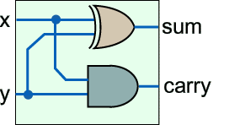
1-bit half adder
We add numbers one bit at a time.
x
ADD
c
y
s
x
y
s
c

Slide 8
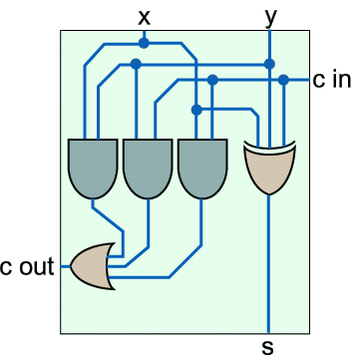
1-bit full adder
x
y
x
y
C_{in}
C_{out}
s
ADD
C_{in}
C_{out}
s

Slide 9
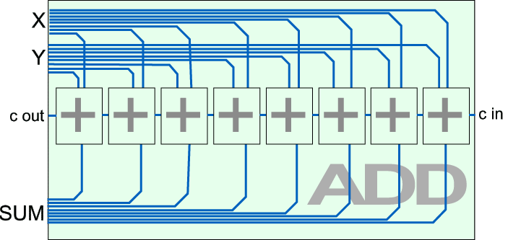
8-bit adder

Slide 10
Let's Make an Adder Circuit
c_{out}
c₃
c₂
c₁
c₀ = 0
Goal. x + y = z for 4-bit integers.
Step 2. [do one bit at a time]
  Build truth table for carry bit.
  Build truth table for summand bit.
x₃
x₂
x₁
x₀
+
y₃
y₂
y₁
y₀
z₃
z₂
z₁
z₀
Carry Bit
Summand Bit
x_{i}
y_{i}
c_{i}
c_{i+1}
x_{i}
y_{i}
c_{i}
z_{i}
0
0
0
0
0
0
0
0
0
0
1
0
0
0
1
1
0
1
0
0
0
1
0
1
0
1
1
1
0
1
1
0
1
0
0
0
1
0
0
1
1
0
1
1
1
0
1
0
1
1
0
1
1
1
0
0
1
1
1
1
1
1
1
1
Notes:
Start by building circuit for one bit only.
Not a bit-by-bit function of inputs because of "carry".

Slide 11
Let's Make an Adder Circuit
Goal. x + y = z for 4-bit integers.
Step 3.
  Derive (simplified) Boolean expression.
Carry Bit
Summand Bit
x_{i}
y_{i}
c_{i}
c_{i+1}
MAJ
x_{i}
y_{i}
c_{i}
z_{i}
ODD
0
0
0
0
0
0
0
0
0
0
0
0
1
0
0
0
0
1
1
1
0
1
0
0
0
0
1
0
1
1
0
1
1
1
1
0
1
1
0
0
1
0
0
0
0
1
0
0
1
1
1
0
1
1
1
1
0
1
0
0
1
1
0
1
1
1
1
0
0
0
1
1
1
1
1
1
1
1
1
1

Slide 12
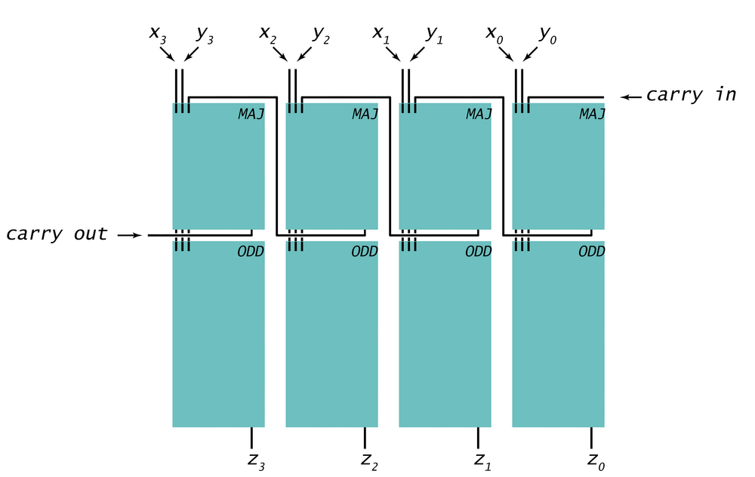
Let's Make an Adder Circuit
Goal. x + y = z for 4-bit integers.
Step 4.
  Transform Boolean expression into circuit.
  Chain together 1-bit adders.
Notes:
"flows" from right to left

Slide 13
Adder: Interface

Slide 14
Adder: Component Level View

Slide 15
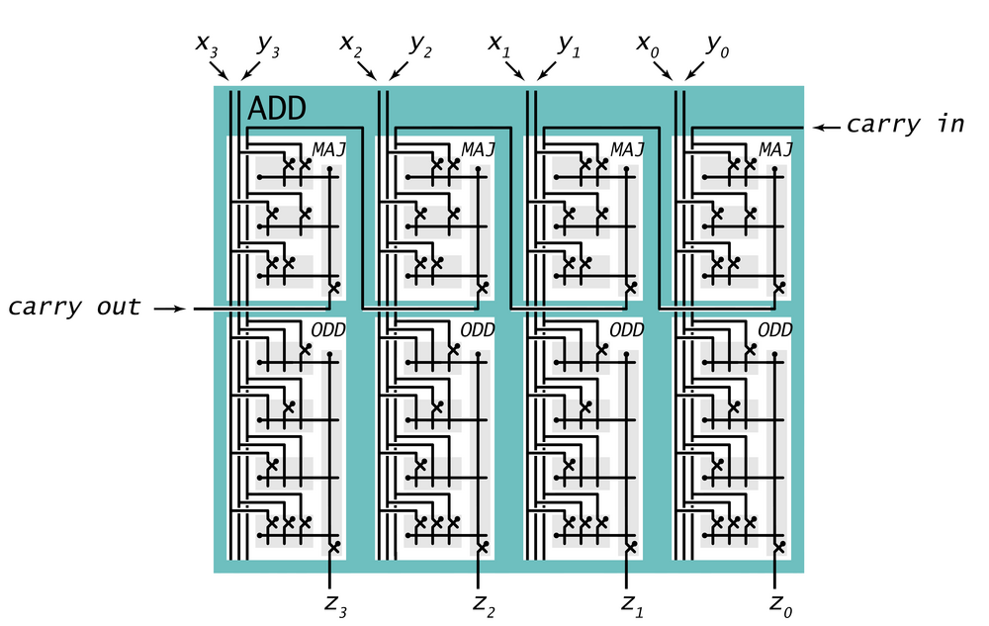
Adder: Switch Level View

Slide 16
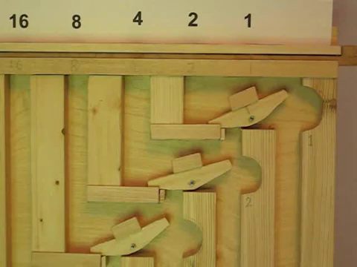
Marble adding machine

Slide 17
Subtractor
Subtractor circuit: z = x – y.
  One approach: design like adder circuit

Slide 18
Subtractor
Subtractor circuit: z = x – y.
  One approach: design like adder circuit
  Better idea: reuse adder circuit
    2’s complement: to negate an integer, flip bits, then add 1

Slide 19
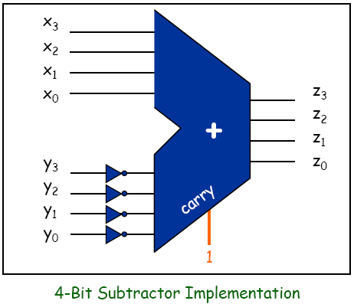
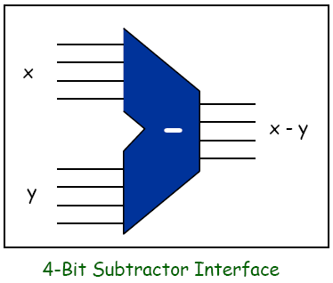
Subtractor
Subtractor circuit: z = x – y.
  One approach: design like adder circuit
  Better idea: reuse adder circuit
    2’s complement: to negate an integer, flip bits, then add 1

Slide 20
Put adder and subtractor together

Slide 21
Shifter
Only one of them will be on at a time.
s₀
s₁
s₂
s₃
SHIFT
x₀
x₁
x₂
x₃
z₀
z₁
z₂
z₃
4-bit Shifter
Notes:
Give formula???

Slide 22
Shifter
 | z₃ | z₂ | z₁ | z₀
s₀
s₁
s₂
s₃

Slide 23
Shifter
 | z₃ | z₂ | z₁ | z₀
s₀ | x₃ | x₂ | x₁ | x₀
s₁ | x₂ | x₁ | x₀ | 0
s₂ | x₁ | x₀ | 0 | 0
s₃ | x₀ | 0 | 0 | 0
z₀ = s₀‧x₀ + s₁‧0 + s₂‧0 + s₃‧0
z₁ = s₀‧x₁ + s₁‧x₀ + s₂‧0 + s₃‧0
z₂ = s₀‧x₂ + s₁‧x₁ + s₂‧x₀ + s₃‧0
z₃ = s₀‧x₃ + s₁‧x₂ + s₂‧x₁ + s₃‧x₀

Slide 24
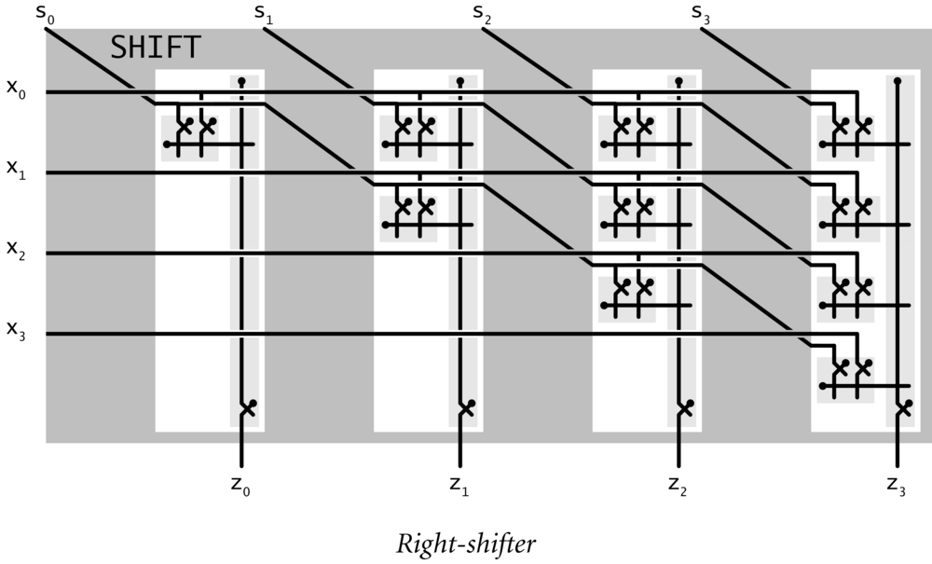
Shifter
z₀ = s₀‧x₀ + s₁‧0 + s₂‧0 + s₃‧0
z₁ = s₀‧x₁ + s₁‧x₀ + s₂‧0 + s₃‧0
z₂ = s₀‧x₂ + s₁‧x₁ + s₂‧x₀ + s₃‧0
z₃ = s₀‧x₃ + s₁‧x₂ + s₂‧x₁ + s₃‧x₀
Notes:
Give formula???

Slide 25
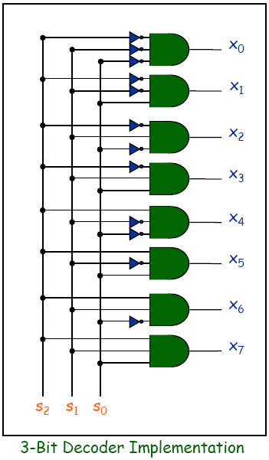
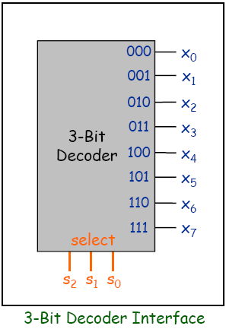
N-bit Decoder
N-bit decoder
  N address inputs, 2^{N} data outputs
  Addresses output bit is 1;
  all others are 0

Slide 26
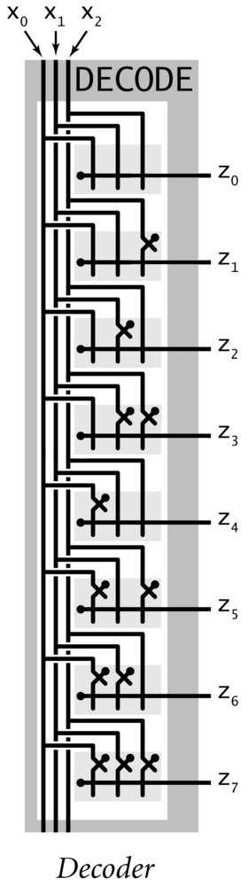
N-bit Decoder
N-bit decoder
  N address inputs, 2^{N} data outputs
  Addresses output bit is 1;
  all others are 0

Slide 27
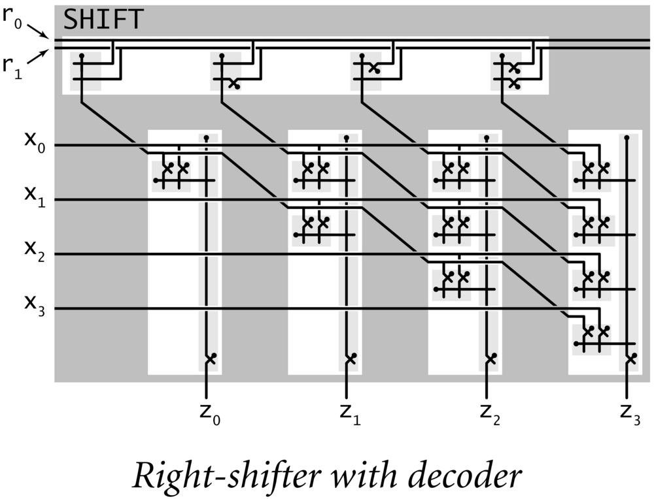
2-Bit Decoder Controlling 4-Bit Shifter
r₀r₁
Ex. Put in a binary amount to shift.

Slide 28
Arithmetic Logic Unit
Arithmetic logic unit (ALU). Computes all operations in parallel.
  Add and subtract.
  Xor.
  And.
  Shift left or right.
Q. How to select desired answer?
Notes:
also get a free "add-1" instruction. Useful for i++.

Slide 29
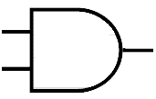

1 Hot OR
x．1 = x
x．0 = 0
x + 0 = x
decoder
adder
xor
shift

Slide 30
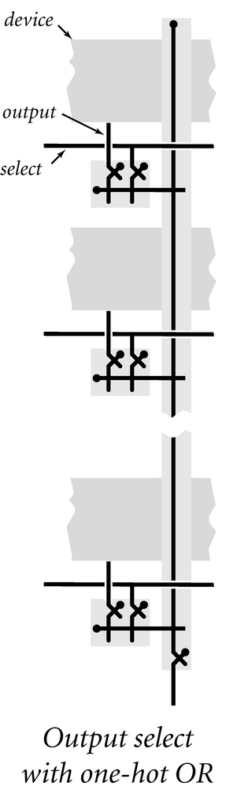
1 Hot OR
1 hot OR.
  All devices compute their answer; we pick one.
  Exactly one select line is on.
  Implies exactly one output line is relevant.
adder
xor
x．1 = x
x．0 = 0
x + 0 = x
shifter
Notes:
mathematician might say we're done since, in principle can build TOY computer with finite amount of resources
engineer wants to build it more efficiently, needs new abstractions
Note: 4080 inputs assumes all registers = 0 initially, mem[FF] not used and and pc = 10. (Does not include stdin)
there are 4096+16+1 outputs plus possibility of infinite loop plus stdout.

Slide 31
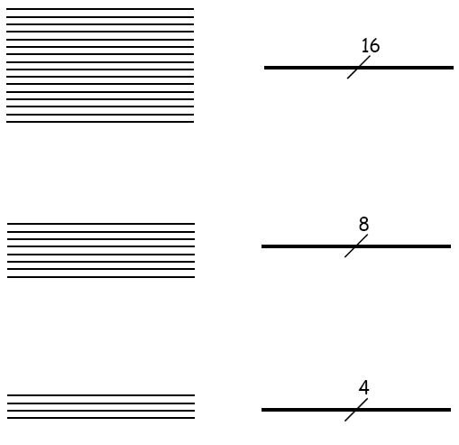
Bus
16-bit bus
  Bundle of 16 wires
  Memory transfer
  Register transfer
8-bit bus
  Bundle of 8 wires
  TOY memory address
4-bit bus
  Bundle of 4 wires
  TOY register address

Slide 32
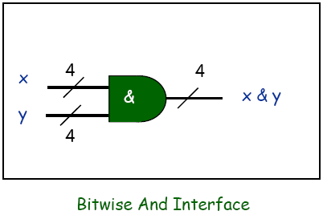
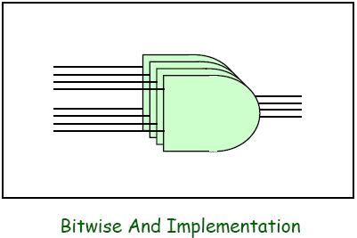
Bitwise AND, XOR, NOT
Bitwise logical operations
  Inputs x and y: n bits each
  Output z: n bits
  Apply logical operation to each corresponding pair of bits

Slide 33
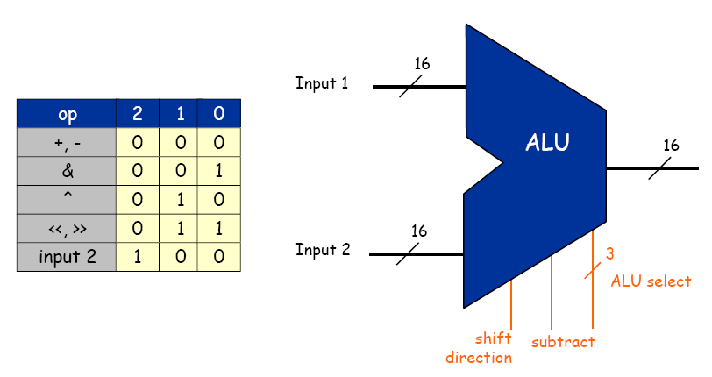
TOY ALU
TOY ALU
  Big combinational logic
  16-bit bus
  Add, subtract, and, xor, shift left, shift right, copy input 2

Slide 34
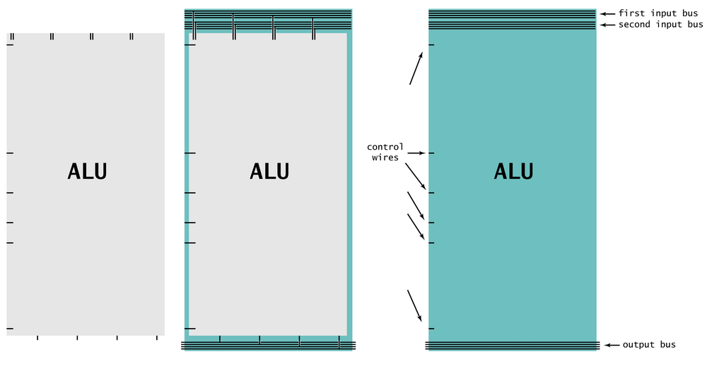
Device Interface Using Buses
16-bit words for TOY memory
Device. Processes a word at a time.
Input bus. Wires on top.
Output bus. Wires on bottom.
Control. Individual wires on side.
Notes:
mathematician might say we're done since, in principle can build TOY computer with finite amount of resources
engineer wants to build it more efficiently, needs new abstractions
Note: 4080 inputs assumes all registers = 0 initially, mem[FF] not used and and pc = 10. (Does not include stdin)
there are 4096+16+1 outputs plus possibility of infinite loop plus stdout.

Slide 35
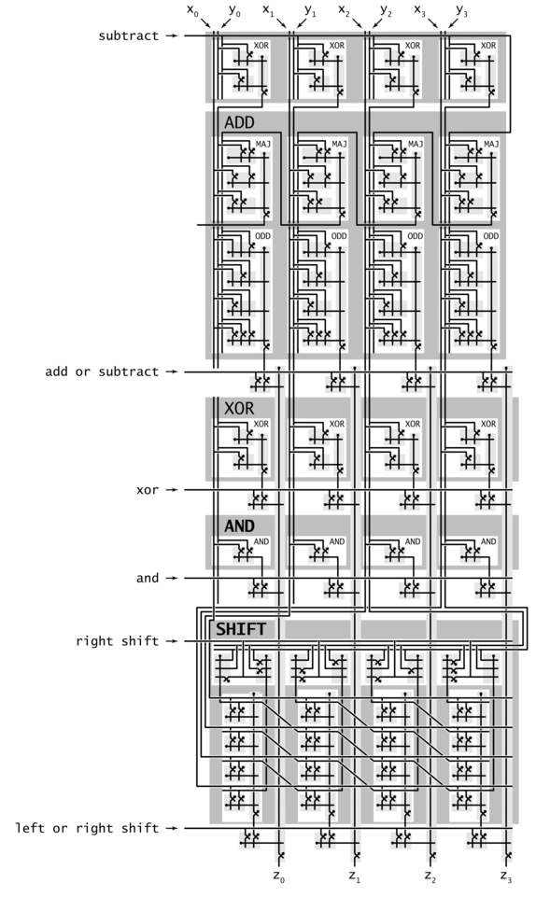
ALU
Arithmetic logic unit.
  Add and subtract.
  Xor.
  And.
  Shift left or right.
Arithmetic logic unit.
  Computes all operations in parallel.
  Uses 1-hot OR to pick each bit answer.
How to convert opcode to
1-hot OR signal?
Notes:
also get a free "add-1" instruction. Useful for i++.

Slide 36
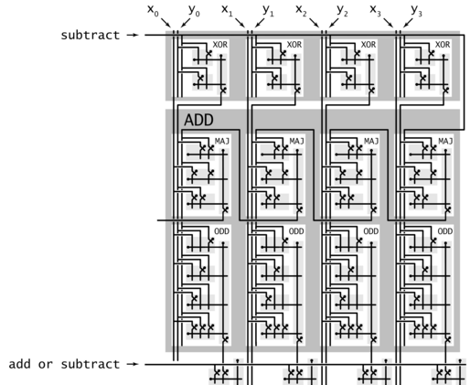

Slide 37
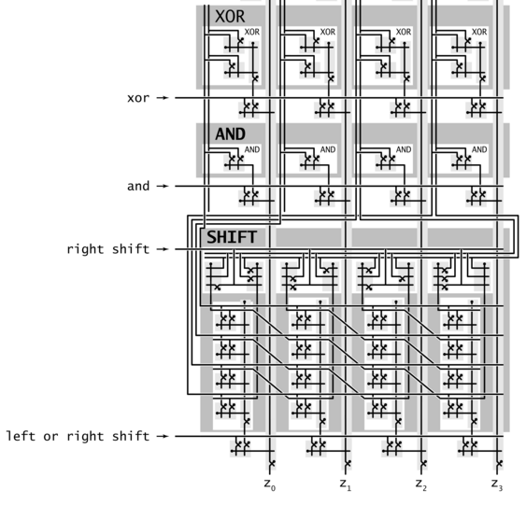

Slide 38
The ALU in the CPU context
Cond
Eval
=0
Registers
>0
10
01
00
W Data
Memory
2
A Data
A
L
U
PC
IR
1
0
1
0
Addr
op
4
0
1
B Data
d
W Addr
5
R Data
1
0
A Addr
s
+
W Data
t
B Addr
1
W
W
1-bit
counter
Opcode
Execute
Control
Fetch
Clock
Clock

Slide 39
Hack ALU
control bits
out(x, y, control bits) =
x+y, x-y, y–x,
0, 1, -1,
x, y, -x, -y,
x!, y!,
x+1, y+1, x-1, y-1,
x&y, x|y
flags

Slide 40
Hack ALU
pre-setting the x input |  | pre-setting the y input |  | selecting between computing + or & | post-setting the output | Resulting ALU output
zx | nx | zy | ny | f | no | out
if zx then x=0 | if nx then x=!x | if zy then y=0 | if ny then y=!y | if f then out=x+y else out=x&y | if no then out=!out | out(x,y)=

Slide 41
Hack ALU
pre-setting the x input |  | pre-setting the y input |  | selecting between computing + or & | post-setting the output | Resulting ALU output
zx | nx | zy | ny | f | no | out
if zx then x=0 | if nx then x=!x | if zy then y=0 | if ny then y=!y | if f then out=x+y else out=x&y | if no then out=!out | out(x,y)=

Slide 42
Hack ALU
pre-setting the x input |  | pre-setting the y input |  | selecting between computing + or & | post-setting the output | Resulting ALU output
zx | nx | zy | ny | f | no | out
if zx then x=0 | if nx then x=!x | if zy then y=0 | if ny then y=!y | if f then out=x+y else out=x&y | if no then out=!out | out(x,y)=

Slide 43
Hack ALU
pre-setting the x input |  | pre-setting the y input |  | selecting between computing + or & | post-setting the output | Resulting ALU output
zx | nx | zy | ny | f | no | out
if zx then x=0 | if nx then x=!x | if zy then y=0 | if ny then y=!y | if f then out=x+y else out=x&y | if no then out=!out | out(x,y)=

Slide 44
Hack ALU
pre-setting the x input |  | pre-setting the y input |  | selecting between computing + or & | post-setting the output | Resulting ALU output
zx | nx | zy | ny | f | no | out
if zx then x=0 | if nx then x=!x | if zy then y=0 | if ny then y=!y | if f then out=x+y else out=x&y | if no then out=!out | out(x,y)=

Slide 45
Hack ALU
pre-setting the x input |  | pre-setting the y input |  | selecting between computing + or & | post-setting the output | Resulting ALU output
zx | nx | zy | ny | f | no | out
if zx then x=0 | if nx then x=!x | if zy then y=0 | if ny then y=!y | if f then out=x+y else out=x&y | if no then out=!out | out(x,y)=

Slide 46
Hack ALU
pre-setting the x input |  | pre-setting the y input |  | selecting between computing + or & | post-setting the output | Resulting ALU output
zx | nx | zy | ny | f | no | out
if zx then x=0 | if nx then x=!x | if zy then y=0 | if ny then y=!y | if f then out=x+y else out=x&y | if no then out=!out | out(x,y)=
1 | 0 | 1 | 0 | 1 | 0 | 0
1 | 1 | 1 | 1 | 1 | 1 | 1
1 | 1 | 1 | 0 | 1 | 0 | -1
0 | 0 | 1 | 1 | 0 | 0 | x
1 | 1 | 0 | 0 | 0 | 0 | y
0 | 0 | 1 | 1 | 0 | 1 | !x
1 | 1 | 0 | 0 | 0 | 1 | !y
0 | 0 | 1 | 1 | 1 | 1 | -x
1 | 1 | 0 | 0 | 1 | 1 | -y
0 | 1 | 1 | 1 | 1 | 1 | x+1
1 | 1 | 0 | 1 | 1 | 1 | y+1
0 | 0 | 1 | 1 | 1 | 0 | x-1
1 | 1 | 0 | 0 | 1 | 0 | y-1
0 | 0 | 0 | 0 | 1 | 0 | x+y
0 | 1 | 0 | 0 | 1 | 1 | x-y
0 | 0 | 0 | 1 | 1 | 1 | y-x
0 | 0 | 0 | 0 | 0 | 0 | x&y
0 | 1 | 0 | 1 | 0 | 1 | x|y

Slide 47
Hack ALU: !x
pre-setting the x input |  | pre-setting the y input |  | selecting between computing + or & | post-setting the output | Resulting ALU output
zx | nx | zy | ny | f | no | out
if zx then x=0 | if nx then x=!x | if zy then y=0 | if ny then y=!y | if f then out=x+y else out=x&y | if no then out=!out | out(x,y)=
1 | 0 | 1 | 0 | 1 | 0 | 0
1 | 1 | 1 | 1 | 1 | 1 | 1
1 | 1 | 1 | 0 | 1 | 0 | -1
0 | 0 | 1 | 1 | 0 | 0 | x
1 | 1 | 0 | 0 | 0 | 0 | y
0 | 0 | 1 | 1 | 0 | 1 | !x
1 | 1 | 0 | 0 | 0 | 1 | !y
0 | 0 | 1 | 1 | 1 | 1 | -x
1 | 1 | 0 | 0 | 1 | 1 | -y
0 | 1 | 1 | 1 | 1 | 1 | x+1
1 | 1 | 0 | 1 | 1 | 1 | y+1
0 | 0 | 1 | 1 | 1 | 0 | x-1
1 | 1 | 0 | 0 | 1 | 0 | y-1
0 | 0 | 0 | 0 | 1 | 0 | x+y
0 | 1 | 0 | 0 | 1 | 1 | x-y
0 | 0 | 0 | 1 | 1 | 1 | y-x
0 | 0 | 0 | 0 | 0 | 0 | x&y
0 | 1 | 0 | 1 | 0 | 1 | x|y

Slide 48
Hack ALU: !x
pre-setting the x input |  | pre-setting the y input |  | selecting between computing + or & | post-setting the output | Resulting ALU output
zx | nx | zy | ny | f | no | out
if zx then x=0 | if nx then x=!x | if zy then y=0 | if ny then y=!y | if f then out=x+y else out=x&y | if no then out=!out | out(x,y)=
1 | 0 | 1 | 0 | 1 | 0 | 0
1 | 1 | 1 | 1 | 1 | 1 | 1
1 | 1 | 1 | 0 | 1 | 0 | -1
0 | 0 | 1 | 1 | 0 | 0 | x
1 | 1 | 0 | 0 | 0 | 0 | y
0 | 0 | 1 | 1 | 0 | 1 | !x
1 | 1 | 0 | 0 | 0 | 1 | !y
0 | 0 | 1 | 1 | 1 | 1 | -x
1 | 1 | 0 | 0 | 1 | 1 | -y
0 | 1 | 1 | 1 | 1 | 1 | x+1
1 | 1 | 0 | 1 | 1 | 1 | y+1
0 | 0 | 1 | 1 | 1 | 0 | x-1
1 | 1 | 0 | 0 | 1 | 0 | y-1
0 | 0 | 0 | 0 | 1 | 0 | x+y
0 | 1 | 0 | 0 | 1 | 1 | x-y
0 | 0 | 0 | 1 | 1 | 1 | y-x
0 | 0 | 0 | 0 | 0 | 0 | x&y
0 | 1 | 0 | 1 | 0 | 1 | x|y
Example: compute !x
x: 1 1 0 0
y: 1 0 1 1 (irrelevant)
Following pre-setting:
x: 1 1 0 0
y: 1 1 1 1
Computation and post-setting:
x&y: 1 1 0 0
!(x&y): 0 0 1 1 (!x)

Slide 49
Hack ALU: x|y
pre-setting the x input |  | pre-setting the y input |  | selecting between computing + or & | post-setting the output | Resulting ALU output
zx | nx | zy | ny | f | no | out
if zx then x=0 | if nx then x=!x | if zy then y=0 | if ny then y=!y | if f then out=x+y else out=x&y | if no then out=!out | out(x,y)=
1 | 0 | 1 | 0 | 1 | 0 | 0
1 | 1 | 1 | 1 | 1 | 1 | 1
1 | 1 | 1 | 0 | 1 | 0 | -1
0 | 0 | 1 | 1 | 0 | 0 | x
1 | 1 | 0 | 0 | 0 | 0 | y
0 | 0 | 1 | 1 | 0 | 1 | !x
1 | 1 | 0 | 0 | 0 | 1 | !y
0 | 0 | 1 | 1 | 1 | 1 | -x
1 | 1 | 0 | 0 | 1 | 1 | -y
0 | 1 | 1 | 1 | 1 | 1 | x+1
1 | 1 | 0 | 1 | 1 | 1 | y+1
0 | 0 | 1 | 1 | 1 | 0 | x-1
1 | 1 | 0 | 0 | 1 | 0 | y-1
0 | 0 | 0 | 0 | 1 | 0 | x+y
0 | 1 | 0 | 0 | 1 | 1 | x-y
0 | 0 | 0 | 1 | 1 | 1 | y-x
0 | 0 | 0 | 0 | 0 | 0 | x&y
0 | 1 | 0 | 1 | 0 | 1 | x|y
Example: compute x|y
x: 0 1 0 1
y: 0 0 1 1
Following pre-setting:
x: 1 0 1 0
y: 1 1 0 0
Computation and post-setting:
x&y: 1 0 0 0
!(x&y): 0 1 1 1

Slide 50
Hack ALU: y-1
pre-setting the x input |  | pre-setting the y input |  | selecting between computing + or & | post-setting the output | Resulting ALU output
zx | nx | zy | ny | f | no | out
if zx then x=0 | if nx then x=!x | if zy then y=0 | if ny then y=!y | if f then out=x+y else out=x&y | if no then out=!out | out(x,y)=
1 | 0 | 1 | 0 | 1 | 0 | 0
1 | 1 | 1 | 1 | 1 | 1 | 1
1 | 1 | 1 | 0 | 1 | 0 | -1
0 | 0 | 1 | 1 | 0 | 0 | x
1 | 1 | 0 | 0 | 0 | 0 | y
0 | 0 | 1 | 1 | 0 | 1 | !x
1 | 1 | 0 | 0 | 0 | 1 | !y
0 | 0 | 1 | 1 | 1 | 1 | -x
1 | 1 | 0 | 0 | 1 | 1 | -y
0 | 1 | 1 | 1 | 1 | 1 | x+1
1 | 1 | 0 | 1 | 1 | 1 | y+1
0 | 0 | 1 | 1 | 1 | 0 | x-1
1 | 1 | 0 | 0 | 1 | 0 | y-1
0 | 0 | 0 | 0 | 1 | 0 | x+y
0 | 1 | 0 | 0 | 1 | 1 | x-y
0 | 0 | 0 | 1 | 1 | 1 | y-x
0 | 0 | 0 | 0 | 0 | 0 | x&y
0 | 1 | 0 | 1 | 0 | 1 | x|y
Example: compute y-1
x: 0 1 0 1 (irrelevant)
y: 0 1 1 0 (6)
Following pre-setting:
x: 1 1 1 1
y: 0 1 1 0
Computation and post-setting:
x+y: 0 1 0 1
x+y: 0 1 0 1 (5)

Slide 51
Hack ALU: y-x
pre-setting the x input |  | pre-setting the y input |  | selecting between computing + or & | post-setting the output | Resulting ALU output
zx | nx | zy | ny | f | no | out
if zx then x=0 | if nx then x=!x | if zy then y=0 | if ny then y=!y | if f then out=x+y else out=x&y | if no then out=!out | out(x,y)=
1 | 0 | 1 | 0 | 1 | 0 | 0
1 | 1 | 1 | 1 | 1 | 1 | 1
1 | 1 | 1 | 0 | 1 | 0 | -1
0 | 0 | 1 | 1 | 0 | 0 | x
1 | 1 | 0 | 0 | 0 | 0 | y
0 | 0 | 1 | 1 | 0 | 1 | !x
1 | 1 | 0 | 0 | 0 | 1 | !y
0 | 0 | 1 | 1 | 1 | 1 | -x
1 | 1 | 0 | 0 | 1 | 1 | -y
0 | 1 | 1 | 1 | 1 | 1 | x+1
1 | 1 | 0 | 1 | 1 | 1 | y+1
0 | 0 | 1 | 1 | 1 | 0 | x-1
1 | 1 | 0 | 0 | 1 | 0 | y-1
0 | 0 | 0 | 0 | 1 | 0 | x+y
0 | 1 | 0 | 0 | 1 | 1 | x-y
0 | 0 | 0 | 1 | 1 | 1 | y-x
0 | 0 | 0 | 0 | 0 | 0 | x&y
0 | 1 | 0 | 1 | 0 | 1 | x|y
Example: compute y-x
x: 0 1 0 1 (5)
y: 0 1 1 0 (6)
Following pre-setting:
x: 0 1 0 1
y: 1 0 0 1
Computation and post-setting:
x+y: 1 1 1 0
!(x+y): 0 0 0 1 (1)

Slide 52
The ALU in the CPU context (a sneak preview of the Hack platform)
c1,c2, … ,c6
D
D register
a
out
A
ALU
A register
A/M
Mux
RAM
(selected register)
M

Slide 53
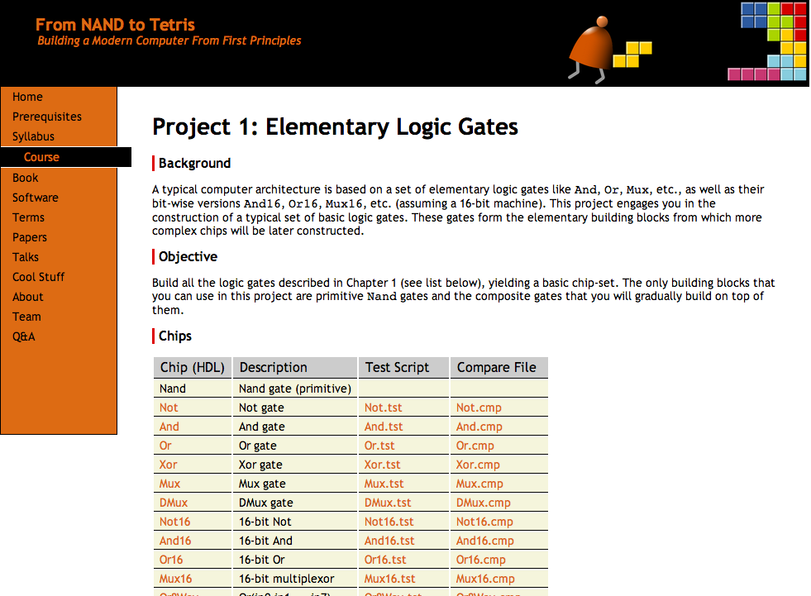
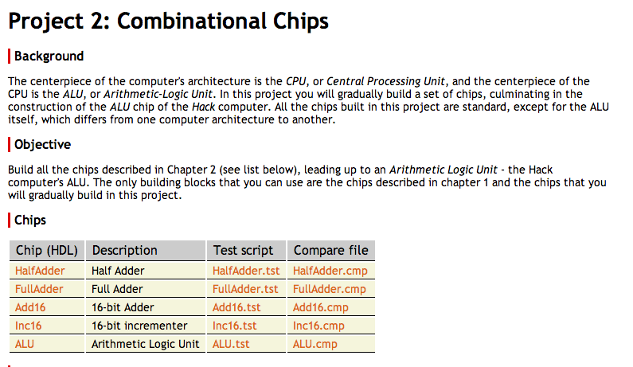
Project 2
www.nand2tetris.org

Slide 54
Project 2
Given: All the chips built in Project 1
Goal: Build the chips:
HalfAdder
FullAdder
Add16
Inc16
ALU

Slide 55
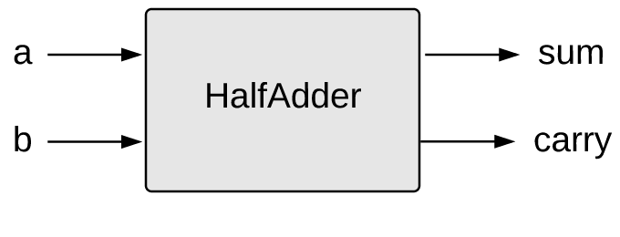
Half Adder
a | b | sum | carry
0 | 0 | 0 | 0
0 | 1 | 1 | 0
1 | 0 | 1 | 0
1 | 1 | 0 | 1
HalfAdder.hdl
/** Computes the sum of two bits. */
CHIP HalfAdder {
IN a, b;
OUT sum, carry;
PARTS:
// Put your code here:
}
Implementation tip
Can be built from two gates built in project 1.

Slide 56
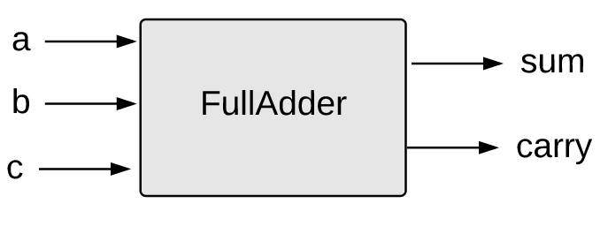
Full Adder
a | b | c | sum | carry
0 | 0 | 0 | 0 | 0
0 | 0 | 1 | 1 | 0
0 | 1 | 0 | 1 | 0
0 | 1 | 1 | 0 | 1
1 | 0 | 0 | 1 | 0
1 | 0 | 1 | 0 | 1
1 | 1 | 0 | 0 | 1
1 | 1 | 1 | 1 | 1
FullAdder.hdl
/** Computes the sum of three bits. */
CHIP FullAdder {
IN a, b, c;
OUT sum, carry;
PARTS:
// Put your code here:
}
Implementation tip
Can be built from two
half-adders.

Slide 57
16-bit Adder
Add16.hdl
/* Adds two 16-bit, two’s-complement values.
The most-significant carry bit is ignored. */
CHIP Add16 {
IN a[16], b[16];
OUT out[16];
PARTS:
// Put you code here:
}
The bitwise additions are done in parallel
The carry propagation is sequential
Yet… it works fine, as is.
Implementation note
If you need to set a pin x to 0 (or 1) in HDL,
use: x = false (or x = true)

Slide 58
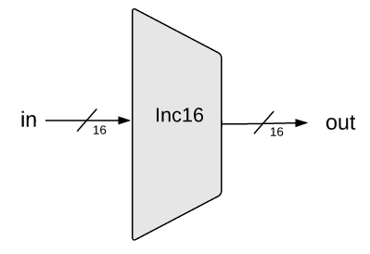
16-bit incrementor
Inc16.hdl
/** Outputs in + 1. */
CHIP Inc16 {
IN in[16];
OUT out[16];
PARTS:
// Put you code here:
}
Implementation:
Simple.

Slide 59
ALU

Slide 60
ALU
ALU.hdl
/** The ALU */
// Manipulates the x and y inputs as follows:
// if (zx == 1) sets x = 0 // 16-bit true
// if (nx == 1) sets x = !x // 16-bit Not
// if (zy == 1) sets y = 0 // 16-bit true
// if (ny == 1) sets y = !y // 16-bit Not
// if (f == 1) sets out = x + y // 2's-complement addition
// if (f == 0) sets out = x & y // 16-bit And
// if (no == 1) sets out = !out // 16-bit Not
// if (out == 0) sets zr = 1 // 1-bit true
// if (out < 0) sets ng = 1 // 1-bit true
...

Slide 61
ALU
Implementation tips
We need logic for:
Implementing “if bit == 0/1” conditions
Setting a 16-bit value to 0000000000000000
Setting a 16-bit value to 1111111111111111
Negating a 16-bit value (bitwise)
Computing Add and And on two 16-bit values
ALU.hdl
/** The ALU */
// Manipulates the x and y inputs as follows:
// if (zx == 1) sets x = 0 // 16-bit true
// if (nx == 1) sets x = !x // 16-bit Not
// if (zy == 1) sets y = 0 // 16-bit true
// if (ny == 1) sets y = !y // 16-bit Not
// if (f == 1) sets out = x + y // 2's-complement addition
// if (f == 0) sets out = x & y // 16-bit And
// if (no == 1) sets out = !out // 16-bit Not
// if (out == 0) sets zr = 1 // 1-bit true
// if (out < 0) sets ng = 1 // 1-bit true
...
Implementation strategy
Start by building an ALU that computes out
Next, extend it to also compute zr and ng.

Slide 62
Relevant bus tips
Using multi-bit truth / false constants:
...
// Suppose that x, y, z are 8-bit bus-pins:
7
6
5
4
3
2
1
0
x:
y:
z:

Slide 63
Relevant bus tips
Using multi-bit truth / false constants:
...
// Suppose that x, y, z are 8-bit bus-pins:
chipPart(..., x = true, y = false, z[0..2] = true, z[6..7] = true);
...
7
6
5
4
3
2
1
0
x:
y:
z:

Slide 64
Relevant bus tips
Using multi-bit truth / false constants:
...
// Suppose that x, y, z are 8-bit bus-pins:
chipPart(..., x = true, y = false, z[0..2] = true, z[6..7] = true);
...
7
6
5
4
3
2
1
0
x:
1
1
1
1
1
1
1
1
y:
z:

Slide 65
Relevant bus tips
Using multi-bit truth / false constants:
...
// Suppose that x, y, z are 8-bit bus-pins:
chipPart(..., x = true, y = false, z[0..2] = true, z[6..7] = true);
...
7
6
5
4
3
2
1
0
x:
1
1
1
1
1
1
1
1
y:
0
0
0
0
0
0
0
0
z:

Slide 66
Relevant bus tips
Using multi-bit truth / false constants:
We can assign values to sub-buses
...
// Suppose that x, y, z are 8-bit bus-pins:
chipPart(..., x = true, y = false, z[0..2] = true, z[6..7] = true);
...
7
6
5
4
3
2
1
0
x:
1
1
1
1
1
1
1
1
y:
0
0
0
0
0
0
0
0
z:
1
1
0
0
0
1
1
1
Unassigned bits are set to 0

Slide 67
Relevant bus tips
Sub-bussing:
We can assign n-bit values to sub-buses, for any n
We can create n-bit bus pins, for any n
/* 16-bit adder */
CHIP Add16 {
IN a[16], b[16];
OUT out[16];
PARTS:
...
}
CHIP Foo {
IN x[8], y[8], z[16]
OUT out[16]
PARTS
...
Add16 (a[0..7] = x, a[8..15] = y, b = z, out = …);
...
Add16 (a = …, b = …, out[0..3] = t1, out[4..15] = t2);
...
}

Slide 68
Relevant bus tips
Sub-bussing:
We can assign n-bit values to sub-buses, for any n
We can create n-bit bus pins, for any n
/* 16-bit adder */
CHIP Add16 {
IN a[16], b[16];
OUT out[16];
PARTS:
...
}
CHIP Foo {
IN x[8], y[8], z[16]
OUT out[16]
PARTS
...
Add16 (a[0..7] = x, a[8..15] = y, b = z, out = …);
...
Add16 (a = …, b = …, out[0..3] = t1, out[4..15] = t2);
...
}
Another example of assigning a multi-bit value to a sub-bus

Slide 69
Relevant bus tips
Sub-bussing:
We can assign n-bit values to sub-buses, for any n
We can create n-bit bus pins, for any n
/* 16-bit adder */
CHIP Add16 {
IN a[16], b[16];
OUT out[16];
PARTS:
...
}
CHIP Foo {
IN x[8], y[8], z[16]
OUT out[16]
PARTS
...
Add16 (a[0..7] = x, a[8..15] = y, b = z, out = …);
...
Add16 (a = …, b = …, out[0..3] = t1, out[4..15] = t2);
...
}
Another example of assigning a multi-bit value to a sub-bus
Creating an n-bit bus (internal pin)

Slide 70
Perspective
Combinational logic
Our adder design is very basic: no parallelism
It pays to optimize adders
Our ALU is also very basic: no multiplication, no division
Where is the seat of more advanced math operations?
a typical hardware/software tradeoff.

