Slide 1
Codes and number systems
Introduction to Computer
Yung-Yu Chuang
with slides by Nisan & Schocken (www.nand2tetris.org) and Harris & Harris (DDCA)

Slide 2

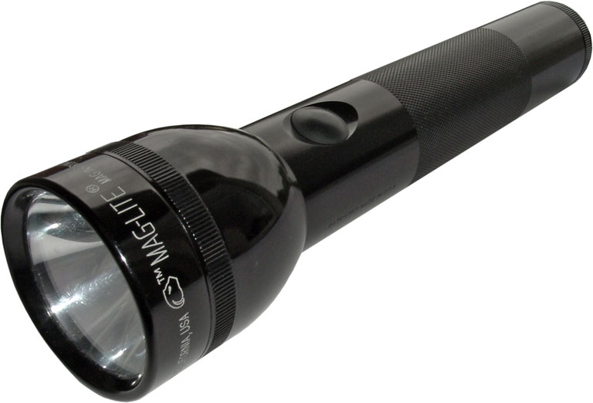
Coding
Assume that you want to communicate with your friend with a flashlight in a night, what will you do?
light painting?
What’s the problem?

Slide 3
Solution #1
A: 1 blink
B: 2 blinks
C: 3 blinks
:
Z: 26 blinks
What’s the problem?
How are you? = 131 blinks

Slide 4
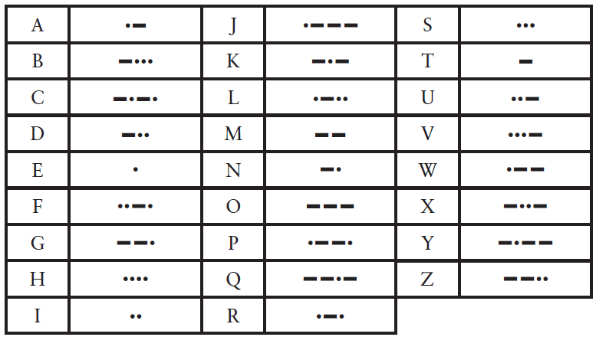
Solution #2: Morse code
Hello

Slide 5
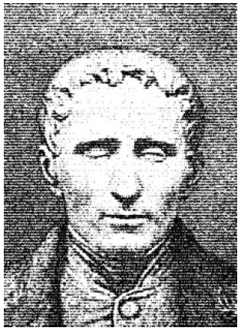
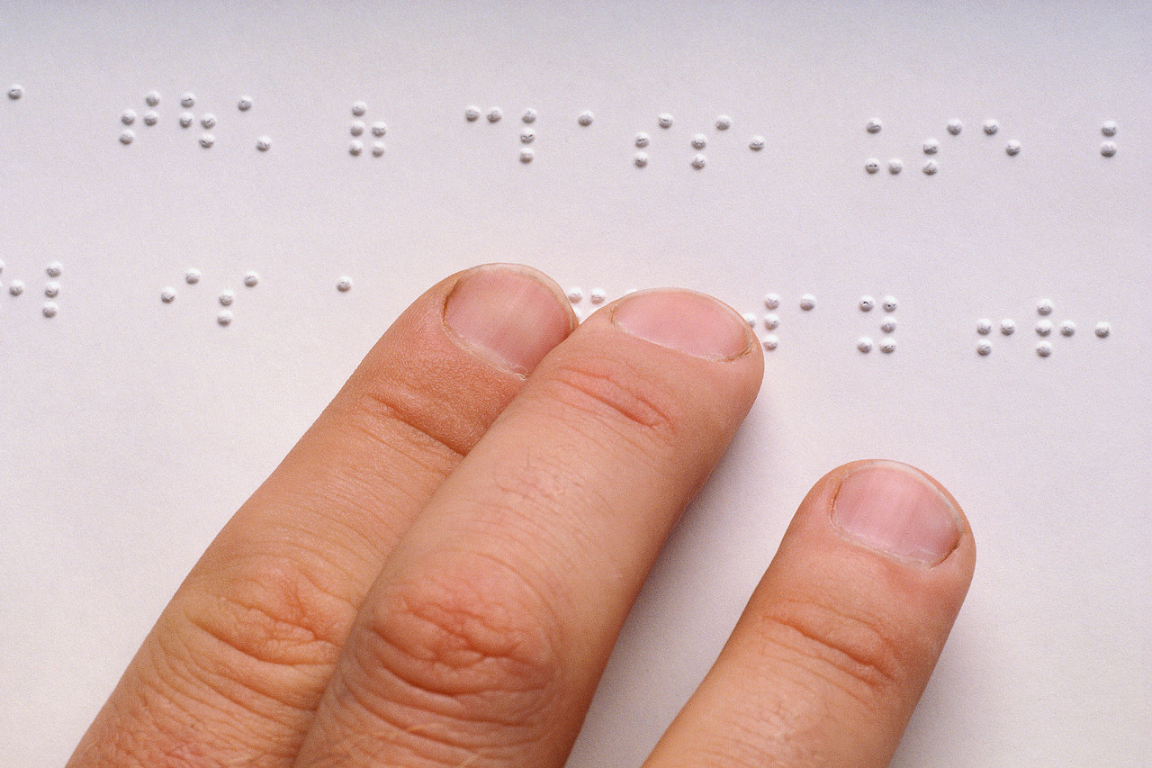
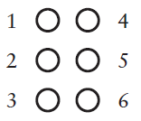
Braille

Slide 6
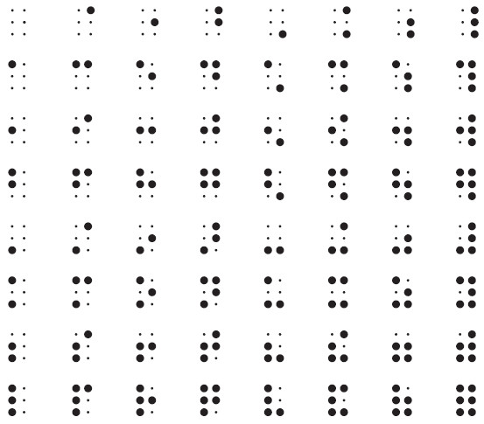
Braille

Slide 7
What’s common in these codes?
They are both binary codes.

Slide 8
Binary representations
Electronic Implementation
  Easy to store with bistable elements
  Reliably transmitted on noisy and inaccurate wires
0
1
0
3.3V
2.8V
0.5V
0.0V

Slide 9
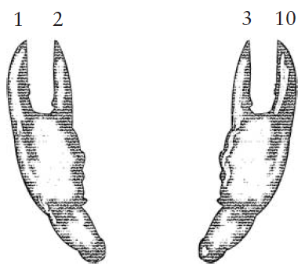
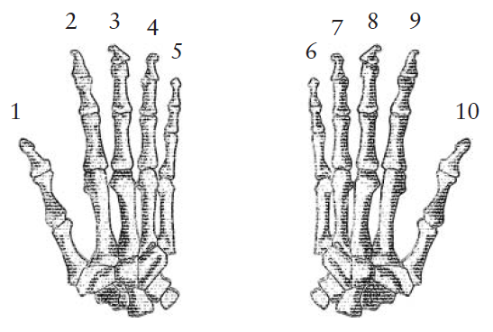
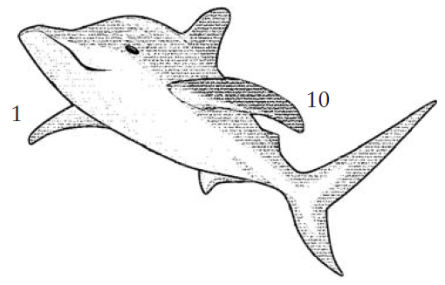
Number systems

Slide 10
Number Systems
Decimal numbers
Binary numbers

Slide 11
Number Systems
Decimal numbers
Binary numbers

Slide 12
Binary numbers
Digits are 1 and 0
(a binary digit is called a bit)
1 = true
0 = false
MSB –most significant bit
LSB –least significant bit
Bit numbering:
A bit string could have different interpretations

Slide 13
Powers of Two
2⁰ =
2¹ =
2² =
2³ =
2⁴ =
2⁵ =
2⁶ =
2⁷ =
2⁸ =
2⁹ =
2¹⁰ =
2¹¹ =
2¹² =
2¹³ =
2¹⁴ =
2¹⁵ =

Slide 14
Powers of Two
2⁰ = 1
2¹ = 2
2² = 4
2³ = 8
2⁴ = 16
2⁵ = 32
2⁶ = 64
2⁷ = 128
Handy to memorize up to 2⁹
2⁸ = 256
2⁹ = 512
2¹⁰ = 1024
2¹¹ = 2048
2¹² = 4096
2¹³ = 8192
2¹⁴ = 16384
2¹⁵ = 32768

Slide 15
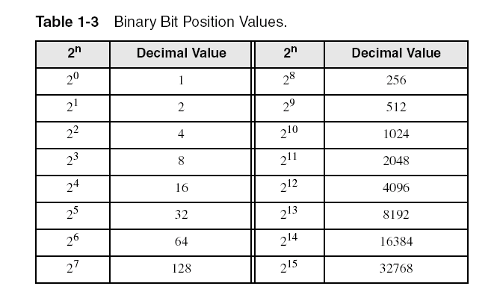
Unsigned binary integers
Each digit (bit) is either 1 or 0
Each bit represents a power of 2:
Every binary number is a sum of powers of 2

Slide 16
Translating binary to decimal
Weighted positional notation shows how to calculate the decimal value of each binary bit:
dec = (D_{n-1} × 2^{n-1}) + (D_{n-2} × 2^{n-2}) + ... + (D₁ × 2¹) + (D₀ × 2⁰)
D = binary digit
binary 00001001 = decimal 9:
(1 × 2³) + (1 × 2⁰) = 9

Slide 17
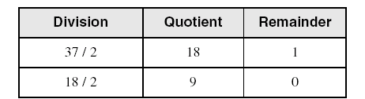
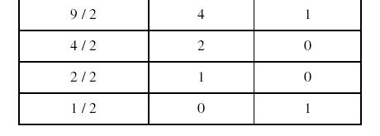
Translating unsigned decimal to binary
Repeatedly divide the decimal integer by 2. Each remainder is a binary digit in the translated value:
37 = 100101

Slide 18
Number Conversion
Binary to decimal conversion:
  Convert 10011₂ to decimal
Decimal to binary conversion:
  Convert 47₁₀ to binary

Slide 19
Number Conversion
Binary to decimal conversion:
  Convert 10011₂ to decimal
  16×1 + 8×0 + 4×0 + 2×1 + 1×1 = 19₁₀
Decimal to binary conversion:
  Convert 47₁₀ to binary
  32×1 + 16×0 + 8×1 + 4×1 + 2×1 + 1×1 = 101111₂

Slide 20
Binary Values and Range
N-digit decimal number
  How many values?
  Range?
  Example: 3-digit decimal number:
N-bit binary number
  How many values?
  Range:
  Example: 3-digit binary number:

Slide 21
Binary Values and Range
N-digit decimal number
  How many values? 10^{N}
  Range? [0, 10^{N} - 1]
  Example: 3-digit decimal number:
    10³ = 1000 possible values
    Range: [0, 999]
N-bit binary number
  How many values? 2^{N}
  Range: [0, 2^{N} - 1]
  Example: 3-digit binary number:
    2³ = 8 possible values
    Range: [0, 7] = [000₂ to 111₂]

Slide 22
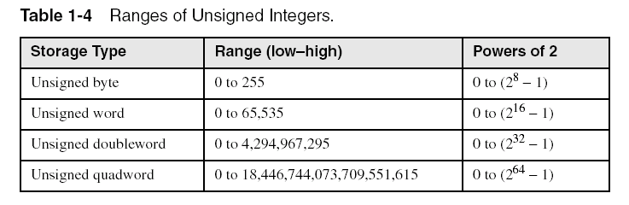
Integer storage sizes
Standard sizes:
Practice: What is the largest unsigned integer that may be stored in 20 bits?

Slide 23
Bits, Bytes, Nibbles…
Bits
Bytes & Nibbles
Bytes

Slide 24
Large Powers of Two
2¹⁰ = 1 kilo ≈ 1000 (1024)
2²⁰ = 1 mega ≈ 1 million (1,048,576)
2³⁰ = 1 giga ≈ 1 billion (1,073,741,824)

Slide 25
Estimating Powers of Two
What is the value of 2²⁴?
How many values can a 32-bit variable represent?

Slide 26
Estimating Powers of Two
What is the value of 2²⁴?
- 2⁴ × 2²⁰ ≈ 16 million
How many values can a 32-bit variable represent?
-2² × 2³⁰ ≈ 4 billion

Slide 27
Large measurements
Kilobyte (KB), 2¹⁰ bytes
Megabyte (MB), 2²⁰ bytes
Gigabyte (GB), 2³⁰ bytes
Terabyte (TB), 2⁴⁰ bytes
Petabyte
Exabyte
Zettabyte
Yottabyte

Slide 28
Hexadecimal Numbers
Hex Digit | Decimal Equivalent | Binary Equivalent
0 | 0
1 | 1
2 | 2
3 | 3
4 | 4
5 | 5
6 | 6
7 | 7
8 | 8
9 | 9
A | 10
B | 11
C | 12
D | 13
E | 14
F | 15

Slide 29
Hexadecimal Numbers
Hex Digit | Decimal Equivalent | Binary Equivalent
0 | 0 | 0000
1 | 1 | 0001
2 | 2 | 0010
3 | 3 | 0011
4 | 4 | 0100
5 | 5 | 0101
6 | 6 | 0110
7 | 7 | 0111
8 | 8 | 1000
9 | 9 | 1001
A | 10 | 1010
B | 11 | 1011
C | 12 | 1100
D | 13 | 1101
E | 14 | 1110
F | 15 | 1111

Slide 30
Hexadecimal Numbers
Base 16
Shorthand for binary

Slide 31

Translating binary to hexadecimal
Each hexadecimal digit corresponds to 4 binary bits.
Example: Translate the binary integer 000101101010011110010100 to hexadecimal:

Slide 32
Converting hexadecimal to decimal
Multiply each digit by its corresponding power of 16:
  dec = (D₃ × 16³) + (D₂ × 16²) + (D₁ × 16¹) + (D₀ × 16⁰)
Hex 1234 equals (1 × 16³) + (2 × 16²) + (3 × 16¹) + (4 × 16⁰), or decimal 4,660.
Hex 3BA4 equals (3 × 16³) + (11 * 16²) + (10 × 16¹) + (4 × 16⁰), or decimal 15,268.

Slide 33
Hexadecimal to Binary Conversion
Hexadecimal to binary conversion:
  Convert 4AF₁₆ (also written 0x4AF) to binary
Hexadecimal to decimal conversion:
  Convert 0x4AF to decimal

Slide 34
Hexadecimal to Binary Conversion
Hexadecimal to binary conversion:
  Convert 4AF₁₆ (also written 0x4AF) to binary
  0100 1010 1111₂
Hexadecimal to decimal conversion:
  Convert 4AF₁₆ to decimal
  16²×4 + 16¹×10 + 16⁰×15 = 1199₁₀

Slide 35
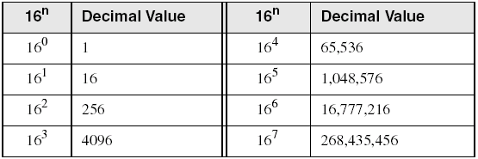
Powers of 16
Used when calculating hexadecimal values up to 8 digits long:

Slide 36
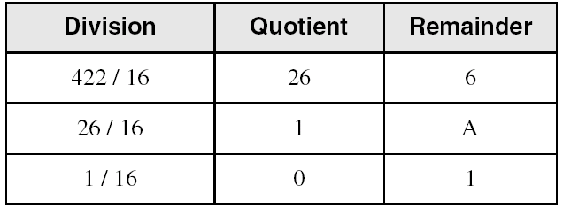
Converting decimal to hexadecimal
decimal 422 = 1A6 hexadecimal

Slide 37
Addition
Decimal
Binary

Slide 38
Binary Addition Examples
Add the following 4-bit binary numbers
Add the following 4-bit binary numbers

Slide 39
Binary Addition Examples
Add the following 4-bit binary numbers
Add the following 4-bit binary numbers
Overflow!

Slide 40
Overflow
Digital systems operate on a fixed number of bits
Overflow: when result is too big to fit in the available number of bits
See previous example of 11 + 6

Slide 41
Hexadecimal addition
Divide the sum of two digits by the number base (16). The quotient becomes the carry value, and the remainder is the sum digit.
1
1
36 28 28 6A
42 45 58 4B
78 6D 80 B5
Important skill: Programmers frequently add and subtract the addresses of variables and instructions.

Slide 42
Signed Binary Numbers
Sign/Magnitude Numbers
Two’s Complement Numbers

Slide 43
Signed integers
The highest bit indicates the sign. 1 = negative,
0 = positive
If the highest digit of a hexadecmal integer is > 7, the value is negative. Examples: 8A, C5, A2, 9D

Slide 44
Sign/Magnitude Numbers
1 sign bit, N-1 magnitude bits
Sign bit is the most significant (left-most) bit
  Positive number: sign bit = 0
  Negative number: sign bit = 1
Example, 4-bit sign/mag representations of ± 6:
+6 =
- 6 =
Range of an N-bit sign/magnitude number:

Slide 45
Sign/Magnitude Numbers
1 sign bit, N-1 magnitude bits
Sign bit is the most significant (left-most) bit
  Positive number: sign bit = 0
  Negative number: sign bit = 1
Example, 4-bit sign/mag representations of ± 6:
+6 = 0110
- 6 = 1110
Range of an N-bit sign/magnitude number:
[-(2^{N-1}-1), 2^{N-1}-1]

Slide 46
Sign/Magnitude Numbers
Problems:
  Addition doesn’t work, for example -6 + 6:
1110
+ 0110
10100 (wrong!)
  Two representations of 0 (± 0):
1000
0000

Slide 47
Two’s Complement Numbers
Don’t have same problems as sign/magnitude numbers:
  Addition works
  Single representation for 0

Slide 48
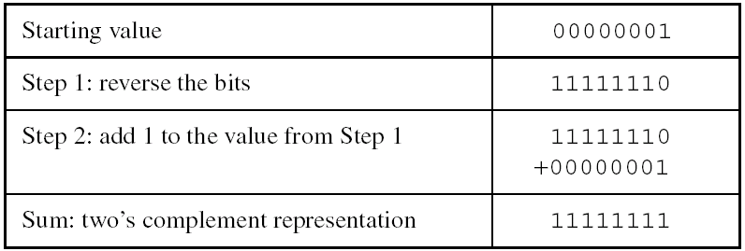
Two's complement notation
Steps:
  Complement (reverse) each bit
  Add 1
Note that 00000001 + 11111111 = 00000000

Slide 49
“Taking the Two’s Complement”
Flip the sign of a two’s complement number
Method:
    Invert the bits
    Add 1
Example: Flip the sign of 3₁₀ = 0011₂

Slide 50
“Taking the Two’s Complement”
Flip the sign of a two’s complement number
Method:
    Invert the bits
    Add 1
Example: Flip the sign of 3₁₀ = 0011₂
    1100
    + 1
    1101 = -3₁₀

Slide 51
Two’s Complement Examples
Take the two’s complement of 6₁₀ = 0110₂
What is the decimal value of 1001₂?

Slide 52
Two’s Complement Examples
Take the two’s complement of 6₁₀ = 0110₂
    1001
    + 1
    1010₂ = -6₁₀
What is the decimal value of the two’s complement number 1001₂?
    0110
    + 1
    0111₂ = 7₁₀, so 1001₂ = -7₁₀

Slide 53
Binary subtraction
When subtracting A – B, convert B to its two's complement
Add A to (–B)
0 1 0 1 0 0 1 0 1 0
– 0 1 0 1 1 1 0 1 0 1
1 1 1 1 1
Advantages for 2’s complement:
No two 0’s
Sign bit
Remove the need for separate circuits for add and sub

Slide 54
Two’s Complement Addition
Add 6 + (-6) using two’s complement numbers
Add -2 + 3 using two’s complement numbers

Slide 55
Two’s Complement Addition
Add 6 + (-6) using two’s complement numbers
Add -2 + 3 using two’s complement numbers

Slide 56
Two’s Complement
b = 1-b
a = 111…1 – a = (2^{N}-1)-a
a +1= 2^{N}-a
In 2’s complement, 2^{N}-a is used to represent –a since 2^{N}-a ≡ -a (mod 2^{N})

Slide 57
Increasing Bit Width
Extend number from N to M bits (M > N) :
  Sign-extension
  Zero-extension

Slide 58
Sign-Extension
Sign bit copied to msb’s
Number value is same
Example 1:
  4-bit representation of 3 = 0011
  8-bit sign-extended value: 00000011
Example 2:
  4-bit representation of -5 = 1011
  8-bit sign-extended value: 11111011

Slide 59
Zero-Extension
Zeros copied to msb’s
Value changes for negative numbers
Example 1:
  4-bit value = 0011₂ = 3₁₀
  8-bit zero-extended value: 00000011 = 3₁₀
Example 2:
  4-bit value = 1011 = -5₁₀
  8-bit zero-extended value: 00001011 = 11₁₀

Slide 60
Number System Comparison
Number System | Range
Unsigned | [0, 2^{N}-1]
Sign/Magnitude | [-(2^{N-1}-1), 2^{N-1}-1]
Two’s Complement | [-2^{N-1}, 2^{N-1}-1]
For example, 4-bit representation:

Slide 61
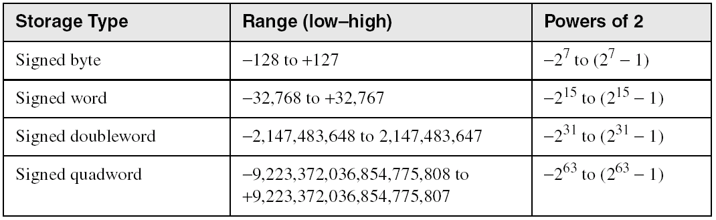
Ranges of signed integers
The highest bit is reserved for the sign. This limits the range:

Slide 62
Character
Character sets
  Standard ASCII (0 – 127)
  Extended ASCII (0 – 255)
  ANSI (0 – 255)
  Unicode (0 – 65,535)
Null-terminated String
  Array of characters followed by a null byte
Using the ASCII table
  back inside cover of book

Slide 63
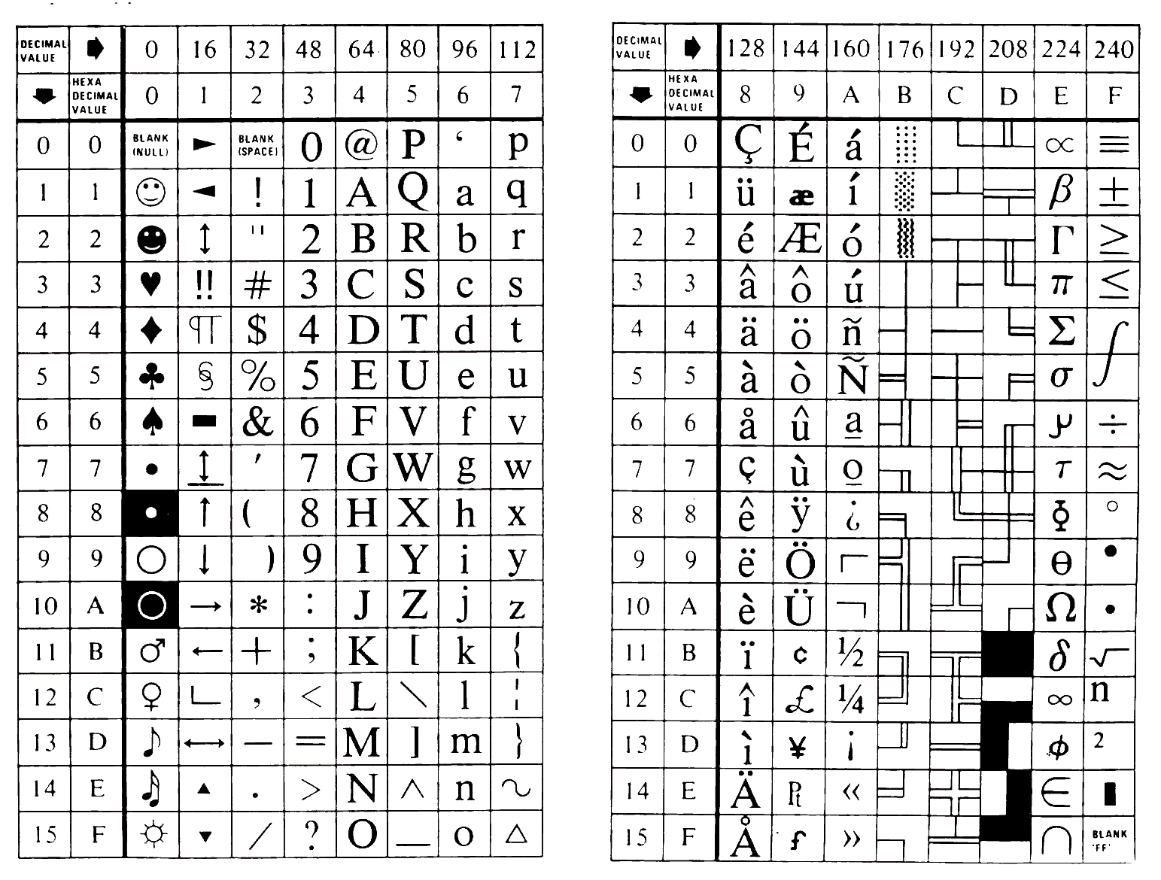

Slide 64
Representing Instructions
int sum(int x, int y)
{
return x+y;
}
Alpha sum
Sun sum
PC sum
00
81
55
00
C3
89
  For this example, Alpha & Sun use two 4-byte instructions
    Use differing numbers of instructions in other cases
  PC uses 7 instructions with lengths 1, 2, and 3 bytes
    Same for NT and for Linux
    NT / Linux not fully binary compatible
30
E0
E5
42
08
8B
01
90
45
80
02
0C
FA
00
03
6B
09
45
08
89
EC
5D
C3
Different machines use totally different
instructions and encodings

