Slide 1
Course overview
Introduction to Computer
Yung-Yu Chuang
with slides by Nisan & Schocken (www.nand2tetris.org)

Slide 2
Logistics
Meeting time: 9:10am-12:00pm, Tuesday
Instructor: 莊永裕 Yung-Yu Chuang
Webpage:
http://www.csie.ntu.edu.tw/~cyy/introcs

Slide 3
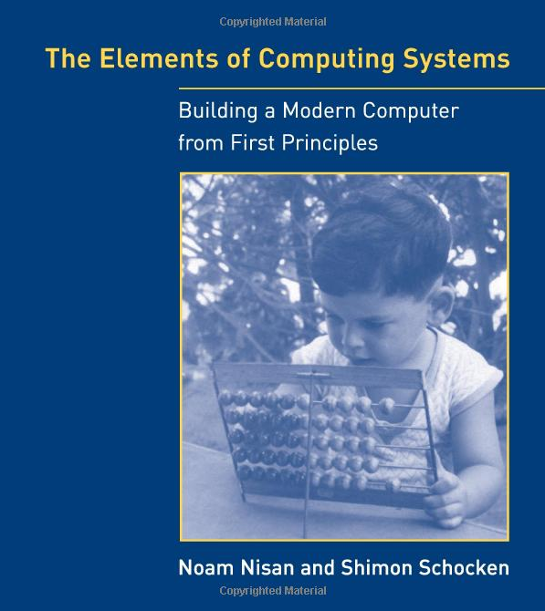
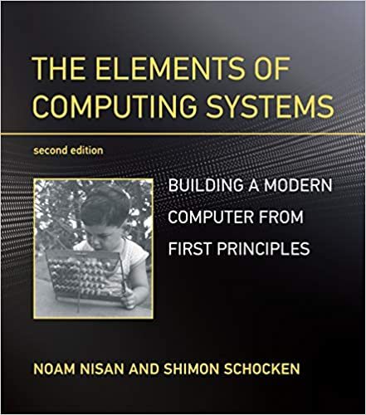
Textbook
The Elements of Computing Systems, Noam Nisan, Shimon Schocken, MIT Press
Nand2Tetris on coursera
Nand2Tetris2 on coursera

Slide 4
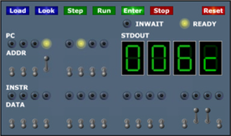
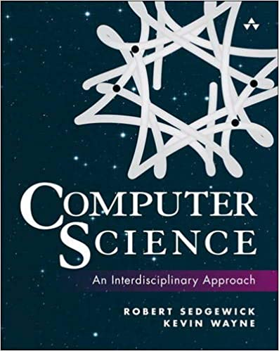
References (TOY)
Princeton’s Introduction to CS, http://www.cs.princeton.edu/introcs/java/60machine/
http://www.cs.princeton.edu/introcs/java/70circuits/
Coursera course
Computer Science: An Interdisciplinary Approach. Robert Sedgewick, Kevin Wayne

Slide 5
Grading (subject to change)
Assignments (5 projects+1 homework, 50%) from the accompanying website
Class participation (5%)
Midterm quiz (20%)
Final project (25%)

Slide 6
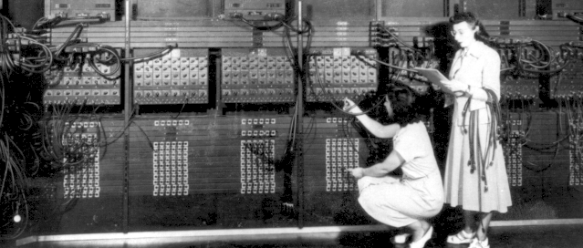
Early computers

Slide 7
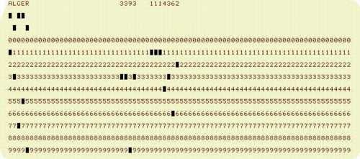
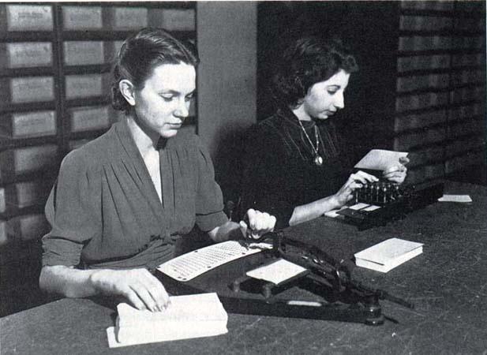
Early programming tools

Slide 8
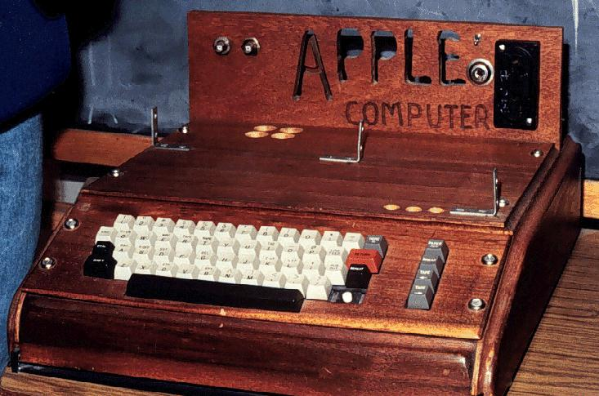

First popular PCs

Slide 9
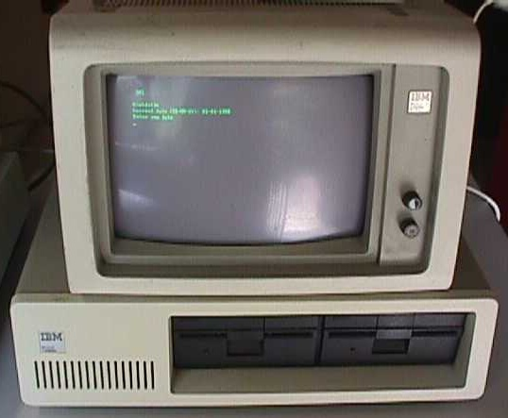
Early PCs
Intel 8086 processor
768KB memory
20MB disk
Dot-Matrix printer (9-pin)

Slide 10
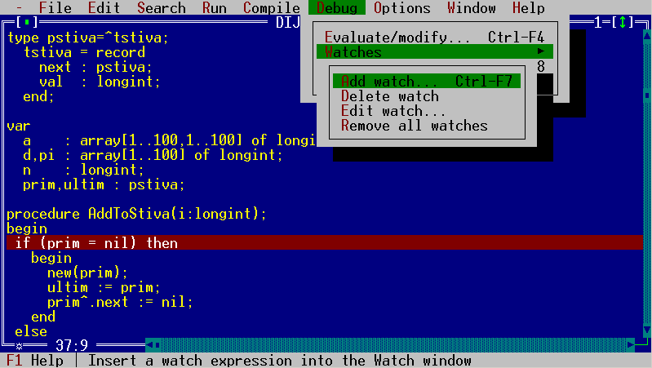
GUI/IDE

Slide 11
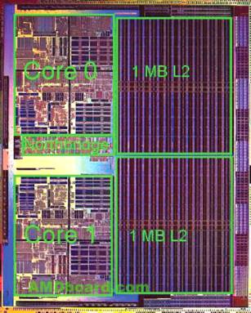
More advanced architectures
Pipeline
SIMD
Multi-core
Cache

Slide 12
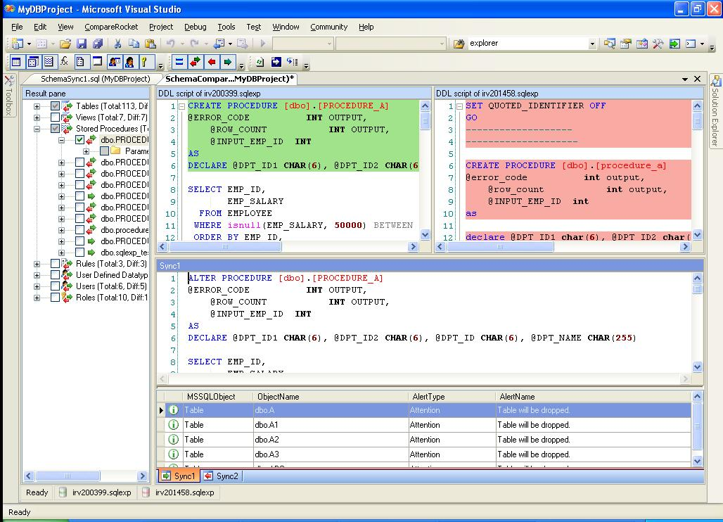
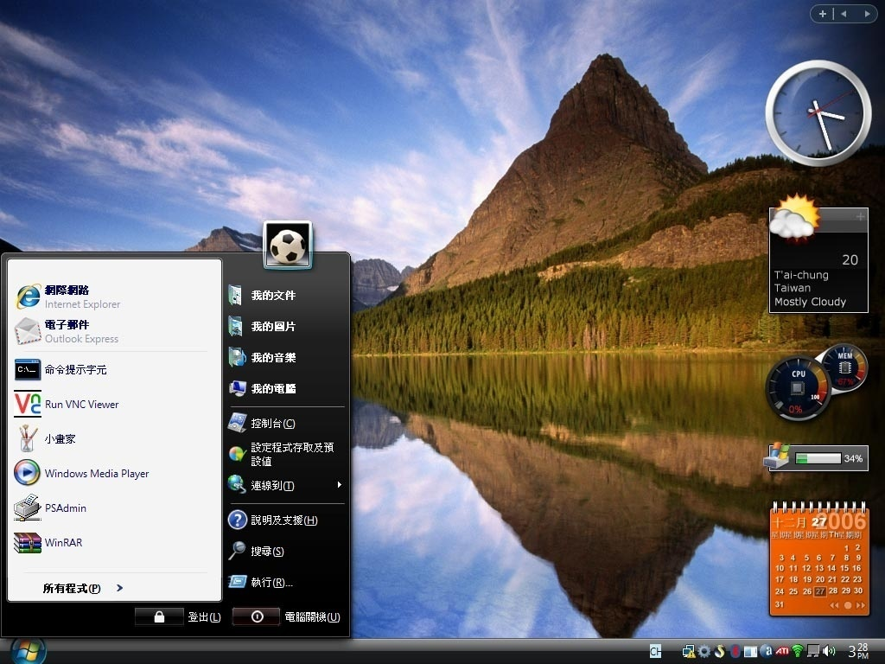
More advanced software

Slide 13
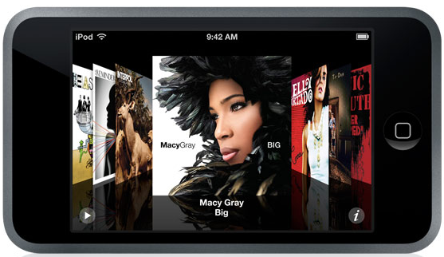
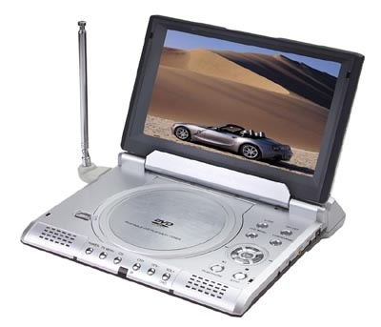
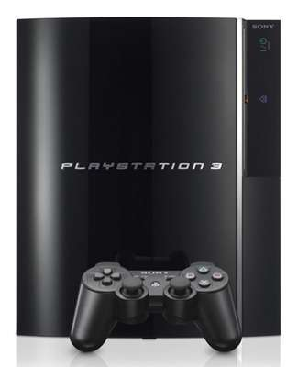
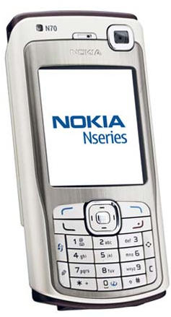
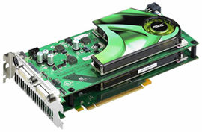
More “computers” around us

Slide 14
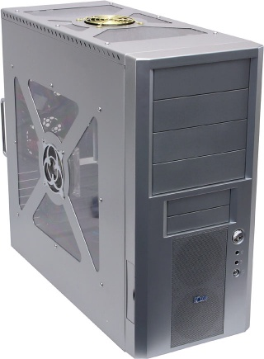
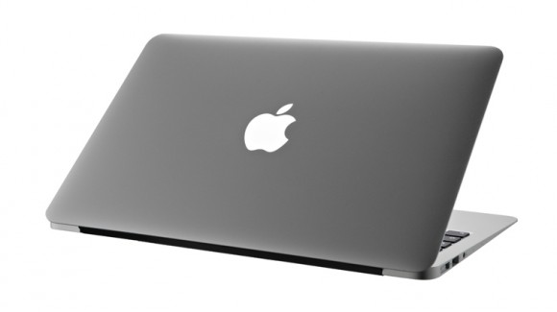
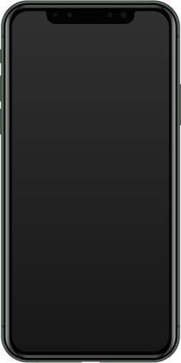
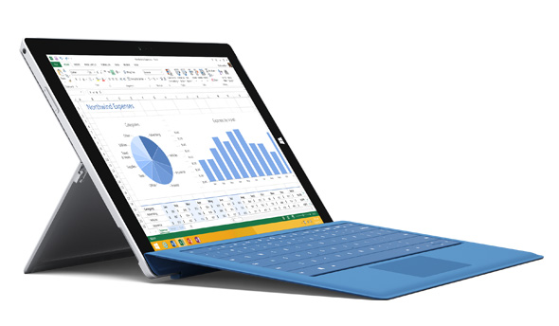
My computers
Desktop
(Intel Core i7-6700
3.4GHz, GTX960)
MacBook Pro
(Intel Core i5, 2.3GHz)
Surface Pro 4
(Intel i5-6300 2.4GHz)
iPhone 11
Pro (A13,
ARMv8.3-A)

Slide 15
The downside
“Once upon a time, every computer specialist had a gestalt understanding of how computers worked. … As modern computer technologies have become increasingly more complex, this clarity is all but lost.” Quoted from the textbook

Slide 16
How is it done?
// First Example in Programming 101
class Main {
function void main () {
do Output.printString("Hello World");
do Output.println(); // New line
return;
}
}

Slide 17
Main secret of computer science
Don’t worry about the “how”
Only about the “what”
Extremely complicated system
Information hiding
implementation
abstraction
what our programming
language promises to do

Slide 18
Main secret of computer science
Don’t worry about the “how”
But, someone has to, for example, you.

Slide 19
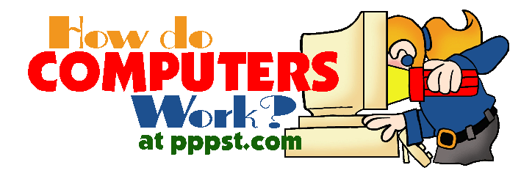
Goal of the course
“The best way to understand how computers work is to build one from scratch.” Quoted from the textbook

Slide 20
The course at a glance
Objectives:
Understand how hardware and software systems are built and how they work together
Learn how to break complex problems into simpler ones
Learn how large scale development projects are planned and executed
Have fun
Methodology:
Build a complete, general-purpose and working computer system
Play and experiment with this computer, at any level of interest

Slide 21
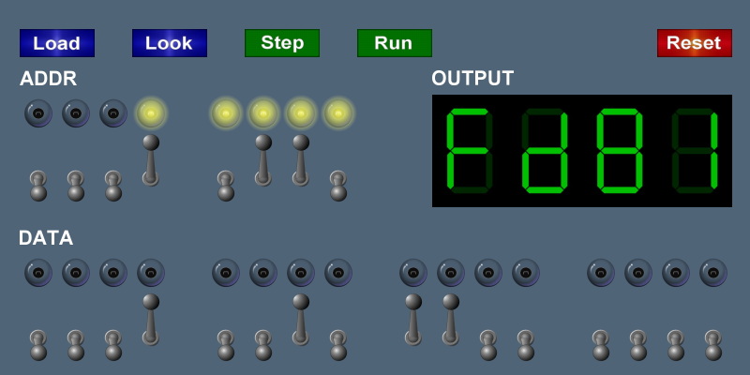
TOY machine

Slide 22
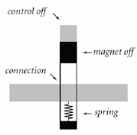
TOY machine
Starting from a simple construct

Slide 23
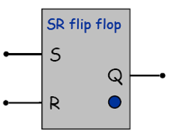
Logic gates

Slide 24
Components
Cond
Eval
Registers
W Data
PC
Memory
IR
A Data
A
L
U
Addr
op
B Data
d
W Addr
R Data
A Addr
s
+
W Data
t
B Addr
1
W
W

Slide 25
Toy machine
Cond
Eval
=0
Registers
>0
10
01
00
W Data
Memory
2
A Data
A
L
U
PC
IR
1
0
1
0
Addr
op
4
0
1
B Data
d
W Addr
5
R Data
1
0
A Addr
s
+
W Data
t
B Addr
1
W
W
1-bit
counter
Opcode
Execute
Control
Fetch
Clock
Clock

Slide 26
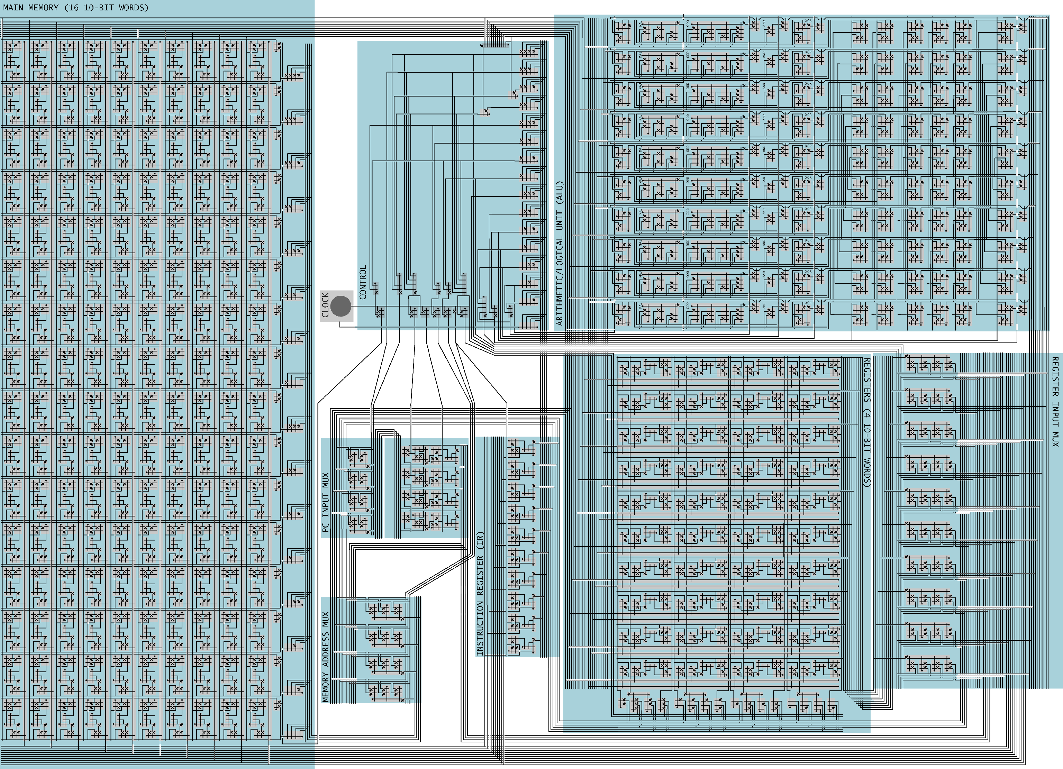
TOY machine
Almost as good as any computers

Slide 27
TOY machine
int A[32];
i=0;
Do {
RD=stdin;
if (RD==0) break;
A[i]=RD;
i=i+1;
} while (1);
printr();
A DUP 32
lda R1, 1
lda RA, A
lda RC, 0
read ld RD, 0xFF
bz RD, exit
add R2, RA, RC
sti RD, R2
add RC, RC, R1
bz R0, read
exit jl RF, printr
hlt
10: C020
20: 7101
21: 7A00
22: 7C00
23: 8DFF
24: CD29
25: 12AC
26: BD02
27: 1CC1
28: C023
29: FF2B
2A: 0000

Slide 28
TOY machine

Slide 29
From NAND to Tetris
The elements of computing systems
Courses
Software
Cool stuffs

Slide 30
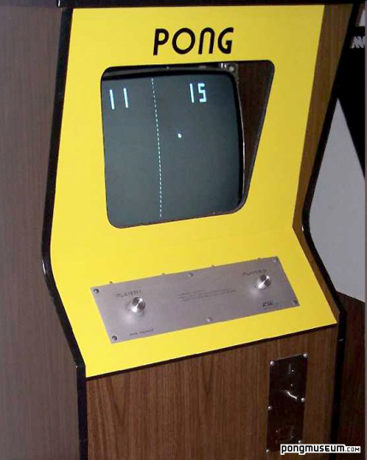
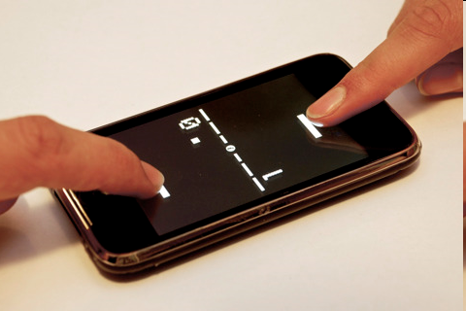
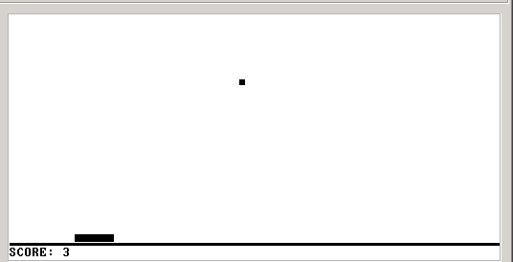
Pong on the Hack computer
Pong, 1985
Pong, 2011
Pong, on our computer

Slide 31
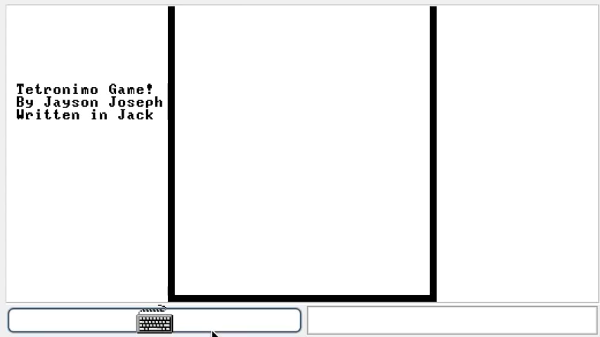
Sample projects

Slide 32
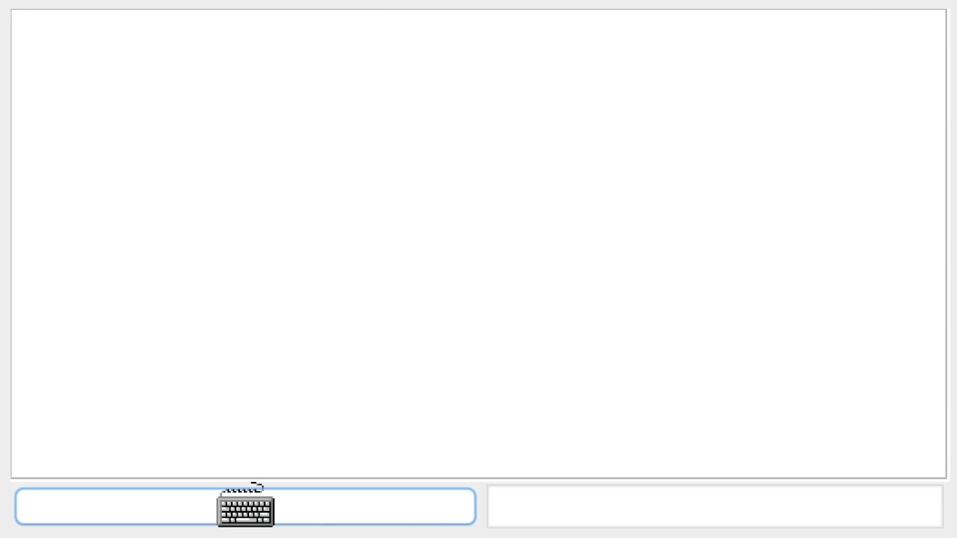
Sample projects

Slide 33
Theme and structure of the book
Human
Abstract design
Software
Thought
abstract interface
hierarchy
Chapters 9, 12
H.L. Language
Compiler
&
abstract interface
Operating Sys.
Chapters 10 - 11
Virtual
VM Translator
Machine
abstract interface
Chapters 7 - 8
Assembly
Language
Assembler
Chapter 6
abstract interface
Computer
Machine
Architecture
Language
abstract interface
Chapters 4 - 5
Gate Logic
Hardware
abstract interface
Platform
Chapters 1 - 3
Electrical
Hardware
Chips &
Engineering
Logic Gates
Physics
hierarchy
(Abstraction–implementation paradigm)

Slide 34
Application level: Pong (an example)

Slide 35
The big picture
Human
Abstract design
Software
Thought
abstract interface
hierarchy
Chapters 9, 12
H.L. Language
Compiler
&
abstract interface
Operating Sys.
Chapters 10 - 11
Virtual
VM Translator
Machine
abstract interface
Chapters 7 - 8
Assembly
Language
Assembler
Chapter 6
abstract interface
Computer
Machine
Architecture
Language
abstract interface
Chapters 4 - 5
Gate Logic
Hardware
abstract interface
Platform
Chapters 1 - 3
Electrical
Hardware
Chips &
Engineering
Logic Gates
Physics
hierarchy

Slide 36
High-level programming (Jack language)
/** A Graphic Bat for a Pong Game */
class Bat {
field int x, y; // screen location of the bat's top-left corner
field int width, height; // bat's width & height
// The class constructor and most of the class methods are omitted
/** Draws (color=true) or erases (color=false) the bat */
method void draw(boolean color) {
do Screen.setColor(color);
do Screen.drawRectangle(x,y,x+width,y+height);
return;
}
/** Moves the bat one step (4 pixels) to the right. */
method void moveR() {
do draw(false); // erase the bat at the current location
let x = x + 4; // change the bat's X-location
// but don't go beyond the screen's right border
if ((x + width) > 511) {
let x = 511 - width;
}
do draw(true); // re-draw the bat in the new location
return;
}
}
Typical call to an OS method

Slide 37
Operating system level (Jack OS)
/** An OS-level screen driver that abstracts the computer's physical screen */
class Screen {
static boolean currentColor; // the current color
// The Screen class is a collection of methods, each implementing one
// abstract screen-oriented operation. Most of this code is omitted.
/** Draws a rectangle in the current color. */
// the rectangle's top left corner is anchored at screen location (x0,y0)
// and its width and length are x1 and y1, respectively.
function void drawRectangle(int x0, int y0, int x1, int y1) {
var int x, y;
let x = x0;
while (x < x1) {
let y = y0;
while(y < y1) {
do Screen.drawPixel(x,y);
let y = y+1;
}
let x = x+1;
}
}
}

Slide 38
The big picture
Human
Abstract design
Software
Thought
abstract interface
hierarchy
Chapters 9, 12
H.L. Language
Compiler
&
abstract interface
Operating Sys.
Chapters 10 - 11
Virtual
VM Translator
Machine
abstract interface
Chapters 7 - 8
Assembly
Language
Assembler
Chapter 6
abstract interface
Computer
Machine
Architecture
Language
abstract interface
Chapters 4 - 5
Gate Logic
Hardware
abstract interface
Platform
Chapters 1 - 3
Electrical
Hardware
Chips &
Engineering
Logic Gates
Physics
hierarchy

Slide 39
A modern compilation model

Slide 40
Compilation 101
Intermediate code
push x
push width
add
push 511
gt
Source code
parsing
Code
generation
(x + width) > 511
Abstraction
Syntax
Analysis
Parse
Tree
Semantic
Synthesis
Implementation
Observations:
Modularity
Abstraction / implementation interplay
The implementation uses abstract services from the level below.

Slide 41
The virtual machine (VM modeled after JVM)
if ((x+width)>511) {
let x=511-width;
}

Slide 42
The big picture
Human
Abstract design
Software
Thought
abstract interface
hierarchy
Chapters 9, 12
H.L. Language
Compiler
&
abstract interface
Operating Sys.
Chapters 10 - 11
Virtual
VM Translator
Machine
abstract interface
Chapters 7 - 8
Assembly
Language
Assembler
Chapter 6
abstract interface
Computer
Machine
Architecture
Language
abstract interface
Chapters 4 - 5
Gate Logic
Hardware
abstract interface
Platform
Chapters 1 - 3
Electrical
Hardware
Chips &
Engineering
Logic Gates
Physics
hierarchy

Slide 43
Low-level programming (on Hack)

Slide 44
Low-level programming (on Hack)

Slide 45
Low-level programming (on Hack)

Slide 46
The big picture
Human
Abstract design
Software
Thought
abstract interface
hierarchy
Chapters 9, 12
H.L. Language
Compiler
&
abstract interface
Operating Sys.
Chapters 10 - 11
Virtual
VM Translator
Machine
abstract interface
Chapters 7 - 8
Assembly
Language
Assembler
Chapter 6
abstract interface
Computer
Machine
Architecture
Language
abstract interface
Chapters 4 - 5
Gate Logic
Hardware
abstract interface
Platform
Chapters 1 - 3
Electrical
Hardware
Chips &
Engineering
Logic Gates
Physics
hierarchy

Slide 47
Machine language semantics (Hack)
Code semantics, as interpreted by the Hack hardware platform
Instruction code
Address
(0=“address” inst.)
Code syntax
0
0 0 0 0 0 0 0 0 0 0 0 0 0 0 0
0000000000000000
@0
1111110111001000
M=M-1
1
1 1
1 1 1 0 1 1 1
0 0 1
0 0 0
Instruction code
ALU
Destination
Jump
(1=“compute” inst.)
operation code
Code
Code
(
M-1
)
(
M
)
(
no jump
)
We need a hardware architecture that realizes this semantics
The hardware platform should be designed to:
  Parse instructions, and
  Execute them.

Slide 48
Computer architecture (Hack)
A typical Von Neumann machine

Slide 49
The big picture
Human
Abstract design
Software
Thought
abstract interface
hierarchy
Chapters 9, 12
H.L. Language
Compiler
&
abstract interface
Operating Sys.
Chapters 10 - 11
Virtual
VM Translator
Machine
abstract interface
Chapters 7 - 8
Assembly
Language
Assembler
Chapter 6
abstract interface
Computer
Machine
Architecture
Language
abstract interface
Chapters 4 - 5
Gate Logic
Hardware
abstract interface
Platform
Chapters 1 - 3
Electrical
Hardware
Chips &
Engineering
Logic Gates
Physics
hierarchy

Slide 50
Logic design
Combinational logic (leading to an ALU)
Sequential logic (leading to a RAM)
Putting the whole thing together (leading to a computer)
Using … gate logic

Slide 51
Gate logic
Hardware platform = inter-connected set of chips
Chips are made of simpler chips, all the way down to elemantary logic gates
Logic gate = hardware element that implements a certain Boolean function
Every chip and gate has an interface, specifying WHAT it is doing, and an implementation, specifying HOW it is doing it.
Interface
Implementation

Slide 52
Hardware description language (HDL)

Slide 53
The tour ends:
Interface
One implementation option (CMOS)

Slide 54
The tour map, revisited
Human
Abstract design
Compiler
Software
Thought
abstract interface
hierarchy
Chapters 9, 12
H.L. Language
Compiler
&
abstract interface
Operating Sys.
Chapters 10 - 11
Virtual
VM Translator
Machine
abstract interface
Operating System
Chapters 7 - 8
Assembly
Course overview:
Building this world,
from the ground up
Language
Assembler
Chapter 6
abstract interface
Computer
Machine
Architecture
Language
abstract interface
Chapters 4 - 5
Gate Logic
Computer Architecture
Hardware
abstract interface
Platform
Chapters 1 - 3
Electrical
Hardware
Chips &
Engineering
Logic Gates
Physics
hierarchy
Digital System Design
Electronics

Slide 55
What you will learn
Number systems
Combinational logic
Sequential logic
Basic principle of computer architecture
Assembler
Virtual machine
High-level language
Fundamentals of compilers
Basic operating system
Application programming

Slide 56
In short

