Slide 1
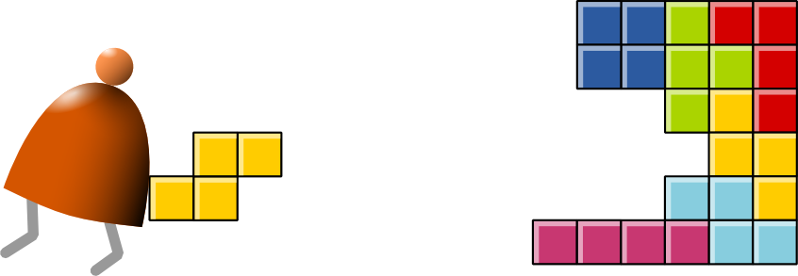
Computer Architecture
Building a Modern Computer From First Principles
www.nand2tetris.org
Notes:
1

Slide 2
Where we are at:
Human
Abstract design
Software
Thought
abstract interface
hierarchy
Chapters 9, 12
H.L. Language
Compiler
&
abstract interface
Operating Sys.
Chapters 10 - 11
Virtual
VM Translator
Machine
abstract interface
Chapters 7 - 8
Assembly
Language
Assembler
Chapter 6
abstract interface
Computer
Machine
Architecture
Language
abstract interface
Chapters 4 - 5
Gate Logic
Hardware
abstract interface
Platform
Chapters 1 - 3
Electrical
Hardware
Chips &
Engineering
Logic Gates
Physics
hierarchy

Slide 3
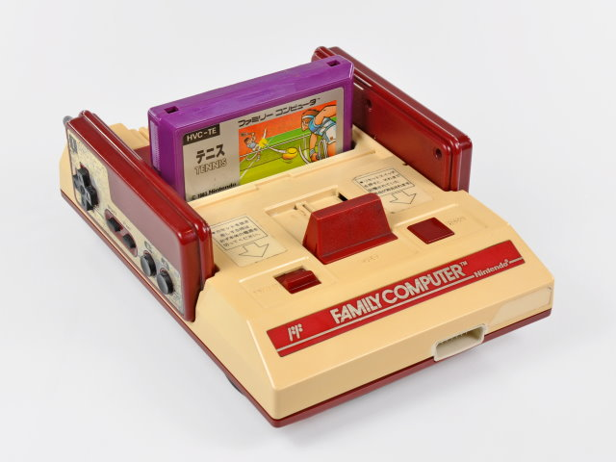
The Hack computer
A 16-bit machine consisting of the following elements:
The program is stored in a ROM.

Slide 4
The A-instruction
symbolic
binary
@value
0value
value is a non-negative decimal number <= 2¹⁵-1 or
A symbol referring to such a constant
value is a 15-bit binary number
Example
@21
0000 0000 0001 0101

Slide 5
The C-instruction
symbolic
binary
dest = comp ; jump
111A C₁C₂C₃C₄ C₅C₆ D₁D₂ D₃J₁J₂J₃
]
comp
dest
jump
not used
opcode

Slide 6
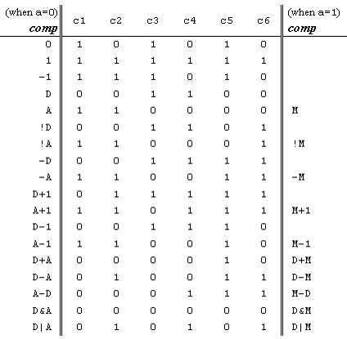

The C-instruction
111A C₁C₂C₃C₄ C₅C₆ D₁D₂ D₃J₁J₂J₃
comp
dest
jump

Slide 7
The C-instruction
111A C₁C₂C₃C₄ C₅C₆ D₁D₂ D₃J₁J₂J₃
comp
dest
jump
A D M
dest | d | d | d | effect: the value is stored in:
null | 0 | 0 | 0 | the value is not stored
M | 0 | 0 | 1 | RAM[A]
D | 0 | 1 | 0 | D register
DM | 0 | 1 | 1 | D register and RAM[A]
A | 1 | 0 | 0 | A register
AM | 1 | 0 | 1 | A register and RAM[A]
AD | 1 | 1 | 0 | A register and D register
ADM | 1 | 1 | 1 | A register, D register, and RAM[A]

Slide 8
The C-instruction
111A C₁C₂C₃C₄ C₅C₆ D₁D₂ D₃J₁J₂J₃
comp
dest
jump
< = >
jump | j | j | j | effect:
null | 0 | 0 | 0 | no jump
JGT | 0 | 0 | 1 | if comp > 0 jump
JEQ | 0 | 1 | 0 | if comp = 0 jump
JGE | 0 | 1 | 1 | if comp ≥ 0 jump
JLT | 1 | 0 | 0 | if comp < 0 jump
JNE | 1 | 0 | 1 | if comp ≠ 0 jump
JLE | 1 | 1 | 0 | if comp ≤ 0 jump
JMP | 1 | 1 | 1 | Unconditional jump

Slide 9
Hack assembly/machine language
Source code (example)
Target code
// Computes 1+...+RAM[0]
// And stored the sum in RAM[1]
@i
M=1 // i = 1
@sum
M=0 // sum = 0
(LOOP)
@i // if i>RAM[0] goto WRITE
D=M
@R0
D=D-M
@WRITE
D;JGT
@i // sum += i
D=M
@sum
M=D+M
@i // i++
M=M+1
@LOOP // goto LOOP
0;JMP
(WRITE)
@sum
D=M
@R1
M=D // RAM[1] = the sum
(END)
@END
0;JMP
0000000000010000
1110111111001000
0000000000010001
1110101010001000
0000000000010000
1111110000010000
0000000000000000
1111010011010000
0000000000010010
1110001100000001
0000000000010000
1111110000010000
0000000000010001
1111000010001000
0000000000010000
1111110111001000
0000000000000100
1110101010000111
0000000000010001
1111110000010000
0000000000000001
1110001100001000
0000000000010110
1110101010000111
assemble
Hack assembler
or CPU emulator
assembly code v.s. machine code

Slide 10
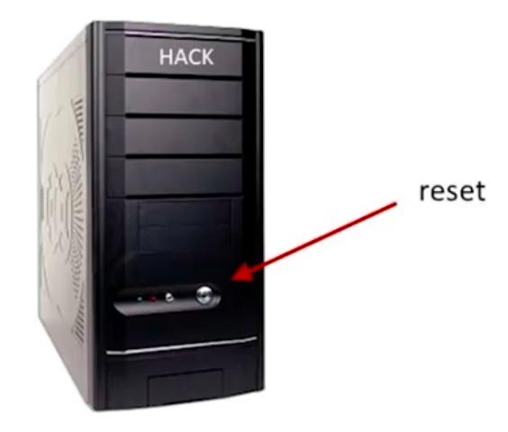
The Hack computer
A 16-bit stored program platform
The instruction memory and the data memory are physically separate
Screen: 512 rows by 256 columns, black and white
Keyboard: standard
Designed to execute programs written in the Hack machine language
Can be easily built from the chip-set that we built so far in the course
Main parts of the Hack computer:
Instruction memory (ROM)
Memory (RAM):
  Data memory
  Screen (memory map)
  Keyboard (memory map)
CPU
Computer (the logic that holds everything together).

Slide 11
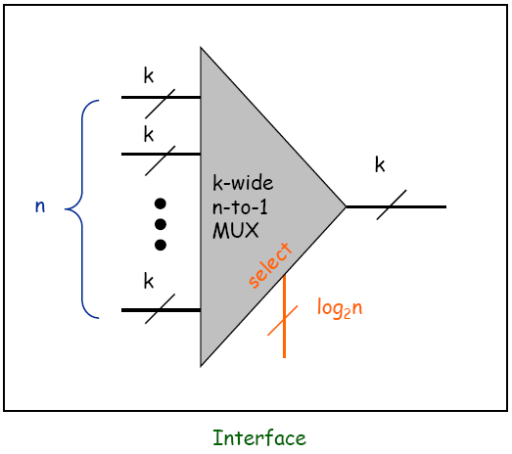
Multiplexer
Goal: select from one of n k-bit buses
  Implemented by layering k n-to-1 multiplexer

Slide 12
Hack ALU
out(x, y, control bits) =
x+y, x-y, y–x,
0, 1, -1,
x, y, -x, -y,
x!, y!,
x+1, y+1, x-1, y-1,
x&y, x|y

Slide 13
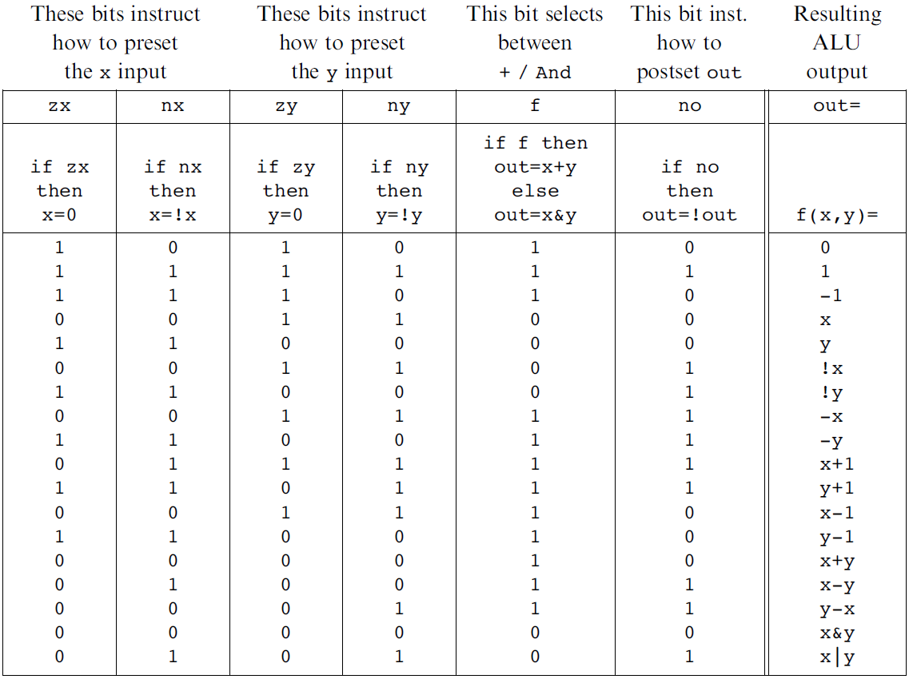
Hack ALU

Slide 14
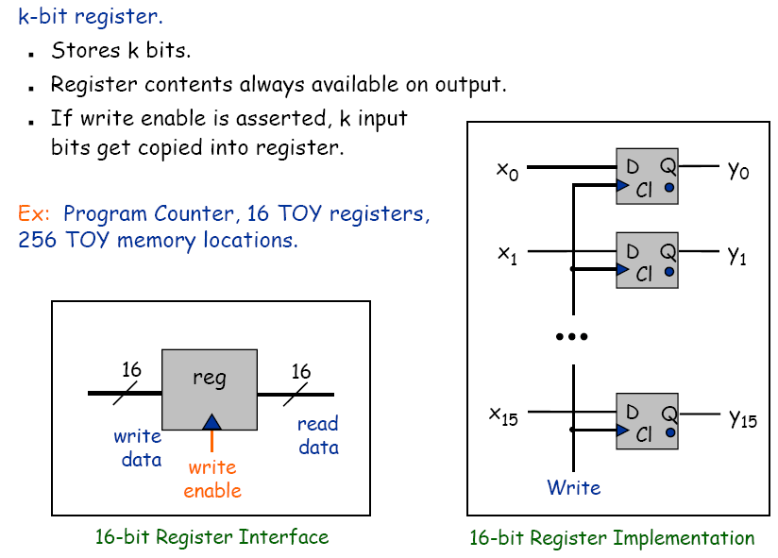
Registers

Slide 15
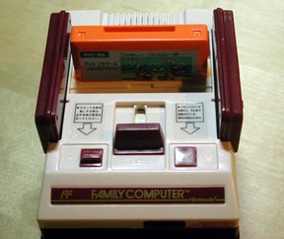
ROM (Instruction memory)
Function:
The ROM is pre-loaded with a program written in the Hack machine language
The ROM chip always emits a 16-bit number:
out = ROM32K[address]
This number is interpreted as the current instruction.

Slide 16
RAM (data memory)
We will discuss the details for Hack’s data memory later.
32K x 16
RAM
16
16
Din
Dout
addr
W
15

Slide 17


Clock
Clock.
  Fundamental abstraction: regular on-off pulse.
    on: fetch phase
    off: execute phase
  External analog device.
  Synchronizes operations of different circuit elements.
  Requirement: clock cycle longer than max switching time.
cycle time
on
Clock
off
Notes:
Clock is outside Boolean/digital logic framework. Need external source. Can wire up minute hand of Big Ben to computer. In real
computer, clock abstraction implemented using electric phenomenon like a crystal oscillator, a piezoelectric device that generates oscillating voltage
Clock is like a conductor's baton or metrononme (asssuming no ritardando = ree-tar-DAHN-doe), except that it beats at rate of millions of times per second. Note 1GHz machine cycle takes 1 billionth of a second (nanosecond). To put things in perspective, a standard light bulb switches on and off at the rate of 120 times per second! (Patt, Patel, p. 83) In that time, a computer completes around 10 million machine cycles.
Computer engineers make circuit, then crank up the clock as fast as possible until circuit no longer works. Then crank it down just a bit, and sell it. Maybe manufactures should put dial on the computer and let user crank it up until their program no longer works! To get faster computer, need to adjust wire lengths, circuit layout, change components.

Slide 18
Design a processor
How to build a processor (Hack, this time)
  Develop instruction set architecture (ISA)
    16-bit words, two types of machine instructions
  Determine major components
    ALU, registers, program counter, memory
  Determine datapath requirements
    Flow of bits
  Analyze how to implement each instruction
    Determine settings of control signals

Slide 19
Hack programming reference card
Hack commands:
A-command: @value // A<-value; M=RAM[A]
C-command: dest = comp ; jump // dest = and ;jump
// are optional
Where:
comp =
0 , 1 , -1 , D , A , !D , !A , -D , -A , D+1 , A+1 , D-1, A-1 , D+A , D-A , A-D , D&A , D|A,
M , !M , -M , M+1, M-1 , D+M, D-M, M-D, D&M, D|M
dest = M, D, A, MD, AM, AD, AMD, or null
jump = JGT , JEQ , JGE , JLT , JNE , JLE , JMP, or null
In the command dest = comp; jump, the jump materialzes (PC<-A) if (comp jump 0) is true. For example, in D=D+1,JLT, we jump if D+1 < 0.

Slide 20
Fetch and execute
  In Toy, we have two phases: fetch and execution .
  We use two cycles since fetch and execute phases each access memory and alter program counter.
    fetch [set memory address from pc]
    fetch and clock [write instruction to IR]
    execute [set ALU inputs from registers]
    execute and clock [write result of ALU to registers]
Phase 2
fetch & clock
Phase 4
execute & clock
Fetch
Phase 1
fetch
Phase 3
execute
Fetch
Execute
Clock
20

Slide 21
Toy architecture
Cond
Eval
Registers
10
01
00
W Data
Memory
IR
2
A Data
A
L
U
PC
1
0
1
0
Addr
op
0
1
B Data
d
W Addr
5
R Data
1
0
A Addr
s
+
W Data
t
B Addr
1
W
W
  Both fetch and execute would access memory. To avoid conflict, we add a MUX. Similar for PC.
  In addition, we need a register IR to store the instruction.

Slide 22
Fetch and execute
  In Hack, we avoid two cycles and IR by using two separate memory chips, one for data and the other for instruction.
22

Slide 23
Design a processor
How to build a processor (Hack, this time)
  Develop instruction set architecture (ISA)
    16-bit words, two types of machine instructions
  Determine major components
    ALU, registers, program counter, memory
  Determine datapath requirements
    Flow of bits
  Analyze how to implement each instruction
    Determine settings of control signals

Slide 24
Program counter
Program counter emits the address of the next instruction.
  To start/restart the program execution: PC=0
  No jump: PC++
  Unconditional jump: PC=A
  Conditional jump: if (cond.) PC=A else PC++
Program counter
(PC)
Din
Dout
15
15
reset
W
Note that the design is slightly different from your project #3.

Slide 25
Program counter
if (reset) PC=0
else if (W) PC=Din
else PC++

Slide 26
Program counter
if (reset) PC=0
else if (W) PC=Din
else PC++
+
0
1
1
Din
0
1
15-bit register
Dout
0
W
W
reset

Slide 27
Hack architecture (component)
CPU
PC
reset
W
ROM
zr
ng
RAM
D
x
W
Dout
A
L
U
Din
Dout
A
W
y
addr
addr
W
Clock

Slide 28
Design a processor
How to build a processor (Hack, this time)
  Develop instruction set architecture (ISA)
    16-bit words, two types of machine instructions
  Determine major components
    ALU, registers, program counter, memory
  Determine datapath requirements
    Flow of bits
  Analyze how to implement each instruction
    Determine settings of control signals

Slide 29
Hack architecture (data path)
CPU
PC
reset
W
ROM
zr
ng
RAM
D
x
W
Dout
A
L
U
Din
Dout
A
W
y
addr
addr
W
Fetch: instruction=ROM[PC]
@value // A<-value; M=RAM[A]
[ADM] = x op y; jump // x=D; y=A or M; if jump then PC<-A

Slide 30
Hack architecture (data path)
CPU
PC
reset
W
ROM
zr
ng
RAM
D
x
W
Dout
A
L
U
Din
Dout
0
1
A
W
0
1
y
addr
addr
W
Fetch: instruction=ROM[PC]
@value // A<-value; M=RAM[A]
[ADM] = x op y; jump // x=D; y=A or M; if jump then PC<-A

Slide 31
Design a processor
How to build a processor (Hack, this time)
  Develop instruction set architecture (ISA)
    16-bit words, two types of machine instructions
  Determine major components
    ALU, registers, program counter, memory
  Determine datapath requirements
    Flow of bits
  Analyze how to implement each instruction
    Determine settings of control signals

Slide 32
Hack architecture (data path)
CPU
PC
reset
W
ROM
zr
ng
RAM
D
x
W
Dout
A
L
U
Din
Dout
0
1
A
W
0
1
y
addr
addr
W

Slide 33
Hack architecture (control)
CPU
PC
reset
W
R_PC
W_PC
ROM
zr
ng
RAM
D
x
W
Dout
W_D
A
L
U
Din
Dout
0
1
A
W
0
1
y
addr
6
addr
W
MUX_A
W_A
MUX_ALU
OP_ALU
writeM
A total of 13 control signals

Slide 34
Hack architecture (control)
CPU
PC
reset
W
R_PC
W_PC
ROM
zr
ng
RAM
D
x
W
control
A
L
U
Dout
W_D
Din
Dout
0
1
A
W
0
1
y
addr
6
addr
W
MUX_A
W_A
MUX_ALU
OP_ALU
writeM

Slide 35
Hack architecture (control)
CPU
PC
reset
W
R_PC
W_PC
ROM
zr
ng
RAM
D
x
W
control
A
L
U
Dout
W_D
Din
Dout
0
1
A
W
0
1
y
addr
6
addr
W
MUX_A
W_A
MUX_ALU
OP_ALU
writeM

Slide 36
Hack architecture (control)
CPU
PC
reset
W
ROM
zr
ng
RAM
D
x
W
control
A
L
U
Dout
Din
Dout
0
1
A
W
0
1
y
addr
6
addr
W

Slide 37
Hack architecture (control)
CPU
PC
reset
W
reset
ROM
zr
ng
RAM
D
x
W
control
A
L
U
Dout
Din
Dout
0
1
A
W
0
1
y
addr
6
addr
W

Slide 38
Hack architecture (control)
CPU
PC
reset
W
reset
R_PC
W_PC
zr
ng
zr
ng
ROM
RAM
D
x
W
control
A
L
U
Dout
instruction
W_D
Din
Dout
0
1
A
W
0
1
y
addr
6
addr
W
MUX_A
W_A
MUX_ALU
OP_ALU
writeM

Slide 39
Hack architecture (control)
Inputs: instruction, zr, ng
  instruction
Outputs:
  OP_ALU = C₁C₂C₃C₄C₅C₆
  MUX_A =
  MUX_ALU = A
  W_A = ( & D₁) +
  W_D = & D₂
  writeM = & D₃
  W_PC = & ( (J₁&ng) + (J₂&zr) + (J₃&gt) ); gt = ng & zr
I
I
15
14..0
0 value
111A C₁C₂C₃C₄ C₅C₆ D₁D₂ D₃J₁J₂J₃
I
15
I
I
15
15
I
15
I
15
I
15

Slide 40
Hack architecture (trace @10 / D=M+1;JGE )
CPU
PC
reset
W
reset
R_PC
W_PC
zr
ng
zr
ng
ROM
RAM
D
x
W
control
A
L
U
Dout
instruction
W_D
Din
Dout
0
1
A
W
0
1
y
addr
6
addr
W
MUX_A
W_A
MUX_ALU
OP_ALU
writeM

Slide 41
Hack architecture (CPU interface)
CPU
PC
PC
reset
W
reset
zr
ng
zr
ng
ROM
RAM
D
x
W
control
A
L
U
Dout
instruction
outM
Din
Dout
0
1
A
W
0
1
y
inM
addr
addr
W
addressM
writeM

Slide 42
Hack architecture (CPU interface)
CPU
PC
PC
reset
W
reset
zr
ng
zr
ng
ROM
RAM
D
x
W
control
A
L
U
Dout
instruction
outM
Din
Dout
0
1
A
W
0
1
y
inM
addr
addr
W
addressM
writeM

Slide 43
Hack CPU

Slide 44
Control (focus on the yellow chips only)
D register
D
a-bit
A
ALU
A register
A/M
Mux
address
input
RAM
(selected register)
M
In the Hack architecture:
ROM = instruction memory
Program = sequence of 16-bit
numbers, starting at
ROM[0]
Current instruction = ROM[PC]
To select instruction n from the ROM, we set A to n, using the instruction @n
address
input
ROM
(selected register)
Instruction
PC

Slide 45
Side note (focus on the yellow chip parts only)
D register
D
a-bit
A
ALU
A register
A/M
Mux
address
input
RAM
(selected register)
M
In the Hack architecture, the A register could address both the RAM and the ROM, simultaneously. Therefore:
Command pairs like @addr followed by D=M;someJumpDirective make no sense
Best practice: in well-written Hack programs, a C-instruction should contain
  either a reference to M, or
  a jump directive,
but not both.
address
input
ROM
(selected register)
Instruction
PC
Notes:
45

Slide 46
The Hack computer (put together)
A 16-bit machine consisting of the following elements:
Both memory chips are 16-bit wide and have 15-bit address space.

Slide 47
RAM (data memory)
The RAM used in Hack is different from a normal RAM. It also plays the role for I/O.
Programmers usually use high-level library for I/O, such as printf, drawline.
But, at low-level, we usually need to manipulate bits directly for I/O.
RAM
16
16
Din
Dout
addr
W
15

Slide 48
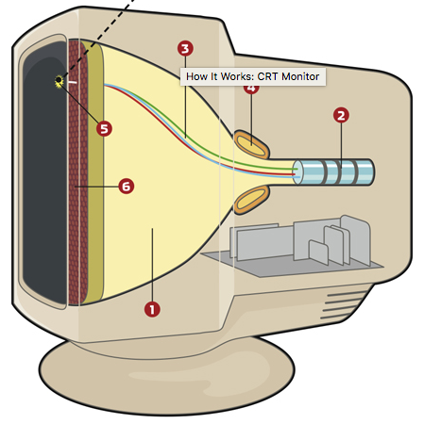
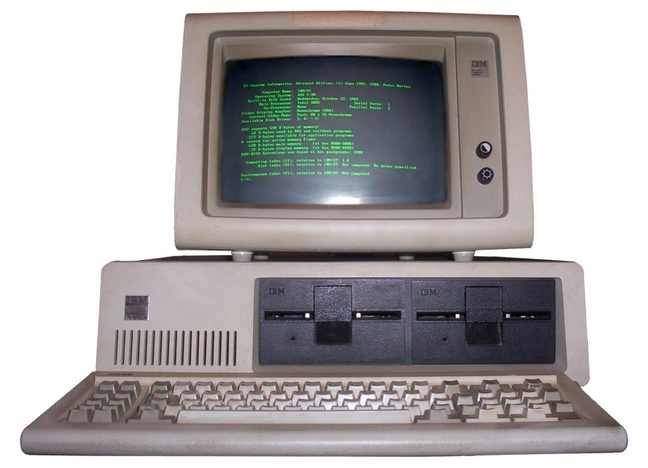
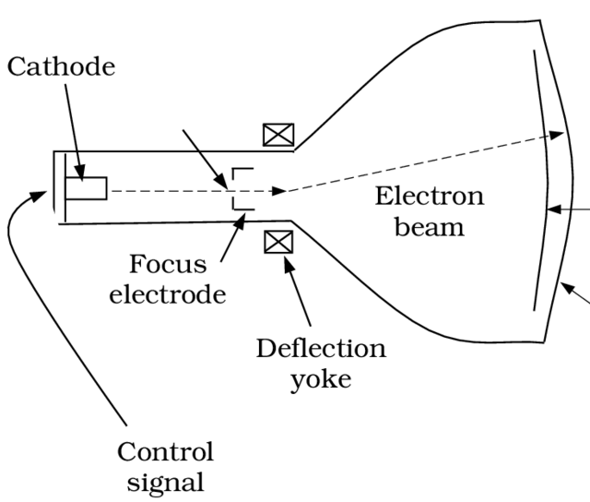
Displays
CRT displays
  resolution
  refresh rate

Slide 49
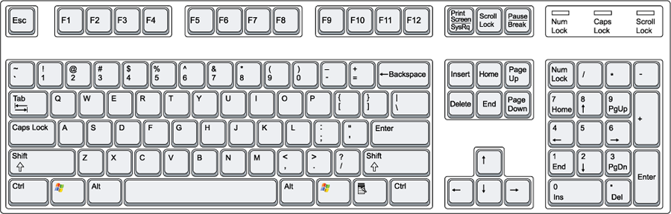
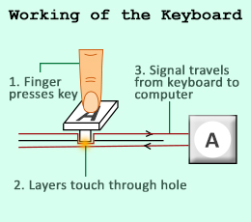
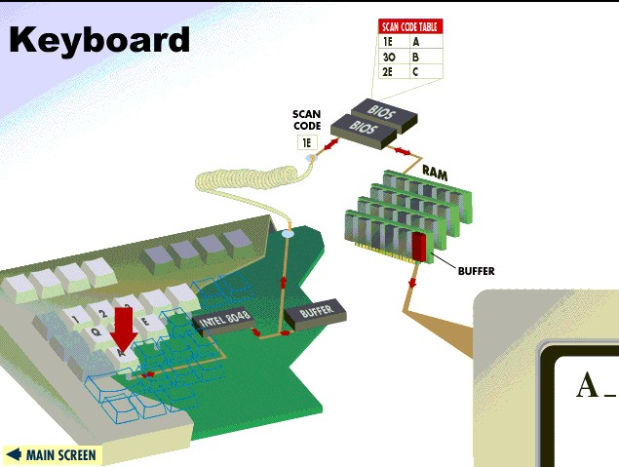
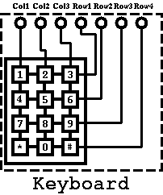
keyboard

Slide 50
Memory: conceptual / programmer’s view
Memory
Data
Screen memory map
Screen
Keyboard map
Keyboard
Using the memory:
To record or recall values (e.g. variables, objects, arrays), use the first 16K words of the memory
To write to the screen (or read the screen), use the next 8K words of the memory
To read which key is currently pressed, use the next word of the memory.
Notes:
50

Slide 51
Memory: physical implementation
load
The Memory chip is essentially a package that integrates the three chip-parts RAM16K, Screen, and Keyboard into a single, contiguous address space.
This packaging effects the programmer’s view of the memory, as well as the necessary I/O side-effects.
Memory
0
in
16
RAM16K
(16K mem. chip)
out
16383
16
address
16384
Screen
(8K mem. chip)
15
24575
Screen
24576
Keyboard
(one register)
Keyboard
Access logic:
Access to any address from 0 to 16,383 results in accessing the RAM16K chip-part
Access to any address from 16,384 to 24,575 results in accessing the Screen chip-part
Access to address 24,576 results in accessing the keyboard chip-part
Access to any other address is invalid.
Notes:
51

Slide 52
Data memory
load
Low-level (hardware) read/write logic:
To read RAM[k]: set address to k,
probe out
To write RAM[k]=x: set address to k,
set in to x,
set load to 1,
run the clock
High-level (OS) read/write logic:
To read RAM[k]: use the OS command out = peek(k)
To write RAM[k]=x: use the OS command poke(k,x)
peek and poke are OS commands whose implementation should effect the same behavior as the low-level commands
More about peek and poke this later in the course, when we’ll write the OS.

Slide 53
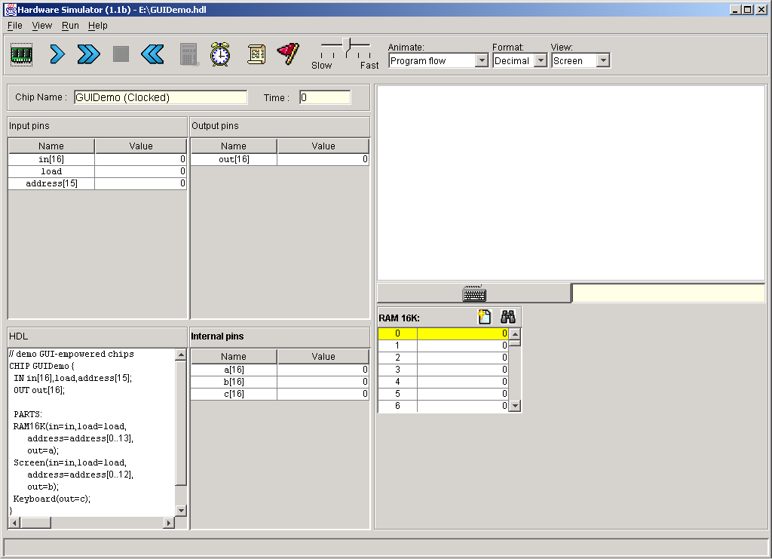
Screen
The bit contents of the Screen chip is called the “screen memory map”
Simulated screen:
In the Hack platform, the screen is implemented as an 8K 16-bit RAM chip with a side effect of refreshing.
The Screen chip has a basic RAM chip functionality:
  read logic: out = Screen[address]
  write logic: if load then Screen[address] = in
Side effect:
Continuously refreshes a 256 by 512 black-and-white screen device
The simulated 256 by 512 B&W screen
  When loaded into the hardware simulator, the built-in Screen.hdl chip opens up a screen window; the simulator then refreshes this window from the screen memory map several times each second.
Notes:
Use the hardware simulator to demo memory chip

Slide 54
Screen memory map
(16384)
refresh
To set pixel (row,col) black
word=Screen[32*row + col/16]
(RAM[16384 + 32*row + col/16])
Set the (col%16)-th bit of word to 1
Commit word to the RAM
(High-level: use the OS command drawPixel(row,col))
Notes:
1d linear array to 2d array mapping. Test real example, eg. (3, 60)

Slide 55
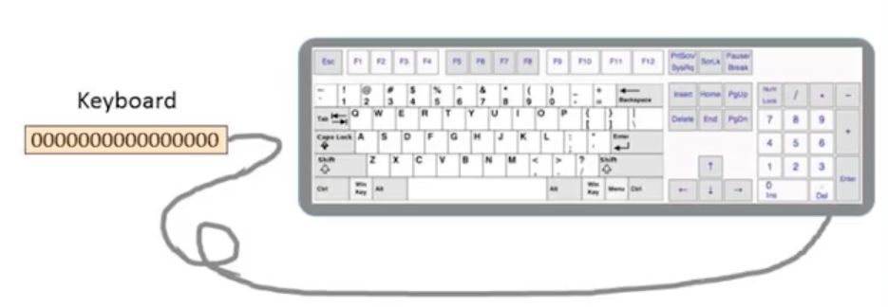
keyboard
A 16-bit register is used to keep the key stroke.
When a key is pressed on the keyboard, the key’s scan code appears in the keyboard memory map .

Slide 56
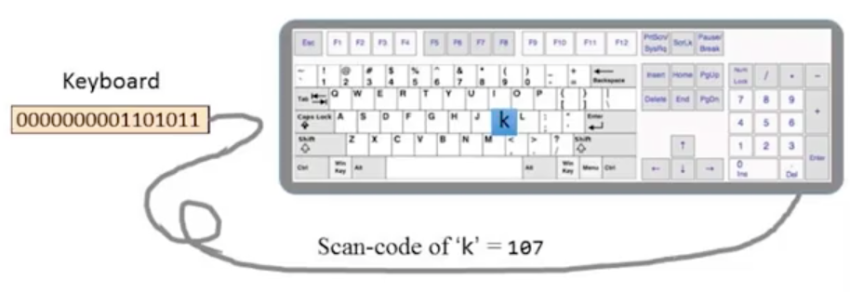
keyboard
A 16-bit register is used to keep the key stroke.
When a key is pressed on the keyboard, the key’s scan code appears in the keyboard memory map .

Slide 57
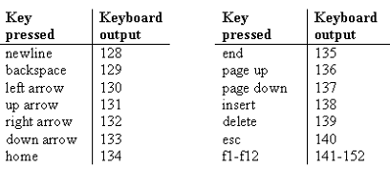
Keyboard
Simulated keyboard:
Keyboard chip: a single 16-bit register
Input: scan-code (16-bit value) of the currently
pressed key, or 0 if no key is pressed
Output: same
The simulated keyboard enabler button
Special keys:
The keyboard is implemented as a built-in Keyboard.hdl chip. When this java chip is loaded into the simulator, it connects to the regular keyboard and pipes the scan-code of the currently pressed key to the keyboard memory map.
How to read the keyboard:
Low-level (hardware): probe the contents of the Keyboard chip
High-level: use the OS command keyPressed()
(effects the same operation, discussed later in the course, when we’ll write the OS).
Notes:
Demo with Hardware simulator

Slide 58
Some scan codes
key | code
(space) | 32
! | 33
“ | 34
# | 35
$ | 36
% | 37
& | 38
‘ | 39
( | 40
) | 41
* | 42
+ | 43
, | 44
- | 45
. | 46
/ | 47
key | code
0 | 48
1 | 49
… | …
9 | 57
key | code
A | 65
B | 66
C | …
… | …
Z | 90
key | code
a | 97
b | 98
c | 99
… | …
z | 122
key | code
newline | 128
backspace | 129
left arrow | 130
up arrow | 131
right arrow | 132
down arrow | 133
home | 134
end | 135
Page up | 136
Page down | 137
insert | 138
delete | 139
esc | 140
f1 | 141
. . . | . . .
f12 | 152
: | 58
; | 59
< | 60
= | 61
> | 62
? | 63
@ | 64
[ | 91
/ | 92
] | 93
^ | 94
_ | 95
` | 96
{ | 123
| | 124
} | 125
~ | 126
(Subset of Unicode)

Slide 59
Keyboard memory map
To check which key is currently pressed:
  Probe the content of the Keyboard chip
  In the Hack computer, probe the content of RAM[24576]
  If the register contains 0, no key is pressed.

Slide 60
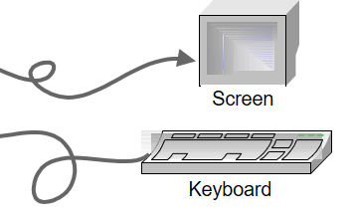
The Hack computer (put together)
A 16-bit machine consisting of the following elements:
Both memory chips are 16-bit wide and have 15-bit address space.
Screen
Keyboard

Slide 61
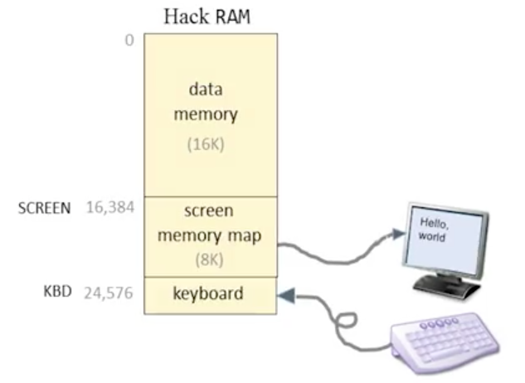
Assembly programming with I/O
Hack language convention:
SCREEN: base address of the screen memory map, 16,384.
KBD: address of the keyboard memory map, 24,576.

Slide 62
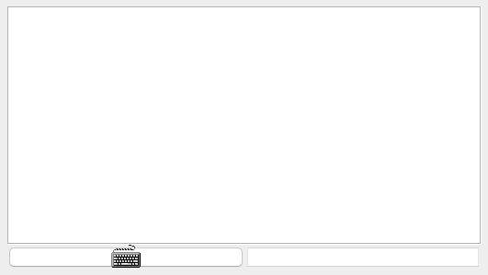
Example: draw a rectangle
Draw a filled rectangle at the upper left corner of the screen, 16 pixels wide and RAM[0] pixels long. (demo)
RAM[0] pixels long
16 pixels wide

Slide 63
Example: draw a rectangle (pseudo code)
// for (i=0; i<n; i++)
// draw 16 black pixels at the beginning of row i
addr = SCREEN
n = RAM[0]
i = 0
LOOP:
if (i>=n) goto END
RAM[addr] = -1 // 1111 1111 1111 1111
addr = addr+32 // advances to the next row
i++;
goto LOOP
END:
goto END

Slide 64
Example: draw a rectangle (assembly)
  @SCREEN
  D=A
  @addr
  M=D // addr = SCREEN
  @0
  D=M
  @n
  M=D // n = RAM[0]
  @i
  M=0 // i=0
addr = SCREEN
n = RAM[0]
i = 0
LOOP:
if (i>=n) goto END
RAM[addr] = -1
addr = addr+32
i++;
goto LOOP
END:
goto END

Slide 65
Example: draw a rectangle (assembly)
  (LOOP)
  @i
  D=M
  @n
  D=D-M
  @END
  D; JGE
  @addr
  A=M
  M=-1
addr = SCREEN
n = RAM[0]
i = 0
LOOP:
if (i>=n) goto END
RAM[addr] = -1
addr = addr+32
i++;
goto LOOP
END:
goto END

Slide 66
Example: draw a rectangle (assembly)
  (LOOP)
  @i
  D=M
  @n
  D=D-M
  @END
  D; JGE
  @addr
  A=M
  M=-1
addr = SCREEN
n = RAM[0]
i = 0
LOOP:
if (i>=n) goto END
RAM[addr] = -1
addr = addr+32
i++;
goto LOOP
END:
goto END

Slide 67
Example: draw a rectangle (assembly)
  @32
  D=A
  @addr
  M=D+M // addr = addr+32
  @i
  M=M+1 // i++
  @LOOP
  0; JMP // goto LOOP
  (END)
  @END
  0; JMP
addr = SCREEN
n = RAM[0]
i = 0
LOOP:
if (i>=n) goto END
RAM[addr] = -1
addr = addr+32
i++;
goto LOOP
END:
goto END

Slide 68
Example: draw a rectangle (assembly)
  @32
  D=A
  @addr
  M=D+M // addr = addr+32
  @i
  M=M+1 // i++
  @LOOP
  0; JMP // goto LOOP
  (END)
  @END
  0; JMP
addr = SCREEN
n = RAM[0]
i = 0
LOOP:
if (i>=n) goto END
RAM[addr] = -1
addr = addr+32
i++;
goto LOOP
END:
goto END

Slide 69
Example: draw a rectangle (assembly)
  @32
  D=A
  @addr
  M=D+M // addr = addr+32
  @i
  M=M+1 // i++
  @LOOP
  0; JMP // goto LOOP
  (END)
  @END
  0; JMP
addr = SCREEN
n = RAM[0]
i = 0
LOOP:
if (i>=n) goto END
RAM[addr] = -1
addr = addr+32
i++;
goto LOOP
END:
goto END

Slide 70
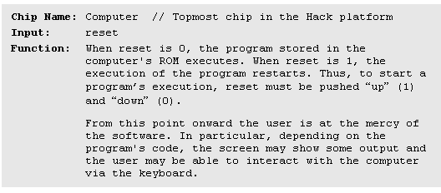
Project #5: Computer-on-a-chip interface

Slide 71
Computer-on-a-chip implementation
CHIP Computer {
IN reset;
PARTS:
// implementation missing
}
Implementation:
  You need to implement Memory and CPU first.
  Simple, the chip-parts do all the hard work.

Slide 72
Perspective: from here to a “real” computer
Caching
More I/O units
Special-purpose processors (I/O, graphics, communications, …)
Multi-core / parallelism
Efficiency
Energy consumption considerations
And more ...

