Slide 1
Boolean logic
Introduction to Computer
Yung-Yu Chuang
with slides by Sedgewick & Wayne (introcs.cs.princeton.edu), Nisan & Schocken (www.nand2tetris.org) and Harris & Harris (DDCA)

Slide 2
Boolean Algebra
Based on symbolic logic, designed by George Boole
Boolean variables take values as 0 or 1.
Boolean expressions created from:
  NOT, AND, OR
George Boole
1815 - 1864

Slide 3
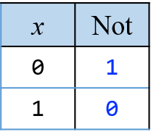
NOT
¬
X
X
X’
Digital gate diagram for NOT:

Slide 4
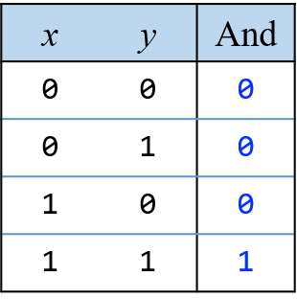
AND
X∧Y
X⋅Y
XY
Digital gate diagram for AND:

Slide 5
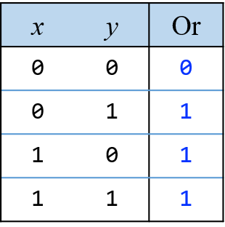
OR
X∨Y
X+Y
Digital gate diagram for OR:

Slide 6
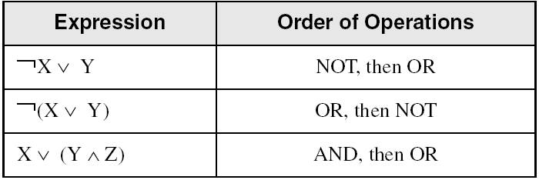
Operator Precedence
Examples showing the order of operations: NOT > AND > OR
Use parentheses to avoid ambiguity

Slide 7
Defining a function
Description: square of x minus 1
Algebraic form : x²-1
Enumeration:
x | f(x)
1 | 0
2 | 3
3 | 8
4 | 15
5 | 24
: | :

Slide 8
Defining a function
Description: number of days of the x-th month of a non-leap year
Algebraic form: ?
Enumeration:
x | f(x)
1 | 31
2 | 28
3 | 31
4 | 30
5 | 31
6 | 30
7 | 31
8 | 31
9 | 30
10 | 31
11 | 30
12 | 31

Slide 9
Truth Table
Truth table.
  Systematic method to describe Boolean function.
  One row for each possible input combination.
  N inputs ⇒ 2^{N} rows.
x
y
x y
0
0
0
0
1
0
1
0
0
1
1
1
AND truth table
Notes:
this is one Boolean function of two inputs. A systematic way to enumerate all input combinations is to count in binary.

Slide 10
Proving the equivalence of two functions
Prove that x²-1=(x+1)(x-1)
Using algebra: (you need to follow some rules)
(x+1)(x-1) = x²+x-x-1= x²-1
Using enumeration:
x | (x+1)(x-1) | x²-1
1 | 0 | 0
2 | 3 | 3
3 | 8 | 8
4 | 15 | 15
5 | 24 | 24
: | : | :

Slide 11
Important laws
x + 1 = 1
x + 0 = x
x + x = 1
x．1 = x
x．0 = 0
x．x = 0
DeMorgan Law
x．y = x + y
x + y = y + x
x + (y+z) = (x+y) + z
x．y = y．x
x．(y．z) = (x．y)．z
x．(y+z) = xy + xz

Slide 12
Simplifying Boolean expressions
Example 1
Y = AB + AB

Slide 13
Simplifying Boolean expressions
Example 1
Y = AB + AB
= B(A + A)
= B(1)
= B

Slide 14
Simplifying Boolean expressions
Example 2
Y = A(AB + ABC)

Slide 15
Simplifying Boolean expressions
Example 2
Y = A(AB + ABC)
= A(AB(1 + C))
= A(AB(1))
= A(AB)
= (AA)B
= AB

Slide 16
DeMorgan’s Theorem
Y = AB = A + B
Y = A + B = A B

Slide 17
Bubble pushing
Backward:
  Body changes
  Adds bubbles to inputs
Forward:
  Body changes
  Adds bubble to output

Slide 18
Bubble pushing
What is the Boolean expression for this circuit?

Slide 19
Bubble pushing
What is the Boolean expression for this circuit?
Y = AB + CD

Slide 20
Bubble pushing rules
Begin at output, then work toward inputs
Push bubbles on final output back
Draw gates in a form so bubbles cancel

Slide 21
Bubble pushing example

Slide 22
Bubble pushing example

Slide 23
Bubble pushing example

Slide 24
Bubble pushing example

Slide 25
Truth Tables
A Boolean function has one or more Boolean inputs, and returns a single Boolean output.
A truth table shows all the inputs and outputs of a Boolean function
x | y | ¬x ∨ y
0 | 0
0 | 1
1 | 0
1 | 1
Example: ¬x ∨ y

Slide 26
Truth Tables
A Boolean function has one or more Boolean inputs, and returns a single Boolean output.
A truth table shows all the inputs and outputs of a Boolean function
x | y | ¬x | ¬x ∨ y
0 | 0
0 | 1
1 | 0
1 | 1
Example: ¬x ∨ y

Slide 27
Truth Tables
A Boolean function has one or more Boolean inputs, and returns a single Boolean output.
A truth table shows all the inputs and outputs of a Boolean function
x | y | ¬x | ¬x ∨ y
0 | 0 | 1 | 1
0 | 1 | 1 | 1
1 | 0 | 0 | 0
1 | 1 | 0 | 1
Example: ¬x ∨ y

Slide 28
Truth Tables
Example: X ∧ ¬Y
x | y | ¬y | x∧¬y
0 | 0
0 | 1
1 | 0
1 | 1

Slide 29
Truth Tables
Example: X ∧ ¬Y
x | y | ¬y | x∧¬y
0 | 0 | 1 | 0
0 | 1 | 0 | 0
1 | 0 | 1 | 1
1 | 1 | 0 | 0

Slide 30
Truth Tables (3 of 3)
When S=0, return X; otherwise, return Y.
Example: (Y ∧ S) ∨ (X ∧ ¬S)
Two-input multiplexer
S | X | Y | Y∧S | ¬S | X∧¬S | (Y ∧ S) ∨ (X ∧ ¬S)
0 | 0 | 0
0 | 0 | 1
0 | 1 | 0
0 | 1 | 1
1 | 0 | 0
1 | 0 | 1
1 | 1 | 0
1 | 1 | 1

Slide 31
Truth Tables (3 of 3)
When S=0, return X; otherwise, return Y.
Example: (Y ∧ S) ∨ (X ∧ ¬S)
Two-input multiplexer
S | X | Y | Y∧S | ¬S | X∧¬S | (Y ∧ S) ∨ (X ∧ ¬S)
0 | 0 | 0 | 0 | 1 | 0 | 0
0 | 0 | 1 | 0 | 1 | 0 | 0
0 | 1 | 0 | 0 | 1 | 1 | 1
0 | 1 | 1 | 0 | 1 | 1 | 1
1 | 0 | 0 | 0 | 0 | 0 | 0
1 | 0 | 1 | 1 | 0 | 0 | 1
1 | 1 | 0 | 0 | 0 | 0 | 0
1 | 1 | 1 | 1 | 0 | 0 | 1

Slide 32
Truth Table for Functions of 2 Variables
2 variables lead to four possible combinations
A 2-variable function f has to define four values
x
y
f
0
0
V₀₀
0
1
V₀₁
1
0
V₁₀
1
1
V₁₁

Slide 33
Truth Table for Functions of 2 Variables
Truth table.
  16 Boolean functions of 2 variables.
every 4-bit value represents one
x
y
ZERO
AND
x
y
XOR
OR
0
0
0
0
0
0
0
0
0
0
0
1
0
0
0
0
1
1
1
1
1
0
0
0
1
1
0
0
1
1
1
1
0
1
0
1
0
1
0
1
Truth table for all Boolean functions of 2 variables
x
y
NOR
EQ
y'
x'
NAND
ONE
0
0
1
1
1
1
1
1
1
1
0
1
0
0
0
0
1
1
1
1
1
0
0
0
1
1
0
0
1
1
1
1
0
1
0
1
0
1
0
1
Truth table for all Boolean functions of 2 variables
Notes:
Let's look at some other functions. ZERO function not very exciting.
Can enumerate all boolean *functions* of N variables by counting in binary too!

Slide 34
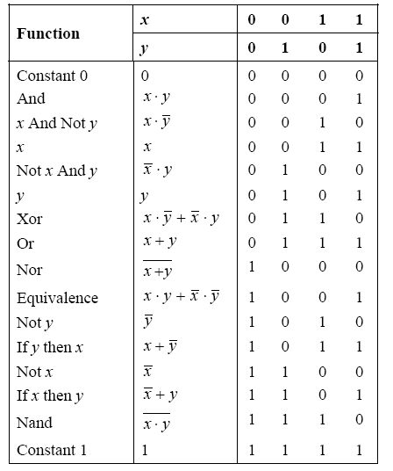
All Boolean functions of 2 variables

Slide 35
Truth Table for Functions of 3 Variables
Truth table.
  16 Boolean functions of 2 variables.
  256 Boolean functions of 3 variables.
  2^(2^n) Boolean functions of n variables!
every 4-bit value represents one
every 8-bit value represents one
every 2^{n}-bit value represents one
x
y
z
AND
OR
MAJ
ODD
0
0
0
0
0
0
0
0
0
1
0
1
0
1
0
1
0
0
1
0
1
0
1
1
0
1
1
0
1
0
0
0
1
0
1
1
0
1
0
1
1
0
1
1
0
0
1
1
0
1
1
1
1
1
1
1
some functions of 3 variables
Notes:
if N = 10, there are roughly 2^2^10 ~ 2^1000 possible circuits. No computer will ever see all of these. We choose the "good" ones.

Slide 36
Sum-of-Products
Sum-of-products. Systematic procedure for representing a Boolean function using AND, OR, NOT.
  Form AND term for each 1 in Boolean function.
  OR terms together.
proves that { AND, OR, NOT }
are universal
x
y
z
MAJ
0
0
0
0
0
0
1
0
0
1
0
0
0
1
1
1
1
0
0
0
1
0
1
1
1
1
0
1
1
1
1
1

Slide 37
Sum-of-Products
Sum-of-products. Systematic procedure for representing a Boolean function using AND, OR, NOT.
  Form AND term for each 1 in Boolean function.
  OR terms together.
proves that { AND, OR, NOT }
are universal
x
y
z
MAJ
0
0
0
0
0
0
1
0
0
1
0
0
0
1
1
1
1
0
0
0
1
0
1
1
1
1
0
1
1
1
1
1
expressing MAJ using sum-of-products

Slide 38
Sum-of-Products
Sum-of-products. Systematic procedure for representing a Boolean function using AND, OR, NOT.
  Form AND term for each 1 in Boolean function.
  OR terms together.
proves that { AND, OR, NOT }
are universal
x
y
z
MAJ
0
0
0
0
0
0
1
0
0
1
0
0
0
1
1
1
1
0
0
0
1
0
1
1
1
1
0
1
1
1
1
1
expressing MAJ using sum-of-products

Slide 39
Sum-of-Products
Sum-of-products. Systematic procedure for representing a Boolean function using AND, OR, NOT.
  Form AND term for each 1 in Boolean function.
  OR terms together.
proves that { AND, OR, NOT }
are universal
x
y
z
MAJ
0
0
0
0
0
0
0
1
0
0
0
1
0
0
0
0
1
1
1
1
1
0
0
0
0
1
0
1
1
0
1
1
0
1
0
1
1
1
1
0
expressing MAJ using sum-of-products

Slide 40
Sum-of-Products
Sum-of-products. Systematic procedure for representing a Boolean function using AND, OR, NOT.
  Form AND term for each 1 in Boolean function.
  OR terms together.
proves that { AND, OR, NOT }
are universal
x
y
z
MAJ
x'yz
0
0
0
0
0
0
0
1
0
0
0
1
0
0
0
0
1
1
1
1
1
0
0
0
0
1
0
1
1
0
1
1
0
1
0
1
1
1
1
0
expressing MAJ using sum-of-products

Slide 41
Sum-of-Products
Sum-of-products. Systematic procedure for representing a Boolean function using AND, OR, NOT.
  Form AND term for each 1 in Boolean function.
  OR terms together.
proves that { AND, OR, NOT }
are universal
x
y
z
MAJ
x'yz
xy'z
0
0
0
0
0
0
0
0
1
0
0
0
0
1
0
0
0
0
0
1
1
1
1
0
1
0
0
0
0
0
1
0
1
1
0
1
1
1
0
1
0
0
1
1
1
1
0
0
expressing MAJ using sum-of-products

Slide 42
Sum-of-Products
Sum-of-products. Systematic procedure for representing a Boolean function using AND, OR, NOT.
  Form AND term for each 1 in Boolean function.
  OR terms together.
proves that { AND, OR, NOT }
are universal
x
y
z
MAJ
x'yz
xy'z
xyz'
xyz
0
0
0
0
0
0
0
0
0
0
1
0
0
0
0
0
0
1
0
0
0
0
0
0
0
1
1
1
1
0
0
0
1
0
0
0
0
0
0
0
1
0
1
1
0
1
0
0
1
1
0
1
0
0
1
0
1
1
1
1
0
0
0
1
expressing MAJ using sum-of-products

Slide 43
Sum-of-Products
Sum-of-products. Systematic procedure for representing a Boolean function using AND, OR, NOT.
  Form AND term for each 1 in Boolean function.
  OR terms together.
proves that { AND, OR, NOT }
are universal
x
y
z
MAJ
x'yz
xy'z
xyz'
xyz
x'yz + xy'z + xyz' + xyz
0
0
0
0
0
0
0
0
0
0
0
1
0
0
0
0
0
0
0
1
0
0
0
0
0
0
0
0
1
1
1
1
0
0
0
1
1
0
0
0
0
0
0
0
0
1
0
1
1
0
1
0
0
1
1
1
0
1
0
0
1
0
1
1
1
1
1
0
0
0
1
1
expressing MAJ using sum-of-products

Slide 44
Universality of AND, OR, NOT
Fact. Any Boolean function can be expressed using AND, OR, NOT.
  { AND, OR, NOT } are universal.
  Ex: XOR(x,y) = xy' + x'y.
Notation
Meaning
x'
NOT x
x y
x AND y
x + y
x OR y
Expressing XOR Using AND, OR, NOT
x
y
x'
y'
x'y
xy'
x'y + xy'
x XOR y
0
0
1
1
0
0
0
0
0
1
1
0
1
0
1
1
1
0
0
1
0
1
1
1
1
1
0
0
0
0
0
0
Notes:
AND, OR, NOT universal means any Boolean function can be made from these gates.
Stresses importance of developing good abstractions.

Slide 45
Universality of AND, OR, NOT
Fact. Any Boolean function can be expressed using AND, OR, NOT.
  { AND, OR, NOT } are universal.
  Ex: XOR(x,y) = xy' + x'y.
Exercise. Show {AND, NOT}, {OR, NOT}, {NAND}, {NOR} are universal.
Hint. DeMorgan's law: (x'y')' = x + y.
Notation
Meaning
x'
NOT x
x y
x AND y
x + y
x OR y
Expressing XOR Using AND, OR, NOT
x
y
x'
y'
x'y
xy'
x'y + xy'
x XOR y
0
0
1
1
0
0
0
0
0
1
1
0
1
0
1
1
1
0
0
1
0
1
1
1
1
1
0
0
0
0
0
0
Notes:
AND, OR, NOT universal means any Boolean function can be made from these gates.
Stresses importance of developing good abstractions.

Slide 46
{AND, NOT} is universal

Slide 47
{NAND} is universal

Slide 48
From Math to Real-World implementation
We can implement any Boolean function using NAND gates only.
We talk about abstract Boolean algebra (logic) so far.
Is it possible to realize it in real world?
The technology needs to permit switching and conducting. It can be built using magnetic, optical, biological, hydraulic and pneumatic mechanism.

Slide 49
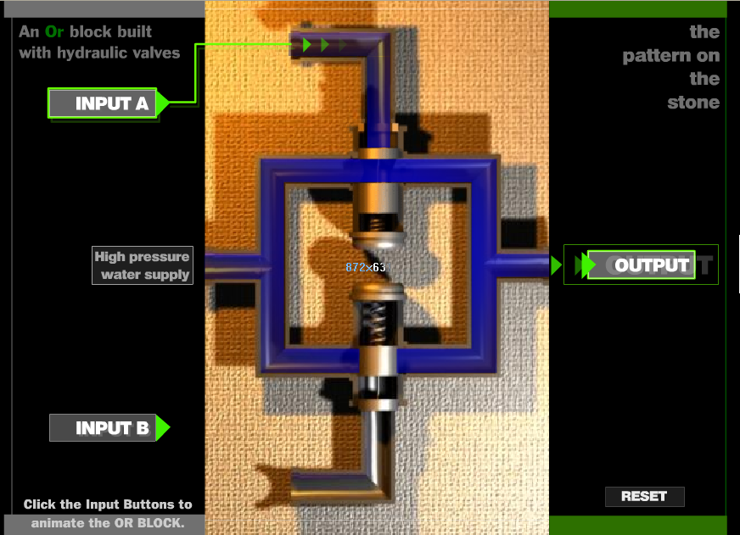
Implementation of gates
Fluid switch
(http://www.cs.princeton.edu/introcs/lectures/fluid-computer.swf)

Slide 50
Digital Circuits
What is a digital system?
  Analog: signals vary continuously.
  Digital: signals are 0 or 1.
Why digital systems?
  Accuracy and reliability.
  Staggeringly fast and cheap.
Basic abstractions.
  On, off.
  Wire: propagates on/off value.
  Switch: controls propagation of on/off values through wires.
0
1
0
3.3V
2.8V
0.5V
0.0V
Notes:
Digital – could in principle take on a discrete set of values, but typically 0/1 (binary)
tiny abstraction, but not obvious this was the right choice (0/1 T/F)
scientists considered analog machines initially (more complicated interface)

Slide 51
Wires
Wires.
  On (1): connected to power.
  Off (0): not connected to power.
  If a wire is connected to a wire that is on, that wire is also on.
  Typical drawing convention: "flow" from top, left to bottom, right.
1
power
connection
1
1
0
Notes:
logical values = information

Slide 52
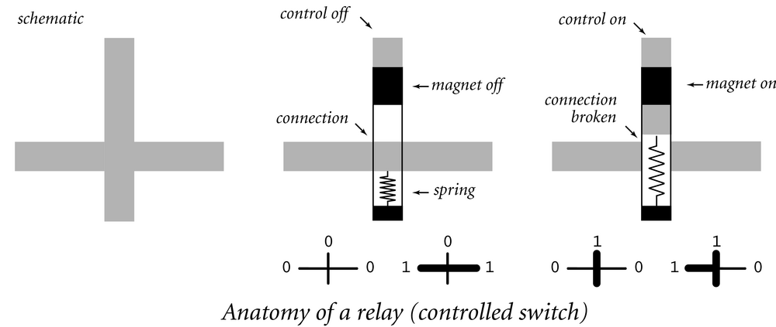
Controlled Switch
Controlled switch. [relay implementation]
  3 connections: input, output, control.
  Magnetic force pulls on a contact that cuts electrical flow.
  Control wire affects output wire, but output does not affect control; establishes forward flow of information over time.
X
X
Notes:
computers are not intrinsically electrical or based on silicon technology: from "The Pattern on the Stone"
water pressure is used to distinguish between two possible signals
amplification: even if input is a little low on pressure due to a leaky pipe, output is always at full pressure as long as signal is strong enough to move valve
restoring logic: gradual decrease in pressure not a problem

Slide 53
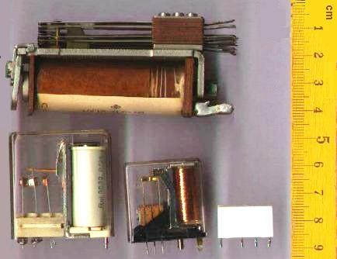
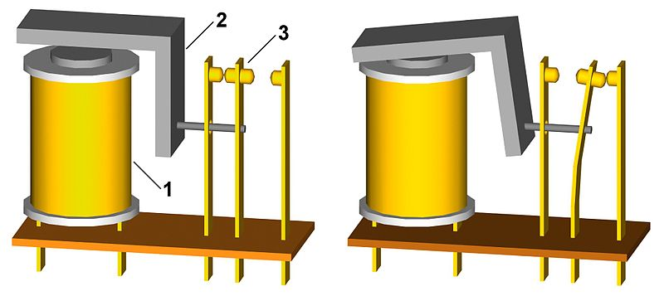
Relay

Slide 54
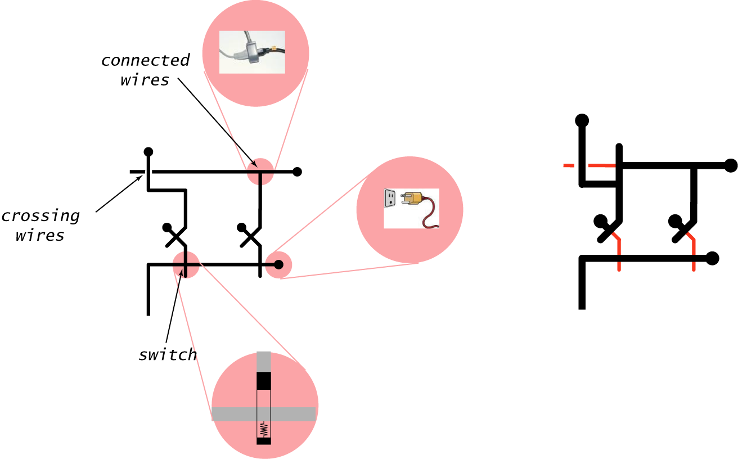
Circuit Anatomy
Notes:
logical values = information

Slide 55
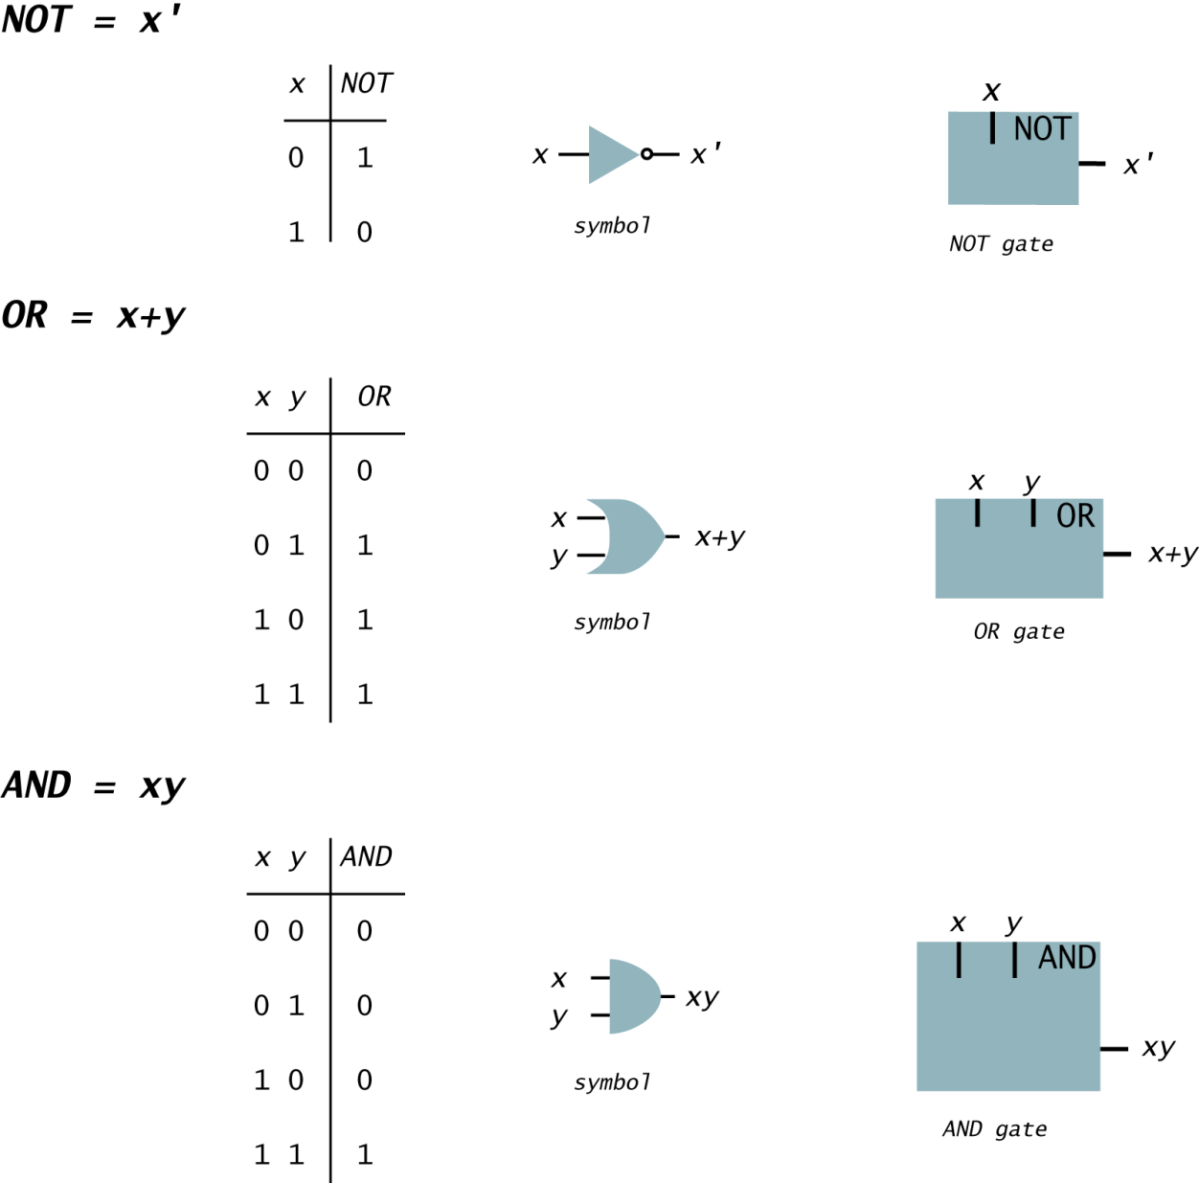
Logic Gates: Fundamental Building Blocks
Notes:
Gates will be used as building block for larger, more complicated, circuit elements.
NOT also called "inverter".
think abstractly (although these abstractions correspond directly with physical world)

Slide 56

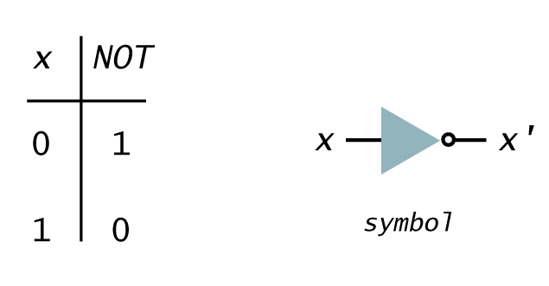
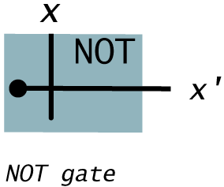
NOT

Slide 57
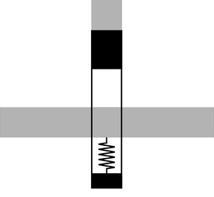
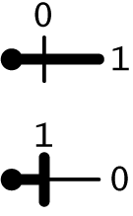
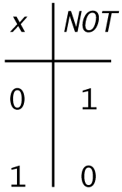
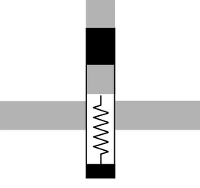
NOT
0
1
1
0

Slide 58

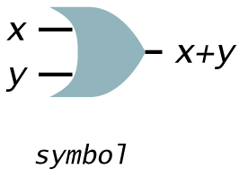
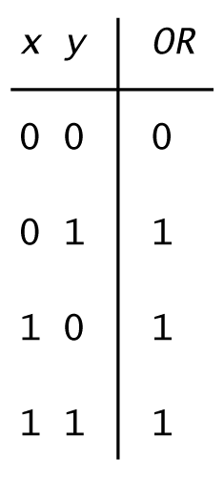
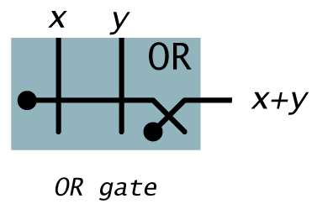
OR

Slide 59
Series relays = NOR
0
0
0
1
1
0
1
0
1
1
0
0

Slide 60
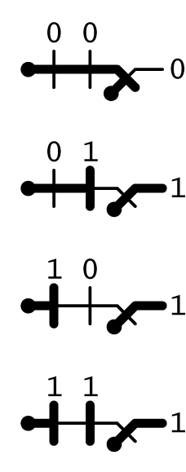
OR

Slide 61

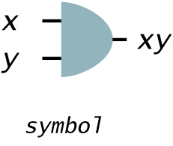
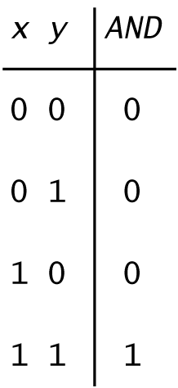
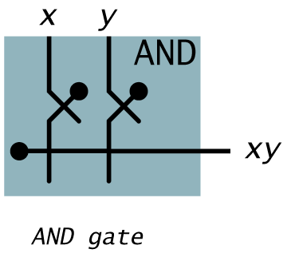
AND

Slide 62
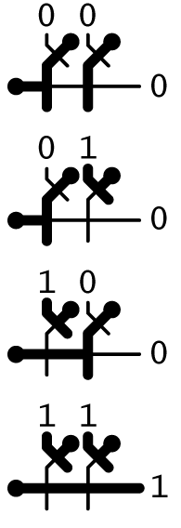
AND

Slide 63
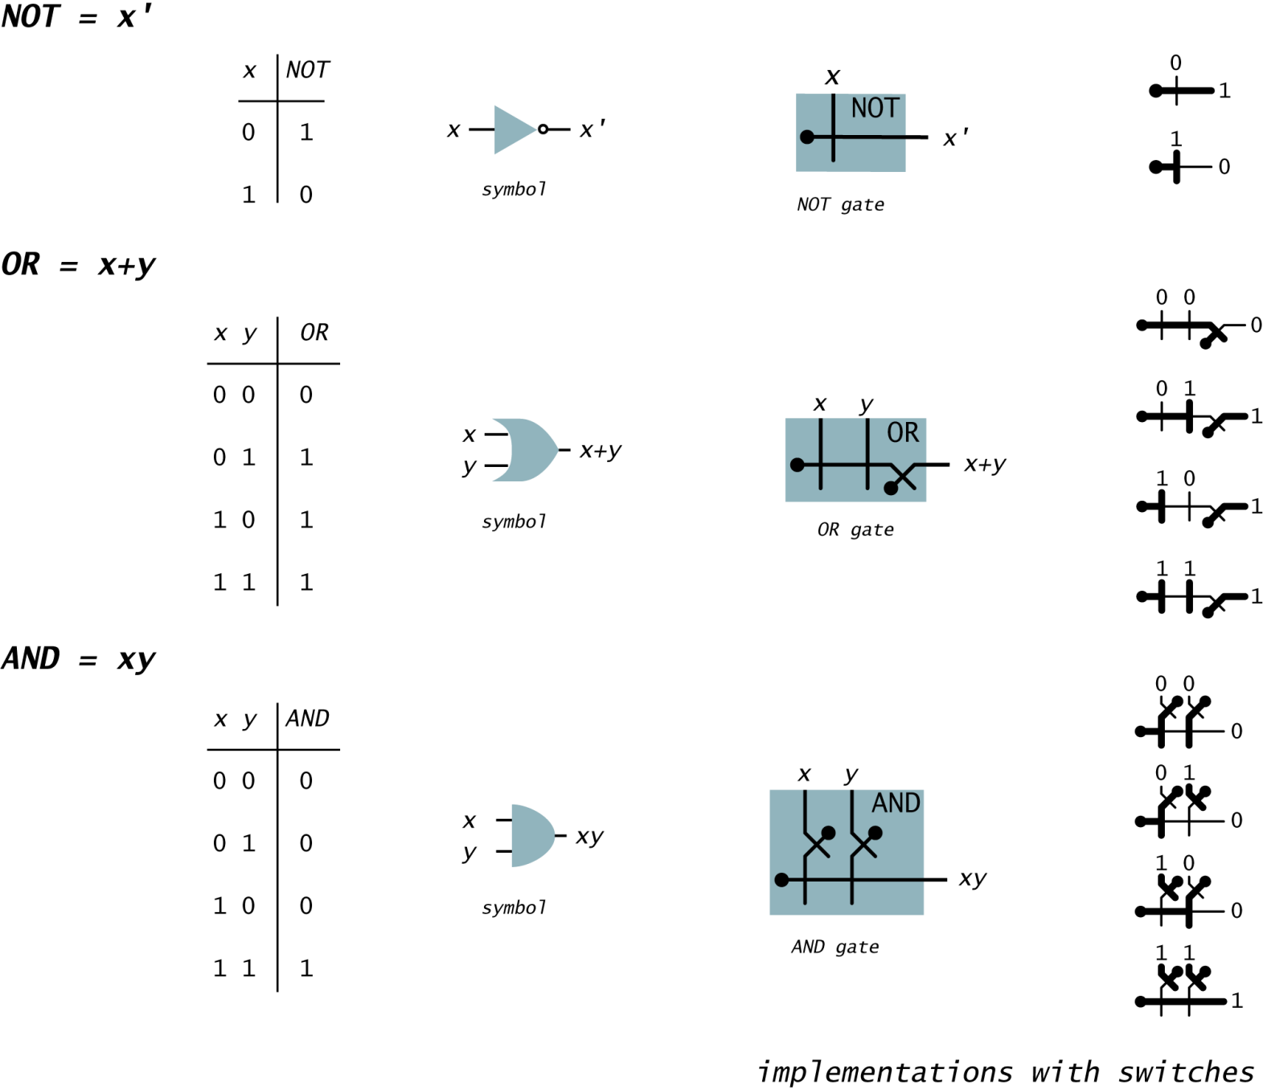
Logic Gates: Fundamental Building Blocks
Notes:
Gates will be used as building block for larger, more complicated, circuit elements.
NOT also called "inverter".
think abstractly (although these abstractions correspond directly with physical world)

Slide 64
What about parallel relays?
=NAND
0
0
1
1
0
1

Slide 65
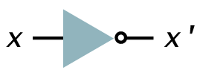
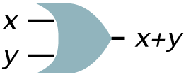
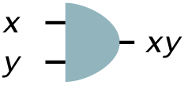
Can we implement AND/OR using parallel relays?
Now we know how to implement AND,OR and NOT. We can just use them as black boxes without knowing how they were implemented. Principle of information hiding.

Slide 66
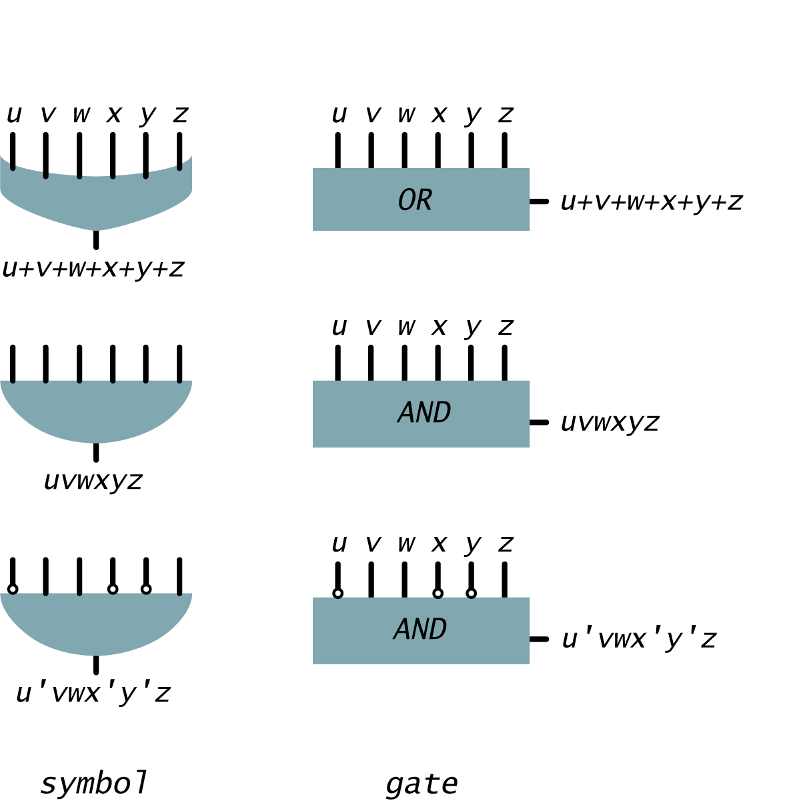
Multiway Gates
Multiway gates.
  OR: 1 if any input is 1; 0 otherwise.
  AND: 1 if all inputs are 1; 0 otherwise.
  Generalized: negate some inputs.
Notes:
wire carries output of one gate to the input(s) of others. Only one output per wire.

Slide 67
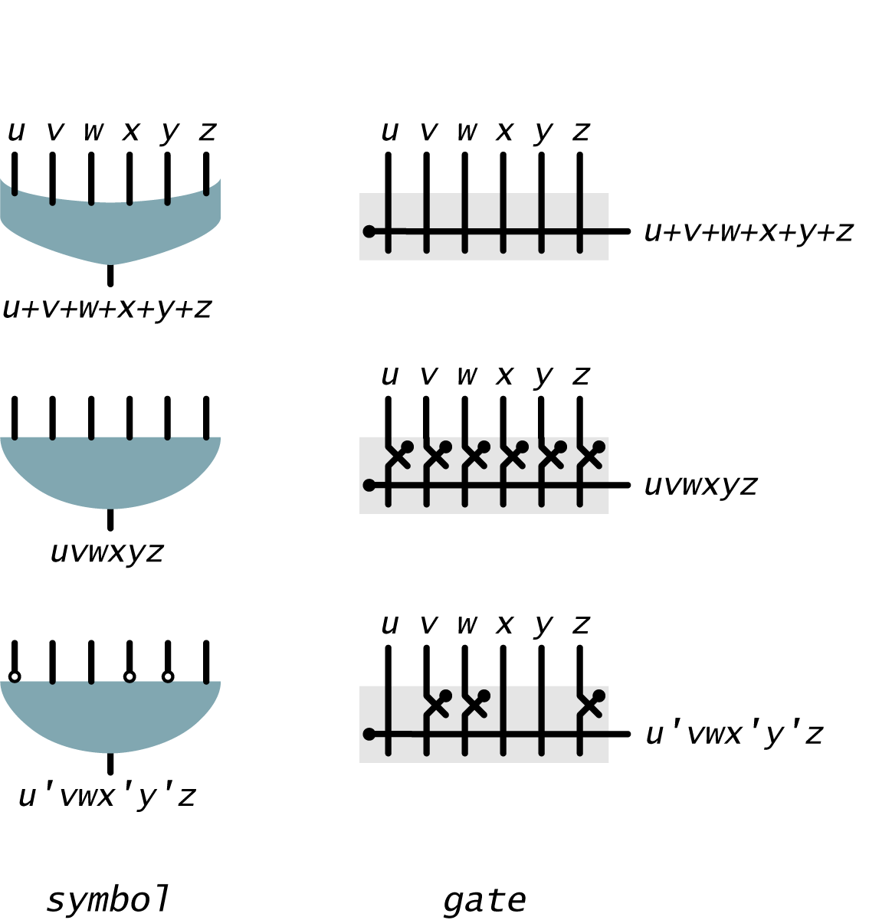
Multiway Gates
Multiway gates.
  OR: 1 if any input is 1; 0 otherwise.
  AND: 1 if all inputs are 1; 0 otherwise.
  Generalized: negate some inputs.
Notes:
wire carries output of one gate to the input(s) of others. Only one output per wire.

Slide 68
Multiway Gates
Multiway gates.
  Can also be built from 2-way gates (less efficient but implementation independent)
  Example: build 4-way OR from 2-way ORs
Notes:
wire carries output of one gate to the input(s) of others. Only one output per wire.

Slide 69
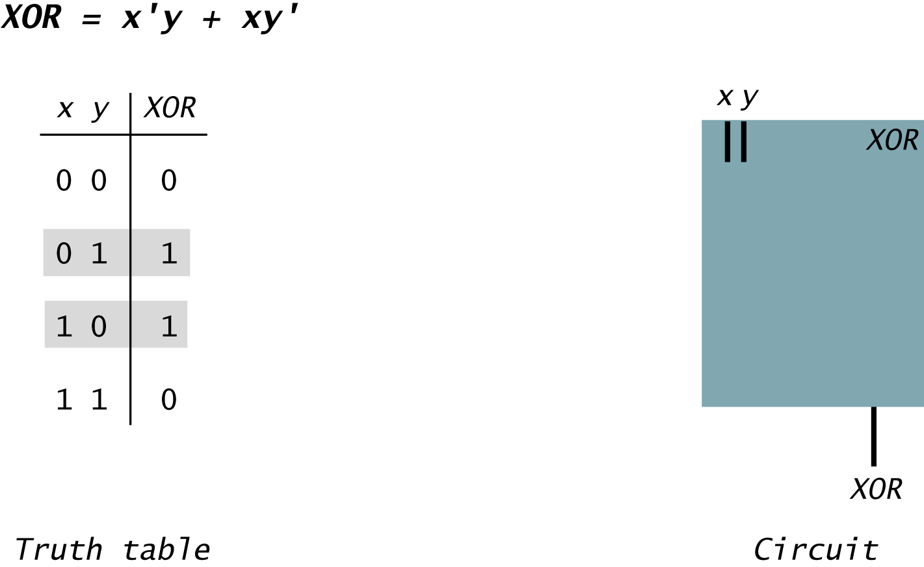
Translate Boolean Formula to Boolean Circuit
Sum-of-products. XOR.

Slide 70
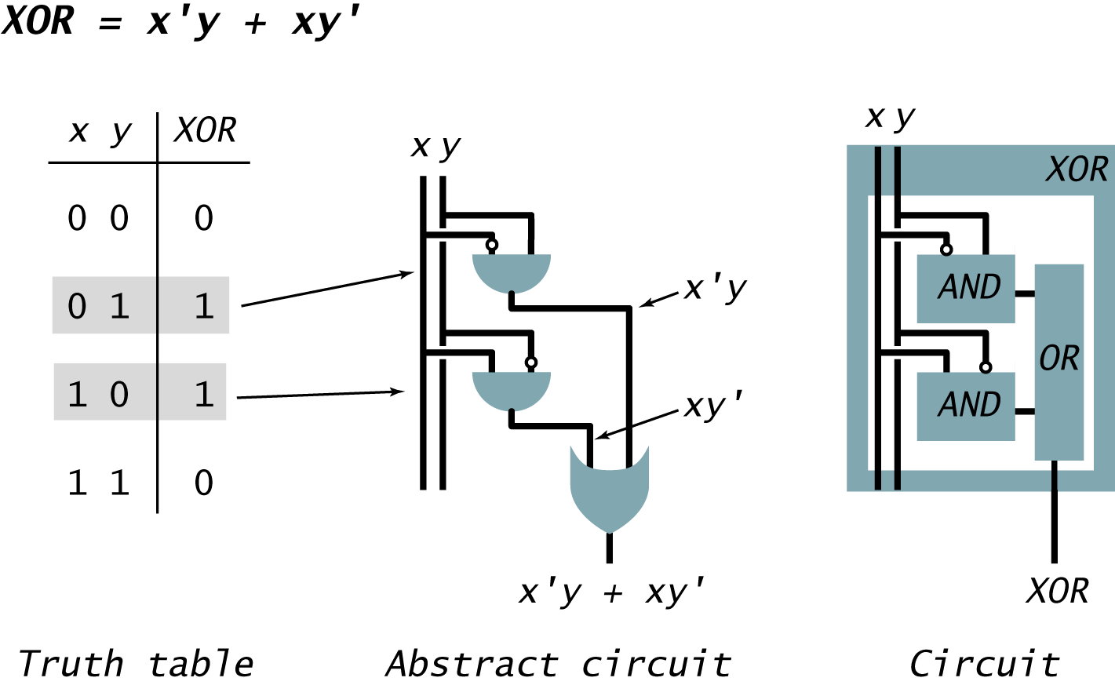
Translate Boolean Formula to Boolean Circuit
Sum-of-products. XOR.

Slide 71
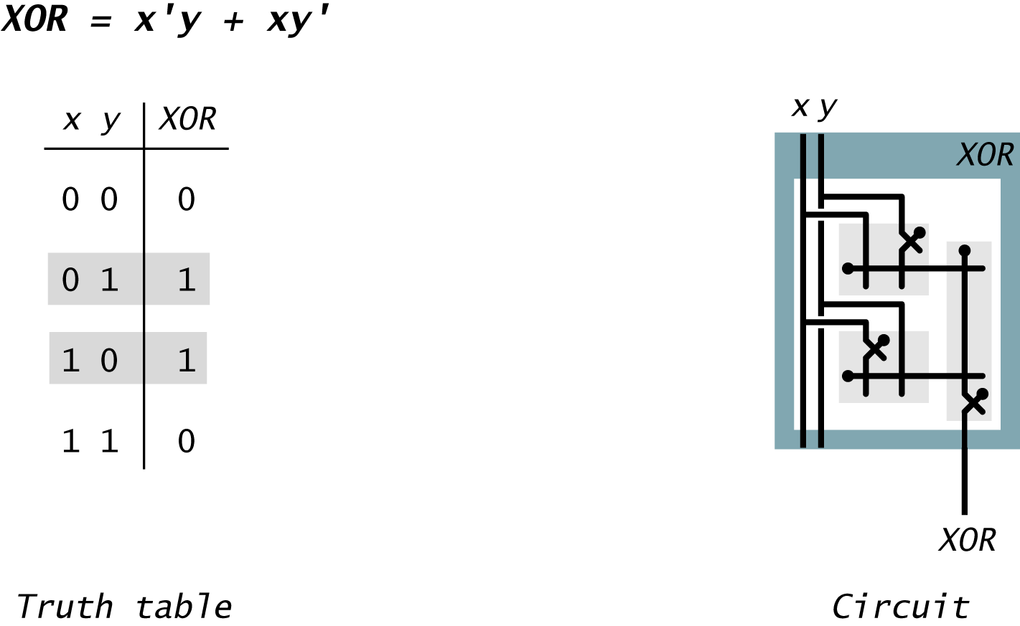
Translate Boolean Formula to Boolean Circuit
Sum-of-products. XOR.

Slide 72
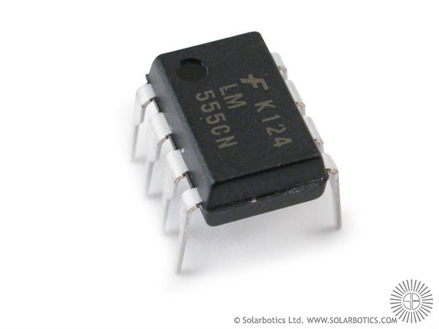
Gate logic
Interface
Implementation
Xor(a,b) = Or(And(a,Not(b)),And(Not(a),b)))

Slide 73
Expressing a Boolean Function Using AND, OR, NOT
Ingredients.
  AND gates.
  OR gates.
  NOT gates.
  Wire.
Instructions.
  Step 1: represent input and output signals with Boolean variables.
  Step 2: construct truth table to carry out computation.
  Step 3: derive (simplified) Boolean expression using sum-of products.
  Step 4: transform Boolean expression into circuit.

Slide 74
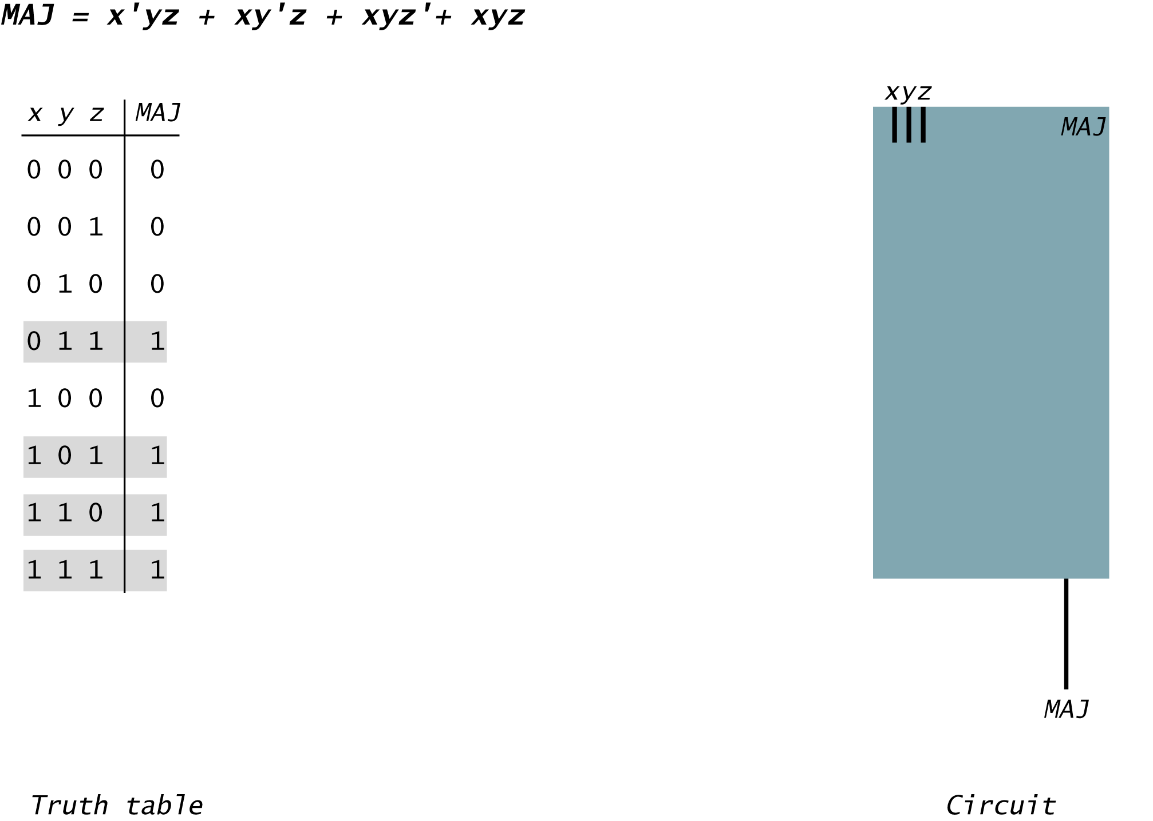
Translate Boolean Formula to Boolean Circuit
Sum-of-products. Majority.

Slide 75
Translate Boolean Formula to Boolean Circuit
Sum-of-products. Majority.

Slide 76
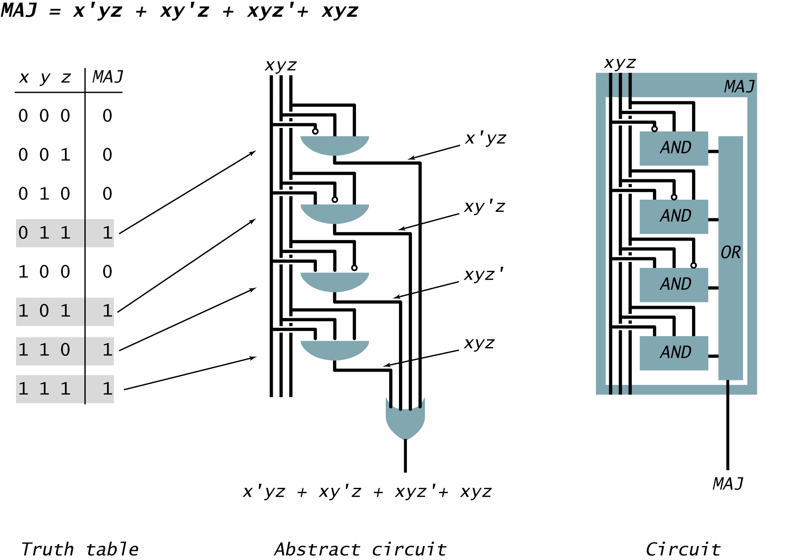
Translate Boolean Formula to Boolean Circuit
Sum-of-products. Majority.

Slide 77
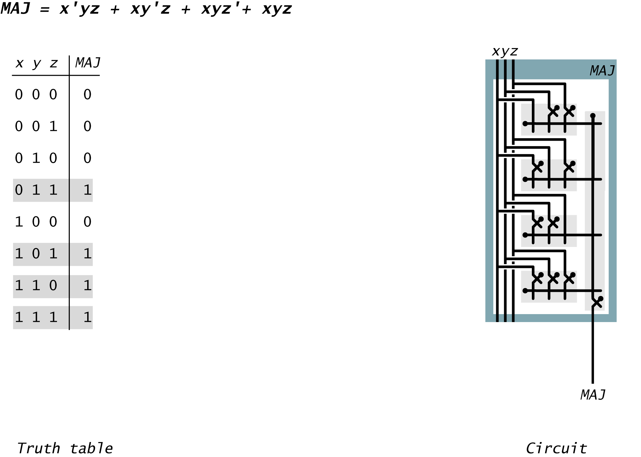
Translate Boolean Formula to Boolean Circuit
Sum-of-products. Majority.

Slide 78
ODD Parity Circuit
ODD(x, y, z).
  1 if odd number of inputs are 1.
  0 otherwise.
Notes:
let's use the recipe
generalizes XOR

Slide 79
ODD Parity Circuit
ODD(x, y, z).
  1 if odd number of inputs are 1.
  0 otherwise.
x
y
z
ODD
x'y'z
x'yz'
xy'z'
xyz
x'y'z + x'yz' + xy'z' + xyz
0
0
0
0
0
0
0
0
0
0
0
1
1
1
0
0
0
1
0
1
0
1
0
1
0
0
1
0
1
1
0
0
0
0
0
0
1
0
0
1
0
0
1
0
1
1
0
1
0
0
0
0
0
0
1
1
0
0
0
0
0
0
0
1
1
1
1
0
0
0
1
1
Expressing ODD using sum-of-products
Notes:
let's use the recipe
generalizes XOR

Slide 80
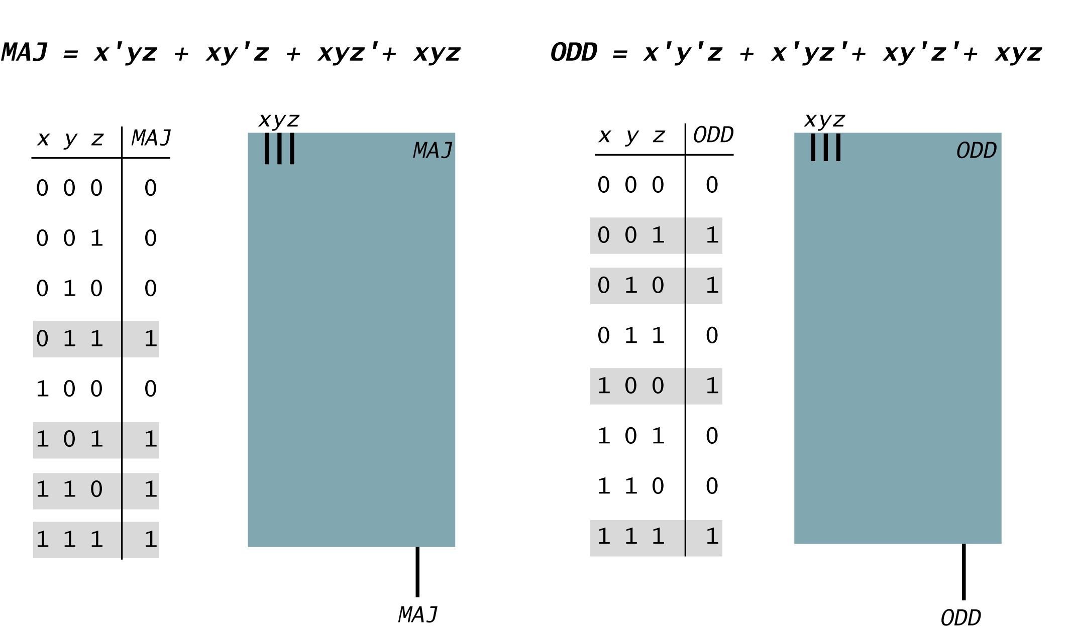
ODD Parity Circuit
ODD(x, y, z).
  1 if odd number of inputs are 1.
  0 otherwise.
Notes:
but this one can't be simplified (take it from Doug)

Slide 81
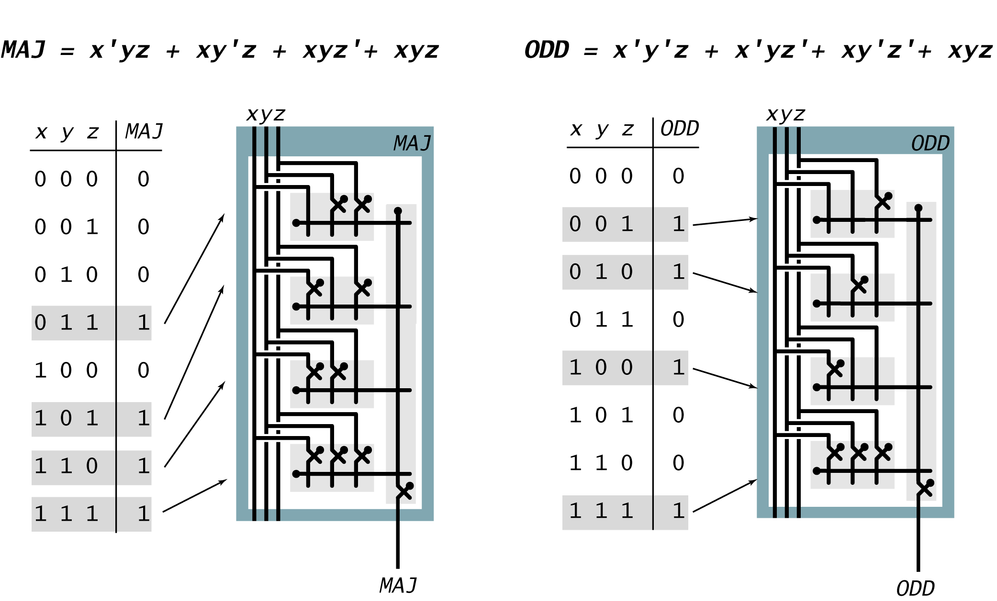
ODD Parity Circuit
ODD(x, y, z).
  1 if odd number of inputs are 1.
  0 otherwise.
Notes:
but this one can't be simplified (take it from Doug)

Slide 82
Simplification Using Boolean Algebra
Every function can be written as sum-of-product
Many possible circuits for each Boolean function.
  Sum-of-products not necessarily optimal in:
    number of switches (space)
    depth of circuit (time)
Notes:
Don't worry about simplifications in COS 126 – just know that they exist.
This mattered a lot in ancient times. Not so important now. Uniformity more critical. Lay down a "sum-of-products" grid. Just burn in the NOT gates.

Slide 83
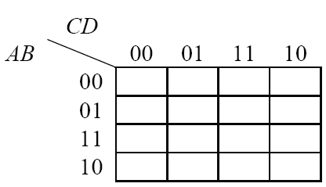
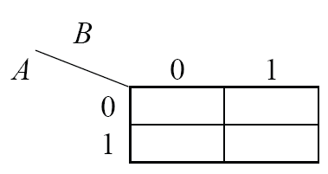
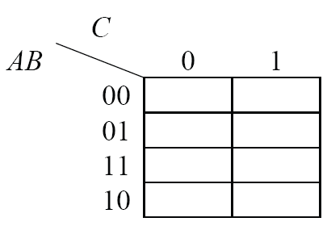
Boolean expression simplification
Karnaugh map

Slide 84
Karnaugh Maps (K-Maps)
Boolean expressions can be minimized by combining terms
K-maps minimize equations graphically
PA + PA = P

Slide 85
K-Map
Circle 1’s in adjacent squares
In Boolean expression, include only literals whose true and complement form are not in the circle
Y = AB

Slide 86
3-Input K-Map

Slide 87
3-Input K-Map
Y = AB + BC

Slide 88
K-Map Rules
Every 1 must be circled at least once
Each circle must span a power of 2 (i.e. 1, 2, 4) squares in each direction
Each circle must be as large as possible
A circle may wrap around the edges
A “don't care” (X) is circled only if it helps minimize the equation

Slide 89
4-Input K-Map

Slide 90
4-Input K-Map

Slide 91
4-Input K-Map

Slide 92
4-Input K-Map with Don‘t care

Slide 93
4-Input K-Map with Don‘t care

Slide 94
4-Input K-Map with Don‘t care

Slide 95
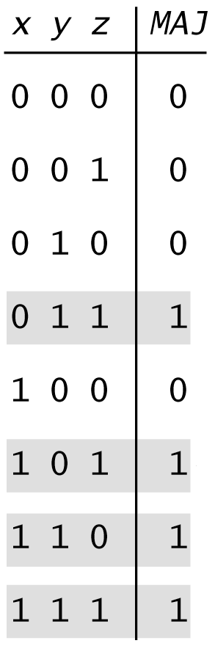
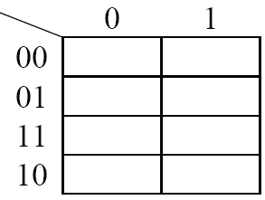
Example
z
xy

Slide 96
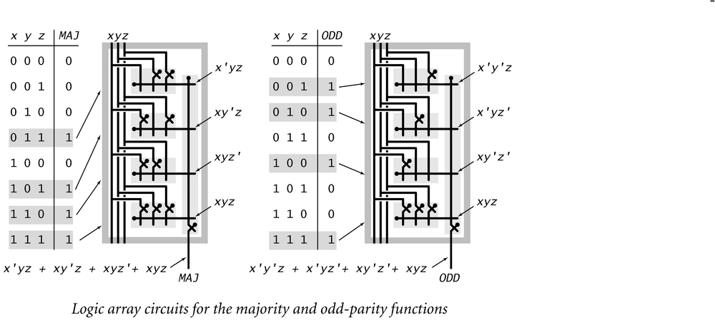
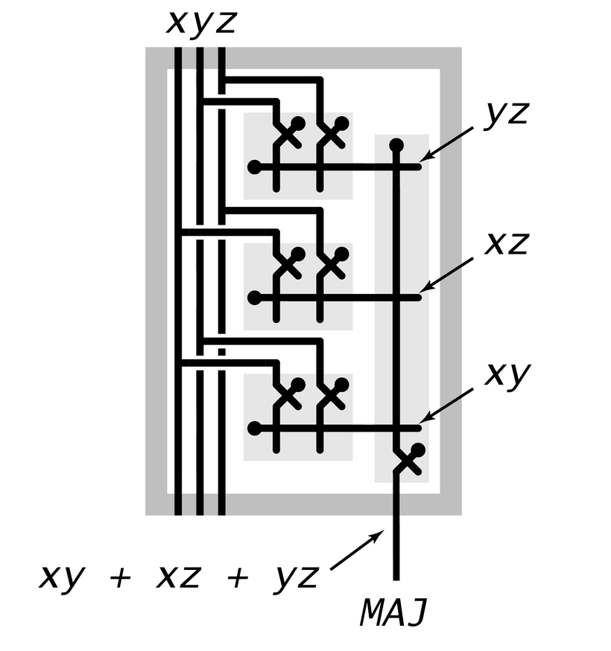
Simplification Using Boolean Algebra
Many possible circuits for each Boolean function.
  Sum-of-products not necessarily optimal in:
    number of switches (space)
    depth of circuit (time)
  MAJ(x, y, z) = x'yz + xy'z + xyz' + xyz = xy + yz + xz.
Notes:
Don't worry about simplifications in COS 126 – just know that they exist.
This mattered a lot in ancient times. Not so important now. Uniformity more critical. Lay down a "sum-of-products" grid. Just burn in the NOT gates.

Slide 97
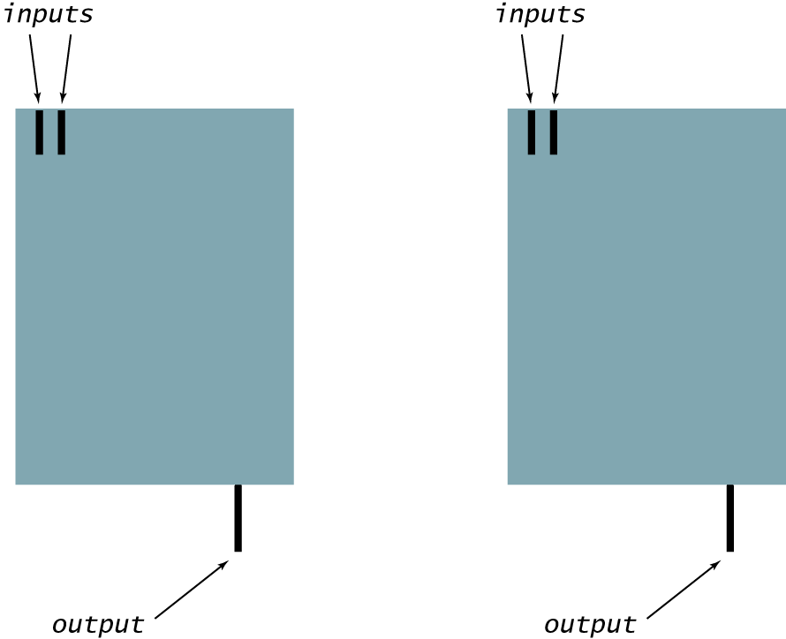
Layers of Abstraction
Layers of abstraction.
  Build a circuit from wires and switches. [implementation]
  Define a circuit by its inputs and outputs. [API]
  To control complexity, encapsulate circuits. [ADT]
Notes:
logical values = information

Slide 98
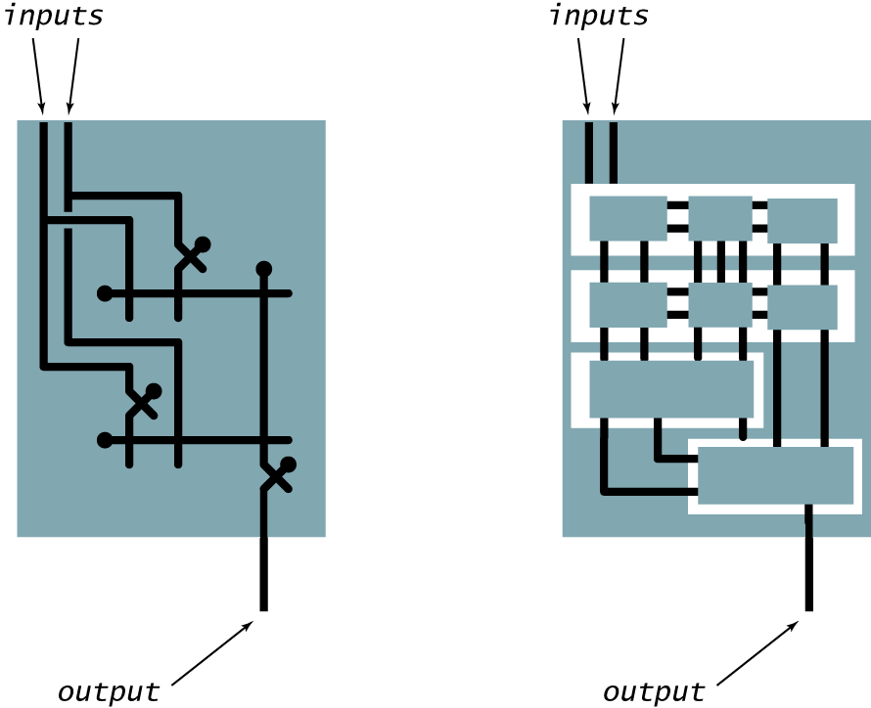
Layers of Abstraction
Layers of abstraction.
  Build a circuit from wires and switches. [implementation]
  Define a circuit by its inputs and outputs. [API]
  To control complexity, encapsulate circuits. [ADT]
Notes:
logical values = information

Slide 99
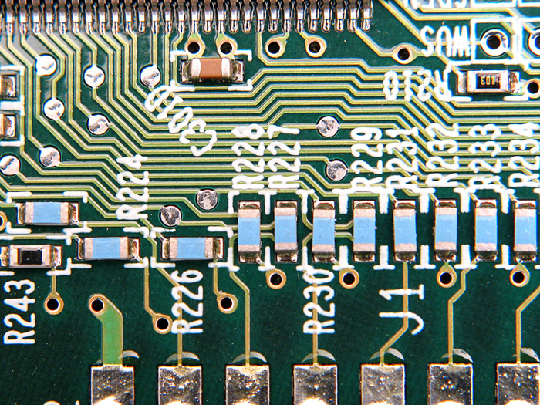

Building a chip
a
?
Xor
out
b
if ((a == 0 and b == 1) or (a == 1 and b == 0))
sets out = 1
else
sets out = 0
The process
Design the chip architecture
Specify the architecture in HDL
Test the chip in a hardware simulator
Optimize the design
Realize the optimized design in silicon.

Slide 100
Building a chip
a
?
Xor
out
b
if ((a == 0 and b == 1) or (a == 1 and b == 0))
sets out = 1
else
sets out = 0
The process
Design the chip architecture
Specify the architecture in HDL
Test the chip in a hardware simulator
Optimize the design
Realize the optimized design in silicon.

Slide 101

Chip design
  Step 1: identify input and output
  Step 2: construct truth table
  Step 3: derive (simplified) Boolean expression using sum-of products.
  Step 4: transform Boolean expression into circuit/implement it using HDL.
You would like to test the gate before packaging.

Slide 102
XOR
a | b | out
0 | 0
0 | 1
1 | 0
1 | 1

Slide 103


Chip interfaces
a
a
And
out
b
in
Not
out
aAndNotb
notb
a
Or
out
out
b
in
Not
out
nota
a
notaAndb
And
out
b
b
CHIP Xor {
IN a, b;
OUT out;
PARTS:
Not (in= , out= );
Not (in= , out= );
And (a= , b=, out=);
And (a= , b=, out=);
Or (a= , b=, out=);
}
If I want to use some chip-parts, how do I figure out their signatures?

Slide 104
Chip interfaces: Hack chip set API
Open the Hack chip set API in a window, and copy-paste chip signatures into your HDL code, as needed
Add16 (a= ,b= ,out= );
ALU (x= ,y= ,zx= ,nx= ,zy= ,ny= ,f= ,no= ,out= ,zr= ,ng= );
And16 (a= ,b= ,out= );
And (a= ,b= ,out= );
Aregister (in= ,load= ,out= );
Bit (in= ,load= ,out= );
CPU (inM= ,instruction= ,reset= ,outM= ,writeM= ,addressM= ,pc= );
DFF (in= ,out= );
DMux4Way (in= ,sel= ,a= ,b= ,c= ,d= );
DMux8Way (in= ,sel= ,a= ,b= ,c= ,d= ,e= ,f= ,g= ,h= );
Dmux (in= ,sel= ,a= ,b= );
Dregister (in= ,load= ,out= );
FullAdder (a= ,b= ,c= ,sum= ,carry= );
HalfAdder (a= ,b= ,sum= , carry= );
Inc16 (in= ,out= );
Keyboard (out= );
Memory (in= ,load= ,address= ,out= );
Mux16 (a= ,b= ,sel= ,out= );
Mux4Way16 (a= ,b= ,c= ,d= ,sel= ,out= );
Mux8Way16 (a= ,b= ,c= ,d= ,e= ,f= ,g= ,h= ,sel= ,out= );
Mux8Way (a= ,b= ,c= ,d= ,e= ,f= ,g= ,h= ,sel= ,out= );
Mux (a= ,b= ,sel= ,out= );
Nand (a= ,b= ,out= );
Not16 (in= ,out= );
Not (in= ,out= );
Or16 (a= ,b= ,out= );
Or8Way (in= ,out= );
Or (a= ,b= ,out= );
PC (in= ,load= ,inc= ,reset= ,out= );
PCLoadLogic (cinstr= ,j1= ,j2= ,j3= ,load= ,inc= );
RAM16K (in= ,load= ,address= ,out= );
RAM4K (in= ,load= ,address= ,out= );
RAM512 (in= ,load= ,address= ,out= );
RAM64 (in= ,load= ,address= ,out= );
RAM8 (in= ,load= ,address= ,out= );
Register (in= ,load= ,out= );
ROM32K (address= ,out= );
Screen (in= ,load= ,address= ,out= );
Xor (a= ,b= ,out= );

Slide 105
Built-in chips
CHIP Foo {
IN ...;
OUT ...;
PARTS:
...
Bar(...)
...
}
Q: Suppose you want to use a chip-part before you’ve implemented it. How to do it?
A: The simulator features built-in implementations of all the project 1 chips
Forcing the simulator to use a built-in chip, say Bar:
Typically, Bar.hdl will be either a given stub-file, or a file that has an incomplete implementation
Remove, or rename, the file Bar.hdl from the project folder
Whenever Bar will be mentioned as a chip-part in some chip definition, the simulator will fail to find Bar.hdl in the current folder. This will cause the simulator to invoke the built-in version of Bar instead.

Slide 106
Design: Requirements
a
a | b | out
0 | 0 | 0
0 | 1 | 1
1 | 0 | 1
1 | 1 | 0
Requirement
Build a chip that delivers this functionality
Xor
out
b
if ((a == 0 and b == 1) or (a == 1 and b == 0))
sets out = 1
else
sets out = 1
/** Sets out = (a And Not(b)) Or (Not(a) And b)) */
CHIP Xor {
IN a, b;
OUT out;
PARTS:
// Missing implementation
Gate Interface
Expressed as an HDL stub file

Slide 107
Design: Implementation
/** Sets out = (a And Not(b)) Or (Not(a) And b)) */
CHIP Xor {
IN a, b;
OUT out;
PARTS:
// Missing implementation
Gate Interface
Expressed as an HDL stub file

Slide 108
Design: Implementation
a
a
And
out
b
Gate diagram
in
Not
out
aAndNotb
notb
a
Or
out
out
b
in
Not
out
nota
a
notaAndb
And
out
b
b
/** Sets out = (a And Not(b)) Or (Not(a) And b)) */
CHIP Xor {
IN a, b;
OUT out;
PARTS:
// Missing implementation
Gate Interface
Expressed as an HDL stub file

Slide 109
Design: Implementation
a
a
And
out
b
Gate diagram
in
Not
out
aAndNotb
notb
a
Or
out
out
b
in
Not
out
nota
a
notaAndb
And
out
b
b
/** Sets out = (a And Not(b)) Or (Not(a) And b)) */
CHIP Xor {
IN a, b;
OUT out;
PARTS:
// Missing implementation
Gate Interface
Expressed as an HDL stub file

Slide 110
Design: Implementation
a
a
And
out
b
in
Not
out
aAndNotb
notb
a
Or
out
out
b
in
Not
out
nota
a
notaAndb
And
out
b
b
/** Sets out = (a And Not(b)) Or (Not(a) And b)) */
CHIP Xor {
IN a, b;
OUT out;
PARTS:
// Missing implementation

Slide 111
Design: Implementation
a
a
And
out
b
in
Not
out
aAndNotb
notb
a
Or
out
out
b
in
Not
out
nota
a
notaAndb
And
out
b
b
/** Sets out = (a And Not(b)) Or (Not(a) And b)) */
CHIP Xor {
IN a, b;
OUT out;
PARTS:
Not (in=a, out=nota);
Not (in=b, out=notb);
And (a=a, b=notb, out=aAndNotb);
And (a=nota, b=b, out=notaAndb);
}

Slide 112
Design: Implementation
a
a
And
out
b
in
Not
out
aAndNotb
notb
a
Or
out
out
b
in
Not
out
nota
a
notaAndb
And
out
b
b
/** Sets out = (a And Not(b)) Or (Not(a) And b)) */
CHIP Xor {
IN a, b;
OUT out;
PARTS:
Not (in=a, out=nota);
Not (in=b, out=notb);
And (a=a, b=notb, out=aAndNotb);
And (a=nota, b=b, out=notaAndb);
}
Practice: Complete the missing HDL code

Slide 113
Design: Implementation
a
a
And
out
b
in
Not
out
aAndNotb
notb
a
Or
out
out
b
in
Not
out
nota
a
notaAndb
And
out
b
b
/** Sets out = (a And Not(b)) Or (Not(a) And b)) */
CHIP Xor {
IN a, b;
OUT out;
PARTS:
Not (in=a, out=nota);
Not (in=b, out=notb);
And (a=a, b=notb, out=aAndNotb);
And (a=nota, b=b, out=notaAndb);
Or (a=aAndNotb, b=notaAndb, out=out);
}

Slide 114
Design: Implementation
a
a
And
out
b
in
Not
out
aAndNotb
notb
a
Or
out
out
b
in
Not
out
nota
a
notaAndb
And
out
b
b
/** Sets out = (a And Not(b)) Or (Not(a) And b)) */
CHIP Xor {
IN a, b;
OUT out;
PARTS:
Not (in=a, out=nota);
Not (in=b, out=notb);
And (a=a, b=notb, out=aAndNotb);
And (a=nota, b=b, out=notaAndb);
Or (a=aAndNotb, b=notaAndb, out=out);
}
gate
interface
A logic gate has:
One interface
Many possible implementations
gate
Implement-ation

Slide 115
Hardware description languages
Observations:
HDL is a functional / declarative language
An HDL program can be viewed as a textual specification of a chip diagram
The order of HDL statements is insignificant.
/** Sets out = (a And Not(b)) Or (Not(a) And b)) */
CHIP Xor {
IN a, b;
OUT out;
PARTS:
Not (in=a, out=nota);
Not (in=b, out=notb);
And (a=a, b=notb, out=aAndNotb);
And (a=nota, b=b, out=notaAndb);
Or (a=aAndNotb, b=notaAndb, out=out);
}

Slide 116
Hardware description languages
Common HDLs
VHDL
Verilog
…
Our HDL
Similar in spirit to other HDLs
Minimal and simple
Provides all you need for this course
  Our HDL Guide / Documentation:
  The Elements of Computing Systems / Appendix 2: HDL
/** Sets out = (a And Not(b)) Or (Not(a) And b)) */
CHIP Xor {
IN a, b;
OUT out;
PARTS:
Not (in=a, out=nota);
Not (in=b, out=notb);
And (a=a, b=notb, out=aAndNotb);
And (a=nota, b=b, out=notaAndb);
Or (a=aAndNotb, b=notaAndb, out=out);
}

Slide 117
Multi-bit bus
Sometimes we wish to manipulate a sequence of bits as a single entity
Such a multi-bit entity is termed “bus”
Example: 16-bit bus
15
14
13
12
11
10
9
8
7
6
5
4
3
2
1
0
1
0
0
0
1
0
0
0
1
1
0
1
1
1
0
1
MSB = Most significant bit
LSB = Least significant bit

Slide 118
Working with buses: Example
/* Adds two 16-bit values. */
CHIP Adder {
IN a[16], b[16];
OUT out[16];
PARTS:
...
}
/* Adds three 16-bit inputs. */
CHIP Adder3Way {
IN a[16], b[16], c[16];
OUT out[16];
15
. . .
1
0
a:
1
. . .
1
1
b:
0
. . .
1
0
c:
0
. . .
0
1
out:
1
. . .
1
0

Slide 119
Working with buses: Example
/* Adds two 16-bit values. */
CHIP Adder {
IN a[16], b[16];
OUT out[16];
PARTS:
...
}
/* Adds three 16-bit inputs. */
CHIP Adder3Way {
IN a[16], b[16], c[16];
OUT out[16];
PARTS:
Adder(a= , b= , out= );
Adder(a= , b= , out= );
}
15
. . .
1
0
a:
1
. . .
1
1
b:
0
. . .
1
0
c:
0
. . .
0
1
out:
1
. . .
1
0

Slide 120
Working with buses: Example
/* Adds two 16-bit values. */
CHIP Adder {
IN a[16], b[16];
OUT out[16];
PARTS:
...
}
/* Adds three 16-bit inputs. */
CHIP Adder3Way {
IN a[16], b[16], c[16];
OUT out[16];
PARTS:
Adder(a=a , b=b, out=ab);
Adder(a=ab, b=c, out=out);
}
15
. . .
1
0
n-bit value (bus) can be treated as a single entity
a:
1
. . .
1
1
b:
0
. . .
1
0
c:
0
. . .
0
1
Creates an internal bus pin (ab)
out:
1
. . .
1
0

Slide 121
Working with individual bits within buses
/* Returns 1 if a==1 and b==1,
* 0 otherwise. */
CHIP And {
IN a, b;
OUT out;
...
}
/* 4-way And: Ands 4 bits. */
CHIP And4Way {
IN a[4];
OUT out;
3
2
1
0
a:
0
1
1
1
out:
0

Slide 122
Working with individual bits within buses
/* Returns 1 if a==1 and b==1,
* 0 otherwise. */
CHIP And {
IN a, b;
OUT out;
...
}
/* 4-way And: Ands 4 bits. */
CHIP And4Way {
IN a[4];
OUT out;
PARTS:
And(a= , b= , out= );
And(a= , b= , out= );
And(a= , b= , out= );
}
3
2
1
0
a:
0
1
1
1
out:
0

Slide 123
Working with individual bits within buses
/* Returns 1 if a==1 and b==1,
* 0 otherwise. */
CHIP And {
IN a, b;
OUT out;
...
}
/* 4-way And: Ands 4 bits. */
CHIP And4Way {
IN a[4];
OUT out;
PARTS:
And(a=a[0], b=a[1], out=and01);
And(a=and01, b=a[2], out=and012);
And(a=and012, b=a[3], out=out);
}
Input bus pins can be subscripted.
3
2
1
0
a:
0
1
1
1
out:
0

Slide 124
Working with individual bits within buses
/* Returns 1 if a==1 and b==1,
* 0 otherwise. */
CHIP And {
IN a, b;
OUT out;
...
}
/* 4-way And: Ands 4 bits. */
CHIP And4Way {
IN a[4];
OUT out;
PARTS:
And(a=a[0], b=a[1], out=and01);
And(a=and01, b=a[2], out=and012);
And(a=and012, b=a[3], out=out);
}
Input bus pins can be subscripted.
3
2
1
0
a:
0
1
1
1
out:
0
3
2
1
0
/* Bit-wise And of two 4-bit inputs */
CHIP And4 {
IN a[4], b[4];
OUT out[4];
a:
0
1
0
1
b:
0
0
1
1
out:
0
0
0
1

Slide 125
Working with individual bits within buses
/* Returns 1 if a==1 and b==1,
* 0 otherwise. */
CHIP And {
IN a, b;
OUT out;
...
}
/* 4-way And: Ands 4 bits. */
CHIP And4Way {
IN a[4];
OUT out;
PARTS:
And(a=a[0], b=a[1], out=and01);
And(a=and01, b=a[2], out=and012);
And(a=and012, b=a[3], out=out);
}
Input bus pins can be subscripted.
3
2
1
0
a:
0
1
1
1
out:
0
3
2
1
0
/* Bit-wise And of two 4-bit inputs */
CHIP And4 {
IN a[4], b[4];
OUT out[4];
PARTS:
And(a= , b= , out= );
And(a= , b= , out= );
And(a= , b= , out=. );
And(a= , b= , out= );
}
a:
0
1
0
1
b:
0
0
1
1
out:
0
0
0
1

Slide 126
Working with individual bits within buses
/* Returns 1 if a==1 and b==1,
* 0 otherwise. */
CHIP And {
IN a, b;
OUT out;
...
}
/* 4-way And: Ands 4 bits. */
CHIP And4Way {
IN a[4];
OUT out;
PARTS:
And(a=a[0], b=a[1], out=and01);
And(a=and01, b=a[2], out=and012);
And(a=and012, b=a[3], out=out);
}
Input bus pins can be subscripted.
3
2
1
0
a:
0
1
1
1
out:
0
3
2
1
0
/* Bit-wise And of two 4-bit inputs */
CHIP And4 {
IN a[4], b[4];
OUT out[4];
PARTS:
And(a=a[0], b=b[0], out=out[0]);
And(a=a[1], b=b[1], out=out[1]);
And(a=a[2], b=b[2], out=out[2]);
And(a=a[3], b=b[3], out=out[3]);
}
a:
0
1
0
1
Output bus pins can be subscripted
b:
0
0
1
1
out:
0
0
0
1

Slide 127

Hardware simulator (demonstrating Xor gate construction)
HDL program
test script

Slide 128
Hardware simulator
HDL program

Slide 129


Hardware simulator
HDL program
output file

Slide 130

Project materials: www.nand2tetris.org
Project 1 web site
And.hdl , And.tst , And.cmp files

Slide 131
Project 1 tips
Read the Introduction + Chapter 1 of the book
Download the book’s software suite
Go through the hardware simulator tutorial
Do Project 0 (optional)
You’re in business.

Slide 132




Gates for project #1 (Basic Gates)

Slide 133





Gates for project #1

Slide 134




Gates for project #1 (Multi-bit version)

Slide 135

Gates for project #1 (Multi-way version)

Slide 136


Gates for project #1 (Multi-way version)

Slide 137


Gates for project #1 (Multi-way version)

Slide 138


Gates for project #1 (Multi-way version)

