Slide 1
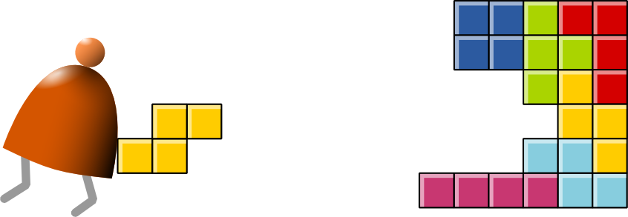
Virtual Machine
Part II: Program Control
Building a Modern Computer From First Principles
www.nand2tetris.org
Notes:
1

Slide 2
Where we are at:
Human
Abstract design
Software
Thought
abstract interface
hierarchy
Chapters 9, 12
H.L. Language
Compiler
&
abstract interface
Operating Sys.
Chapters 10 - 11
Virtual
VM Translator
Machine
abstract interface
Chapters 7 - 8
Assembly
Language
Assembler
Chapter 6
abstract interface
Computer
Machine
Architecture
Language
abstract interface
Chapters 4 - 5
Gate Logic
Hardware
abstract interface
Platform
Chapters 1 - 3
Electrical
Hardware
Chips &
Engineering
Logic Gates
Physics
hierarchy
Notes:
2

Slide 3
The big picture
. . .
. . .
Jack
Some
Some Other
language
language
language
Jack
Chapters 9-13
Some
Some Other
compiler
compiler
compiler
Implemented in Projects 7-8
VM language
VM
VM imp.
implementation
VM imp.
VM
over the Hack
Chapters 7-8
over CISC
over RISC
emulator
platform
platforms
platforms
A Java-based emulator is included in the course software suite
CISC
RISC
. . .
written in
Hack
machine
machine
a high-level
machine
language
language
language
language
. . .
. . .
Chapters 1-6
CISC
RISC
other digital platforms, each equipped
Any
Hack
machine
machine
with its VM implementation
computer
computer
Notes:
3

Slide 4
The VM language
Goal: Complete the specification and implementation of the VM model and language
Arithmetic / Boolean commands
add
sub
neg
eq
gt
lt
and
or
not
Memory access commands
pop x (pop into x, which is a variable)
push y (y being a variable or a constant)
Program flow commands
label (declaration)
goto (label)
if-goto (label)
Function calling commands
function (declaration)
call (a function)
return (from a function)
Chapter 7
Chapter 8
Method: (a) specify the abstraction (model’s constructs and commands)
(b) propose how to implement it over the Hack platform.
Notes:
4

Slide 5
The compilation challenge
Source code (high-level language)
Target code
class Main {
static int x;
function void main() {
// Inputs and multiplies two numbers
var int a, b, c;
let a = Keyboard.readInt(“Enter a number”);
let b = Keyboard.readInt(“Enter a number”);
let c = Keyboard.readInt(“Enter a number”);
let x = solve(a,b,c);
return;
}
}
// Solves a quadratic equation (sort of)
function int solve(int a, int b, int c) {
var int x;
if (~(a = 0))
x=(-b+sqrt(b*b–4*a*c))/(2*a);
else
x=-c/b;
return x;
}
}
0000000000010000
1110111111001000
0000000000010001
1110101010001000
0000000000010000
1111110000010000
0000000000000000
1111010011010000
0000000000010010
1110001100000001
0000000000010000
1111110000010000
0000000000010001
0000000000010000
1110111111001000
0000000000010001
1110101010001000
0000000000010000
1111110000010000
0000000000000000
1111010011010000
0000000000010010
1110001100000001
0000000000010000
1111110000010000
0000000000010001
...
Our ultimate goal:
Translate high-level programs into executable code.
Compiler
Notes:
5

Slide 6
The compilation challenge / two-tier setting
Jack source code
VM (pseudo) code
Machine code
if (~(a = 0))
x = (-b+sqrt(b*b–4*a*c))/(2*a)
else
x = -c/b
push a
push 0
eq
not
if-goto A_NEQ_ZERO
// We get here if a==0
push c
neg
push b
call div
pop x
goto CONTINUE
label A_NEQ_ZERO
// We get here if !(a==0)
push b
neg
push a
push b
push c
call disc
call sqrt
add
push 2
push a
call mult
call div
pop x
label CONTINUE
// code continues
0000000000010000
1110111111001000
0000000000010001
1110101010001000
0000000000010000
1111110000010000
0000000000000000
1111010011010000
0000000000010010
1110001100000001
0000000000010000
1111110000010000
0000000000010001
0000000000010000
1110111111001000
0000000000010001
1110101010001000
0000000000010000
1111110000010000
0000000000000000
1111010011010000
0000000000010010
1110001100000001
0000000000010000
1111110000010000
0000000000010001
0000000000010010
1110001100000001
...
Compiler
We’ll develop the compiler later in the course
We now turn to describe how to complete the implementation of the VM language
That is -- how to translate each VM command into assembly commands that perform the desired semantics.
VM translator
Notes:
6

Slide 7
The compilation challenge / two-tier setting
Jack source code
VM (pseudo) code
Machine code
if (~(a = 0))
x = (-b+sqrt(b*b–4*a*c))/(2*a)
else
x = -c/b
push a
push 0
eq
not
if-goto A_NEQ_ZERO
// We get here if a==0
push c
neg
push b
call div
pop x
goto CONTINUE
label A_NEQ_ZERO
// We get here if !(a==0)
push b
neg
push a
push b
push c
call disc
call sqrt
add
push 2
push a
call mult
call div
pop x
label CONTINUE
// code continues
0000000000010000
1110111111001000
0000000000010001
1110101010001000
0000000000010000
1111110000010000
0000000000000000
1111010011010000
0000000000010010
1110001100000001
0000000000010000
1111110000010000
0000000000010001
0000000000010000
1110111111001000
0000000000010001
1110101010001000
0000000000010000
1111110000010000
0000000000000000
1111010011010000
0000000000010010
1110001100000001
0000000000010000
1111110000010000
0000000000010001
0000000000010010
1110001100000001
...
Compiler
We’ll develop the compiler later in the course
We now turn to describe how to complete the implementation of the VM language
That is -- how to translate each VM command into assembly commands that perform the desired semantics.
VM translator
Notes:
7

Slide 8
The compilation challenge
Typical compiler’s source code input:
// Computes x = (-b + sqrt(b^2 -4*a*c)) / 2*a
if (~(a = 0))
x = (-b + sqrt(b * b – 4 * a * c)) / (2 * a)
else
x = - c / b
program flow logic (branching)
Boolean expressions
function call and return logic
arithmetic expressions
(this lecture)
(previous lecture)
(this lecture)
(previous lecture)
How to translate such high-level code into machine language?
In a two-tier compilation model, the overall translation challenge is broken between a front-end compilation stage and a subsequent back-end translation stage
In our Hack-Jack platform, all the above sub-tasks (handling arithmetic / Boolean expressions and program flow / function calling commands) are done by the back-end, i.e. by the VM translator.
Notes:
8

Slide 9
Lecture plan
Arithmetic / Boolean commands
add
sub
neg
eq
gt
lt
and
or
not
Memory access commands
pop x (pop into x, which is a variable)
push y (y being a variable or a constant)
Program flow commands
label (declaration)
goto (label)
if-goto (label)
Function calling commands
function (declaration)
call (a function)
return (from a function)
Chapter 7
Notes:
9

Slide 10
Program flow commands in the VM language
VM code example:
In the VM language, the program flow abstraction is delivered using three commands:
function mult 1
push constant 0
pop local 0
label loop
push argument 0
push constant 0
eq
if-goto end
push argument 0
push 1
sub
pop argument 0
push argument 1
push local 0
add
pop local 0
goto loop
label end
push local 0
return
label c // label declaration
goto c // unconditional jump to the
// VM command following the label c
if-goto c // pops the topmost stack element;
// if it’s not zero, jumps to the
// VM command following the label c
How to translate these abstractions into assembly?
Notes:
10

Slide 11
Flow of control
pseudo code
VM code
if (cond)
statement1
else
statement2
~cond
if-goto elseLabel
statement1
goto contLabel
label elseLabel
statement2
label contLabel

Slide 12
Flow of control
pseudo code
VM code
while (cond)
statement
...
label contLabel
~(cond)
if-goto exitLabel
statement
goto contLabel
label exitLabel
...

Slide 13
Branching
High-level program
Pseudo VM code
Label:
// Returns x * y
int mult(int x, int y) {
int sum = 0;
int n = 1;
// sum = sum + x, y times
while !(n > y) {
sum = sum + x;
n++;
}
return sum;
}
function mult(x,y)
push 0
pop sum
push 1
pop n
label WHILE_LOOP
push n
push y
gt
if-goto ENDLOOP
push sum
push x
add
pop sum
push n
push 1
add
pop n
goto WHILE_LOOP
label ENDLOOP
push sum
return
label label
defines a label.
compiler

Slide 14
Branching
High-level program
Pseudo VM code
Label:
// Returns x * y
int mult(int x, int y) {
int sum = 0;
int n = 1;
// sum = sum + x, y times
while !(n > y) {
sum = sum + x;
n++;
}
return sum;
}
function mult(x,y)
push 0
pop sum
push 1
pop n
label WHILE_LOOP
push n
push y
gt
if-goto ENDLOOP
push sum
push x
add
pop sum
push n
push 1
add
pop n
goto WHILE_LOOP
label ENDLOOP
push sum
return
label label
defines a label.
Unconditional branching:
goto label
Jumps to execute the
command just after label.
compiler

Slide 15
Branching
High-level program
Pseudo VM code
Label:
// Returns x * y
int mult(int x, int y) {
int sum = 0;
int n = 1;
// sum = sum + x, y times
while !(n > y) {
sum = sum + x;
n++;
}
return sum;
}
function mult(x,y)
push 0
pop sum
push 1
pop n
label WHILE_LOOP
push n
push y
gt
if-goto ENDLOOP
push sum
push x
add
pop sum
push n
push 1
add
pop n
goto WHILE_LOOP
label ENDLOOP
push sum
return
label label
defines a label.
Unconditional branching:
goto label
Jumps to execute the
command just after label.
Conditional branching:
compiler
if-goto label
VM logic:
cond = pop;
if cond jump to execute the
command just after label.

Slide 16
Lecture plan
Arithmetic / Boolean commands
add
sub
neg
eq
gt
lt
and
or
not
Memory access commands
pop x (pop into x, which is a variable)
push y (y being a variable or a constant)
Program flow commands
label (declaration)
goto (label)
if-goto (label)
Function calling commands
function (declaration)
call (a function)
return (from a function)
previous
lecture
Notes:
16

Slide 17
Subroutines
// Compute x = (-b + sqrt(b^2 -4*a*c)) / 2*a
if (~(a = 0))
x = (-b + sqrt(b * b – 4 * a * c)) / (2 * a)
else
x = - c / b
Subroutines = a major programming artifact
Basic idea: the given language can be extended by user-defined commands (aka subroutines/functions/procedures/methods ...)
Important: the language’s primitive commands and the user-defined commands have the same look-and-feel
This transparent extensibility is the most important abstraction delivered by high-level programming languages
The challenge: implement this abstraction, i.e. allow the program control to flow effortlessly between one subroutine to the other
Notes:
17

Slide 18
Subroutines in the VM language
Calling code, aka “caller” (example)
Called code, aka “callee” (example)
...
// computes (7 + 2) * 3 - 5
push constant 7
push constant 2
add
push constant 3
call mult 2
push constant 5
sub
...
function mult 1
push constant 0
pop local 0 // result (local 0) = 0
label loop
push argument 0
push constant 0
eq
if-goto end // if arg0==0, jump to end
push argument 0
push 1
sub
pop argument 0 // arg0--
push argument 1
push local 0
add
pop local 0 // result += arg1
goto loop
label end
push local 0 // push result
return
VM subroutine call-and-return commands
Notes:
18

Slide 19
Subroutines in the VM language
The invocation of the VM’s primitive commands and subroutines
follow exactly the same rules (consistent with other stack operations):
The caller pushes the necessary argument(s) and calls the command / function for its effect
The callee is responsible for removing the argument(s) from the stack, and for popping onto the stack the result of its execution.

Slide 20
What behind subroutines
The following scenario happens
The caller pushes the necessary arguments and call callee
The state of the caller is saved
The space of callee’s local variables is allocated
The callee executes what it is supposed to do
The callee pushes the result to the stack
Removes all arguments
The space of the callee is recycled
The caller’s state is reinstalled
Jump back to where is called

Slide 21
Memory Segments
@16?
@LCL
Static
Local
Host
RAM
@ARG
Argument
Pointer
Temp
@THIS
@THAT
This
That

Slide 22
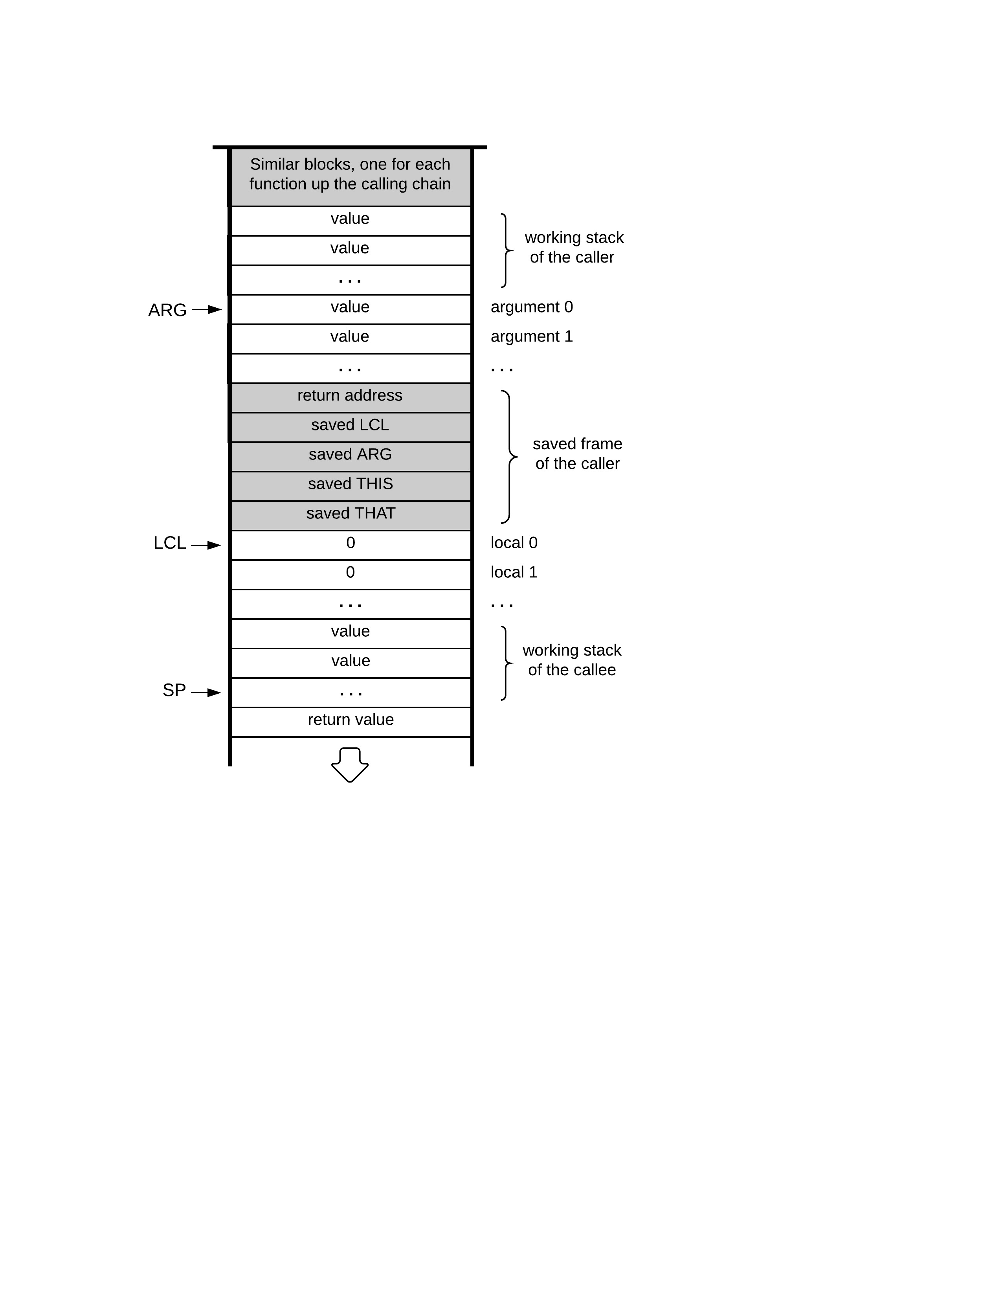
Function call and return: abstraction
Example: computing mult(17,212)
Caller’s stack (before)
sp

Slide 23
Function call and return: abstraction
Example: computing mult(17,212)
Caller’s stack (before)
17
sp
212

Slide 24
Function call and return: abstraction
Example: computing mult(17,212)
Caller’s stack (before)
Caller’s stack (after)
call mult 2
17
sp
3604
sp
212
Net effect:
The function’s arguments were replaced by the function’s value

Slide 25
Function call and return: implementation
The function is running,
doing something
sp

Slide 26
Function call and return: implementation
The function prepares
to call another function:
sp

Slide 27
Function call and return: implementation
The function pushes arguments:
sp

Slide 28
Function call and return: implementation
The function says:
call foo nArgs
nArgs
sp

Slide 29
Function call and return: implementation
The function says:
call foo nArgs
VM implementation (handling call):
nArgs
sp

Slide 30
Function call and return: implementation
The function says:
call foo nArgs
VM implementation (handling call):
Sets ARG
nArgs
sp

Slide 31
Function call and return: implementation
The function says:
call foo nArgs
VM implementation (handling call):
Sets ARG
nArgs
sp

Slide 32
Function call and return: implementation
The function says:
call foo nArgs
VM implementation (handling call):
Sets ARG
sp

Slide 33
Function call and return: implementation
The function says:
call foo nArgs
VM implementation (handling call):
Sets ARG
Saves the caller’s frame
sp

Slide 34
Function call and return: implementation
The function says:
call foo nArgs
VM implementation (handling call):
Sets ARG
Saves the caller’s frame
sp

Slide 35
Function call and return: implementation
The function says:
call foo nArgs
VM implementation (handling call):
Sets ARG
Saves the caller’s frame
Jumps to execute foo
sp

Slide 36
Function call and return: implementation
The called function is entered:
function foo nVars
VM implementation (handling call):
Sets ARG
Saves the caller’s frame
Jumps to execute foo
sp

Slide 37
Function call and return: implementation
The called function is entered:
function foo nVars
VM implementation (handling call):
Sets ARG
Saves the caller’s frame
Jumps to execute foo
VM implementation (handling function):
sp

Slide 38
Function call and return: implementation
The called function is entered:
function foo nVars
VM implementation (handling call):
Sets ARG
Saves the caller’s frame
Jumps to execute foo
VM implementation (handling function):
Sets up the local segment
of the called function
sp

Slide 39
Function call and return: implementation
The called function is entered:
function foo nVars
VM implementation (handling call):
Sets ARG
Saves the caller’s frame
Jumps to execute foo
VM implementation (handling function):
Sets up the local segment
of the called function
nVars
sp

Slide 40
Function call and return: implementation
The called function is entered:
function foo nVars
VM implementation (handling call):
Sets ARG
Saves the caller’s frame
Jumps to execute foo
VM implementation (handling function):
Sets up the local segment
of the called function
sp

Slide 41
Function call and return: implementation
The called function is running,
doing something
sp

Slide 42
Function call and return: implementation
The called function is running,
doing something
sp

Slide 43
Function call and return: implementation
The called function prepares to return:
it pushes a return value
sp

Slide 44
Function call and return: implementation
The called function prepares to return:
it pushes a return value
sp

Slide 45
Function call and return: implementation
The called function says:
return
sp

Slide 46
Function call and return: implementation
The called function says:
return
VM implementation (handling call):
Sets ARG
Saves the caller’s frame
Jumps to execute foo
VM implementation (handling function):
Sets up the local segment
of the called function
VM implementation (handling return):
sp

Slide 47
Function call and return: implementation
The called function says:
return
VM implementation (handling call):
Sets ARG
Saves the caller’s frame
Jumps to execute foo
returned value
VM implementation (handling function):
Sets up the local segment
of the called function
VM implementation (handling return):
Copies the return value onto argument 0
sp

Slide 48
Function call and return: implementation
The called function says:
return
VM implementation (handling call):
Sets ARG
Saves the caller’s frame
Jumps to execute foo
returned value
VM implementation (handling function):
Sets up the local segment
of the called function
VM implementation (handling return):
Copies the return value onto argument 0
Sets SP for the caller
sp

Slide 49
Function call and return: implementation
The called function says:
return
VM implementation (handling call):
Sets ARG
Saves the caller’s frame
Jumps to execute foo
returned value
sp
VM implementation (handling function):
Sets up the local segment
of the called function
VM implementation (handling return):
Copies the return value onto argument 0
Sets SP for the caller

Slide 50
Function call and return: implementation
The called function says:
return
VM implementation (handling call):
Sets ARG
Saves the caller’s frame
Jumps to execute foo
returned value
sp
VM implementation (handling function):
Sets up the local segment
of the called function
VM implementation (handling return):
Copies the return value onto argument 0
Sets SP for the caller
Restores the segment pointers of the caller

Slide 51
Function call and return: implementation
The called function says:
return
VM implementation (handling call):
Sets ARG
Saves the caller’s frame
Jumps to execute foo
returned value
sp
VM implementation (handling function):
Sets up the local segment
of the called function
VM implementation (handling return):
Copies the return value onto argument 0
Sets SP for the caller
Restores the segment pointers of the caller

Slide 52
Function call and return: implementation
The called function says:
return
VM implementation (handling call):
Sets ARG
Saves the caller’s frame
Jumps to execute foo
returned value
sp
VM implementation (handling function):
Sets up the local segment
of the called function
VM implementation (handling return):
Copies the return value onto argument 0
Sets SP for the caller
Restores the segment pointers of the caller
Jumps to the return address within the caller’s code
(note that the stack space below sp is recycled)

Slide 53
Function call and return: implementation
The caller
resumes its execution
VM implementation (handling call):
Sets ARG
Saves the caller’s frame
Jumps to execute foo
returned value
sp
VM implementation (handling function):
Sets up the local segment
of the called function
VM implementation (handling return):
Copies the return value onto argument 0
Sets SP for the caller
Restores the segment pointers of the caller
Jumps to the return address within the caller’s code
(note that the stack space below sp is recycled)

Slide 54
The global stack
global stack
states of other functions
up the calling chain
(possibly many) similar blocks, one for each function up the calling chain
“block”
sp

Slide 55
Recap: function call and return
The caller says:
call foo nArgs
The caller resumes
its execution
Abstraction:
sp
return value of foo
sp

Slide 56
Recap: function call and return
The caller says:
call foo nArgs
The caller resumes
its execution
Implementation:
returned value
sp
return value of foo
sp
sp

Slide 57
Example: factorial
High-level program
Pseudo VM code
VM program
// Tests the factorial function
int main() {
return factorial(3);
}
// Returns n!
int factorial(int n) {
if (n==1)
return 1;
else
return n * factorial(n-1);
}
function main
push 3
call factorial
return
function factorial(n)
push n
push 1
eq
if-goto BASECASE
push n
push n
push 1
sub
call factorial
call mult
return
label BASECASE
push 1
return
function mult(a,b)
// Code omitted
function main 0
push constant 3
call factorial 1
return
function factorial 0
push argument 0
push constant 1
eq
if-goto BASECASE
push argument 0
push argument 0
push constant 1
sub
call factorial 1
call mult 2
return
label BASECASE
push constant 1
return
function mult 2
// Code omitted
compiler

Slide 58
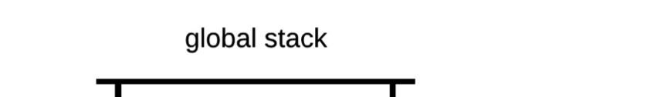
Example: factorial
VM program
function main 0
push constant 3
call factorial 1
return
function factorial 0
push argument 0
push constant 1
eq
if-goto BASECASE
push argument 0
push argument 0
push constant 1
sub
call factorial 1
call mult 2
return
label BASECASE
push constant 1
return
function mult 2
// Code omitted

Slide 59
Example: factorial
function main 0
push constant 3
call factorial 1
return
function factorial 0
push argument 0
push constant 1
eq
if-goto BASECASE
push argument 0
push argument 0
push constant 1
sub
call factorial 1
call mult 2
return
label BASECASE
push constant 1
return
function mult 2
// Code omitted

Slide 60
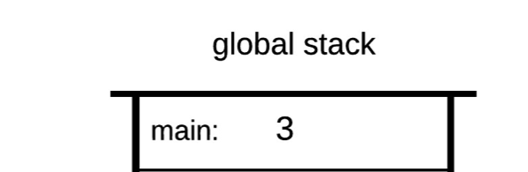
Example: factorial
function main 0
push constant 3
call factorial 1
return
function factorial 0
push argument 0
push constant 1
eq
if-goto BASECASE
push argument 0
push argument 0
push constant 1
sub
call factorial 1
call mult 2
return
label BASECASE
push constant 1
return
function mult 2
// Code omitted

Slide 61
Example: factorial
function main 0
push constant 3
call factorial 1
return
function factorial 0
push argument 0
push constant 1
eq
if-goto BASECASE
push argument 0
push argument 0
push constant 1
sub
call factorial 1
call mult 2
return
label BASECASE
push constant 1
return
function mult 2
// Code omitted

Slide 62
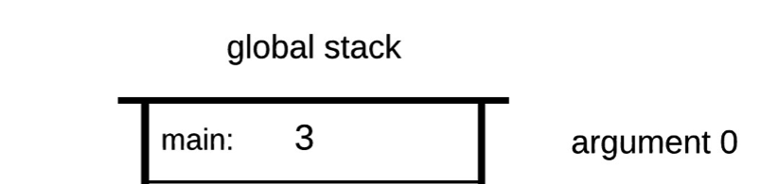
Example: factorial
function main 0
push constant 3
call factorial 1
return
function factorial 0
push argument 0
push constant 1
eq
if-goto BASECASE
push argument 0
push argument 0
push constant 1
sub
call factorial 1
call mult 2
return
label BASECASE
push constant 1
return
function mult 2
// Code omitted

Slide 63
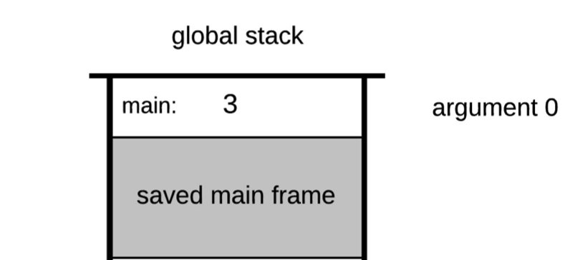
Example: factorial
function main 0
push constant 3
call factorial 1
return
function factorial 0
push argument 0
push constant 1
eq
if-goto BASECASE
push argument 0
push argument 0
push constant 1
sub
call factorial 1
call mult 2
return
label BASECASE
push constant 1
return
function mult 2
// Code omitted

Slide 64
Example: factorial
function main 0
push constant 3
call factorial 1
return
function factorial 0
push argument 0
push constant 1
eq
if-goto BASECASE
push argument 0
push argument 0
push constant 1
sub
call factorial 1
call mult 2
return
label BASECASE
push constant 1
return
function mult 2
// Code omitted

Slide 65
Example: factorial
function main 0
push constant 3
call factorial 1
return
function factorial 0
push argument 0
push constant 1
eq
if-goto BASECASE
push argument 0
push argument 0
push constant 1
sub
call factorial 1
call mult 2
return
label BASECASE
push constant 1
return
function mult 2
// Code omitted
impact on the global stack
not shown

Slide 66
Example: factorial
function main 0
push constant 3
call factorial 1
return
function factorial 0
push argument 0
push constant 1
eq
if-goto BASECASE
push argument 0
push argument 0
push constant 1
sub
call factorial 1
call mult 2
return
label BASECASE
push constant 1
return
function mult 2
// Code omitted

Slide 67
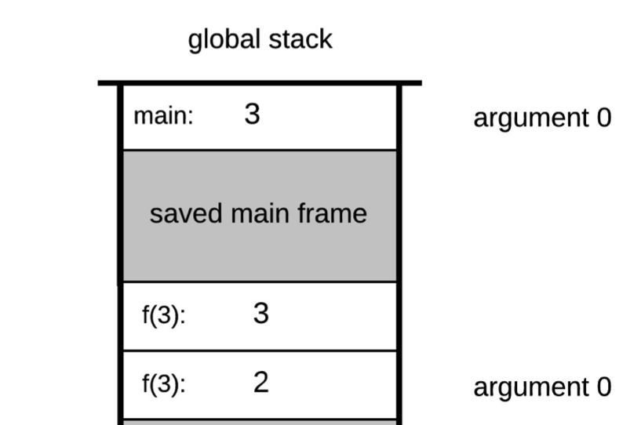
Example: factorial
function main 0
push constant 3
call factorial 1
return
function factorial 0
push argument 0
push constant 1
eq
if-goto BASECASE
push argument 0
push argument 0
push constant 1
sub
call factorial 1
call mult 2
return
label BASECASE
push constant 1
return
function mult 2
// Code omitted

Slide 68
Example: factorial
function main 0
push constant 3
call factorial 1
return
function factorial 0
push argument 0
push constant 1
eq
if-goto BASECASE
push argument 0
push argument 0
push constant 1
sub
call factorial 1
call mult 2
return
label BASECASE
push constant 1
return
function mult 2
// Code omitted

Slide 69
Example: factorial
function main 0
push constant 3
call factorial 1
return
function factorial 0
push argument 0
push constant 1
eq
if-goto BASECASE
push argument 0
push argument 0
push constant 1
sub
call factorial 1
call mult 2
return
label BASECASE
push constant 1
return
function mult 2
// Code omitted

Slide 70
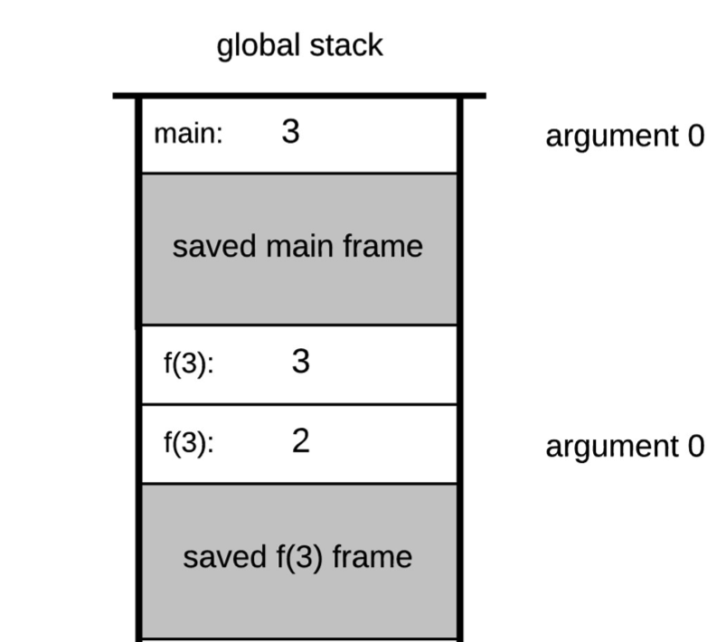
Example: factorial
function main 0
push constant 3
call factorial 1
return
function factorial 0
push argument 0
push constant 1
eq
if-goto BASECASE
push argument 0
push argument 0
push constant 1
sub
call factorial 1
call mult 2
return
label BASECASE
push constant 1
return
function mult 2
// Code omitted

Slide 71
Example: factorial
function main 0
push constant 3
call factorial 1
return
function factorial 0
push argument 0
push constant 1
eq
if-goto BASECASE
push argument 0
push argument 0
push constant 1
sub
call factorial 1
call mult 2
return
label BASECASE
push constant 1
return
function mult 2
// Code omitted

Slide 72
Example: factorial
function main 0
push constant 3
call factorial 1
return
function factorial 0
push argument 0
push constant 1
eq
if-goto BASECASE
push argument 0
push argument 0
push constant 1
sub
call factorial 1
call mult 2
return
label BASECASE
push constant 1
return
function mult 2
// Code omitted
impact on the global stack
not shown

Slide 73
Example: factorial
function main 0
push constant 3
call factorial 1
return
function factorial 0
push argument 0
push constant 1
eq
if-goto BASECASE
push argument 0
push argument 0
push constant 1
sub
call factorial 1
call mult 2
return
label BASECASE
push constant 1
return
function mult 2
// Code omitted

Slide 74
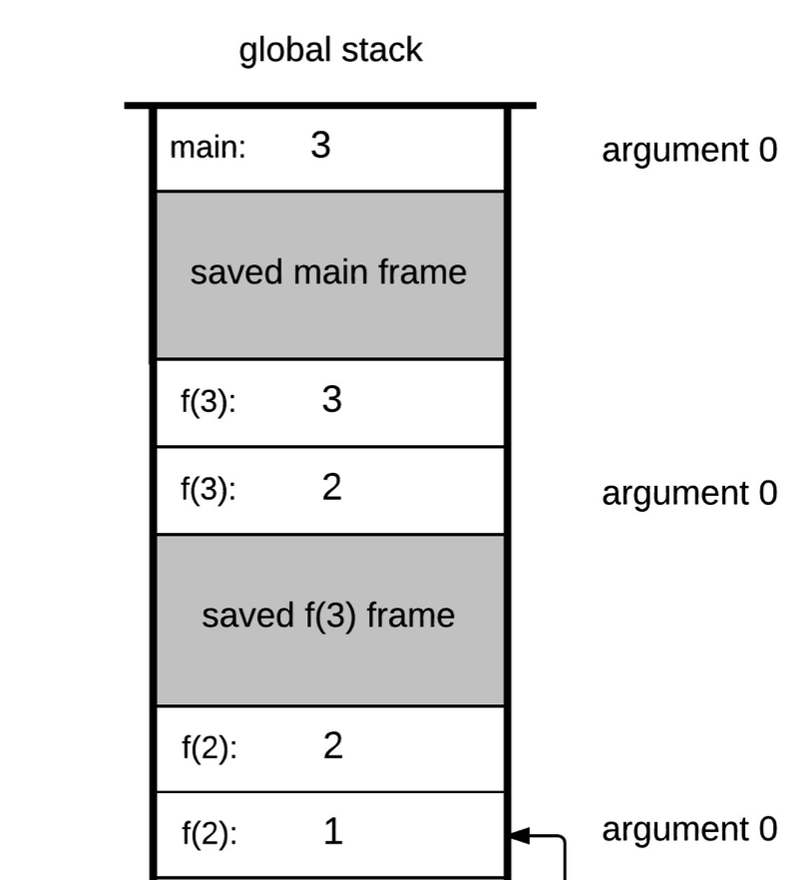
Example: factorial
function main 0
push constant 3
call factorial 1
return
function factorial 0
push argument 0
push constant 1
eq
if-goto BASECASE
push argument 0
push argument 0
push constant 1
sub
call factorial 1
call mult 2
return
label BASECASE
push constant 1
return
function mult 2
// Code omitted

Slide 75
Example: factorial
function main 0
push constant 3
call factorial 1
return
function factorial 0
push argument 0
push constant 1
eq
if-goto BASECASE
push argument 0
push argument 0
push constant 1
sub
call factorial 1
call mult 2
return
label BASECASE
push constant 1
return
function mult 2
// Code omitted

Slide 76
Example: factorial
function main 0
push constant 3
call factorial 1
return
function factorial 0
push argument 0
push constant 1
eq
if-goto BASECASE
push argument 0
push argument 0
push constant 1
sub
call factorial 1
call mult 2
return
label BASECASE
push constant 1
return
function mult 2
// Code omitted

Slide 77
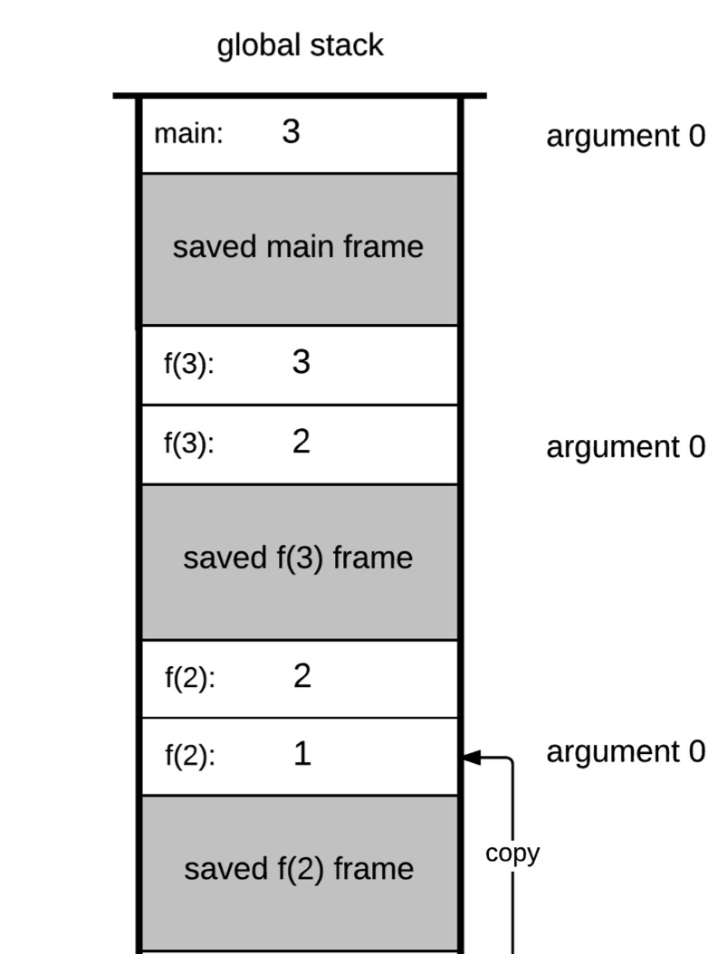
Example: factorial
function main 0
push constant 3
call factorial 1
return
function factorial 0
push argument 0
push constant 1
eq
if-goto BASECASE
push argument 0
push argument 0
push constant 1
sub
call factorial 1
call mult 2
return
label BASECASE
push constant 1
return
function mult 2
// Code omitted

Slide 78
Example: factorial
function main 0
push constant 3
call factorial 1
return
function factorial 0
push argument 0
push constant 1
eq
if-goto BASECASE
push argument 0
push argument 0
push constant 1
sub
call factorial 1
call mult 2
return
label BASECASE
push constant 1
return
function mult 2
// Code omitted

Slide 79
Example: factorial
function main 0
push constant 3
call factorial 1
return
function factorial 0
push argument 0
push constant 1
eq
if-goto BASECASE
push argument 0
push argument 0
push constant 1
sub
call factorial 1
call mult 2
return
label BASECASE
push constant 1
return
function mult 2
// Code omitted
impact on the global stack
not shown

Slide 80
Example: factorial
function main 0
push constant 3
call factorial 1
return
function factorial 0
push argument 0
push constant 1
eq
if-goto BASECASE
push argument 0
push argument 0
push constant 1
sub
call factorial 1
call mult 2
return
label BASECASE
push constant 1
return
function mult 2
// Code omitted

Slide 81
Example: factorial
function main 0
push constant 3
call factorial 1
return
function factorial 0
push argument 0
push constant 1
eq
if-goto BASECASE
push argument 0
push argument 0
push constant 1
sub
call factorial 1
call mult 2
return
label BASECASE
push constant 1
return
function mult 2
// Code omitted

Slide 82
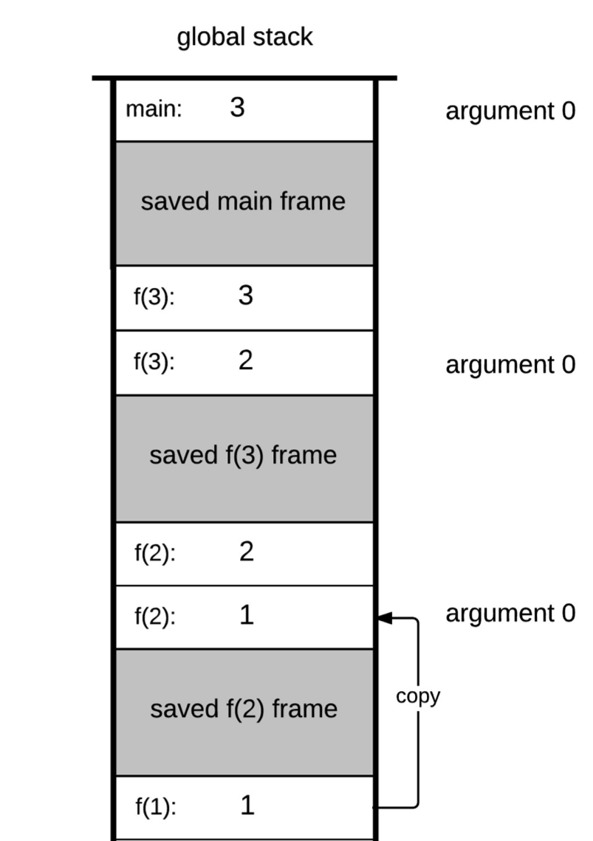
Example: factorial
function main 0
push constant 3
call factorial 1
return
function factorial 0
push argument 0
push constant 1
eq
if-goto BASECASE
push argument 0
push argument 0
push constant 1
sub
call factorial 1
call mult 2
return
label BASECASE
push constant 1
return
function mult 2
// Code omitted

Slide 83
Example: factorial
function main 0
push constant 3
call factorial 1
return
function factorial 0
push argument 0
push constant 1
eq
if-goto BASECASE
push argument 0
push argument 0
push constant 1
sub
call factorial 1
call mult 2
return
label BASECASE
push constant 1
return
function mult 2
// Code omitted
get the
return address

Slide 84
Example: factorial
function main 0
push constant 3
call factorial 1
return
function factorial 0
push argument 0
push constant 1
eq
if-goto BASECASE
push argument 0
push argument 0
push constant 1
sub
call factorial 1
call mult 2
return
label BASECASE
push constant 1
return
function mult 2
// Code omitted
handle the
return value

Slide 85
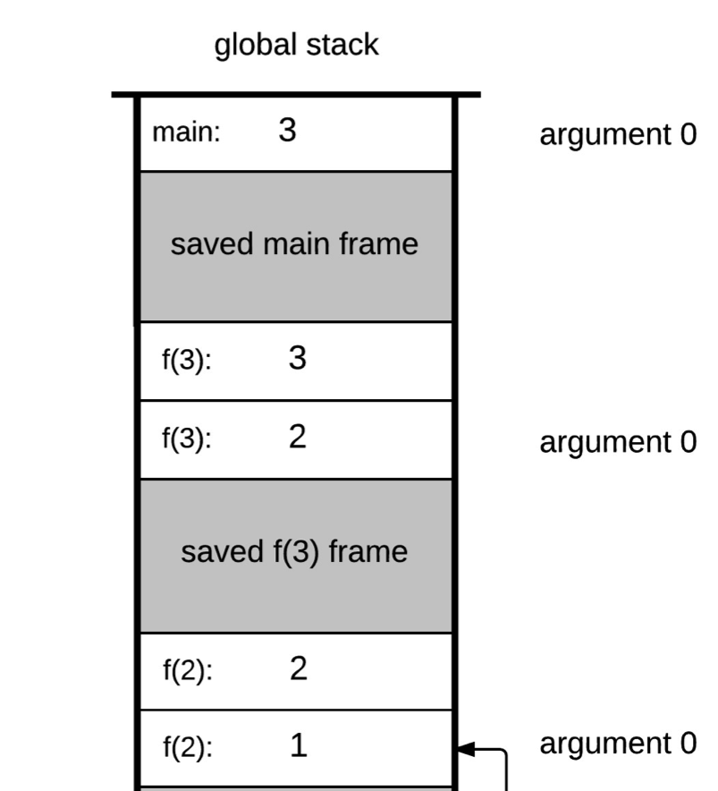
Example: factorial
function main 0
push constant 3
call factorial 1
return
function factorial 0
push argument 0
push constant 1
eq
if-goto BASECASE
push argument 0
push argument 0
push constant 1
sub
call factorial 1
call mult 2
return
label BASECASE
push constant 1
return
function mult 2
// Code omitted

Slide 86
Example: factorial
function main 0
push constant 3
call factorial 1
return
function factorial 0
push argument 0
push constant 1
eq
if-goto BASECASE
push argument 0
push argument 0
push constant 1
sub
call factorial 1
call mult 2
return
label BASECASE
push constant 1
return
function mult 2
// Code omitted
impact on the global stack not shown
(except for end result)

Slide 87
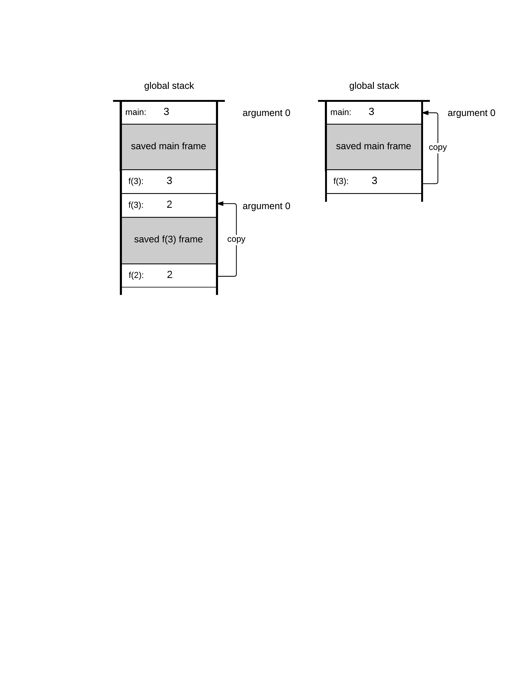
Example: factorial
function main 0
push constant 3
call factorial 1
return
function factorial 0
push argument 0
push constant 1
eq
if-goto BASECASE
push argument 0
push argument 0
push constant 1
sub
call factorial 1
call mult 2
return
label BASECASE
push constant 1
return
function mult 2
// Code omitted

Slide 88
Example: factorial
function main 0
push constant 3
call factorial 1
return
function factorial 0
push argument 0
push constant 1
eq
if-goto BASECASE
push argument 0
push argument 0
push constant 1
sub
call factorial 1
call mult 2
return
label BASECASE
push constant 1
return
function mult 2
// Code omitted
get return address

Slide 89
Example: factorial
function main 0
push constant 3
call factorial 1
return
function factorial 0
push argument 0
push constant 1
eq
if-goto BASECASE
push argument 0
push argument 0
push constant 1
sub
call factorial 1
call mult 2
return
label BASECASE
push constant 1
return
function mult 2
// Code omitted
handle the
return value

Slide 90
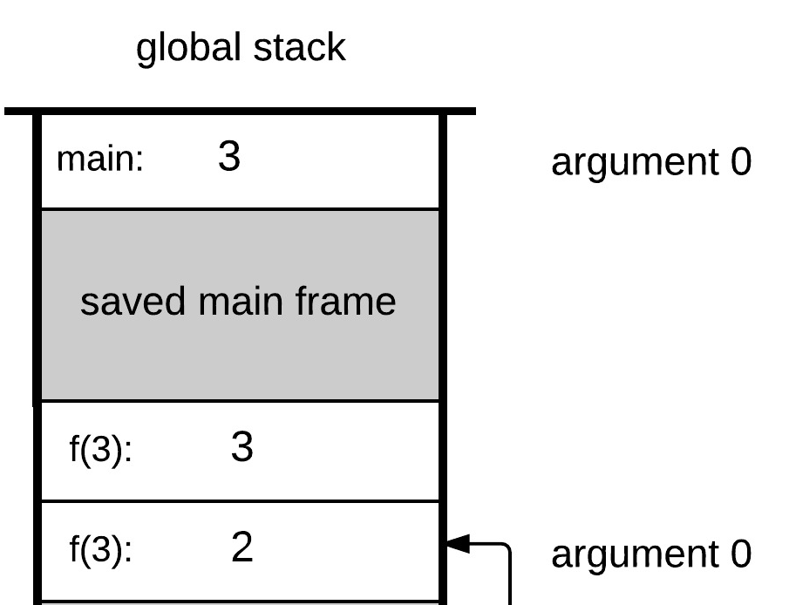
Example: factorial
function main 0
push constant 3
call factorial 1
return
function factorial 0
push argument 0
push constant 1
eq
if-goto BASECASE
push argument 0
push argument 0
push constant 1
sub
call factorial 1
call mult 2
return
label BASECASE
push constant 1
return
function mult 2
// Code omitted

Slide 91
Example: factorial
function main 0
push constant 3
call factorial 1
return
function factorial 0
push argument 0
push constant 1
eq
if-goto BASECASE
push argument 0
push argument 0
push constant 1
sub
call factorial 1
call mult 2
return
label BASECASE
push constant 1
return
function mult 2
// Code omitted
impact on the global stack not shown
(except for end result)

Slide 92
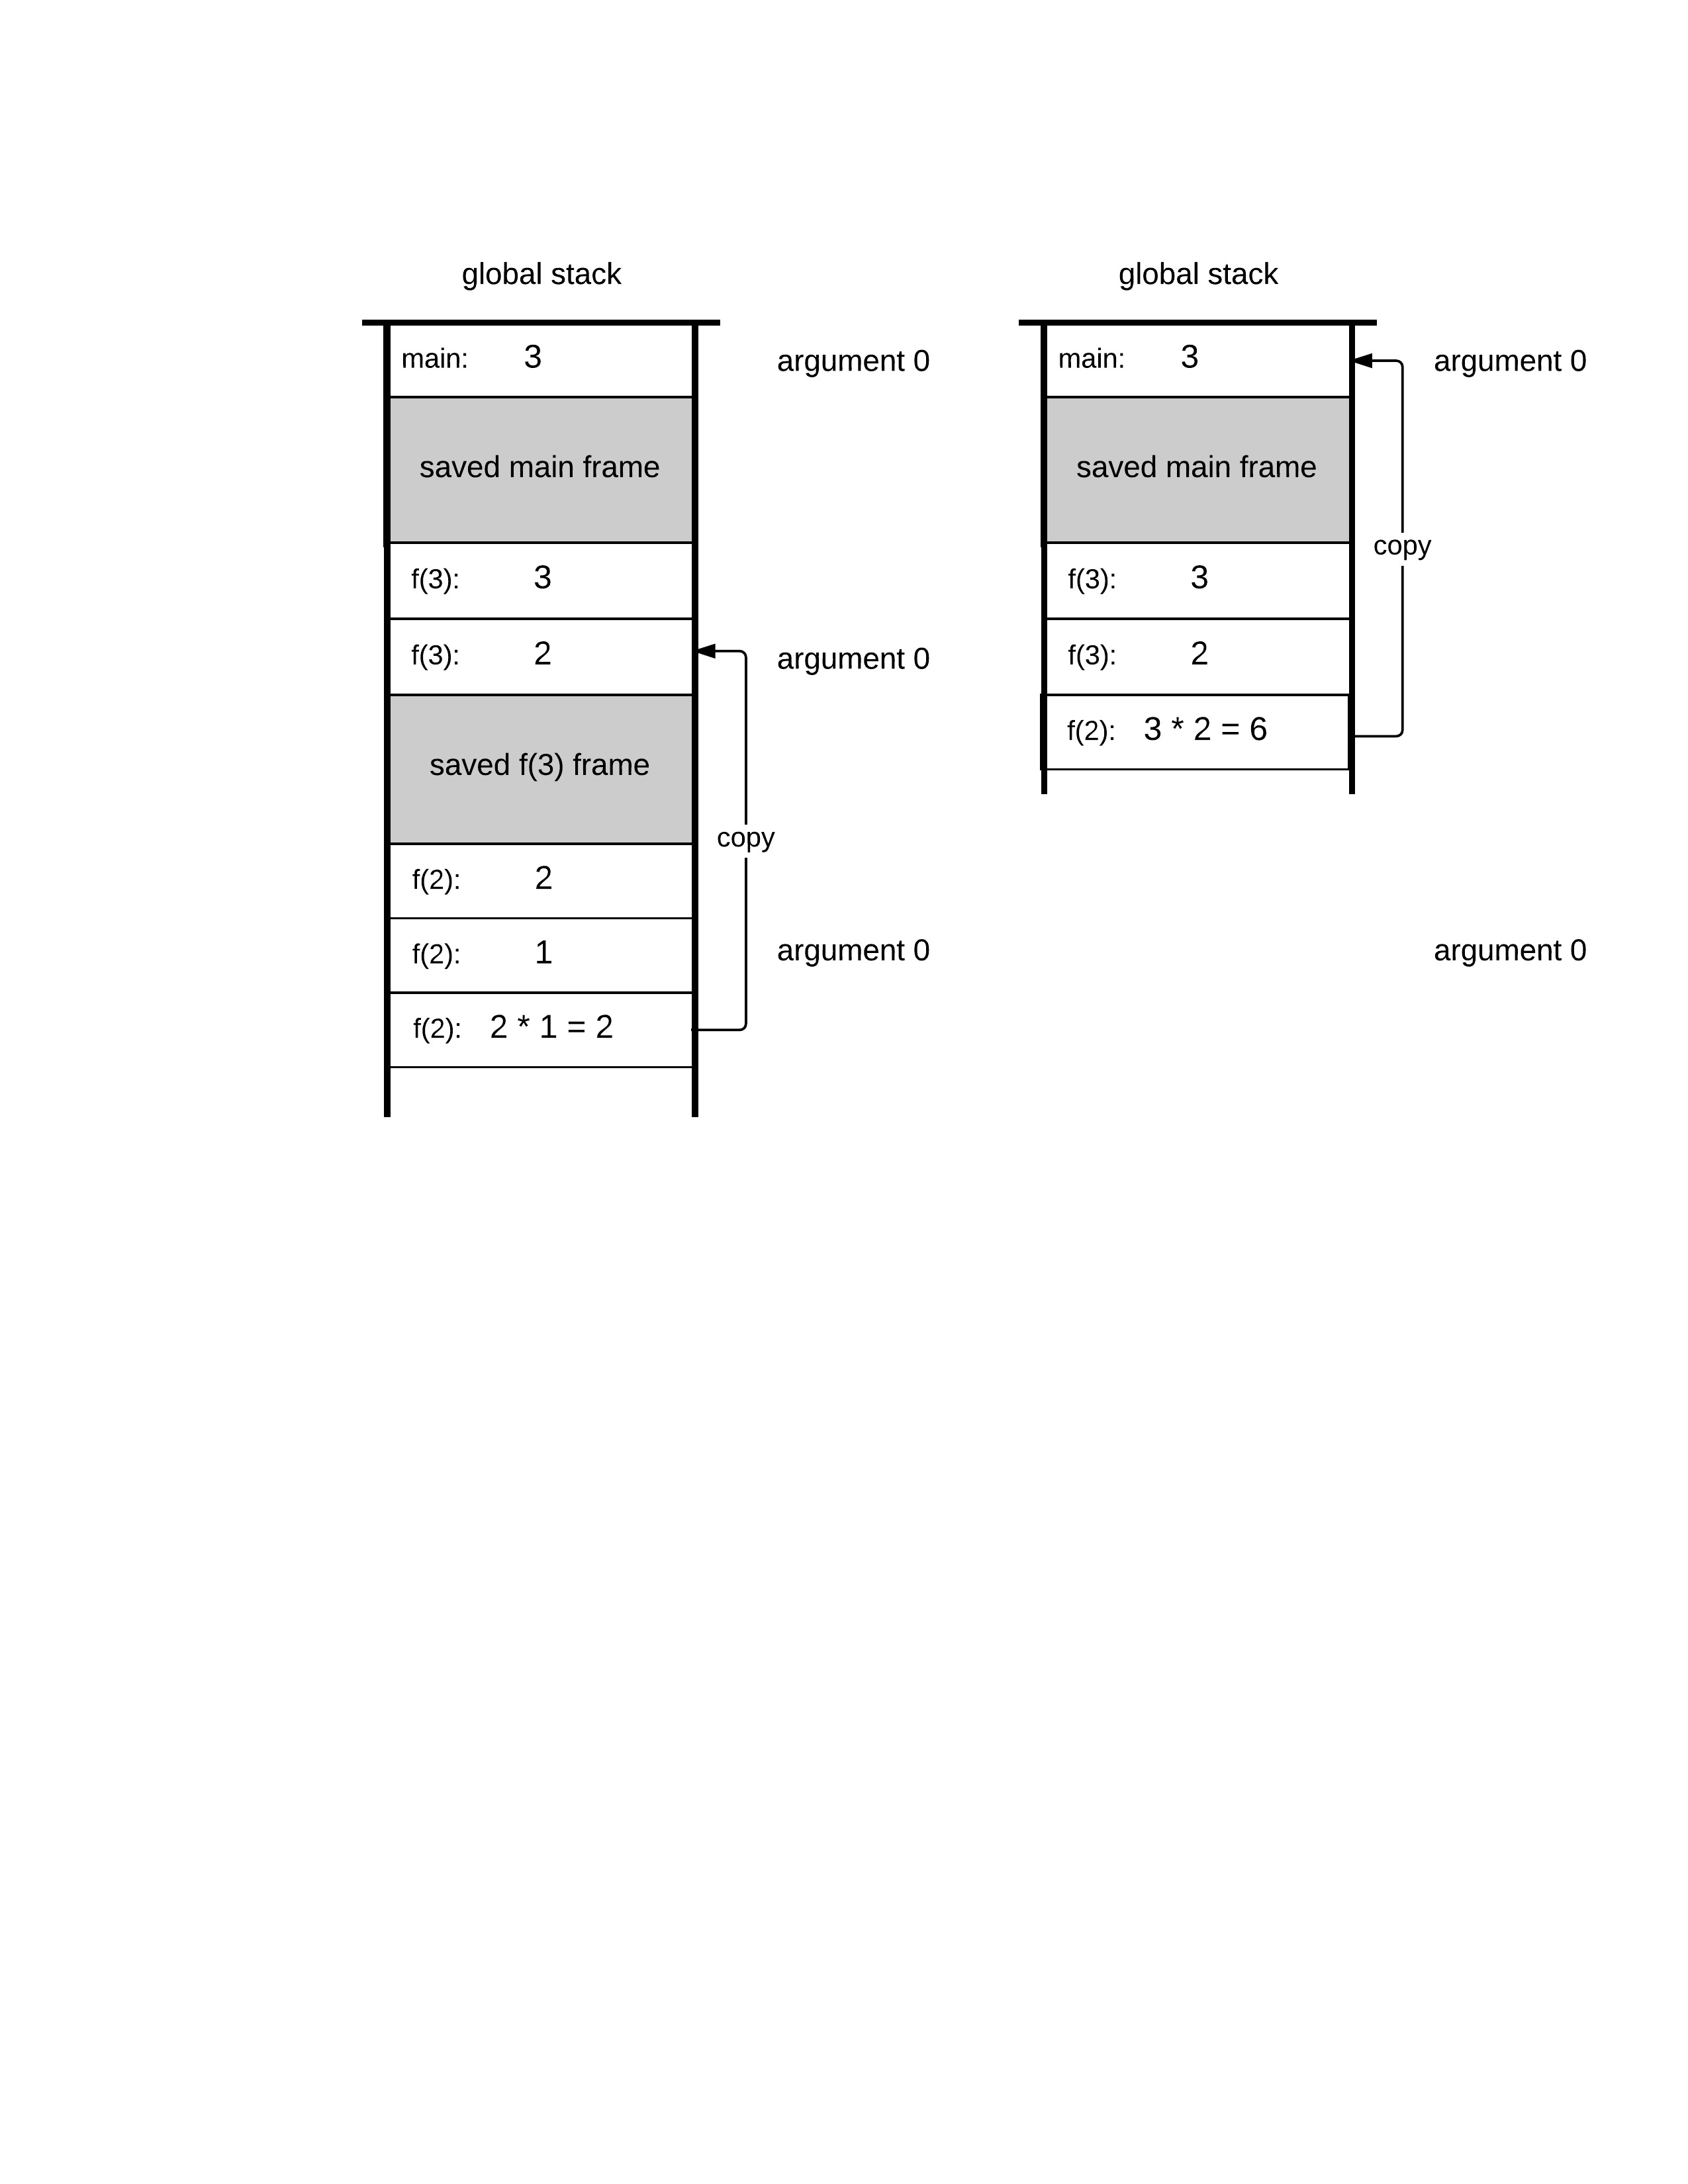
Example: factorial
function main 0
push constant 3
call factorial 1
return
function factorial 0
push argument 0
push constant 1
eq
if-goto BASECASE
push argument 0
push argument 0
push constant 1
sub
call factorial 1
call mult 2
return
label BASECASE
push constant 1
return
function mult 2
// Code omitted
6
impact on the global stack not shown
(except for end result)

Slide 93
Example: factorial
function main 0
push constant 3
call factorial 1
return
function factorial 0
push argument 0
push constant 1
eq
if-goto BASECASE
push argument 0
push argument 0
push constant 1
sub
call factorial 1
call mult 2
return
label BASECASE
push constant 1
return
function mult 2
// Code omitted
get return address
6

Slide 94
Example: factorial
function main 0
push constant 3
call factorial 1
return
function factorial 0
push argument 0
push constant 1
eq
if-goto BASECASE
push argument 0
push argument 0
push constant 1
sub
call factorial 1
call mult 2
return
label BASECASE
push constant 1
return
function mult 2
// Code omitted
6
handle the
return value
6

Slide 95
Example: factorial
function main 0
push constant 3
call factorial 1
return
function factorial 0
push argument 0
push constant 1
eq
if-goto BASECASE
push argument 0
push argument 0
push constant 1
sub
call factorial 1
call mult 2
return
label BASECASE
push constant 1
return
function mult 2
// Code omitted
6

Slide 96
Example: factorial
function main 0
push constant 3
call factorial 1
return
function factorial 0
push argument 0
push constant 1
eq
if-goto BASECASE
push argument 0
push argument 0
push constant 1
sub
call factorial 1
call mult 2
return
label BASECASE
push constant 1
return
function mult 2
// Code omitted
6

Slide 97

Example: factorial
function main 0
push constant 3
call factorial 1
return
function factorial 0
push argument 0
push constant 1
eq
if-goto BASECASE
push argument 0
push argument 0
push constant 1
sub
call factorial 1
call mult 2
return
label BASECASE
push constant 1
return
function mult 2
// Code omitted
6
The caller (main function) wanted to compute 3!
  it pushed 3, called factorial, and got 6
  from the caller’s view, nothing exciting happenned...
abstraction
implementation

Slide 98
Function commands in the VM language
function g nVars // here starts a function called g,
// which has nVars local variables
call g nArgs // invoke function g for its effect;
// nArgs arguments have already been pushed
// onto the stack
return // terminate execution and return control
// to the caller
Q: Why this particular syntax?
A: Because it simplifies the VM implementation.
Notes:
98

Slide 99
Function call and return
VM code (arbitrary example)
function Foo.main 4
...
// computes –(19 * (local 3))
push constant 19
push local 3
call Bar.mult 2
neg
...
function Bar.mult 2
// Computes the product of the first two
// arguments and puts the result in local 1
...
push local 1 // return value
return
caller
We focus on the VM function commands:
call functionName nArgs
function functionName nVars
return
callee
Notes:
99

Slide 100
Contract: the caller’s view
VM code
function Foo.main 4
...
// computes –(19 * (local 3))
push constant 19
push local 3
call Bar.mult 2
neg
...
function Bar.mult 2
// Computes the product of the first two
// arguments and puts the result in local 1
...
push local 1 // return value
return
Before calling another function, I must push as many arguments as the function expects to get
Next, I invoke the function using
call functionName nArgs
After the called function returns, the argument values that I pushed before the call have disappeared from the stack, and a return value
(that always exists) appears at the top of the stack;
After the called function returns, all my memory segments are exactly the same as they were before the call
(except that temp is undefined and some values of my static segment may have changed).
caller
Notes:
100

Slide 101
Contract: the caller’s view
VM code
function Foo.main 4
...
// computes –(19 * (local 3))
push constant 19
push local 3
call Bar.mult 2
neg
...
function Bar.mult 2
// Computes the product of the first two
// arguments and puts the result in local 1
...
push local 1 // return value
return
Before calling another function, I must push as many arguments as the function expects to get
Next, I invoke the function using
call functionName nArgs
After the called function returns, the argument values that I pushed before the call have disappeared from the stack, and a return value
(that always exists) appears at the top of the stack;
After the called function returns, all my memory segments are exactly the same as they were before the call
(except that temp is undefined and some values of my static segment may have changed).
caller
blue: must be handled by the VM implementation
Notes:
101

Slide 102
Contract: the callee’s view
VM code
function Foo.main 4
...
// computes –(19 * (local 3))
push constant 19
push local 3
call Bar.mult 2
neg
...
function Bar.mult 2
// Computes the product of the first two
// arguments and puts the result in local 1
...
push local 1 // return value
return
Before I start executing, my argument segment has been initialized with the argument values passed by the caller
My local variables segment has been allocated and initialized to zeros
My static segment has been set to the static segment of the VM ﬁle to which I belong
(memory segments this, that, pointer, and temp are undeﬁned upon entry)
My stack is empty
Before returning,
I must push a value onto the stack.
callee
Notes:
102

Slide 103
Contract: the callee’s view
VM code
function Foo.main 4
...
// computes –(19 * (local 3))
push constant 19
push local 3
call Bar.mult 2
neg
...
function Bar.mult 2
// Computes the product of the first two
// arguments and puts the result in local 1
...
push local 1 // return value
return
Before I start executing, my argument segment has been initialized with the argument values passed by the caller
My local variables segment has been allocated and initialized to zeros
My static segment has been set to the static segment of the VM ﬁle to which I belong
(memory segments this, that, pointer, and temp are undeﬁned upon entry)
My stack is empty
Before returning,
I must push a value onto the stack.
callee
blue: must be handled by the VM implementation
Notes:
103

Slide 104
The VM implementation view
VM code
Generated assembly code
function Foo.main 4
...
// computes –(19 * (local 3))
push constant 19
push local 3
call Bar.mult 2
neg
...
function Bar.mult 2
// Computes the product of the first two
// arguments and puts the result in local 1
...
push local 1 // return value
return
VM translator
Notes:
104

Slide 105
The VM implementation view
VM code
Generated assembly code
function Foo.main 4
...
// computes –(19 * (local 3))
push constant 19
push local 3
call Bar.mult 2
neg
...
function Bar.mult 2
// Computes the product of the first two
// arguments and puts the result in local 1
...
push local 1 // return value
return
(Foo.main) // created and plugged by the translator
// assembly code that handles the initialization of the
// function’s execution
...
VM translator
Notes:
105

Slide 106
The VM implementation view
VM code
Generated assembly code
function Foo.main 4
...
// computes –(19 * (local 3))
push constant 19
push local 3
call Bar.mult 2
neg
...
function Bar.mult 2
// Computes the product of the first two
// arguments and puts the result in local 1
...
push local 1 // return value
return
(Foo.main) // created and plugged by the translator
// assembly code that handles the initialization of the
// function’s execution
...
// assembly code that handles push constant 19
// assembly code that handles push local 3
VM translator
Notes:
106

Slide 107
The VM implementation view
VM code
Generated assembly code
function Foo.main 4
...
// computes –(19 * (local 3))
push constant 19
push local 3
call Bar.mult 2
neg
...
function Bar.mult 2
// Computes the product of the first two
// arguments and puts the result in local 1
...
push local 1 // return value
return
(Foo.main) // created and plugged by the translator
// assembly code that handles the initialization of the
// function’s execution
...
// assembly code that handles push constant 19
// assembly code that handles push local 3
// assembly code that saves the caller’s state on the stack,
// sets up for the function call, and then:
goto Bar.mult // (in assembly)
(Foo$ret.1) // created and plugged by the translator
VM translator
Notes:
107

Slide 108
The VM implementation view
VM code
Generated assembly code
function Foo.main 4
...
// computes –(19 * (local 3))
push constant 19
push local 3
call Bar.mult 2
neg
...
function Bar.mult 2
// Computes the product of the first two
// arguments and puts the result in local 1
...
push local 1 // return value
return
(Foo.main) // created and plugged by the translator
// assembly code that handles the initialization of the
// function’s execution
...
// assembly code that handles push constant 19
// assembly code that handles push local 3
// assembly code that saves the caller’s state on the stack,
// sets up for the function call, and then:
goto Bar.mult // (in assembly)
(Foo$ret.1) // created and plugged by the translator
// assembly code that handles neg
...
VM translator
Notes:
108

Slide 109
The VM implementation view
VM code
Generated assembly code
function Foo.main 4
...
// computes –(19 * (local 3))
push constant 19
push local 3
call Bar.mult 2
neg
...
function Bar.mult 2
// Computes the product of the first two
// arguments and puts the result in local 1
...
push local 1 // return value
return
(Foo.main) // created and plugged by the translator
// assembly code that handles the initialization of the
// function’s execution
...
// assembly code that handles push constant 19
// assembly code that handles push local 3
// assembly code that saves the caller’s state on the stack,
// sets up for the function call, and then:
goto Bar.mult // (in assembly)
(Foo$ret.1) // created and plugged by the translator
// assembly code that handles neg
...
(Bar.mult) // created and plugged by the translator
// assembly code that handles the initialization of the
// function’s execution
...
VM translator
Notes:
109

Slide 110
The VM implementation view
VM code
Generated assembly code
function Foo.main 4
...
// computes –(19 * (local 3))
push constant 19
push local 3
call Bar.mult 2
neg
...
function Bar.mult 2
// Computes the product of the first two
// arguments and puts the result in local 1
...
push local 1 // return value
return
(Foo.main) // created and plugged by the translator
// assembly code that handles the initialization of the
// function’s execution
...
// assembly code that handles push constant 19
// assembly code that handles push local 3
// assembly code that saves the caller’s state on the stack,
// sets up for the function call, and then:
goto Bar.mult // (in assembly)
(Foo$ret.1) // created and plugged by the translator
// assembly code that handles neg
...
(Bar.mult) // created and plugged by the translator
// assembly code that handles the initialization of the
// function’s execution
...
// assembly code that handles push local 1
VM translator
Notes:
110

Slide 111
The VM implementation view
VM code
Generated assembly code
function Foo.main 4
...
// computes –(19 * (local 3))
push constant 19
push local 3
call Bar.mult 2
neg
...
function Bar.mult 2
// Computes the product of the first two
// arguments and puts the result in local 1
...
push local 1 // return value
return
(Foo.main) // created and plugged by the translator
// assembly code that handles the initialization of the
// function’s execution
...
// assembly code that handles push constant 19
// assembly code that handles push local 3
// assembly code that saves the caller’s state on the stack,
// sets up for the function call, and then:
goto Bar.mult // (in assembly)
(Foo$ret.1) // created and plugged by the translator
// assembly code that handles neg
...
(Bar.mult) // created and plugged by the translator
// assembly code that handles the initialization of the
// function’s execution
...
// assembly code that handles push local 1
// Assembly code that gets the return address (which happens
// to be Foo$ret.1) off the stack, copies the return value to
// the caller, reinstates the caller’s state, and then:
goto Foo$ret.1 // (in assembly)
VM translator
Notes:
111

Slide 112
The VM implementation view
VM code
Generated assembly code
function Foo.main 4
...
// computes –(19 * (local 3))
push constant 19
push local 3
call Bar.mult 2
neg
...
function Bar.mult 2
// Computes the product of the first two
// arguments and puts the result in local 1
...
push local 1 // return value
return
(Foo.main) // created and plugged by the translator
// assembly code that handles the initialization of the
// function’s execution
...
// assembly code that handles push constant 19
// assembly code that handles push local 3
// assembly code that saves the caller’s state on the stack,
// sets up for the function call, and then:
goto Bar.mult // (in assembly)
(Foo$ret.1) // created and plugged by the translator
// assembly code that handles neg
...
(Bar.mult) // created and plugged by the translator
// assembly code that handles the initialization of the
// function’s execution
...
// assembly code that handles push local 1
// Assembly code that gets the return address (which happens
// to be Foo$ret.1) off the stack, copies the return value to
// the caller, reinstates the caller’s state, and then:
goto Foo$ret.1 // (in assembly)
VM translator
psuedo code
We now turn to describe the more
detailed handling of the VM commands:
call
function
return
Notes:
112

Slide 113
The VM implementation view
VM code
Generated assembly code
function Foo.main 4
...
// computes –(19 * (local 3))
push constant 19
push local 3
call Bar.mult 2
neg
...
function Bar.mult 2
// Computes the product of the first two
// arguments and puts the result in local 1
...
push local 1 // return value
return
(Foo.main) // created and plugged by the translator
// assembly code that handles the initialization of the
// function’s execution
...
// assembly code that handles push constant 19
// assembly code that handles push local 3
// assembly code that saves the caller’s state on the stack,
// sets up for the function call, and then:
goto Bar.mult // (in assembly)
(Foo$ret.1) // created and plugged by the translator
// assembly code that handles neg
...
(Bar.mult) // created and plugged by the translator
// assembly code that handles the initialization of the
// function’s execution
...
// assembly code that handles push local 1
// Assembly code that gets the return address (which happens
// to be Foo$ret.1) off the stack, copies the return value to
// the caller, reinstates the caller’s state, and then:
goto Foo$ret.1 // (in assembly)
VM translator
Notes:
113

Slide 114
Handling call
VM command:
call functionName nArgs
global stack
(calls a function, informing that nArgs arguments
have been pushed onto the stack)
states of other functions
up the calling chain
the caller is running, doing some work...
Notes:
114

Slide 115
Handling call
VM command:
call functionName nArgs
global stack
(calls a function, informing that nArgs arguments
have been pushed onto the stack)
states of other functions
up the calling chain
nArgs
Notes:
115

Slide 116
Handling call
VM command:
call functionName nArgs
global stack
(calls a function, informing that nArgs arguments
have been pushed onto the stack)
states of other functions
up the calling chain
Assembly code (generated by the translator):
nArgs
Notes:
116

Slide 117
Handling call
VM command:
call functionName nArgs
global stack
(calls a function, informing that nArgs arguments
have been pushed onto the stack)
states of other functions
up the calling chain
Assembly code (generated by the translator):
nArgs
push retAddrLabel // Using a translator-generated label
Notes:
117

Slide 118
Handling call
VM command:
call functionName nArgs
global stack
(calls a function, informing that nArgs arguments
have been pushed onto the stack)
states of other functions
up the calling chain
Assembly code (generated by the translator):
nArgs
push retAddrLabel // Using a translator-generated label
Notes:
118

Slide 119
Handling call
VM command:
call functionName nArgs
global stack
(calls a function, informing that nArgs arguments
have been pushed onto the stack)
states of other functions
up the calling chain
Assembly code (generated by the translator):
nArgs
push retAddrLabel // Using a translator-generated label
push LCL // Saves LCL of the caller
Notes:
119

Slide 120
Handling call
VM command:
call functionName nArgs
global stack
(calls a function, informing that nArgs arguments
have been pushed onto the stack)
states of other functions
up the calling chain
Assembly code (generated by the translator):
nArgs
push retAddrLabel // Using a translator-generated label
push LCL // Saves LCL of the caller
Notes:
120

Slide 121
Handling call
VM command:
call functionName nArgs
global stack
(calls a function, informing that nArgs arguments
have been pushed onto the stack)
states of other functions
up the calling chain
Assembly code (generated by the translator):
nArgs
push retAddrLabel // Using a translator-generated label
push LCL // Saves LCL of the caller
push ARG // Saves ARG of the caller
Notes:
121

Slide 122
Handling call
VM command:
call functionName nArgs
global stack
(calls a function, informing that nArgs arguments
have been pushed onto the stack)
states of other functions
up the calling chain
Assembly code (generated by the translator):
nArgs
push retAddrLabel // Using a translator-generated label
push LCL // Saves LCL of the caller
push ARG // Saves ARG of the caller
Notes:
122

Slide 123
Handling call
VM command:
call functionName nArgs
global stack
(calls a function, informing that nArgs arguments
have been pushed onto the stack)
states of other functions
up the calling chain
Assembly code (generated by the translator):
nArgs
push retAddrLabel // Using a translator-generated label
push LCL // Saves LCL of the caller
push ARG // Saves ARG of the caller
push THIS // Saves THIS of the caller
Notes:
123

Slide 124
Handling call
VM command:
call functionName nArgs
global stack
(calls a function, informing that nArgs arguments
have been pushed onto the stack)
states of other functions
up the calling chain
Assembly code (generated by the translator):
nArgs
push retAddrLabel // Using a translator-generated label
push LCL // Saves LCL of the caller
push ARG // Saves ARG of the caller
push THIS // Saves THIS of the caller
Notes:
124

Slide 125
Handling call
VM command:
call functionName nArgs
global stack
(calls a function, informing that nArgs arguments
have been pushed onto the stack)
states of other functions
up the calling chain
Assembly code (generated by the translator):
nArgs
push retAddrLabel // Using a translator-generated label
push LCL // Saves LCL of the caller
push ARG // Saves ARG of the caller
push THIS // Saves THIS of the caller
push THAT // Saves THAT of the caller
Notes:
125

Slide 126
Handling call
VM command:
call functionName nArgs
global stack
(calls a function, informing that nArgs arguments
have been pushed onto the stack)
states of other functions
up the calling chain
Assembly code (generated by the translator):
nArgs
push retAddrLabel // Using a translator-generated label
push LCL // Saves LCL of the caller
push ARG // Saves ARG of the caller
push THIS // Saves THIS of the caller
push THAT // Saves THAT of the caller
Notes:
126

Slide 127
Handling call
VM command:
call functionName nArgs
global stack
(calls a function, informing that nArgs arguments
have been pushed onto the stack)
states of other functions
up the calling chain
Assembly code (generated by the translator):
nArgs
push retAddrLabel // Using a translator-generated label
push LCL // Saves LCL of the caller
push ARG // Saves ARG of the caller
push THIS // Saves THIS of the caller
push THAT // Saves THAT of the caller
ARG = SP-5-nArgs // Repositions ARG
Notes:
127

Slide 128
Handling call
VM command:
call functionName nArgs
global stack
(calls a function, informing that nArgs arguments
have been pushed onto the stack)
states of other functions
up the calling chain
Assembly code (generated by the translator):
nArgs
push retAddrLabel // Using a translator-generated label
push LCL // Saves LCL of the caller
push ARG // Saves ARG of the caller
push THIS // Saves THIS of the caller
push THAT // Saves THAT of the caller
ARG = SP-5-nArgs // Repositions ARG
Notes:
128

Slide 129
Handling call
VM command:
call functionName nArgs
global stack
(calls a function, informing that nArgs arguments
have been pushed onto the stack)
states of other functions
up the calling chain
Assembly code (generated by the translator):
nArgs
push retAddrLabel // Using a translator-generated label
push LCL // Saves LCL of the caller
push ARG // Saves ARG of the caller
push THIS // Saves THIS of the caller
push THAT // Saves THAT of the caller
ARG = SP-5-nArgs // Repositions ARG
LCL = SP // Repositions LCL
Notes:
129

Slide 130
Handling call
VM command:
call functionName nArgs
global stack
(calls a function, informing that nArgs arguments
have been pushed onto the stack)
states of other functions
up the calling chain
Assembly code (generated by the translator):
nArgs
push retAddrLabel // Using a translator-generated label
push LCL // Saves LCL of the caller
push ARG // Saves ARG of the caller
push THIS // Saves THIS of the caller
push THAT // Saves THAT of the caller
ARG = SP-5-nArgs // Repositions ARG
LCL = SP // Repositions LCL
Notes:
130

Slide 131
Handling call
VM command:
call functionName nArgs
global stack
(calls a function, informing that nArgs arguments
have been pushed onto the stack)
states of other functions
up the calling chain
Assembly code (generated by the translator):
nArgs
push retAddrLabel // Using a translator-generated label
push LCL // Saves LCL of the caller
push ARG // Saves ARG of the caller
push THIS // Saves THIS of the caller
push THAT // Saves THAT of the caller
ARG = SP-5-nArgs // Repositions ARG
LCL = SP // Repositions LCL
goto functionName // Transfers control to the called function
Notes:
131

Slide 132
Handling call
VM command:
call functionName nArgs
global stack
(calls a function, informing that nArgs arguments
have been pushed onto the stack)
states of other functions
up the calling chain
Assembly code (generated by the translator):
nArgs
push retAddrLabel // Using a translator-generated label
push LCL // Saves LCL of the caller
push ARG // Saves ARG of the caller
push THIS // Saves THIS of the caller
push THAT // Saves THAT of the caller
ARG = SP-5-nArgs // Repositions ARG
LCL = SP // Repositions LCL
goto functionName // Transfers control to the called function
(retAddrLabel) // the same translator-generated label
Notes:
132

Slide 133

Handling call
VM code
Generated assembly code
function Foo.main 4
...
// computes –(19 * (local 3))
push constant 19
push local 3
call Bar.mult 2
neg
...
function Bar.mult 2
// Computes the product of the first two
// arguments and puts the result in local 1
...
push local 1 // return value
return
(Foo.main) // created and plugged by the translator
// assembly code that handles the initialization of the
// function’s execution
...
// assembly code that handles push constant 19
// assembly code that handles push local 3
// assembly code that saves the caller’s state on the stack,
// sets up for the function call, and then:
goto Bar.mult // (in assembly)
(Foo$ret.1) // created and plugged by the translator
// assembly code that handles neg
...
(Bar.mult) // created and plugged by the translator
// assembly code that handles the initialization of the
// function’s execution
...
// assembly code that handles push local 1
// Assembly code that gets the return address (which happens
// to be Foo$ret.1) off the stack, copies the return value to
// the caller, reinstates the caller’s state, and then:
goto Foo$ret.1 // (in assembly)
VM translator
Notes:
133

Slide 134
Handling function
VM code
Generated assembly code
function Foo.main 4
...
// computes –(19 * (local 3))
push constant 19
push local 3
call Bar.mult 2
neg
...
function Bar.mult 2
// Computes the product of the first two
// arguments and puts the result in local 1
...
push local 1 // return value
return
(Foo.main) // created and plugged by the translator
// assembly code that handles the initialization of the
// function’s execution
...
// assembly code that handles push constant 19
// assembly code that handles push local 3
// assembly code that saves the caller’s state on the stack,
// sets up for the function call, and then:
goto Bar.mult // (in assembly)
(Foo$ret.1) // created and plugged by the translator
// assembly code that handles neg
...
(Bar.mult) // created and plugged by the translator
// assembly code that handles the initialization of the
// function’s execution
...
// assembly code that handles push local 1
// Assembly code that gets the return address (which happens
// to be Foo$ret.1) off the stack, copies the return value to
// the caller, reinstates the caller’s state, and then:
goto Foo$ret.1 // (in assembly)
VM translator
Notes:
134

Slide 135
Handling function
VM command:
function functionName nVars
global stack
states of other functions
up the calling chain
(here starts a function that has nVars local variables)
Assembly code (generated by the translator):
Notes:
135

Slide 136
Handling function
VM command:
function functionName nVars
global stack
states of other functions
up the calling chain
(here starts a function that has nVars local variables)
Assembly code (generated by the translator):
(functionName) // using a translator-generated label
Notes:
136

Slide 137
Handling function
VM command:
function functionName nVars
global stack
states of other functions
up the calling chain
(here starts a function that has nVars local variables)
Assembly code (generated by the translator):
(functionName) // using a translator-generated label
repeat nVars times: // nVars = number of local variables
push 0 // initializes the local variables to 0
Notes:
137

Slide 138
Handling function
VM command:
function functionName nVars
global stack
states of other functions
up the calling chain
(here starts a function that has nVars local variables)
Assembly code (generated by the translator):
(functionName) // using a translator-generated label
repeat nVars times: // nVars = number of local variables
push 0 // initializes the local variables to 0
nVars
Notes:
138

Slide 139
Handling function
VM command:
function functionName nVars
global stack
states of other functions
up the calling chain
(here starts a function that has nVars local variables)
Assembly code (generated by the translator):
(functionName) // using a translator-generated label
repeat nVars times: // nVars = number of local variables
push 0 // initializes the local variables to 0
Notes:
139

Slide 140
Handling function
VM code
Generated assembly code
function Foo.main 4
...
// computes –(19 * (local 3))
push constant 19
push local 3
call Bar.mult 2
neg
...
function Bar.mult 2
// Computes the product of the first two
// arguments and puts the result in local 1
...
push local 1 // return value
return
(Foo.main) // created and plugged by the translator
// assembly code that handles the initialization of the
// function’s execution
...
// assembly code that handles push constant 19
// assembly code that handles push local 3
// assembly code that saves the caller’s state on the stack,
// sets up for the function call, and then:
goto Bar.mult // (in assembly)
(Foo$ret.1) // created and plugged by the translator
// assembly code that handles neg
...
(Bar.mult) // created and plugged by the translator
// assembly code that handles the initialization of the
// function’s execution
...
// assembly code that handles push local 1
// Assembly code that gets the return address (which happens
// to be Foo$ret.1) off the stack, copies the return value to
// the caller, reinstates the caller’s state, and then:
goto Foo$ret.1 // (in assembly)
VM translator
Notes:
140

Slide 141
Handling return
VM code
Generated assembly code
function Foo.main 4
...
// computes –(19 * (local 3))
push constant 19
push local 3
call Bar.mult 2
neg
...
function Bar.mult 2
// Computes the product of the first two
// arguments and puts the result in local 1
...
push local 1 // return value
return
(Foo.main) // created and plugged by the translator
// assembly code that handles the initialization of the
// function’s execution
...
// assembly code that handles push constant 19
// assembly code that handles push local 3
// assembly code that saves the caller’s state on the stack,
// sets up for the function call, and then:
goto Bar.mult // (in assembly)
(Foo$ret.1) // created and plugged by the translator
// assembly code that handles neg
...
(Bar.mult) // created and plugged by the translator
// assembly code that handles the initialization of the
// function’s execution
...
// assembly code that handles push local 1
// Assembly code that gets the return address (which happens
// to be Foo$ret.1) off the stack, copies the return value to
// the caller, reinstates the caller’s state, and then:
goto Foo$ret.1 // (in assembly)
VM translator
Notes:
141

Slide 142
Handling return
global stack
states of other functions
up the calling chain
the callee is running, doing some work...
Notes:
142

Slide 143
Handling return
global stack
VM command:
return
states of other functions
up the calling chain
the callee is running, doing some work...
Notes:
143

Slide 144
Handling return
global stack
VM command:
return
states of other functions
up the calling chain
return value
Notes:
144

Slide 145
Handling return
global stack
VM command:
return
states of other functions
up the calling chain
Assembly code (generated by the translator):
Notes:
145

Slide 146
Handling return
global stack
VM command:
return
states of other functions
up the calling chain
Assembly code (generated by the translator):
endFrame = LCL // endframe is a temporary variable
retAddr = *(endFrame – 5) // gets the return address
Notes:
146

Slide 147
Handling return
global stack
VM command:
return
states of other functions
up the calling chain
Assembly code (generated by the translator):
endFrame = LCL // endframe is a temporary variable
retAddr = *(endFrame – 5) // gets the return address
*ARG = pop() // repositions the return value for the caller
Notes:
147

Slide 148
Handling return
global stack
VM command:
return
states of other functions
up the calling chain
Assembly code (generated by the translator):
endFrame = LCL // endframe is a temporary variable
retAddr = *(endFrame – 5) // gets the return address
*ARG = pop() // repositions the return value for the caller
return value
Notes:
148

Slide 149
Handling return
global stack
VM command:
return
states of other functions
up the calling chain
Assembly code (generated by the translator):
endFrame = LCL // endframe is a temporary variable
retAddr = *(endFrame – 5) // gets the return address
*ARG = pop() // repositions the return value for the caller
SP = ARG + 1 // repositions SP of the caller
return value
Notes:
149

Slide 150
Handling return
global stack
VM command:
return
states of other functions
up the calling chain
Assembly code (generated by the translator):
endFrame = LCL // endframe is a temporary variable
retAddr = *(endFrame – 5) // gets the return address
*ARG = pop() // repositions the return value for the caller
SP = ARG + 1 // repositions SP of the caller
return value
Notes:
150

Slide 151
Handling return
global stack
VM command:
return
states of other functions
up the calling chain
Assembly code (generated by the translator):
endFrame = LCL // endframe is a temporary variable
retAddr = *(endFrame – 5) // gets the return address
*ARG = pop() // repositions the return value for the caller
SP = ARG + 1 // repositions SP of the caller
return value
recycled
Notes:
151

Slide 152
Handling return
global stack
VM command:
return
states of other functions
up the calling chain
Assembly code (generated by the translator):
endFrame = LCL // endframe is a temporary variable
retAddr = *(endFrame – 5) // gets the return address
*ARG = pop() // repositions the return value for the caller
SP = ARG + 1 // repositions SP of the caller
THAT = *(endFrame – 1) // restores THAT of the caller
THIS = *(endFrame – 2) // restores THIS of the caller
ARG = *(endFrame – 3) // restores ARG of the caller
LCL = *(endFrame – 4) // restores LCL of the caller
goto retAddr // goes to the caller’s return address
return value
recycled
Notes:
152

Slide 153
Handling return
global stack
VM command:
return
states of other functions
up the calling chain
Assembly code (generated by the translator):
endFrame = LCL // endframe is a temporary variable
retAddr = *(endFrame – 5) // gets the return address
*ARG = pop() // repositions the return value for the caller
SP = ARG + 1 // repositions SP of the caller
THAT = *(endFrame – 1) // restores THAT of the caller
THIS = *(endFrame – 2) // restores THIS of the caller
ARG = *(endFrame – 3) // restores ARG of the caller
LCL = *(endFrame – 4) // restores LCL of the caller
goto retAddr // goes to the caller’s return address
return value
Net impact: the caller is back in business, with the return value at the top of the stack
Notes:
153

Slide 154
Handling return
VM code
Generated assembly code
function Foo.main 4
...
// computes –(19 * (local 3))
push constant 19
push local 3
call Bar.mult 2
neg
...
function Bar.mult 2
// Computes the product of the first two
// arguments and puts the result in local 1
...
push local 1 // return value
return
(Foo.main)
// assembly code that handles the setting up of
// a function’s execution
...
// assembly code that handles push constant 19
// assembly code that handles push local 3
// assembly code that saves the caller’s state,
// handles some pointers, and then:
goto Bar.mult // (in assembly)
(Foo$ret.1)
// assembly code that handles neg
...
(Bar.mult)
// assembly code that handles the setting up of
// a function’s execution
...
// assembly code that handles push local 1
// Assembly code that moves the return value to the
// caller, reinstates the caller’s state, and then:
goto Foo$ret.1 // (in assembly)
VM translator
Notes:
154

Slide 155
Recap
global stack
We showed how to generate the assembly code that, when executed, will end up building and maintaining the global stack during run-time
This code will implement the function call-and-return commands and behavior
The code is language- and platform-independent
It can be implemented in any machine language.
states of other functions
up the calling chain
return value
Notes:
155

Slide 156
The big picture: program compilation and translation
myProg directory
myProg directory
myProg directory
Foo.jack
myProg.asm
class Foo
function main {...}
method bla {...}
}
Foo.vm
function Foo.main
...
function Foo.bla
...
(Foo.main)
...
(Foo.bla)
...
(Bar.new)
...
(Bar.bla)
...
compiler
VM translator
Bar.jack
Bar.vm
class Bar
constructor new {...}
method bla {...}
}
function Bar.new
...
function Bar.bla
...
Compiling a program directory: > JackCompiler directoryName (later in the course)
Translating a program directory: > VMTranslator directoryName
The VM translator developed in projects 7-8
Notes:
156

Slide 157
Booting
VM program convention
one file in any VM program is expected to be named Main.vm;
one VM function in this file is expected to be named main
VM implementation conventions
the stack starts in address 256 in the host RAM
when the VM implementation starts running, or is reset,
it starts executing an argument-less OS function named Sys.init
Sys.init is designed to call Main.main, and then enter an infinite loop
These conventions are realized by the following code:
// Bootstrap code (should be written in assembly)
SP = 256
call Sys.init
In the Hack platform, this code should be put in the ROM, starting at address 0
Notes:
157

