Slide 1
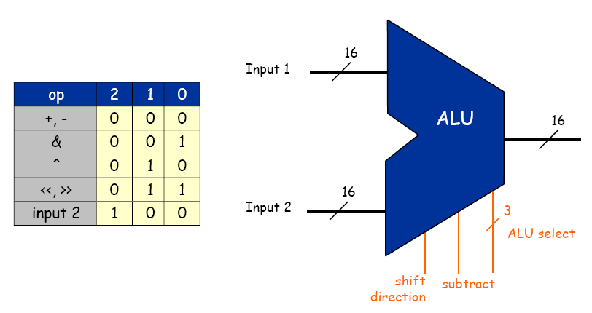
Recap: ALU
  Big combinational logic (16-bit bus)
  Add/subtract, and, xor, shift left/right, copy input 2
  A 3-bit control for 5 primary ALU operations
    ALU performs operations in parallel
    Control wises select which result ALU outputs
Can we combine these 5 bits into
3 bits for 7 operations?
Yes, you can. But, you will still
need 5 bits at the end.

Slide 2
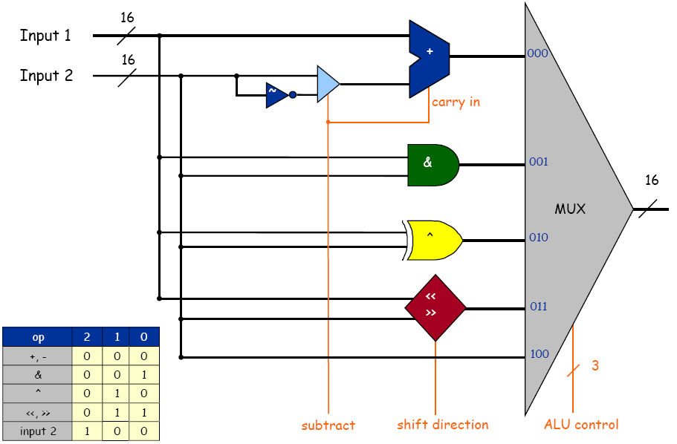
Recap: ALU

Slide 3
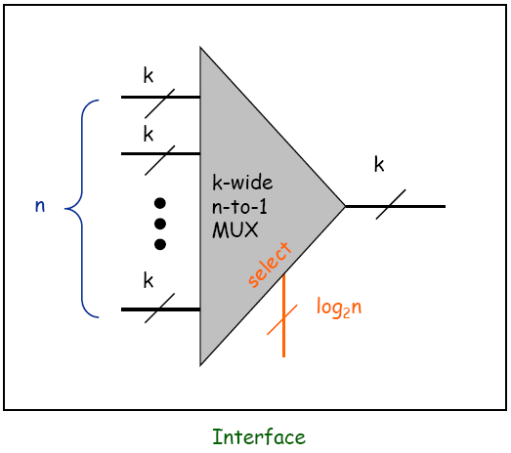
Recap: Multiplexer
Goal: select from one of n k-bit buses
  Implemented by layering k n-to-1 multiplexer

Slide 4
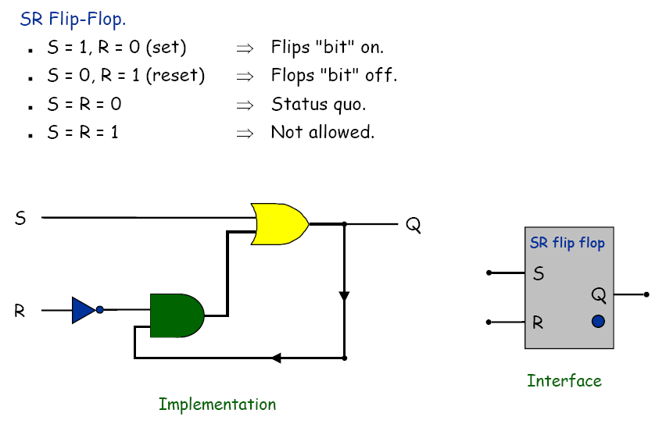
Recap: flip flop

Slide 5
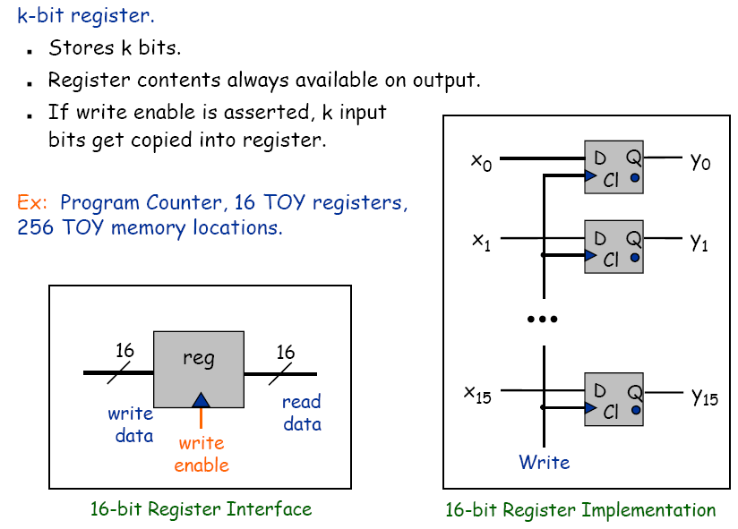
Stand-Alone Register

Slide 6
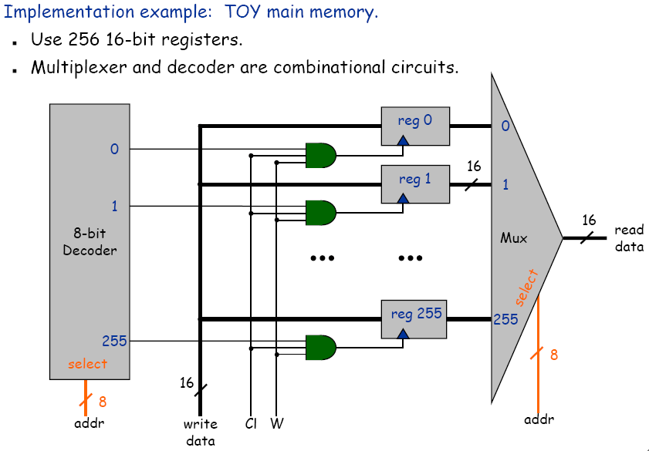
Register file implementation

Slide 7
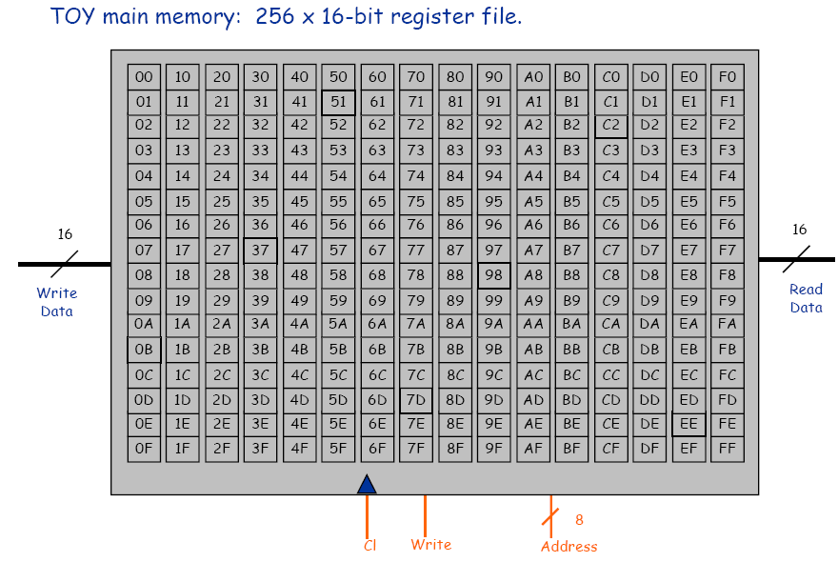
Recap: memory

Slide 8
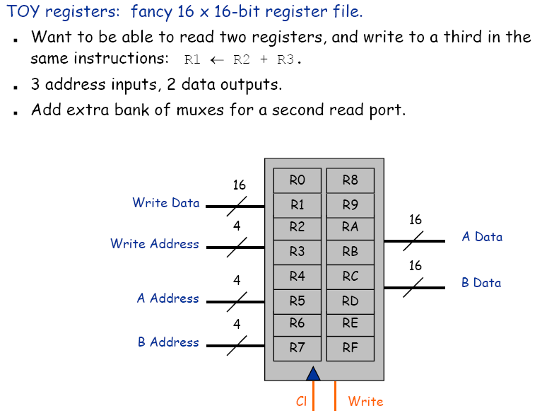
Recap: register file

Slide 9


Clock
Clock.
  Fundamental abstraction: regular on-off pulse.
    on: fetch phase
    off: execute phase
  External analog device.
  Synchronizes operations of different circuit elements.
  Requirement: clock cycle longer than max switching time.
cycle time
on
Clock
off
Notes:
Clock is outside Boolean/digital logic framework. Need external source. Can wire up minute hand of Big Ben to computer. In real
computer, clock abstraction implemented using electric phenomenon like a crystal oscillator, a piezoelectric device that generates oscillating voltage
Clock is like a conductor's baton or metrononme (asssuming no ritardando = ree-tar-DAHN-doe), except that it beats at rate of millions of times per second. Note 1GHz machine cycle takes 1 billionth of a second (nanosecond). To put things in perspective, a standard light bulb switches on and off at the rate of 120 times per second! (Patt, Patel, p. 83) In that time, a computer completes around 10 million machine cycles.
Computer engineers make circuit, then crank up the clock as fast as possible until circuit no longer works. Then crank it down just a bit, and sell it. Maybe manufactures should put dial on the computer and let user crank it up until their program no longer works! To get faster computer, need to adjust wire lengths, circuit layout, change components.

Slide 10
TOY Machine Architecture
Notes:
1-12,15-21,23-26,28-34
goal: by end of lecture you should have a concrete idea of how a real microprocessor is built

Slide 11
The TOY Machine
Combinational circuits. ALU.
Sequential circuits. Memory.
Machine architecture. Wire components together to make computer.
TOY machine.
  256 16-bit words of memory.
  16 16-bit registers.
  1 8-bit program counter.
  16 instruction types.
Fetch
Execute
Notes:
2 different software TOY simulators (TOY.java, Visual X-TOY)
We aren't actually going to build TOY machine with wires and transistors. But we present a blueprint should you want to build your own.

Slide 12
Design a processor
How to build a processor
  Develop instruction set architecture (ISA)
    16-bit words, 16 TOY machine instructions
  Determine major components
    ALU, memory, registers, program counter
  Determine datapath requirements
    Flow of bits
  Analyze how to implement each instruction
    Determine settings of control signals

Slide 13
Practice: 4-bit counter
operation | op | semantics
reset | 00 | C ← 0
load | 01 | C ← in
inc | 10 | C ← C+1
dec | 11 | C ← C-1
4
4
in
4-bit counter
out
op

Slide 14
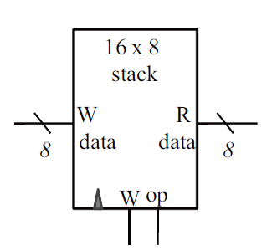
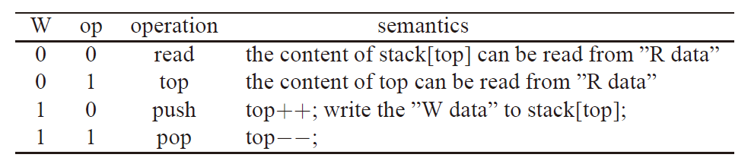
Practice: stack

Slide 16
Design a processor
How to build a processor
  Develop instruction set architecture (ISA)
    16-bit words, 16 TOY machine instructions
  Determine major components
    ALU, memory, registers, program counter
  Determine datapath requirements
    Flow of bits
  Analyze how to implement each instruction
    Determine settings of control signals

Slide 17
Build a TOY: Interface
Instruction set architecture (ISA).
  16-bit words, 256 words of memory, 16 registers.
  Determine set of primitive instructions.
    too narrow ⇒ cumbersome to program
    too broad ⇒ cumbersome to build hardware
  16 instructions.
Instructions
Instructions
0:
halt
8:
load
1:
add
9:
store
2:
subtract
A:
load indirect
3:
and
B:
store indirect
4:
xor
C:
branch zero
5:
shift left
D:
branch positive
6:
shift right
E:
jump register
7:
load address
F:
jump and link
Notes:
These should now be quite familiar.
ISA is layer between machine and programmer. We didn't take you through the design process of choosing which instructions to include, but it took many iterations and refinements.
The history of computing faced similar design issues. Programmers and compiler writers say we need more instructions. Hardware designers say we need fewer instructions. Tradeoff and pendulum swings from RISC to CISC and back and forth.

Slide 18
TOY Reference Card
15
14
13
12
11
10
9
8
7
6
5
4
6
3
2
1
0
Format 1
opcode
dest d
source s
source t
Format 2
opcode
dest d
addr
#
Operation
Fmt
Pseudocode
0:
halt
1
exit(0)
1:
add
1
R[d] ← R[s] + R[t]
2:
subtract
1
R[d] ← R[s] - R[t]
3:
and
1
R[d] ← R[s] & R[t]
4:
xor
1
R[d] ← R[s] ^ R[t]
Register 0 always 0.
Loads from mem[FF] from stdin.
Stores to mem[FF] to stdout.
5:
shift left
1
R[d] ← R[s] << R[t]
6:
shift right
1
R[d] ← R[s] >> R[t]
7:
load addr
2
R[d] ← addr
8:
load
2
R[d] ← mem[addr]
9:
store
2
mem[addr] ← R[d]
A:
load indirect
1
R[d] ← mem[R[t]]
B:
store indirect
1
mem[R[t]] ← R[d]
C:
branch zero
2
if (R[d] == 0) pc ← addr
D:
branch positive
2
if (R[d] > 0) pc ← addr
E:
jump register
1
pc ← R[t]
F:
jump and link
2
R[d] ← pc; pc ← addr

Slide 19
Design a processor
How to build a processor
  Develop instruction set architecture (ISA)
    16-bit words, 16 TOY machine instructions
  Determine major components
    ALU, memory, registers, program counter
  Determine datapath requirements
    Flow of bits
  Analyze how to implement each instruction
    Determine settings of control signals

Slide 20
Components
Cond
Eval
Registers
W Data
PC
Memory
IR
A Data
A
L
U
Addr
op
B Data
d
W Addr
R Data
A Addr
s
+
W Data
t
B Addr
1
W
W
Clock

Slide 21
Cond. Eval.
X₀
:
Y₀
X₁₅
=0
Y₀
Y₁
16
Cond
Eval
X
>0
Y₁
Y₁=x>0
=(x≥0) and (x≠0)
=X₁₅ ∧Y₀

Slide 22
Design a processor
How to build a processor
  Develop instruction set architecture (ISA)
    16-bit words, 16 TOY machine instructions
  Determine major components
    ALU, memory, registers, program counter
  Determine datapath requirements
    Flow of bits
  Analyze how to implement each instruction
    Determine settings of control signals

Slide 23
Datapath
Cond
Eval
Registers
W Data
PC
Memory
IR
A Data
A
L
U
Addr
op
B Data
d
W Addr
R Data
A Addr
s
+
W Data
t
B Addr
1
W
W
1-6
7
8
R[d] ← R[s] ALU R[t]
R[d] ← addr
R[d] ← mem[addr]
9
A
B
mem[addr] ← R[d]
R[d] ← mem[R[t]]
mem[R[t]] ← R[d]
CD
E
F
if (R[d]?) pc ← addr
pc ← R[t]
R[d] ← pc; pc ← addr

Slide 24
Datapath
8
16
pc for jump
and branch
address for
load/store
result of ALU or address
for load address
Cond
Eval
0
8
Registers
pc for jal
load
W Data
PC
Memory
IR
A Data
A
L
U
Addr
op
B Data
d
W Addr
R Data
A Addr
s
+
W Data
t
B Addr
16
1
W
W
addr
0
8
8
pc+1
store data

Slide 25
Design a processor
How to build a processor
  Develop instruction set architecture (ISA)
    16-bit words, 16 TOY machine instructions
  Determine major components
    ALU, memory, registers, program counter
  Determine datapath requirements
    Flow of bits
  Analyze how to implement each instruction
    Determine settings of control signals

Slide 26
Datapath
Cond
Eval
Registers
10
01
00
W Data
PC
Memory
IR
A Data
A
L
U
1
0
1
0
Addr
op
0
1
B Data
d
W Addr
R Data
1
0
A Addr
s
+
W Data
t
B Addr
1
W
W

Slide 27
Control
Cond
Eval
Registers
10
01
00
W Data
Memory
IR
2
A Data
A
L
U
PC
1
0
1
0
Addr
op
WRITE_REG
MUX
0
1
B Data
d
W Addr
5
MEM_ADDR
MUX
R Data
1
0
ALU_OP
PC_MUX
s
A Addr
ALU MUX
WRITE_PC
+
W Data
t
B Addr
1
W
W
READ_REG
A MUX
WRITE_IR
WRITE_MEM
WRITE_REG
CLOCK_MEM
CLOCK_REG
A total of 17 control signals

Slide 28
TOY architecture
Cond
Eval
=0
Registers
>0
10
01
00
W Data
Memory
2
A Data
A
L
U
PC
IR
1
0
1
0
Addr
op
4
0
1
B Data
d
W Addr
5
R Data
1
0
A Addr
s
+
W Data
t
B Addr
1
W
W
1-bit
counter
Opcode
Execute
Control
Fetch
Clock
Clock

Slide 29
Clock
Cond
Eval
=0
Registers
>0
10
01
00
W Data
Memory
2
A Data
A
L
U
PC
IR
1
0
1
0
Addr
op
4
0
1
B Data
d
W Addr
5
R Data
1
0
A Addr
s
+
W Data
t
B Addr
1
W
W
1-bit
counter
Opcode
Execute
Control
Fetch
Clock
Clock

Slide 30
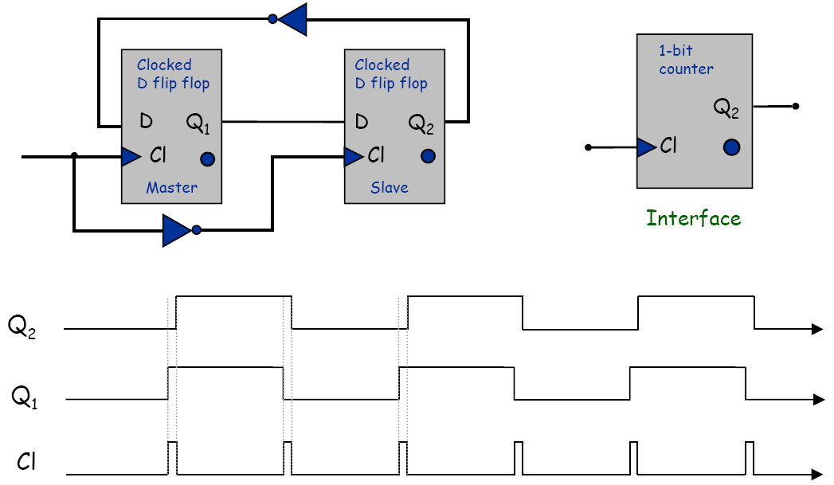
1-bit counter
1-bit counter
  Circuit that oscillates between 1 and 0.

Slide 31
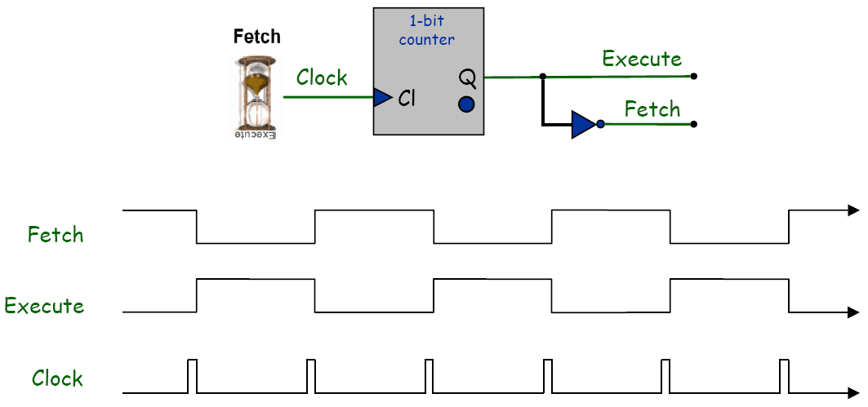
Clock
Two cycle design (fetch and execute)
  Use 1-bit counter to distinguish between 2 cycles.
  Use two cycles since fetch and execute phases each access memory and alter program counter.

Slide 32
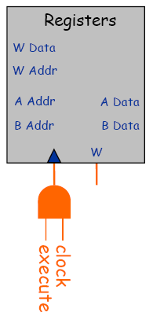
Clocking Methodology
Two-cycle design.
  Each control signal is in one of four epochs.
    fetch [set memory address from pc]
    fetch and clock [write instruction to IR]
    execute [set ALU inputs from registers]
    execute and clock [write result of ALU to registers]
Phase 2
fetch & clock
Phase 4
execute & clock
Fetch
Phase 1
fetch
Phase 3
execute
Fetch
Execute
Clock

Slide 33
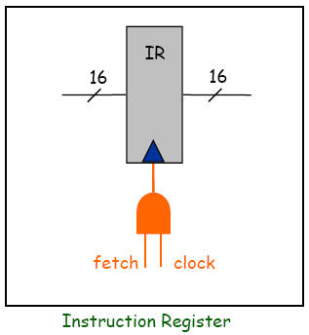
Instruction register

Slide 34
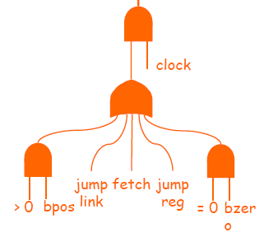


Clocking Methodology
Cond
Eval
Registers
10
01
00
W Data
Memory
IR
2
A Data
A
L
U
PC
1
0
1
0
Addr
op
0
1
B Data
d
W Addr
5
R Data
1
0
A Addr
s
+
W Data
t
B Addr
1
W
W
fetch
execute

Slide 35
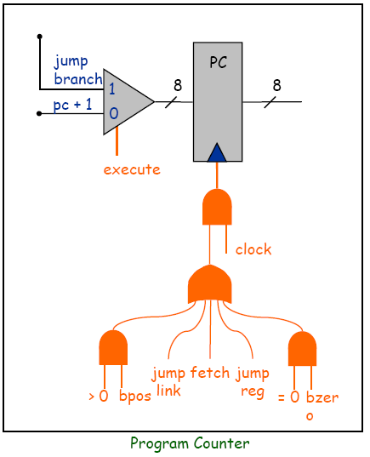
Program counter
Read program counter when
  Fetch
  Execute for jal
Write program counter when
  Fetch and clock
  Execute and clock depending on conditions

Slide 36
Example: ADD
Cond
Eval
Registers
10
01
00
W Data
20
????
Memory
IR
2
A Data
A
L
U
PC
1
0
1
0
Addr
op
0
1
B Data
d
W Addr
5
R Data
1
0
A Addr
s
+
W Data
t
B Addr
1
W
W
PC=20
Mem[20]=1234
R[3]=0028 R[4]=0064

Slide 37
Example: ADD (fetch)
Cond
Eval
Registers
10
01
00
W Data
20
????
Memory
IR
2
A Data
A
L
U
PC
1
0
1
0
Addr
op
0
1
20
B Data
d
W Addr
5
R Data
1
0
A Addr
s
+
W Data
t
B Addr
1
W
W
PC=20
Mem[20]=1234
R[3]=0028 R[4]=0064

Slide 38
Example: ADD (fetch)
Cond
Eval
Registers
10
01
00
W Data
20
????
Memory
IR
2
A Data
A
L
U
PC
1
0
1
0
Addr
op
0
1
20
B Data
d
W Addr
5
R Data
1
0
A Addr
1234
s
+
W Data
t
B Addr
1
W
W
PC=20
Mem[20]=1234
R[3]=0028 R[4]=0064

Slide 39
Example: ADD (fetch)
Cond
Eval
Registers
10
01
00
W Data
20
????
Memory
IR
2
A Data
A
L
U
PC
1
0
1
0
Addr
op
0
1
20
B Data
21
d
W Addr
5
R Data
1
0
A Addr
1234
s
+
W Data
t
B Addr
1
W
W
21
PC=20
Mem[20]=1234
R[3]=0028 R[4]=0064

Slide 40
Example: ADD (fetch and clock)
Cond
Eval
Registers
10
01
00
W Data
21
1234
Memory
IR
2
A Data
A
L
U
PC
1
0
1
0
Addr
op
1
0
1
B Data
21
d
W Addr
5
R Data
2
s
1
0
A Addr
3
B Addr
+
W Data
t
4
1
W
W
Mem[20]=1234
R[3]=0028 R[4]=0064
PC=21
IR=1234

Slide 41
Example: ADD (execute)
Cond
Eval
Registers
10
01
00
W Data
21
1234
Memory
IR
2
A Data
A
L
U
PC
1
0
1
0
Addr
op
1
0
1
B Data
d
W Addr
5
R Data
2
s
1
0
A Addr
3
3
+
W Data
t
B Addr
1
4
4
W
W
Mem[20]=1234
R[3]=0028 R[4]=0064
PC=21
IR=1234

Slide 42
Example: ADD (execute)
Cond
Eval
Registers
10
01
00
W Data
21
1234
0028
Memory
IR
2
A Data
A
L
U
PC
1
0
1
0
Addr
op
1
0
1
B Data
d
W Addr
0064
5
R Data
2
s
1
0
A Addr
3
3
+
W Data
t
B Addr
1
4
4
W
W
Mem[20]=1234
R[3]=0028 R[4]=0064
PC=21
IR=1234

Slide 43
Example: ADD (execute)
Cond
Eval
008C
Registers
10
01
00
W Data
21
1234
0028
Memory
IR
2
A Data
A
L
U
008C
PC
1
0
1
0
Addr
op
1
0
1
B Data
d
W Addr
0064
5
R Data
2
s
1
0
A Addr
3
3
+
W Data
t
B Addr
1
4
4
W
W
Mem[20]=1234
R[3]=0028 R[4]=0064
PC=21
IR=1234

Slide 44
Example: ADD (execute and clock)
Cond
Eval
008C
Registers
10
01
00
W Data
21
1234
Memory
IR
2
A Data
A
L
U
PC
1
0
1
0
Addr
op
1
0
1
B Data
d
W Addr
5
R Data
2
2
s
1
0
A Addr
3
B Addr
+
W Data
t
4
1
W
W
Mem[20]=1234
R[3]=0028 R[4]=0064
PC=21
IR=1234
R[2]=008C

Slide 45
Example: Jump and link
Cond
Eval
Registers
10
01
00
W Data
Memory
IR
2
A Data
A
L
U
PC
1
0
1
0
Addr
op
0
1
B Data
d
W Addr
5
R Data
1
0
A Addr
s
+
W Data
t
B Addr
1
W
W
PC=20
Mem[20]=FF30
R[3]=0028 R[4]=0064

Slide 46
Fetch
Cond
Eval
=0
Registers
>0
10
01
00
W Data
Memory
2
A Data
A
L
U
PC
IR
1
0
1
0
Addr
op
4
0
1
B Data
d
W Addr
5
R Data
1
0
A Addr
s
+
W Data
t
B Addr
1
W
W
1-bit
counter
Opcode
Execute
Control
Fetch
Clock
Clock

Slide 47
Fetch and clock
Cond
Eval
=0
Registers
>0
10
01
00
W Data
Memory
2
A Data
A
L
U
PC
IR
1
0
1
0
Addr
op
4
0
1
B Data
d
W Addr
5
R Data
1
0
A Addr
s
+
W Data
t
B Addr
1
W
W
1-bit
counter
Opcode
Execute
Control
Fetch
Clock
Clock

Slide 48
Execute
Cond
Eval
=0
Registers
>0
W Data
Memory
2
A Data
A
L
U
PC
IR
Addr
op
4
B Data
d
W Addr
5
R Data
A Addr
s
+
W Data
t
B Addr
1
W
W
1-bit
counter
Opcode
Execute
Control
Fetch
Clock
Clock

Slide 49
Control
Two approaches to implement control
  Micro-programming
    Use a memory (ROM) for micro-code
    More flexible
    Easier to program
  Hard-wired
    Use logic gates and wire
    More efficient
17 control signals
…
512x17 ROM
9-bit address
:
:
>0
=0
17 control signals
…
Opcode
Execute
Control
Fetch
Clock

Slide 50
Control
Cond
Eval
Registers
10
01
00
W Data
Memory
IR
2
A Data
A
L
U
PC
1
0
1
0
Addr
op
WRITE_REG
MUX
0
1
B Data
d
W Addr
5
MEM_ADDR
MUX
R Data
1
0
ALU_OP
PC_MUX
s
A Addr
ALU MUX
WRITE_PC
+
W Data
t
B Addr
1
W
W
READ_REG
A MUX
WRITE_IR
WRITE_MEM
WRITE_REG
CLOCK_MEM
CLOCK_REG
A total of 17 control signals

Slide 51
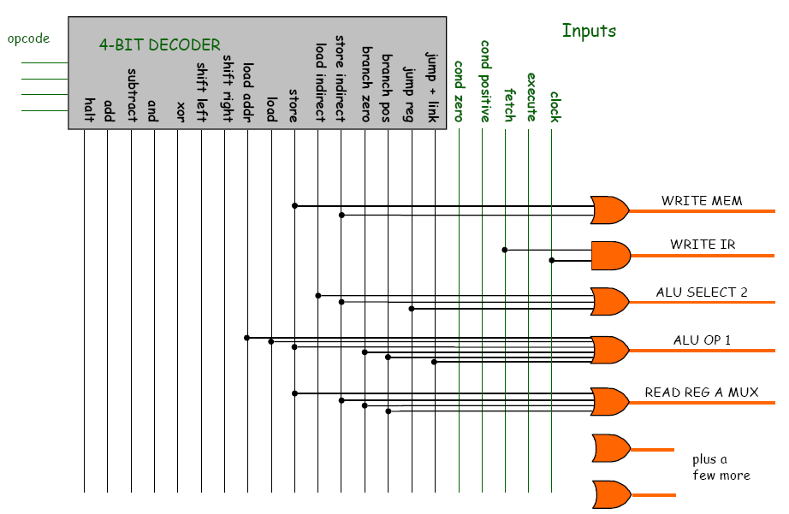
Control
ALU MUX

Slide 52
TOY Reference Card
15
14
13
12
11
10
9
8
7
6
5
4
6
3
2
1
0
Format 1
opcode
dest d
source s
source t
Format 2
opcode
dest d
addr
#
Operation
Fmt
Pseudocode
0:
halt
1
exit(0)
1:
add
1
R[d] ← R[s] + R[t]
2:
subtract
1
R[d] ← R[s] - R[t]
3:
and
1
R[d] ← R[s] & R[t]
4:
xor
1
R[d] ← R[s] ^ R[t]
Register 0 always 0.
Loads from mem[FF] from stdin.
Stores to mem[FF] to stdout.
5:
shift left
1
R[d] ← R[s] << R[t]
6:
shift right
1
R[d] ← R[s] >> R[t]
7:
load addr
2
R[d] ← addr
8:
load
2
R[d] ← mem[addr]
9:
store
2
mem[addr] ← R[d]
A:
load indirect
1
R[d] ← mem[R[t]]
B:
store indirect
1
mem[R[t]] ← R[d]
C:
branch zero
2
if (R[d] == 0) pc ← addr
D:
branch positive
2
if (R[d] > 0) pc ← addr
E:
jump register
1
pc ← R[t]
F:
jump and link
2
R[d] ← pc; pc ← addr

Slide 53
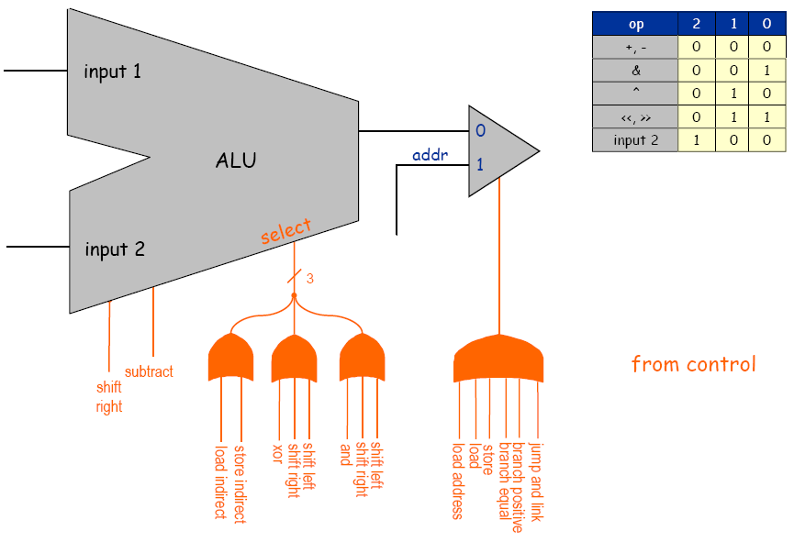
ALU control

Slide 54
Execute and clock (write-back)
Cond
Eval
=0
Registers
>0
10
01
00
W Data
Memory
2
A Data
A
L
U
PC
IR
1
0
1
0
Addr
op
4
0
1
B Data
d
W Addr
5
R Data
1
0
A Addr
s
+
W Data
t
B Addr
1
W
W
1-bit
counter
Opcode
Execute
Control
Fetch
Clock
Clock

Slide 55

Writing registers and memory
Memory
Registers
Addr
W Data
A Data
R Data
B Data
W Data
W Addr
A Addr
W
B Addr
W

Slide 56
More examples
Cond
Eval
Registers
10
01
00
W Data
Memory
IR
2
A Data
A
L
U
PC
1
0
1
0
Addr
op
0
1
B Data
d
W Addr
5
R Data
1
0
A Addr
s
+
W Data
t
B Addr
1
W
W

Slide 57
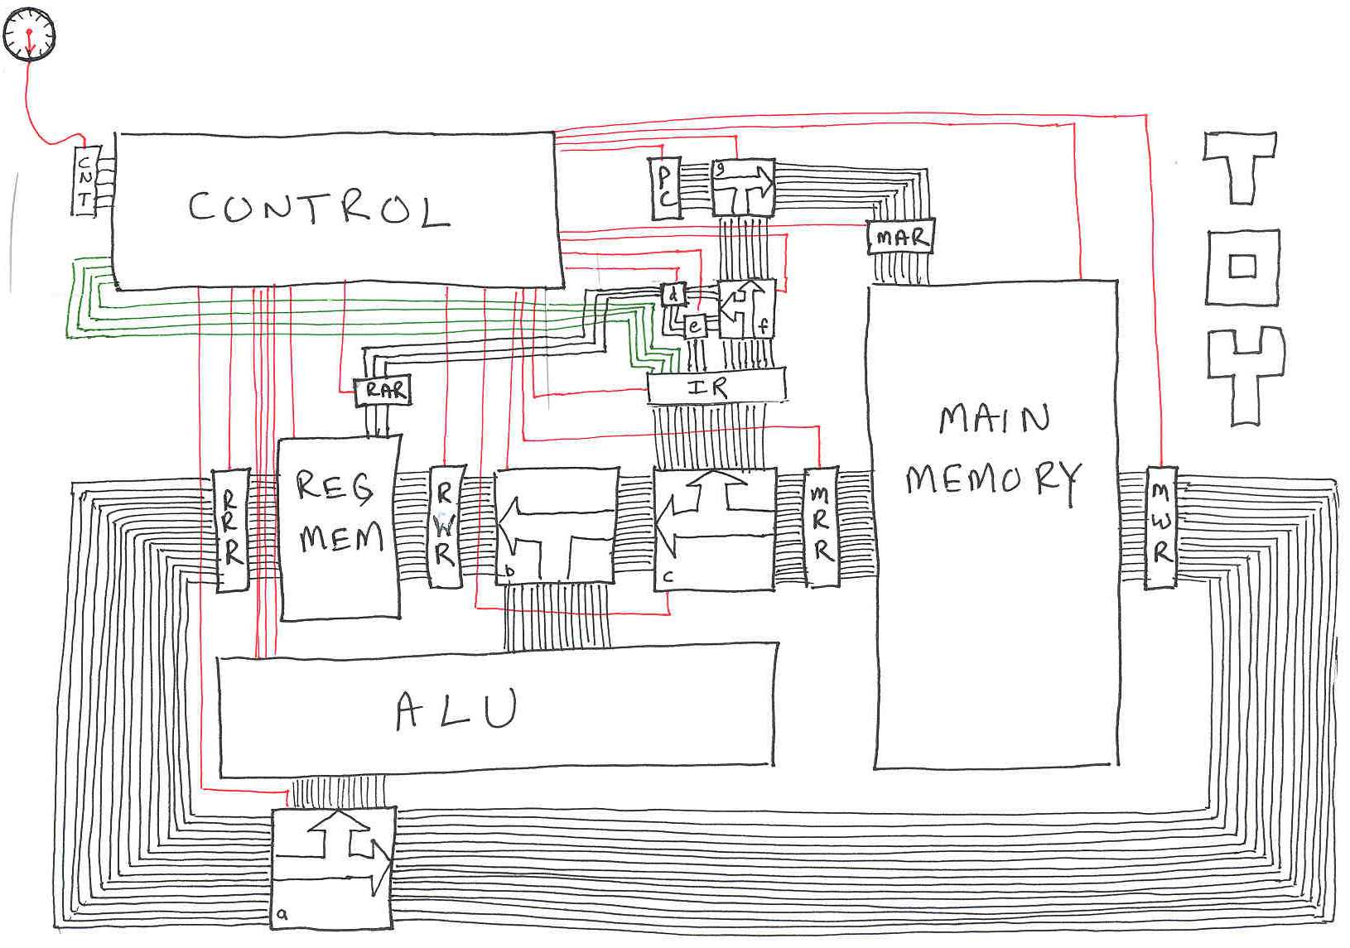
TOY "Classic", Back Of Envelope Design
Notes:
This is TOY, version 0 created by non hardware person. We'll consider a more modern architecture for TOY machine next.
red = control, black = data, green = opcode
most of circuit area devoted to wires connecting various components
TOY is 16-bit machine, so it is convenient (but not necessary) to move data 16 wires at a time (bus) = word size
to move from 32-bit Nintendo to 64-bit, need to make wires half as big (or improve layout)
control wires not really needed for path splitting???
memory and register buffers not needed, already in memory???
need to implement pc???
control needs a buffer coming in from counter???

Slide 58
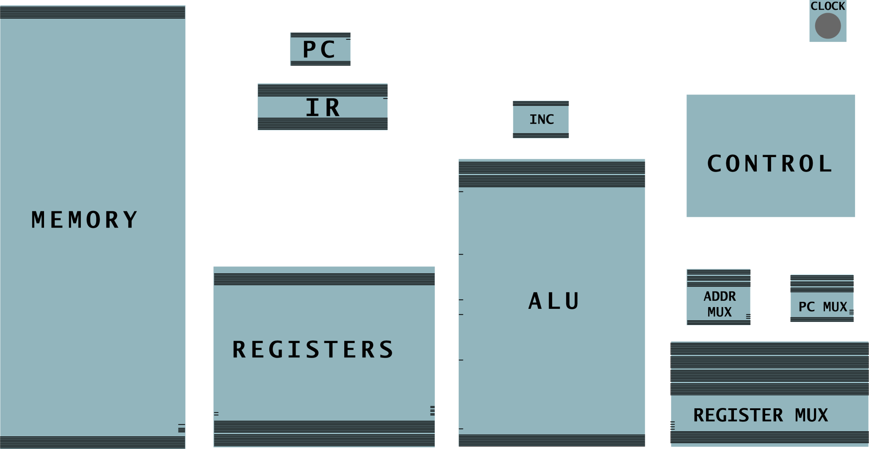
Build a TOY-Lite: Devices
10-bit word,
4-word register
16-word memory
Notes:
Central processing unit.
Two memory banks (registers, main memory).
Two registers (program counter, instruction register).
Three 1-hot multiplexers (memory address, PC input, register input).
Control (stay tuned).
Clock (stay tuned).

Slide 59
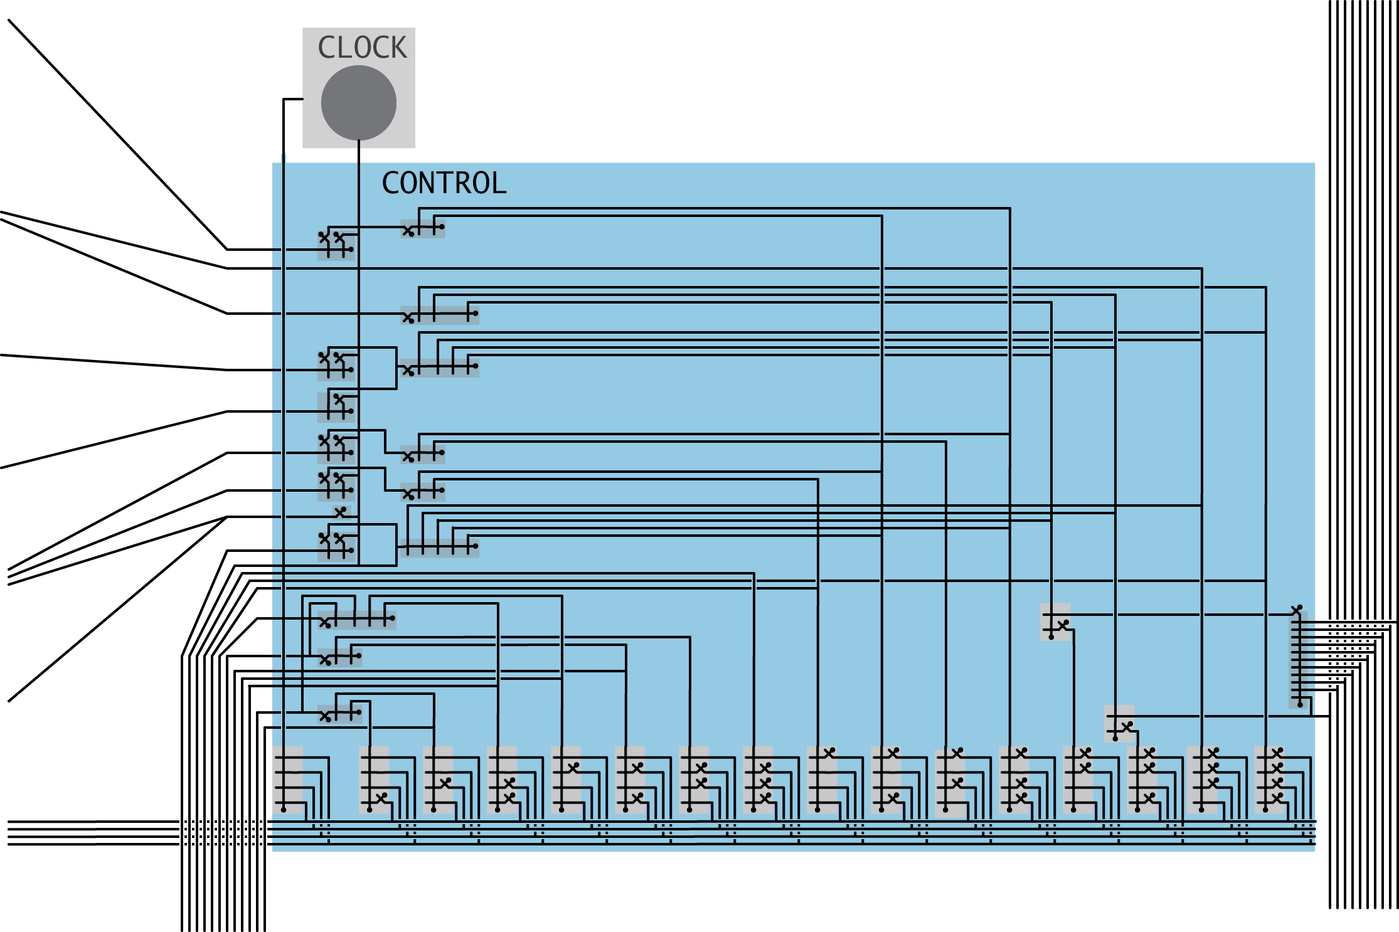
Control
Control. Circuit that determines control line sequencing.
data bus
to memory input
external clock just ticks
control lines
to processor registers
opcode
from IR
control lines
to ALU
data bus
from ALU

Slide 60
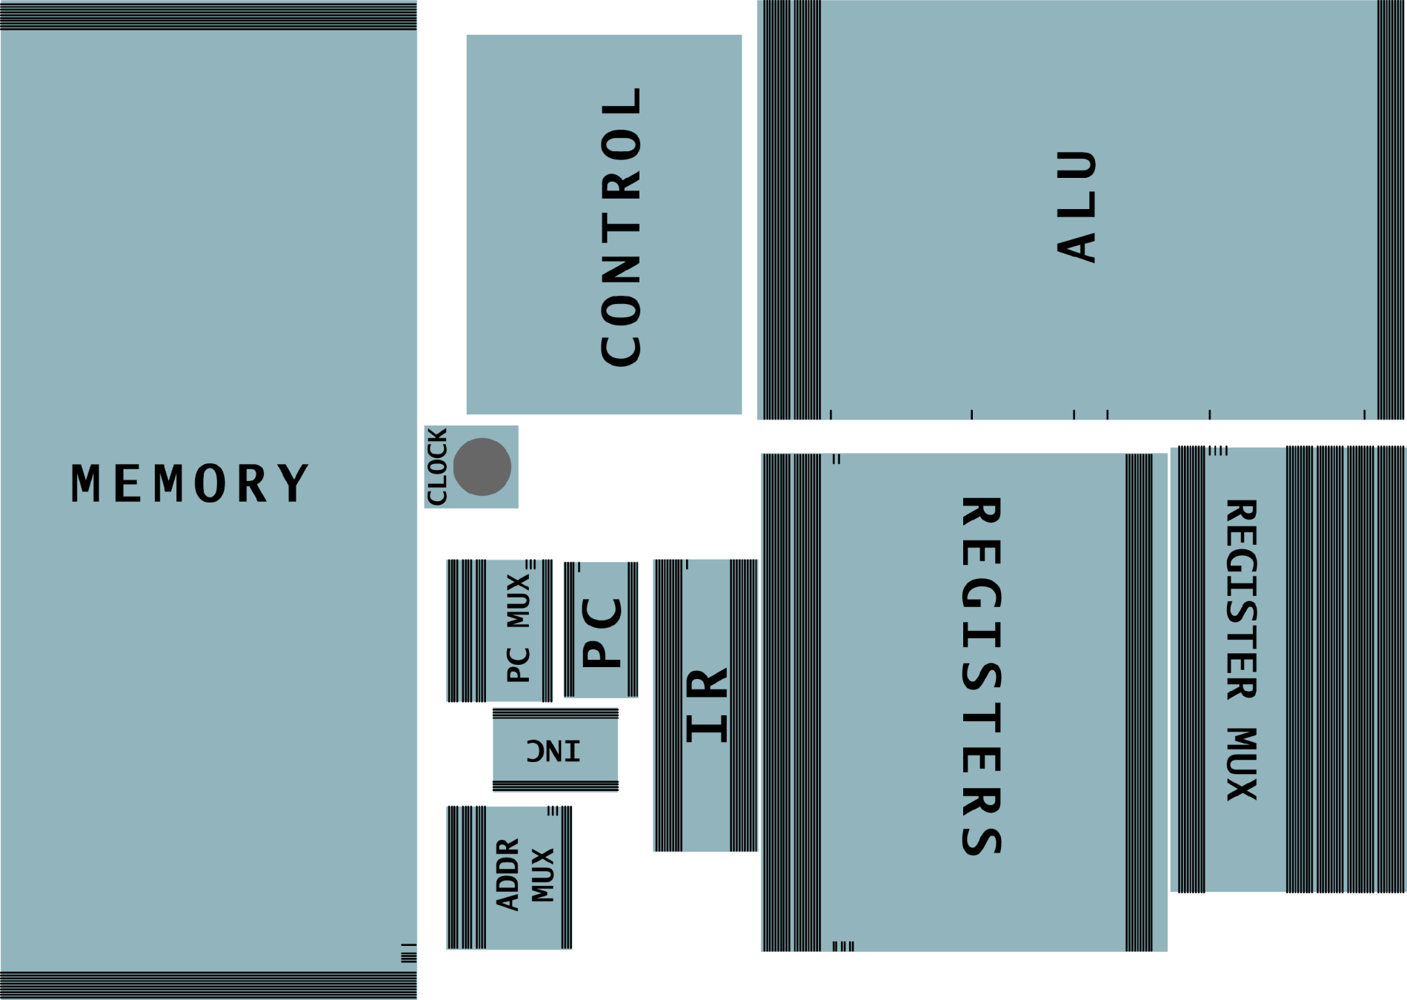
Build a TOY-Lite: Layout

Slide 61
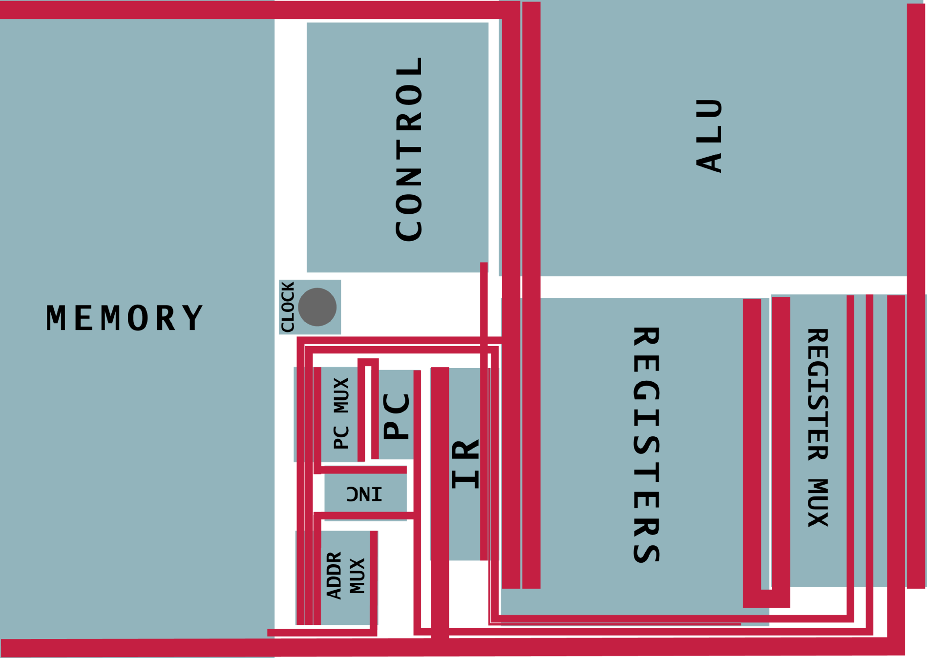
Build a TOY-Lite: Datapath

Slide 62
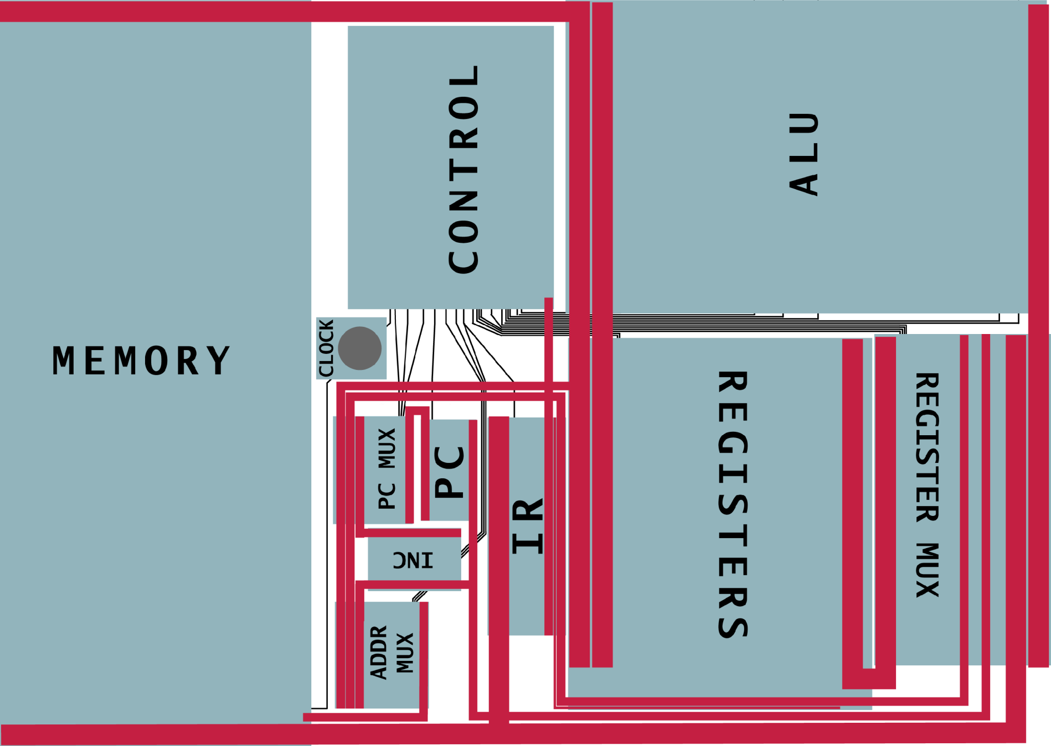
Build a TOY-Lite: Control

Slide 63
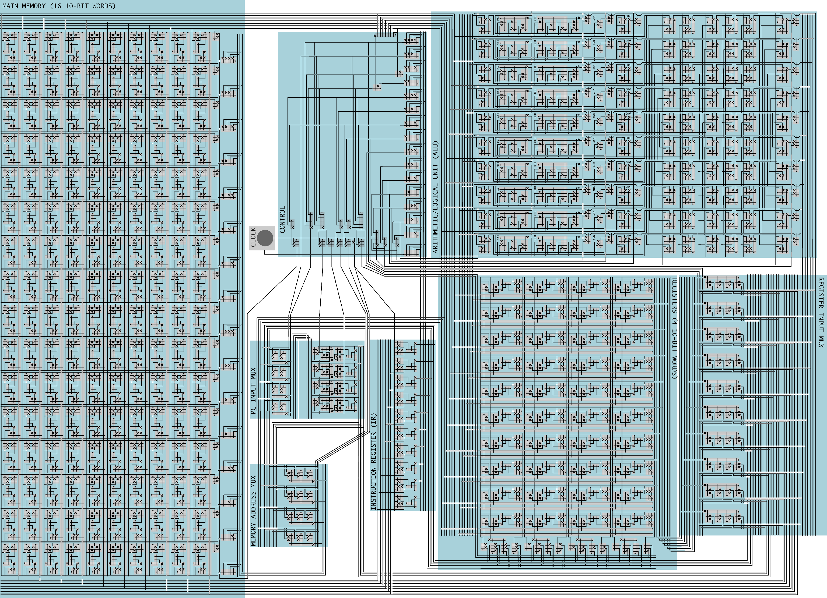

Slide 64
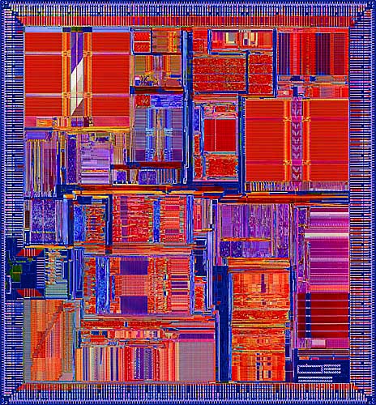
Real Microprocessor (MIPS R10000)
Notes:
~10M transistors, size of your little fingernail
die photo, ca. 1995

Slide 65
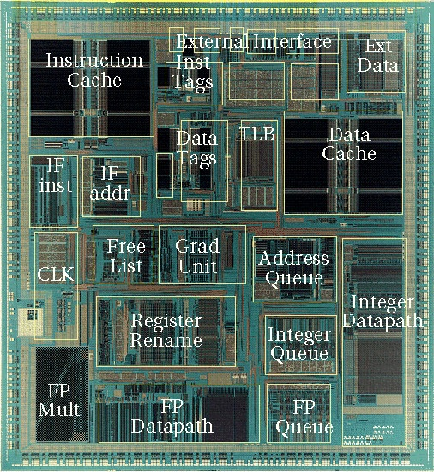
Real Microprocessor (MIPS R10000)
Notes:
~10M transistors, size of your little fingernail
die photo, ca. 1995

Slide 66
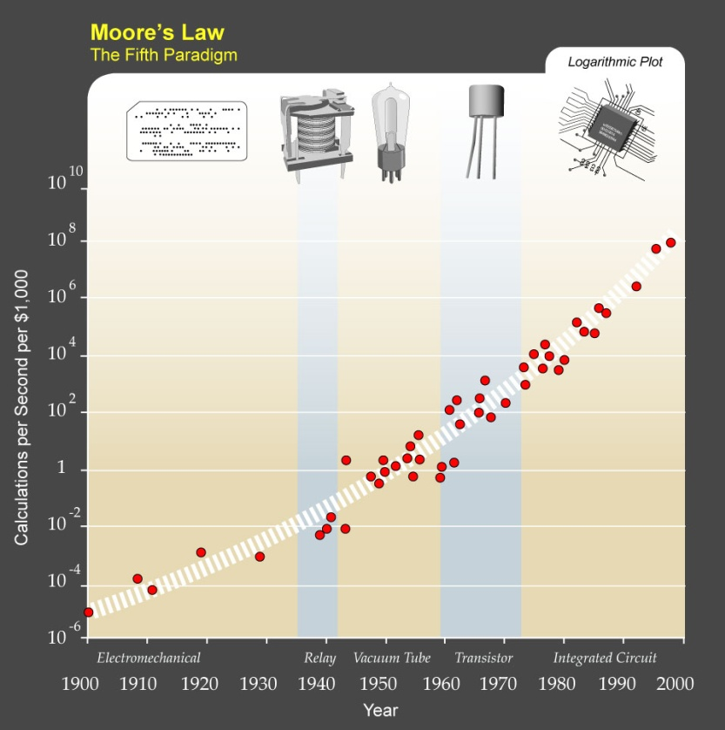
History + Future
Computer constructed by layering abstractions.
  Better implementation at low levels improves everything.
  Ongoing search for better abstract switch!
History.
  1820s: mechanical switches.
  1940s: relays, vacuum tubes.
  1950s: transistor, core memory.
  1960s: integrated circuit.
  1970s: microprocessor.
  1980s: VLSI.
  1990s: integrated systems.
  2000s: web computer.
  Future: quantum, optical soliton, …
Ray Kurzweil (http://en.wikipedia.org/wiki/Image:PPTMooresLawai.jpg)
Notes:
1820s: Babbage's difference engine
Moore's law: computer hardware technology has improved at an incredible rate, 30-40% per year (speed, storage capacity, price). If the automobile industry improved at such a rate since the 1960's, your car would go 30,000mph, get 100,000 miles per gallon, and cost $1 !
To which an automobile executive retorts, “Yeah, and if cars were like software, they would crash twice a day for no reason, and when you called for service, they’d tell you to reinstall the engine.”
In contrast, mammalian brains grow a cubic inch every 100,000 years!
same basic design for last 50 years: most significant changes have been in technology of switch
Babbage: arithmetic functions, but too many levers and gears => hard to realize physically and Babbage's blueprint failed….until a few years ago, some scientists at MIT built Babbage's machine, and it worked!
relays: electromagnetic (used in doorbells nowadays) main problem: timing
vacuum tubes: main problem: not reliable – they would occasionally blow up
transistors: more reliable, small, fast, low energy
core memory: doughnuts with 3 wires going through them. Got workers from Dominican Republic to string them up. Very labor intensive.
integrated circuit: all on a card
microprocessor: all on a chip
VLSI: nowadays there's no difference between drawing the picture and building the chip – can use program to transform drawing into physical chip!!
soliton: soliton collisions in photorefractive crystals or fibers

