Slide 1
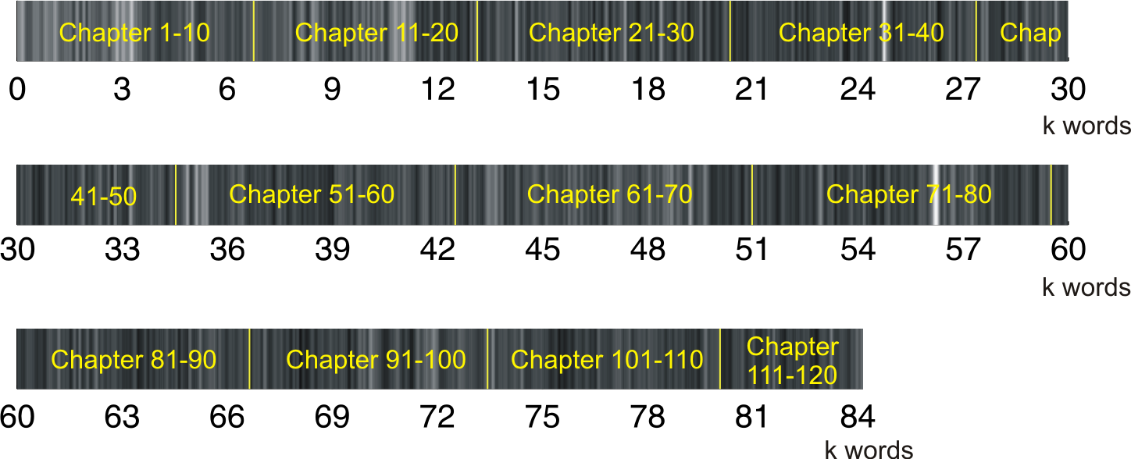
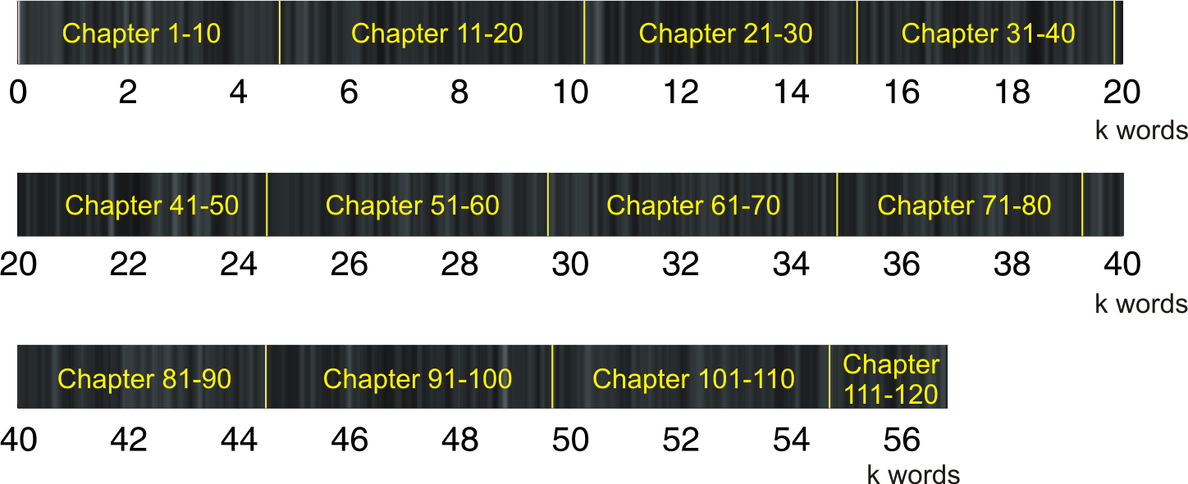
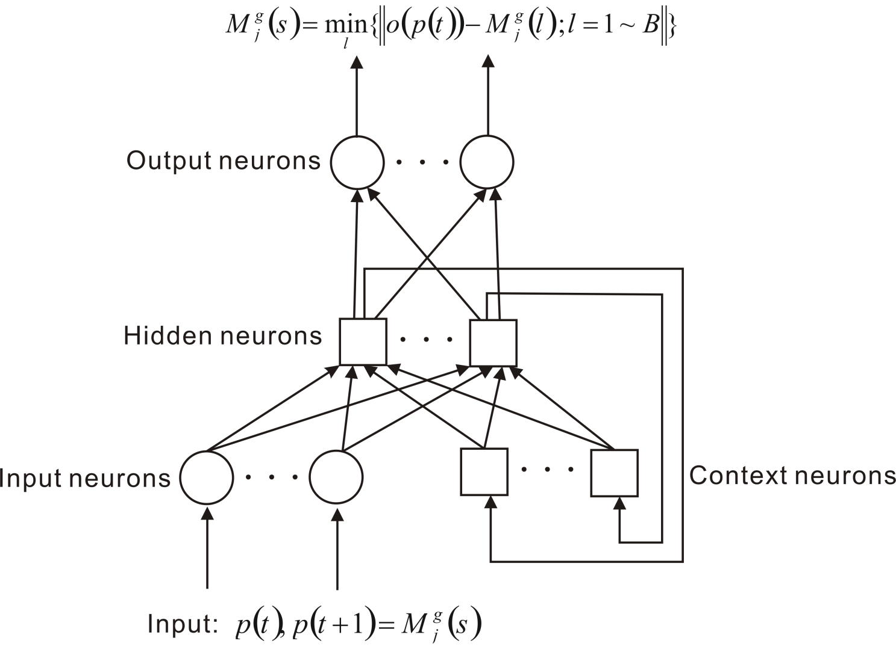
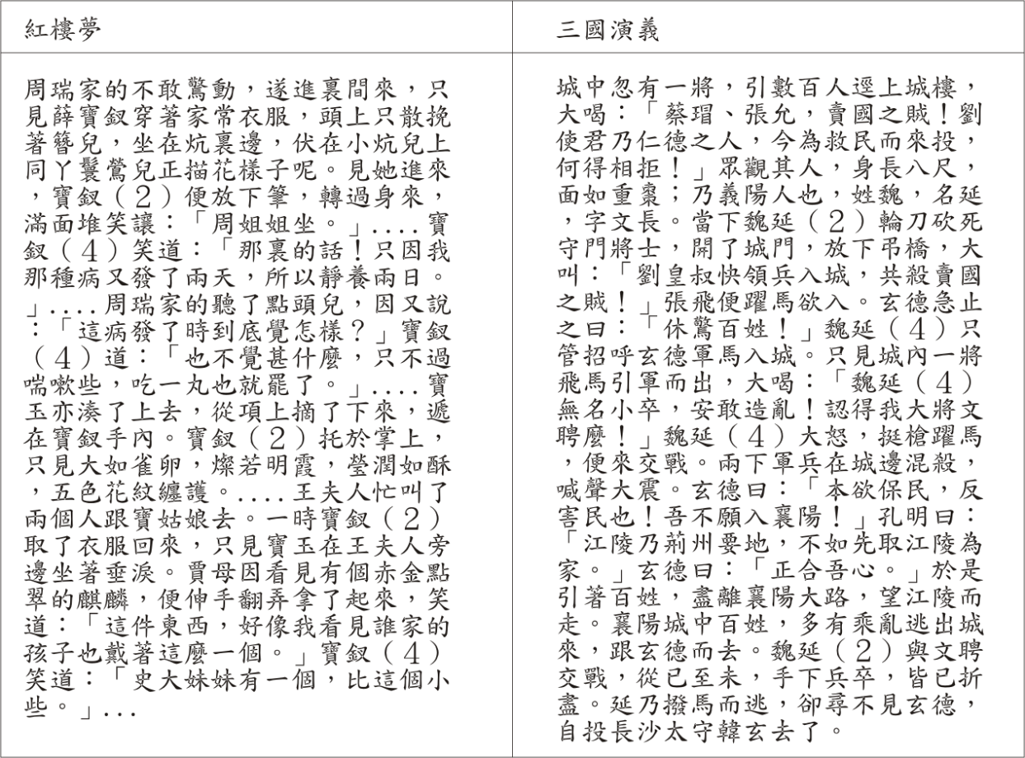
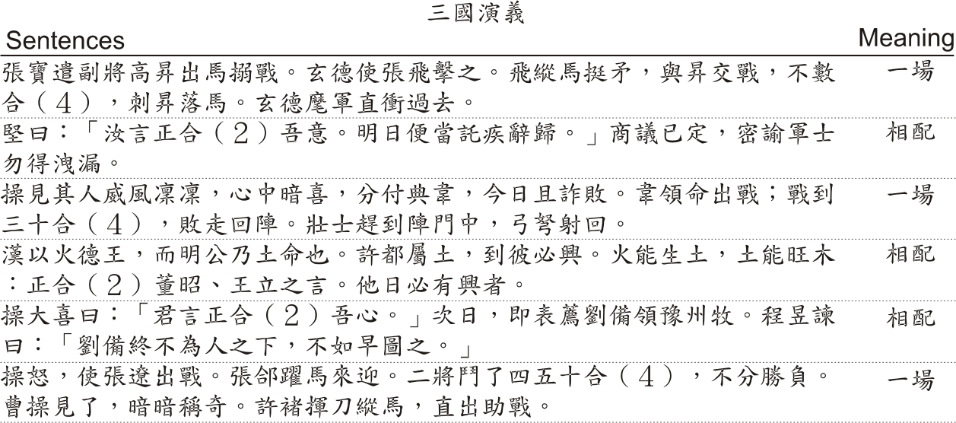
Auto-encoder for Polysemous Word
Cheng-Yuan Liou, Wei-Chen Cheng, Jiun-Wei Liou, Daw-Ran Liou
Department of Computer Science and Information Engineering, National Taiwan University
Polysemous word ‘bank’
Authorship and stylish analysis
 | money | river
bank = | $$\left[\begin{matrix}\begin{matrix}{Attribute}_{1} \\ {Attribute}_{2}\end{matrix} \\ ⋯ \\ {Attribute}_{R}\end{matrix}\right],$$ | $$\left[\begin{matrix}\begin{matrix}{Attribute}_{1} \\ {Attribute}_{2}\end{matrix} \\ ⋯ \\ {Attribute}_{R}\end{matrix}\right]$$
紅樓夢
Cost and controversy for the manually assigned attributes by linguistic experts
Generating attributes for words automatically !
三國演義
Elman network
Name having multiple codes
Renewed attributes
Updating network’s weights after presentation
of each word to reduce the prediction error.
Averaged prediction for a specific meaning of the next word is used as the renewed attributes of that meaning after each training pass.
Applications
Context-based method (Changing scenario)
Symbol–free sequence
Attributes can be calibrated by similar words.
Stylish analysis
Authorship
Semantic indexing, ranking, and categorization
Internet
DNA, gene, or protein
Cryptography
Ancient language, machine translation

