Slide 1
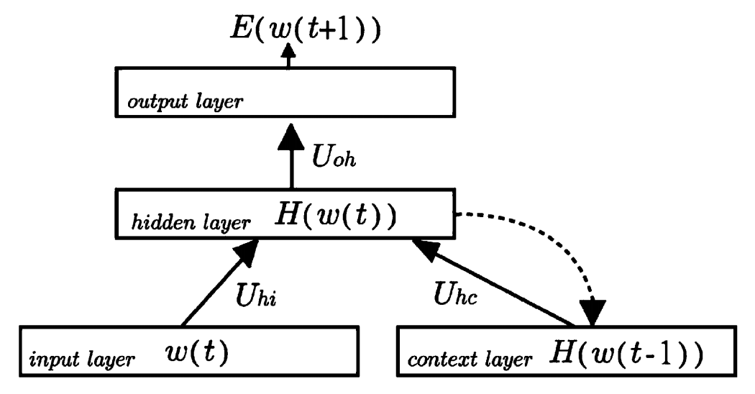
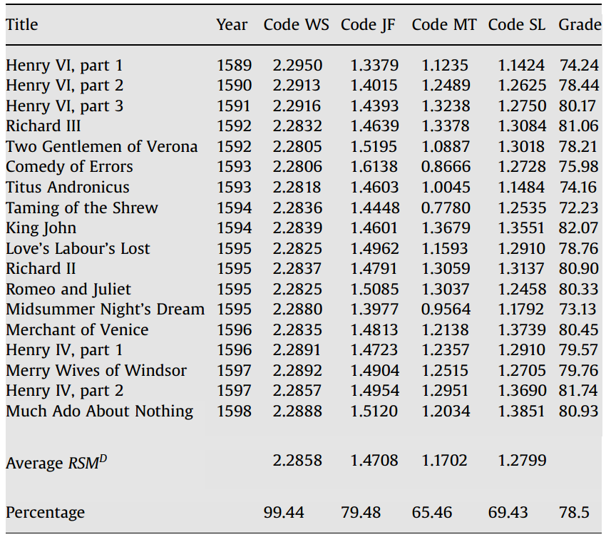
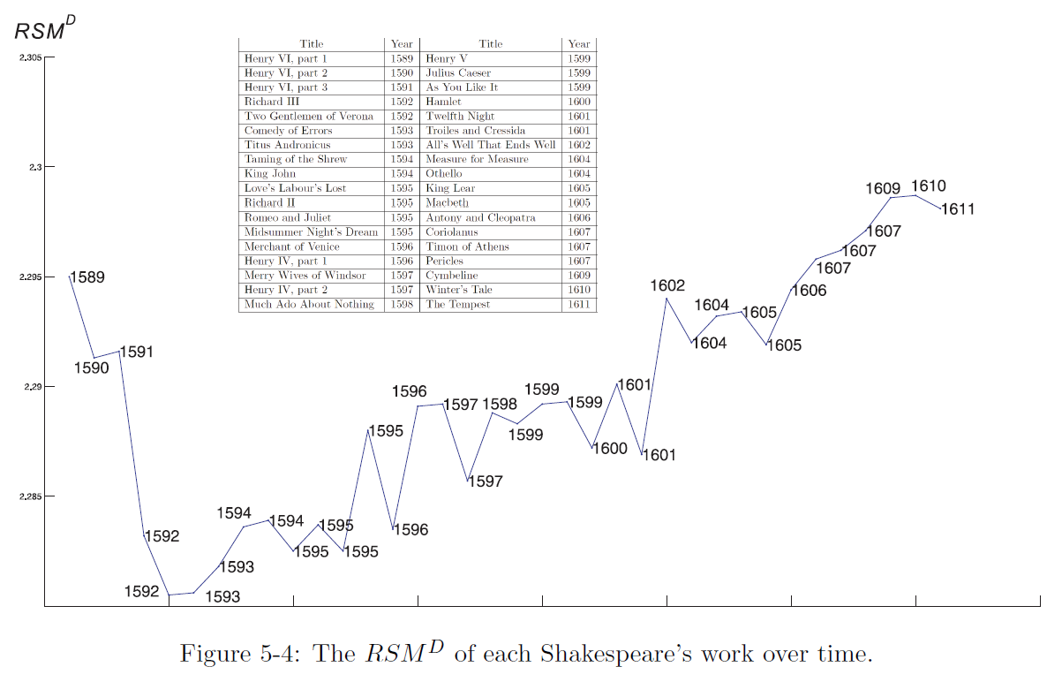
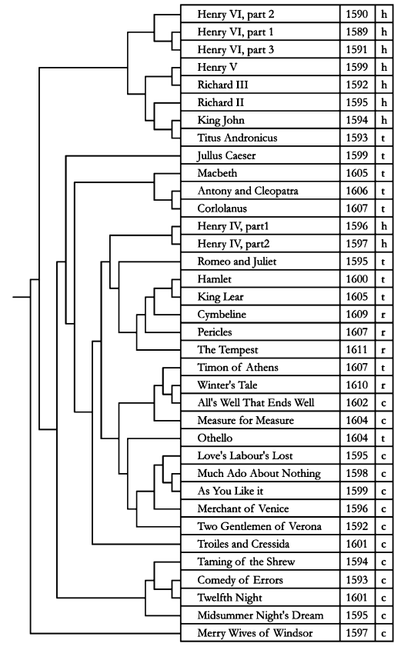
Auto-encoder for Semantic indexing
Cheng-Yuan Liou, Wei-Chen Cheng, Jiun-Wei Liou, Daw-Ran Liou
Department of Computer Science and Information Engineering, National Taiwan University
Idea
Query result without keywords
Cost and controversy for the manually assigned attributes by linguistic experts
http://red.csie.ntu.edu.tw/demo/literal/SAS.htm
Query | query result in Shakespeare plays
she loves kiss | BENVOLIO: Tut, you saw her fair, none else being by herself poised with herself in either eye; but in that crystal scales let there be weigh.d. Your lady.s love against some other maid that I will show you shining at this feast, and she shall scant show well that now shows best. -Romeo and Juliet
armies die in blood | MARCUS AND RONICUS: Which of your hands hath not defended Rome, and rear.d aloft the bloody battle-axe, writing destruction on the enemy.s castle? O, none of both but are of high desert my hand hath been but idle; let it serve. To ransom my two nephews from their death; then have I kept it to a worthy end. -Titus Andronicus
Generating attributes for each word automatically !
Predicting next word’s attributes
Renewed attributes in each iteration pass
Stylish similarity between four authors
Updating network’s weights after presentation of each word to reduce the prediction error.
Averaged prediction for each word is used as the renewed attributes after each training pass.
Ranking Shakespeare's 36 plays
Categorization of Shakespeare's 36 plays
Summary
Context-based method (Changing scenario)
Symbol–free sequence
Meaning of a learned attribute can be calibrated by its similar words.
Predicating the next word (symbol) of a given word sequence.
Applications
Stylish analysis
Authorship
Semantic indexing, ranking, and categorization
Internet
DNA, gene, and protein
Cryptography
Ancient language, machine translation

