Slide 1

IScIDE 2013
Beijing

Slide 2
Syntactic sensitive complexity
for symbol-free sequence
Bo-Shiang Huang, Daw-Ran Liou, Alex A. Simak
Cheng-Yuan Liou
National Taiwan University
Dept. of Computer Science and Information Engineering

Slide 3
Symbols

Slide 4
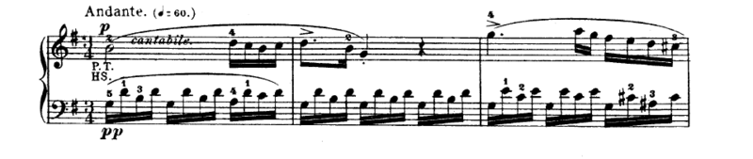
Piano Sonata No. 16 in C major, K. 545, by Mozart mov 2

Slide 5
Influenza A virus H7N9
MEQEQDTPWTQSTEHINTQKKESGQRTQRLEHPNSIQLMDHYLRTTSRVGMHKRIVYWKQWLSLKNLTQGSLKTRVSKRWKLFSKQEWIN
(A/Shanghai/02/2013(H7N9))
Segment: PB1-F2 protein
Protein ID: AGL44435
Length: 90 AA

Slide 6
Languages
滾滾長江東逝水 浪花淘盡英雄是非成敗轉頭空 青山依舊在,幾度夕陽紅 白髮漁樵江渚上 慣看秋月春風 一壺濁酒喜相逢 古今多少事 都付笑談中

Slide 7
Transmission bits
….. 01110010010101…

Slide 8
Time series
A: maximal ˄
V: minimal ˅
U: up ↑
D: down ↓
Oil price (Dubai, 52 week records of 2012)
A
V
U
D

Slide 9
Symbols
Bits
Characters
Words
Features
Meanings
Concepts
…
…..

Slide 10
Introduction and review
Complexity of L-system
(2011)
Complexity of symbol sequence
10

Slide 11
Lindenmayer system (1968)
Powerful system used to model the growth processes of plants.

Slide 12
Lindenmayer system (1968)
G=(V, ω, P)
  V: alphabets
  ω: the initial state of system
  P: parallel rewriting rules;
  mapping P: V →V* .

Slide 13
variables: A , B
start: A
rules: (A → AB), (B → A)
n = 0 : A
n = 1 : AB
n = 2 : ABA
n = 3 : ABAAB
A
/ \
A B
/ | \
A B A
/ | | | \
A B A A B

Slide 14
Koch snowflake graph
Variables: F, +, -
Start: F--F--F
Rules: F→F+F--F+F
n=0
n=1
n=2

Slide 15

Lindenmayer system
Context-free grammar can be used to build a tree.
F→F+F--F+F (bracket strings)
Context-free grammar
tree

Slide 16
Lindenmayer system
Can we deconstruct a tree to context-free grammars?
tree
?
Context-free grammar

Slide 17
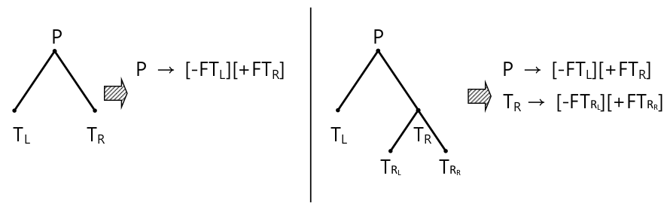
Deconstruction of tree

Slide 18
Rewriting rules
P
P → [-FT_{L}][+FT_{R}]
T_{R} → [-FT_{RL}][+FT_{RR}]
T_{L} → null
T_{RL} → null
T_{RR} → null
T_{L} T_{R}
T_{RL} T_{RR}

Slide 19
Bracketed strings of tree
[ FP ]
[-FT_{L}] [+FT_{R}]
[-FT_{RL}] [+FT_{RR}]
[FP[-FT_{L}][+FT_{R} [-FT_{RL}][+FT_{RR}]]]

Slide 20
Context-free grammar
Every non-terminal node can be rewritten as: P→LR
[ FP ]
[FP[-FT_{L}][+FT_{R} [-FT_{RL}][+FT_{RR}]]]
[-FT_{L}] [+FT_{R}]
P → [-FT_{L}][+FT_{R}]
T_{R} → [-FT_{RL}][+FT_{RR}]
T_{L} → null
T_{RL} → null
T_{RR} → null
[-FT_{RL}] [+FT_{RR}]

Slide 21
Abbreviation
[FP[-FT_{L}[-FT_{LL}][-FT_{LR}]][+FT_{R} [-FT_{RL}][+FT_{RR}[-FT_{RRL}][+FT_{RRR}[-FT_{RRRL}]]]]]
P → [-FT_{L}][+FT_{R}]
T_{L} → [-FT_{LL}][+FT_{LR}]
T_{R} → [-FT_{RL}][+FT_{RR}]
T_{RR} → [-FT_{RRL}][+FT_{RRR}]
T_{RRR} → [-FT_{RRRL}]
T_{LL} → null
T_{LR} → null
T_{RL} → null
T_{RRL} → null
T_{RRRL} → null
→ [-F][+F]
→ [-F][+F]
→ [-F][+F]
→ [-F][+F]
→ [-F]
→ null
→ null
→ null
→ null
→ null

Slide 22
Classification
Reason
  There are too many rules.
  Some of them are similar to each other.
P → [-FT_{L}][+FT_{R}] → [-F][+F]
T_{L} → [-FT_{LL}][+FT_{LR}] → [-F][+F]
T_{R} → [-FT_{RL}][+FT_{RR}] → [-F][+F]
T_{RR} → [-FT_{RRL}][+FT_{RRR}] → [-F][+F]
T_{RRR} → [-FT_{RRRL}] → [-F]
T_{LL} → null → null
T_{LR} → null → null
T_{RL} → null → null
T_{RRL} → null → null
T_{RRRL} → null → null

Slide 23
Classification method 1
Homomorphism
P → [-FT_{L}][+FT_{R}] → [-F][+F]
T_{L} → [-FT_{LL}][+FT_{LR}] → [-F][+F]
T_{R} → [-FT_{RL}][+FT_{RR}] → [-F][+F]
T_{RR} → [-FT_{RRL}][+FT_{RRR}] → [-F][+F]
T_{RRR} → [-FT_{RRRL}] → [-F]
T_{LL} → null → null
T_{LR} → null → null
T_{RL} → null → null
T_{RRL} → null → null
T_{RRRL} → null → null

Slide 24
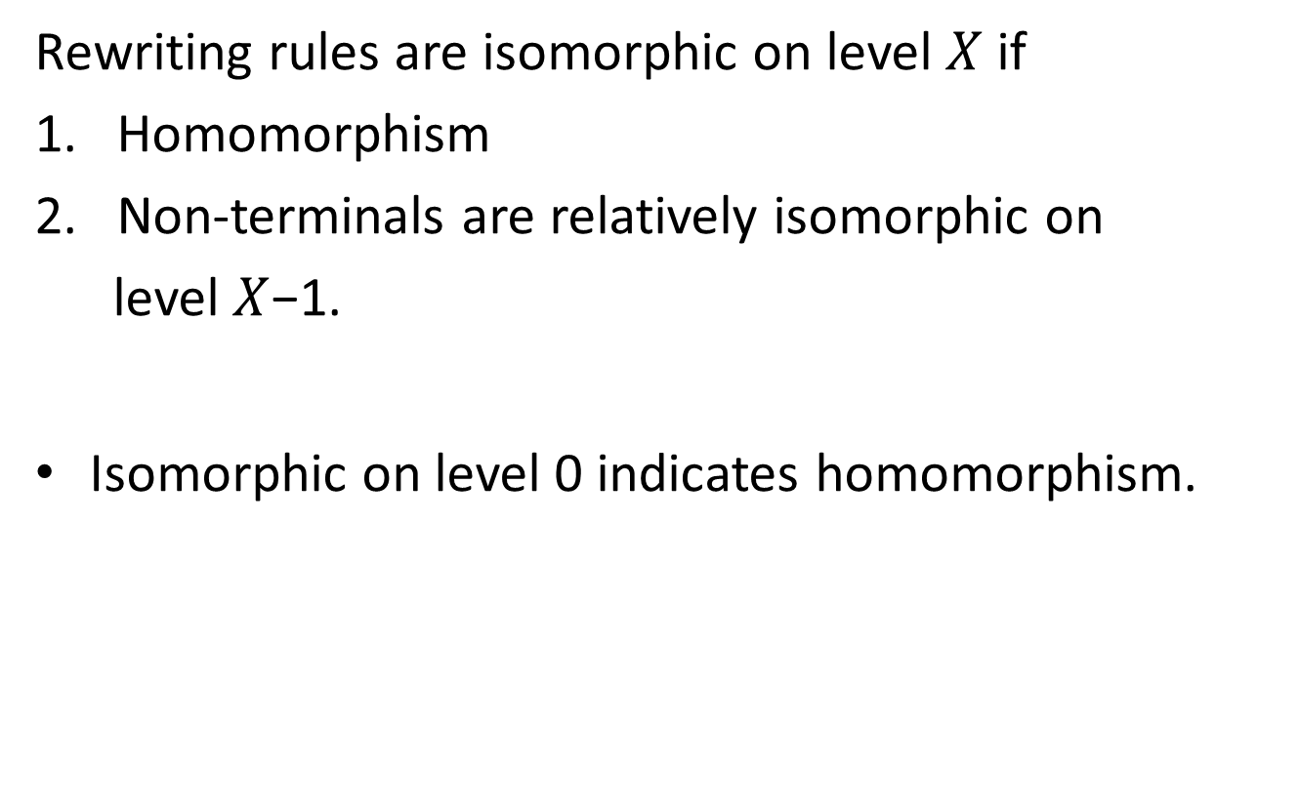
Isomorphism

Slide 25
Classification method 2
Isomorphism
Level 0
Level 1
Level 2

Slide 26
Classification
Combine homomorphism and isomorphism
P → [-FT_{L}][+FT_{R}] → [-F][+F]
T_{L} → [-FT_{LL}][+FT_{LR}] → [-F][+F]
T_{R} → [-FT_{RL}][+FT_{RR}] → [-F][+F]
T_{RR} → [-FT_{RRL}][+FT_{RRR}] → [-F][+F]
T_{RRR} → [-FT_{RRRL}] → [-F]
T_{LL} → null → null
T_{LR} → null → null
T_{RL} → null → null
T_{RRL} → null → null
T_{RRRL} → null → null
(1)Class 3 → C₃C₃
₄ (1)Class 3 → C₁C₁
(1)Class 3 → C₁C₃
(1)Class 3 → C₁C₂
(1)Class 2 →C₁
(5)Class 1 →null

Slide 27
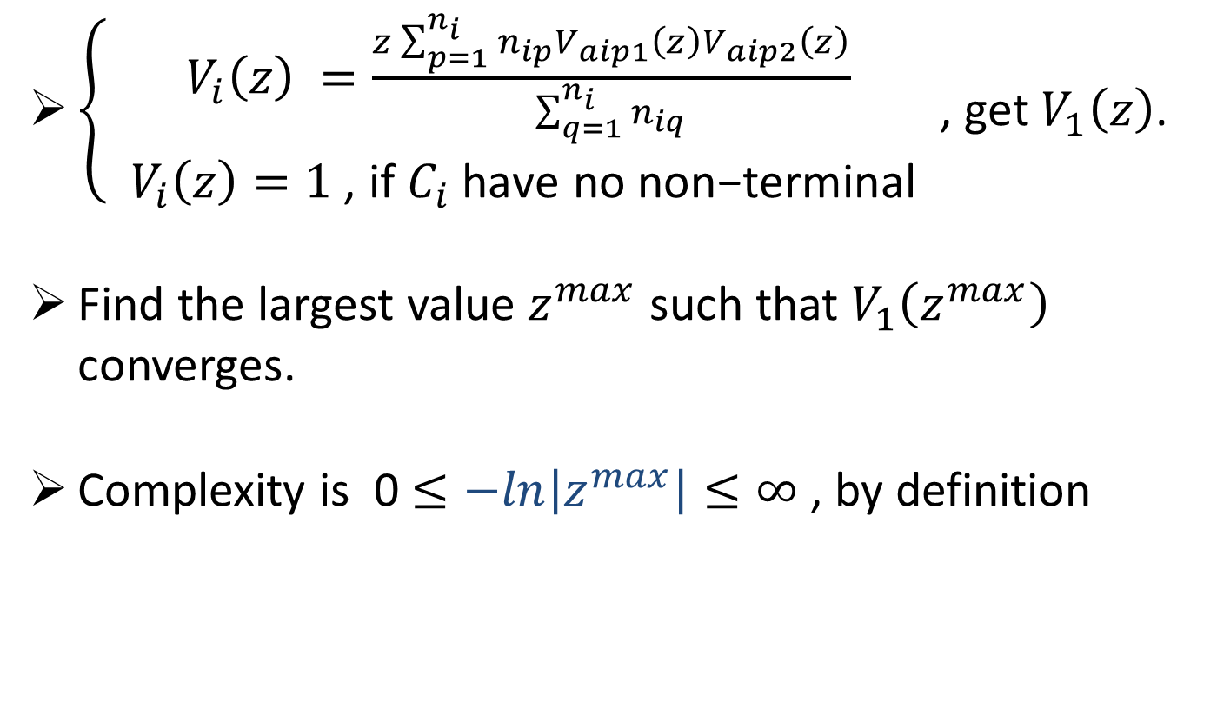
Complexity formula (2011)
1

Slide 28
String to context-free grammar
[FP[-FT_{L}][+FT_{R} [-T_{RL}][+FT_{RR}]]]
V₁ → V₂V₃V₄
V₂ → V₂V₃
V₃ → V₁
V₄ → V₃V₂V₃

Slide 29
Deconstruction procedure
Symbol sequence
Tree
Context-free grammar (bracketed strings)
Classification (levels)
Complexity

Slide 30
Psychological complexity

Slide 31
Complexity of Music
(2011)

Slide 32
One musical note can be divided into two or three sub units.

Slide 33
A half note can be rewritten into dierent notes.

Slide 34
Musical tree of Beethoven's Piano Sonata No. 6, Mov. 3.

Slide 35
Music tree of Rachmaninos piano concerto No.3 mov.

Slide 36
Bracketed strings for two trees.

Slide 37
Bracketed String of Beethoven Piano Sonata no 6. mov. 3

Slide 38
Bracketed strings for each node of rhythmic tree in Beethoven Piano Sonata no 6. mov. 3. (2 bracketed strings omitted)

Slide 39
Bracketed string of Rachmaninos piano concerto No.3 mov.1

Slide 40
Mozarts 19 Piano Sonatas, using isomorphic level 1

Slide 41
Mozarts 19 Piano Sonatas, using isomorphic level 2

Slide 42
Mozarts 19 Piano Sonatas, using isomorphic level 3

Slide 43
Beethovens 32 Piano Sonatas, using isomorphic level 1

Slide 44
Beethovens 32 Piano Sonatas, using isomorphic level 2

Slide 45
Beethovens 32 Piano Sonatas, using isomorphic level 3

Slide 46
Complexity of DNA sequence
(2013)

Slide 47
Computation procedure
DNA sequence
DNA tree
Context-free grammar
Classification
Complexity

Slide 48
Tree representation
AATTCCGGACTGCAGT
?

Slide 49
Tree representation
A C T G

Slide 50
Building tree
A C T G
A A T T C CG G A C T G C A G T

Slide 51
Classification table
Classification of Rules | Isomorphic Level #0 | Isomorphic Level #1
Class #1 | (19) C₁ → C₁C₁ | ( 8) C₁ → C₁C₁
 | ( 4) C₁ → C₁C₂ | ( 1) C₁ → C₁C₃
 | ( 4) C₁ → C₂C₁ | ( 1) C₁ → C₂C₂
 | (20) C₁ → C₂C₂ | ( 1) C₁ → C₂C₄
 |  | ( 1) C₁ → C₃C₁
 |  | ( 1) C₁ → C₃C₃
 |  | ( 1) C₁ → C₄C₂
 |  | ( 5) C₁ → C₄C₄
Class #2 | (48) C₂ → null | ( 4) C₂ → C₄C₅
Class #3 |  | ( 4) C₃ → C₅C₄
Class #4 |  | (20) C₄ → C₅C₅
Class #5 |  | (48) C₅ → null

Slide 52
Complexity
V₅(z) = 1 (definition)
V₄(z) = (z x ((20 x V₅(z) x V₅(z)))) / 20 = z
V₃(z) = (z x (( 4 x V₅(z) x V₄(z)))) / 4 = z²
V₂(z) = (z x (( 4 x V₄(z) x V₅(z)))) / 4 = z²
V₁(z) = (z x (( 8 x V₁(z) x V₁(z)) +
( 1 x V₁(z) x V₃(z)) +
( 1 x V₂(z) x V₂(z)) +
( 1 x V₂(z) x V₄(z)) +
( 1 x V₃(z) x V₁(z)) +
( 1 x V₃(z) x V₃(z)) +
( 1 x V₄(z) x V₂(z)) +
( 5 x V₄(z) x V₄(z)))) / 19
Classification of Rules | Count | Isomorphic Depth #1
Class #1 | 19 | ( 8) C₁ → C₁C₁
 |  | ( 1) C₁ → C₁C₃
 |  | ( 1) C₁ → C₂C₂
 |  | ( 1) C₁ → C₂C₄
 |  | ( 1) C₁ → C₃C₁
 |  | ( 1) C₁ → C₃C₃
 |  | ( 1) C₁ → C₄C₂
 |  | ( 5) C₁ → C₄C₄
Class #2 | 4 | ( 4) C₂ → C₄C₅
Class #3 | 4 | ( 4) C₃ → C₅C₄
Class #4 | 20 | (20) C₄ → C₅C₅
Class #5 | 48 | (48) C₅ → null

Slide 53

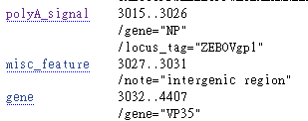
Ebola virus

Slide 54
Complexity of H7N9 PB1-F2

Slide 55
Complexity of text sequence
Using 1 to 27 (5 bits) to represent alphabets plus space character. (BIN)
Constructing binary tree.

Slide 56
Building tree for text sequence
00 01 10 11
00 00 10 10 01 01 11 11 00 01 10 11 01 00 11 10

Slide 57
Procedure
Text sequence
Tree structure
Rewriting rules
Classification
Complexity

Slide 58
Complexity of “Declaration of Independence”
Calculated every 256 bits. (July 4, 1776)

Slide 59
Complexity of “Declaration of Independence”
Calculated every 512 bits. (July 4, 1776)

Slide 60
Complexity of “Declaration of Independence”
Calculated every 1024 bits. (July 4, 1776)

Slide 61
紅Dream of Red Chamber,1754?, 紅樓夢
Unicode + ASCII
32 bits for each Character and punctuation
Complexity (tree) for each 1024 bits

Slide 62
Complexity of “紅樓夢 第 1~10 回”
Dream of the Red Chamber 1754, Unicode

Slide 63
Complexity of “紅樓夢第 11~20 回”
第11~20回

Slide 64
Complexity of “紅樓夢 第 21~30 回”

Slide 65
Complexity of “紅樓夢 第 31~40 回”

Slide 66
Complexity of “紅樓夢 第 41~50 回”

Slide 67
Complexity of “紅樓夢 第 51~60 回”

Slide 68
Low complexity sections in 紅樓夢
第一回
便是『了』，『了』便是『好』；若不『了』便不『好』；若要『好』，
第五回
：「癡情司」，「結怨司」，「朝啼司」，「暮哭司」，「春感司」，「
第十三回
、賈敕、賈效、賈敦、賈赦、賈政、賈琮、賈㻞、賈珩、賈珖、賈琛、賈
第四十回
梅花式的，也有荷葉式的，也有葵花式的，也有方的，也有圓的，其式不
第五十四回 (lowest complexity)
、太婆婆、媳婦、孫子媳婦、重孫子媳婦、親孫子媳婦、姪孫子、重孫子

Slide 69
Quasi-regular structure
To our knowledge, there is no other method can pick such
quasi-regular sections in
arts, music, DNA, literatures, and transmission bits ...

Slide 70
Complexity of “三國演義 第 1~10 回”

Slide 71
Complexity of “三國演義 第 11~20 回”

Slide 72
Complexity of “三國演義 第 21~30 回”

Slide 73
Low complexity sections in Three Kindom
第二十回
劉昂。昂生漳侯劉祿。祿生沂水侯劉戀。戀生欽陽侯劉英。英生安國侯劉
第二十二回
常之人，然後有非常之事；有非常之事，然後立非常之功。夫非常者，固
第二十三回
也；不讀詩書，是口濁也；不納忠言，是耳濁也；不通古今，是身濁也；

Slide 74
Summary
Representation is not unique.
Study of ancient languages.
Transmission anomaly
different from Kullback-Leibler
divergence
Measure of structural complexity.

Slide 75
Thanks for listening.

