Slide 1
CSCI 2016
Las Vegas
Dec. 15
16:20

Slide 2
A Parallel Bi-perceptron Approach and its Application to Data Classification
Daw-Ran Liou Yang-En Chen Cheng-Yuan Liou
Dept of Computer Sci and Information Eng National Taiwan University

Slide 3
INTRODUCTION
The kernel function in support vector machine (1995) is arbitrary, it carries no physical meaning in practical applications.
No effective BP training algorithm (1986) that gives 100% correction on training dataset
(such as, radial basis functions NN and Gaussian mixture model).

Slide 4
Bi-Perceptron
Works in real physical space.
All network parameters can be obtained in a constructive way without training.
Divide and-conquer way with 100% correction on training dataset.
Satisfies the faithful condition in ‘Theorem for convergence’ in tiling algorithm (1989) effectively.
two input patterns having different output should have different internal representations.

Slide 5
Bi-Perceptron
Fixed feed-forward network.
Three hidden layers, OR, ANDs, perceptrons.
Each AND neuron receives from its 2 perceptrons.
One AND and its 2 perceptrons form a strip.

Slide 6
2D

Slide 7
A network for a two-class problem, $c_{p}∈\{O, X\}$, in a two dimensional space, $D=n_{0}=2$.

Slide 9
Building a strip
Pick one class as “Target”.
For input with n attributes, randomly pick n data points from the “Target” class.
Form a n-dimensional hyper-plane.

Slide 10
Building a strip
“Expand” the hyperplane into two parallel perceptrons.
Stop the expanding before they touch an “non-Target” class point.
Note that strips resemble radial basis fctns and elongated distributions.

Slide 11
Bi-perceptron network
Randomly generate many strips, e.g. 1000.
Keep the most significant ones, significant: e.g. with large strip width.
Remove the data points in the kept strips from the rest strips.
Strips resemble radial basis fctns and elongated distributions.

Slide 12
Bi-perceptron network
Convert each edge of each kept strip into a perceptron.
Feed every two perceptrons of each strip into an “AND” neuron.
Connect all “AND” neurons to an “OR” neuron.

Slide 14
Six Datasets for Performance Testing
“Cross” and “Circle” were manually generated in a 2D space.
“Sonar”, “Wine”, “Ionosphere”, and “Promoters” are real datasets from websites [see references].

Slide 15
Results
Table I : number of patterns in each class.
Table II : average testing accuracies of 50 networks, cross validations (1/5 vs. 4/5).
Table III : testing accuracies of various methods .

Slide 16
Table I. Number of patterns in six testing datasets
(#) | Class 1 | Class 2 | Class 3
Cross Dataset | 138 | 165 | -
Circle Dataset | 140 | 97 | -
Sonar | 97 | 111 | -
Wine | 59 | 71 | 48
Ionosphere | 225 | 126 | -
Promoters | 53 | 53 | -

Slide 17
Table II. Average testing accuracies of bi-perception for different classes
(%) | Class 1 | Class 2 | Class 3
Cross Dataset | 94.6 | 73.9 | -
Circle Dataset | 96.9 | 69.4 | -
Sonar | 53.4 | 51.8 | -
Wine | 87.3 | 92.2 | 94.2
Ionosphere | 79.4 | 71.4 | -
Promoters | 53.3 | 50.9 | -

Slide 18
Table III. Testing accuracies of different methods
(%) | Bi-perceptron | Gaussian SVM | Cubic SVM
Cross Dataset | 94.6 (50 overlap ) | 95.0 (5 non overlap) | 77.9 (5 non overlap)
Circle Dataset | 96.9 | 97.0ª | 97.9
Sonar | 53.4 | 59.6ª | 88.9
Wine | 94.2 | 42.7ª | 98.3
Ionosphere | 79.4 | 93.7 ª | 90.3
Promoters | 53.3 | 89.6 ^{b} | 88.7
^{a. Kernel scale = 5.7}
^{b. Kernel scale = 7.5}

Slide 19
Comparisons with k-NN and SOM perceptron
Table IV and Table V listed all their parameters.
3 of 1000 strips are kept in each iteration of building the bi-perceptrons. (Table IV)
k-NN :
k: the number of neighboring cells in the.
SOM Perceptron:
$n_{m}$ : number of layers
$n_{1}^{c}$ : number of neurons in neuron layers
$n_{2}^{c}$ : number of neurons in labeling sector

Slide 20
Table IV. Parameters in k-NN, SOM perceptron, and Bi-perceptron
 | k-NN | SOMP | Bi-perceptron
 |  | $${(n}_{m}, n_{1}^{c},n_{2}^{c})$$ | kept ratio
Sonar | (3,1,1,3,3) (3,1,1,1,1) | (35,5,1) | 3 of 1000
Wine | (3,15,13,11,19) (15,19,13,15,11) | (10,5,3) | 3 of 1000
Ionosphere | (1,3,1,1,1) (1,11,1,1,1) | (10,5,1) | 3 of 1000
Promoters | (3,5,1,3,1) (3,3,3,3,3) | (100,40,1) | 3 of 1000

Slide 21
Comparisons
SVM
C: cost for the error tolerance
γ: gamma in the Gaussian kernel.
The above are optimized using an inner 5-fold (nonoverlap) cross-validation procedure.
MLP: two hidden layers.

Slide 22
Table V. Parameters in SVM and MLP
 | SVM |  | MLP
 | C | gamma | $$n_{1}^{MLP}$$ | $$n_{2}^{MLP}$$
Sonar | (2⁵, 2¹, 2⁵, 2³, 2⁷) (2⁷, 2⁷, 2³, 2³, 2⁵) | (2⁻³,2⁻¹,2⁻³,2⁻³,2⁻⁵) (2⁻⁵,2⁻⁵,2⁻¹,2⁻³,2⁻³) | 30 | 10
Wine | (2⁻¹, 2¹,2⁻¹, 2³, 2¹) (2⁵,2⁻¹, 2¹,2⁻¹, 2¹) | (2⁻¹,2⁻¹,2⁻¹,2⁻⁹,2⁻³) (2⁻⁵,2⁻¹,2⁻¹,2⁻¹,2⁻³) | 20 | 5
Ionosphere | (2³, 2³, 2³, 2³, 2¹) (2⁵,2⁻¹, 2¹,2⁻¹, 2¹) | (2⁻¹,2⁻¹,2⁻¹,2⁻¹,2⁻⁵) (2⁻³,2⁻⁵,2⁻¹,2⁻³,2⁻¹) | 20 | 5
Promoters | (2¹, 2¹, 2¹, 2³, 2¹) (2⁵, 2¹, 2³, 2¹, 2⁵) | (2⁻⁹,2⁻¹¹,2⁻⁷,2⁻¹³,2⁻⁷) (2⁻¹⁵,2⁻⁹,2⁻¹¹,2⁻⁹,2⁻¹¹) | 20 | 5

Slide 23
Table VI : training accuracies
Table VII : testing accuracies
The results are the average of the 5-fold cross-validation (nonoverlap).
The bi-perceptron
training accuracy : 100%
testing accuracies : comparable

Slide 24
Table VI. Training accuracies on real datasets
(%) | k-NN | SOMP | MLP | SVM | Bi-perceptron
Sonar | 95.46 | 100.0 | 98.24 | 100.00 | 100.0
Wine | 97.88 | 100.0 | 100.00 | 99.56 | 100.0
Ionosphere | 97.69 | 100.0 | 99.46 | 99.05 | 100.0
Promoters | 93.72 | 100.0 | 100.00 | 100.00 | 100.0

Slide 25
Table VII. Testing accuracies on real datasets
(%) | k-NN | SOMP | MLP | SVM | Bi-perceptron
Sonar | 82.74 | 86.60 | 84.14 | 88.00 | 53.4 (50 overlap)
Wine | 97.78 | 98.33 | 97.78 | 98.30 | 87.3
Ionosphere | 85.17 | 90.60 | 88.32 | 94.87 | 79.4
Promoters | 72.64 | 86.55 | 85.73 | 89.36 | 53.3

Slide 26
Examples of constructed Bi-perceptron
Fig. 2 and Fig. 3
(a): networks constructed for datasets.
(b): all strips in the networks.
The locations and directions of the 3 kept strips in an iteration are very similar.
This suggests that there is no need to keep more than 3 strips in each iteration.
One should keep only one of those heavily overlapped strips and delete the rest.

Slide 27
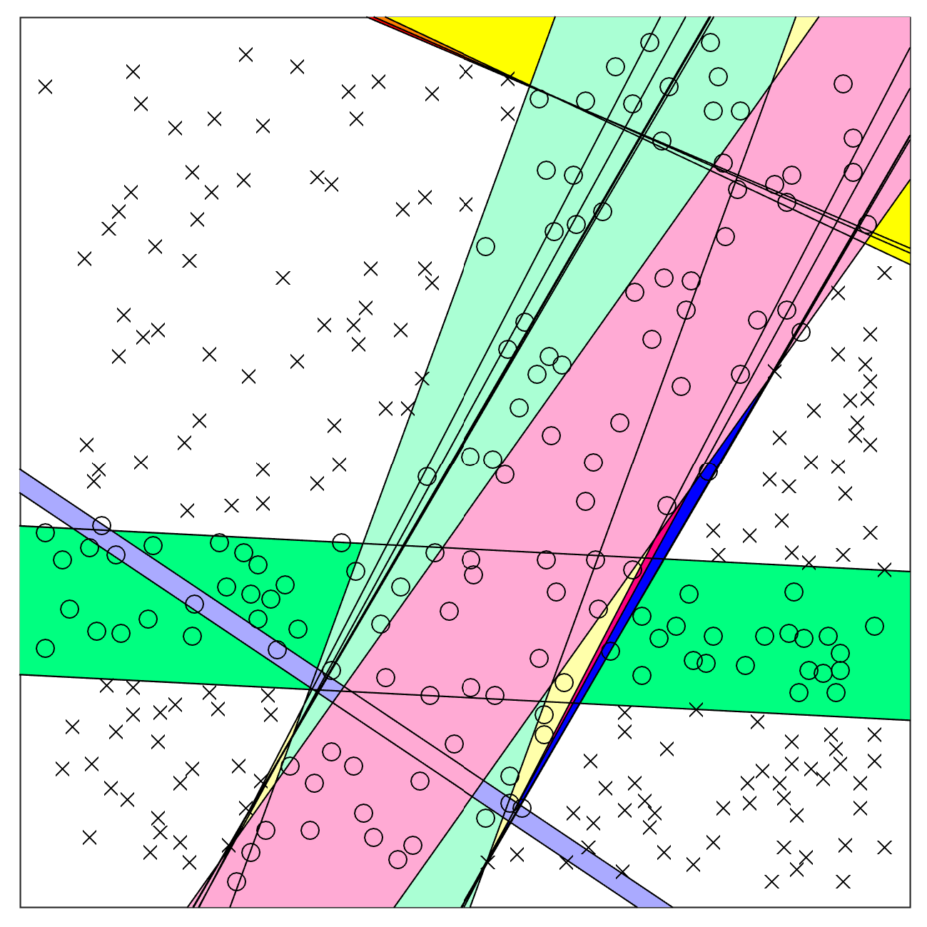
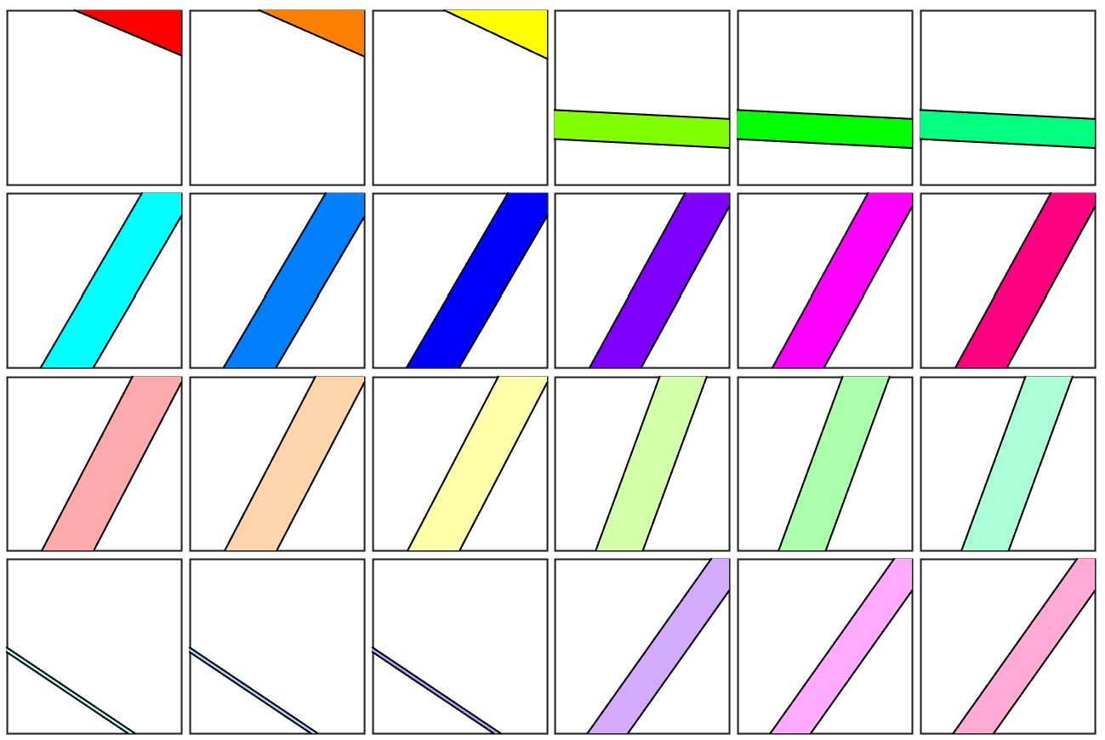
For “Cross” dataset

Slide 28
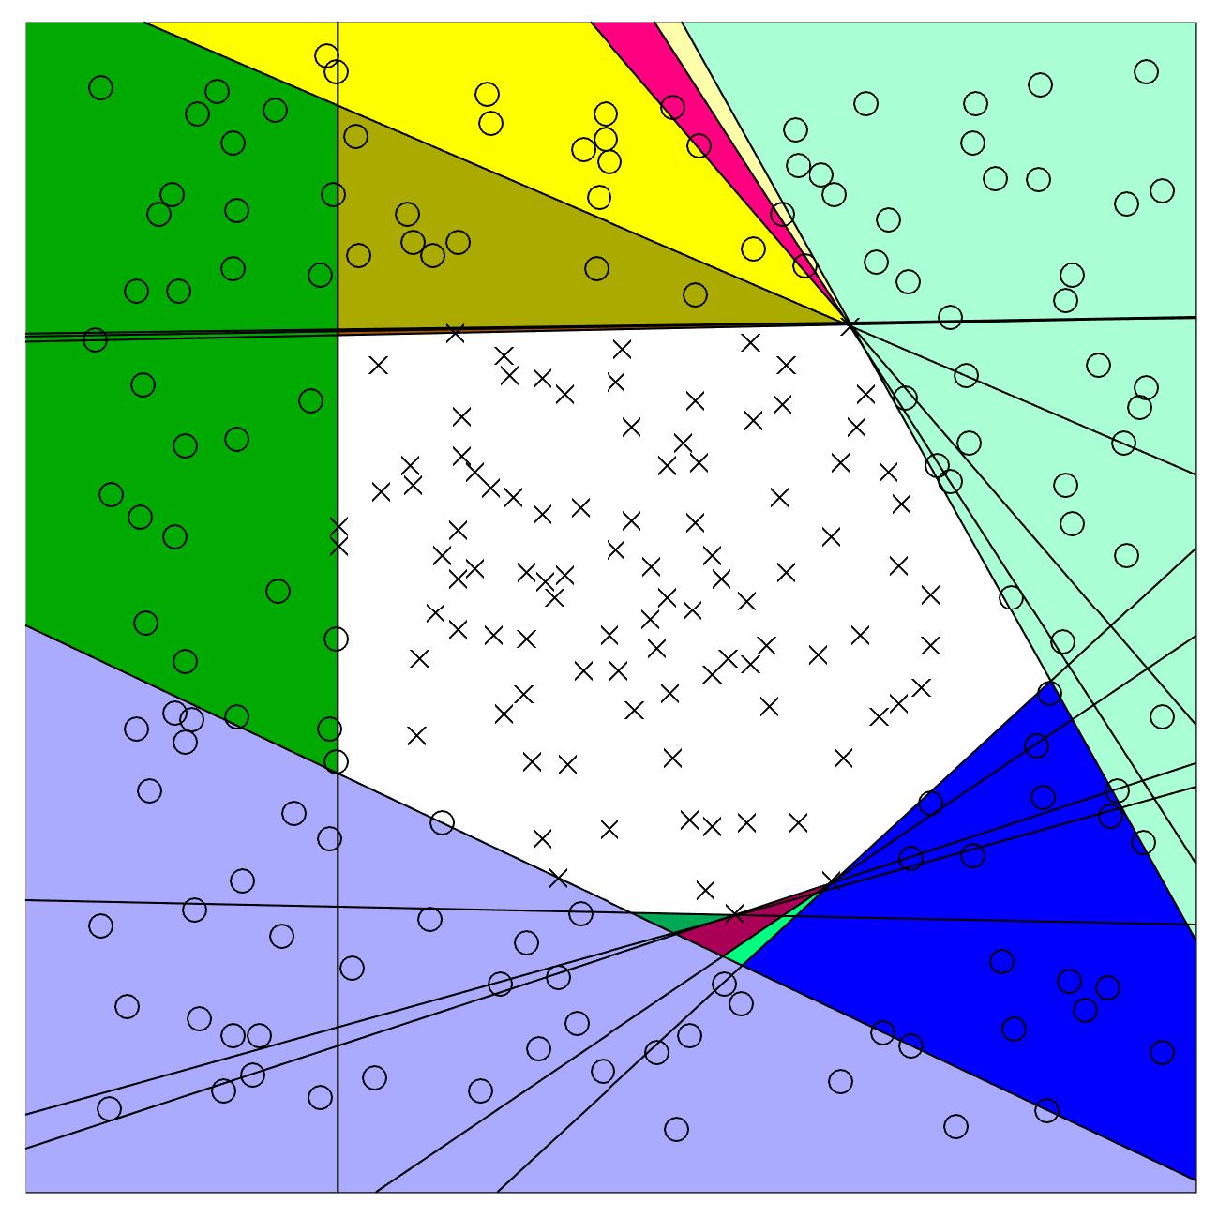
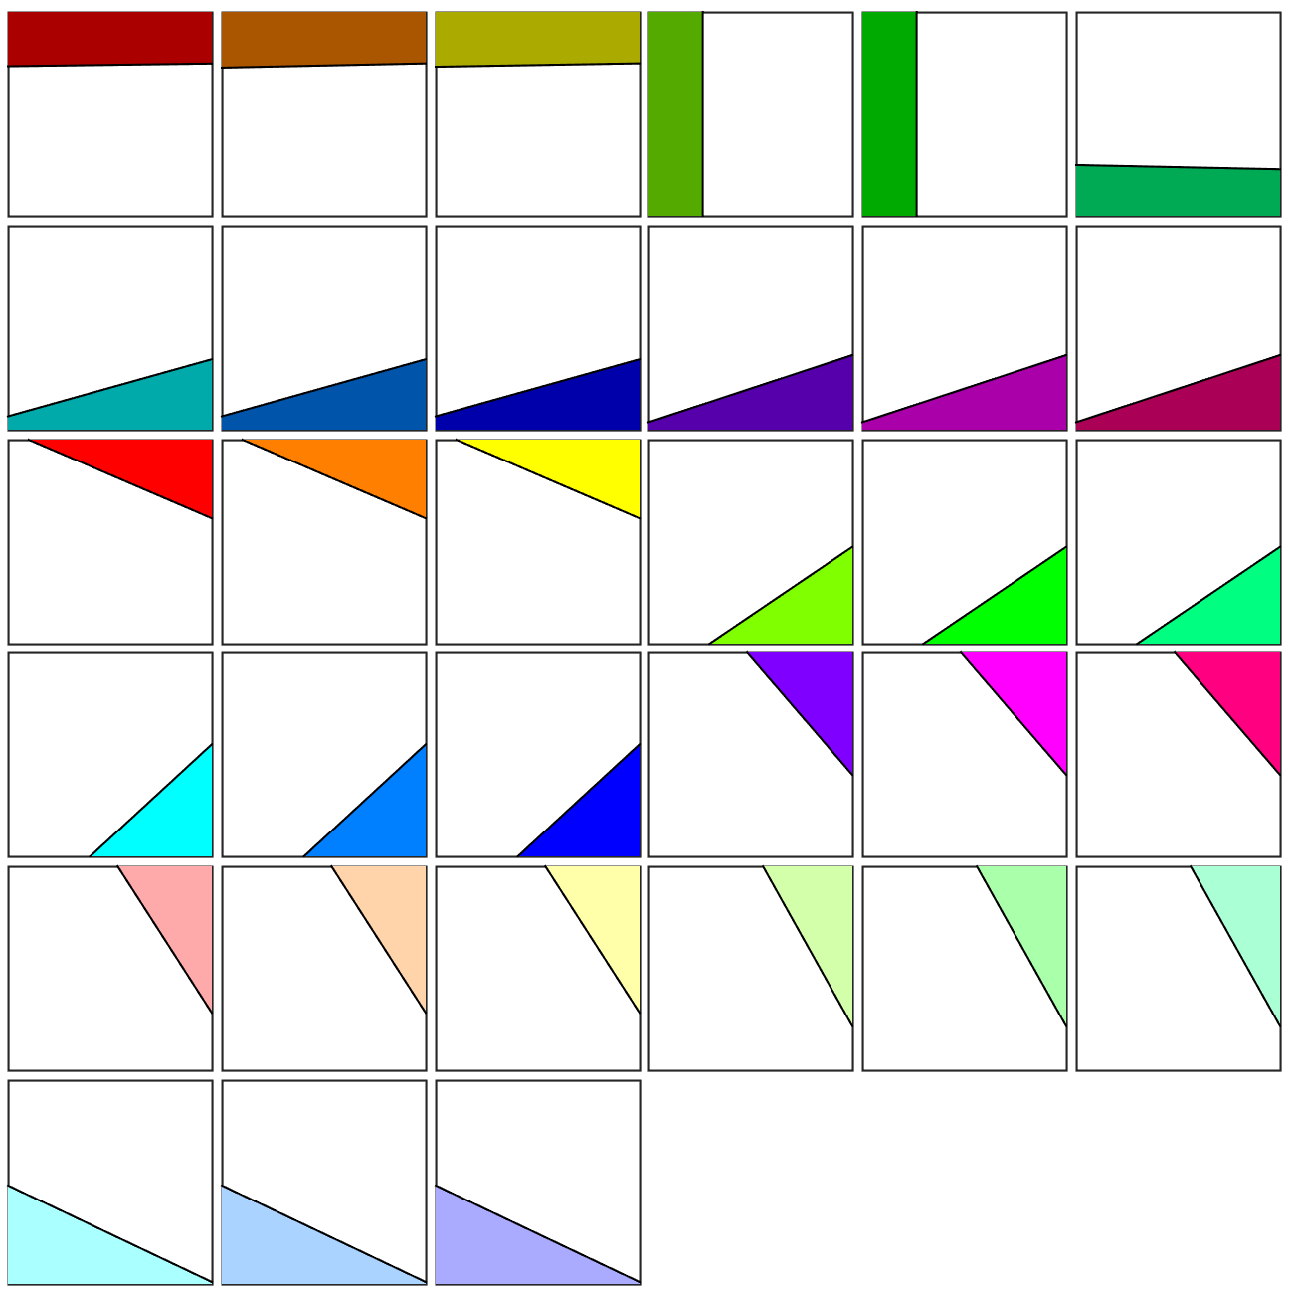
For “Circle” dataset

Slide 29
Summary and Suggestions
Works in real physical space.
Effective constructive way without training.
Divide and-conquer way with 100% correction on training dataset.
Satisfies the faithful condition in ‘Theorem for convergence’ in tiling algorithm (1989) effectively.
two input patterns having different output should have different internal representations.

Slide 30
Finite polygonal approach
When the class patterns scattered over isolated regions, it’s hard to do prediction using infinitive strips.
Instead of infinitive strips, finite polygonal regions for isolated clusters will give much better performance on testing datasets.

Slide 31
Polygonal regions
The construction of finite polygonal regions is similar to that of strips.
Pick D+1 nearest neighbors (data points) from the other class ‘X’ as cornels of a polygon.
Pick the nearest internal class point ‘0’ of each polygon boundary (perceptron).
Set a new boundary right in between this point and its polygon boundary.
Based on these D+1 new boundaries, construct a new polygon region.
Each new polygon contains class patterns ‘0’ in its internal region.

Slide 32
“Polygonal” region
$D+1$ , or more, neurons to enclose an isolated polyhedral region.
Using polyhedrons will increase the flexibility of the network, but it also increases the complexity drastically.

Slide 33
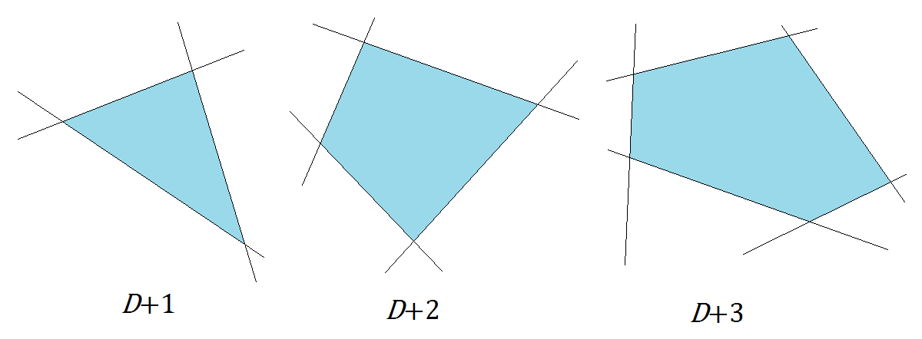
Polygonal regions

Slide 34
Have a nice day.

