Slide 1
機器發明與社群網路探勘實驗室
Machine Discovery and Social Network Mining Lab (MSLAB)
林守德 副教授
sdlin@csie.ntu.edu.tw
詳情請參照以下link:
老師的網頁：http://www.csie.ntu.edu.tw/~sdlin/
FAQ：http://www.csie.ntu.edu.tw/~sdlin/faq_perspective_students.htm
科普文章介紹我們的領域：http://www.csie.ntu.edu.tw/~sdlin/pscience.html

Slide 2
機器發明與社群網路探勘實驗室（MSLAB, R302）
指導教授:
Shou-de Lin（林守德）
  台大電機系學士
  密西根大學電機碩士
  南加大語言學碩士
  南加大資訊工程博士
  美國羅沙拉摩斯國家
  實驗室博士後研究
成員:
7 Ph.D. students
14 MS students
5 undergrad students
學生獲獎：
國科會大專學生研究計畫 （3 +1, 1 award）
趨勢科技騰雲駕霧雲端程式競賽冠軍
Yahoo Hack Day冠軍
Yahoo Internship Award
ACM KDDCUP冠軍
ACLCLP，資訊學會論文獎
Microsoft Fellowship
Many others
研究領域
社群網路分析
知識發現與機器學習 (KDD Cup)
人工智慧
搜尋引擎與自然語言應用
感測網路資料分析（INTEL-NTU Lab）

Slide 3
為什麼妳/你選擇MSLAB
我喜歡思考，對於創造發明有興趣
我有強烈意願學到如何對大量資料作智慧型分析與處理
我不討厭理論/數學，卻不想做純理論/數學；我不討厭程式實作，卻不想只是寫程式實作的同學
我喜歡挑戰且做出很酷的東西的同學 (we are beyond just ideas)

Slide 4
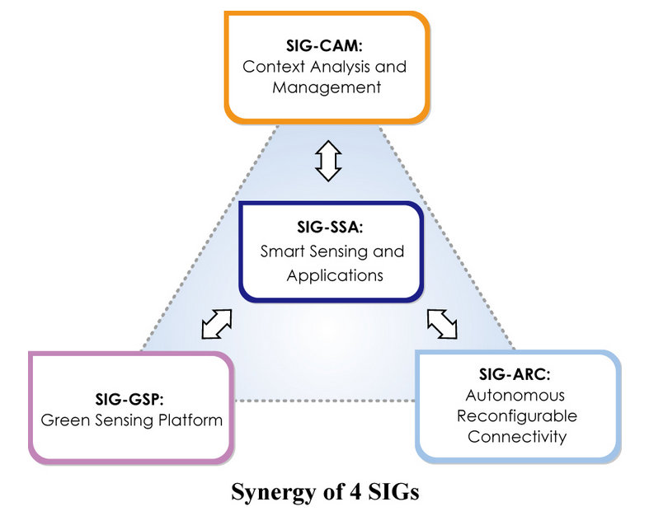
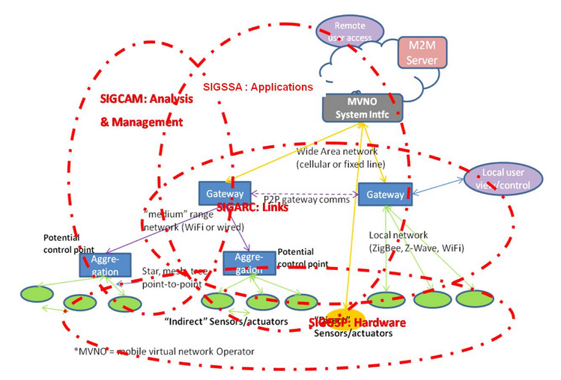
INTEL-NTU Lab Project (有機會去國外實習）
Big data analysis
M2M data analysis
Time-sequence mining
Anomaly detection

Slide 5
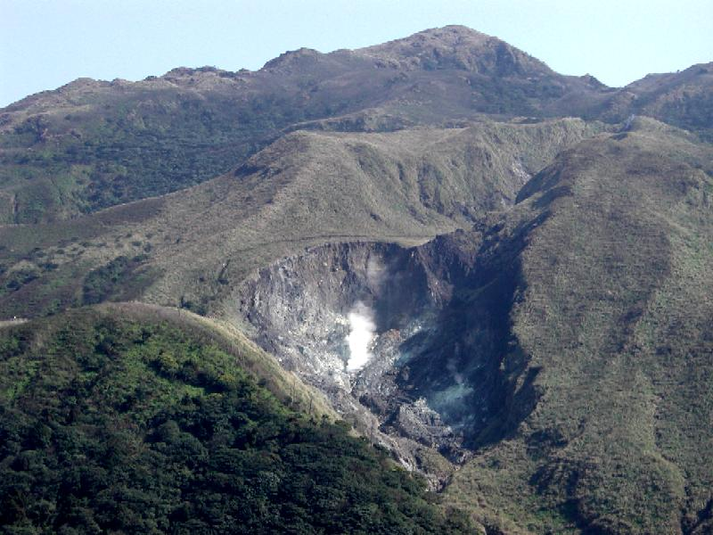
Case Study: 災難預測
Local WSN 4
Local WSN 1
Local WSN 2
Local WSN 3
Local WSN N
Local distributed
server 1
Local distributed
server 2
Local distributed
server 3
Local distributed
server 4
Local distributed
server N
Central server

Slide 6
社群網路探勘
社群網路如何影響人類的投票行為？
社群網路上的推薦
社群網路上的取樣與族群分析
社群為本的逃生模擬 http://mslab.csie.ntu.edu.tw/evaplanner/
社群網路上的多人影響最佳化
結合地理資訊的社群網路探勘
http://mslab.csie.ntu.edu.tw/memetube/demo/

Slide 7


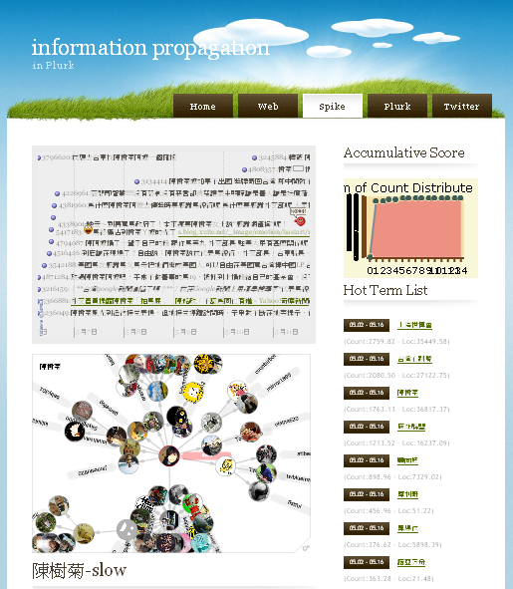
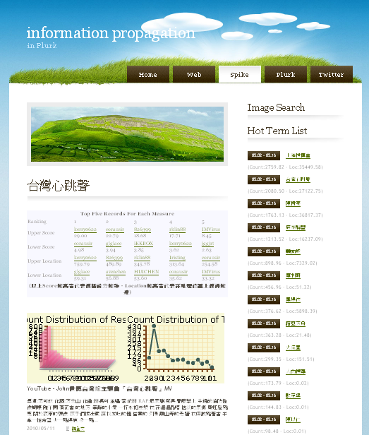
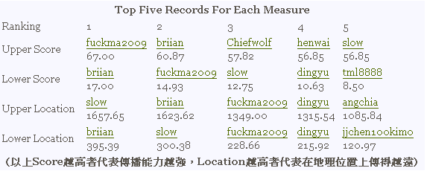
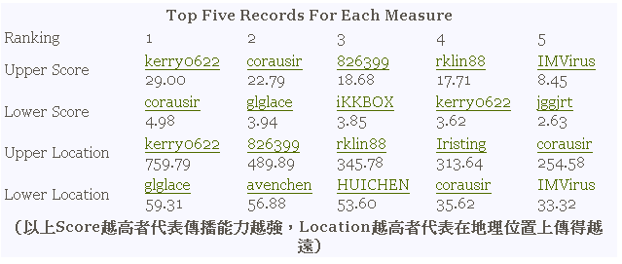
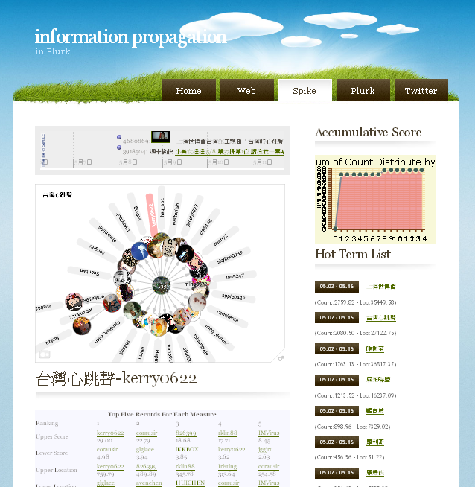
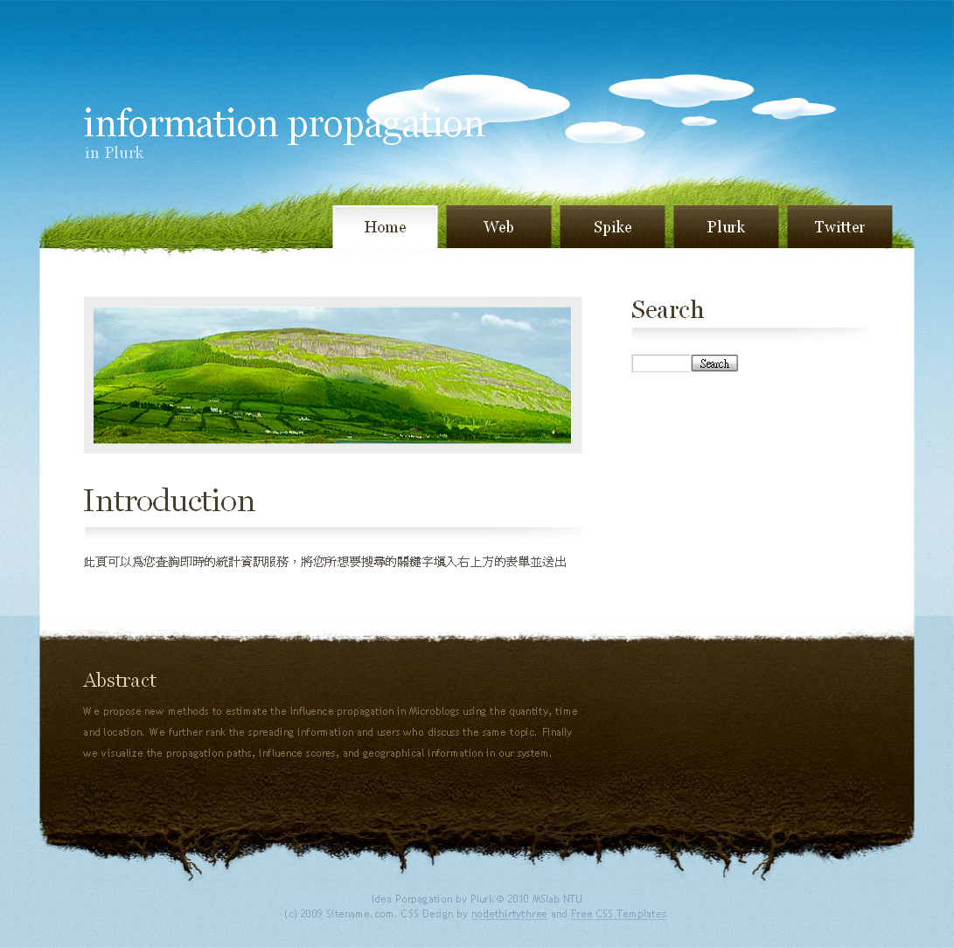
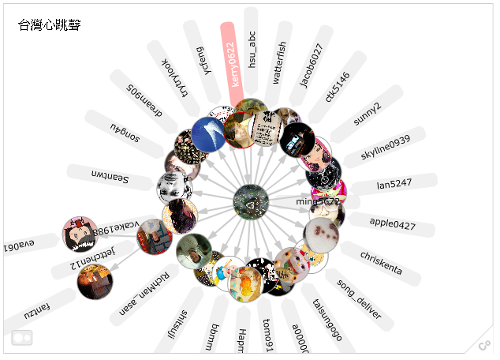
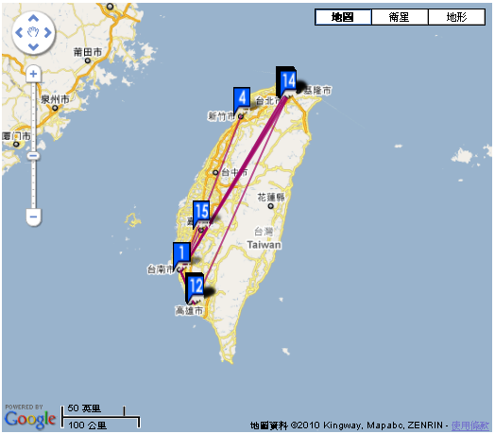
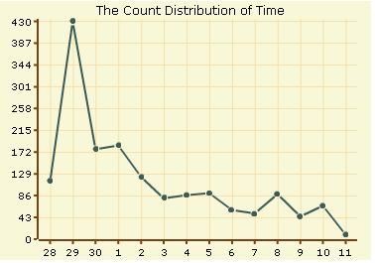

Information Propagation – Best Paper in ASONAM 2011
台灣心跳聲
Measurement of Influence
台灣心跳聲
http://140.112.31.186/~tongtong/analyze_plurk/web_new5/index.php

Slide 8


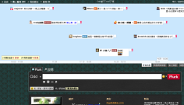
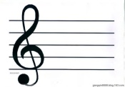
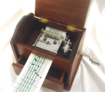
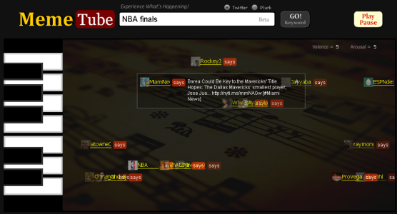
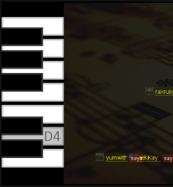
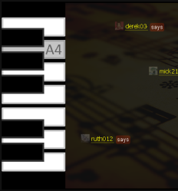
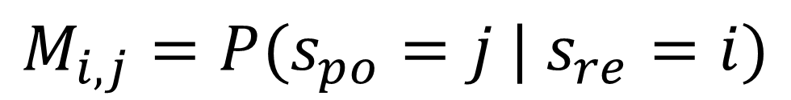
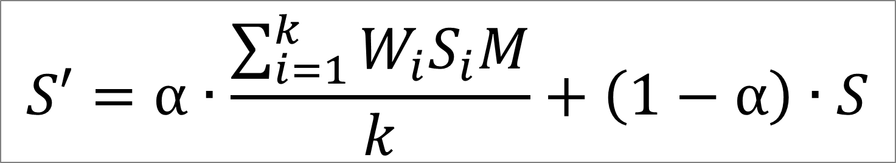
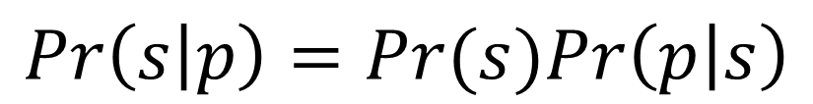
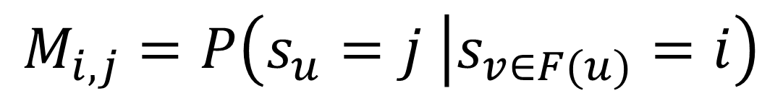
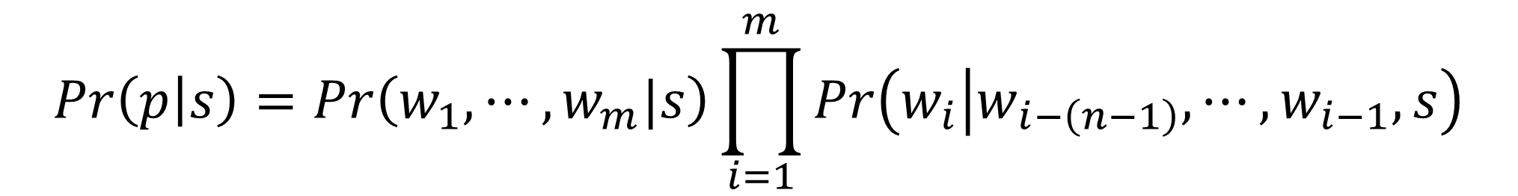
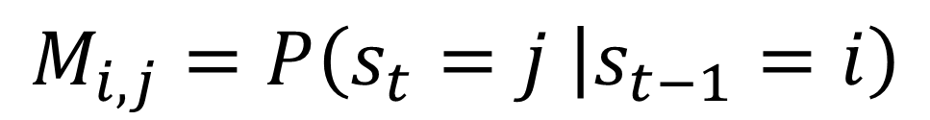
MemeTube: A Sentiment-based Audiovisual System for Analyzing and Displaying Microblog Messages (ACL11)
Cheng-Te Li Chien-Yuan Wang Chien-Lin Tseng Shou-De Lin
National Taiwan University, Taiwan
Introduction
System Flow
Motivation.
User Experience: (a) information overload,
(b) drag-and-drop or scrolling are not intuitive.
Characteristics of Microblogging:
(a) Real-time reflect senses, (b) Exhibit collective feelings
MemeTube.
Music-based topic exploration system
Message-driven music generator
Audiovisual presentation of net art
Applications.
Capture sentiments for keyword advertising
Provide domain experts to quickly understand
real-time public opinion about any terms
Compose music via collective senses as a novel net art
Demo. http://mslab.csie.ntu.edu.tw/memetube/
Query
Information
Extraction
messages
Sentiment
Detection
keyword
Sentiment Detection
messages
Arousal
Valence
messages
sentiments
music
MemeTube
Audiovisual
Presentation
Animation
Generation
Chord
Rhythm
Music
Generation
+
+
Plurk
Music Staff
Music Box
– Machine Learning Approach
$$\operatorname{Pr}\left(p | s\right)=Pr\left(w_{1},⋯, w_{m}|s\right)\prod_{i=1}^{m}{Pr\left(w_{i} | w_{i−\left(n−1\right)},⋯,w_{i−1},s\right)}$$
Basic Classifier.
Language model.
Response Factor.
Sentiment of a post is highly related to its responses.
Post-Response sentiment transition
Contextual Factor.
Sentiment of a user’s post is related to her previous posts.
Temporal personal sentiment transition
Friendship Factor.
Sentiments of those who are friends affect each other.
User-Friend sentiment transition
$$Pr\left(s | p\right)=Pr(s)Pr\left(p | s\right)$$
Anger
Arousal
Surprise
$$S′=α∙\frac{\sum_{i=1}^{k}{W_{i}S_{i}M}}{k}+\left(1−α\right)∙S$$
Fear
Joy
$$M_{i,j}=P(s_{po}=j | s_{re}=i)$$
Sadness
Valence
$$M_{i,j}=P\left(s_{t}=j | s_{t−1}=i\right)$$
Disgust
Russell’s Sentiment Model
 | Accuracy | RMSE(V) | RMSE(A)
LM | 33.8% | 0.784 | 0.640
Response | 34.7% | 0.683 | 0.522
Context | 34.8% | 0.684 | 0.516
Friend | 35.1% | 0.703 | 0.538
Combine | 36.5% | 0.679 | 0.514
Music Generation
$$M_{i,j}=P\left(s_{u}=j | s_{v∈F(u)}=i\right)$$
– Rule-based Heuristic Mapping
Chord Set Selection → controlled by valence
Exploit nine basic chord sets as {A, Am, Bm, C, D, Dm, Em, F, G} to compose 20 chord sequences based on the shifting of valence.
Rhythm Determination → determined by arousal
Normalize the arousal to five levels to decide the speed of the music.

Slide 9

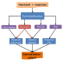
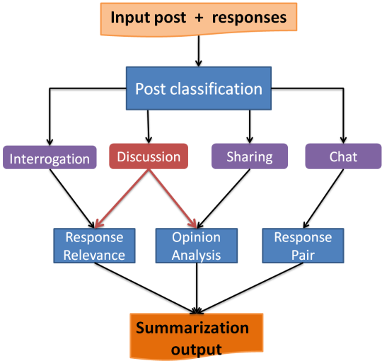

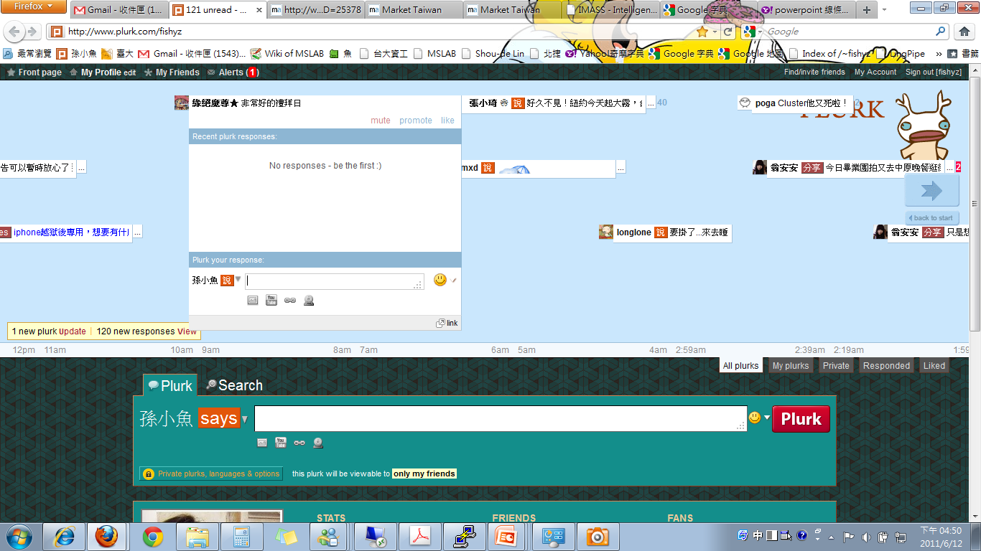
IMASS
An Intelligent Microblog Analysis and Summarization System
Jui-Yu Weng Cheng-Lun Yang Bo-Nian Chen Yen-Kai Wang Shou-De Lin
National Taiwan University (ACL 2011)
GO!
Keyword
GO!
UserID
Motivation As Microblog services such as Twitter and Plurk have become increasingly popular, it can be beneficial if there is an intelligent tool assisting summarizing the overwhelming information on those media platforms.
:
Goal To summarize a Microblog post and its responses with the goal to provide readers a more constructive and concise set of information for efficient digestion.
:
mute promote like
mute promote like
Demo http://mslab.csie.ntu.edu.tw/~fishyz/plurk/
shares
Why four subsystems Different types of posts need different summarization strategies.
?
mute promote like
mute promote like
System Architecture Two-phase scheme; Four subsystems.
Recent responses:
:
OA for sharing posts – do your friends like them?
RPI for chat posts – how many topics involve in them?
RRD for interrogative posts – just show me the answers!
mute promote like
X
Recent responses:
Post intention Classification (PC)
Opinion Analysis (OA)
Response Pair Identification (RPI)
Response Relevance Detection (RRD)
Post your responses:
Post your responses:
ACL
likes
User
says
June 24 | June 23 | June 22 | June 21 | June 20 | June 19

Slide 10
資料探勘方法組
建保資料探勘
人際關係預測
機器學習與實務
參加KDDCUP
  Imbalanced Data Classification（ACM KDDCUP2008, Champion）in medical data
  Fast prediction of Customers（ACM KDDCUP2009, 3rd place）in tel-comm data, joint work with Prof. CJLIN and HTLIN
  Dependency modeling in（ACM KDDCUP2010, Champion）for education data, joint work with Prof. CJLIN and HTLIN
  Music recommendation (ACM KDDCUP 2011, Champion), joint work with Prof. CJLIN and HTLIN
  Social Network and Web click Analysis (ACM KDDCUP2012, Champion), with HTLIN

Slide 11
自然語言與搜尋引擎組
自動出題系統
瞭解不同主題的訊息如何在Facebook上傳播？
IBM華生的解析：探討電腦如何理解語言

Slide 12
研究的型態
沒有background？沒關係，我們會開發你的興趣與潛能
  第一學期以訓練為主，第二學期以後專注於研究
  會幫助同學把好的成果發表國際論文（超過一半的學生發表國際論文，實驗室會補助出國）
研究：第一年跟學長姐一組做研究，第二年之後有獨立研究能力
  50%方法（可能會用到機率，線性代數，演算法），50％實作（任何語言皆可）
  每週與指導教授（就是我）meeting一次
  隨時都可以開始研究 (there is never too early to start, never too late to join)
過人的能力需要嚴格的訓練來培養 →加入我們之前請有心理準備

Slide 13
指導學生獲獎
2012 Facebook Fellowship Nomination
2012 計算語言學會碩士論文獎
2011 SIGIR Travel Award
2010 Microsoft Fellowship
2010 國科會大專生專題研究獎
2010 訊連科技菁英獎學金
2009 趨勢騰雲駕霧雲端程式大賽冠軍（56萬元獎金＋預聘書）
2010 SIGGRAPH Student Research Award Finalist
2009 Yahoo Hack Day程式競賽冠軍（十萬元獎金）
2009 中華民國資訊學會碩士論文獎佳作
2009 計算語言學會碩士論文獎佳作
2009 訊連科技菁英獎學金
2007 國科會科普寫作獎第二名
Enjoy Research and have fun !!

Slide 14
還想知道更多的同學請參照
SD老師的網頁：http://www.csie.ntu.edu.tw/~sdlin/
FAQ for new students：http://www.csie.ntu.edu.tw/~sdlin/faq_perspective_students.htm
科普文章介紹我們的領域：http://www.csie.ntu.edu.tw/~sdlin/pscience.html

