Slide 1
ACBiMA: Advanced Chinese Bi-Character Word Morphological Analyzer
Ting-Hao (Kenneth) Huang Yun-Nung (Vivian) Chen Lingpeng Kong HTTP://acbima.org

Slide 2
Outline
Introduction
Related Work
Morphological Type Scheme
Morphological Type Classification
Drived Word: Rule-Based Approach
Compond Word: ML Approach
Experiments
ACBiMA Corpus 1.0
Experimental Results
Conclusion & Future Work

Slide 3
Outline
Introduction
Related Work
Morphological Type Scheme
Morphological Type Classification
Drived Word: Rule-Based Approach
Compond Word: ML Approach
Experiments
ACBiMA Corpus 1.0
Experimental Results
Conclusion & Future Work

Slide 4
Introduction
NLP tasks usually focus on segmented words
Morphology is how words are composed with morphemes
Usages of Chinese morphological structures
Sentiment Analysis (Ku, 2009; Huang, 2009)
POS Tagging (Qiu, 2008)
Word Segmentation (Gao, 2005)
Parsing (Li, 2011; Li, 2012; Zhang, 2013)
Challenge for Chinese morphology
Lack of complete theories
Lack of category schema
Lack of toolkits
抗 菌
anti bacteria
verb object

Slide 5
Outline
Introduction
Related Work
Morphological Type Scheme
Morphological Type Classification
Drived Word: Rule-Based Approach
Compond Word: ML Approach
Experiments
ACBiMA Corpus 1.0
Experimental Results
Conclusion & Future Work

Slide 6
Related Work
Focus on longer unknown words
Tseng, 2002; Tseng, 2005; Lu, 2008; Qiu, 2008
Focus on the functionality of morphemic characters
Bruno, 2010
Focus on Chinese bi-character words
Huang, et al., 2010 (LREC)
52% multi-character Chinese tokens are bi-character
analyze Chinese morphological types
developed a suite of classifiers for type prediction
Issue: covers only a subset of Chinese content words and has limited scalability

Slide 7
Outline
Introduction
Related Work
Morphological Type Scheme
Morphological Type Classification
Drived Word: Rule-Based Approach
Compond Word: ML Approach
Experiments
ACBiMA Corpus 1.0
Experimental Results
Conclusion & Future Work

Slide 8
Morphological Type Scheme
Single-Morpheme Word
els
Chinese Bi-Char Content Word
Derived Word
dup, pfx, sfx, neg, ec
Synthetic Word
Compound Word
a-head, conj, n-head, nsubj, v-head, vobj, vprt, els

Slide 9
Derived Word

Slide 10
Compond Word

Slide 11
Outline
Introduction
Related Work
Morphological Type Scheme
Morphological Type Classification
Drived Word: Rule-Based Approach
Compond Word: ML Approach
Experiments
ACBiMA Corpus 1.0
Experimental Results
Conclusion & Future Work

Slide 12
Morphological Type Classification
Assumption: Chinese morphological structures are independent from word-level contexts (Tseng, 2002; Li, 2011)
Derived words
Rule-based approach
Compound words
ML-based approach

Slide 13
Derived Word: Rule-Based
Idea
a morphologically derived word can be recognized based on its formation
Approach
pattern matching rules
Evaluation
Data: Chinese Treebank 7.0
Result:
2.9% of bi-char content words are annotated as derived words
Precision = 0.97
Rule-based methods are able to effectively recognizing derived words.

Slide 14
Compond Word: ML-Based
Idea
The characteristics of individual characters can help decide the type of compond words
ML classification models
Naïve Bayes
Random Forest
SVM

Slide 15
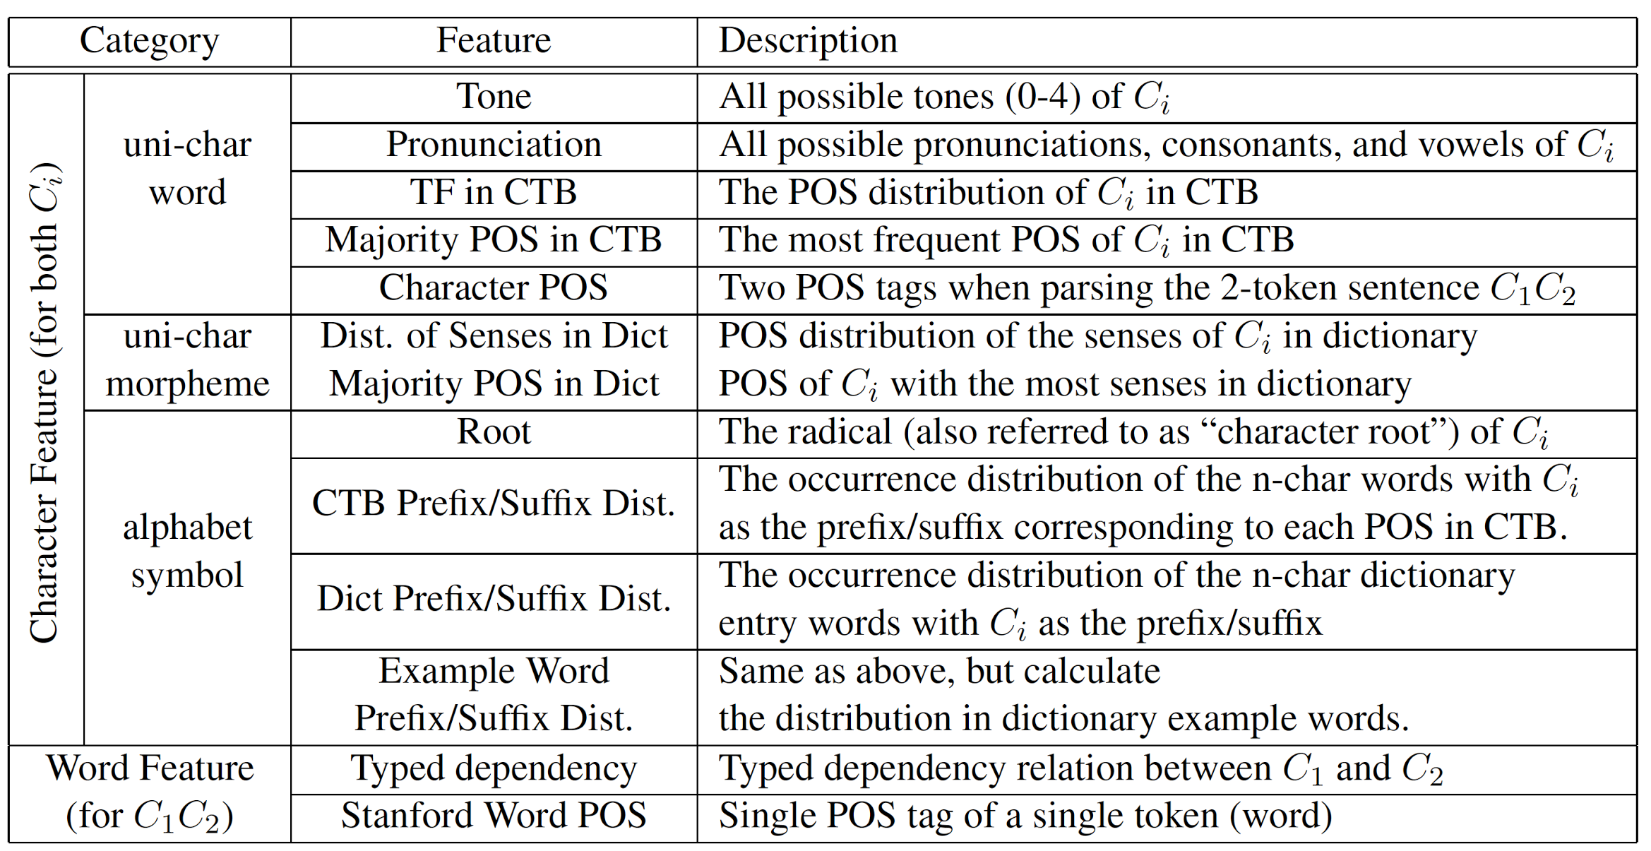
Classification Feature
Dict: Revised Mandarin Chinese Dictionary (MoE, 1994)
CTB: Chinese Treebank 5.1 (Xue et al., 2005)

Slide 16
Outline
Introduction
Related Work
Morphological Type Scheme
Morphological Type Classification
Drived Word: Rule-Based Approach
Compond Word: ML Approach
Experiments
ACBiMA Corpus 1.0
Experimental Results
Conclusion & Future Work

Slide 17
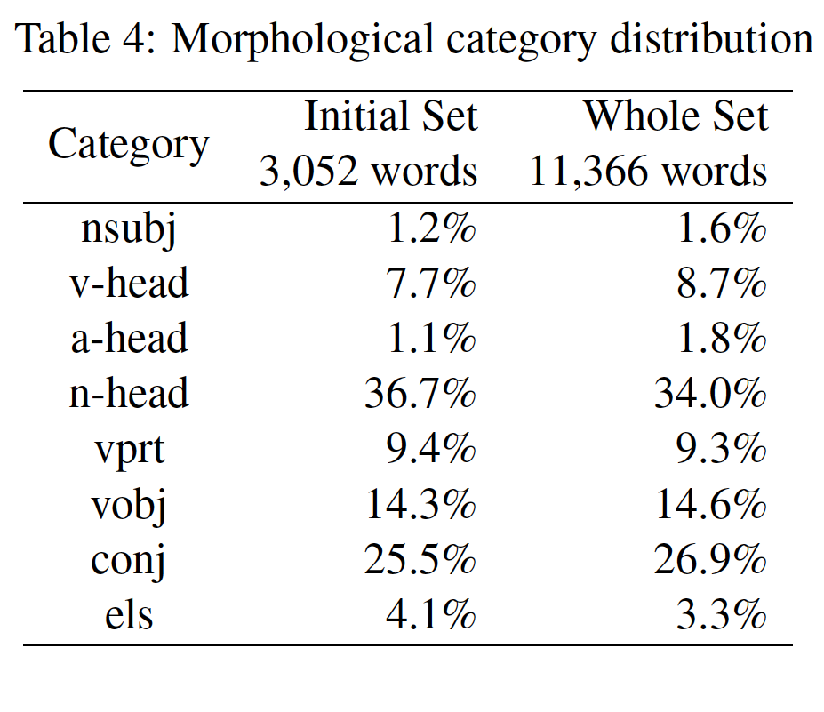
ACBiMA Corpus 1.0
Initial Set
3,052 words
Extracted from CTB5
Annotated with difficulty level
Whole Set
11,366 words
Initial Set + 3k words from CTB 5.1 + 6.5k words from (Huang, 2010)

Slide 18
Baseline Models
Majority
Stanford Dependency Map
Tabular Models
Step 1: assign the POS tags to each known character based on different heuristics
Step 2: assign the most frequent morphological type obtained from training data to each POS combination, e.g., “(VV, NN) = vobj”

Slide 19
Experimental Result
Setting: 10-fold cross-validation
Metrics: Macro F-measure (MF), Accuracy (ACC)
Approach |  | nsubj | v-head | a-head | n-head | vprt | vobj | conj | els | MF | ACC
Majority |  | 0 | 0 | 0 | .507 | 0 | 0 | 0 | 0 | .172 | .340
Stanford Dep. Map |  | 0 | 0 | 0 | .525 | .351 | .438 | .213 | .010 | .332 | .388
Tabular | Stanford | 0 | .296 | 0 | .524 | .389 | .434 | .162 | .064 | .349 | .395
 | CTB | .021 | .337 | .009 | .645 | .397 | .529 | .421 | .095 | .479 | .508
 | Dict | 0 | .292 | .060 | .670 | .253 | .572 | .484 | .035 | .495 | .526
Tablular approaches perform better among all baselines.

Slide 20
Experimental Result
Setting: 10-fold cross-validation
Metrics: Macro F-measure (MF), Accuracy (ACC)
Approach |  | nsubj | v-head | a-head | n-head | vprt | vobj | conj | els | MF | ACC
Majority |  | 0 | 0 | 0 | .507 | 0 | 0 | 0 | 0 | .172 | .340
Stanford Dep. Map |  | 0 | 0 | 0 | .525 | .351 | .438 | .213 | .010 | .332 | .388
Tabular | Stanford | 0 | .296 | 0 | .524 | .389 | .434 | .162 | .064 | .349 | .395
 | CTB | .021 | .337 | .009 | .645 | .397 | .529 | .421 | .095 | .479 | .508
 | Dict | 0 | .292 | .060 | .670 | .253 | .572 | .484 | .035 | .495 | .526
Naïve Base |  | .273 | .406 | .195 | .523 | .679 | .566 | .547 | .188 | .519 | .518
Random Forest |  | .250 | .421 | .063 | .760 | .803 | .643 | .656 | .076 | .647 | .674
SVM |  | .413 | .541 | .288 | .748 | .791 | .657 | .636 | .271 | .662 | .665
ML-based methods outperform all baselines, where SVM & RF perform best.

Slide 21
Experimental Result
Setting: 10-fold cross-validation
Metrics: Macro F-measure (MF), Accuracy (ACC)
Approach |  | nsubj | v-head | a-head | n-head | vprt | vobj | conj | els | MF | ACC
Majority |  | 0 | 0 | 0 | .507 | 0 | 0 | 0 | 0 | .172 | .340
Stanford Dep. Map |  | 0 | 0 | 0 | .525 | .351 | .438 | .213 | .010 | .332 | .388
Tabular | Stanford | 0 | .296 | 0 | .524 | .389 | .434 | .162 | .064 | .349 | .395
 | CTB | .021 | .337 | .009 | .645 | .397 | .529 | .421 | .095 | .479 | .508
 | Dict | 0 | .292 | .060 | .670 | .253 | .572 | .484 | .035 | .495 | .526
Naïve Base |  | .273 | .406 | .195 | .523 | .679 | .566 | .547 | .188 | .519 | .518
Random Forest |  | .250 | .421 | .063 | .760 | .803 | .643 | .656 | .076 | .647 | .674
SVM |  | .413 | .541 | .288 | .748 | .791 | .657 | .636 | .271 | .662 | .665
Avg Difficulty |  | 1.74 | 1.55 | 1.64 | 1.36 | 1.38 | 1.38 | 1.47 | 1.95 | - | -

Slide 22
Outline
Introduction
Related Work
Morphological Type Scheme
Morphological Type Classification
Drived Word: Rule-Based Approach
Compond Word: ML Approach
Experiments
ACBiMA Corpus 1.0
Experimental Results
Conclusion & Future Work

Slide 23
Conclusion & Future Work
Contribution
Linguistic
Propose a morphological type scheme
Develop a corpus containing about 11K words
Technical
Develop an effective morphological classifier
Practical
Data and tool available
Additional features for any Chinese task
Future
Improve other NLP tasks by using ACBiMA

Slide 24
Q & A
HTTP://ACBIMA.ORG
Thanks for your attentions!!

