Slide 1
The Complexity of the Network Design Problem
Networks, 1978
Classic Paper Reading 99.12

Slide 2
Outline
Introduction
NDP is NP-complete
SNDP is NP-complete
Conclusion

Slide 3
Introduction
B96902094 傅莉雯

Slide 4
Combinatorial optimization
is a topic in
-theoretical computer science
-applied mathematics
Notes:
A mathematical problem is a problem that is amenable to being analyzed, and possibly solved, with the methods of mathematics.

Slide 5
Combinatorial optimization
finding the least-cost solution to a mathematical problem in which each solution is associated with a numerical cost.
Ex.
-finding shortest path
-the traveling salesman problem
-the minimum spanning tree problem
-…

Slide 6
P
The class P consists of all the problems that can be solved in polynomial time.
– Sorting
– Exact string matching
– Primes

Slide 7
P v.s. NP
P consists of the problems that can be solved in (deterministically) polynomial time.
NP consists of the problems that can be solved in non-deterministically polynomial time.
Deterministic
Non-deterministic
Reject
f (n) = O ( n^k )
Accept
Accept/Reject
Reject

Slide 8
P v.s. NP
P ⊆ NP
Any problem in NP can be solved in (deterministically) exponential time.
Could it be the case that any problem in NP can also be solved in (deterministically) polynomial time?
P = NP?

Slide 9
NP-hard
A problem is NP-hard if it is at least as hard as all the problems in NP.
a problem X is NP-hard if the following condition holds:
If X can be solved in (deterministic) polynomial time, then all the problems in NP can be solved in (deterministic) polynomial time.

Slide 10
NP-complete
A problem is NP-complete if the following holds.
– it is NP-hard
– it is in NP
An NP-complete problem is a “hardest” problem in NP.

Slide 11
NP-complete
If one proves that a NP-complete broblem can be solved by a polynomial-time algorithm, then NP = P.
If somebody proves that a NP-complete problem cannot be solved by any polynomial-time algorithm, then NP ≠ P.

Slide 12
Reduction
Problem A can be reduced (in polynomial time) to Problem B if the following condition holds:
-we can map input to A in polynomial time to an input to B, and get A’s answer when we get B’s.
– if problem B has a polynomial-time algorithm, then so does problem A.

Slide 13
Network Design Problem
Input:
a weighted undirected graph
Output:
a subgraph which connects all the original vertices and minimizes the sum of the shortest path weights between all vertex pairs, subject to a budget constraint on the sum of its edge weights
Notes:
optimization version

Slide 14
NDP is NP-complete
R99943153 張允耀
R99943143 楊凱文

Slide 15
NDP
Notes:
首先這是先前所提到的NDP問題, 我們在圖形裡面找一個子圖, 然後讓他在規定的B和C之內,
那麼它是經由一連串的計算來獲得最後的數值, 我們稱這種方法為optimal的解
但是這篇paper的證明方法, 其實是使用decision的方式來解(換頁)

Slide 16
Optimal v.s. Decision
Calculate
↓
Optimal value
Optimal
Calculate
↓
Illegal or not?
Decision
96
97
X
O
95
O
90
96
100
X
Notes:
讓我們先來看一下optimal和decision的差異
Optimal是經由一連串的計算來獲得最佳德解
而decision則是只問結果有沒有在可接受範圍內
那兩者的最終結果可以是一樣的
因為我只要多計算幾次可以用逼近法讓decision的結果變得跟optimal一樣
例如optimal的答案是96(按一下滑鼠)
那我只要反覆執行decision就可以得到一樣的答案了(按一下滑鼠)

Slide 17






Knapsack Problem
iPad
0.73KG
iPhone
0.137KG
iMac
13.8KG
2KG
GALAXY
0.38KG
Lenovo NB
1.27KG
ViewSonic
3.1KG
Notes:
證明的一開始我們先討論一個叫做knapsack的問題
Knapsack是指我有t樣物品, 而每樣物品分別具有a的cost,
今天我要任挑幾樣物品, 使得他們的cost加起來恰等於b
現在舉一個例子
假設我是一個小偷
我背的一個只能承重兩公斤的包包來到一間3C商店(按一下滑鼠)
因為我只能帶走兩公斤的東西(按一下滑鼠)
所以我必須挑加起來剛好兩公斤
所以我就挑了這兩樣(按一下滑鼠)
這樣就滿足knapsack的敘述相加等於b

Slide 18
NDP is NP-complete
NDP
Knapsack
Polynomial-bounded
knapsack
NDP
reducible
knapsack
NP-complete
NDP
Notes:
我們現在假設Knapsack是屬於NDP的一個子集合
如果我可以找到一種背包問題, 可以被reducible成NDP的問題
而且這個過程是屬於polynomial-bounded
而我們知道knapsack是NPC
那麼我就可以說NDP至少有NPC的複雜度

Slide 19
example
Notes:
那我們要怎麼樣說明我們的說法是正確的呢?
讓我們來設計一個例子
V是點E是邊L是點和點的距離
然後我們給了T=4個值
它們的WEIGHT分別是2 3 5 6(換頁)

Slide 20
1
1’
2
2
2
4
2
6
3
6
0
3
6
3
4’
2’
5
5
3’
5
3
Notes:
我們來看一下她建構出了甚麼樣的一張圖
首先是會建出各個點

Slide 21
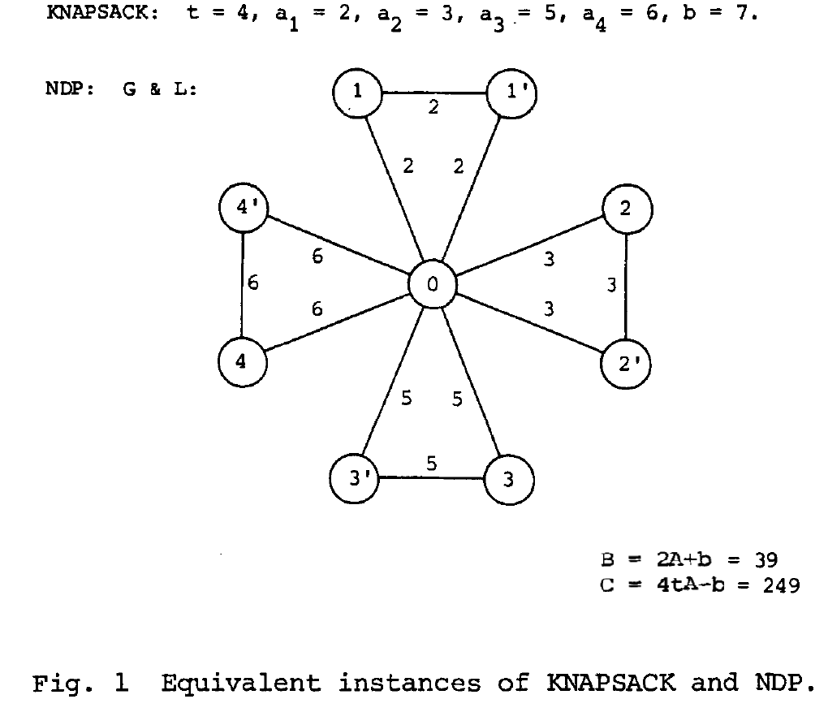

Slide 22
KNAPSACK has solutions <=> NDP has solutions??
KNAPSACK problem:
t = 4, a₁ = 2, a₂ = 3, a₃ = 5, a₄ = 6, b =7.
t = 4, a₁ = 2, a₂ = 3, a₃ = 5, a₄ = 6, b =7.
Solution:
a₁ + a₃ = b

Slide 23
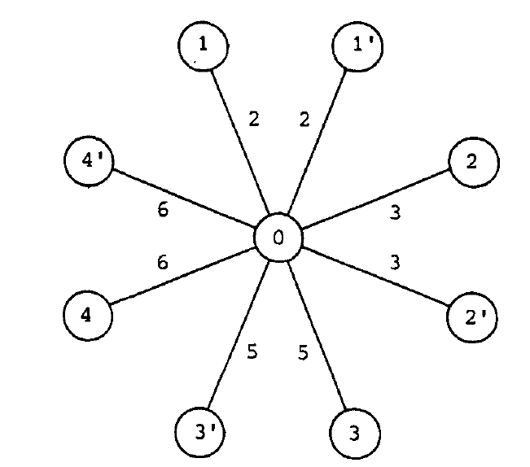
B = 2A+b = 39
C = 4tA-b = 249
Sum of weights = 2A = 32
Sum of the shortest path weights between all vertex pairs = 4tA = 256
2 x 2t ( a₁ + a₂ + a₃ + a₄ ) = 4tA

Slide 24
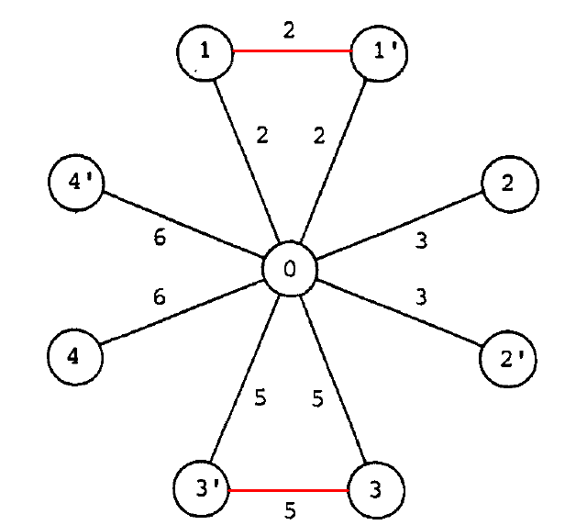
B = 2A+b = 39
C = 4tA-b = 249

Slide 25
Another example:
KNAPSACK problem:
t = 4, a₁ = 2, a₂ = 3, a₃ = 5, a₄ = 6, b =4.
We can’t find any solution for this KNAPSACK problem!

Slide 26
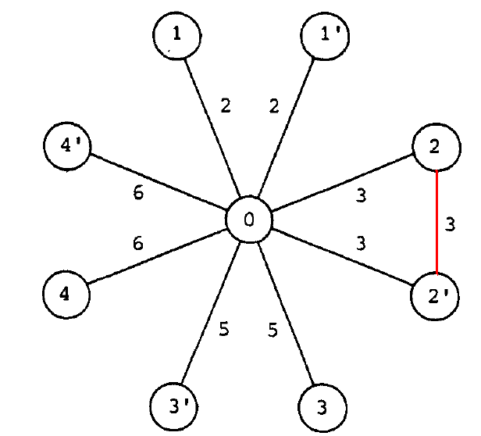
B = 2A+b = 36
C = 4tA-b = 252
This is not a solution.

Slide 27
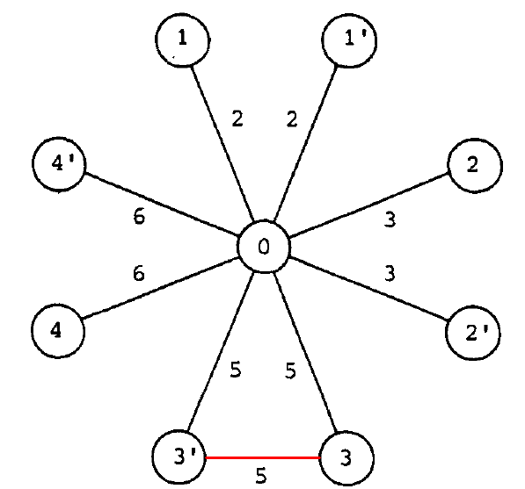
B = 2A+b = 36
C = 4tA-b = 252
5
There are not solutions.

Slide 28
SNDP is NP-complete
D99922018 陳琨
D98922013 吳彥緯

Slide 29
Problem Formulation of SNDP
Simple Network Design Problem (SNDP):
NDP with L({i, j}) = 1 for all {i, j}∈E and B = |V| − 1
unit edge weight
spanning tree
SNDP∈NP

Slide 30
A Known NPC problem: Exact 3-cover
Given a collection S = {σ₁, σ₂, …, σ_{s}} of 3-element subsets of a set T= {τ₁, τ₂, …, τ_{3t}}, does there exist a subcollection S’⊂ S of pairwise
disjoint sets such that
Example:
  T = {1,2,3,4,5,6}, S={{1,2,3}, {1,2,4}, {1,2,5}, {1,2,6}}
  T = {1,2,3,4,5,6}, S={{1,2,3}, {3,4,5}, {1,2,5}, {1,2,6}}
No!
S’={{3,4,5},{1,2,6}}
Yes!

Slide 31
Reduction
Given any instance of EXACT 3-COVER, we define an instance of SNDP as follows:
= r

Slide 32
Illustration of reduction
S
T

Slide 33
Illustration of reduction
R

Slide 34
Illustration of reduction
R
S
T
polynomial-time reduction

Slide 35

Claim
EXACT 3-COVER
SNDP
∅
G
Sol. ∅
Sol. G
  ⎡∅ has a feasible solution⎦
  if and only if
  ⎡G has a feasible solution ⎦

Slide 36
Beginning of the proof
Sol. G
SNDP
Let G’ = (V,E’) be a spanning tree of G.
Let F_{PQ}(G’) denote the sum of the weights of all shortest paths in G’ between vertex sets P and Q (P, Q ⊂ V).
Example:
G
Sol. G
P
P
R
SNDP
Q
G
Q
G
G’
F_{PQ}(G’)=1+1+2+2=6

Slide 37
Observations
Under the mentioned reduction, any feasible G’ has 3 properties.
  G’ contains all edges on 3rd floor
  G’ contains all edges on 2nd floor
  G’ contains some edges on 1st floor in a specific way
R
SNDP
Sol. G
G
S
T

Slide 38
2nd Property
If {ρ₀, σ}∉E’ for some σ∈S, then
  F(G’) = F_{RR}(G’) + F_{RS}(G’) + F_{RT}(G’)+F_{SS}(G’)+F_{ST}(G’)+F_{TT}(G’)
  > F_{RR}(G’) + F_{RS}(G’) + F_{RT}(G’)
  ≥ C_{RR} + C_{RS} + 2(r+1) + C_{RT}
  > C_{RR} + C_{RS} + r + C_{RT}
  = C_{RR} + C_{RS} + C_{RT} + r
  = C_{RR} + C_{RS} + C_{RT} + C_{SS} + C_{ST} + C_{TT}
  = C
{ρ₀, σ}∈E’ for all σ∈S
  Implication: In G’, each vertex in T is adjacent to exactly one vertex in S
  F_{RR}(G’)=C_{RR} , F_{RS}(G’)=C_{RS} , F_{SS}(G’)=C_{SS} ,
  F_{RT}(G’)=C_{RT} , F_{ST}(G’)=C_{ST} ⎡ F(G’)<=C⎦ iff ⎡ F_{TT}(G’)=C_{TT}⎦
C_{RR} = r²
C_{RS} = 2rs + s
C_{RT} = 9rt + 6t
C_{SS} = s² – s
C_{ST} = 9st – 6t
C_{TT} = 18t² – 12t

Slide 39
3rd Property
Denote the number of vertices in S being adjacent in G’ to exactly h vertices in T by S_{h} (h=0,1,2,3)
  Example: S₀=2, S₁=1, S₂=1, S₃=0
Clearly, ⎡F_{TT}(G’) ≤ C_{TT}=18t²-12t⎦ iff ⎡ S₃=t, S₀=s-t, S₁=S₂=0 ⎦

Slide 40
Proved
EXACT 3-COVER
SNDP
  ⎡∅ has a feasible solution⎦
  if and only if
  ⎡G has a feasible solution ⎦

Slide 41
Conclusion

Slide 42
It is generally believed that P≠NP
This justifies the development of
  Enumerative optimization methods with heuristics
  Approximation algorithms

Slide 43
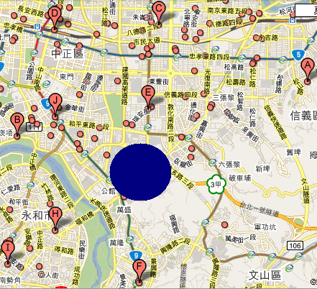
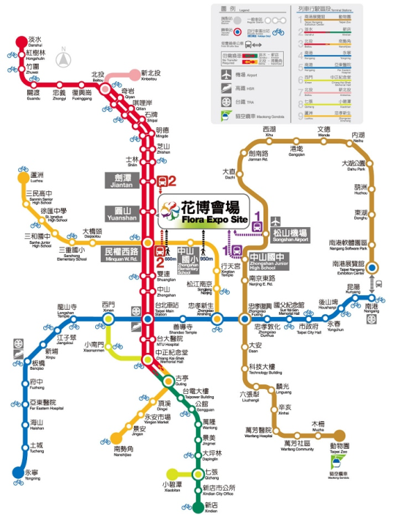
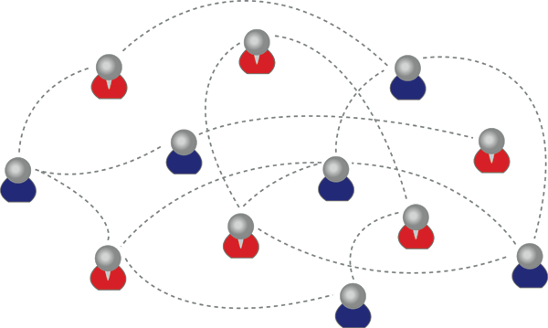
Applications
Common Issues of network construction
  communication convenience
  construction cost
Fire fighting network
MRT network
Sensor network

Slide 44
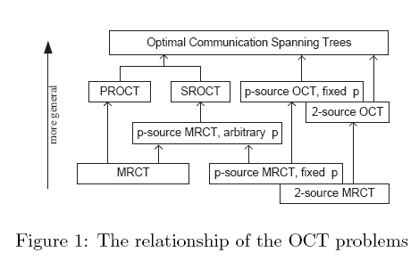
NDP is NP-complete.
Generation of NDP
Optimal Communication spanning Tree min∑u,vЄVλ(u,v)dT(u,v)

Slide 45
Given a weighted graph with a specific vertex p and an integer k, we wish to find
a spanning tree of
minimum total weight
subject to the constraint that
each subtree incident with p contains at most k other vertices.

Slide 46
k = 2 ↔ matching problem;
k = 3 → NP-complete by a reduction of 3-DIMENSIONAL MATCHING

