Slide 1
BLAST@NCBI
組員:林哲賢 謝友恆 李沂芳 黃堂榮 林資皓

Slide 2
Outline
A brief introduction on various kind of BLAST
Different Sequences: introduction of NCBI and FASTA format
Web version BLAST
BLAST on Linux system
An application of BLAST on Bioengineering

Slide 3
A Brief Introduction on various kind of BLAST
R05921040 Yu-Heng Hsieh

Slide 4
Sequence Homology
Definition:
Shared ancestry in evolutionary history of life
Biological homology between DNA and protein sequence
How to we detect sequence homology?
Two homology sequence would be similar
Sequence similarity!!!

Slide 5
Sequence Similarity
Global vs Local
A dynamic programming method (Needleman & Wunsch, 1970)
High computational complexity
Impractical for searching large databases

Slide 6
Objective
Found Sequence Homology between species
DNA and amino acid sequence databases
A database contains known gene sequence
Hundreds of millions of sequence and hundreds of billions of base
Will be introduced later
With this size of databases, an efficient tool is needed to found the sequence homology

Slide 7
BLAST algorithm
Maximal Segment Pair(MSP):
highest scoring pair of identical length segments chosen from 2 sequences.
In other words, the most similar part of 2 sequences.
Local Maximal Segment Pair:
One may be interested in not only the most similar part, but all sequence.
The sequence is local MSP if its score cannot be improved either by extending or by shortening both segments
BLAST search all local MSP with a cutoff score

Slide 8
Algorithm steps
Finds the interesting word list
Find all word match with score > T
Extend these words to find MSP

Slide 9
Analysis of BLAST
Use a parameter T to control the trade off between speed and sensitivity
Higher value of T increase the speed but also increase the probability of missing weak similarity
What is the bottleneck of BLAST algorithm?
The extension step.
How about lower T value, but strict extension rule?
That’s what Gapped Blast does.

Slide 10
Gapped BLAST
Lower T value to have more hits in phase 1
However, only extends word that are on the same diagonal and within a distance
Since fewer hits have to be extended in this step, the running time decrease significantly (up to 3x speed up)
However, the result subsequence alignment may become insignificant due to low T

Slide 11
Gapped BLAST (continue)
To make the result subsequence more significant, we have to increase T
Change extending rule to a dynamic programming method and looks for an area near both end of the hit.

Slide 12
PSI-BLAST
Motif search
Search motifs in the sequence
More sensitive than pairwise comparison methods at detecting distant relationships
However, typically need substantial user intervention when running.
Automates this process!!!
Modify BLAST to generate position-specific score matrix at each iteration, and uses it as the input for next iteration.

Slide 13
Different Sequences: introduction of NCBI and FASTA format
R09549010 李沂芳

Slide 14
NCBI
National Center for Biotechnology Information
houses a series of databases relevant to biotechnology
important resource for bioinformatics tools and services
DNA sequence database GenBank (with EMBL in Europe and DDBJ in Japan)
Notes:
國家生物技術資訊中心

Slide 15
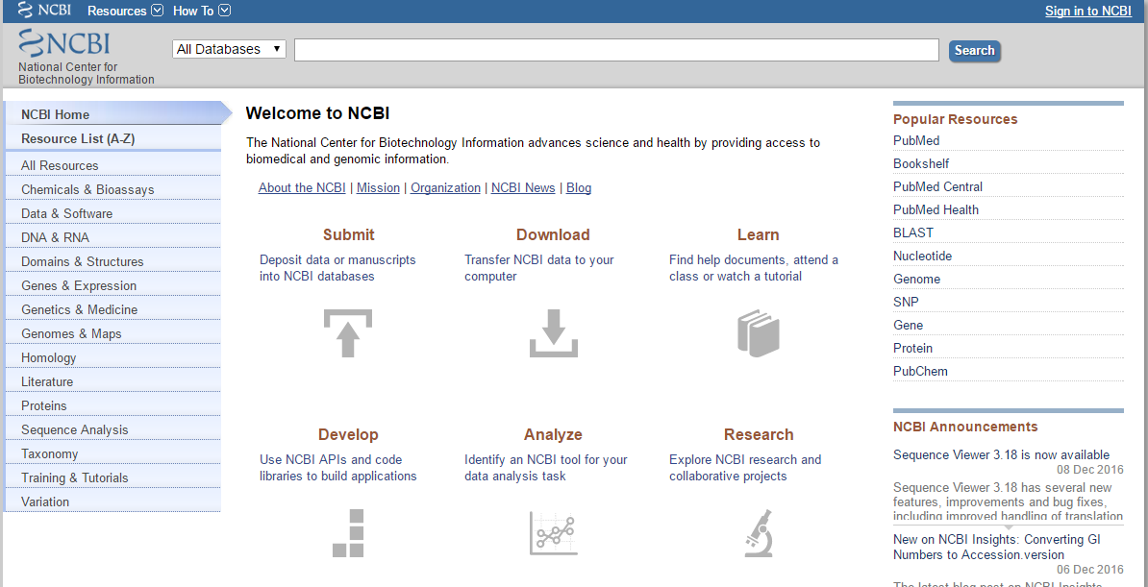
NCBI

Slide 16
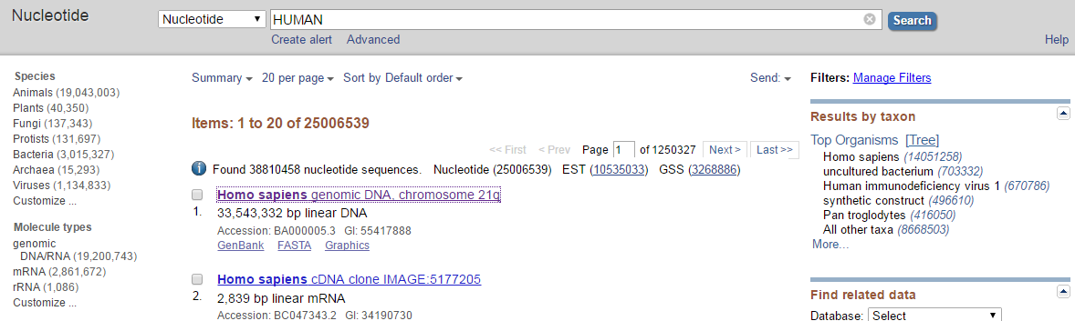
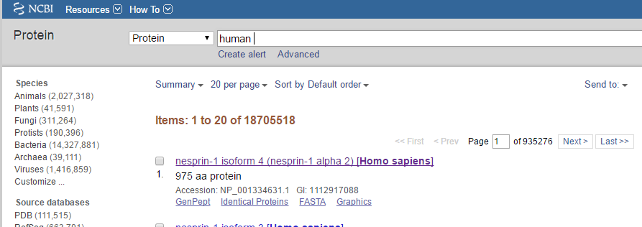
Search for Sequence

Slide 17
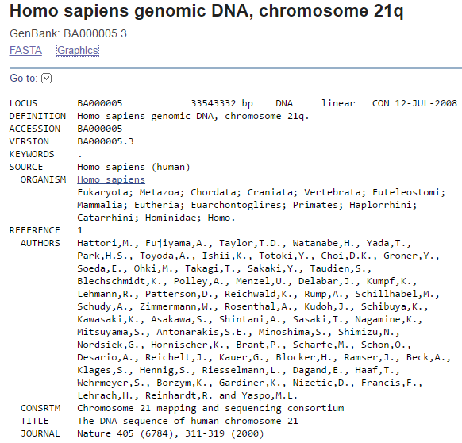
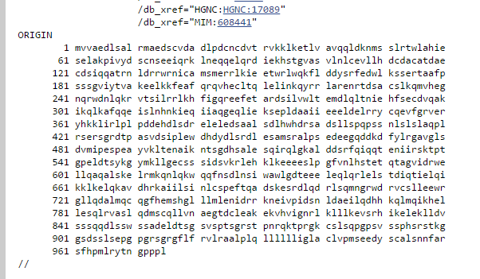
Notes:
https://www.ncbi.nlm.nih.gov/Sitemap/samplerecord.html#LocusNameB

Slide 18
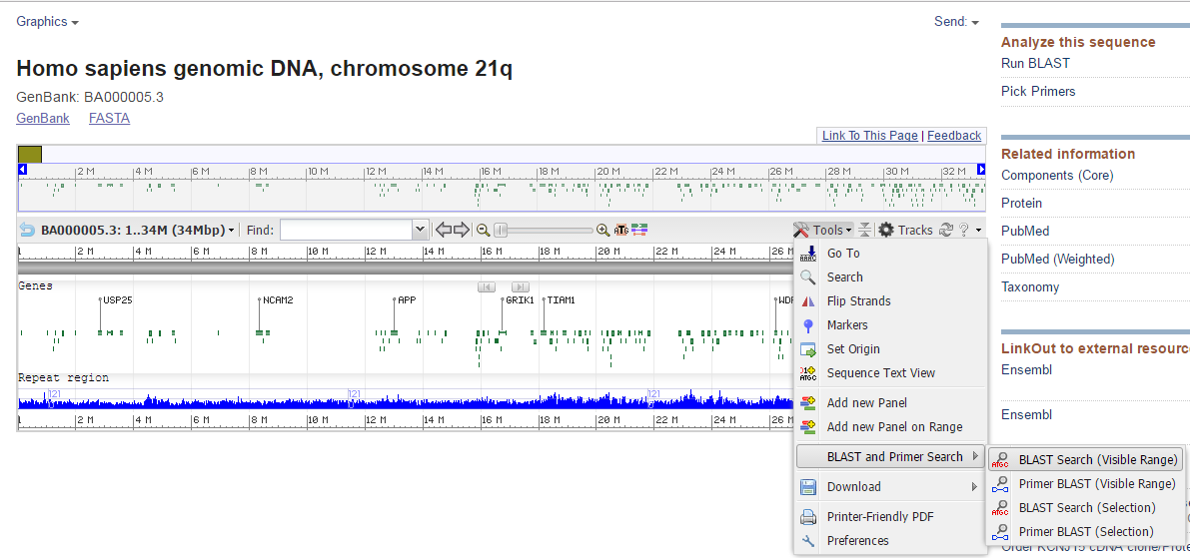

Slide 19
FASTA
text format for amino acid and nucleic acid
begins with a single-line description
followed by lines of sequence data
“>” symbol at the beginning
bar “|” separates different fields
Notes:
記錄核酸序列或蛋白質氨基酸序列的文字格式
核酸或胺基酸均以單個字母編碼呈現
https://www.ncbi.nlm.nih.gov/books/NBK21097/
The description line (defline) is distinguished from the sequence data by a greater-than (">") symbol at the beginning. It is recommended that all lines of text be shorter than 80 characters in length. An example sequence in FASTA format is:

Slide 20
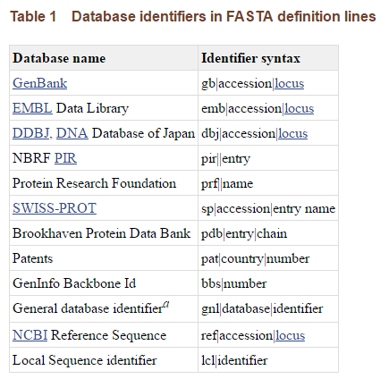
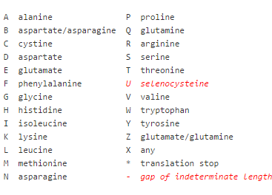
FASTA format
gb|M73307|AGMA13GT
gb tag :from GenBank
M73307 :GenBank Accession number
AGMA13GT :GenBank locus
Notes:
LOCUS - A short mnemonic name for the entry, chosen to suggest the sequence's definition. Mandatory keyword/exactly one record.
the first three characters usually designated the organism; the fourth and fifth characters were used to show other group designations, such as gene product; for segmented entries, the last character was one of a series of sequential integers. (See GenBank release notes section 3.4.4 for more info.)
ftp://ftp.ncbi.nih.gov/genbank/gbrel.txt

Slide 21
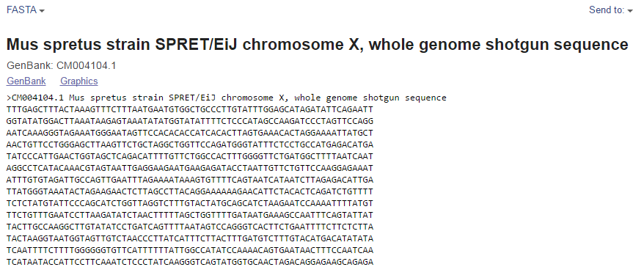
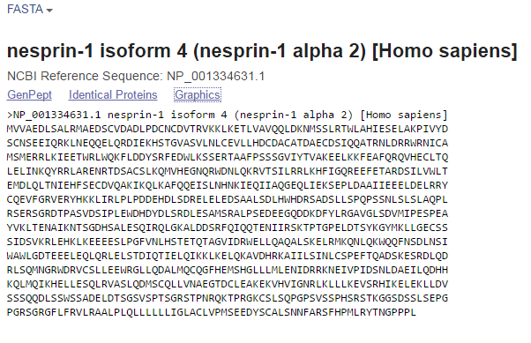
FASTA

Slide 22
Web version BLAST
R05921043 林哲賢

Slide 24
Step 1

Slide 25
Step 2

Slide 26
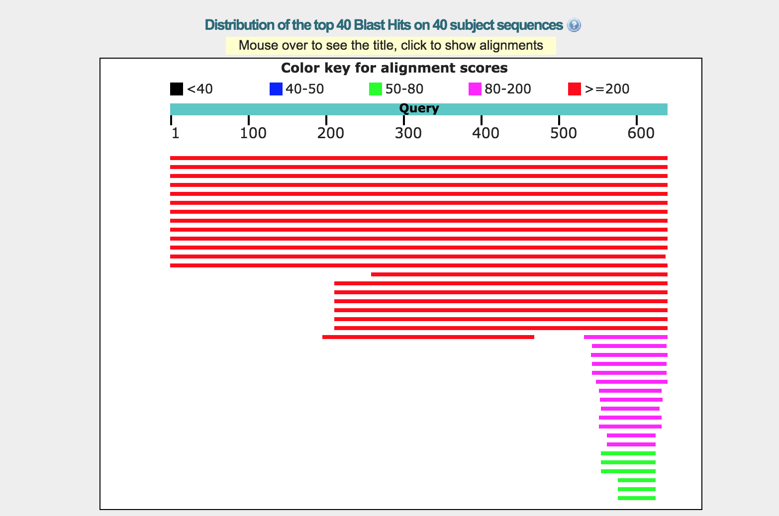
step3

Slide 27
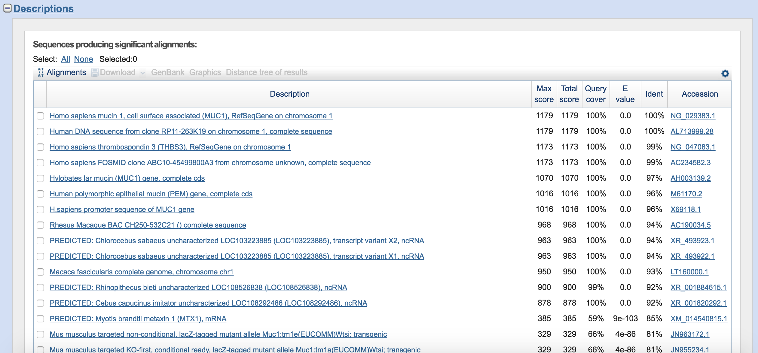
step4

Slide 28
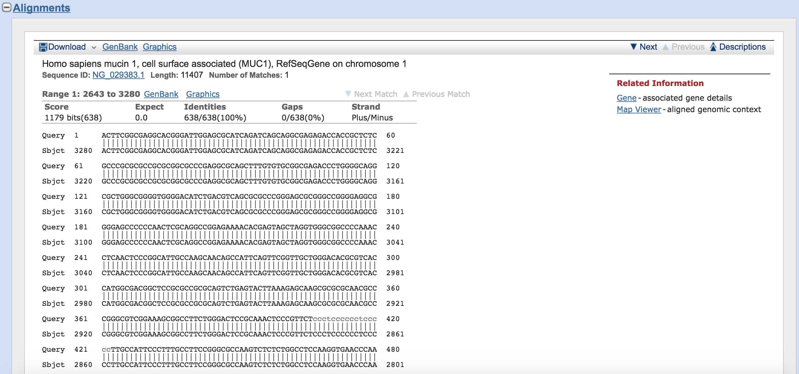
step5

Slide 29
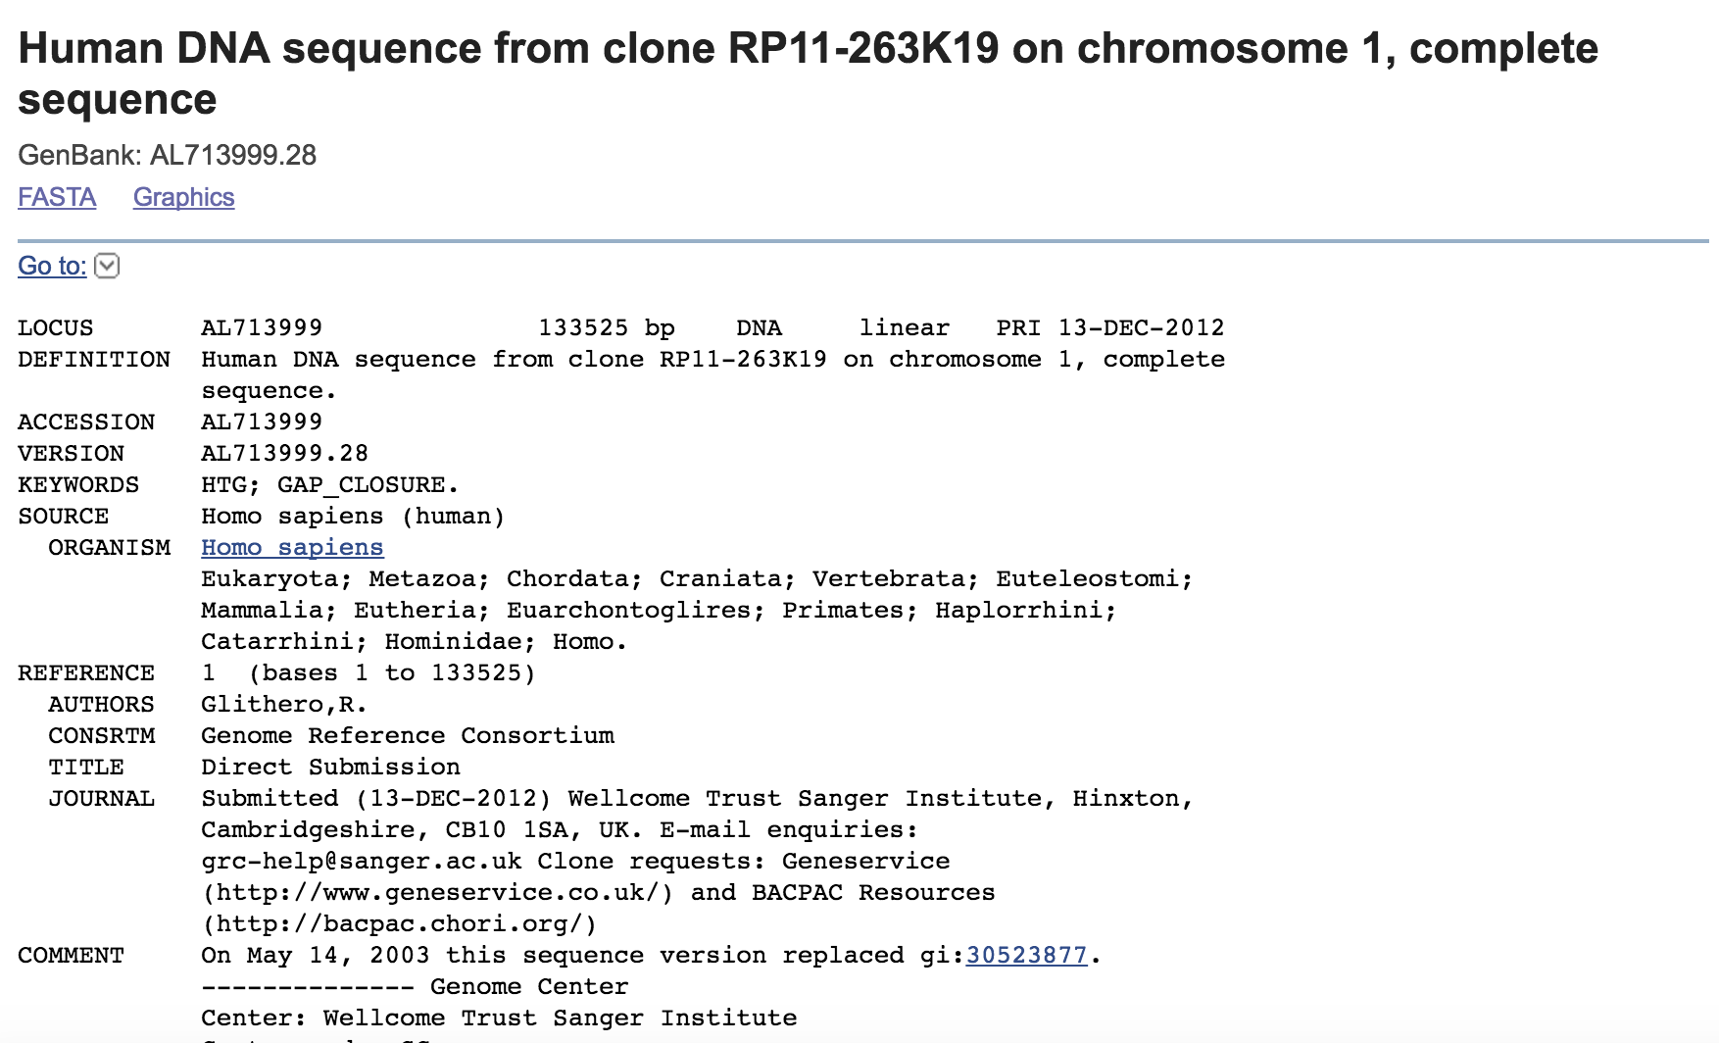
step6

Slide 30
Other resources
NCBI API
Image on cloud server

Slide 31
BLAST on Linux system
R05945018 林資皓

Slide 32
BLAST on Linux
Command:
blastn: nucleotide → nucleotide
blastx: nucleotide → protein
tblastn: protein → nucleotid
blastp: protein →protein

Slide 33
Example -- blastn
-db: database (“makeblastdb” to create your own database)
-query: input file.fasta
-out: output file
-outfmt: 0~11 (different formation)
-evalue: evalue (e.g. 1e-100)
-perc_identity: float value
-max_target_seqs: numbers of sequences
-num_threads: integer number

Slide 34
Example -- blastn
blastn -db blast_db/rna_refseq_human/refseq_rna -query trinity_out_dir/trinity_len_523_upper.fa -out blast_out_len_523 -evalue 1e-100 -num_threads 8 -max_target_seqs 1 -perc_identity 100.0 -outfmt 6

Slide 35
Example -- blastn
Output (outfmt 6)
Query ID
subject ID
Identity
mismatches
Query start & end
E-value
Alignment length
Gap opens
Subject start & end
Bit score

Slide 36
Example -- blastn
Output (outfmt 0)

Slide 37
R05945037 Tang-Jung,Huang
Let’s talk about HLA typing.
HLA typing-人類白血球組織抗原分型
Reference:
Next-Generation Sequencing (NGS) HLA Typing:
Beyond Allele Assignment, Pedro Cano et al.,
Abstracts / Human Immunology 77 (2016) 40–156

Slide 38
R05945037 Tang-Jung,Huang
Aim:
To create a method to open the data collected by NGS to any kind of query.
Variation of HLA
-Located on Chr6
-polygeny(多基因性)
-genetic polymorphism
(遺傳多形性)
biological information
Allele assignment
Notes:
To expand the analytical potential of NGS in HLA typing. Studies based on SNP analysis have revealed the DNA sequence of HLA genes to carry important biological information typically overlooked in the simple exercise of allele assignment.
NGS software is optimized to match sample sequences against databases of HLA allele sequence references.

Slide 39
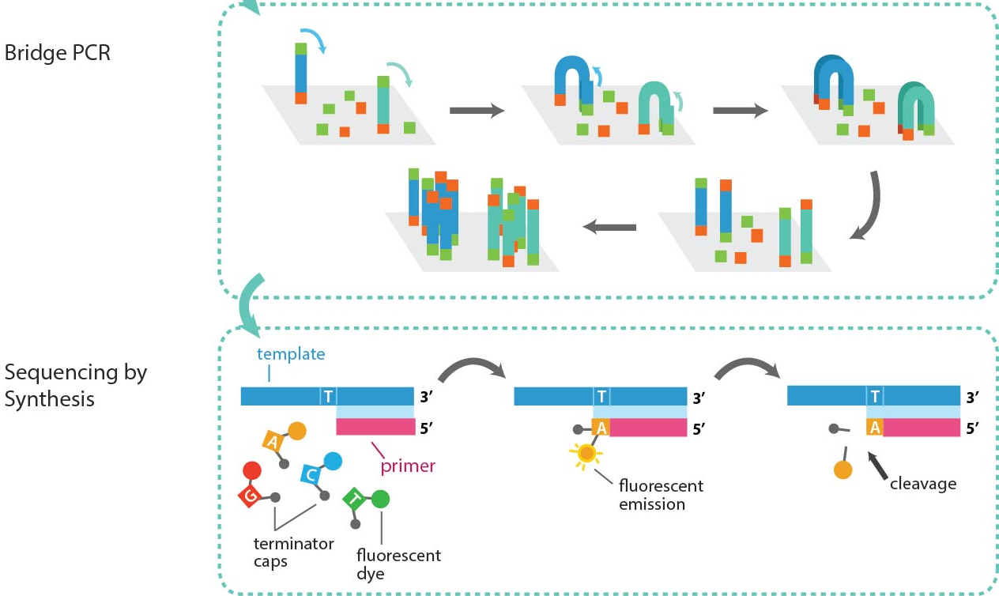
R05945037 Tang-Jung,Huang
HLA-typing
A test to compatibility between tissues from different people
NGS :
Notes:
(1)輸血：找到HLA 相合非親屬的捐血者已大有可
病人與捐腎者間HLA 的matching（配合）可以改善病人的存活及移植腎臟的功能
發現和僵直性脊椎炎(ankylosing spondylitis, AS) 有很高的關聯
(2)將DNA打斷成300-500bp，並於兩端街上adapter。→load到帶有互補adapter序列的晶片上→橋式聚合酶鏈鎖增幅→load 不同鹼基且標定特定可移除的螢光分子dNTP，
重複進行螢光標記和移除。

Slide 40
R05945037 Tang-Jung,Huang
Method:
BLAST is still one of the most robust and efficient sequence-matching and sequence-alignment methods.

Slide 41
R05945037 Tang-Jung,Huang
Method:
Compile a database
Old-fashioned:
built with reference sequences against which a sample sequence is queried for matches.
Convert sample
format
Here reverse the approach
build a database of sample sequences against which we query for matches for particular sequences of interest
Create a BLAST
database
Run any BLAST
query
Notes:
1.Compile a database of sample sequences included in a given study
2.Convert sample sequences to FASTA format.
3. Create a BLAST database with the study sample sequences
4. Run any BLAST query against the BLAST database of the study sample sequences

Slide 42
R05945037 Tang-Jung,Huang
Discussion/Result:
dataset collected only for typing purposes
The BLAST output
accurate information -sequences carried the query polymorphism, which matched what is known about the association of these SNPs with HLA-C alleles.
Notes:
(The HLA-C 3’UTR polymorphisms which bind to miRNAs and regulate the level of expression (Nature 2011; 472:7344) were used. )

Slide 43
R05945037 Tang-Jung,Huang
Conclusion:
NGS provides data that goes beyond the need for simple allele assignment.
The method(BLAST) presented here provides
-a robust and reliable way to store this
accumulated information
-a quick and simple way to query this
database of sequence data
-an open method to ask any sequence
question

